Slide 1
LhARA to serve the ITRF
Laser-hybrid Accelerator for Radiobiological Applications
to serve the Ion Therapy Research Facility

Slide 2
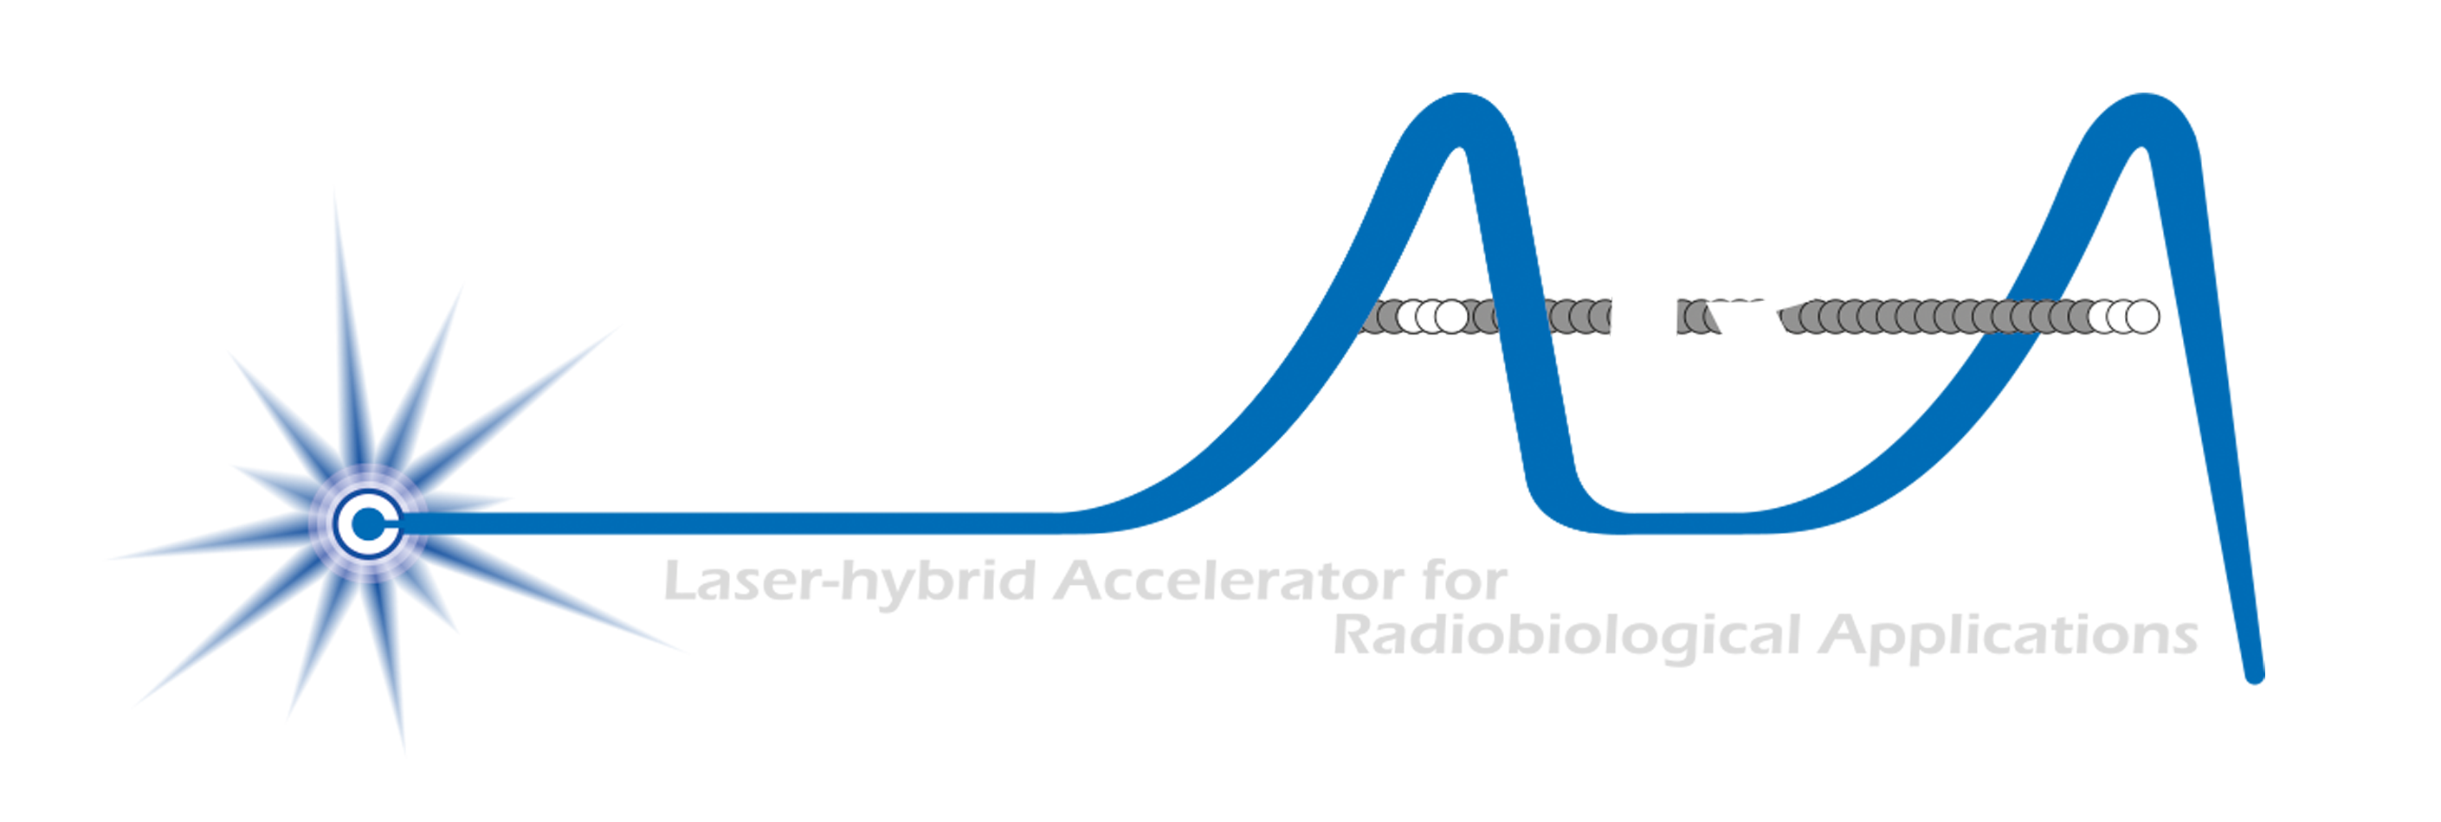

Our mission is to:
Deliver a systematic and definitive radiation biology programme
Prove the feasibility of laser-driven hybrid acceleration
Lay the technological foundations for the transformation of PBT
  automated, patient-specific proton and ion beam therapy
ITRF
/

Slide 3
What is LhARA?
A novel, hybrid, approach:
Laser-driven, high-flux proton/ion source
  Overcome instantaneous dose-rate limitation
    Capture at >10 MeV
  Delivers protons or ions in very short pulses
    Bunches as short as 10—40 ns
  Triggerable; arbitrary pulse structure
Novel “electron-plasma-lens” capture & focusing
  Strong focusing (short focal length) without the use of high-field solenoid
Fast, flexible, fixed-field post acceleration
  Variable energy
    Protons: 15—127 MeV
    Ions: 5—34 MeV/u
Front. Phys., 29 September 2020; DOI: 10.3389/fphy.2020.567738

Slide 4
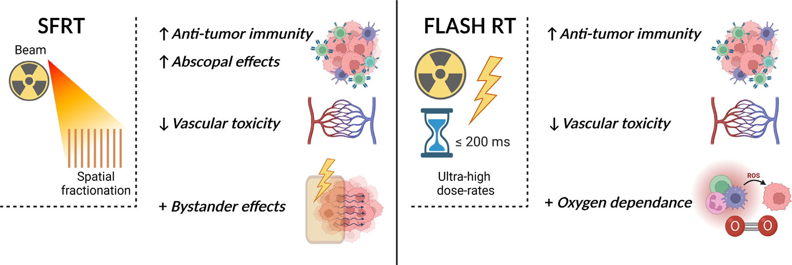
Radiobiology in new regimens
T. Schneider, C. Fernandez-Palomo, Annaïg Bertho et al.
> 40 Gy/s
Dose escalation in the tumour possible – larger tumor control prob.

Slide 5
Proton FLASH data review
J. McGarrigle
To appear in
Study impact of beam parameters in vitro & in vivo
Overall picture somewhat unclear
Continuing analysis of impact on LhARA specification

Slide 6
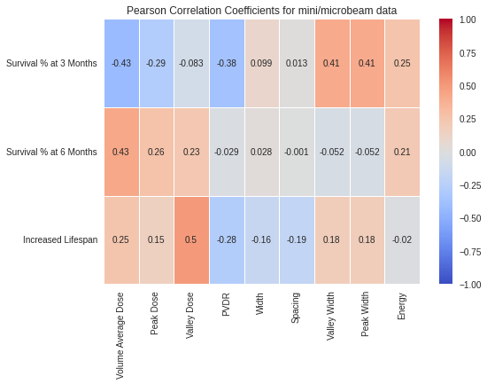
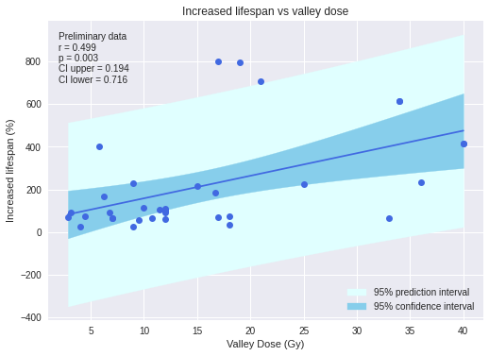
SFTR data review
J. McGarrigle
Publication in preparation
Study impact of beam parameters on effect in vivo
Seeking now to pursue experimental programme

Slide 7
Impact on specification of LhARA?
Initiative to build-up evidence base leading to prioritised parameter set underway:
  Measurements:
    At Birmingham MC-40 cyclotron
    Later at SCAPA (see later)
  Simulation/study:
    TOPAZ-nBio
Develop programme to build:
  Evidence base and understanding
  Collaborations with biologists
  Provide basis for prioritised
  beam/instrumentation specification
Parsons/McGarrigle
Puerta/Prezado

Slide 8
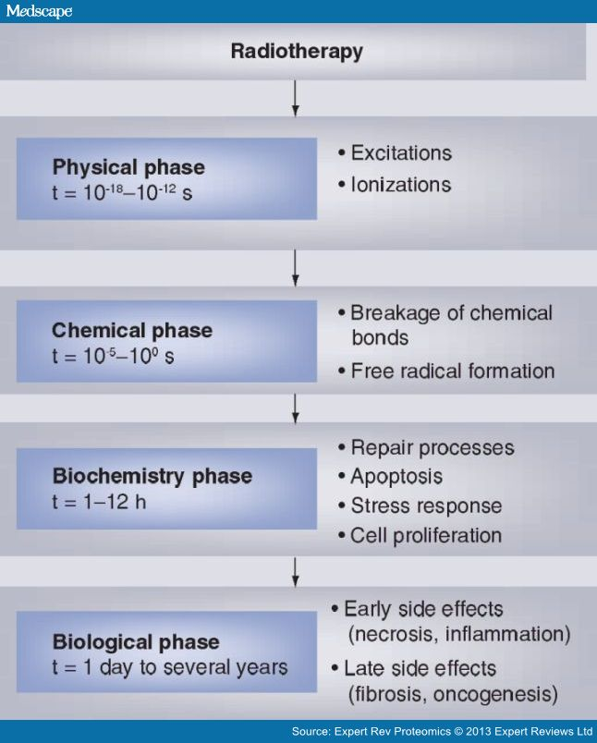
Radiobiology in new regimens
Time
domain
Space
domain
The ideally
flexible beam facility
can deliver it all!
⇒ substantial
opportunity for a
step-change in
understanding!
Ion
species
Energy
In combination
and with chemo/immuno Therapies

Slide 9
Status: resources
2-year Preliminary Activity – Project start 01Oct22
To serve ITRF: 2 + 3-year project
in 6 work packages:
  Project Management
  Laser-driven proton and ion source
  Proton and ion capture
  Real-time dose-deposition profiling
  Novel, automated, end-station development
  Facility design and integration
First two years of
“Five-year plan”
CCAP-TN-10

Slide 10
Progress: design & integration: Stage 1
Activation study:
Ongoing contract with TUVSUD; seek to determine:
  Required shielding thickness and building constraints
  Guidance on operation method
  Guidance on material use & activation
T.J. Kuo
K. Long
J. Pasternak
R. Razak
W. Shields
N. Bliss, A. Goulden,
C. Hill, H. Owen, C. Whyte

Slide 11
Progress: source
N. Dover
T.S. Dascalu
R&D objectives:
“Full-scale” tests in conditions approaching LhARA specification
LhARA-focused diagnostic and targetry development
High-repetition rate, automation and longevity studies
Accurate numerical modelling 3D simulation codes
PhysRevLett.90.185002
Realistic, 2-stage simulation on ARCHER2 using accurate “pre-plasma” profile
Study proton production as a function of angle of incidence, spot size, proton-layer thickness
Seek to benchmark against data

Slide 12
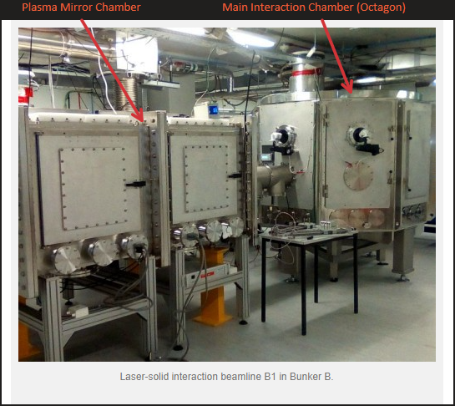
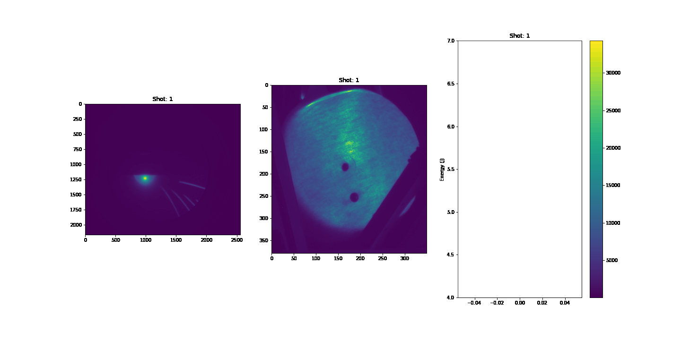
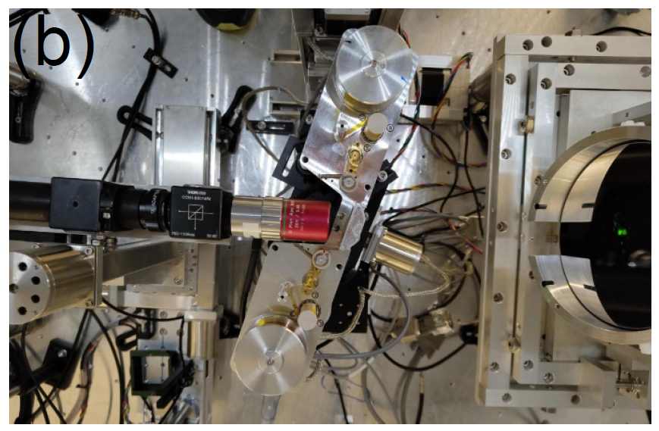
Experiments at SCAPA
N. Dover, G. Casati
Laser energy
R. Gray

Slide 13
Progress source: diagnostics & high rep-rate
Diagnostics
High-rep rate / longevity …
Scintillators: key for high rep rate operation
Dedicated calibration effort led by
N. Dover (ICL):
  Birmingham MC40 cyclotron
N. Dover, O. Ettlinger, N. Xu, Z. Najmudin

Slide 14
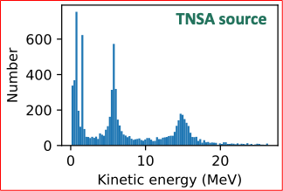
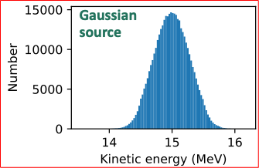
Progress: design & integration: Stage 1
M. Maxouti, N. Dover, K. Long
W. Shields, J. Pasternak, K. Long
Standardised TNSA source
Revised Stage 1 baseline
Impact: look at entrance to arc:
7 Gabor lens adopted
Greater flexibility
Drifts longer:
  Diagnostics
  Shielding
Gabor lens/solenoid
focusing equivalence
Gabor
lenses
Momentum
selection in arc
Solenoids
Important for (e.g.) activation calculation

Slide 15
Progress: capture
P. Ruksasakchia, A. Isaac, S. Eriksson
Key issues:
  Electron density, plasma stability
Measurements on Penning-Malmberg trap at Swansea University
  “Moving potential well” capture
  “Rotating wall” to “spin-up” plasma to gain stability
Ongoing campaign:
  Already significant increase in hold time and plasma density
  Next steps:
    Improved diagnostics
    Numerical analysis to interpret and optimise experiments
Future plan:
K. Long, C. Dyson (PhD from Oct24)

Slide 16
Progress: real-time dose measurment
M. Maxouti,
C. Bird,
O. Jeremy,
K. Ladhams,
K. Long,
D. Nardini
B. Cox, J. Bamber

Slide 17
Progress: real-time dose measurment
M. Maxouti,
C. Bird,
O. Jeremy,
K. Ladhams,
K. Long,
D. Nardini
P. Hobson,
B. Cox, J. Bamber

Slide 18
Progress: Stage 2: injection & FFA magnet
T.J. Kuo
K. Long
J. Pasternak
R. Razak
W. Shields
Injection-line update
FFA magnet
J. Pasternak, W. Shields
T.J. Kuo
Resign revision encorporates:
Shielding, collimation & diagnostics
Continued design effort:
  Match to FFA cell requirements
  Study & mitigate space charge
BDSIM model now synced with accommodates:
  Vacuum valves, diagnostics, shielding shutters,
  correctors …
Emerging collaboration with ISIS u/g team
T.J. Kuo
N. Bliss, A. Goulden, C. Hill, J.B. Lagrange, H. Owen, C. Whyte

Slide 19
Progress: consultation & end-station
Peer-group consultation:
  Stage 1 in vitro & 2 in vivo
  Focus on Stage 1 in vitro
  Focus on Stage 2 in vivo
Beam-line diagnostics:
  Gas-jet (Liverpool): tested at DCF
Seek increasing engagement with more novel techniques:
  Initiated “ART” meeting series
Conclusions and
recommendations documented at:
https://ccap.hep.ph.ic.ac.uk/trac/browser/LhARA/Governance/ProjectManagementBoard/LhARA-Gov-PMB-2023-04
to be updated!
N. Kumar, R. McLauchlan, T. Price

Slide 21
Feedback on PA2 proposal to STFC Visions Team
Broad support
  High impact potential
  Could deliver step change
  Potential for broad reach
  Ambitious
But not selected
  Fit with international landscape unclear
  Potential for target community unclear
  Progress of first preliminary activity unclear (but only 9 months into 2 year project when written)
Now seeking access to bridging funds

Slide 22
Structuring the bridging activity
Define bridging programme to optimise delivery of:
Biology/proof-of-principle programme
R&D programme to address key project risks
Strategic partnerships

Slide 23
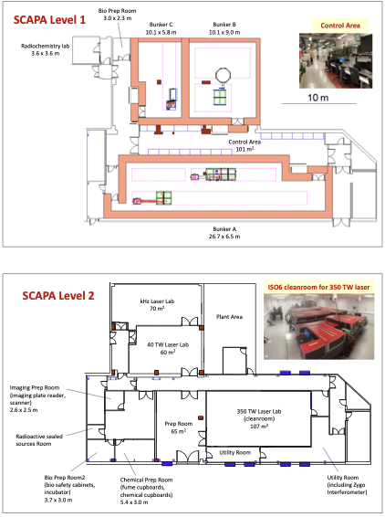
Development of radiation biology programme:
  At existing facilities:
    Novel (e.g. laser driven)
    Conventional
LhARA proof-of-principle experiment:
  CW: “… include as many of key LhARA elements as possible …”
“WP7”, led by J. Parsons
Increasingly import aspect of the programme going forward

Slide 24
Conclusions
Significant progress in ITRF/LhARA:
  Beamline design and optimisation
  Engineering, initial studies of FFA magnet
  Initial characterisation of laser-driven source
  Progress on understanding and stablisation of plasma for Gabor lens
  Design of ion-acoustic proof-of-principle experiment
  Peer-group consultation leading to specification of end-station
Looking forward:
  Recognition of importance of development of biological programme:
    First steps in design and specification of proof-of-principle experiment as part of broader radiation-biology programme
  Project programme for Bridging Period now being developed
Exciting programme, but, clear need to make the case!

Slide 25
Backup

Slide 26
N. Bliss (DL)
Front. Phys., 29 September 2020; DOI: 10.3389/fphy.2020.567738
Draft
⇒ compact, uniquely flexible facility

Slide 27
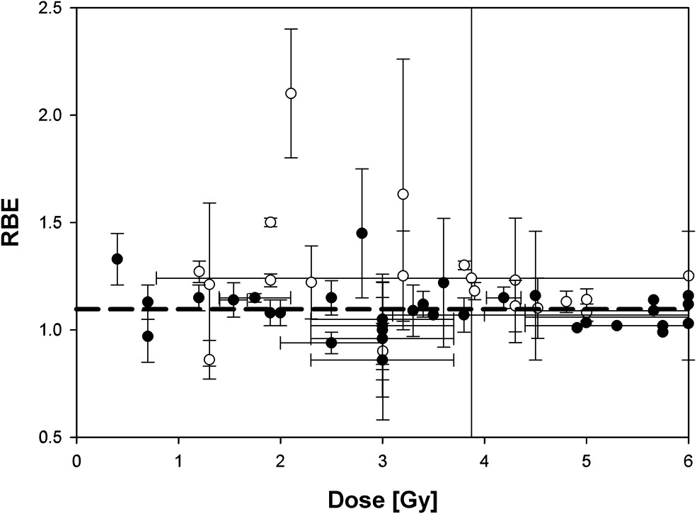
The case for fundamental radiobiology
Relative biological effectiveness:
  Defined relative to reference X-ray beam
  Known to depend on:
    Energy, ion species
    Dose & dose rate
    Tissue type
    Biological endpoint
Yet:
  p-treatment planning uses 1.1
  Effective values are used for C⁶⁺
Maximise the efficacy of PBT now & in the future:
  Require systematic programme to develop
  full understanding of radiobiology
Paganetti,
van Luijk
(2013)
SemRadOncol

Slide 28
Progress: selected engineering highlights

Slide 29
Progress capture

Slide 30
Progress: capture

Slide 31
Progress capture

Slide 32
Outreach & engagement (WP8); progress to date
Communication Strategy
  Public: LhARA Website – strategy devised for web development, management/domains/social media/LinkedIn for public and patient engagement
  Public engagement events: Planning for Great Exhibition and Royal Society Exhibition 2025
  Media: Mentioned as future innovation in cancer care on Radio4 Today podcast Feb 2024
  Parliamentary: Mentioned in UK Radiotherapy ten year Vision documents launched at HOC Feb 2024. Meetings being planned with Scottish SNP science spokesman Carol Monaghan and Shadow science minister Chi Onwurah. Planned to be included in future Westminster MedTech commission .
Stakeholder engagement
  Discission with MRC, the Radiotherapy UK charity and NGO-Global Coalition for Radiotherapy on engaging national and international clinical colleagues and radiobiology community, patients and the radiotherapy industry in parallel.
  International workshop of clinical/biologists planed for Q3 2024
Professional Bodies Engagement
  Links with IPO via Richard Amos and arranging engagement with other professional bodies
MRC Engagement
  Work started to engage MCR in biological/translational clinical areas
International Engagement
LMU, HZDR, CNRS/Institute Curie
CERN
ELI/ELIMED

Slide 33
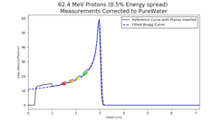
Multiple ion source & capture
Dosimetry, instrumentation
image processing,
fast feedback, control
Fundamental
radiobiology

