Slide 1

STELLA and FLASH therapy
Manjit Dosanjh
JAI Advisory Board Meeting
15 April 2024

Slide 2
  Update on STELLA and VHEE
  STELLA (Smart Technologies to Extend Lives with a Linear Accelerator)
    global multidisciplinary collaboration with CERN, Oxford, Lancaster, STFC, Europe, USA, Canada, Africa, Balkans, Baltics, Central Asia, Caucasus under the umbrella of ICEC (International Cancer Expert Corps)
    1.75M$ funding from DOE to ICEC , collaboration established between ICEC, CERN, Oxford, Cambridge, Lancaster and African partners: kick-off meeting 29-30 May CERN
    Use ML and AI for early fault prediction: MLC fault analysis in Oxford, Exeter and Abuja
    Funding for Moldova for a scoping study for sustainable RT and Regional workshop in Tbilisi, Georgia to help with establishing cancer registries and training
  VHEE FLASH Activities (Very High Energy Electrons (50-250 MeV))
    CLEAR Collaborations
    VHEE UHDR Dosimetry and Beam Monitoring
    VHEE Dose Delivery
    VHEE GaToroid Gantry

Slide 3
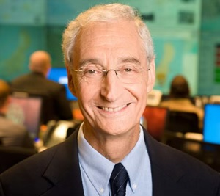

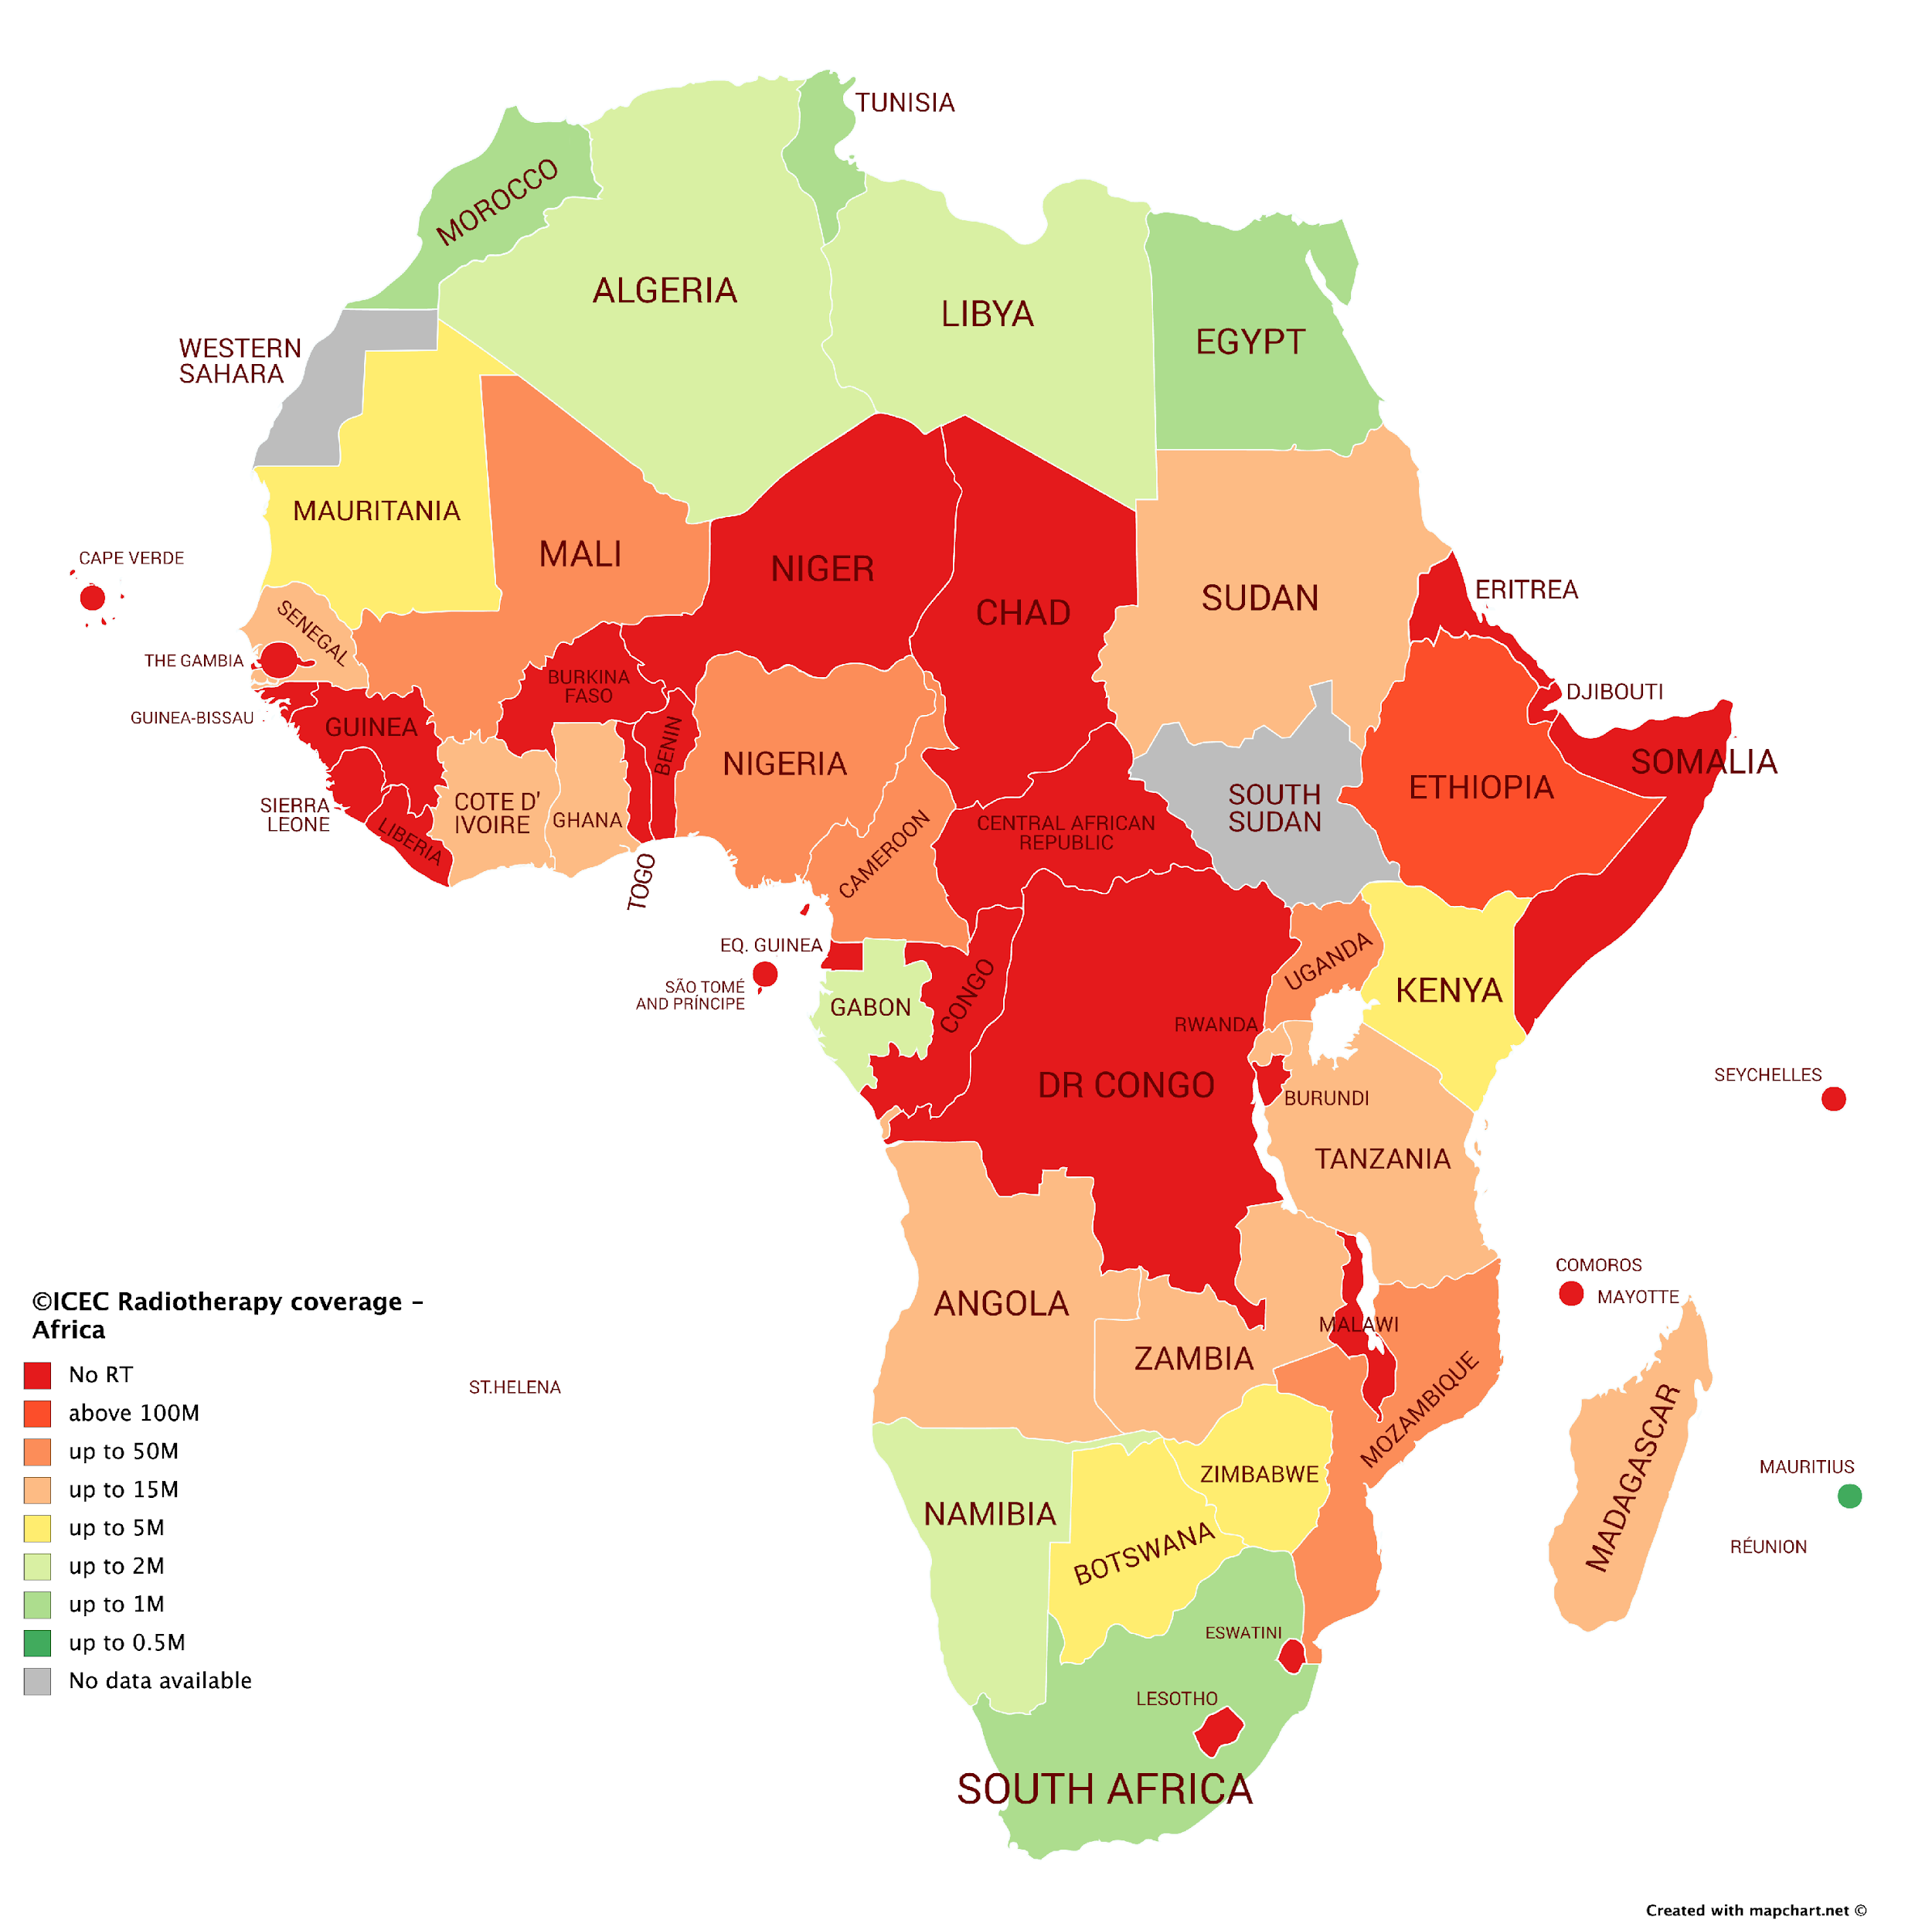
Project STELLA: improving access by examining all aspects for optimal delivery of RT, from hardware to software including consideration of capacity building that address the unique challenges in LMICs
Project STELLA
Pillar I
New LINAC Prototype
Steinar Stapnes
CERN
Pillar II
Software
Integrated Platform
Raj Jena
Cambridge
Pillar III
Training &
Mentoring
ICEC
C. Norman Coleman 1945-2024)
Notes:
2

Slide 4
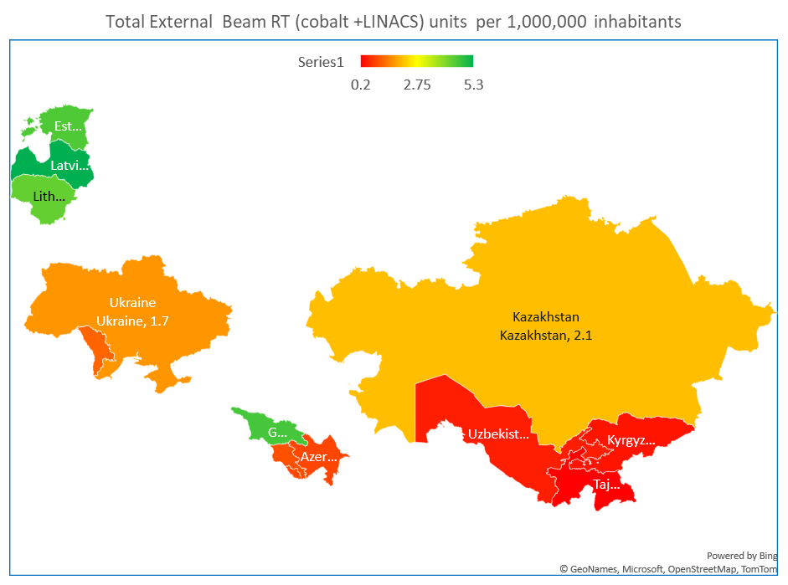
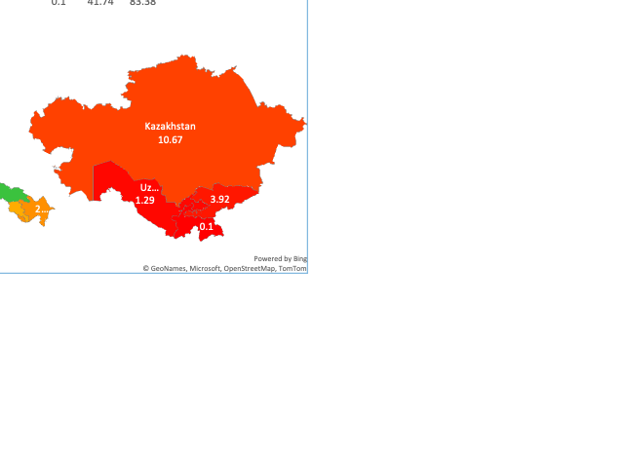
Access to Radiotherapy Technologies Study (ART)
in Former Soviet Union countries lead by ICEC
Azerbaijan, Estonia, Georgia, Kazakhstan, Kyrgyzstan, Latvia, Lithuania, Moldova, Tajikistan, Turkmenistan, Ukraine and Uzbekistan
We have received funding for follow up projects arising from the ART study in Moldova and workshop in Tbilisi, Georgia
5

Slide 5
STELLA – Current Status
Good news is that we now have 1.75 M $ from DOE-NNSA to ICEC for STELLA (Manjit Dosanjh coordinator)
Define the overall desired RTT system from hardware to software and training
Steinar Stapnes from CERN is taking the accelerator Pillar 1 lead, Raj Jena from Cambridge for Pillar 2 and ICEC for Pillar 3 for mentoring, collaborators from Africa, UK, USA. Kick-off meeting at CERN, 29-30 May, 18 months.
Provide written reports and develop strategy for the next steps beyond the current funding…….
We have also received funding for follow up projects from the ART study
Chişinău, Moldova, PHOI (Public Hospital Oncology Institute) scoping study of how to support the sustainable adoption of the new Varian Linac being provided via IAEA.
Regional workshop in Tbilisi, Georgia at the beginning of September 2024

Slide 6
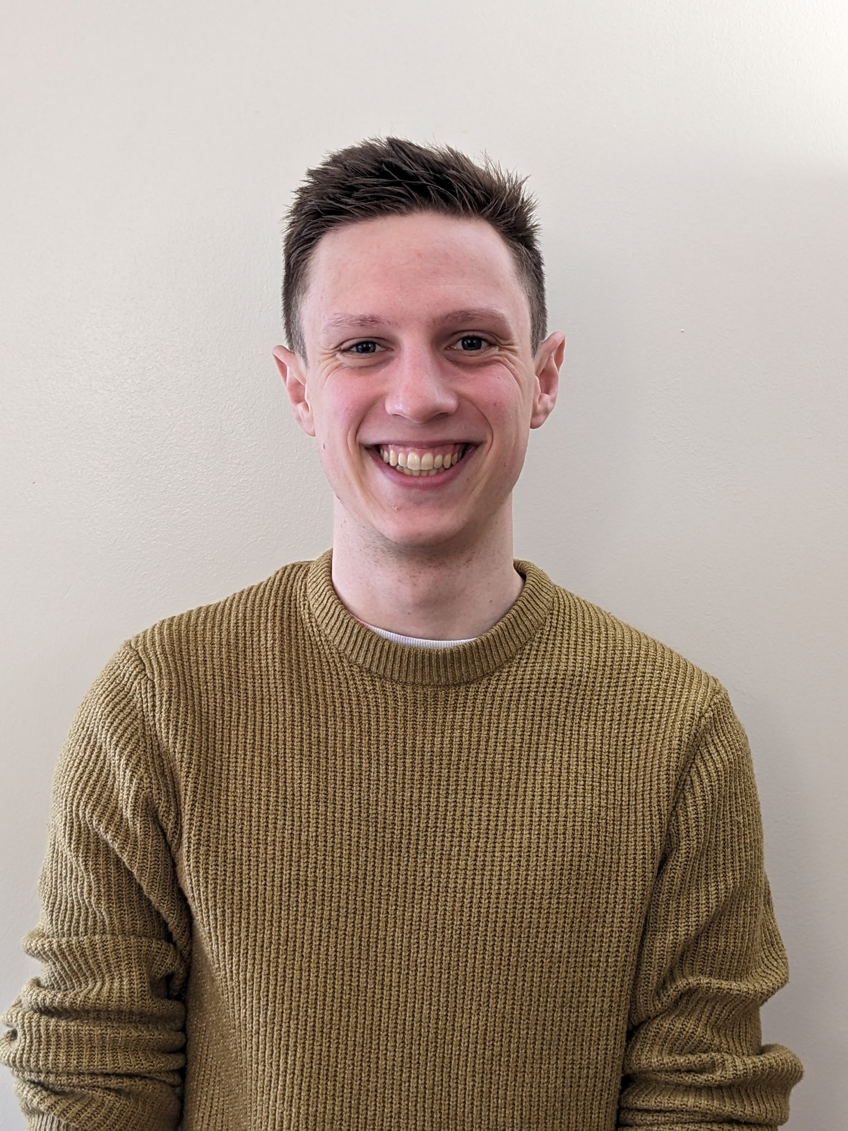
Early fault detection in the STELLA RT LINAC
(collaboration with Cambridge, CERN and Oxford)
Existing machines are highly susceptible to breakdowns
  Non-optimal infrastructure conditions
  (heat, humidity fluctuations, power brownouts)
  Lack of qualified maintenance personnel
→ Long downtimes while the RT machines are fixed, lack of spare parts
Early fault detection allows for reductions in LINAC downtime
  Increased patient access & throughput
  More consistent treatment over extended time periods
  Timely maintenance
→ Use AI and machine learning to reduce LINAC faults, allowing for more efficient repair, more uptime
S. Leadley
JAI Oxford 1st year DPhil

Slide 7
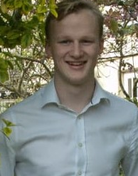

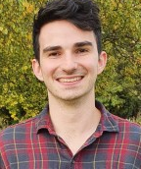
  Failure and Downtime of Linacs linked to MLCs: a comparative study between Oxford, Exeter & Abuja
  Processed and analysed linac fault logbook data from Oxford, Exeter and Abuja hospitals.
  Investigation to aid and inform the next steps of the STELLA project on how well faults can be predicted and whether simplifying MLC design can reduce Linac downtime.
D. Pugh
Oxford 4th year MPhys
J. Bateman
JAI Oxford 4th year DPhil
L. Wroe
CERN Fellow

Slide 8
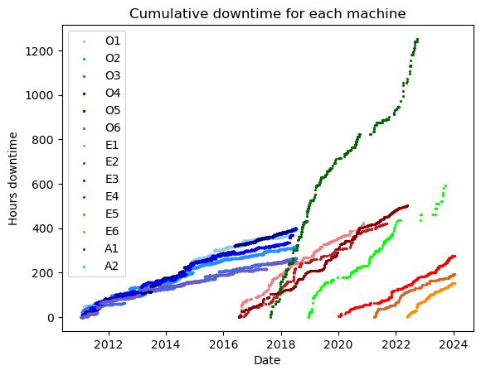
  Failure and Downtime of Linacs and MLCs: a comparative study between Oxford, Exeter & Abuja
  Analysis shows higher frequency of severe MLC faults in Abuja AND more Linac downtime per fault.
  Study provided valuable insight on level of fault reporting required for Linac fault prediction.
Abuja
Oxford
Exeter

Slide 9
The FLASH Effect – still gaining momentum

Slide 10



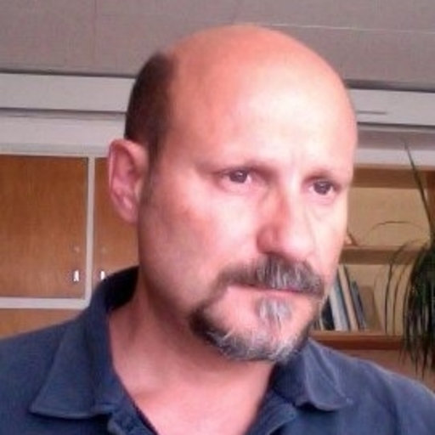


Studies in CLEAR
R. Corsini,
Head of CLEAR Facility
P. Korysko
JAI Oxford Postdoc &
CLEAR

Slide 11

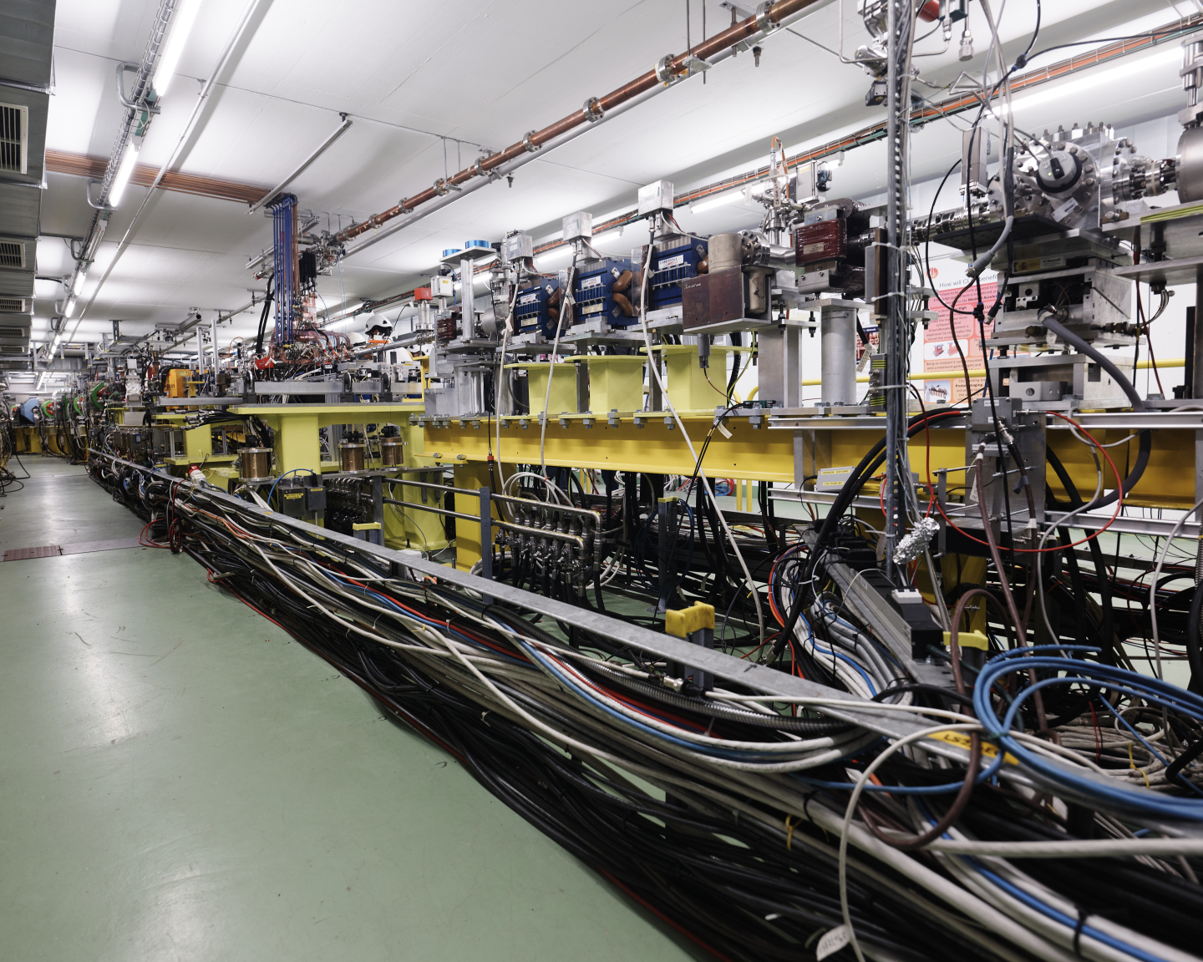
CLEAR Accelerator
CERN Linear Electron Accelerator for Research
Experimental beamline, as a multi-purpose user facility
high quality e-beams
60 – 220 MeV electron beam.
User facility detached from LHC complex
10 pC – 70 nC / pulse
0.833 Hz - 10 Hz pulse rep. freq.
Pulse length 1 ps – 50 ns
Used for accelerator and component R&D, electronics irradiations and medical applications.
Significant focus on FLASH-UHDR VHEE RT research.

Slide 12
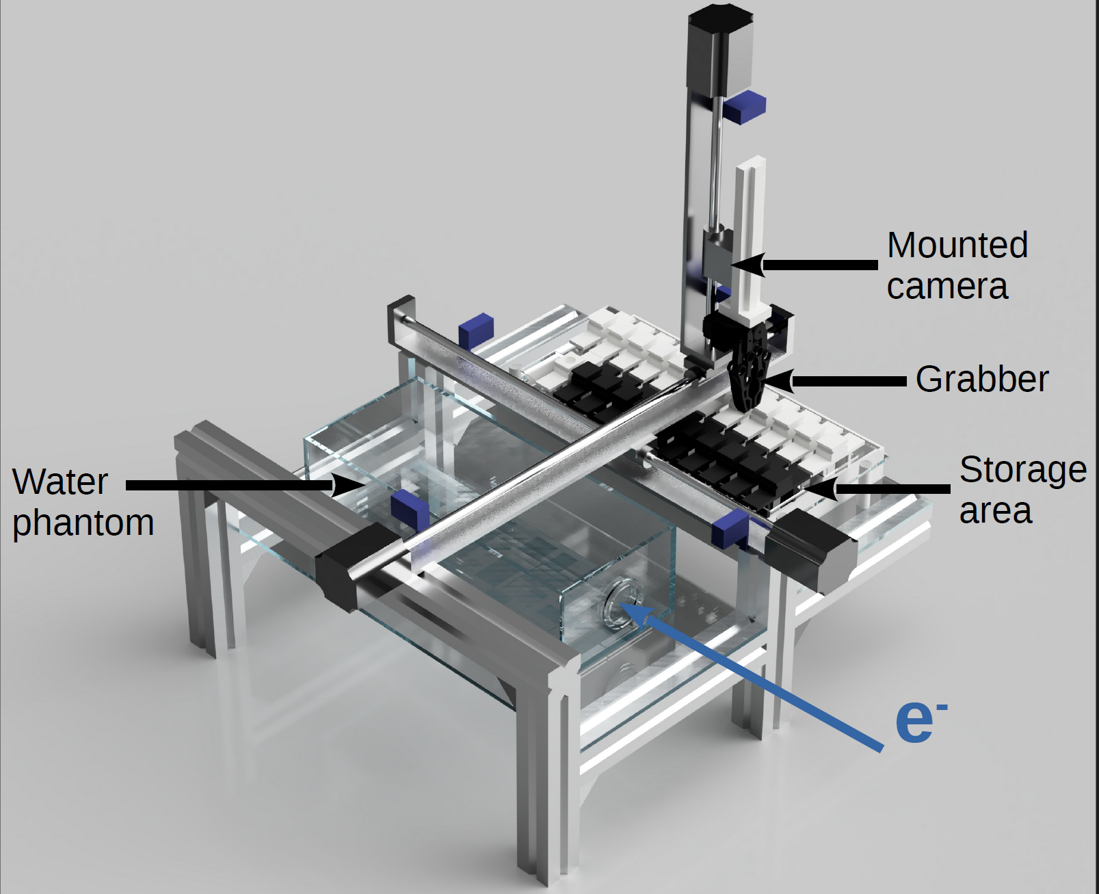
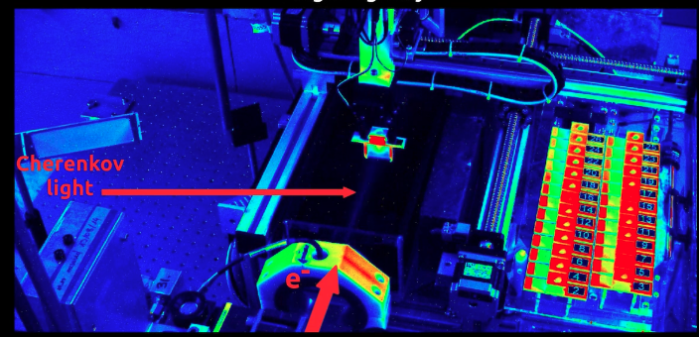
  CLEAR VHEE FLASH Experiments
  More and more users are studying the FLASH effect, Irradiation Methods and Dosimetry in CLEAR, leading to:
    14 weeks of beam dedicated to medical applications in 2023.
    A new robot, the C-Robot 2.0. (3 similar robots are being built inc. one at PITZ, DESY).
    New beam line with flexible beam parameters, particularly suited for medical applications.
    Example collaborations with CLEAR and JAI Oxford on next few slides…

Slide 13

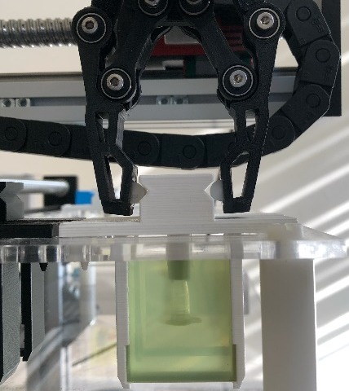
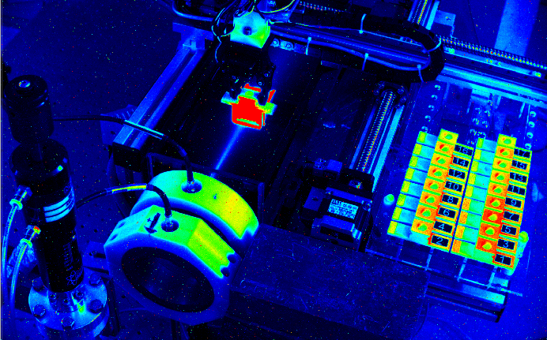
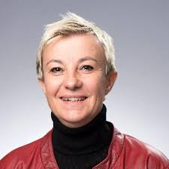
  Collaboration with Prof Vozenin’s group HUG (prev. CHUV)
  VHEE FLASH Radiobiology and Physico-Chemistry Experiments
  VHEE FLASH Radiobiology studies investigating mechanisms behind FLASH effect using:
    Chemistry experiments measuring ROS generation in water for FLASH and CONV
    Plasmid irradiations to measure DNA damage
    Zebrafish eggs as biodosimeters to measure FLASH sparing effect
    Normal and cancerous cell irradiations
  Publication under review
Prof. M. C. Vozenin
Head of Radiobiology and Radio-oncology, HUG, Geneva

Slide 14


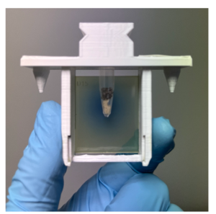
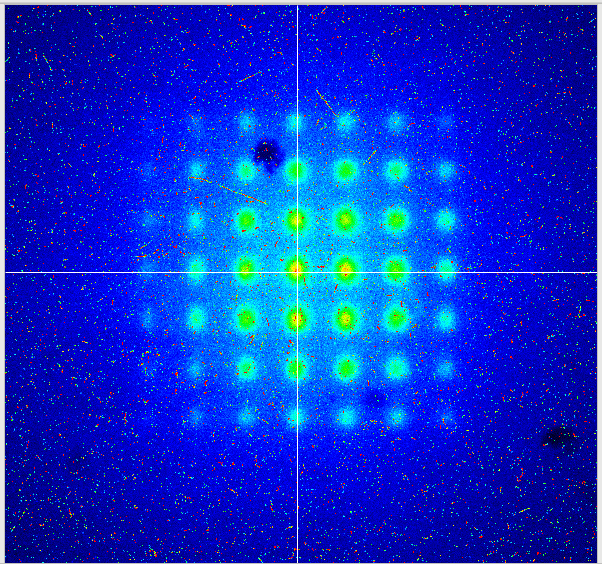
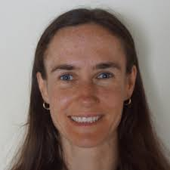
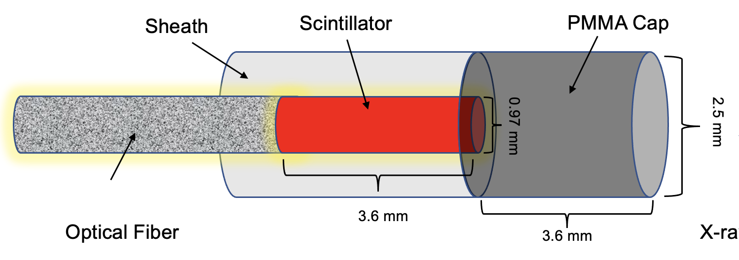
  Collaboration with Prof Bazalova-Carter’s group Victoria Uni
  VHEE Spatial Fractionation – Scintillator Dosimetry – Drosophilae Biodosimeters
  VHEE Spatial Fractionation using tungsten GRID collimator.
    (paper published in Phys. Med. Bio.)
  VHEE UHDR Real-time dosimetry using plastic scintillator-coupled fibres at MedScintTM CCD spectrometer.
  (paper published in IEEE Sensors)
  In vivo radiobiology studies on drosophila melanogaster larvae as biodosimeters to investigate VHEE RBE and FLASH mechanisms/parameter space.
Prof. M. Bazalova-Carter
Head of XCITE Lab, UVic, Canada

Slide 15
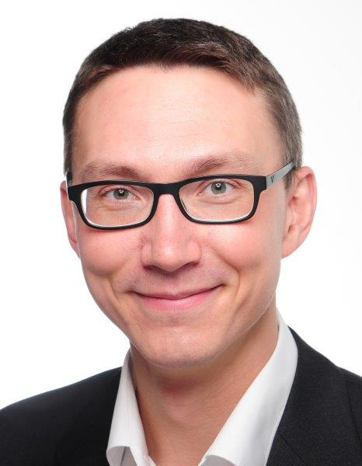
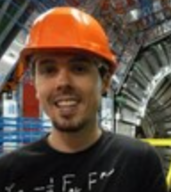

  VHEE UHDR Beam Dosimetry (Joseph Bateman)
  Continued to contribute to development and optimisation of dosimetry protocols at the CLEAR Facility for VHEE and FLASH radiobiological and physics experiments (shown in previous slides).
  Developed and tested first prototype of the Fibre Optic FLASH Monitor (FOFM) – a novel detector for real-time beam profile and dose monitoring at ultrahigh dose rates for VHEE-FLASH RT.
A.Gerbershagen
PARTREC, Groningen
R.Corsini
CLEAR, CERN
I. Ortega Ruiz
BI, CERN
J. Bateman
JAI Oxford 4th year DPhil

Slide 16
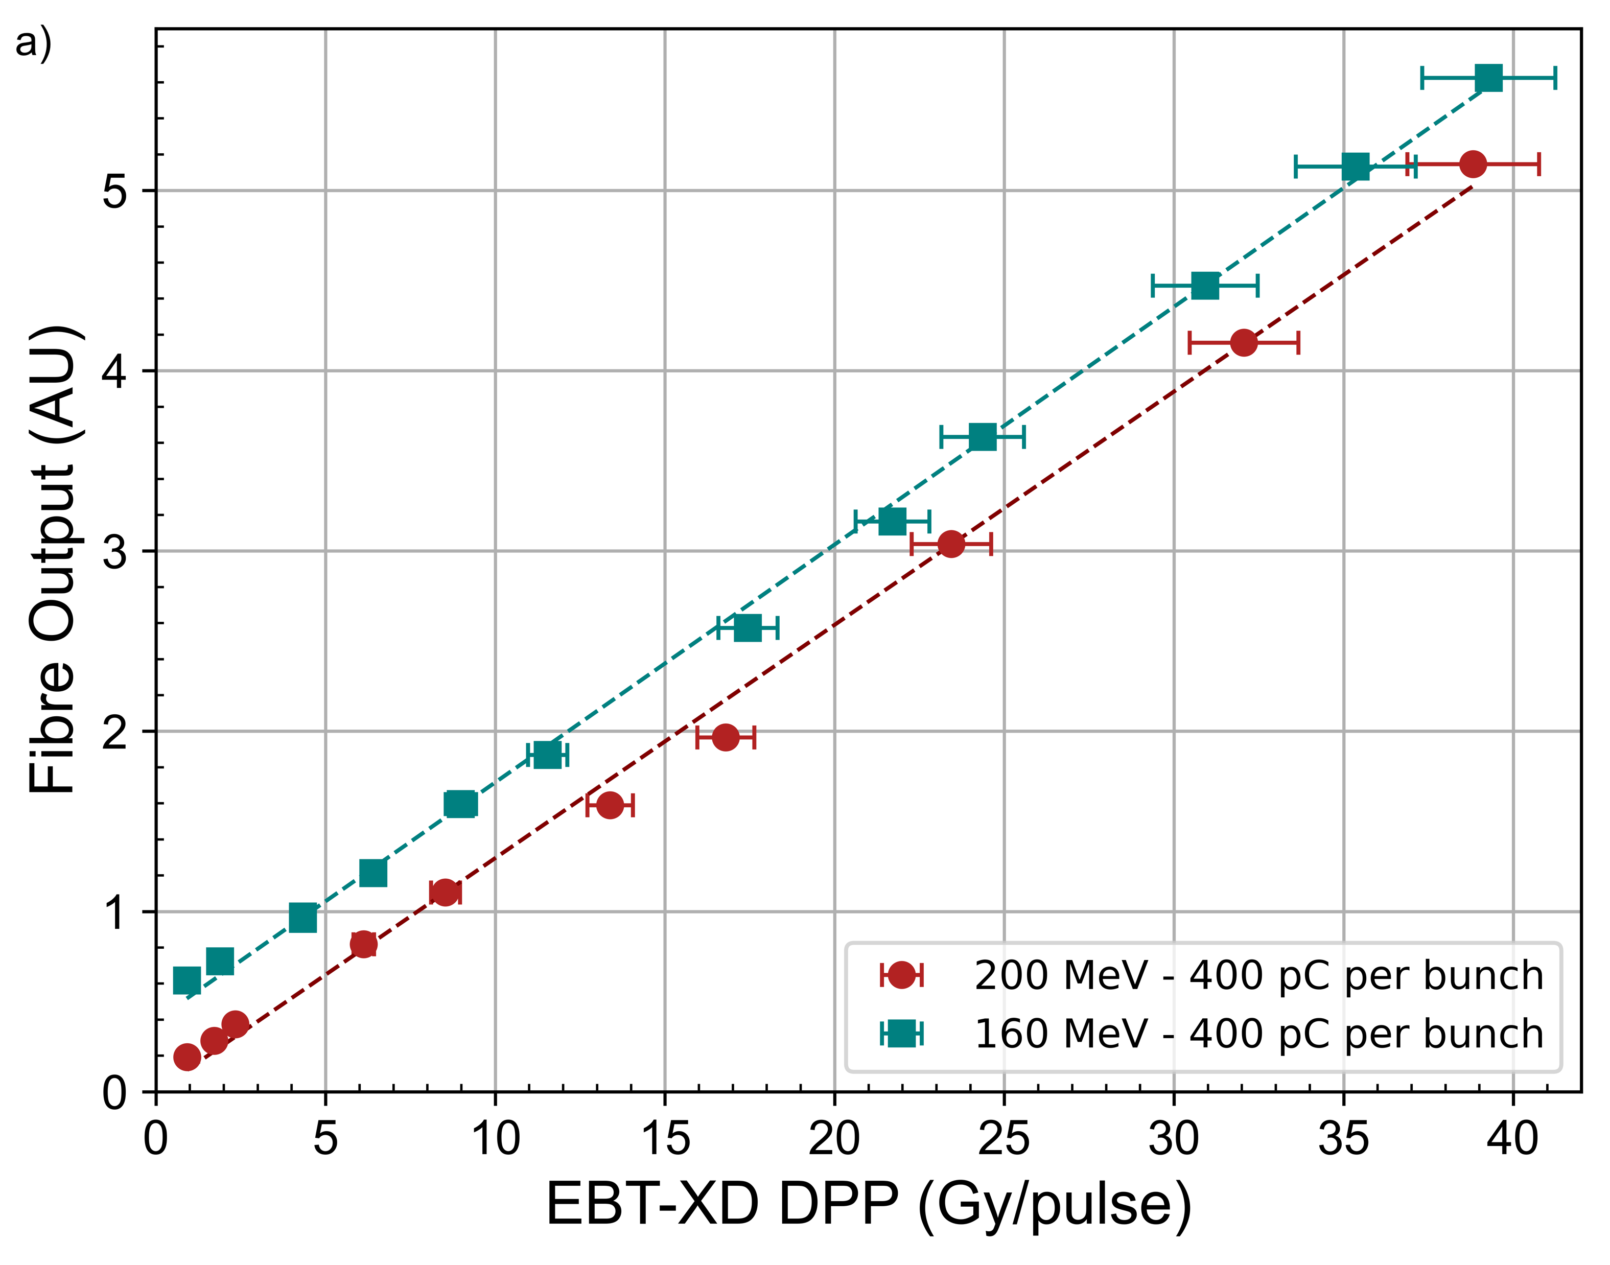
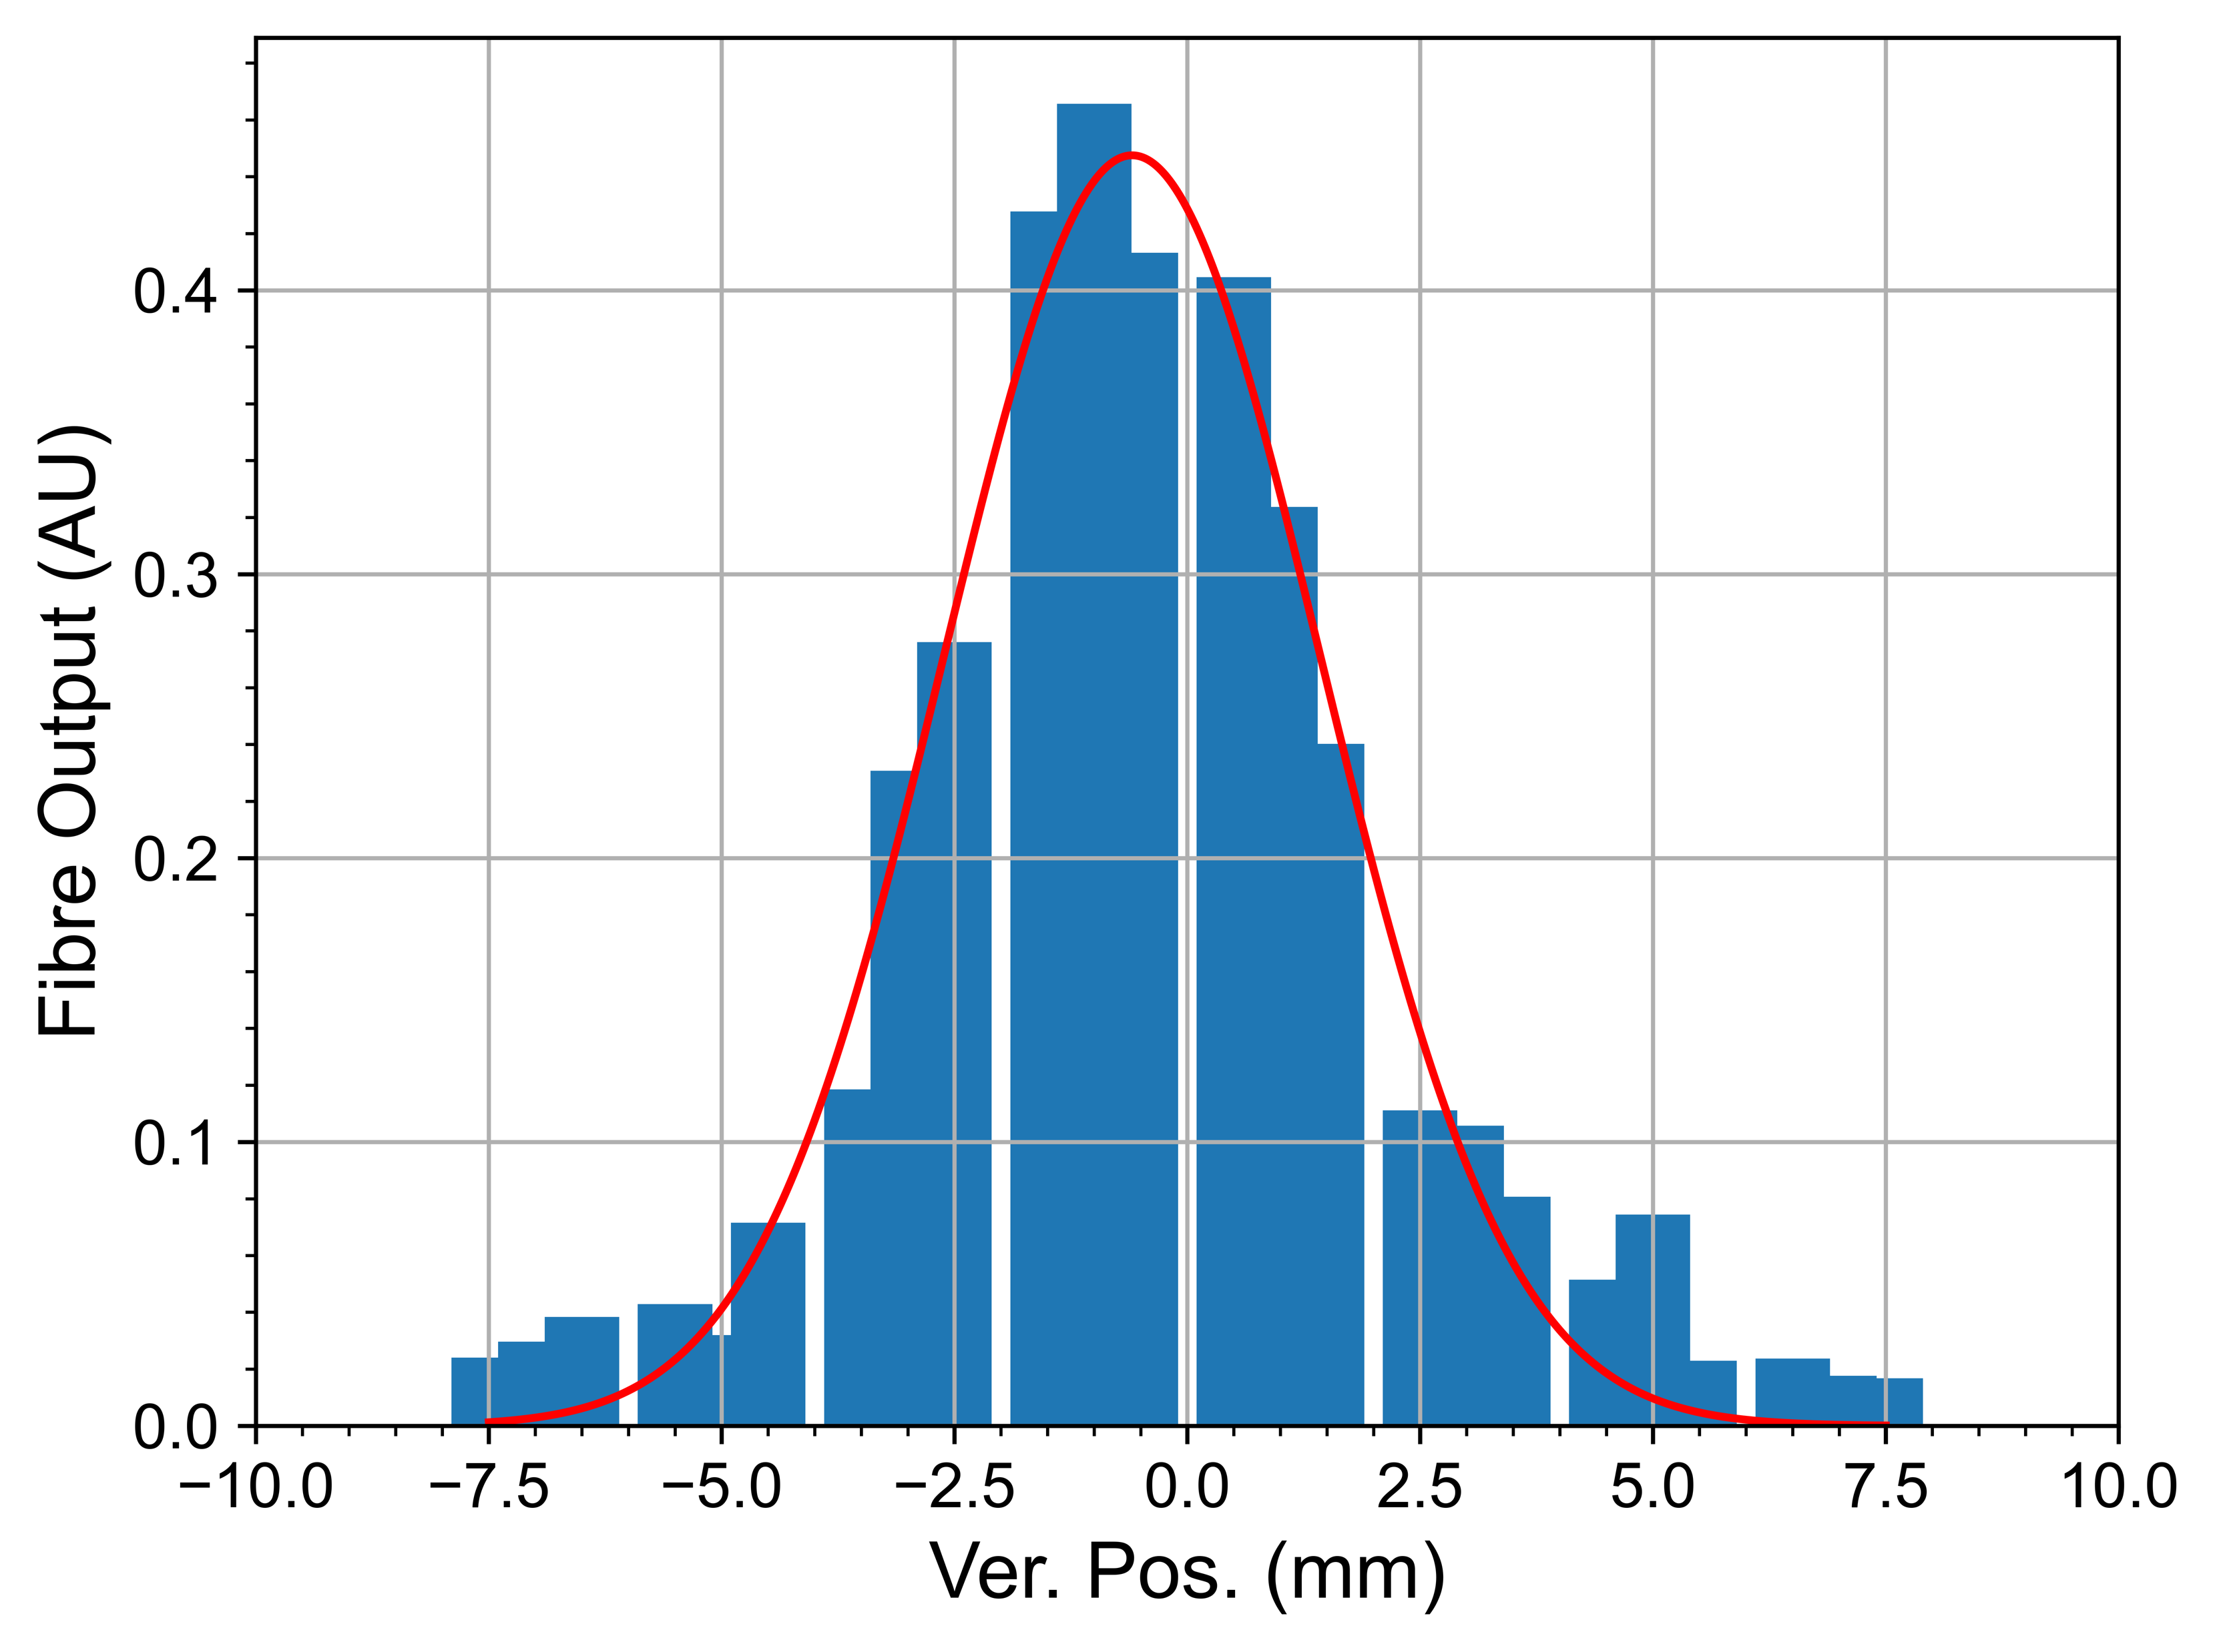
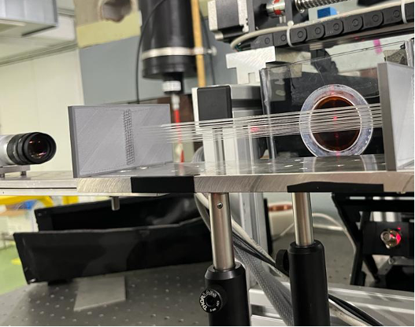
  Fibre Optic FLASH Monitor
  Novel detector consisting of two orthogonal arrays of silica fibre-based Cherenkov sensors readout using CMOS camera.
  Multiple experiments conducted at the CLEAR facility to dosimetrically characterise the detector and evaluate its feasibility for VHEE FLASH beam profile and dose monitoring.
  So far demonstrated linear response at ultrahigh dose-per-pulses (up to 40 Gy/pulse) and accurate beam profile measurements.

Slide 17
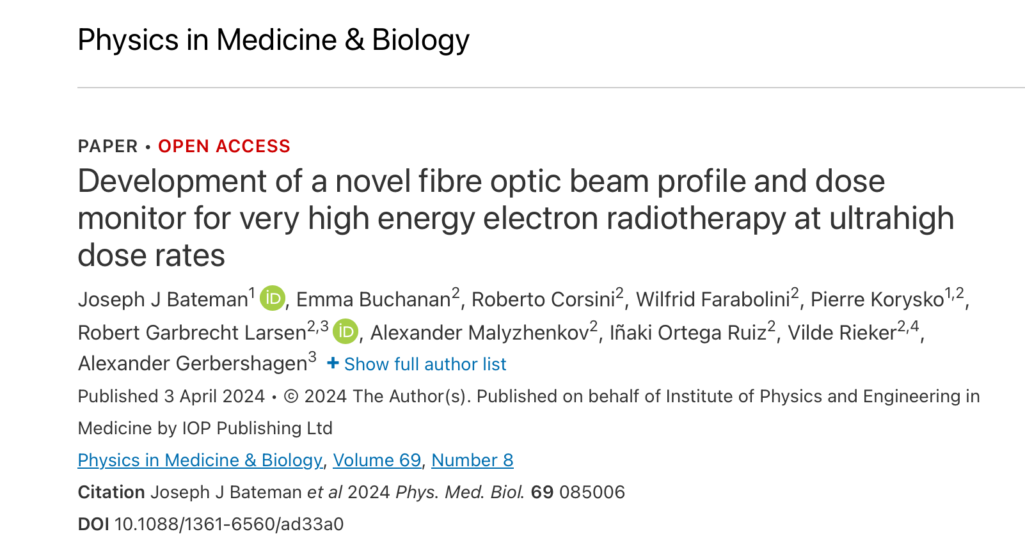

  Fibre Optic FLASH Monitor
  1st publication in Phys. Med. Bio. in April 2024.
  Proffered paper presentation at European Society for Radiotherapy and Oncology (ESTRO) 2024 Congress in Glasgow in May along with invited publication in ESTRO journal.
  Envisioned continued development of FOFM prototype with future DPhil and MPhys students alongside PARTREC & CERN BI doctoral students.

Slide 18
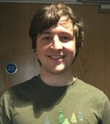


Delivery systems for treatment beams
(Cameron Robertson)
Cameron Robertson,
University of Oxford/CERN
Alexander Gerbershagen,
Groningen and PARTREC
(Particle Therapy Research Center)
Andrea Latina CERN

Slide 19
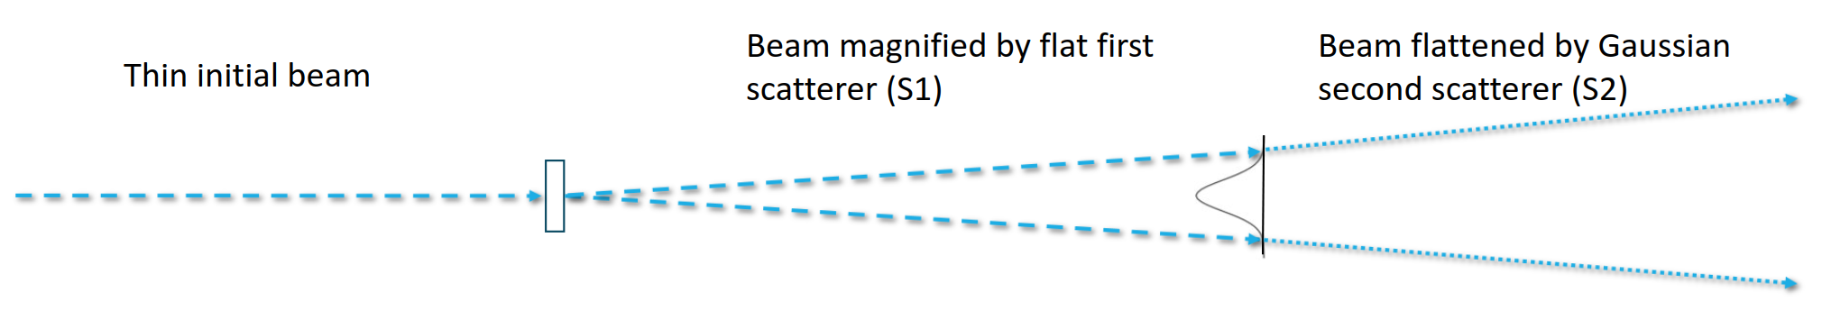
  VHEE Dual-Scattering Systems
  Beam magnification and flattening for conformal VHEE Radiotherapy - passive scattering commonly used in other modalities
  Regained interest due to dose rate independence for FLASH - few studies for VHEE
  Extensive simulation work on impact of particle production, energy spread and losses on dose

Slide 20
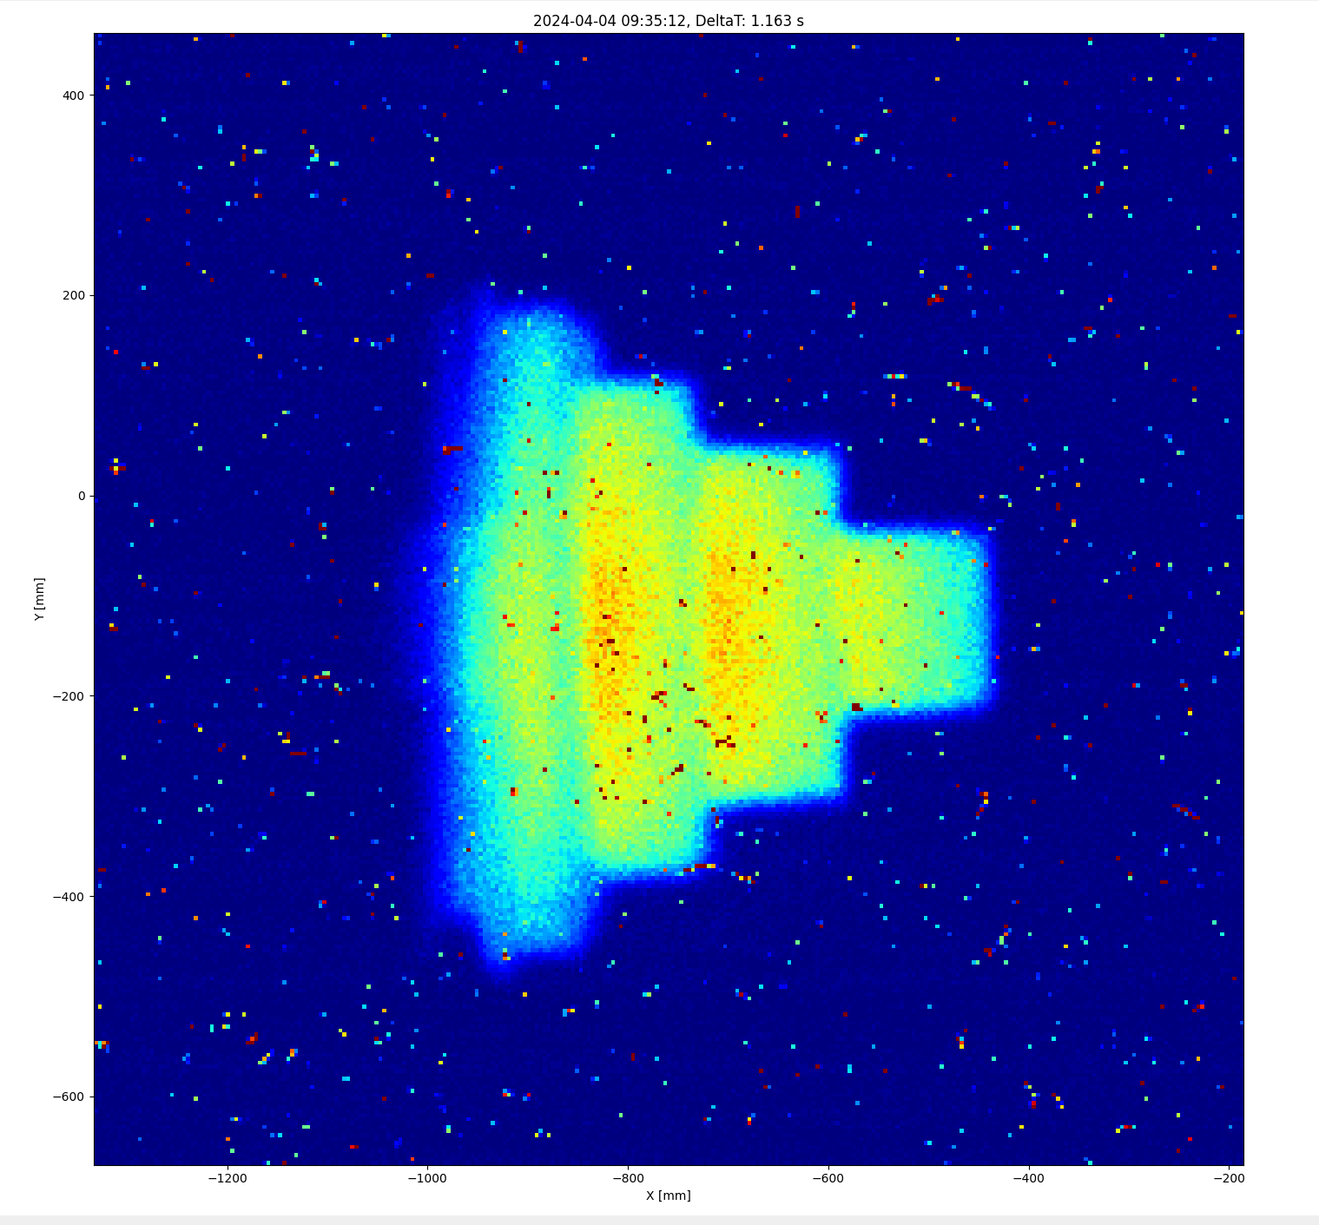
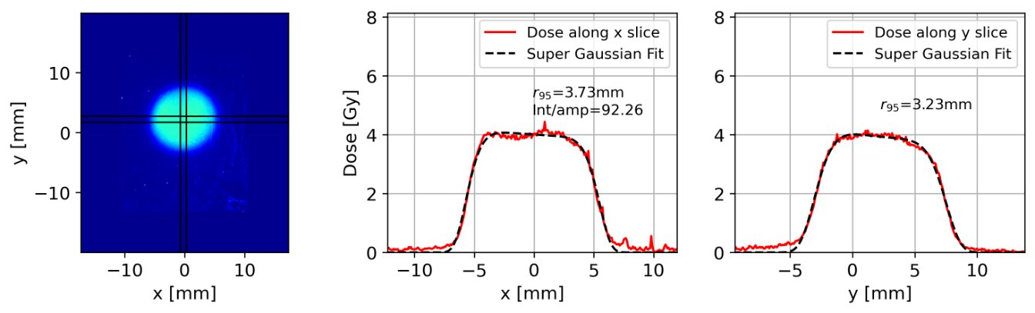
  VHEE Dual-Scattering Systems
  Successful experiments demonstrating magnified, flattened dose distributions at CLEAR – publication in Phys. Med. Bio. under review
  Permanent in-vacuum CLEAR dual-scattering system developed and installed by operators in beamline
  System well characterised and operational with collimator to provide up to 1cm uniform beam profile for sample irradiations and conformal VHEE dose studies – now used as standard for CLEAR radiobiological studies
  Further publication on dose characterisation and uniform VHEE beam evolution in preparation
~2mm

Slide 21
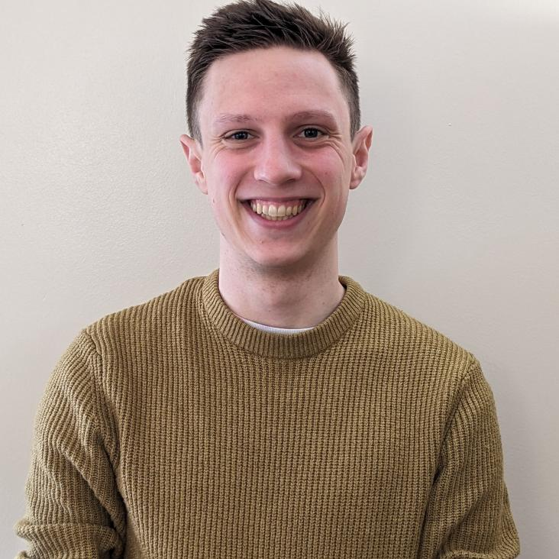
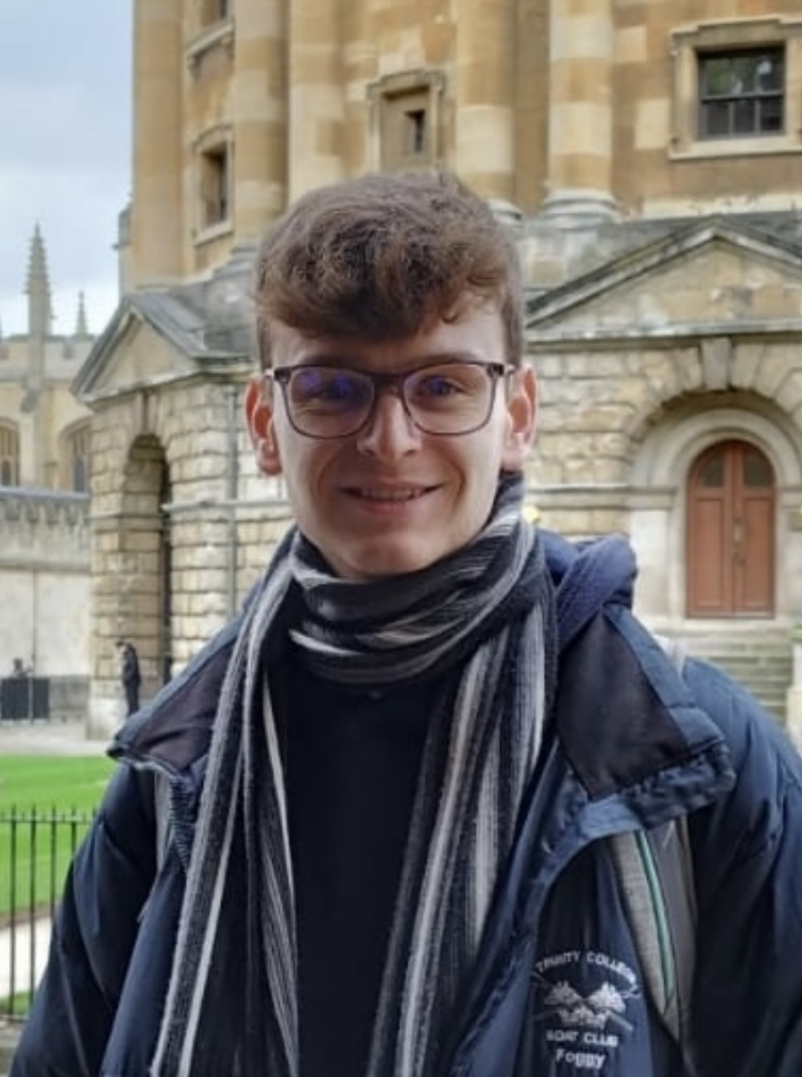
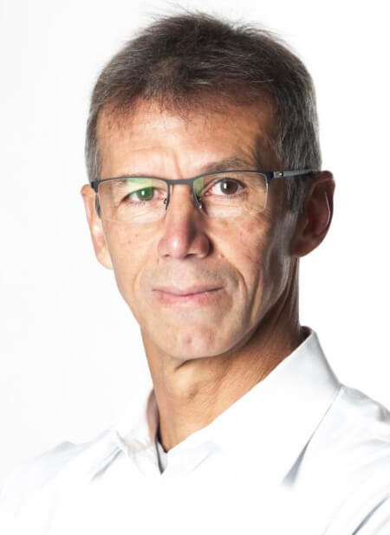
  VHEE GaToroid
Sam Leadley,
University of Oxford
Cameron Robertson,
University of Oxford/CERN
Thomas Fogg,
University of Oxford
Andrea Latina CERN
Alexander Gerbershagen,
Groningen and PARTREC
(Particle Therapy Research Center)
Luca Bottura
CERN

Slide 22
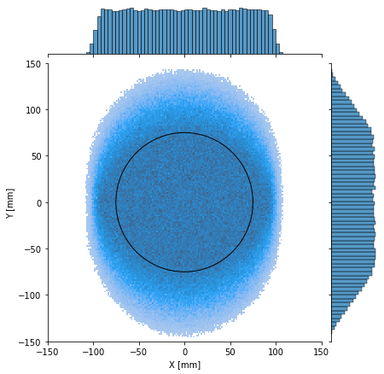
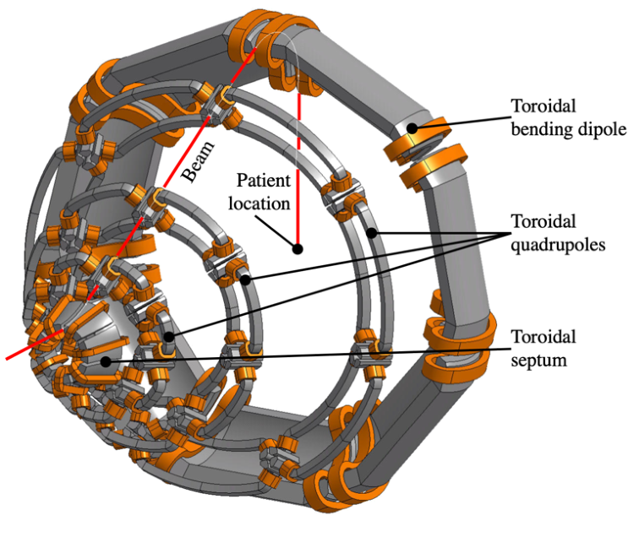
  Initial Studies and Magnetic Design
  Novel concept for static gantry based on toroidal magnets
  Optics design and sensitivity analysis carried out for normal conducting VHEE version
  System geometry defined and studies on magnet design Magnetic Design of a Compact GaToroid for Very High Energy Electron and Pre-clinical Hadron Beams Bottura et. al in IEEE Transactions on Applied Superconductivity
  Fogg , Oxford MPhys student and Roberstson have extended this further
~2mm

Slide 23
In summary
STELLA is progressing …..
Following ART Study: funding for Moldova and regional workshop in Tbilisi, Georgia
FLASH, lots of interest and progress but much remains to be done
First series of research publications by Bateman on Fibre Optic FLASH Monitor and Robertson on VHEE Dual-Scattering Systems for uniform beam profiles
Initial studies and magnet design for VHEE GaToroid getting ready for future funding
Seminars, conferences and talks:
  VHEE 2023 Conference in Hamburg, July 2023 (M. Dosanjh on Organising and Scientific committee)
  Posters at IPAC 2023,
  Oral presentations at PPRIG, FRPT 2023 and VHEE’23
  Best poster prize in dosimetry @ VHEE’23 (J. Bateman).
  Proffered paper talk at ESTRO 2024.
  From Particle Physics Medicine: CERN’s 70th Anniversary event (2024)
  HITRIplus: Global seminar (2023)

