Slide 1


Update on
Education & Training and Public Engagement at JAI
Emmanuel Tsesmelis
CERN & JAI University of Oxford
JAI Advisory Board 2024
15 April 2024

Slide 2
Introduction
The JAI programme is organised around three pillars:
  Research & development in accelerator science.
  Training next generation of accelerator scientists.
  Knowledge exchange, impact & public engagement.

Slide 3
Education and Training

Slide 4
Guiding Strategy
Training in accelerator science & technology is one of the pillars of JAI mission and recognised by JAI Advisory Board to be world-leading.
Objective is to develop skills of next generation accelerator scientists.
JAI has provided graduate & undergraduate training in accelerator science & technology since first course delivered in 2005 (for 20 academic years).
Students participate in comprehensive core formal training through academic courses & projects and 3 years of cutting-edge research at state-of-the-art facilities (national & international).
Many JAI academic staff invited to give courses & lectures at international accelerator schools.

Slide 5
JAI Graduates & Careers
JAI training is well aligned with STFC strategic aims to address national demand for scientifically-skilled workforce to sustain UK’s world-leading position in research & technology (2017 STFC Accelerator Strategy Review & 2019 Accelerator Programme Evaluation).
PhD graduates more than 120; all obtained fruitful employment; about 20% female.
  Alumni consistently pursue careers in science & technology
    Destinations include research positions in universities, ASTeC, BNL, CERN, CI, DESY, LBNL, LLNL, NPL, RAL, SLAC, PSI etc.
    Some reached full academic positions; about 15% work in industry.

Slide 6
Graduate Accelerator Physics Course
Term I October-December 2023
Lectures (23)
Types of Accelerators*
Applications of Accelerators*
Live Connection – LHC Control Centre*
Transverse Optics (2)
Longitudinal Dynamics
Momentum Effects
Lattice Design
Beams & Imperfections
Basic Plasma Physics Concepts for Plasma Accelerators
Plasma-based Electron Acceleration
Plasma-based Ion Acceleration
RF Cavities (4)
Beam Diagnostics & Instrumentation
Synchrotron Radiation
Wigglers & Undulators
Radiation Damping & Excitation
Hamiltonian Dynamics (2)
Parameters for LhARA Student Project
Exercise Classes (6)
Introduction to Accelerators*
Transverse Dynamics
Longitudinal Dynamics
RF Cavities
Hamiltonian Dynamics
Synchrotron Radiation
* Combined Particle Physics &
Accelerator Physics cohort
Course carried out in hybrid format
(in person & Zoom)

Slide 7
Graduate Accelerator Physics Course
Term II January-March 2024
Lectures (22)
Magnet Design (2)
Non-linear Dynamics (2)
Beam-beam Effects
Space Charge Tune Shift
Injection, Beam Transport and Extraction
Linear Colliders (4)
Instabilities (2)
Beamlines for Fixed-target Experiments
Cyclotrons for Various Applications
Particle Sources
Free Electron Lasers
Vacuum and Surface Science
Accelerator Science & Particle Therapy
Introduction to Radiobiology & its Applications to Accelerator Science
Particle Accelerator Sustainability*
Commercialisation of Accelerator Technologies*
Exercise Classes (2)
Magnet Design
Introduction to LhARA Student Project
Tutorials (6)
LhARA Student Project
JAI Seminar (1)
LhARA Student Project
Course carried out in hybrid format
(in person & Zoom)
* Lectures following proposal of JAI AB 2023

Slide 8
Graduate Accelerator Physics Course 2023-2024
Number of Students
    University of Oxford
      Particle Physics (13) *
      JAI Accelerator Physics (4)
    JAI Royal Holloway, University of London (2)
    JAI Imperial College London (4)
* Registered for first three lectures and tutorial of Term I only

Slide 9
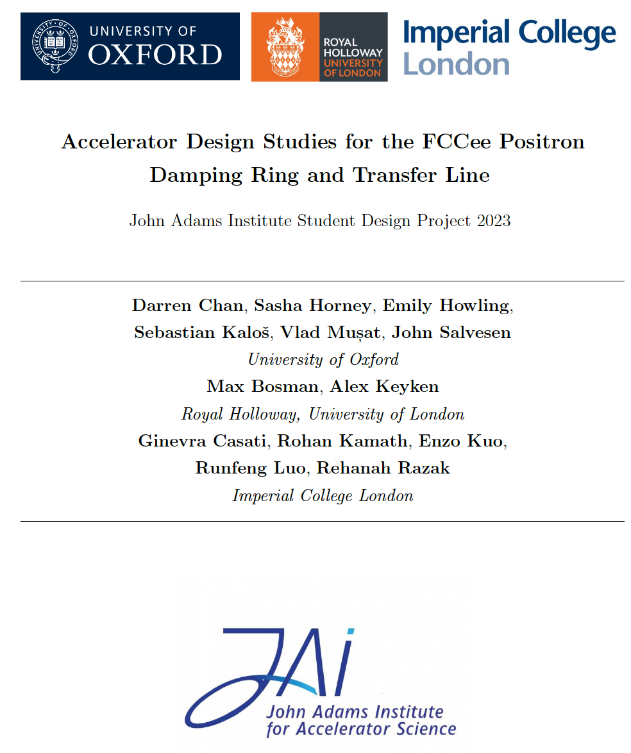
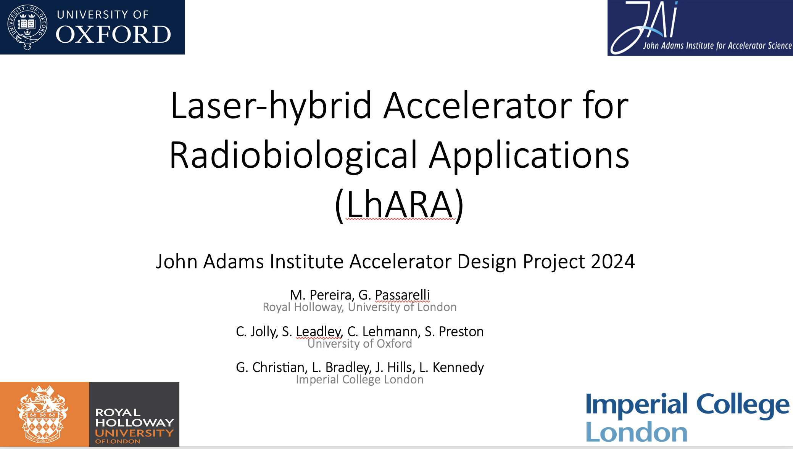
Accelerator Design Project
Accelerator Design Study for
  FCC-ee Booster Ring: 2021-2022
  FCC-ee Positron Damping Ring: 2022-2023
  LhARA Stage I: 2023-2024
  Design work consisted of study of the lattice, magnet systems and RF cavities.
“The design project significantly contributes to the value of a PhD at the JAI and is a very effective learning tool ... it played an essential role in helping me to find a postdoc.”
“To me, the design project was by far the best part of the course. It puts the material taught into context and bridges the gap between lectures ... and a DPhil project ... .”
For 2022-2023: FCC-ee Positron Damping
Ring & Transfer Line Design Report
published on CDS
(DOI 10.17181/CERN.E06E.3CHI )
and students delivered JAI Seminar.
on 9 March 2024.
LhARA
Design Report to be published
on CDS & students delivered JAI Seminar on 15 March 2024

Slide 10
Consolidated Accelerator Course
Graduate lecture course includes plasma research training.
  Lectures provided by ICL, as part of development of integrated accelerator-laser-plasma training,
  Training in ‘Centre for Postgraduate Training in Plasma Physics & High Energy Density Science’ – established in 2014 by ICL, Oxford, and Warwick.
  Plasma-related lecture courses also provided in Oxford.
Graduate students take additional courses in related subjects – statistics, EM, safety, particle physics and astrophysics.
Universities offer courses on transferable skills – Research Skills & Techniques, Written & Oral Communication, Team Working.
Lecturers & Instructors
  M. Dosanjh (Oxford), M. Fraser (CERN), H. Garcia-Morales (Oxford/PickleTech), A. Gerbershagen (Groningen), D. Kelliher (RAL), S. Lawrie (RAL), S. Mangles (ICL), I. Martin (Diamond), A. Milanese (CERN), Z. Najmudin (ICL), S. Patel (RAL), C. Plostinar (ESS), M. Schippers (PSI), P. Tait (Oxford), F. Tecker (CERN), E. Tsesmelis (CERN/Oxford), H. Wakeling (Oxford), Rob Williamson (RAL)
  Lecturers / instructors from JAI universities and from external institutes – CERN, Uni. Groningen, DIAMOND, ESS, PSI, RAL.

Slide 11
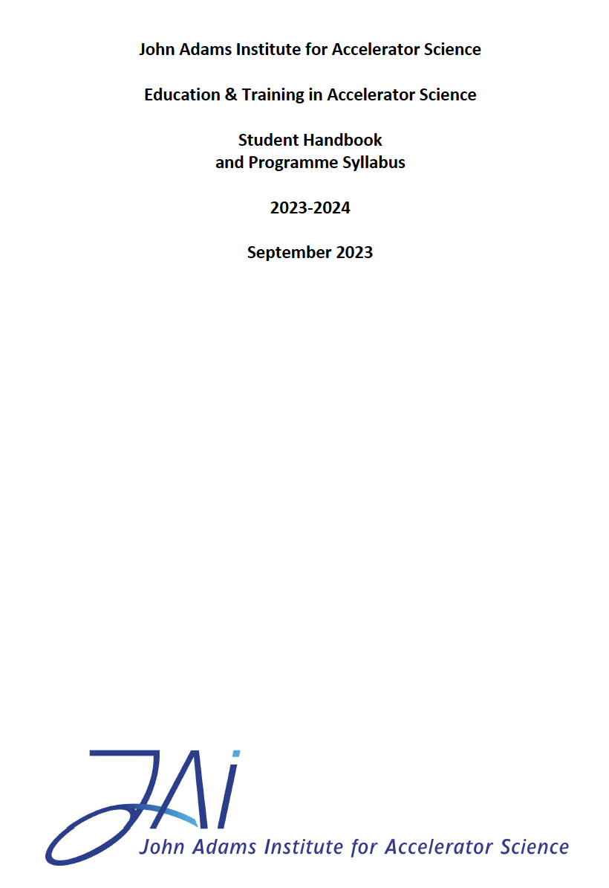
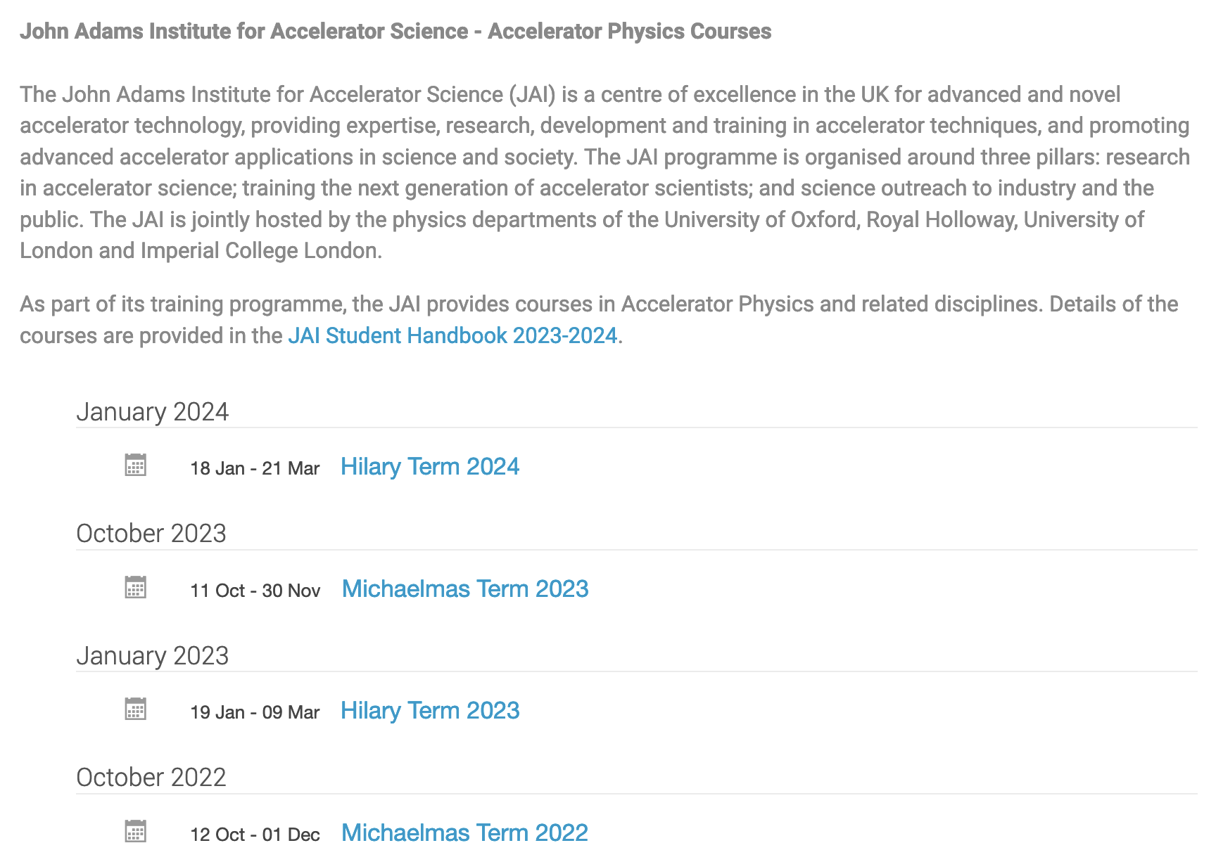
JAI Student Resources
Student Handbook provides information to the students of the training programme in accelerator science at JAI.
  Syllabus & course content, course resources, assessment, evaluation, recommended textbooks.
  Supplementary information (public engagement, lecture series, summer student programme etc.)
Dedicated site on INDICO
  https://indico.cern.ch/category/5869/
  Timetable, slides / documents, Zoom connection

Slide 12
New Graduate Students 2024-2025 Academic Year
Oxford
  Joshua Appleby – ISIS (A. Oeftiger); ISIS funding
  Ibrahim Najmudin – Wakefield Acceleration (R. D’Arcy); STFC funding
  Sabrina Wang – VHEE/FLASH (M. Dosanjh); STFC funding
RHUL
  N.N. on STFC funding
ICL
  Calvin Dyson – ITRF/LhARA (K. Long); STFC funding
  Process for graduate student selection on-going at all JAI universities

Slide 13
Graduate Student Funding
Since 2019, JAI included in STFC quota PhD studentships scheme receiving three studentships per year. Expect four per year as of 2024.
This leverages additional funding sources allowing JAI to recruit typically an additional 6 PhD students / year.
Various funding sources include JAI universities, the Royal Society, EPSRC Industrial CASE & Centres for Doctoral Training, DLS, CLF RAL/ISIS/PPD, CERN Doctoral Student programme, European Research Council, Helmholtz Foundation, Marie Curie Fellowships, Thai government fellowships, industry (e.g. TRUMPF Scientific Lasers) & other non-UK sources. Collaboration with external universities through cooperation agreements, e.g. Humboldt University Berlin.
Continue to explore wide range of possibilities for sustainable funding.

Slide 14
Undergraduate Accelerator Physics Courses
RHUL
  Short option course (12hr) for 3rd year students.
  Annual intercollegiate course for 4th year MSc students from the University of London and as well as BSc/MSc project students.
University of Oxford
  4th year undergraduate projects undertaken annually (e.g. plasma accelerators, medical accelerators).
  Undergraduate course is currently being revised and is expected to become available during STFC funding period 2025-2029.
Expect programmes to attract undergraduate students to accelerator science.

Slide 15
Undergraduate Accelerator Physics
Summer Student Internships
Oxford University Internship Programme (CERN in July/August annually)
  Two students join CLEAR accelerator project supervised by Oxford faculty & graduate students.
  Participate in CERN Summer Student lecture series and in an accelerator project.
Imperial College
  Around 4 students appointed annually.
  Spend 8 weeks working at Imperial College & RAL.
RHUL
  Around 2 students appointed annually.
  Carry out research work at RHUL.
Expect programmes to attract undergraduate students to accelerator science.

Slide 16
UK Accelerator Institutes Seminar Series
JAI has teamed up with ASTeC and the Cockcroft Institute to organise jointly the new UK Accelerator Institutes Seminar Series https://indico.cern.ch/category/13863/
  Delivered by distinguished speakers from the participating institutes and from laboratories / universities world-wide.
Seminars held in person and via videoconference and scheduled so that the graduate student body can attend.
Latest Session in January – March 2024
Title | Speaker
R&D on CW Normal-conducting VHF Gun at Tsinghua University | Y. Du (Tsinghua Uni.)
A Hybrid, Asymmetric, Linear Higgs Factory based on Plasma Acceleration . The HALHF Concept | R. D’Arcy (JAI Oxford)
Gamma Factory – A Tool-driven Revolution? | M. W. Krasny (LPNHE, Paris)
Physics at the CERN Secondary Beamlines | N. Charitonidis (CERN)
Future Particle Physics Colliders with Sustainable Accelerating Systems | J. D’Hondt (Vrije Universiteit Brussel)
Beam Irradiation Facilities | A. Nasreddine (ARIEL)

Slide 17
JAI AB Recommendation 2023
Include accelerator sustainability & commercialisation
  Graduate Lectures
  UK Accelerator Institute Seminar Series
Title | Speaker
Particle Accelerator Sustainability | H. Wakeling (Oxford)
Commercialisation of Accelerator Technologies | P. Tait (Oxford)
Title | Speaker
Future Particle Physics Colliders with Sustainable Accelerating Systems | J. D’Hondt (Vrije Universiteit Brussel)
Beam Irradiation Facilities | A. Nasreddine (ARIEL)
The Sustainable HECAP+ Initiative | K. Lohwasser (University of Sheffield)
Particle Accelerators for Security Applications | M. Jenkins (Rapiscan Systems)

Slide 18
External Training Commitments (Abridged)
In addition to providing courses on accelerator physics at JAI, academic staff are invited to participate at various international forums:
  EU Integrating Activity Projects on Training, Communications & Outreach in Accelerators –
  TIARA 2011-2014, ARIES 2017-2021, I.FAST 2021-2025 (P. Burrows serves as WP Leader). Will coordinate new European panel on education & training in accelerator science under TIARA auspices.
  CERN Accelerator School CAS (various JAI faculty and staff, P. Burrows serves on CAS AB).
  Joint Universities Accelerator School (JAI is partner institute, P. Burrows serves on JUAS AB).
  US Particle Accelerator School (USPAS, various JAI faculty and staff).
  Cockcroft Institute graduate accelerator physics course (S. Gibson).
  University of London intercollegiate undergraduate & graduate accelerator physics courses (S. Gibson, P. Karataev).
  University of Melbourne Medical Accelerator Physics Programme (S. Sheehy).
  Nanyang Technological University undergraduate lectures on accelerator physics (E. Tsesmelis).
  York Fusion Frontiers Lecture Series – Laser Plasma Accelerators (Z. Najmudin)
  Culham Summer School on Plasma Physics - Laser Wakefield Accelerators (S. Mangles)
  Centre for Postgraduate Training on Plasma Physics & High Energy Density Science
  High Power Laser Meeting on Laser Wakefield Acceleration of Electrons

Slide 19
Future Programme - Training
Proposal & plan for the future education & training programme at JAI:
  World-class graduate & undergraduate training in accelerator science & technology.
  Strengthen current graduate training programme within JAI and develop further collaboration with outside institutes.
  Enhance integration of the 3 universities by fostering & supporting student exchanges, common lectures and seminars, and other events, e.g. the UK Accelerator Institutes Seminar Series.
  Increase frequency of joint JAI and CI programme of lectures on specialised topics of advanced accelerator physics & applications.
  Pre-PhD programmes - Summer studentship programmes at all 3 universities; BSc, MSci and MSc. programmes at RHUL; restructured undergraduate module at Oxford making it more attractive.
  JAI academic staff continue to deliver courses & lectures at international accelerator schools, thus providing important accelerator community service.

Slide 20
Public engagement

Slide 21
Introduction
JAI continues to develop its high-profile public engagement in difficult post-Covid environment.
Covid pandemic devastated in-person events, throwing them into online events.
Greatly reduced activities and only now events are approaching pre-pandemic levels.

Slide 22
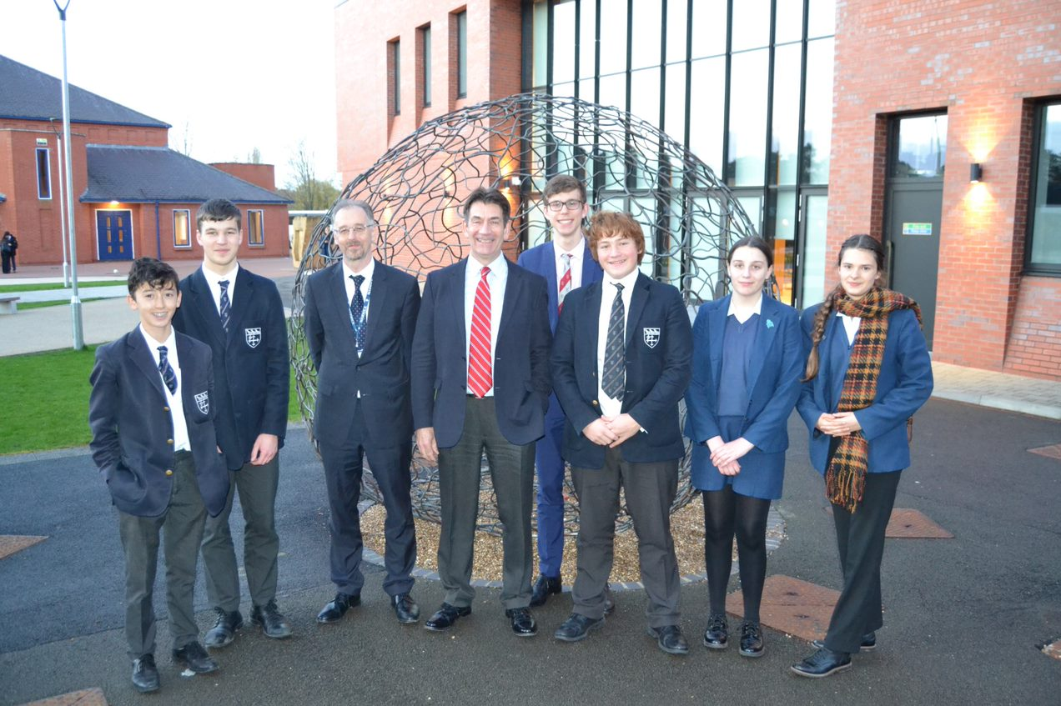
Public Engagement & Schools Outreach
‘Particle Accelerators: from Higgs Bosons to Curing Cancer’
Delivered 40 times in pre-pandemic decade
Continued in 2023 at nearby school: >100 attendees
Feedback from female GCSE student:
‘It meant a lot to me that you spent your time discussing my ambition to have a career in physics once I am older. I greatly appreciate that you talked with me and I thank you for the advice you gave me.
Our discussion really inspired me and I am more determined than ever, … at the moment I am likely to be the only student at my school taking Physics and Further Maths A-Level, but this will not deter me.’
Phil Burrows

Slide 23


Public Engagement & Music
Oxford May Music Festival (17th season).
Einstein’s Universe given over 100 times over almost 20 years to a live audience totalling more than 30,000
Brian Foster

Slide 24
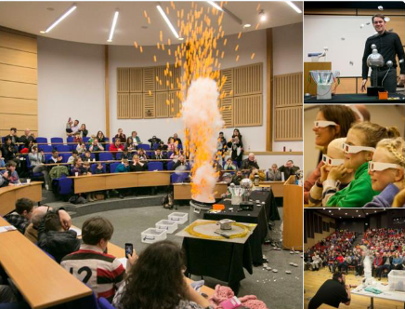

Public Engagement & The Big Bang Experience!
Brief history and future of the LHC revealing wonders of the LHC at CERN and how it is unravelling mysteries of the universe.
Re-started in-person events at RHUL following Covid-19.
  Annual Physics Taster Days (June 2022)
  Particle Physics Masterclass: A-level students (March 2023)
  Royal Holloway Science Festival (May 2023)
  Girls into AstroPhysics residential (July 2023)

Slide 25

Public Engagement & Literature
Popular science book
by Suzie Sheehy
Outreach events, interviews and coverage in Australia, the UK and the US reaching over 4000 people live.
Spin-off Nature article ‘The Woman Who Broke Parity’ (January 2024).

Slide 26

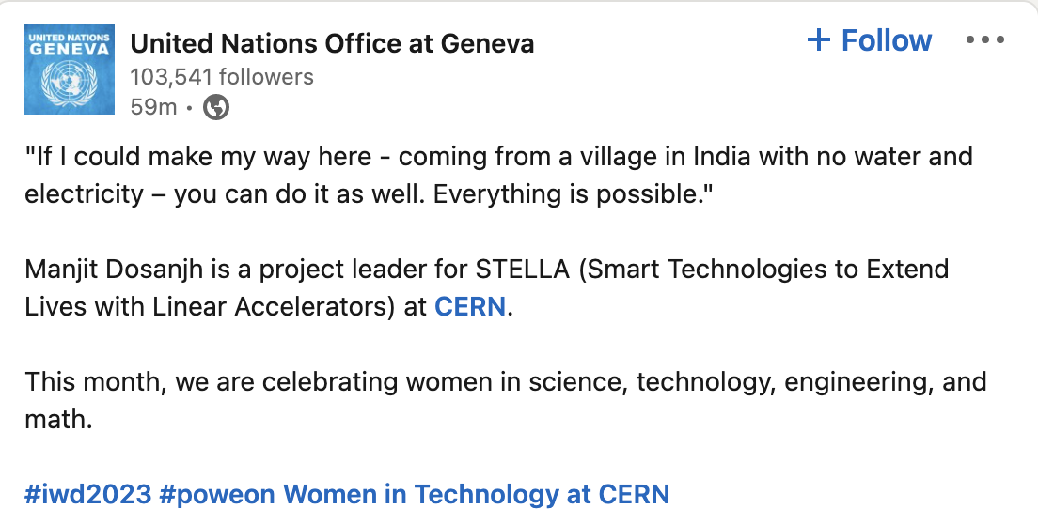
Public Engagement & the SDGs
SDG 3 – Good Health and Well-being
  Climate Change and Health Task Force Meeting (World Health Organization).
  Member of Conference of Non-Governmental Organizations in Consultative Relationship with the United Nations (CoNGO) Board and Invited Speaker at WSIS 2022.
SDG 5 – Gender Equality
  Committee on Status of Women - Geneva (CSW-Geneva)
  UK Civil Society Women’s Alliance (UKCSWA)
Participated in UN General Assembly Third Committee with Non-Governmental Organisations.
Talk to UN ‘Commission on the Status of Women’ Forum.
Manjit Dosanjh

Slide 27
Proposal and Plan for Future
JAI continues to be leader in communicating accelerators & associated physics.
Envisage significant return to previous strengths in in-person events post-Covid.
Activities for future include:
  Training days for teachers (APPEAL – Accelerator and Particle Physics at A-Level) and IoP events for science teachers.
  Long-standing schools programmes – ‘Accelerate’, ‘Einstein’s Universe’ and ‘Big Bang Experience’.
  High-profile collaborative public engagement attracting new audience to science – Big Bang Fair & Oxford May Music.

Slide 28
Summary
JAI continues to deliver world-class accelerator science education & training and public engagement programmes.
  Intense accelerator physics course.
  Innovative and educational accelerator design projects.
  Successful placement of students once they enter professional careers.
  Recognised and award-winning public engagement activities with global reach - continue strengthening existing portfolio and encourage new & innovative ideas.

