Slide 1
FCC-ee Positron Damping Ring and Transfer Line
John Adams Institute Accelerator Design Project 2023

Slide 2



JAI Design Project 2023
The John Adams Institute is a UK research centre for novel accelerator technology
Many different accelerators across the UK and Europe used in many different scientific fields
Collaboration between Royal Holloway University of London, Imperial College London and University of Oxford

Slide 3

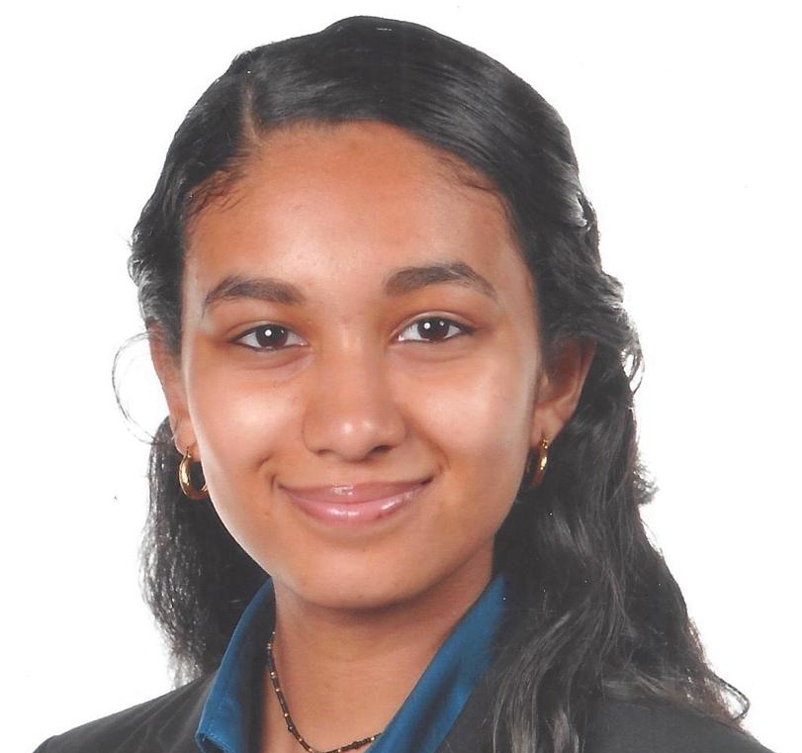
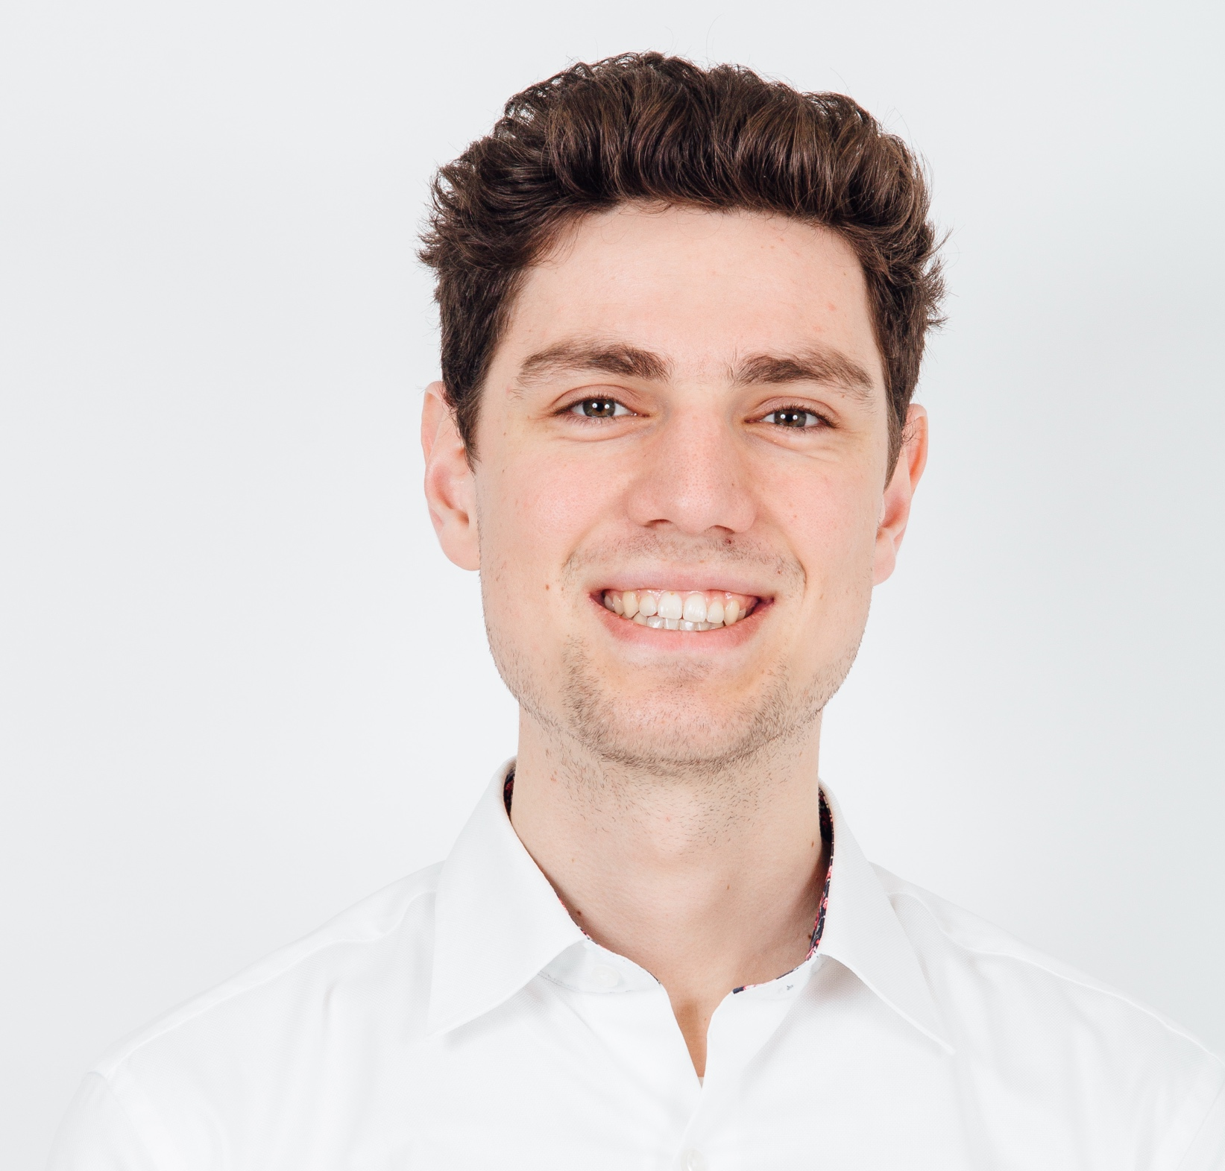
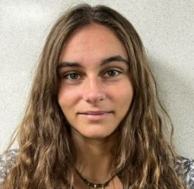

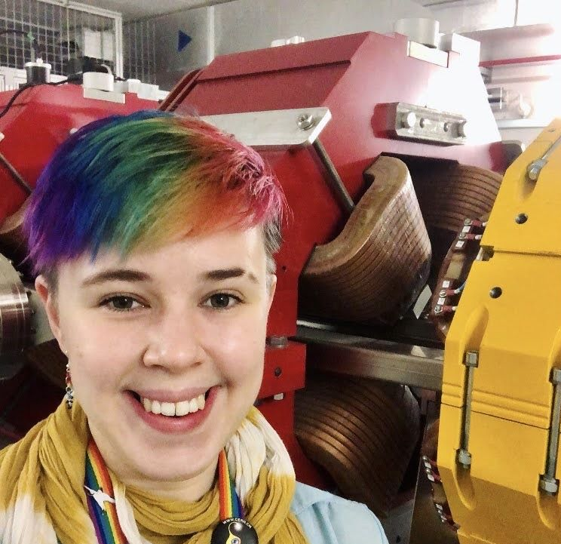



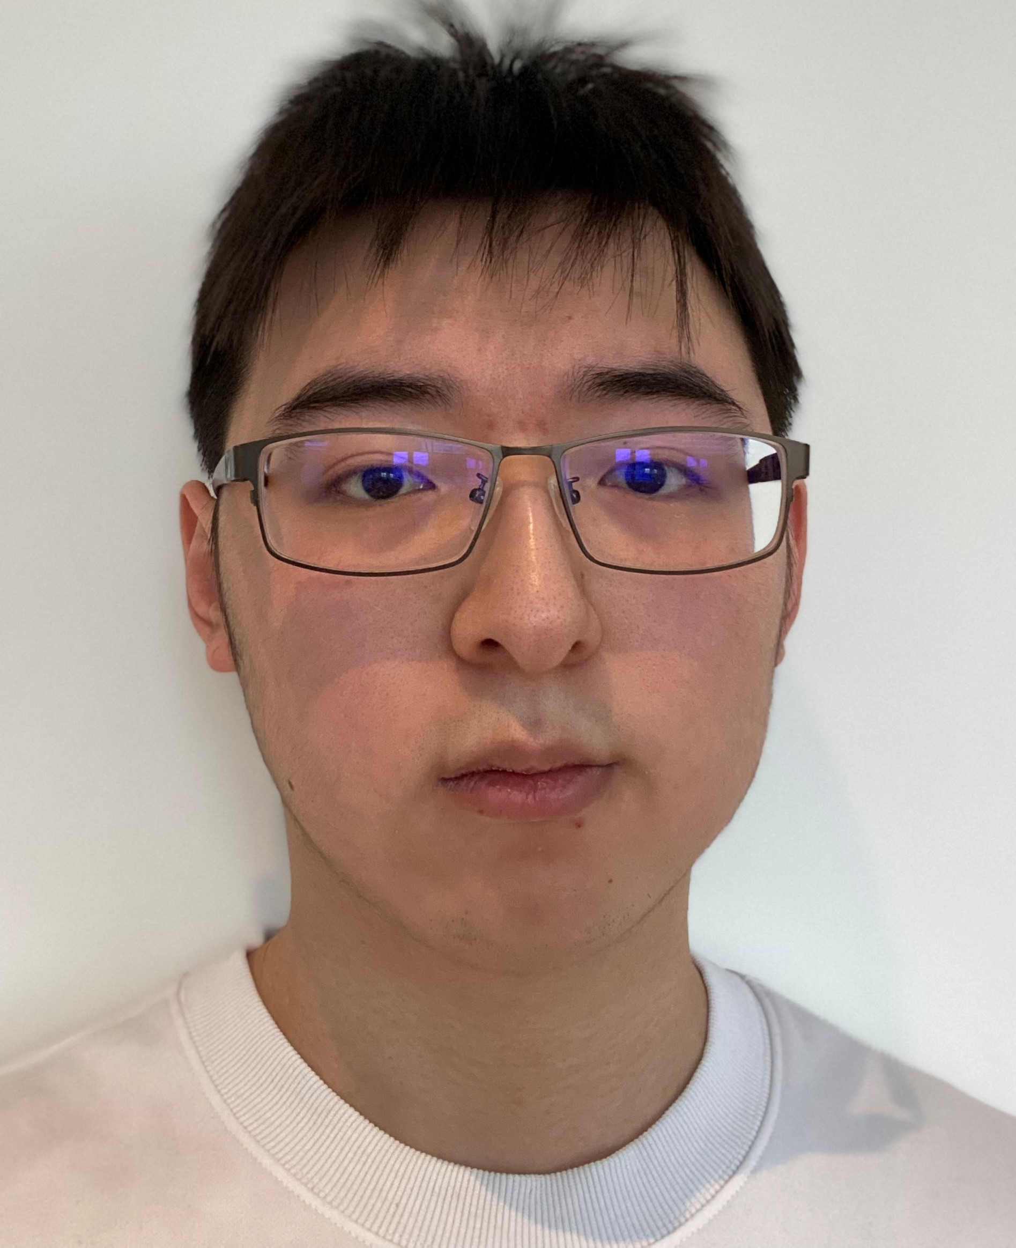
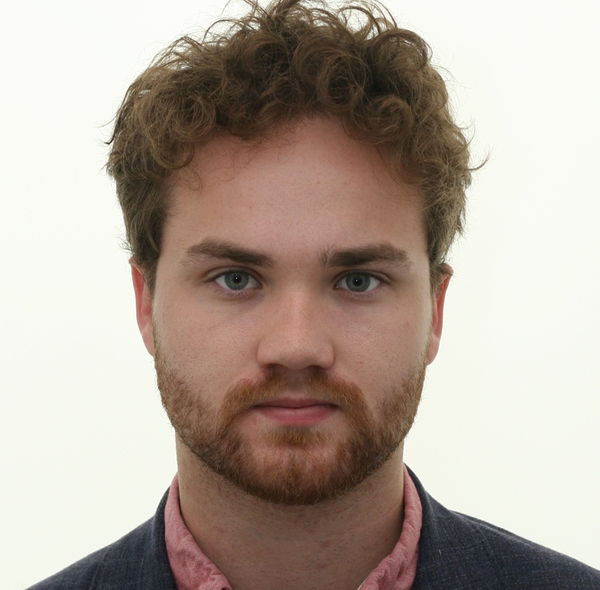

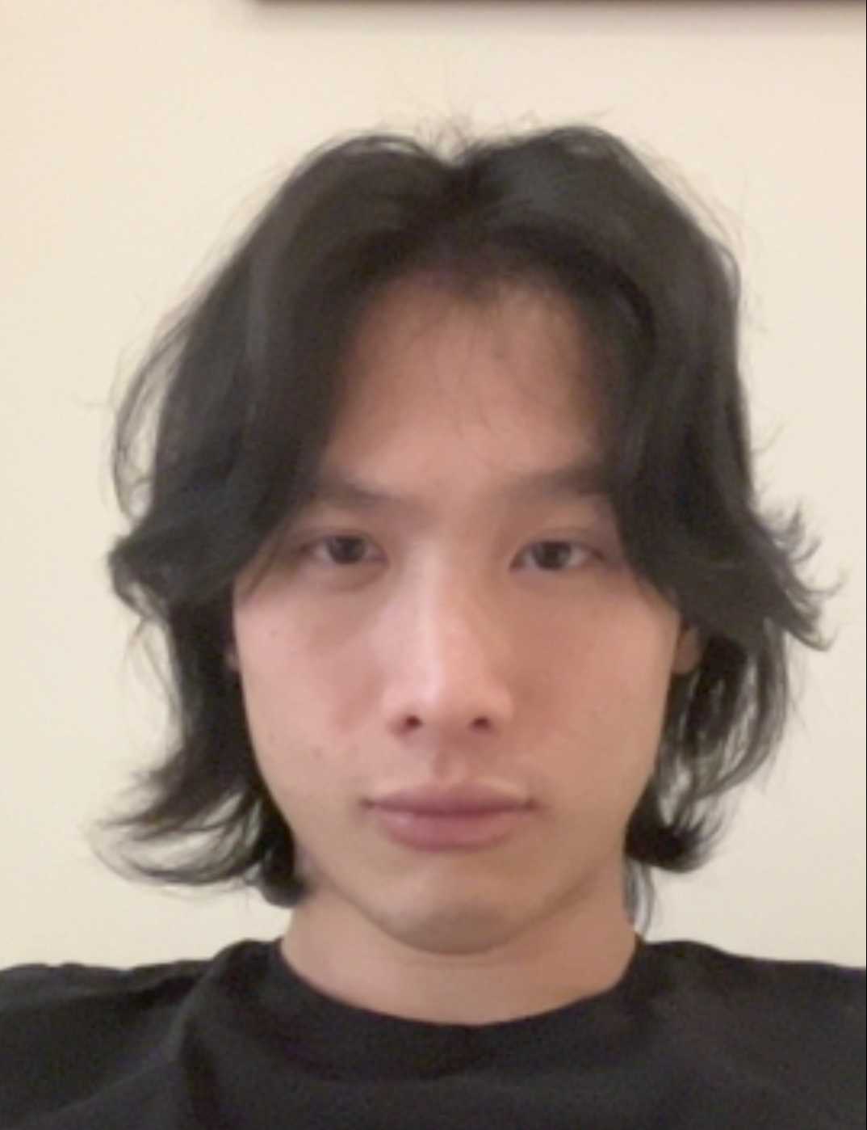
Meet the Team
Lattice
RF Cavities
Magnets
Alex Keyken
Rehanah Razak
Max Bosman
Ginevra Casati
Darren Chan
Emily Howling
Sebastian Kaloš
Rohan Kamath
Vlad Mușat
Runfeng Luo
Jack Salvesen
Sasha Horney
Sasha Horney
Enzo Kuo

Slide 4

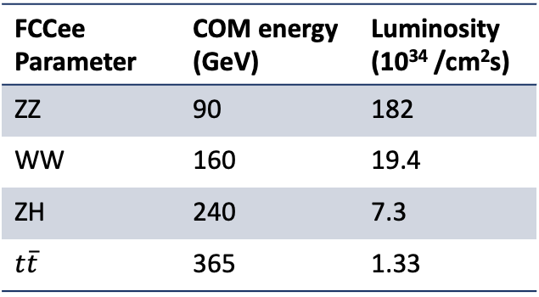
Introducing the FCC
Future Circular Collider
$\sim$100 km collider proposed by CERN, with higher centre-of-mass energy than any collider to date (100 TeV hh compared to LHC’s 13 TeV)
A century of physics: FCCee, FCChh, FCCeh and heavy ions
Collider | Peak COM energy(GeV) | Luminosity (10³⁴ /cm²s)
CLIC | 3000 | 1.5
ILC | 500 | 1.35
C3 | 2000 | 4.5
CEPC | 240 | 1.74
FCCee Parameter | COM energy (GeV) | Luminosity (10³⁴ /cm²s)
ZZ | 90 | 182
WW | 160 | 19.4
ZH | 240 | 7.3
$t\overline{t}$ | 365 | 1.33
See references
Notes:
Very similar luminosity
Lowish COM energy but only Higgs factory for now

Slide 5
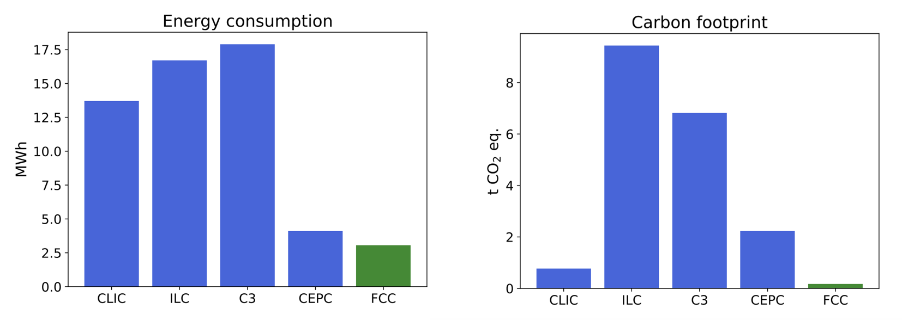
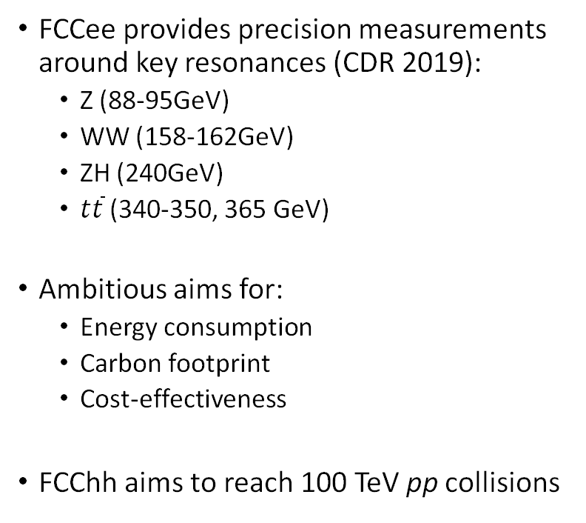
FCCee Design Aims
FCCee provides precision measurements around key resonances (CDR 2019):
  Z (88-95GeV)
  WW (158-162GeV)
  ZH (240GeV)
  $t\overline{t}$ (340-350, 365 GeV)
Ambitious aims for:
  Energy consumption
  Carbon footprint
  Cost-effectiveness
FCChh aims to reach 100 TeV pp collisions
Janot, P., Blondel, A. The carbon footprint of proposed e+e−e+e− Higgs factories. Eur. Phys. J. Plus 137, 1122 (2022). https://doi.org/10.1140/epjp/s13360-022-03319-w

Slide 6

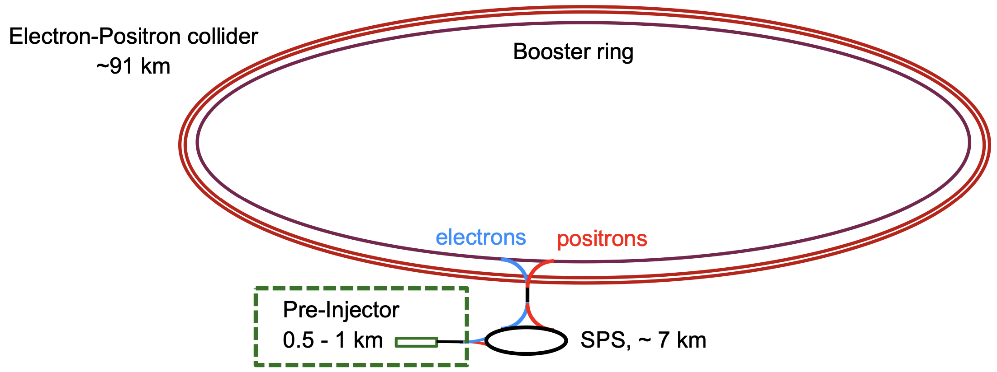
The FCCee Physics Program
Pre-injector complex: currently in development
Focus of this project: positron damping ring of pre-injector complex
Transfer line of pre-injector complex

Slide 7
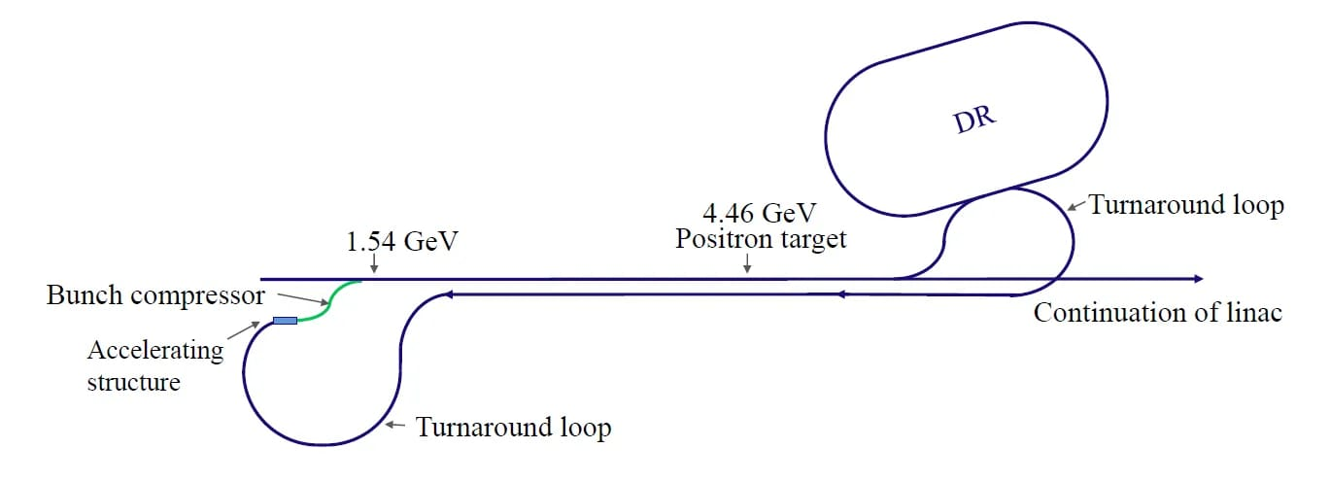
The Positron Damping Ring
Positrons are produced with high emittance
Emittance: spread in position-momentum (or energy-phase) relation
low spread in position and momentum make the beam more concentrated and more easily steerable
Damping ring reduces emittance, before further injection
Notes:
Example of emittance of the beam before the damping ring

Slide 8
Project Overview
Lattice: description of general configuration and requirements of a bunch compressor, including stand-alone bunch compressor configuration in MAD-X at the exit of the transfer line from the pDR to the Common Linac
Magnets: FEMM modelling of main magnets of the pDR – dipoles, quadrupoles and sextupoles, as well as finding requirements and geometry for kicker/septa and wiggler magnets
RF cavity: optimization in 2D using Superfish of the superconducting RF cavity at 400 MHz and 800 MHz, as well as a normal conducting RF cavity, followed by 3D modelling in CST

Slide 9
Lattice
Bunch Compressor Design

Slide 10
Bunch Compressor

Slide 11
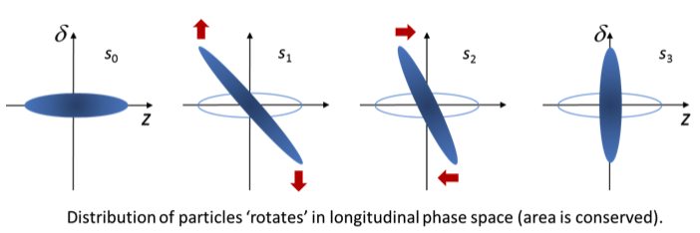
A bunch compressor is …
… needed as high energy accelerators require high peak current, meaning that the bunch must be compressed to lengths in the pico/femtosecond range.
… necessary because the space charges, in the beam, stretch the bunch length and increase the longitudinal emittance.
… used to compress a bunch, longitudinally, to reduce the bunch length by rotating the longitudinal phase space.

Slide 12
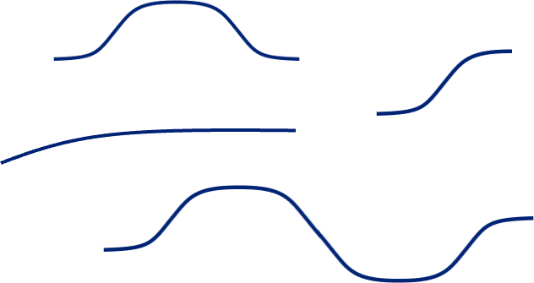
Types of bunch compressors
Here are some examples of possible bunch compressor schematics:
C-bend Achromat
Dog-Leg
Arc F0D0
S-Chicane

Slide 13
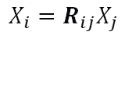
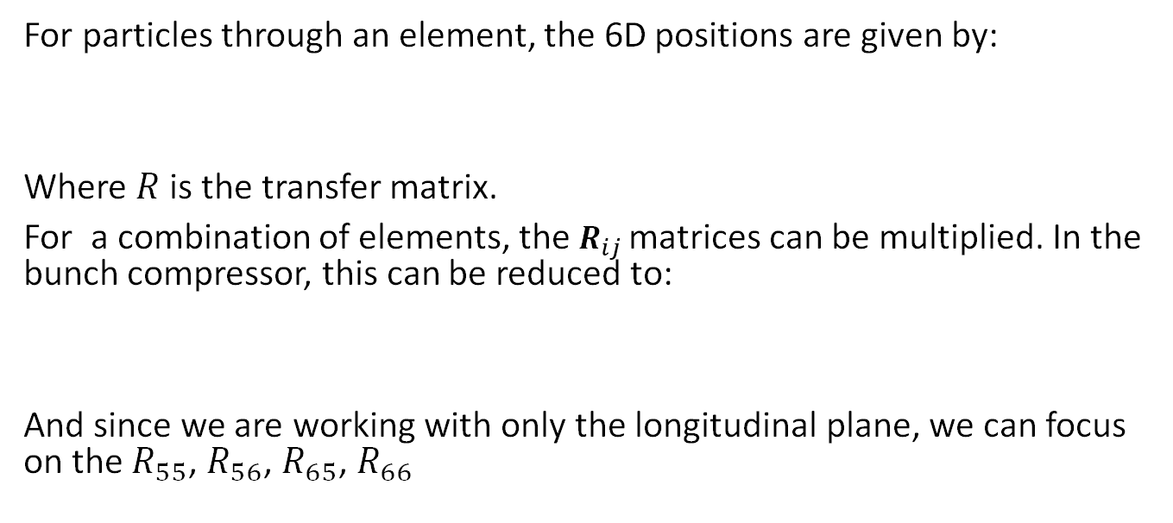

Theory
For particles through an element, the 6D positions are given by:
Where $R$ is the transfer matrix.
For a combination of elements, the $R_{ij}$ matrices can be multiplied. In the bunch compressor, this can be reduced to:
And since we are working with only the longitudinal plane, we can focus on the $R_{55}$, $R_{56}$, $R_{65}$, $R_{66}$
$$X_{i}=R_{ij}X_{j}$$
$$X_{i}=R_{optics}{R_{cavity}X}_{j}$$

Slide 14
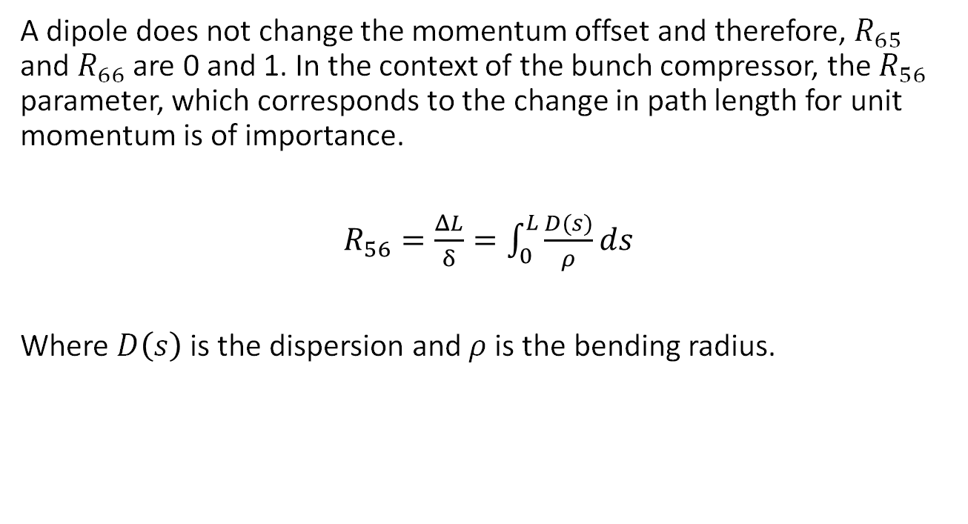
Transfer Matrix of a Dipole
A dipole does not change the momentum offset and therefore, $R_{65}$ and $R_{66}$ are 0 and 1. In the context of the bunch compressor, the $R_{56}$ parameter, which corresponds to the change in path length for unit momentum is of importance.
$R_{56}=\frac{ΔL}{δ}=\int_{0}^{L}{\frac{D(s)}{ρ}ds}$
Where $D\left(s\right)$ is the dispersion and $ρ$ is the bending radius.

Slide 15
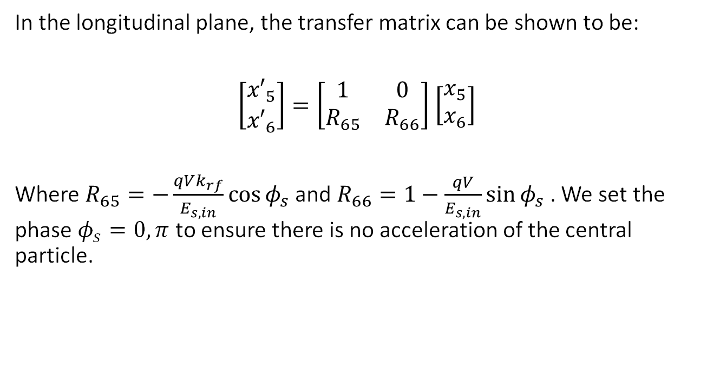
Transfer Matrix of an RF Cavity
In the longitudinal plane, the transfer matrix can be shown to be:
$\left[\begin{aligned}{x′}_{5} \\ {x′}_{6}\end{aligned}\right]=\left[\begin{matrix}1 & 0 \\ R_{65} & R_{66}\end{matrix}\right]$ $\left[\begin{aligned}x_{5} \\ x_{6}\end{aligned}\right]$
Where $R_{65}=−\frac{qVk_{rf}}{E_{s,in}}\cos{φ_{s}}$ and $R_{66}=1−\frac{qV}{E_{s,in}}\sin{φ_{s}}$ . We set the phase $φ_{s}=0, π$ to ensure there is no acceleration of the central particle.

Slide 16

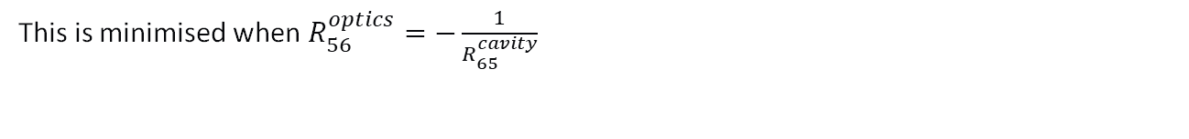
Bringing it all together…
Finally, on multiplying the transfer matrices of the optics and the cavity,
$$z_{out}=\left(1+R_{56}^{optics}R_{65}^{cavity}\right)z_{in}+R_{56}^{optics}δ_{in}$$
On averaging over all particles in the bunch, the RMS bunch length $σ_{out}$ becomes:
$$σ_{out}=\sqrt{{\left(1+R_{56}^{optics}R_{65}^{cavity}\right)}^{2}σ_{in}^{2}+{R_{56}^{optics}}^{2}δ_{in}^{2}}$$
This is minimised when $R_{56}^{optics}=−\frac{1}{R_{65}^{cavity}}$

Slide 17
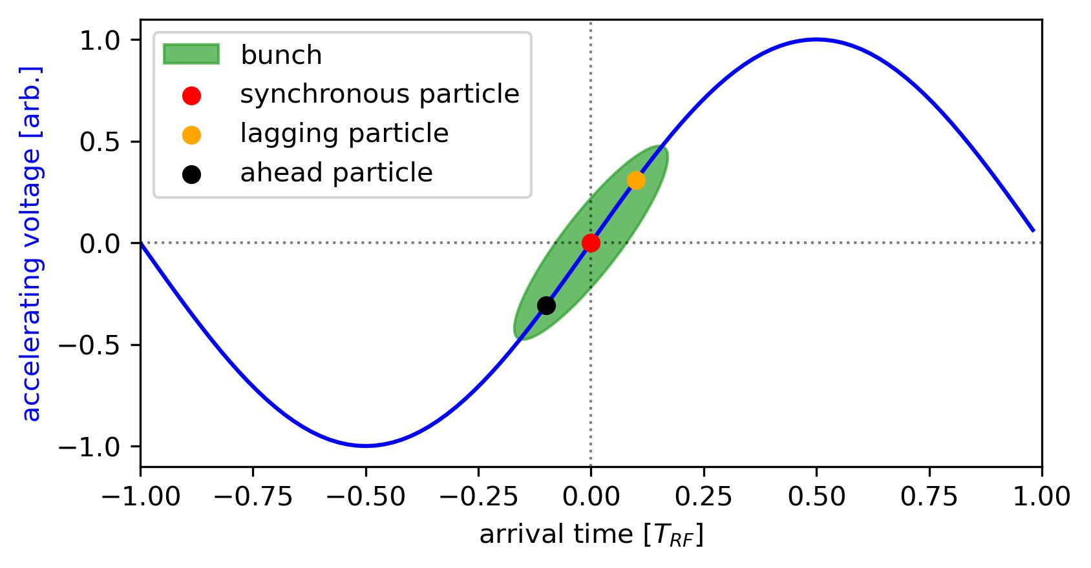
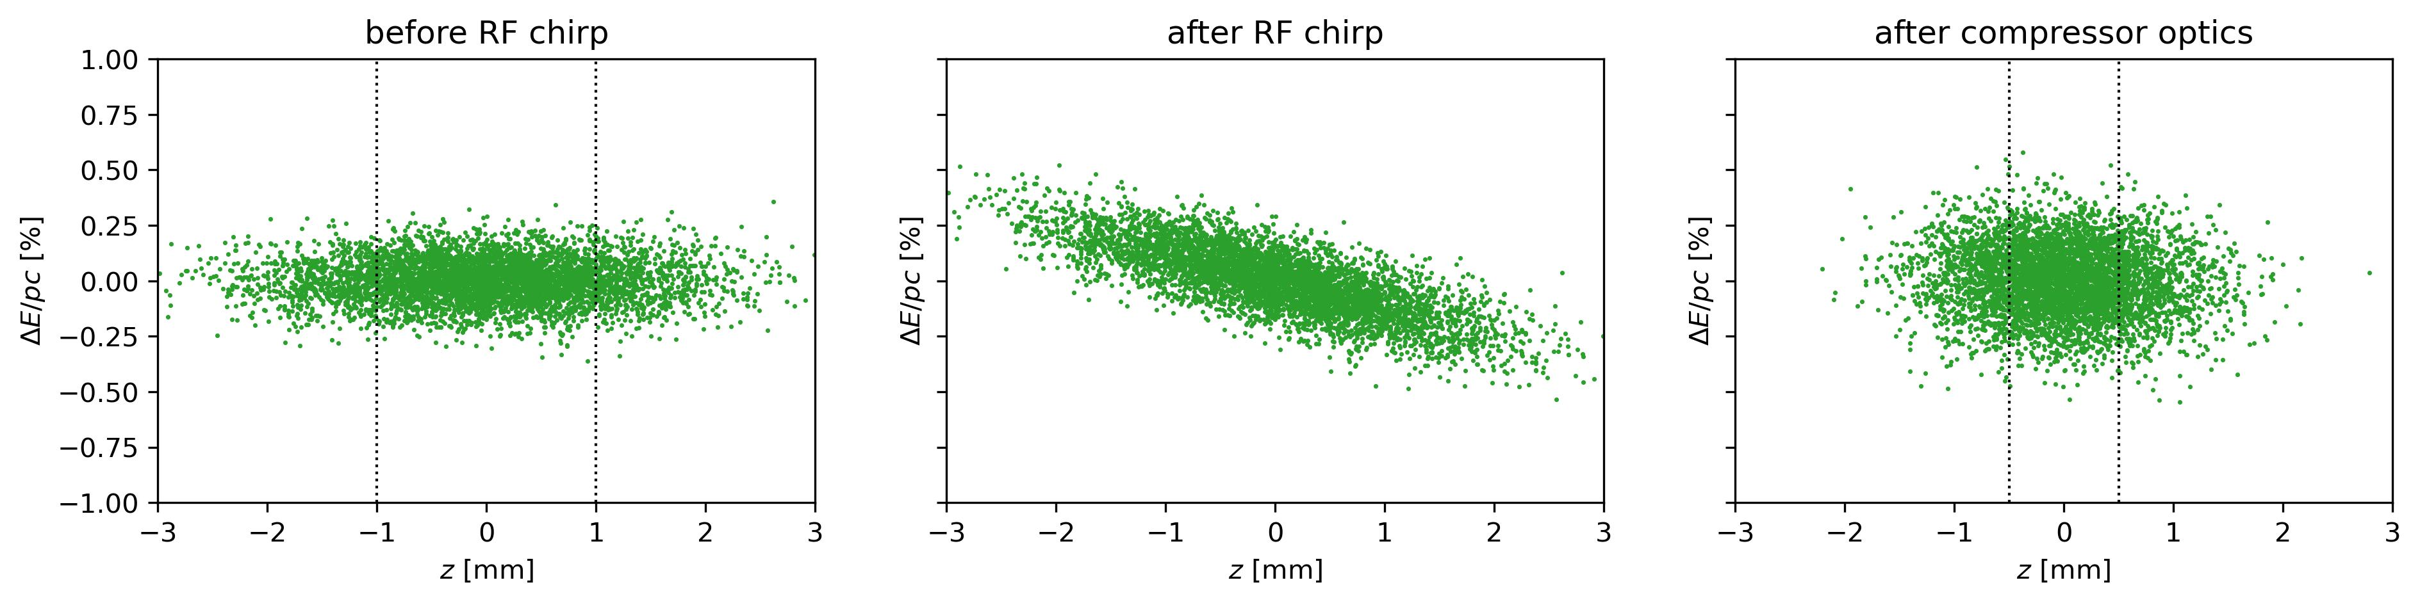
Bunch Compression
Parameters:
1.54 GeV positron beam
0.1% momentum spread
RMS bunch length:
  2mm (initial)
  1mm (final)
Adding energy chirp
in RF cavity
Longitudinal phase space development (with C-Bend Achromat):
2mm RMS
1mm
RMS

Slide 18
C-bend Achromat: Single Cell
K₂
L_{QF}
K₁
𝛉
𝛉
RF
K₁
𝛉
𝛉
to MS
L_{BM}
L_{1Q}
L_{2Q}
L_{Q2}
L_{QD}
Dimension | Value (m)
L_{BM} | 1.5
L_{1Q} | 0.45
L_{QF} | 0.3
L_{2Q} | 0.55
L_{QD} | 0.3
L_{MS0} | 1.4
L_{MS1} | 2.2
Magnet Parameter | Value
K₁ | 1.1 m⁻²
K₂ | 1.92 m⁻²
𝛉 | 12.5^{O}
K_{MS} | +- 1.5 m⁻²
Matching Section (MS):
K_{MS-}
K_{MS+}
K_{MS-}
RF Parameter | Value
f (accel. frequency) | 3 GHz
V (peak accel. voltage) | 10 MV
L_{MS0}
L_{QD}
L_{MS1}
L_{QF}
L_{QD}

Slide 19
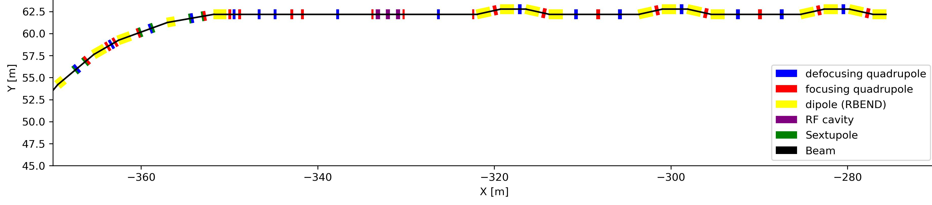
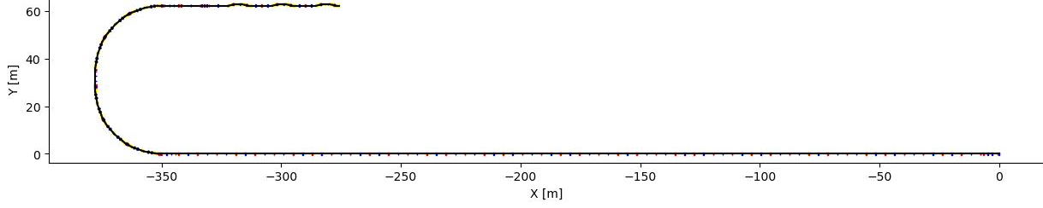
C-Bend Achromat: Global Layout
RF
CELL 1
CELL 2
CELL 3
MS_{arc}
FODO
MS
MS
MS
ARC
zoom
ARC
1.54 GeV positrons from
damping ring
POSITRON TRANSFER LINE

Slide 20
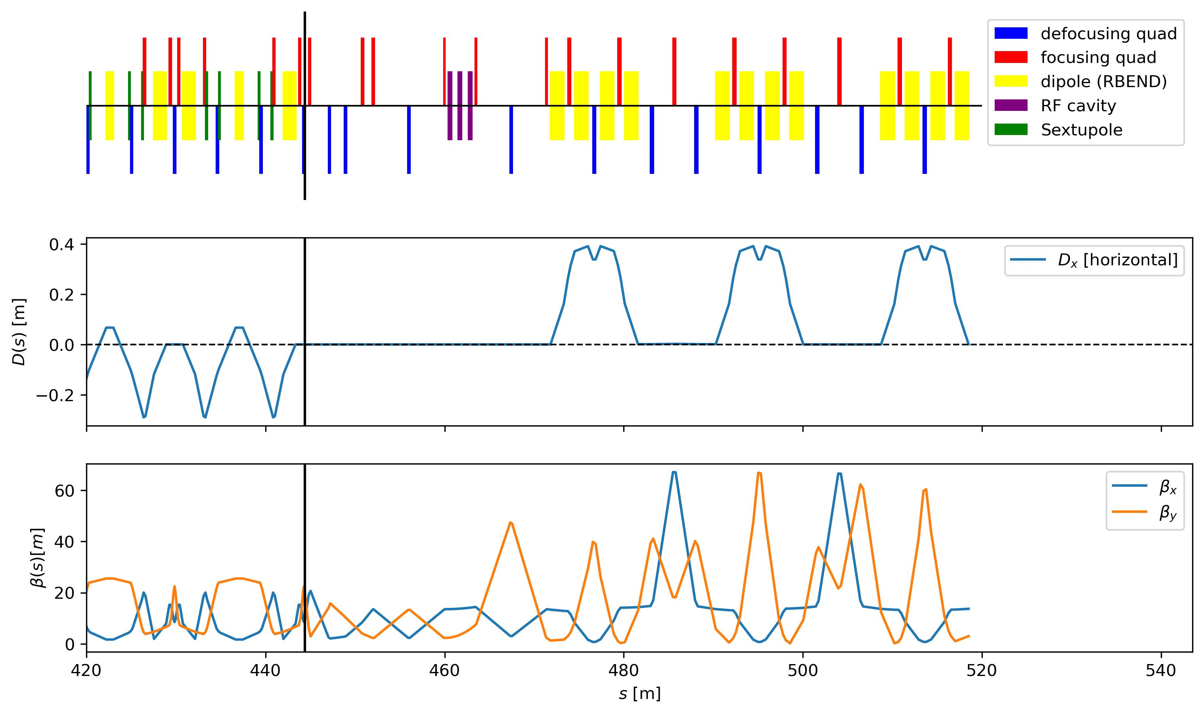
C-Bend Achromat: Lattice Design
TRANSFER LINE
BUNCH COMPRESSOR
RF
CELL 1
CELL 2
CELL 3
Element sequence
FODO
MS
MS
MS
Dispersion
β-function
Distance along the transfer line [m]

Slide 21
FDDF Dog-Leg
K_{1D}
L_{Q}
to LINAC
K_{1F}
L_{Q}
RF
𝛉
Alternatively...
L_{BtoQ}
L_{BM}
L_{BtoQ}
L_{QtoQ1}
L_{QtoQ2}
L_{QtoQ1}
RF parameter | Value
f | 3 GHz
V | 10 MV
Segment | Value (m)
L_{BM} | 1.0
L_{Q} | 0.5
L_{BtoQ} | 8.0
L_{QtoQ1} | 2.0
L_{QtoQ2} | 4.0
Magnet Parameter | Value
K₁ | 1.322 m⁻²
K₂ | -1.322 m-2
𝛉 | 60.0^{O}
Magnet Parameter | Value
K_{1F} | 1.02 m⁻²
K_{1D} | -0.61 m⁻²
𝛉 | 60.0^{O}

Slide 22
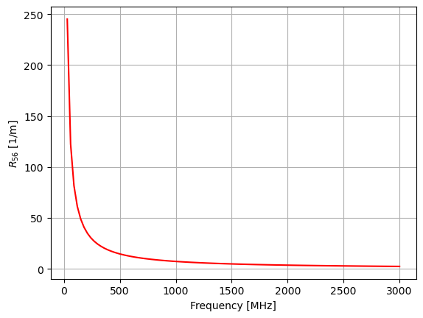
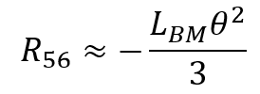
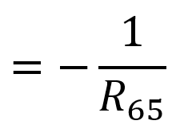
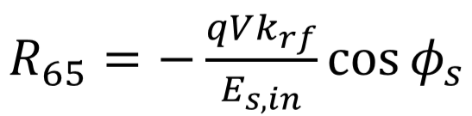
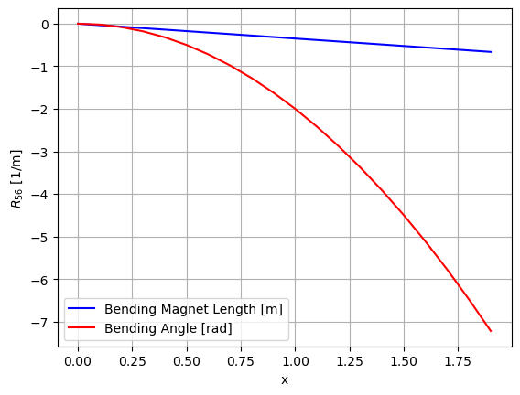
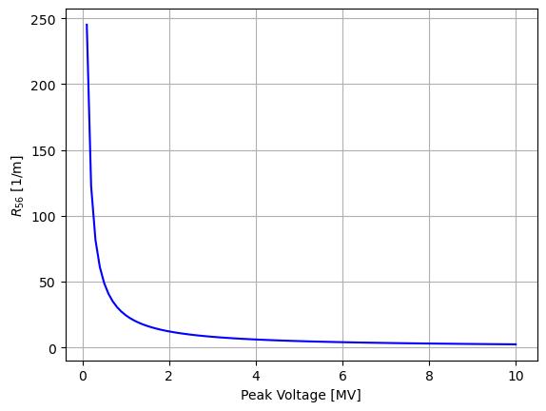
R56 Matching for Dog-Leg
In bunch compressor:
In RF Cavity:

Slide 23
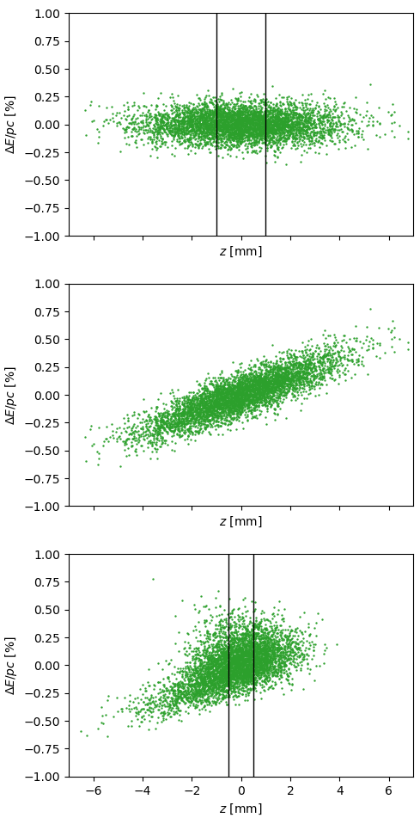
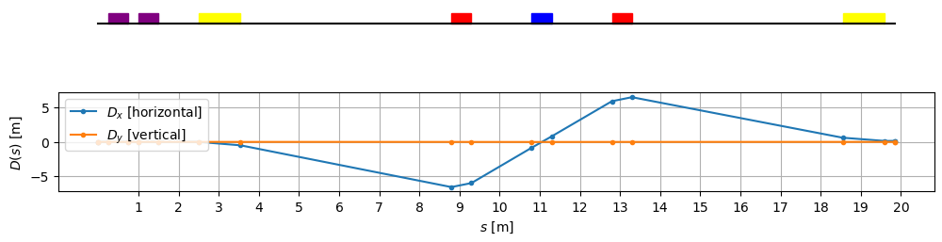
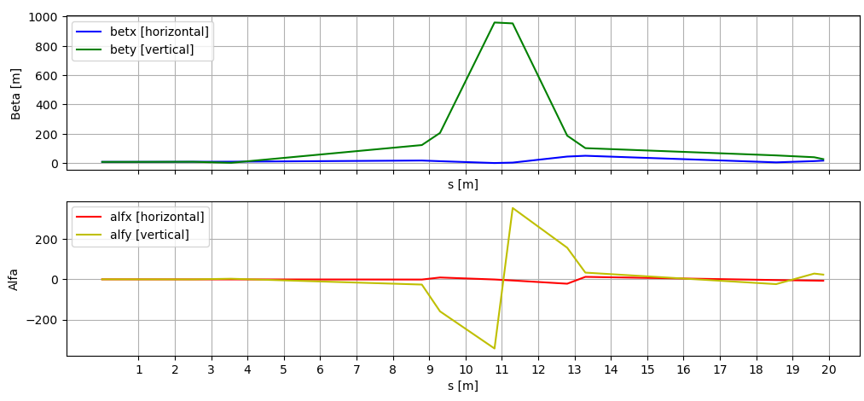
Before RF
F0D0 Dog-Leg Results
After RF

Slide 24
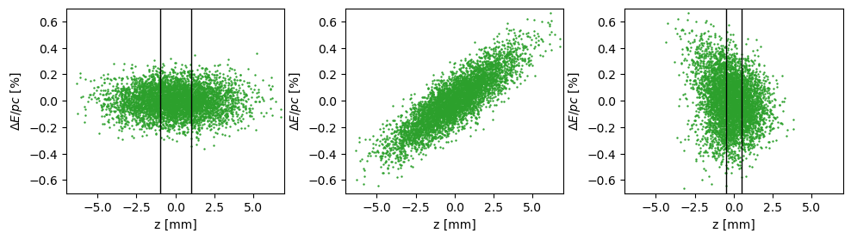
FDDF Dog-Leg Results
Before RF
After RF
Before LINAC

Slide 25
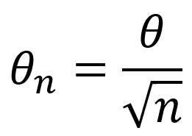
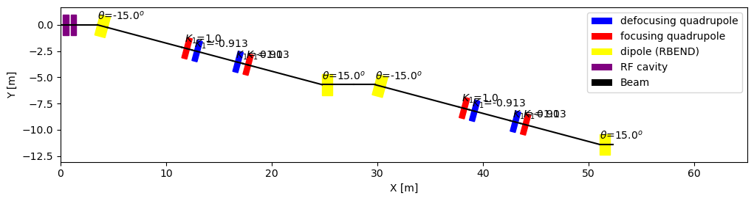
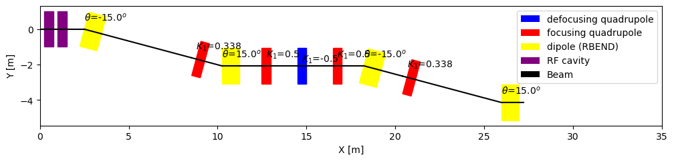
Reducing the Bending Angle by chaining Dog-Legs
Coupled dog-legs can contain matching sequences
Centre Achromat Dog-Legs allows K1 tuning of R56!

Slide 26


Design Comparison
C-BEND Achromat
+ | -
_{Tunable R_56} | Large size (~80m)
_{Modular} | Additional matching to linac required
Dog-Leg
+ | -
_{R_56 tunable in} _{some designs} | R_56 tuning is very limited
_{Simple, with few elements} | Larger chromatic effects
_{Direct matching to linac}
Future Work:
Synchrotron radiation study required
Higher order chromaticity corrections (adding sextupoles)
Matching to Linac
RF cavity for the compressor requires dedicated design (3 GHz!)

Slide 27
Magnets

Slide 28
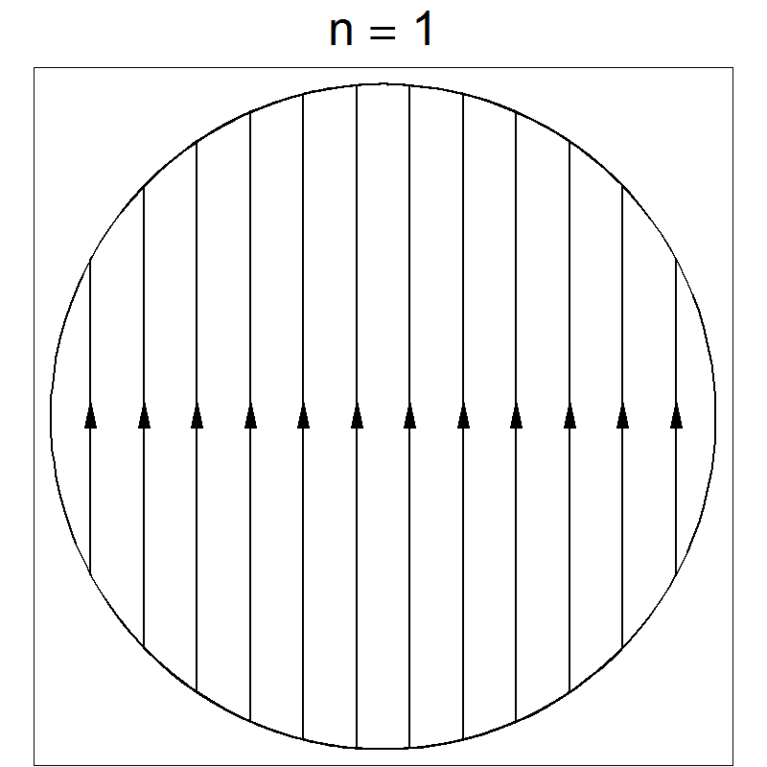
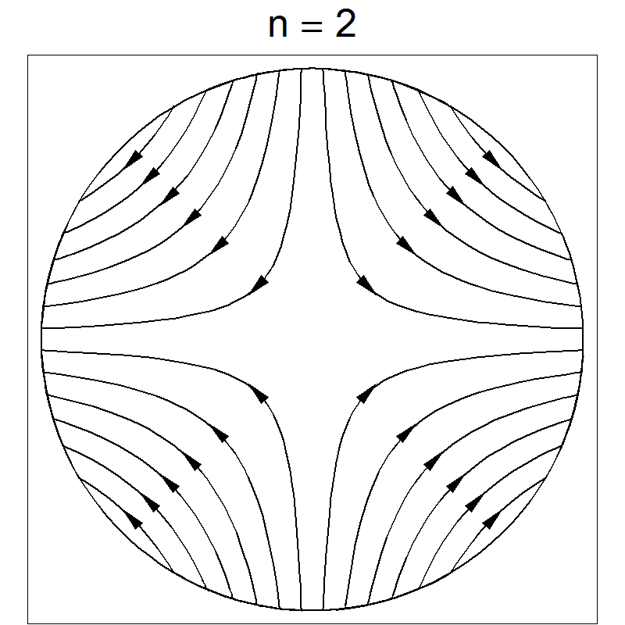
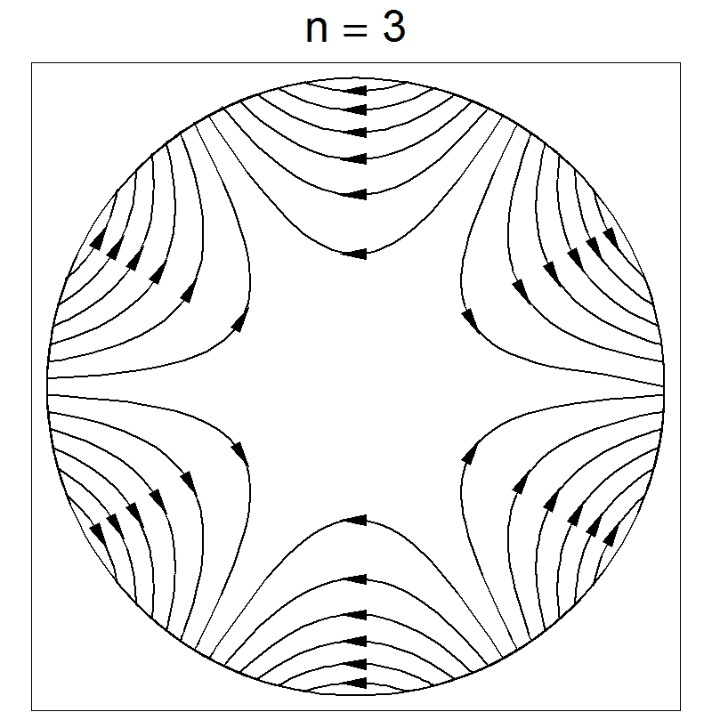
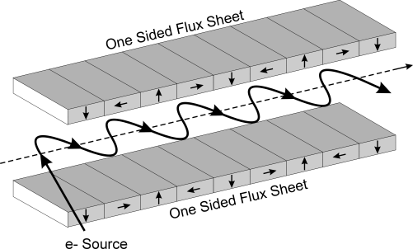
What magnets and why?
Dipole
Beam Steering
Quadrupole
Beam Focussing
Sextupole
Chromaticity Correction
Quad
Kicker
Septum
Wiggler
Emittance damping in pDR
Kicker and Lambertson septum
Injection/Extraction
Darren

Slide 29
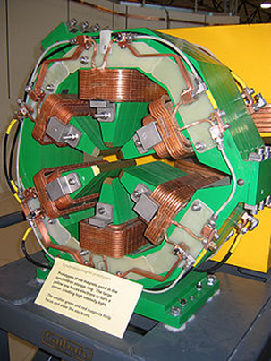
Design Goals
Aim: High performance Normal Conducting Magnets
  In line with FCC aim: high efficiency to reduce power consumption and running costs
  Removes the requirement for cryogenic installation
Lattice requires multiple quadrupole and sextupole configurations, taken to match the MADX file
  1 design for each, tuneable by varying current
Enzo

Slide 30
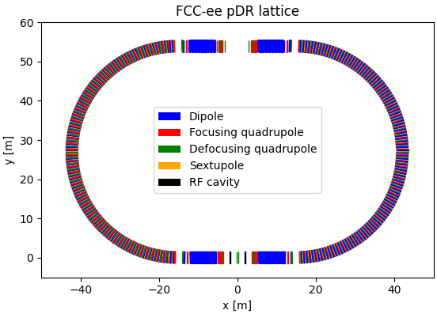
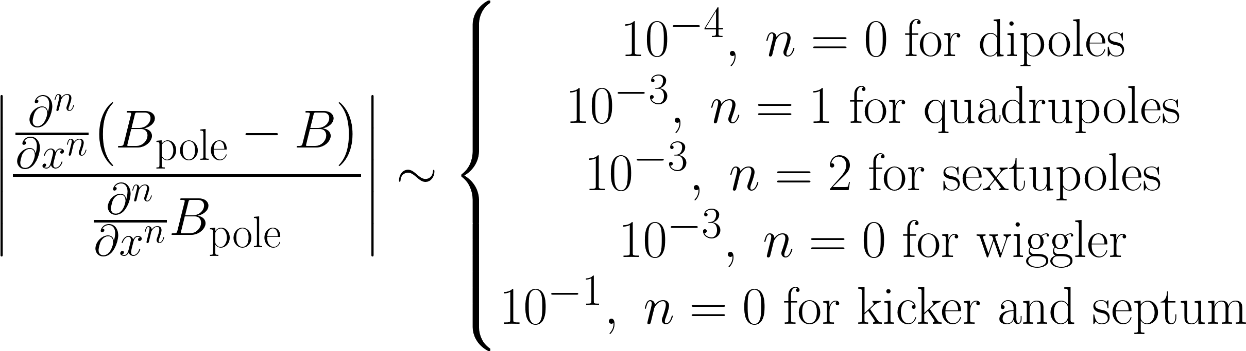
Design Parameters
Design parameters for all magnets taken from MADX file
  Match emittance requirements of lattice
Beampipe: 50mm diameter, 1.5mm thickness steel
Performance Criteria: Good Field Region >= 2/3 beampipe diameter
Darren

Slide 31
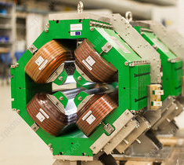
Material Choices
In line with FCC environmental design philosophy, aim to use readily available, lower carbon footprint materials
Electromagnets designed using Iron Yokes and Copper Coils
Wiggler: two options, permanent magnet (ferrite) and electromagnet
Dipoles, Quadrupoles, Sextupoles and Wiggler all fixed field: saturation and ramping is less relevant
Sesame Quadrupole
Jack

Slide 32
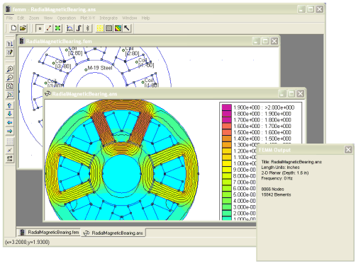
Analysis Techniques
Magnetics Simulations performed in FEMM 4.2 Finite Element Method Magnetics
Data extraction and analysis using Python with PyFEMM
Quadrupole and Sextupole results based on Multipole Analysis
Kicker/Septum analysed using Numerical Derivatives
Jack

Slide 33
Magnets- results
Darren

Slide 34
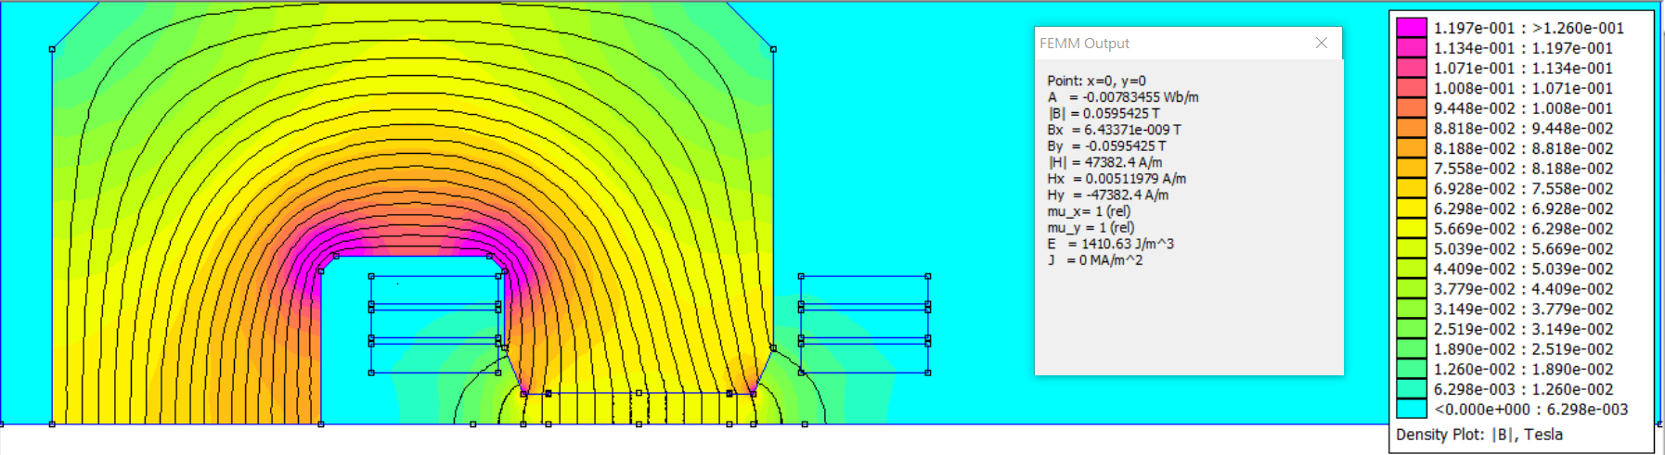
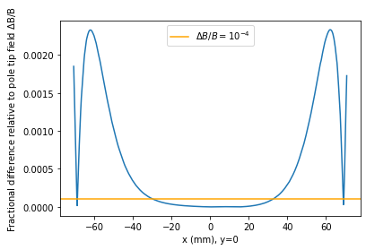
Dipoles
C-type dipole based on JAI tutorial example
Electromagnet coils: 18 turns, 21.986 A
Chamfering to reduce saturation
  Yoke remains far from saturation magnetization of iron
Achieved target B-field of 0.0595 T, 30 mm radial GFR covers full extent of beampipe
Darren

Slide 35



Quadrupoles
Good field region: 16.97 mm radial, above the target value of 16.67 mm
Magnetic gradient: 3.717 T/m matches the target gradient
Coils: 20 turns, 48.305 A
Chamfering to reduce saturation
Shimming: increase GFR

Slide 36



Sextupoles
1D Good Field Region: 16.05 mm radial, below target value of 16.67 mm
2D Good Field Region: 18.01 mm mean radial, above target value of 16.67 mm
GFR is not circularly symmetric
Hyperbolic Pole Tips
18 coils @ 6.5x6.5 mm²
Focussing Sextupole:
  Target: SF: 523.81 T/m²
  Current: 104.7A
Defocussing Sextupole:
  Target: -743.74 T/m²
  Current: -148.7 A
Notes:
Fields and derivatives calculated using multipole expansion
200 Samples, at 0.95*Beam Pipe Radius, 20 harmonics evaluated

Slide 37



Ferrite Wiggler – Design
•Two Halbach array of permanent magnets – creates strong field inside wiggler and weak field outside.
•Ferrite permanent magnets attached to a steel frame.
•End magnet poles have an increased gap and therefore have weaker fields, meaning the overall particle path in on axis.
•This requires optimisation and simulation of particle paths to verify.

Slide 38
Ferrite Wiggler – Properties
Wiggler Properties | Value
Length | 6.75 m
Energy emitted per wiggler per particle | 40.7 keV
Magnitude of field max | 0.166 T
Wiggler gap | 60 mm
Cost of ferrite (Y30) and steel for 1 wiggler | CHF 365

Slide 39



Electromagnetic wiggler
More tunable and resists demagnetization
B-field of each dipole was 0.162 T
  2 mm total GFR
  All fields in magnet < 1 T
42 two-dipole cells, each 158 mm long
Coils: 8 turns, 151.198 A
Cost: For a magnet depth of 10 cm
  Iron: 4844.40 CHF / m³, total 741 CHF
  Copper: 2.02 × 10⁵ CHF / m³, total 14750 CHF
Darren

Slide 40








Kicker/Septum
Kicker
Kicker:
Average B-field = $1.558±0.003×{10}^{−5}$ T
Coils: 20 turns at 0.025A
Field outside negligible (${10}^{−9}$ T)
Lambertson Septum:
Average B-field = $1.18±0.05×{10}^{−5}$ T
Coils: 4 turns at 0.025A
Field in beam pipe negligible (${10}^{−9}$ T)
Lambertson septum
B-field for kicker
B-field for septum

Slide 41
Magnets conclusion
Dipoles, quadrupoles, sextupoles, and kicker/septa were designed with a sufficient GFR
  For wigglers, GFR analysis requires full 3D simulation
The B-field of all magnets is always kept below the saturation value
Two different wiggler designs were explored which provide the desired field
  Advantage of the electromagnetic wiggler is tunability of the field
  Permanent magnet wiggler is cheaper to build and run but harder to adjust and may need more maintenance due to demagnetisation – further studies needed
Sasha

Slide 42
Further Work
Model in 3D (Opera) to establish good field region (edge effects significant, particularly for wiggler)
Particle tracking
Look at impacts on lattice (vertical focusing etc)
More in-depth studies to compare different possible materials
Structural and thermal analysis
Calculation of off-axis magnetic fields to validate circular symmetry
Investigate ramping effects on kicker
Optimise wiggler ends to have beam on average on-axis
More in-depth comparison of different kinds of wigglers
Sasha

Slide 43
RF Cavities

Slide 44
Design of the RF cavity
The pDR requires RF cavities:
no more than 1.5 m in length
with a minimum RF voltage of 4 MV
Parameter | Value | Unit
Beam energy | 1.54 | GeV
Energy loss per turn | 0.227 | MeV
Total radiated power | 16 | kW
RF voltage | 4 | MV
Available length | 1.5 | m
Cavity types considered:
Elliptical superconducting (400/800 MHz)
Side-coupled normal conducting (400 MHz)
Notes:
Objective of the cavity is to cumulatively add 4 MV to the bunch
Constraint: 1.5 m length
Quick rundown of other

Slide 45


Cavity optimisation goals
Maximise:
1.G = Rs*Q
2.r/Q
3.Transit time factor
Minimise:
1.Peak E and H fields
2.Bmax/Emax

Slide 46

400 MHz NC: 2D optimisation in Poisson Superfish
Parameter | Value | Units
Frequency | 400 | MHz
Gradient | 3 | MV/m
Length | 18.747 | cm
Diameter | 47.840 | cm
Gap length | 22.484 | cm
Outer corner radius | 3 | cm
Inner corner radius | 1 | cm
Outer nose radius | 1 | cm
Inner nose radius | 1 | cm
Flat length | 4 | cm
Cone angle | 30 | deg
Bore radius | 6 | cm
Notes:
This is our normal conducting 2D model in Superfish, optimised for this length and frequency using accelerating gradient on next slide. We tweaked to get:
Low kilpatric
Low Bmax/Emax
Flat energy profile
Importantly
Frequency
Length
Bore radius
The rest is not important to mention!

Slide 47



3D model in CST Microwave
 | Superfish parameters | CST parameters | Percentage difference
Frequency | 400.0025 | 399.9596 | 0.011
Transit time | 0.7872 | 0.8060 | 2.38
R/Q | 108.8700 | 109.0400 | 0.16
Max E | 8.9330 | 10.2205 | 14.41
Max H | 9599.8234 | 9623.7836 | 0.25
RF Voltage | 1.1160 | 1.1421 | 2.33
Notes:
- Consequently modelled in CST
Good agreement
Mention voltage and how much we need

Slide 48


400 MHz SC: 2D optimisation in Poisson Superfish
Parameter | Value | Units
Frequency | 399.702 | MHz
Gradient | 10 | MV/m
Length | 37.47 | cm
Diameter | 65.31 | cm
Left Dome B | 10.5 | cm
Right Dome B | 7.99 | cm
Dome A/B | 1.2
Left wall angle | 11 | deg
Right wall angle | 7.8 | deg
Iris A/B | 1.5
Bore radius | 9 | cm
An asymmetrical optimisation was used to mitigate E field extension into the beam pipe and ensure field flatness.
Notes:
Briefly mention frequency and length

Slide 49


3D model in CST Microwave
Parameter | Superfish | CST | Unit | Percentage difference (%)
RF voltage | 7.4994 | 7.5019 | MV | 0.03
Frequency | 399.68205 | 399.67745 | MHz | 0.0011
R/Q | 134.206 | 134.228 | Ohm | 0.016
T | 0.7280 | 0.7279 |  | 0.024
Max E | 16.904 | 16.870 | MV/m | 0.20
Max H | 25562.2 | 25565.0 | A/m | 0.01
Notes:
- Consequently modelled in CST
- Great agreement
Also mention voltage and how many we need

Slide 50

800 MHz SC: 2D optimisation in Poisson Superfish
Parameter | Value | Units
Frequency | 800 | MHz
Gradient | 10 | MV/m
Length | 18.737 | cm
Diameter | 34.798 | cm
Left Dome B | 6.500 | cm
Right Dome B | 4.470 | cm
Dome A/B | 1.1
Left wall angle | 18 | deg
Right wall angle | 18 | deg
Iris A/B | 0.5
Bore radius | 7.5 | Cm
Notes:
Briefly mention frequency and length

Slide 51


3D model in CST Microwave
Parameter | Superfish | CST | Unit | Percentage difference
RF Voltage | 5.622080 | 5.623472 | MV | 0.02
Frequency | 799.9992 | 799.8342 | MHz | 0.02
R/Q | 125.656 | 125.7449 | Ohm | 0.07
T | 0.647773 | 0.647273 |  | 0.08
Max E | 18.6329 | 19.50229 | MV/m | 4.7
Max H | 27642.7 | 25775.8 | A/m | 6.8
Notes:
- Consequently modelled in CST
- Great agreement
Also mention voltage and how many we need

Slide 52

Conclusion: Cavity choice
SC 400 MHz
NC 400 MHz
SC 800 MHz
Given the high RF voltage involved and limited available space, a SC cavity was selected.
Due to its compactness and availability at the LHC, the 400 MHz cavity was chosen for the pDR.
Notes:
Describe each square, then each arrow, then which of the three works best
Finally we selected a SC cavatiy due to space and 400 MHz because ??

Slide 53
Further work
Superconducting cavities:
  Cryomodule design
  HOM coupler configuration to limit higher order modes
  Sensitivity study of secondary effects: wake fields, wake potentials, multipacting, field emission
  Normal conducting cavities:
  Modelling the full four-cavity LINAC
  Tuning the cavity to 800MHz instead of 400MHz to reduce overall size

Slide 54
Conclusion
Lattice: The C-Bend Achromat and Dog-Leg successfully demonstrated a bunch length compression from 2mm to 1mm in the pDR transfer line to the common linac
Magnets: the required magnetic fields were achieved with a dipole, quadrupole, sextupole, wigglers and kickers/septa, which were optimised until the fields were sufficiently uniform along the central axis
RF cavities: Given the high RF voltage involved and limited available space, a SC cavity was selected. ​Due to its compact design, and availability at the LHC, the 400 MHz cavity was selected to be the preferred choice

Slide 55
Acknowledgements
Professor Emmanuel Tsesmelis
Lattice: Rebecca Louise Ramjiawan
RF cavities: Ciprian Plostinar
Magnets: Ian Martin, Zena Patel, Attilio Milanese
And all other lecturers and guests who contributed to the JAI Accelerator Course!

Slide 56
References (1)
Zimmerman, F. FCC-ee design overview (2019). FCC Week 2019 Brussels, 24 June 2019. https://indico.cern.ch/event/727555/contributions/3447588/attachments/1867605/3071651/FCC-ee_Overview.pdf
Barklow, T. et al. C3: An Advanced Concept for a High Energy e+e- Linear Collider (2021). https://www.snowmass21.org/docs/files/summaries/AF/SNOWMASS21-AF3_AF4-EF1_EF2_C3_Collaboration-243.pdf
Latina, A. CLIC Luminosity Studies (2019). LCWS 2019. https://agenda.linearcollider.org/event/8217/contributions/44778/attachments/34920/53970/CLIC_Luminosity_Latina.pdf
Yamamoto, H. Luminosity and Site AC Power of the ILC (2019). https://linearcollider.web.cern.ch/sites/linearcollider.web.cern.ch/files/1_NOTE_Luminosity-vs-Energy_HYamamoto_09052019_FINAL.pdf
Gao, J. The strategy of Accelerator based High Energy Physics of China (2014). Rencontres du Vietnam 2014: Physics at LHC and beyond. https://indico.cern.ch/event/300048/contributions/1661107/attachments/565207/778694/High_Energy_Physics_Strategy_in_China_-_Jie_Gao.pdf
Raubenheimer, Tor. Accelerator Overview (2022). FCC Week 2022. https://indico.cern.ch/event/1064327/contributions/4891237/attachments/2452429/4202848/220530%20Accelerator%20Overview%20posted.pdf
Janot, P., Blondel, A. The carbon footprint of proposed e+e−e+e− Higgs factories. Eur. Phys. J. Plus 137, 1122 (2022). https://doi.org/10.1140/epjp/s13360-022-03319-w

Slide 57
References (2)
Wolski, Andy. "Nonlinear Dynamics: Part 1." CAS: Introduction to Accelerator Physics, Budapest, Hungary (2016).
SHARMA, AMALENDU. OPTICS DESIGN AND OPTIMIZATION OF ELECTRON BUNCH COMPRESSOR TRANSFER LINE (WITH A CASE STUDY OF CTF3 BUNCH COMPRESSOR). Diss. HOMI BHABHA NATIONAL INSTITUTE, 2013.
Charles, T. K., et al. "Bunch compression and turnaround loops in the FCC-ee injector complex." Journal of Physics: Conference Series. Vol. 1067. No. 6. IOP Publishing, 2018.
Di Mitri, Simone. "Bunch length compressors." CERN Yellow Reports: School Proceedings 1 (2018): 363-363.
Byrd, John. "Bunch Compressors." Lecture of Short Bunches in Accelerators: USPAS, Boston, MA, USA (2010): 21-25.
Wolski, Andy. "A short introduction to Bunch Compressors for Linear Colliders." Notes for USPAS Course on Linear Colliders, Santa Barbara (2003).
Jacobson, B. T., J. M. J. Madey, and P. Niknejadi. "DESIGN AND COMMISSIONING OF CHASMAN-GREEN DOUBLE BEND ACHROMAT LATTICE LINEAR TRANSPORT LINE AT THE UNIVERSITY OF HAWAI’I MKV ACCELERATOR FACILITY." (2013).

Slide 58
Appendix

Slide 59


Slide 60

HOM couplers
Dimensions of the HOM coupler are optimised to have a fundamental cut-off frequency larger than the TEM010 mode, and smaller than HOM modes.
Cut-off frequency of the fundamental mode

Slide 61








Rectangular waveguide
Mode 1
Mode 2
Mode 3
Mode 4
Mode 5
Mode 6

Slide 62

Normal conducting VS superconducting
NC cavities
+ less infrastructure
+ simpler technology
+ simpler tuning
Higher RF power required
Lower gradients
Thermal effects
Larger cavities
SC cavities
+ no thermal effects
+ efficient use of input power for acceleration
+ larger gradient
Cryogenic system
Complex fabrication process
Less tolerant against beam loss
Notes:
We compared nc and sc on a few points
Name them all

