Slide 1
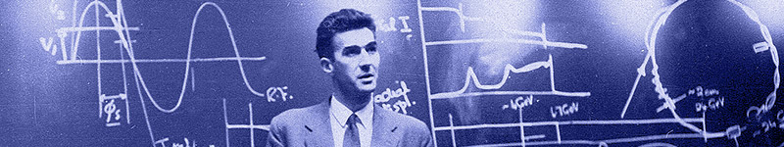

Update on
Education & Training and Public Engagement at JAI
Emmanuel Tsesmelis
CERN & JAI University of Oxford
JAI Advisory Board 2023
27 March 2023

Slide 2
Introduction
The JAI programme is organised around three pillars:
  Research & development in accelerator science.
  Training next generation of accelerator scientists.
  Knowledge exchange, impact & public engagement.

Slide 3
Education and Training

Slide 4
Guiding Strategy
Training in accelerator science & technology is one of the pillars of JAI mission and recognised by JAI Advisory Board to be world-leading.
Objective is to develop skills of next generation accelerator scientists.
JAI has provided graduate & undergraduate training in accelerator science & technology since first course delivered in 2005.
Students participate in comprehensive core formal training through academic courses & projects and 3 years of cutting-edge research at state-of-the-art facilities (national & international).
Many JAI academic staff invited to give courses & lectures at international accelerator schools.

Slide 5
JAI Graduates & Careers
JAI training is well aligned with STFC strategic aims to address national demand for scientifically-skilled workforce to sustain UK’s world-leading position in research & technology (2017 STFC Accelerator Strategy Review).
PhD graduates more than 70; all obtained fruitful employment; about 20% female.
  Alumni consistently pursue careers in science & technology
    Destinations include research positions in universities, ASTeC, BNL, CERN, CI, DESY, LBNL, LLNL, NPL, RAL, SLAC, & PSI.
    Some reached full academic positions; about 15% work in industry.

Slide 6
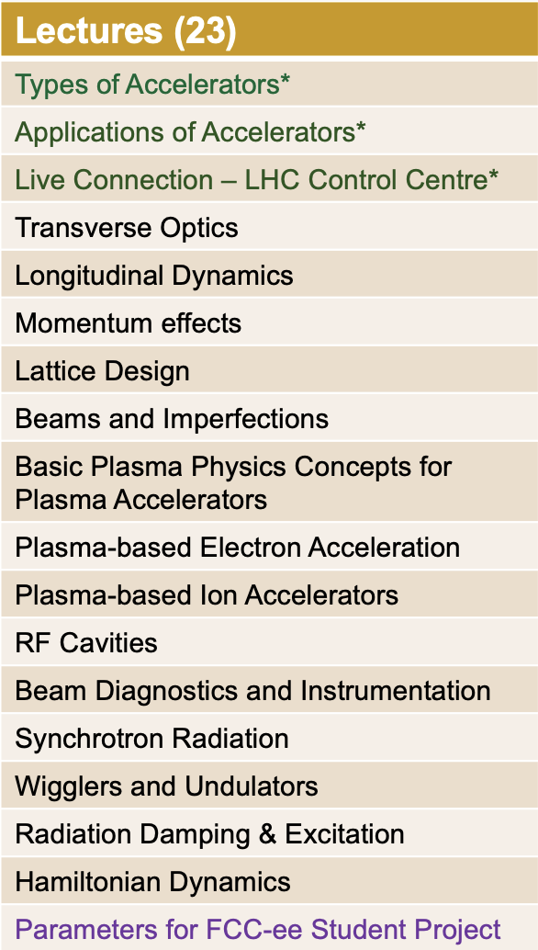
Graduate Accelerator Physics Course
Term I October-December 2022
Exercise Classes (6)
Introduction to Accelerators*
Transverse Dynamics
Longitudinal Dynamics
RF Cavities
Hamiltonian Dynamics
Synchrotron Radiation
* Combined Particle Physics &
Accelerator Physics cohort
Course carried out in hybrid format
(in person & Zoom)

Slide 7
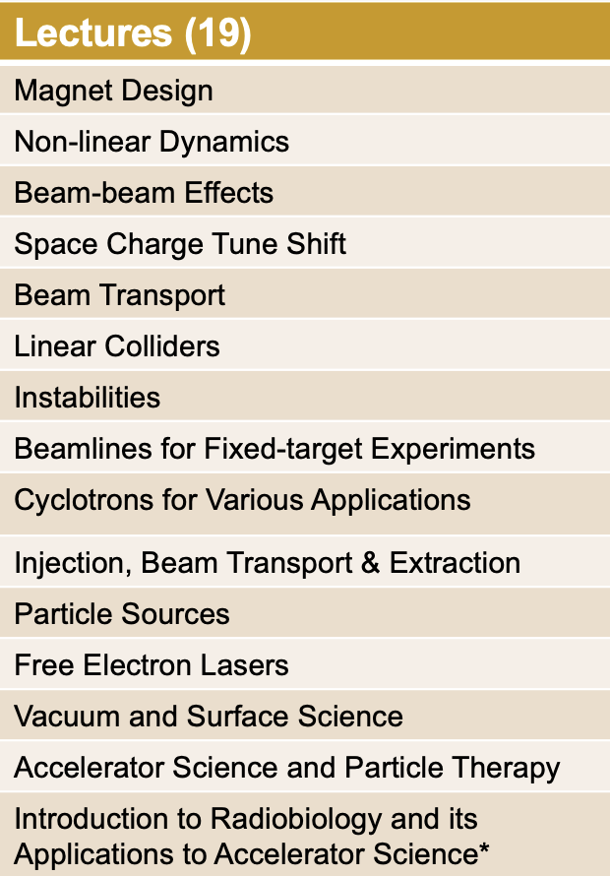
Graduate Accelerator Physics Course
Term II January-March 2023
Exercise Classes (2)
Magnet Design
Introduction to FCC-ee Student Project
Tutorials (8)
FCC-ee Student Project
JAI Seminar (1)
FCC-ee Student Project
Course carried out in hybrid format
(in person & Zoom)
* Lecture following proposal of JAI AB 2021

Slide 8
Graduate Accelerator Physics Course 2022-2023
Number of Students
    University of Oxford
      Particle Physics (11) *
      JAI Accelerator Physics (6)
    JAI Royal Holloway, University of London (2)
    JAI Imperial College London (6)
* Registered for first three lectures and tutorial of Term I only

Slide 9
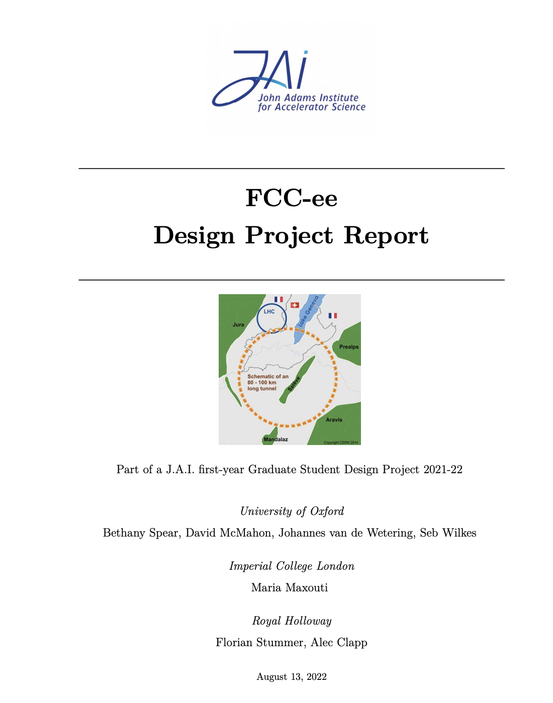
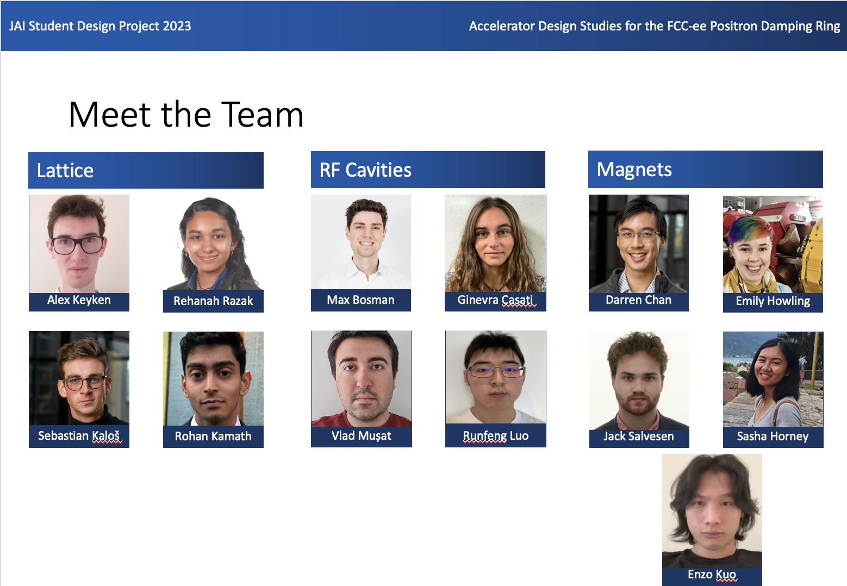
Accelerator Design Project
Accelerator Design Study for
  Electron SPS: 2020-2021
  FCC-ee Booster Ring: 2021-2022
  FCC-ee Positron Damping Ring: 2022-2023
  Design work consisted of study of the lattice, magnet systems and RF cavities.
“The design project significantly contributes to the value of a PhD at the JAI and is a very effective learning tool ... it played an essential role in helping me to find a postdoc.”
“To me, the design project was by far the best part of the course. It puts the material taught into context and bridges the gap between lectures ... and a DPhil project ... .”
For 2021-2022: FCC-ee Booster Ring
Design Report published on CDS
(10.17181/CERN.GSBF.JG2K)
and students delivered JAI Seminar.
on 9 March 2023.
FCC-ee Positron Damping Ring
Design Report to be published
on CDS & students delivered JAI Seminar on 9 March 2023

Slide 10
JAI AB Recommendation 2022
Aspects of engineering and actual manufacturing of real accelerator components should be brought to the attention of the students.
  Student visits and presentations at CERN planned for June 2023, including visits to accelerator and technical infrastructure and exchange with experts on engineering and manufacturing aspects.
Students to make estimate of power consumption of facility as sustainability has become an area of highest relevance.
  Included in study (and presentation / report).
Availability of toolbox of applications scripts.
  Students provided with software scripts for MAD-X (lattice), FEMM (magnets), and Superfish/CST (RF cavities).

Slide 11
Consolidated Accelerator Course
Graduate lecture course includes plasma lectures provided by ICL, as part of development of integrated accelerator-laser-plasma training.
Lecturers & Instructors
  M. Dosanjh (Oxford), M. Fraser (CERN), H. Garcia-Morales (Oxford/PickleTech), A. Gerbershagen (Groningen),
  D. Kelliher (RAL), S. Lawrie (RAL), S. Mangles (ICL),
  I. Martin (Diamond), A. Milanese (CERN), Z. Najmudin (ICL),
  S. Patel (RAL), C. Plostinar (ESS), M. Schippers (PSI),
  F. Tecker (CERN), E. Tsesmelis (CERN/Oxford),
  Rob Williamson (RAL)
  Lecturers / instructors from JAI universities and from external institutes – CERN, Uni. Groningen, DIAMOND, ESS, PSI, RAL.
  Following Brexit, all non-UK lecturers require permit/visa to lecture in person.

Slide 12
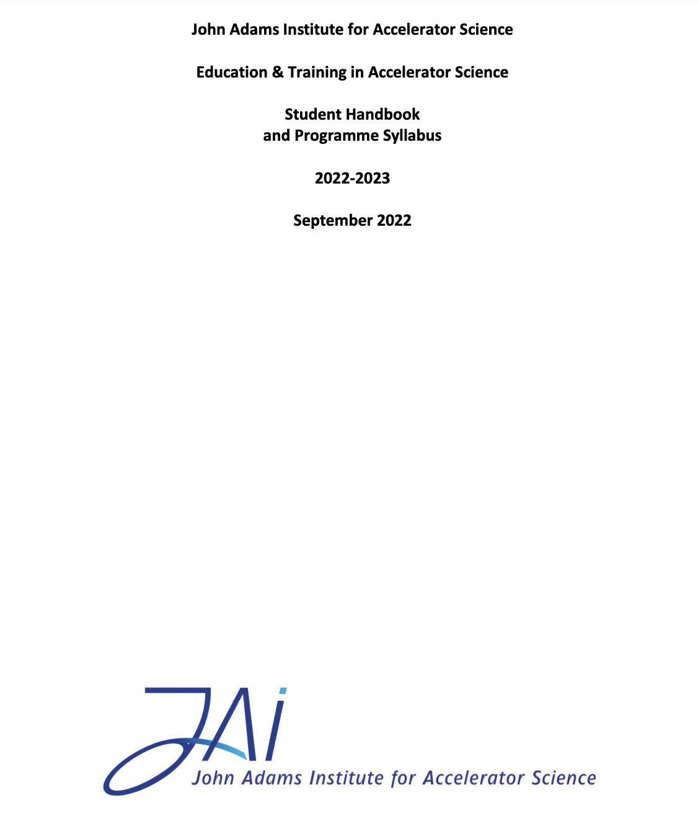
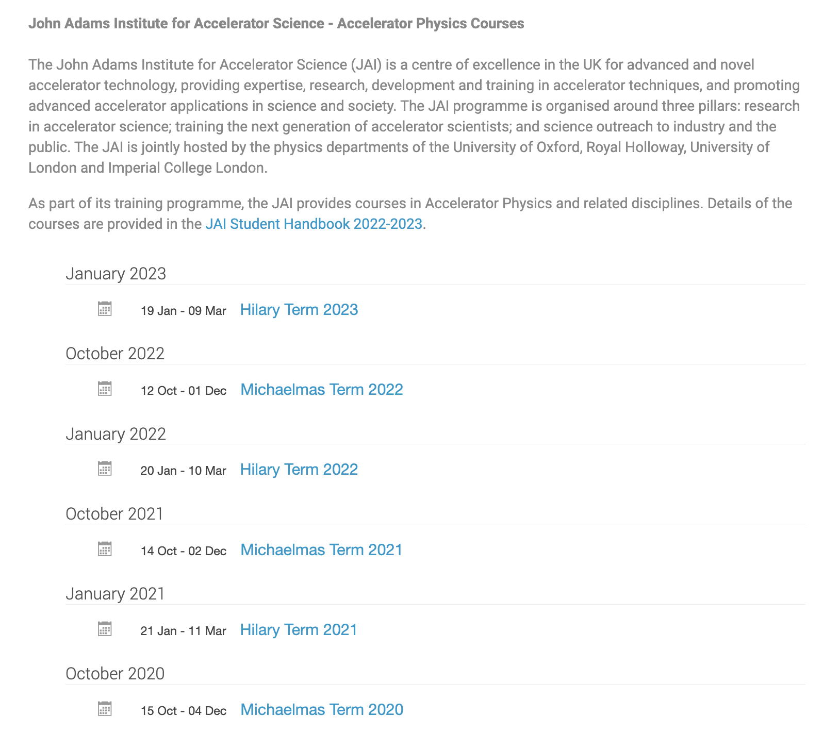
JAI Student Resources
Student Handbook provides information to the students of the training programme in accelerator science at JAI.
  Syllabus & course content, course resources, assessment, evaluation, recommended textbooks.
  Supplementary information (public engagement, lecture series, summer student programme etc.)
Dedicated site on INDICO
  https://indico.cern.ch/category/5869/
  Timetable, slides / documents, Zoom connection

Slide 13
New Graduate Students 2023-2024 Academic Year
Oxford
  Cory Lehman – Fast Beam Loss Monitor System for Diamond-II and Machine Learning Applications (Oxford / Diamond funding)
  Carl Jolly – ISIS (part-time student, ISIS Staff)
  Shaun Preston – Applications of Machine Learning Techniques for Online Optimisation of Synchrotron Light Sources (Oxford / Ada Lovelace Institute funding)
RHUL
  Mark McCallum, RF Electronics for Beam Position Monitor (STFC JAI quota, joined in January 2023)
  N.N. for a JAI STFC quota.
  Studentship expected on EIC (Electro-Optic BPM), potentially with US funding is being planned.
ICL
  Jasmin Hills – Laser Wakefield Acceleration (JAI STFC funding)
  N.N. – Development of Time Resolved X-ray Absorption Spectroscopy Using LWFAs (CLF/JAI funding)
  Additional recruitment on laser wakefield acceleration.
  Process for graduate student selection on-going at all JAI universities

Slide 14
Graduate Student Funding
Since 2019, JAI included in STFC quota PhD studentships scheme receiving three studentships per year. Expect four per year as of 2024.
This leverages additional funding sources allowing JAI to recruit typically an additional 6 PhD students / year.
Various funding sources include universities, the Royal Society, STFC CASE, EPSRC DTP, DLS, CLF and RAL/ISIS/PPD, as well as the CERN Doctoral Student programme, European Research Council, Helmholtz Foundation, Marie Curie Fellowships, Thai government fellowships, industry (e.g. TRUMPF Scientific Lasers) & other non-UK sources.
For future: Developing new Doctoral Training Alliance (DTA) application on plasma accelerators together with University of Warwick and funding mechanism through EIC/US.
Continue to explore wide range of possibilities for sustainable funding.

Slide 15
Undergraduate Accelerator Physics
Summer Student Internships
Oxford University Internship Programme (CERN in July/August annually)
  Two students join CLEAR accelerator project supervised by Oxford faculty & graduate students.
  Participate in CERN Summer Student lecture series and in an accelerator project.
Imperial College
  Around 4 students appointed annually.
  Spend 8 weeks working at Imperial College & RAL.
RHUL
  Around 2 students appointed annually.
  Carry out research work at RHUL.
Expect programmes to attract undergraduate students to accelerator science.

Slide 16
UK Accelerator Institutes Seminar Series
JAI has teamed up with ASTeC and the Cockcroft Institute to organise jointly the new UK Accelerator Institutes Seminar Series https://indico.cern.ch/category/13863/
  Delivered by distinguished speakers from the participating institutes and from laboratories / universities world-wide.
Seminars held in person and via videoconference and scheduled so that the graduate student body can attend.
Latest Session in January – March 2023
Title | Speaker
The Perle Project Plans and Status | Maude Baylac (LAL, Orsay), Walid Kalib (LAL, Orsay)
Clinical Proton Beam Therapy: A Look into the Future | Richard Amos (University College London)
Search for the Electric Dipole Moment of the Muon Using the Frozen-spin Method | Philipp Schmidt-Wellenburg (PSI)
Linacs to Narrow the Radiotherapy Gap | Manjit Dosanjh (JAI)
Towards a High-power Cyclotron | Huiwen Koay (TRIUMF)

Slide 17
JAI AB Recommendation 2022
Add lectures on societal applications and technology transfer to course curriculum.
Incorporated into the UK Accelerator Institute Seminar Series.
Title | Speaker
Distributed Coupling Linear Accelerators and their Applications | Sami Tantawi (SLAC)
Lessons Learnt in Building a Research Capability for Proton Therapy | Karen Kirkby (University of Manchester)
Societal Impact of CERN Accelerator Technologies: from Cancer Therapy to Artwork Analysis | Maurizio Vretenar (CERN)
Machine Learning Project Development in Particle Acceleraors: A Business Perspective | Hector Garcia Morales (Pickle Tech)
Synchrotron Light Illuminates the Origin of the Solar System | Tomoki Nakamura (Tohoku University)
Clinical Proton Therapy: A Look into the Future | Richard Amos (University College London)
Linacs to Narrow the Radiotherapy Gap | Manjit Dosanjh (JAI)

Slide 18
External Training Commitments (Abridged)
JAI participates in external training initiatives
  EU Integrating Activity Projects on Training, Communications & Outreach in Accelerators –
  TIARA 2011-2014, ARIES 2017-2021, I.FAST 2021-2025 (P. Burrows serves as WP Leader).
  CERN Accelerator School CAS (various JAI faculty and staff).
  Joint Universities Accelerator School (JAI is partner institute, P. Burrows serves on JUAS AB).
  Cockcroft Institute graduate accelerator physics course (S. Gibson).
  University of London intercollegiate undergraduate & graduate accelerator physics courses
  (S. Gibson, P. Karataev).
  University of Melbourne Medical Accelerator Physics Programme (S. Sheehy).
  Nanyang Technological University and University of Saskatchewan undergraduate & graduate lectures on accelerator physics (E. Tsesmelis).
  York Fusion Frontiers Lecture Series – Laser Plasma Accelerators (Z. Najmudin)
  Culham Summer School on Plasma Physics - Laser Wakefield Accelerators (S. Mangles)

Slide 19
Future Programme - Training
Proposal & plan for the future education & training programme at JAI:
  World-class graduate & undergraduate training in accelerator science & technology.
  Collaboration with outside institutes through cooperation agreements (e.g. Humboldt University Berlin) in few special cases & student accelerator design projects.
  Strengthen integration of the 3 universities by fostering & supporting student exchanges, common lectures and seminars, and other events, e.g. the UK Accelerator Institutes Seminar Series.
  Establish joint JAI and CI programme of lectures on specialised topics of advanced accelerator physics & applications.
  Pre-PhD programmes - Summer studentship programmes at all 3 universities; BSc, MSci and MSc. programmes at RHUL; restructured undergraduate module at Oxford making it more attractive.
  JAI academic staff continue to deliver courses & lectures at international accelerator schools, thus providing important accelerator community service.

Slide 20
Public engagement

Slide 21
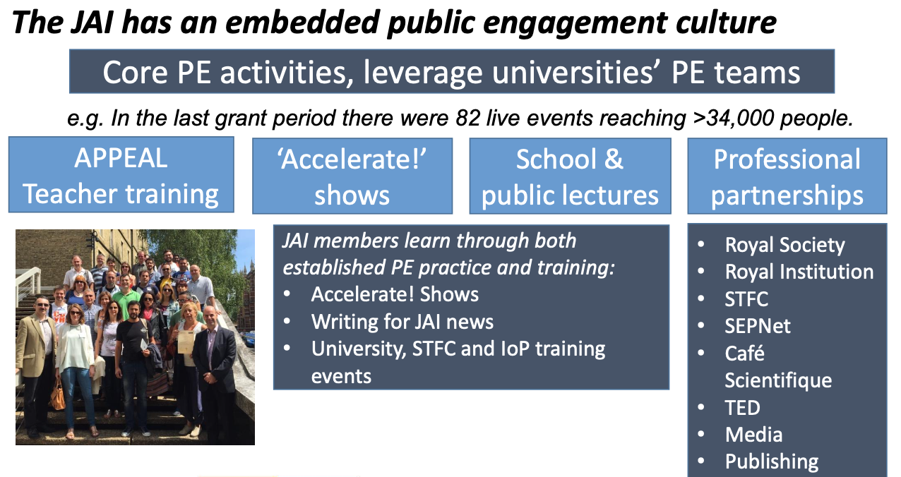
Guiding Strategy

Slide 22
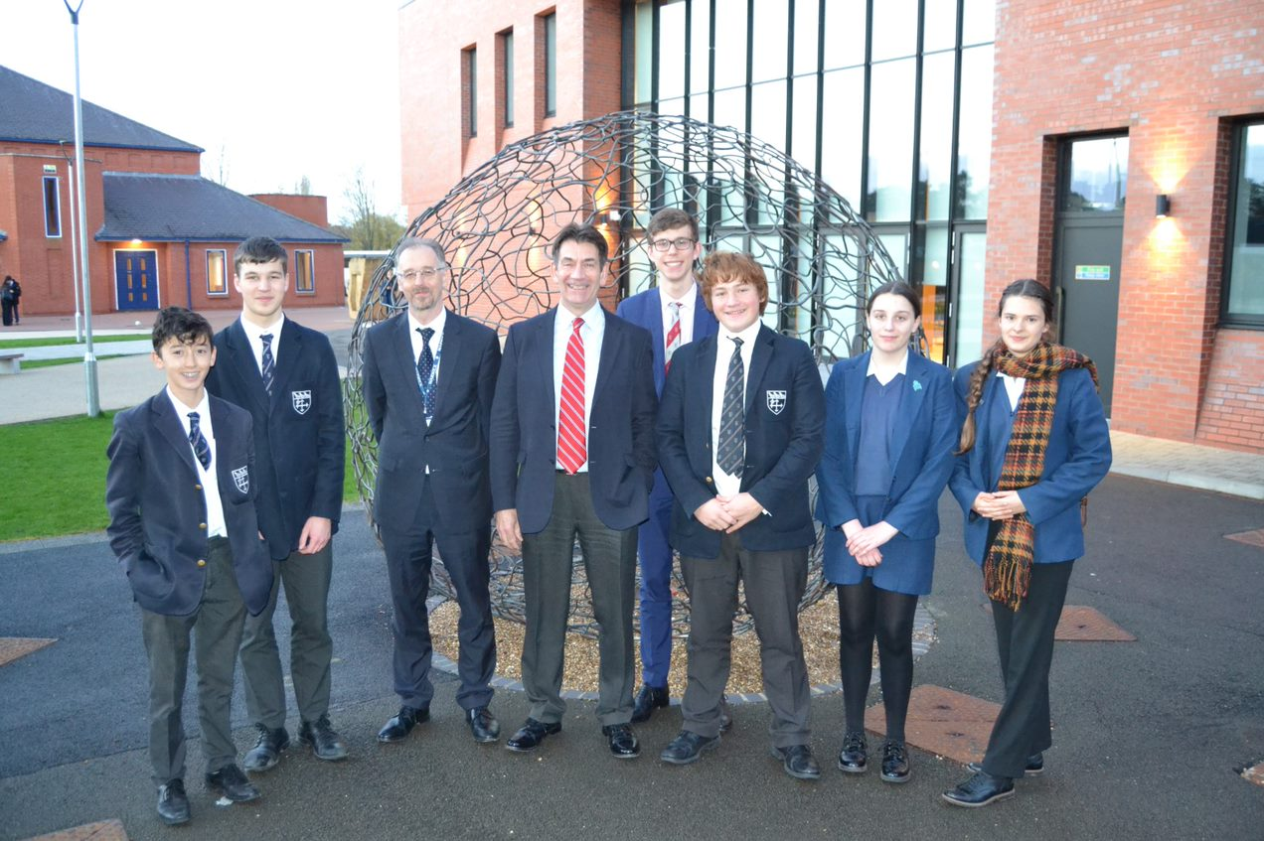
Public Engagement & Schools Outreach
‘Particle Accelerators: from Higgs Bosons to Curing Cancer’
Delivered 40 times in pre-pandemic decade
First post-pandemic talk: November 2022 at nearby school: >100 attendees
Feedback from female GCSE student:
‘It meant a lot to me that you spent your time discussing my ambition to have a career in physics once I am older. I greatly appreciate that you talked with me and I thank you for the advice you gave me.
Our discussion really inspired me and I am more determined than ever, … at the moment I am likely to be the only student at my school taking Physics and Further Maths A-Level, but this will not deter me.’
Phil Burrows

Slide 23


Public Engagement & Music
Oxford May Music Festival (April/May 2022).
Einstein and the LHC at Australian Chamber Music Festival, Townsville, July 2022.
Brian Foster

Slide 24

Public Engagement and Medicine
Patient and Public Engagement (PPI)
  With Amato Giacca (Oxford Institute for Radiation Oncology), LhARA initiative was presented at Queen’s University Belfast (QUB) and followed up with discussion with the QUB PPI group.
  With the PPI representatives LhARA is now planning
    A “4-nation” PPI activity to raise the profile of novel approaches to proton and ion beam therapy and the LhARA initiative as a coordinated discussion at Maggies cancer charity centres in the UK.
Ken Long

Slide 25
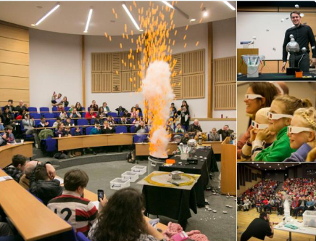

Public Engagement & The Big Bang Experience!
Brief history and future of the LHC revealing wonders of the LHC at CERN and how it is unravelling mysteries of the universe.
Re-started in-person events at RHUL following Covid-19.
  Annual Physics Taster Days (June 2022)
  Particle Physics Masterclass: A-level students (March 2023)
  Royal Holloway Science Festival (May 2023)
  Girls into AstroPhysics residential (July 2023)

Slide 26

Public Engagement & Literature
Popular Science Book
Suzie Sheehy
Outreach events and coverage around launches in the UK (April 2022), Australia (May 2022) and US (January 2023).

Slide 27

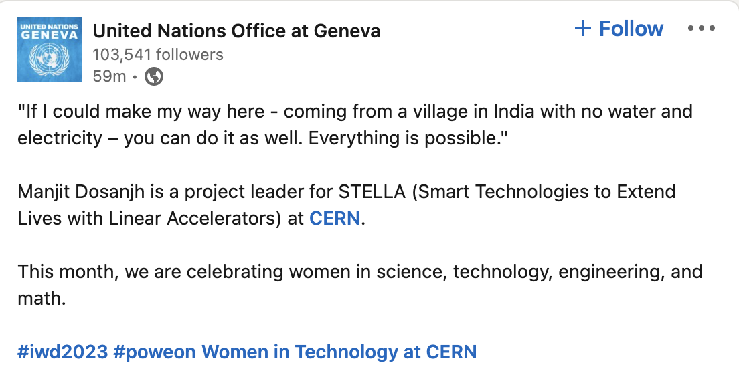
Public Engagement & the SDGs
SDG 3 – Good Health and Well-being
  Climate Change and Health Task Force Meeting (World Health Organization).
  Member of Conference of Non-Governmental Organizations in Consultative Relationship with the United Nations (CoNGO) Board and Invited Speaker at WSIS 2022.
SDG 5 – Gender Equality
  Committee on Status of Women - Geneva (CSW-Geneva)
  UK Civil Society Women’s Alliance (UKCSWA)
Manjit Dosanjh

Slide 28
Summary
JAI continues to deliver world-class accelerator science education & training and public engagement programmes.
  Intense accelerator physics course.
  Innovative and educational accelerator design projects.
  Successful placement of students once they enter professional careers.
  Recognised and award-winning public engagement activities with global reach - continue strengthening existing portfolio and encourage new & innovative ideas.

