Slide 1
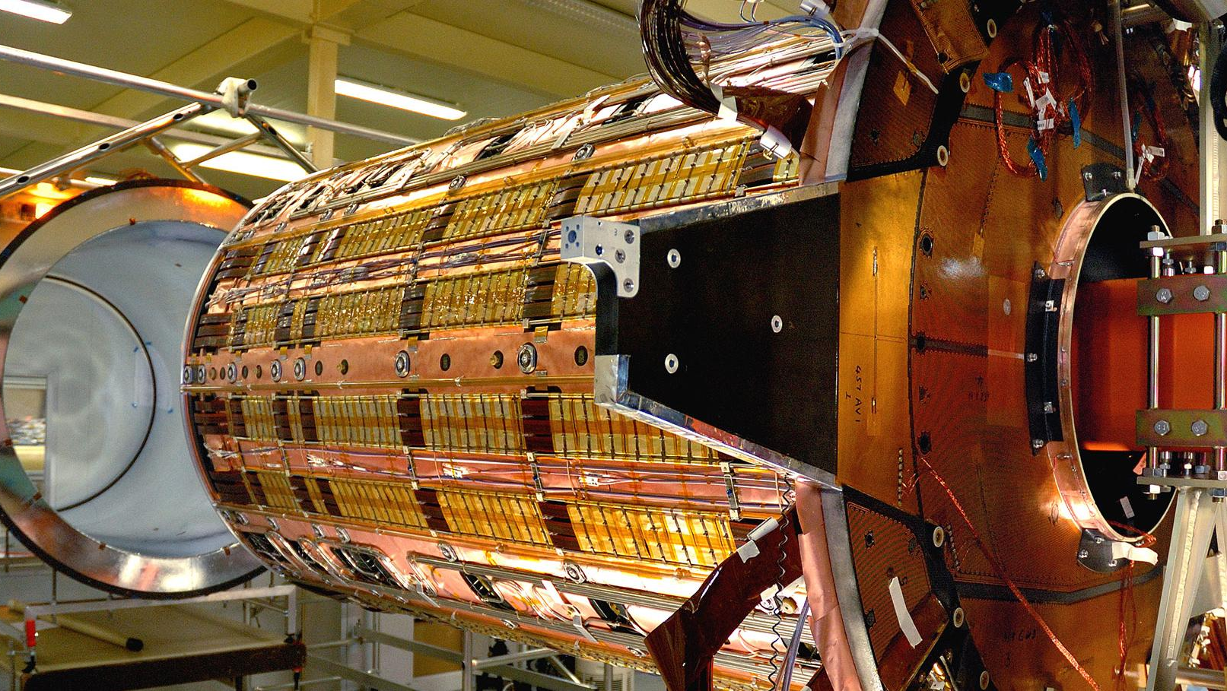
OPTEC
Commercialisation Opportunities
Oxford Physics Technical Excellence Centre
JAI Advisory Board Meeting, 27th March 2023
Vishal Francis

Slide 2
OPTEC
Who is OPTEC
OPTEC and Commercialisation - Impact

Slide 3
Who is OPTEC

Slide 4
OPTEC
OPTEC
Oxford Physics Technical Excellence Centre
Thin Films Facility
Photo Fabrication Unit
Cryo Magnetics Group
Nano Fabrication
Infrared Multilayer
(IML)
Space Instruments (AOPP – SI)
Mechanical Engineering Group
Electronics and Electrical Group
The OPTEC Family (Currently) ~60 Highly skilled team members
8 Specialist Groups
Great Teams Make OPTEC
Notes:
OPTEC is Oxford Physics Technical Excellence Centre
8 specialist groups providing essential and specialist support for our departmental activities

Slide 5
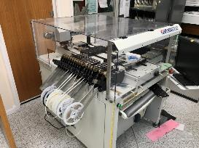
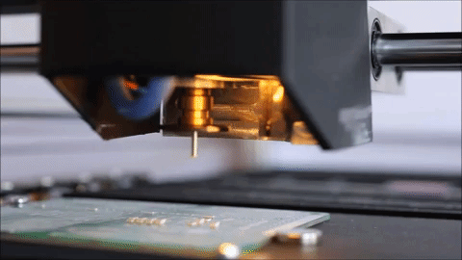
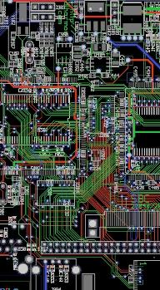
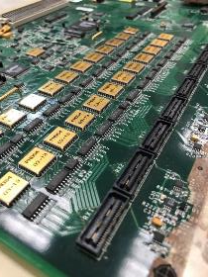
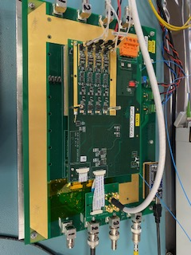
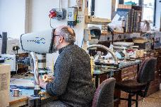
Electronics and Electrical Group
Notes:
Some images of what we do
We provide the the support to realise the science goals – Design, develop manufacture and validate
Providing growth in FPGA hardware and firmware development
4 channel Daedalus OPTO board

Slide 6
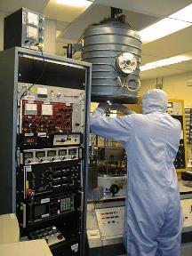
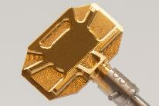
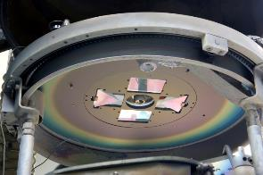
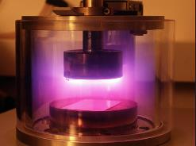
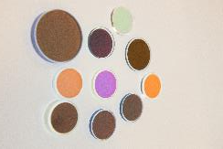
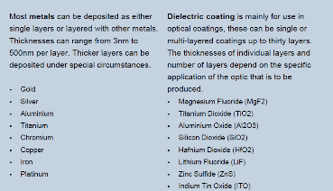
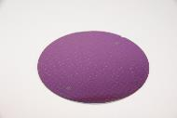
Thin Films Facility
Provides a comprehensive coating design, manufacture and measurement service
Custom coatings are provided for the optical, electronic, semiconductor and aerospace fields using a range of thermal and electron beam evaporation techniques.
Notes:
Coatings developed by Oxford and produced for Hexagon by Oxford – critical for the JAI PaMIr project

Slide 7
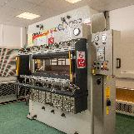
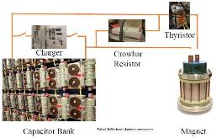
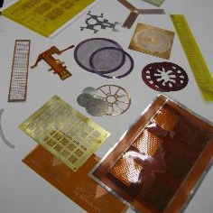
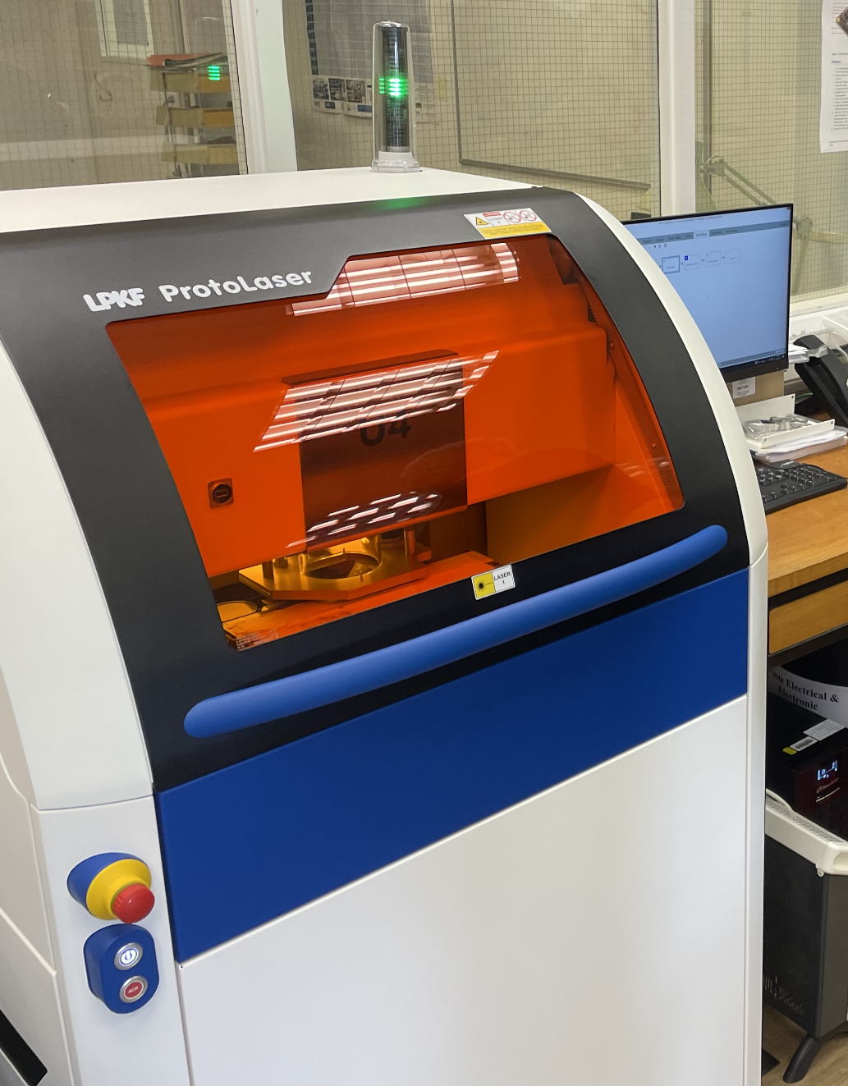
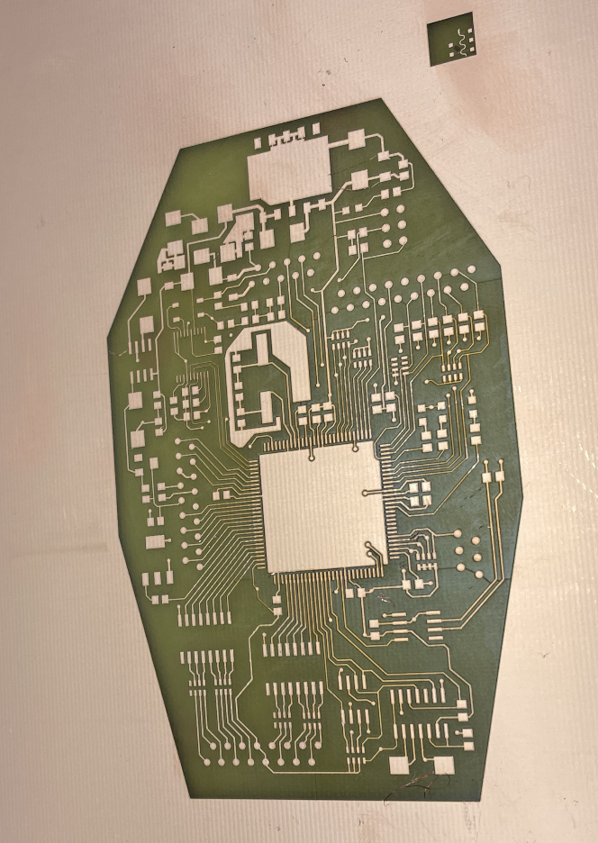
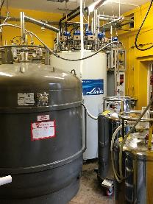
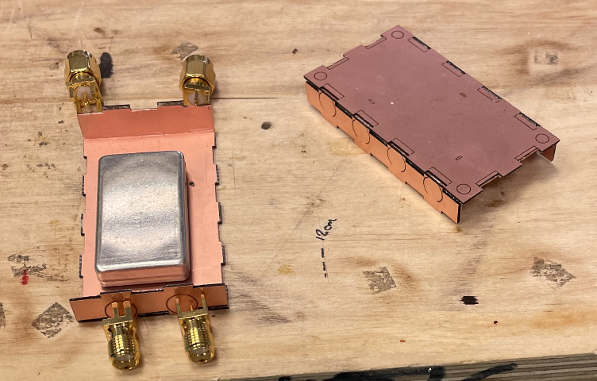
Photo Fabrication Unit
Cryomagnetics
Produce printed circuitry, ribbon cables, springs and other complex items using chemical etching techniques.
New Laser Router capable of very high resolution work
Used by industry
  Deliver LN2
  Deliver LHe
  Maintain the recovery system
Mobile superconducting magnet systems up to 21 T
Coil winding and vacuum impregnation expertise
Extensive expertise in adhesives and non-metallic composites at low temperatures
Notes:
Busy slide : New laser router

Slide 8
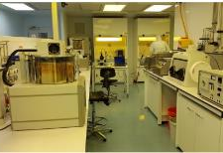
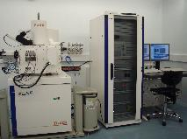
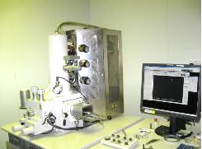
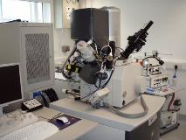
Nano-Fabrication Facility
Provides researchers with access to state-of-the-art capabilities for micro- and nano-fabrication
Scanning electron microscopy.
The foundation of the facility is a Class 100 and Class 1000
Used for sample preparation and lithography, including equipment for resist processing, metal and insulator deposition, and dry etching.
Notes:
Facility for MICRO and NANO fabrication
Scanning electron Microscope
Class 100 / 1000 cleanrooms

Slide 9

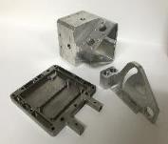
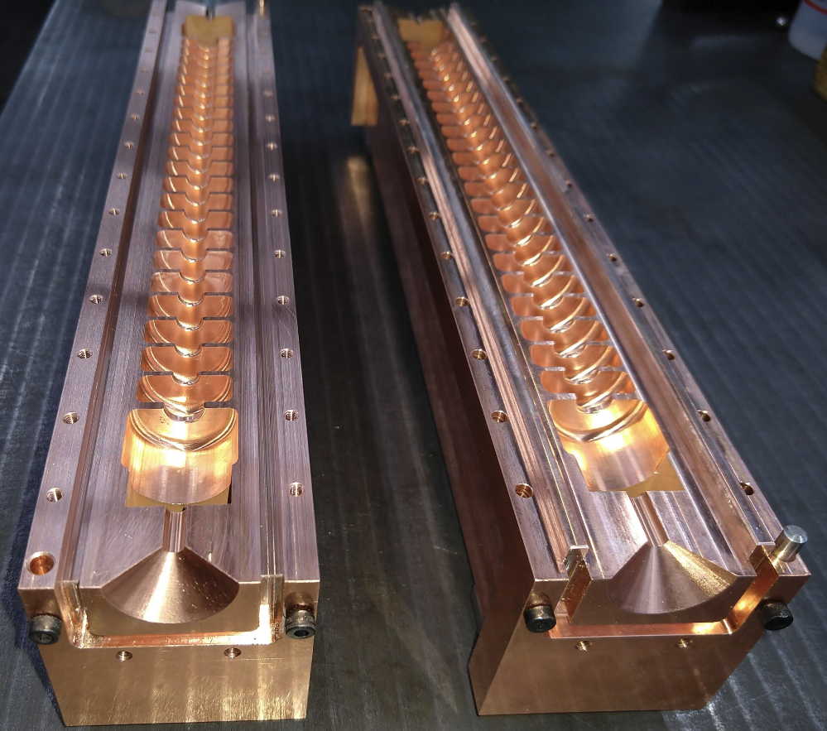
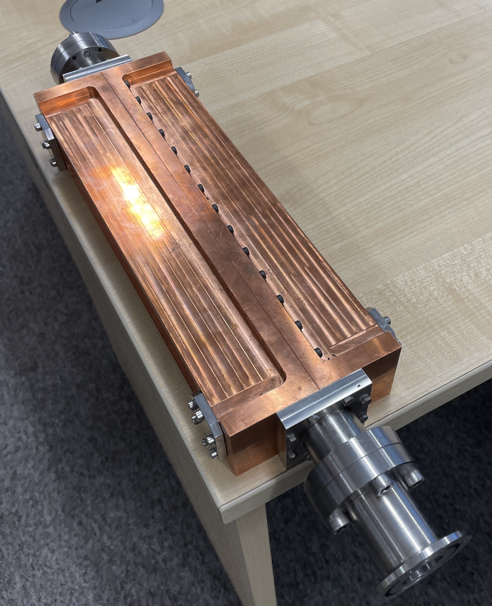
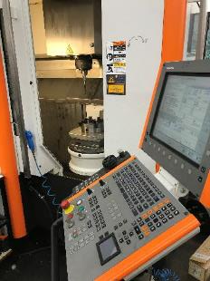
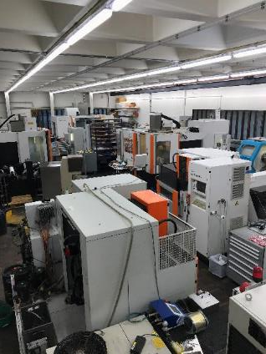
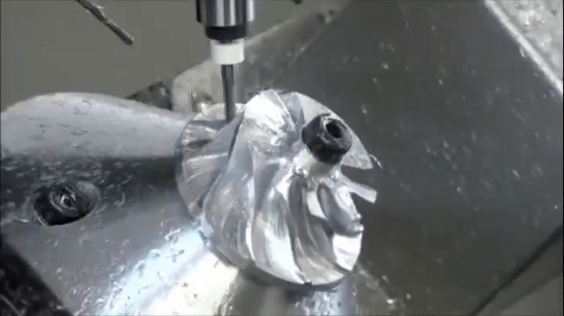
Mechanical Engineering and Manufacturing
Specialist manufacturing facility
Supporting our customers with design and development
Industry does not like to take risk – high-cost impact
Notes:
Two Large high-tech well equipped mechanical workshops with highly skilled technicians to support our equipment
You can recognize the RF cavity in the top left – Made for JAI

Slide 10
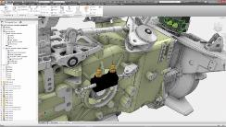
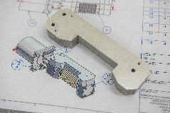
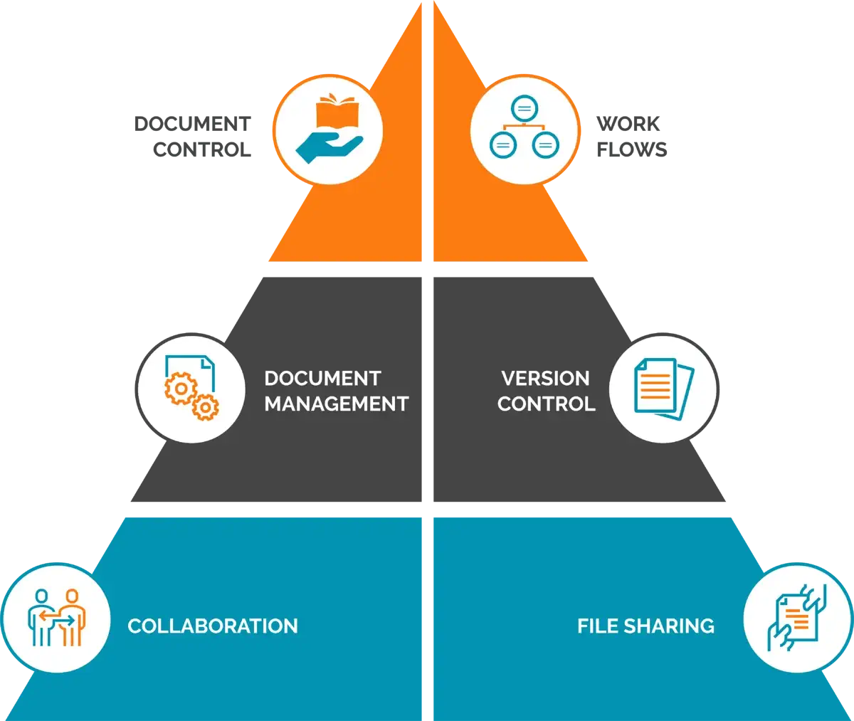
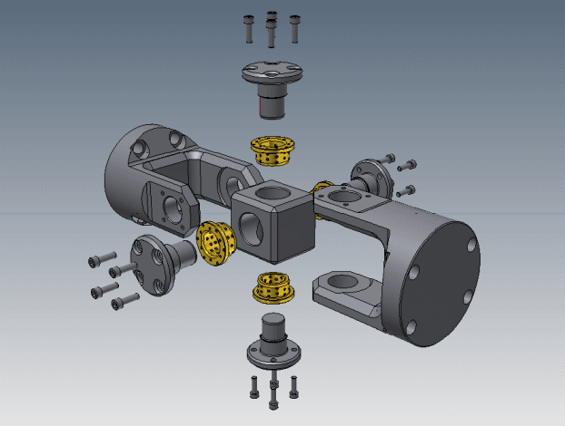
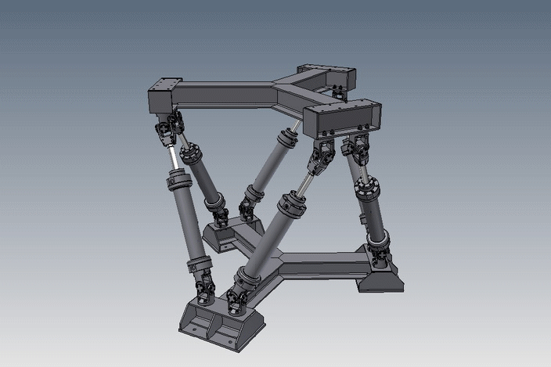
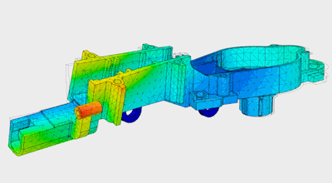
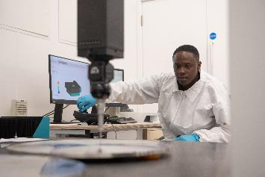
Design / Develop /Prototype
Production drawings for Manufacture
Analysis
Validate
Notes:
Full produce lifecycle management
Version control, project management, and document management

Slide 11
OPTEC
&
Commercialisation
(Impact)

Slide 12
Who are our customers?
Department of Physics
MPLS Division
Wider University
Other Academia
Industrial support
Particle Physics (JAI)
ASTRO Physics
Condensed Matter Physics
Atomic Laser Physics
Atmospheric Oceanica and Planetary Physics
Engineering
Biology
Chemistry
Zoology
Etc.
Archaeology
University Museum
Etc.
Imperial
STFC
Texas A&M
Oslo University
Manchester Uni
Yale
CERN
Etc.
First Light Fusion
Oxford Nano Systems
Oxford Cryosystems
Etc.
Notes:
Who are our customers?
Department – the sub divisions PP – ASTRO – CMP – ALP - AOPP - This is where PaMIr comes in
MPLS – Engineering – Biology, chemistry etc.
Other areas of the university
Other universities or other research facilities
Other industrial activities

Slide 13
OPTC Commercialisation
Oxford University Innovations (OUI) supporting OPTEC
Our output provides economic impact for our customers – Enabling commercial opportunities to be explored further
  Industrial partners upskilled to provide new services
  Using industry to bulk manufacture – low risk
  Supporting UKPLC – Positive economic impact
Notes:
We support academia and research activities and thus we are not competing with commercial activities

Slide 14
PaMIr Progress since the last AB
£58k of extra funding to further develop the prototypes for which Hexagon are going to take out licenses
Two good summer students, one of whom developed a C++ parallelised algorithm that can analyse OFFLINE PaMIr data with the full required accuracy.
  This offline version is intended as the basis for a merger of the PaMIr technology with the older Multiline technology. The two are plug compatible but need different analysis algorithms.
£33k to further develop the offline algorithms and bring them onto a GPU computing platform.
  Very good news indeed and the project can start as early as the start of next month.
Notes:
Update since the last AB where Armin Reichold presented the PaMIr status

Slide 15
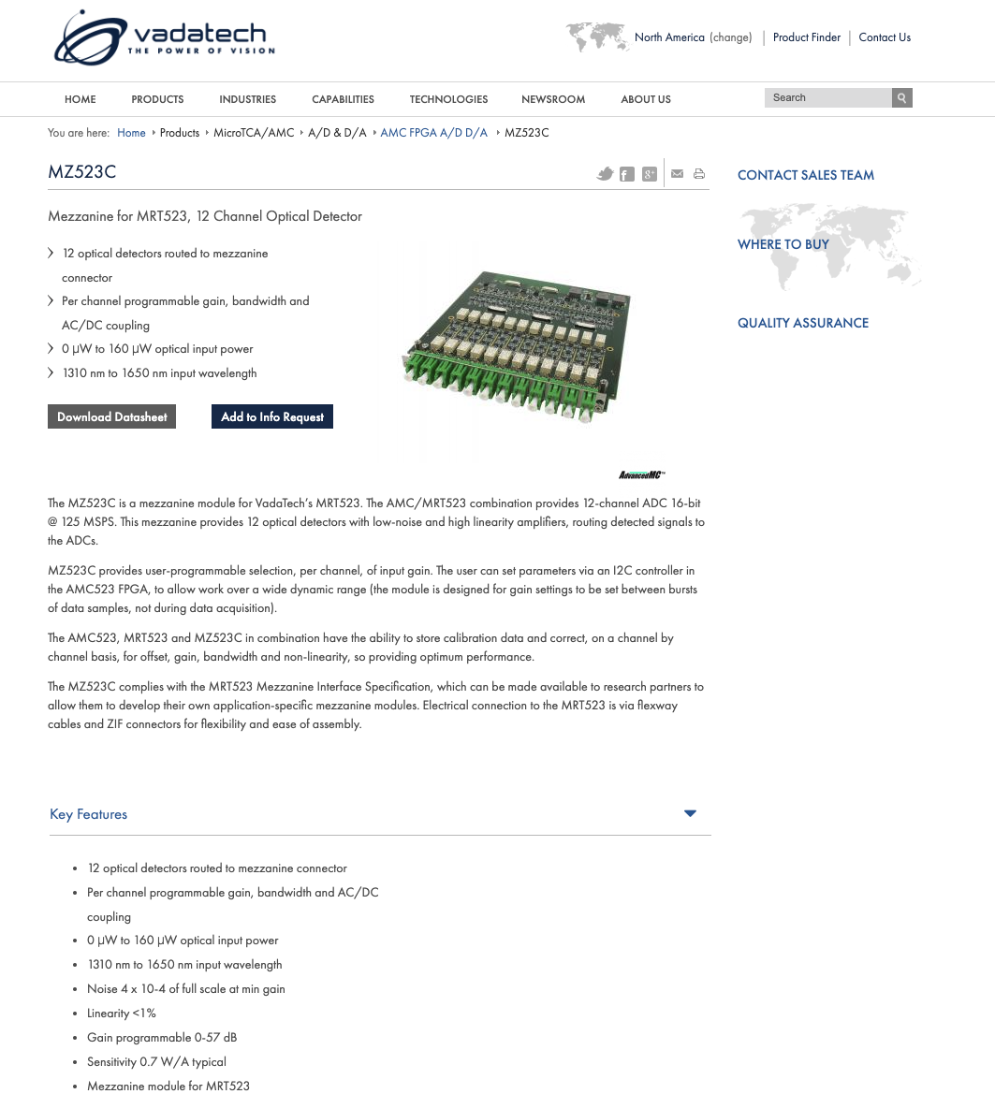
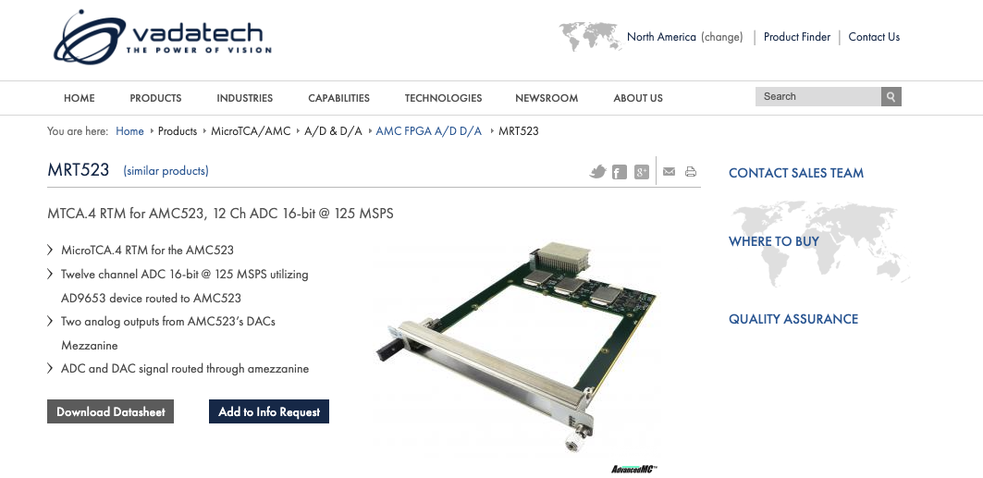
OPTEC and PaMIr’s partnership
OPTEC has provided 75% of the required PaMIr staff resources
  OPTEC is critical and core to the project management, development, manufacture, and success
Notes:
We designed a 12-channel optical mezzanine card to integrate with commercial DAQ
Developed and sold under license to VADATECH
Our engineers designed this board
PaMIr makes new 12 channel low noise board developed by EEG and released by Vadatech soon

Slide 16
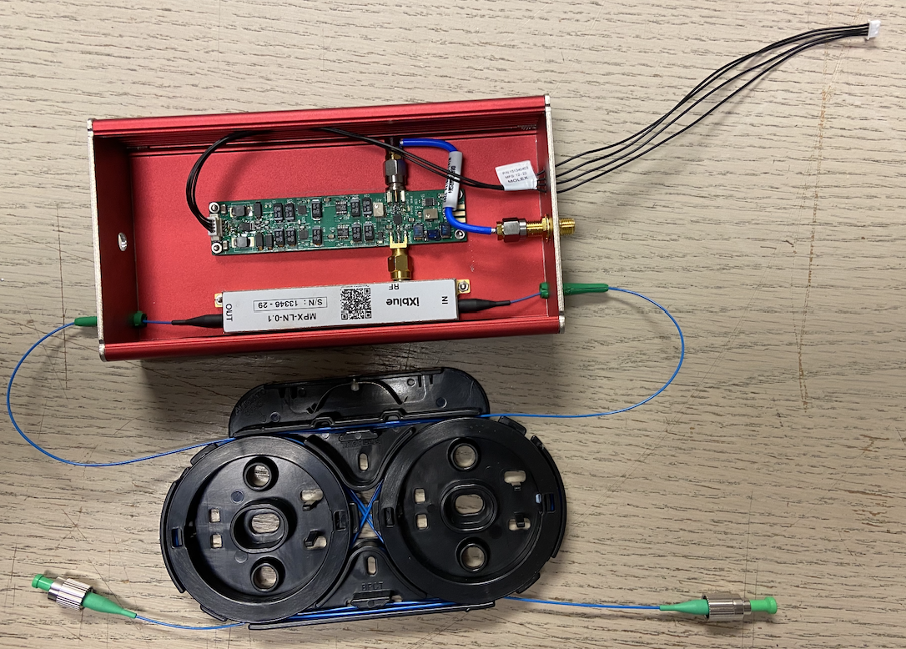
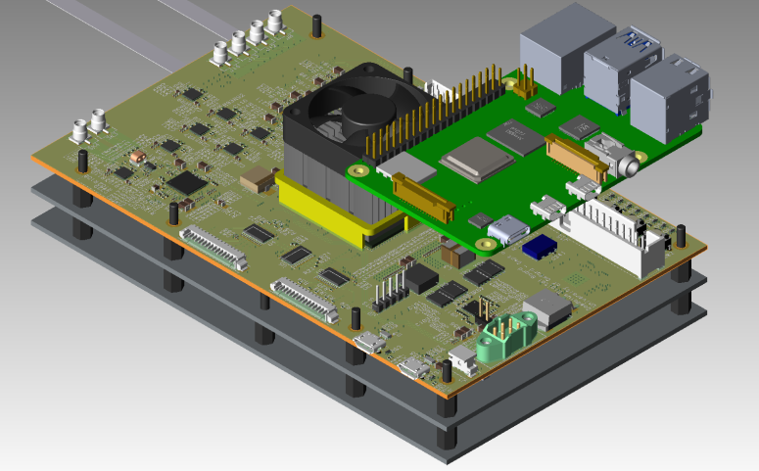
Modulator Driver
4 Channel OPTO Board
Super low noise 4 channel optical amplifier
FPGA control board for data control and transfer
  Real time FPGA data analysis, low latency feedback (10 micro-seconds)
We have deployed 10 specialists over the past two years
Low noise, compact, high dynamic range laser phase modulator driver – currently not commercially available – designed, developed and manufactured by our electronics group
Notes:
Daedalus : FPGA card and Raspberry Pi connect together with the optical card from above to make a complete readout system.

Slide 17
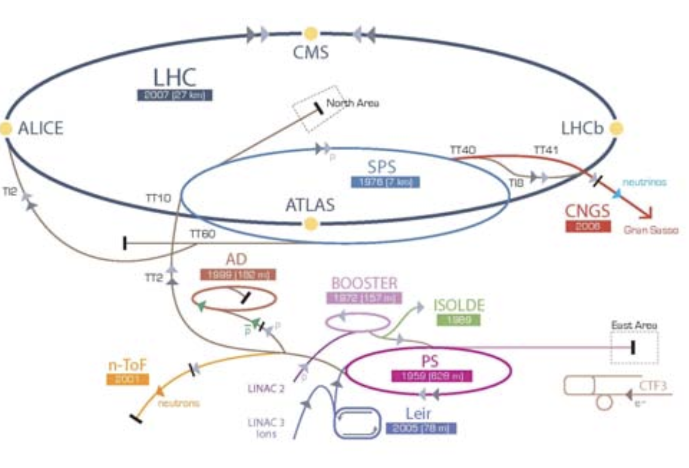
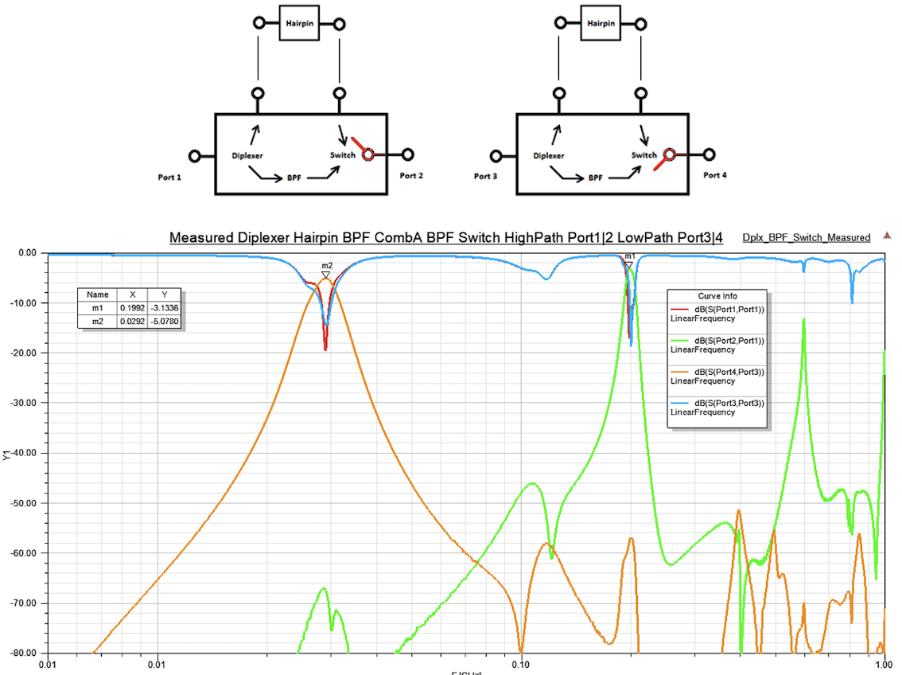
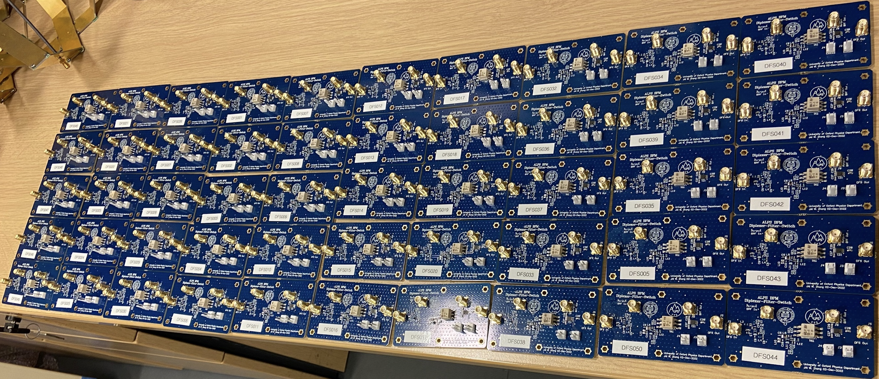
Filter Boards production - BPM
For JAI
Our specialist engineers developed, designed, simulated, and managed production of 50 filters for particle beam positioning monitors on TT2 and TT10 beam-line (between PS and SPS in LHC)
Notes:
Simulation to manufactured hardware – all activities inhouse – manufacturing farmed out to commercial company (boring part – also supporting our industrial pipeline)

Slide 18
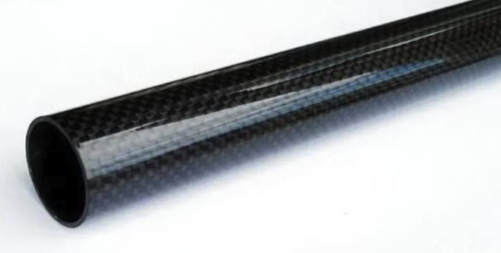
Future beam lines development work
Low Impedance ✓
Low Mass ✓
Ultra High vacuum Compatible ✓
Reduces the use of toxic ✓ (conventional) materials ✓
Low magnetic permeability ✓
Copper carbon composite material
Received good feedback from VELO collaboration (presented at Nikef)
  Collaboration between OPTEC groups (EEG/MEG)
Currently exploring IP protection with Oxford University Innovations
Exploring Commercial applications
Seeking funding from STFC Impact Acceleration Account (IAA)
Example of a carbon fibre thin wall tube
Notes:
Game changer – Recently presented at VELO as a new beam pipe proposal
30-micron laminate thickness with an effective thickness for particles are ~5 microns
Extreme high vacuum compatible 1x10-12mbar
Potential for patenting – Ref. Phill

Slide 19
Extras

Slide 20
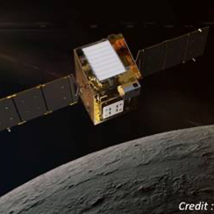
Space Activities
Current activities – All external contracts
NASA Lunar Thermal Mapper (LTM)
ESA Atmospheric Remote-sensing Infrared Exoplanet Large-survey (ARIEL)
ESA Copernicus Land Surface Temperature Monitoring (LSTM)
NASA Net Flux Radiometer (NFR)
ESA ARIEL (Atmospheric Remote-sensing Infrared Exoplanet Large-survey)
Platino ( – In Negotiation)

Slide 21
Oxford University – Spin-out Policy
Oxford University Innovation Ltd (wholly owned by Oxford University) supports spin-out formation where Oxford owns IP
Academic Founders of a spinout receive:
80% founding shares in spinout (20% to the university of which half goes to Oxford Science Enterprise)
Royalty returns on IP licensed to spinout
Opportunity for Academic Consulting to spinout (30 days+)
IP License Royalty returns
Imperial and Royal Holloway have similar Spin-out policies
Oxford Formed 287 companies (July 2022) – 20-30 p.a. Since 2010 our spinouts have raised over £2.5bn of external investment.
In 2015 Oxford partnered with Oxford Science Enterprise (a venture fund). OSE raised €1bn and invested half in Oxford spinouts so far.
Oxford Physics has formed 16 spinouts (11 spinouts since 2016). Many have gone on to raise tens of millions in Series A and B rounds. 2 spinouts linked to JAI (Living Optics and Machine Discovery).
Total net revenue | Researcher(s) | University | Department(s)
Up to £50K | 85.7% | 14.3% | 0%
£50K to £500K | 45% | 30% | 25%
Over £500K | 22.5% | 40% | 37.5%

Slide 22
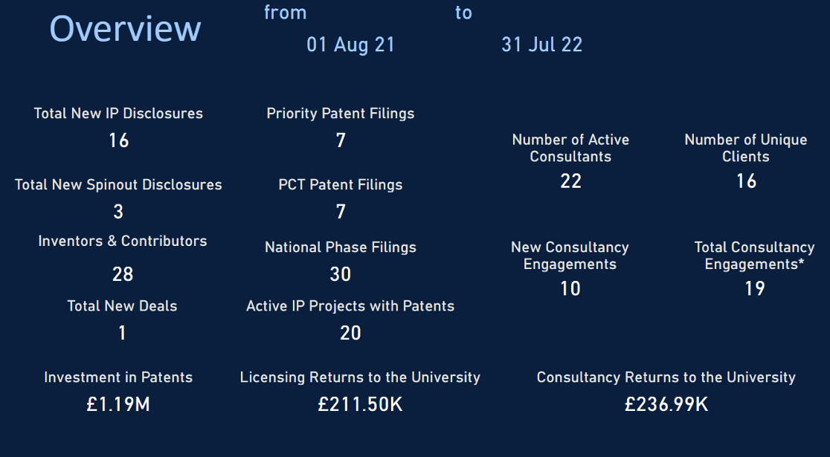

Slide 23
OPTEC Provides
Project Managing PaMIr
  Essential service provided
Providing a Chief Engineer for the FPGA board design (hardware and firmware), supporting three other engineers
Testing and validation of the hardware
Monitoring inhouse prototypes manufacturing that has been subcontracted to commercial supplier
  Overseeing the whole supplier management
Developing a 4 channel Opto board, designed for more industrial application
  Improved manufacturing machine controls, assembly equipment etc.

Slide 24
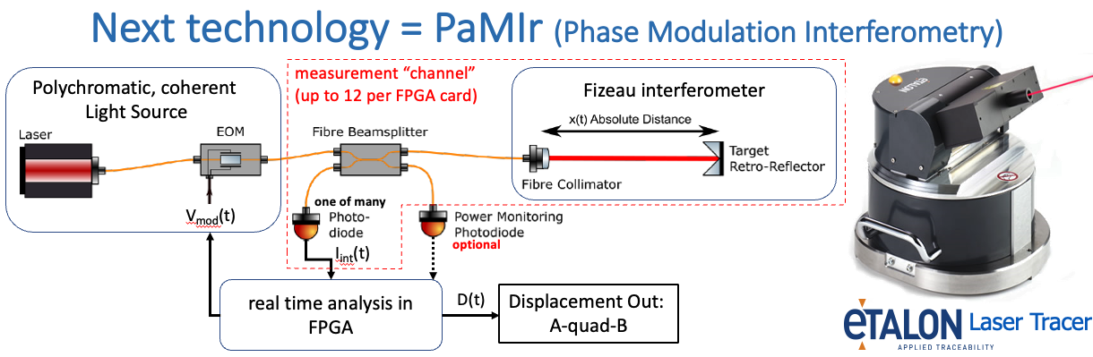
Our Impact
OPTEC engineers and technicians from electronics group are backbone of PaMIr project
  FPGA firmware, analogue and digital board design & manufacture, and mechanics
Notes:
PaMIr evolution and exploitation is a great example, and something you saw during the last AB
It has been a journey from LICAS to AMULET to Monalisa to PaMIr and then the future and upcoming Dedalus 4 channel project
real time interferometric displacement sensor which is plug compatible with the previous FSI absolute distance measurement technology
This will initially be used in a new version of the laser tracer which you show below. The new version of the tracer will be called Daedalus.

Slide 25
What we did for LICAS and now
OPTEC provided engineers and technicians to produce prototypes for test setup at Desy
OPTEC supported the subsequent development of the Monalisa system, Monitoring – Alignment - & - Stabilising – with high Accuracy
OPTEC designed and built measurement crates which were sold through Etalon (external company)
Technology developed by OPTEC licensed and sold via OUI
We continue to make and develop PaMIr project boards for other uses via Etalon/Hexagon
Notes:
We built 8 crates for etalon before licencing
We continued to provide support for the product via repairs and trouble shooting
Each crate consisted of a multilayer back plane, linear power supplies 6 Fpga control cards and 12 measurement cards. The complete system was built in house . (apart from the bare pcbs which were externally manufactured due to layer count being so high)
PaMIr 4 channel low noise system in one box

Slide 26
OPTEC and PaMIr’s partnership
OPTEC has provided 75% of the required PaMIr staff resources
  OPTEC is critical and core to the project management, development, manufacture, and success
OPTEC provides
  Electronics design
  Electronic build and validation
  Simulation
  FPGA (hardware and firmware) – 5 specialists and growing
  Engineering support
  Specialist coating for fibres – developed and provided by OPTEC for Hexagon
  Vacuum systems design + specialists
  And more!
All these are essential skills required to support the department, JAI and future activities

Slide 27
OPTEC continues to develop and support JAI activities - PaMIr
Super low noise 4 channel optical amplifier
FPGA control board for data control and transfer
  Real time FPGA data analysis, low latency feedback (10 micro-seconds)
We have deployed specialists over the past two years
  7 Engineers and 3 Technicians

Slide 28
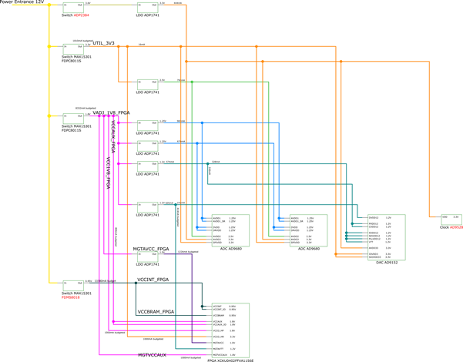


4 Channel Opto Board - Daedalus
Design
Hardware Development
Oppo board Test Rig
Production Board
Notes:
FPGA card and Raspberry Pi connect together with the optical card from above to make a complete readout system.
We have had 7 engineers and 3 technicians deployed on this project for various tasks over the last 2 years.

Slide 29
OPTEC Provides
Project Managing PaMIr
  Essential service provided
Providing a Chief Engineer for the FPGA board design (hardware and firmware), supporting three other engineers
Testing and validation of the hardware
Monitoring inhouse prototypes manufacturing that has been subcontracted to commercial supplier
  Overseeing the whole supplier management
Developing a 4 channel Opto board, designed for more industrial application
  Improved manufacturing machine controls, assembly equipment etc.

Slide 30
Modulator Driver
Low noise, compact, high dynamic range laser phase modulator driver – currently not commercially available – designed, developed and manufactured by our electronics group
Developed, designed by OPTEC for PaMIR laser needs – essential technology and solution provided

Slide 31
Our flexibility
We take development risks that commercial suppliers do not take
We provide support during design development
  Again – a costly option via an external supplier
We provide project management, quality assurance
  Providing reporting, planning, resources management and any funding agency financial/status reporting
Provide a systems approach to our work
We resolve industrial project problems
Advise during proposals
  Ensuring resources are understood and requested
Requirements monitoring on large projects

