Slide 1

Light Sources Update
I. Martin
JAI Advisory Board Meeting
27th March 2023

Slide 2
Talk Outline
Updates on Diamond-II:
Project goals
Recent developments
Ongoing Accelerator Physics studies
Updates from JAI members:
Feasibility Studies of Cherenkov Diffraction Radiation BPMs (A. Clapp, RHUL/DLS)
Investigating Provision for Timing Mode Users at Diamond-II (S. Wilkes, UO/DLS)
Joint-Appointment PDRA between Oxford / Diamond (R. Husain, UO/DLS)
New studentships (starting September 2023):
Machine Learning Techniques for Online Optimisation of Synchrotron Light Sources
Fast Beam Loss Monitor System for Diamond-II and Machine Learning Applications
Conclusions
Ian Martin, Light Sources, JAI AB, 27/03/2023

Slide 3
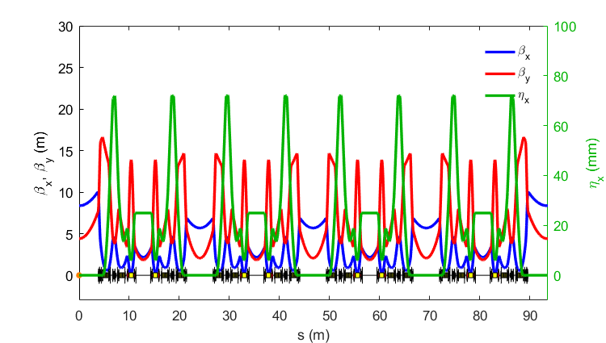
Reminder: Diamond-II Design Goals
Objective #1: Optimise the science enabled at Diamond
Objective #2: Maximise the impact it has for researchers both in universities and in industry
New Modified Hybrid 6-Bend Achromat (M-H6BA) storage ring
  Lower emittance (x~20) to increase brightness and coherence
  Double number of straight sections to increase capacity
Raise energy from 3 GeV to 3.5 GeV to increase flux and brightness above 10 keV
Upgrade insertion devices, new flagship beamlines
Improved data handling/computation, automation, ...
Technical Design Report published in October 2022:
https://www.diamond.ac.uk/Home/News/LatestNews/2022/14-10-22.html
1 super-period of M-H6BA
 | Bare lattice | With IDs
Average ε_{x}* | 163 pm.rad | 120 pm.rad
Average σ_{E}* | 0.095 % | 0.109 %
Average σ_{L}* (RMS) | 49.1 ps | 48.1ps
Total Lifetime* | 7.0 ± 0.2 | 7.0 ± 0.3
*final parameters including effects of intra-beam scattering, wake-fields and harmonic cavity
Ian Martin, Light Sources, JAI AB, 27/03/2023

Slide 4
Diamond-II: Project Approval and Funding Status
April 2021 - Wellcome approved its share of funding (14%) for Diamond-II, subject UK Government approval
June 2022 - UKRI confirmed first phase of funding (Apr 22-Mar 25), contingent on Final Business Case approval …. but which doesn’t match what was contained in the already-approved Outline Business Case
Final Business Case to be reviewed by UKRI’s Infrastructure Advisory Working Group (IAWG), Executive Committee (Exco) and DSIT Project and Investment Committee (PIC), April-June 2023
Impact:
Adjustment of spending profile to match available funds
Delay of >1 year to beginning of dark period (September 2026 => December 2027)
Number of items removed from baseline design:
  Two additional flagship beamlines removed from first phase of Diamond-II; changes to ID build programme
  No linac upgrade (100 MeV into booster instead of 150 MeV)
  Fewer RF cavities (7 instead of 8 in the storage ring, no EU type cavities in the booster)
  Numerous cost saving measures for engineering design, vacuum components, installed diagnostics, ….
Ian Martin, Light Sources, JAI AB, 27/03/2023

Slide 5
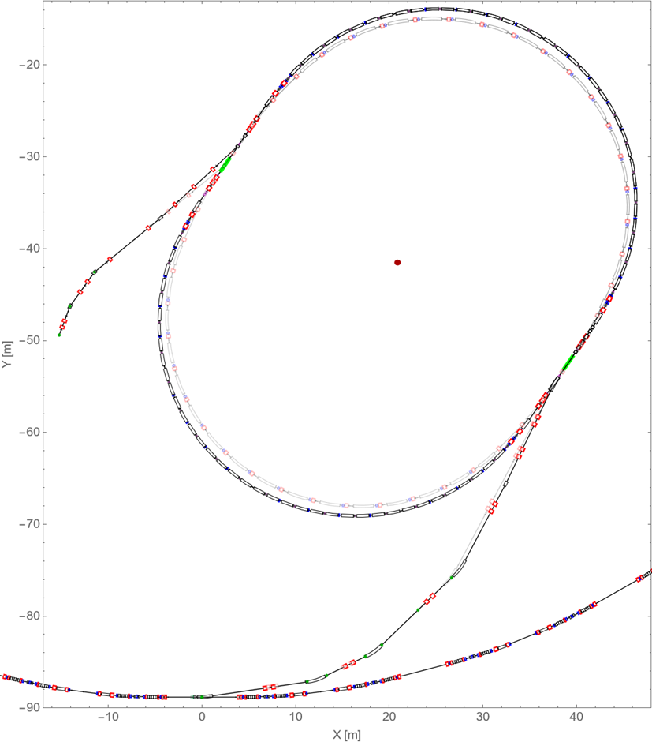
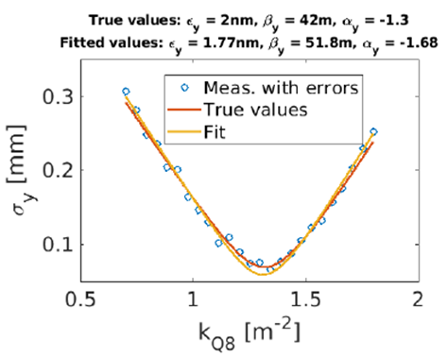
Diamond-II: Injector
Replacement booster retained: ensures high injection efficiency into the storage ring:
  Emittance reduced from 134 nm to 17 nm, bunch length reduced from 99 ps to 38 ps
  Extraction energy increased from 3 GeV to 3.5 GeV
Updated Booster-to-storage ring transfer line layout
  Added dispersion-free section for emittance measurements using quadrupole scans and downstream OTR screen
Existing booster
Simulated emittance measurement
New optics and layout for BTS
New booster
Storage Ring
BTS transfer line
Quad doublet
OTR screen
Ian Martin, Light Sources, JAI AB, 27/03/2023

Slide 6
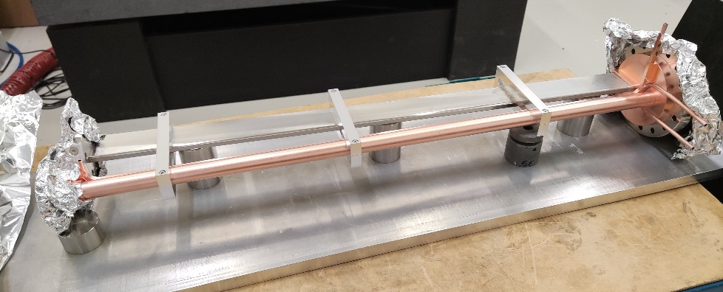
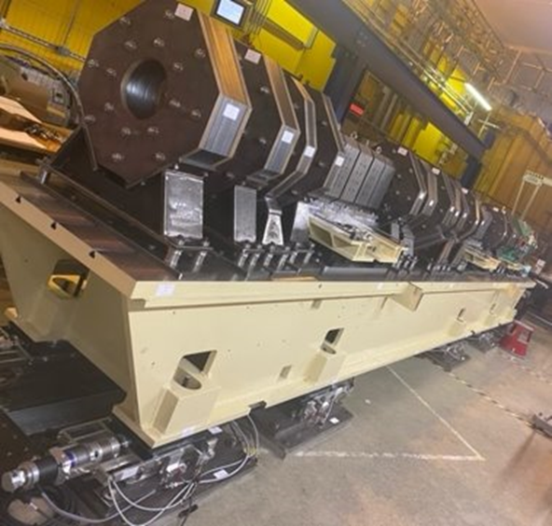
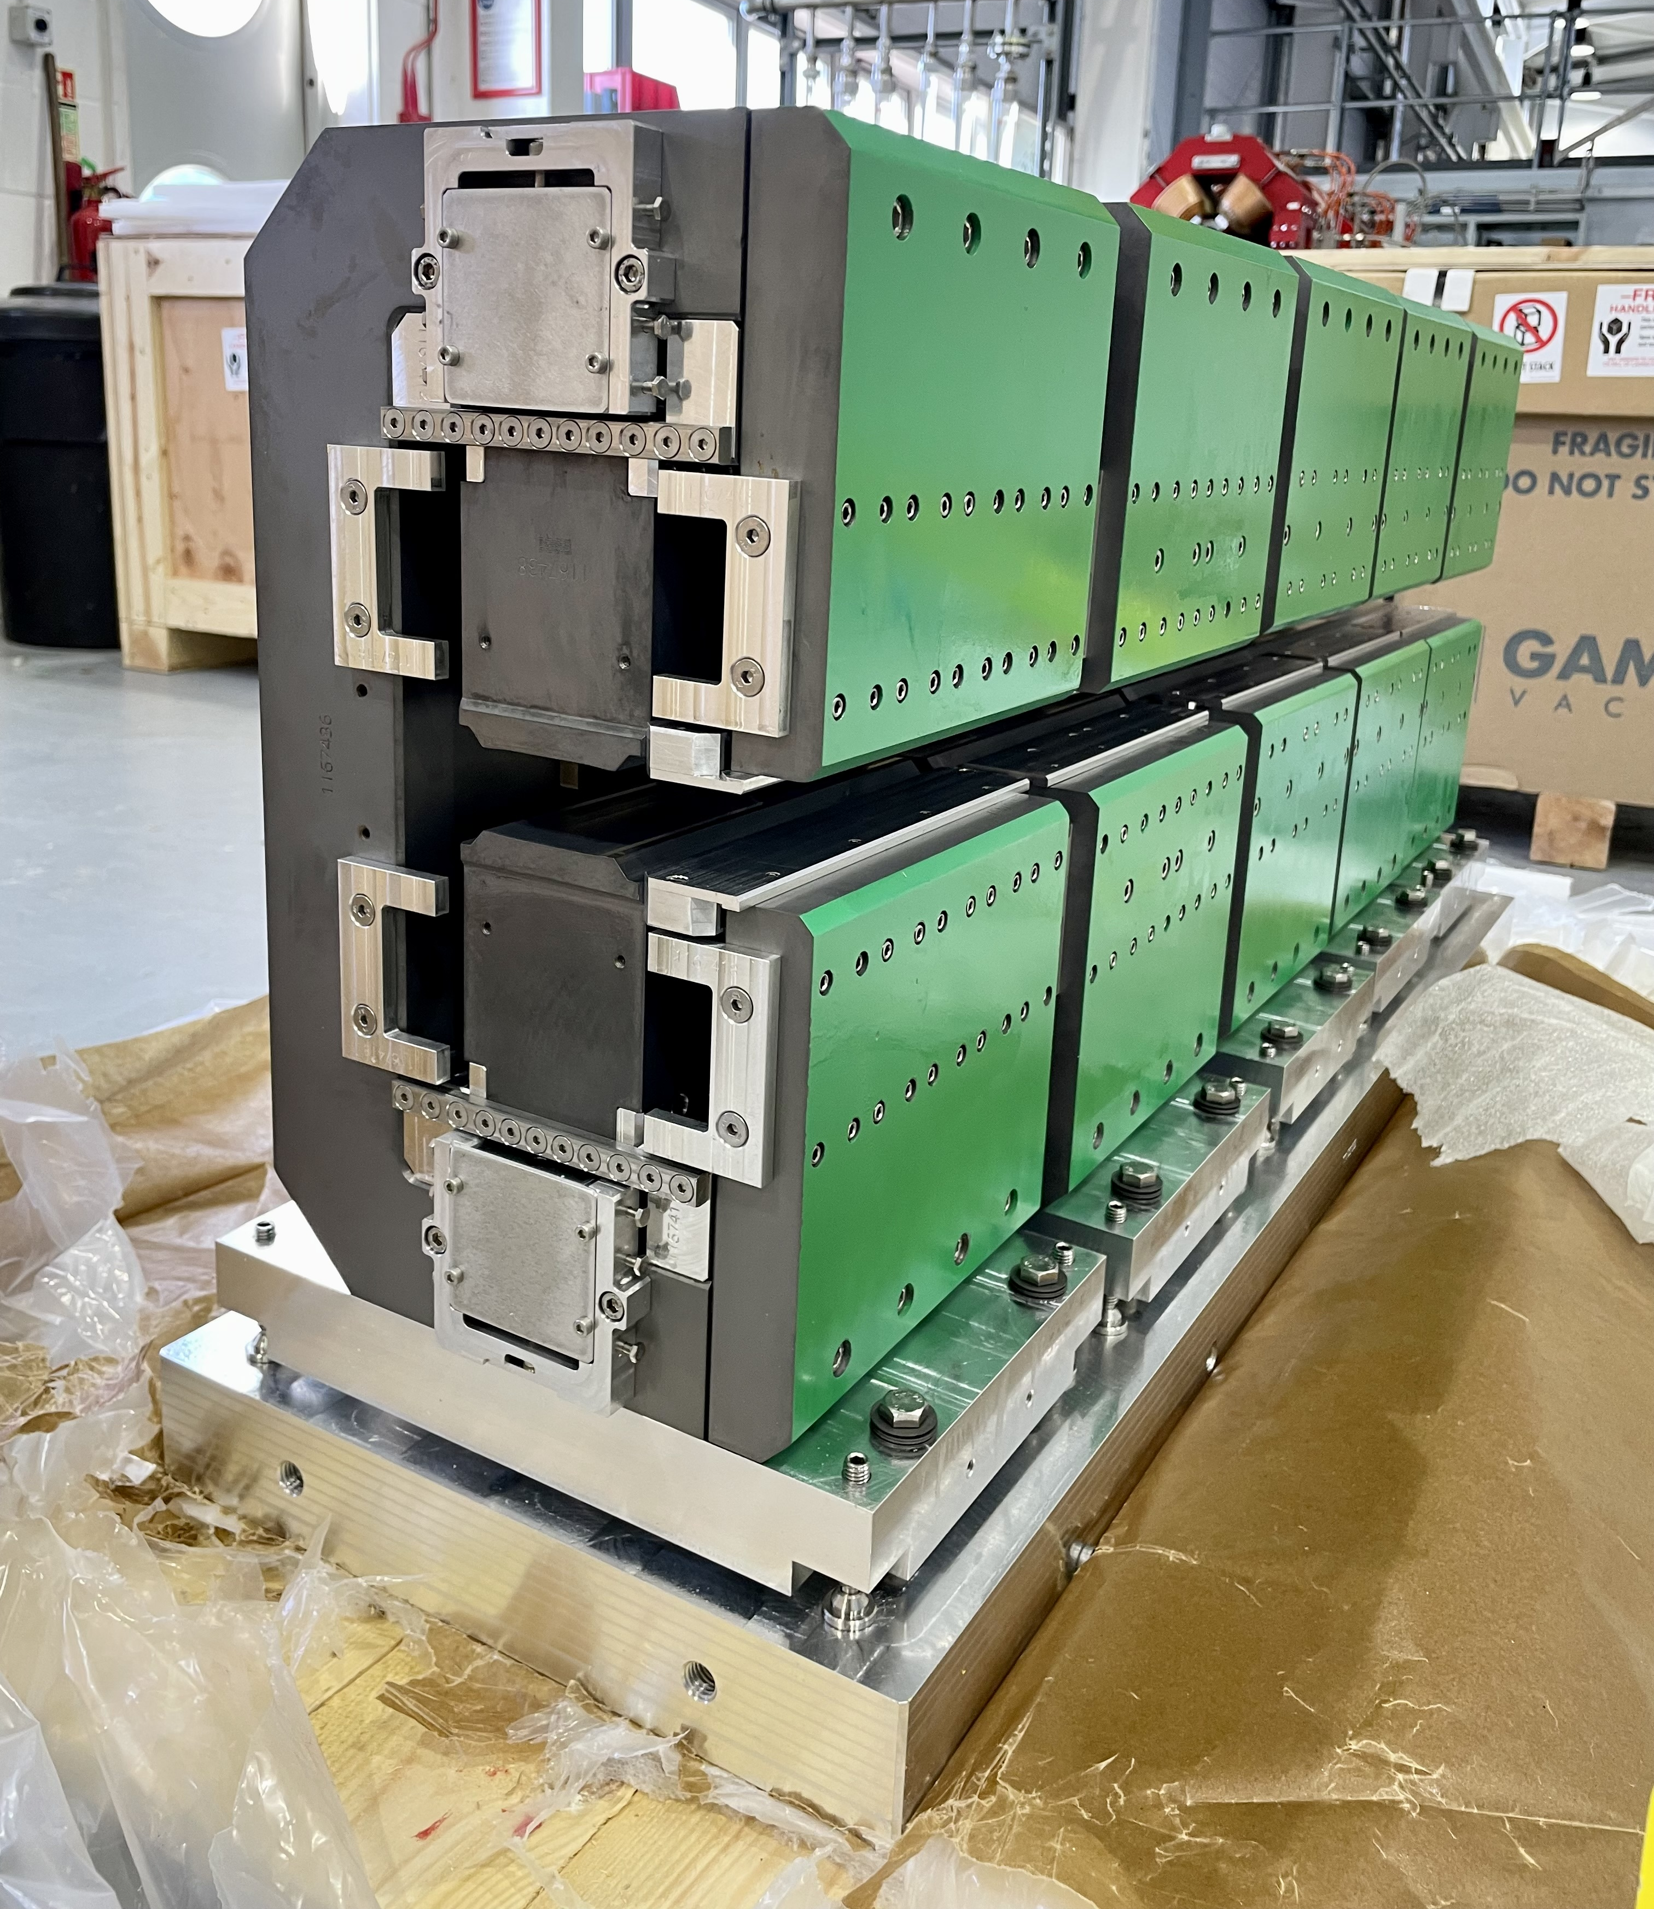
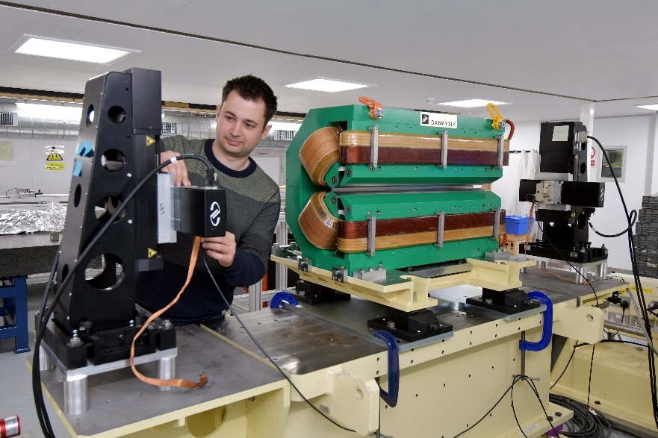
Diamond-II: Prototyping
Prototype Cu/SS crotch vessel
Prototype 8 m girder
Other developments underway …
Girder electrical wiring
Power supply controller
Front-end/ID rack upgrades
New BPM electronics/vessel
New fast-feedback architecture
Storage ring/booster vessels
Prototype Gradient-Dipole magnet on the stretched wire bench
Magnet alignment trials
Girder alignment / motion system
Vibration / modal analysis
Prototype PM Dipole
Ian Martin, Light Sources, JAI AB, 27/03/2023

Slide 7
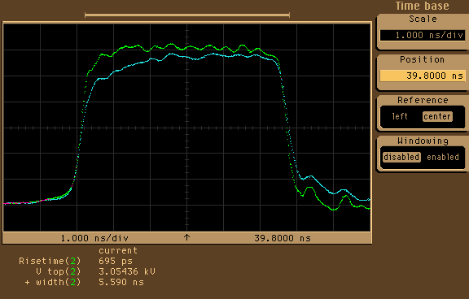
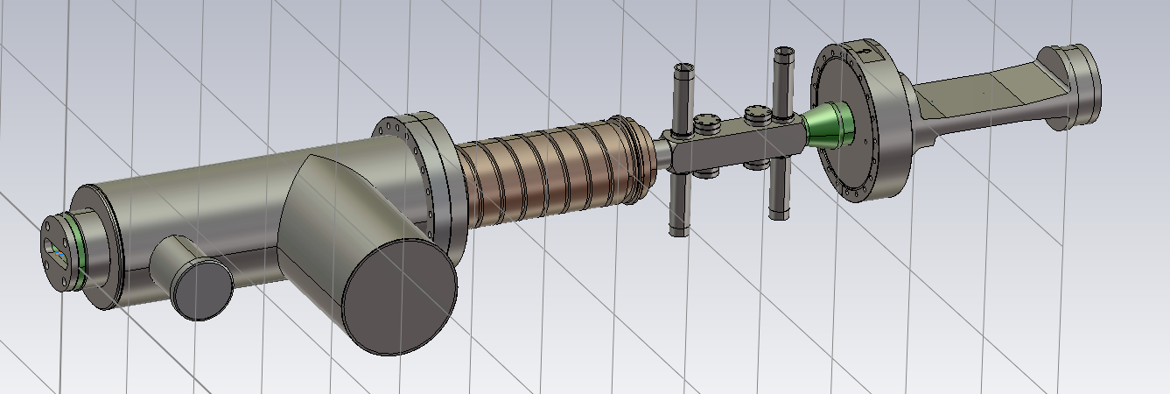
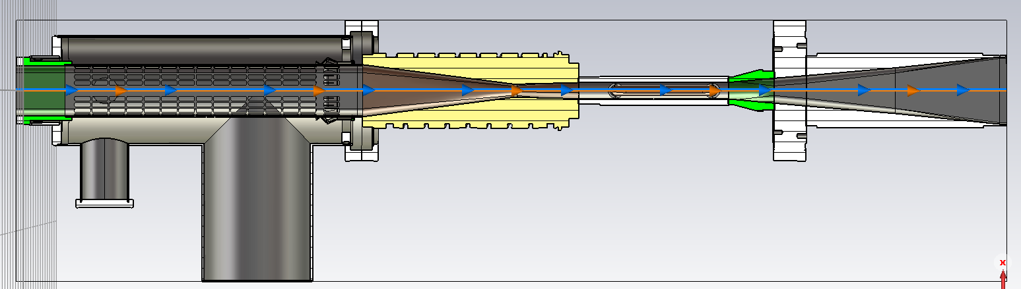
Diamond-II: Prototyping
Prototyping for transparent single-bunch injection also begun:
3 ns / ±30 kV pulser ordered from FID Technology – due end March 2023
Design of prototype striplines suitable for Diamond well-advanced
  Will install in BTS first, then storage ring
  Allows many aspects to be tested (calibration, reliability, pulse stability, impedance/heating effects, …)
  Lessons-learnt to be fed into Diamond-II injection stripline design
Test pulser at FID
Prototype stripline assembly
Diamond-II stripline field simulation
At pulser
pump
End of 12 m cable
Striplines
absorber
ID taper
A. Morgan, DLS
Ian Martin, Light Sources, JAI AB, 27/03/2023

Slide 8
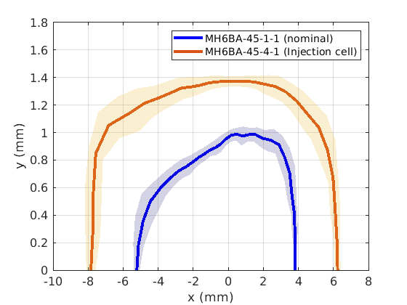
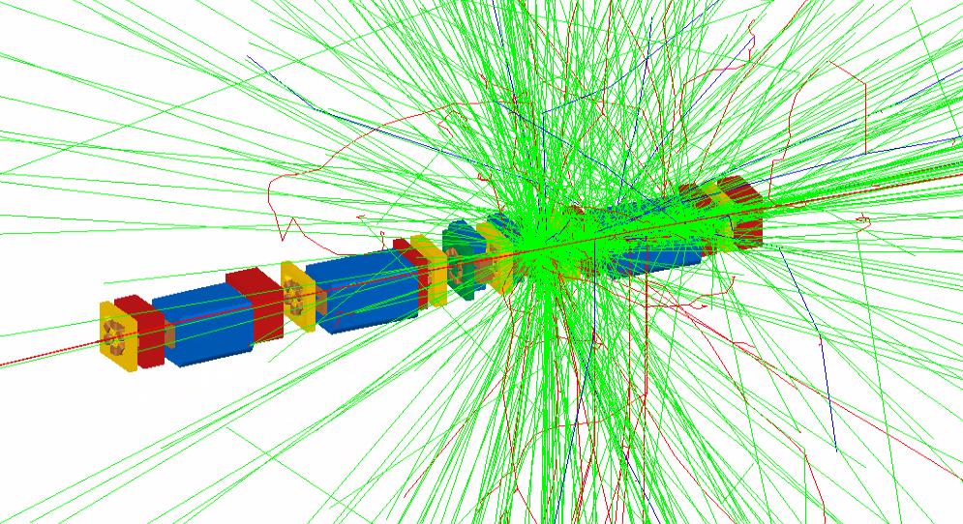
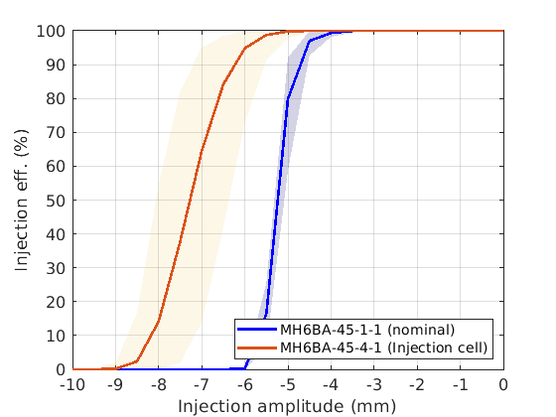
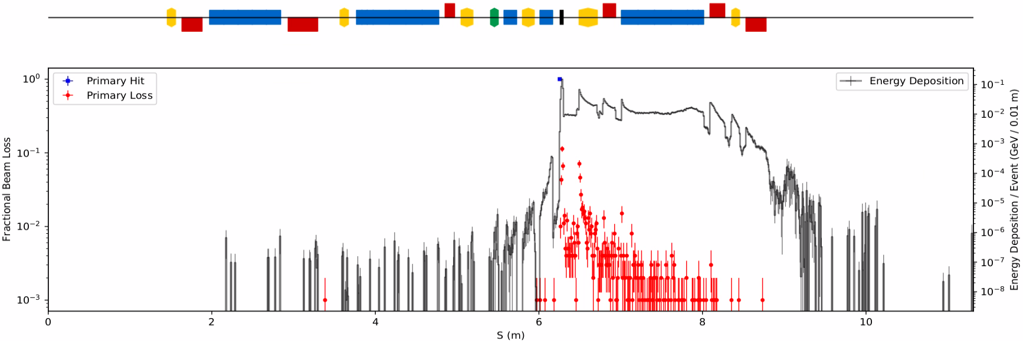
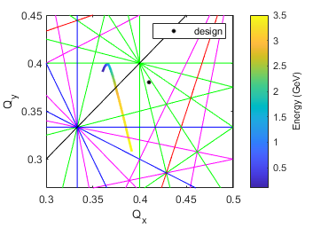
Diamond-II: Ongoing Accelerator Physics Studies
‘High-beta’ optics studies
Saturation in booster combined-function magnets leads to change in optics with beam energy
Collimation studies using BDSIM
Stored beam hitting collimator blade
Studies of beam loss on collimators:
Is there risk of damage to collimators?
Will the PM dipoles de-magnetise over time?
Does the EM shower reach the ID section?
H. Ghasem, DLS
Ian Martin, Light Sources, JAI AB, 27/03/2023

Slide 9
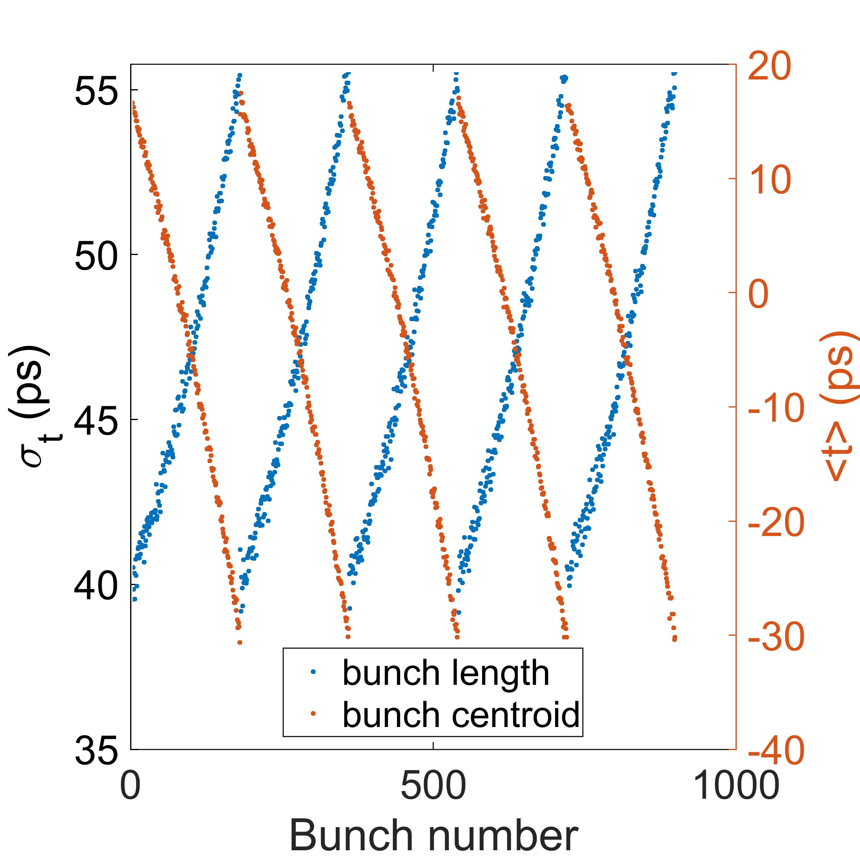
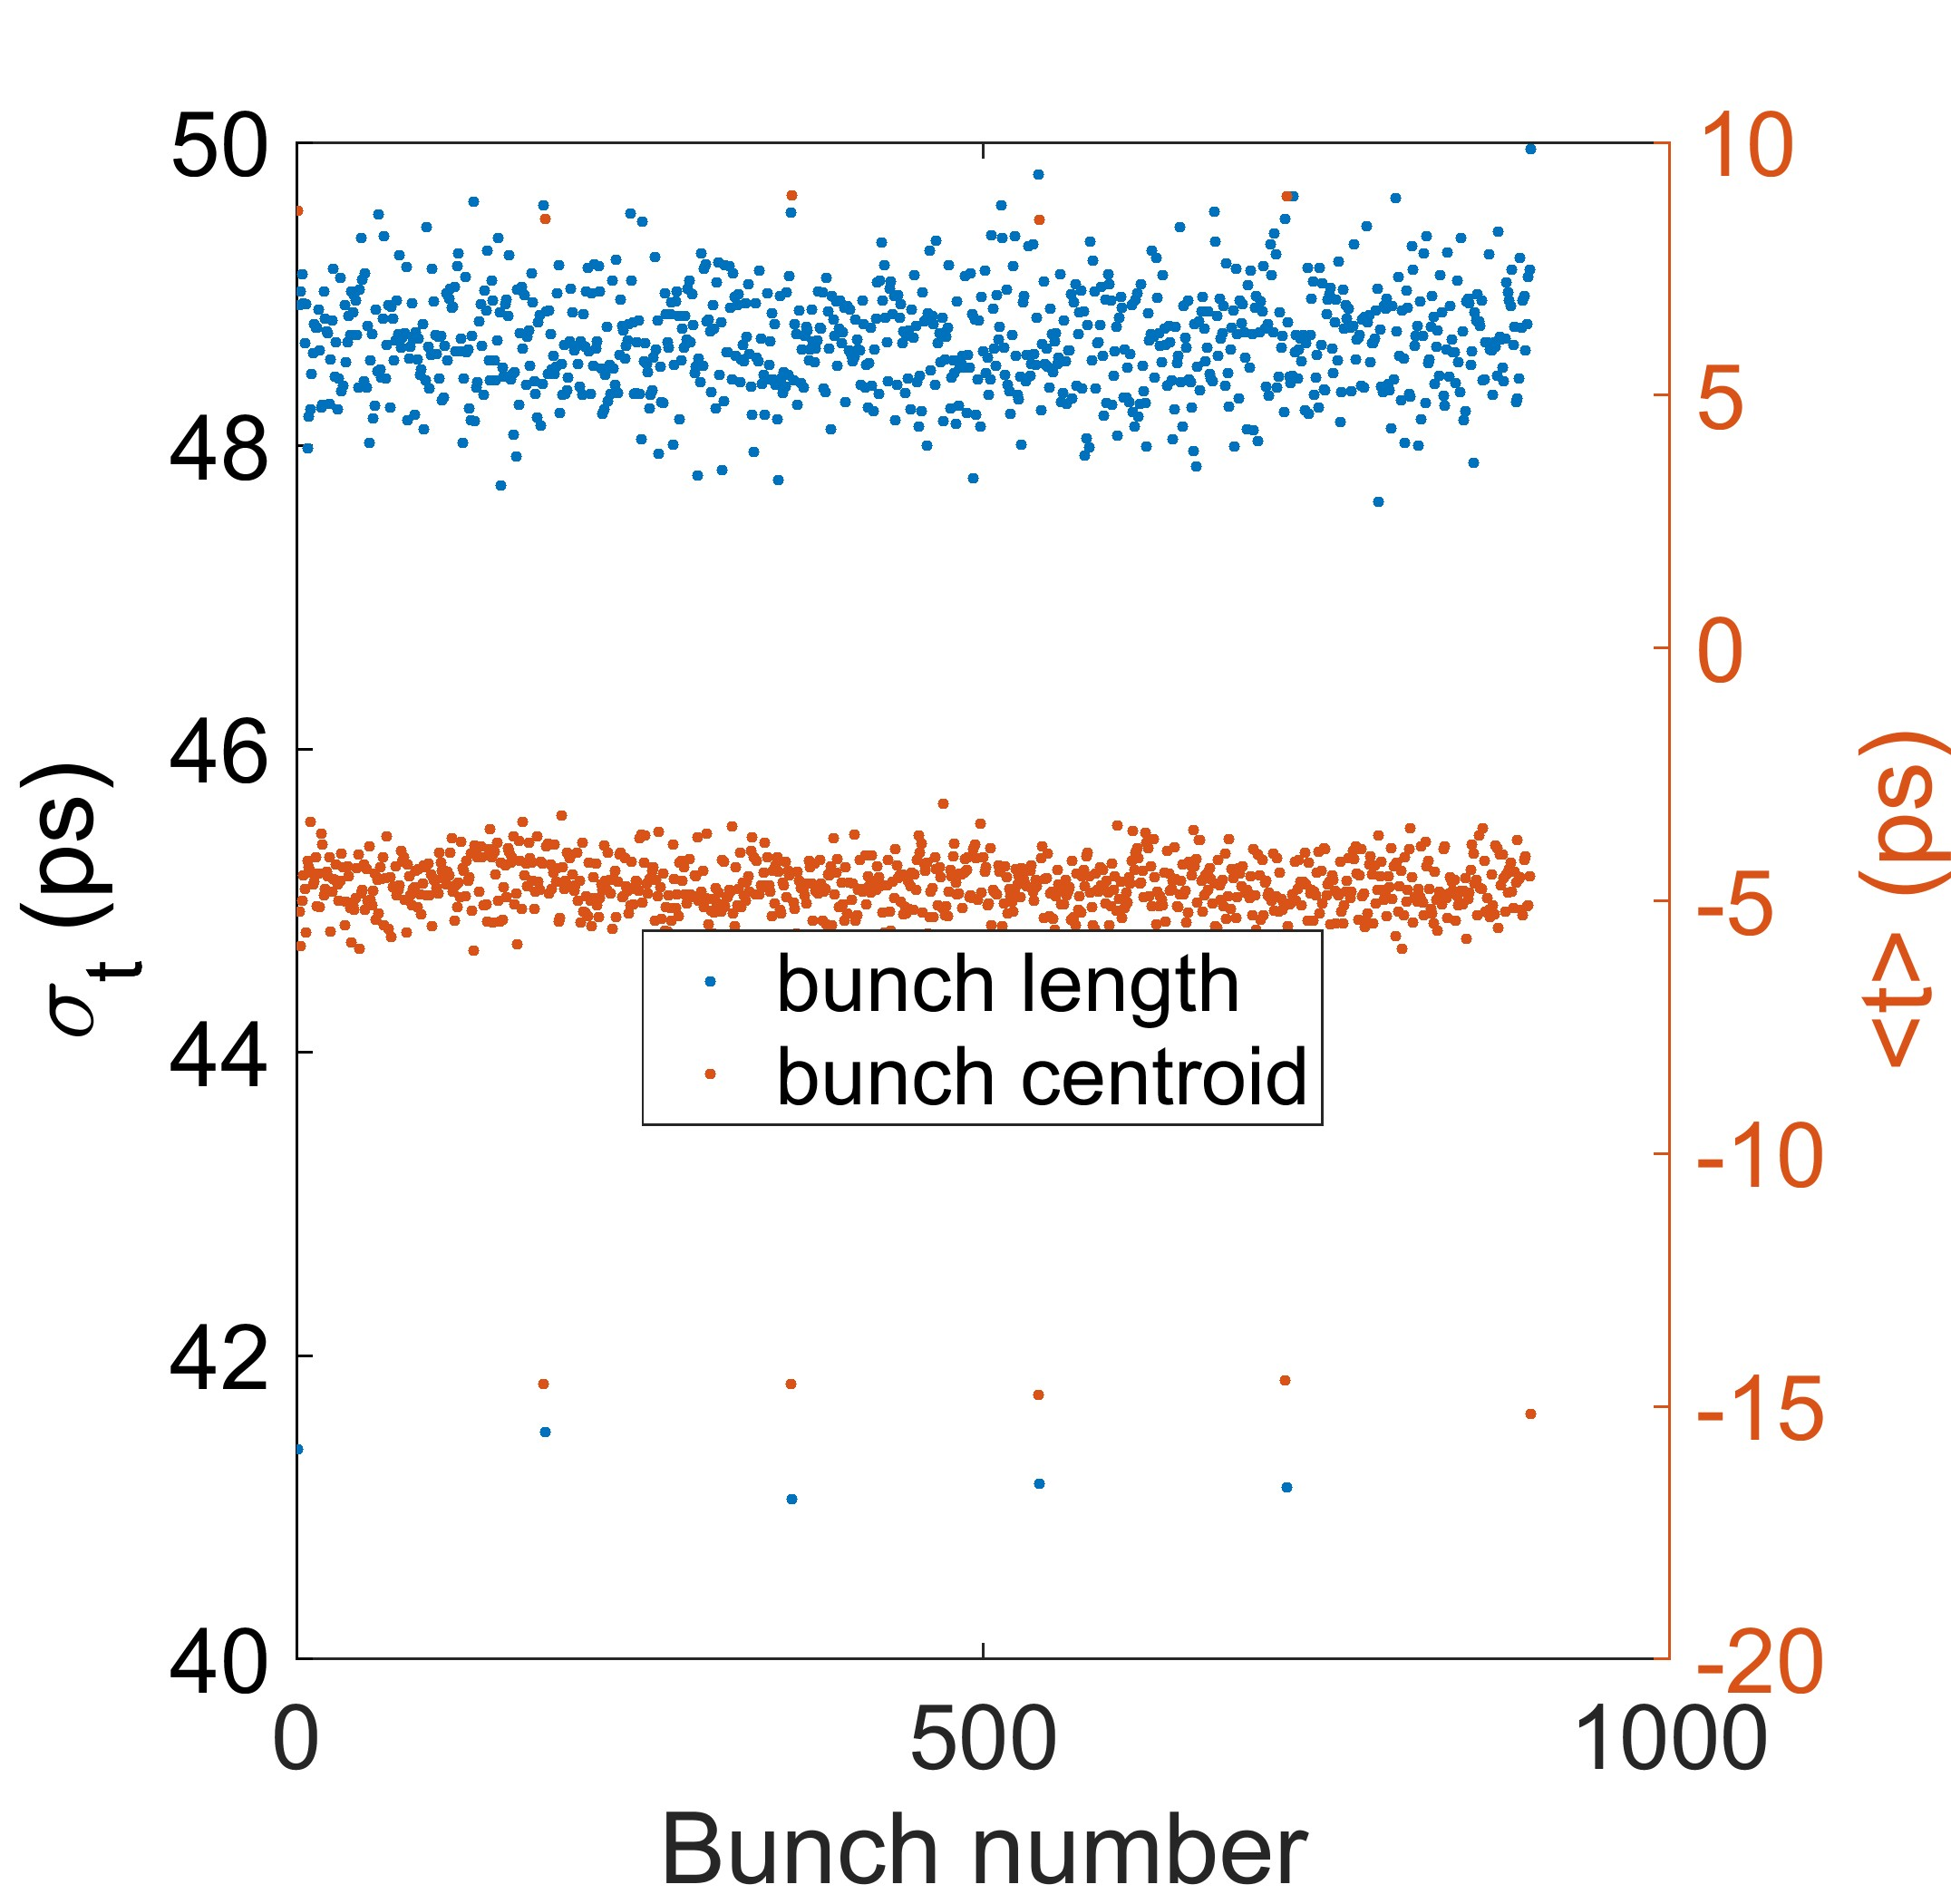
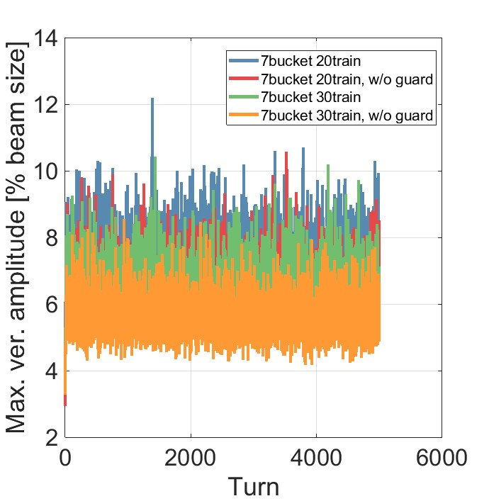
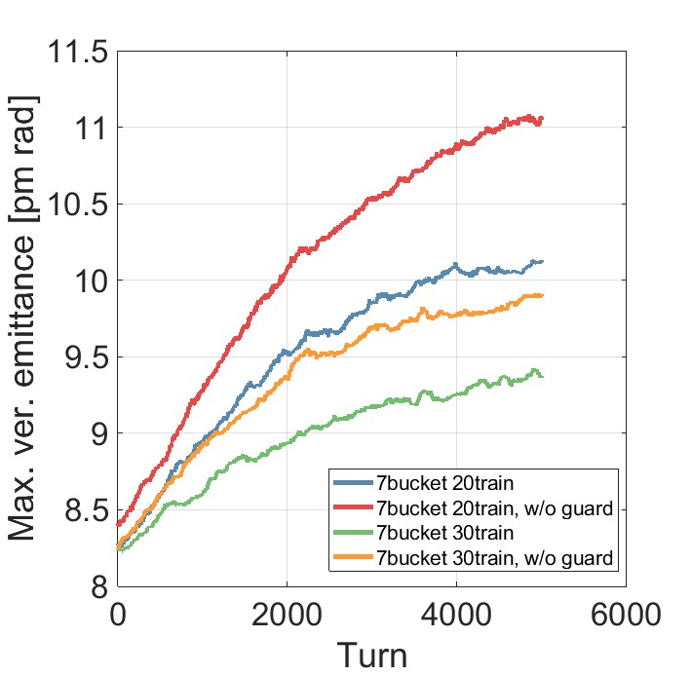
Diamond-II: Ongoing Accelerator Physics Studies
Magnet cross-talk studies
Beam transients due to passive SC harmonic RF cavity
Without guard bunches
With guard bunches
Drop in field
Electron beam vibration studies
Additional multipole field components in gaps
Ion-effects / vacuum conditioning schedule
Benchmarking in Diamond
S. Wang, DLS
Ian Martin, Light Sources, JAI AB, 27/03/2023

Slide 10
Diamond-II: Timeline
Nominal Timeline:
Project approval and start of funding July 2023
Start of dark period December 2027
Start of storage ring commissioning December 2028
First users on operational beamlines September 2029
Diamond-II project completes March 2030
Ian Martin, Light Sources, JAI AB, 27/03/2023

Slide 11
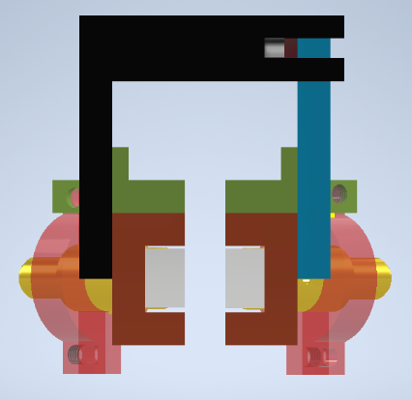
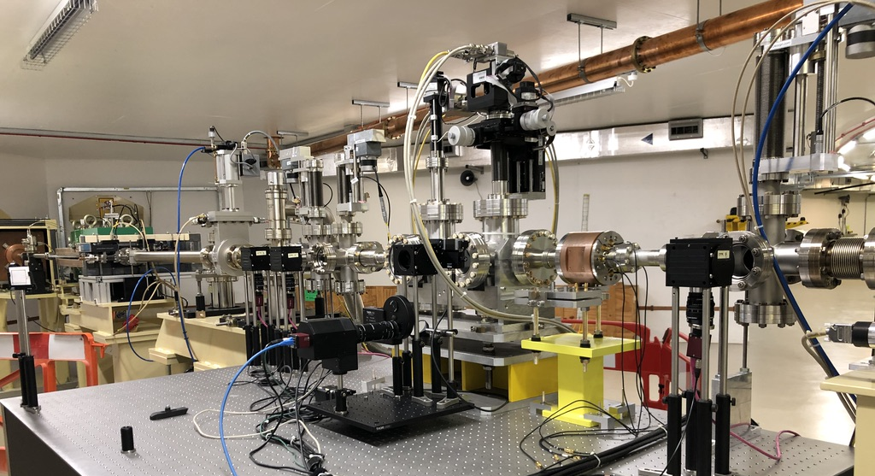
PhD Student: Alec Clapp (started 2021)
“Feasibility study on the use of incoherent Cherenkov Diffraction Radiation to develop a non-invasive BPM”
Cherenkov Diffraction Radiation (ChDR) is a type of polarisation radiation. It occurs when a charged particle moves in the vicinity a medium, with the photon yield dependent upon the distance between the charged particle and the dielectric medium.
New dual pick-up design using two targets, collimators and fibre optics is underway:
  Electron beam passes between targets (going into the page denoted by X)
  ChDR is emitted by target and collected by collimators
  Light is propagated out of vacuum by fibre optic feedthroughs and PMT (replaces previous imaging system using traditional optics)
First step towards demonstration of a 1D BPM
BTS Test Stand
Supervisors: P. Karataev and L. Bobb
Ian Martin, Light Sources, JAI AB, 27/03/2023

Slide 12
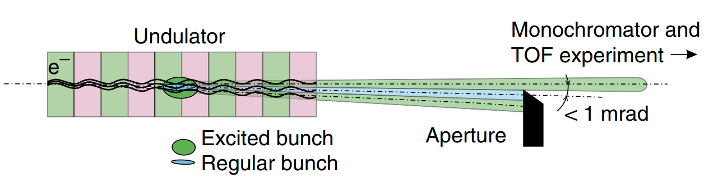
D.Phil. Student: Juan Martinez Wilkes (Started 2021)
“Investigating Provision for Timing Mode Users at Diamond-II”
Context:
Timing mode users care about temporal properties of photon beams
    Represent ~O(1%) of users
Various methods already successfully implemented at other synchrotron radiation facilities
Difference is Diamond-II has a passive harmonic cavity
    Ran Elegant simulations which quantified reduction in multi-bunch feedback effect
Increasingly, sensor technology able to resolve down to individual bunches
    Means that some of these light separation modes not needed; maybe enough to investigate a special harmonic cavity-free set up?
Simplest method ‘Pulse-Picking by Resonant Excitation’ is being investigated
    Changed the multi-bunch feedback excitation gain and imaged the beam during an experiment
Pulse-Picking by Resonant Excitation
K. Holldack , Nat Comm, 5 4010
Supervisors: P. Burrows and I. Martin
Ian Martin, Light Sources, JAI AB, 27/03/2023

Slide 13
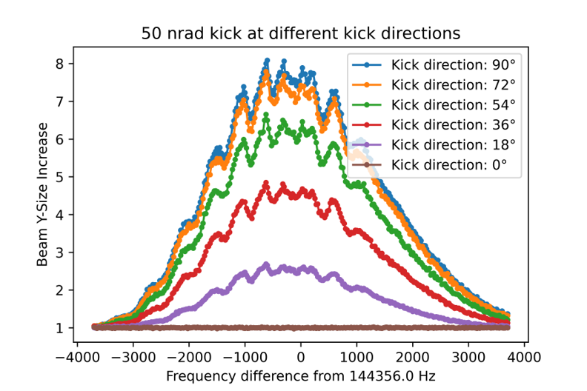
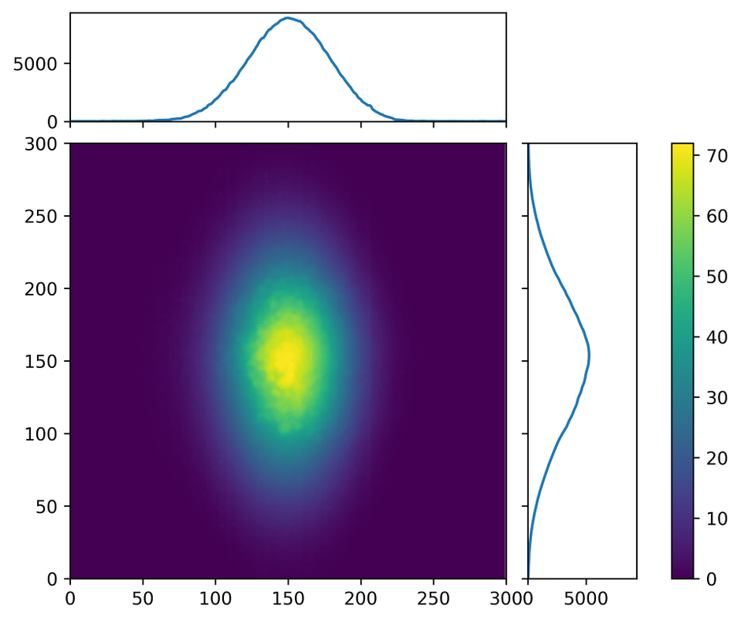
D.Phil. Student: Juan Martinez Wilkes (Started 2021)
“Investigating Provision for Timing Mode Users at Diamond-II”
Simulated vertical beam size increase at Diamond-II as a function of excitation frequency
Increased vertical beam size at Diamond as seen on x-ray pinhole camera
Projection
Pixel value
[Elegant simulation with Passive Harmonic Cavity]
Y pixels
X pixels
Projection
Supervisors: P. Burrows and I. Martin
Ian Martin, Light Sources, JAI AB, 27/03/2023

Slide 14
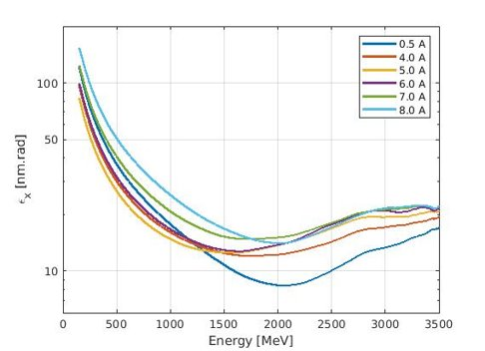
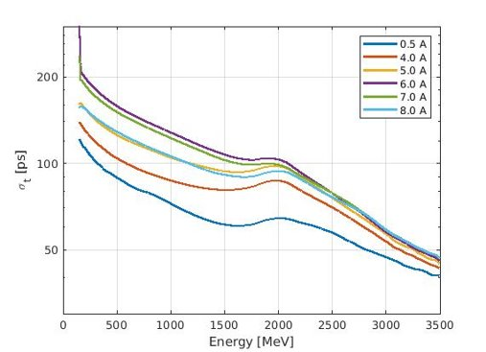
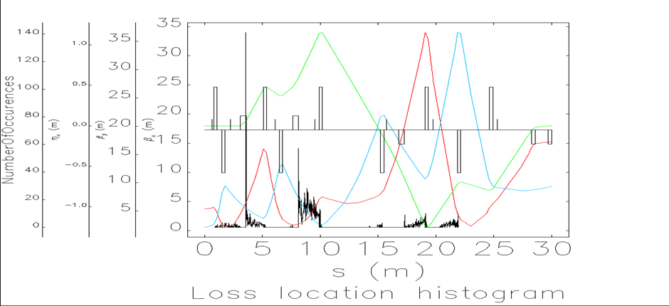
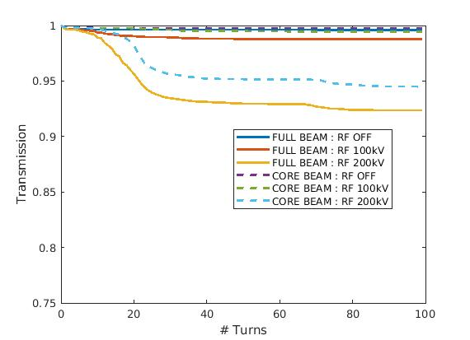
Oxford / DLS PDRA: Riyasat Husain
Joint appointment for a PDRA created between Oxford University and Diamond Light Source Feb 2023 to Feb 2024 with potential to extend for extra 12 months
Main topic of study is the Diamond-II injector performance, concentrating on studying the impact of collective effects during the booster ramp as a function of bunch charge and injection energy
Emittance during ramp
Bunch length during ramp
Bunch structure out of linac
Losses in transfer line
Booster capture efficiency
Large energy tails
Losses at high dispersion points
S-band linac bunchlets
500 MHz booster RF bucket
Supervisors: P. Burrows and I. Martin
Ian Martin, Light Sources, JAI AB, 27/03/2023

Slide 15
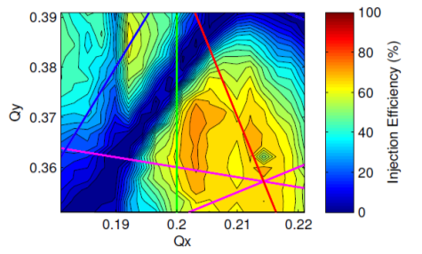
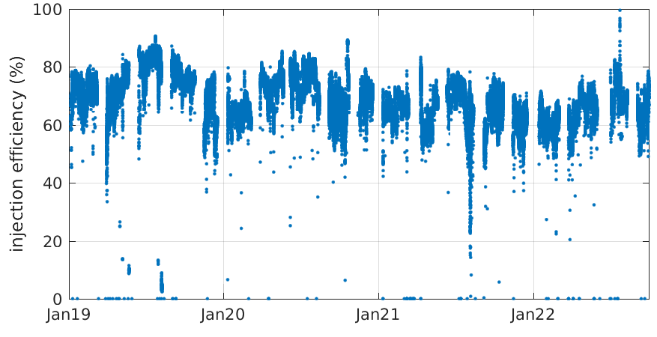
New Studentship: Shaun Preston (starts Sept. 2023)
“Application of Machine Learning Techniques for Online Optimisation of Synchrotron Light Sources”
Joint appointment between Oxford JAI and Ada Lovelace Centre, hosted by Diamond
Ada Lovelace Centre newly formed cross-disciplinary data intensive science centre at RAL for better exploitation of research carried out at large-scale national facilities (including Diamond, ISIS, CLF, Culham, …)
Can provide support and expertise on range of topics (imaging and reconstruction, modelling for data interpretation, machine learning, data management and analysis, automation)
Primary goals:
Demonstrate improved performance and / or stability of Diamond
Build tools, techniques, knowledge, experience and collaboration networks in field of ML
Acquire the tools and experience to assist in the commissioning and early operation of Diamond-II
Injection efficiency changes with ID gap
Project outline:
Research, test and apply ML techniques to improve understanding / optimise the performance of the Diamond Accelerators
Seasonal drift in injection efficiency
Supervisors: P. Burrows and I. Martin
Ian Martin, Light Sources, JAI AB, 27/03/2023

Slide 16
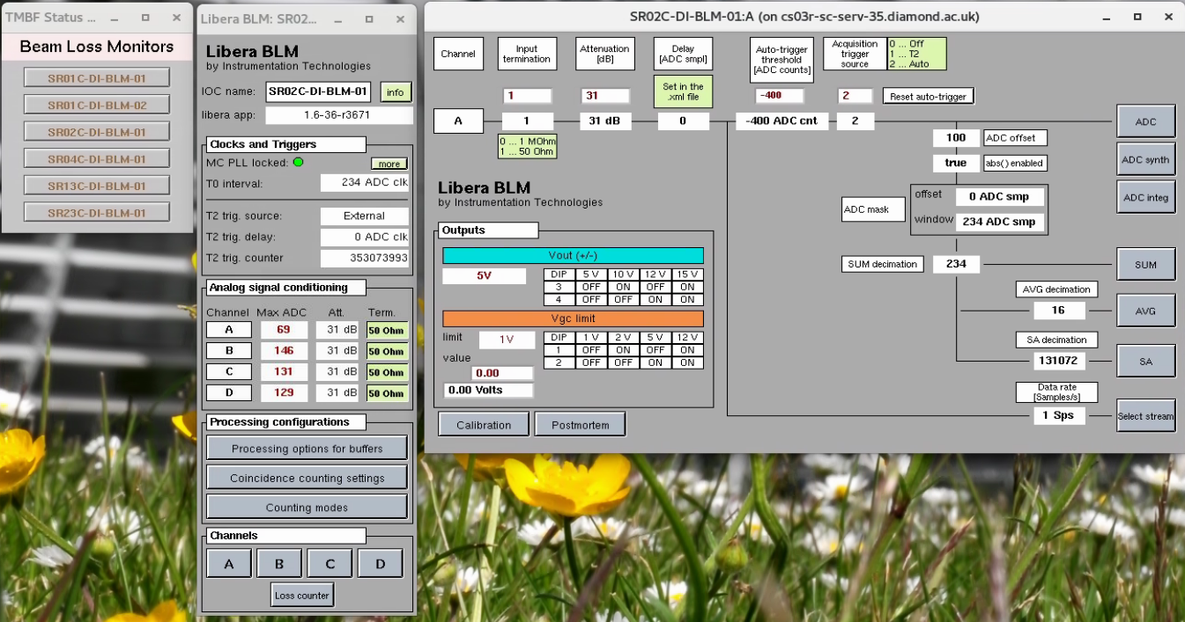
New Studentship: Corey Lehmann (starts Sept. 2023)
“Fast Beam Loss Monitor System for Diamond-II and Machine Learning Applications”
Joint appointment between Oxford JAI and Diamond Light Source
Project outline:
  Commission a fast BLM system enabling slow and fast loss monitoring at Diamond in preparation for Diamond-II
  Explore ML applications using the new data available from the fast BLMs for fault detection.
Primary goals:
  Commission fast BLMs on the storage ring at Diamond
  Evaluation of new EPICS tools for fast BLMs in preparation for Diamond-II
  Conduct review of machine learning techniques applicable for beam loss data and fault detection
  Demonstrate the proof-of-principle application of a suitable ML algorithm to fast BLMs
  Document and/or publish findings as appropriate
Existing Fast BLMs on Diamond
Supervisors: P. Burrows and L. Bobb
Ian Martin, Light Sources, JAI AB, 27/03/2023

Slide 17
Conclusions
JAI continues to be active in a number of areas of light source design and operation:
Facility design
Enhanced performance / special operating modes
Photon / electron beam diagnostics
Providing training and expertise for next generation of accelerator physicists:
PhD Studentships started September 2021 (RHUL and Oxford)
Joint Diamond / JAI PDRA working on Diamond-II
Two new studentships to begin in September 2023
Updates from previous students:
Dan Harryman (PhD at RHUL) – “Cherenkov Diffraction Radiation to develop a non-invasive BPM”
      Viva August 2022, final submission November 2022
      Now working as Electrical Engineer on diagnostic systems at Tokomak Energy Ltd, Milton
Ian Martin, Light Sources, JAI AB, 27/03/2023

