Slide 1

Intense Hadron Beams @ RAL
Rob Williamson
With thanks to John Thomason, Dean Adams, Shinji Machida and many others at ISIS
JAI Advisory Board 2023
27th March 2023

Slide 2
Contents
Introduction to ISIS
High-Intensity Hadron R&D at ISIS
ISIS-II Megawatt Upgrade
IBEX

Slide 4
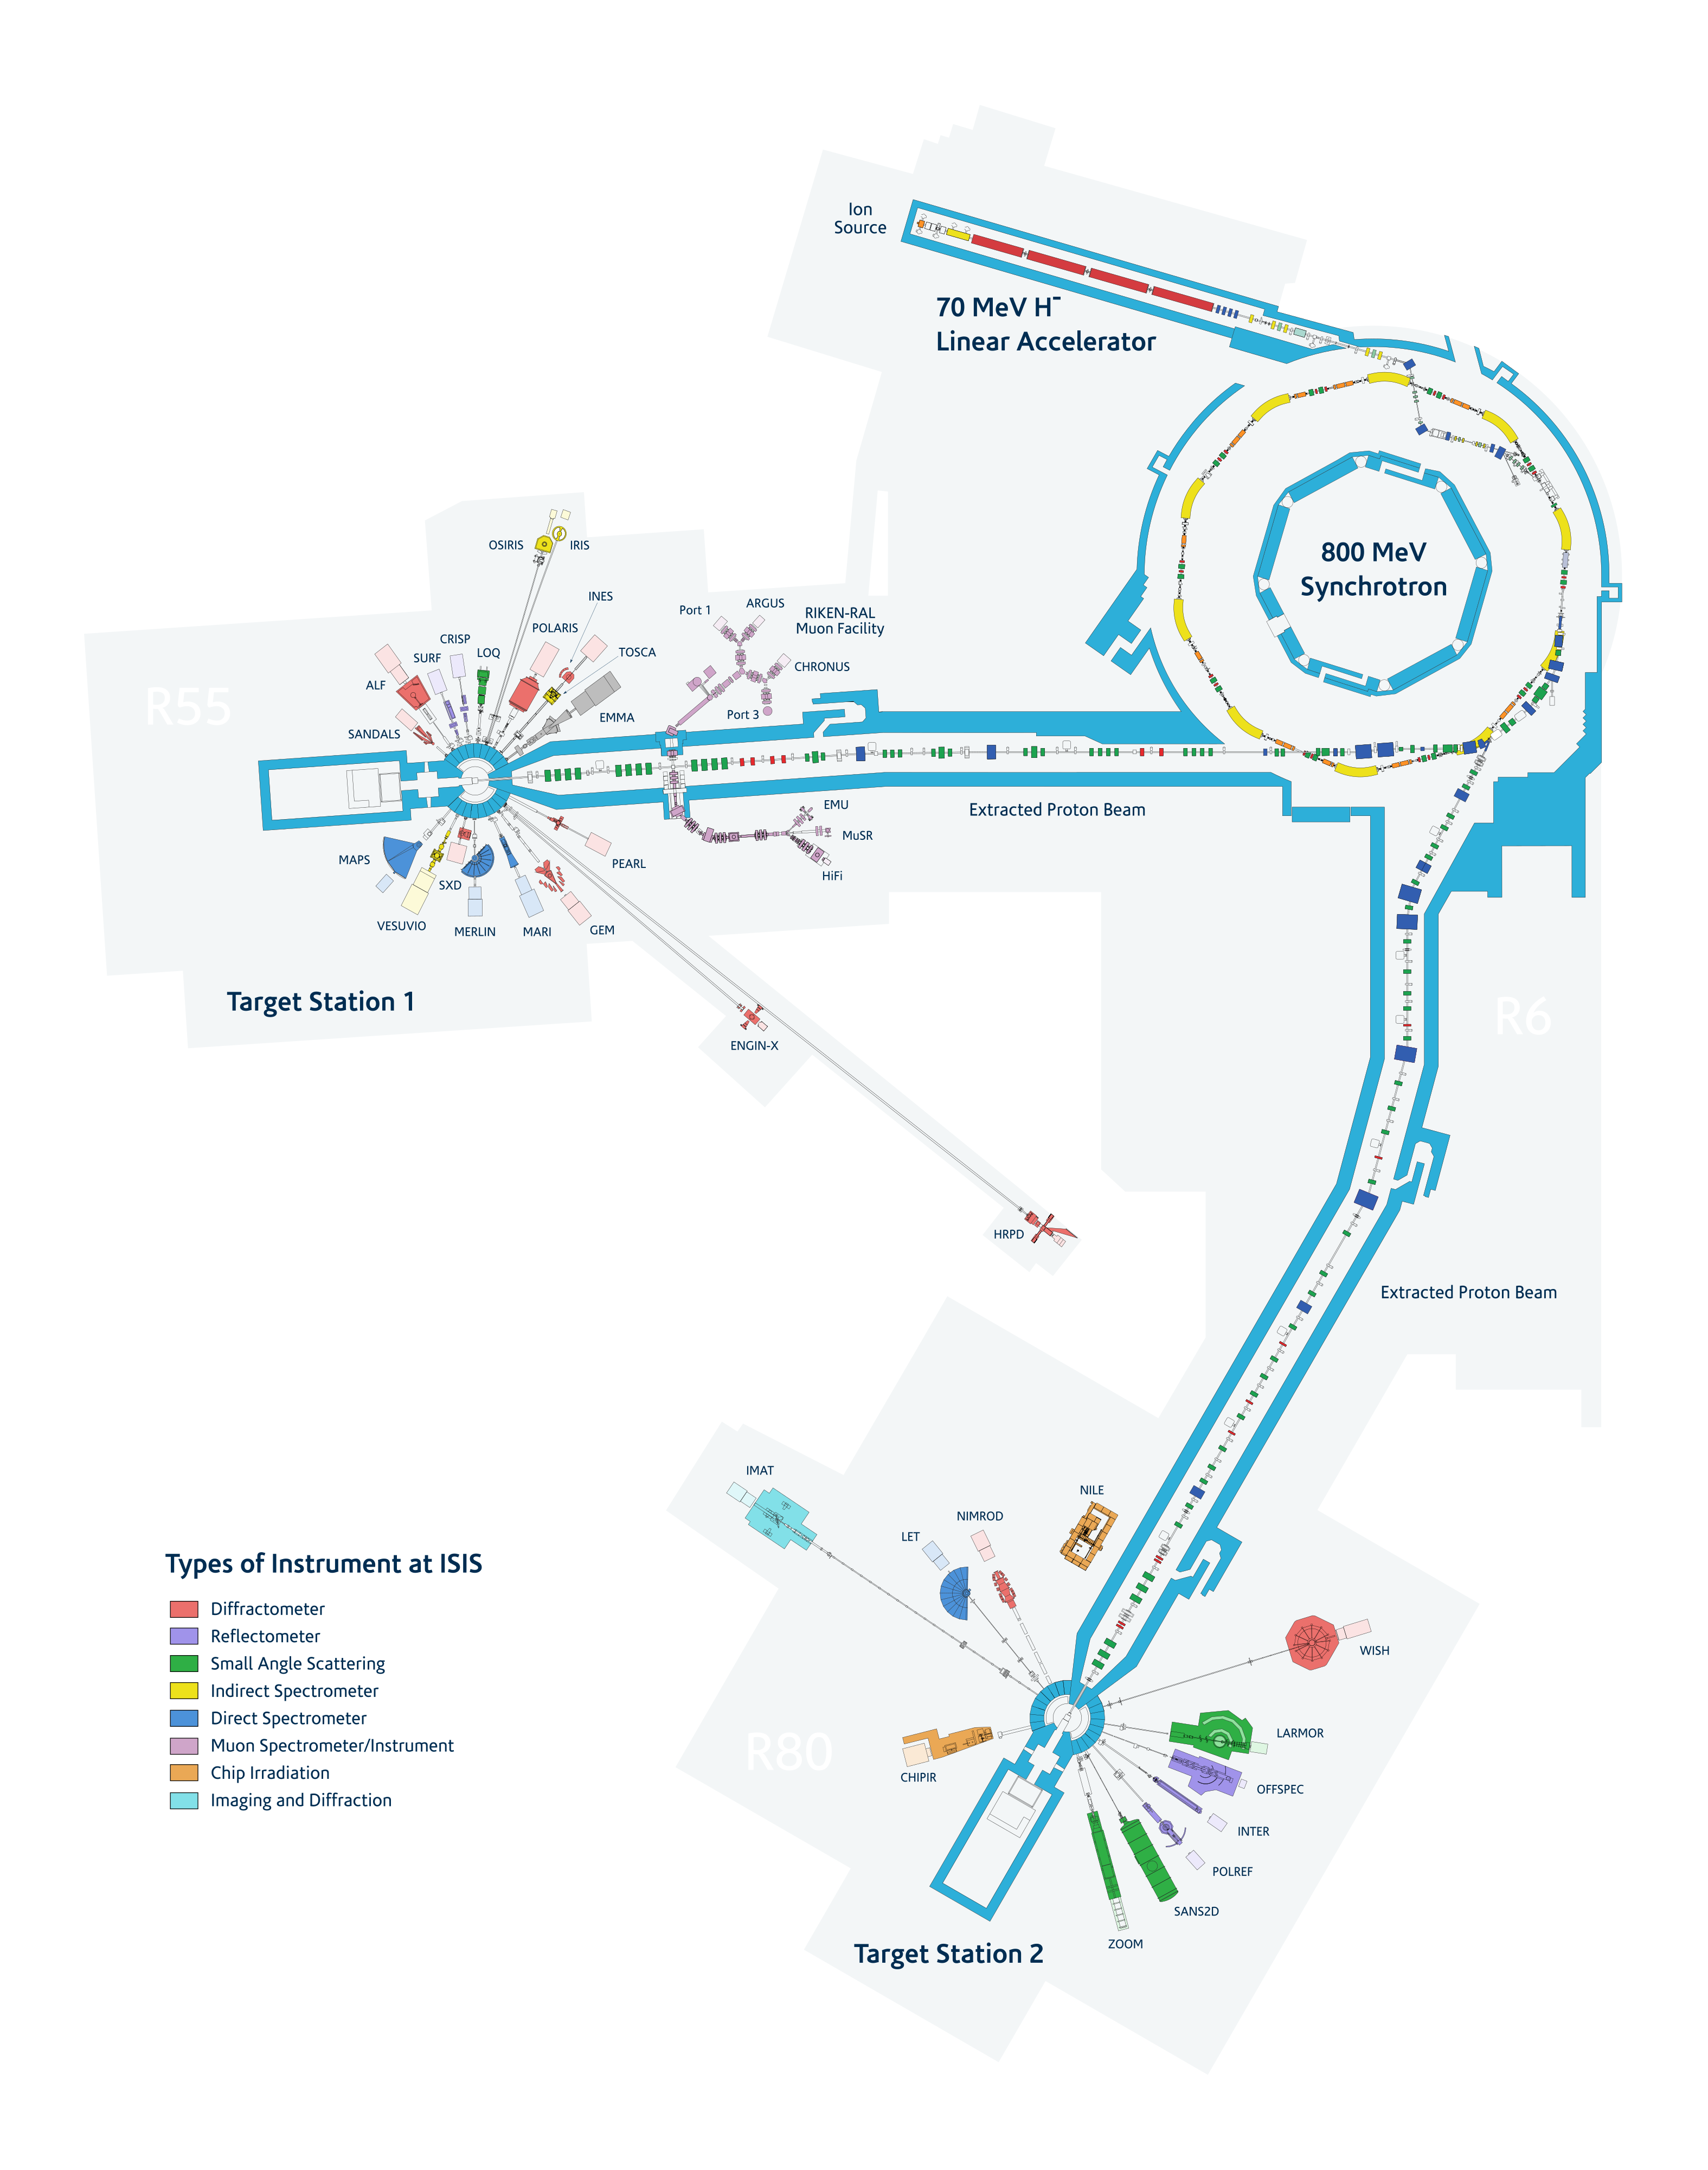

H- Ion source
RFQ & DTL
Rapid Cycling
Synchrotron
Target Stations

Slide 5
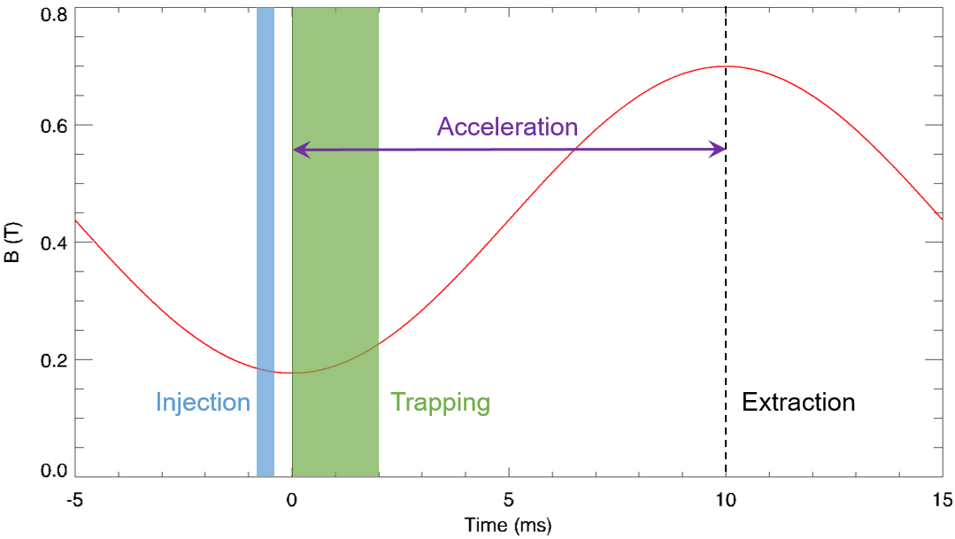
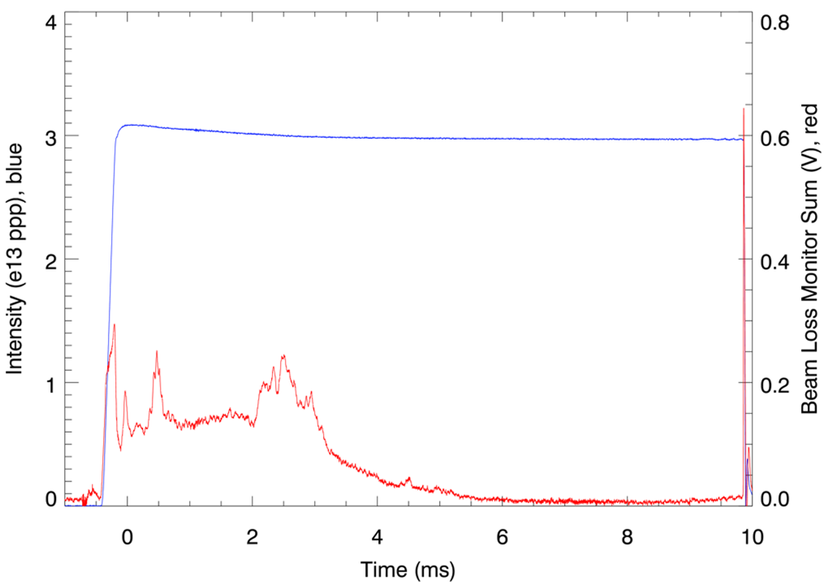
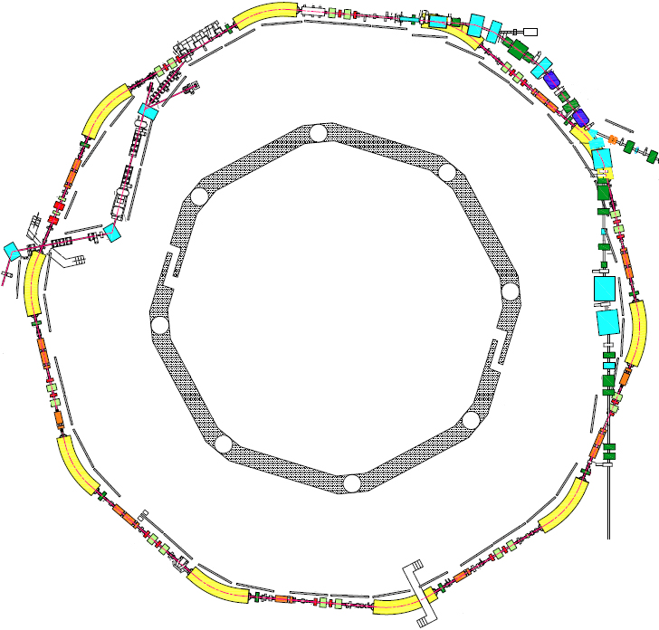
ISIS Parameters
Circumference: 163 m
Energy: 70–800 MeV
Repetition Rate: 50 Hz
Intensity: ~3x10¹³ ppp
Power: ~190 kW
Injection: 220 µs, 130 turn, charge exchange
Extraction: single turn, vertical
Betatron Tunes: (Q_{x}, Q_{y}) = (4.31, 3.83), programmable
Beam-Losses: Injection: 2%, Trapping: <3%,
Acceleration/Extraction: <0.5%
RF System: h=2, 1.3-3.1 MHz, 160 kV/turn
h=4, 2.6-6.2 MHz, 80 KV/turn
Extraction
Injection

Slide 6
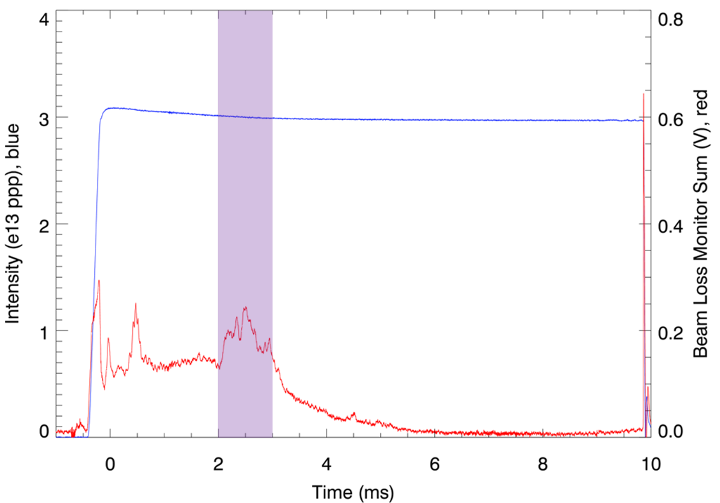
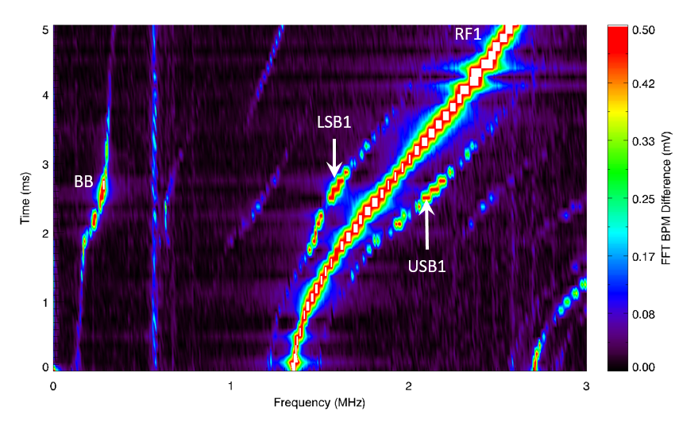
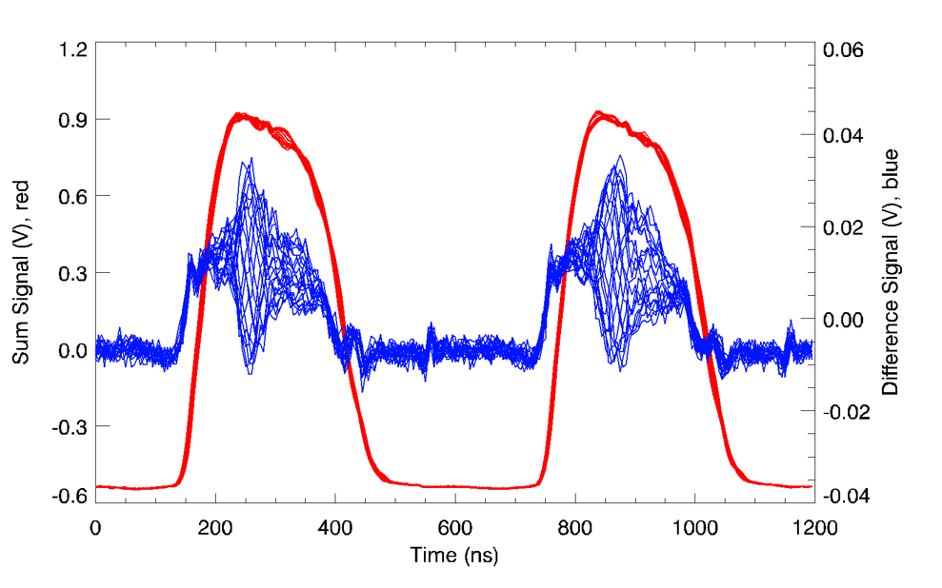
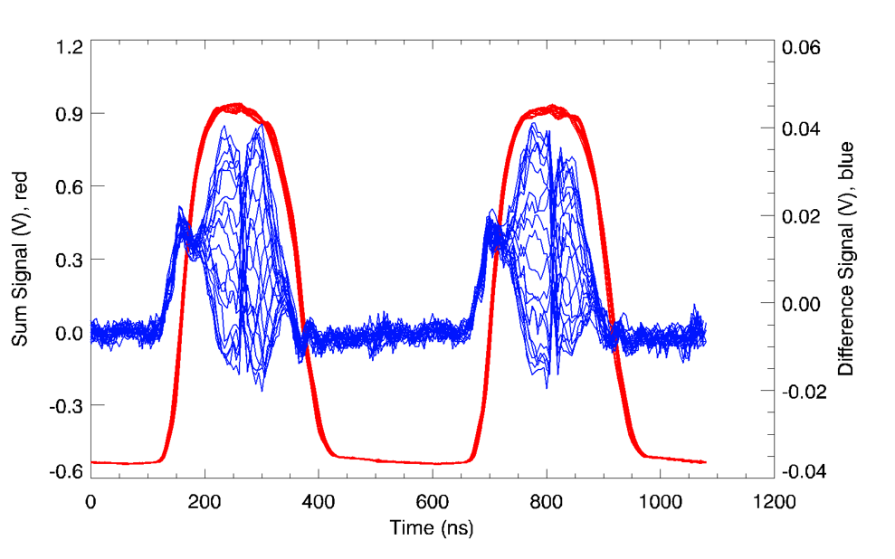
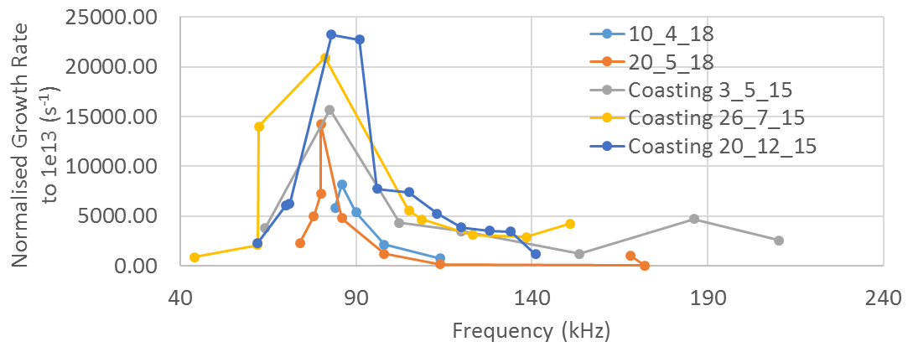
High-Intensity Hadron R&D @ ISIS –
Instabilities – Rob Williamson
(P/T JAI student and lecturer)
Betatron sidebands
Time (ms)
A key intensity limit on ISIS – beam-loss
Coherent, vertical, head-tail instability
Observed 1 – 2.5 ms through acceleration
Sinusoidal intrabunch mode structure with zero or one node
Likely driven by low-frequency impedance
  Resistive wall
  Narrowband resonator
Growth rates of 0.2 – 0.6 ms
Mitigated using:
  Vertical tune
  Longitudinal bunch shape
  Injection painting
Frequency (MHz)
BPM signals @ 2.0 and 2.6 ms

Slide 7
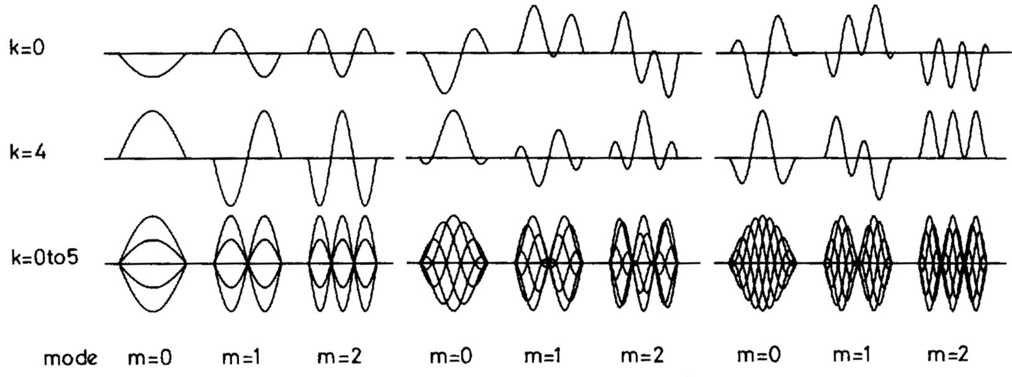
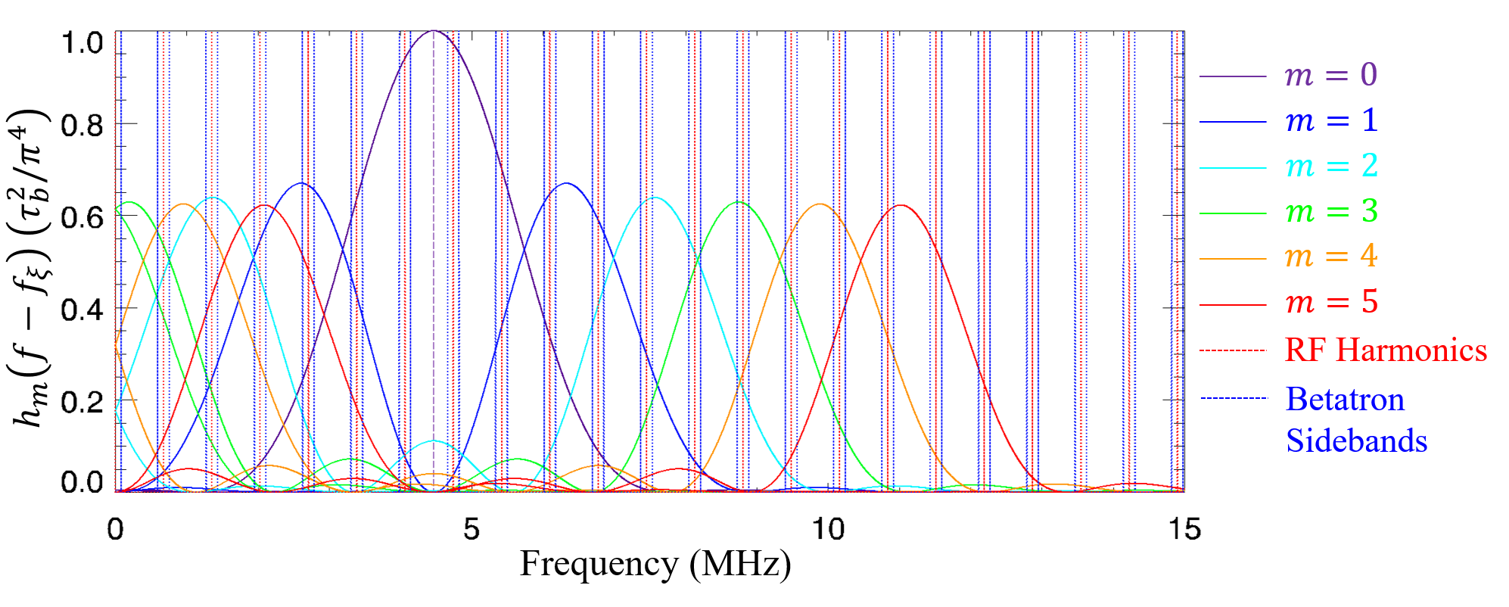
High-Intensity Hadron R&D @ ISIS –
Instabilities – Rob Williamson
(P/T JAI student and lecturer)
Experimental Setup and Theory
Sinusoidal Modes
Design & utilise new mode of operation – Bunched Storage Ring Mode
  Reduce complexity
  Finer control of beam and lattice parameters
  Enables more direct comparison with theory
Characterise instability
  Intrabunch mode structure
  Bunch frequency content
  Growth rate dependence
Systematic exploration of the head-tail instability as a function of
  Vertical tune
  Initial vertical beam size
Compare with theoretical predictions
Increasing chromaticity
Betatron Sideband Envelope

Slide 8
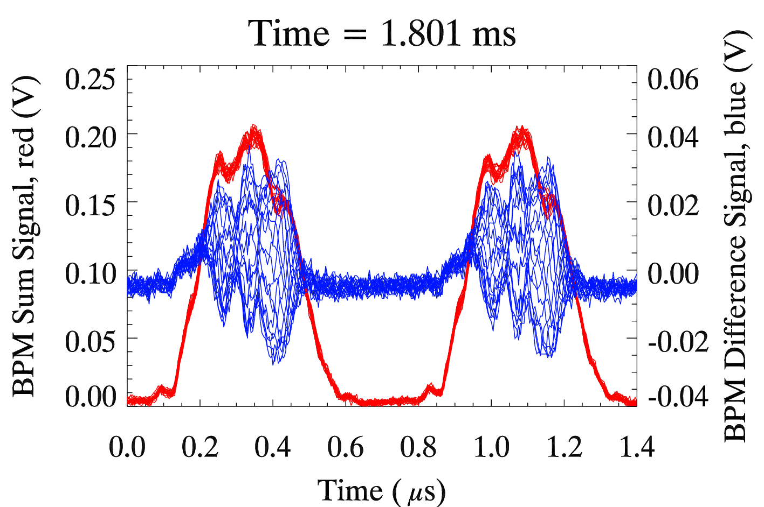
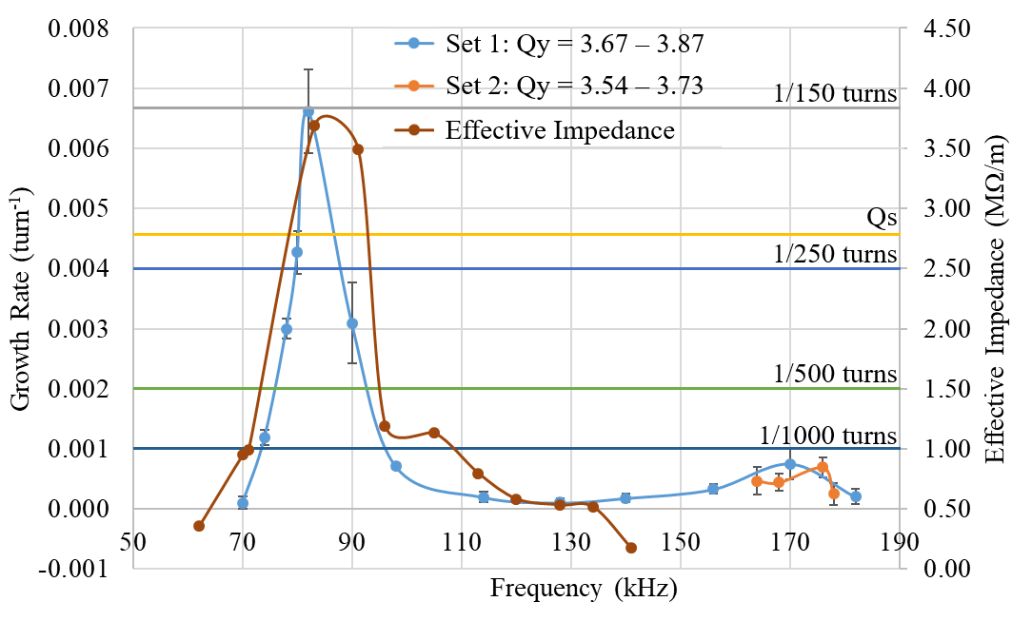
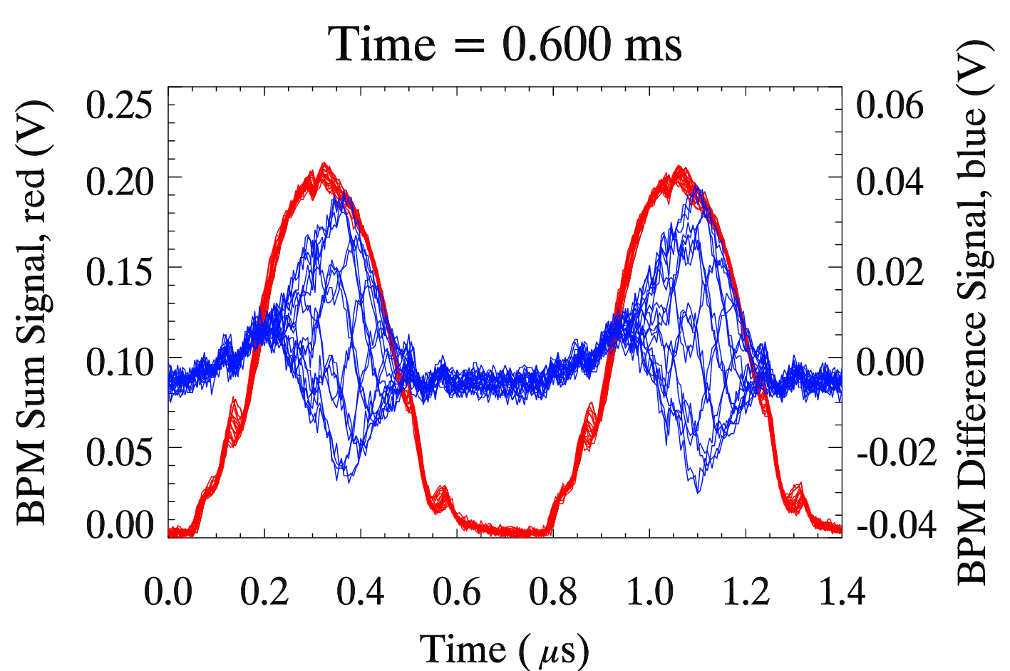

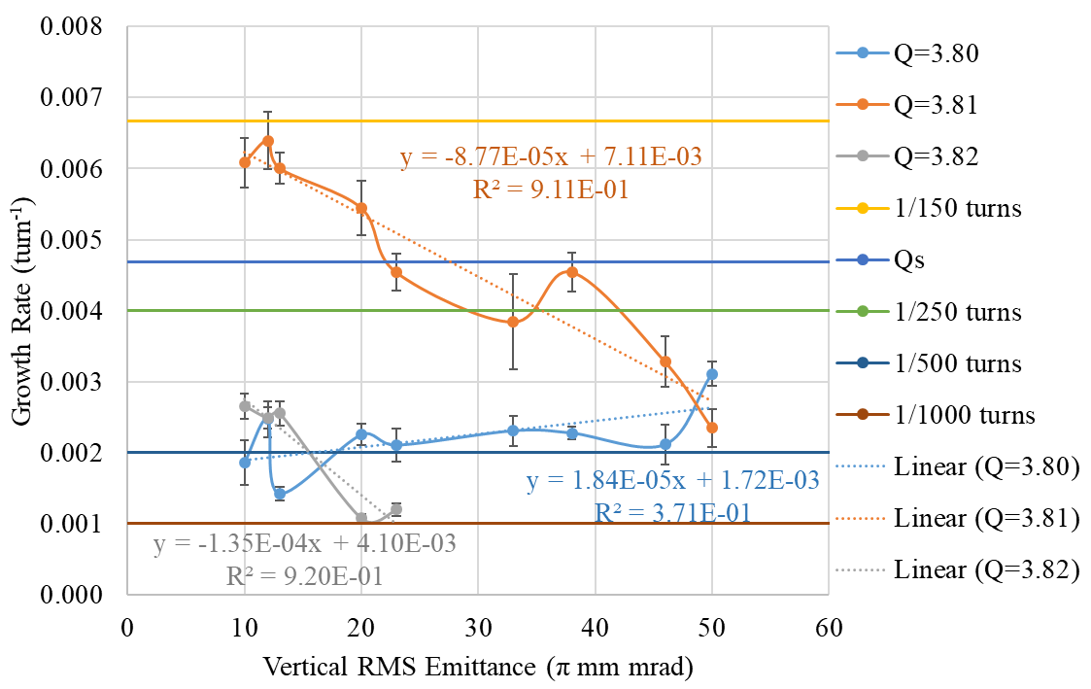
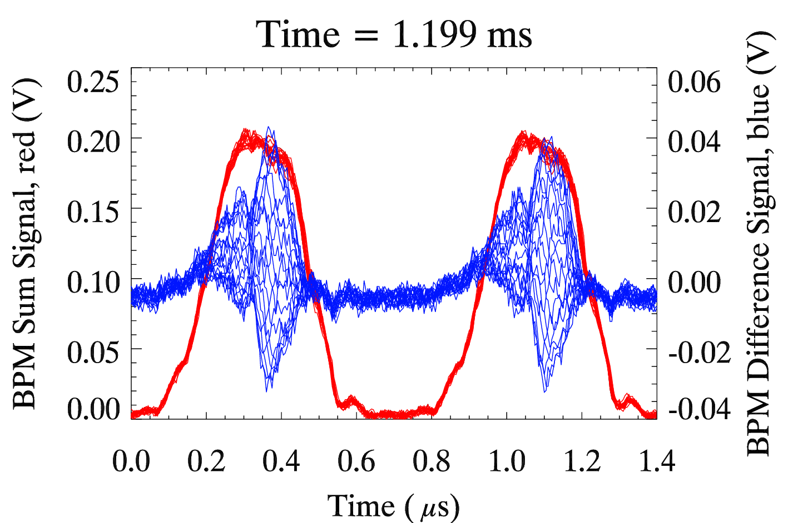

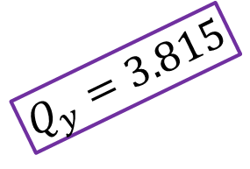
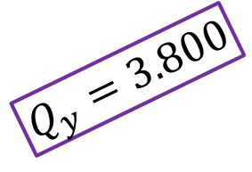
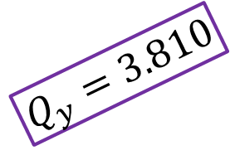
High-Intensity Hadron R&D @ ISIS –
Instabilities – Rob Williamson
(P/T JAI student and lecturer)
Experimental Results
$$Q_{y}=3.800$$
Theoretical Expectation:
Dominant mode m = 3 with possible m = 2 or 4
Mode independent of vertical tune
Full bunch length oscillates vertically
Growth rate is dependent on the vertical tune
Growth rate is independent of vertical beam size
$$Q_{y}=3.810$$
Observations:
Modes m = 0, 1 and 2 observed
Mode dependent on vertical tune
Effective bunch length – only a fraction of the bunch length is unstable
Growth rate is dependent on the vertical tune
Growth rate is dependent of vertical beam size
$$Q_{y}=3.815$$

Slide 9
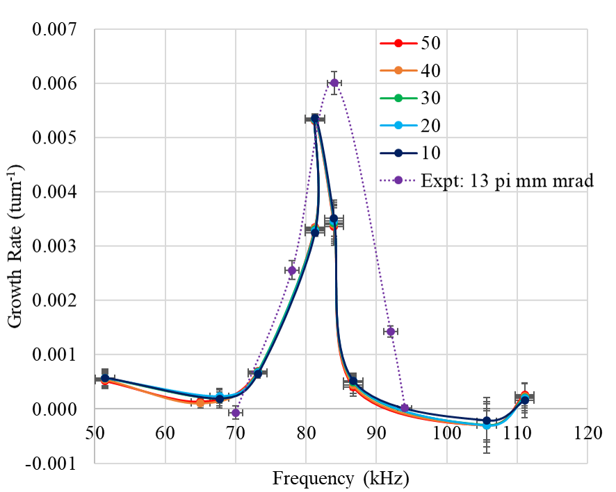
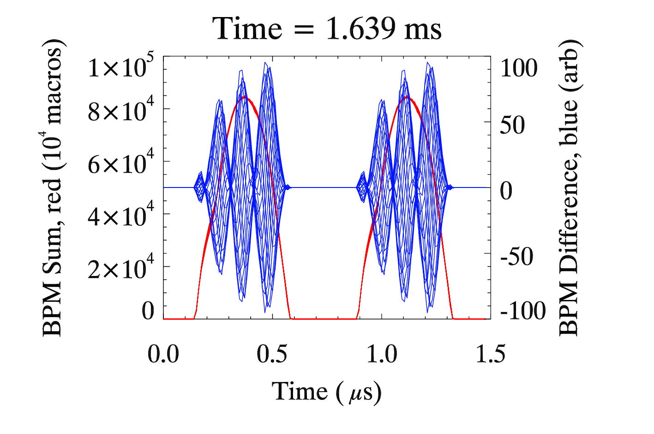
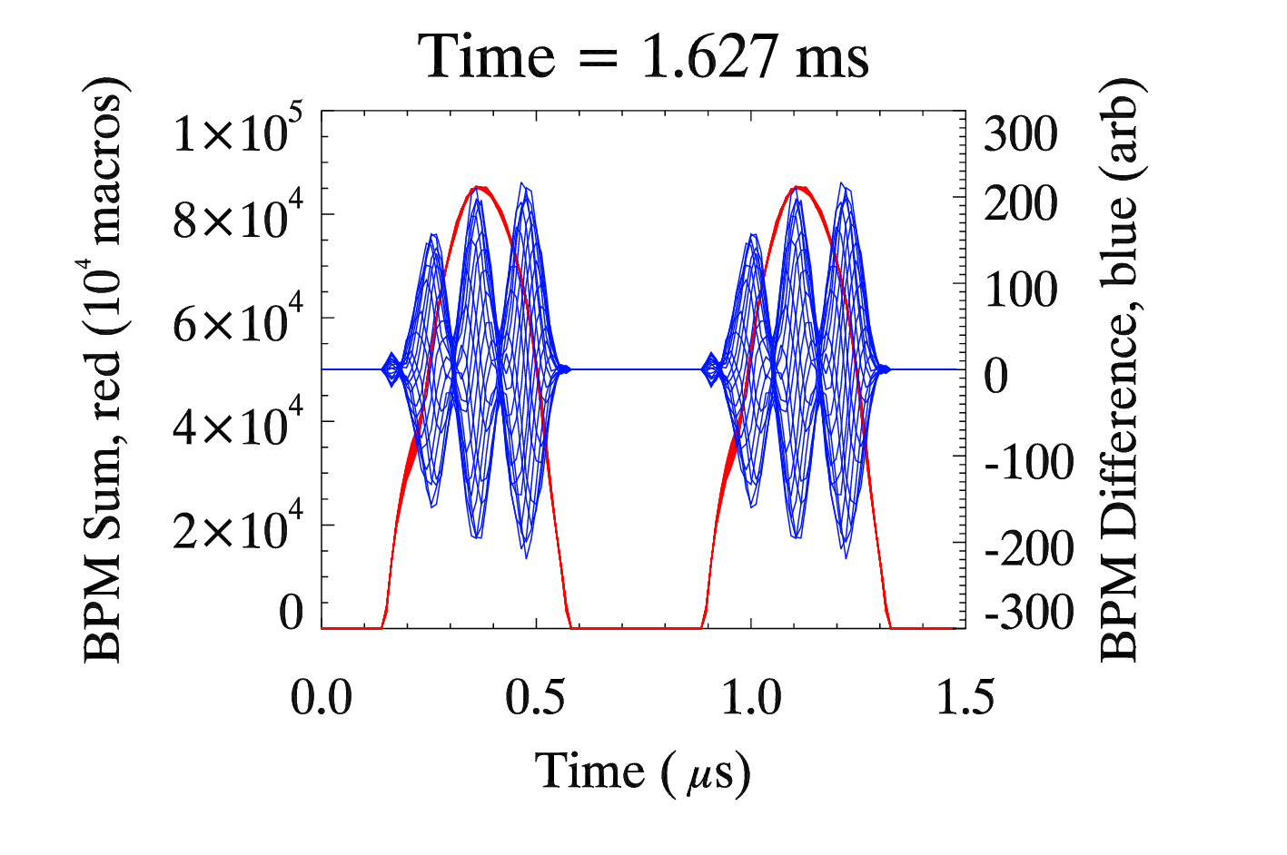
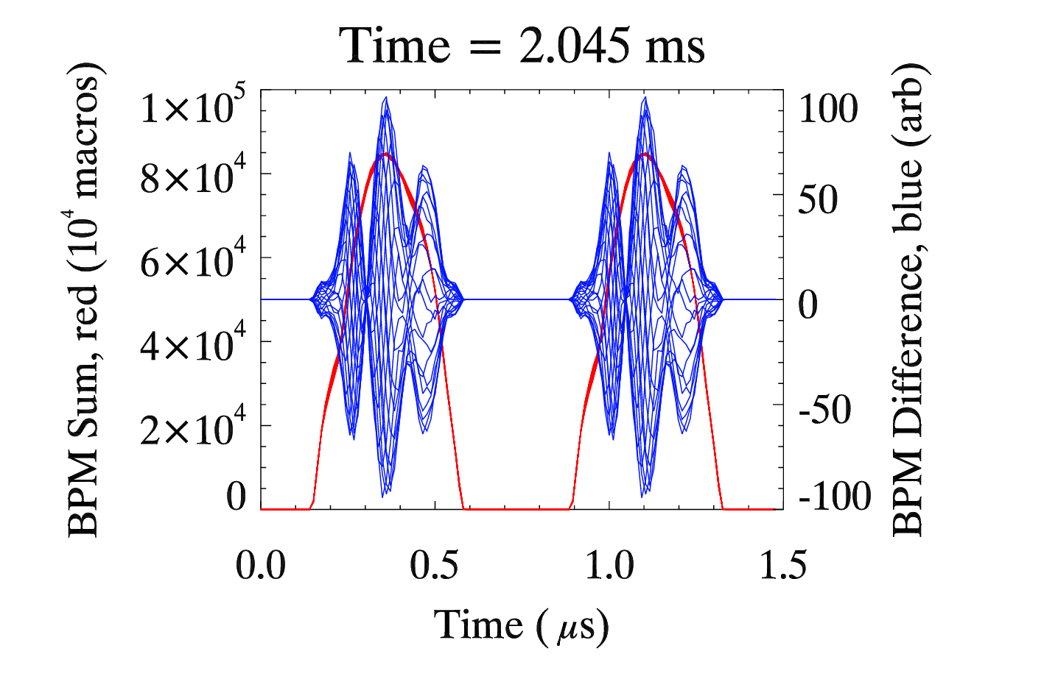
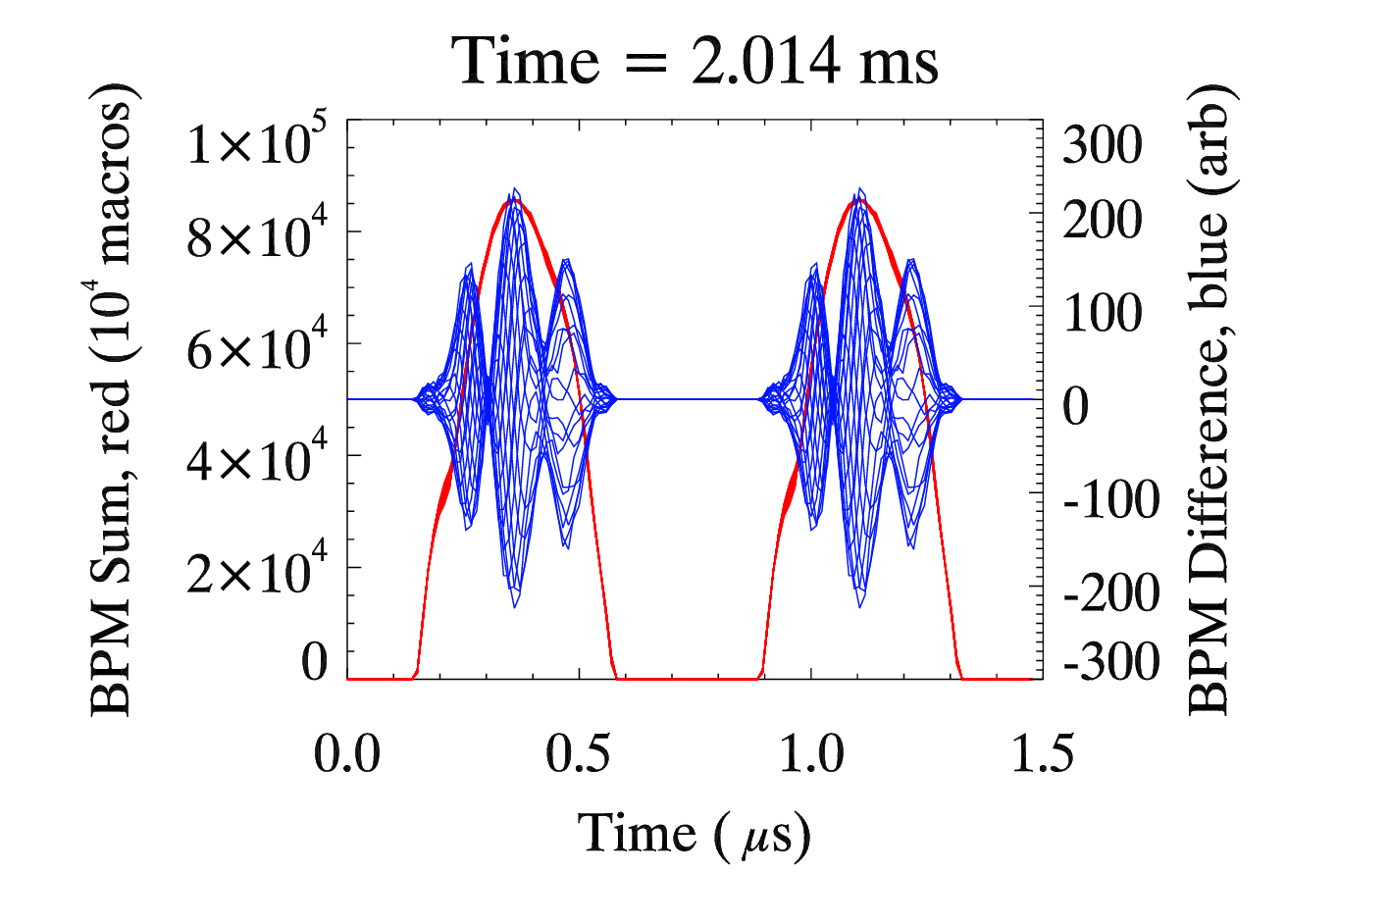
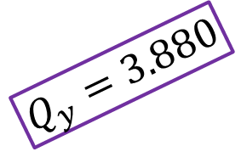
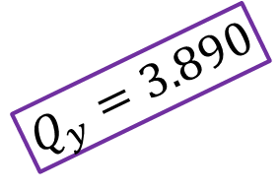
High-Intensity Hadron R&D @ ISIS –
Instabilities – Rob Williamson
(P/T JAI student and lecturer)
Simulations without Space Charge
10 π mm mrad
50 π mm mrad
Theoretical Expectation:
Dominant mode m = 3 with possible m = 2 or 4
Mode independent of vertical tune
Full bunch length oscillates vertically
Growth rate is dependent on the vertical tune
Growth rate is independent of vertical beam size
$$Q_{y}=3.880$$
Observations:
Modes m = 2 and 3 observed
Mode slightly dependent on vertical tune
Full bunch length oscillates
Growth rate is dependent on the vertical tune
Growth rate is independent of vertical beam size
$$Q_{y}=3.890$$

Slide 10
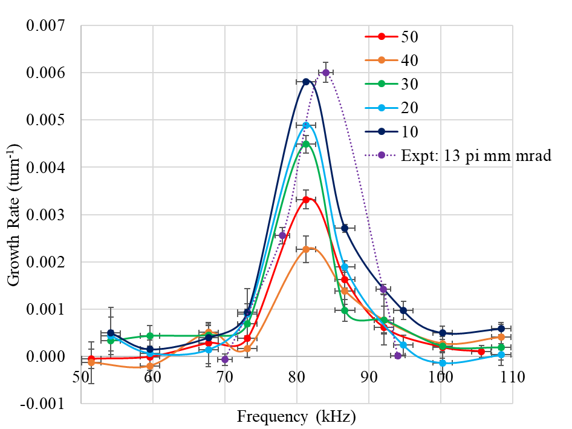
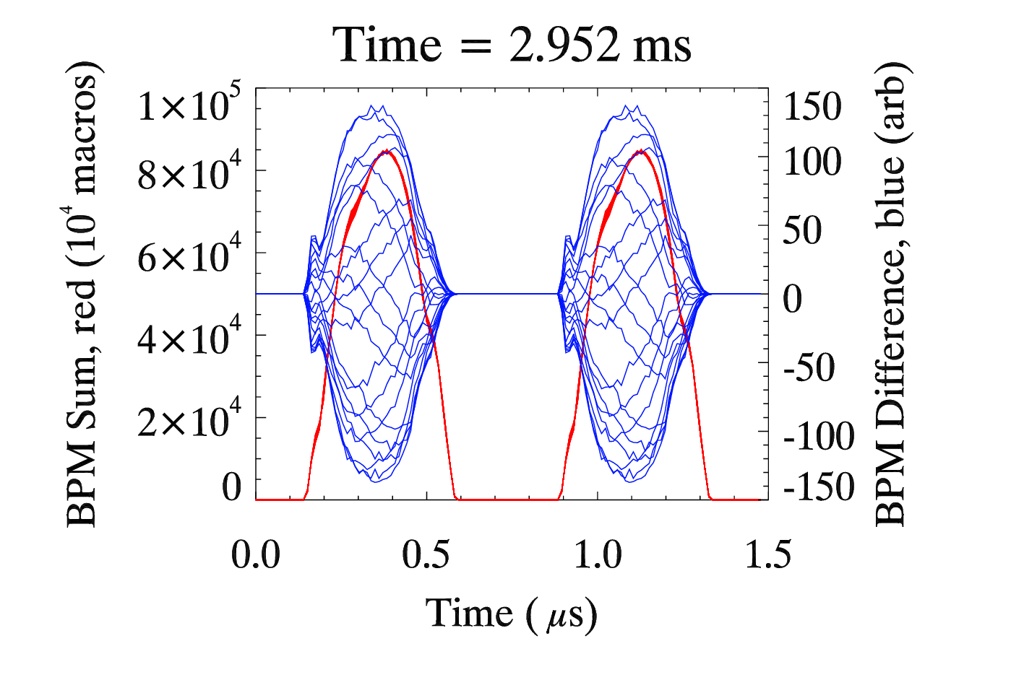
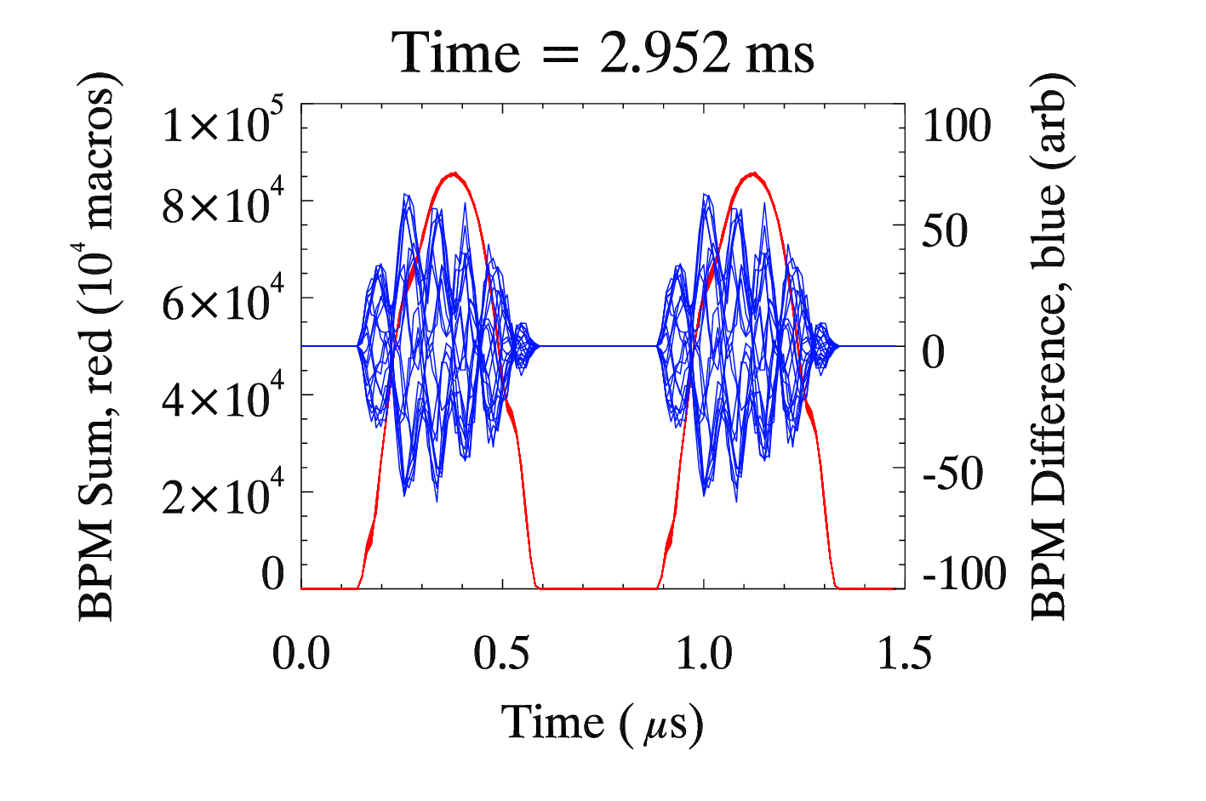
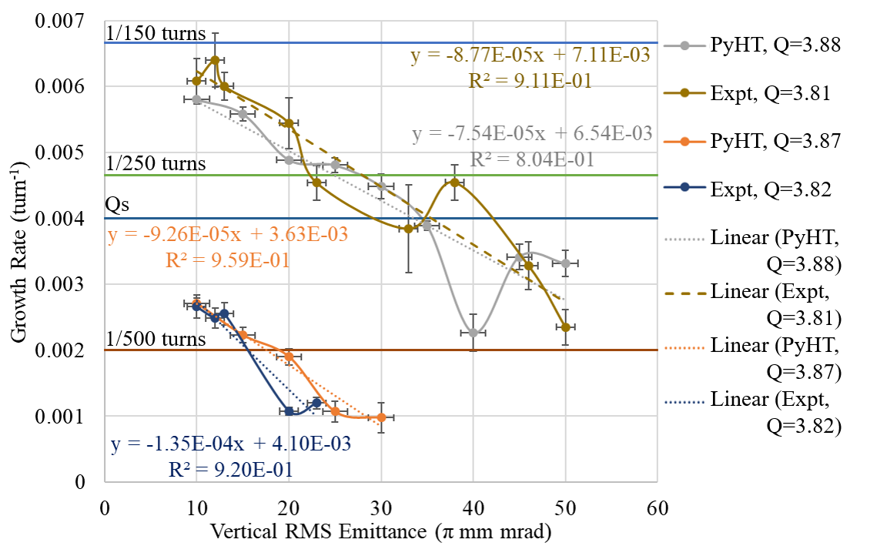
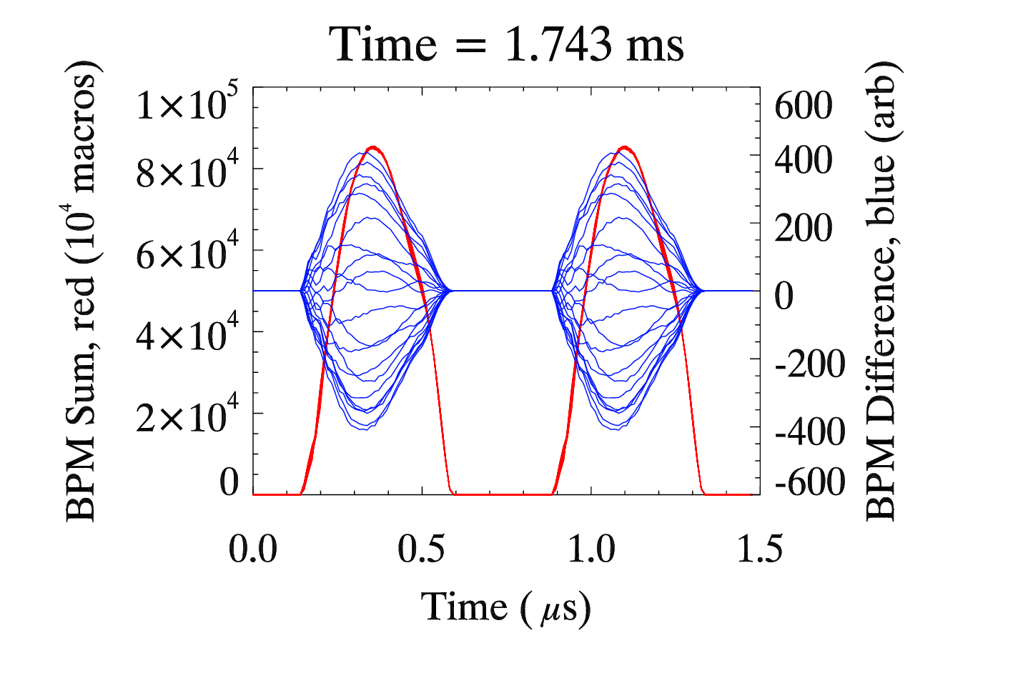
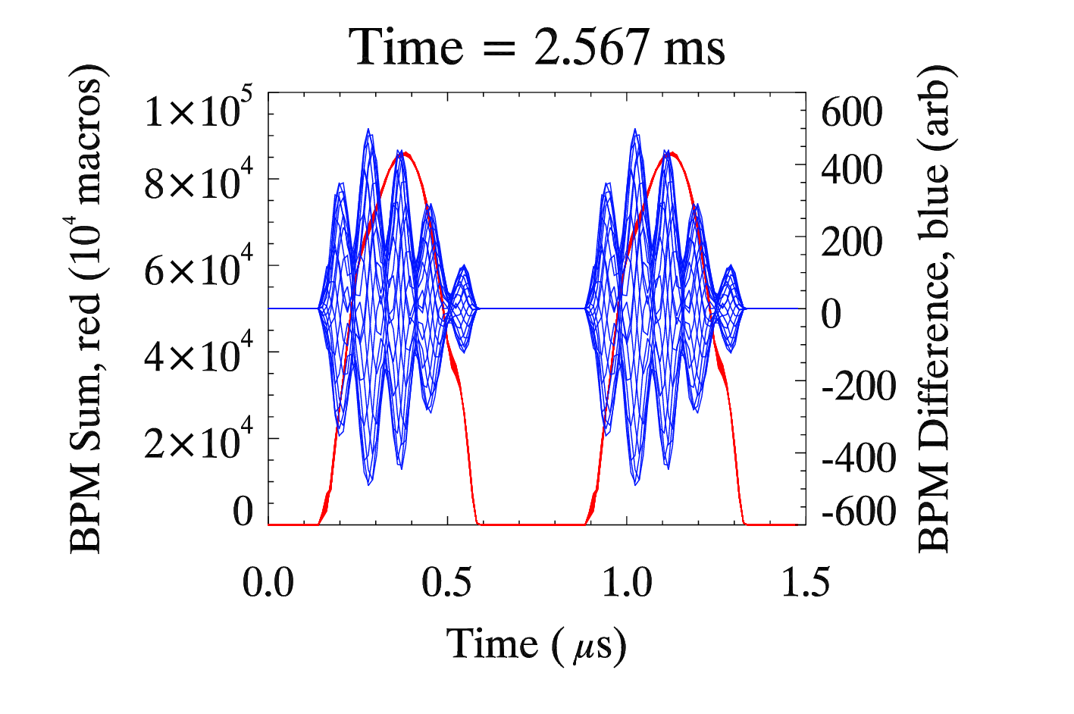
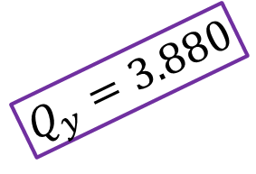
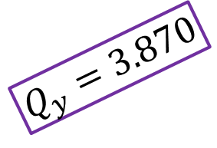
High-Intensity Hadron R&D @ ISIS –
Instabilities – Rob Williamson
(P/T JAI student and lecturer)
Simulations with Space Charge
10 π mm mrad
50 π mm mrad
Theoretical Expectation:
Dominant mode m = 3 with possible m = 2 or 4
Mode independent of vertical tune
Full bunch length oscillates vertically
Growth rate is dependent on the vertical tune
Growth rate is independent of vertical beam size
$$Q_{y}=3.870$$
Observations:
Mode does not match theory
Mode dependent on vertical tune and beam size
Full bunch length oscillates
Growth rate is dependent on the vertical tune
Growth rate is dependent of vertical beam size
$$Q_{y}=3.880$$

Slide 11
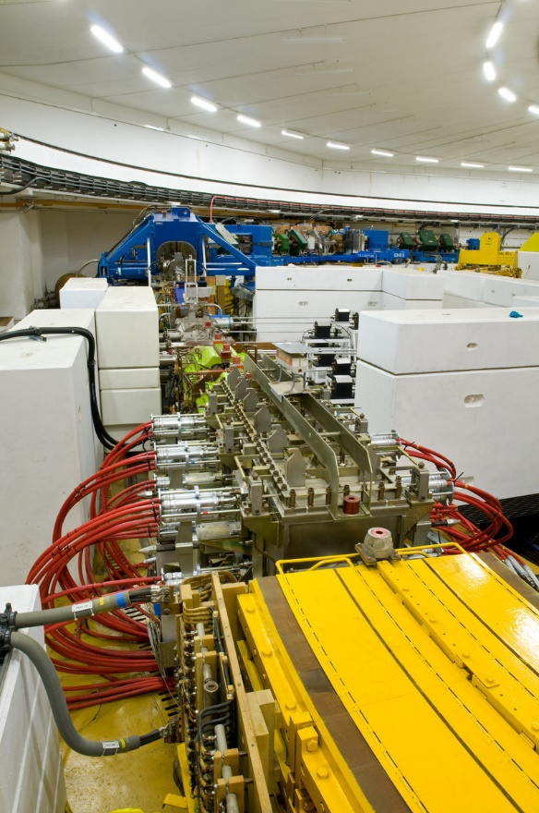
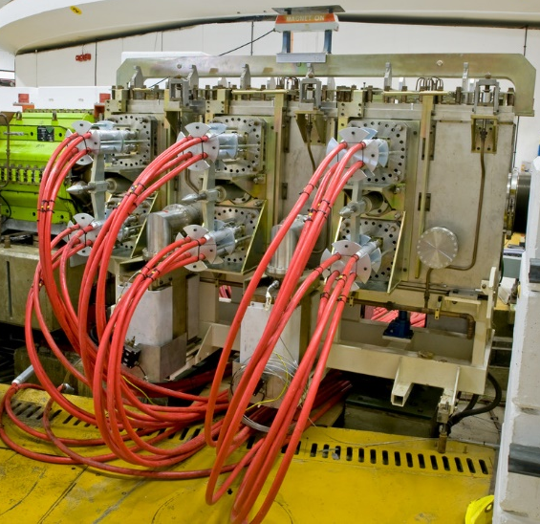
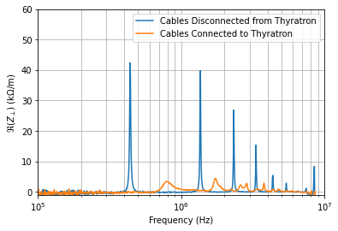
High-Intensity Hadron R&D @ ISIS –
Impedances – David Posthuma de Boer
(P/T JAI student)
New studies assessing low-frequency transverse impedances on ISIS RCS
Expect contribution from RCS magnets (~45% ring)
  Laminated poles
  Ceramic vacuum vessels
  RF shields
Extract kickers
  Vertical plane
  Long cables => low frequency
  Impedance not at instability frequency and are not large enough to explain growth rate
Extraction kicker measurements

Slide 12
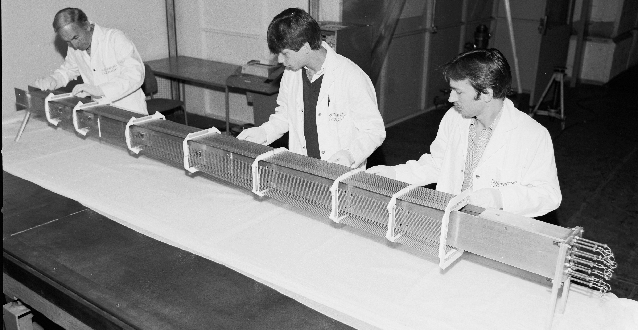
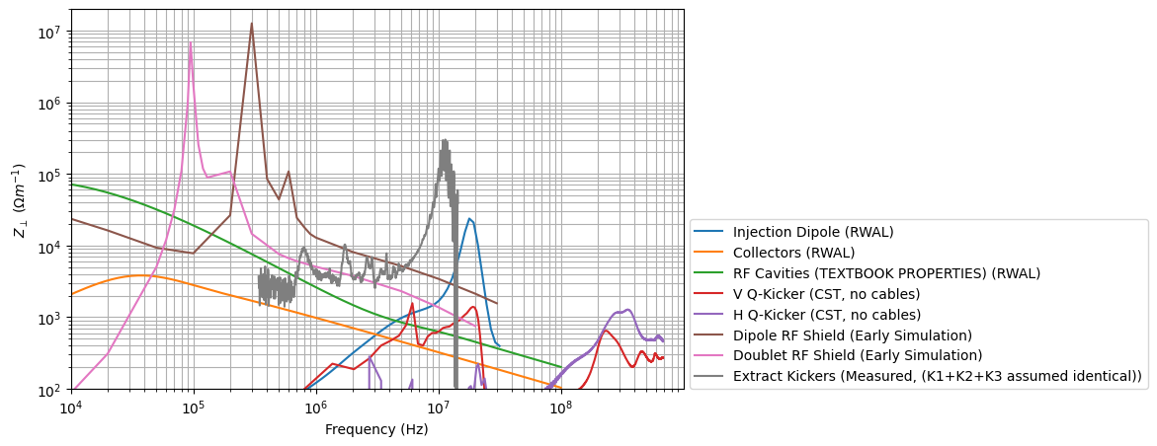
High-Intensity Hadron R&D @ ISIS –
Impedances – David Posthuma de Boer
(P/T JAI student)
Overall machine impedance assessment
  New simulation code: RWAL for cylindrical multi-layer vacuum vessels
  CST also utilised for impedance estimates
RF shield contributions
  Simulations have predicted resonances at low frequencies
  Impedance amplitude => correct order-of-magnitude instability growth rates
  Bench measurements planned

Slide 13
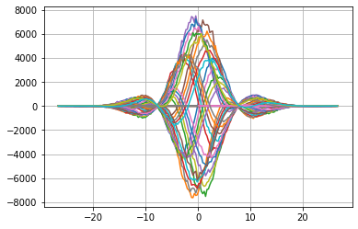
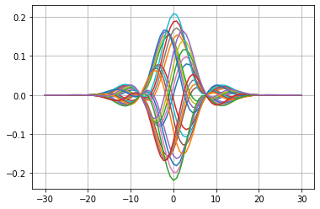
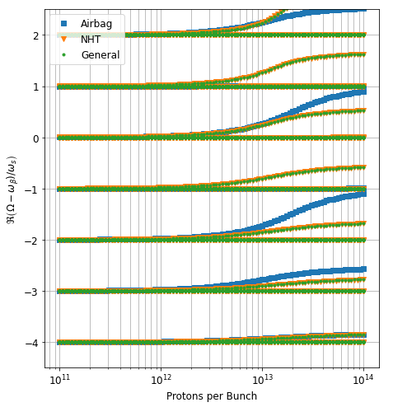
High-Intensity Hadron R&D @ ISIS –
Impedances – David Posthuma de Boer
(P/T JAI student)
PyHT
Vlasov
New Vlasov solver for instability predictions
  Coupled-mode head-tail
  Complicated impedances possible
  Variety of beam distributions
  Benchmarks with PyHEADTAIL and published results
Example calculations for ISIS
  Low-frequency narrowband
  Airbag and Gaussian long. Distribution
  Indicates no coupled modes

Slide 14
ISIS-II Megawatt Upgrade –
Introduction & Parameters
ESFRI Neutron Scattering Facilities in Europe Report
…by far the most cost effective solution would therefore be to build a MW-class short pulse facility at ISIS, reusing existing infrastructure and facilities as well as drawing upon on-site competences. The current facility could operate until the new facility is operational with its initial suite of instruments.
Europe (incl. UK) is a world leader in neutron-based science
Decommissioning of reactor sources of neutrons
Potential European “neutron drought”
Announcement of £5.1m UKRI infrastructure funding for ISIS-II Feasibility, Design Studies and R&D – ‘Phase 1.2a’ to cover the next several years.
ISIS-II Working Specifications
1.25 MW proton accelerator
1.2 GeV beam on target
0.1% beam-loss
Exact specification to be determined
Several accelerator options
Phase 1
Phase 2
Phase 3
2019
2021
2027
2031
2040
Feasibility, design studies and R&D
Integrated facility technical design
ISIS-II construction
Phase 1.1
Physics design
Small-scale prototypes
Phase 1.2
Physics design
Large-scale prototypes

Slide 15
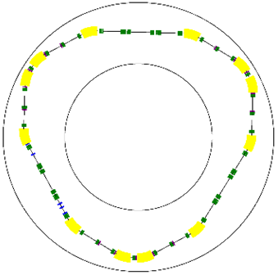
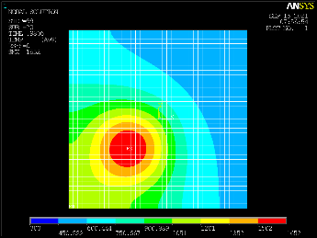
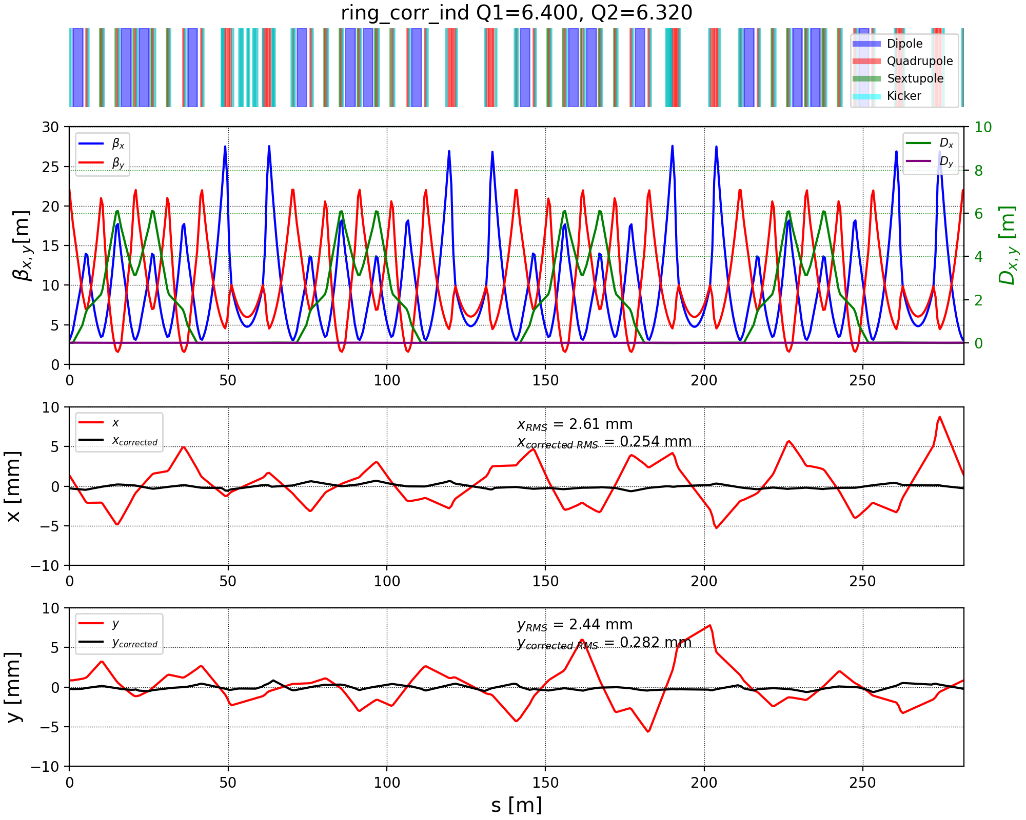
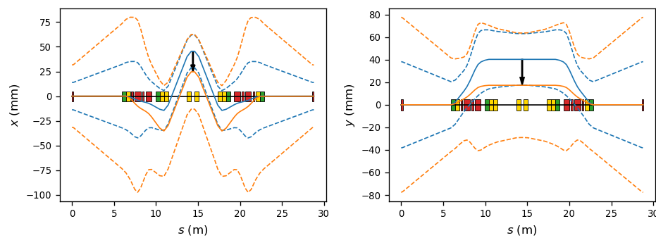
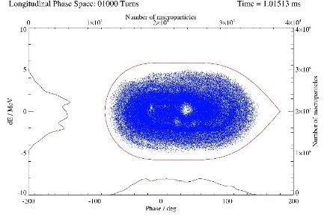
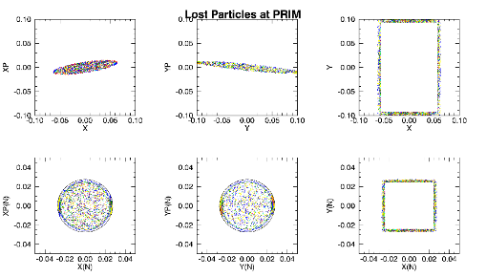
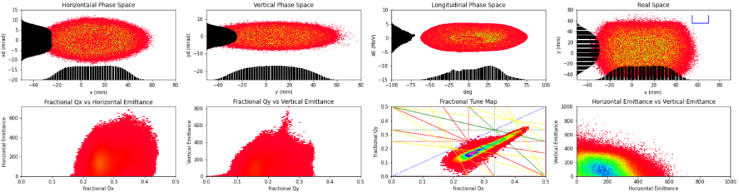
ISIS-II Megawatt Upgrade –
“Conventional” Rings
1. Lattice Design (Dean Adams)
2. Longitudinal Dynamics (Rob Williamson – JAI student)
3. Transverse Dynamics (Chris Warsop – JAI supervisor, et al.)
4. 3D Beam Dynamics Design (Dean Adams, et al.)
5. Injection Straight Design and Foils (Hayley Cavanagh, Bill Kyle, et al.)
6. Correction Systems (Peter Griffin-Hicks – JAI student, Haroon Rafique)
7. Collimation, Extraction (Hayley Cavanagh, Haroon Rafique, et al.)
8. Instabilities (Rob Williamson, David Posthuma de Boer – JAI students)
Recently completed exploratory designs
  2 x Rapid Cycling Synchrotron
  2 x Accumulator Rings
Working Point
Injection Straight & Foil Temperature
Closed Orbit Correction
Lattice Design
Longitudinal Simulations
Collimation Simulations
3D Simulations

Slide 16
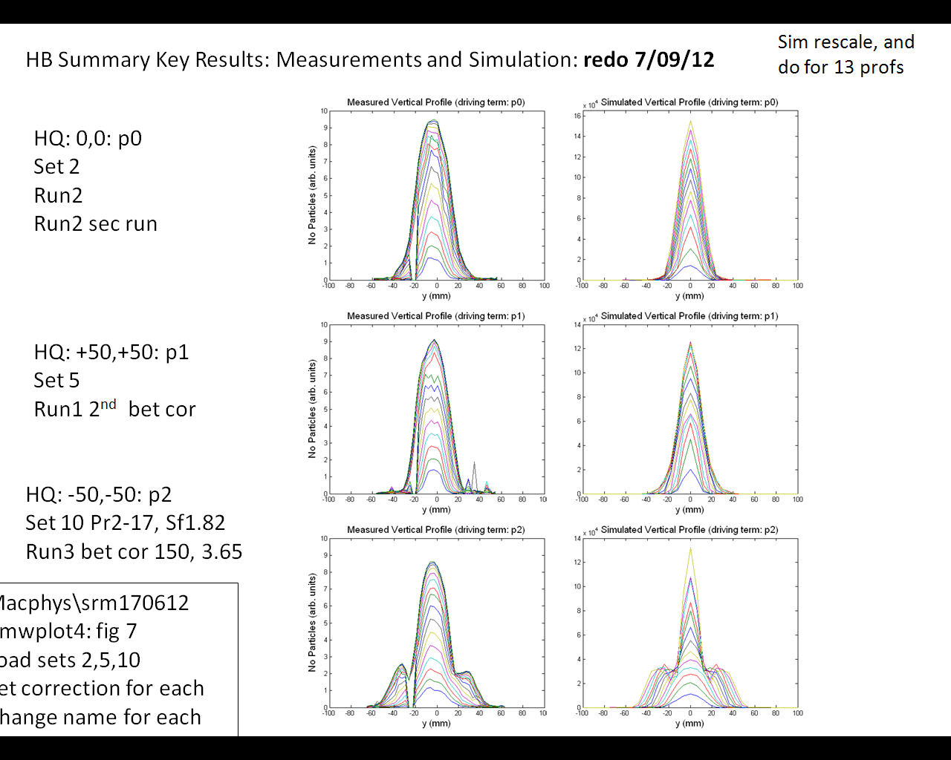





ISIS-II Megawatt Upgrade –
“Conventional” Rings R&D
Transverse Profiles, grad. error (2Q_{v}=7)
Measured
ORBIT
Tune Plane Measurements
Design studies highlighted
  Need to reliably predict loss on the 0.01 – 0.1% level
  Track halo evolution
  Reason for beam-loss in codes often not clear
Need models benchmarked to measurements => ISIS
  Test particular loss mechanisms
  Effects of resonances, instabilities
  2D and 3D injection painting, trapping, etc.
Compare with other accelerators and other codes => systematic exploration of the high intensity limit
  Frozen space charge halo
Predict 2→3 SFP: observe?
Chromaticity
  Non-linear components

Slide 17


ISIS-II Megawatt Upgrade –
Fixed Field Accelerator Option
1. Optics and Dynamics (Shinji Machida – JAI supervisor, David Kelliher – JAI lecturer, et al.)
2. Analytical Approach (Max Topp-Mugglestone – JAI student)
3. Injection & Extraction (Chris Rogers, Jaroslaw Pasternak – JAI staff)
4. Longitudinal Dynamics (David Kelliher – JAI lecturer)
5. Collective Effects (David Kelliher – JAI lecturer)
6. Magnet Physics Design (Jean Baptiste-Lagrange, Alan Letchford)
7. Magnet Engineering (Iker Rodriguez, et al.)
8. Collimation & Diagnostics (Emi Yamakawa)
9. RF Hardware (Bradley Kirk, Ian Gardner)
Machine design work:
FFA proof-of-concept – FETS FFA
  Demonstrator for FFA for ISIS-II
  Experimental study of injection painting, orbit correction, resonances, collimation, etc.
FFA for ISIS-II
Aiming for
  Sustainability
  Reliable operation
  Capacity
  Capability

Slide 18


ISIS-II Megawatt Upgrade –
FETS FFA
Testing magnetic alloy cores for FFA RF cavities
3 – 12 MeV
4 – 4.4 m radius
50 Hz beam repetition
3x10¹¹ protons per bunch
30 W power
Space charge tune shift ~-0.35
Still a work in progress
Completion of Conceptual Design Report by March 2025
Prototype BPM sent to Kyoto University hFFA for tests

Slide 19



IBEX 2.0 – Non-linear upgrade
Jake Flowerdew (JAI student)
Electron Gun
Experimental Region
Faraday Cup
Why?
Instability and resonance experiments including strong space charge are difficult
Particle tracking codes: clarification at a cost
Possibilities
Test lattices with non-linearities
  Space charge effects
  Quasi-Integrable Optics
Both sextupole and octupole fields possible
Octupole field
Ionisation Region
19

Slide 20

Summary
Introduction to ISIS
High-Intensity Hadron R&D at ISIS
  Unique facility for intense proton beams
  Instabilities with strong space charge
  Measurements and simulations of impedances
ISIS-II Megawatt Upgrade
  “Conventional” ring options
  FFA design including FETS-FFA
IBEX
  Updates on recent non-linear upgrade

Slide 21
Back-up Slides

Slide 22




Why Intense Hadron Beams?
Wide variety of applications
  Investigate radioactive nuclei
  Particle physics
  Neutron and muon sources
  …
Proposed for
  Nuclear transmutation
  Muon accelerators/colliders
  Fission and fusion reactors
  …

Slide 23

Challenges of Intense Hadron Beams
Beam-loss!
Activation from beam >10 MeV
  Limiting hands-on maintenance
  Possible physical damage
For regular maintenance, aim for < 1 mSv/h
Corresponds to beam-loss levels of < 1 W/m for energies 0.1 – 10 GeV
  Uncontrolled beam-loss < 0.01%
Myriad causes of beam-loss including:
  Intrinsically inefficient processes
  Mismatched parameters
  Misalignments, field errors, …
  Impedances and instabilities
  Space charge!

Slide 24





IBEX Experiment
Jake Flowerdew (JAI student)
Transverse confinement
$±$100 V
Why study accelerator physics in a Paul trap?
  Equivalent transverse focusing
  Fast measurement times (1 s ~ 1 million FODO cells)
  Large parameter space
    Change lattice structure easily
    Change intensity easily
$∓$100 V
$∓$100 V
$±$100 V
Low energy ions => no damage due to beam-loss
Dispersion and chromaticity free
Cost effective
Faraday cup
end caps
Central rods
MCP
end caps

