Slide 1

Electron and X-ray source based on a pyroelectric crystal driven by a periodically varying temperature
^{Majid Ali}
John Adams Institute at Royal Holloway, University of London, Egham, UK.

Slide 2
Outline
    Pyroelectric effect
    Particle generation and acceleration using pyroelectric effect
    History and development of pyroelectric accelerator
    COOL-X by Amptek
    Miniature X-Ray source based on Pyroelectric effect
    Study of pyroelectric accelerator in RHUL
    Experimental results
    Further development
Majid Ali. Electron and X-ray source based on a pyroelectric single crystal driven by a periodically varying temperature

Slide 3
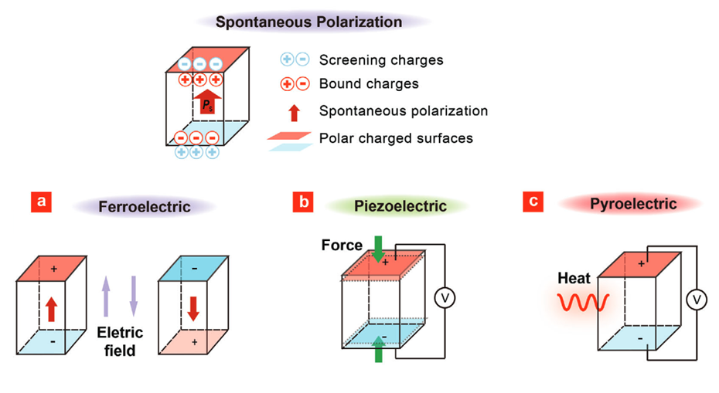
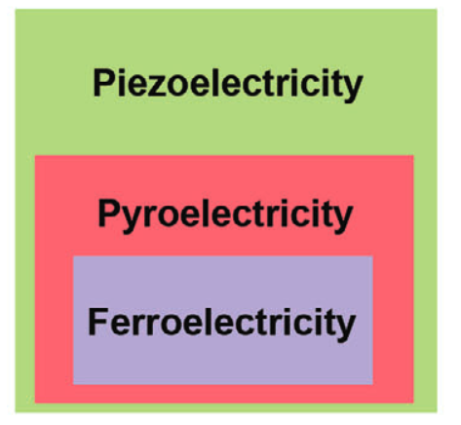
Pyroelectric effect
Main three ways to change the
value or direction of spontaneous polarization.
Application of external electric field
Application of mechanical stress
Variation of temperature
Wang, W., Li, J., Liu, H., Ge, S., Advancing Versatile Ferroelectric Materials Toward Biomedical Applications. Adv. Sci. 2021, 8, 2003074.

Slide 4
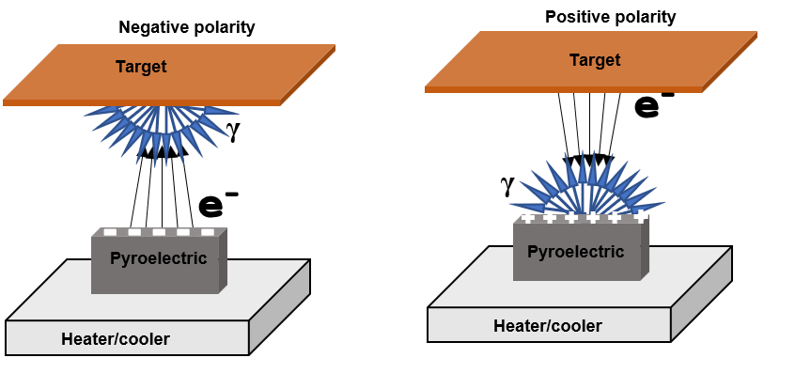
Particles generation and acceleration using pyroelectric effect
Pyroelectric materials used
Lithium Tantalate, Lithium niobate
Temperature variation
10-100 °c
Pressure Range
Up to 100 mTorr
X ray end point energy
Up to 200 keV
Electron current
Up to 10 nA
Positive ion generators
Nitrogen, oxygen, hydrogen, argon ions (max energy up to 150 keV)
Neutron generators
Fast neutrons energy up to 2.45 MeV
Main Scheme of operation

Slide 5
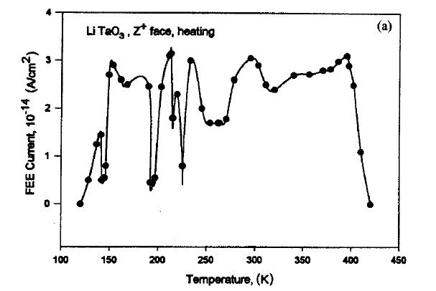
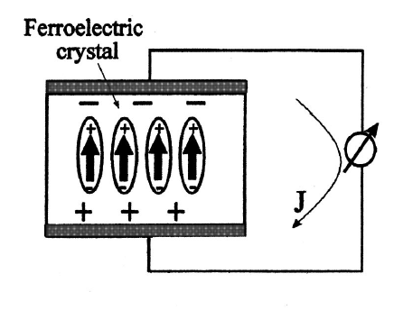
Electron emission from LiNbO₃
1974 - Stimulated electron emission by change in temperature of pyroelectric material
Generating of ferroelectric electron emission.
FEE in a crystal during the pyroelectric effect: upon heating
B. Rosenblum, P. Bräunlich, and J. P. Carrico, Thermally stimulated field emission from pyroelectric LiNbO3 Appl. Phys. Lett. 25, 17 (1974); https://doi.org/10.1063/1.1655260

Slide 6
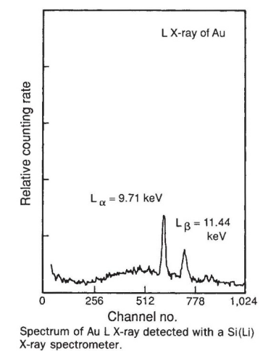
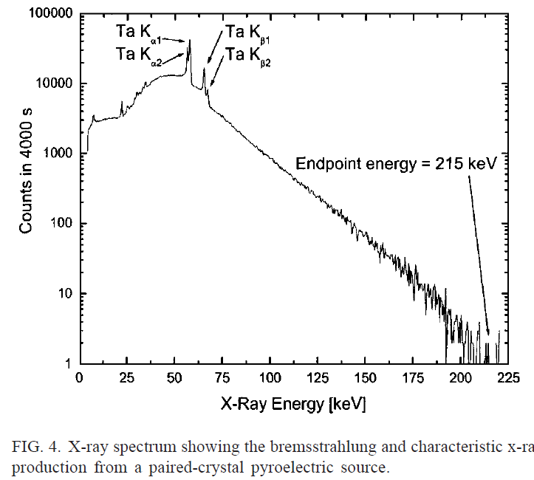
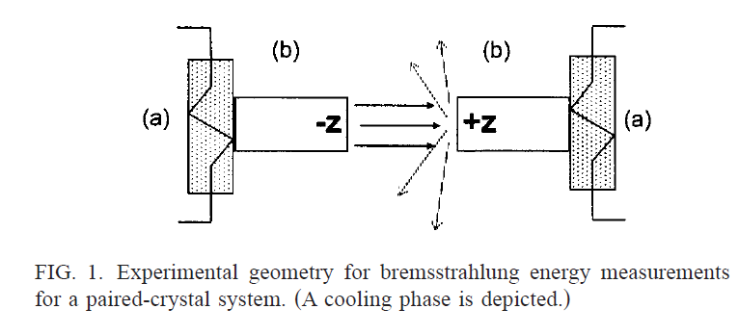
X-ray source based on pyroelectric effect
In 1992, Brownridge published the first report about X-ray generation stimulated by change in temperature of the pyroelectric material
Development of x-ray source based on pyroelectric crystal
Electron and positive ion acceleration with pyroelectric crystals
Jeffrey A. Geuther and Yaron Danon , Journal of Applied Physics 97, 074109 (2005); https://doi.org/10.1063/1.1884252⁾

Slide 7
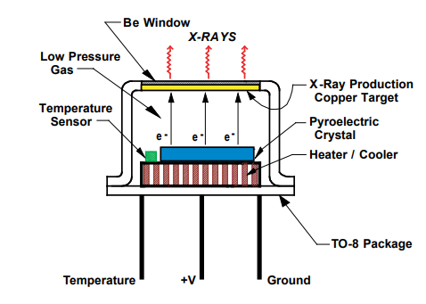
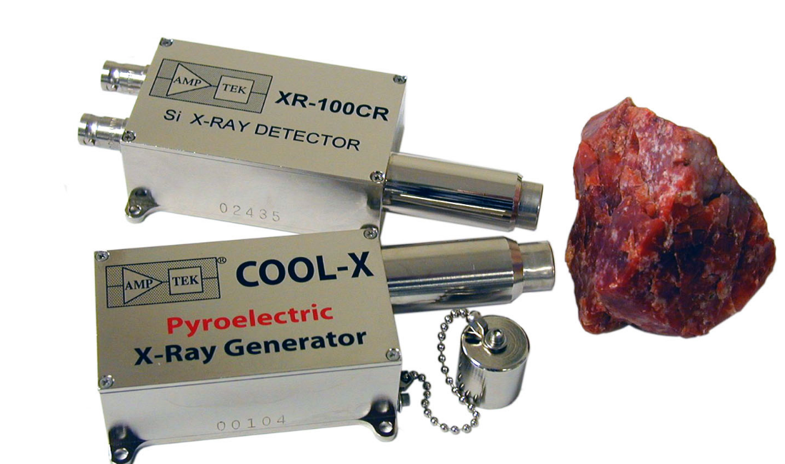
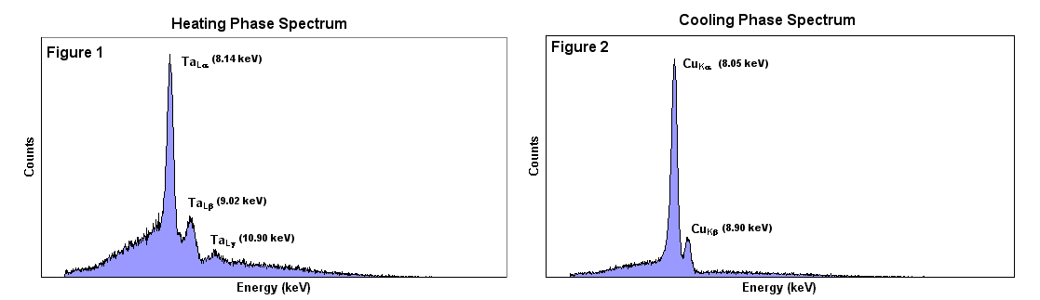
COOL-X by Amptek
Miniature X-Ray source based on pyroelectric effect
COOL-X
COOL-X shown with the Amptek XR-100CR X-Ray Detector
The x-ray spectrum obtained by COOL-X.
https://www.amptek.com/internal-products/obsolete-products/cool-x-pyroelectric-x-ray-generator

Slide 8
Amptek COOL-X, Pyroelectric X-ray Source
ADVANTAGES
Compact pocket-style X-ray source
Low power: < 300 mW
No radioactive sources
Does not required external high voltage source: Runs on standard 9 V battery
Variable end point energy: up to 35 kV
Weight: 185 g
DISADVANTAGES
The x-ray flux varies vary from cycle to cycle.
Dead time: without x-ray generation, when thermal phase is change.
Interruptions of particle generation by electric breakdowns
Short lifetime: Approximately 200 hours.

Slide 9
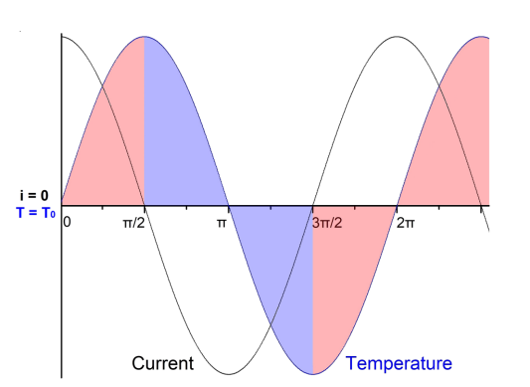
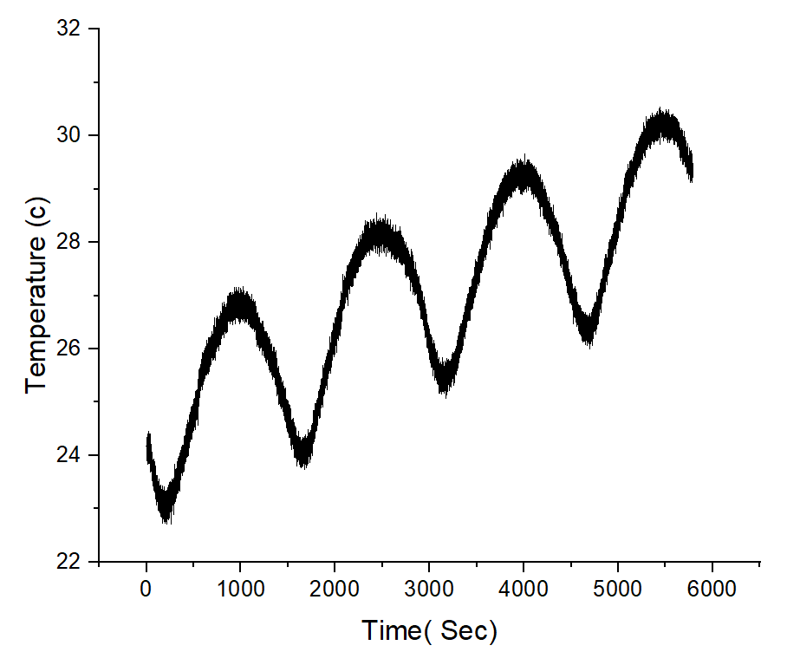
Periodically varying temperature of LiTaO₃
A periodically varying temperature of pyroelectric as a way of stabilizing particle yield
Sinusoidal temperature variation enable us to produce stable, continues and reproduceable temperature variation cycle by cycle through operation. Which is the key to stable x ray generation.
T(t) = T₀ + T₁sin(Ꙍt)
i_{pyr}= pAT ₁Ꙍcos(Ꙍt)
L. E. Garn and E. J. Sharp, J. Appl. Phys. 53, 8974 (1982)
L. E. Garn and E. J. Sharp, J. Appl. Phys. 53, 8980 (1982)

Slide 10
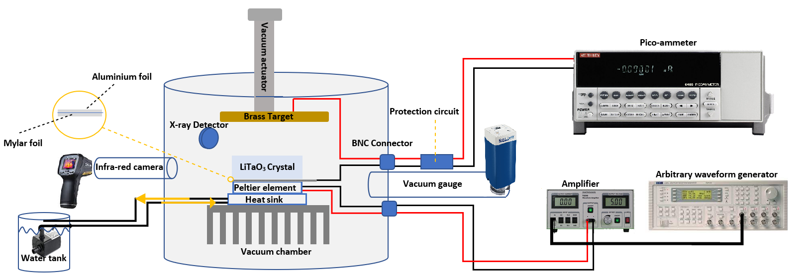
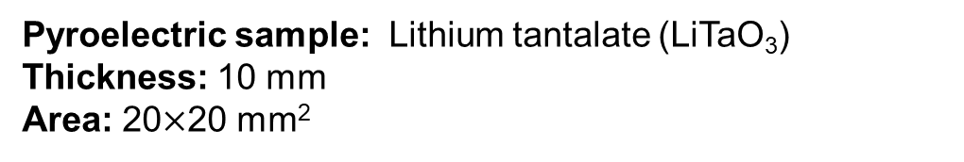
Experimental setup in RHUL
Scheme of experimental setup
Current measurement system
0.01 pA – 20 mA
X-Ray detection system
0.5- 150 keV
Vacuum system
Variable pressure from 0.1 mTorr- atmospheric pressure
Changing temperature system
Roughly 5-70 °c (depend on the frequency of temperature variation)
Temperature monitoring
Temperature monitoring of pyroelectric crystal inside vacuum chamber
Pyroelectric sample: Lithium tantalate (LiTaO₃)
Thickness: 10 mm
Area: 20$×$20 mm²
Majid Ali. Electron and X-ray source based on a pyroelectric single crystal driven by a periodically varying temperature

Slide 11
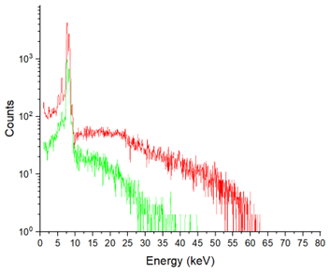
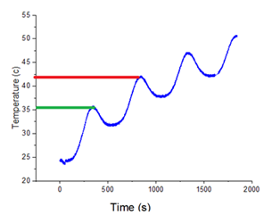
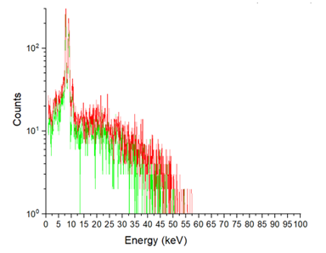
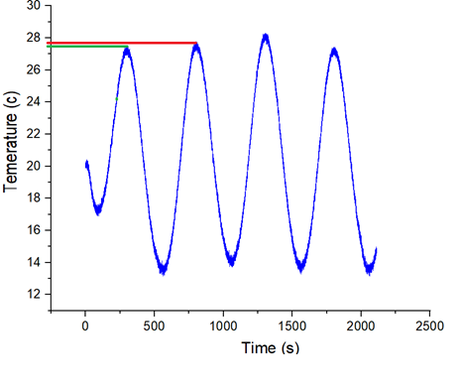
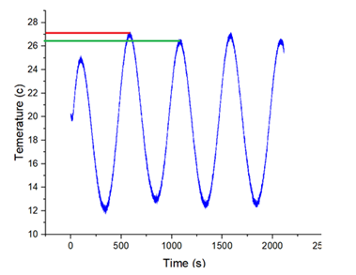
Impact of temperature oscillations shift on stability of x-ray generation
Without cooling system
An example of the degradation of the X-ray spectrum recorded in one thermal cycle during periodic temperature variation with the frequency of 2mHz.
A stable mode of periodic generation of an electric field of the approximately identical magnitude.
Such conditions should provide the generation of electrons and X-rays in the same amount with almost the same periodicity.
Initial temperature difference 7 °c
Initial temperature difference 7 °c
Initial temperature difference 1 °c
(a)
Without cooling system
Cooling system with ice
Initial temperature difference 0.5 °c
Initial temperature difference 1 °c
(b)
(c)
Cooling system without ice
Cooling system with ice
Cooling system

Slide 12
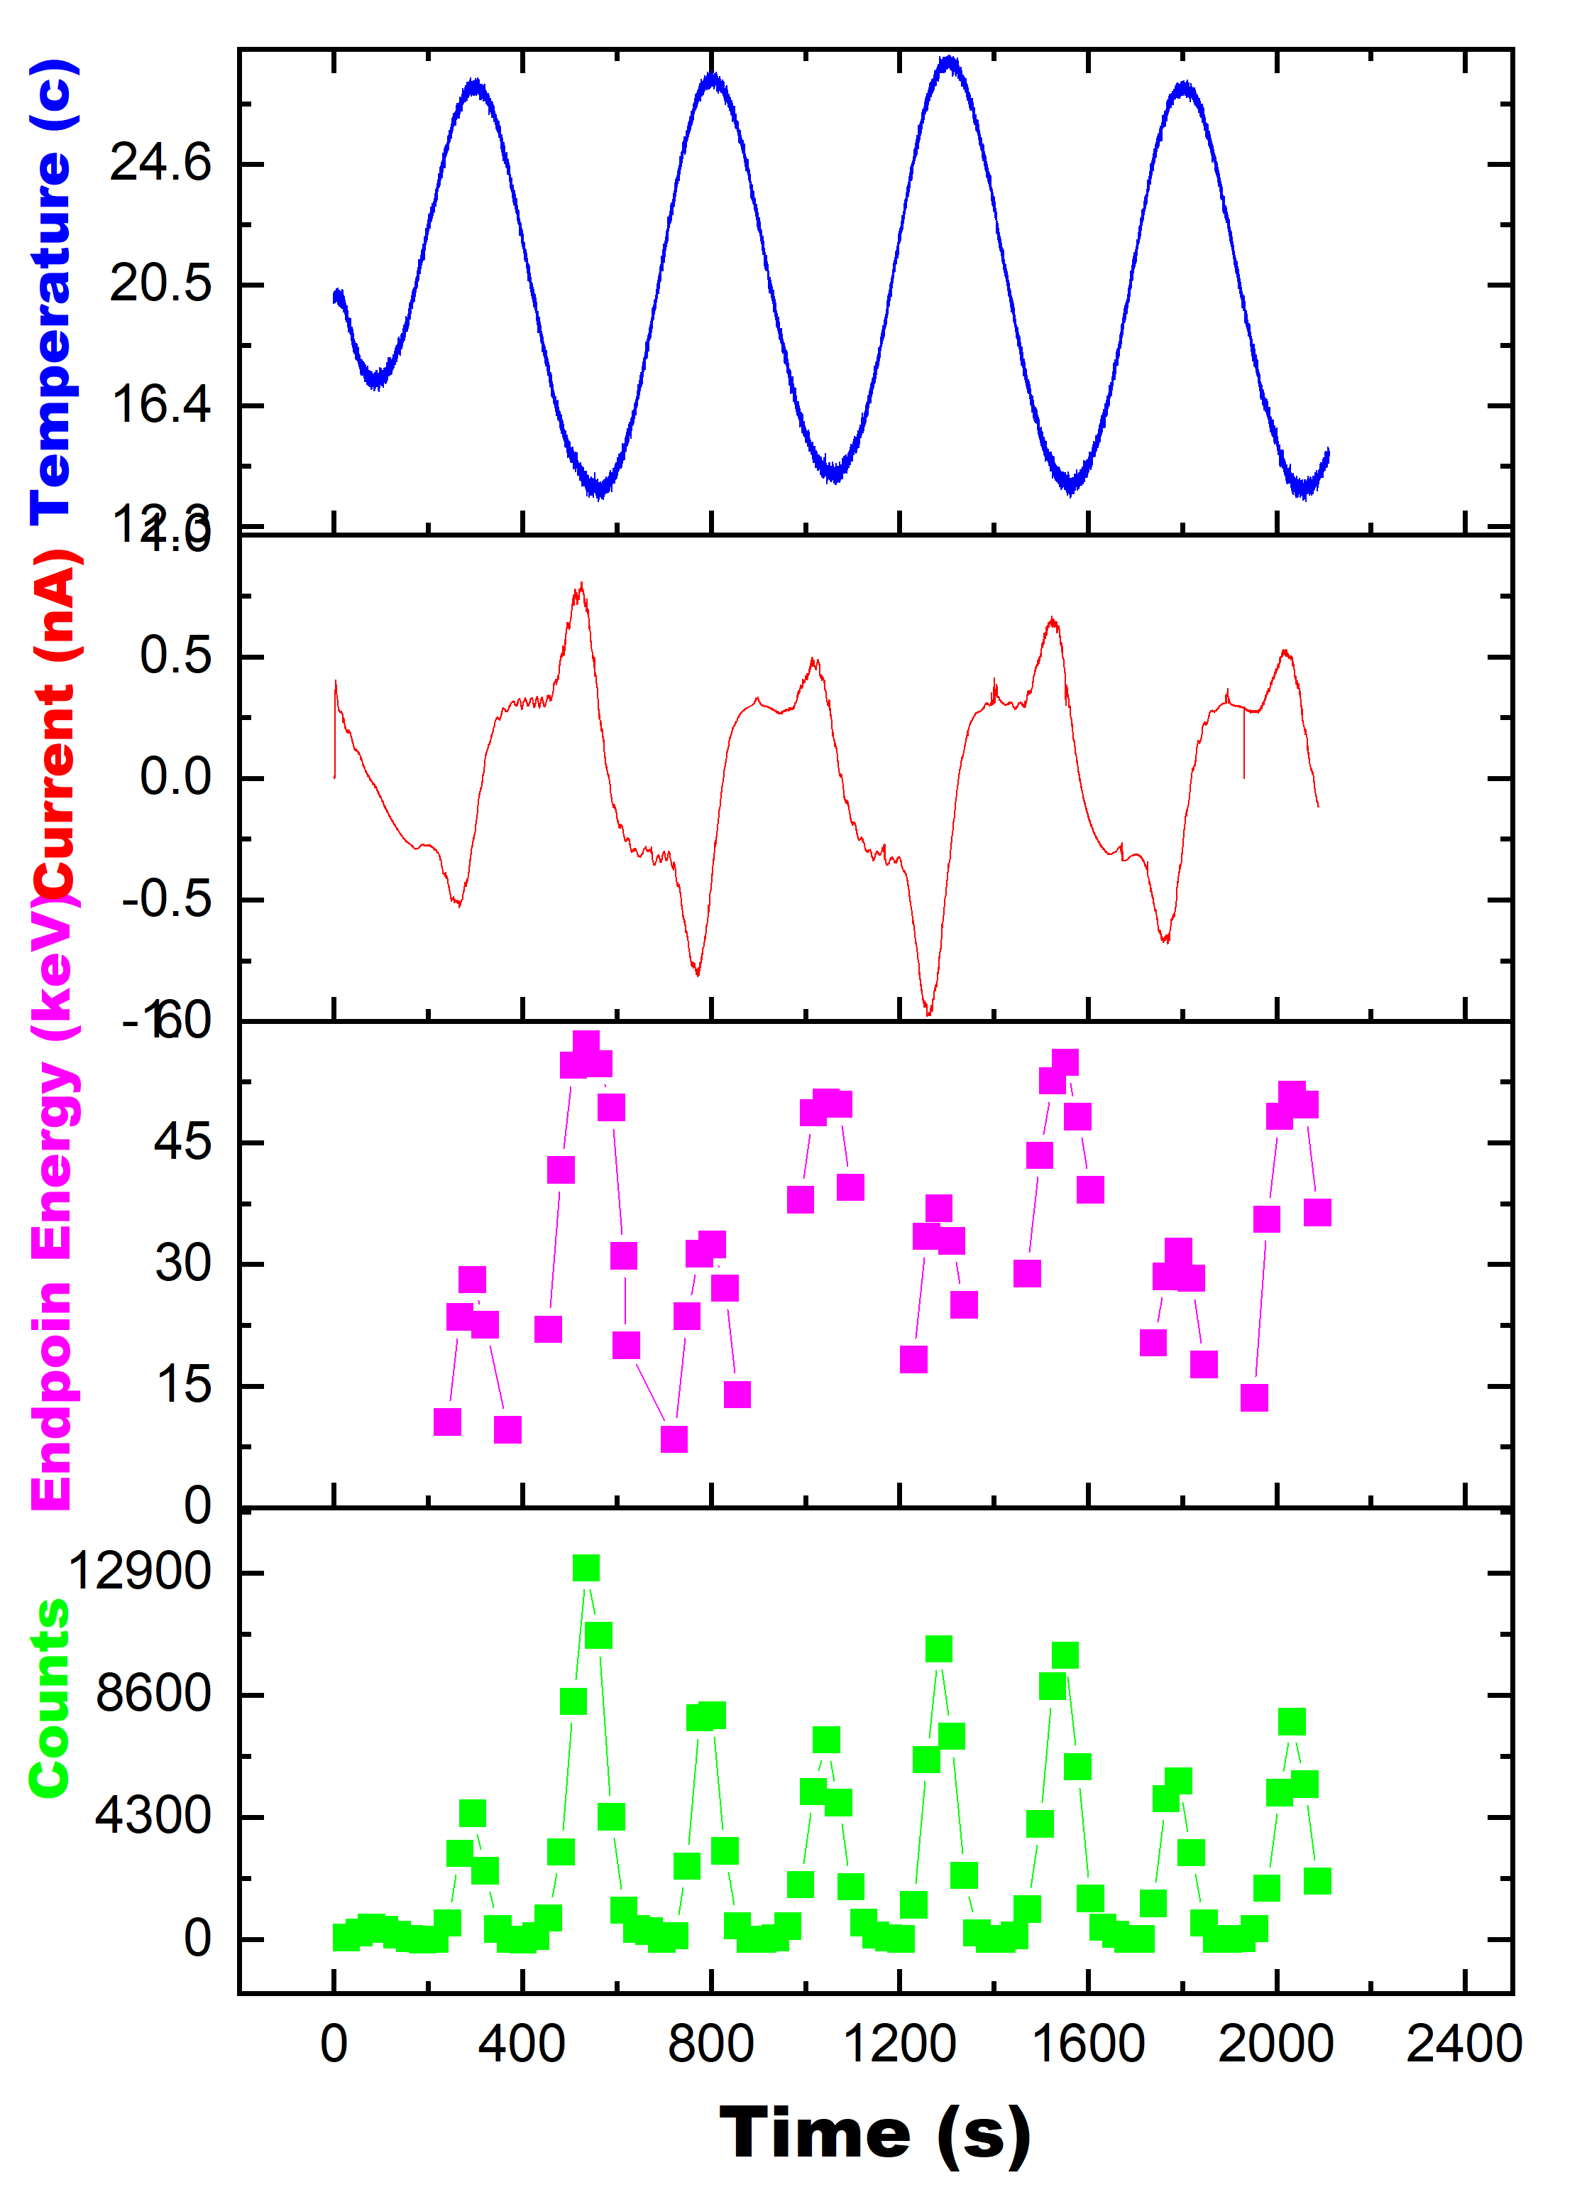
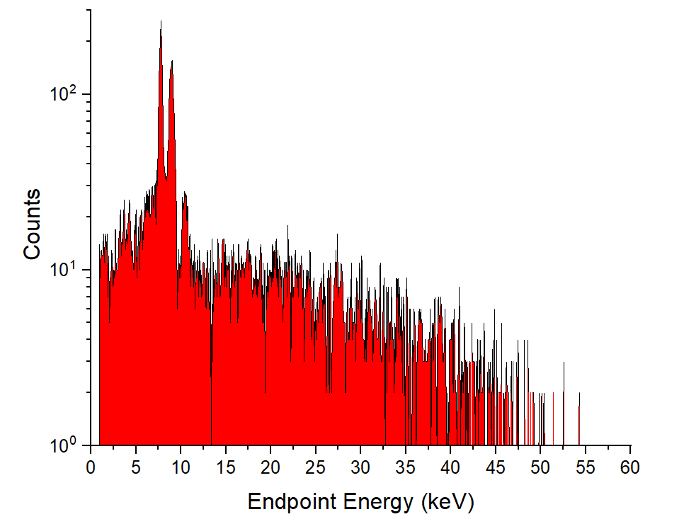
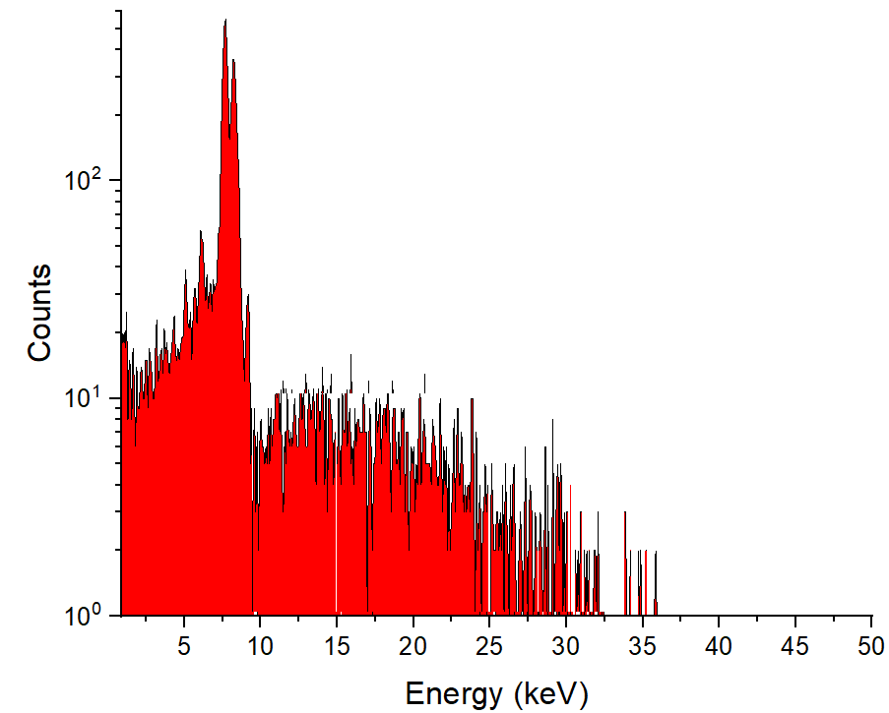
Stable electron and x-ray generation
Parameters of pyroelectric accelerator during temperature variation with frequency of 2mHz, and at pressure range 1-2 mTorr.
Ta (Lα=80.8 keV)
Ta (Lβ=9.34 keV)
0.6 nA
Ta (Lγ=10.89 keV)
0.3 nA
Positive Polarity
Cooling phase
Cu (Kα=8.05 keV)
Zn (Kα=8.64 keV)
Fe (Kα=6.40 keV)
Negative Polarity
Heating phase

Slide 13
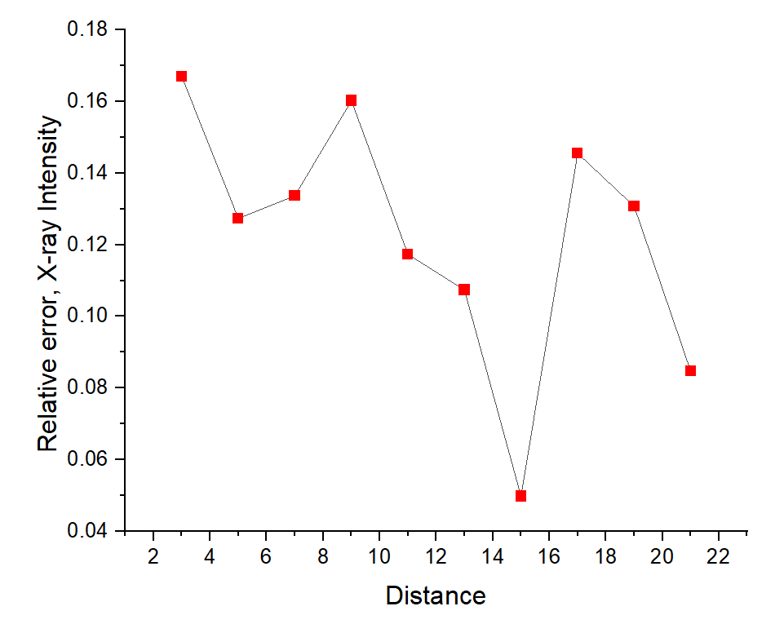
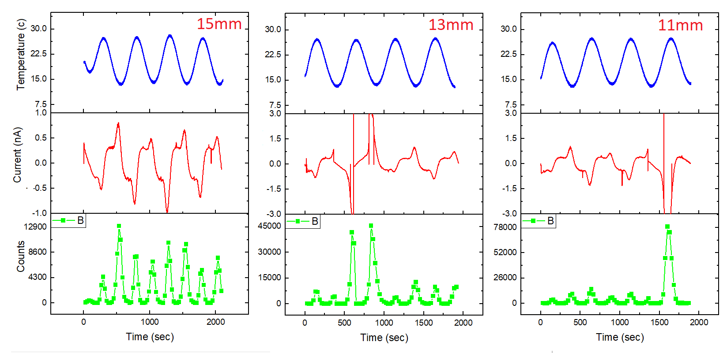
  Influence of the gap between the target and the crystal
Temperature variation frequency: 2mHz
Amplitude: 150mVrms ( Amplifier high gain X10)
Pressure range: 1-2 mTorr
(mm)

Slide 14
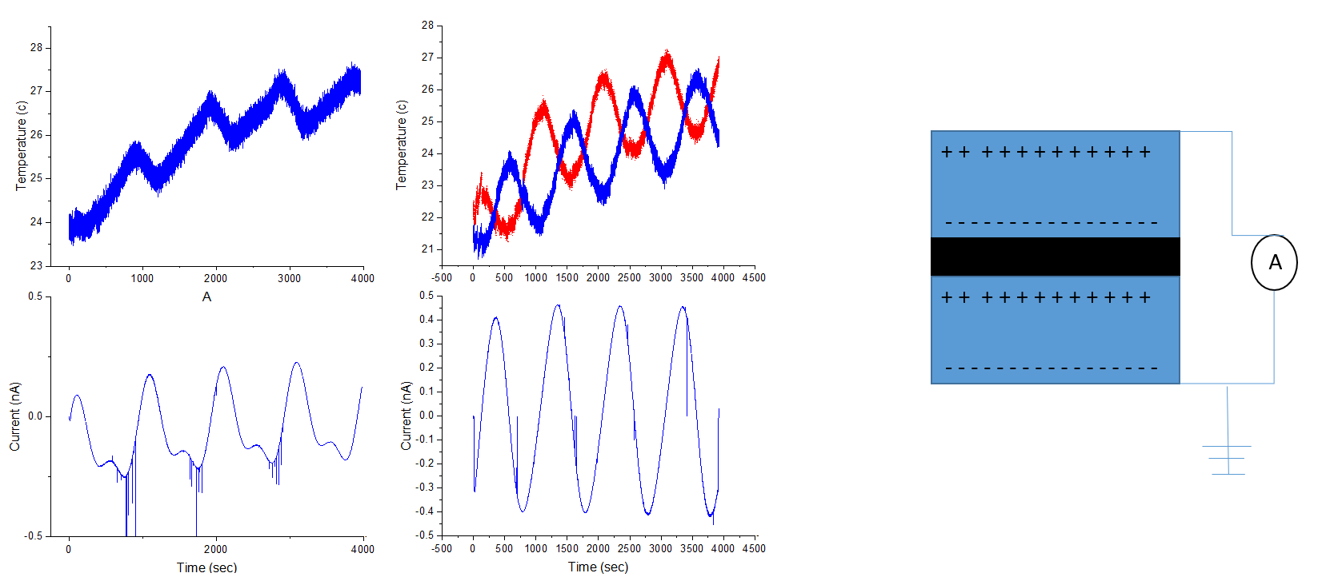
Under investigation, two Crystal System
A paired crystal system was explored in which two 10 mm crystals were arranged in series to double the potential difference across the crystal was observed.
We have tested the two crystals system and produce double potential difference in series.
Now we will try to accelerate electrons with the combined electric field of two crystals to double the maximum x-ray energy.
Peltier element
(0.5nA ) – (-0.5nA)
(0.25nA ) – (-0.25nA)

Slide 15
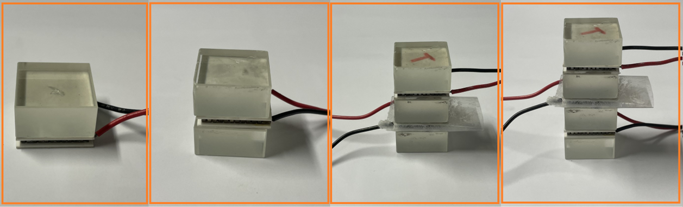
Further development, multiple Crystal system
Expected potential difference across the crystal will be double, triple and four time in 2, 3 and 4 crystals system respectively.
The X –ray energy can be further increase by stacking more crystal in series as show.
Single Crystal source
Paired-crystal source
Three-Crystals source
Four Crystals source
Majid Ali. Electron and X-ray source based on a pyroelectric single crystal driven by a periodically varying temperature

Slide 16
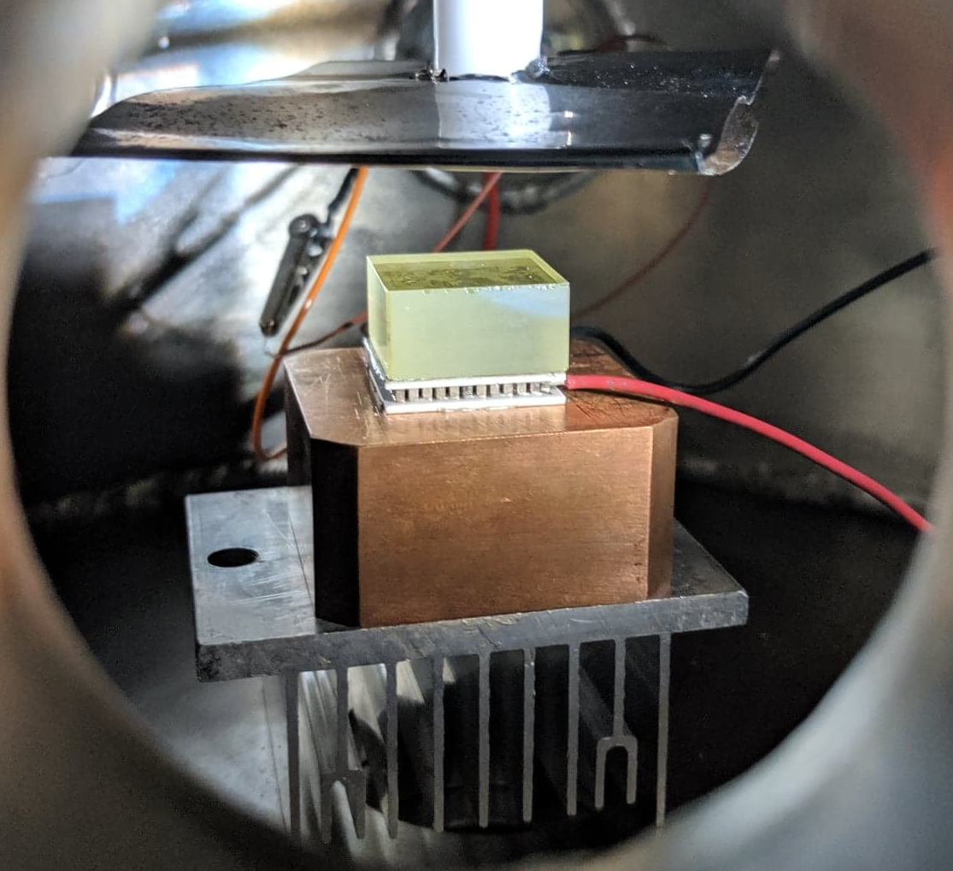
THANK YOU!
Majid Ali Electron and X-ray source based on a pyroelectric single crystal driven by a periodically varying temperature

