Slide 1
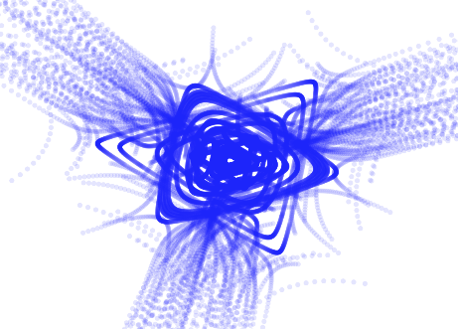
RF techniques for slow extraction at the CERN PS & SPS
Pablo Arrutia
JAI Fest, 12 December 2022

Slide 2
RF techniques for slow extraction at the CERN PS & SPS

Slide 3
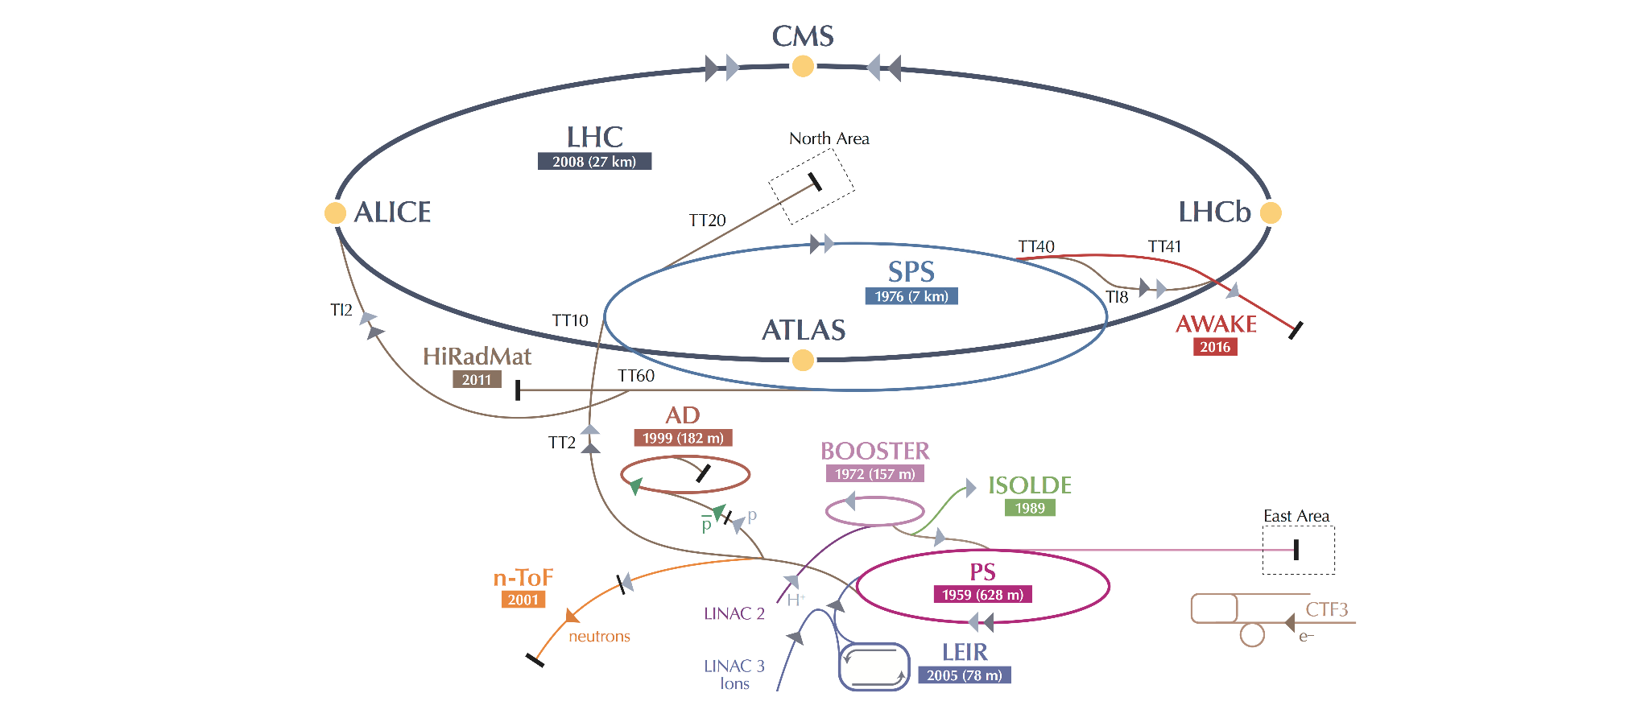
North Area
SPS revolution period: 23 us
Proton beam at 400 GeV/c
5 s of continuous intensity on target
East Area
PS revolution period: 2.1 us
Proton beam at 24 GeV/c
400 ms of continuous intensity on target
cds.cern.ch

Slide 4
North Area
SPS revolution period: 23 us
Proton beam at 400 GeV/c
5 s of continuous intensity on target
How do we provide continuous beam for 200k + turns ?
East Area
PS revolution period: 2.1 us
Proton beam at 24 GeV/c
400 ms of continuous intensity on target
cds.cern.ch

Slide 5
RF techniques for slow extraction at the CERN PS & SPS

Slide 6
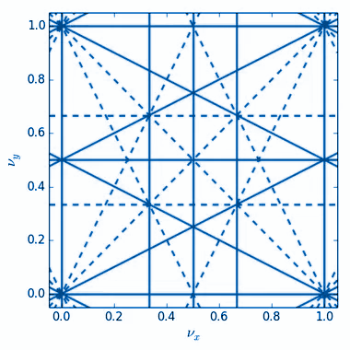
Resonant extraction
1/3
A resonance (typically 3rd order) can be used to slowly ‘peel’ particles from the circulating beam
The extraction rate is controlled by ramping magnets
Particles at large amplitude are kicked out by septum
source

Slide 7
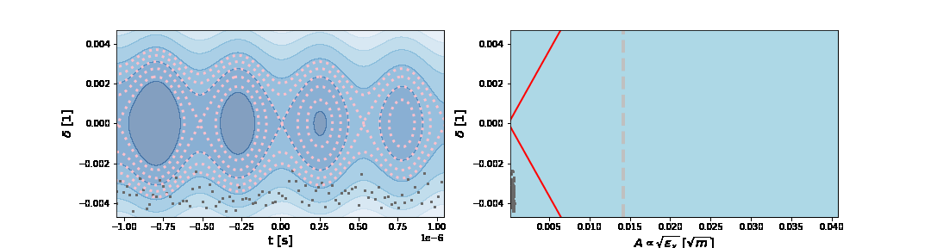
Resonant extraction
1/3
A resonance (typically 3rd order) can be used to slowly ‘peel’ particles from the circulating beam
The extraction rate is controlled by ramping magnets
Particles at large amplitude are kicked out by septum
Ring
To experiment
No field
E-field
Septum
Distance to resonance
unstable
source
Radial amplitude

Slide 8

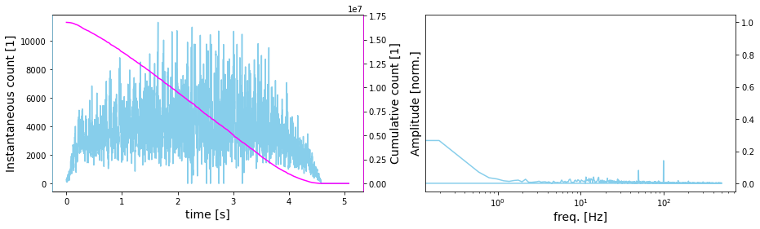
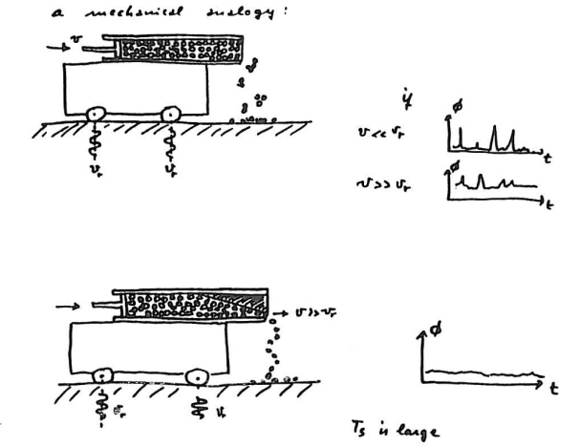
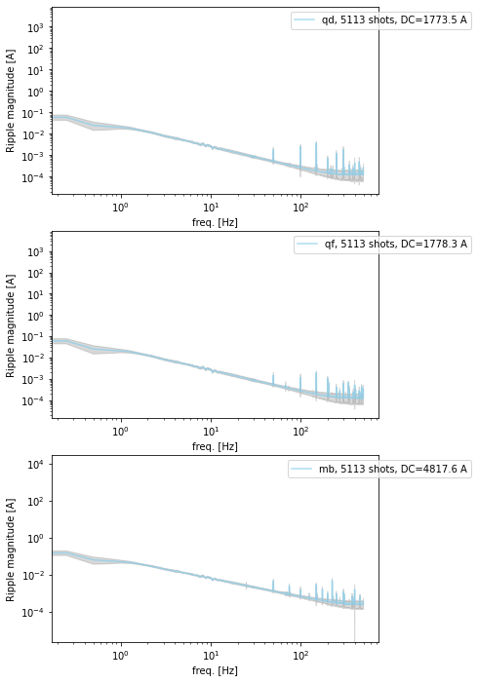
‘The beam sees everything’
Programmed ramp
Spill
F-quad
Undesired ripple
Slow extraction
T(f ; p₁, p₂, …)
Input
output

Slide 9
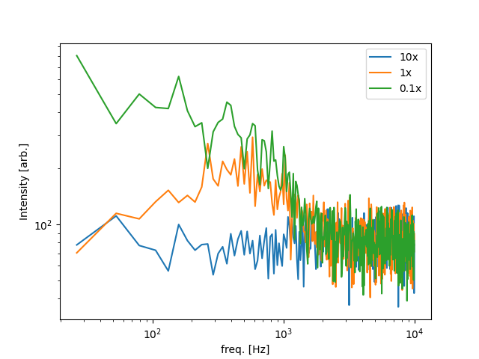
Faster is better
Faster extraction rates suppress noise!
We don’t want shorter spills
There’s a limit to the magnet ramp rate
We can mitigate the relative size of variations by ramping magnets faster
FFT of extracted spill
Slow extraction
T(f ; v)
White noise
Input
output

Slide 10
RF techniques for slow extraction at the CERN PS & SPS

Slide 11
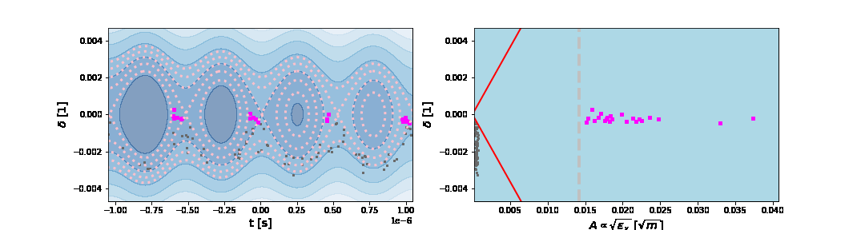
Empty bucket channelling (EBC)
RF technique tested in the 1980s in the CERN PS, but not operational
Later used in medical synchrotrons like MedAustron & CNAO
Advances in digital RF control & simulation -> bring it back to life at CERN
Principle: empty RF buckets can be used to increase tune speed close to stability boundary
Fast region
(almost) unperturbed region

Slide 12
Empty bucket channelling (EBC)
RF technique tested in the 1980s in the CERN PS, but not operational
Later used in medical synchrotrons like MedAustron & CNAO
Advances in digital RF control & simulation -> bring it back to life at CERN
Principle: empty RF buckets can be used to increase tune speed close to stability boundary
Fast region
(almost) unperturbed region

Slide 13
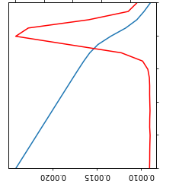

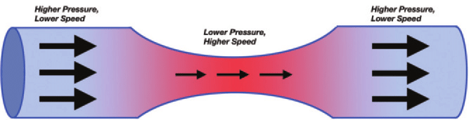
Liouville summoned once more
‘The beam distribution behaves like an incompressible fluid in phase space’
Simulation for PS (red)
Time [arb.]
Liouville
source
Bernoulli: A₁v₁ = A₂v₂
source
dQ/dt [arb.]

Slide 14
RF techniques for slow extraction at the CERN PS & SPS

Slide 15
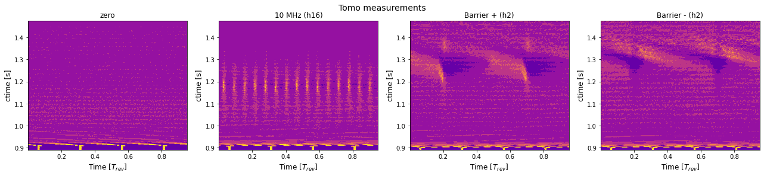
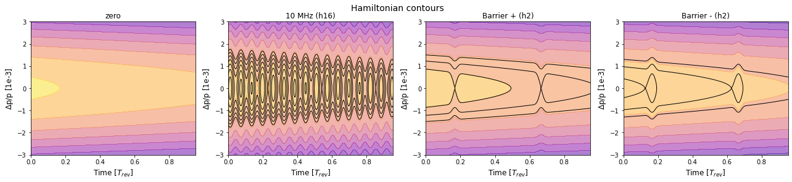
Results in the PS
Results in the PS (i)
Wide-band cavity
Ramp magnets, beam channels between buckets
RF off, let beam debunch and prepare extraction
Arrival at flat top

Slide 16
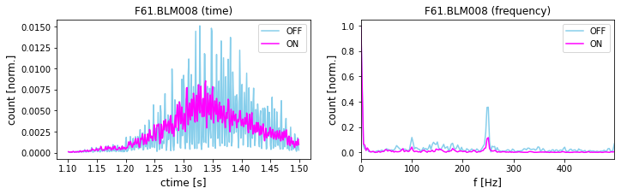
Results in the PS (ii)
Tests in 2021 performed in CERN PS
Successful demonstration of spill quality improvement across entire low frequency spectrum:

Slide 17
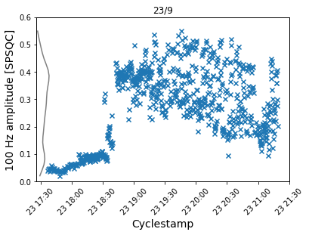
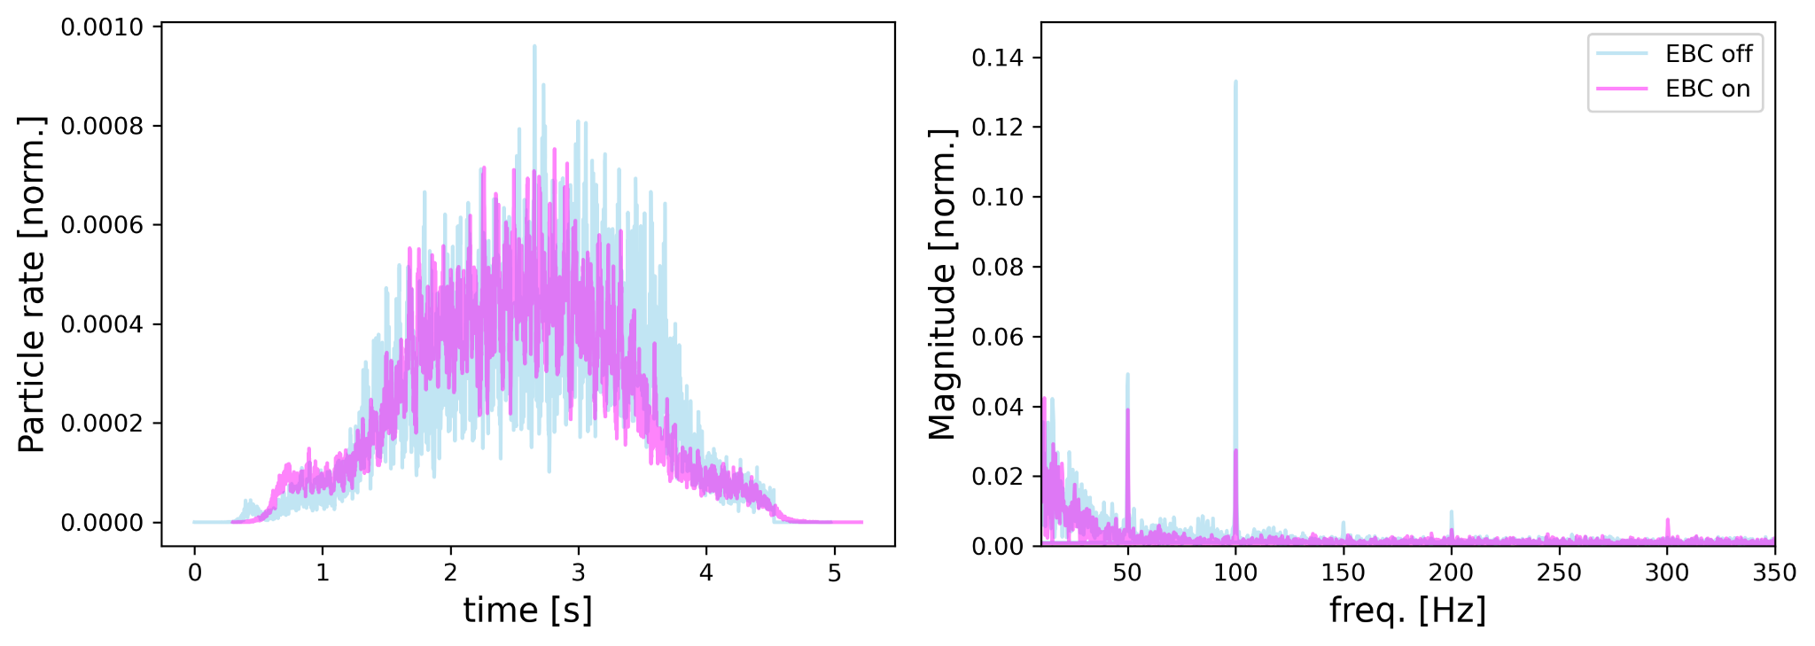
Results in SPS
Operational tests performed in 2022, drawing from lessons learnt in PS
Key Performance Indicator given by experiments: Magnitude of 100 Hz spill component -> Improved by factor 5
Data from NA62
EBC
test
5x

Slide 18
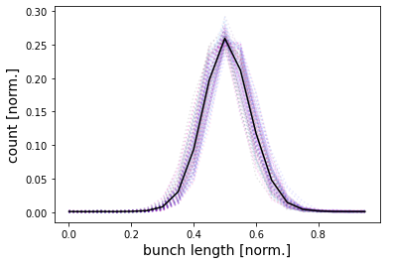

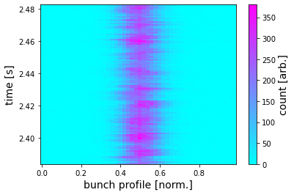
Future experiment: BDF/SHiP
Experimental test
SHiP requests an alternative operation mode with bunched slow extraction from SPS -> neutrino time of flight discrimination
Empty bucket channelling: low voltage -> low loss
Proof of concept demonstrated in experimental test
200 MHz
5 ns

Slide 19
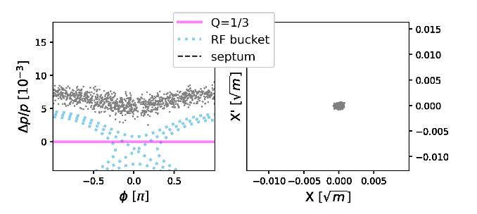
Future therapy: FLASH
Instead of ramping magnets, one can ramp RF frequency through the beam -> fast and customizable to provide pulsed extraction
Technique known as RF phase displacement, used in Intersecting Storage Rings to accelerate beams

Slide 20
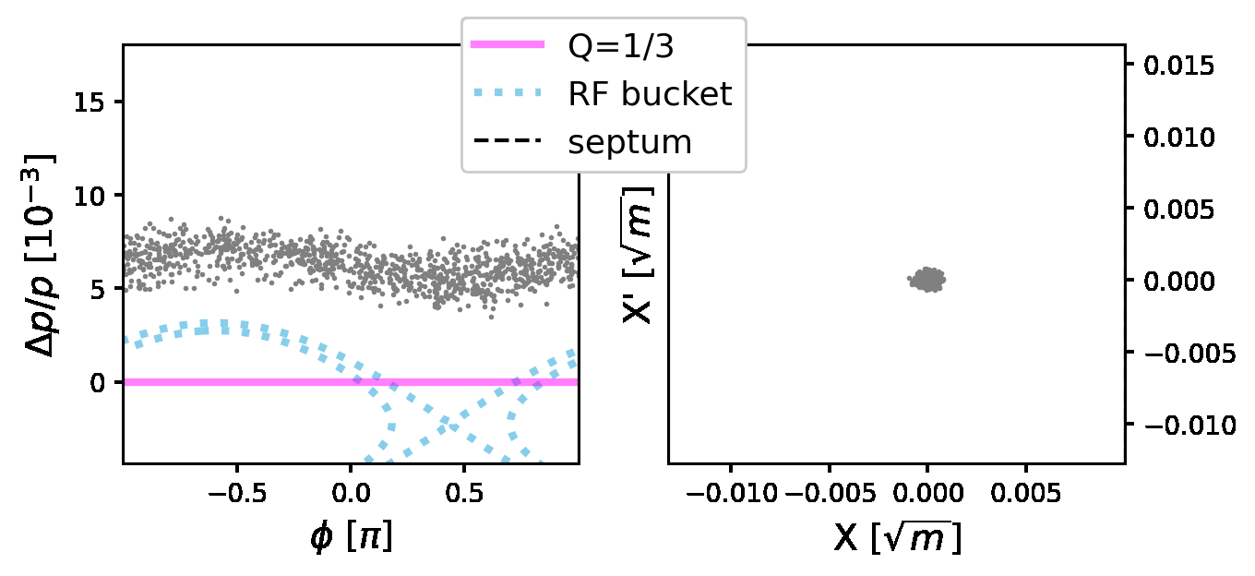
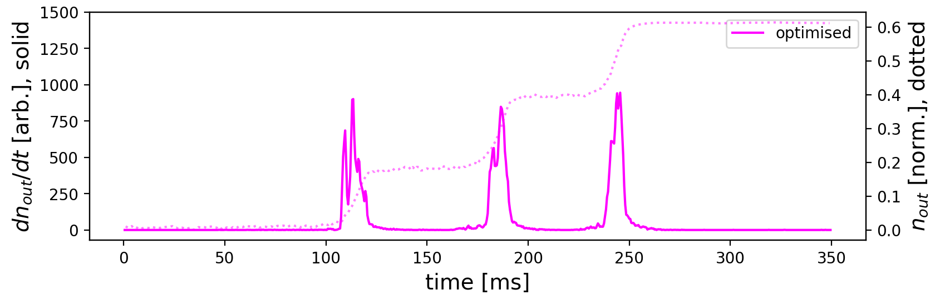
Future therapy: FLASH
Instead of ramping magnets, one can ramp RF frequency through the beam -> fast and customizable to provide pulsed extraction
Technique known as RF phase displacement, used in Intersecting Storage Rings to accelerate beams
Proof of concept in PS

Slide 21
Conclusion
Empty bucket channelling implemented in CERN PS and SPS
Goal to make technique operational in SPS in 2023
Empty bucket channelling suitable to slow extracted bunched beams for SHiP
RF phase displacement promising for pulsed resonant extraction
RF techniques powerful and flexible for variety of extraction challenges

