Slide 1


Development of compact radio frequency source
Mark McCallum
12/12/22

Slide 2
Overview
Introduction to the project
Theory
Applications
Prototypes 1, 2, 3, 4
Future of the project
Other aspects of the project
Conclusion

Slide 3
Introduction to the project
Aim:
Produce an RF generator that achieves phase noise and spectral purity performance of a mid-range benchtop RF generator.
Requirements:
Compact
Cost-effective
Control over ethernet
Suitable for RF Based Beam Diagnostics, i.e. Local Oscillators
Prototype achieved by use of XMicrowave modular components

Slide 4
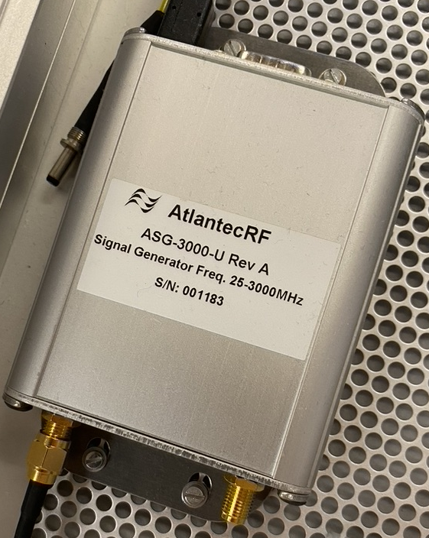
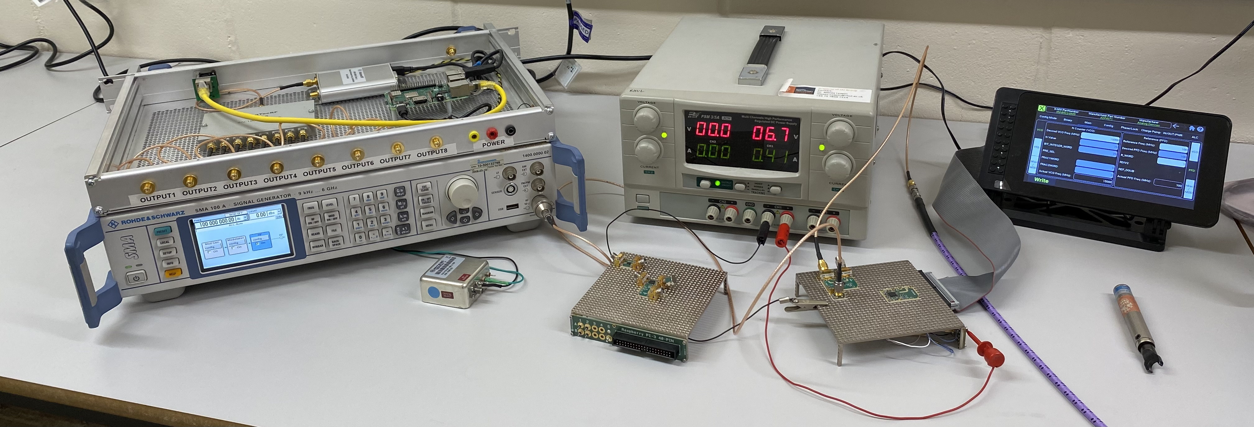
Introduction to the project
The two benchmark sources that are used for the comparison are:
Rohde & Schwarz SMA 100A,
AtlanTecRF ASG-3000 compact signal source

Slide 5

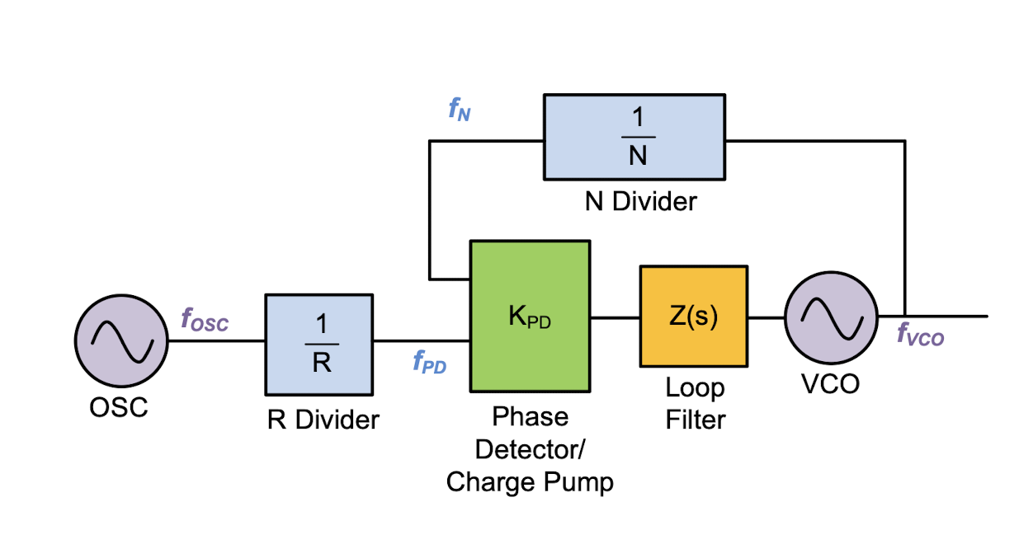
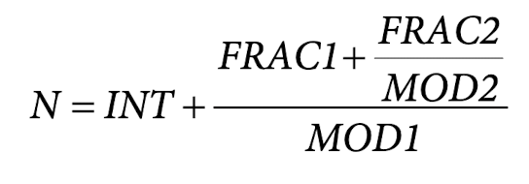

Theory
Equation of RF output
Phase Locked Loop (PLL) with integrated Voltage Controlled Oscillator (VCO)
The VCO output is a fraction of the phase frequency detector.
The INT, FRAC1, FRAC2, MOD1, MOD2, and R counter make it possible to generate output frequencies that are spaced by fractions of the PFD
Characteristics of RF output
Phase Noise: noise arising from the rapid, short-term, random phase fluctuations that occur in a signal.
Harmonics: integer multiple of the fundamental frequency.
Spurs: noise that is concentrated at a specific offset from the main frequency.
INT is the integer value of N.
FRAC1 is the numerator of the primary modulus .
FRAC2 is the numerator of the auxiliary modulus.
MOD1 is the primary modulus with a fixed value of $2^{24}$or $2^{32}$, depending on the frequency synthesiser.
MOD2 is the programable auxiliary fractional modulus.

Slide 6
Applications of source
Local Oscillator for various stages of mixers
Stand-alone signal generator
Telecommunications
Qubit read out and manipulation. Requires:
  Arbitrary Waveform Generator (AWG)
  Phase Modulation
  Pulse control

Slide 7
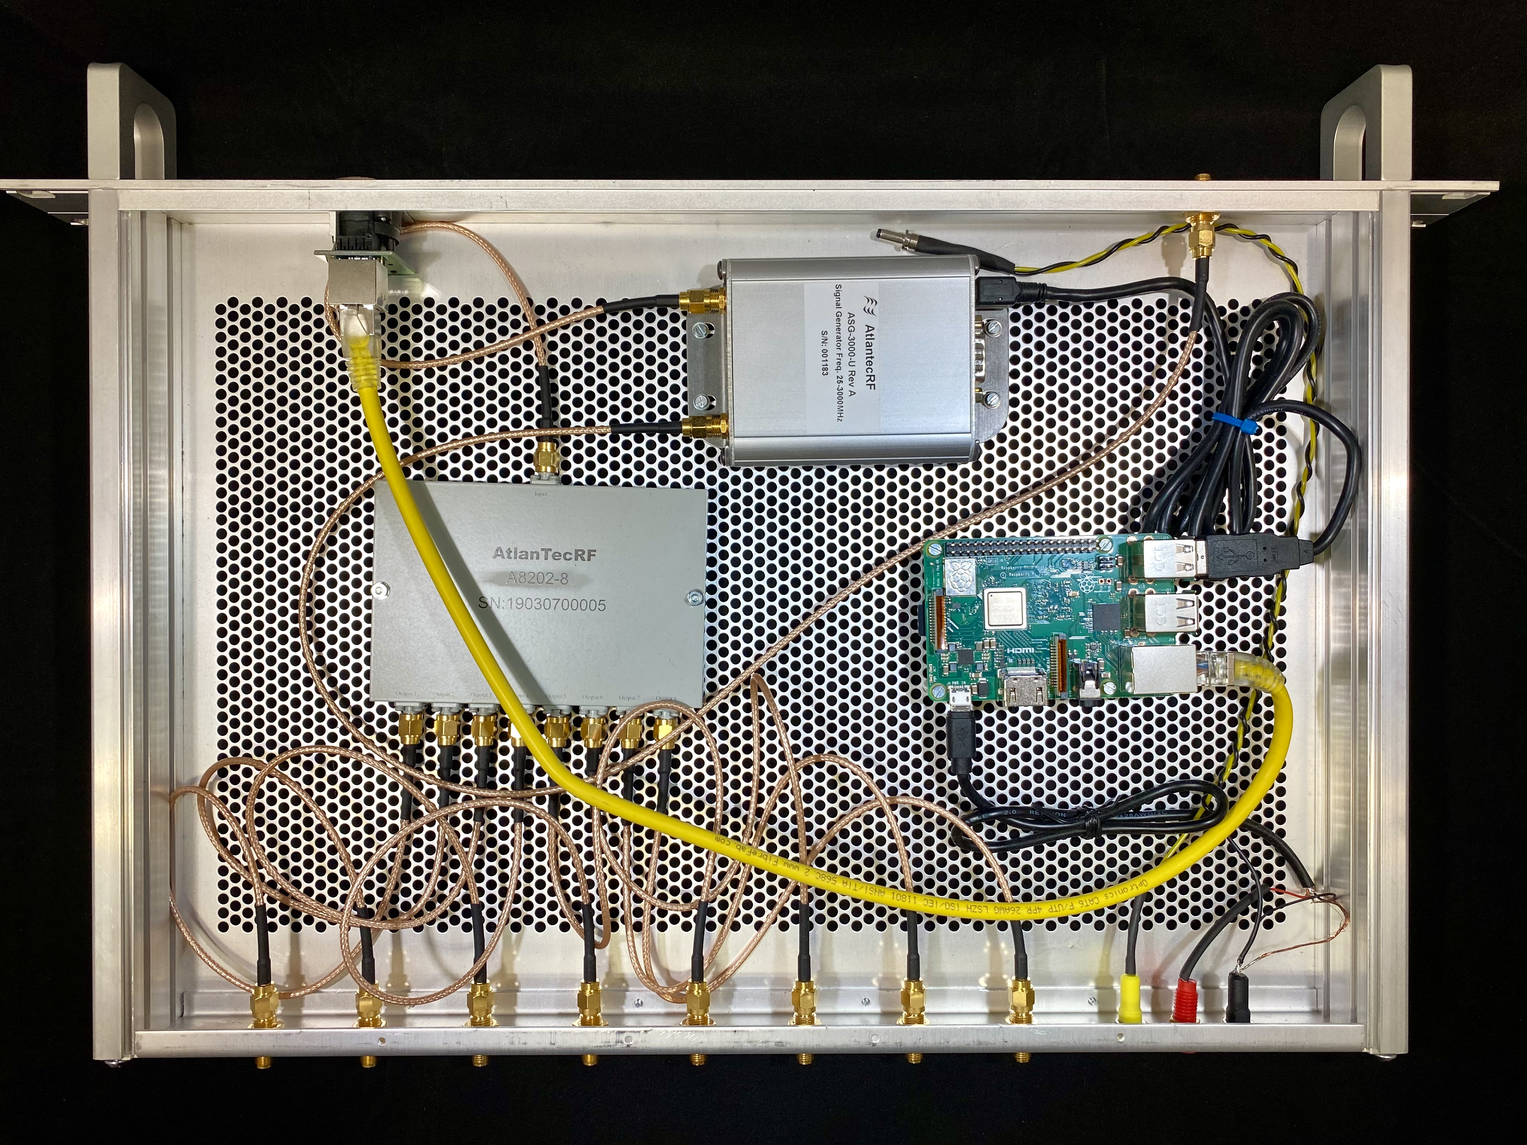
Prototype 1 – Daresbury laboratory
AtlanTecRF ASG-3000
AtlanTecRF ASG-3000
Off the shelf source
25 – 3000 MHz output range
1 Hz resolution
+13 dBm @ 3 GHz
Typical spurs @ -70 dBc
Typical harmonics @ -25dBc
Raspberry Pi
Running custom software written in python that changes the frequency
Enables the source to be network accessible via EPICS for control and monitoring
8-way RF Splitter
Allows for up to 8 channels of RF as Local Oscillators
Raspberry Pi
8-way RF splitter

Slide 8
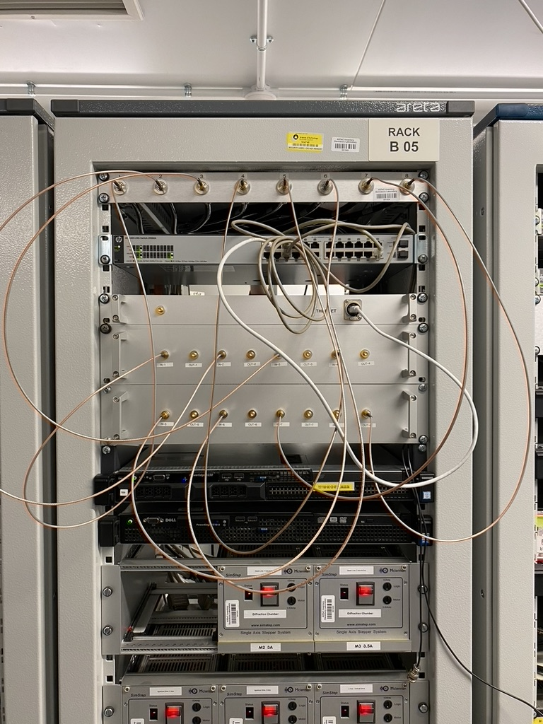
Prototype 1 – Daresbury laboratory
Now installed at Daresbury Laboratory and is awaiting beam time.
A short preliminary test in March 2022 showed the devices was functioning correctly.

Slide 9
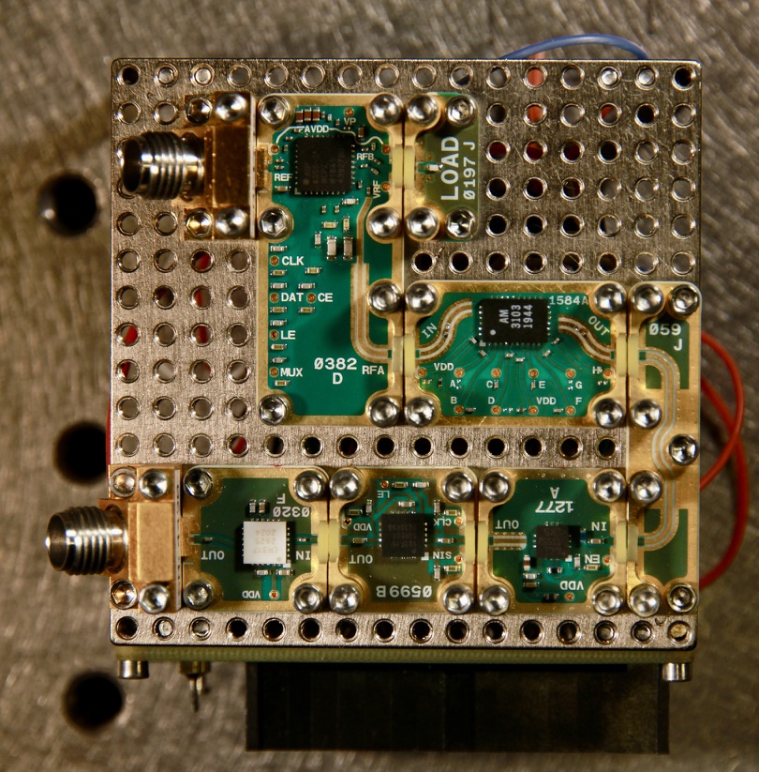
Prototype 2
Prototype two has been the main focus of my project and serves as a proof of concept for what I want to achieve.
50 Ohm load
REF in
Tuneable Band Pass Filter
ADF4355
Amplifier
Pre-amp
RF out
Digital Step Attenuator

Slide 10
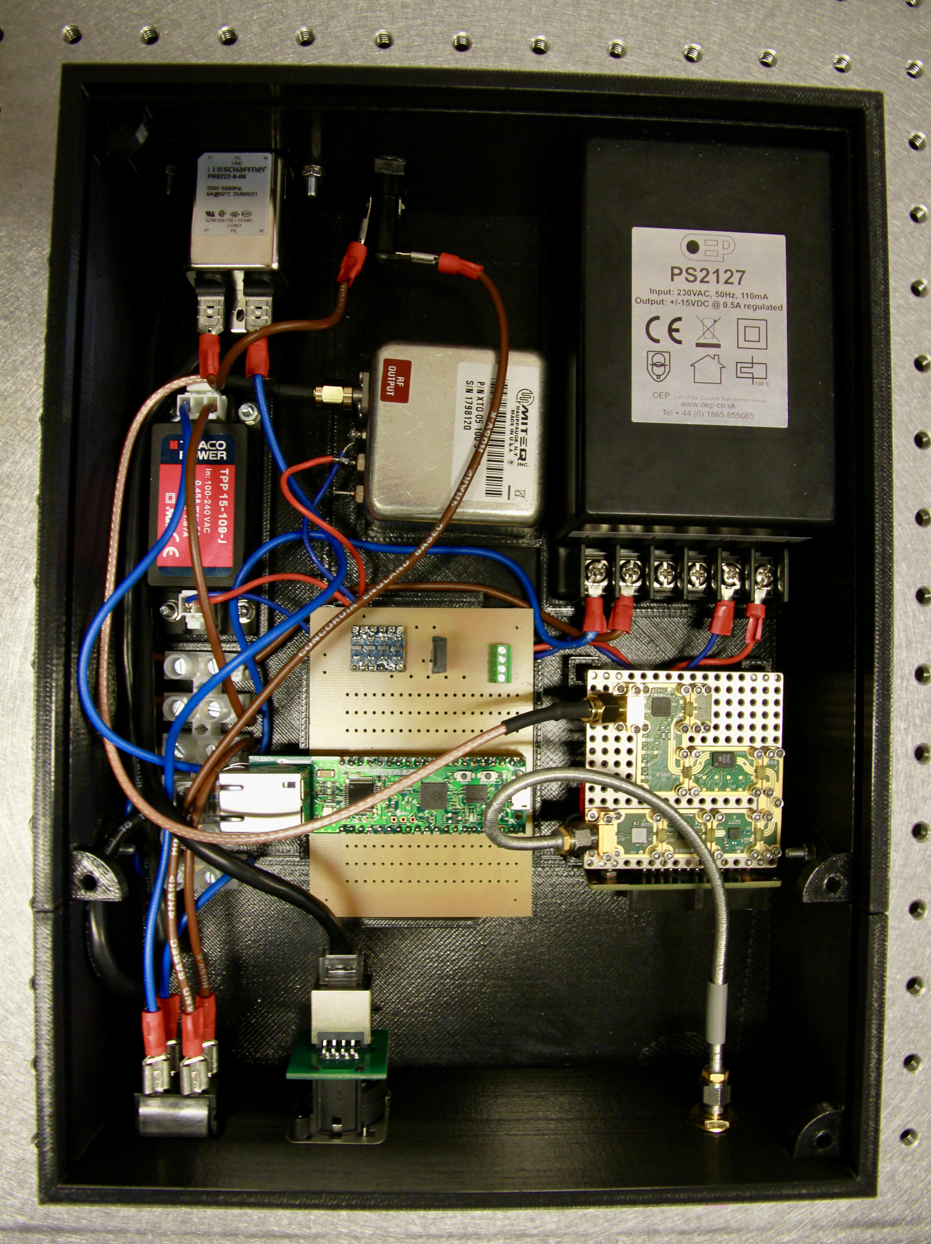
Prototype 2- 1 GHz – 3 GHZ source
230V in
15V power supply for reference source
Ref source
Custom PCB
9V power supply for 1-3 GHz source
1-3 GHz source
Pi Pico with WIZnet Ethernet HAT
Ethernet connection
On/off switch
RF Out

Slide 11
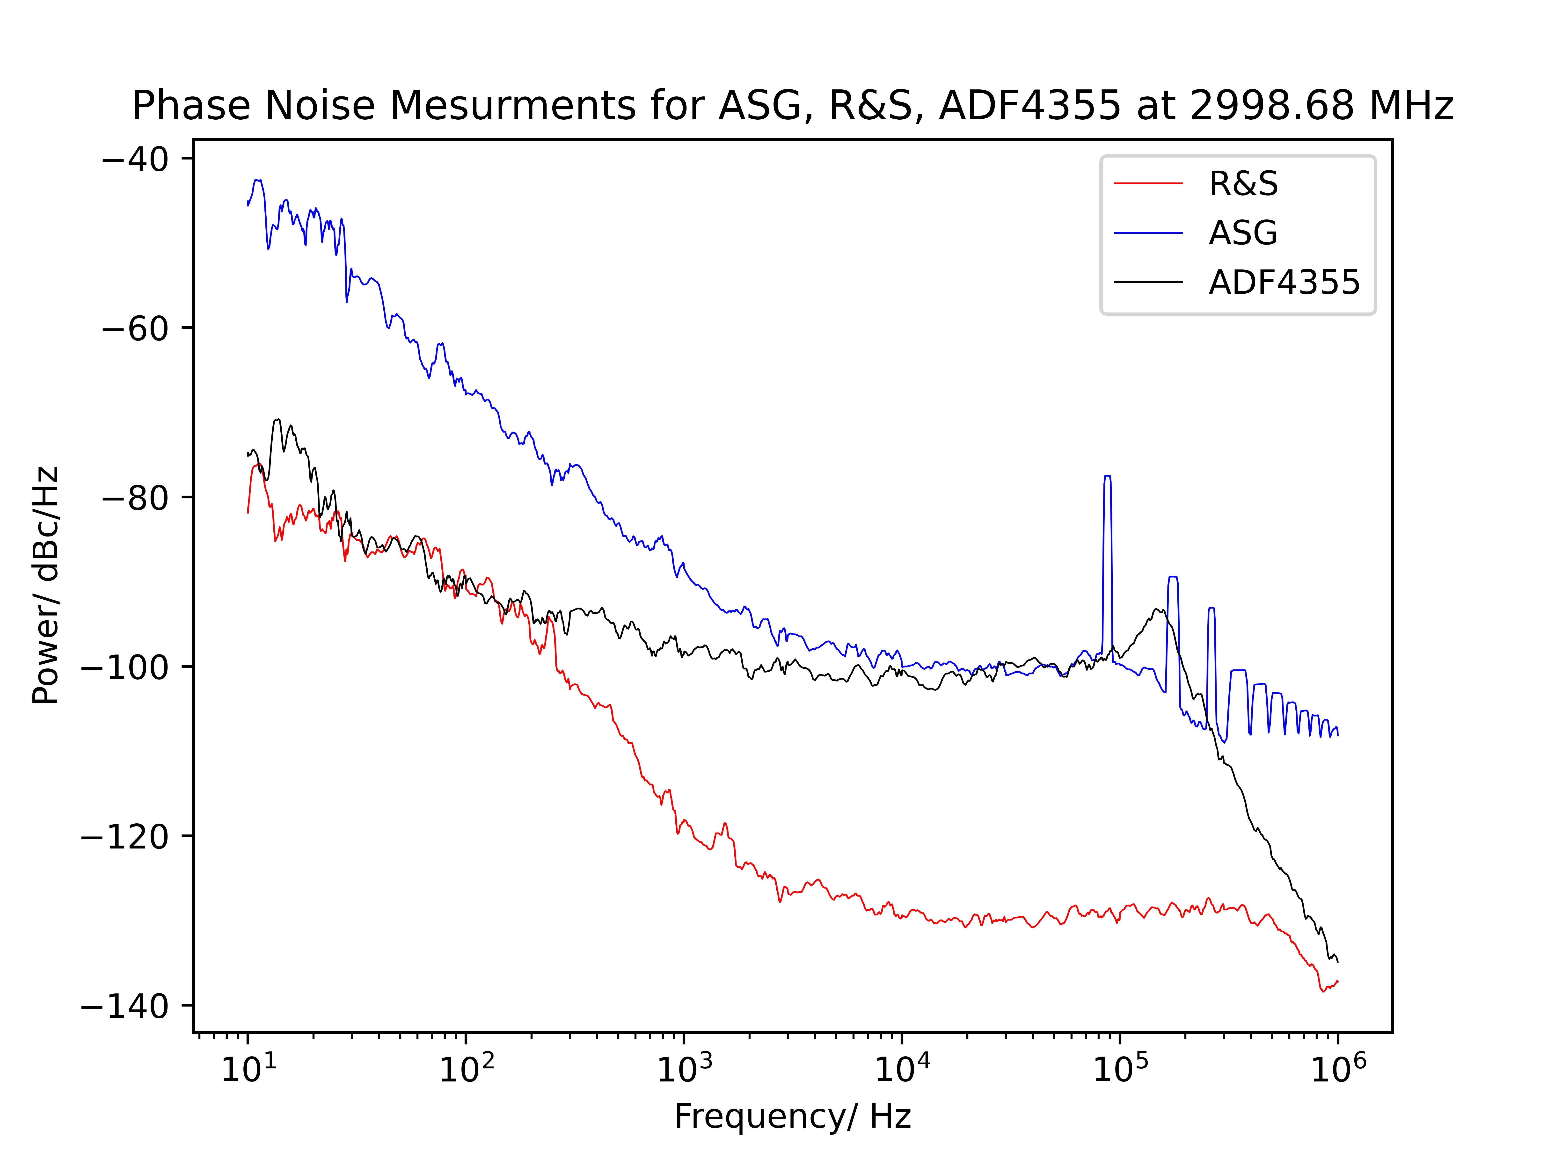
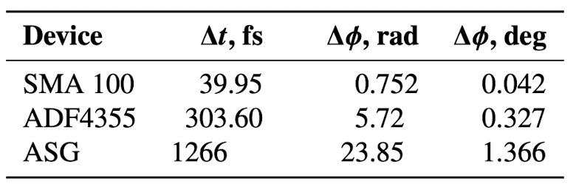
Results of 1-3 GHz source
~ -100 dBc/Hz @ 10 kHz
Timing jitter results for a frequency output of 2998.68 MHz
-130 dBc/Hz @ 10 kHz

Slide 12
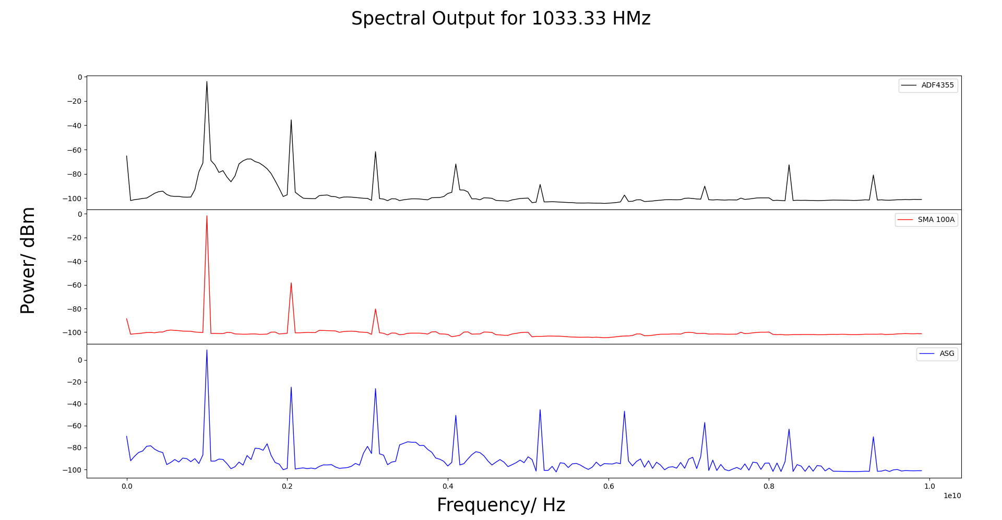
Results of 1-3 GHz source
MHz

Slide 13
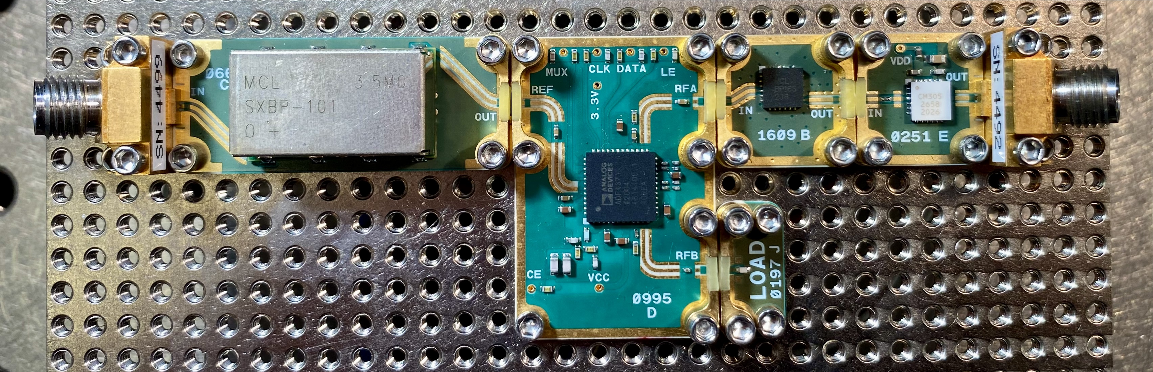
Prototype 3 – 15 GHz source
ADF4371 frequency synthesizer will provide a 15 GHz RF signal for applications at CERN
VCO range: 4 – 8 GHz, max output power: 7 dBm
Filters on the output improve spectral purity
Summer student helped design the PCB
Provide an LO of 15 GHz for cavity BPMs
Band Pass Filter
Low Pass Filter
RF out
REF input
ADF4371
Amplifier

Slide 14
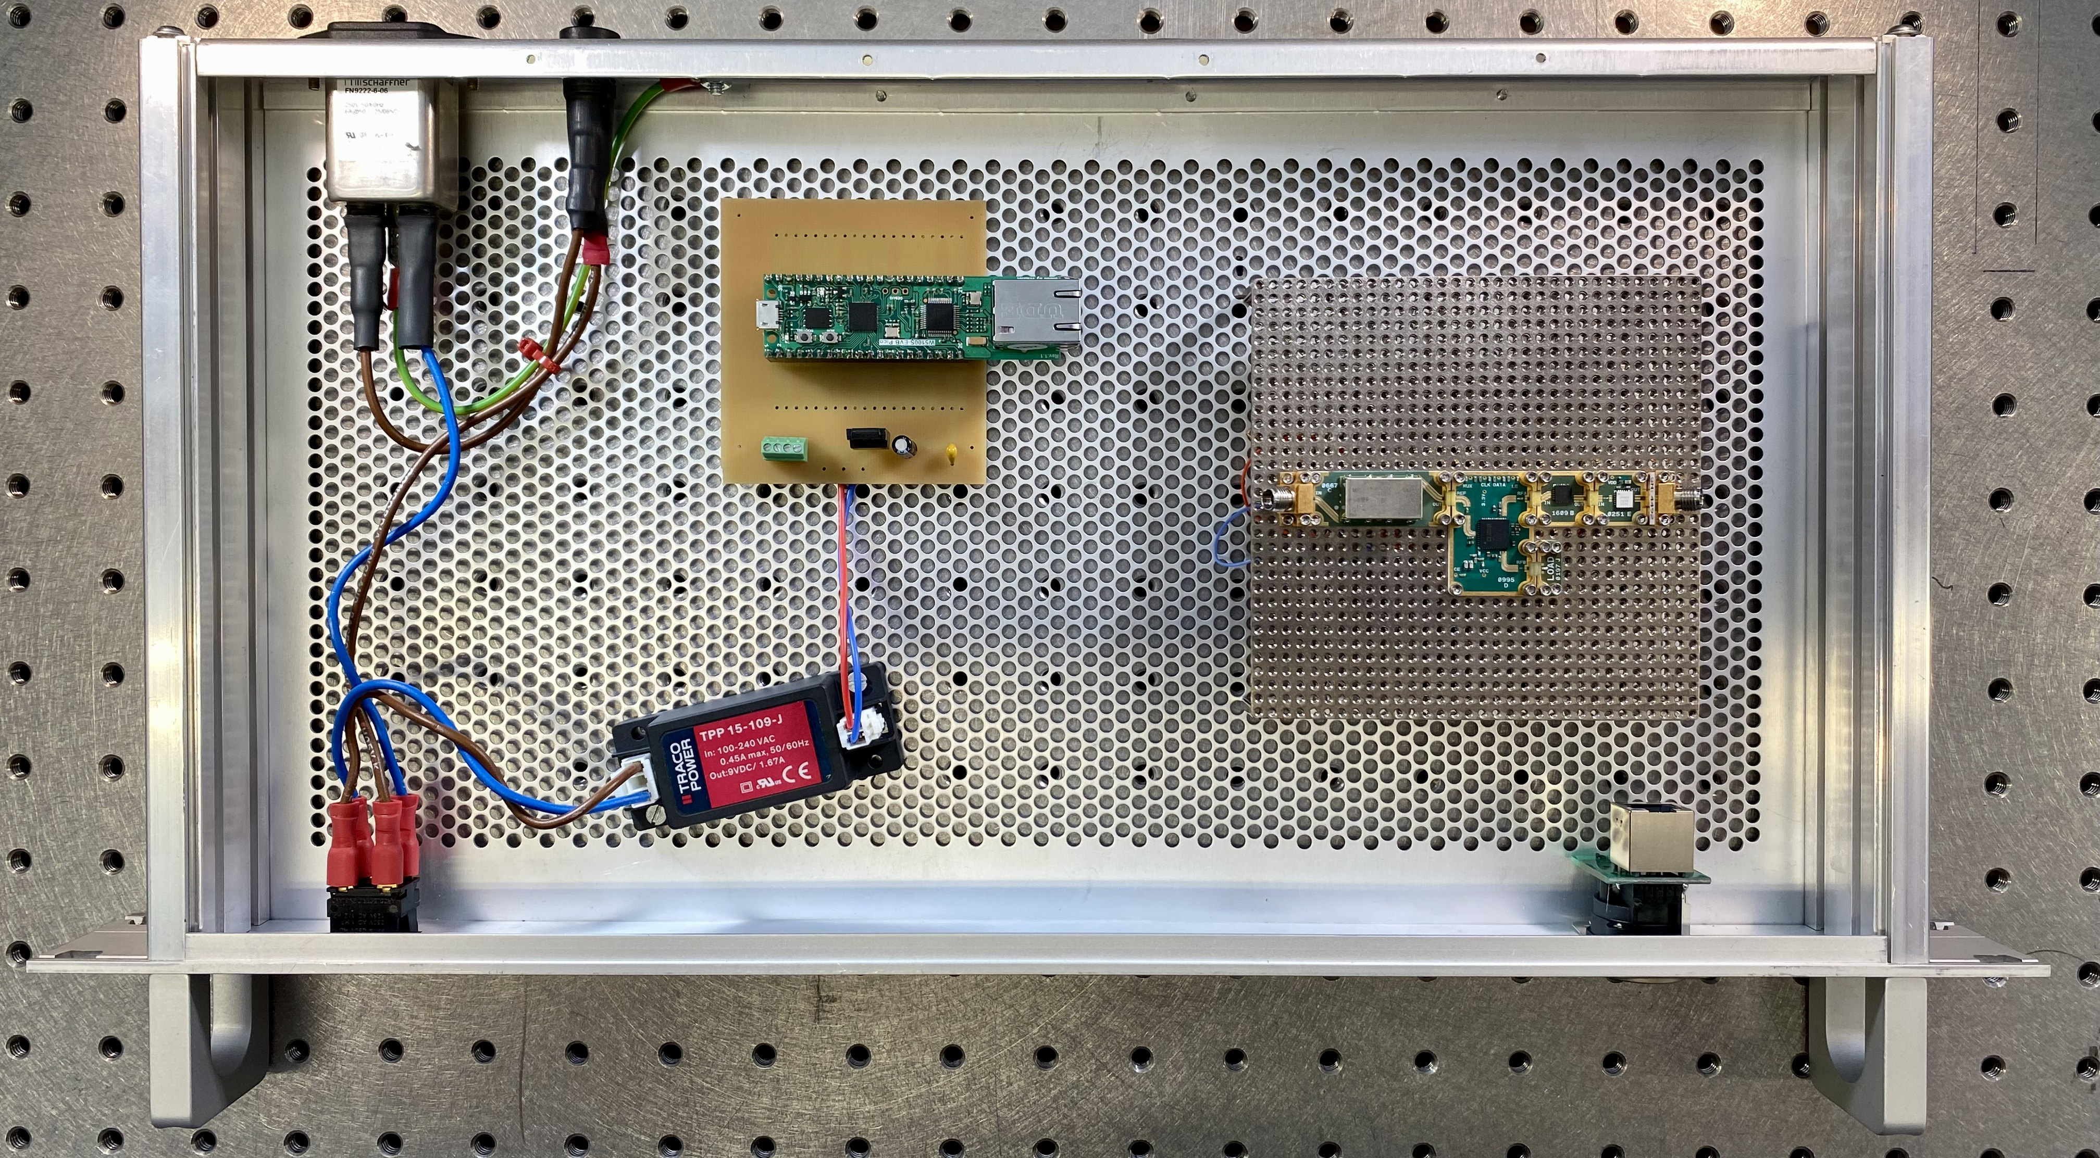
Prototype 3 – 15 GHz source
ADF4371 has a 39-bit fractional modulus. Which means the mathematical capabilities no longer match.
Raspberry Pi Pico
230V in
15 GHz source
Ethernet control
Switch
9V out

Slide 15
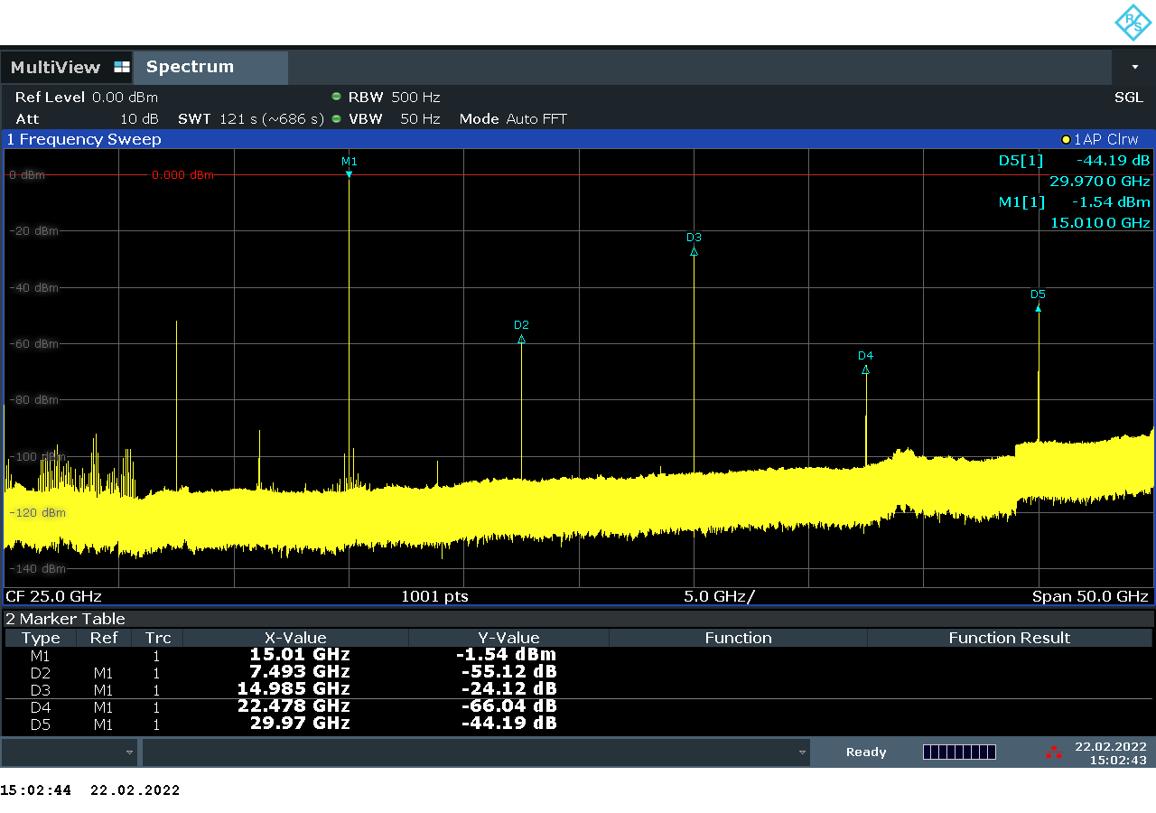
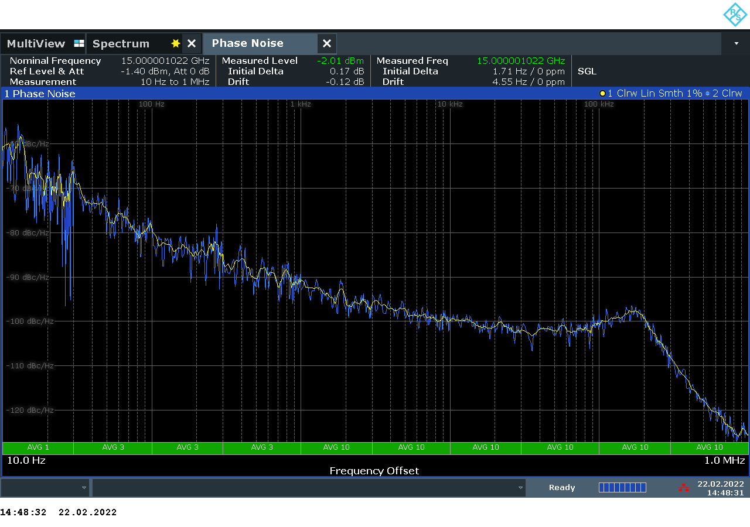
Prototype 3 – 15 GHz source
Spectral output and phase noise measurements for the ADF4371 frequency synthesiser were taken on a Rohde & Schwarz FSW 50 spectrum analyser with built-in phase noise measurements.
-1 dBm
-56 dBm
-25 dBm
-100 dBc/Hz @ 10 kHz

Slide 16
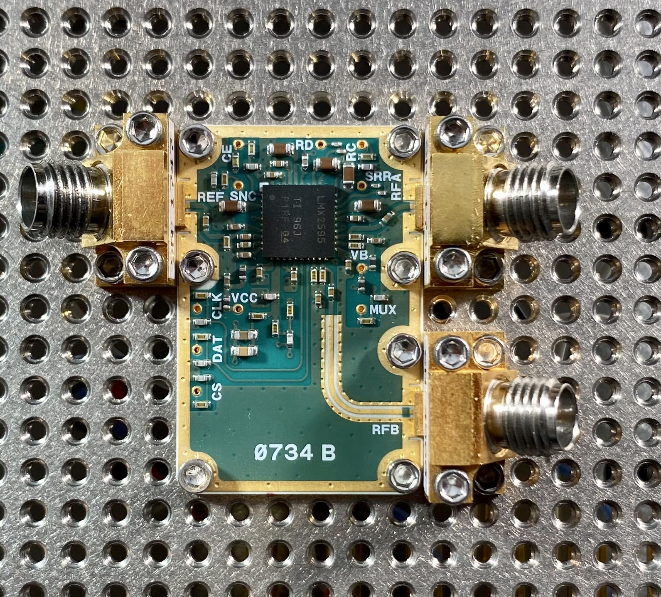

Prototype 4- 0.1 Ghz – 20 ghz
REF in
RF A OUT
0.1 GHz – 15GHz
Texas Instruments LMX2595 frequency synthesizer provides an output of 100 MHz – 20 GHz for applications at CERN
Phase modulation and pulsed source (under investigation)
Covers frequency range we want to explore
Comparable in price to the ADF4355
Control via Raspberry Pi or Pi Pico
Key features of the LMX2595 frequency synthesiser:
0.1 GHz – 20 GHz range
Programmable output power
32-bit fractional-N divider
Support for SYSREF with 9-$ρs$ resolution programmable delay
<20 $μs$ VCO calibration speed
RF B OUT
15GHz – 20 GHz

Slide 17
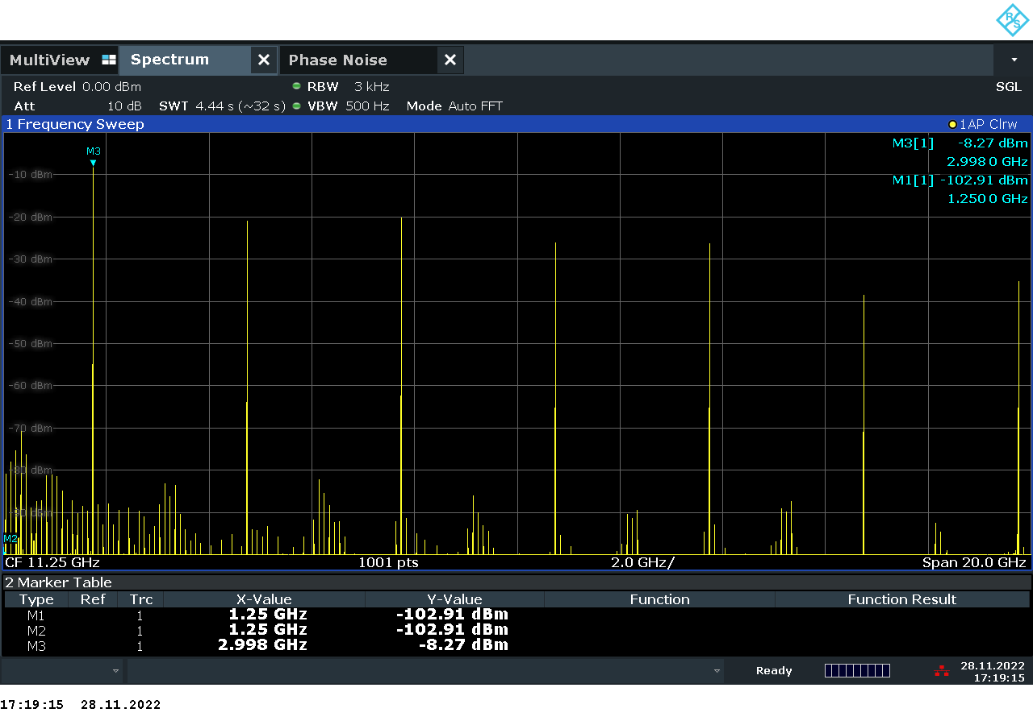
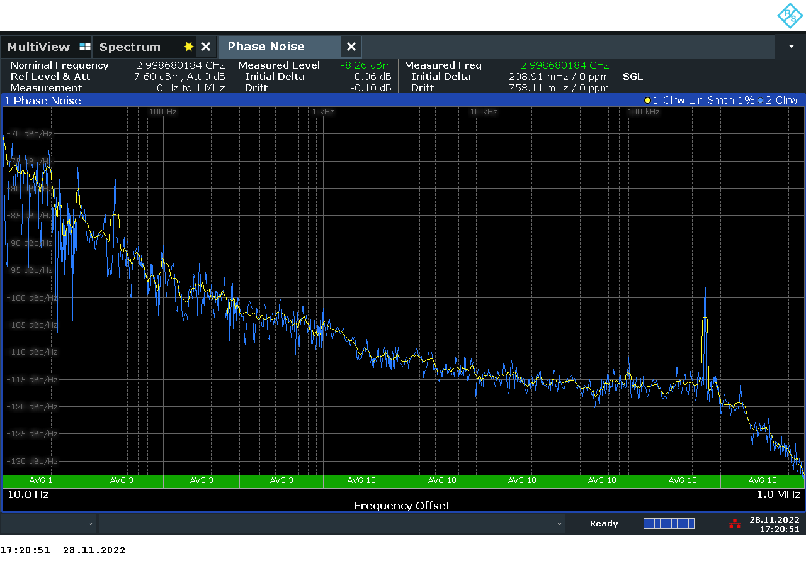
Prototype 4- 0.1 Ghz – 20 ghz
Raw spectral output and phase noise measurements at 2998.68 MHz.
-8 dBm
-21 dBm
-20 dBm
-25 dBm
-115 dBc/Hz @ 10 KHz

Slide 18
Future of the project
Phase Noise @ 10 kHz
1-3 GHz: -100 dBc/ Hz
ADF4371: -100 dBc/ Hz
LMX2595: -115 dBc/ Hz
Develop a preproduction prototype
Based on the LMX2595 frequency synthesiser
Take data from the LMX2595 and apply S21 parameters from filters to see how the spectral output changes/improves
Design custom PCB based on LMX2595 and selected filters
Assemble PCB and test first preproduction prototype

Slide 19
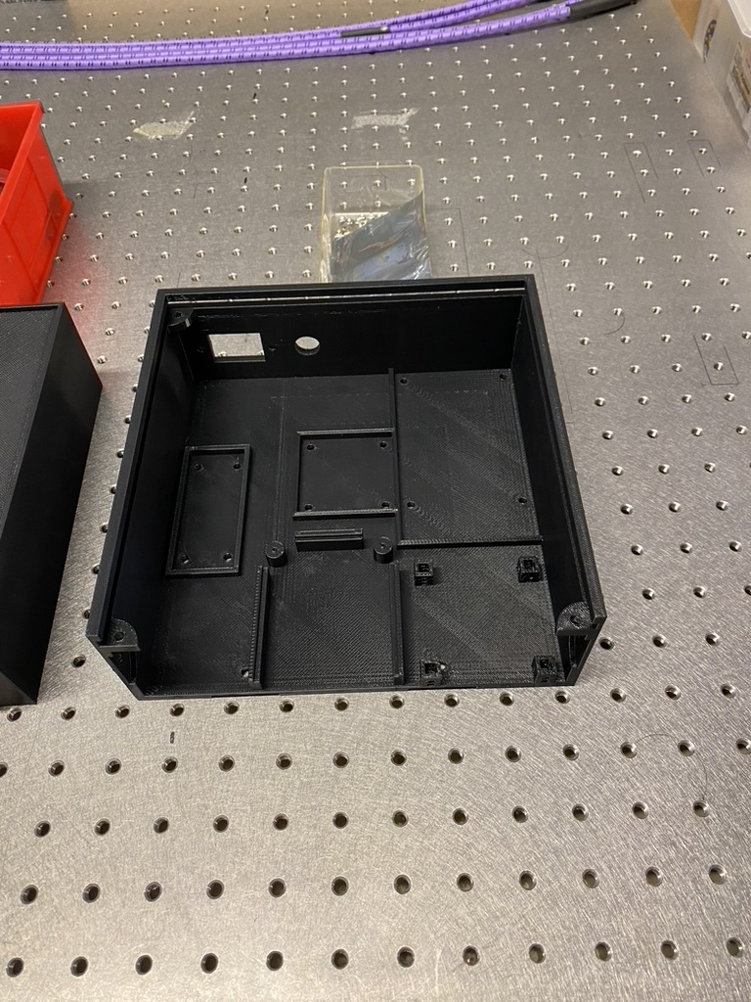
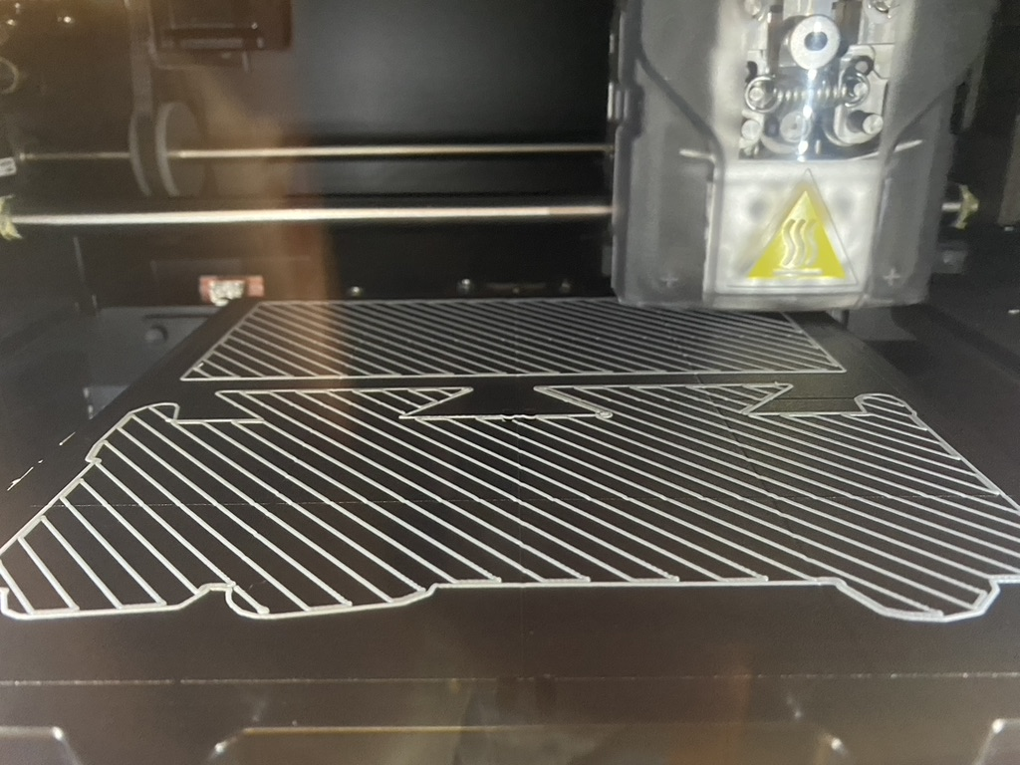
Other interesting aspects of the project
In addition to the RF side of the project, there have been other skills that have been developed along the way.
3D Printing
3D printed housing for 1-3 GHz source
Enables rapid prototyping
Fusion 360 was used to design the housing
Work experience project for two college students
ABS plastic is not the best for shielding against electromagnetic radiation
Production units will be made out of metal to better shield the RF electronics

Slide 20
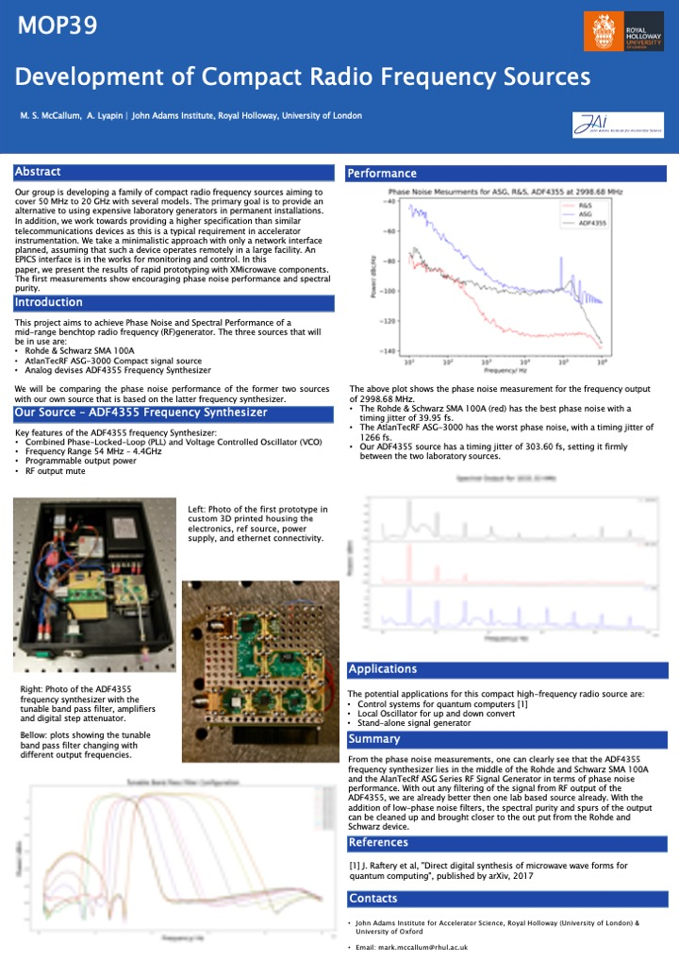
IBIC 2022 – Kraków, Poland
Presented a paper “Development of Compact Radio Frequency Sources”, MOP39*, at IBIC 2022.
Poster presentation
Applied for and was granted the student travel grant for young scientists
Networked and made positive connections within the community
* https://ibic2022.vrws.de/papers/mop39.pdf

Slide 21
Conclusion
Our first prototype of a compact RF source is en route to achieving its goals in terms of signal quality, where we outperform commercially available budget options and in some aspects approach the specs of expensive benchtop Rf generators.
We are on track to produce a pre-production prototype based on the LMX2595.
Thank you for listening!

