Slide 1


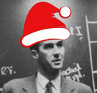

Delivery of treatment beams for Very High Energy Electron FLASH therapy
Cameron Robertson

Slide 2
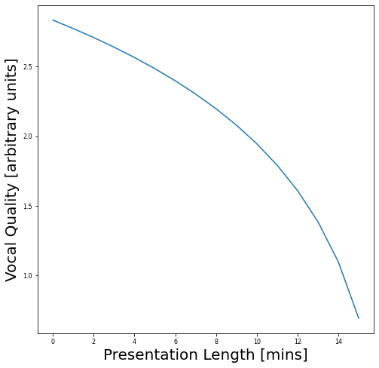
Disclaimer
I'm recovering from an unspecified non-covid illness from last week
My voice may go at some point
Sorry

Slide 3
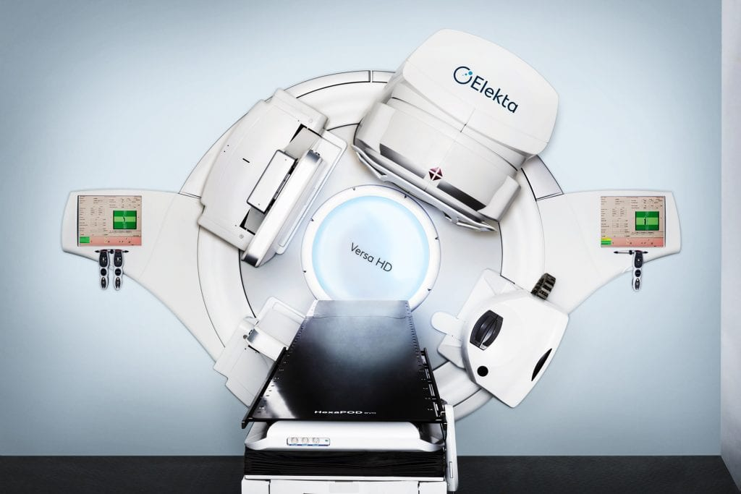
Introduction
Radiotherapy clinically required for ~50% of cancer cases
Conventional X-Ray therapy
  IMRT, VMAT
Particle therapy
  Heavy ions – proton, carbon
  Electrons – superficial tumours
Gantries for multi-directional hadron therapy
Image from GenesisCare

Slide 4
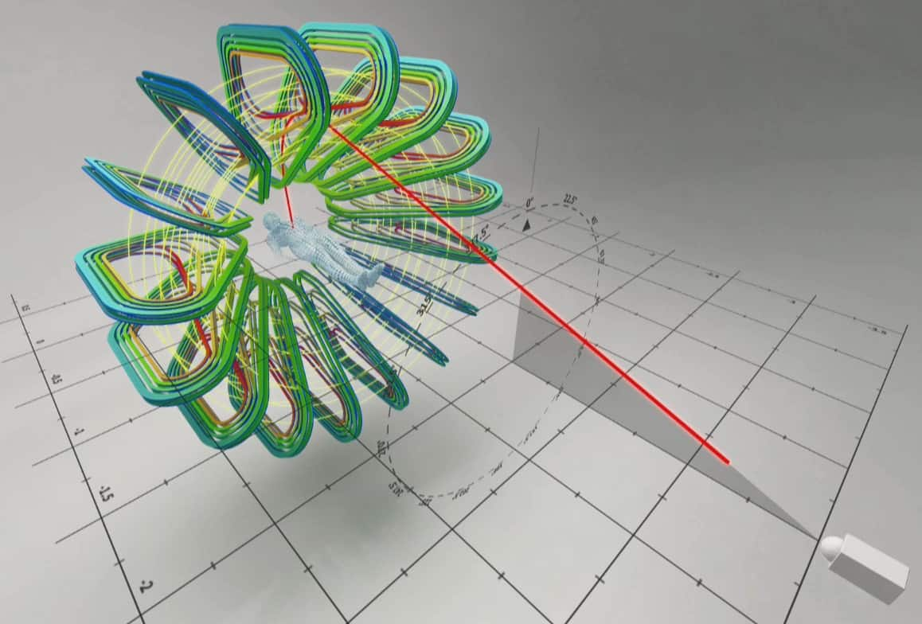
GaToroid
Novel concept for static proton gantry
  Superconducting toroidal system
Conformal treatment from 360 degrees
  Direction defined by initial kicker magnet
Full multidirectional treatment could be carried out at Ultrahigh Dose Rate (UHDR)
FLASH effect
  Normal tissue sparing at high dose rates
Image from L. Bottura, E. Felcini, G. De Rijk, B. Dutoit (2020), GaToroid: A novel toroidal gantry for hadron therapy,Nuclear Instruments and Methods in Physics Research Section A: Accelerators, Spectrometers, Detectors and Associated Equipment,Volume 983

Slide 5
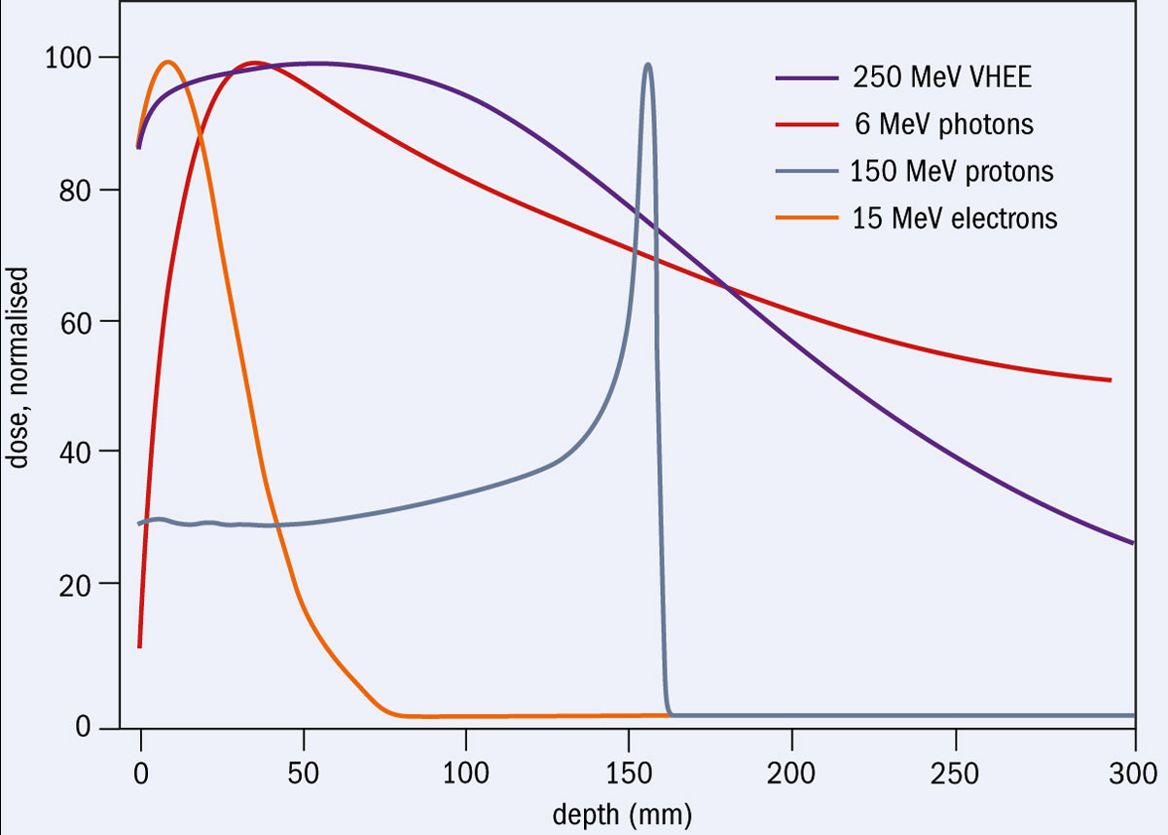
VHEE
Very High Energy Electron (VHEE) Therapy – treatment with electrons above clinically available range
  Capable of reaching deep seated tumours
As yet un-implemented
Encouraging simulated evidence for desirable characteristics
Lower magnetic rigidity than heavy ions for treatment
  Compact acceleration also feasible
Image from Manjit Dosanjh, Roberto Corsin, Angeles Faus-Golf and Marie-Catherine Vozenin (2020), Very high-energy electrons for cancer therapy, Cern Courier

Slide 6
VHEE
+

Slide 7
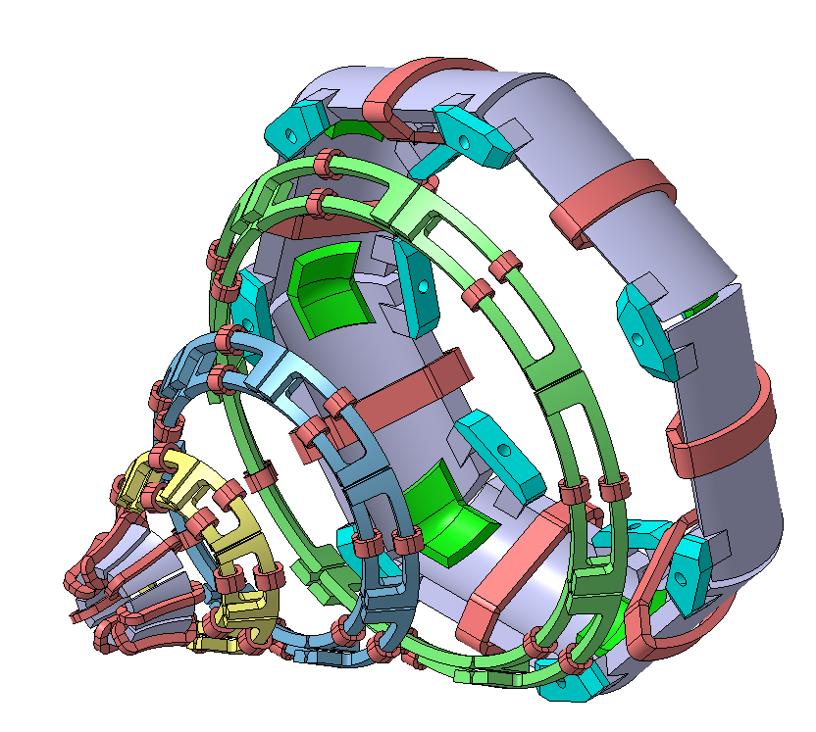
=
VHEE
+
VHEE GaToroid

Slide 8
Advantages of VHEE GaToroid
Achievable with normal conducting magnets
Additional components
  Magnification of beam
  Reduced length
Reduced neutron production from collimation
Tuukka Lehtinen

Slide 9
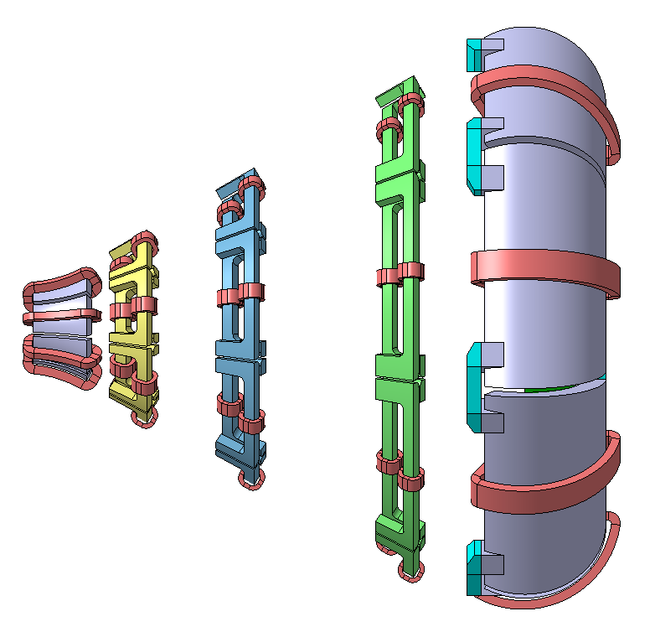
VHEE GaToroid
Septum Dipole

Slide 10
VHEE GaToroid
Septum Dipole
Toroidal Quadrupoles

Slide 11
VHEE GaToroid
Septum Dipole
Toroidal Quadrupoles
Combined Function Dipole

Slide 12
VHEE GaToroid Geometry
Enforce 1.5m Downstream Gantry Radius

Slide 13
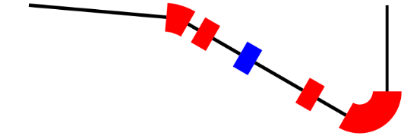
Take the most 'difficult' scenario
Start with small (1mm), flat beam with significant energy spread
Magnify up to 75mm, retaining constant intensity distribution
Enforce low dispersion and maximise transmission of flat region
Minimise quad strengths and required apertures as much as possible
Carried out with simplex minimisation and RF-Track
septum
Quad matching section
Combined Function Dipole

Slide 14
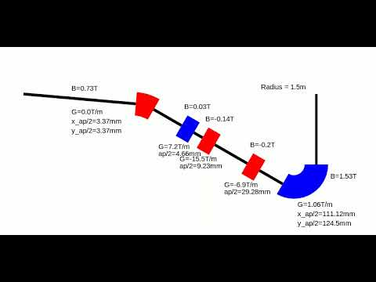
Simplex Minimisation
Characterise final beam distribution with merit function
Carry out minimisations based on simplex algorithm
  Many, many local minima with this method, use repeated random seeds

Slide 15
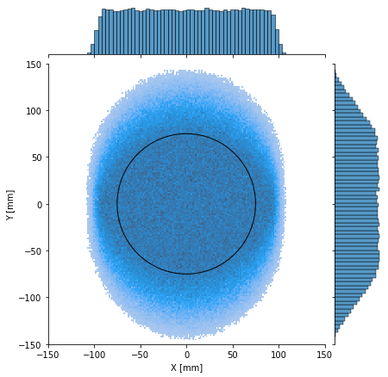
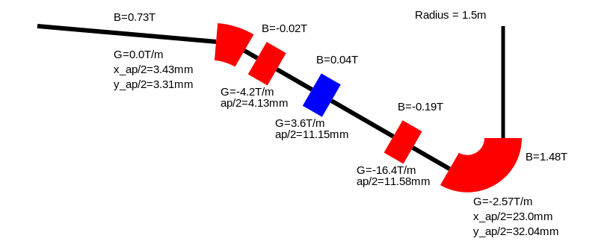
Results
Desired Beam Profile at isocentre
>50% transmission after penumbra colimation
Low required magnet strengths
Lower beam sizes achievable with varied magnet strengths

Slide 16
Take the most 'difficult' scenario
Start with small (1mm), flat beam with significant energy spread
Magnify up to 75mm, retaining constant intensity distribution
Enforce low dispersion and maximise transmission of flat region
Minimise quad strengths and required apertures as much as possible
septum
Quad matching section
Combined Function Dipole

Slide 17
Take the most 'difficult' scenario
Start with small (1mm), flat beam with significant energy spread
Magnify up to 75mm, retaining constant intensity distribution
Enforce low dispersion and maximise transmission of flat region
Minimise quad strengths and required apertures as much as possible
septum
Quad matching section
Combined Function Dipole

Slide 18
Optics Solution Conclusion
Magnification with optics dependent on initial beam distribution
Still valid with appropriate initial beam
  Work in progress on more realistic initial beam
Alternatives for beam magnification and flattening
  Dual Scattering Foil
Fewer magnets could be utilised with alternative system – potentially more cost effective and compact system

Slide 19
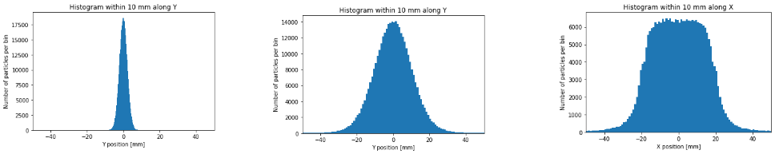
Dual Scattering Foil

Slide 20
Dual Scattering Foil
Insert flat scatterer into beam path to magnify

Slide 21
Dual Scattering Foil
Insert flat scatterer into beam path to magnify
Insert second, Gaussian Shaped scatterer to flatten beam

Slide 22
Dual Scattering Foil
Insert flat scatterer into beam path to magnify
Insert second, Gaussian shaped scatterer to flatten beam
Collimate Gaussian tails

Slide 23
Dual Scattering Advantages and Disadvantages
Pros
Cons
Loss of transmission from collimation
Particle Production: X-Rays and Positrons
Angular alignment still important
Less sensitive to initial beam distribution than optics
Cheap and simple to implement
Easy to provide narrower or broader beams with different scatterers

Slide 24
Characterisation of Dual Scattering for VHEE
Multiple Scattering Theory
Monte-Carlo Simulations
Experiment

Slide 25
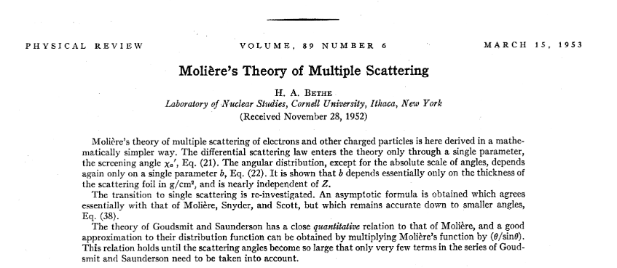
Characterisation of Dual Scattering for VHEE
Multiple Scattering Theory
Monte-Carlo Simulations
Experiment

Slide 26


Characterisation of Dual Scattering for VHEE
Multiple Scattering Theory
Monte-Carlo Simulations
Experiment

Slide 27

Characterisation of Dual Scattering for VHEE
Multiple Scattering Theory
Monte-Carlo Simulations
Experiment

Slide 28
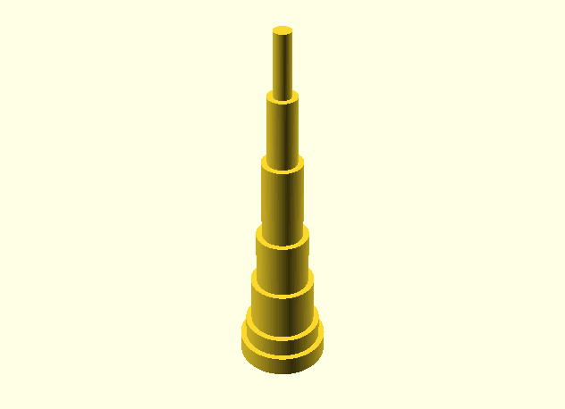
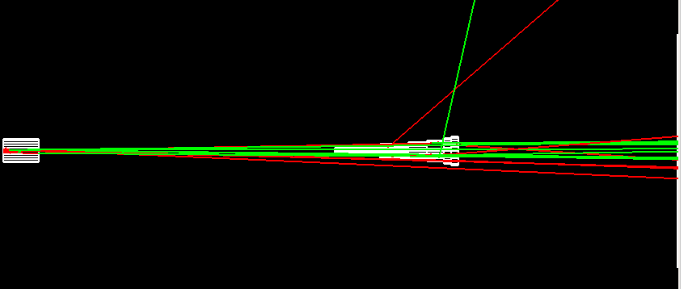
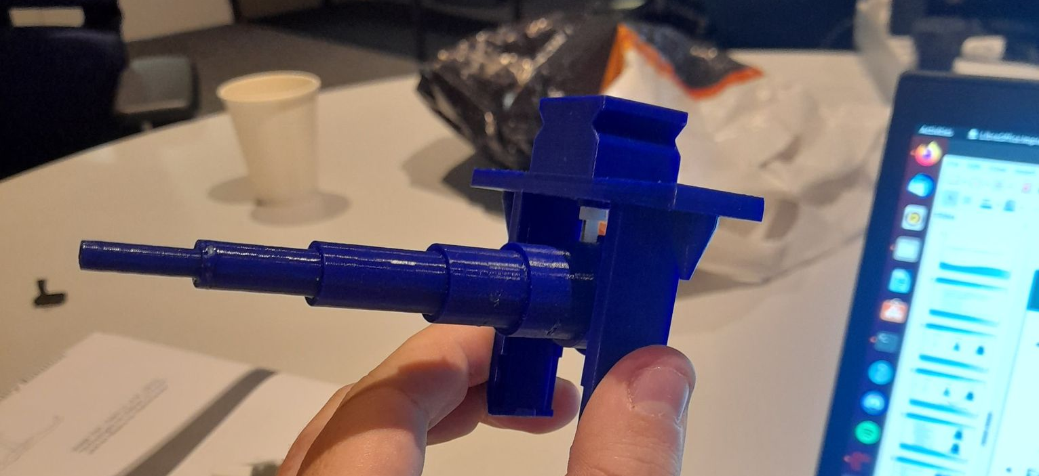
Initial Verification at CLEAR
CLEAR user facility at CERN
  200MeV electron beam
  In-air test stand with ample space
  Flat beam for users also desirable
Plastic Scattering system designed using MC simulations
  YAG screen used to analyse transverse profile

Slide 29
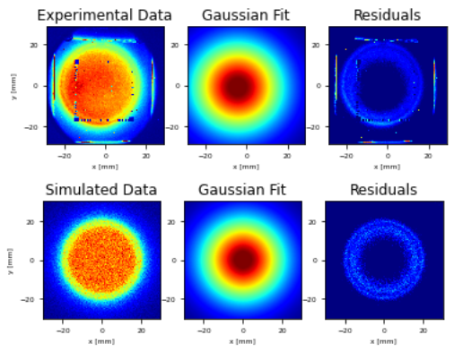
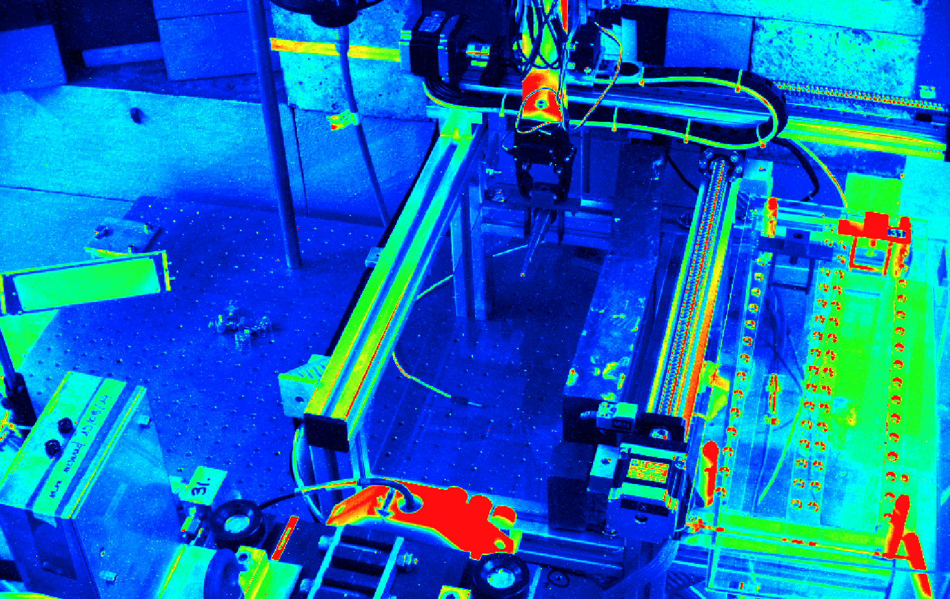
Profile Result

Slide 30
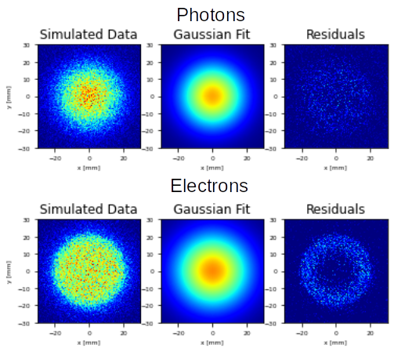
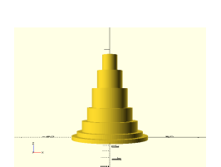
Dose Experiment at CLEAR
Simulations of dual scattering system show flat electron beam, but Gaussian X-Ray beam
Effect on dose in-air investigated
  Dosimetric films held by C-Robot
Aluminium 2nd scatterer used
  Enhanced precision, alignment simpler

Slide 31
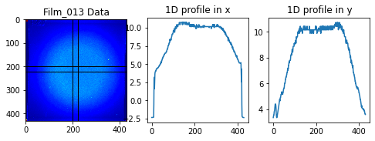
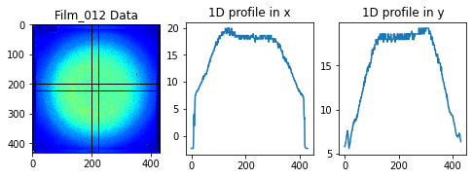
Dose Experiment result
Electron beam dominates dose in air
Double peak in distribution
  More scattering than simulated
  Energy loss with high bunch number?

Slide 32
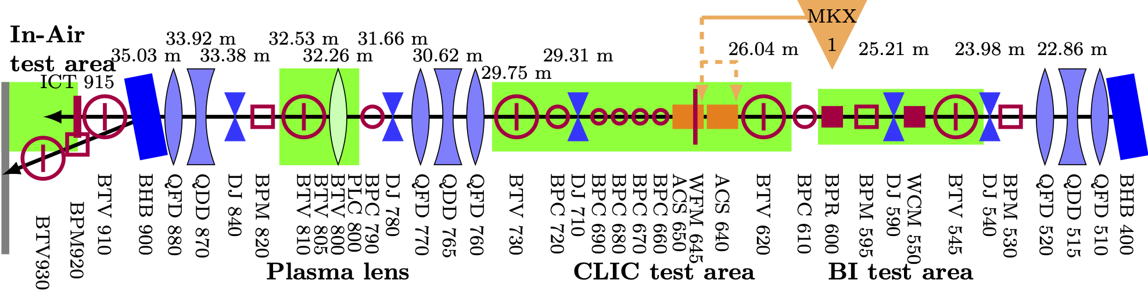
Future Experiments
Flat beam can be provided at Clear with dual scattering system
Simulations and Experiments Required for full characterisation for VHEE implementation and CLEAR studies
  Dose in Water
  X-Ray Component of Dose
  Energy Loss and Energy Spread
Installation upstream in CLEAR beamline could assist with this

Slide 33
Conclusion
VHEE is a promising modality for cancer treatment
VHEE GaToroid capable of magnifying beam with toroidal quadrupoles to irradiate large tumour from multiple angles within FLASH timescale
  Oral presentation at FRPT 2022
Dual Scattering Foil could be a desirable alternative to optics for beam magnification
Simulation-based and experimental characterisation of dual-scattering foils for VHEE is in progress

