Slide 1



Designing a
Low-Energy Beamline for NA61/SHINE
Carlo A. Mussolini
University of Oxford,
CERN (BE-EA)
Supervisors:
P. Burrows
John Adams Institute
N. Charitonidis
CERN (BE-EA)

Slide 2
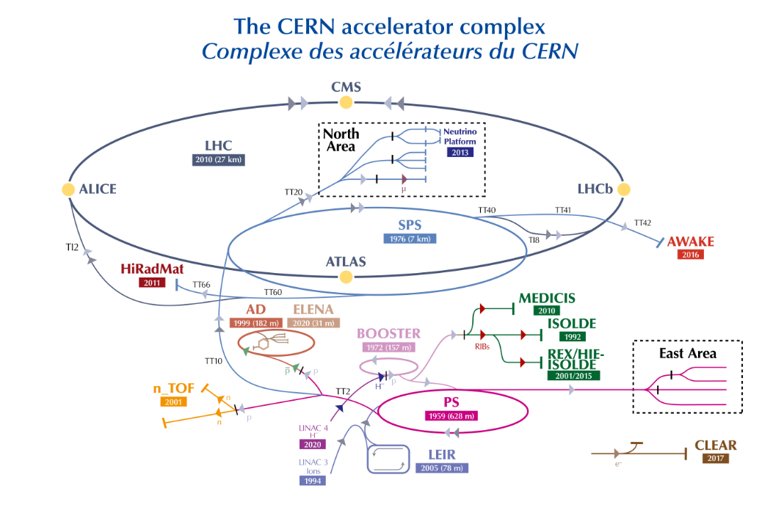
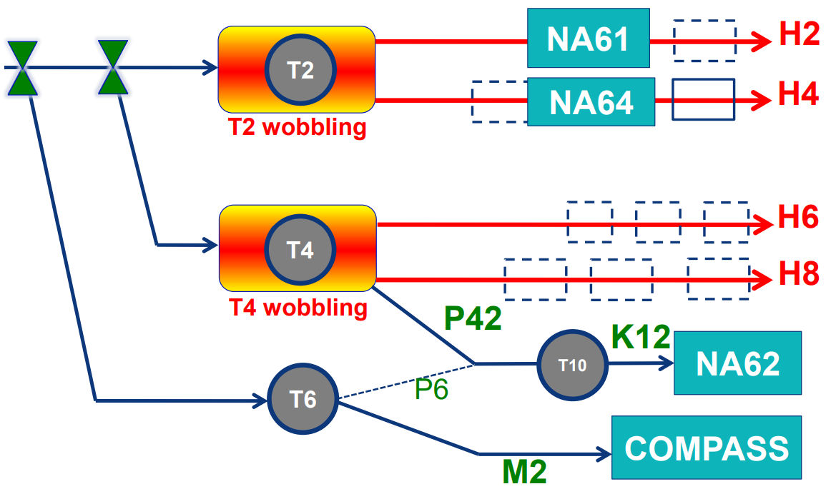
CERN’s North Area
CERN has many experimental areas for a range of physics goals. One of these is the North Area
400 GeV/c protons from the SPS are slowly extracted over 4.8 seconds
Impinging onto a Be target
Can deliver beams from 30-400 GeV/c momentum to several experiments

Slide 3
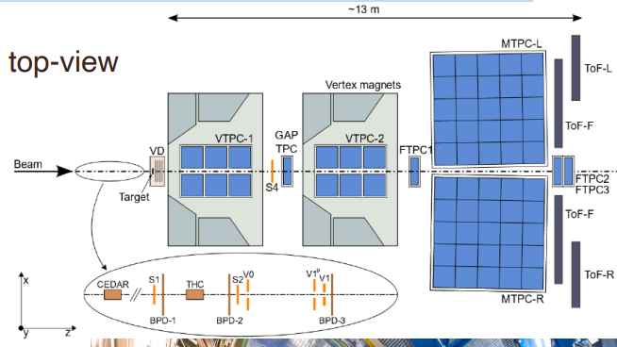
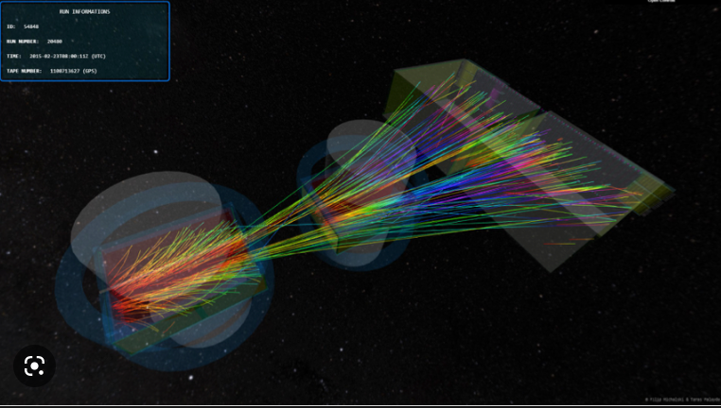
The NA61/SHINE Experiment
NA61/SHINE is a permanent fixed-target experiment served by the H2 beamline
Two main physics goals:
Critical-point searches: investigate the transition between quark-gluon plasma and hadron gas
Neutrino programme: hadron production cross section measurements and replica targets to better predict neutrino flux

Slide 4
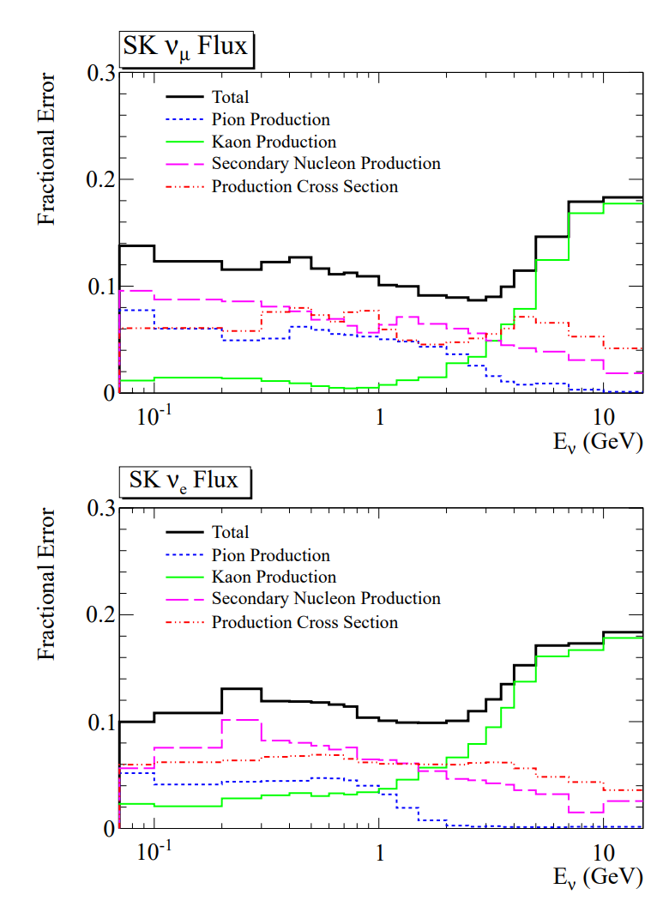
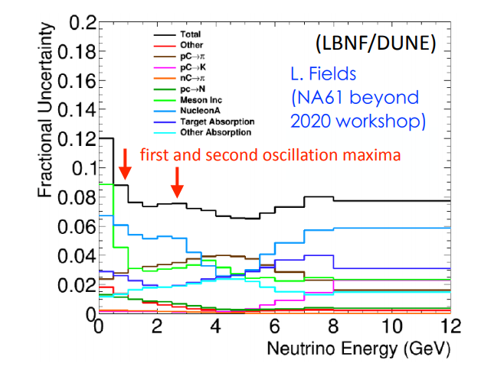
Need for a new low-energy branch
There is a lack of particle production data in the 1 – 13 GeV/c momentum range, results obtained by NA61/SHINE using this beamline could prove to be of great use in reducing the systematic uncertainties of many experiments such as [1]:
T2K
DUNE
Hyper-K
JSNS2
COHERENT
[1] “NA61/SHINE at Low Energy” workshop, December 2020
Plot on left from: L. Fields, Overview and hadron production for LBNF/DUNE, “NA61 beyond 2020” workshop, July 2017
Plots on right from: T2K Collaboration, K. Abe et al., "T2K neutrino flux prediction", in "Phys. Rev. D", vol. 87, p. 012001 (2013)

Slide 5
Need for a new low-energy branch
CERN’s North Area beam facilities offer a unique place for test-beams and fixed target experiments, however low-energy particles are extremely challenging:
SHINE’s current H2 beamline is designed for momenta greater than 300 GeV/c
Limitations on the magnets, the power supplies, and the acceptance
Length is a limiting factor as beamline is too long for low energy particles and many of the pions and kaons decay before they reach the experiments (H2 length to NA61 is 600 m)
For these reasons, a new design has been studied, tailor-made for lower energy particles

Slide 6
Need for a new low-energy branch
The only solution is to modify the current H2 beamline to be able to transport low energy:
Pions 2-13 GeV/c
Protons 1-13 GeV/c
Kaons 8-13 GeV/c
While minimising the lepton contamination and at the NA61/SHINE experiment.
This is done by adding a secondary target and using the primary 400 GeV/c beam to produce secondary particles

Slide 7
How do you design a secondary beamline?
Acceptance Quadrupoles
Final Focusing Quadrupoles
Target Collimator NA61/SHINE Experiment

Slide 8
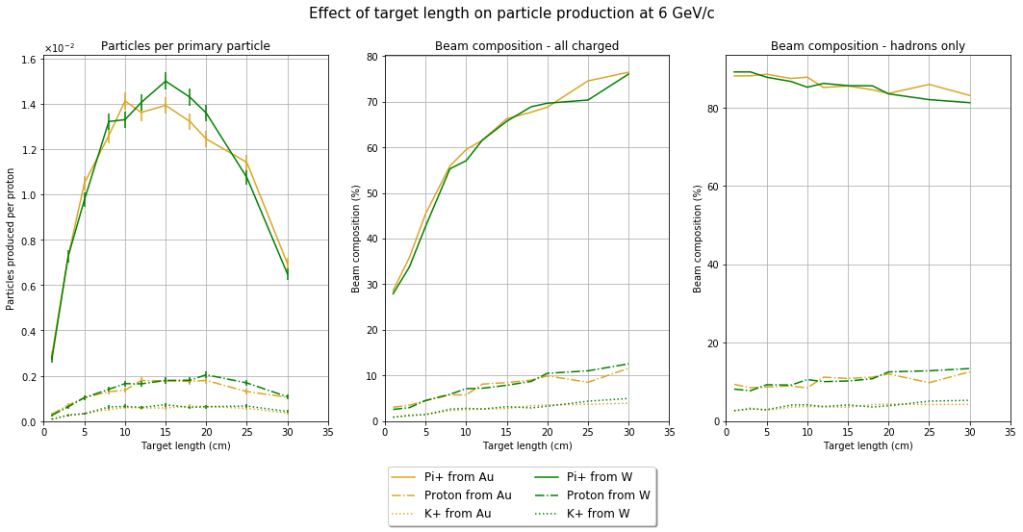
Target optimisation
Attempting to maximise the number of pions, protons and kaons while minimising number of positrons
Simulated many different targets geometries and materials, both high and low-Z
Found that there was a trade-off between rate and beam purity
There is no target which is optimal for the whole energy range for each particle

Slide 9
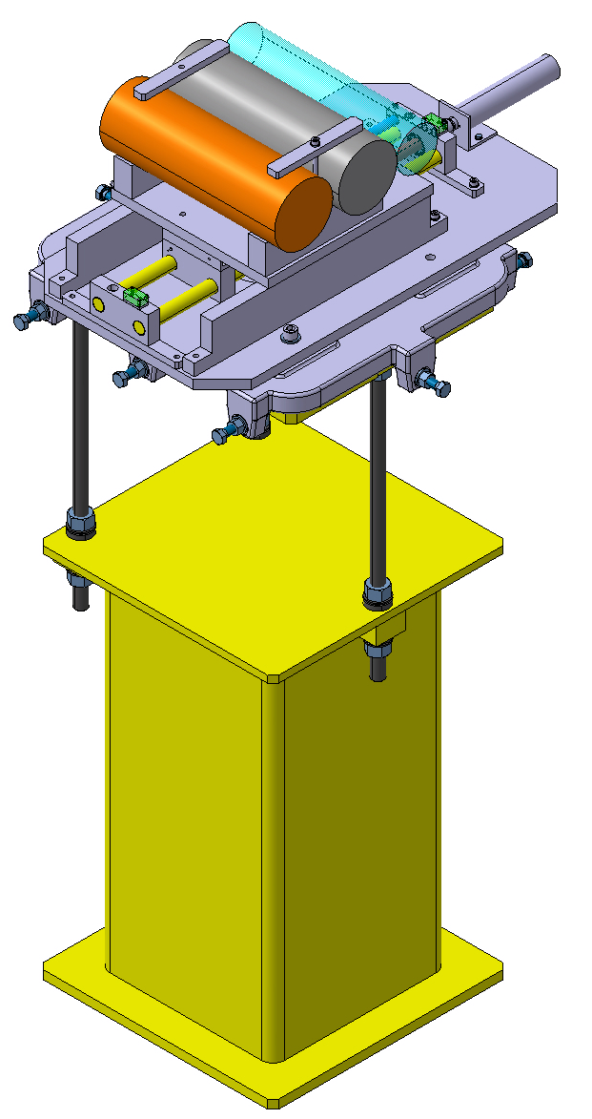
Optimal targets
Since the targets behaved so differently three different targets have been chosen.
For high yields : 20 cm W target with a 400 GeV primary
For balanced : 30 cm W target with a 400 GeV primary
For high hadron compositions : 15 cm W target with a 70 GeV primary
These can be placed on a target switching station which can be operated remotely and NA61 can change the configuration as they desire
Beam

Slide 10
Requirements for the beamline optics
The beamline must:
Have a large acceptance, for a sufficient rate, to be maximised
Be short, minimising particle decays
Have a good momentum resolution, capable of reaching <1% dP/P
Have a small spot size at the NA61 target, <20 mm in both planes
Not be too contaminated by backgrounds, few hundred electrons per spill
All of these requirements are difficult to optimise simultaneously
No analytical formula for phase space acceptance for a whole beamline
Some assumptions usually made (point-like) target do not hold
Matching techniques do not take into account higher order terms and chromaticity
In general matching does not take into account effects on phase space

Slide 11
Solution: a scan of the parameter space
Beamline parameter scan for the back end
(Order 100 M configurations)
Beamline parameter scan for the front end of the beamline
(Order 100 M configurations)
Select beamlines based on acceptance and spot-size on NA61 target
(Order 100s configurations)
Select beamlines based on acceptance and momentum resolution
(Order 100 configurations)
Run tracking code using output of target studies to select the best beamline
Run tracking code using output of target studies to select the best front end

Slide 12
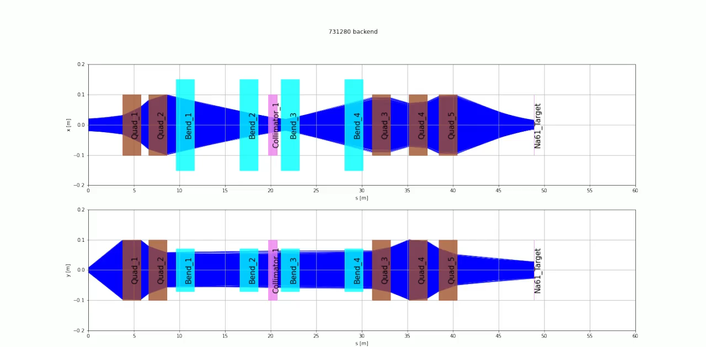
Simulating the beamline

Slide 13
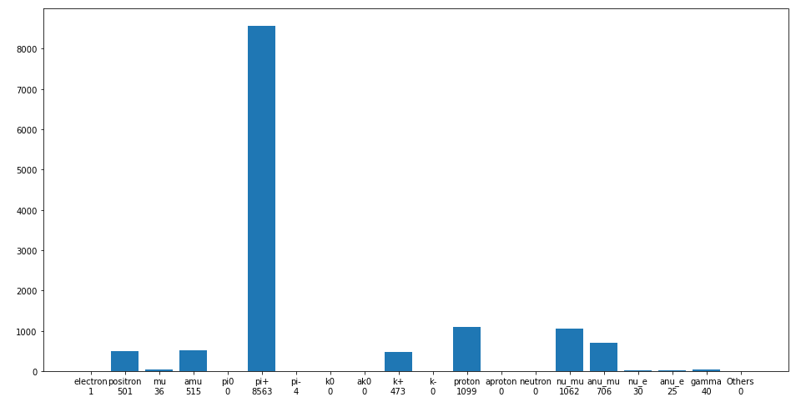
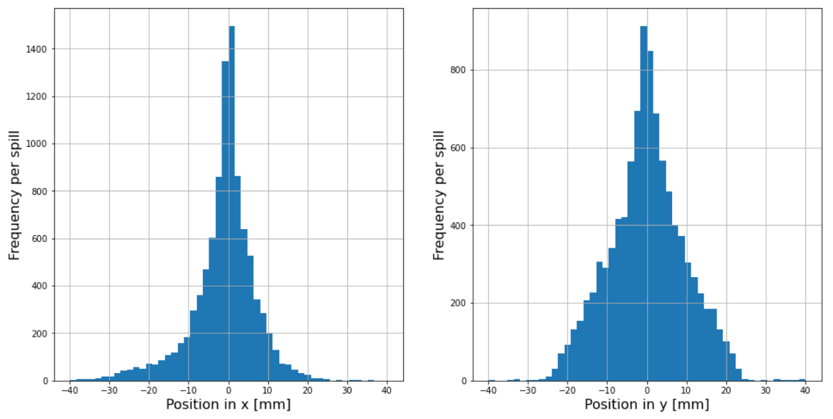
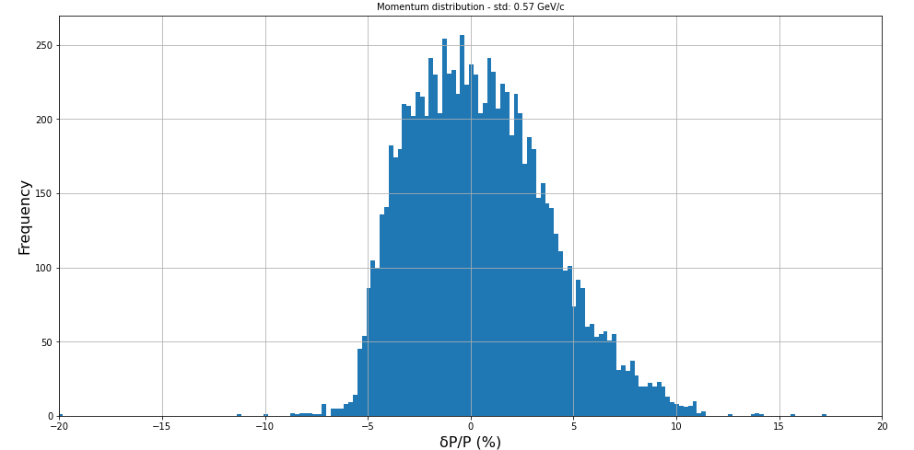
Performance of the line
Run simulations at several energies in the range of 1-13 GeV/c. Checked:
Particle rates
Momentum resolution
Beam-spot
The beamline meets the specifications at all energies

Slide 14
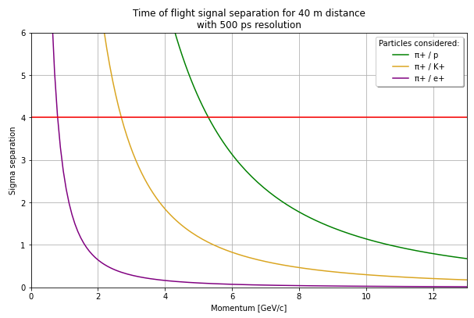
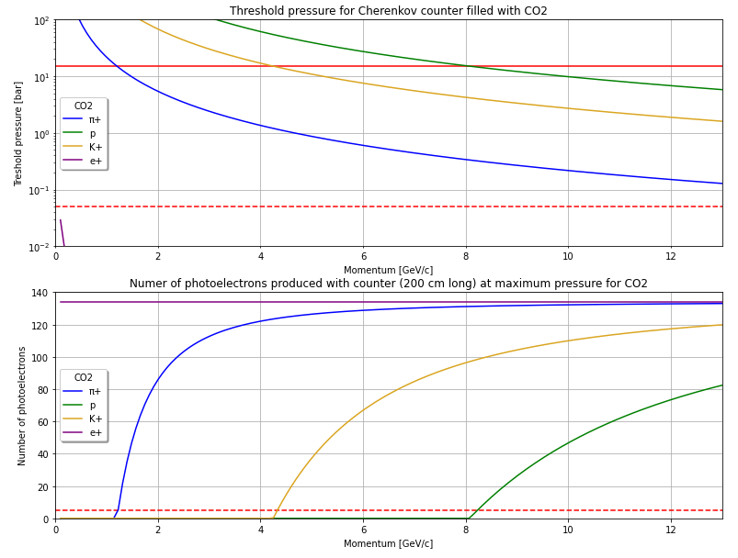
Particle Identification
Necessity for NA61/SHINE to know which type of particles are interacting with their target over the whole momentum range
Use a combination of:
Time of flight detectors for low-energy end of the spectrum
Threshold Cherenkov counters for the higher end of the spectrum
To detect a particle, the pressure has to be above threshold and below the maximum allowed pressure (15 bar)

Slide 15
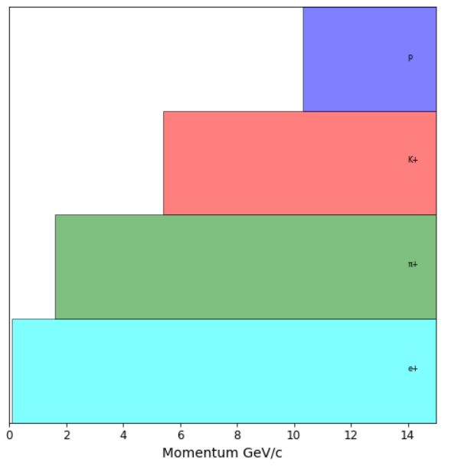
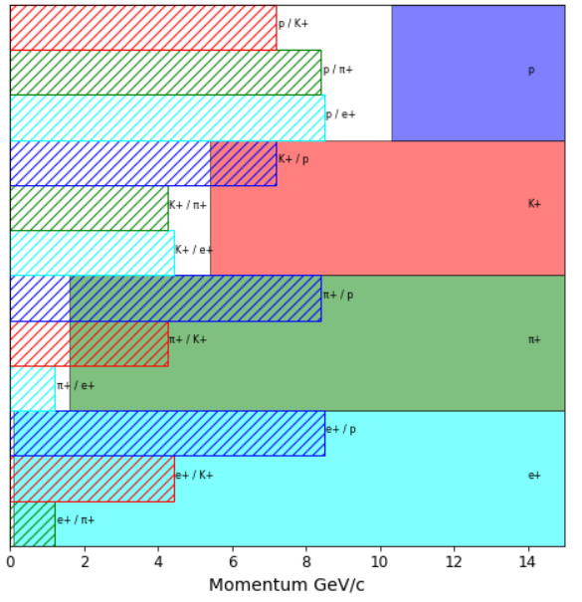
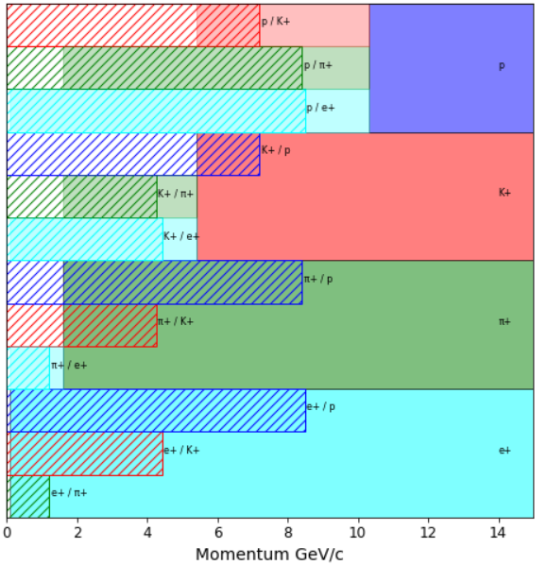
Particle Identification
With ToF
Combine
XCET only

Slide 16

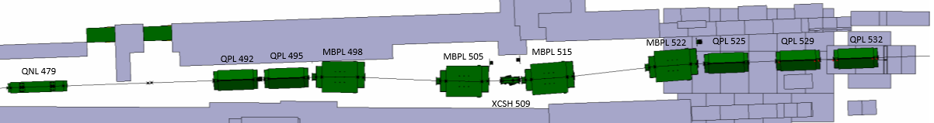
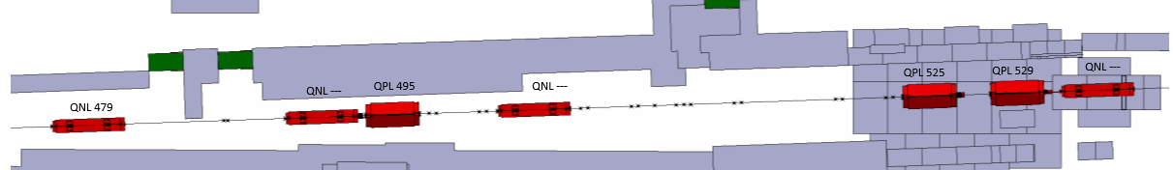

Installation in the North Area
To minimise the switch time between the low-energy and the standard H2 beamline a system using rails is currently being envisioned
Rail system

Slide 17
Conclusion
A new low-energy beamline has been proposed and is in an advanced stage of development:
Optimisation of targets and beamline optics completed
Meeting all requirements set out by NA61/SHINE
Studied the implementation of the beamline a system to switch between low-energy and 400 GeV/c operation in a reasonable timescale
Minimising the impact on the existing experiments
Developed a scheme for the instrumentation to enable particle-by-particle identification

Slide 18
Thank you for your attention
Any questions?

Slide 19
Additional slides

Slide 20
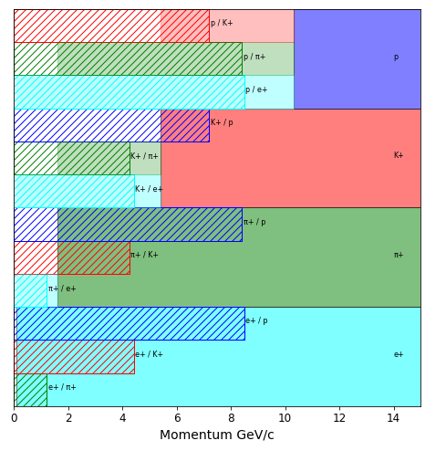
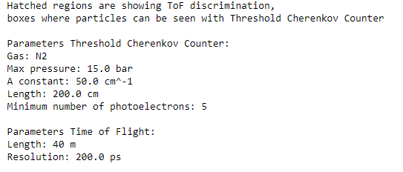
General information on instrumentation

Slide 21
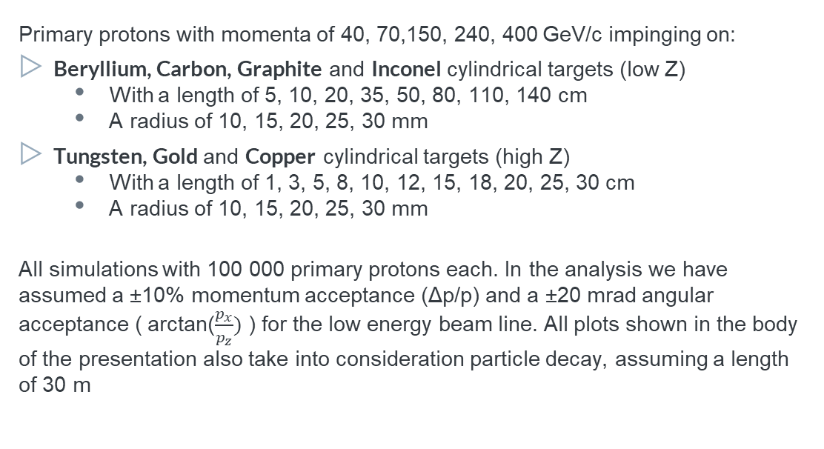
Library of targets and Analysis
Primary protons with momenta of 40, 70,150, 240, 400 GeV/c impinging on:
Beryllium, Carbon, Graphite and Inconel cylindrical targets (low Z)
  With a length of 5, 10, 20, 35, 50, 80, 110, 140 cm
  A radius of 10, 15, 20, 25, 30 mm
Tungsten, Gold and Copper cylindrical targets (high Z)
  With a length of 1, 3, 5, 8, 10, 12, 15, 18, 20, 25, 30 cm
  A radius of 10, 15, 20, 25, 30 mm
All simulations with 100 000 primary protons each. In the analysis we have assumed a ±10% momentum acceptance (Δp/p) and a ±20 mrad angular acceptance ( arctan($\frac{p_{x}}{p_{z}})$ ) for the low energy beam line. All plots shown in the body of the presentation also take into consideration particle decay, assuming a length of 30 m

Slide 22
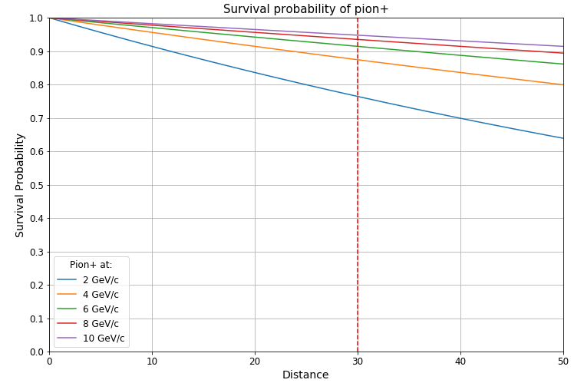
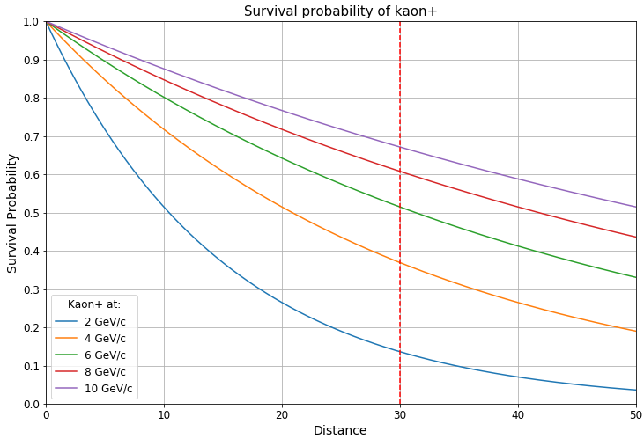
Expected survival in beamline
With a 30 meter beamline we expect a survival of above 75% for pions at all energies
For Kaons, we expect a survival of 13.6% @ 2 GeV/c, 36.9% @ 4 GeV/c, 51.4% @ 6 GeV/c

Slide 23
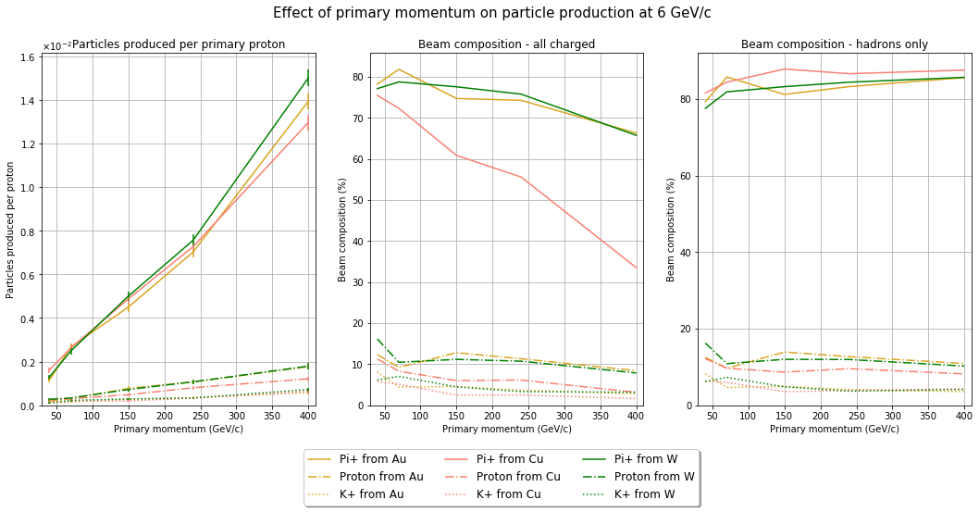
Effects of primary momentum (High Z)
Primary momentum
Considering a realistic beam on 15 cm long targets
Trade off between high particle yields and beam composition
Electron suppression may be necessary

Slide 24
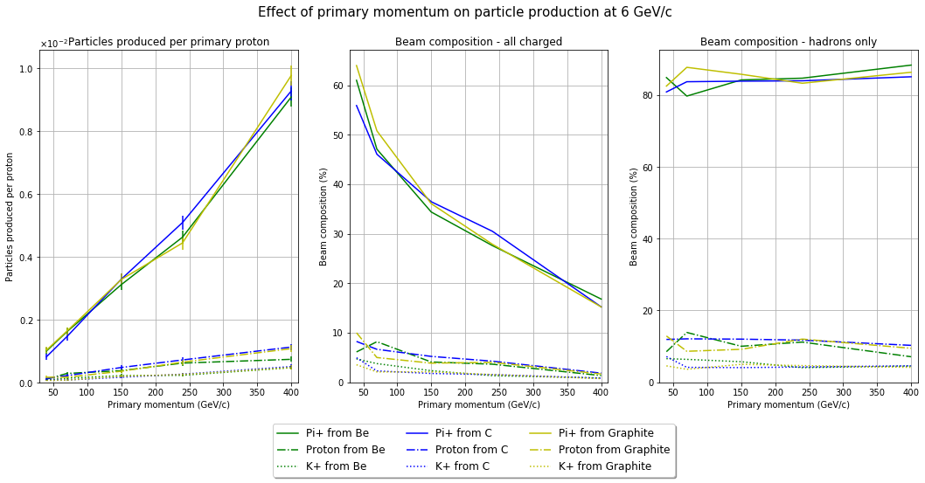
Effects of primary momentum (Low Z)
Primary momentum
Considering a realistic beam on 80 cm long targets
Trade off between high particle yields and beam composition
Electron suppression may be necessary

Slide 25
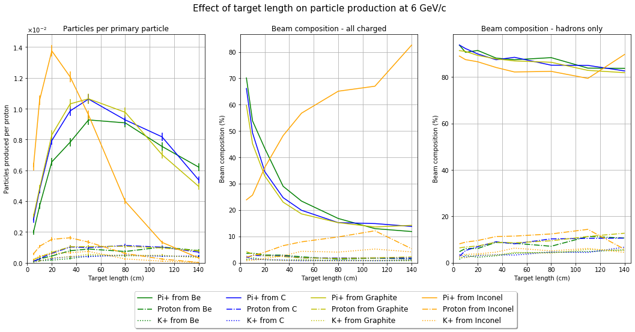
Effects of length (Low Z)
Target Length
Considering a realistic beam at 400 GeV/c
Trade off between high particle yields and beam composition
Electron suppression may be necessary

Slide 26
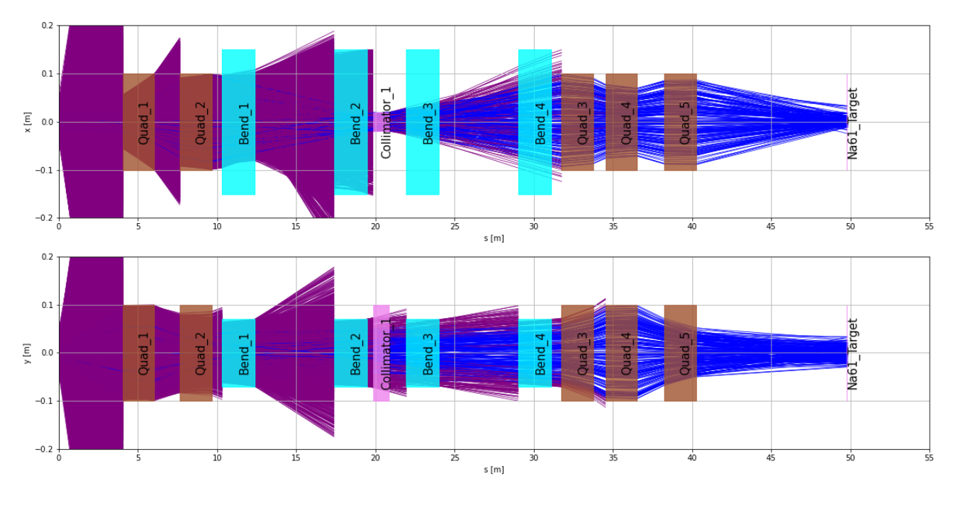
Beamline design
Tracks which do not reach the end of the line are shown in purple. The back end does not significantly affect the overall acceptance, so back end and front end can be designed separately

Slide 27
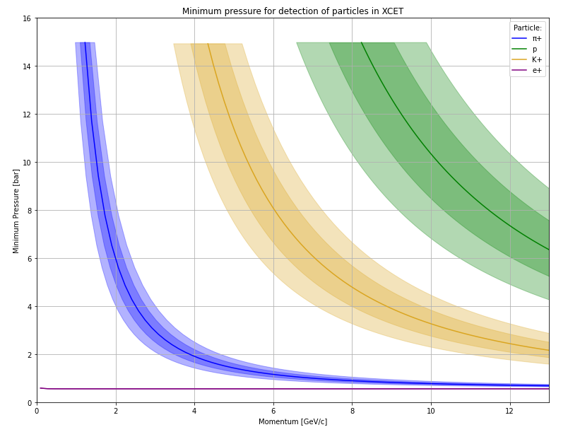
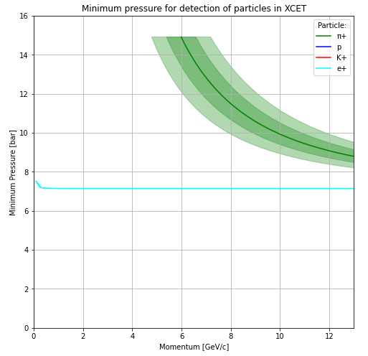
XCET Resolution
To detect single particles we need to pick a pressure where we have no uncertainty over what is scintillating.
CO2 (left) works everywhere except for separating pions and electrons, but this can be solved by using He in one of the XCET

