Slide 1
Advanced Acceleration
Zulfikar Najmudin
The John Adams Institute for Accelerator Science, Imperial College London
JAI Advisory Board
Thursday 7 April 2022
              http://www.adams-institute.ac.uk http://www3.imperial.ac.uk/johnadamsinstitute

Slide 2
JAI Advanced Acceleration Effort
Institute | Staff | Projects
Imperial | Ken Long, Stuart Mangles, Zulfikar Najmudin, Jaroslaw Pasternak, Juergen Pozimski, Steve Rose | Wakefield Acceleration, Ion Acceleration, Betatron radiation, High-Field Physics, HEDP Lhara, AWAKE, ELI-ALPS, EuPRAXIA, J-Karen, CALA
Oxford | Phil Burrows, Brian Foster, Simon Hooker, Peter Norreys, Roman Walczak | Wakefield Acceleration, AWAKE, EuPRAXIA, FlashForward, CALA, LaserNet
Royal Holloway | Pavel Karataev | Wakefield Acceleration, AWAKE

Slide 3


CUOS
LUND
DESY
HZDR
CERN
KANSAI
BNL
ELI-ALPS
SLAC
CALA

Slide 4
Repetition rate of plasma accelerators

Slide 5
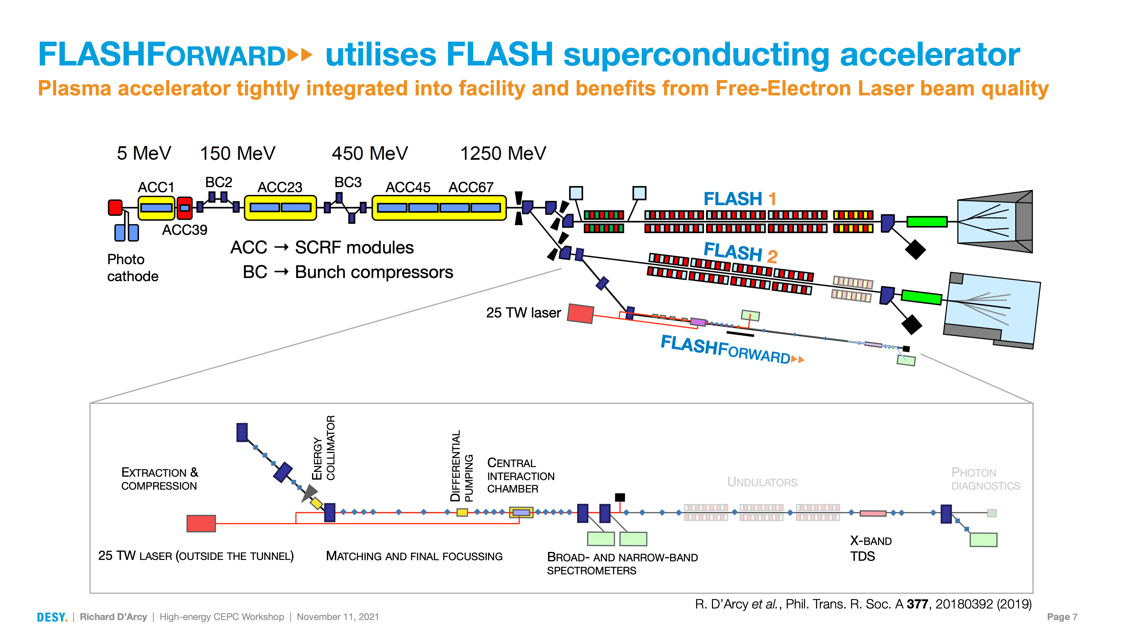

Slide 6
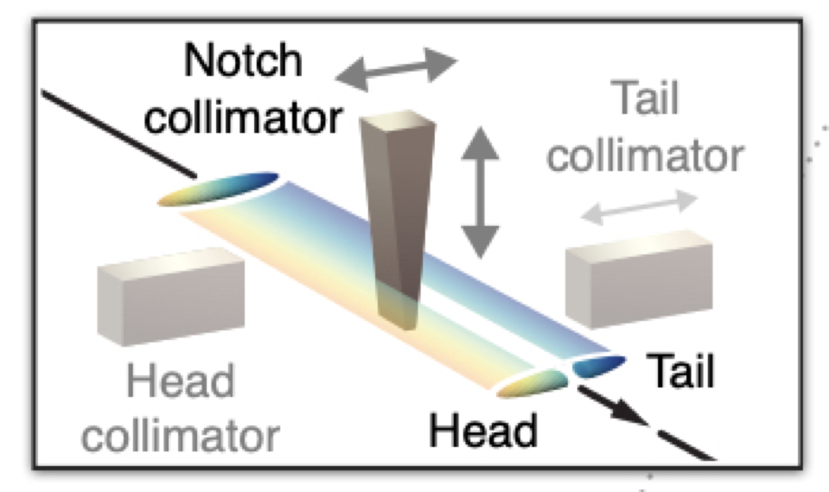
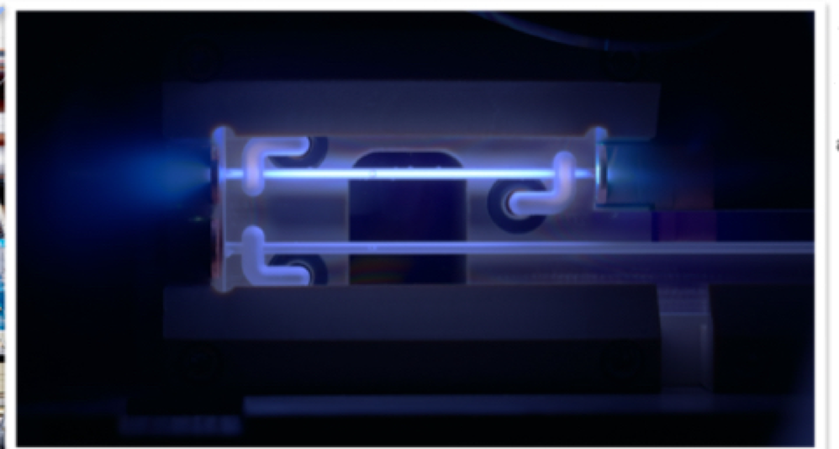
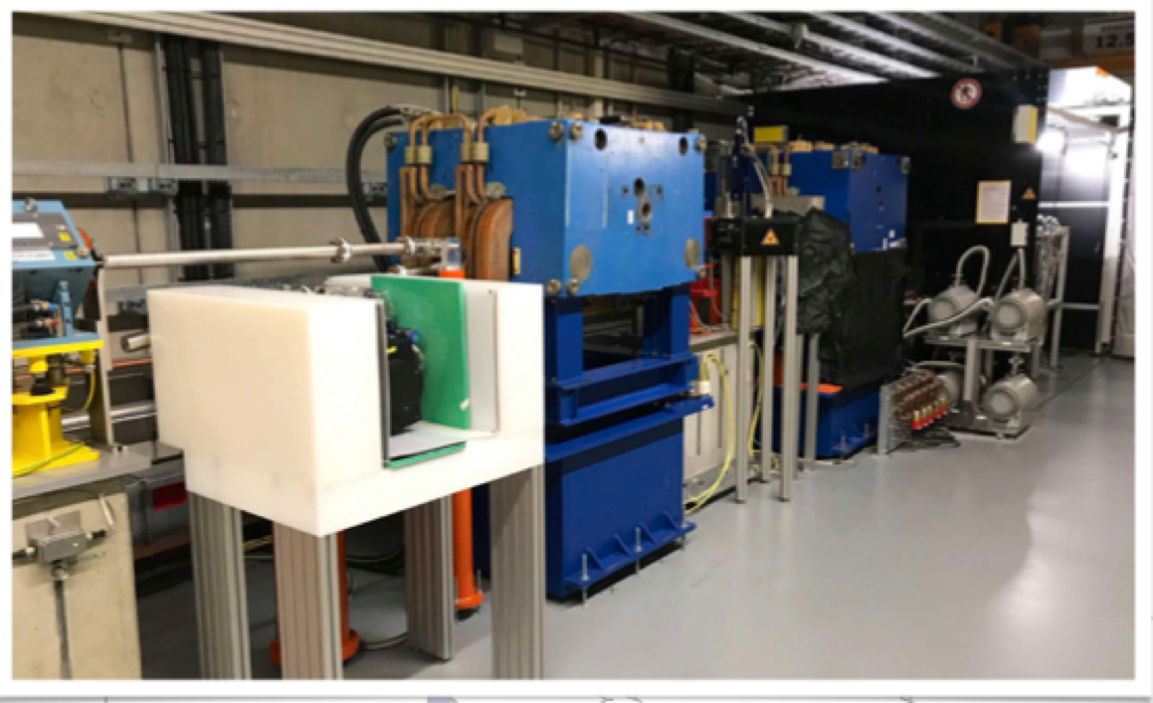
FlashForward features:
Advanced collimator system for longitudinal bunch shaping
Two discharge capillaries provide density-controlled plasma
Two electron spectrometers used for diagnostic purposes

Slide 7
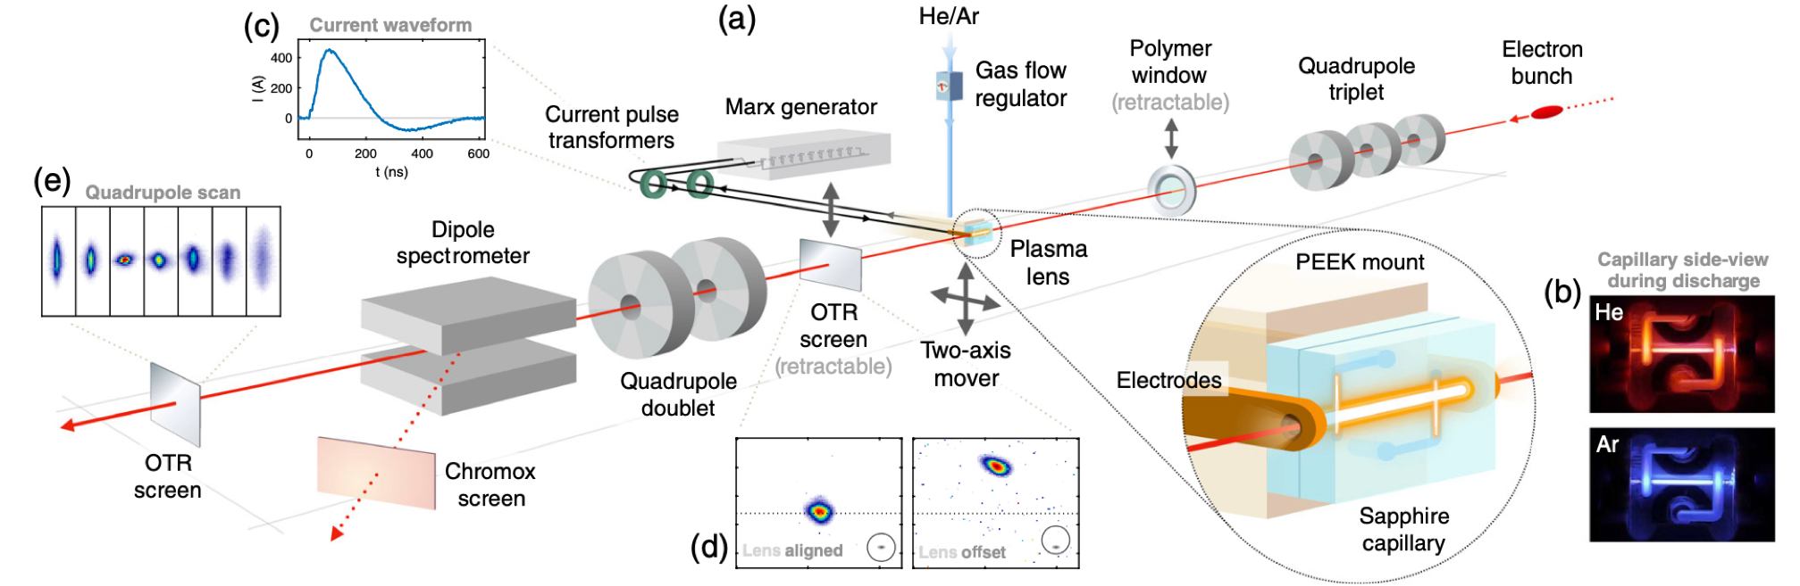
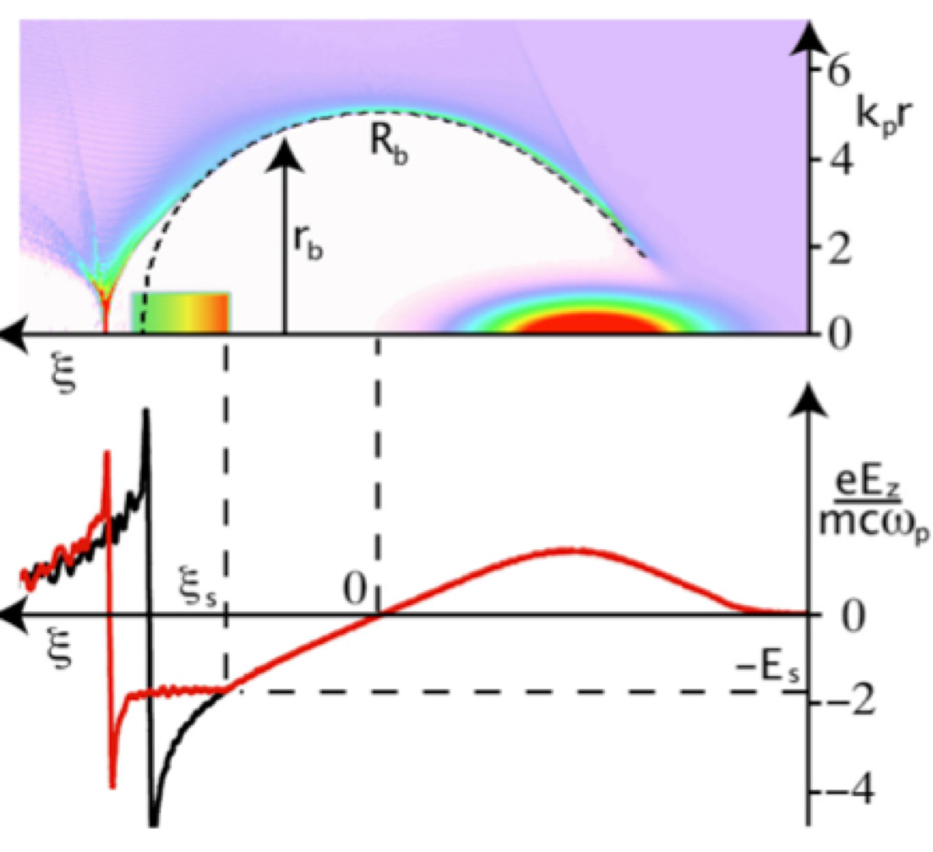
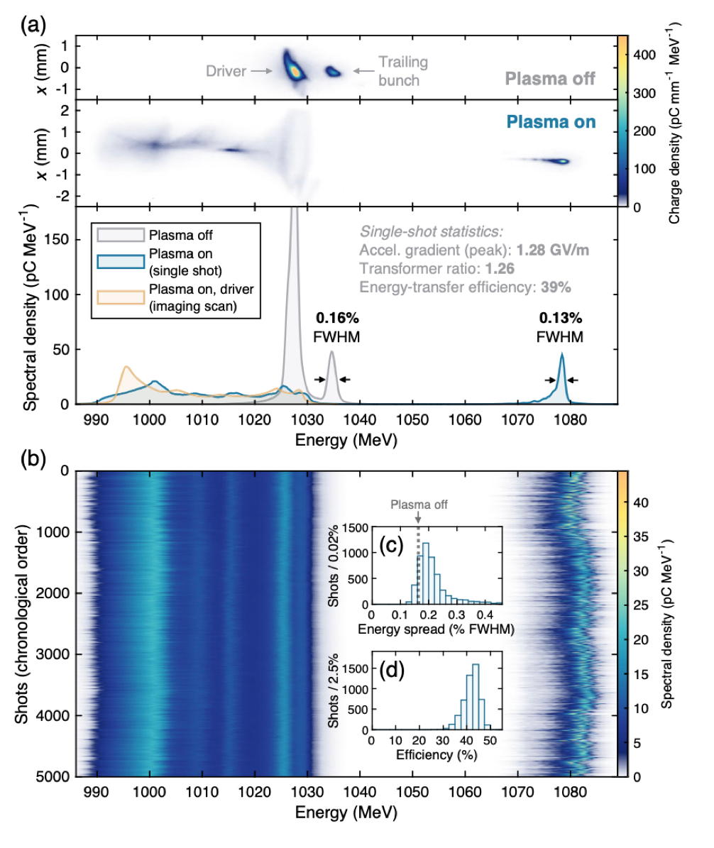
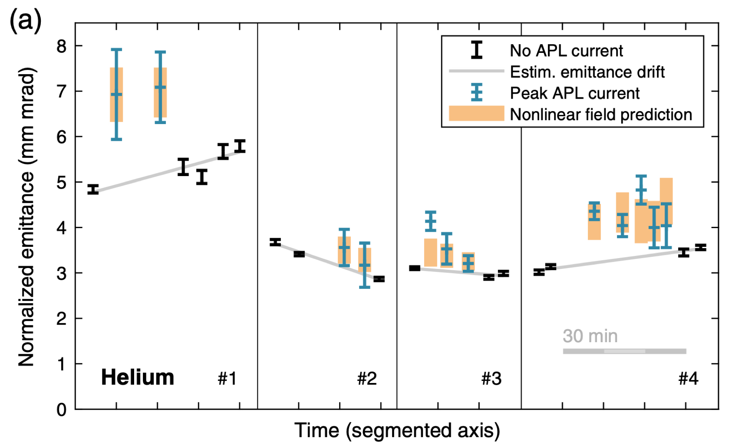
FLASHForward achievements:
FLASHForward now contributing to cutting edge research led by DESY group
Emittance Preservation in an Aberration-Free Active Plasma Lens
C. A. Lindstrøm, E. Adli, G. Boyle, R. Corsini, A. E. Dyson, W. Farabolini, S. M. Hooker, M. Meisel, J. Osterhoff, J.-H. Röckemann, L. Schaper, and K. N. Sjobak
Phys. Rev. Lett. 121, 194801 – Published 7 November 2018; Erratum Phys. Rev. Lett. 122, 129901 (2019)`
Energy-Spread Preservation and High Efficiency in a Plasma-Wakefield Accelerator
C. A. Lindstrøm, J. M. Garland, S. Schröder, L. Boulton, G. Boyle, J. Chappell, R. D’Arcy, P. Gonzalez, A. Knetsch, V. Libov, G. Loisch, A. Martinez de la Ossa, P. Niknejadi, K. Põder, L. Schaper, B. Schmidt, B. Sheeran, S. Wesch, J. Wood, and J. Osterhoff
Phys. Rev. Lett. 126, 014801 – Published 6 January 2021
Tunable Plasma-Based Energy Dechirper
R. D’Arcy et al.
Phys. Rev. Lett. 122, 034801 – Published 24 January 2019

Slide 8
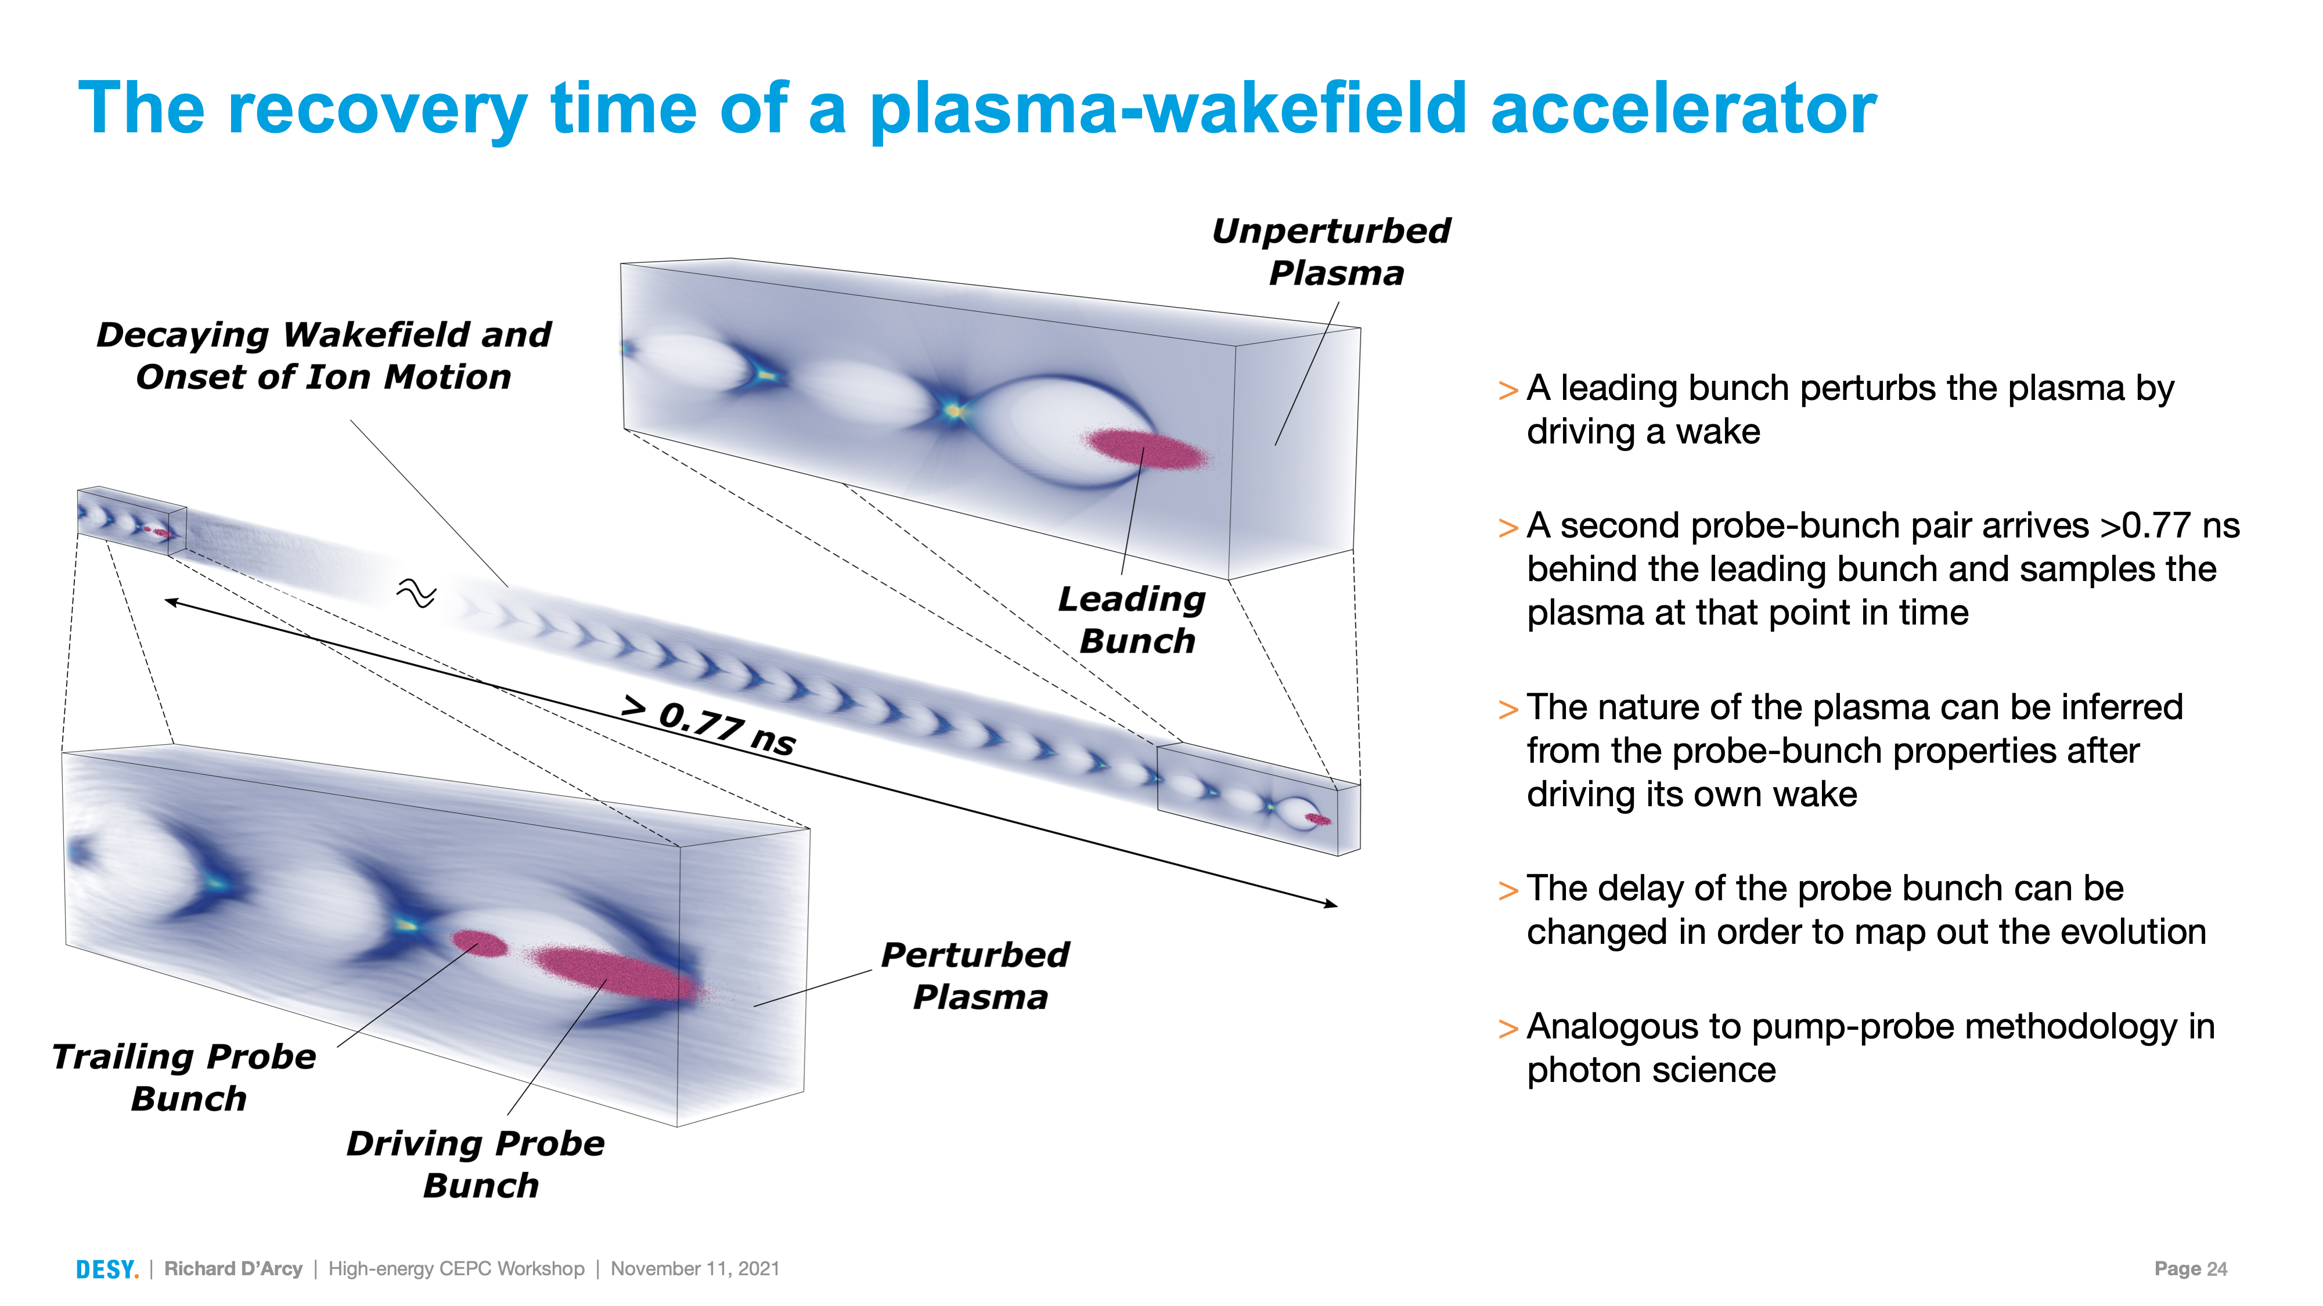

Slide 9
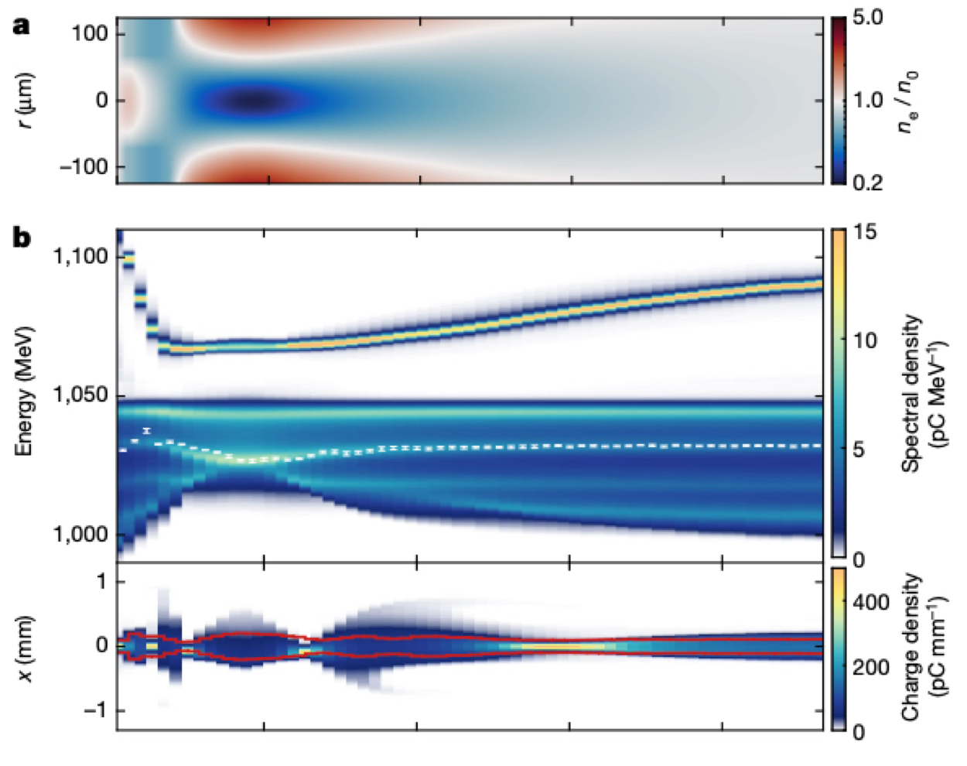
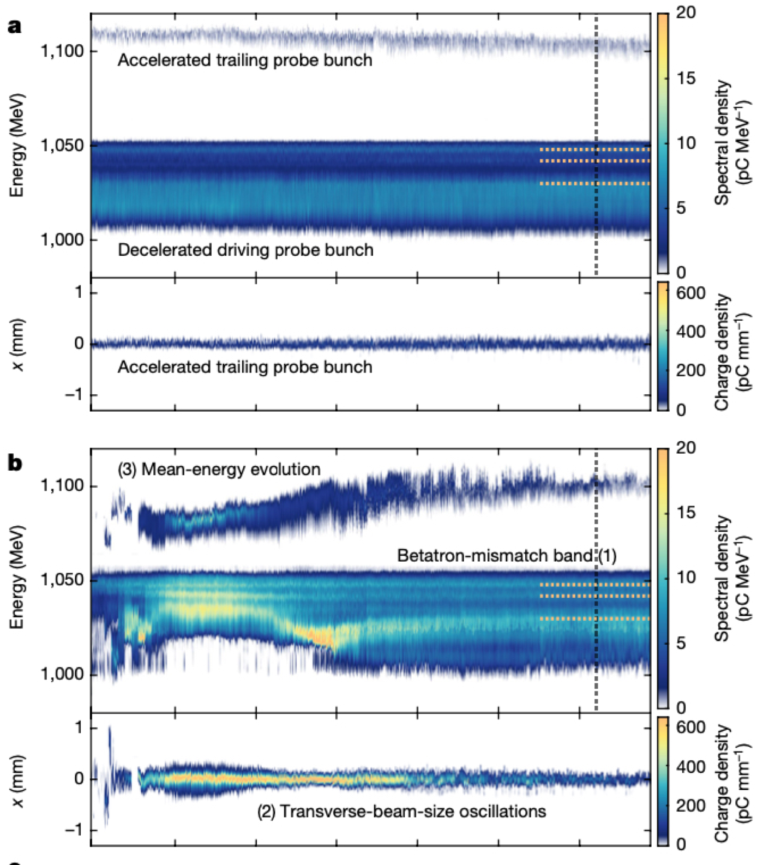
Recovery time of a plasma-wakefield accelerator
60 ns
50 ns
Equivalent to a repetition-rate upper limit of O(10 MHz)
Published: 02 March 2022
Recovery time of a plasma-wakefield accelerator
R. D’Arcy, J. Chappell, J. Beinortaite, S. Diederichs, G. Boyle, B. Foster, M. J. Garland, P. Gonzalez Caminal, C. A. Lindstrøm, G. Loisch, S. Schreiber, S. Schröder, R. J. Shalloo, M. Thévenet, S. Wesch, M. Wing & J. Osterhoff
Nature volume 603, pages 58–62 (2022)

Slide 10
Laser Wakefield Accelerators

Slide 11

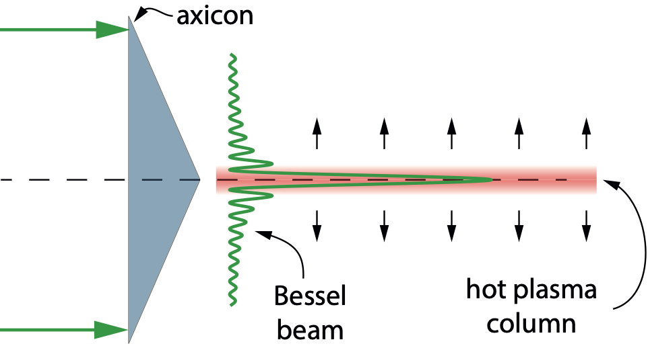
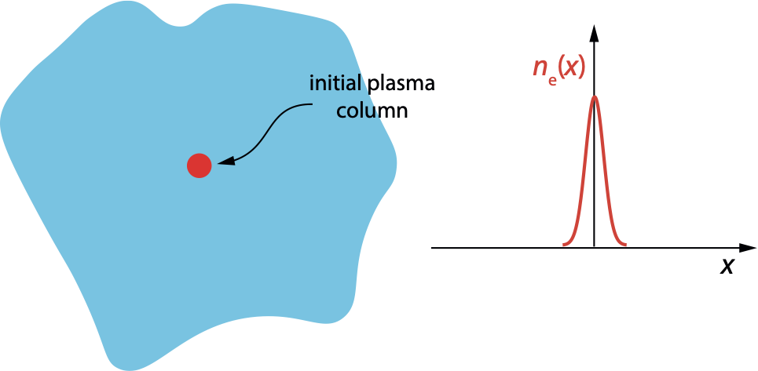
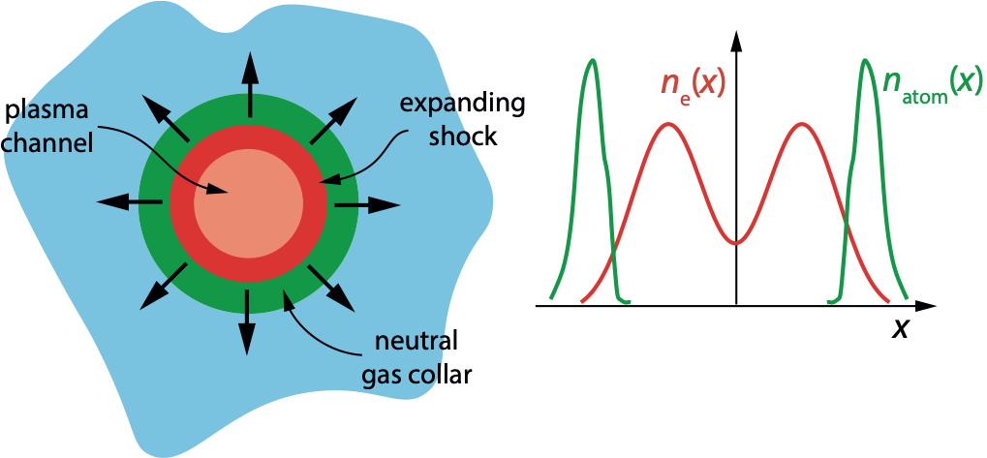



All-optical plasma channels
  Multi-GeV stages require accelerator stages 100s mm long with densities ~ 10¹⁷ cm⁻³:
  We have developed all-optical (“indestructible”) plasma channels with properties ideal for high rep-rate, GeV-scale laser-plasma accelerators:
    On-axis density ~ 10¹⁷ cm⁻³
    Attenuation length > 10 m
1. Axicon creates a long (> 100 mm) cylinder of plasma
2. This expands radially, driving a shock wave & forming a weak plasma channel.
3. Expansion pushes out a collar of neutral gas.
4. Ionization of collar by guided pulse creates a deeper, lower loss channel
t = 0
t > 0
  Details in:
    R.J. Shalloo et al. Phys Rev E 97 053203 (2018)
    A. Picksley et al. Phys Rev Accel Beam 23 81303 (2020)
    A. Picksley et al. Phys Rev E 102 053201 (2020)
    A. Alejo et al. Phys Rev Accel Beam 25 011301 (2022)

Slide 12
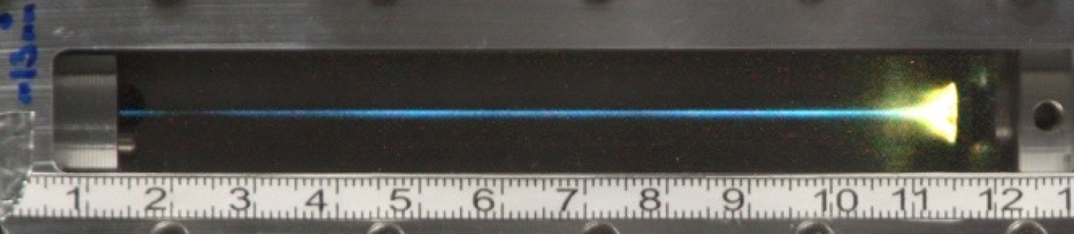
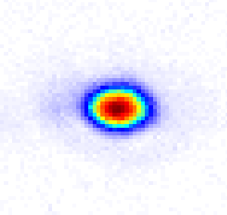
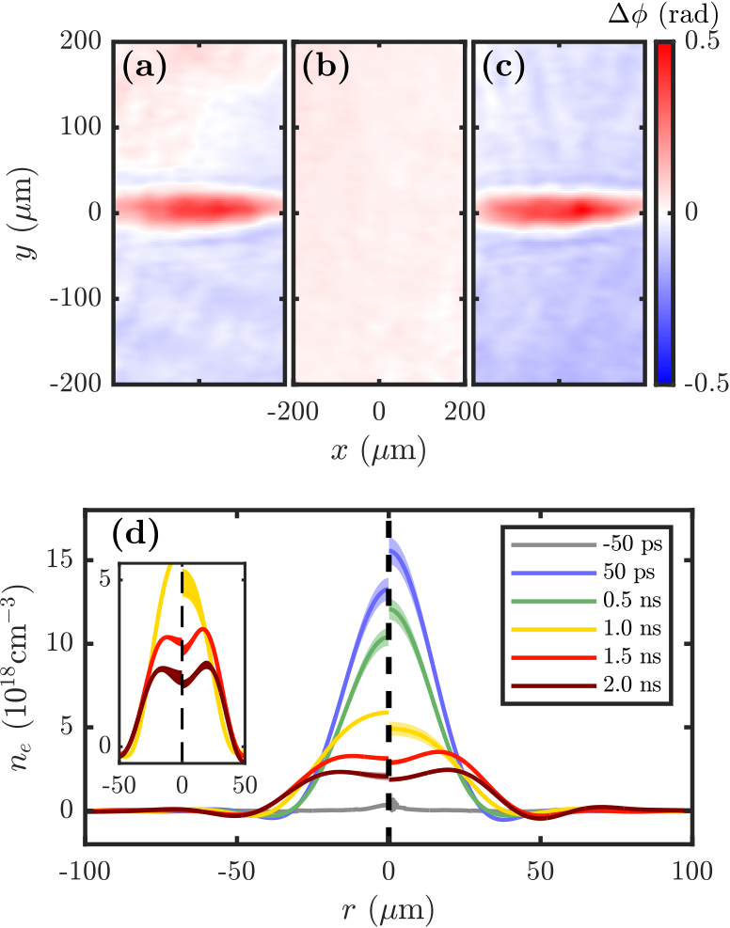
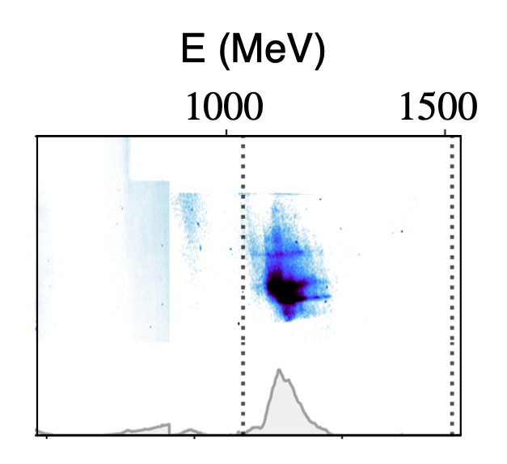

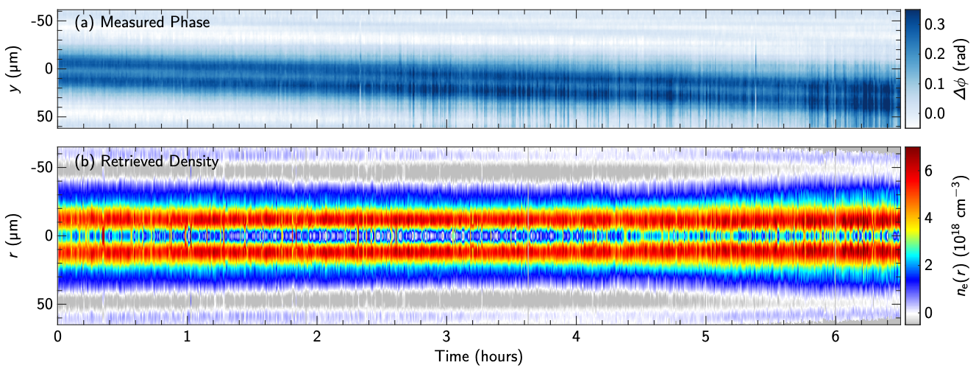
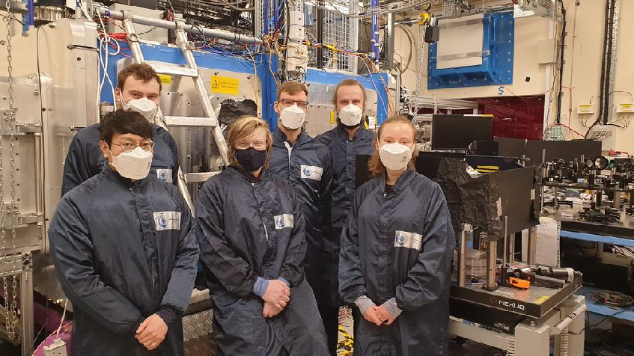
All-optical plasma channels
  Towards high-quality multi-GeV beams
  Collaboration with Prof. Martin Booth (Oxford University Engineering) on controlled injection of high brightness electron beams.
Guiding in > 100 mm long channels
1 kHz channels demonstrated
Short HOFI channels have been generated at frep = 1 kHz for the first time.
Interferometry shows: (a) channel formed by pulse 1; (b) plasma immediately before pulse 2, 1 ms after pulse 1; (c) channel formed by pulse 2; (d) temporal evolution of channels formed by pulse 1 (left) and pulse 2 (right)
Very stable channels generated at frep = 0.4 kHz over 6 hour run!
A. Alejo et al., PRAB 25 011301 (2022).
100 mm long channel generated in Gemini experiments
Recently completed two experiments with the Gemini laser at CLF.
Preliminary analysis suggests:
High-quality guiding of 10¹⁸ W cm⁻² pulses over 300 mm demonstrated
Electron acceleration in HOFI channels to > 1 GeV.
High-quality guiding of trains of ~ 10 pulses over 100 mm.
Resonant excitation of plasma wakefields by channel-guided pulse trains.
Warning! Preliminary analysis !

Slide 13
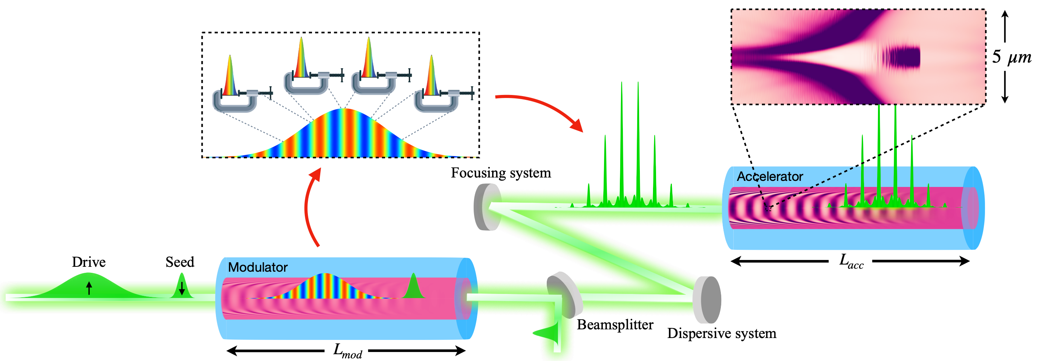
Towards GeV@kHz - Resonant LWFA using thin disk lasers
  Ti:Sa lasers are limited to few-Hz repetition rates at high pulse energies and low wall-plug efficiencies.
  Commercially-available, high-efficiency thin-disk lasers can deliver the kW average power and kHz repetition rate needed for GeV@kHz, but their ps-duration pulses are too long for LWFA.
  A novel scheme has been proposed to generate a train of fs-duration pulses to resonantly drive large-amplitude plasma wakes with 10s of GV/m acceleration gradients.
  Collaboration between Oxford University, CLF, LMU Munich and TRUMPF Scientific Lasers to develop this scheme.
  Joint PhD studentship at Oxford funded by CLF and TRUMPF.
  Aim for a proof-of-principle demonstration in new Oxford lab.
  Experimental demonstration of full scheme in Munich using 0.5 J, 1 ps, 1 kHz thin-disk laser
  Plan to apply for major (> £5M) research grants to support this new programme.
  Plasma wake driven by low-energy fs pulse spectrally modulates long pulse in plasma channel.
  Compression gives train of pulses separated by plasma wavelength.
  Acceleration of micrometer-sized pC electron bunches to GeV energies.
  Details in:
  O. Jakobsson et al. Phys. Rev. Lett. 127, 184801 (2021)

Slide 14
EXAFS with Betatron source

Slide 15
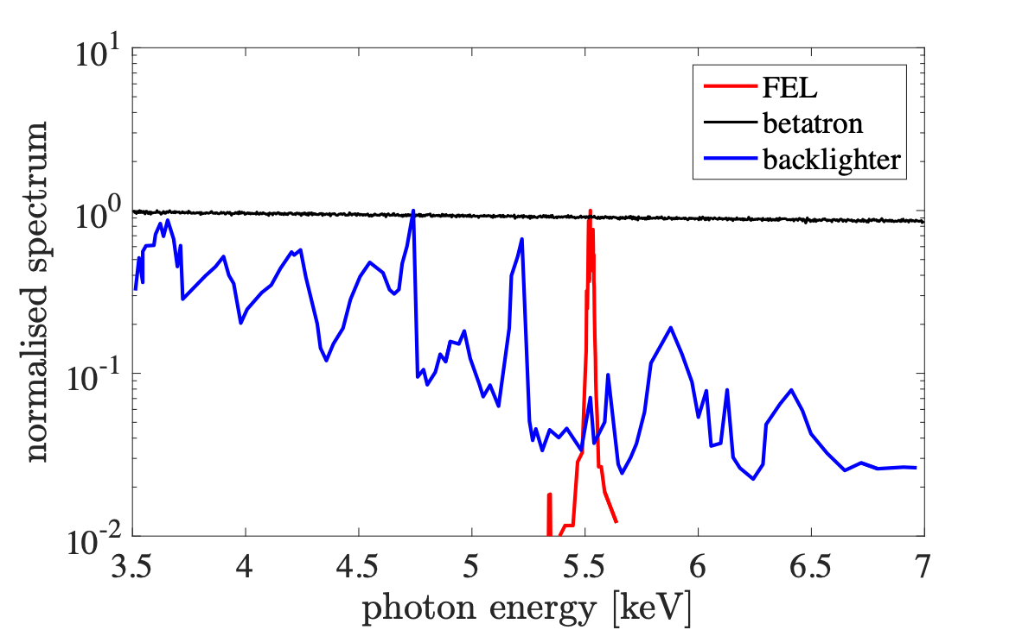
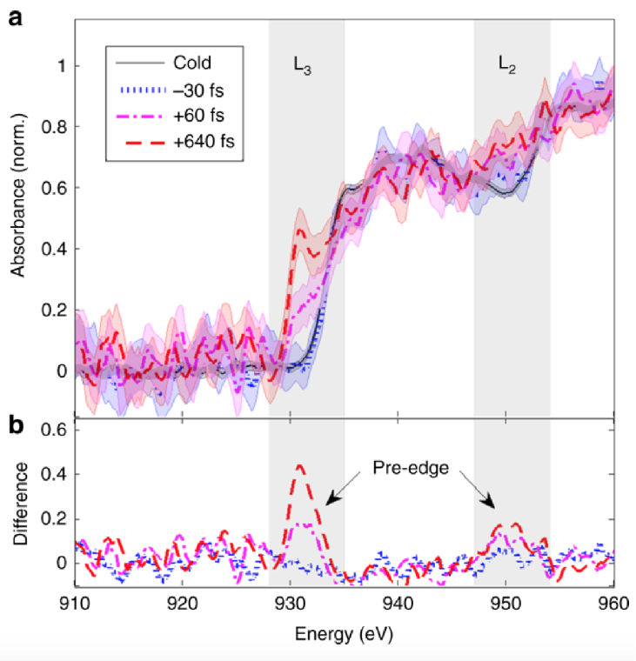
Ultrafast X-ray Absorption Spectroscopy Platform at Gemini
X-rays produced by a LWFA are unique
  broadband and ultra-fast
  can be synchronised with other lasers
Well-suited for pump probe X-ray absorption studies
  XANES and EXAFS are standard XAS methods employed at synchrotrons
  XANES: reveals details of electronic structure / temperature
  EXAFS: reveals details of ion structure / temperature
  Can we use a LWFA to do these?
Experiments at with lower power lasers have suffered from:
  low energy (< 1 keV): limits materials which can be probed
  low flux: many shots needed for a single spectrum
Ultra-fast X-ray spectra from different sources
LOA group work: Mahieu Nature Communications 2018
50 TW laser: 50 shots per spectrum

Slide 16
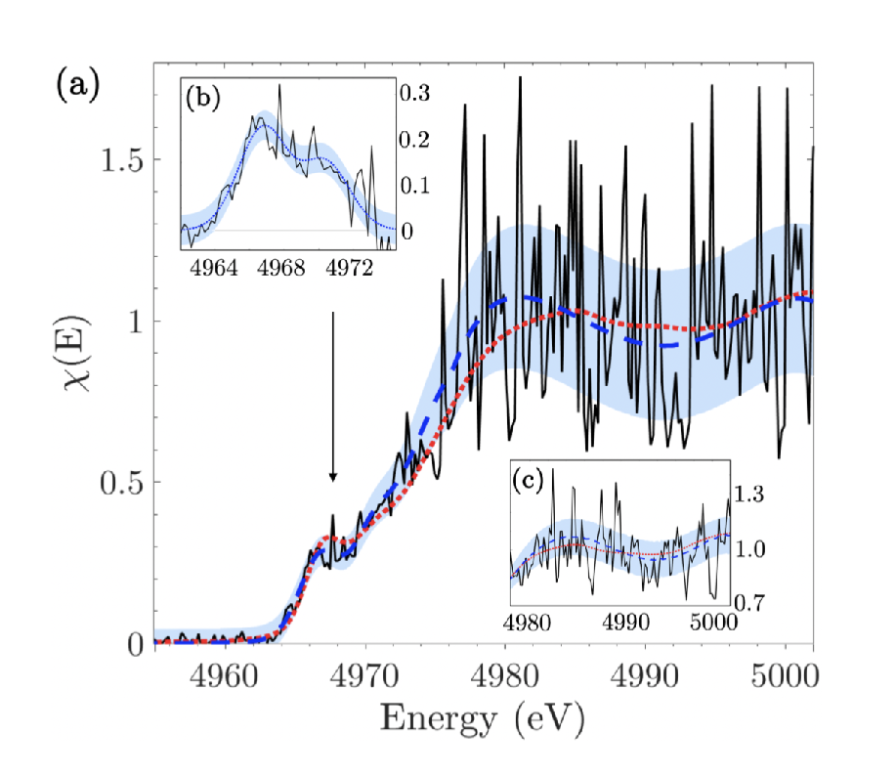
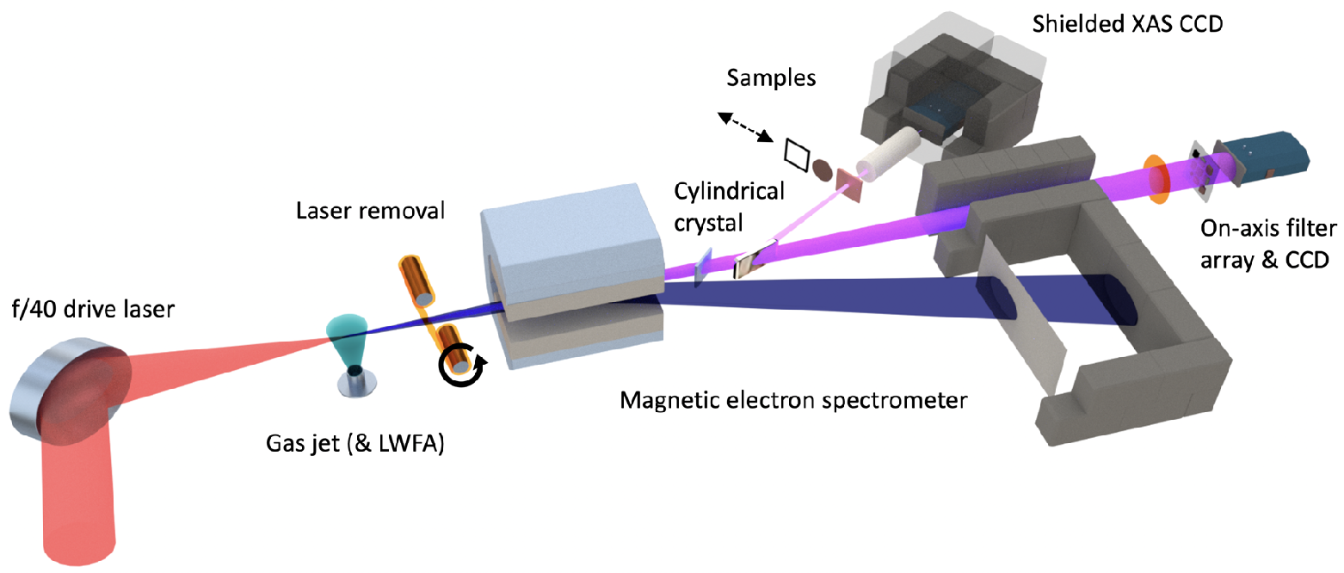
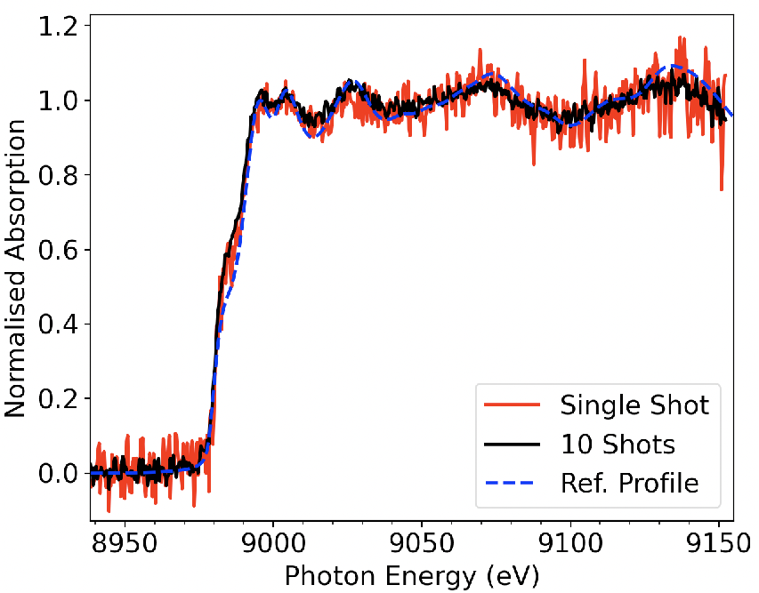
Realising single-shot XANES spectrum using betatron radiation from a LWFA
In 2019 we showed first single-shot XANES spectrum using betatron radiation from a LWFA
  Electron features (slope and pre edge) well resolved
  ion features (EXAFS) still poorly resolved
B Kettle et al
PRL, 123, 254801 (2019)
B Kettle et al
unpublished
Experiment in 2020 First single-shot XANES+EXAFS spectrum using betatron radiation from a LWFA
  Improvements to beam line: better shielding (noise ↓), focusing X-ray spectrometer (signal ↑)
  Single shot EXAFS now achieved - electron and ion features now resolved in a single shot

Slide 17
Ion acceleration with lasers

Slide 18
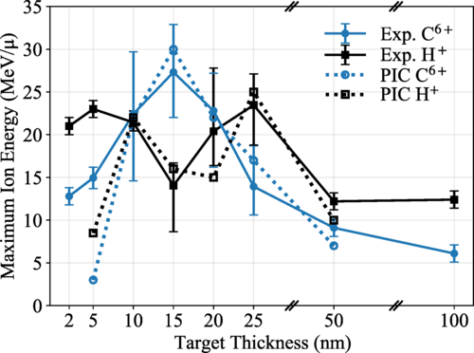
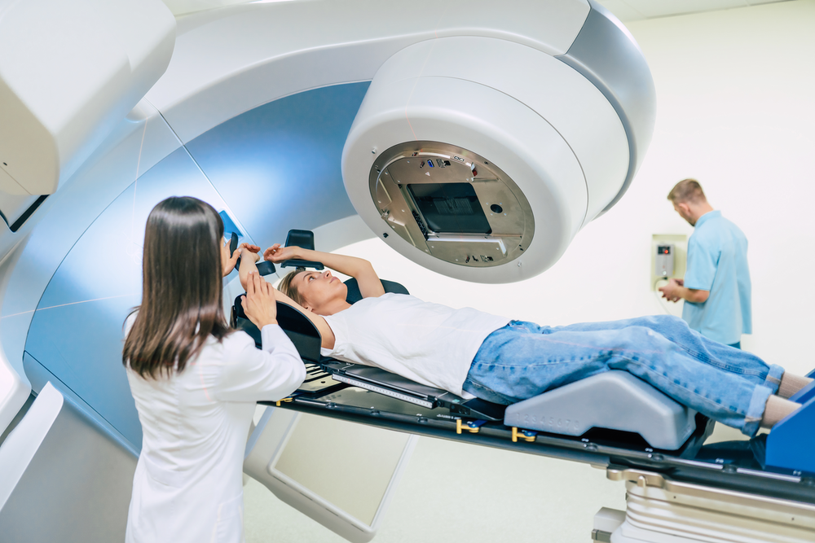
Selective Ion Acceleration by Intense Radiation Pressure
Carbon ions selectively accelerated for right target thickness
A New Trick to Make Short-Pulse Ion Beam
November 1, 2021• Physics 14, 153
Selective Ion Acceleration by Intense Radiation Pressure
A. McIlvenny, D. Doria, L. Romagnani, H. Ahmed, N. Booth, E. J. Ditter, O. C. Ettlinger, G. S. Hicks, P. Martin, G. G. Scott, S. D. R. Williamson, A. Macchi, P. McKenna, Z. Najmudin, D. Neely, S. Kar, and M. Borghesi
Phys. Rev. Lett. 127, 194801 – Published 1 November 2021

Slide 19
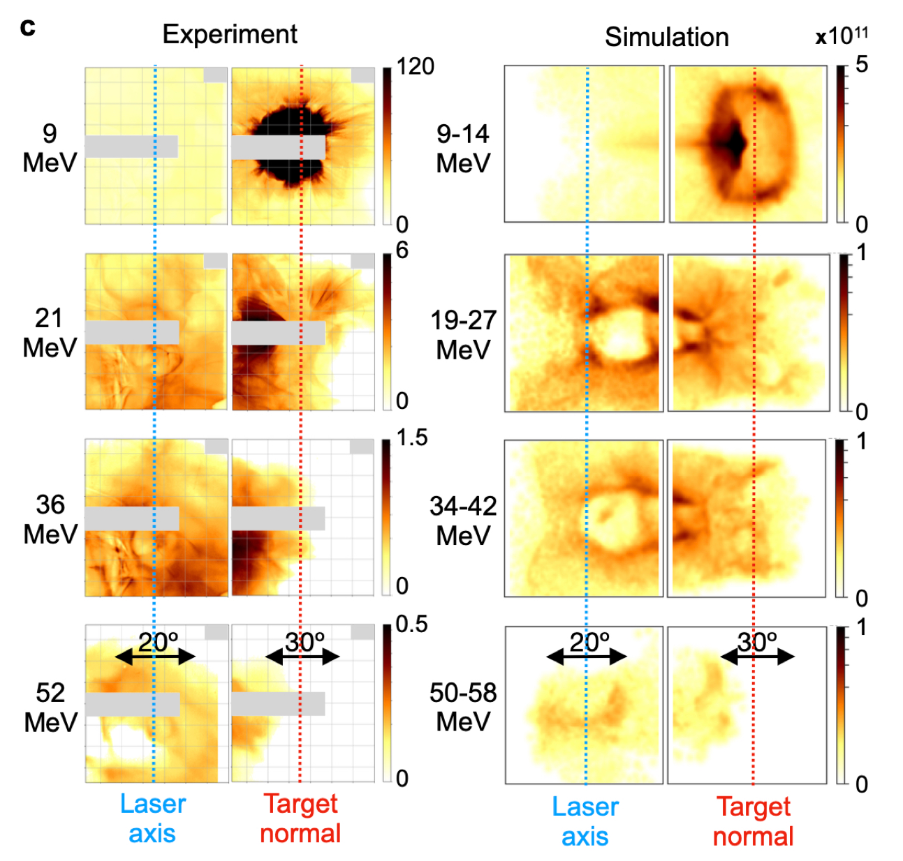
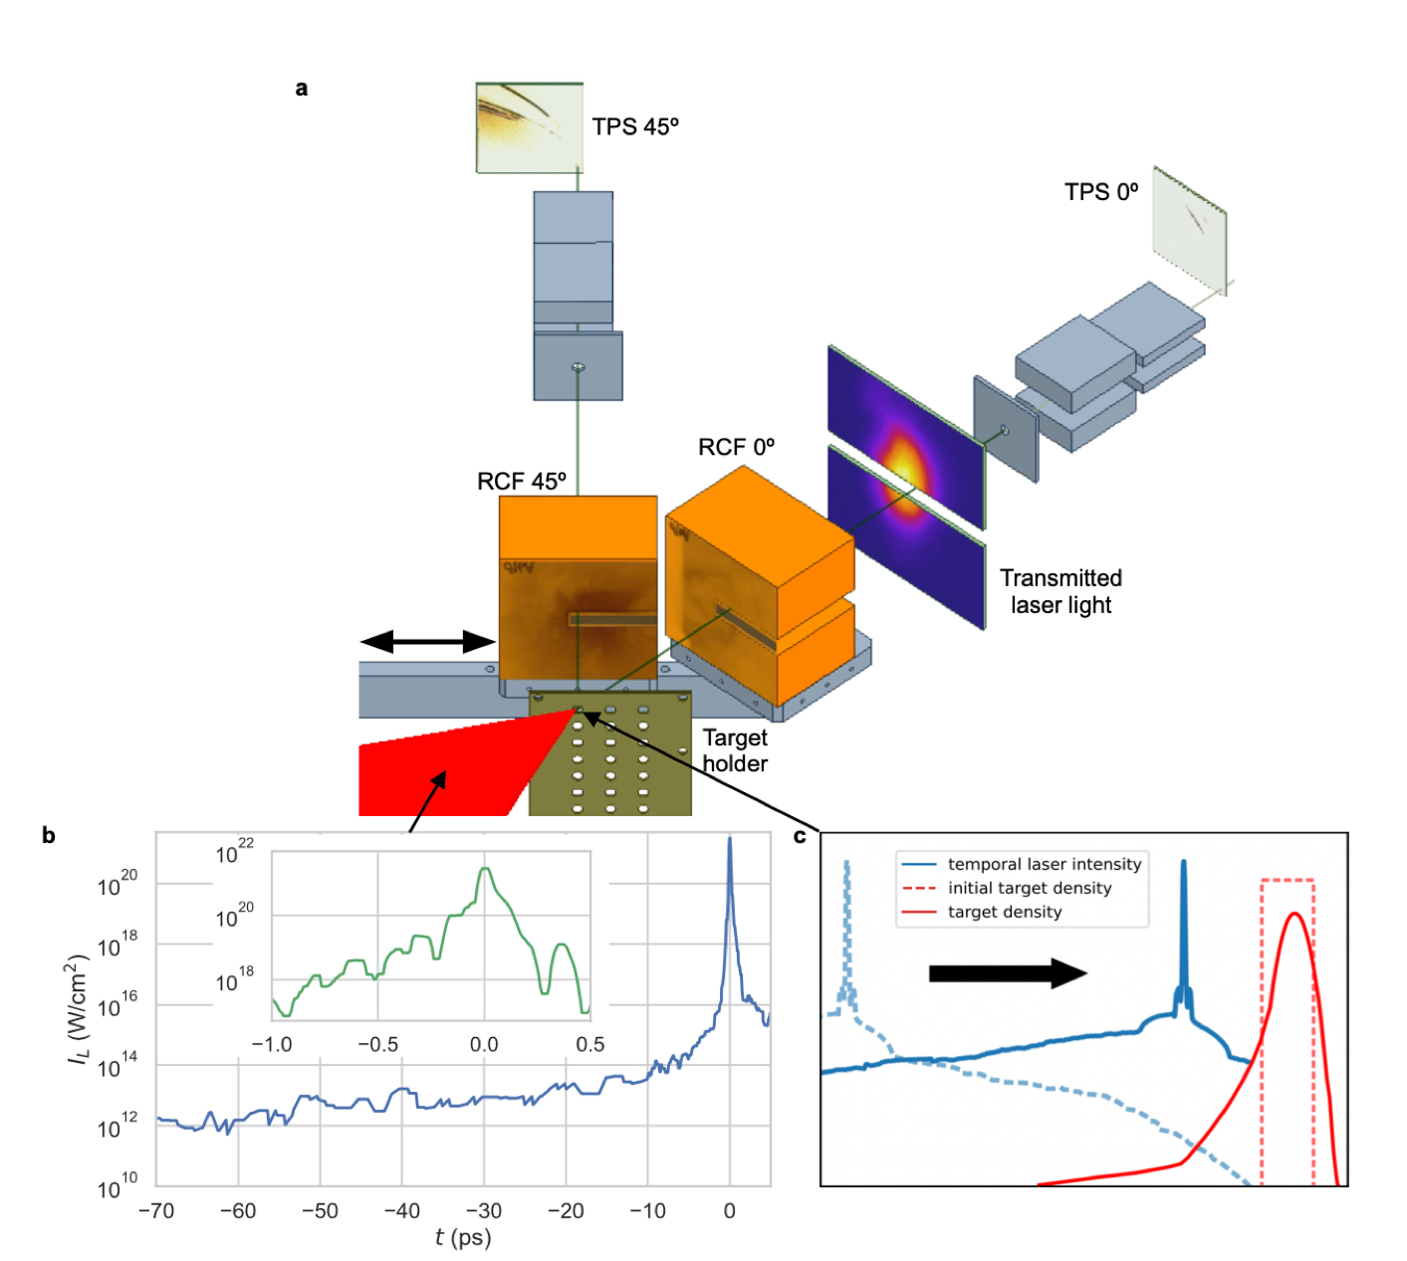
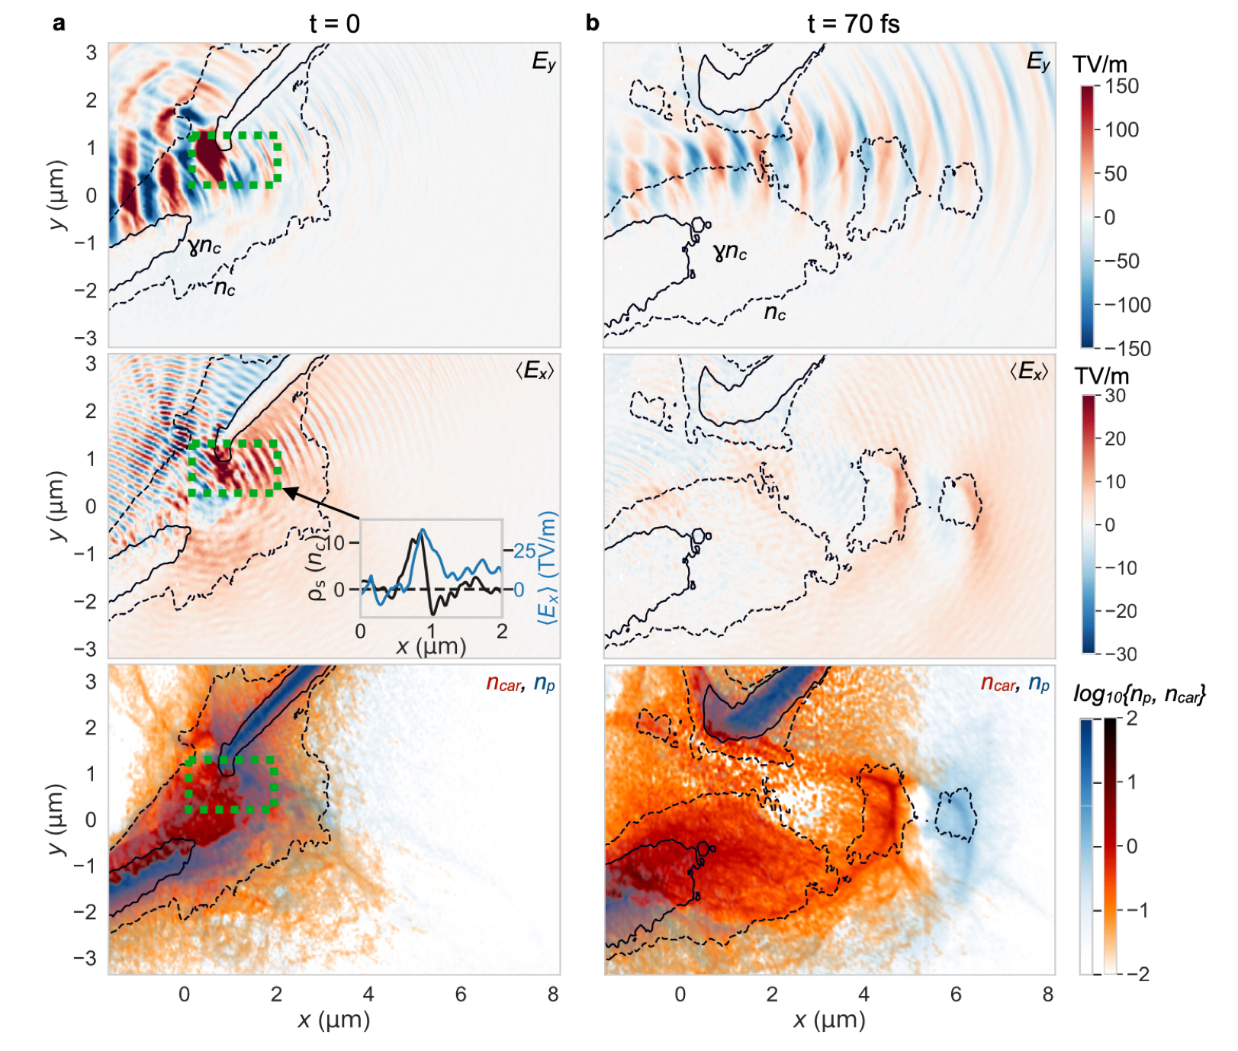
Relativistically induced transparency
Proton energies exceeding 60 MeV
Similar effects seen in p-polarised interaction at oblique incidence. Compression of target can lead to confined areas of radiation driven Coulomb expansion.
Energetic ion emission from prepulse-expanded relativistically transparent foils driven by ultra-intense femtosecond class lasers
N. Dover et al - in preparation

Slide 20
Automation of plasma accelerators

Slide 21
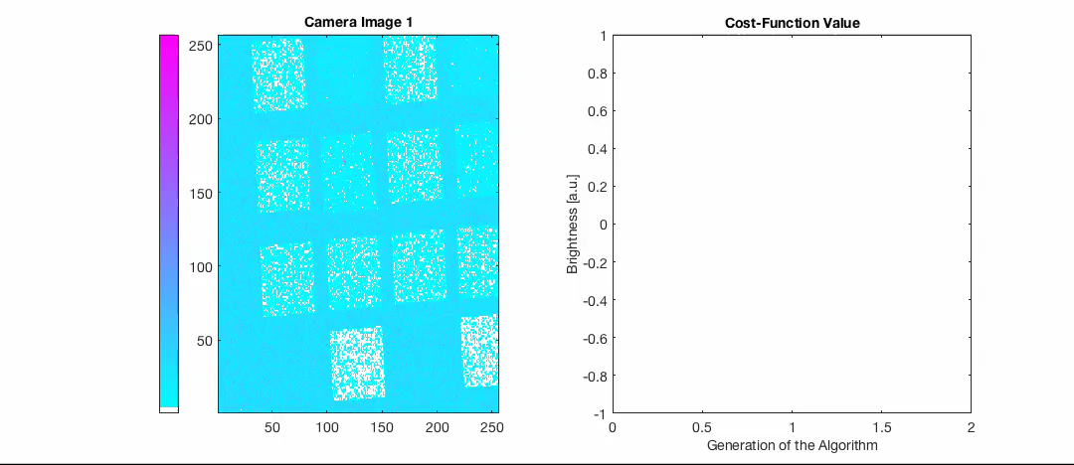
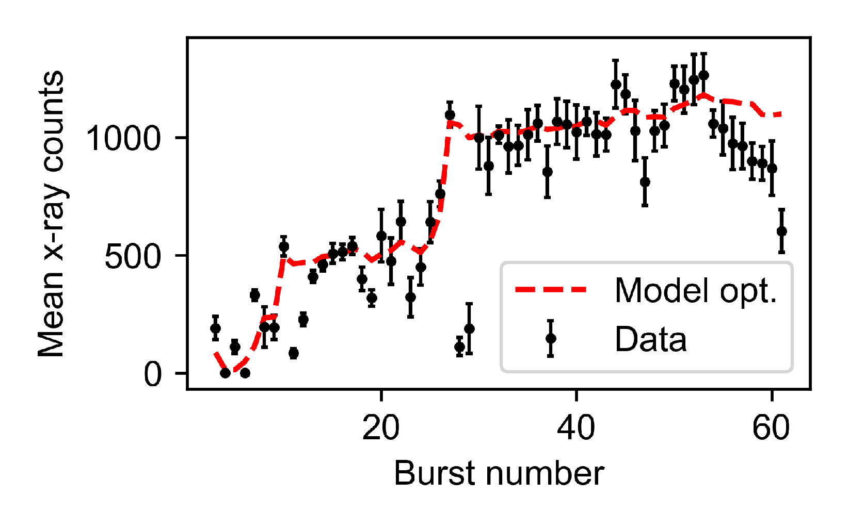
Machine Learning Applied to Plasma Accelerators
6D optimisation of mean x-ray CCD counts
Optimisation of betatron source using genetic algorithm
x-ray filter image from 5 TW source
Faster & Better Optimisations (BO: 20 minutes compared to 35 mins for 4 successive 1D scans)
Optimisation algorithm makes morning start-up efficient and easy
Shalloo, R. J., et al. “Automation and Control of Laser Wakefield Accelerators Using Bayesian Optimization.” Nature Communications 11, no. 1 (2020): 6355.
  Streeter, M. J. V., et al. APL, 112(24), 244101 (2018).
  Dann, S. J. D. et al PRAB, 22(4), 041303 (2019).

Slide 22
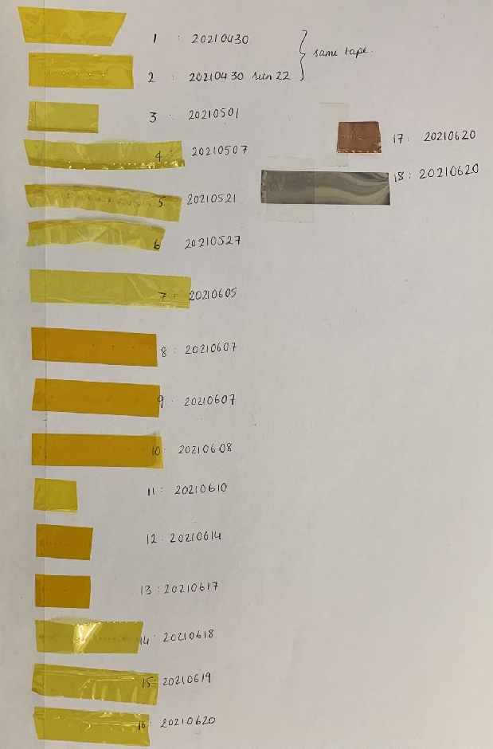
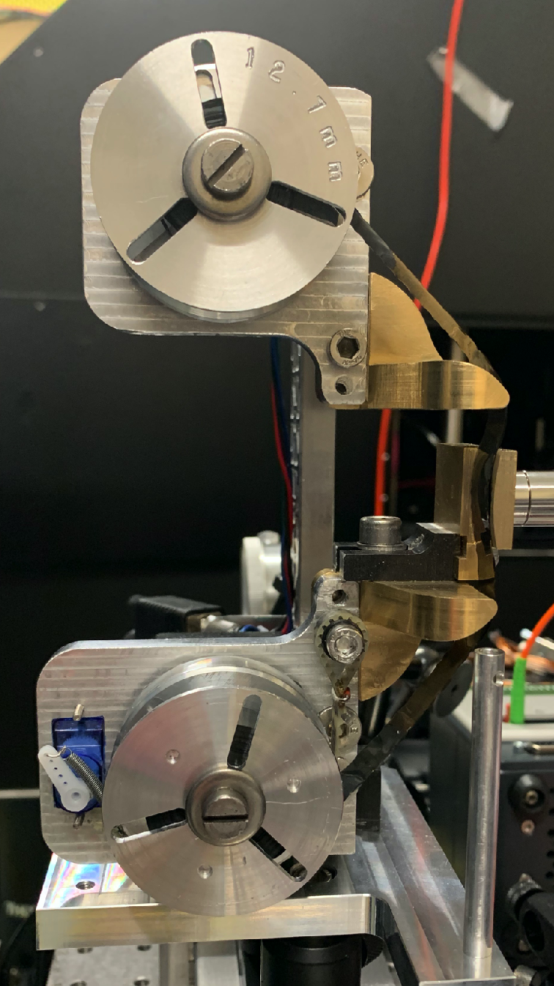
Automation applied to ion acceleration
Tape samples:
Developed by Nuo Xu at Imperial College London
Compact with excellent rear surface access and stability of a few microns.
Supports variety of materials (we used kapton, copper and steel) with thicknesses 12.7 - 50 microns.

Slide 23
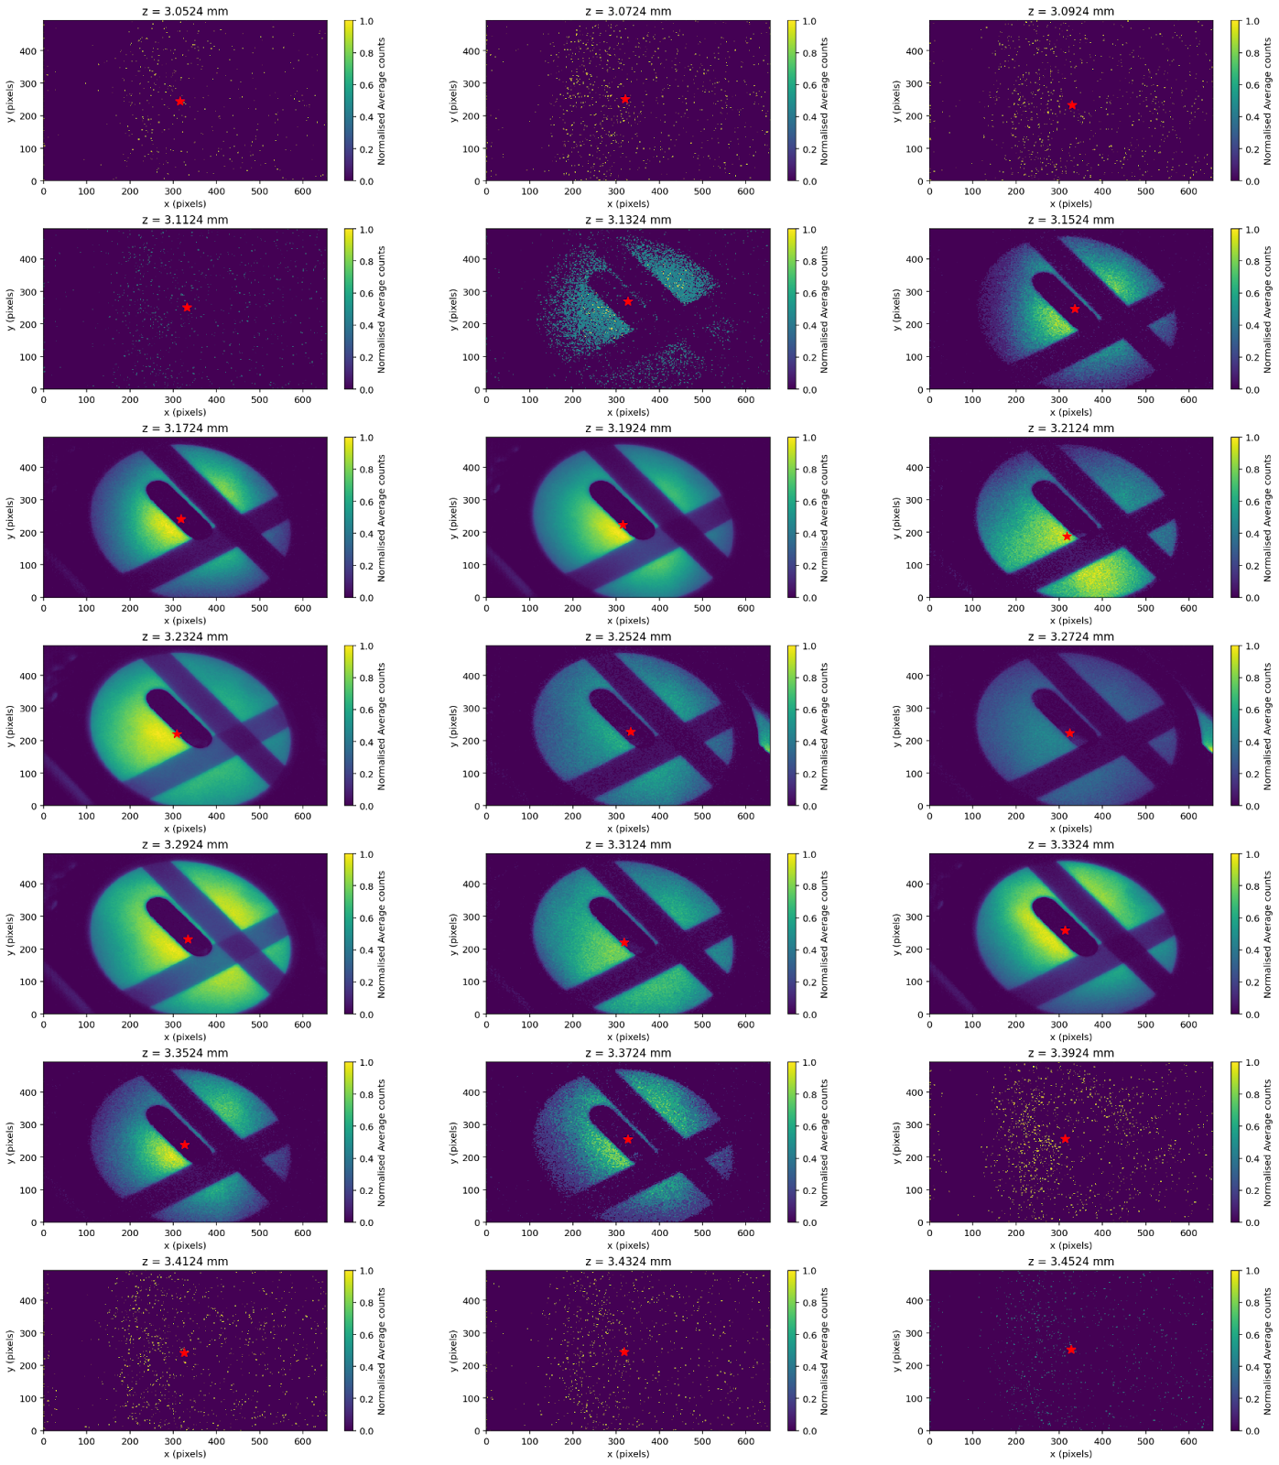
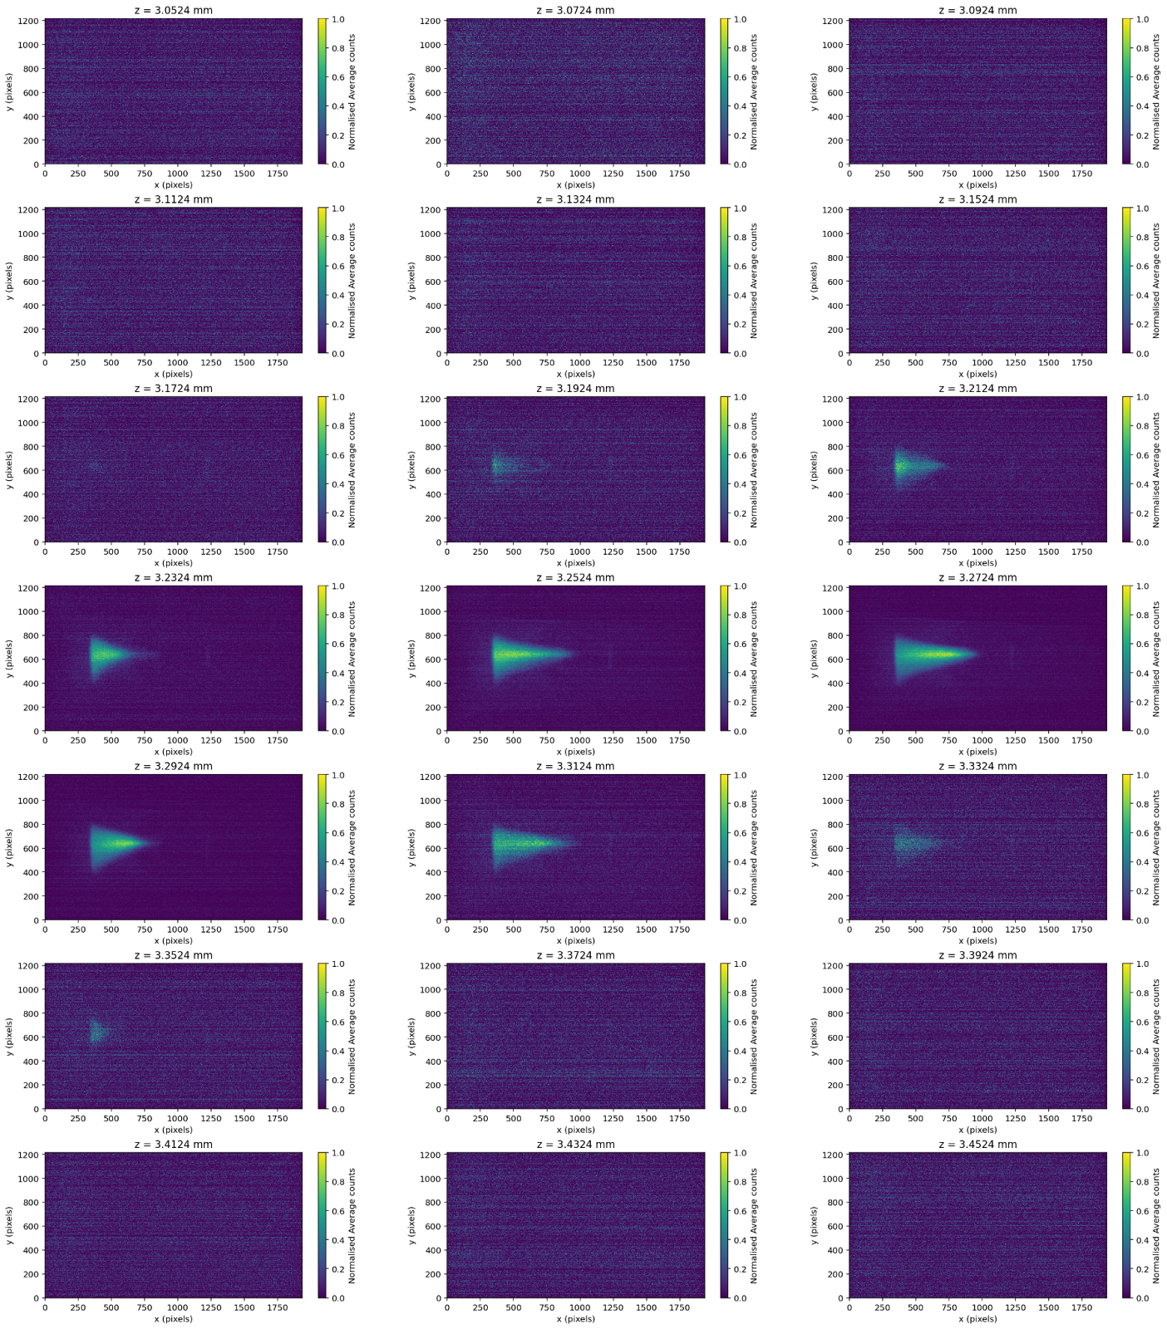
Dependence on target z: tape drive burst averaged 2D images
Typical Proton Spatial z-scan from tape drive:
Reduction in signal at best focus
Typical ESpec z-scan from tape drive:
Peak in signal at best focus

Slide 24

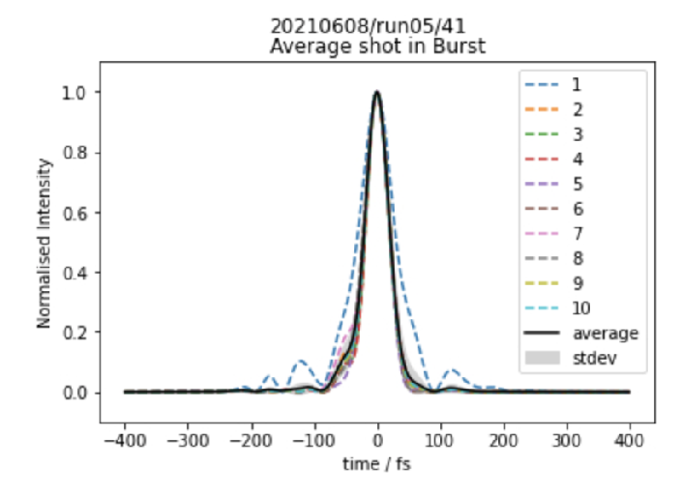
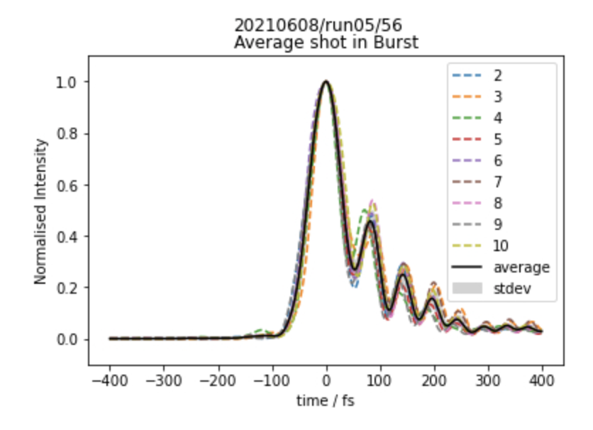
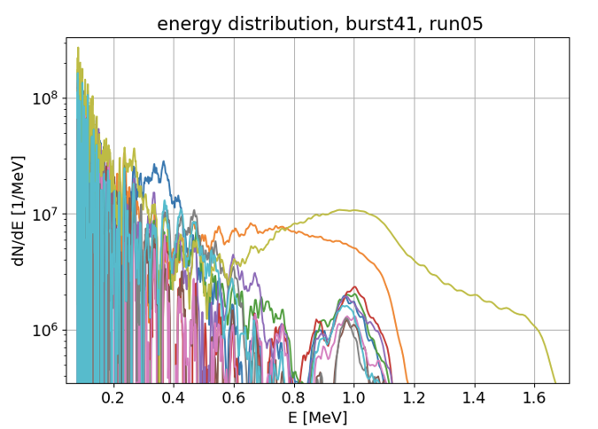
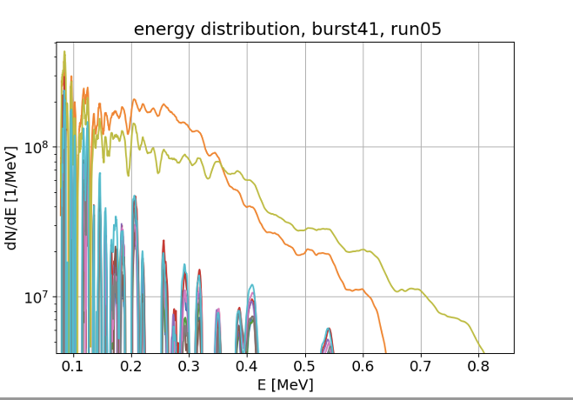
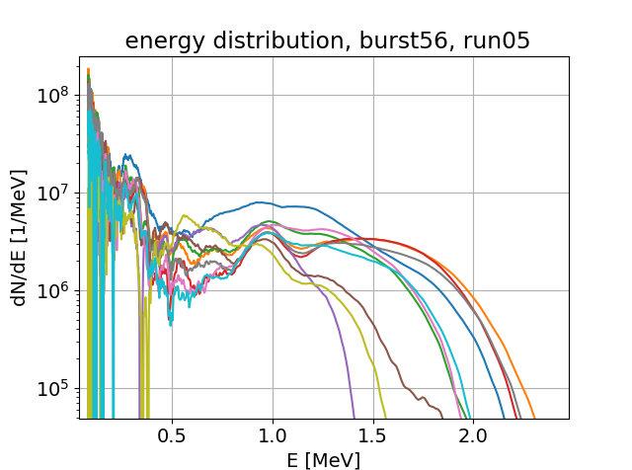
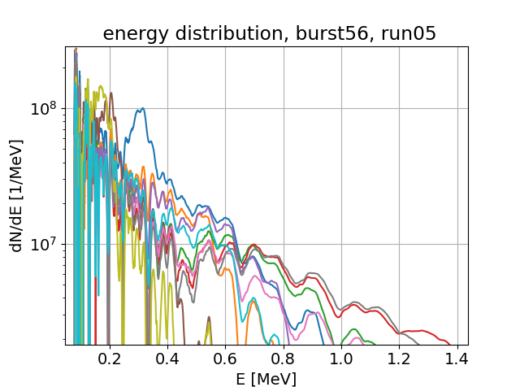
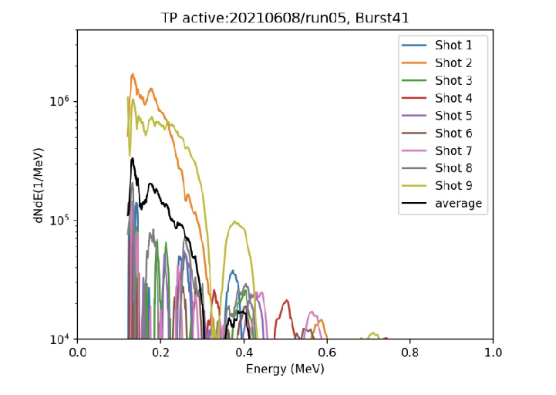
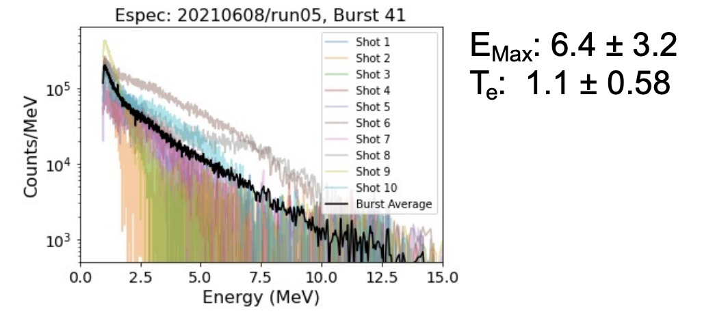
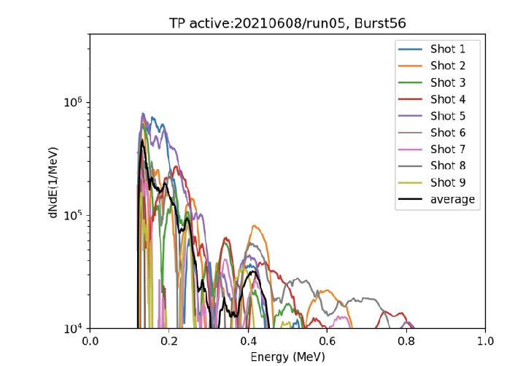
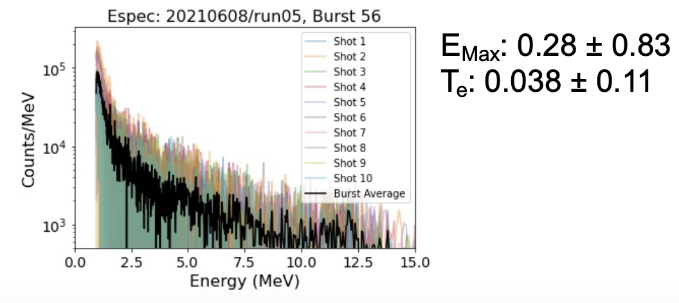
Effect of the pulse shape
Pulse
Pulse
courtesy of C. Palmer
Front TOF
Rear TOF
Front TOF
Rear TOF
TP
ESpec
TP
ESpec

Slide 25
AWAKE

Slide 26
AWAKE-UK
New AWAKE-UK grant approved by STFC
£1.9m awarded (£0.6m JAI) with a gateway after two year to extend funding for another 3 years - supposed to lead until run-2 after next shutdown
  Gateway step due later this year!
7 funded UK institutes including JAI-OX and JAI-IC (also UCL, Lancaster, Liverpool, Manchester, Strath)
Aligned to AWAKE run-2:
  Accelerate higher beam capture
  Acceleratre over multiple cells
Goal is to have an electron beam usable for HEP after run 2.

Slide 27
e⁻ injection to the 2nd plasma cell
Requirement of $σ^{∗}=\sqrt{4.8mm×ε}$ at injection to be “matched to the plasma” $→$for $ε_{x,y}=2μm$: $σ^{∗}=5.75μm$.
Gaussian bunch at injection.
Transfer line should be achromatic, with no bunch lengthening.
Spatial constraints shown below.
Parameter | Nominal value
Dispersion | 0
 | 5.75 m
Bunch length | 200 fs/60 m
Electron energy | 150 MeV
 | <2 mm mrad
Mom. spread | <0.2%
Charge | 100 pC
At injection point
horiz.
dipole
e⁻
quadrupoles
< 3 m
< 1 m
15°
0.1 m
plasma cell 1
plasma cell 2
750 mm
R. Ramjiawan, F.M. Velotti

Slide 28
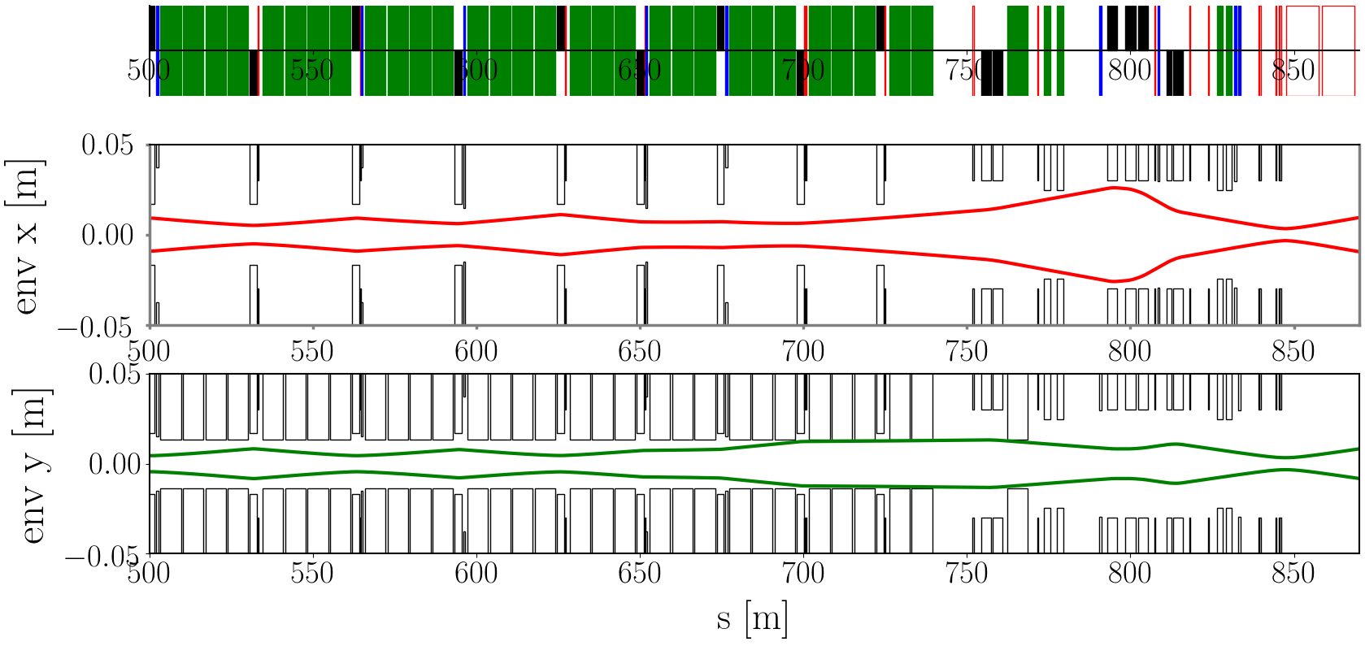
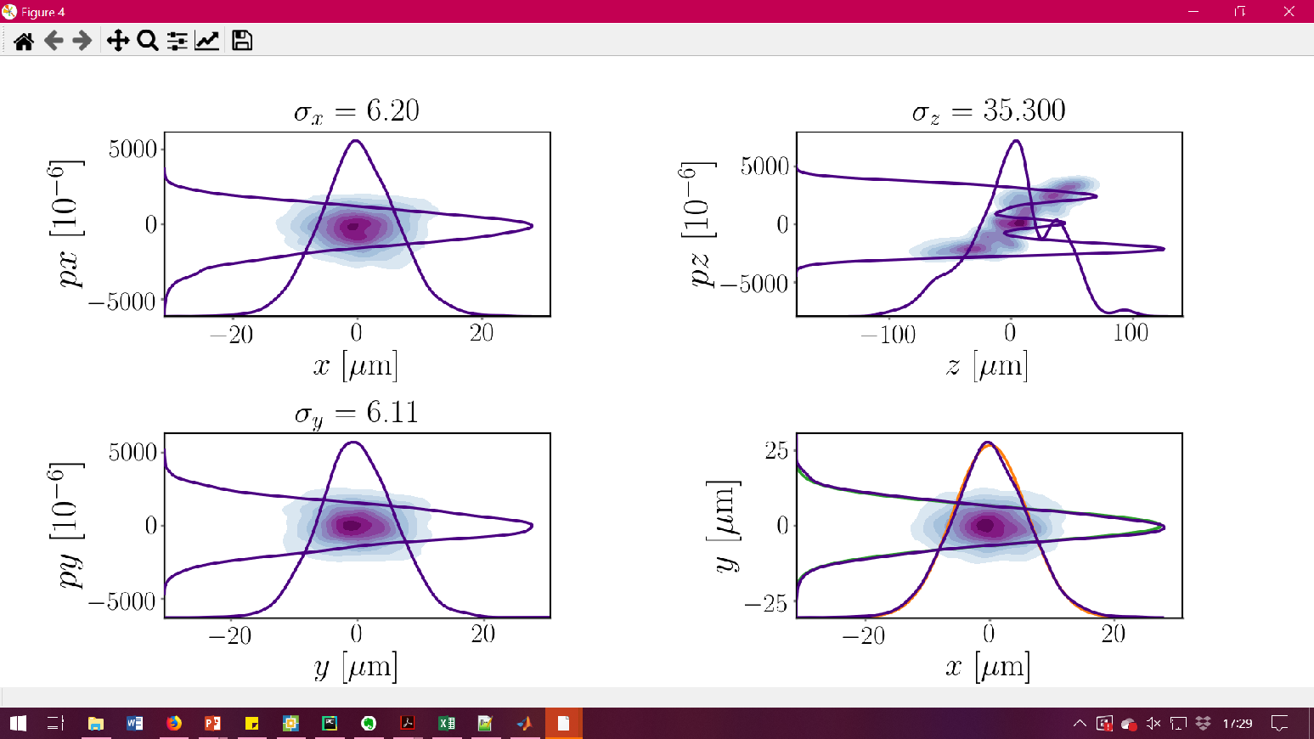
Summary of Aligment and Beam Size requirements
Alignment
The shot-to-shot jitter of the proton beam challenges driver-witness alignment. Impossible to reduce without replacing the PCs.
More studies will be done to characterise jitter.
Studies to be done adjusting the optics to reduce $β^{∗}$.
Beam size
85% of shots satisfying beam size requirements.
Utilise BTV measurements (beam size resolution of 1 µm) at the injection-point help to quantify the alignment.
Magnet specifications seem possible, but still to be confirmed.
On-going discussions with (BI, PC, magnet) teams to determine the limits for hardware and the time and cost involved.
For 2 µm emittance $→$ $σ_{matched}=5.75μm$
To keep acceleration quality $Q_{t}$ within 20% of maximum, we should try to keep beam size within 50% of matched value $<8.6μm$.
Beam distributions (no errors)

Slide 29
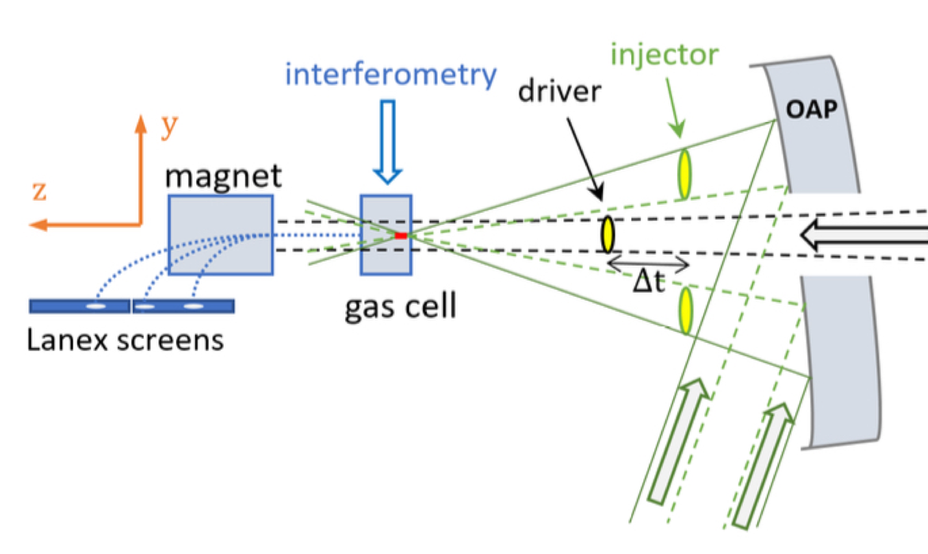



Visualising the density profile in plasma columns
Oblique-angle Single-shot Frequency Domain Holography Diagnostic
Alternative Electron Injection Scheme using Modified Two-Pulse Ionisation Injection (M2PII)
Successful implementation on CUOS laser system M. von der Leyen et al.

Slide 30







Coherent ChDR electron Bunch Length Monitor
C. Davut, O. Apsimon, P. Karataev, T. Lefevre, S. Mazzoni, G. Xia
To be implemented after first plasma cell
  Achieved so far
Bunch length prototype designed and being manufactured
Analyzed using polarization current approach and CST Studio Suite;
A shot-by-shot quick bunch length monitoring and a precise Martin-Pupplet Fourier spectrometer is foreseen.
  Current Status
All components ordered
Vacuum vessel manufacturing completed
Commissioning is scheduled for May-June 2022
1st

Slide 31




Plasma discharge being developed at CERN
10 m Ar discharge plasma to developed by IST/CERN to be implemented later this year
Developing plasma diagnostics including:
Spectroscopy
Interferometry

Slide 32
Summary
Repeatability of plasma accelerators determined (10’s MHz achievable)
CHOFI waveguides demonstrated at kHz and up to 30 cm
kHz MP-LWFA scheme developed
Betatron Absorption Spectroscopy used for XANES in single shot
Selective light sail acceleration of carbon ions observed
Bayesian optimisation applied to laser ion acceleration
AWAKE:
  electron beamline designed and pointing and beam size variations assessed
  New bunch length diagnostic based on coherent Cherenkov diffraction to be implemented
  Discharge cell to be implemented at CERN

