Slide 1

Light Sources Update
I. Martin
JAI Advisory Board Meeting
7th April 2022

Slide 2
Talk Outline
Update on Diamond-II:
Project goals
Recent developments
Ongoing and future AP studies
Updates from JAI members:
Feasibility Studies of Cherenkov Diffraction Radiation BPMs (D. Harryman, A. Clapp)
Provision for Timing Mode Users at Multi-bend Achromat Synchrotron Light Sources (S. Wilkes)
Joint-Appointment PDRA between Oxford / Diamond
Conclusions
Ian Martin, Light Sources, JAI AB, 07/04/2022

Slide 3
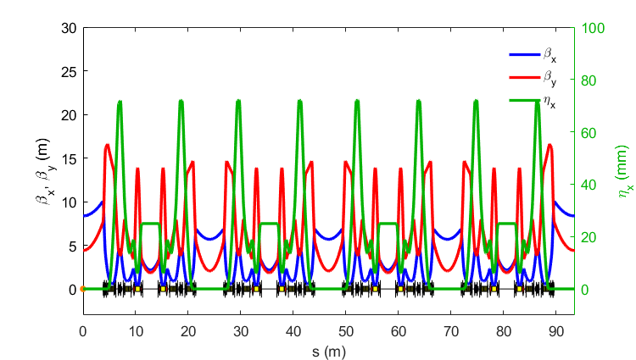
Diamond-II: Design Goals
Objective #1: Optimise the science enabled at Diamond
Objective #2: Maximise the impact it has for researchers both in universities and in industry
New Modified Hybrid 6-Bend Achromat (M-H6BA) storage ring
  Lower emittance (x~20) to increase brightness and coherence
  Double number of straight sections to increase capacity
Raise energy from 3 GeV to 3.5 GeV to increase flux and brightness above 10 keV
Upgrade insertion devices, new flagship beamlines
Improved data handling/computation, automation, ...
Science case and Conceptual Design Report published in 2019: https://www.diamond.ac.uk/Home/About/Vision/Diamond-II.html
1 super-period of M-H6BA
 | Bare lattice | With IDs
Average ε_{x}* | 163 pm.rad | 120 pm.rad
Average σ_{E}* | 0.095 % | 0.109 %
Average σ_{L}* (RMS) | 49.1 ps | 48.1ps
Total Lifetime* | 7.0 ± 0.2 | 7.0 ± 0.3
*final parameters including effects of intra-beam scattering, wake-fields and harmonic cavity
Ian Martin, Light Sources, JAI AB, 07/04/2022

Slide 4
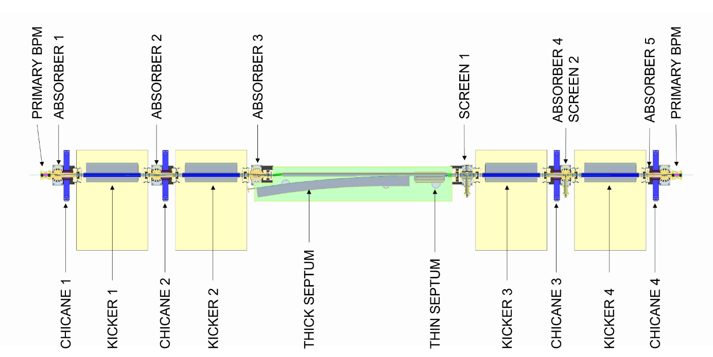
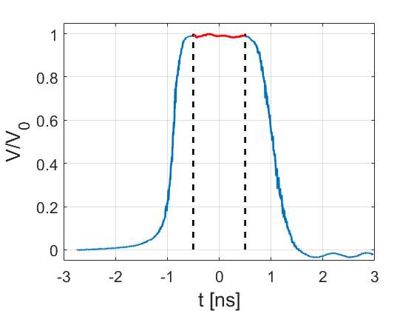
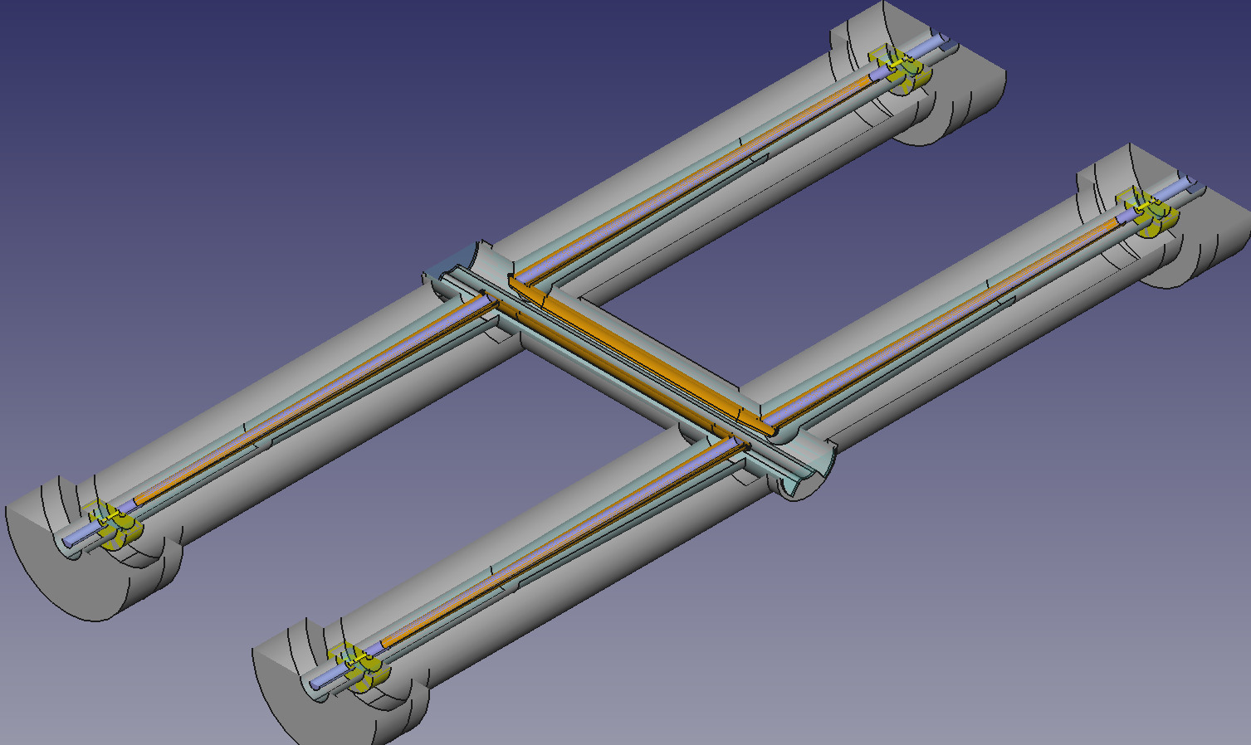
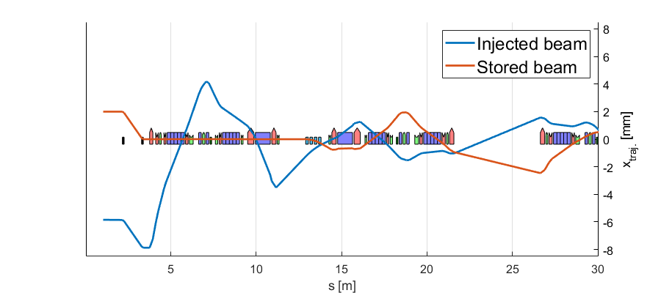
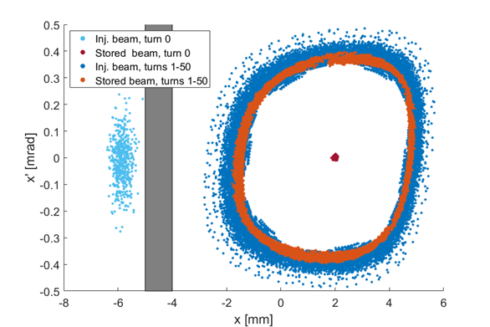
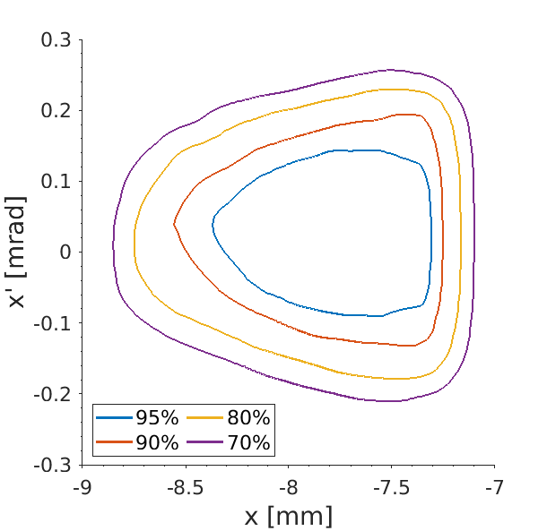
Diamond-II: Injection Scheme
Diamond-II injection will use a single-bunch ‘aperture-sharing’ scheme utilising a combination of thick/thin septum magnets and fast stripline kickers to improve transparency of injection process
Stripline pulse
(FID GmbH)
2 ns
150 mm striplines
Inj. eff. vs position/angle
Injection straight
Stripline kickers
J. Kallestrup, DLS
Ian Martin, Light Sources, JAI AB, 07/04/2022

Slide 5
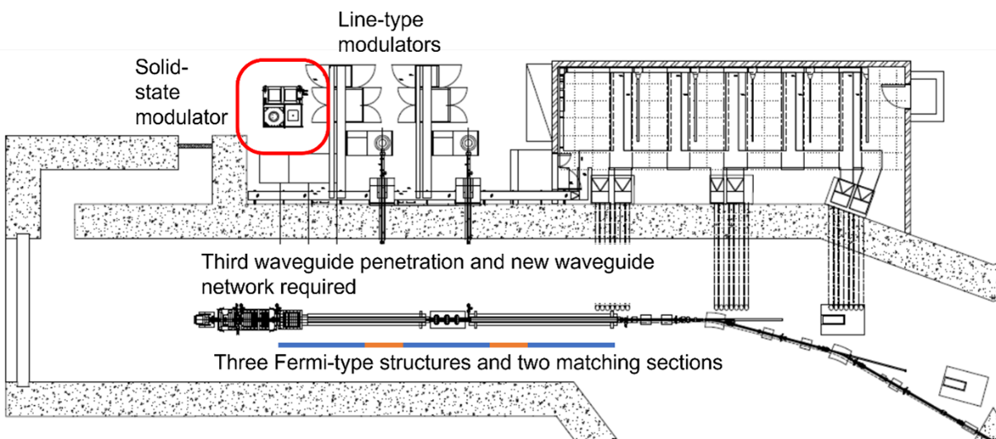
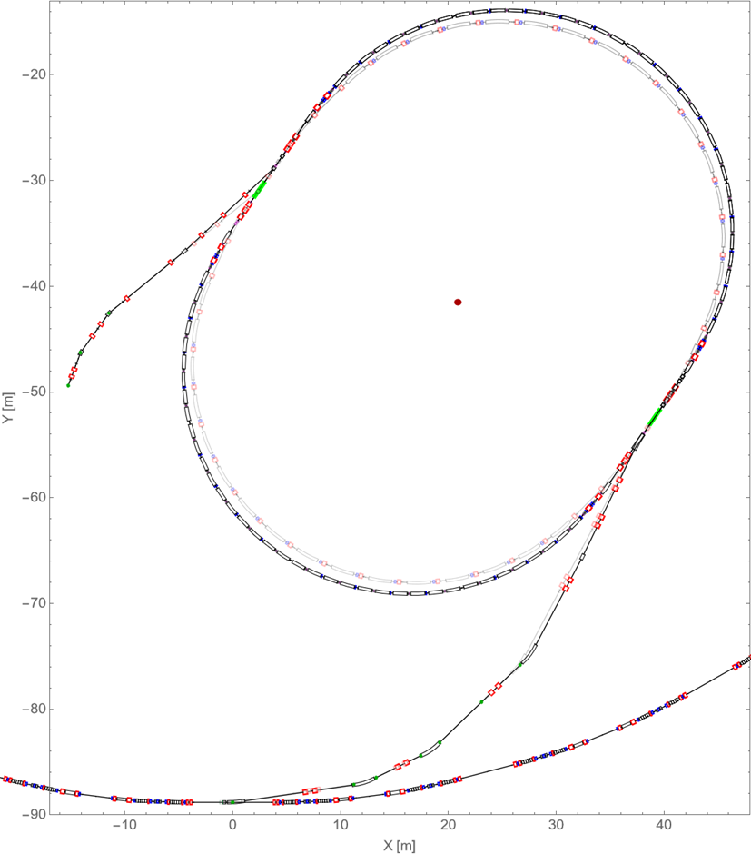
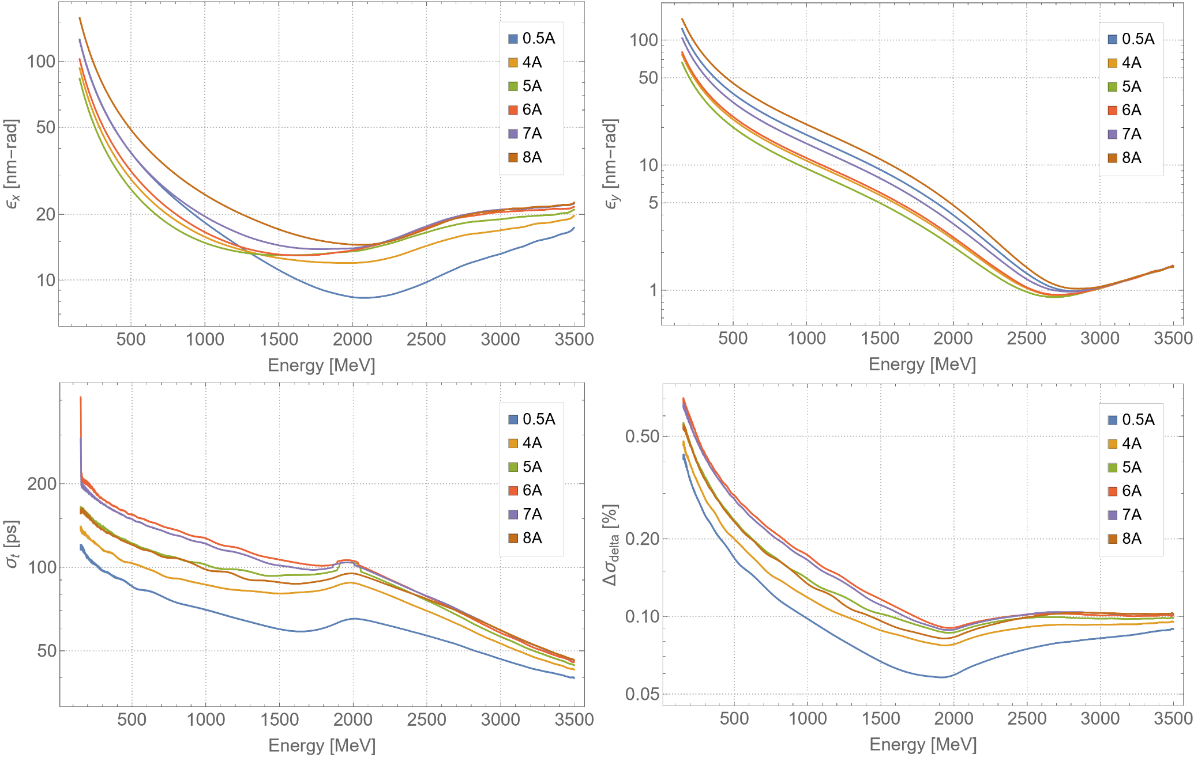
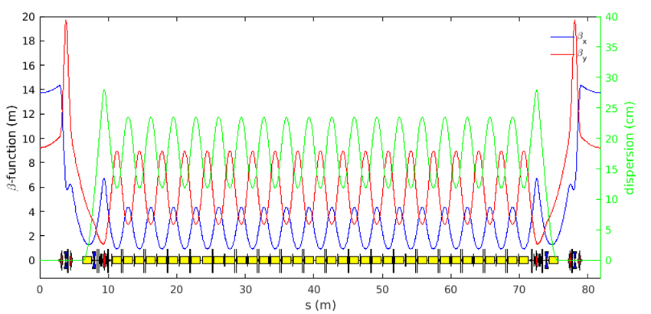
Diamond-II: Injector
Efficient injection into Diamond-II storage ring at higher energy requires a new linac, a new booster and reconfigured transfer lines
Aim to maximise charge/shot to reduce fill times and enable a variety injection schemes
Linac energy raised from 100 MeV to 150 MeV
Emittance lowered from 150 nm to 20 nm
Bunch length shortened from 100 ps to 40 ps
J. Jones, ASTeC
Ian Martin, Light Sources, JAI AB, 07/04/2022

Slide 6
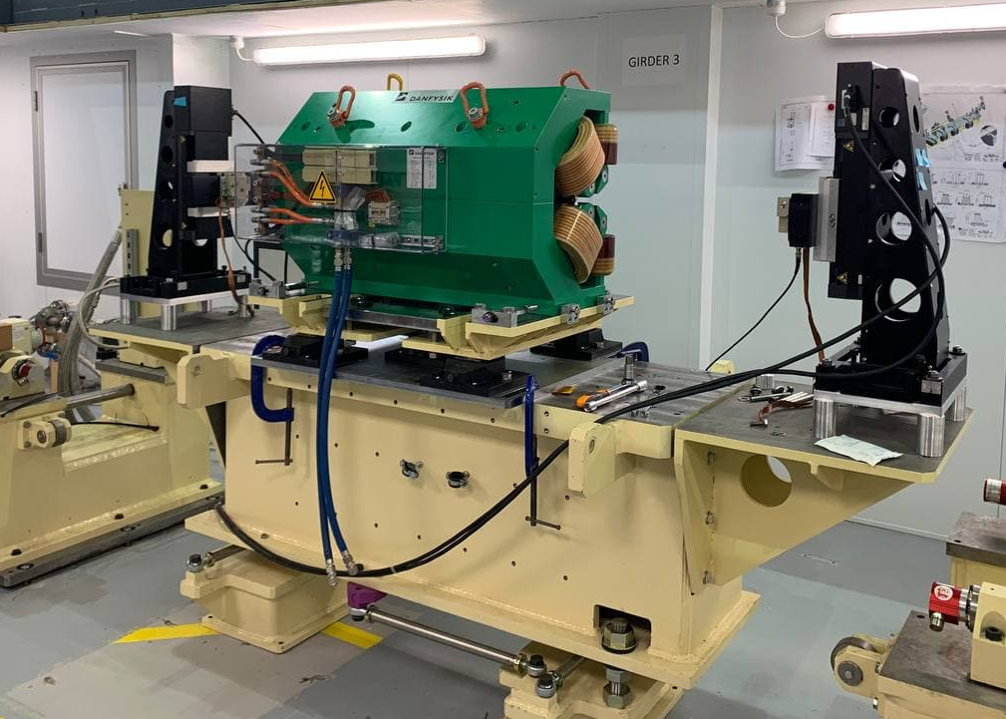
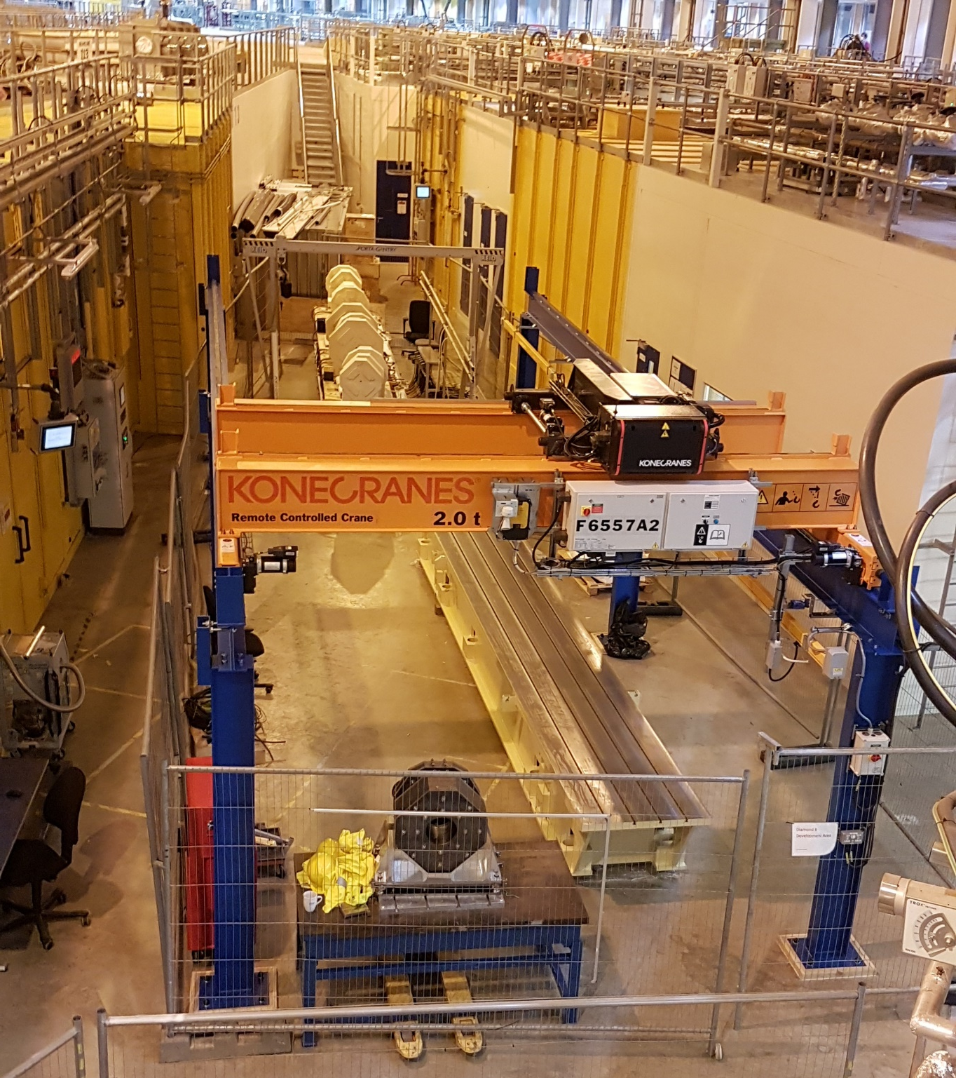
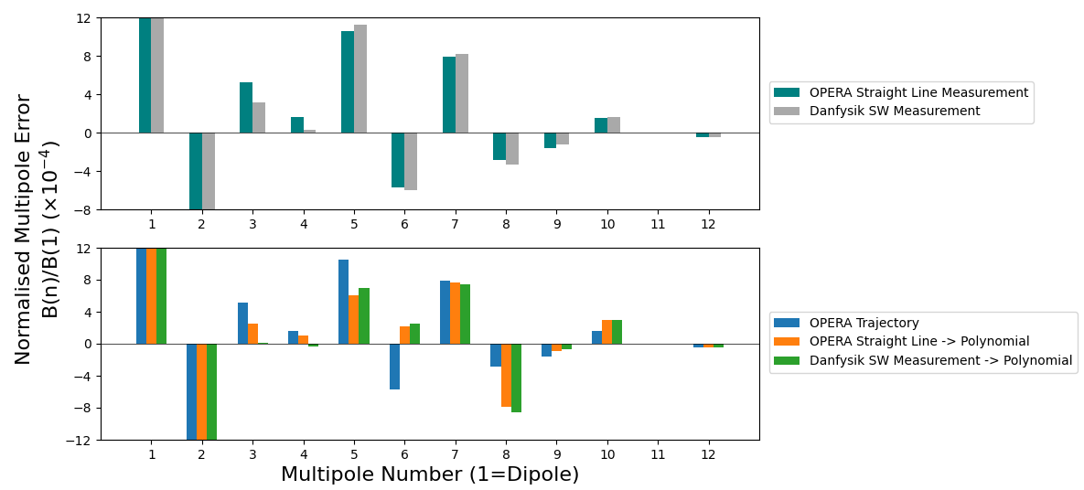
Diamond-II: Prototyping
Many developments are either underway …
Magnet alignment trials
Girder electrical wiring
Power supply controller
Front-end/ID control rack upgrades
New BPM electronics
New fast-feedback architecture
Girder motion system
… or planned:
Permanent magnet dipoles
Injection stripline(s) and pulser
Multi-bunch feedback
Ceramic kicker vessel
Fast corrector & power supply
Collimators
First girder mock-up
DQ prototype on the stretched wire bench
Prototype girder
Magnet positioning trials
A. Shahveh, DLS
Ian Martin, Light Sources, JAI AB, 07/04/2022

Slide 7
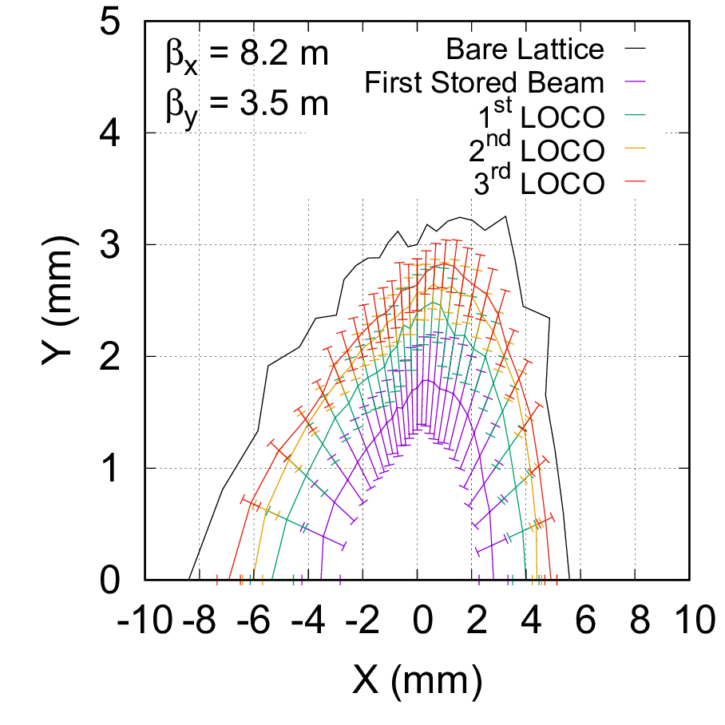
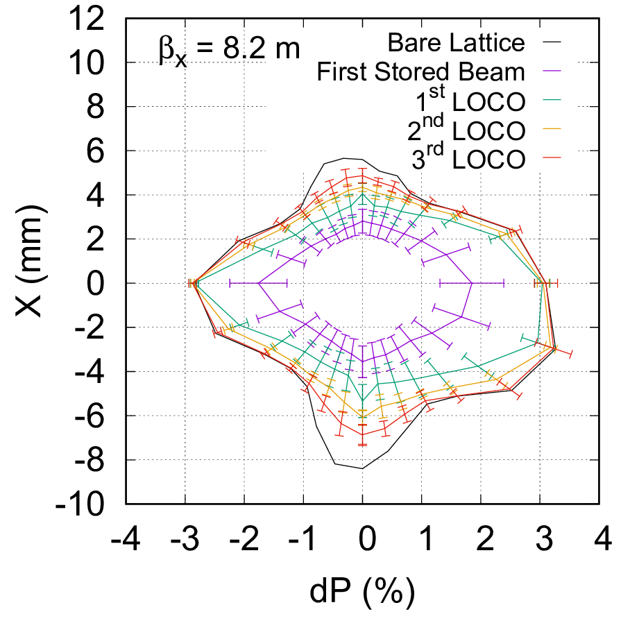
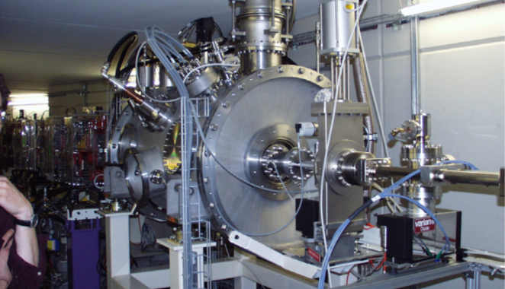
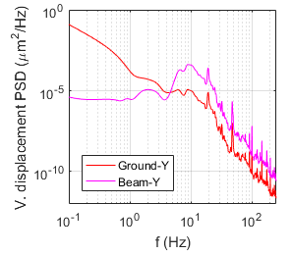
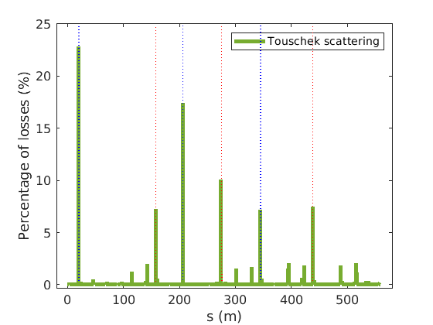
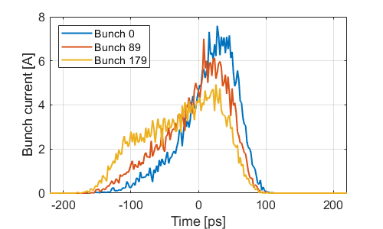
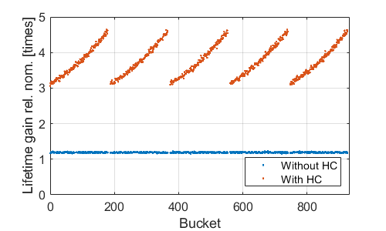
Diamond-II: Ongoing and Future AP Activities
Currently finalising the Technical Design Report. Draft reviewed by Machine Advisory Committee March 2022.
Simulated commissioning process from first turns through to ID commissioning
SC harmonic cavity at SLS
Loss distributions studied for different scattering mechanisms
H.-C. Chao, DLS
Electron beam stability due to ground motion, power supply ripple, …
Equilibrium bunch profile and lifetime gain due to harmonic cavity
H. Ghasem, DLS
T. Olsson, DLS
Ian Martin, Light Sources, JAI AB, 07/04/2022

Slide 8
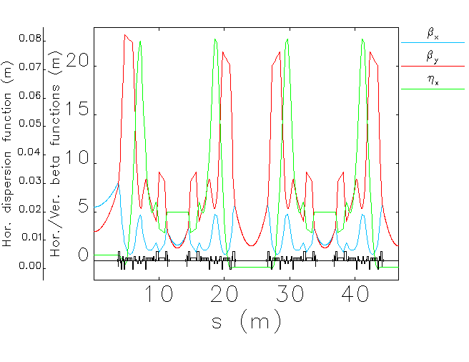


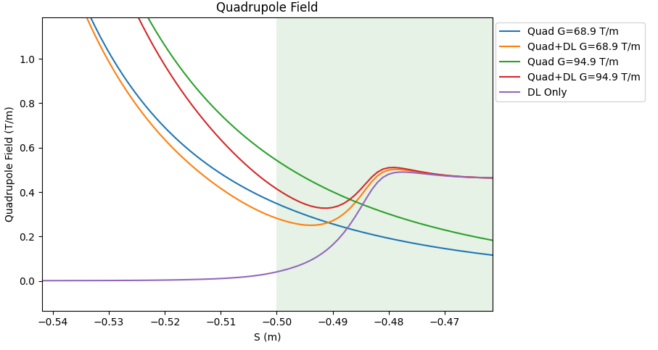
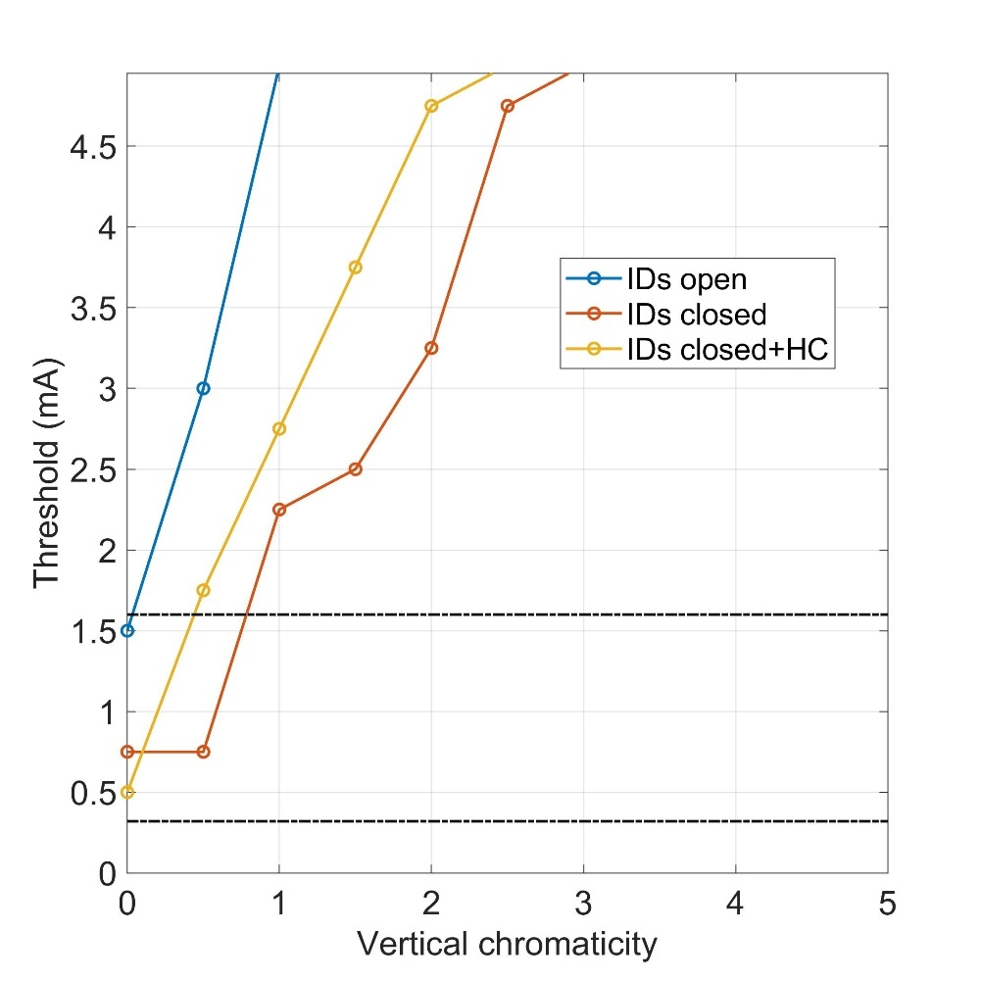
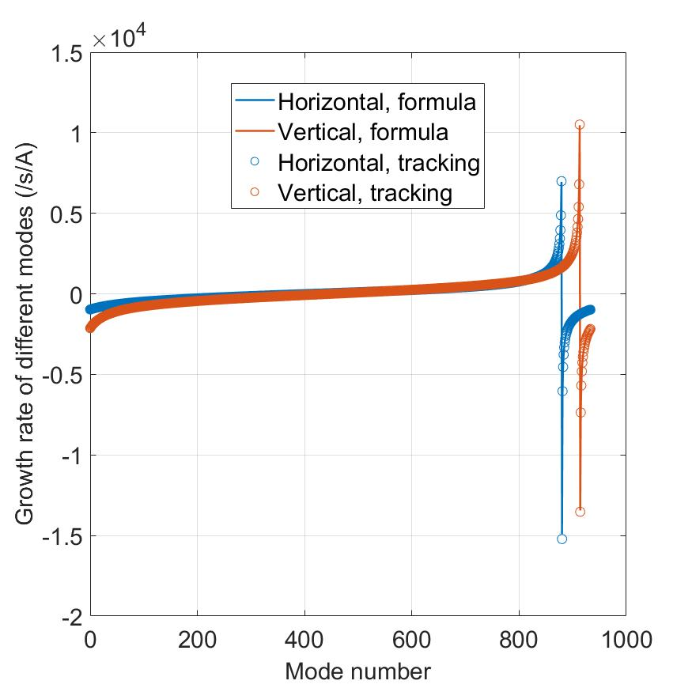
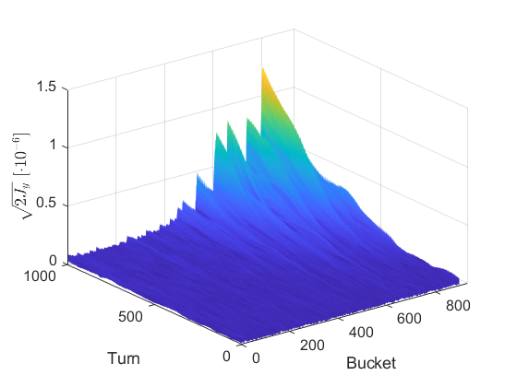
Diamond-II: Ongoing and Future AP Studies
Impact of magnet cross-talk due to high-fields and close proximity
Alternative lattice solutions to increase photon beam brightness (reduce emittance, improved optics at IDs)
quadrupole
sextupole
PM DL dipole
Single and coupled-bunch instability thresholds
Vertical instability due to ion-trapping
Quad. only
Combined
Dipole only
B. Nicolson, DLS
T. Olsson, DLS
Ian Martin, Light Sources, JAI AB, 07/04/2022
S. Wang, DLS

Slide 9
Diamond-II: Timeline
Diamond funded as a Joint Venture between two sources (UK Govn./STFC 86% and Wellcome Trust 14%):
  Same funding structure planned for Diamond-II
  Full Business Case (FBC) to be reviewed by UKRI’s Infrastructure Advisory Working Group (IAWG), Executive Committee (Exco) and BEIS Project and Investment Committee (PIC), June-August 2022
  Wellcome Trust have approved funding for D-II, subject to final approval from UK Government
  Funding decision expected November 2022
Nominal Timeline:
TDR published May 2022
Start of shutdown September 2026
End of booster commissioning July 2027
End of storage ring commissioning December 2027
User beam resumes March 2028
Ian Martin, Light Sources, JAI AB, 07/04/2022

Slide 10
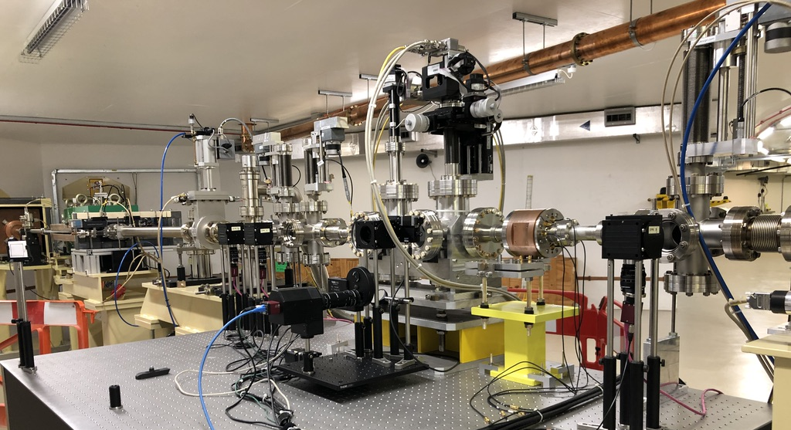
PhD Students: Dan Harryman, Alec Clapp (started 2021)
“Feasibility study on the use of incoherent Cherenkov Diffraction Radiation to develop a non-invasive BPM”
This work is part of a wider research group* exploring the applications of ChDR for beam diagnostics in collaboration with CERN, Tomsk and Royal Holloway, Uni of London, with experimental setups at CERN, KEK and Diamond Light Source.
Cherenkov Diffraction Radiation (ChDR) occurs when a charged particle moves in the vicinity a medium.
The photon yield of ChDR is dependent upon the distance between the charged particle and the dielectric medium.
Thus ChDR can be exploited for novel beam position monitors (BPM), where traditional rf pick-ups are challenging, (e.g. inside a bending magnet)
Experimental station with multi-axis manipulation capabilities
BTS Test Stand Vessel String at Diamond
*R. Kieffer et al., Phys. Rev. Lett. 121, 054802 (2018)
Supervisors: P. Karataev and L. Bobb
Ian Martin, Light Sources, JAI AB, 07/04/2022

Slide 11

PhD Students: Dan Harryman, Alec Clapp (started 2021)
Experimental Observations (imaging of ChDR target):
When imaging the ChDR radiator three distinct areas can be seen.
Incoherent unfiltered emission can’t be seen until impact parameters of 3.5mm or less are reached.
Given the beam size at these areas there will be noise and contamination from direct Cherenkov radiation caused by direct beam and radiator collision
Dependence on Impact parameter – the shortest distance from the target
target
Horizontal Bump: 0 to 4mm
Status:
New radiator is being developed taking into account experimental experience from CERN and Daresbury Laboratory
Experimental work is planned every shutdown
Supervisors: P. Karataev and L. Bobb
Ian Martin, Light Sources, JAI AB, 07/04/2022

Slide 12
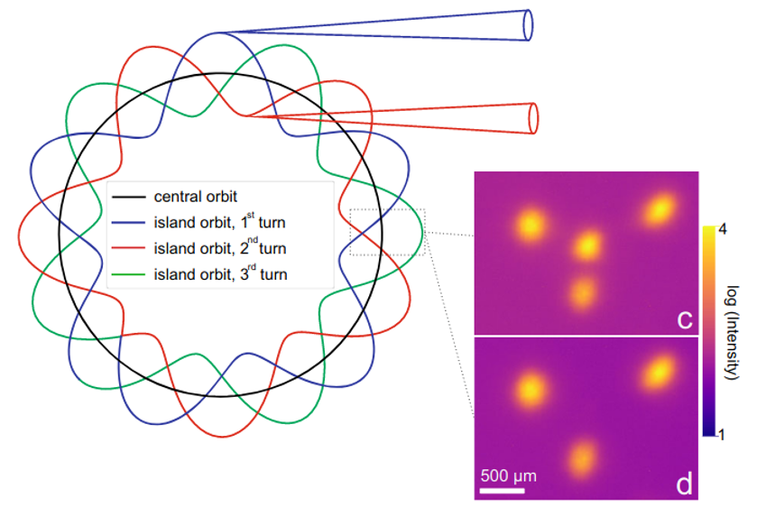
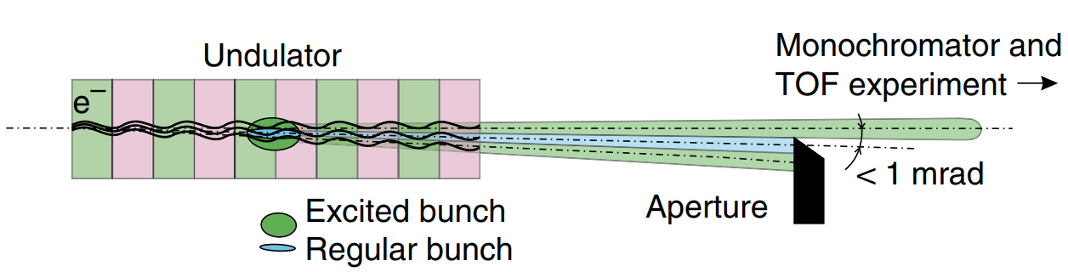
D.Phil. Student: Seb Wilkes (Started 2021)
“Provision for Timing Mode Users at Multi-bend Achromat Synchrotron Light Sources”
An open question for Diamond-II is how best to provide short, isolated x-ray pulses for time-resolved studies
Many options to study:
‘hybrid-mode’ filling pattern with an isolated single bunch in a long gap
‘Pulse-Picking by Resonant Excitation’ by increasing the vertical beam size of a single bunch by driving at the synchrotron sideband
‘Pseudo single bunch’ by kicking a single bunch onto a different trajectory
‘Transverse Resonant Island Buckets’ by shifting the tune point close to a resonance
Use of a higher-harmonic RF cavity to manipulate the longitudinal potential well
Transverse Resonance Island Buckets
K. Holldack, Comm Phys, 3, 61
Pseudo-Single Bunch
Pulse-Picking by Resonant Excitation
C. Sun, PRL, 109, 264801
K. Holldack , Nat Comm, 5 4010
Supervisors: P. Burrows and I. Martin
Ian Martin, Light Sources, JAI AB, 07/04/2022

Slide 13
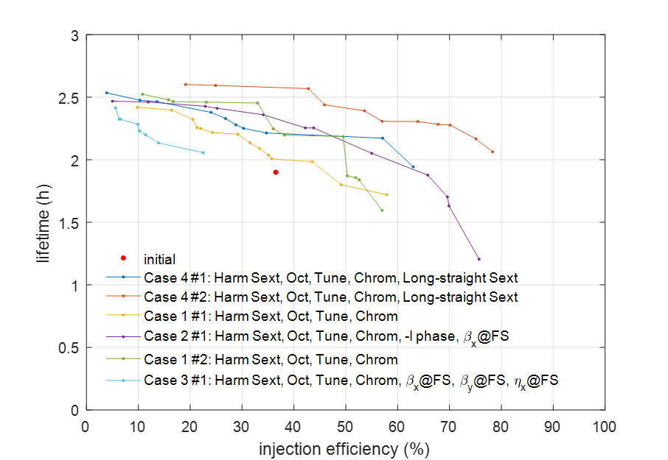
Oxford / Diamond PDRA Joint Appointment
Joint appointment for a PDRA created between Oxford University and Diamond Light Source (up to March 2025)
Aim to conduct numerical optimisation of the Diamond-II lattice
  apply multi-objective optimisation algorithms to maximise lifetime and dynamic aperture for injection
  systematic scans of tune-point and chromaticity
  re-configure magnet families to investigate if better solutions exist
  study baseline and high-brightness optics
An offer has been accepted, start data beginning July 2022 (TBC)
Scans of the Diamond lattice to identify best tune point for injection efficiency
Early MOGA optimisation of the D-II lattice
Ian Martin, Light Sources, JAI AB, 07/04/2022

Slide 14
Conclusions
JAI continues to be active in a number of areas of light source design and operation:
Facility design
Enhanced performance
Special operating modes
Photon / electron beam diagnostics
Providing training and expertise for next generation of accelerator physicists:
Two new PhD Studentships started September 2021 (RHUL and Oxford)
Joint Diamond / JAI PDRA to work on Diamond-II
Updates from previous students:
Niki Vitoratou: PDRA at CI on AWAKE (2020-2021)
Permanent position at Diamond working on visible light diagnostics (May 2021)
Ji Li: Fellowship at institute in Chinese Academy of Science
Ian Martin, Light Sources, JAI AB, 07/04/2022

