Slide 1
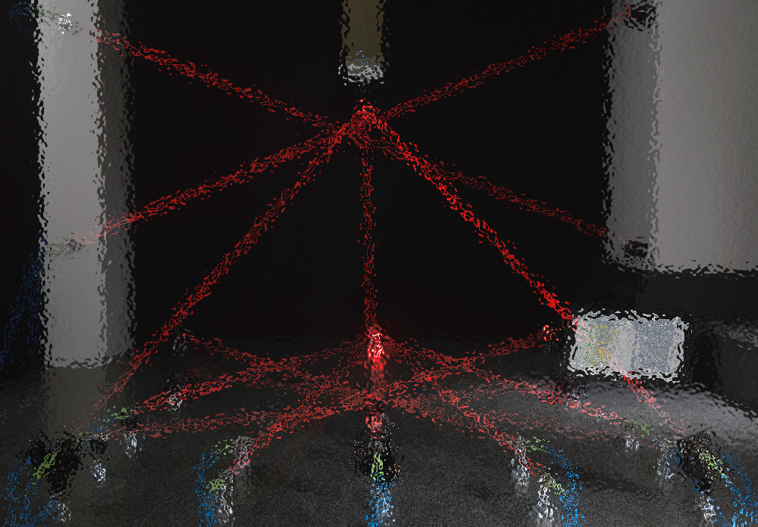






Innovation in Metrology from the JAI
JAI Advisory Board Meeting, April 7th 2022
Armin Reichold
TexPoint fonts used in EMF.
Read the TexPoint manual before you delete this box.: AAAAAAAA

Slide 2

Overview
Historic Origin’s
Technology Transfer Model
  Goals
  Method
  Past performance
Our Technology
  Current commercial technology = Multiline
  Current R&D technology = PaMIr
Summary

Slide 3
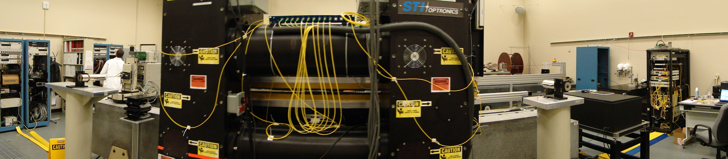
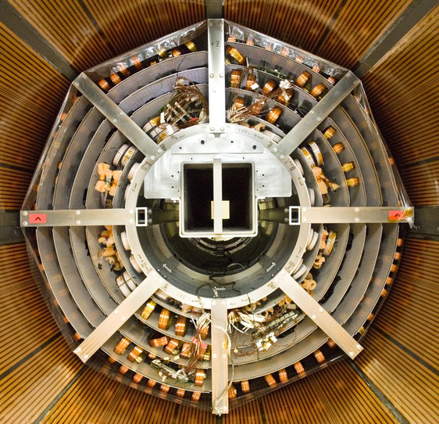
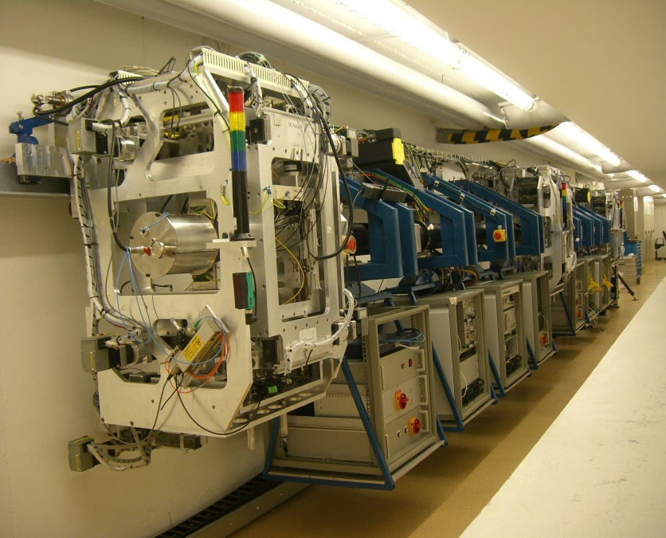
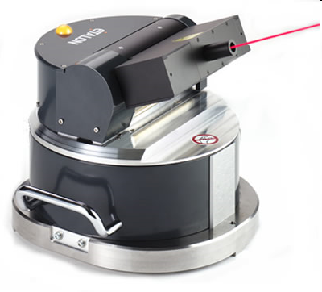
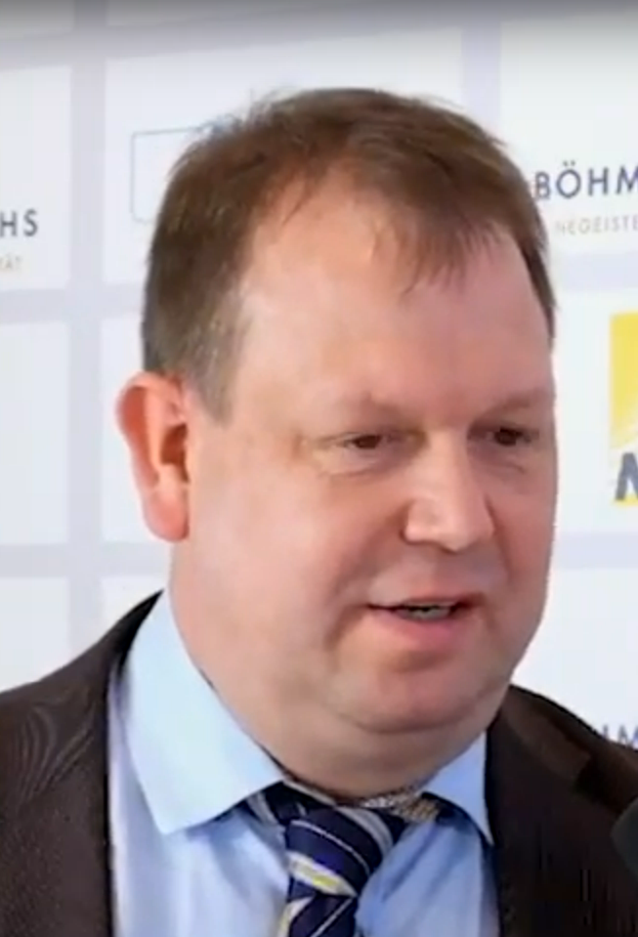


Historic origins
SLAC undulator gap monitoring
Linear Collider Alignment and Survey seed
corn for ground motion, stabilisation and
alignments at ILC ➔ FSI technology Mark-II
STFC withdraws from ILC
WP6 terminates prematurely
1993
ATLAS SCT alignment system
Oxford FSI technology Mark-I
2004
2008
2009
2010
2013
2003
EPSRC-NPL-ETALON-JAI
AMULET = general purpose
absolute distance
measurement system
for laser tracers
Robotic
Tunnel
Reference
Surveyor
(ILC @ DESY)
LC-ABD WP6
Reichold
meets Schwenke
CEO Etalon
Laser Tracer

Slide 4
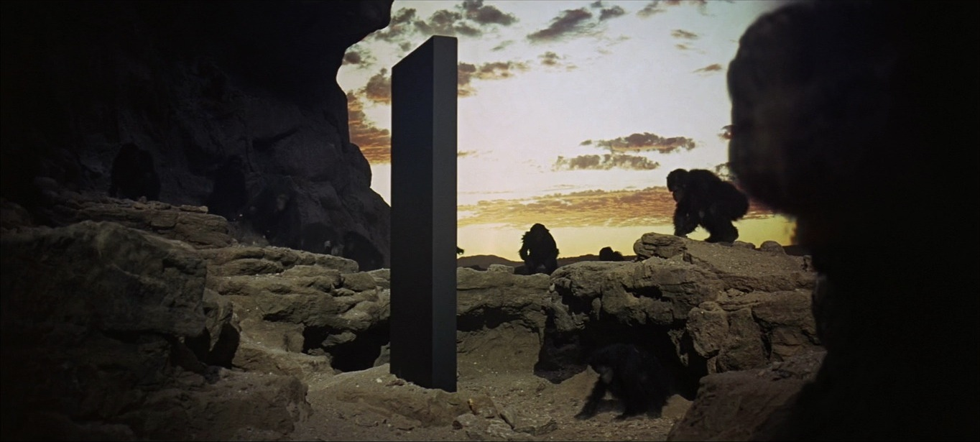
Technology
Transfer
Model

Slide 5
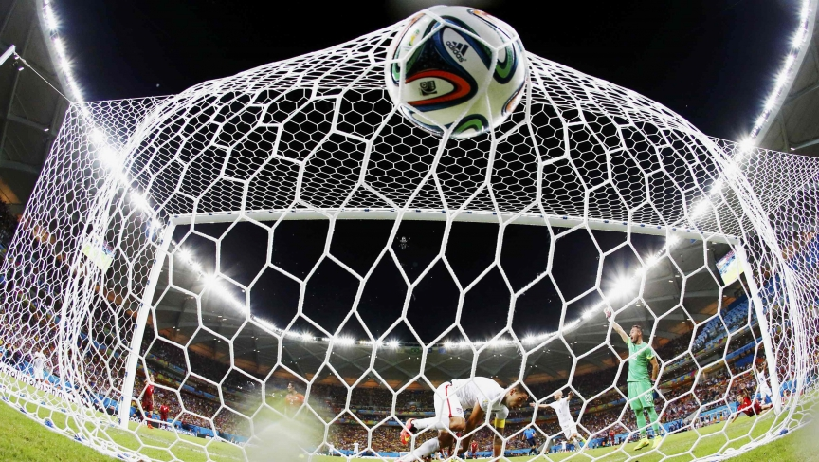
Technology Transfer Model
Goals:
  Generate & publish advances in science AND innovation
  Increase impact of JAI technology beyond the few science projects small JAI groups can support
  Generate revenue for University and Inventors
  Create jobs outside of academia

Slide 6
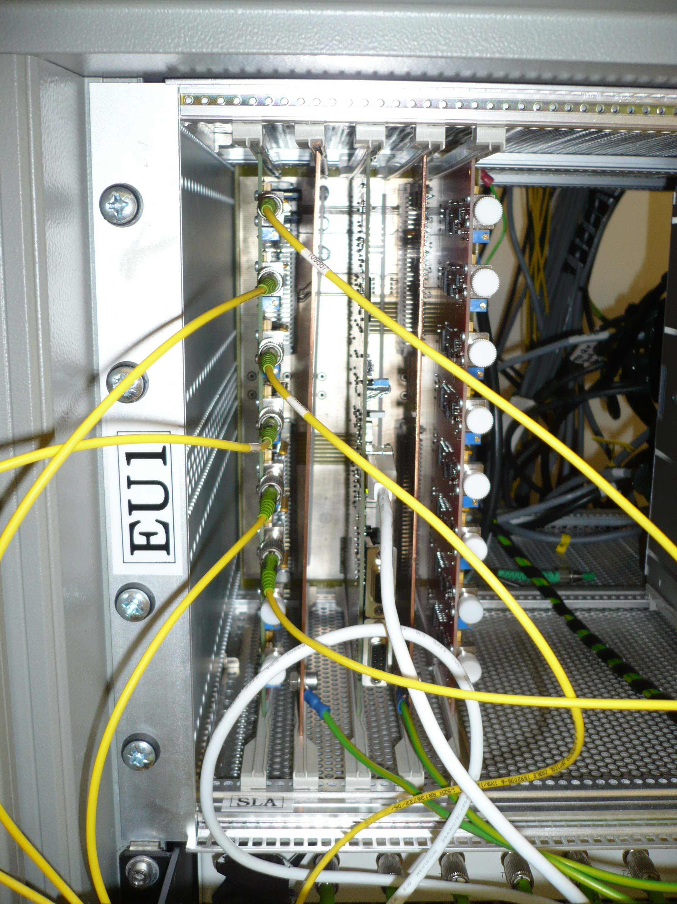
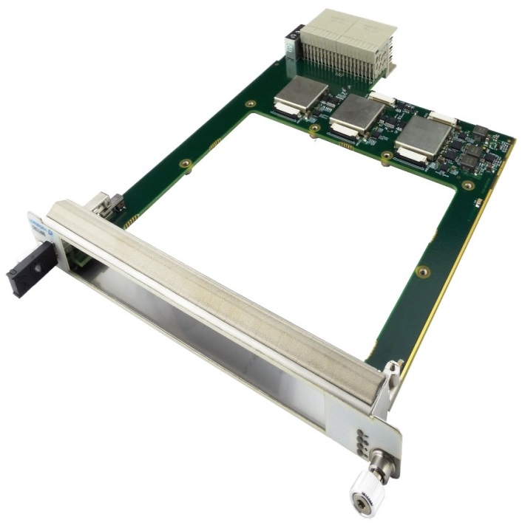
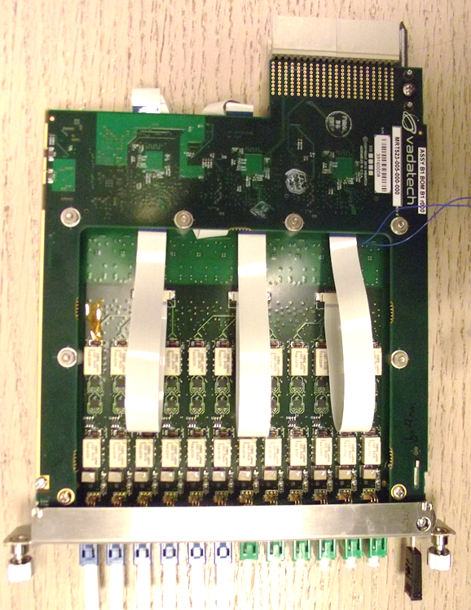
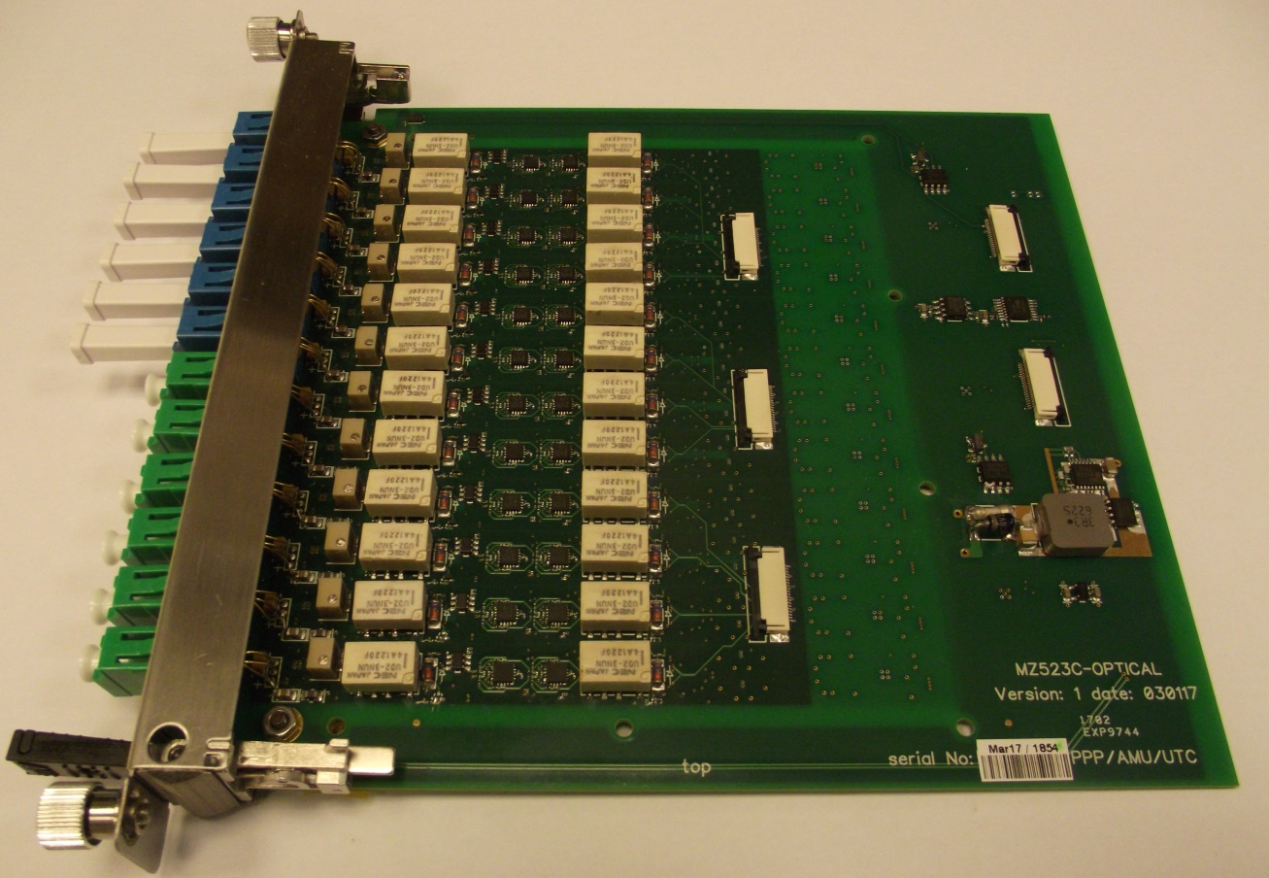
Technology Transfer Model
Method:
  Maximise utility of JAI technology through turn-key instruments, produced under license by industrial partners.
  Development targets widest applicability
  Protect IP with Patents (paid by Industry) then publish
  Continuously update technology to suit science AND industry ➔ new partner for uTCA-DAQ = VadaTech
  Long term relations with industry partners
1st commercial dFSI:
DAQ fully home built
5U-crate
2.77 MHz ADC
8-ch opto-board
2nd generation dFSI DAQ
full uTCA RTM, now in Gen-4
VadaTech uTCA
MRT
JAI optical dFSI mezzanine
accelerator control wants uTCA & high density

Slide 7
Technology Transfer Model
Past Performance
  Grants:
    3 grants for accelerator science using metrology all before March 2010: £2M
    12 grants for innovation from the above science all after January 2010: £1.66M
    Industry contribution to the above all after Jan 2010: £0.545M
    Only five DPhil students 2004 to 2015 (none after that), but multiple master’s & summer students
  Industry total R&D input (productisation) : €1.5M
  License Income
    total since 2010 = £354,622
  Total turnover to date: €6M
  Expected turnover 2022: €1.8M
  Consulting
    5 consulting contracts for JAI team
  Publications from innovation only
    2 patents
    2 papers
Etalon part of Hexagon
➔ Better sales and marketing!
prediction based on turnover

Slide 8
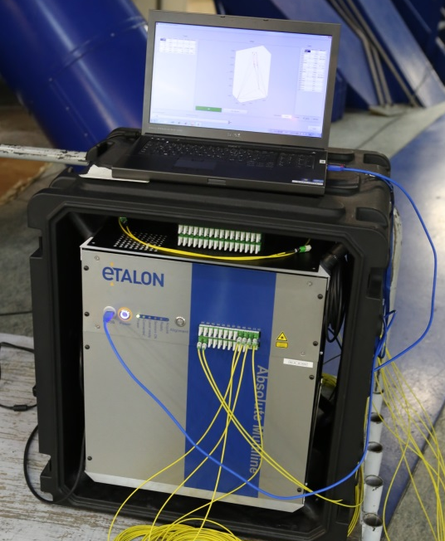
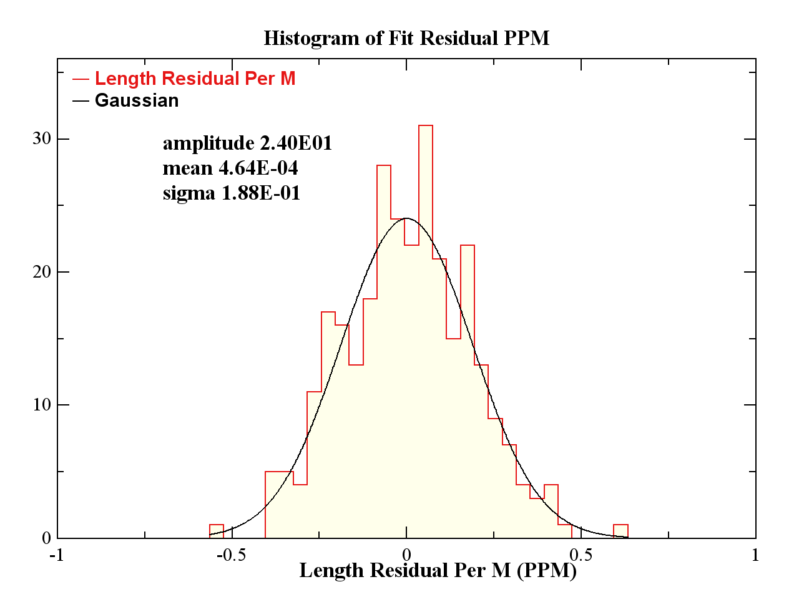

Current Technology = Frequency Scanning Interferometry
Measure absolute distances 15 mm – 30 m
Dynamic measurement < 19 mm/s
Scan time resolution 125 MHz
Scan position resolution < ± 0.1 μm
Scan repetition rate 0.1 to 10 Hz
Uncertainty: < ±0.5 μm/m @ 95% confidence
Measurement errors highly statistical
➔ Averaging improves
accuracy at fixed length
mean = 464 pm/m
sigma = 188 nm/m
statistics of ~200 measurement residuals from 0.2 to 20 m comparing against reference instrument at NPL
relative length residual [ppm]

Slide 9
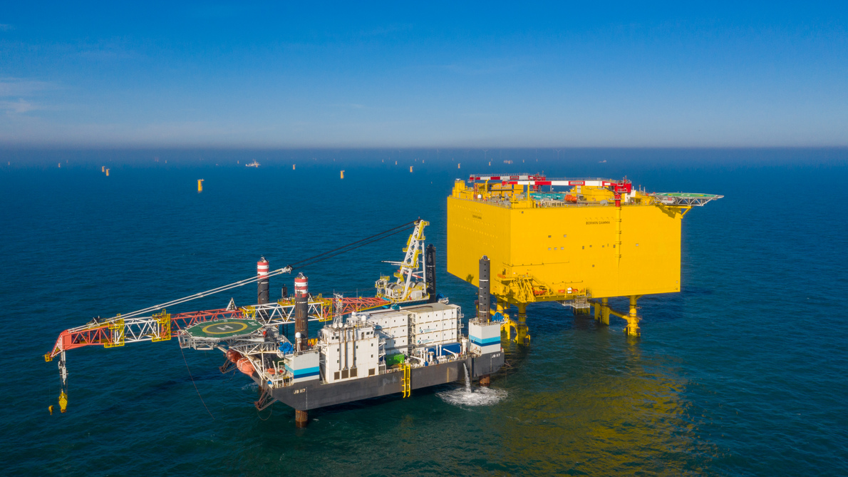
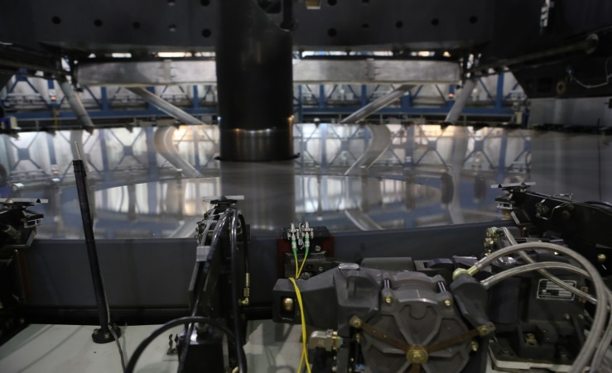

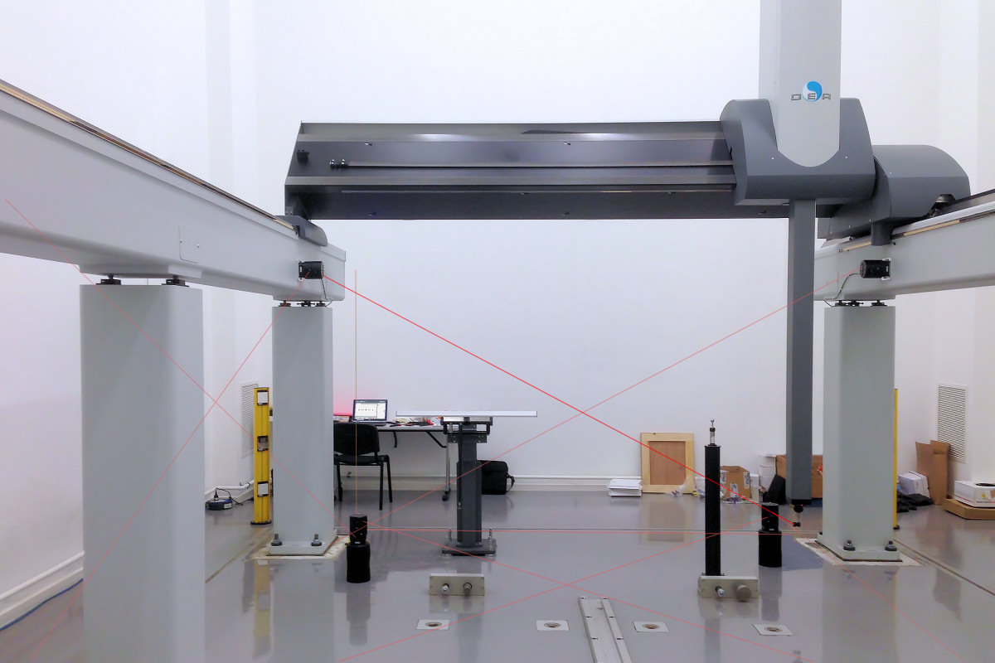

Current Technology Customers
Accelerator customers:
  2 x CERN (in-vacuum alignment of high luminosity LHC crab cavities and quadrupoles),
  2 x SLAC (alignment of undulator magnets at LCLS-II),
  GSI (general purpose instrument),
  PSI (Paul Scherrer Institute, in vacuum form measurement & alignment of X-ray mirrors for MAX IV synchrotron)
  Argonne National Lab: monitoring of x-ray laser components
  IHEP China: Monitoring of Accelerator components.
  Expected: Argonne 2nd system, in vacuum XFEL alignment
Industry Customers:
  Siemens Energy (€1Bn off shore wind-energy platform monitoring),
  SAFRAN Reosc (form metrology of 900 EELT mirrors at 20nm uncertainty),
  DMG Pfronten (CNC machine deformation monitoring)
  Heidenhain (calibration methods and thermal CNC monitoring)
  Alstom: Monitoring of large machine tools
  Expected: SAFRAN Reosc, 2nd system, in process
  telescope mirror manufacturing
Siemens Energy (Borwin-3: €1Bn off shore wind-energy HV-DC platform monitoring, Borwin-5 interested),
PSI (Paul Scherrer Institute, in vacuum form measurement & alignment of X-ray mirrors for MAX IV synchrotron)
Astronomy customers:
  GMT (Giant Magellan Telescope, align primary to secondary mirror, currently installed at the Large Binocular Telescope to increase usable observation time by 30 minutes per night.)
  LBT (Large Binocular Telescope) align primary to secondary, increases usable observation time by 30 minutes per night.
  ESO (mirror deformation measurement and alignment of Harmoni instrument in cryostat)
  LMT (Large Millimetre Telescope), Mexico: Monitoring of secondary mirror
  SRT (Sardinian Radio Telescope) Monitor secondary mirror
  Russian Academy of Science (cryogenic, in-vacuum deformation tests for Millimetron Space Telescope)
  CCAT (Cerro Chajnantor Atacama Telescope, measure form of 6m x 6m primary in situ, align prim. to secondary)
  Expected: GMT 2nd system, full alignment network for GMT
Other Research customers:
  PTB (Physikalisch Technische Bundesanstalt) = Campus wide FSI network ➔ test mobile metrology instruments , large ultra-precision CMM; wind energy deformation, torque-tests
  NARMC (UK’s Nuclear Advanced Materials Research Centre, facility wide CNC and CMM machine calibration network),
  RWTH Aachen Machine Tool Lab (deformations of CNC machines),
  University of Dresden (deformation of robots, presses, tools),
  Expected:
  Uni Hannover, positioning mobile machine tools
  Frauenhofer-IFAM, Robot Monitoring
  NASA, space component deformations in simulators
  PTB (Physikalisch Technische Bundesanstalt) = Campus wide FSI fibre network ➔ test mobile metrology instruments , large ultra-precision CMM; wind energy deformation, torque-tests
VLT alignment
LBT (Large Binocular Telescope)
align primary to secondary,
increases usable observation time
by 30 minutes per night.
Ultra-precision CMM calibration
Braunschweig
PTB

Slide 10
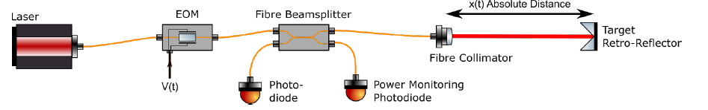
Next technology = PaMIr (Phase Modulation Interferometry)
Polychromatic, coherent
Light Source
measurement “channel”
(up to 12 per FPGA card)
Fizeau interferometer
one of many
V_{mod}(t)
I_{int}(t)
optional
real time analysis in FPGA
D(t)
Displacement Out:
A-quad-B
Laser Tracer
Single detector, fibre coupled, multi-channel displacement sensor
Plug compatible with Multiline™ interferometer optics and readout
Single laser source + EDFA for up to 90 channels
Aimed at CNC machines, real time stabilisation and laser tracers
Maximum speed 1 m/s
Distance range 0.1m to 30m
Real time signal analysis in FPGA:
  ΔT_{latency}< 10 μs (design)
  Update rate 12.5 MHz
  12 channels per AMC523 (4 chan. version Sept. 2022)
Any interferometer measures any distance inside range
10

Slide 11
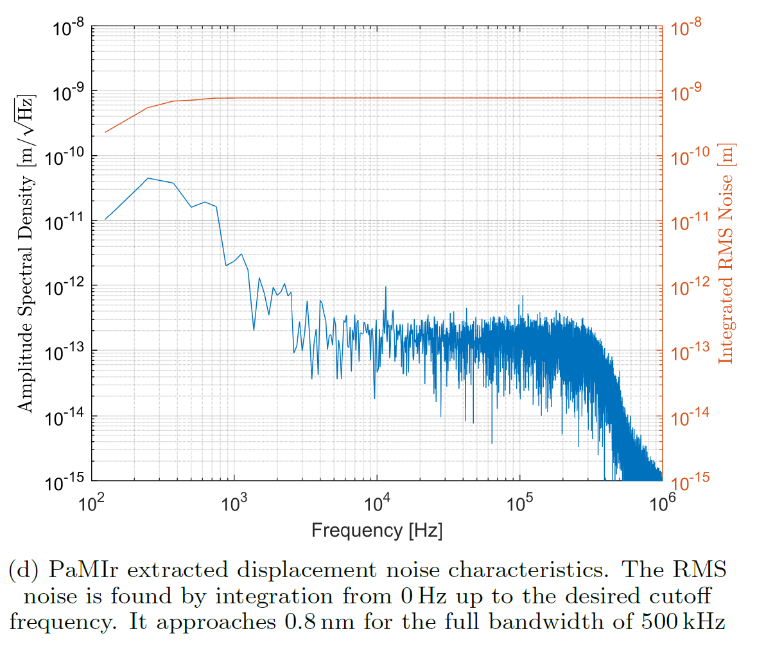
Real Data results
(Displacement noise)
RMS noise 0.8 nm up to 500 kHz (offline analys.)
Stationary target with OPD approx. 1m
Now verified at 1 m/s
Realtime test expected May 2022
Next Goal = simultaneous combination with FSI

Slide 12
Summary
JAI metrology work has spread far in industry, accelerator science, astronomy and other research fields
This is a long term activity with continuous project updates.
Funding after 2010 is hard work (small grants) and only available under the Impact Agenda but we delivered multiple projects
Science project funding seized in 2010 ➔ How can we recover this?
No DPhil students after 2015
Steady income stream via licenses with growing trajectory

Slide 13
Backup Slides

Slide 14
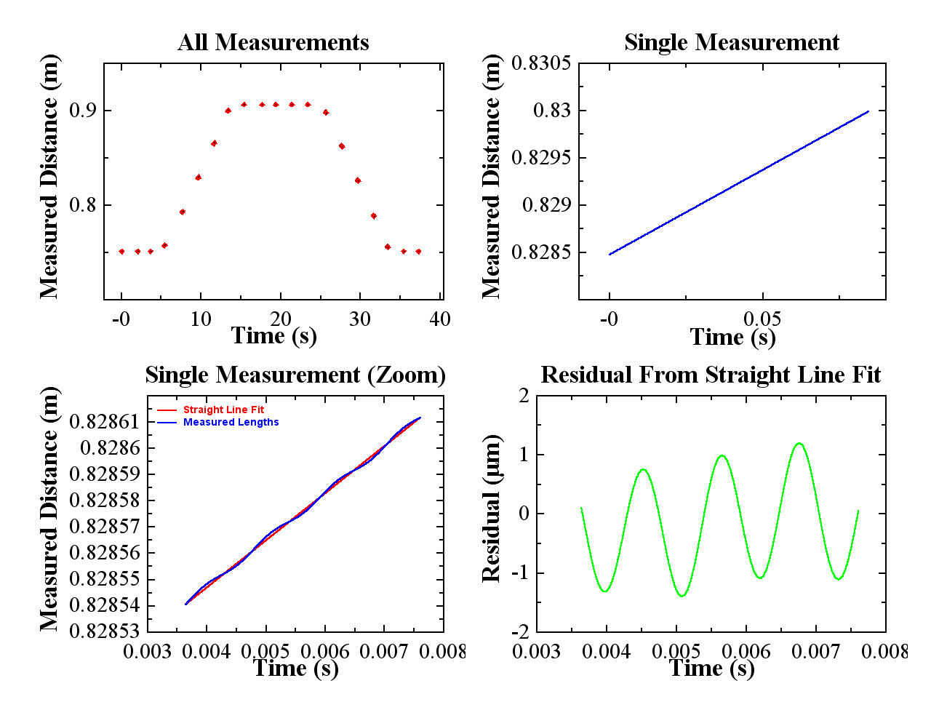
Current Technology = Frequency Scanning Interferometry
Velocity = 18 mm/s
Reflector on stepper motor stage
L_{min} = 75 cm
L_{max} = 90 cm
v_{max} = 18 mm/s
150 mm
1 mm
reflector
1 μm
collimator
±750 mm
±150 mm @ <=18 mm/s

Slide 15
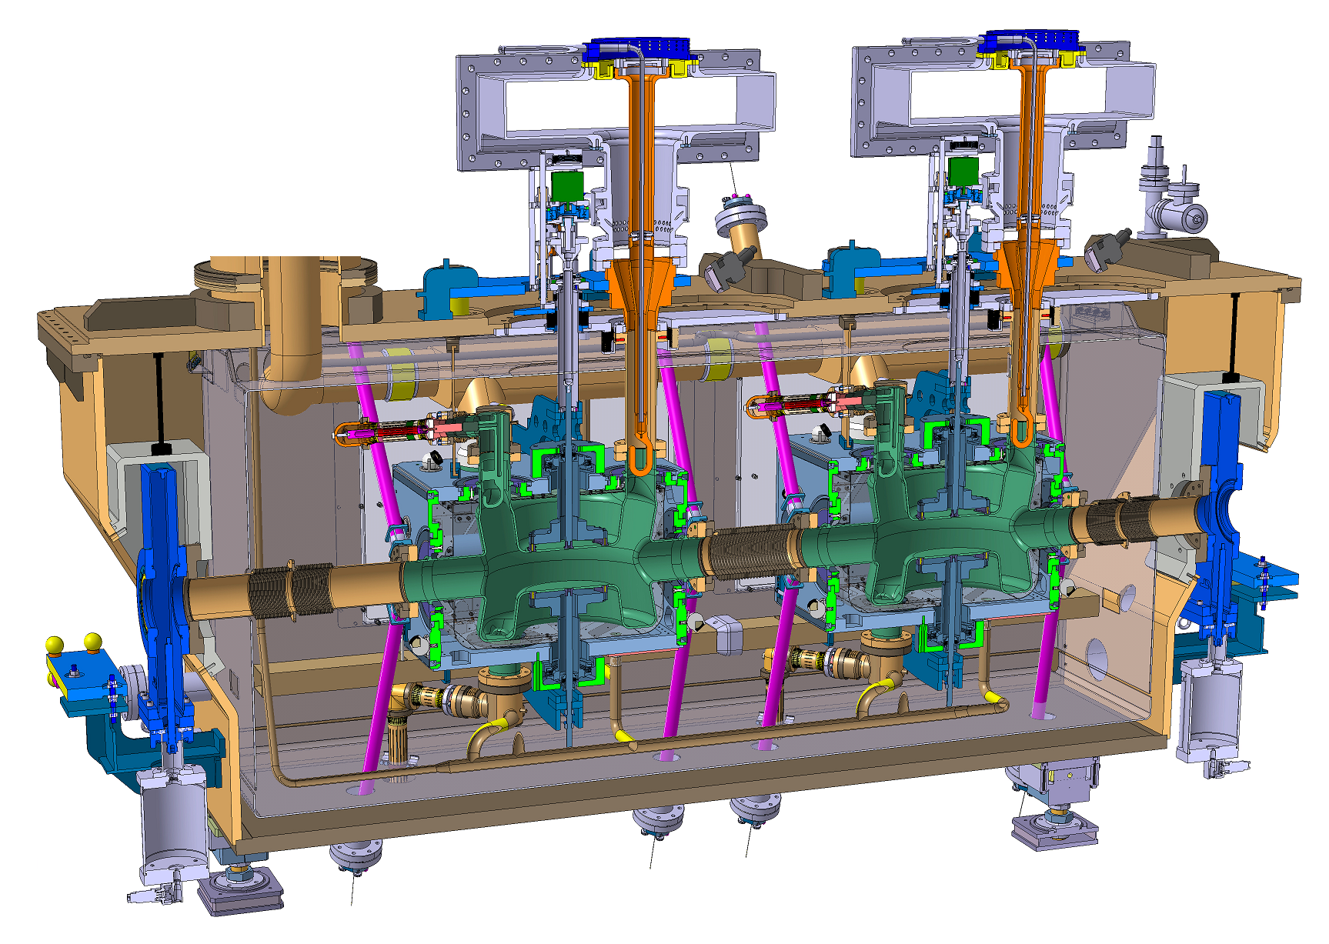
HL-LHC : Crab-cavities
Feedthrough commercially developed
by CERN knowledge transfer team.
Tunnel
conditions
Suspension system
Crab-cavity
Operating conditions :
Radiation : 1 MGy / year
Vacuum : 10⁻⁶ mbar
Temperature : 4 K
Operating conditions
Magnetic and thermal shielding
Cryostat
Cryostat and cavities axes
→ Alignment requirements :
+/-0.25 mm at 3σ
Cryostat
axis
Parameters | Precision
Tx : radial (mm) | 0.021
Ty : vertical (mm) | 0.009
Tz : longitudinal (mm) | 0.028
Rx : pitch (mrad) | 0.030
Ry : yaw (mrad) | 0.072
Rz : roll (mrad) | 0.187
Helium tank
Crab-cavity axis
CERN developed it’s own FSI system based on older & cheaper FSI versions
from Oxford as the commercial version deemed too expensive.
15

Slide 16
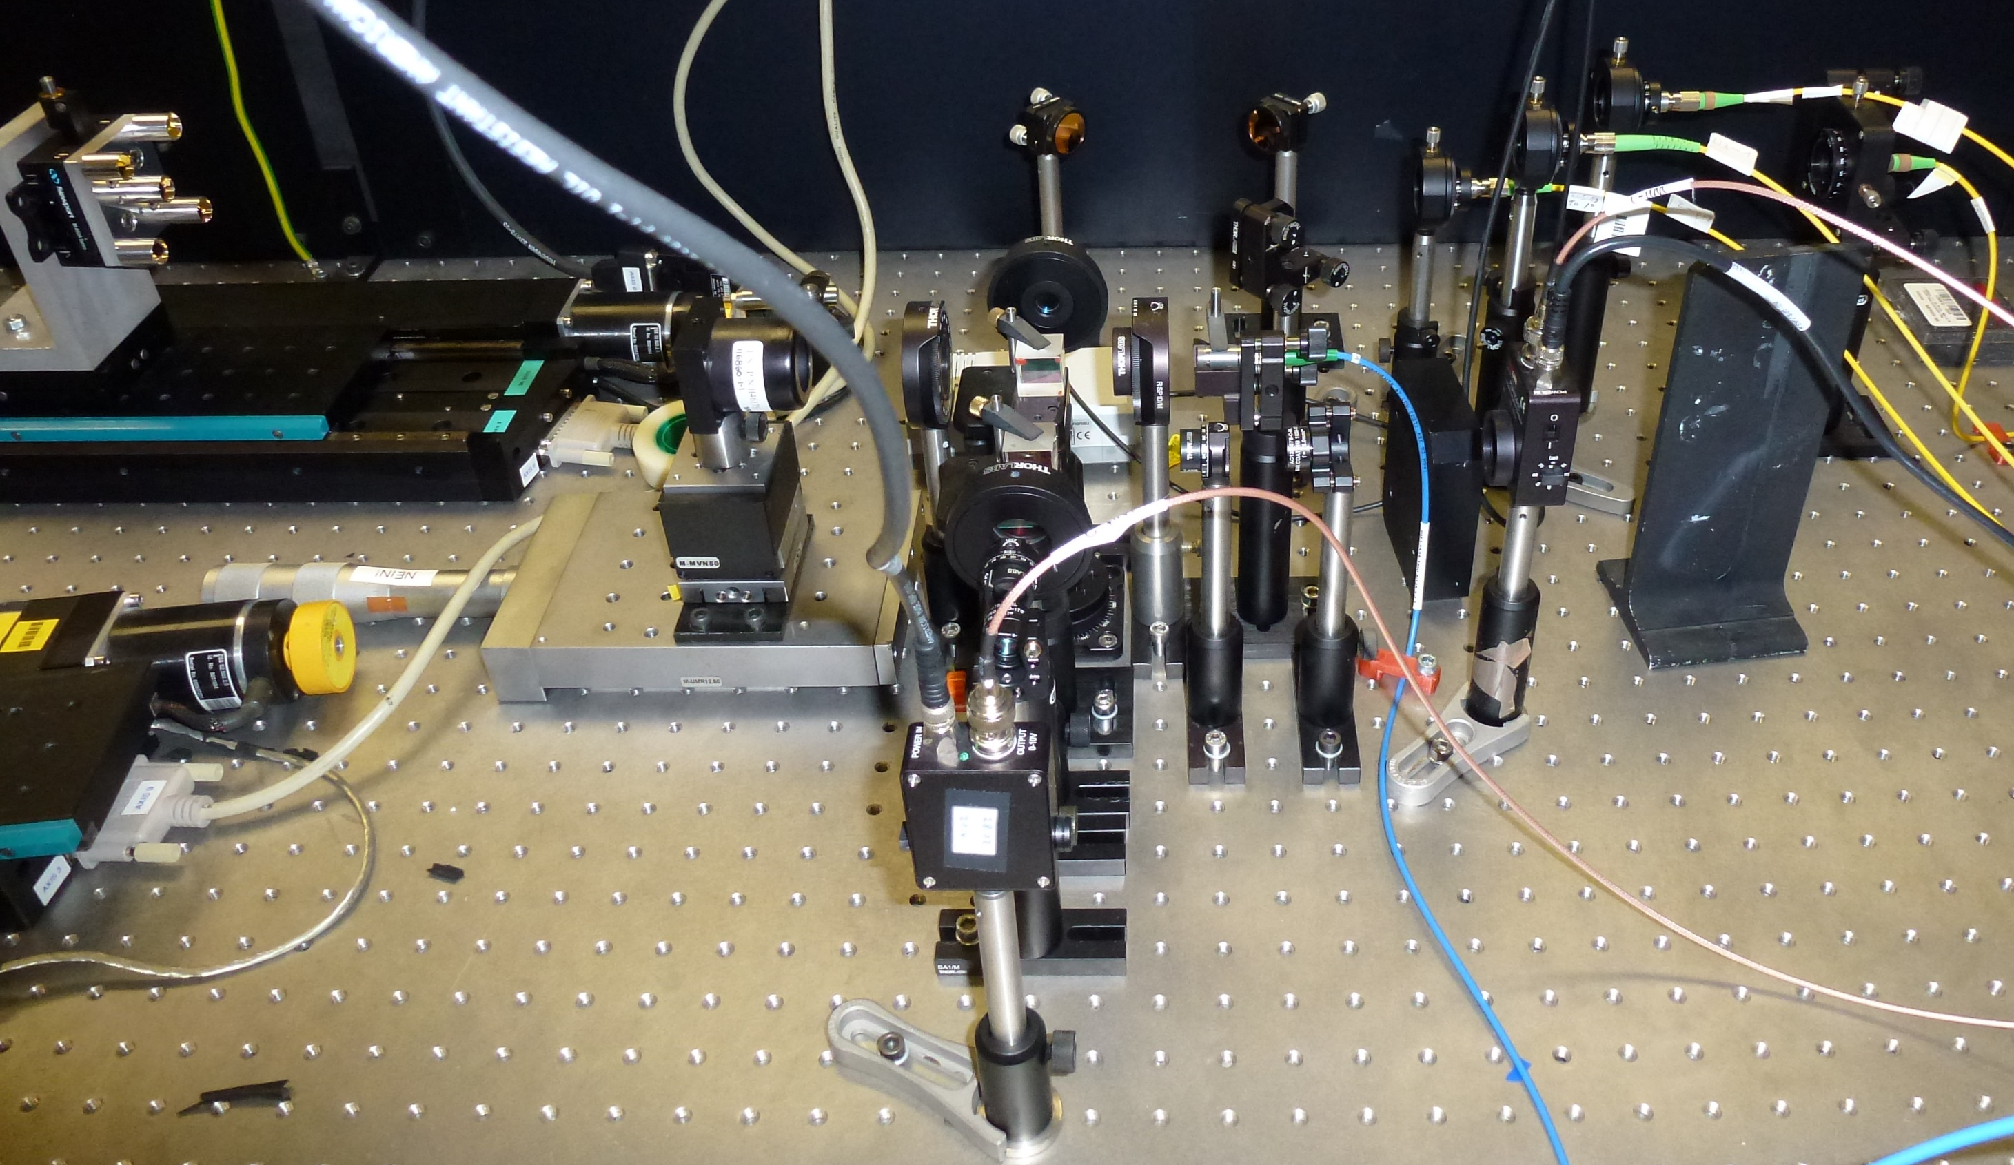
Prototype Setup
PaMIr
Attocube x3
Conventional polarisation based
homodyne interferometer

Slide 17

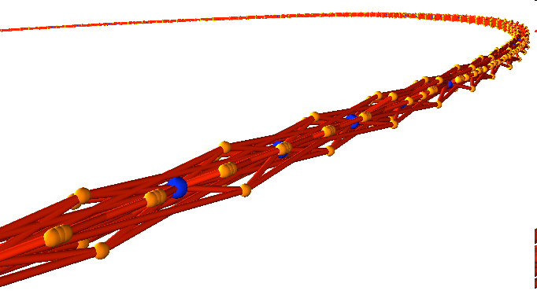
Historic origins
SLAC undulator gap monitoring
Linear Collider Alignment and Survey seed
corn for ground motion, stabilisation and
alignments at ILC ➔ FSI technology Mark-II
STFC withdraws from ILC
WP6 terminates prematurely
1993
ATLAS SCT alignment system
Oxford FSI technology Mark-I
2004
2008
2009
2010
2013
2003
EPSRC-NPL-ETALON-JAI
AMULET = general purpose
absolute distance
measurement system
for laser tracers
Robotic
Tunnel
Reference
Surveyor
(ILC @ DESY)
LC-ABD WP6
CAOX: geodetic
network software at
Petra-III survey
network.
Reichold
meets Schwenke
CEO Etalon

