Slide 1


Update on
Education & Training and Public Engagement at JAI
Emmanuel Tsesmelis
CERN & JAI University of Oxford
JAI Advisory Board 2022
7 April 2022

Slide 2
Introduction
The JAI programme is organized around three pillars:
  Research in accelerator science.
  Training next generation of accelerator scientists.
  Public engagement.

Slide 3
Education and Training

Slide 4
Guiding Strategy
Training in accelerator science & technology is one of the pillars of JAI mission and recognised by JAI Advisory Board to be world-leading.
Objective is to develop skills of next generation accelerator scientists.
JAI has provided graduate & undergraduate training in accelerator science & technology since first course delivered in 2005.
Students participate in comprehensive core formal training through academic courses & projects and 3 years of cutting-edge research at state-of-the-art facilities (national & international).
Many JAI academic staff invited to give courses & lectures at international accelerator schools.

Slide 5
JAI Graduates & Careers
JAI training is well aligned with STFC strategic aims to address national demand for scientifically-skilled workforce to sustain UK’s world-leading position in research & technology (2017 STFC Accelerator Strategy Review).
PhD graduates more than 70; all obtained fruitful employment; about 20% female.
  Alumni consistently pursue careers in science & technology
    Destinations include research positions in universities, ASTeC, BNL, CERN, CI, DESY, LBNL, LLNL, NPL, RAL, SLAC, & PSI.
    Some reached full academic positions; about 15% work in industry.

Slide 6
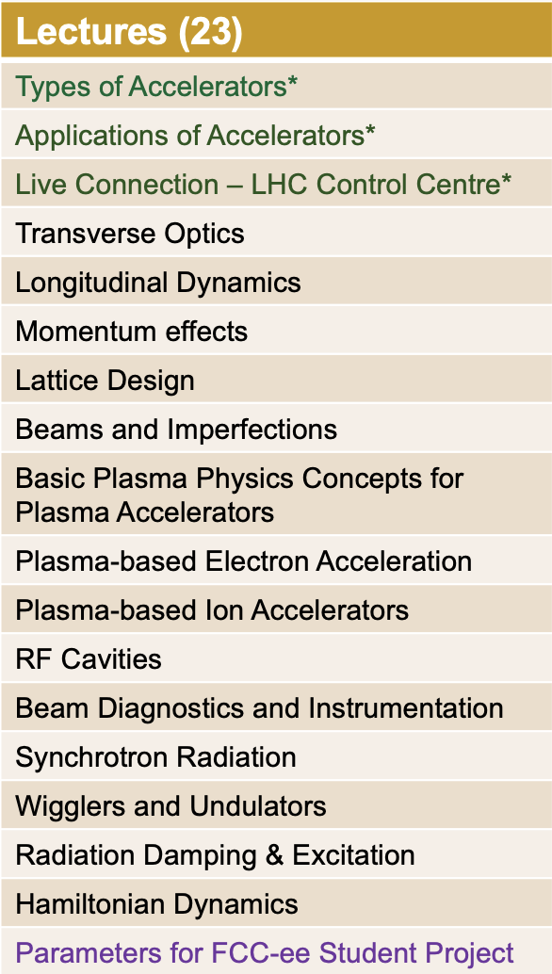
Graduate Accelerator Physics Course
Term I October-December 2021
Exercise Classes (6)
Introduction to Accelerators*
Transverse Dynamics
Longitudinal Dynamics
RF Cavities
Hamiltonian Dynamics
Synchrotron Radiation
* Combined Particle Physics &
Accelerator Physics cohort
Course carried out in hybrid format
(in person & videoconference) due to Covid-19

Slide 7
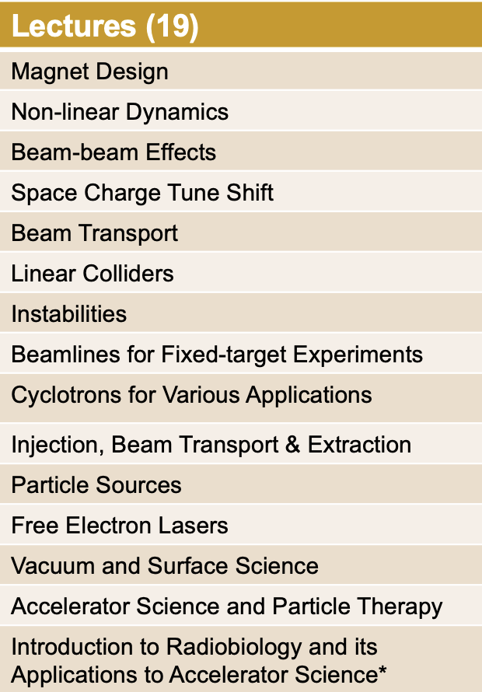
Graduate Accelerator Physics Course
Term II January-March 2022
Exercise Classes (2)
Magnet Design
Introduction to FCC-ee Student Project
Tutorials (8)
FCC-ee Student Project
JAI Seminar (1)
FCC-ee Student Project
Course carried out in hybrid format
(in person & videoconference) due to Covid-19
* New lecture following proposal of JAI AB 2021

Slide 8
Graduate Accelerator Physics Course 2021-2022
Number of Students
    University of Oxford
      Particle Physics (9) *
      JAI Accelerator Physics (4)
    JAI Royal Holloway, University of London (2)
    JAI Imperial College London (1)
    Humboldt University of Berlin (2) **
      Following cooperation agreement with University of Oxford
    University College London (1) **
* Registered for first three lectures and tutorial of Term I only
** Registered for Term I only

Slide 9
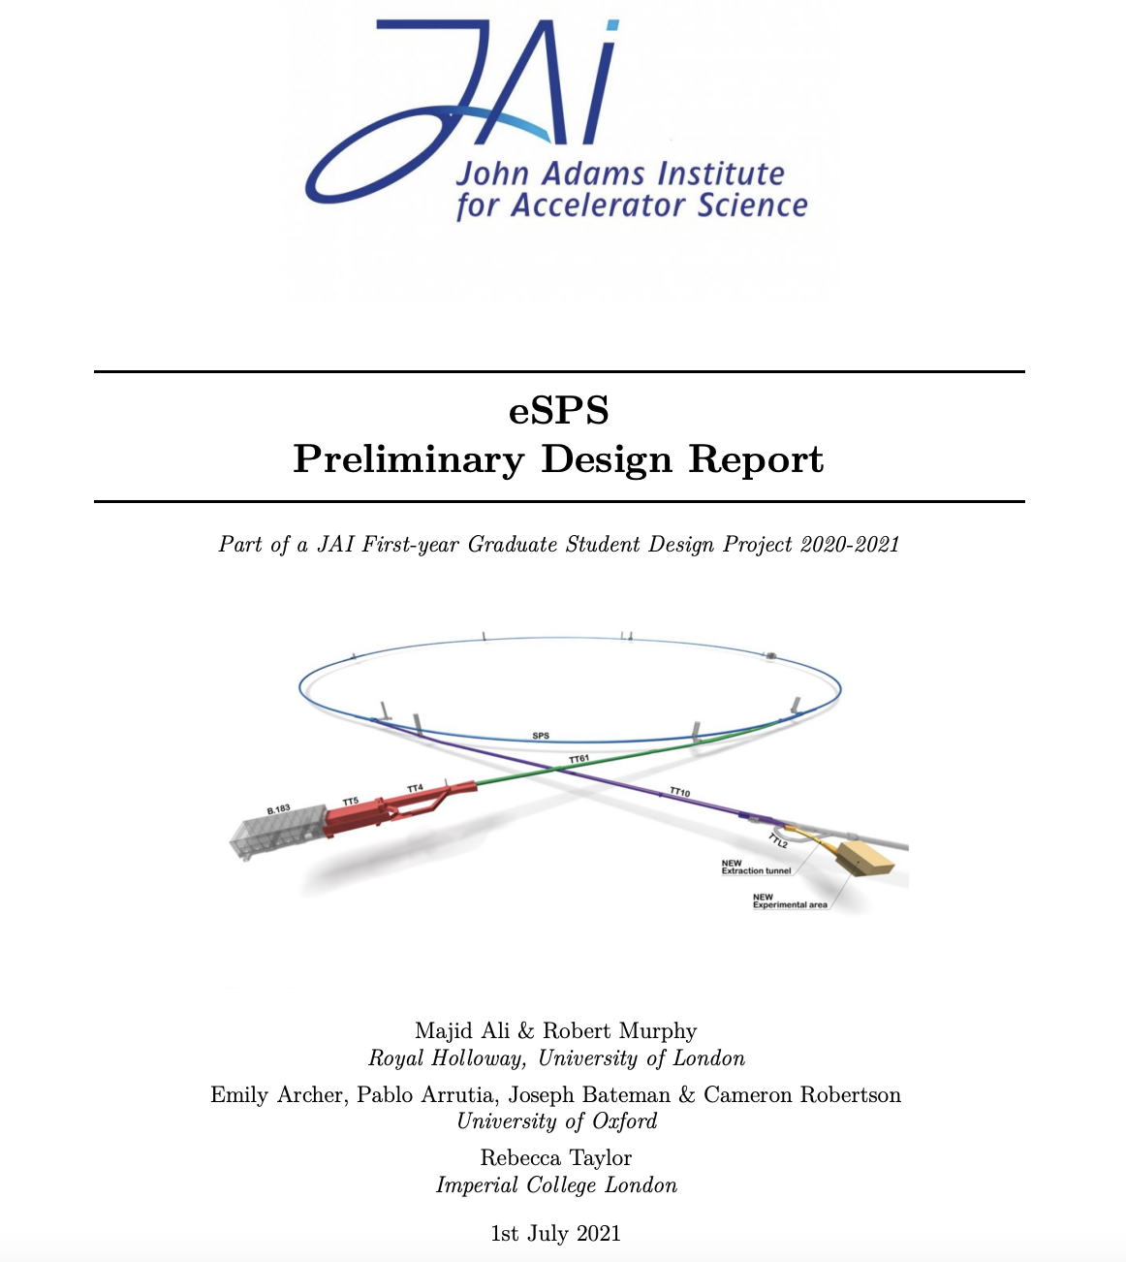
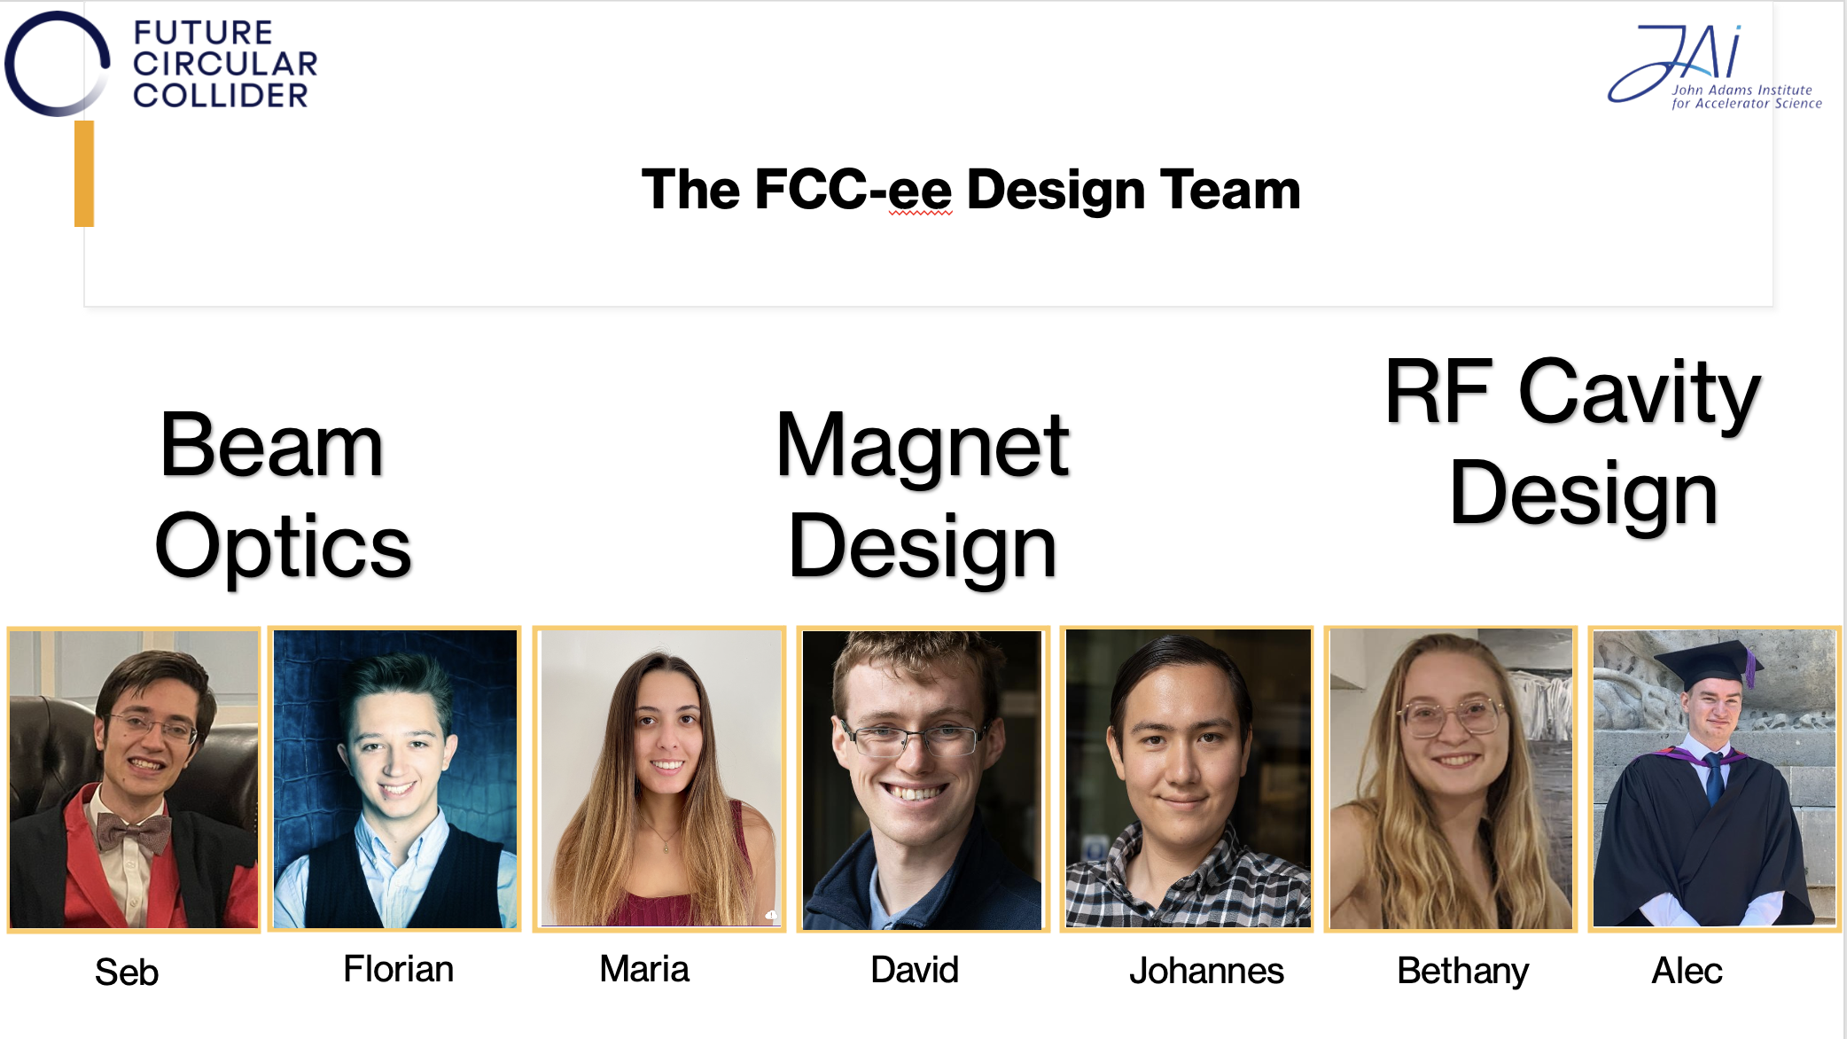
Accelerator Design Project
Accelerator Design Study for
  Electron SPS: 2020-2021
  FCC-ee: 2021-2022
  Design work consisted of study of the lattice, magnet systems and RF cavities.
Student visits and presentations at CERN planned for June 2022.
“The design project significantly contributes to the value of a PhD at the JAI and is a very effective learning tool ... it played an essential role in helping me to find a postdoc.”
“To me, the design project was by far the best part of the course. It puts the material taught into context and bridges the gap between lectures ... and a DPhil project ... .”
eSPS Design Report
published on CDS
(DOI 10.17181/CERN.Q29A.V5M6)
and students delivered JAI Seminar.
FCC-ee Design Report to be published
on CDS & students delivered JAI Seminar

Slide 10
Consolidated Accelerator Course
Graduate lecture course includes plasma lectures provided by ICL, as part of development of integrated accelerator-laser-plasma training.
Lecturers & Instructors
  M. Fraser (CERN), Hector Garcia-Morales (Oxford),
  A. Gebershagen (CERN), David Kelliher (RAL),
  S. Lawrie (RAL), S. Mangles (ICL), I. Martin (Diamond),
  A. Milanese (CERN), Z. Najmudin (ICL), S. Patel (RAL),
  C. Plostinar (ESS), Marco Schippers (PSI),
  F. Tecker (CERN), E. Tsesmelis (CERN/Oxford),
  Rob Williamson (RAL)
  Lecturers / instructors from all JAI universities and from external institutes – CERN, DIAMOND, ESS, PSI, RAL.
  Following Brexit, all non-UK lecturers require permit/visa to lecture in person.

Slide 11
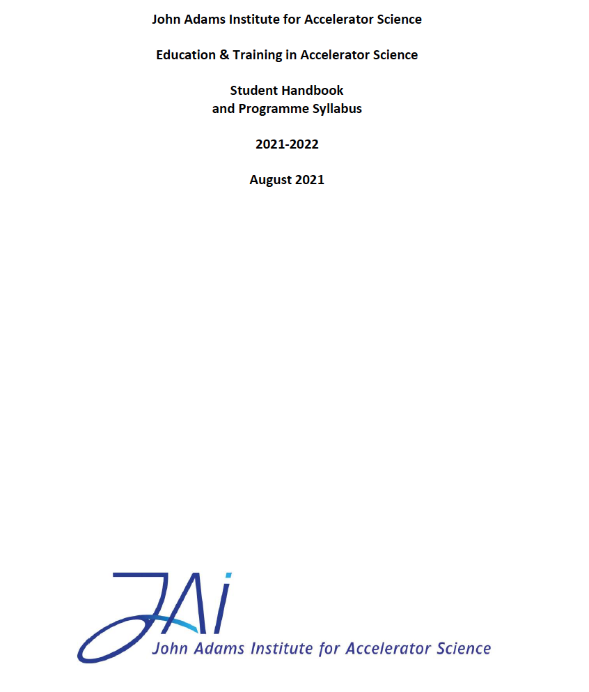
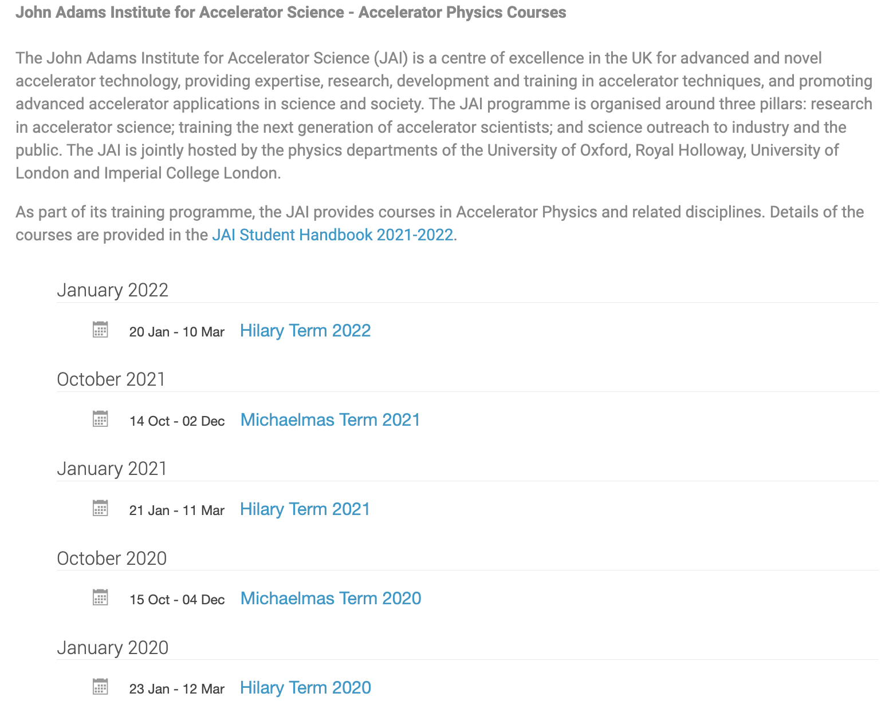
JAI Student Resources
Student Handbook provides information to the students of the training programme in accelerator science at JAI.
  Syllabus & course content, course resources, assessment, evaluation, recommended textbooks.
  Supplementary information (public engagement, lecture series, summer student programme etc.)
Dedicated site on INDICO
  https://indico.cern.ch/category/5869/
  Timetable, slides / documents, Zoom connection

Slide 12
New Graduate Students 2022-2023 Academic Year
Oxford
  Vlad-Costin Musat, Development of an inverse Compton scattering source based on CLIC technology, CERN Doctoral Studentship.
  Emily Howling, AWAKE or FCC-ee, STFC or CERN Doctoral Studentship.
  CERN Doctoral Studentship on FCC-ee beam instrumentation (with CERN/BI).
  Dosimetry for VHEE/FLASH beam therapy (partly STFC supported).
RHUL
  HL-LHC-UK-Phase II STFC Project Studentship on EO-BPM beam instrumentation with long term attachment for Run 3 beam tests at CERN.
  2 JAI STFC studentships (selection in progress).
  Thomas Hyatt, p/t PhD funded by the UK Health Security Agency on medical applications.
  Thomas Bass, MSc. / CERN Technical Studentship on RF slow extraction techniques (with CERN SY-ABT-BTP).
ICL
  Rehanah Razak (JAI/ISIS).
  Recruitment on the muon programme (JAI/PPD).
  Ginevra Casati - Laser Generate Ion Beams (JAI/CLF)
  Runfeng Luo - Wakefield based radiation sources (self funded).
  Process for graduate student selection on-going at all JAI universities

Slide 13
Graduate Student Funding
Since 2019, JAI included in STFC quota PhD studentships scheme receiving three studentships per year.
This leverages additional funding sources allowing JAI to recruit typically an additional 6 PhD students / year.
Various funding sources include universities, the Royal Society, STFC CASE, EPSRC DTP, DLS, CLF and RAL/ISIS/PPD, as well as the CERN Doctoral Student programme, European Research Council, Helmholtz Foundation, Marie Curie Fellowships, Thai government fellowships, industry (e.g. TRUMPF Scientific Lasers) & other non-UK sources.
Continue to explore wide range of possibilities for sustainable funding.

Slide 14
Undergraduate Accelerator Physics Courses
Undergraduate training has been provided at the University of Oxford and independently annually at RHUL with dedicated accelerator physics courses.
  The Oxford course was offered as a Short Option (12 h) for physics students in their 3rd year, while the RHUL course offers an annual intercollegiate undergraduate course for 4th Year MSc students of the University of London.
  There are also BSc/MSci/MSc. project students at RHUL.
We plan to restructure the Oxford undergraduate module to make it more attractive for students by including accelerator applications and hands-on laboratory sessions.

Slide 15
Undergraduate Accelerator Physics
Summer Student Internships
Oxford University Internship Programme (CERN in July/August annually)
  Two / three students join CLEAR accelerator project supervised by Oxford faculty & graduate students.
  Participate in CERN Summer Student lecture series and in an accelerator project.
Imperial College
  Around 4 students appointed annually.
  Spend 8 weeks working at RAL.
RHUL
  Around 2 students appointed annually.
  Carry out research work at RHUL.
Expect programmes to attract undergraduate students to accelerator science.

Slide 16
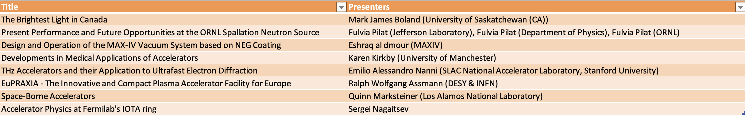
UK Accelerator Institutes Seminar Series
JAI has teamed up with ASTeC and the Cockcroft Institute to organise jointly the new UK Accelerator Institutes Seminar Series https://indico.cern.ch/category/13863/
  Delivered by distinguished speakers from the participating institutes and from laboratories / universities world-wide.
Seminars scheduled so that the graduate student body can attend.
January – March 2022
Attendance has been excellent

Slide 17
External Training Commitments (Abridged)
JAI participates in external training initiatives
  EU Integrating Activity Projects on Training, Communications & Outreach in Accelerators –
  TIARA 2011-2014, ARIES 2017-2021, I.FAST 2021-2025 (P. Burrows serves as WP Leader).
  CERN Accelerator School CAS (various JAI faculty and staff).
  Joint Universities Accelerator School (JAI is partner institute, P. Burrows serves on JUAS AB).
  Cockcroft Institute graduate accelerator physics course (S. Gibson).
  University of London intercollegiate undergraduate & graduate accelerator physics courses
  (S. Gibson, P. Karataev).
  University of Melbourne Medical Accelerator Physics Programme (S. Sheehy).
  Nanyang Technological University and University of Saskatchewan undergraduate & graduate lectures on accelerator physics (E. Tsesmelis).

Slide 18
Future Programme - Training
Proposal & plan for the future education & training programme at JAI:
  World-class graduate & undergraduate training in accelerator science & technology.
  Collaboration with outside institutes through cooperation agreements (e.g. Humboldt University Berlin) & student accelerator design projects.
  Strengthen integration of the 3 universities by fostering & supporting student exchanges, common lectures and seminars, and other events, e.g. the UK Accelerator Institutes Seminar Series.
  Establish joint JAI and CI programme of lectures on specialised topics of advanced accelerator physics & applications.
  Pre-PhD programmes - Summer studentship programmes at all 3 universities; BSc, MSci and MSc. programmes at RHUL; restructured undergraduate module at Oxford making it more attractive.
  JAI academic staff continue to deliver courses & lectures at international accelerator schools, thus providing important accelerator community service.

Slide 19
Public engagement

Slide 20
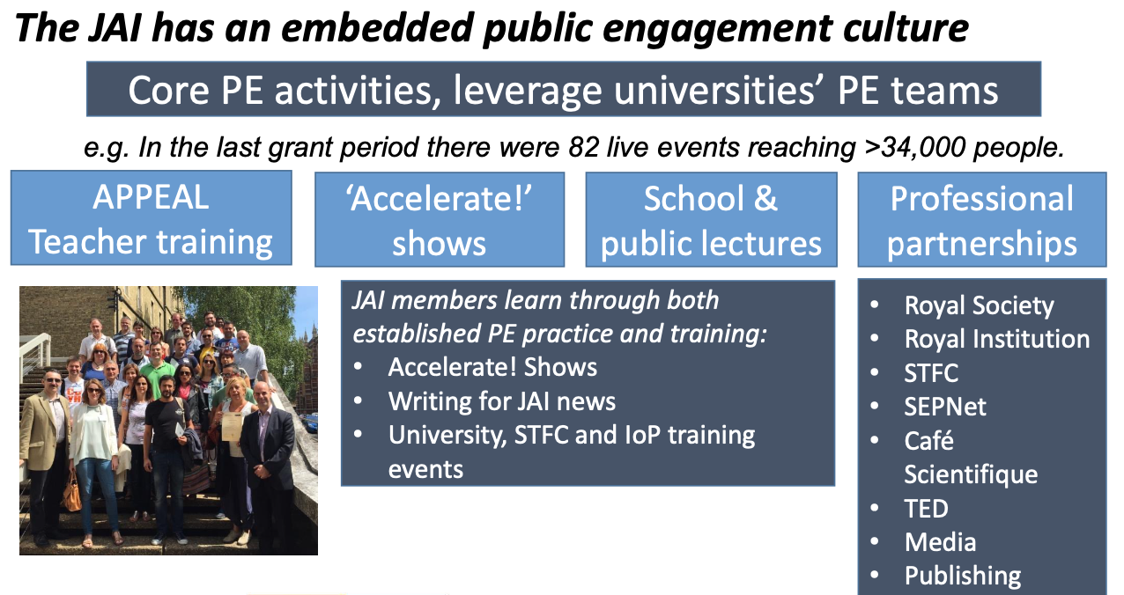
Guiding Strategy

Slide 21
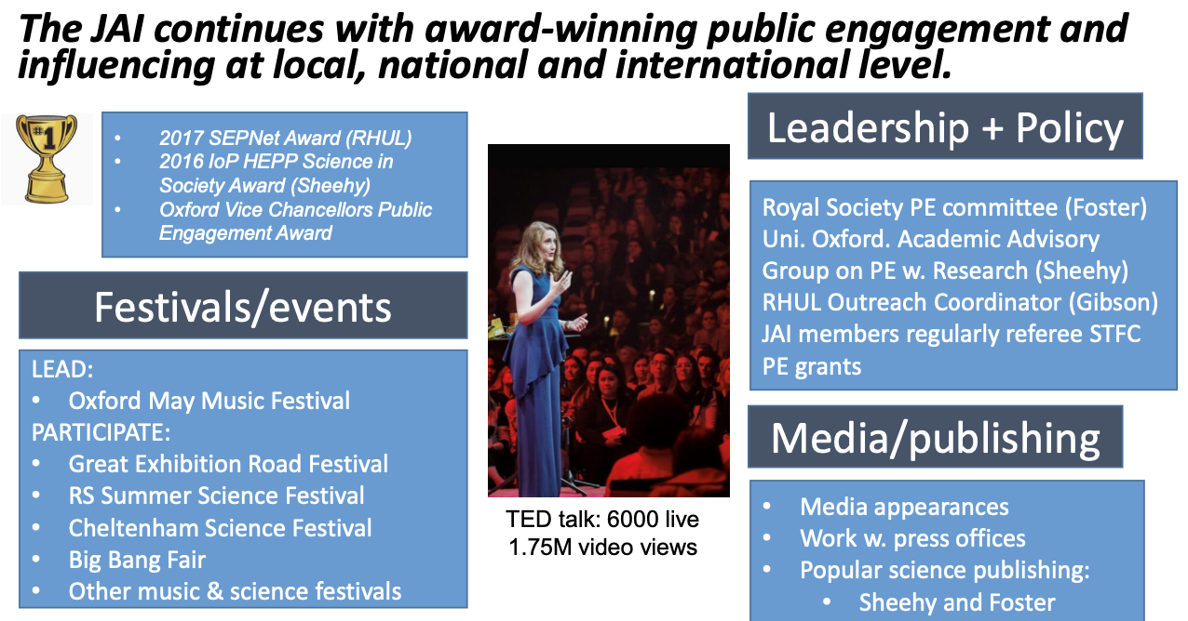
Award-winning Public Engagement

Slide 22

Public Engagement & Music
Online Oxford May Music Festival (1 May 2021)
  Talk by Sir Venki Ramakhrishnan (PRS) on his new book “The Gene Machine”, which was attended by about 100 over Zoom and followed by a concert.
Einstein Lecture at Australian Chamber Music Festival 2022
Einstein’s Universe events in UK

Slide 23

Public Engagement and Medicine
Patient and Public Engagement (PPI)
  Two patient representatives
    Members of LhARA Institute Board, providing “Lay Summaries”.
LhARA/JAI members (Long, Kurup) have made presentation at Maggies cancer charity group.
  With the PPI representatives LhARA is now planning
    A “4-nation” PPI activity to raise the profile of novel approaches to proton and ion beam therapy and the LhARA initiative as a coordinated discussion at Maggies centres in the UK.

Slide 24
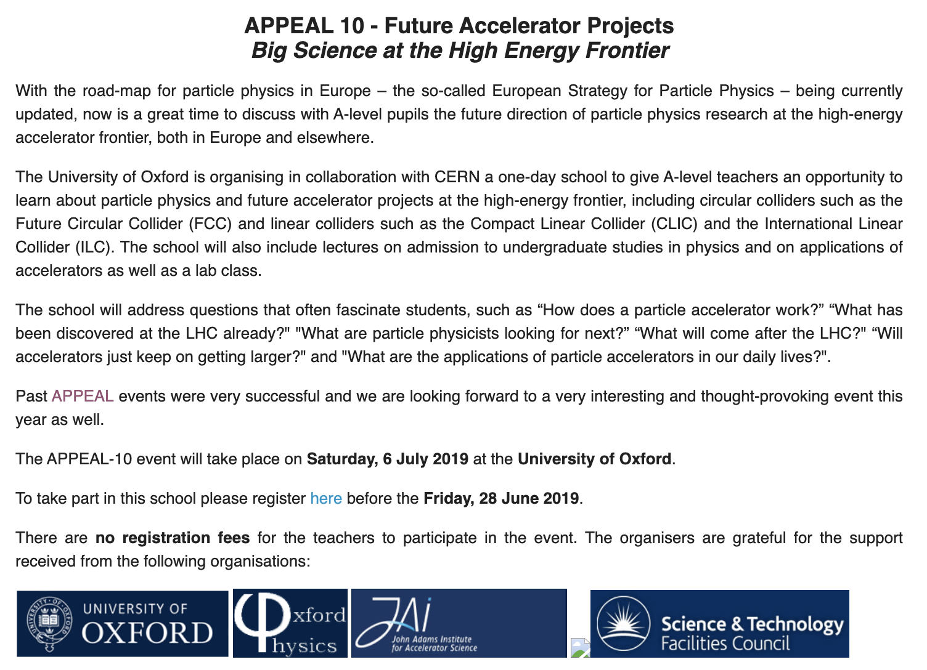
Public Engagement & Teachers
Accelerator and Particle Physics Education at A-Level (APPEAL)
  Annual training since 2010
APPEAL-10 2019
Future Accelerator Projects
Big Science at the Energy Frontier
APPEAL-11 2020
Particle Accelerators and
Plasma Technology
The Wave of the Future
(postponed due to Covid-19)
APPEAL-10 in 2019
Aim to re-start in-person events
following Covid-19

Slide 25
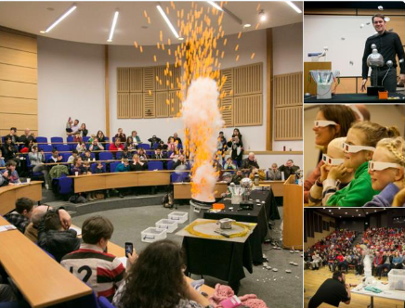

Public Engagement & The Big Bang Experience!
Brief history and future of the LHC revealing wonders of the LHC at CERN and how it is unravelling mysteries of the universe.
Re-starting in-person events following Covid-19.
  Particle Physics Masterclasses
  Open Days
  Girls into Physics (with Smallpiece Trust)

Slide 26

Public Engagement & Literature
Popular Science Book
Outreach events in the pipeline around launches in the UK (28 April), Australia (3 May) and US (January 2023).

Slide 27

Public Engagement & the SDGs
SDG 3 – Good Health and Well-being
  Skeptics in the Pub: "From Higgs to Healthcare in low-resource regions.”
  Particle accelerators: from making Higgs bosons to curing cancer’ for the Oxford Prospects Programme
  Social Justice: Migration, Racism, and Health on SDG 3 - Ensure healthy lives and promote well-being for all at all ages (CoNGO 2021)
  The importance of equality in the recovery from the COVID-19 pandemic and SDGs (UN GA Third Committee with Non-Governmental Organisations, Feb. 2022)
SDG 5 – Gender Equality
  Panels of U.N. Commission on the Status of Women Forum 66 (2022)
  Disparities in Cancer Care for Women: An Urgent Global Need (Panel for CSW66 Forum, March 2022)
  Women in STEM: Mind the Gap Panel for CSW66 Forum (March 2022)

Slide 28
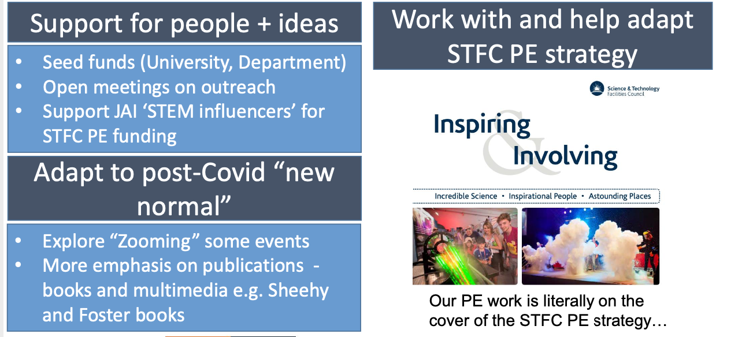
Future Programme – Public Engagement
We will continue strengthening our existing portfolio and encourage new and innovative ideas.

Slide 29
Summary
JAI continues to deliver world-class accelerator science education & training and public engagement programmes.
  Intense accelerator physics course.
  Innovative and educational accelerator design projects.
  Successful placement of students once they enter professional careers.
  Recognised and award-winning public engagement activities – with global reach.

