Slide 1
Synchrotron Radiation Interferometry for Beam Size Measurement at the LHC
Daniele BUTTI

Slide 2
Introduction

Slide 3
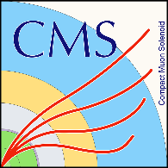




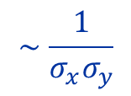


Why measure transverse beam size?
Large Hadron Collider
event rate
P4
BI & RF
$$ℒ≜\frac{1}{σ_{p}}\frac{dN_{p}}{dt}$$
$$∼\frac{1}{σ_{x}σ_{y}}$$
$$B2$$
$$B1$$
Luminosity:
→ quantifies collider performance
→ depends on transverse beam size
Machine optimization ⇒ beam size measurement

Slide 4
Transverse diagnostics at the LHC
Wire-scanners
Shower intensity
Shower of
secondaries
absolute measurement
invasive
→ limited use
Carbon wire
Beam profile
Scintillator
2σ_{y}
Wire position
Beam
Synchrotron radiation telescope
y
no absolute measurement, calibration required
non-invasive
→ continuous monitoring
Telescope
Beam image
2σ_{y}
Beam
Synchrotron radiation (SR)
Camera
Beam profile
2σ_{x}
x
Current status: telescope calibrated against wire-scanners in dedicated fills and used in nominal operation

Slide 5
Need for synchrotron radiation interferometry
… future?
Synchrotron radiation telescope
Synchrotron radiation interferometer
no absolute measurement, calibration required
non-invasive
→ continuous monitoring
absolute measurement
non-invasive
not suitable for continuous monitoring
(intensifier ageing)
Wire-scanners
Goal: use interferometer to complement SR telescope and wire-scanners.
periodically check calibration stability
redundant and independent measurement
absolute measurement
invasive
→ limited use
Present…

Slide 6
Synchrotron radiation interferometry at the LHC

Slide 7
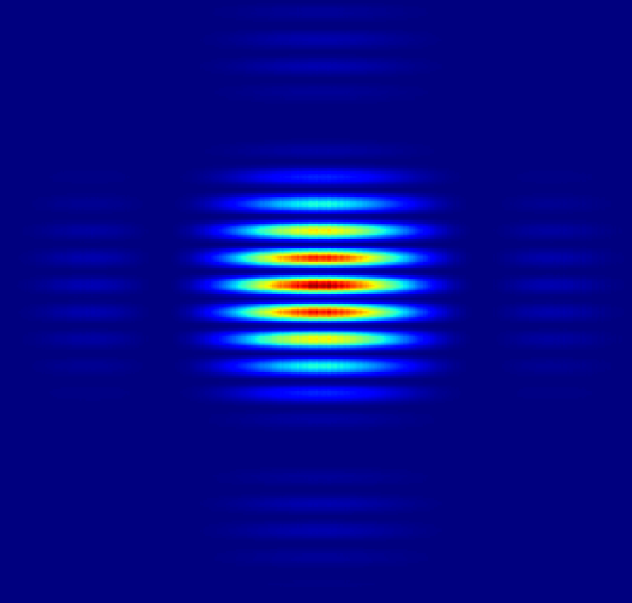
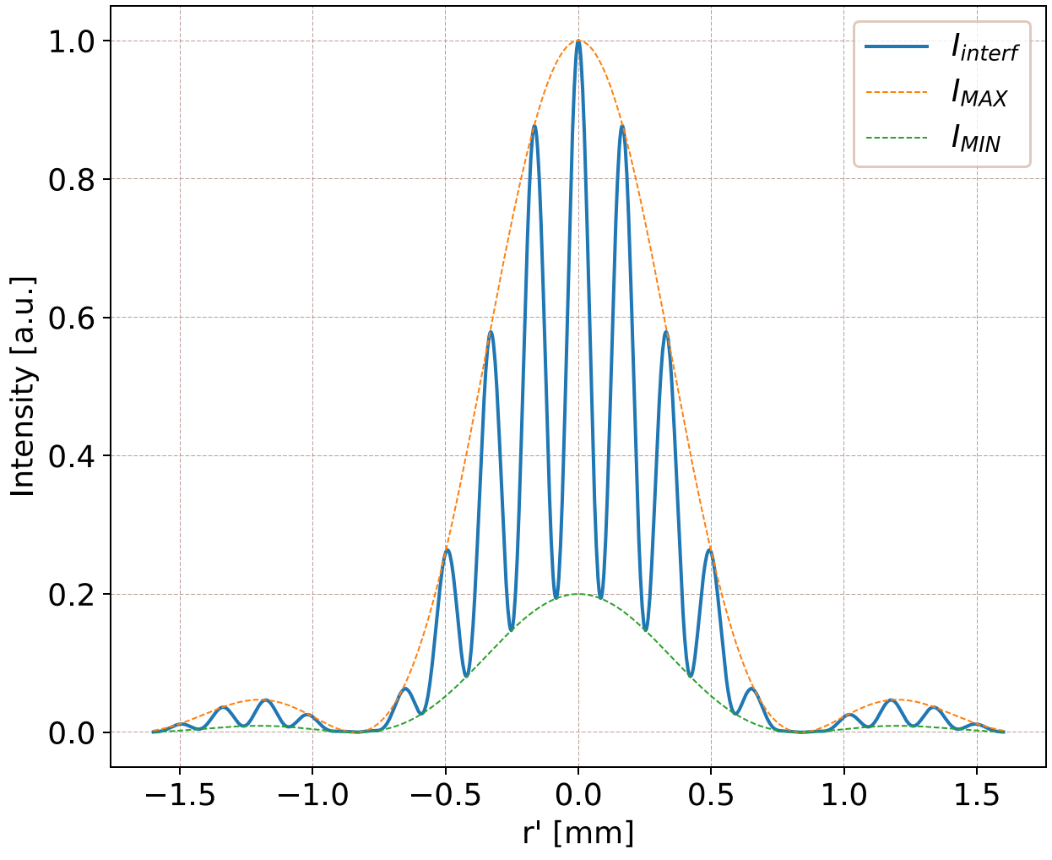
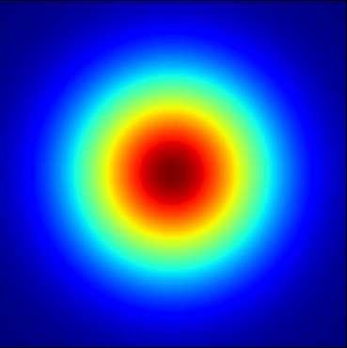





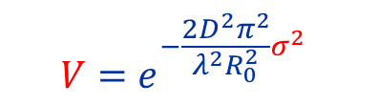



Interferometry for source size measurement
interferogram
light source
lens
$$Visibility$$
$$V$$
$$Size$$
$$σ$$
$$D$$
$$R_{0}$$
slits
In classical optics, Van Cittert-Zernike theorem:
Assumptions about the source:
(apparently) small
incoherent
isotropic
$$Fourier$$
$$Source$$
$$distribution$$
$Visibility$
$$V=e^{−\frac{2D^{2}π^{2}}{λ^{2}R_{0}^{2}}σ^{2}}$$
If source is Gaussian:
Typical application field
→ astronomy (stellar interferometer)

Slide 8
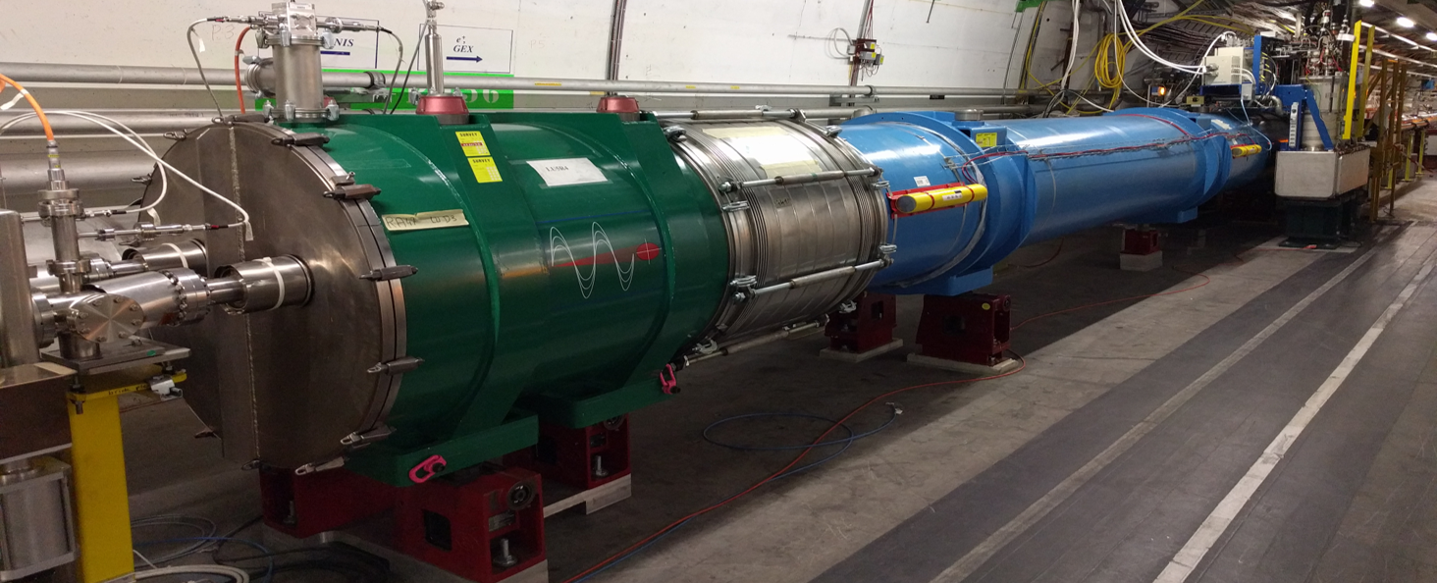
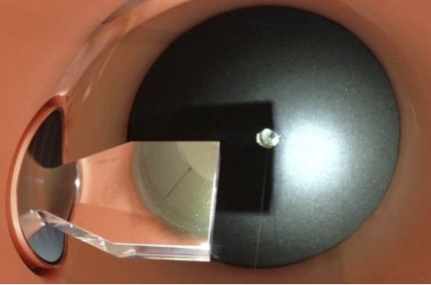
LHC Synchrotron Radiation source
Point 4
D3_{L}
~100m straight section
U
D3_{R}
extraction
mirror
LHC ring
mirror
acceptance
In-vacuum mirror to intercept and extract SR
Undulator and dipole at the right side of LHC Point 4

Slide 9
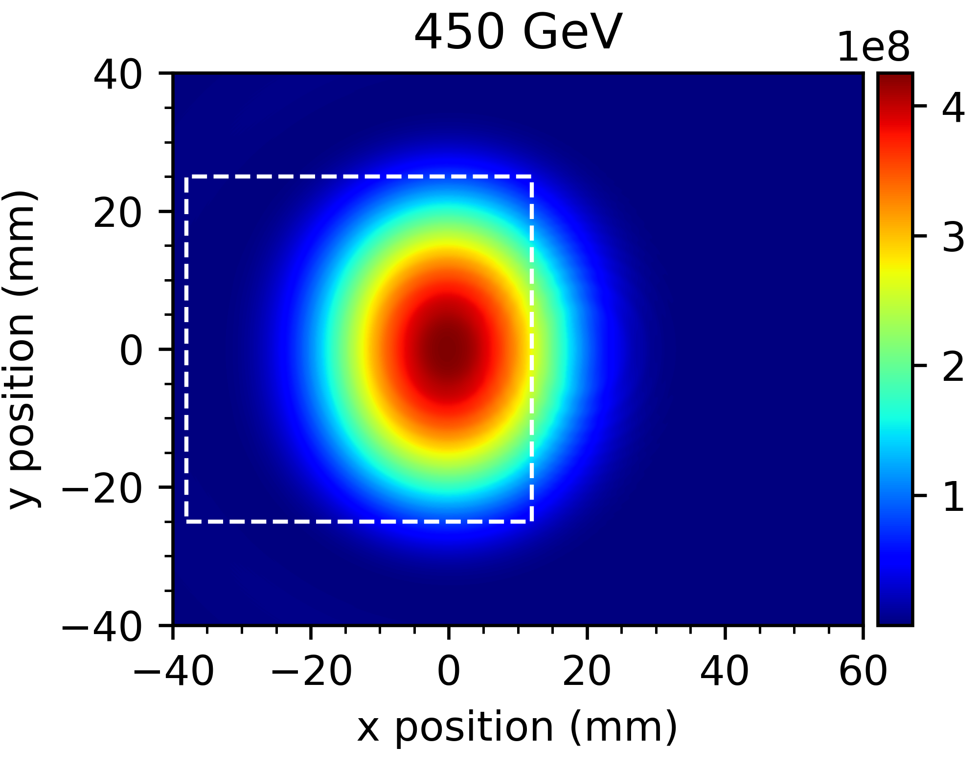
Injection energy
Point 4
D3_{L}
~100m straight section
U
D3_{R}
extraction
mirror
LHC ring
≈
mirror acceptance
Injection energy → undulator main source of light
quite smooth and broad light distribution
well localized source at undulator centre
marginal mirror effect
beam
⇒ VCZ should work as it is
SR intensity at the extraction mirror plane simulated at $λ=560 nm$

Slide 10
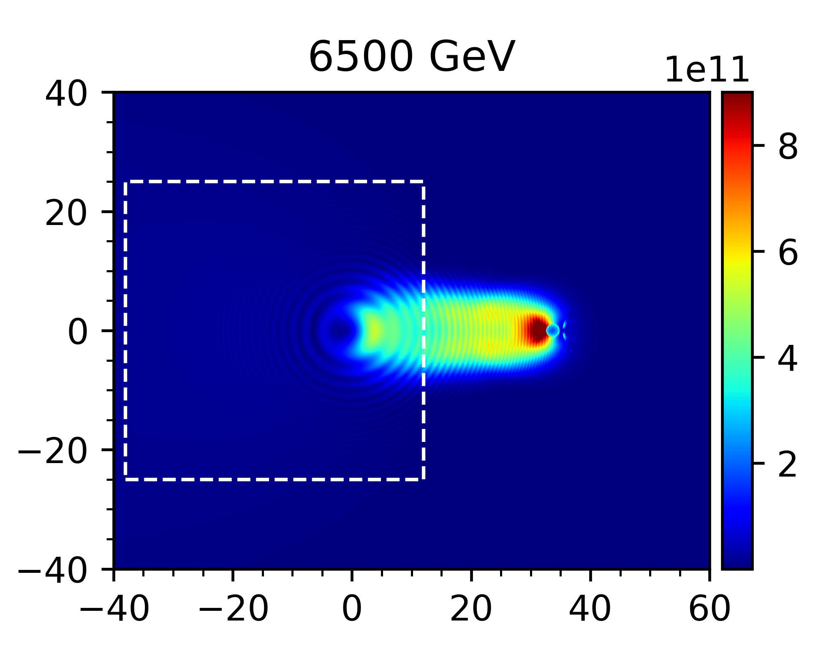
LHC Synchrotron Radiation source
Point 4
D3_{L}
~100m straight section
U
D3_{R}
extraction
mirror
LHC ring
≠
mirror acceptance
Flat-top energy → dipoles main source of light
asymmetric and narrow light emission
two interfering sources ~100m afar
relevant diffraction effects from mirror edge
beam
⇒ dedicated simulations needed
SR intensity at the extraction mirror plane simulated at $λ=560 nm$

Slide 11
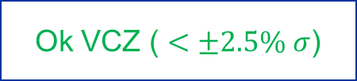
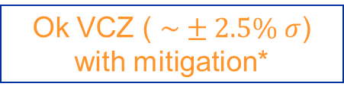
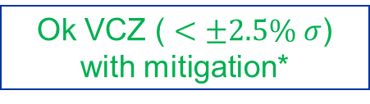
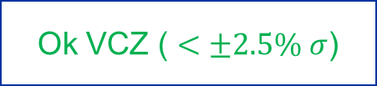
Simulations
Package based on Synchrotron Radiation Workshop written
computation of radiated SR field
Physical Optics Propagation through interferometer system
Goal: test interferometer performance aiming at $±2.5\% σ$ relative error (requested by operation)
Vertical
Horizontal
Output: interferometry expected to meet operational requirements
Critical situation for horizontal beam size at flat-top (due to symmetry of dipole radiation)
Ok VCZ ( $<±2.5\% σ$)
Ok VCZ ( $<±2.5\% σ$)
Inj
FT
Ok VCZ ( $<±2.5\% σ$)
with mitigation*
Ok VCZ ( $\sim ±2.5\% σ$)
with mitigation*
*specific slit configurations are needed to compensate for dipole interference effects, mirror diffraction…

Slide 12
Interferometer for LHC Run 3

Slide 13
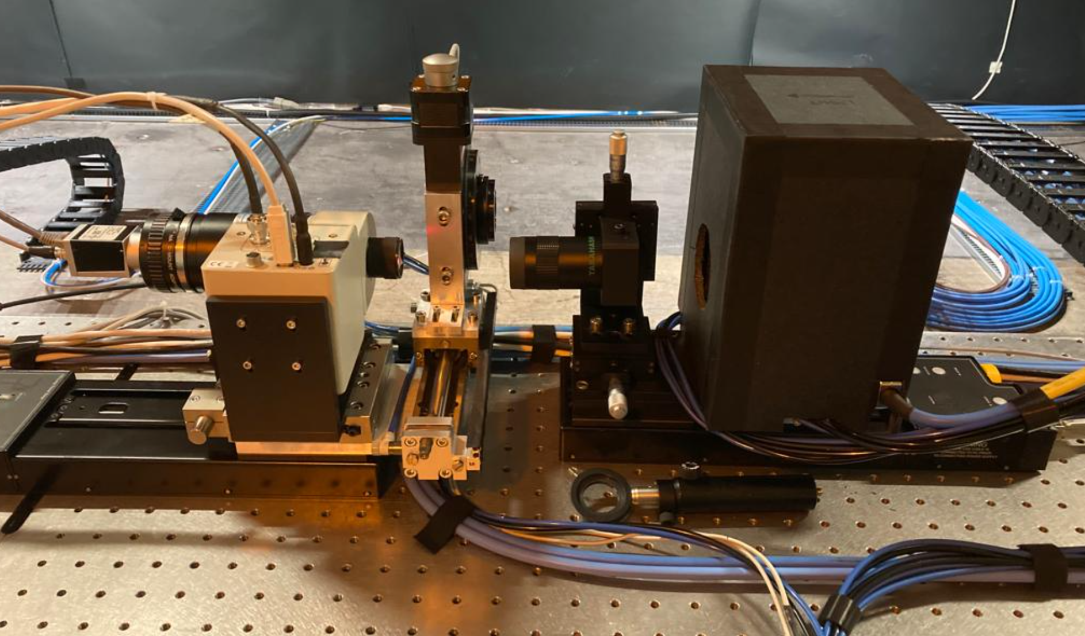
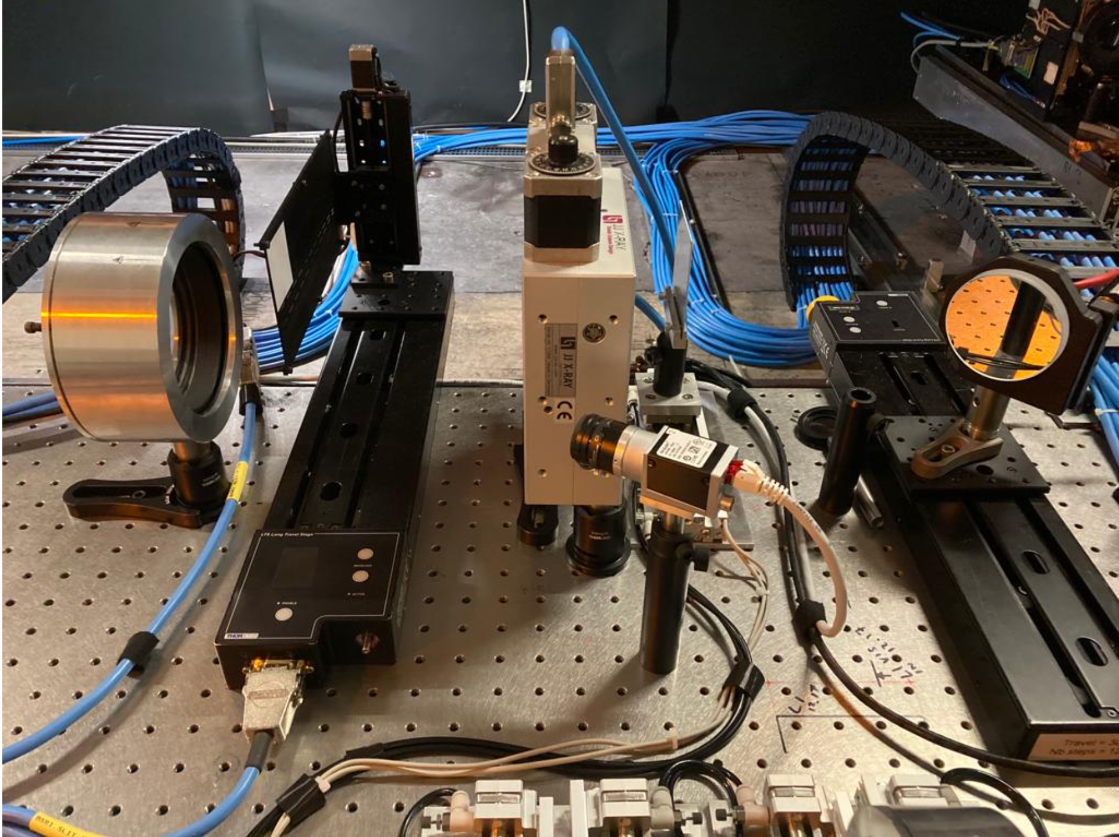
Experimental setup
collimator
camera
polarizer
eyepiece
filters
lens
slits
from
SR source

Slide 14
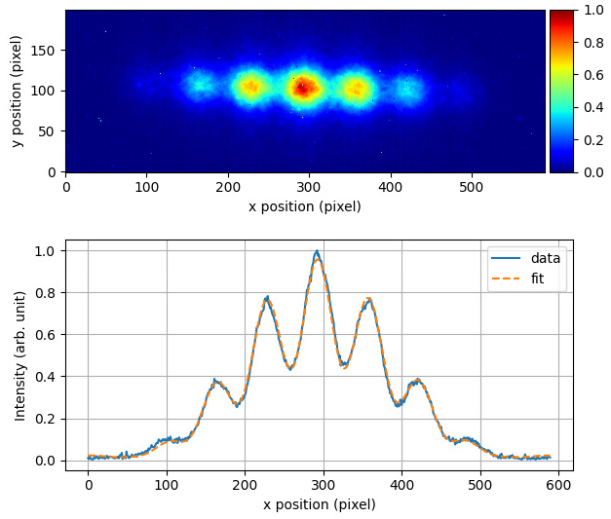
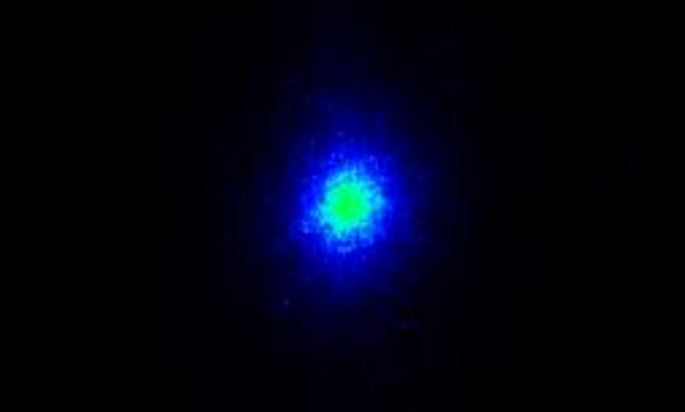
First measurements during beam test
Example of 2D interferogram (horizontal beam size)
Preparation test for Run 3 performed in Oct. 2021:
very tight schedule
only few nominal bunches injected
stable beams at injection energy only!
A few interferometer measurements taken in parallel with SR telescope operation
Extracted profile fitted to assess fringe visibility
First circulating beam captured by SR telescope

Slide 15
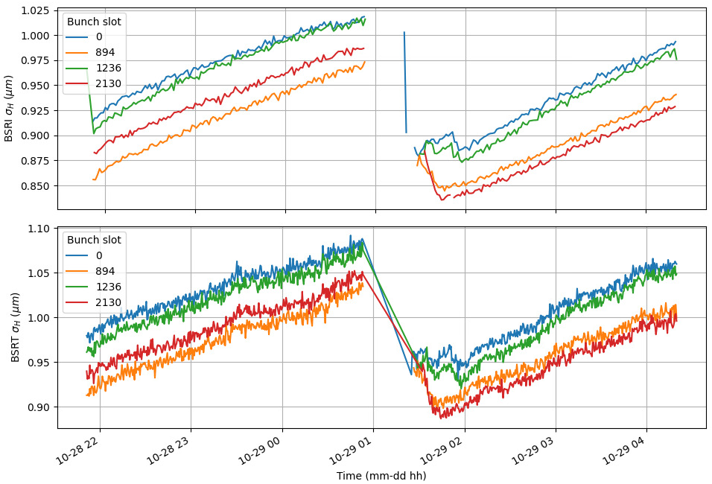
First measurements during 2021 beam test
Dump and refill
Interferometer
Outcome:
good interferometer sensitivity to bunches of different size
precise measurement
qualitative agreement with telescope.
Quantitative not available as telescope not calibrated
(no time allocated in beam test)
Dump and refill
Telescope (not calibrated!)

Slide 16
Conclusion

Slide 17
Summary:
in principle, synchrotron radiation interferometry is a powerful technique to complement current LHC transverse diagnostics
synchrotron radiation source is rather complex. Dedicated simulations confirm the applicability to the LHC case.
setup to benchmark the simulation is now operational.
Good qualitative results from beam test at injection energy
Plans for upcoming Run 3:
systematic and quantitative benchmark of simulations at injection
performance assessment during energy ramp and at flat-top
Thank you for your attention!

Slide 18
Spares

Slide 19
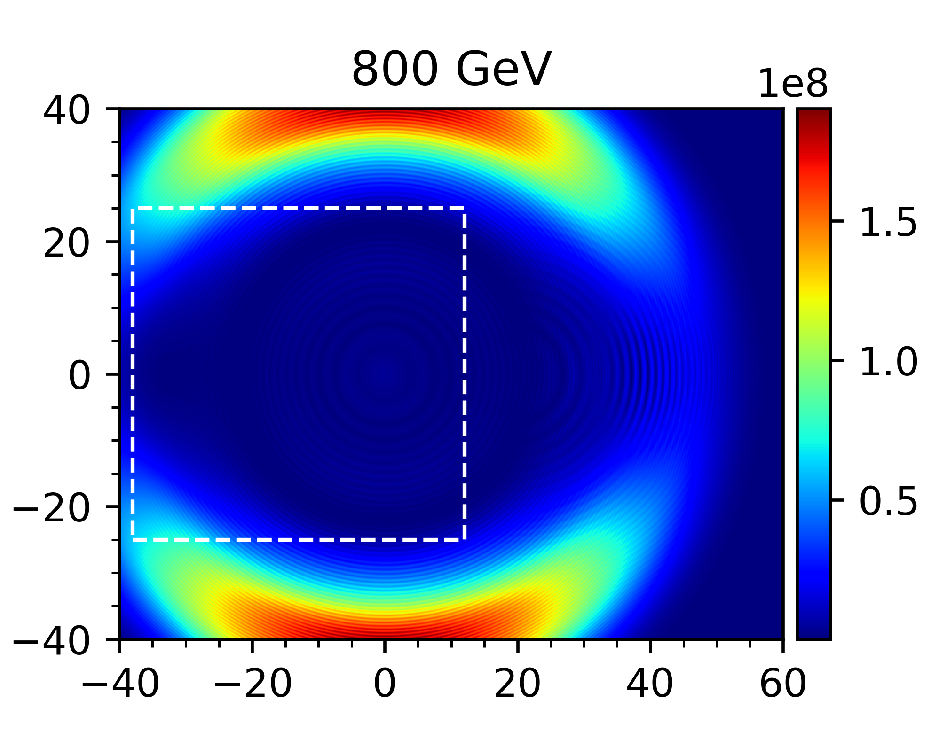
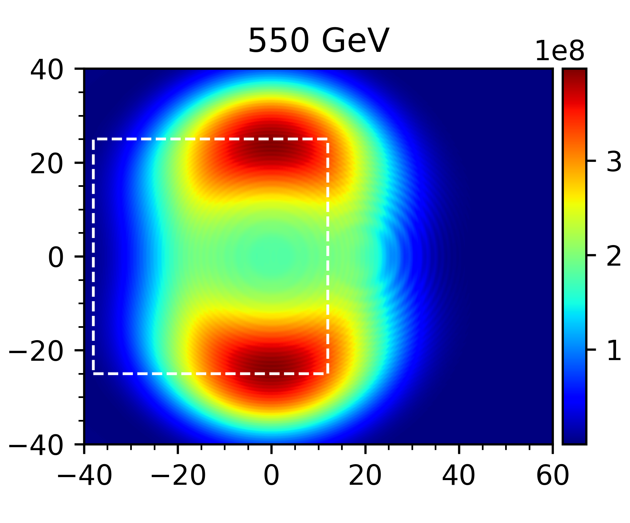
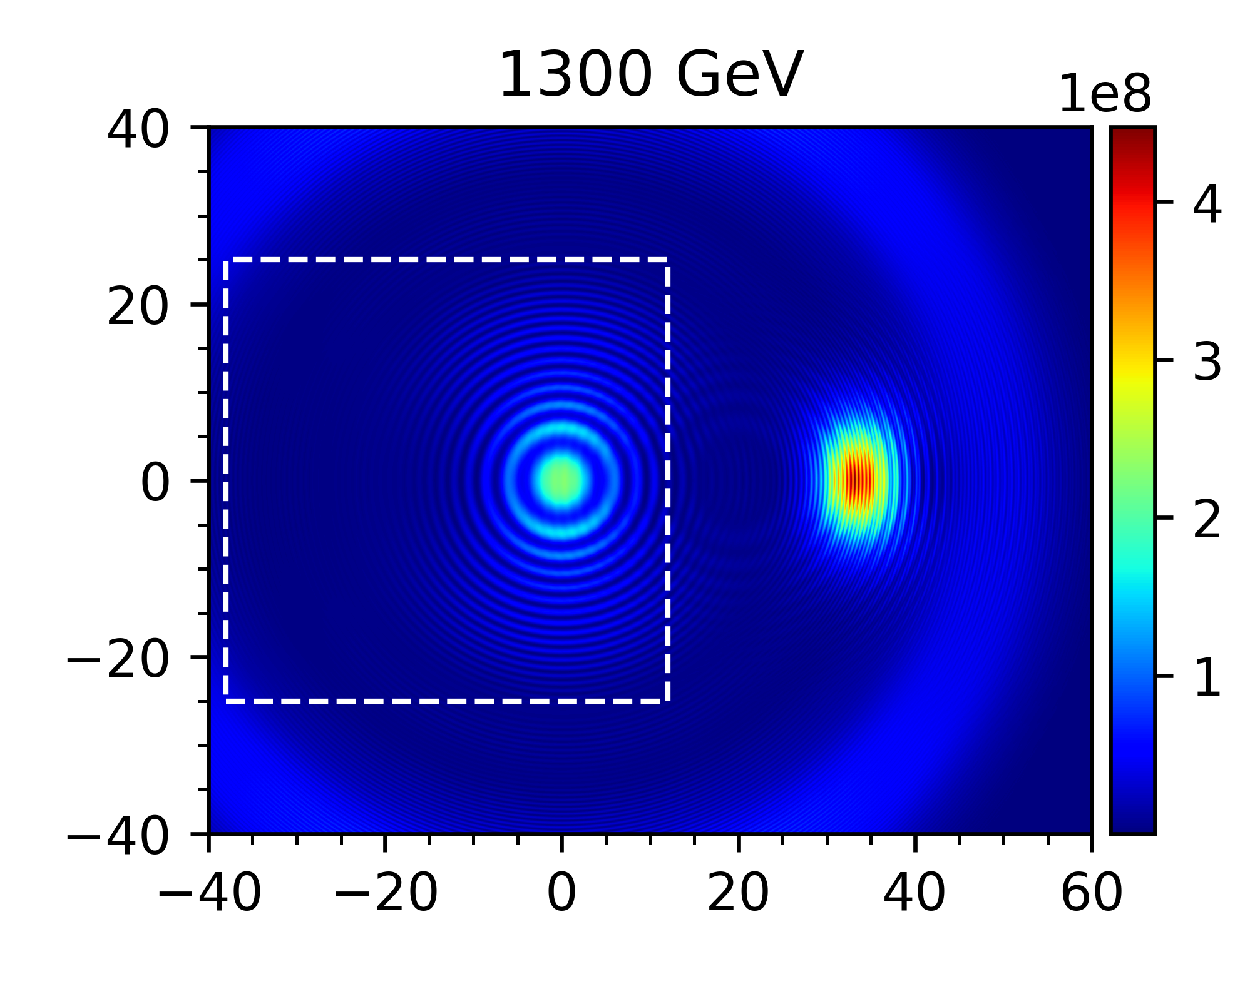
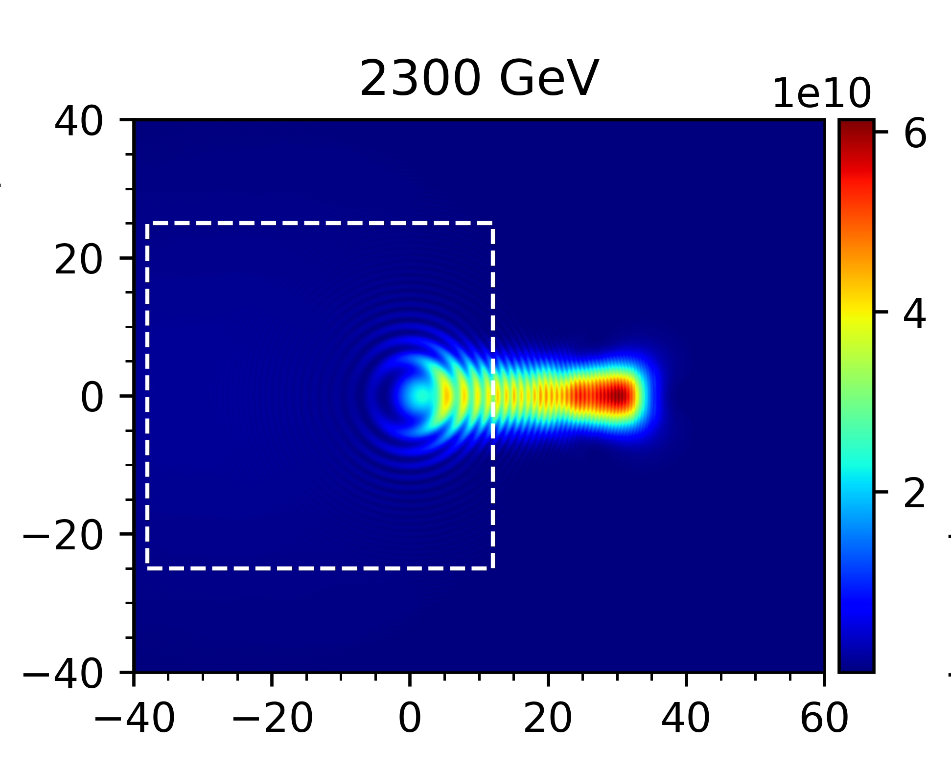
LHC SR source in the visible domain
mirror acceptance
Undulator radiation
U_{R}
D3_{R}
extraction
mirror
B1
from P3
RF section
to P5
B2
D3_{L}
U_{L}
Edge radiation
Core radiation

Slide 20
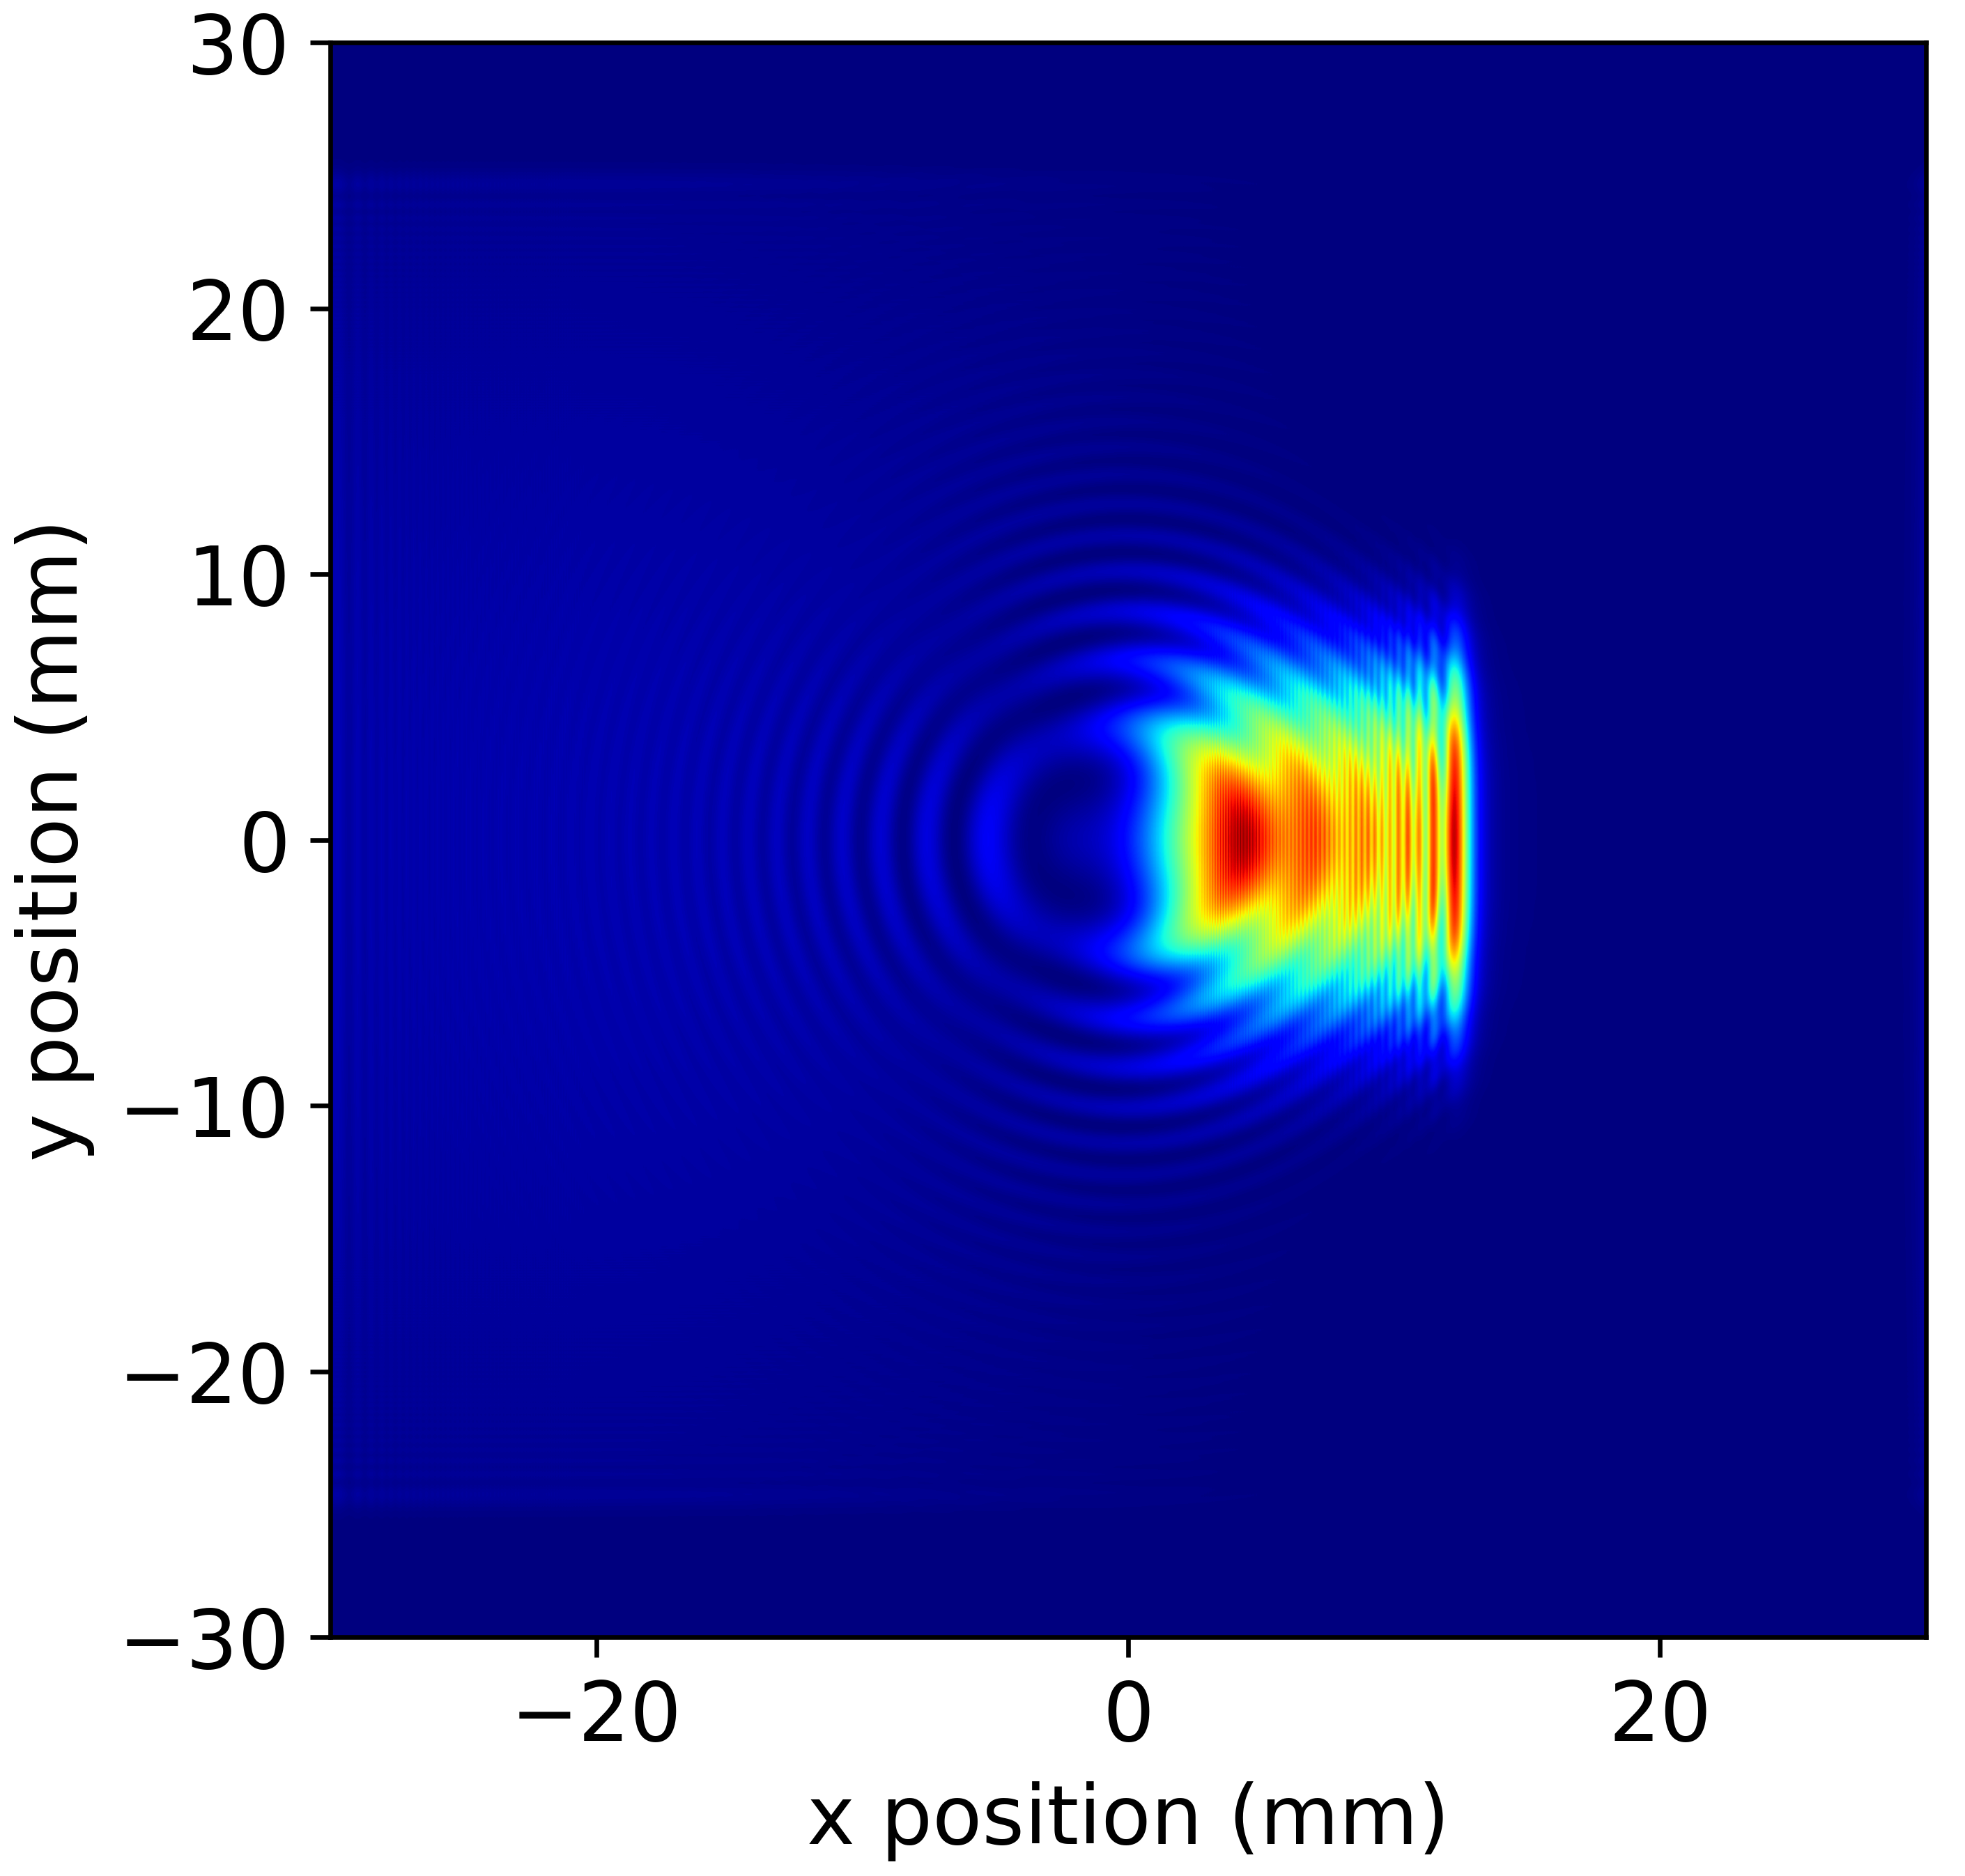
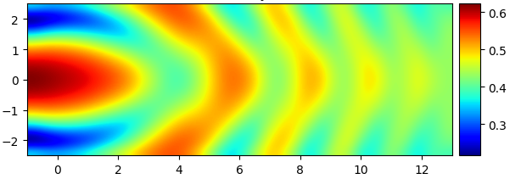
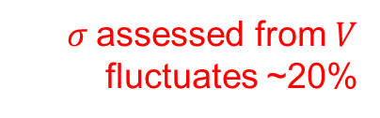
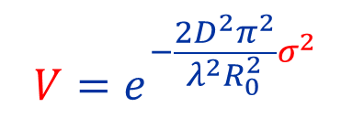



Flat-top vertical
to slits
extraction
mirror
D3_{L}
U_{R}
D3_{R}
B1
RF section
y center
D
x center
source
source
SR source are the D3 dipoles
longitudinally extended
narrow emission
D3 interference oscillations
Scan the incoming light, expect a uniform visibility but…
$σ$assessed from $V$ fluctuates ~20%
→ strictly, VCZ not satisfied
$$y_{centre} (mm)$$
$$Visibility (1)$$
$$V=e^{−\frac{2D^{2}π^{2}}{λ^{2}R_{0}^{2}}σ^{2}}$$
$$x_{centre} (mm)$$

Slide 21
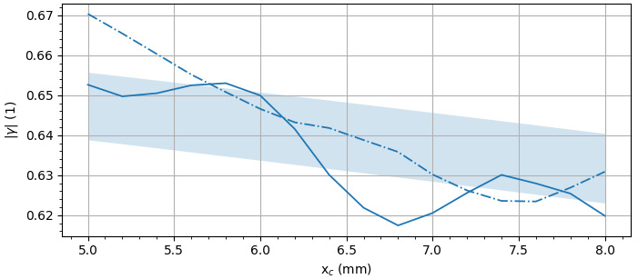
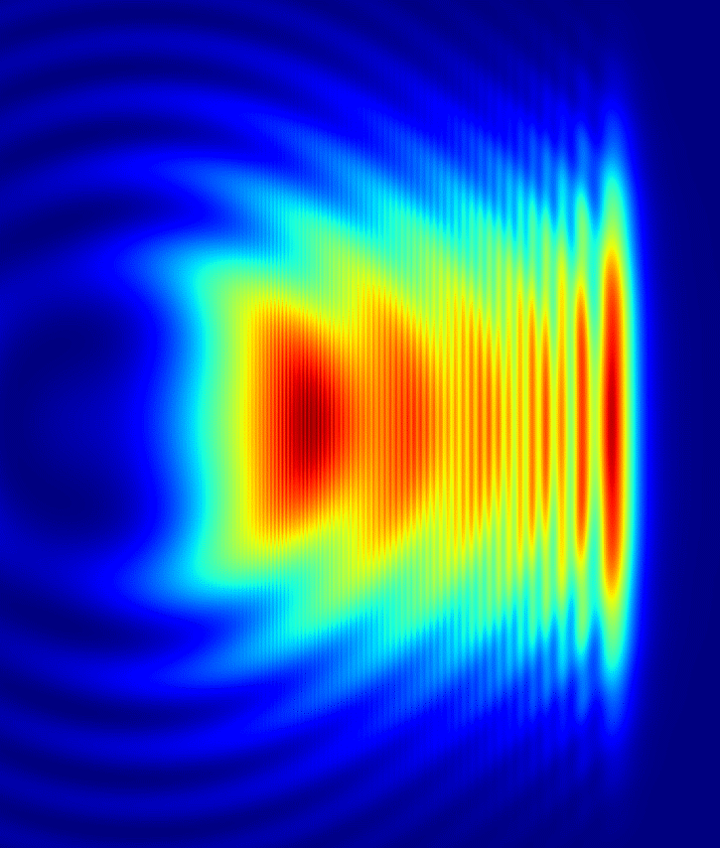





Flat-top horizontal
to slits
extraction
mirror
D3_{L}
U_{R}
D3_{R}
D
B1
RF section
y center
x center
source
source
Visibility cross-cut
Mitigation:
decay
oscillation → wider slits
$$Visibility (1)$$
oscillation
decay → adjust $R_{0}$
$$R_{0}$$
$$x_{centre}$$
D3_{R}
$$x_{centre} (mm)$$

Slide 22
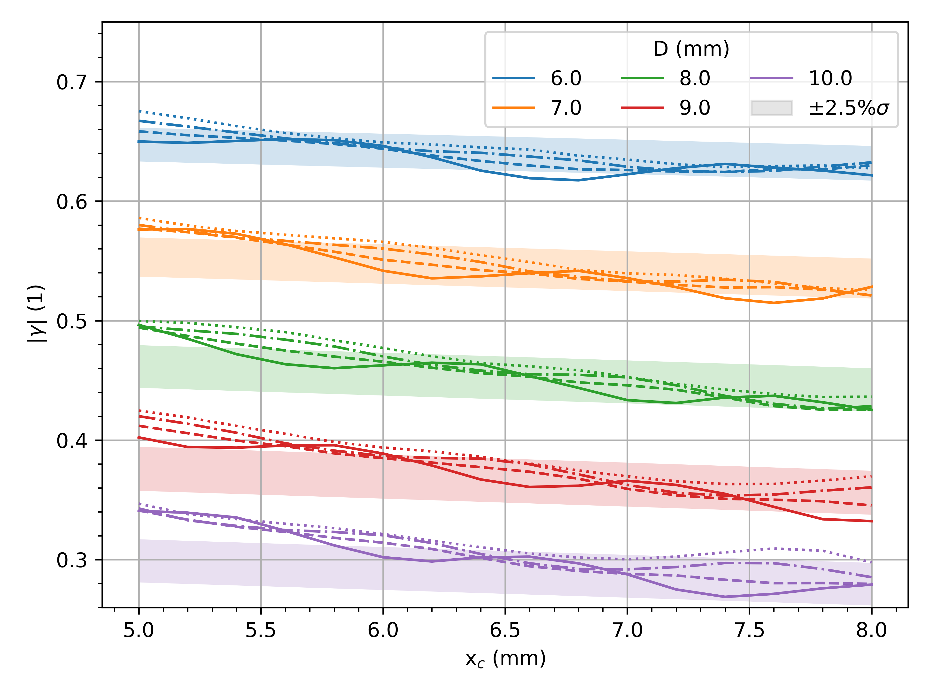
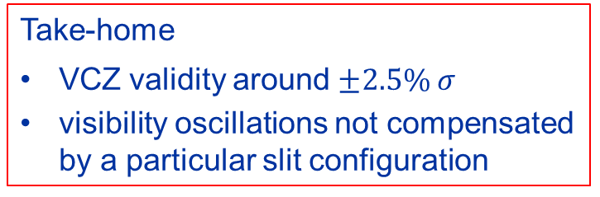
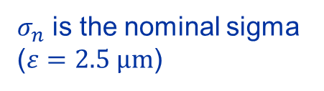
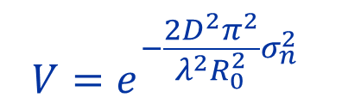


Flat-top horizontal
Source are two D3 → source not well-defined
Take-home
VCZ validity around $±2.5\% σ$
visibility oscillations not compensated by a particular slit configuration
Is the measured visibility constant over the wavefront?
No significanlty better working region
slit configuration
$$Visibility (1)$$
$$V=e^{−\frac{2D^{2}π^{2}}{λ^{2}R_{0}^{2}}σ_{n}^{2}}$$
D
y center
$σ_{n}$ is the nominal sigma ($ε=2.5 μm$)
x center
$$x_{c} (mm)$$

