Slide 1



A beam position monitor for the AWAKE experiment based on Cherenkov diffraction radiation
Collette Pakuza
JAI Fest
Friday 10th December 2021

Slide 2
Contents
The AWAKE experiment
Motivation for the Cherenkov diffraction radiation (ChDR) beam position monitor (BPM)
Design considerations
Status and future tests

Slide 3
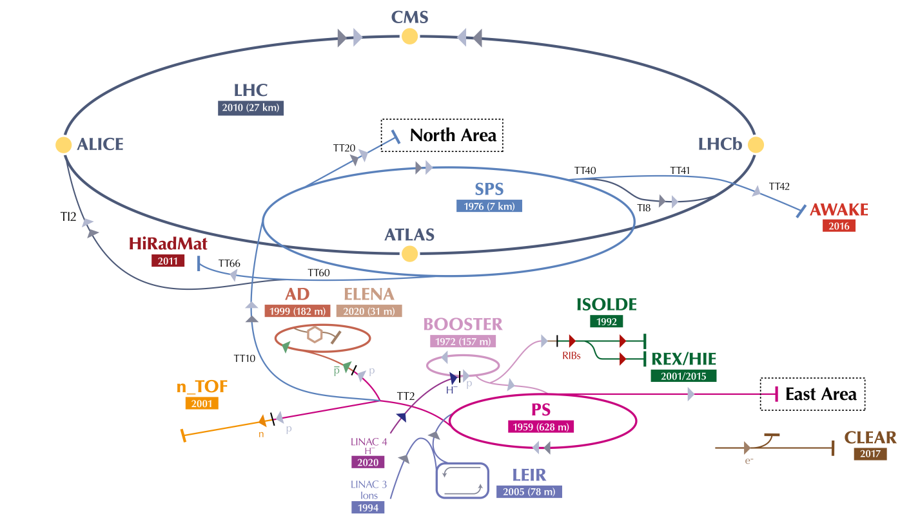
The AWAKE experiment
AWAKE: Advanced Proton Driven Plasma Wakefield Acceleration Experiment

Slide 4
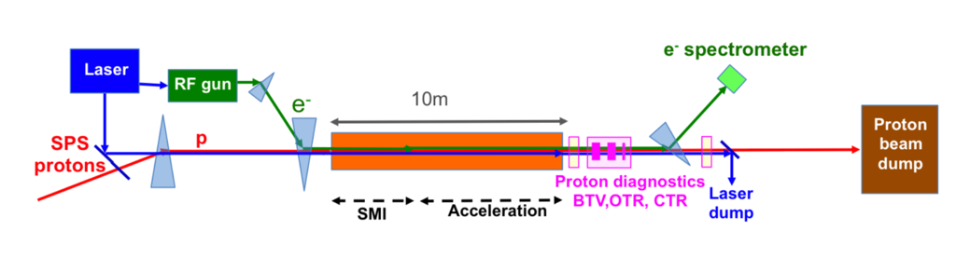
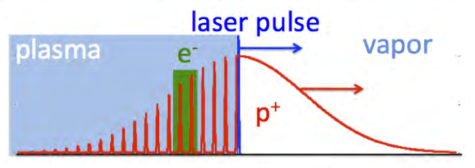
The AWAKE experiment
Protons 48 nC, 250 ps sigma
Electrons 150 pC, 2.5 ps sigma
Laser 120 fs, 450 mJ
Rb vapour
Run 1 (2016-18)
ChDR BPMs

Slide 5
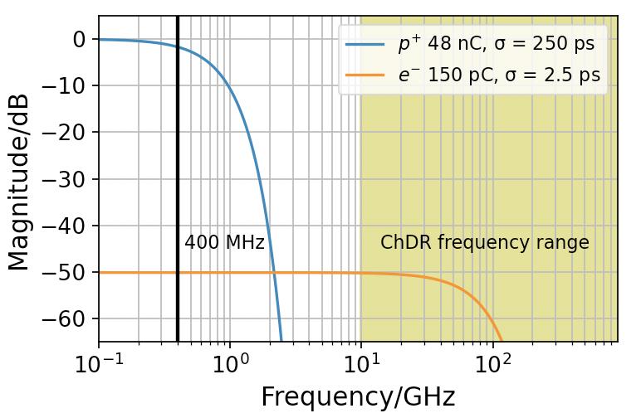
Motivation for ChDR BPM
Proton signal dominates below 2 GHz
Current system cannot measure electrons in presence of protons
Exploit the different bunch lengths
Operate at high frequency
Very mechanically challenging for traditional electrostatic monitors

Slide 6
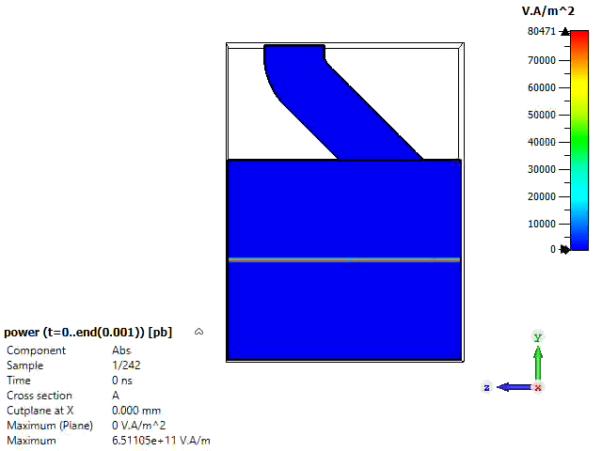
Motivation for ChDR BPM
New technique based on Cherenkov diffraction radiation
Polarization radiation produced when charged particle travels in close proximity to the surface of a dielectric target
  Non-invasive measurement
  Large emitted photon flux
  Well-defined angular emission

Slide 7
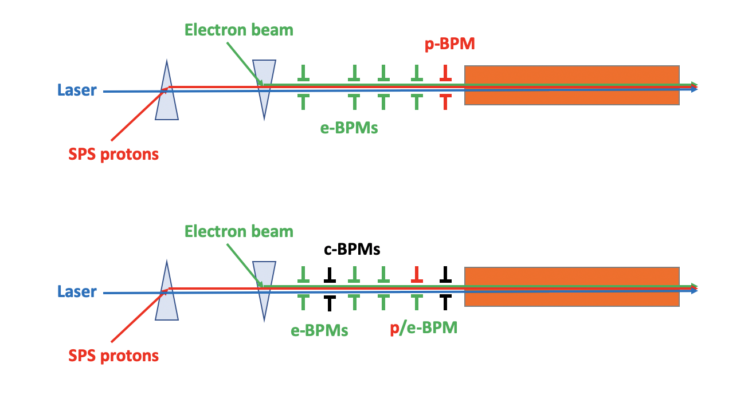
Design for AWAKE
Limited space available
ChDR buttons designed to be compatible with existing p-BPM body
Plan:
Convert one p-BPM to c-BPM
Split signal of e-BPM to measure protons
Install additional c-BPM in drift space

Slide 8
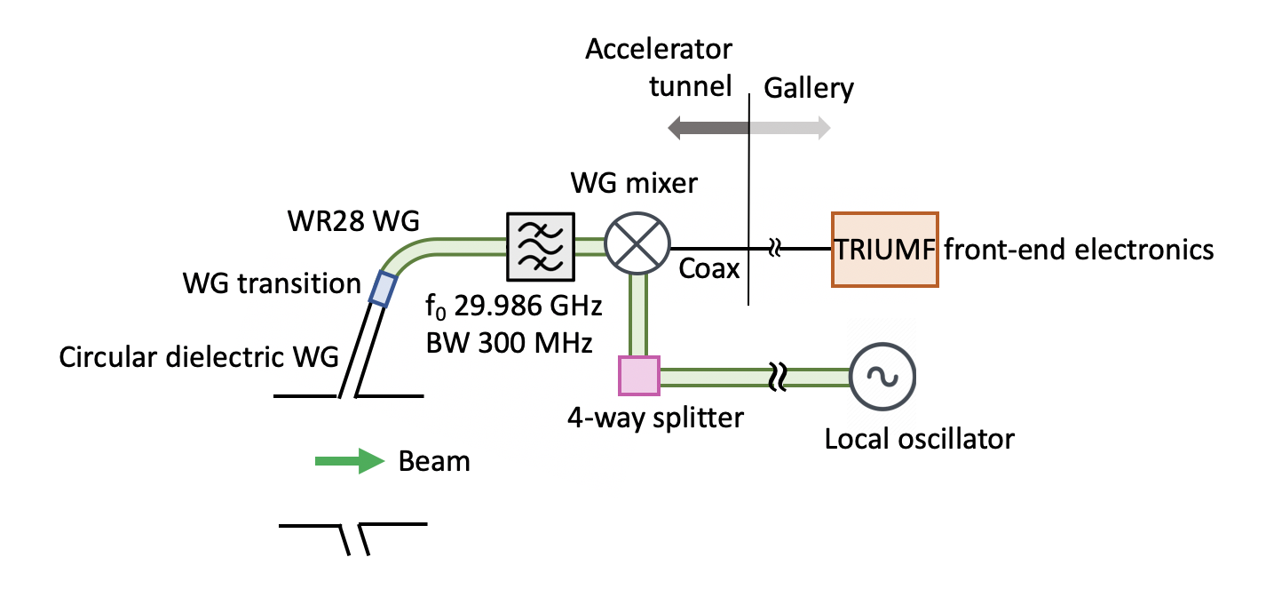
Design for AWAKE
Schematic of entire ChDR BPM setup
Proton bunch not gaussian, spectrum extends to frequencies higher than expected
Operating frequency in the range of 10s GHz means electron signal dominates
30 GHz chosen due to availability of waveguide (WG) components in house
WR28 WG used with cutoff 21 GHz acting as high-pass filter
Collaboration with TRIUMF for the front-end electronics

Slide 9
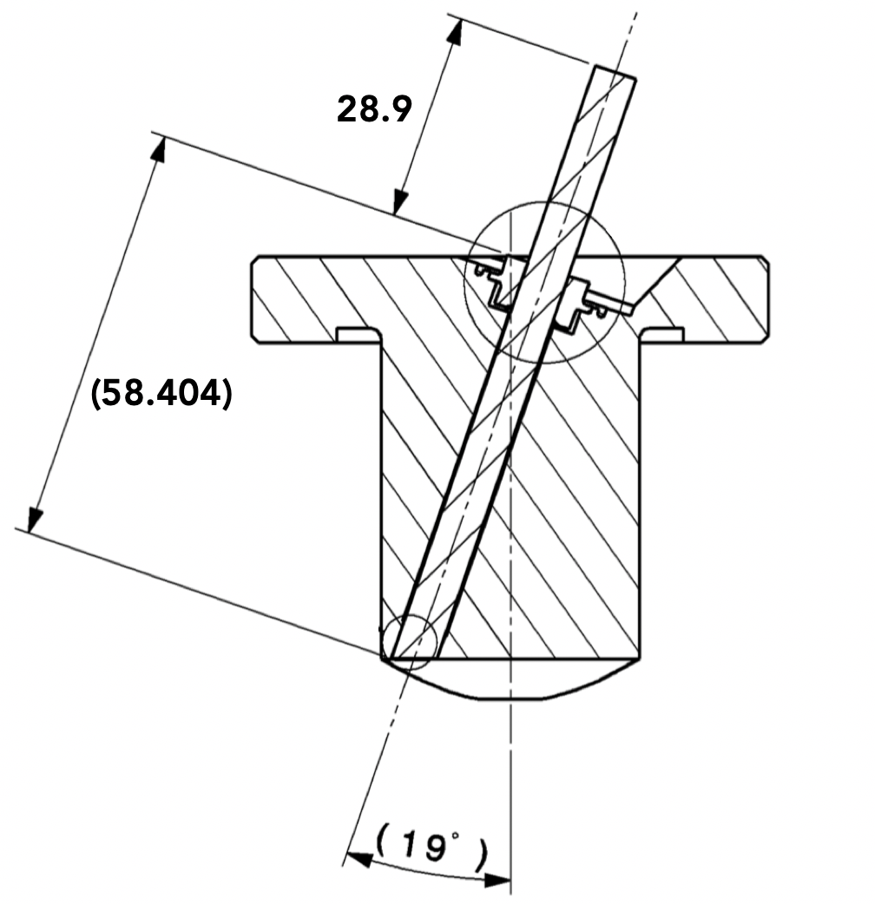
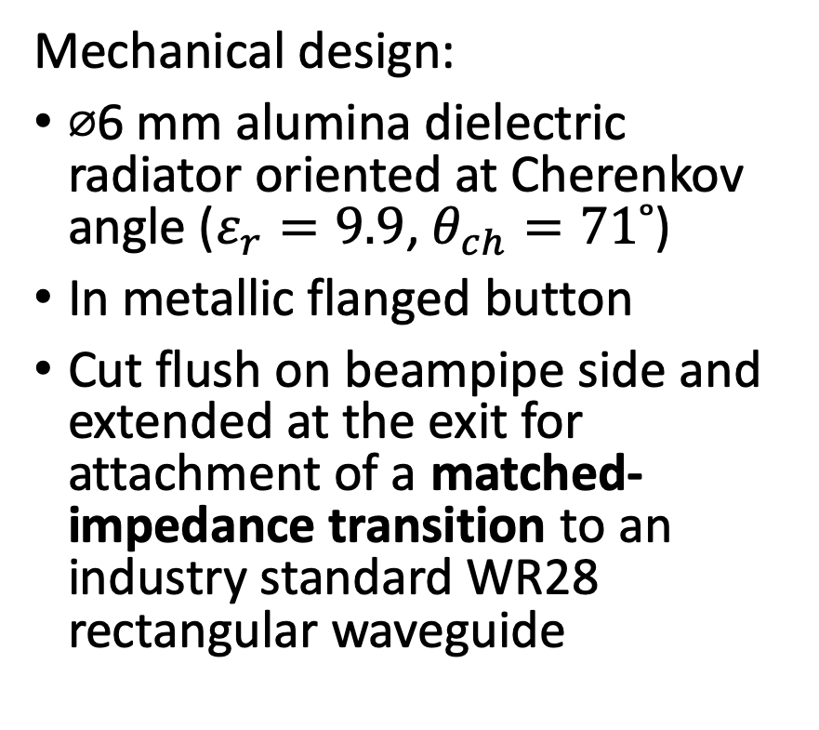
Design for AWAKE
Alumina rod ⌀6 mm
Mechanical design:
⌀6 mm alumina dielectric radiator oriented at Cherenkov angle ($ε_{r}=9.9$, $θ_{ch}=71˚$)
In metallic flanged button
Cut flush on beampipe side and extended at the exit for attachment of a matched-impedance transition to an industry standard WR28 rectangular waveguide
Transition can be attached here
Flange
Button
Beam

Slide 10
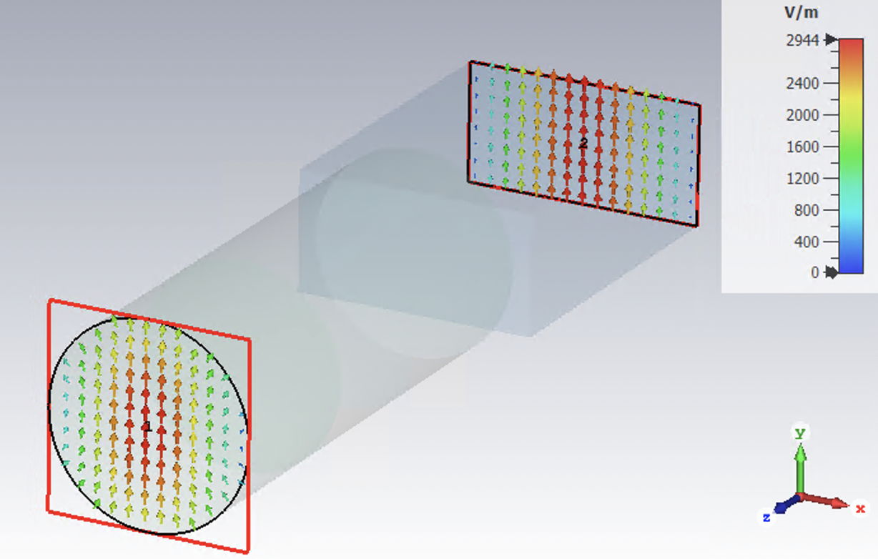
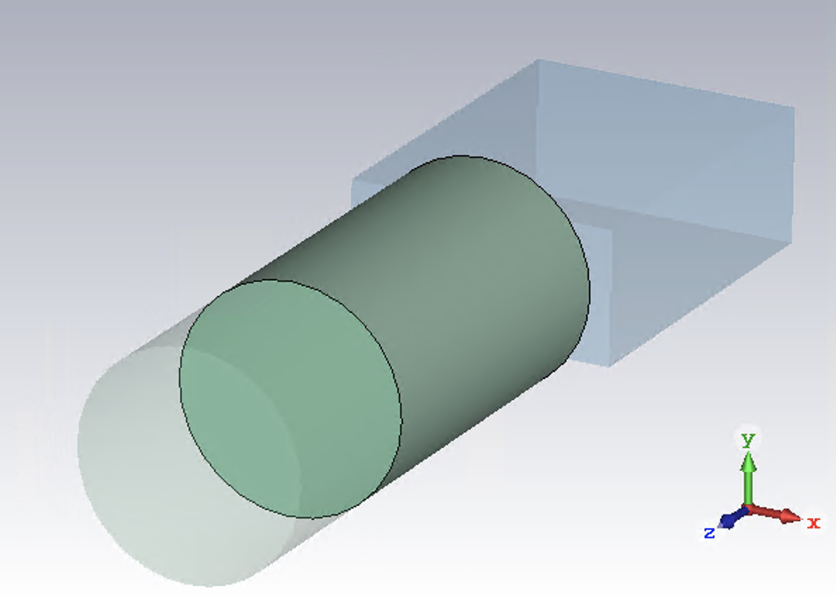





WG transitions
TE10 mode
Transition designed to maximize power transfer at 30 GHz between dominant modes of the waveguides
Based on quarter-wave impedance transformer
Section introduced with intermediate value of dielectric constant
TE11 mode
WR28 (Ka-band)
$$Z_{r}=530 Ω$$
Fused quartz $ε_{r}=3.75$
$$Z_{i}=225 Ω$$
9.88 mm
Alumina $ε_{r}=9.9$
$$Z_{c}=126 Ω$$

Slide 11
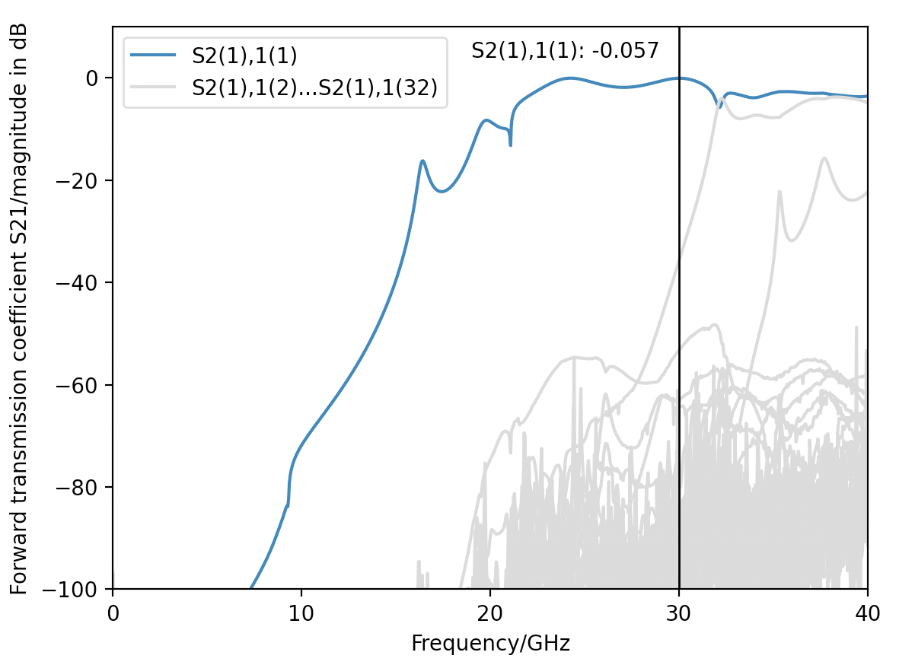
WG transitions
Mode number in brackets
Numerical analysis shows forward transmission coefficient for all modes below 40 GHz
Length of intermediate section optimized to produce largest contribution of power from the fundamental mode of circular dielectric (TE11)
S21^2 = 99% power transmission @ 30 GHz
Contributions from all other modes in circular dielectric are suppressed

Slide 12
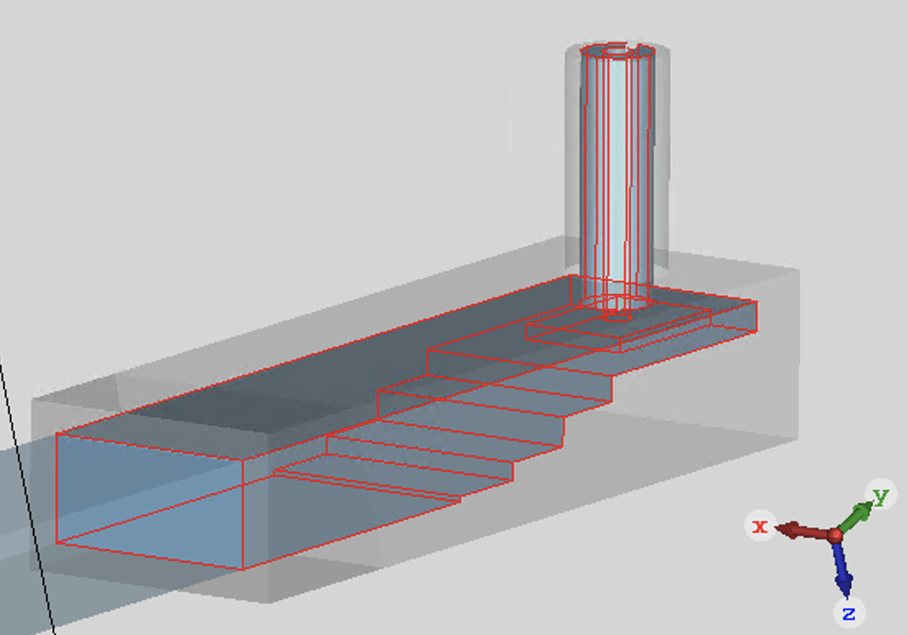
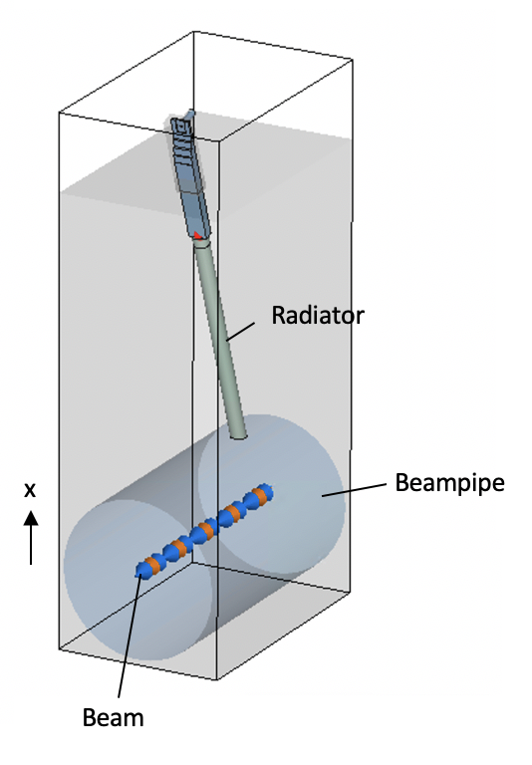
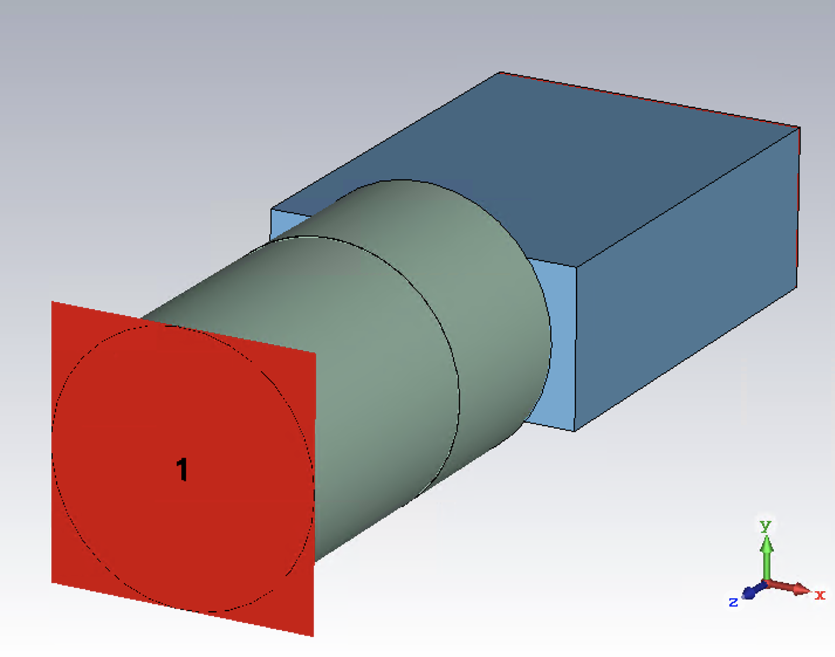
Numerical simulations
Parameter | Value
Bunch sigma | 2.5 ps
Bunch charge | 150 pC
Radiator angle | 71˚
Radiator length | 86.27 mm
Radiator dielectric constant (alumina 99.5% purity) | 9.9
Mesh | 10 mesh cells per wavelength
Total number of mesh cells | 252 million
Average simulation time | Approx. 15 h
Beampipe diameter (AWAKE) | 60 mm
R281A WR28 to 50 Ω coaxial adapter
Full simulation with beam to investigate system behavior
Circular to rectangular waveguide transition

Slide 13
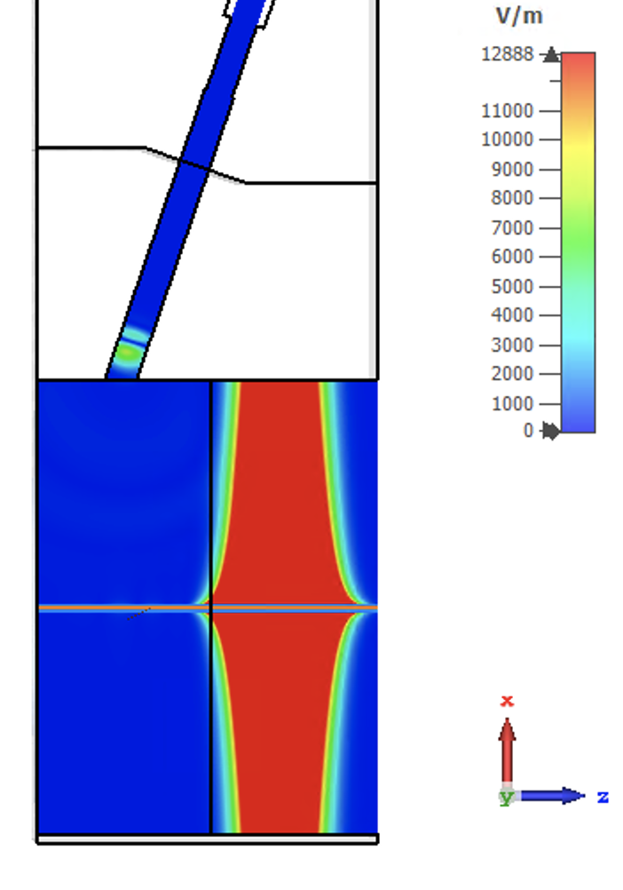
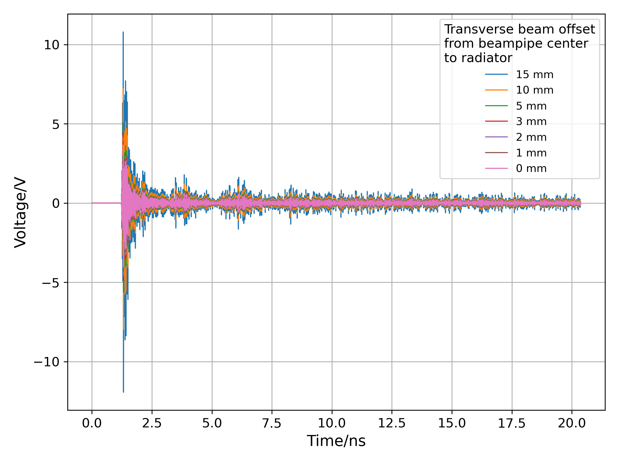
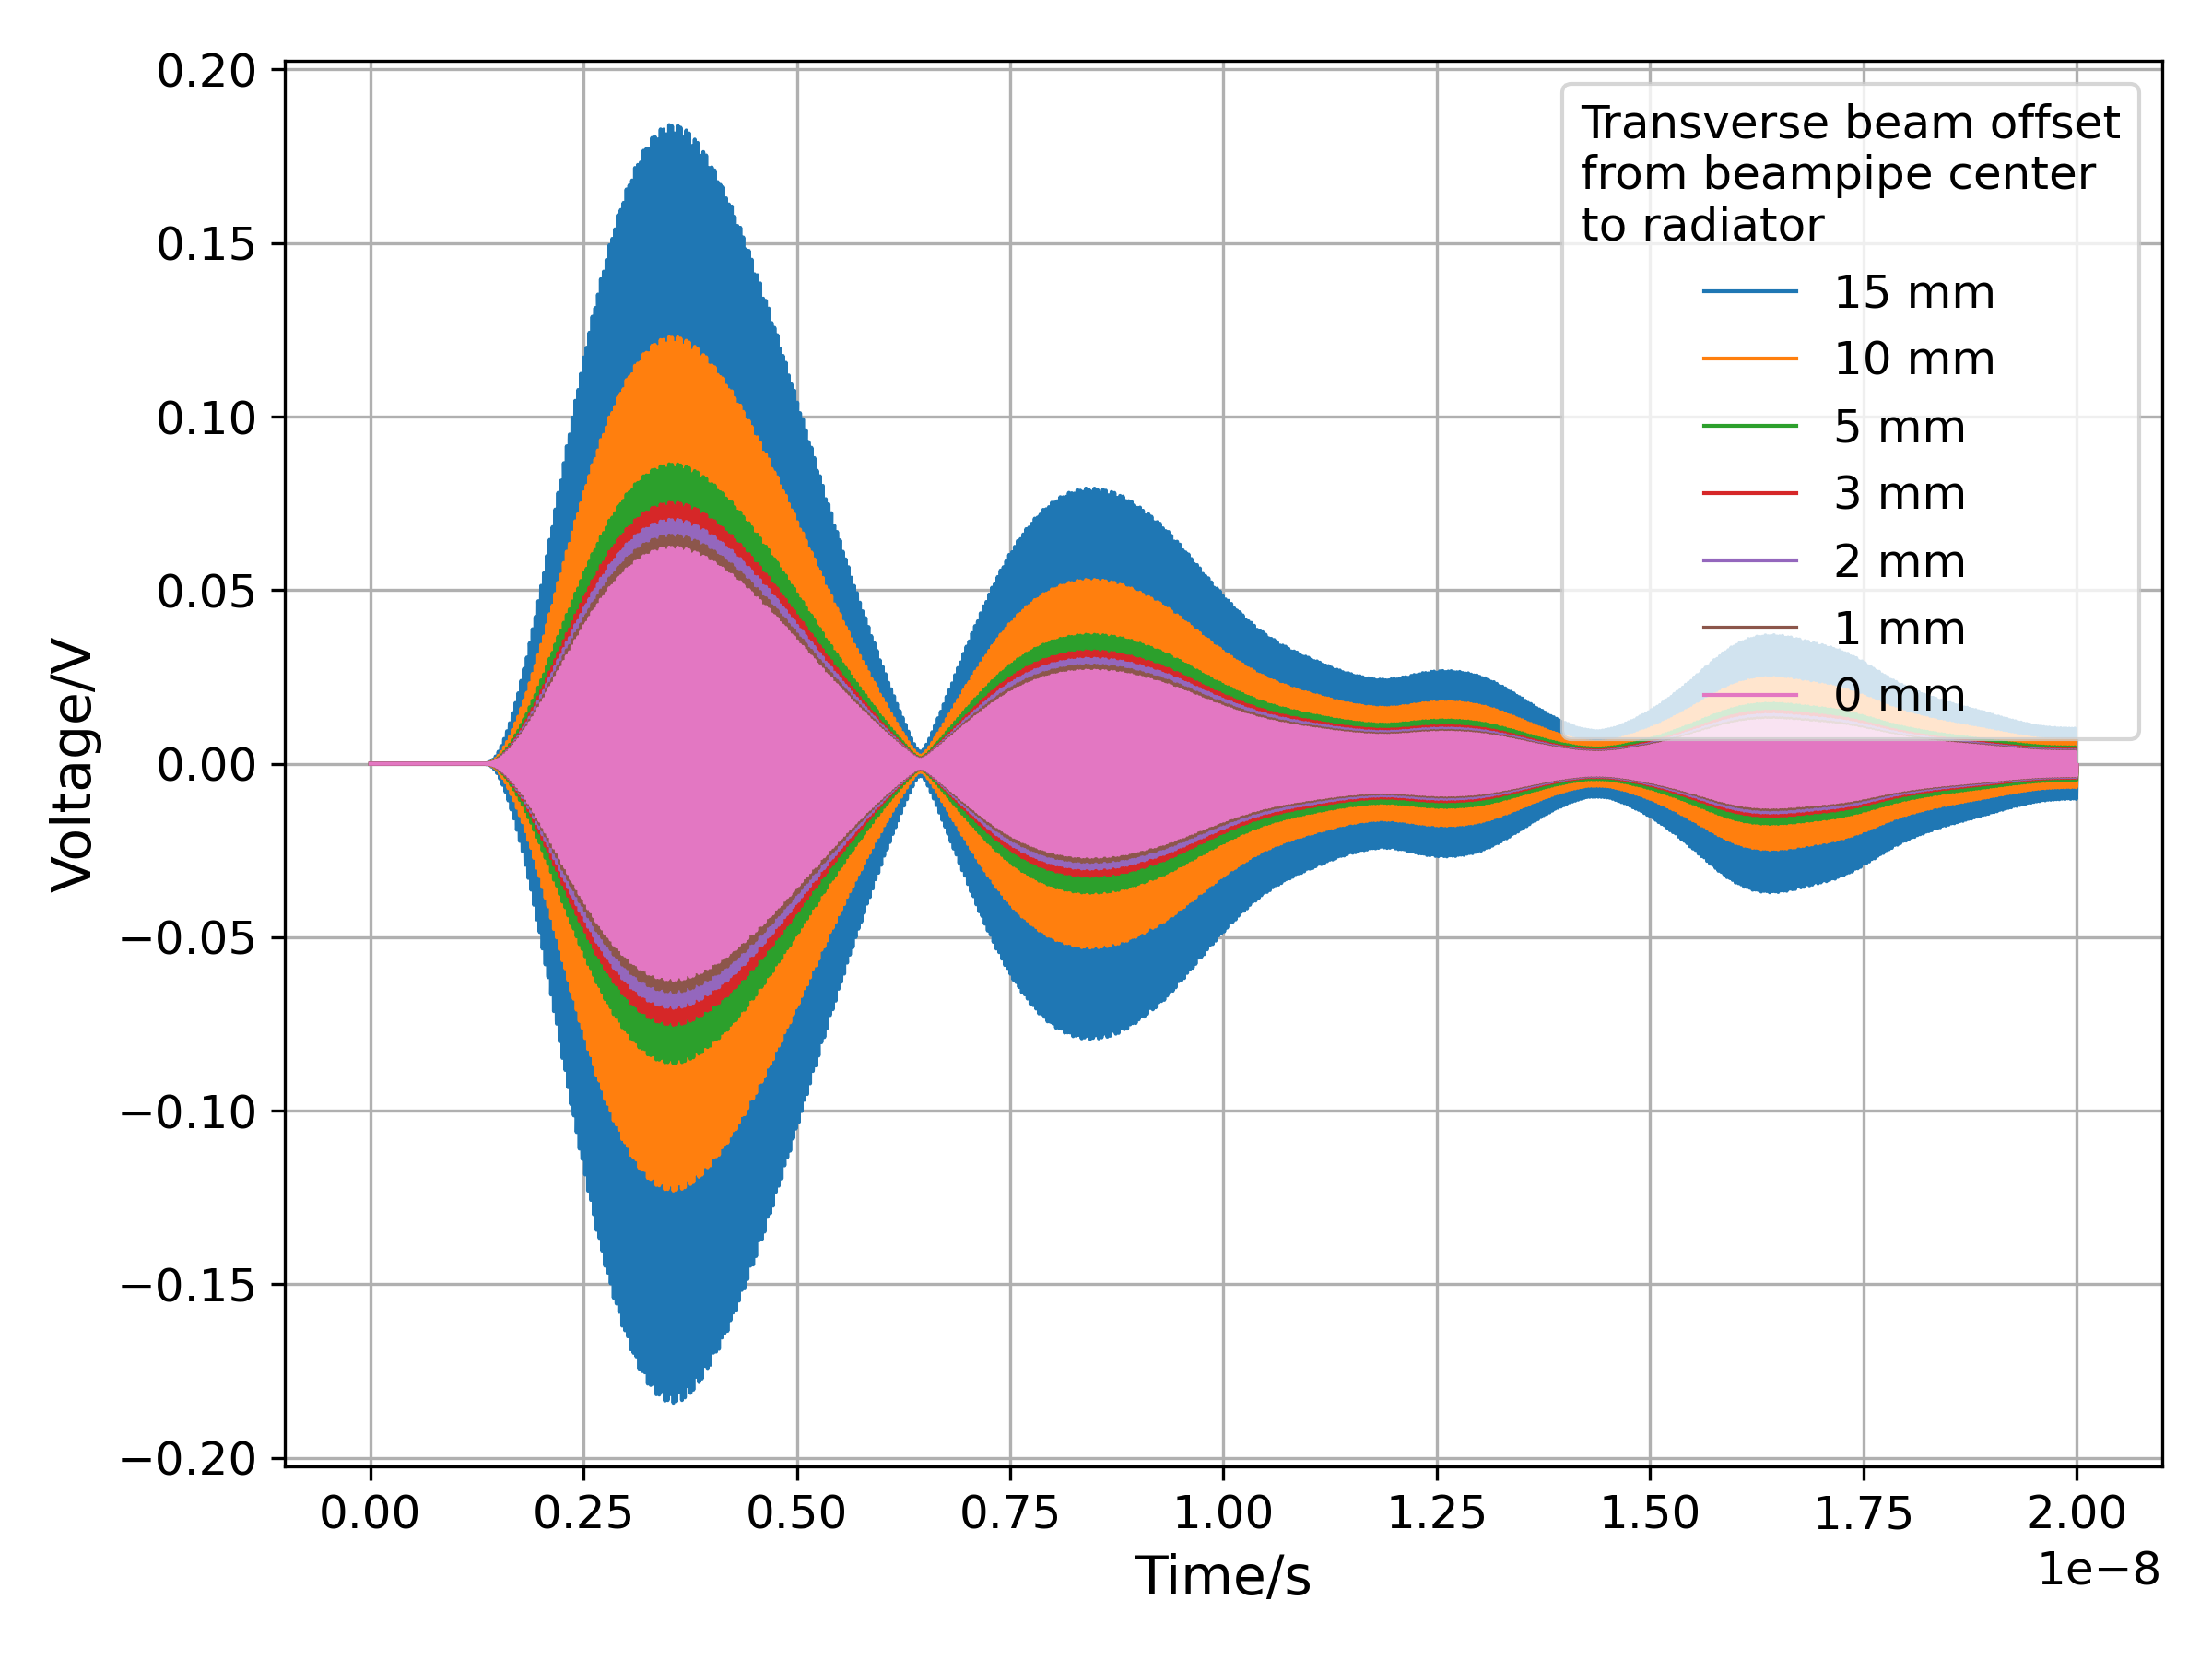
Numerical simulations
Provides the expected signal output for different beam offsets
Promising signal level out
E-field
ChDR
30 GHz, 300 MHz BW Butterworth filter
Electron beam field

Slide 14
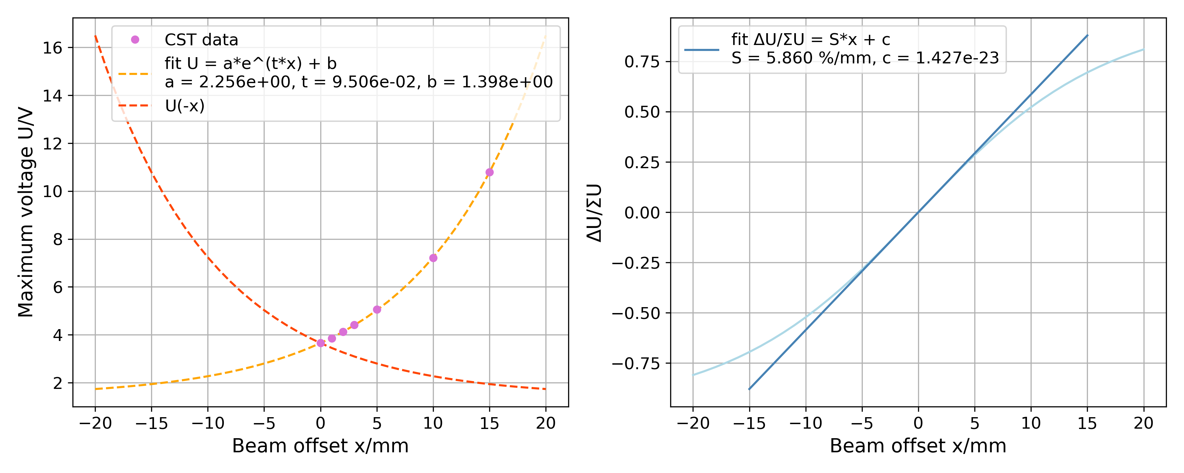
Numerical simulations
By taking the signal level at a given time for different beam offsets, provides position response curve
Summary of BPM specifications for 150 pC, 2.5 ps σ electron bunch
Parameter | Value
Position sensitivity | 5.86 %/mm
Signal-to-noise ratio | Approx. 60/70 dB
Resolution | 34.6 µm (300 MHz BW BPF)
Useful system requirements for development of front-end electronics by TRIUMF

Slide 15
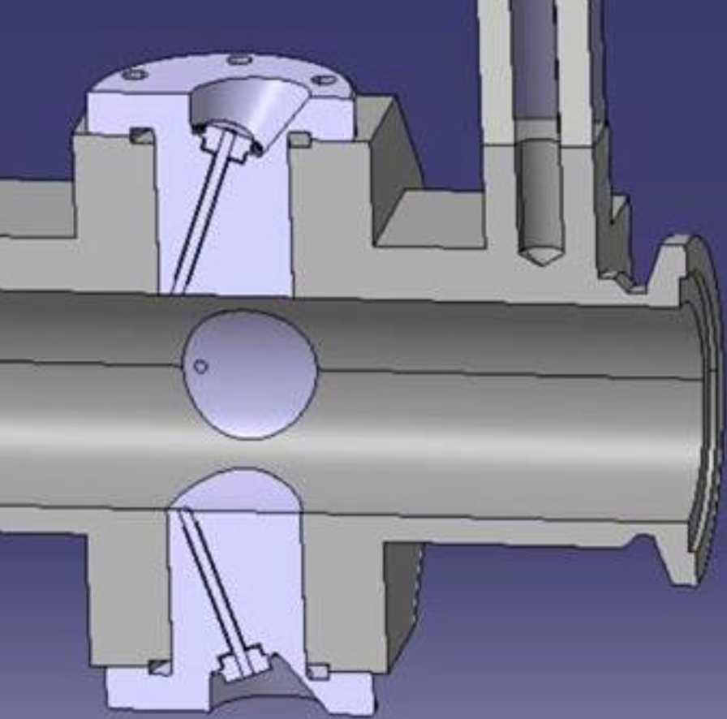
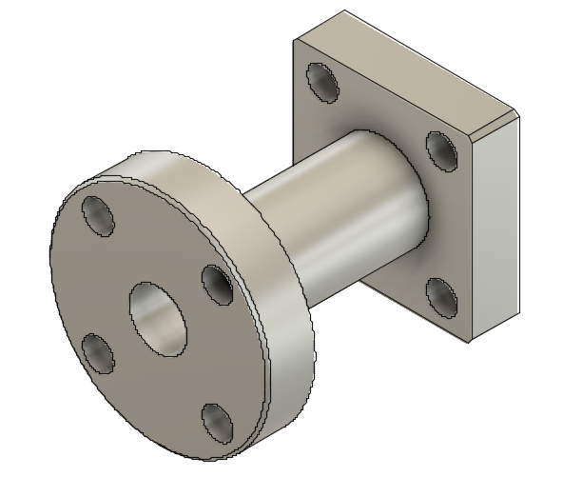
Status of BPM and future tests
Flanged button compatible with pBPM body
Collar
Alumina rods and fused quartz pieces should arrive in following weeks
Allows for completion of manufacturing process of buttons and transitions
Buttons to be tested in-vacuum at CLEAR once accelerator restarts in March 2022
Installation of c-BPMs at AWAKE with TRIUMF electronics in Summer 2022
Radiator (alumina)
ChDR buttons in existing pBPM body
WG transition

Slide 16

Thank you for your attention!
Wish you all a Merry Christmas!

