Slide 1
RF Cavities: Thinking Outside Circular Boxes
Laurence Wroe
Suzie Sheehy, Rob Apsimon, Manjit Dosanjh

Slide 2
The Plan
Pillbox cavity
Maths (brief)
Gifs (cool)
Conclusion
Drums
Questions (please)

Slide 3
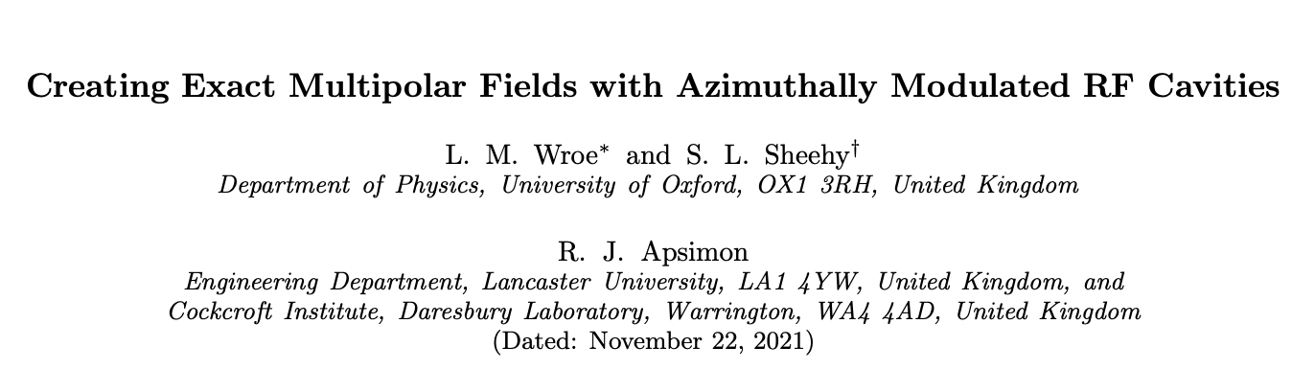
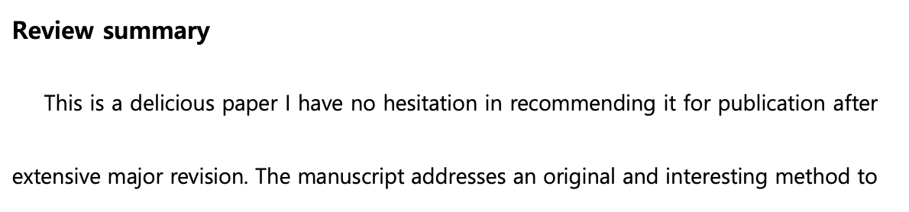
Paper

Slide 4
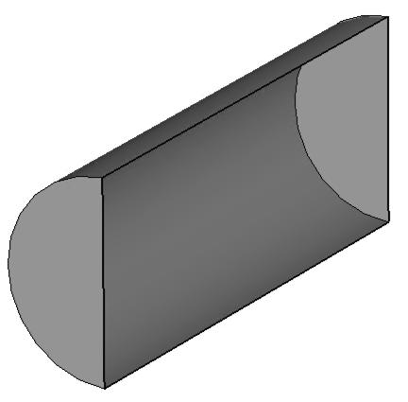
The RF Cavity Pillbox
TM_{mnp} modes:
m = azimuthal order
n = radial order
p = longitudinal order
For this talk:
p = 0
f = 3 GHz

Slide 5
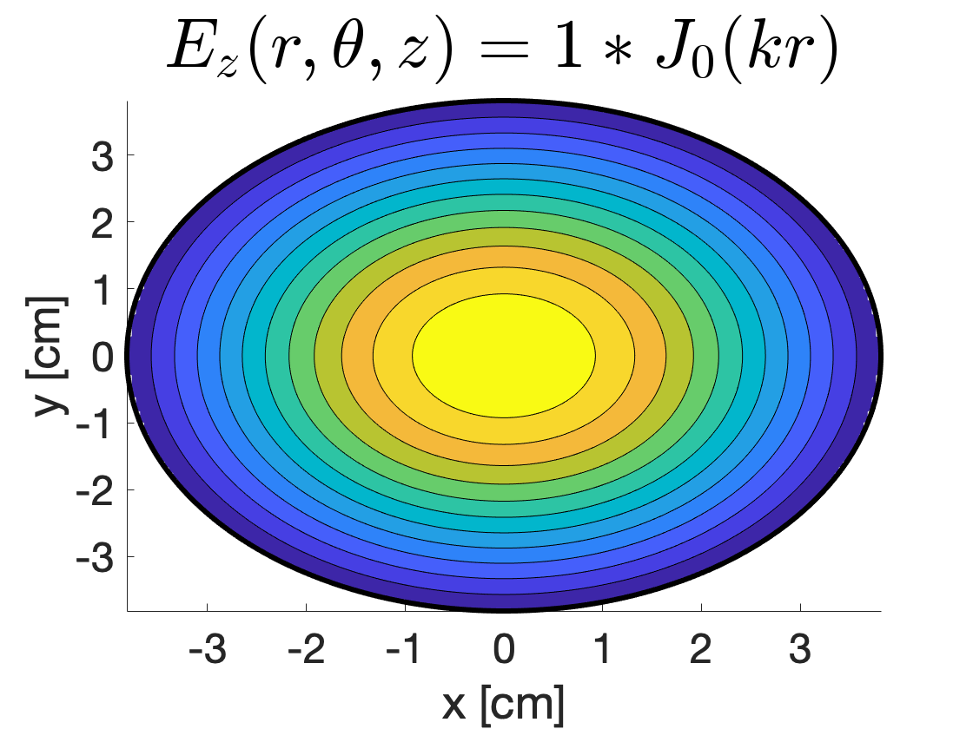
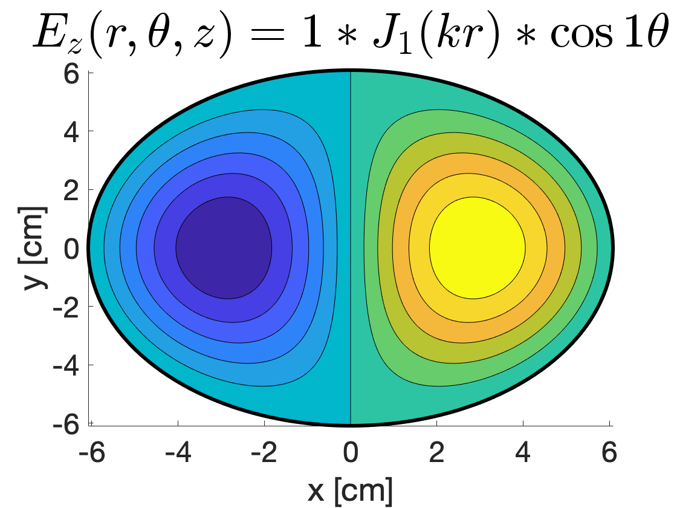
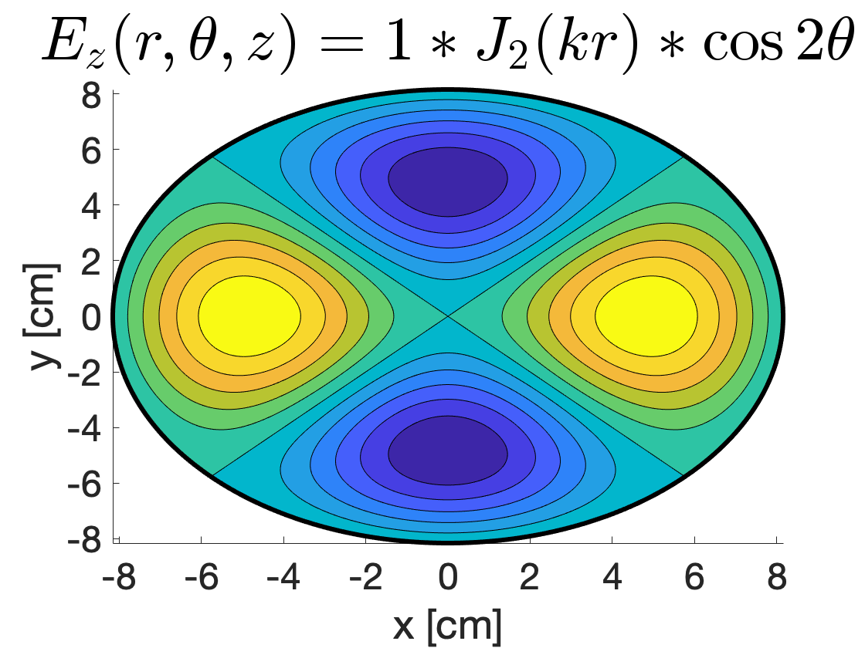
Useful Pillbox Modes
However, different radii!
Monopole TM₀₁₀ mode:
Accelerating
Dipole TM₁₁₀ mode:
Deflecting
Crabbing
Splitting
Longitudinal diagnostics
Quadrupole TM₂₁₀ mode:
Focusing
Landau damping

Slide 6

Aim of the game…
r = r₀
r = r₀(θ)
Azimuthally Modulated

Slide 7
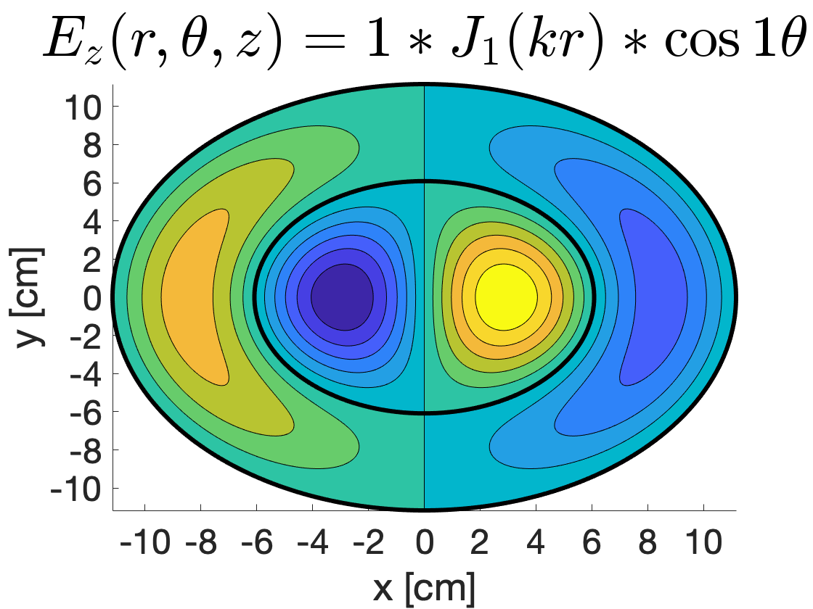
Reminder of n
TM₁₂₀ Mode

Slide 8
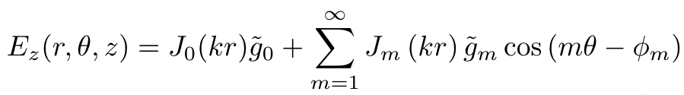
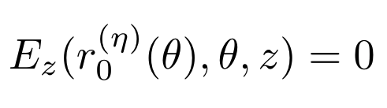
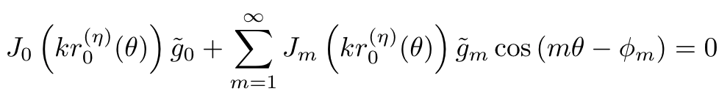
The Only Maths in this Presentation…

Slide 9
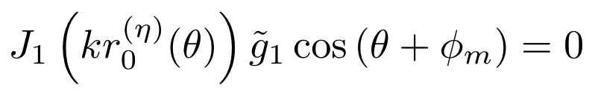
Solving the Equation
Cannot generally solve for r₀(θ) analytically.
Numerical methods to solve
Graphical methods to understand
Introduce with…

Slide 10
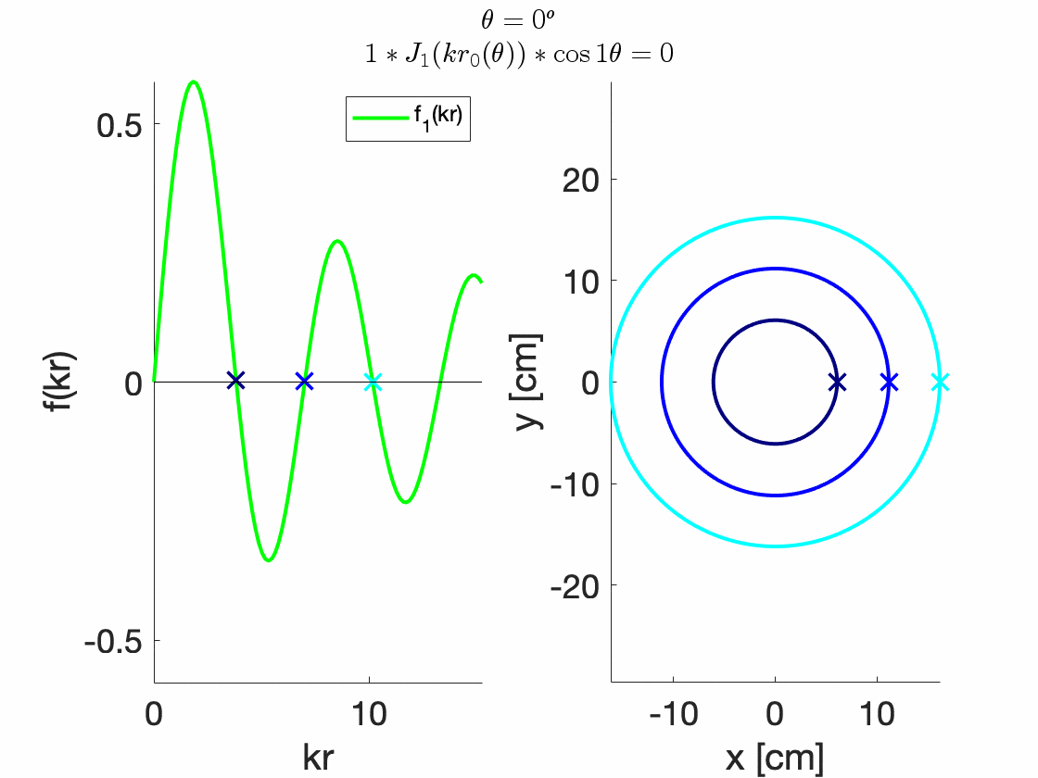
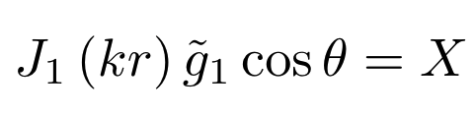
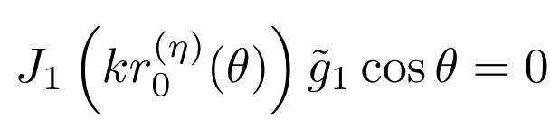
Graphical Techniques: Sanity Check
Plot:
To find:

Slide 11
Solving for Two Multipoles

Slide 12
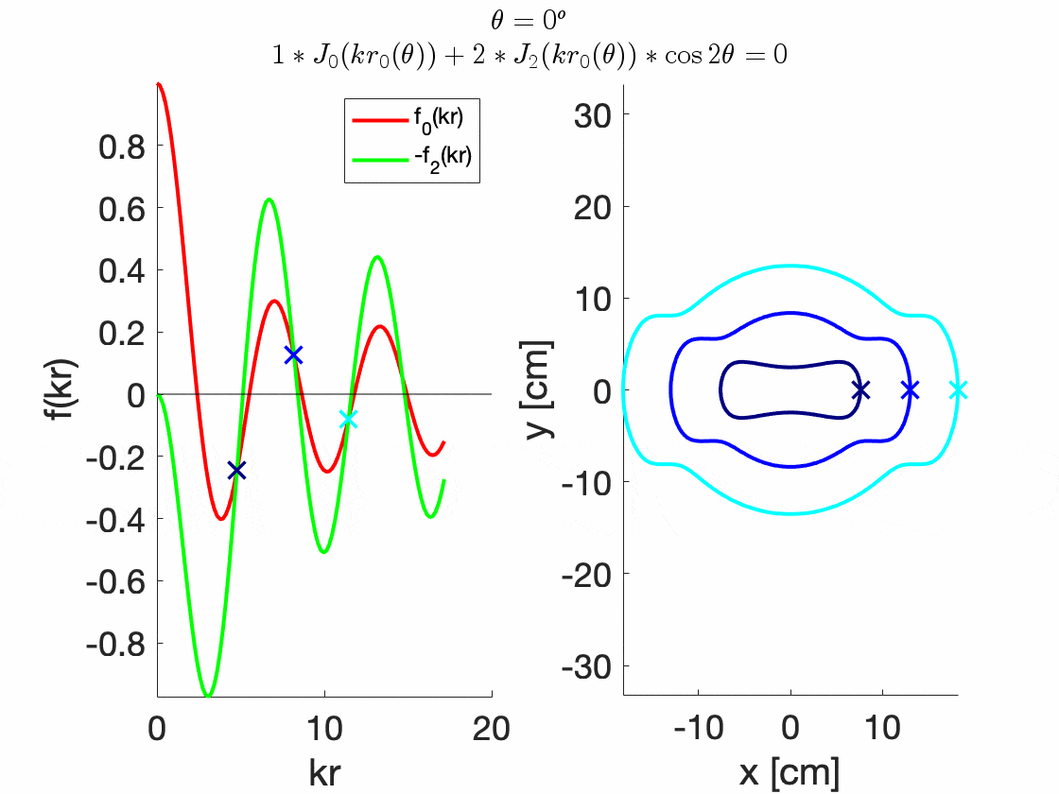
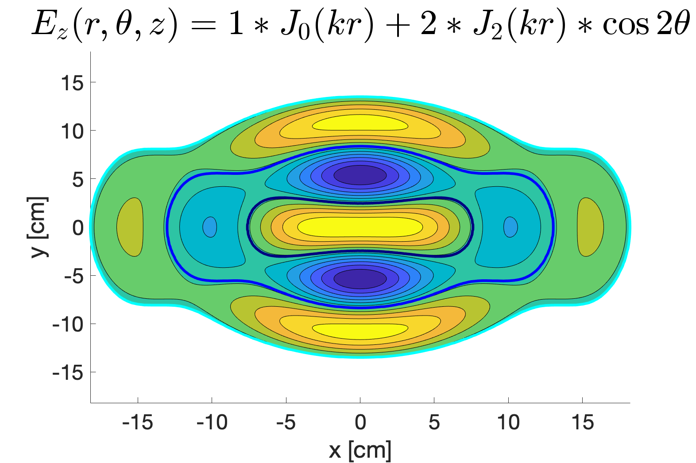
Quadrupole TWICE as strong as monopole

Slide 13
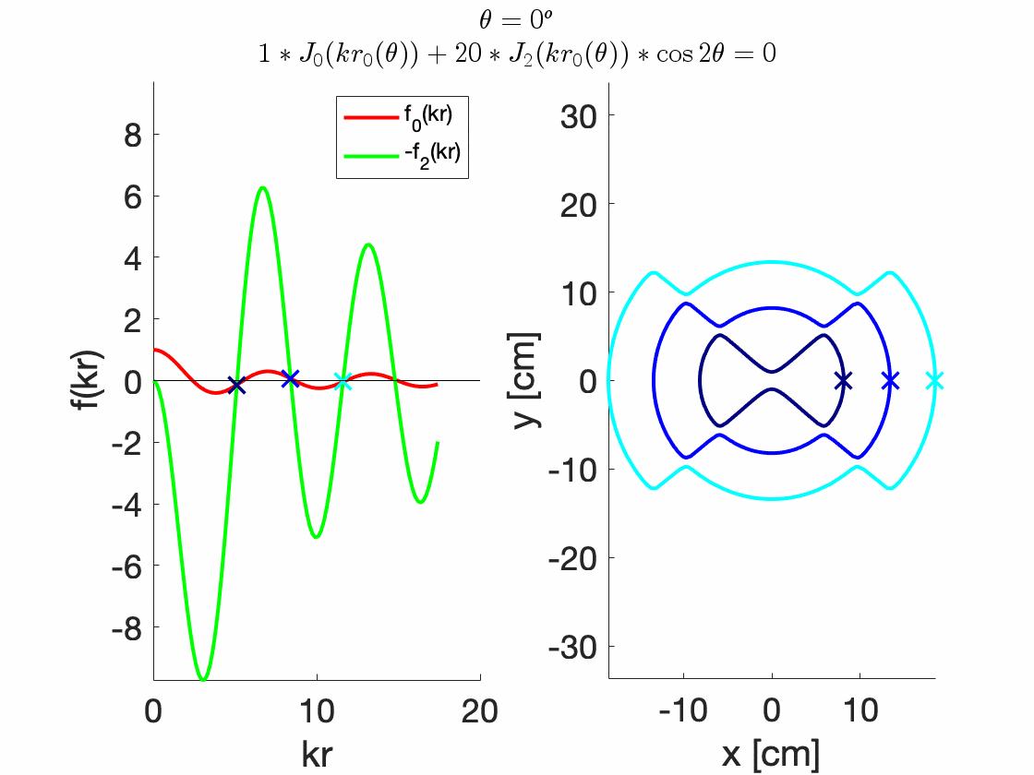
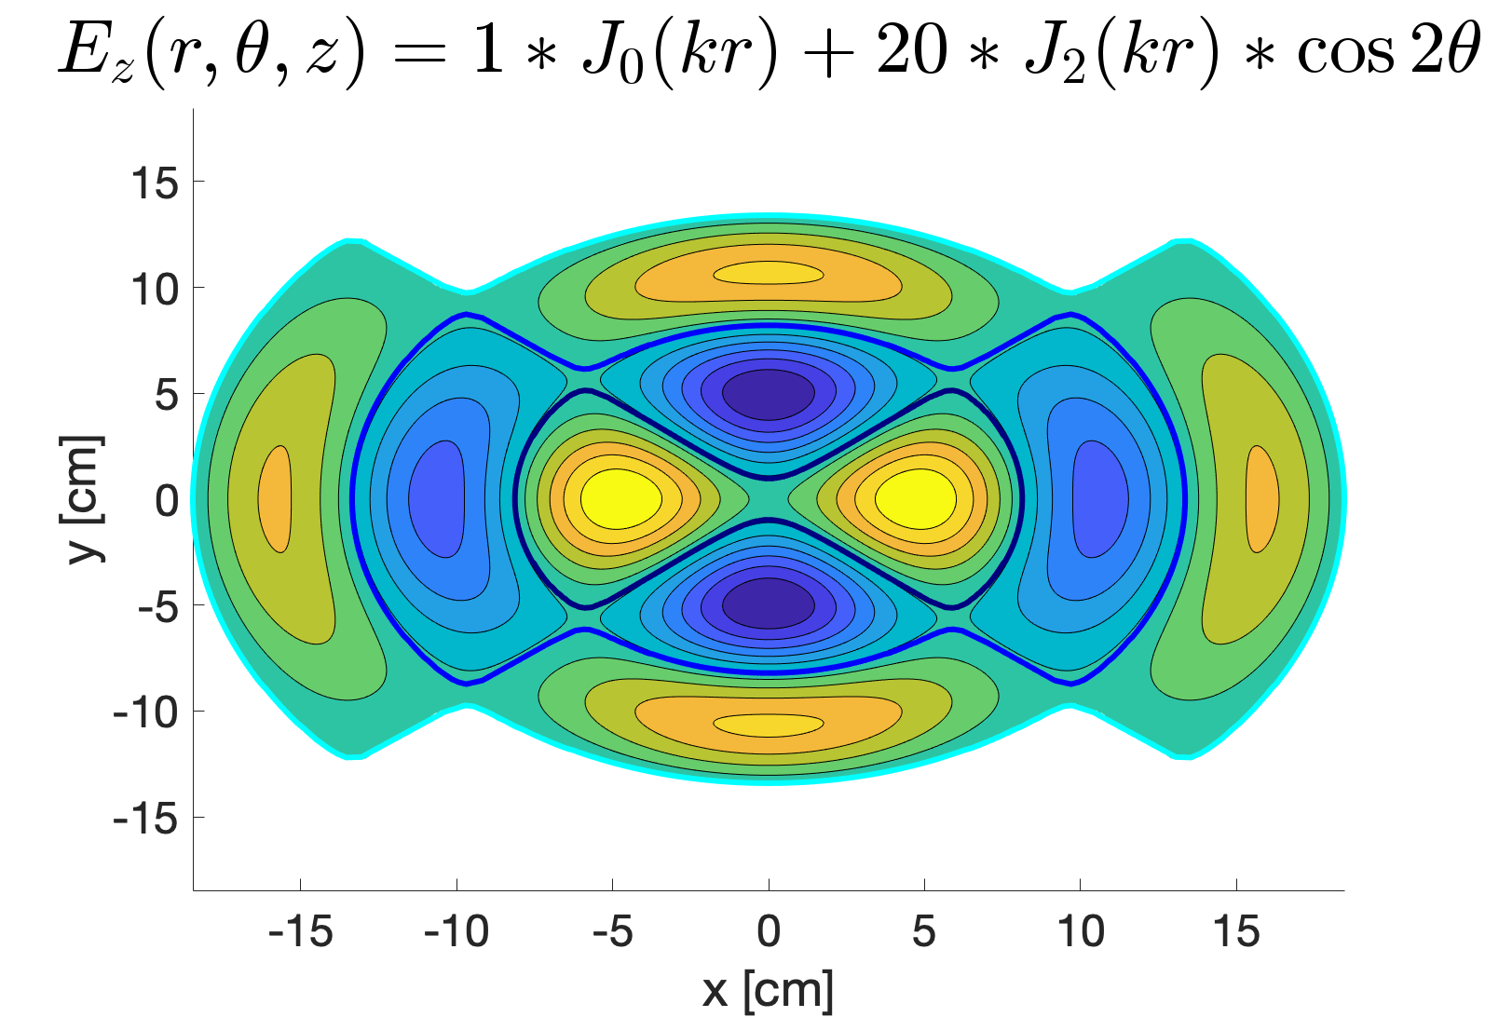
Quadrupole TWENTY times stronger than monopole

Slide 14
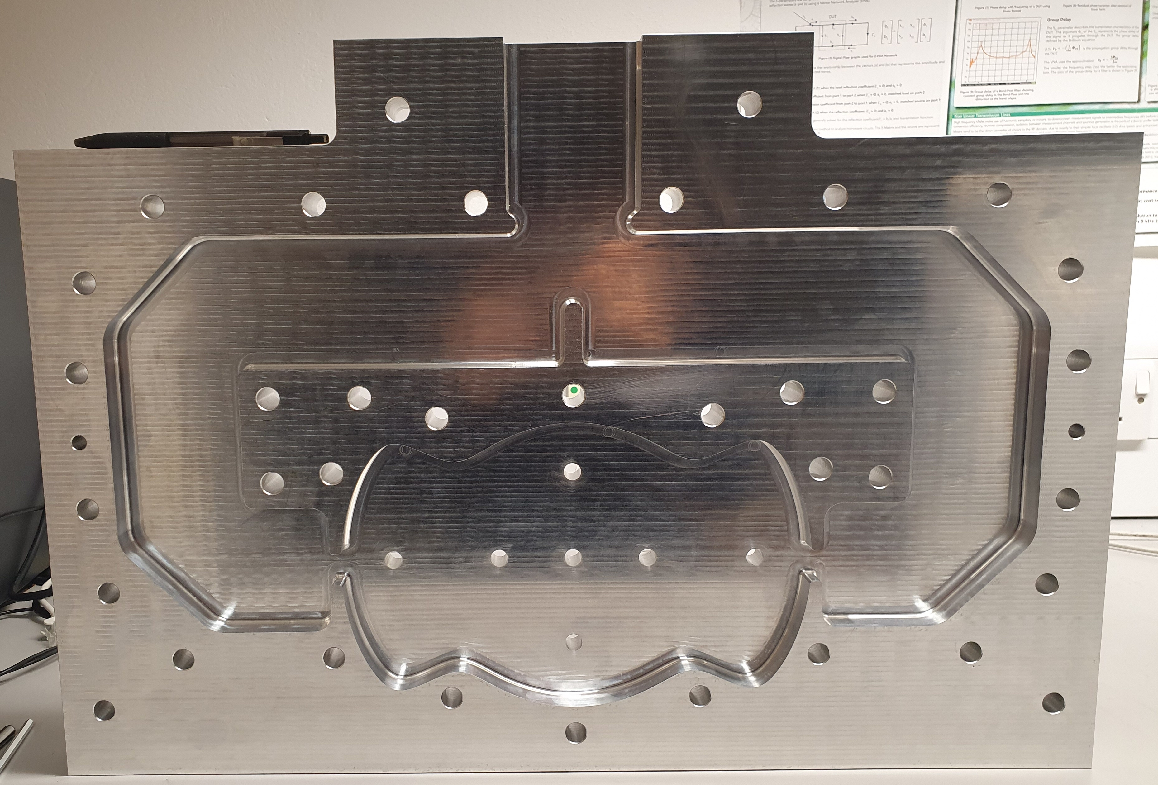
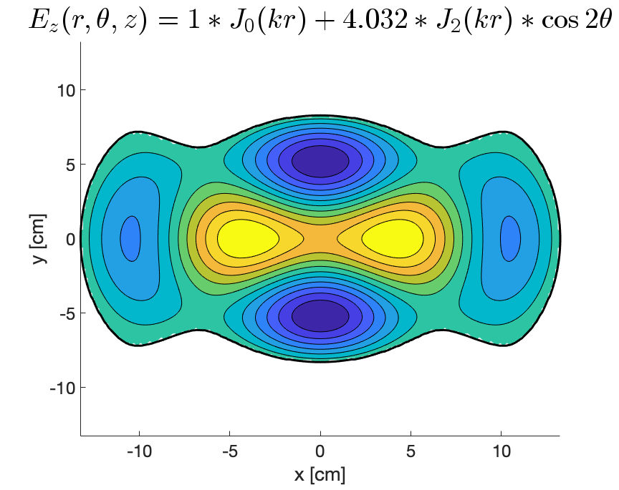
Monopole + Quadrupole - Experiment

Slide 15
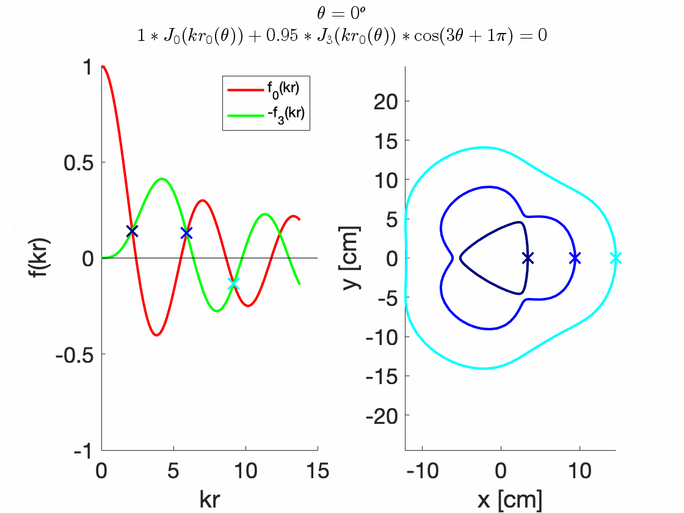
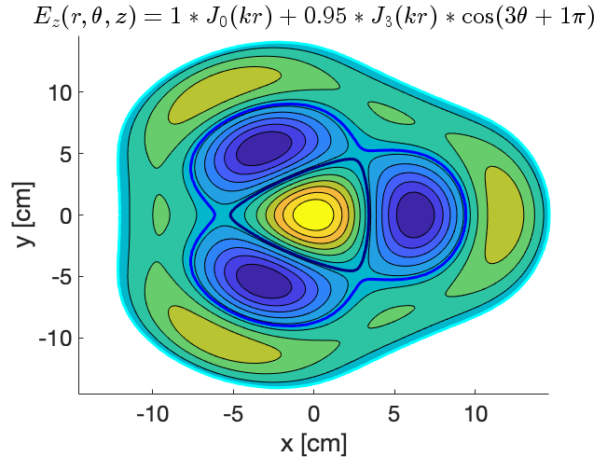
Sextupole 0.95 TIMES stronger than monopole

Slide 16
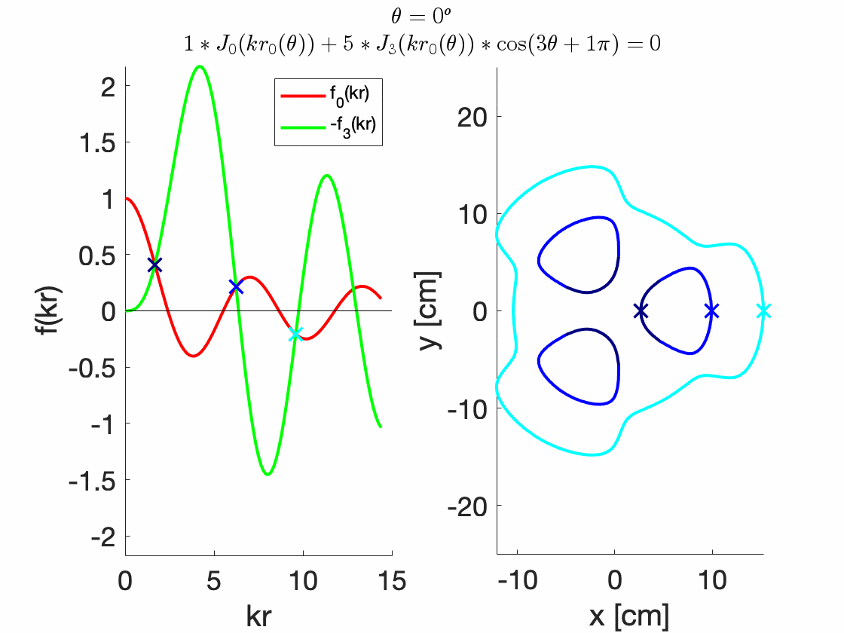
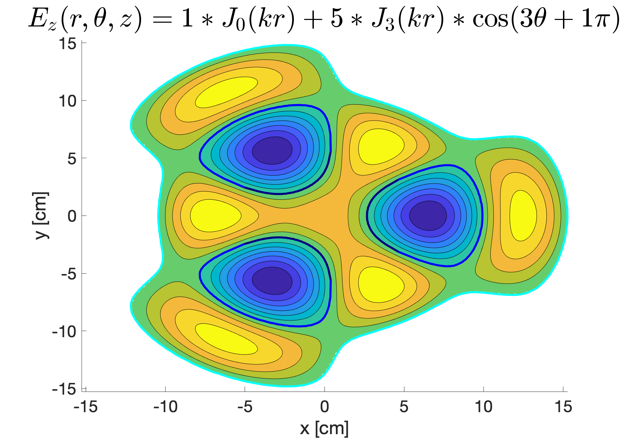
Sextupole 5 TIMES stronger than monopole (Conditional)

Slide 17
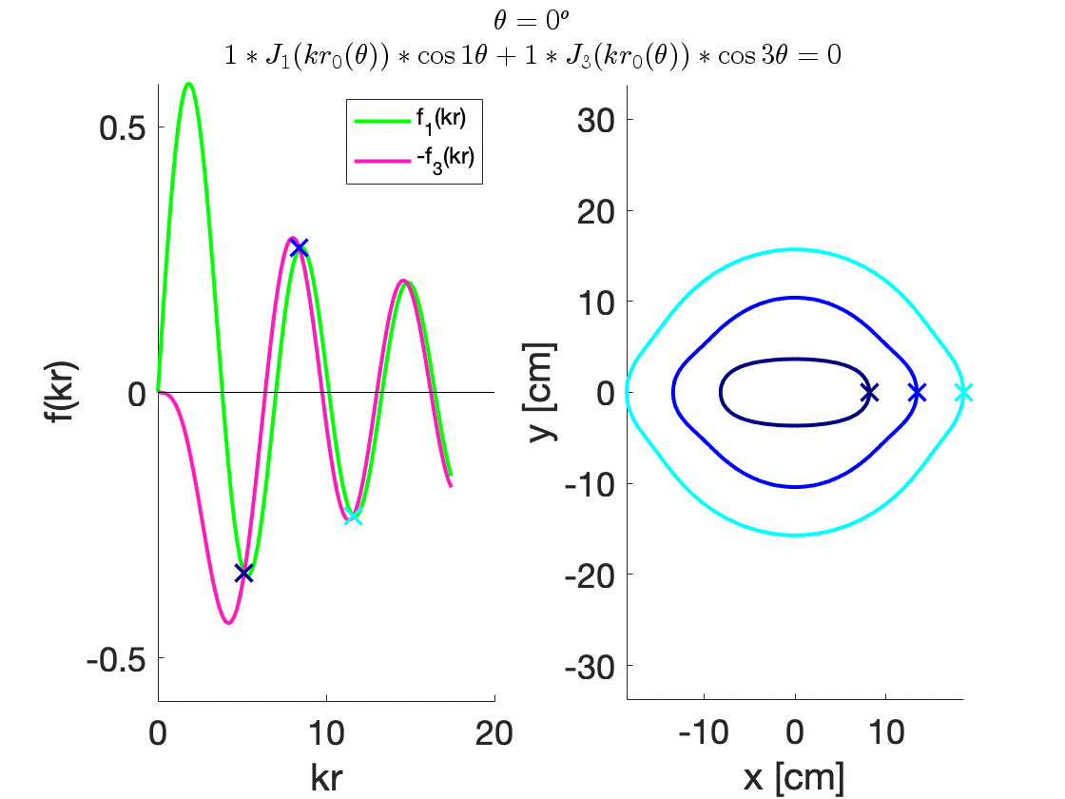
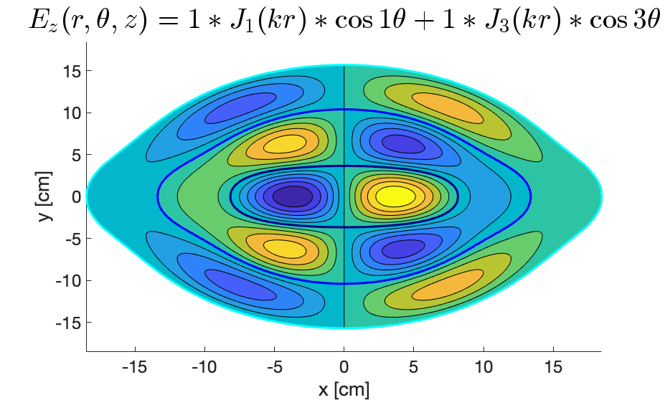
Dipole and Sextupole EQUAL

Slide 18
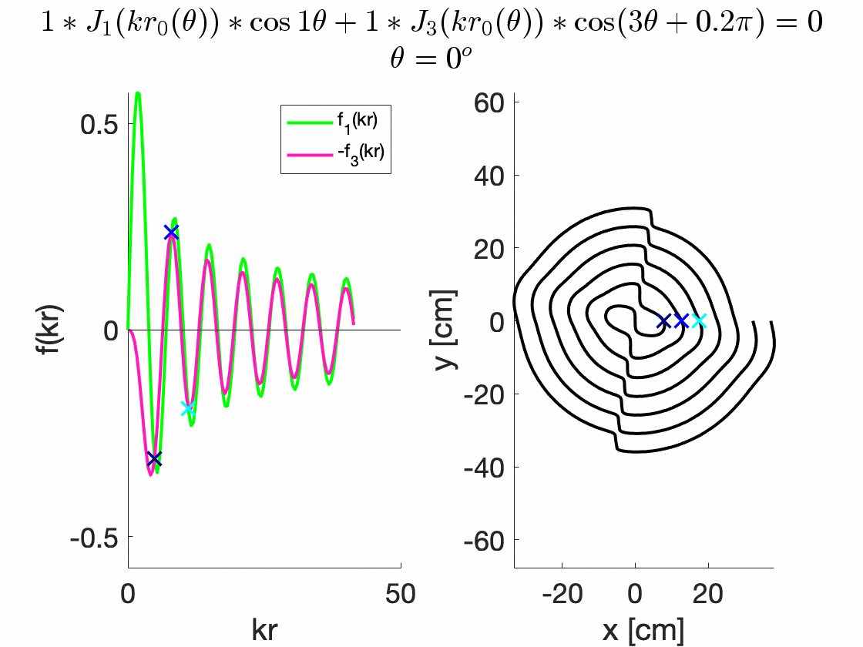
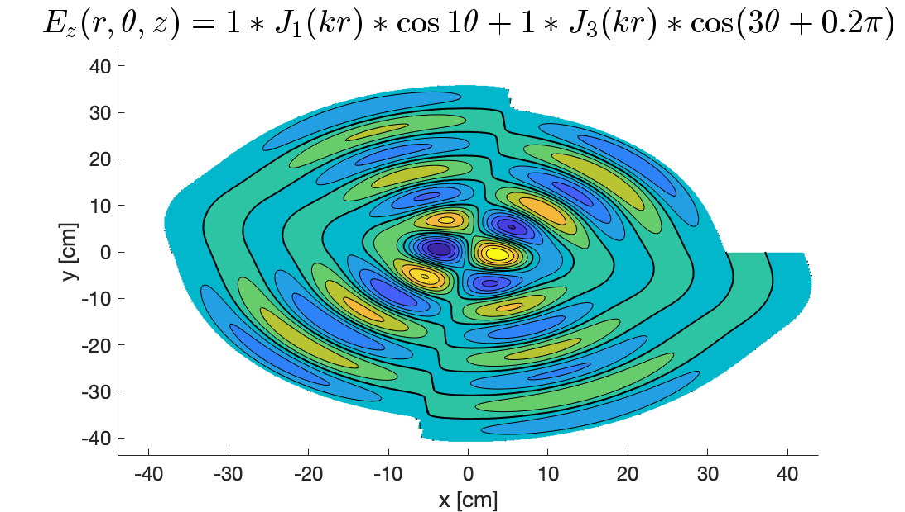
Dipole and Sextupole EQUAL but PHASE DIFFERENCE (Spiral)

Slide 19
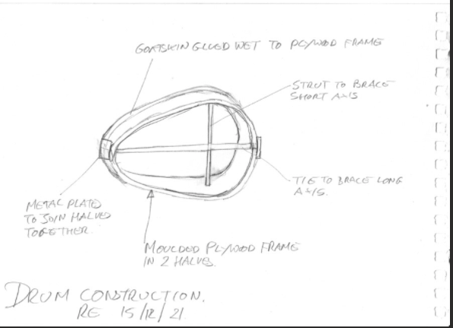
Summary
Method for any mode BUT
Conditional modes
Spiral modes
Forbidden Modes

Slide 20
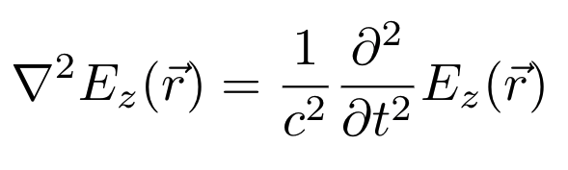
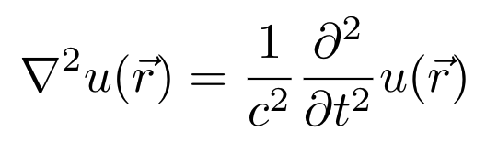
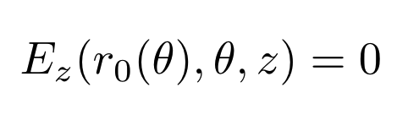
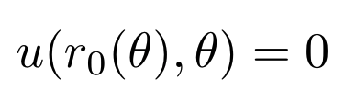
Drums and Particle Accelerators
RF Cavity
Drums
Equation of Motion
Boundary Condition

Slide 21
Applications
Flattest possible field (FFA, Cyclotron)
Extraction cavity (FFA, Cyclotron)
Quadrupole focusing + Acceleration (CLIC, linacs)
Alternative RFQ (Low energy hadron acceleration)
Cancellation of multipoles (Any accelerator)
Crab cavity (Next-gen collider)
Landau damping (Next-gen collider)
Precise fields (FFA, Non-linear optic accelerator)
Accelerating + kicker cavity (Transfer lines)
Pulse compressors (X-band)
Drums (Next-gen music)

Slide 22
CREDITS.
Presentation Template: SlidesMania
Images: Unsplash

