Slide 1
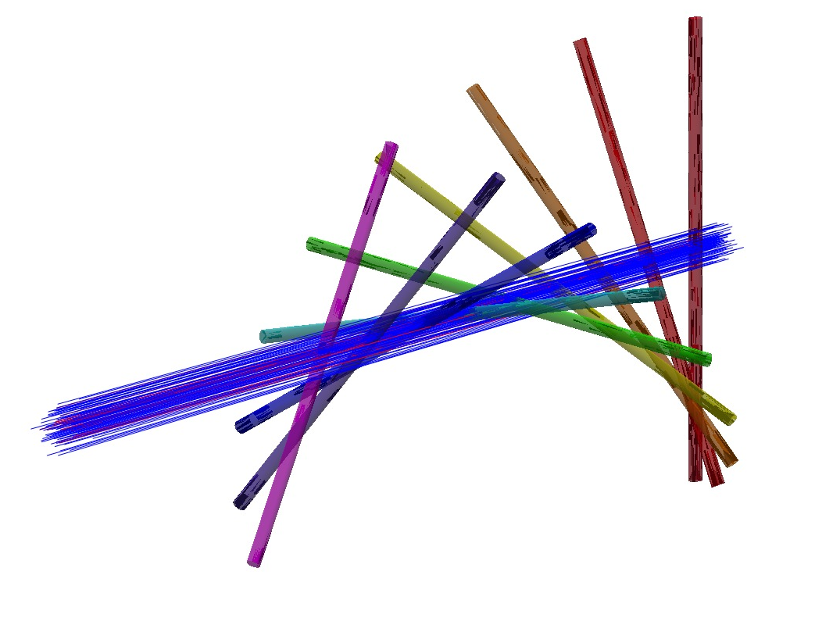



Development of laser-particle process for GEANT4 and validation with ATF2
Siobhan Alden (RHUL)
JAIFest
10/12/2021

Slide 2
Overview
PhD project focuses on the development of laserwire diagnostic methods.
Example installations & processes behind laser interaction.
The types of measurements made and interaction rate prediction.
Making a laser in GEANT4 and BDSIM.
Probability of interaction for single particles.
Multi-step vs cumulative probability approaches.
Validating the model on ATF2 by building ATF2 laserwire scan in BDSIM.
Results of the laserwire vertical scan in BDSIM vs prediction.
Applications for the model / potential developments.
Summary.

Slide 3
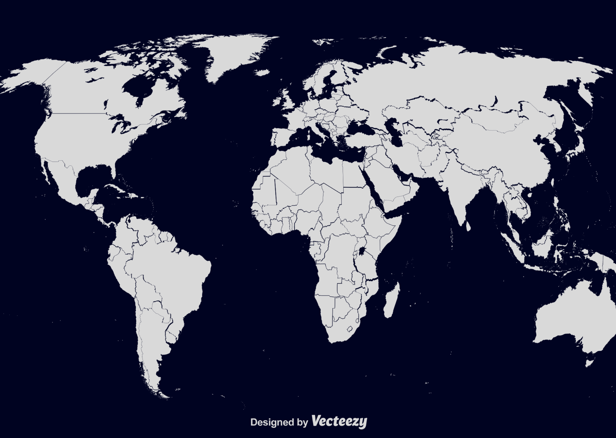
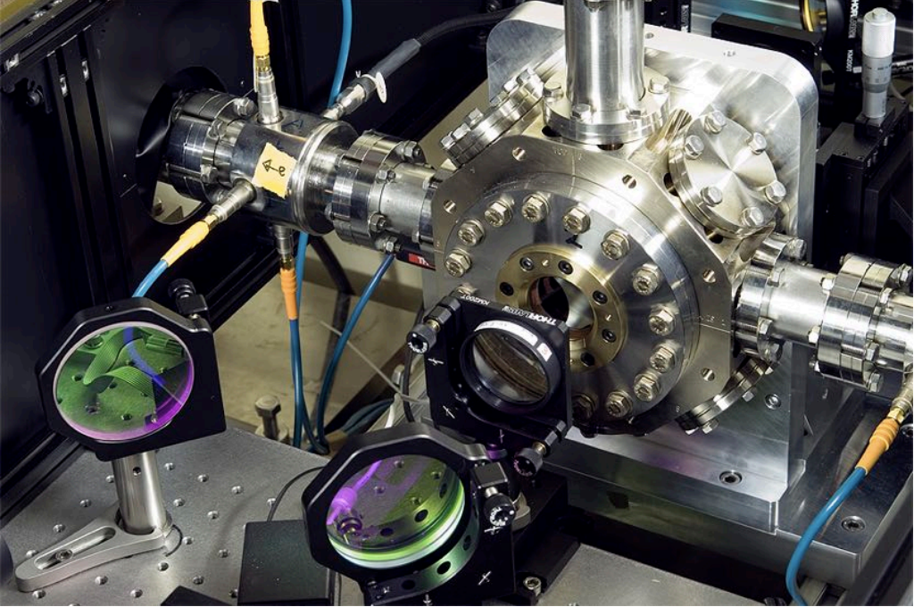

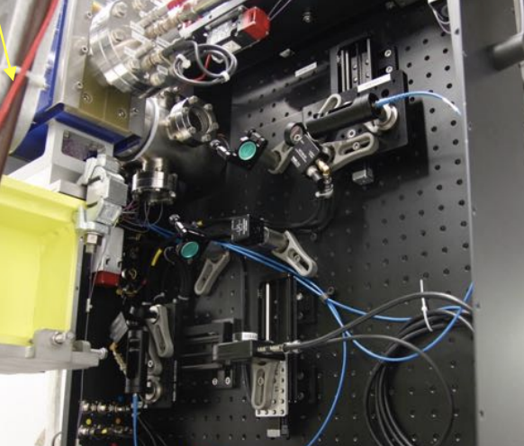
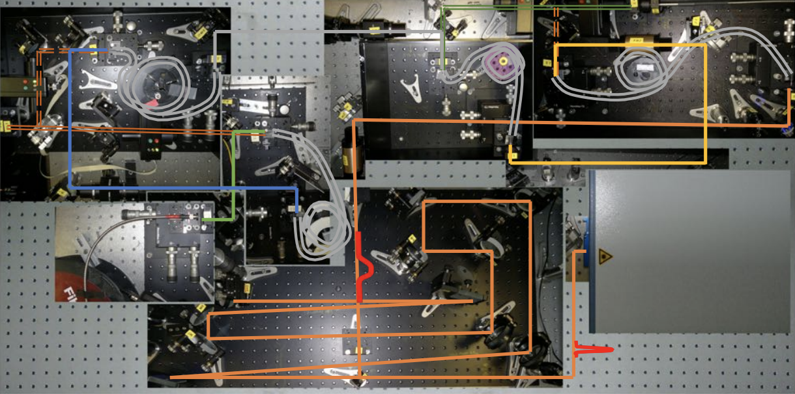
Laserwire Diagnostics
Installed on electron/positron machines or H⁻ beamlines.
Analogous to wire scanner.
Minimally invasive method – no physical components in the beamline.
ATF2 @KEK – Japan (e⁻)
PETRA III @DESY – Germany (e⁻)
LINAC4 @CERN – Switzerland (H⁻)
FETS @RAL – UK (H⁻)
BNL @ Brookhaven – USA (H⁻)
SNS @ Oakridge – USA (H⁻)
ITS @ los Alamos – USA (H⁻)
ATF2
LINAC4
PETRA3

Slide 4
Particle-Photon Processes
Inverse Compton Scattering
Photodetachment
Hydrogen ions have a weakly bound secondary electron.
Laser photon provided enough energy to photo-eject the electron from the system.
e⁻ or H⁰ can be detected.
Photon scatters off charge particle.
Photon gains energy.
Lorentz boosted along the charge beam trajectory.
Scattered photon is detectable.

Slide 5
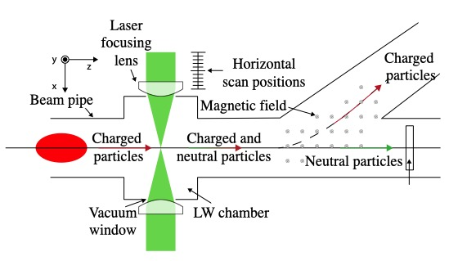
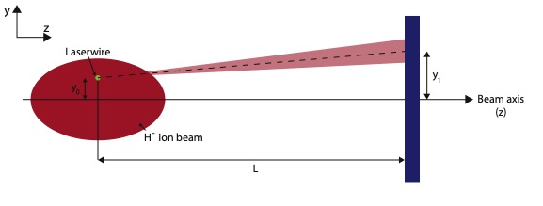
Measurements
A beam profile is measured by recording the signal from multiple transverse offsets for the laserwire.
detector
For H⁻ beams the emittance can also be measured by comparing the vertical displacement of the signal relative to the laser offset.
Typically aligned orthogonal to beam.
Small % of neutrals generated.
Minimally invasive.
The neutrals travel in along the beam axis and are separated from the main beam via dipole.

Slide 6
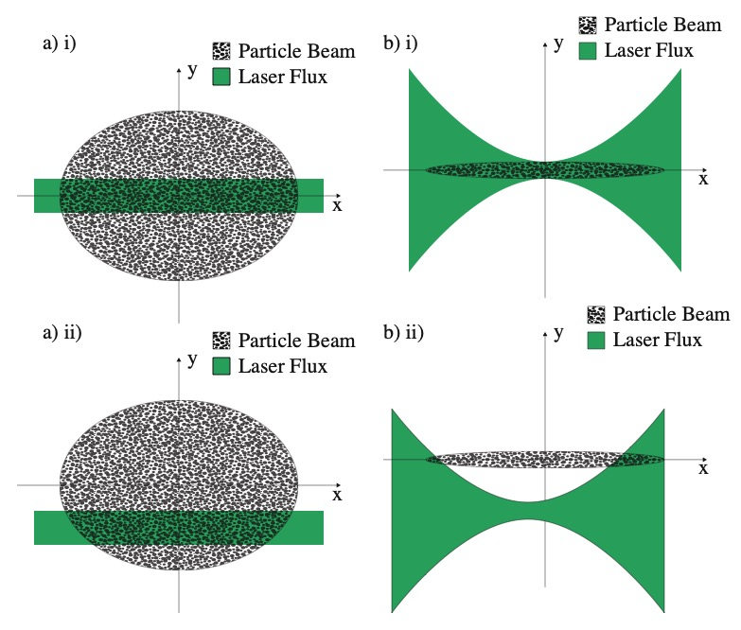
Interaction Rate
Where :
N_{p} = number of particles in the beam.
P_{l} = laser power.
λ = laser wavelength.
σ _{cs} = cross section of interaction.
h = planks constant.
c = the speed of light.
σ_{x} = the horizonal beam size.
σ_{y} = the vertical beam size.
σ_{l} = the laser beam size.
∆x and ∆y = horizontal and vertical offset of the laser relative to the beam respectively.
Notes:
N(\Delta x \Delta y) = \frac{N_p P_l \lambda \sigma_{cs} }{h c^2} \frac{1}{2 \pi \sigma_x} \int_{-\infty}^{\infty} \frac{1}{\sqrt{(\sigma_y^2 + \sigma_l(x-\Delta x)^2)}} exp \Bigg( \frac{-x^2}{2\sigma_x^2} - \frac{\Delta y^2}{\sqrt{(\sigma_y^2+\sigma_l(x-\Delta x)^2)}^2} \Bigg) dx

Slide 7
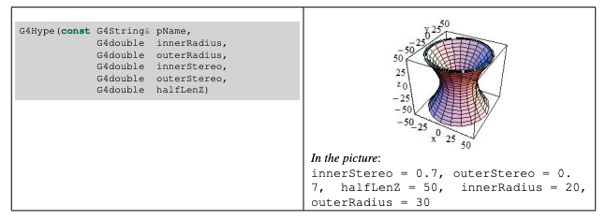
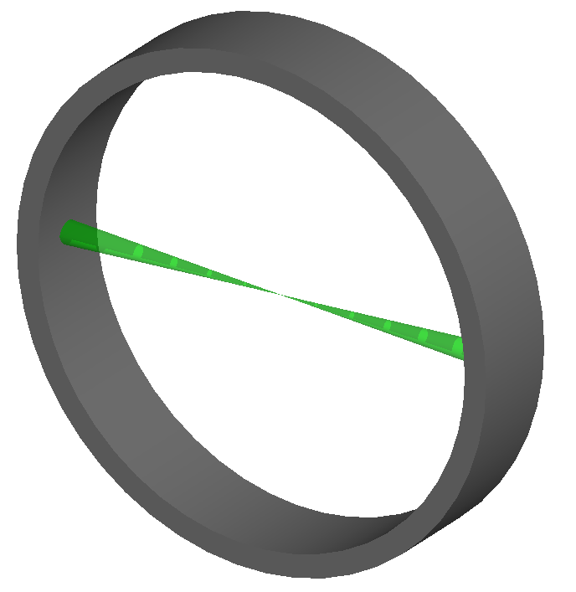
Lasers for GEANT4
Tool kit for simulating particles through matter.
Builds accelerator models to simulate tracking of particles and uses GEANT4 for particle – matter interactions.
Added a laser using a hyperboloid volume – (G4 solid).
Defined Gaussian optics.
To place in BDSIM a drift tube is around to laser to add into accelerator model.

Slide 8
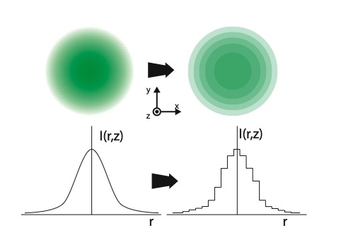
Probability of Interaction
For a single particle:
F_{l} = photon flux.
t = time spent in laser
The photon flux is non uniform so the probability is modified:
F_{ln} flux of step
t_{n} time for step.
Notes:
P=1-e^{-\sigma_{cs} F_l t}

Slide 9
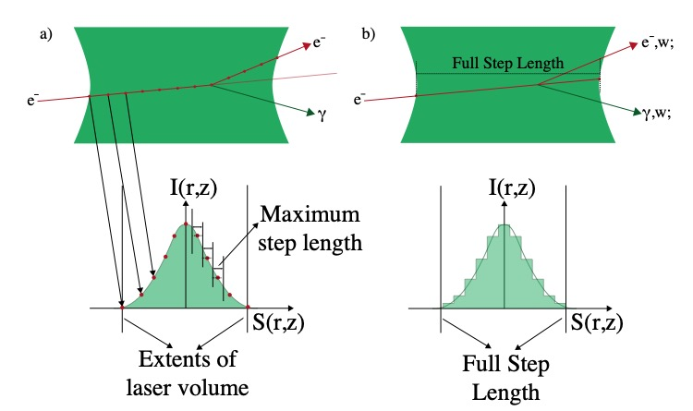
Multi-Step Approach
Particle enters laser volume.
A small step is taken (σ_{l}/100).
At each step a density is calculated for the new coordinate.
The time of the step is also calculated.
A probability of interaction based upon the step is calculated.
The probability is used in a Monte Carlo rejection algorithm to trigger interaction kinematics.

Slide 10
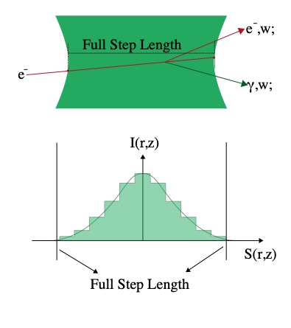
Cumulative Approach
Particle enters laser volume.
The step to the exiting boundary is taken.
This trajectory is used to construct a histogram of the photon flux.
The integrated photon flux and time for the step are used to calculate a cumulative probability of interaction.
This cumulative probability is applied as a weight to secondary particles.
A secondary is generated for every particle that enters the laser.

Slide 11
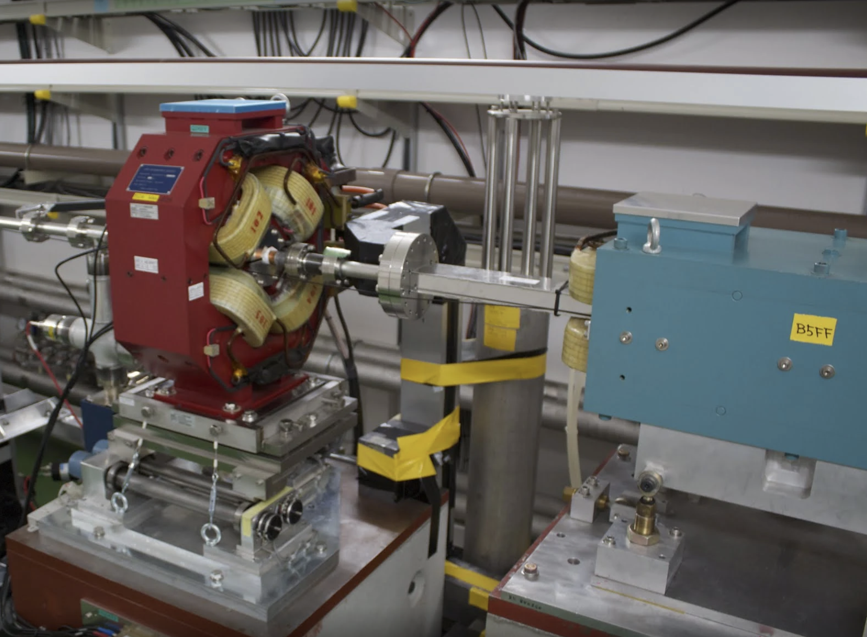
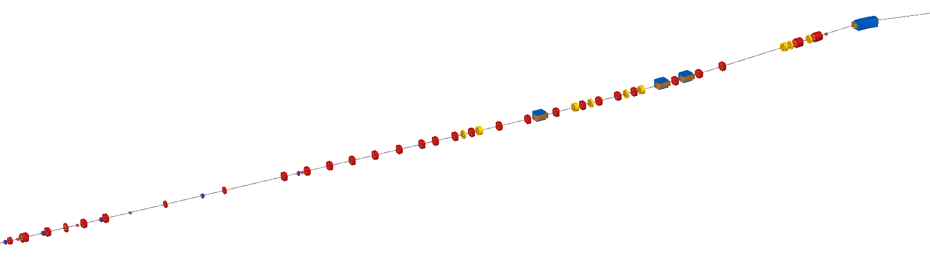
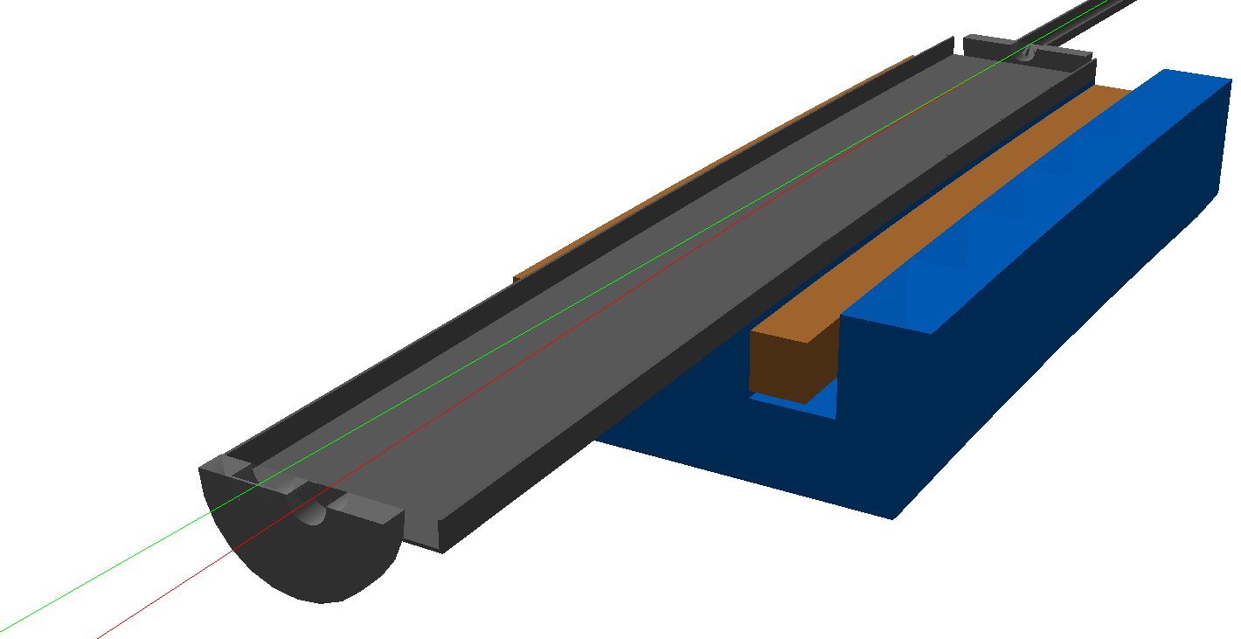
Validating on ATF2
Model of ATF2 laser model made in BDSIM with matching optics
Custom geometry created for the detector flange.
Laser location matched to experiment with non-linear vertical scan.
Detector Location
Laserwire Location

Slide 12
Vertical Scan Simulation
A total of 53 vertical laser offsets were used.
Variation from random probability seen.
Multi-step – good agreement except at extreme offsets.
Statistically limited at 6σ_{x} of beam.
Cumulative model sees stronger agreement at all laser offsets.
Allows for comparison between total γ produced and those that are detectable.

Slide 13
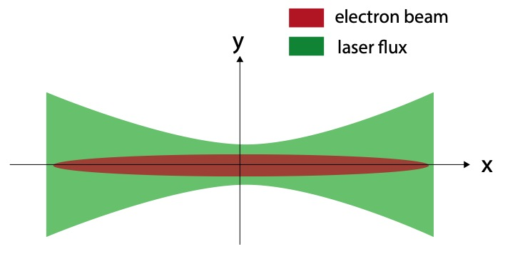
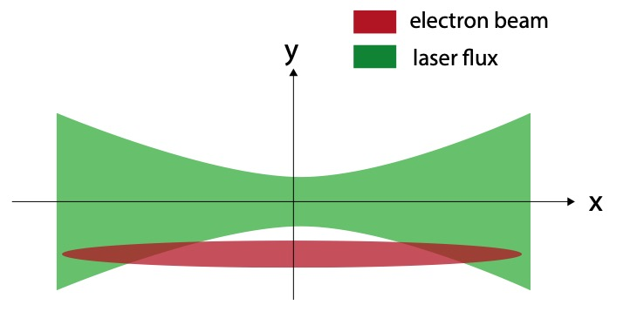
Transverse distribution γ
Model shows transverse distribution of γ for different laser offsets – important to carefully design beamline to avoid any clipping

Slide 14
Detector Distributions
Drift ~13.5m to detector
At the detector lobes indistinguishable.
Plotting the lobes separately shows reveals distinct contributions from each.

Slide 15
Future Developments
Model currently being used for FETS laserwire.
Reconstructed Emittance
True Emittance
Potential for application on LHC-HL.
FCC electron or proton.

Slide 16
Summary
Overview of laserwires methodology.
The types of processes and interaction rate.
How lasers were added to GEANT4.
Modelling single particle – laser probabilistic interactions.
Building ATF2 laserwire experiment in BDSIM.
Validating the BDSIM model against the interaction rate.
Value in simulating before building a beamline!
Potential uses for the model.

Slide 17
Thank you for listening.
Any Questions?

