Slide 1
Applications of Bayesian Inference in Radiation Reaction Experiments
E. E. Los, S.P.D Mangles

Slide 2
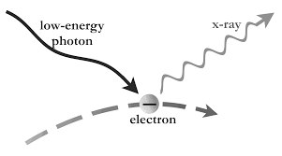
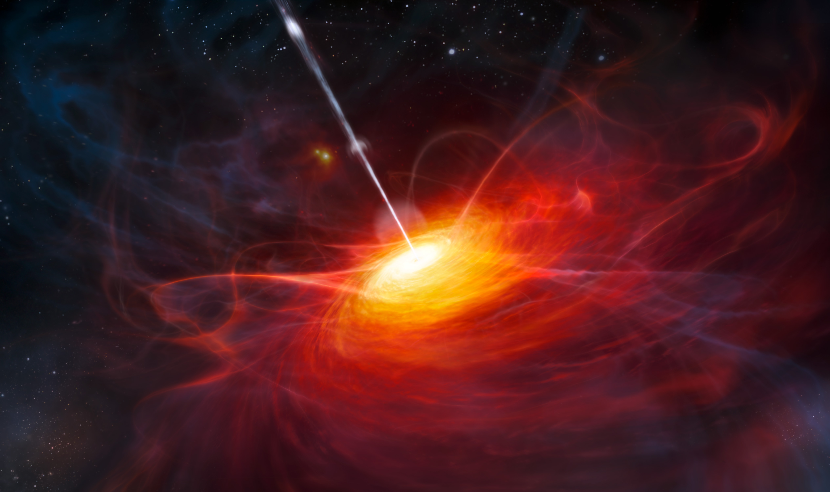
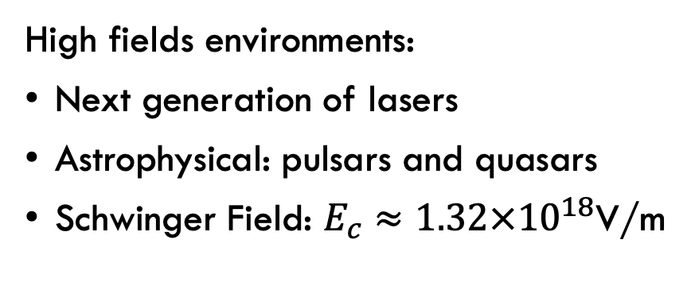
Radiation Reaction
Apatruno.files.wordpress.com, 2019
High fields environments:
Next generation of lasers
Astrophysical: pulsars and quasars
Schwinger Field: $E_{c}≈1.32×{10}^{18}$V/m
By ESO/M. Kornmesser - http://www.eso.org/public/images/eso1122a/, CC BY 4.0, https://commons.wikimedia.org/w/index.php?curid=15700804
R. Ruffini et al 2010, Phys. Rep. 487, 1
J. Sultana et al 2013, Astrophys. J. 779, 16.
I. C. E. Turcu et al. 2016, Romanian reports in Physics 68, S145

Slide 3
Experimental Set-up
F40 focusing optic
F2 focusing optic
Lanex
CsI array
Drive laser
Gas jet
Scattering laser
Electron beam
Gamma-ray beam
Gamma profile
Magnet

Slide 4
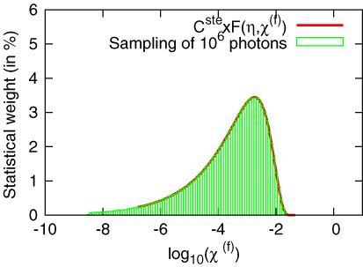
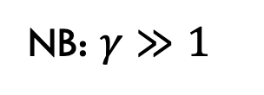
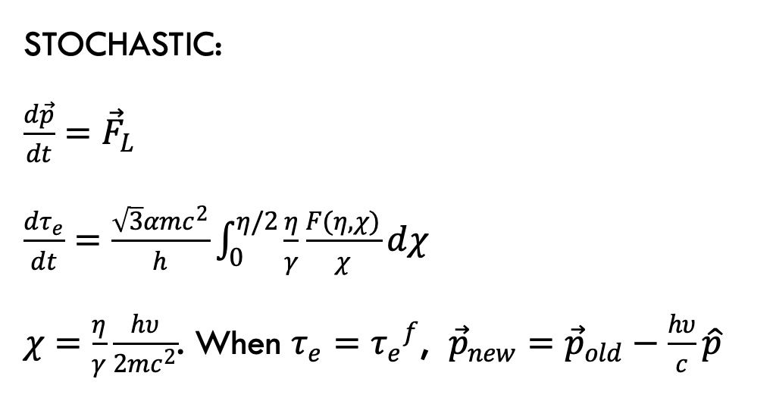
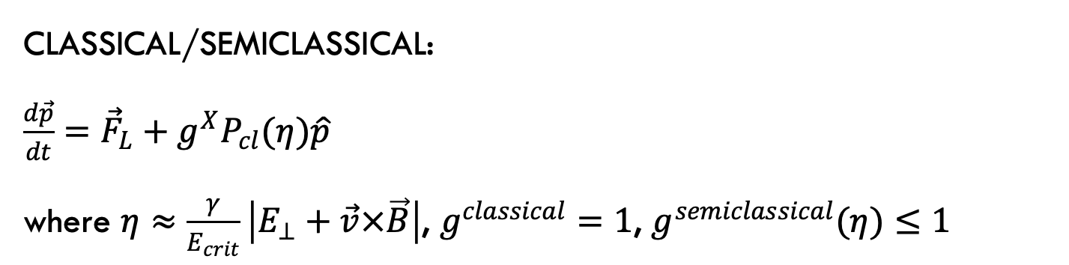
Radiation Reaction Models: Single Particle
CLASSICAL/SEMICLASSICAL:
$\frac{d\vec{p}}{dt}={\vec{F}}_{L}+g^{X}P_{cl}(η)\hat{p}$
where $η≈\frac{γ}{E_{crit}}\left|E_{⊥}+\vec{v}×\vec{B}\right|$, $g^{classical}=1$, $g^{semiclassical}(η)≤1$
NB: $γ≫1$
STOCHASTIC:
$\frac{d\vec{p}}{dt}={\vec{F}}_{L}$
$\frac{dτ_{e}}{dt}=\frac{\sqrt{3}αmc^{2}}{h}\int_{0}^{η/2}{\frac{η}{γ}\frac{F(η, χ)}{χ}dχ}$
$χ=\frac{η}{γ}\frac{hυ}{2mc^{2}}$. When $τ_{e}={τ_{e}}^{f}$, ${\vec{p}}_{new}={\vec{p}}_{old}−\frac{hυ}{c}\hat{p}$
What about a distribution?
J G Kirk et al 2009 Plasma Phys. Control. Fusion 51 085008
R Duclous et al 2011 Plasma Phys. Control. Fusion53
R Duclous et al 2011 Plasma Phys. Control. Fusion53

Slide 5
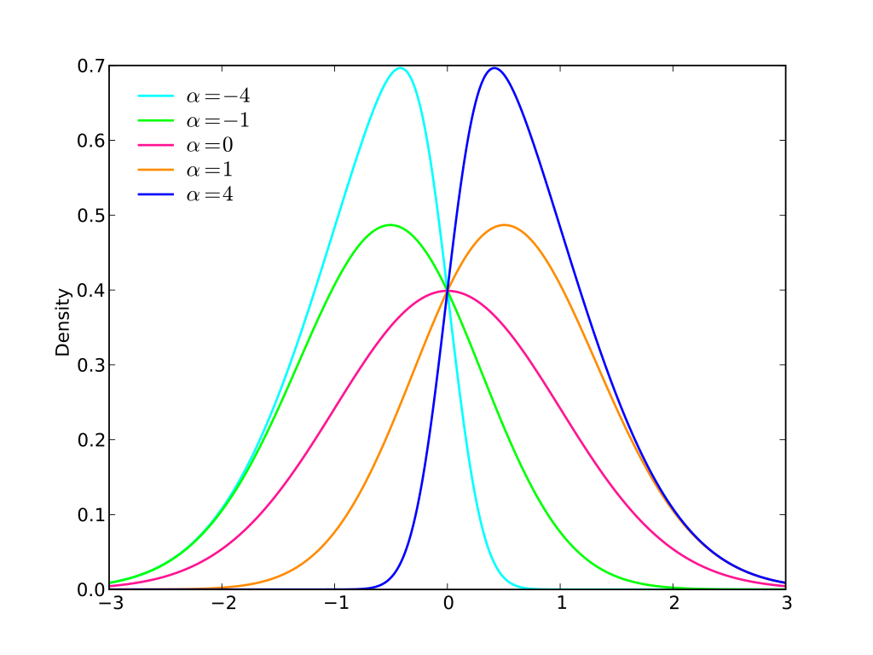
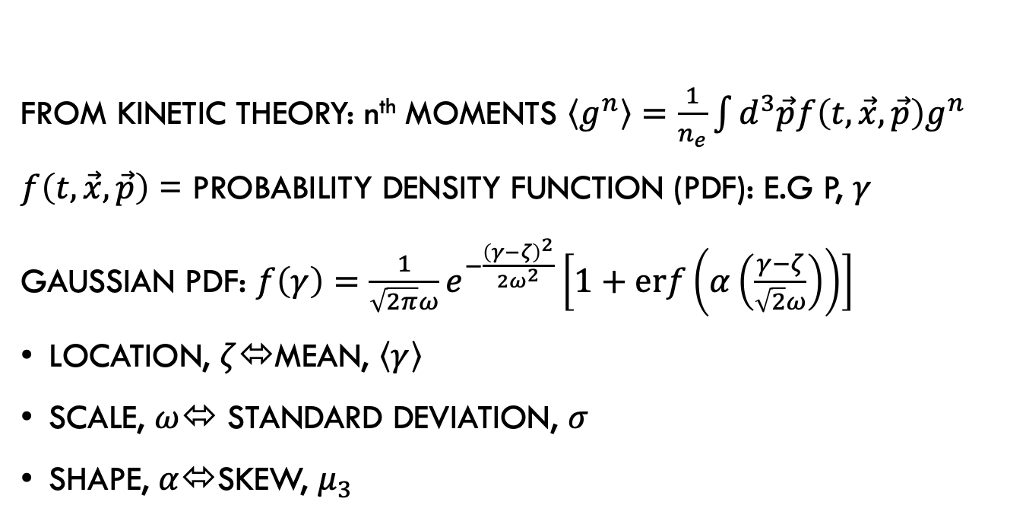
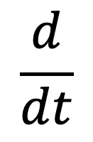
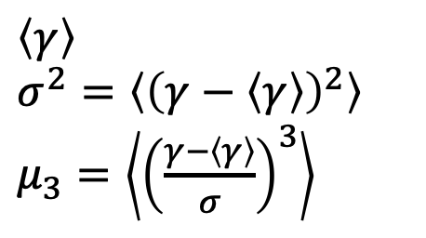
Radiation Reaction Models: Charge Distribution
From kinetic theory: n^{th} moments $\left\langle g^{n}\right\rangle =\frac{1}{n_{e}}\int{d^{3}\vec{p}f\left(t,\vec{x}, \vec{p}\right)g^{n}}$
$f\left(t,\vec{x}, \vec{p}\right)$ = probability density function (PDF): e.g p, $γ$
Gaussian PDF: $f\left(γ\right)=\frac{1}{\sqrt{2π}ω}e^{−\frac{{\left(γ−ζ\right)}^{2}}{2ω^{2}}}\left[1+erf\left(α\left(\frac{γ−ζ}{\sqrt{2}ω}\right)\right)\right]$
location, $ζ$⬄mean, $\left\langle γ\right\rangle$
scale, $ω$⬄ standard deviation, $σ$
shape, $α$⬄skew, $μ_{3}$
$\left\langle γ\right\rangle$
$σ^{2}=\left\langle {\left(γ−\left\langle γ\right\rangle \right)}^{2}\right\rangle$
$μ_{3}=\left\langle {\left(\frac{γ−\left\langle γ\right\rangle }{σ}\right)}^{3}\right\rangle$
$$\frac{d}{dt}$$
By Skbkekas - Own work, CC BY-SA 3.0, https://commons.wikimedia.org/w/index.php?curid=6066637

Slide 6
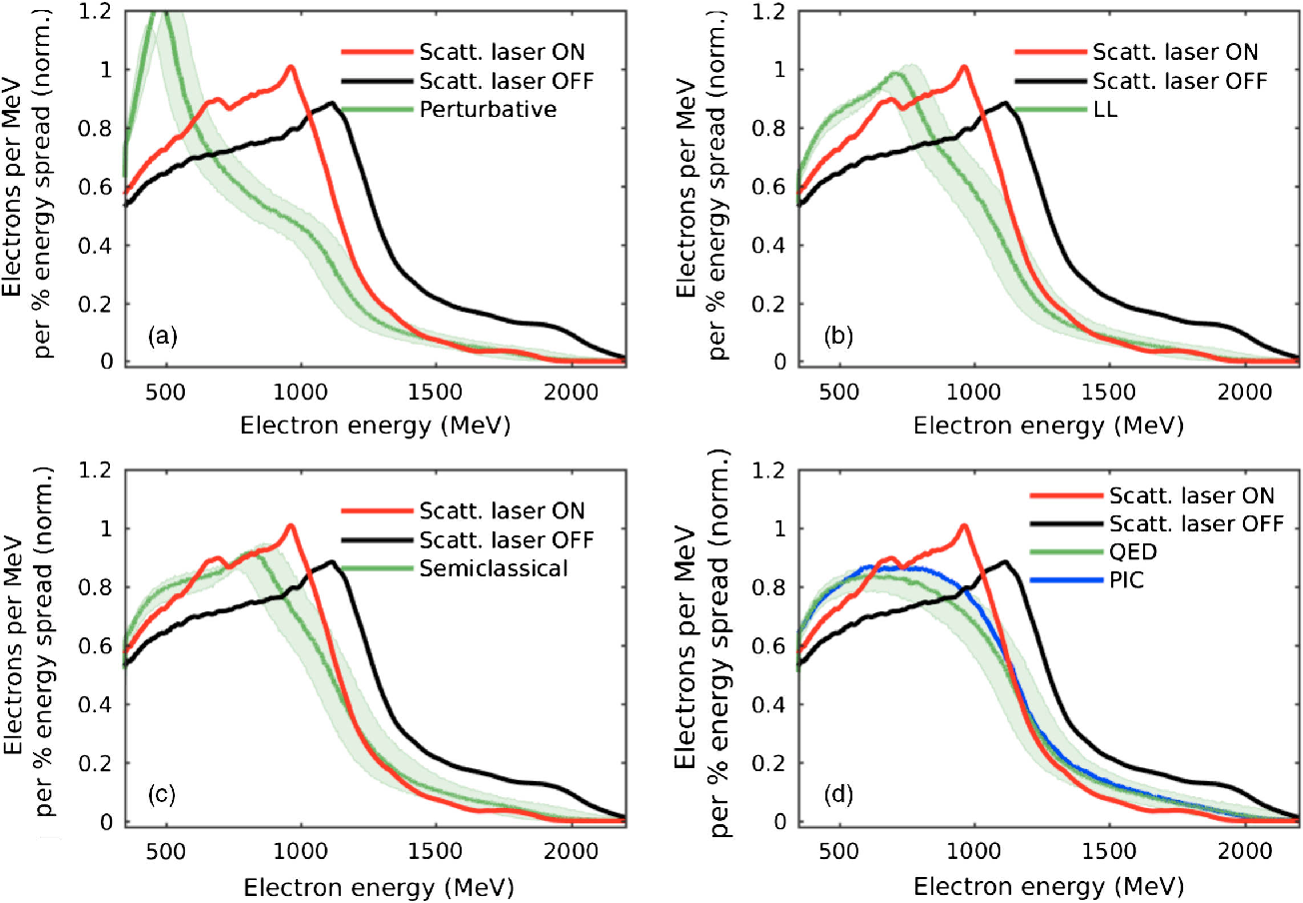
Experimental Observation of Radiation Reaction
Missing/inaccurate collision parameters, e.g. chirp?
How (much) does knowledge of collision parameters affect ability to determine which radiation reaction model best explains data?
(K. Poder et al., 2018)

Slide 7
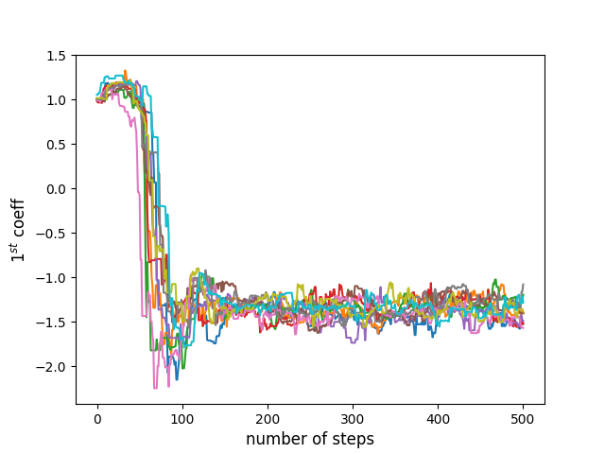
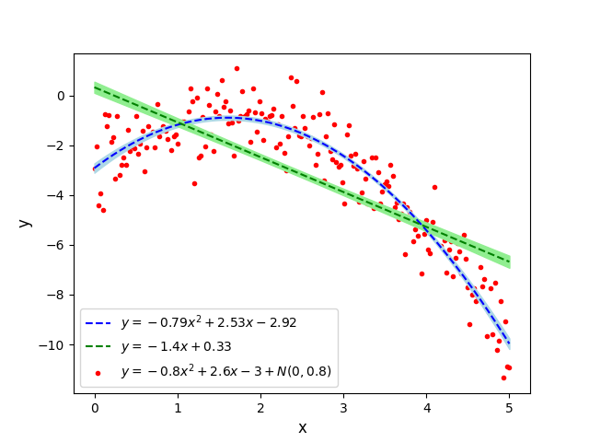
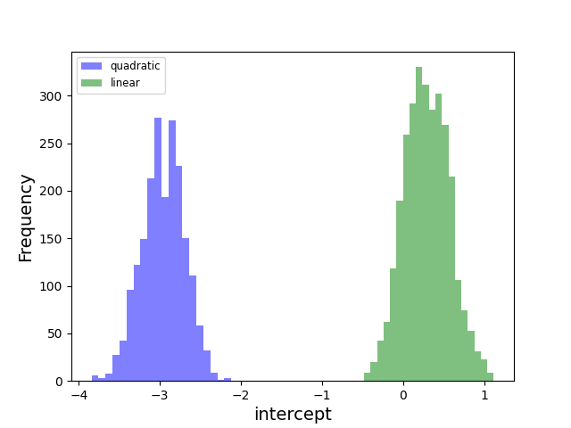
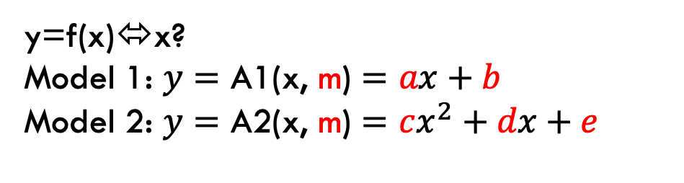
Bayesian Inference
M=model,
D=data
y=f(x)⬄x?
Model 1: $y=\text{A}\text{1}\text{(}\text{x}\text{, }\text{m}\text{)}=ax+b$
Model 2: $y=\text{A}\text{2}\text{(}\text{x}\text{, }\text{m}\text{)}=cx^{2}+dx+e$

Slide 8

Bayesian Information Criterion
Compare A1, A2 using Bayesian information criterion (BIC)
BIC=ln(n)k-2ln(likelihood)
n=no. data points, k=no. fitted parameters
Model with BIC closest to $−∞$ wins
BIC model2-BIC model1 | Interpretation
0-2 | Neither model favoured
2-6 | M₁ favoured
6-10 | M₁ strongly favoured
BIC quadratic=337.52, BIC linear = 493.76
BIC linear - BIC quadratic = 156.24
Need model of collision…

Slide 9
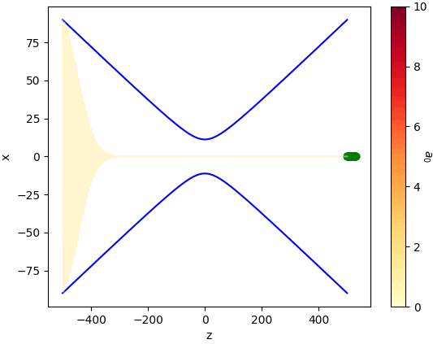
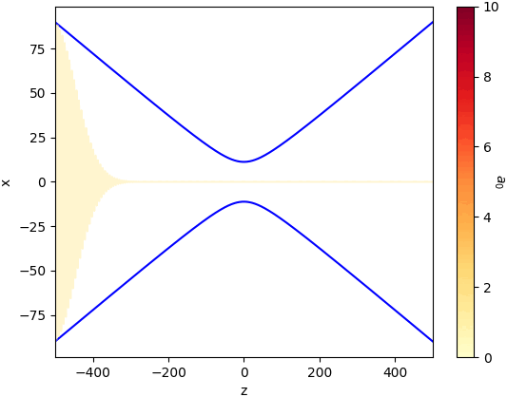
Effect of electron spatial distributions on collision

Slide 10
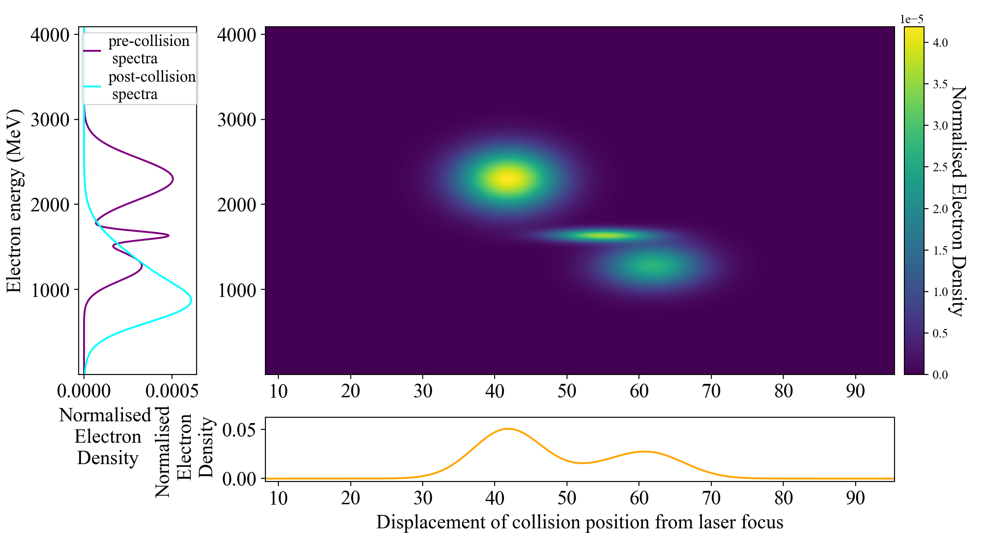
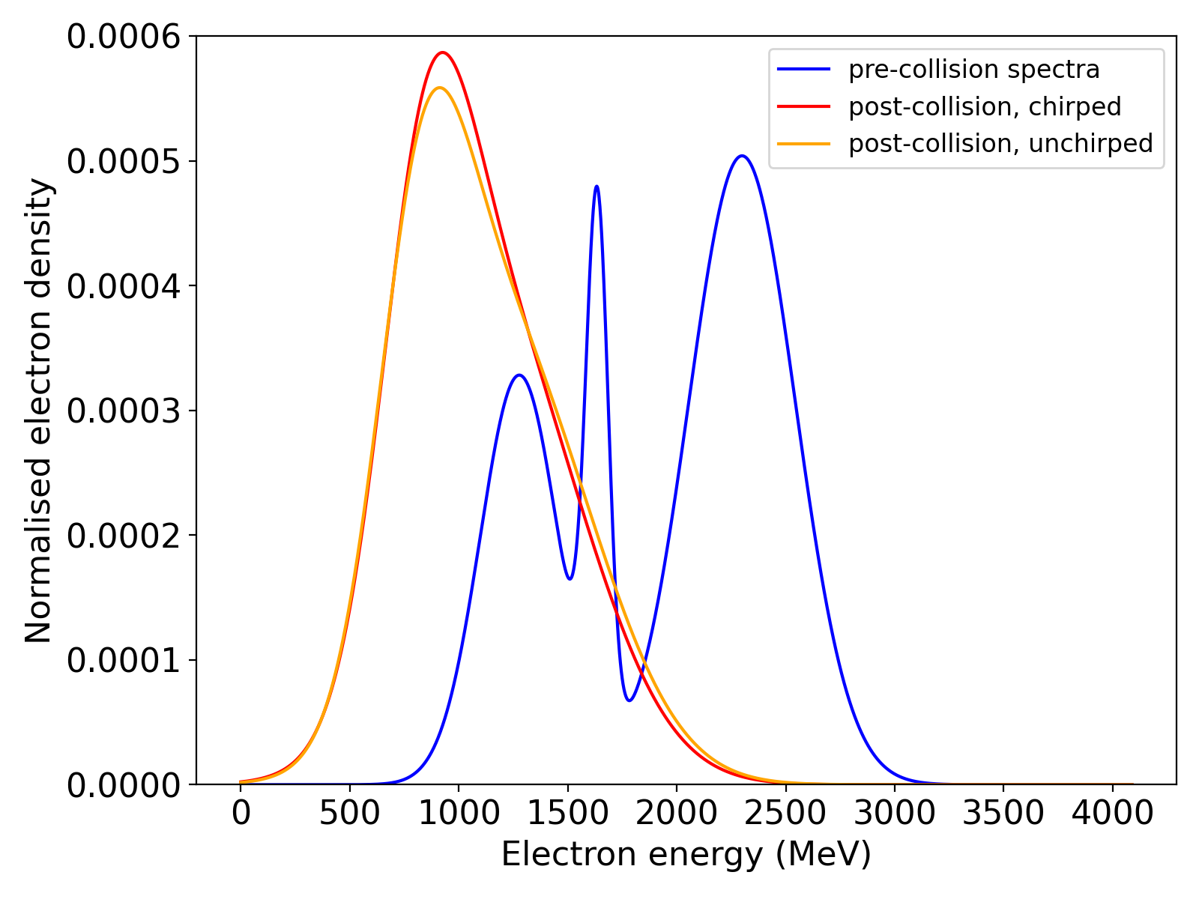
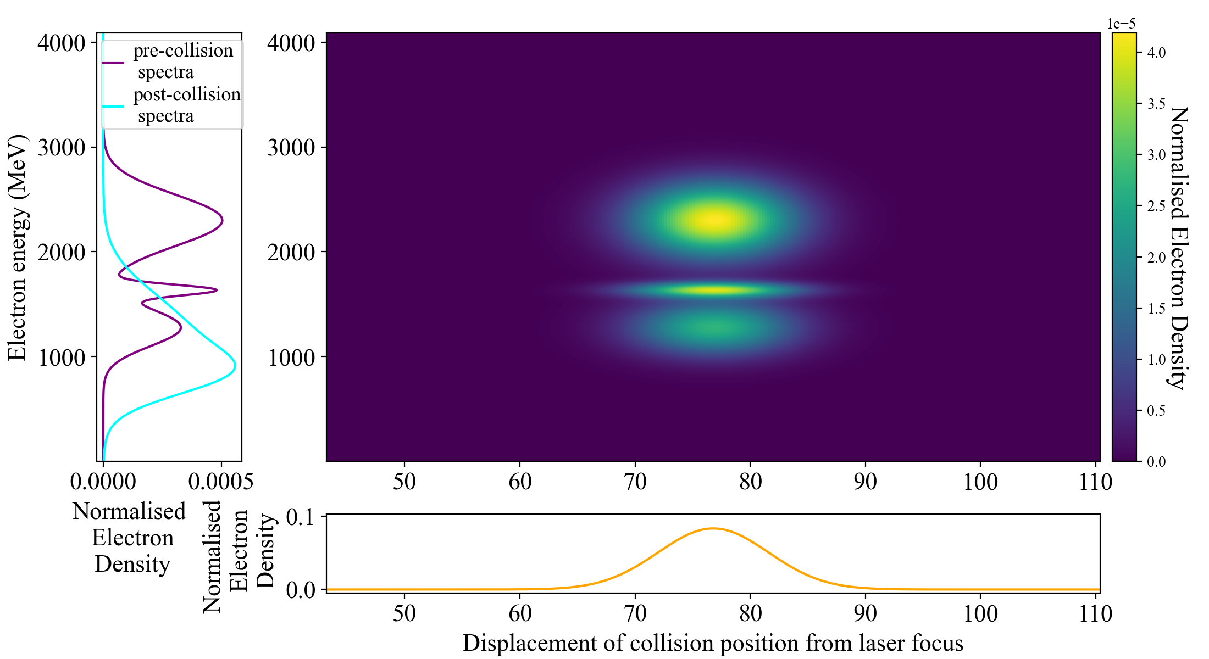
Chirped Electrons affect post-collision spectrum
Comparison of post-collision spectra for chirped and un-chirped electron beams.

Slide 11
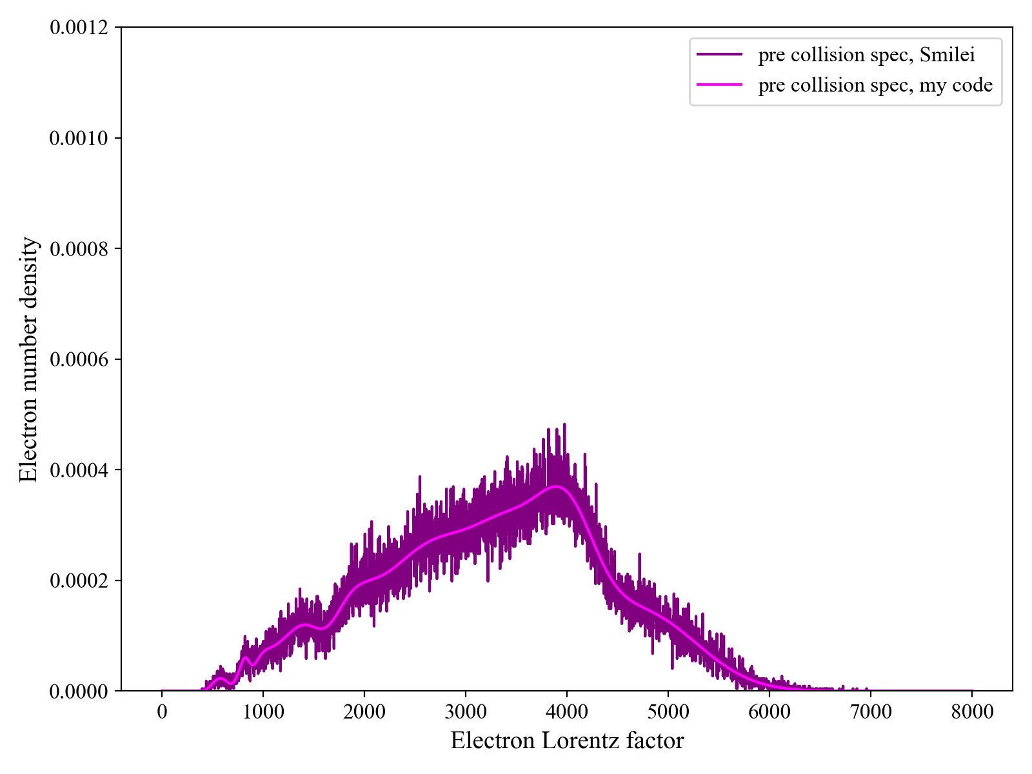
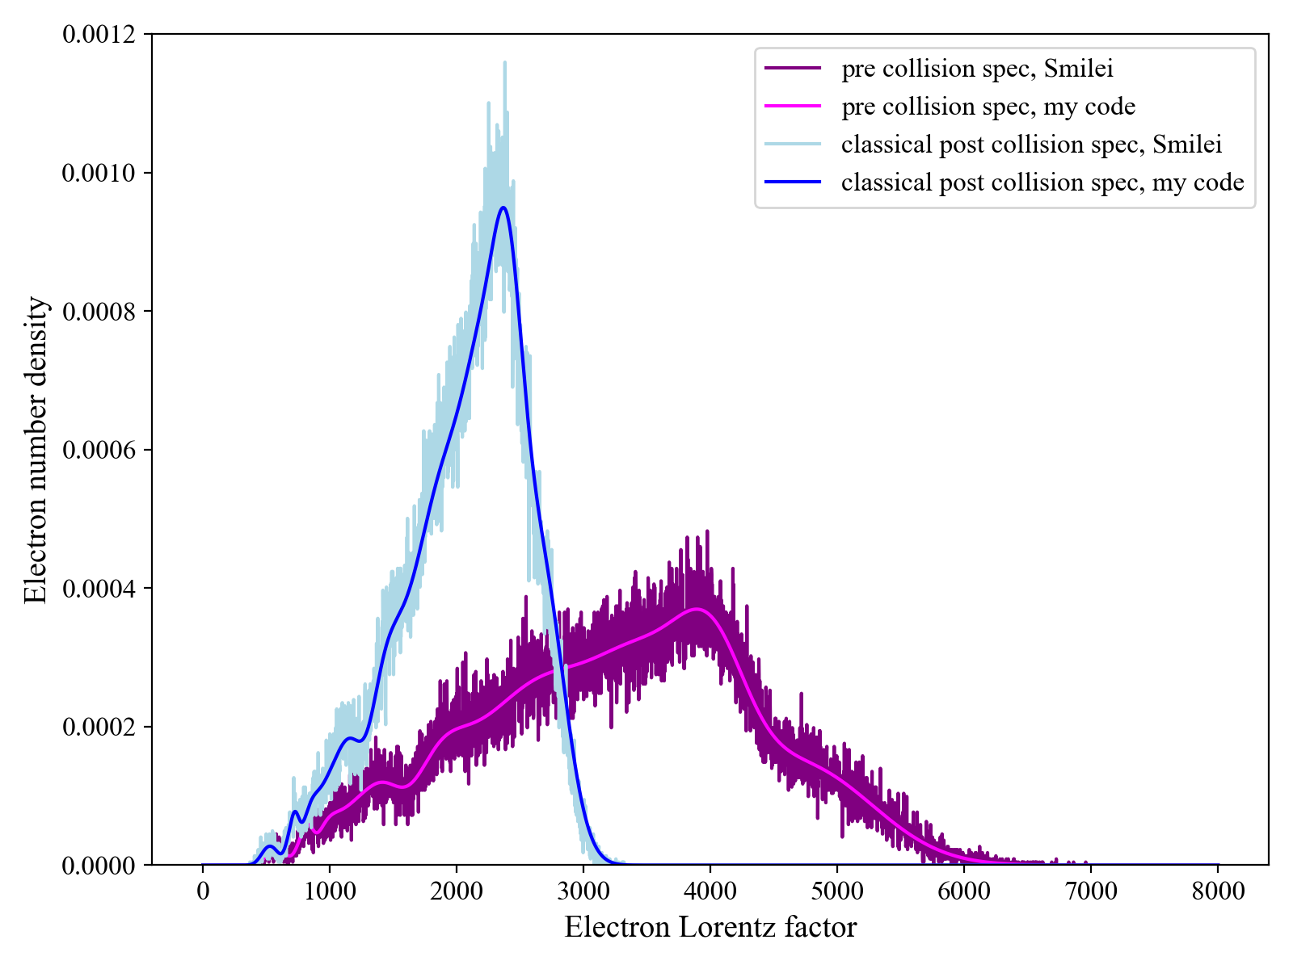
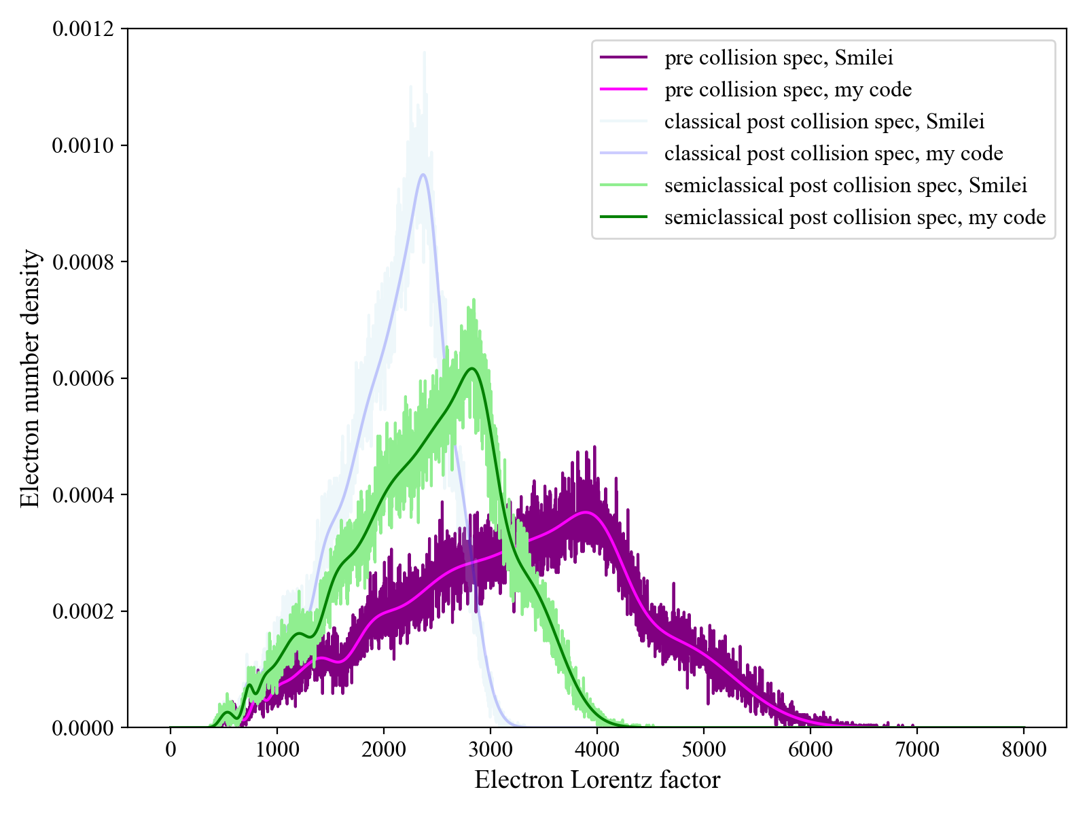
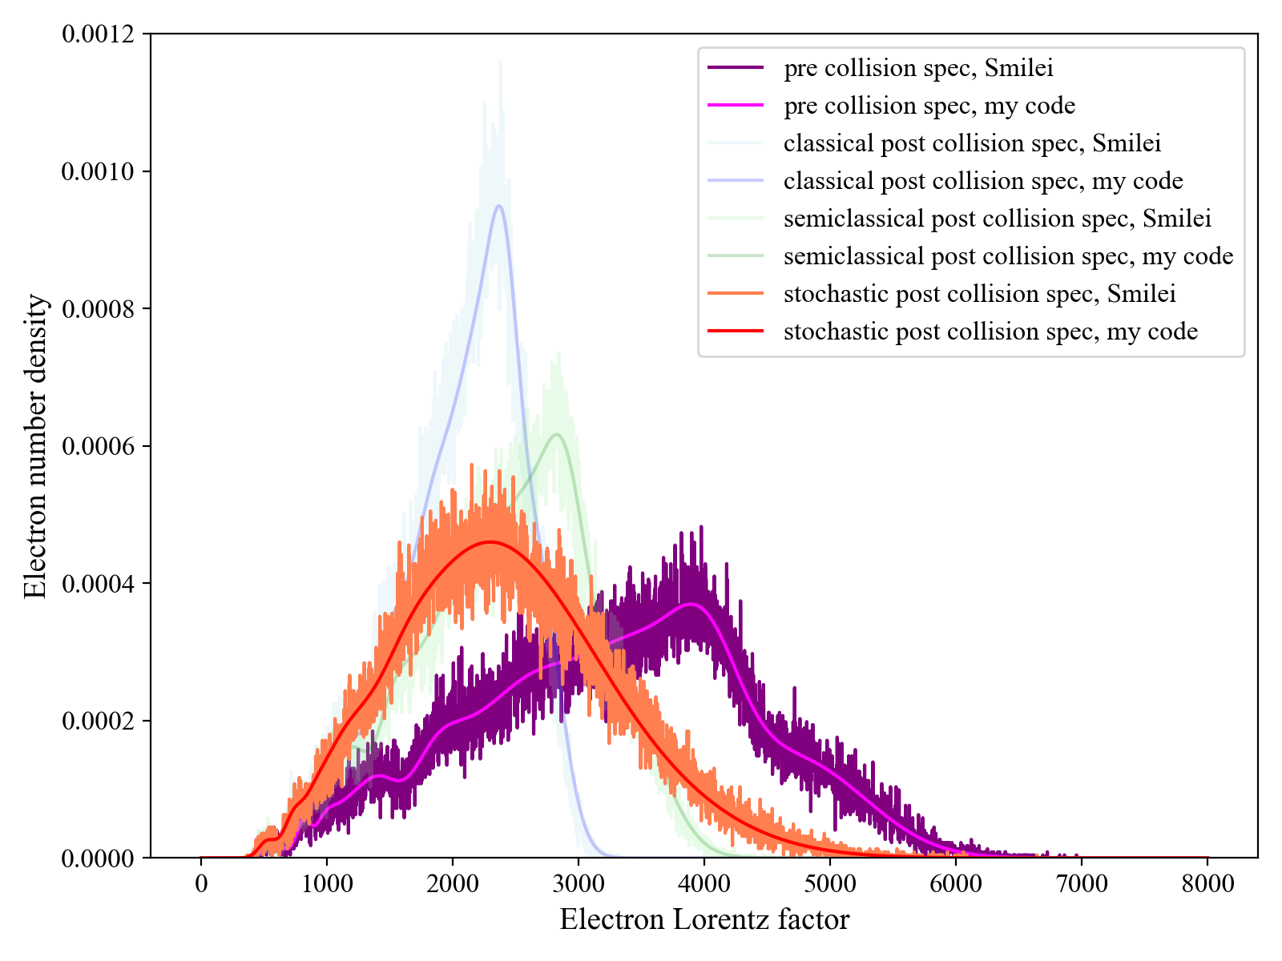
Benchmarks: my code vs Smilei

Slide 12
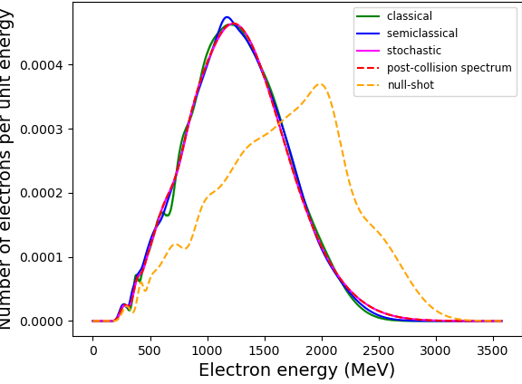
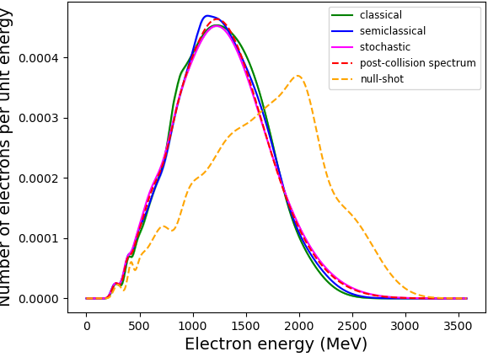
Results: retrieval of POST-COLLISION spectrum using linear model
Chirp
No chirp

Slide 13
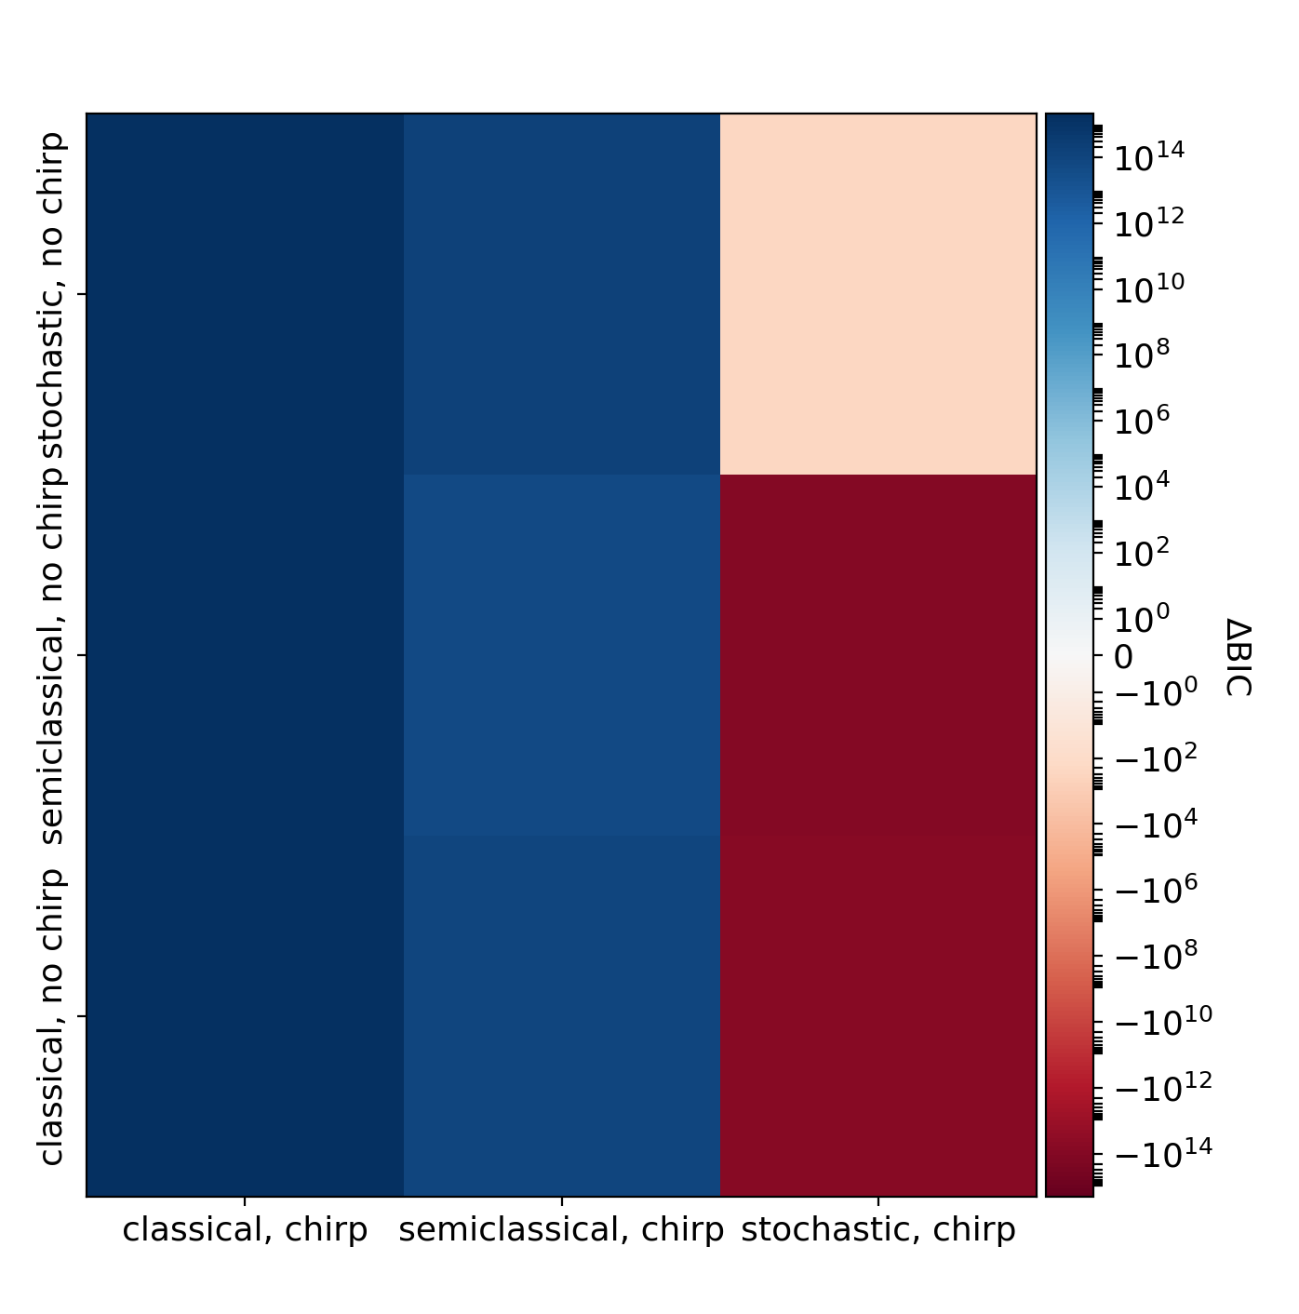
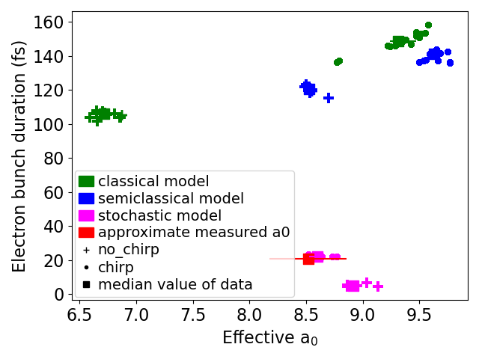
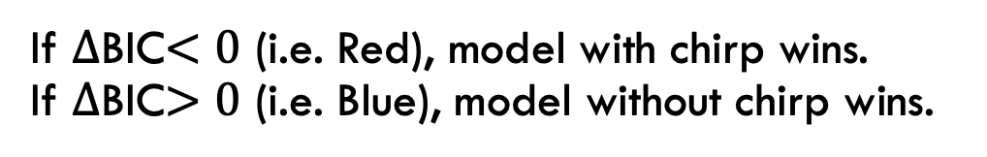
Results: retrieval of POST-COLLISION spectrum using linear model
Stochastic model with chirp is the only model which falls within 1 std of true parameters
If $∆$BIC$<0$ (i.e. Red), model with chirp wins.
If $∆$BIC$>0$ (i.e. Blue), model without chirp wins.

Slide 14
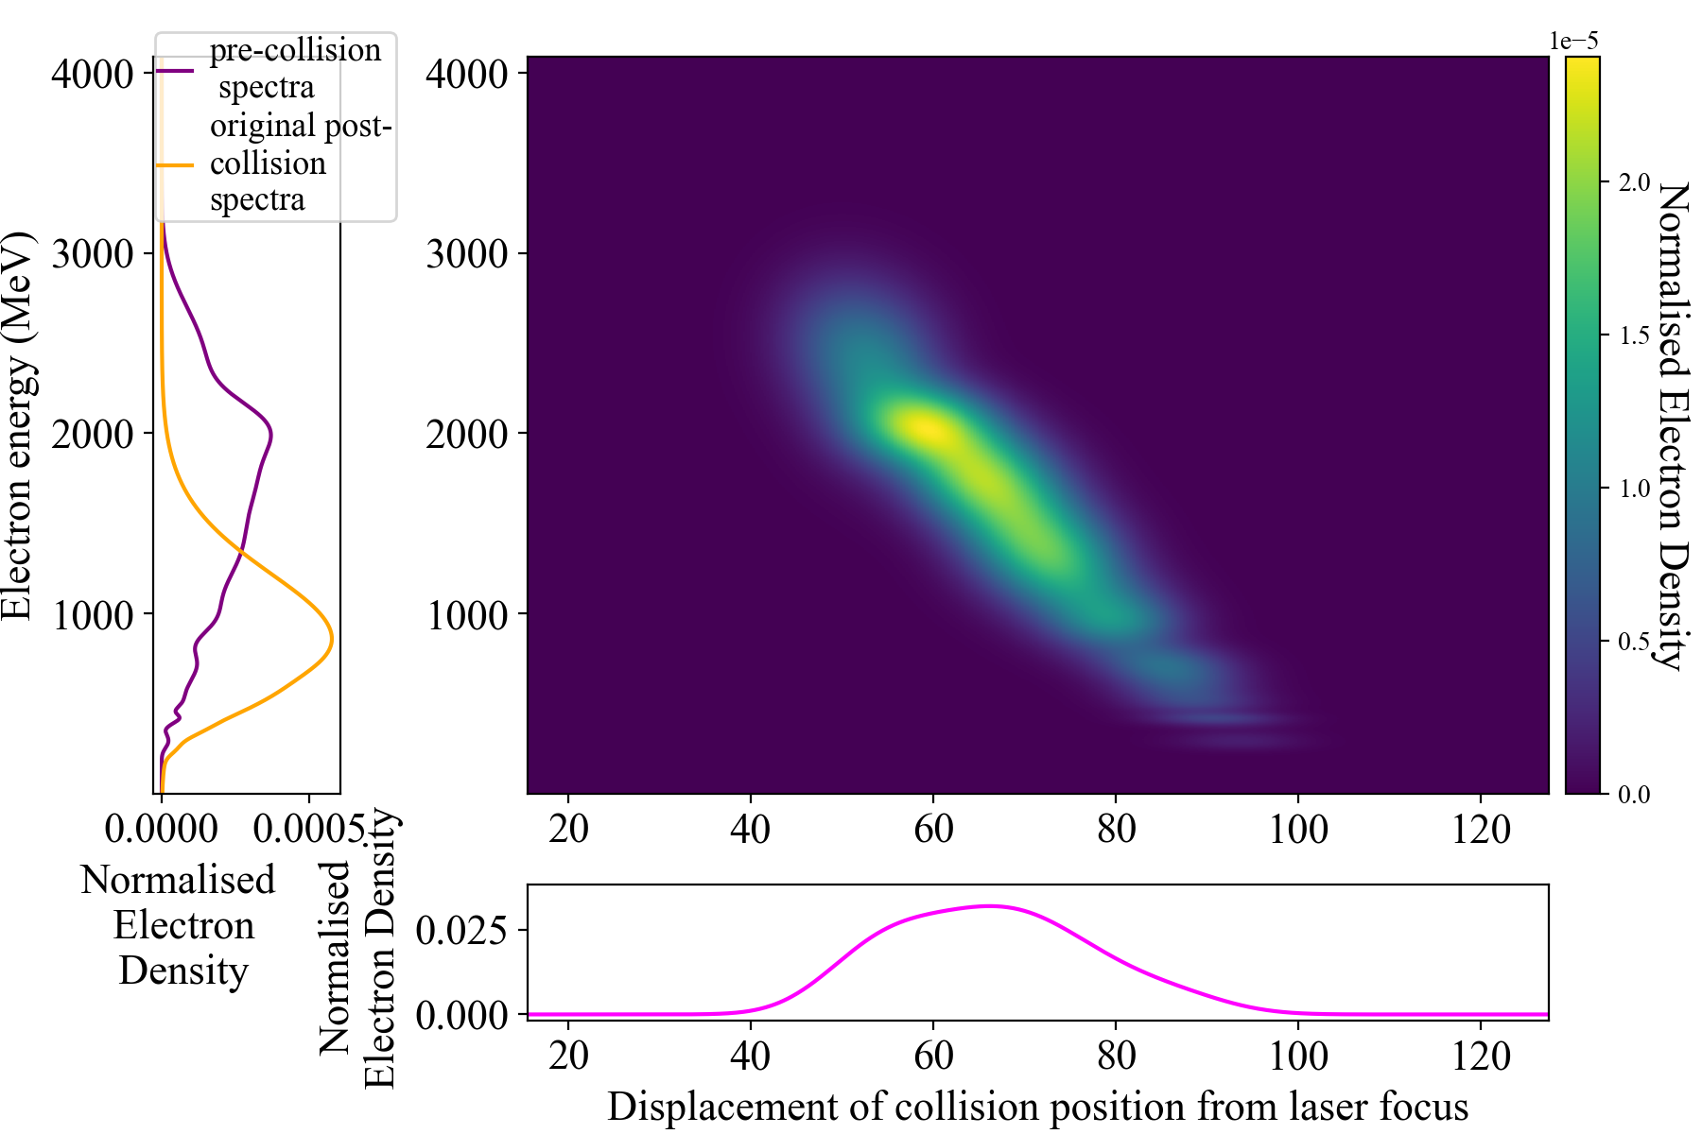
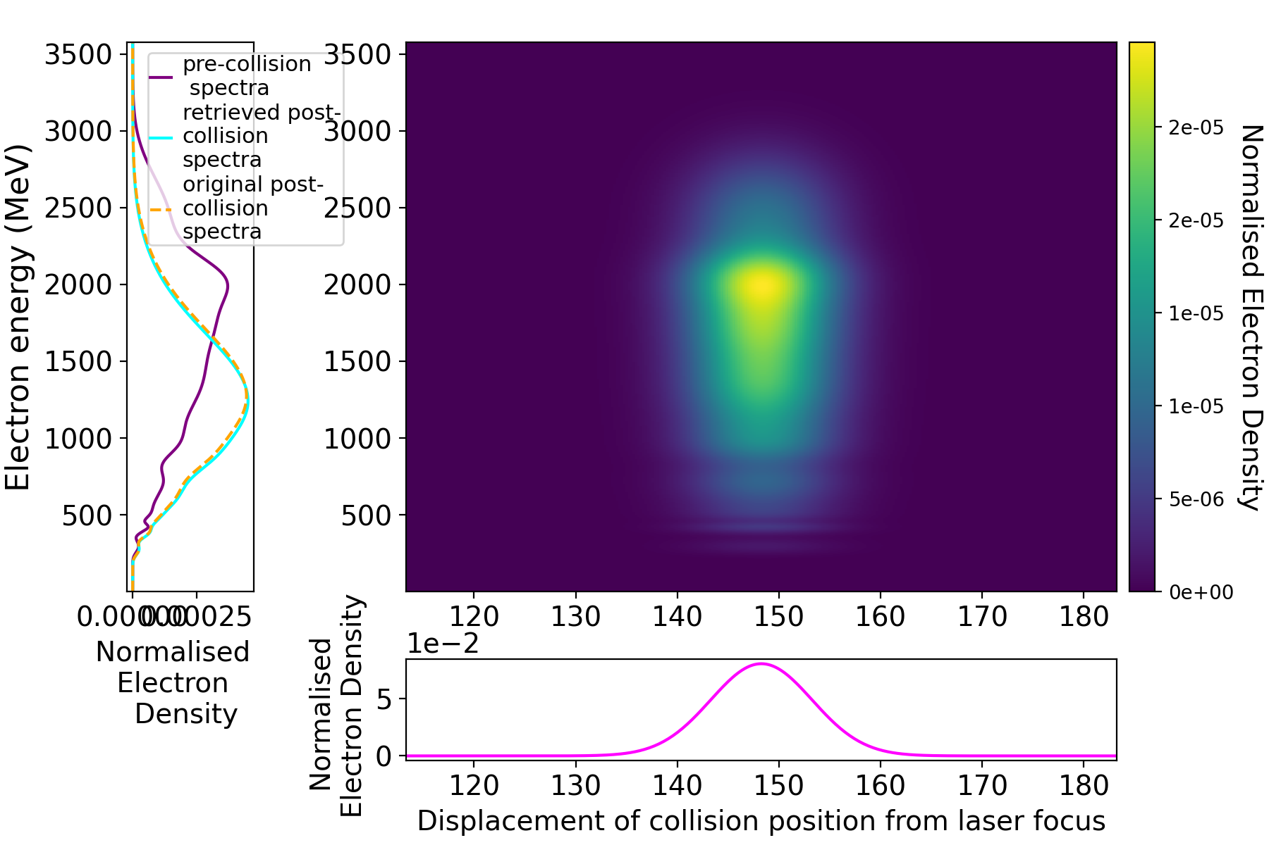
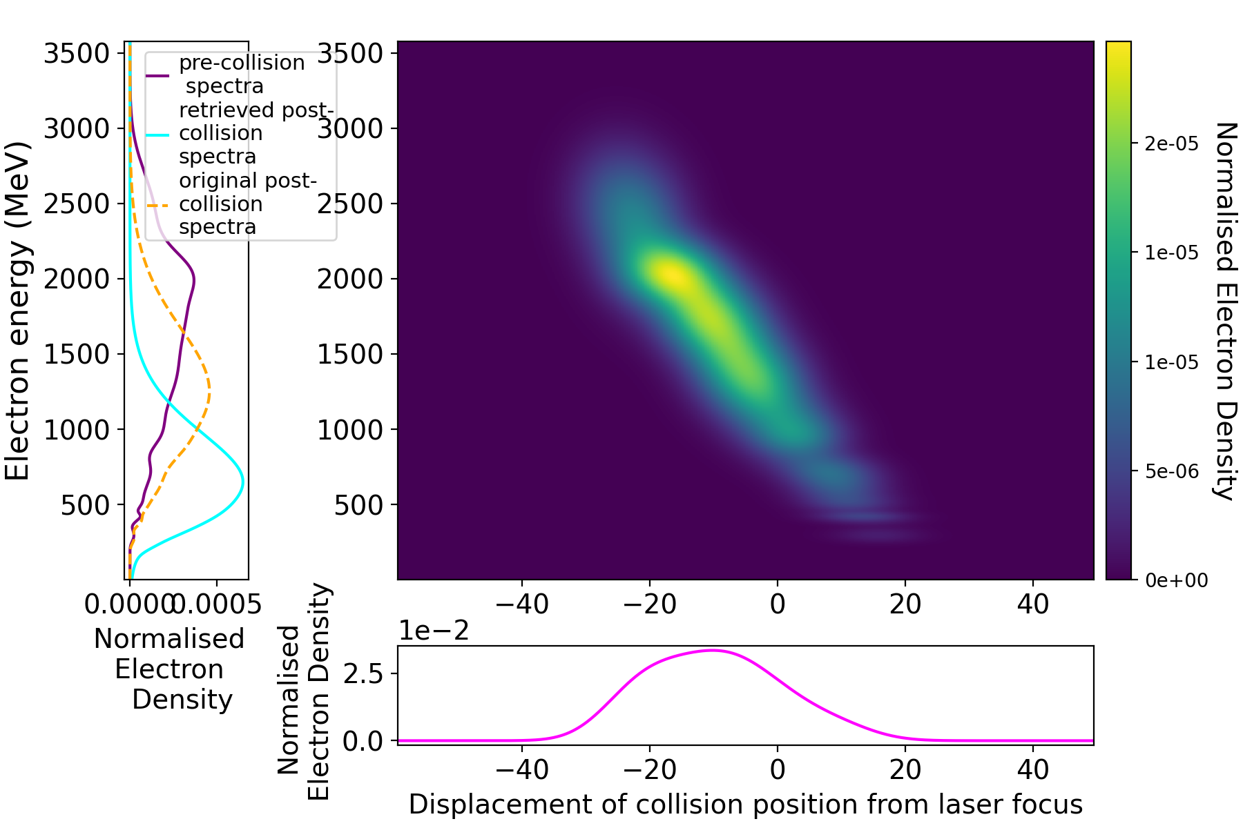
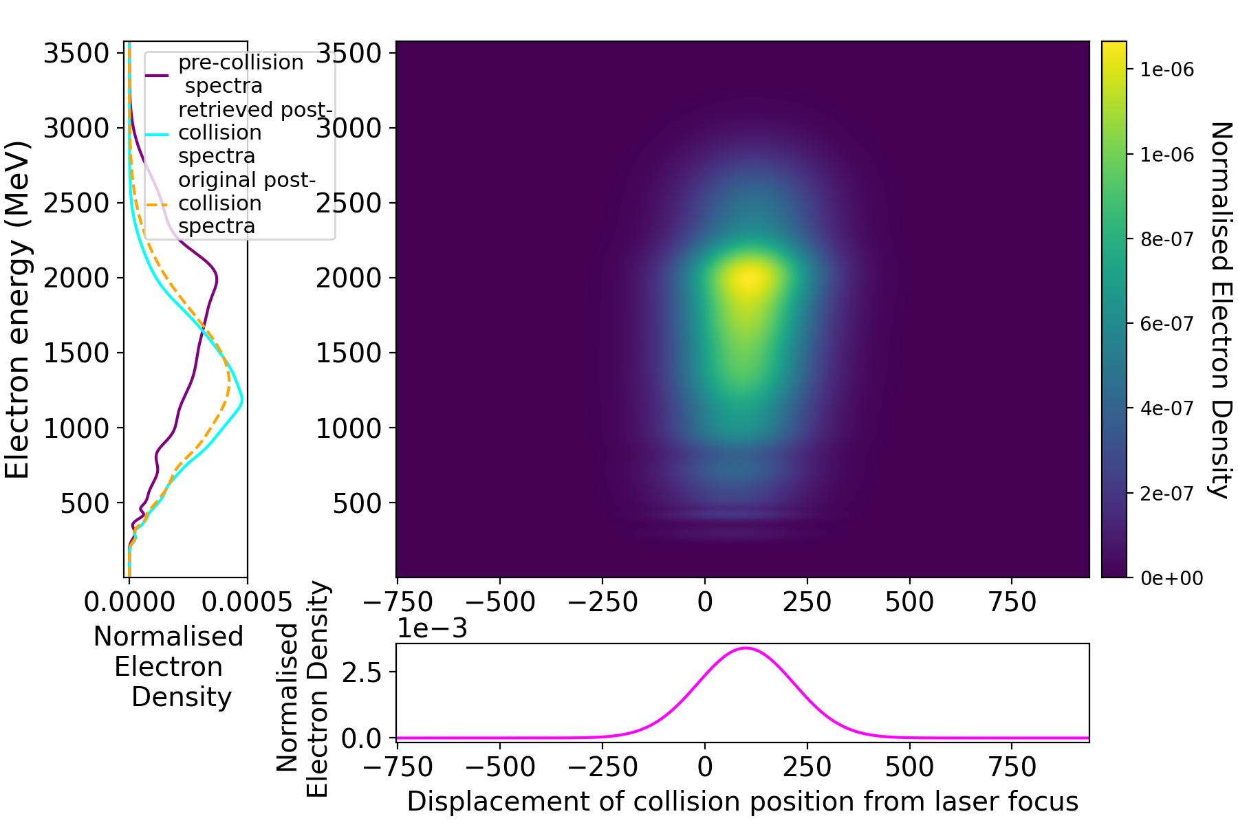
Results: retrieval of eLECTRON BUNCH STRUCTURE using linear model
Original (input electron distribution) Retrieved: stochastic, no chirp
Retrieved spectrum: Stochastic, chirped (left), semiclassical, chirped (right)

Slide 15
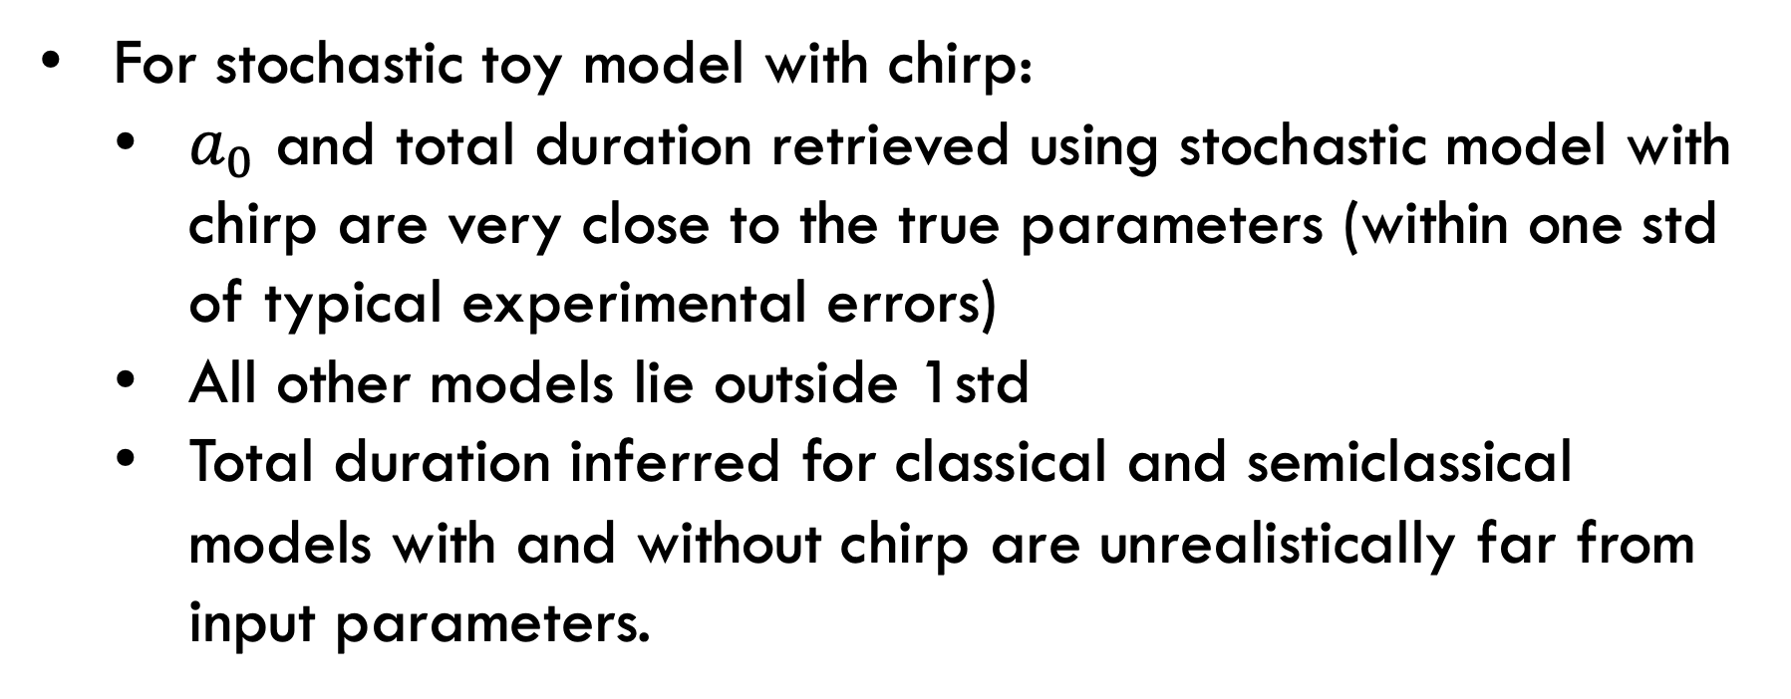
Summary
For stochastic toy model with chirp:
  $a_{0}$ and total duration retrieved using stochastic model with chirp are very close to the true parameters (within one std of typical experimental errors)
  All other models lie outside 1std
  Total duration inferred for classical and semiclassical models with and without chirp are unrealistically far from input parameters.

Slide 16
Future Work
Include effect of transverse electron beam size in forward model
Try method on real data

Slide 17
Missing/inaccurate collision parameters?
parameter | Included in Poder, 2018? | Current work
vector potential | Y | y
Laser duration | y | y
Delay | y | y
Electron chirp | n | y
Electron duration | y, not measured | y
Transverse offset | y | n
Laser spot shape | y | n
Transverse electron bunch shape | y | n

Slide 18
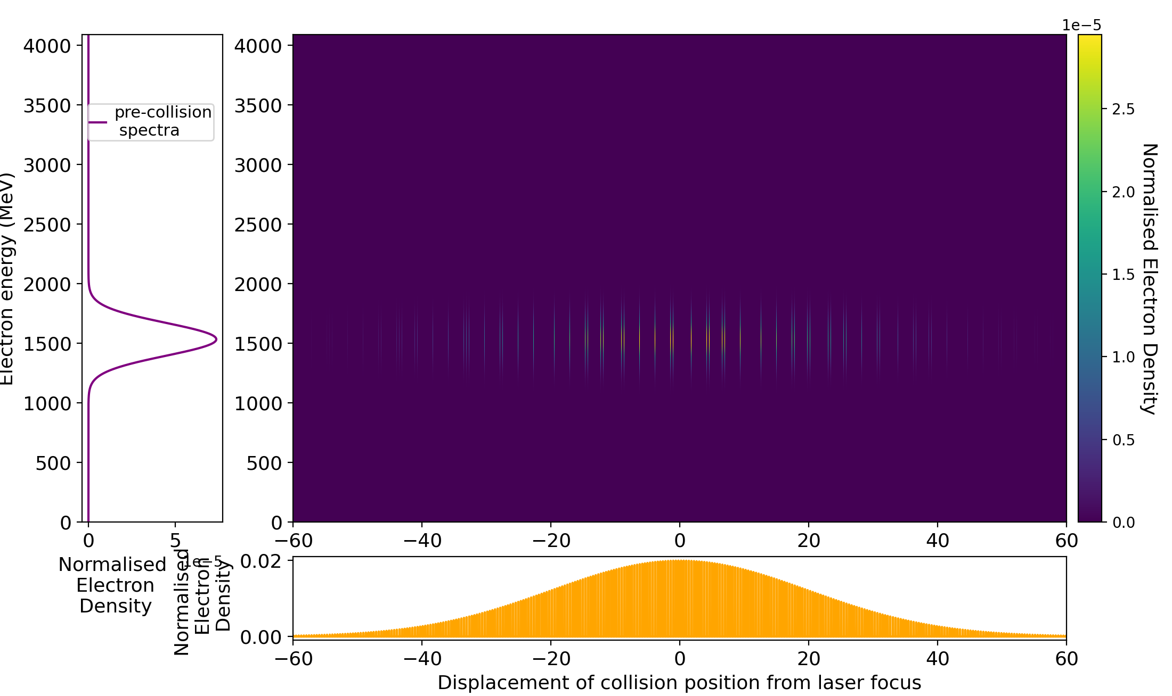
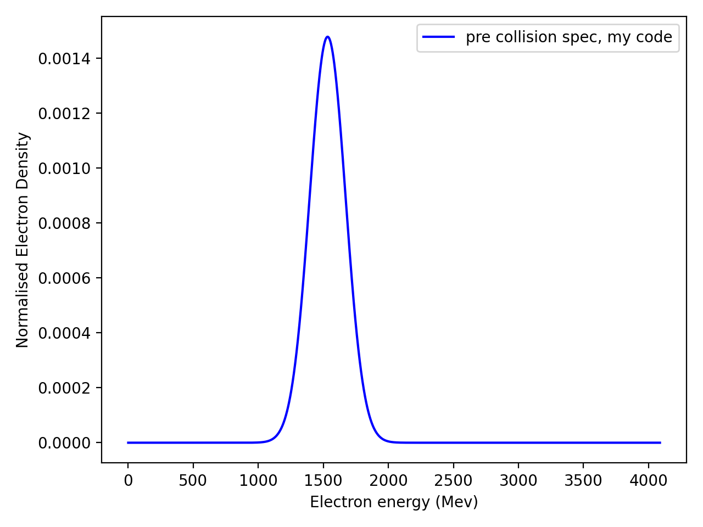
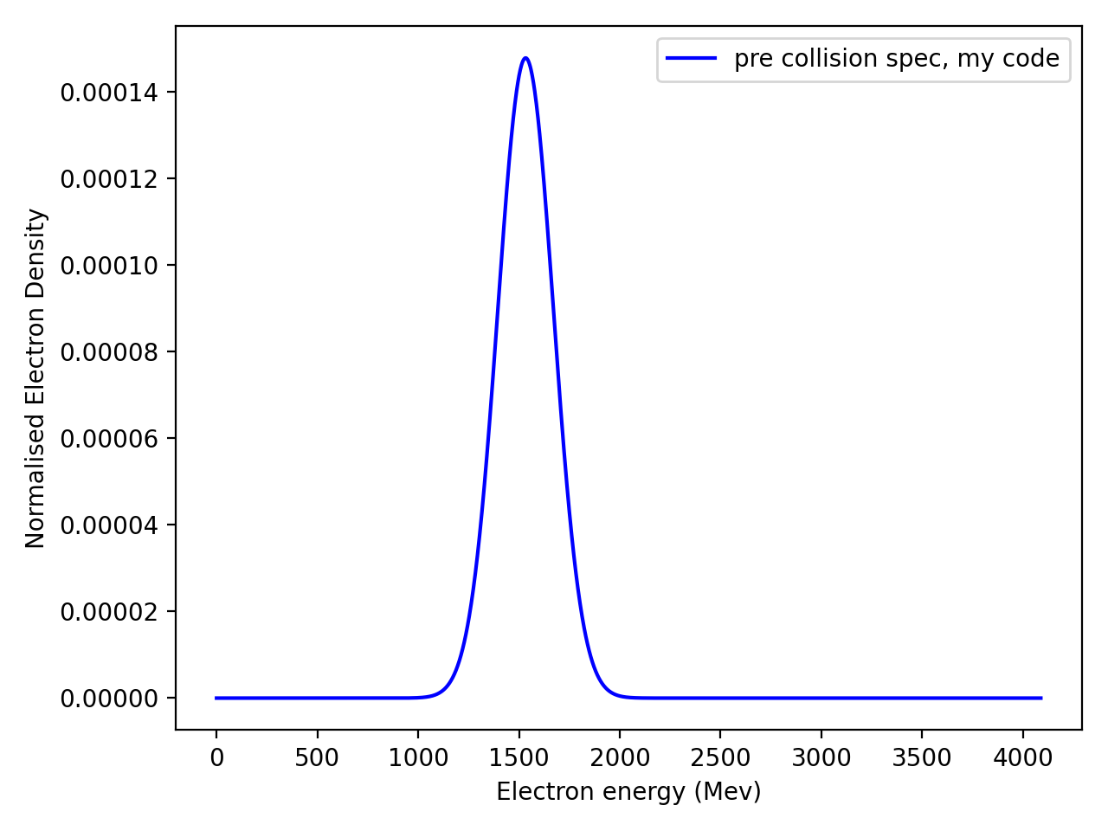
Electron ENERGY SPECTRUM DECOMPOSITION & projection along longitudinal axis
Electron spectrum modelled by a single gaussian:
x500
For electron spectra modelled by multiple gaussians, apply this method to every gaussian

Slide 19
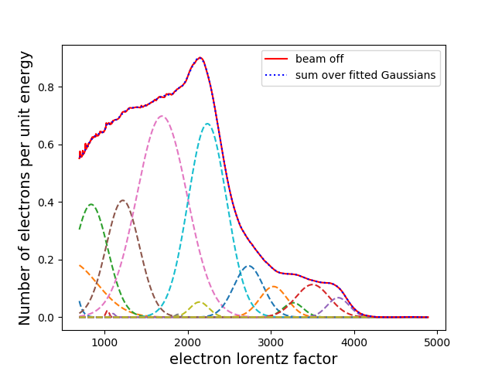
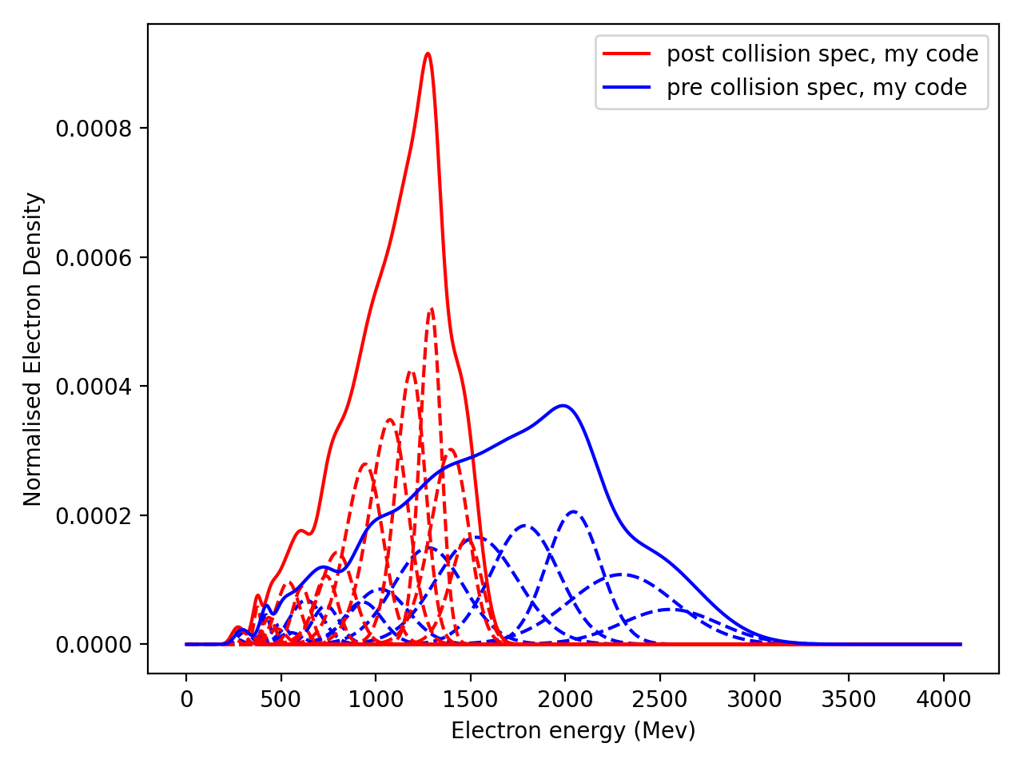
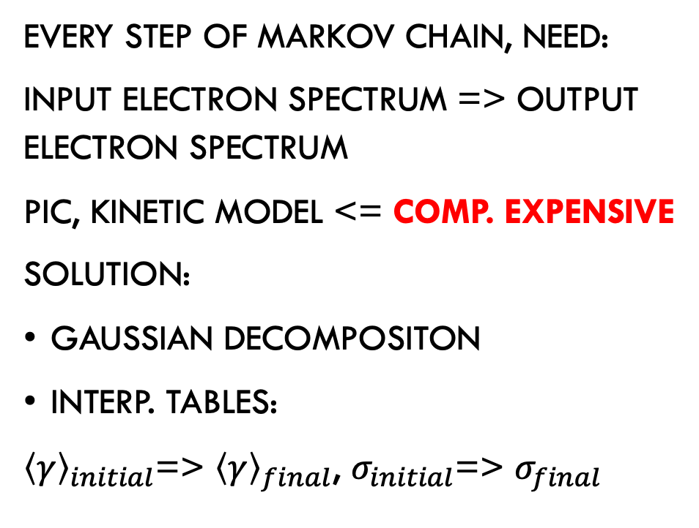
Modelling Radiation Reaction: Gaussian Decomposition
Every step of Markov Chain, need:
Input electron spectrum => output electron spectrum
PIC, kinetic model <= comp. expensive
Solution:
Gaussian decompositon
Interp. tables:
${\left\langle γ\right\rangle }_{initial}$=> ${\left\langle γ\right\rangle }_{final}$, $σ_{initial}$=> $σ_{final}$

