Slide 1
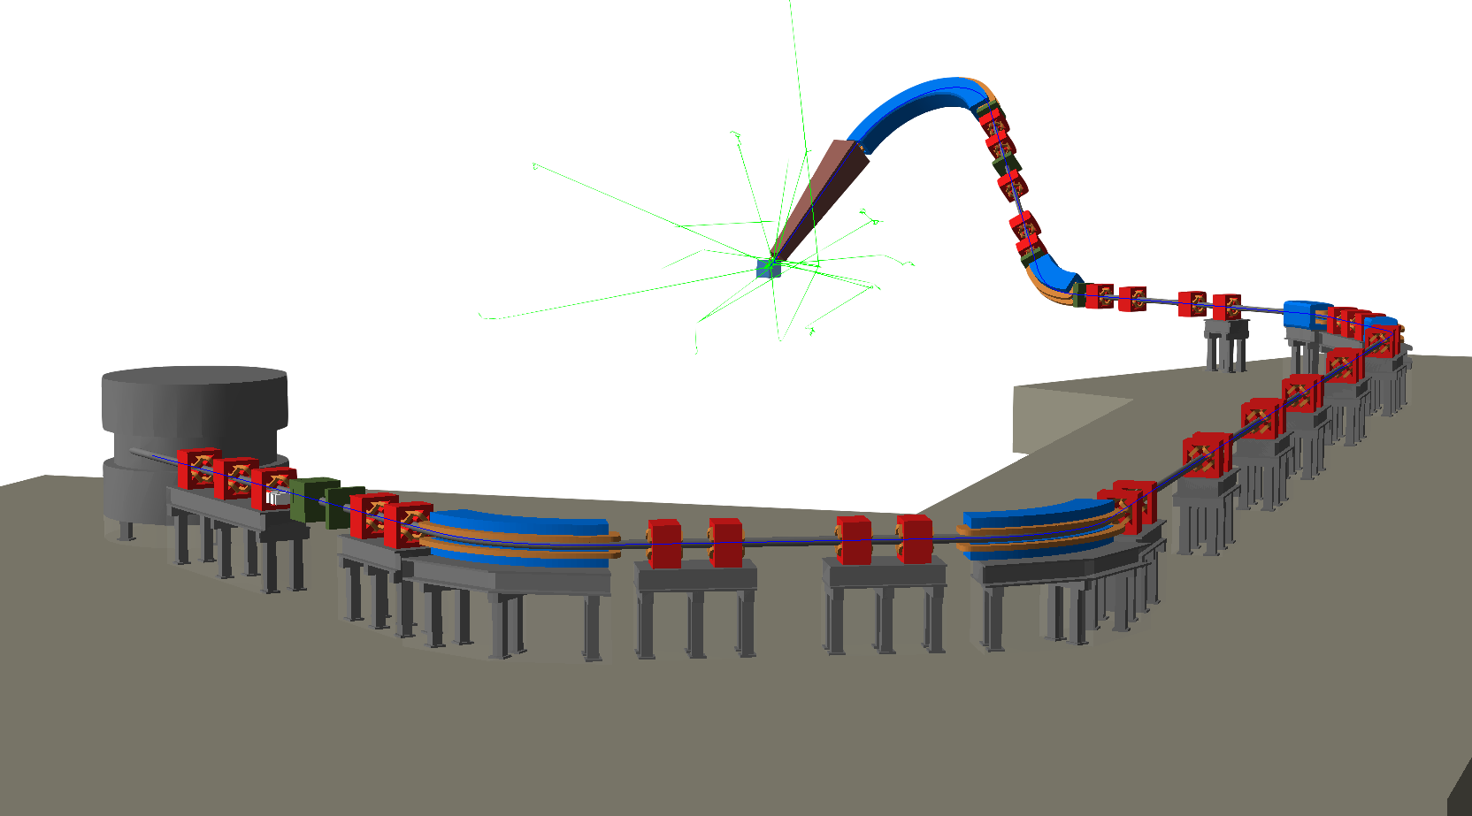

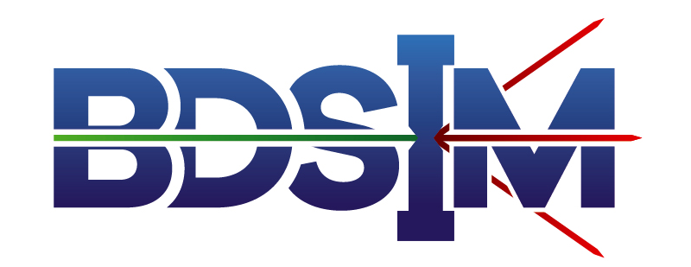


Medical Accelerators in BDSIM
William Shields
(william.shields@rhul.ac.uk)
JAI Fest
10th December 2021

Slide 2

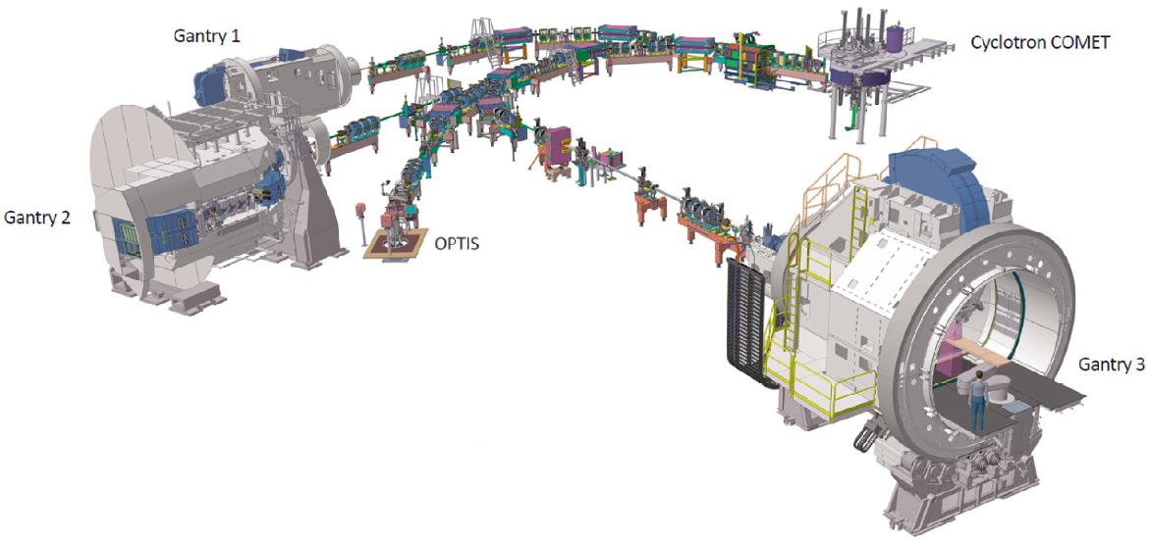
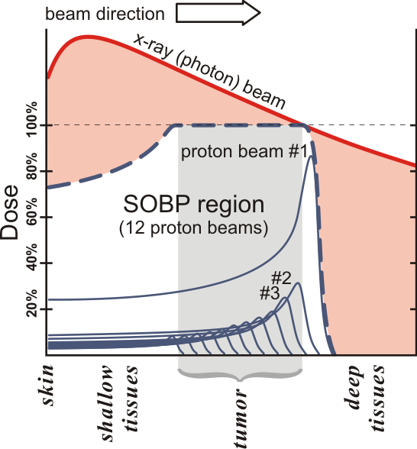
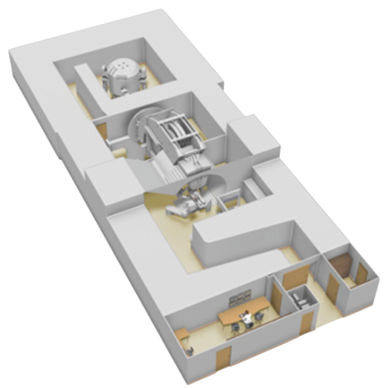
Proton Therapy: Concept
70-250 MeV protons to deliver a dose at a precise depth – the Bragg peak.
Depth dependant on particle energy.
  Control position of the dose delivered to the patient.
Centre for Proton Therapy, PSI
Spread Out Bragg Peak (SOBP): multiple beams with different energies.
  Uniform dose across the tumour.
  Reduced dose to the surrounding healthy tissue.
Cyclotron
Gantry
Treatment room
Beams commonly delivered through gantries that rotate around patients.
Multi-room facilities as beam lines from a fixed energy cyclotron.
Compact single-room solutions.
IBA ProteusOne compact proton therapy beam line
2

Slide 3
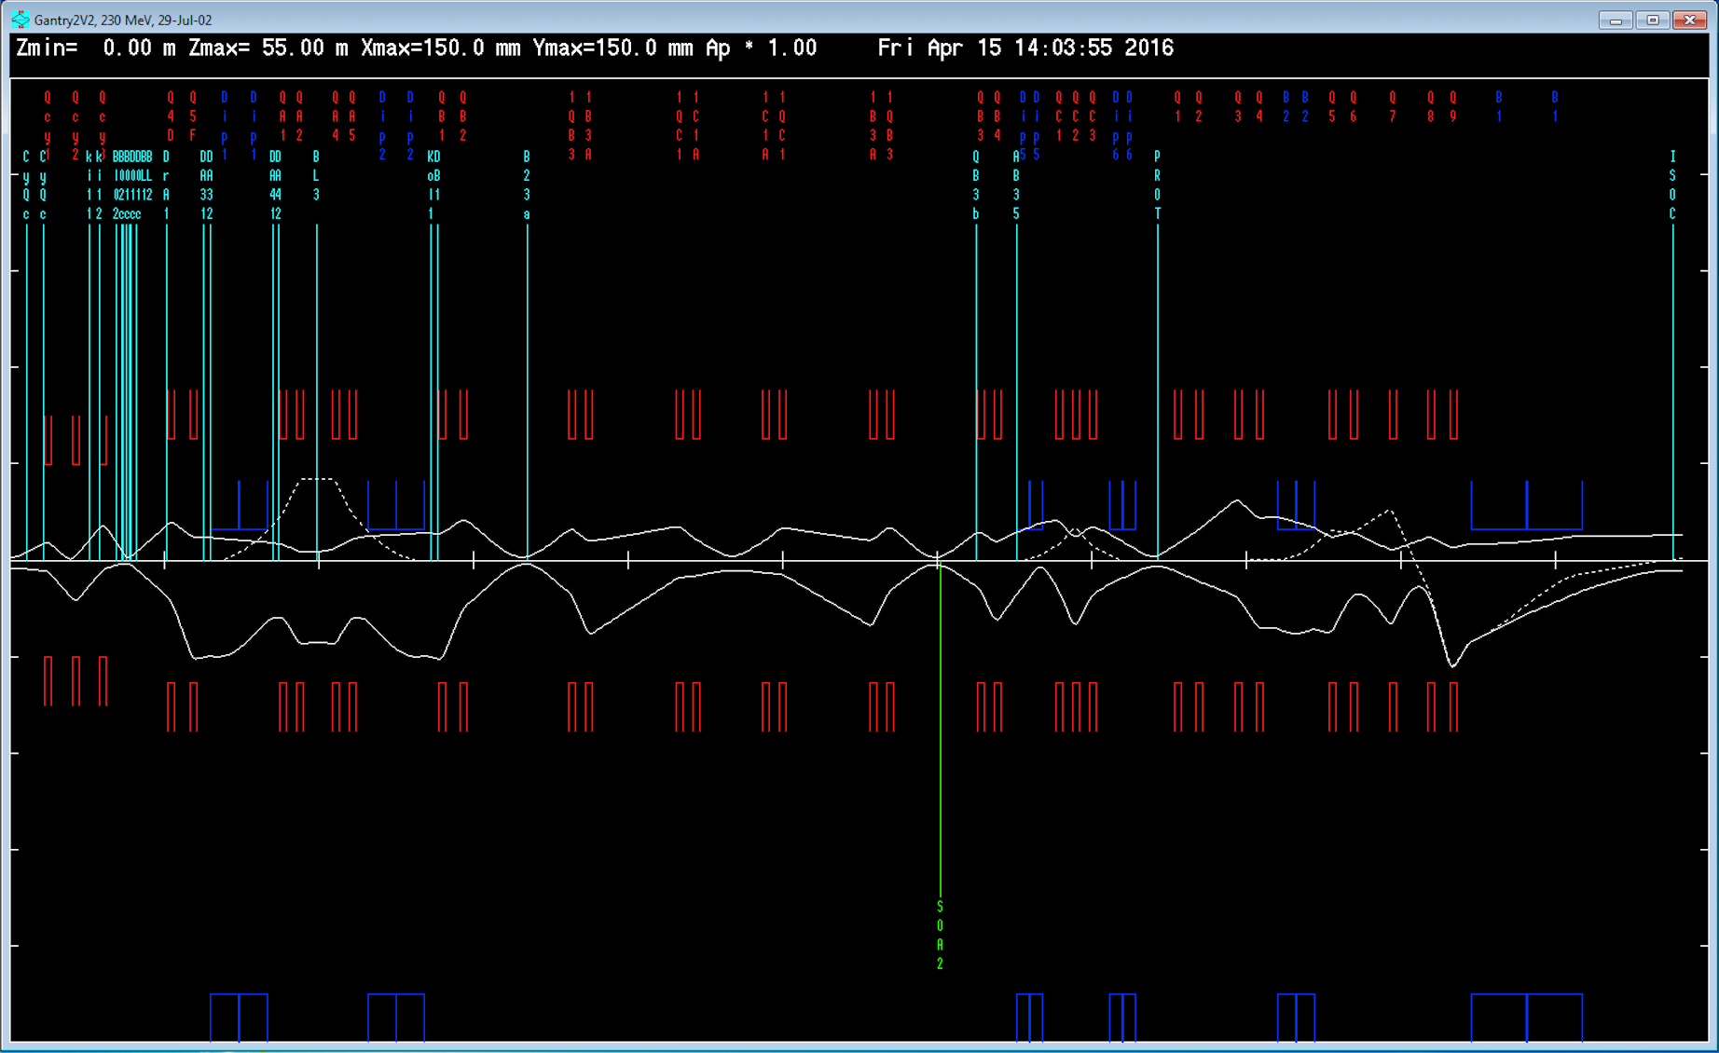
Proton Therapy: Gantry Modelling
Modelling used to understand & improve accelerator performance.
  Particle tracking: MADX, PTC, TRANSPORT, Sixtrack, OPAL, etc.
  Typically no particle-matter interactions – can limit the validity of optics model.
Typical technique: run tracking codes, inspect machine optics, and identify regions of interest.
  Develop independent Monte Carlo simulations as required in a toolchain.
Degrader and collimation
Nozzle and isocentre
Shielding aperture
Single-room compact solutions require more detailed simulation.
  Tight coupling of beam characteristics, beam losses, and shielding.
  Needs simultaneous consideration: only achievable with start-to-end Monte-Carlo beam line modelling.
3

Slide 4


BDSIM
Beam Delivery Simulation (BDSIM):
  Open-source code for Monte Carlo particle tracking through 3D models of accelerators.
Combines Geant4’s geometry & particle-matter interaction physics with accelerator tracking routines.
Specific developments added and validated for medical beam line modelling.
  Tracking routines, variance reduction, scoring, degrader, etc.
Model energy deposition throughout a particle accelerator.
Example:
  Protons deliberately collide with an energy degrader & scatter.
    Aperture hits downstream.
  Secondary particles continue propagating.
    Scatter off accelerator components & environment (air).
  Energy deposited in magnets & shielding.
Scattering
Aperture impact
Energy deposition
Deliberate impact
Beam
Patient
BDSIM Paper: Computer Physics Communications (252), July 2020, 107200
Gantry rotation axis
Energy degrader
BDSIM Manual: http://www.pp.rhul.ac.uk/bdsim/
Quadrupole
Concrete shielding
Sector bend
4

Slide 5
BDSIM Medical Studies
RHUL In-House Model
  Demonstrate BDSIM’s medical capabilities
IBA & ULB
  ProteusOne
  ProteusPlus
CCAP
  Design of proposed UK radiobiology research facility
MedAustron
  Nozzle & collimation studies
PSI
  Isotope production beam line, gantry 2 & 3 simulations
Huddersfield/Manchester
  Beam scraping diagnostic tool to measure beam energy & energy spread
Clatterbridge
  Ocular proton therapy beam line (UCL/Liverpool)
RHUL In-House Model
  Demonstrate BDSIM’s medical capabilities
IBA & ULB
  ProteusOne
  ProteusPlus
CCAP
  Design of proposed UK radiobiology research facility
MedAustron
  Nozzle & collimation studies
PSI
  Isotope production beam line, gantry 2 & 3 simulations
Huddersfield/Manchester
  Beam scraping diagnostic tool to measure beam energy & energy spread
Clatterbridge
  Ocular proton therapy beam line (UCL/Liverpool)
5

Slide 6
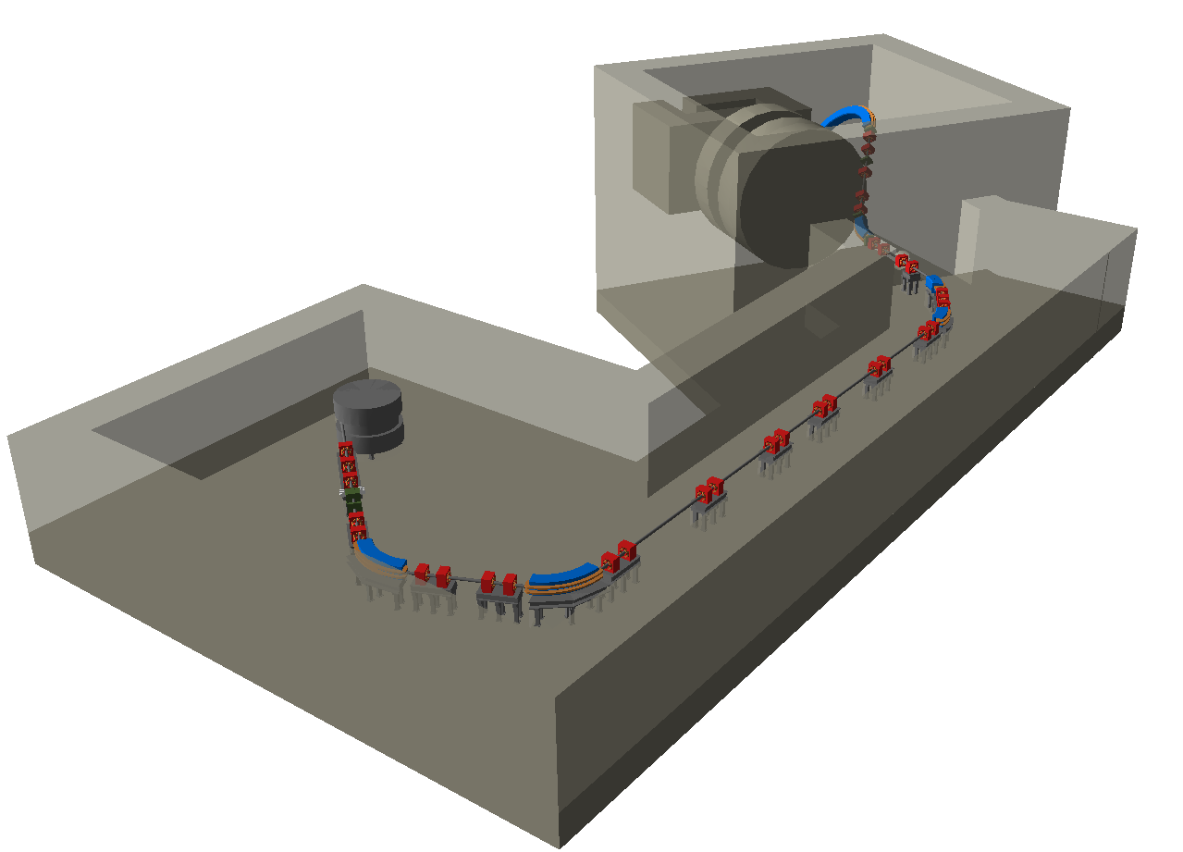
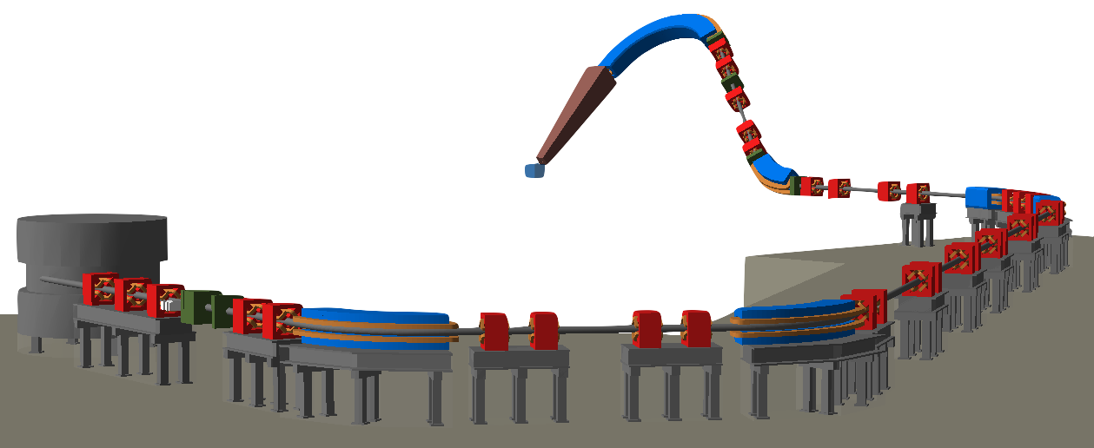
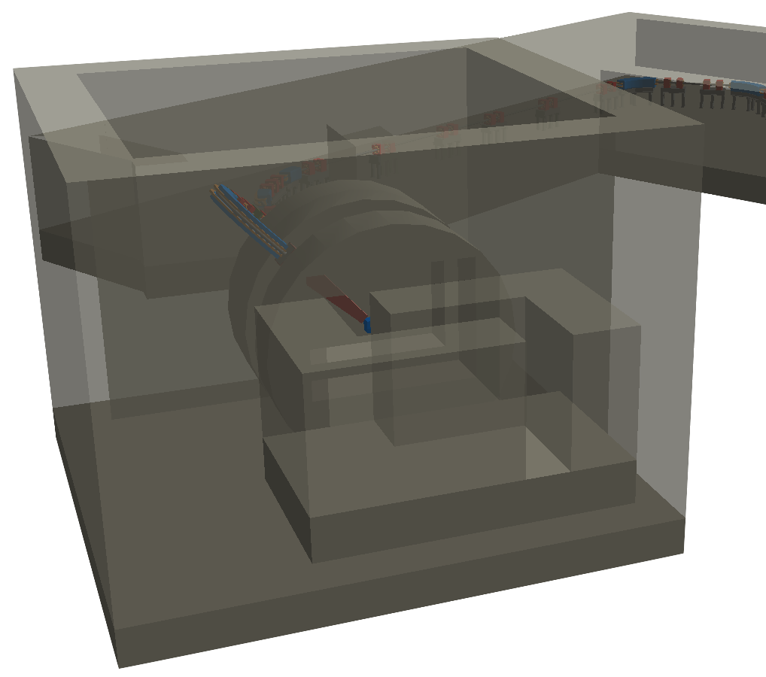
BDSIM In-House Model
Model for demonstrating BDSIM’s medical functionality.
  Overcome limitations of traditional tracking codes.
Publication to be submitted imminently.
Gantry 2 from Paul Scherrer Institute in Switzerland.
  Lattice publicly available: http://aea.web.psi.ch/Urs_Rohrer/MyFtp
  Conceptual design – different from real machine.
Gantry Pit & Treatment Room
Beam Transport
Shielding wall with aperture
Since added geometry for shielding, magnet supports, cyclotron, nozzle, & water phantom.
Example tunnel shielding
Cyclotron Geometry
Degrader for energy selection
Nozzle
Isocentre & phantom
Gantry
Treatment Room
Example magnet supports
Shielding Maze
6

Slide 7
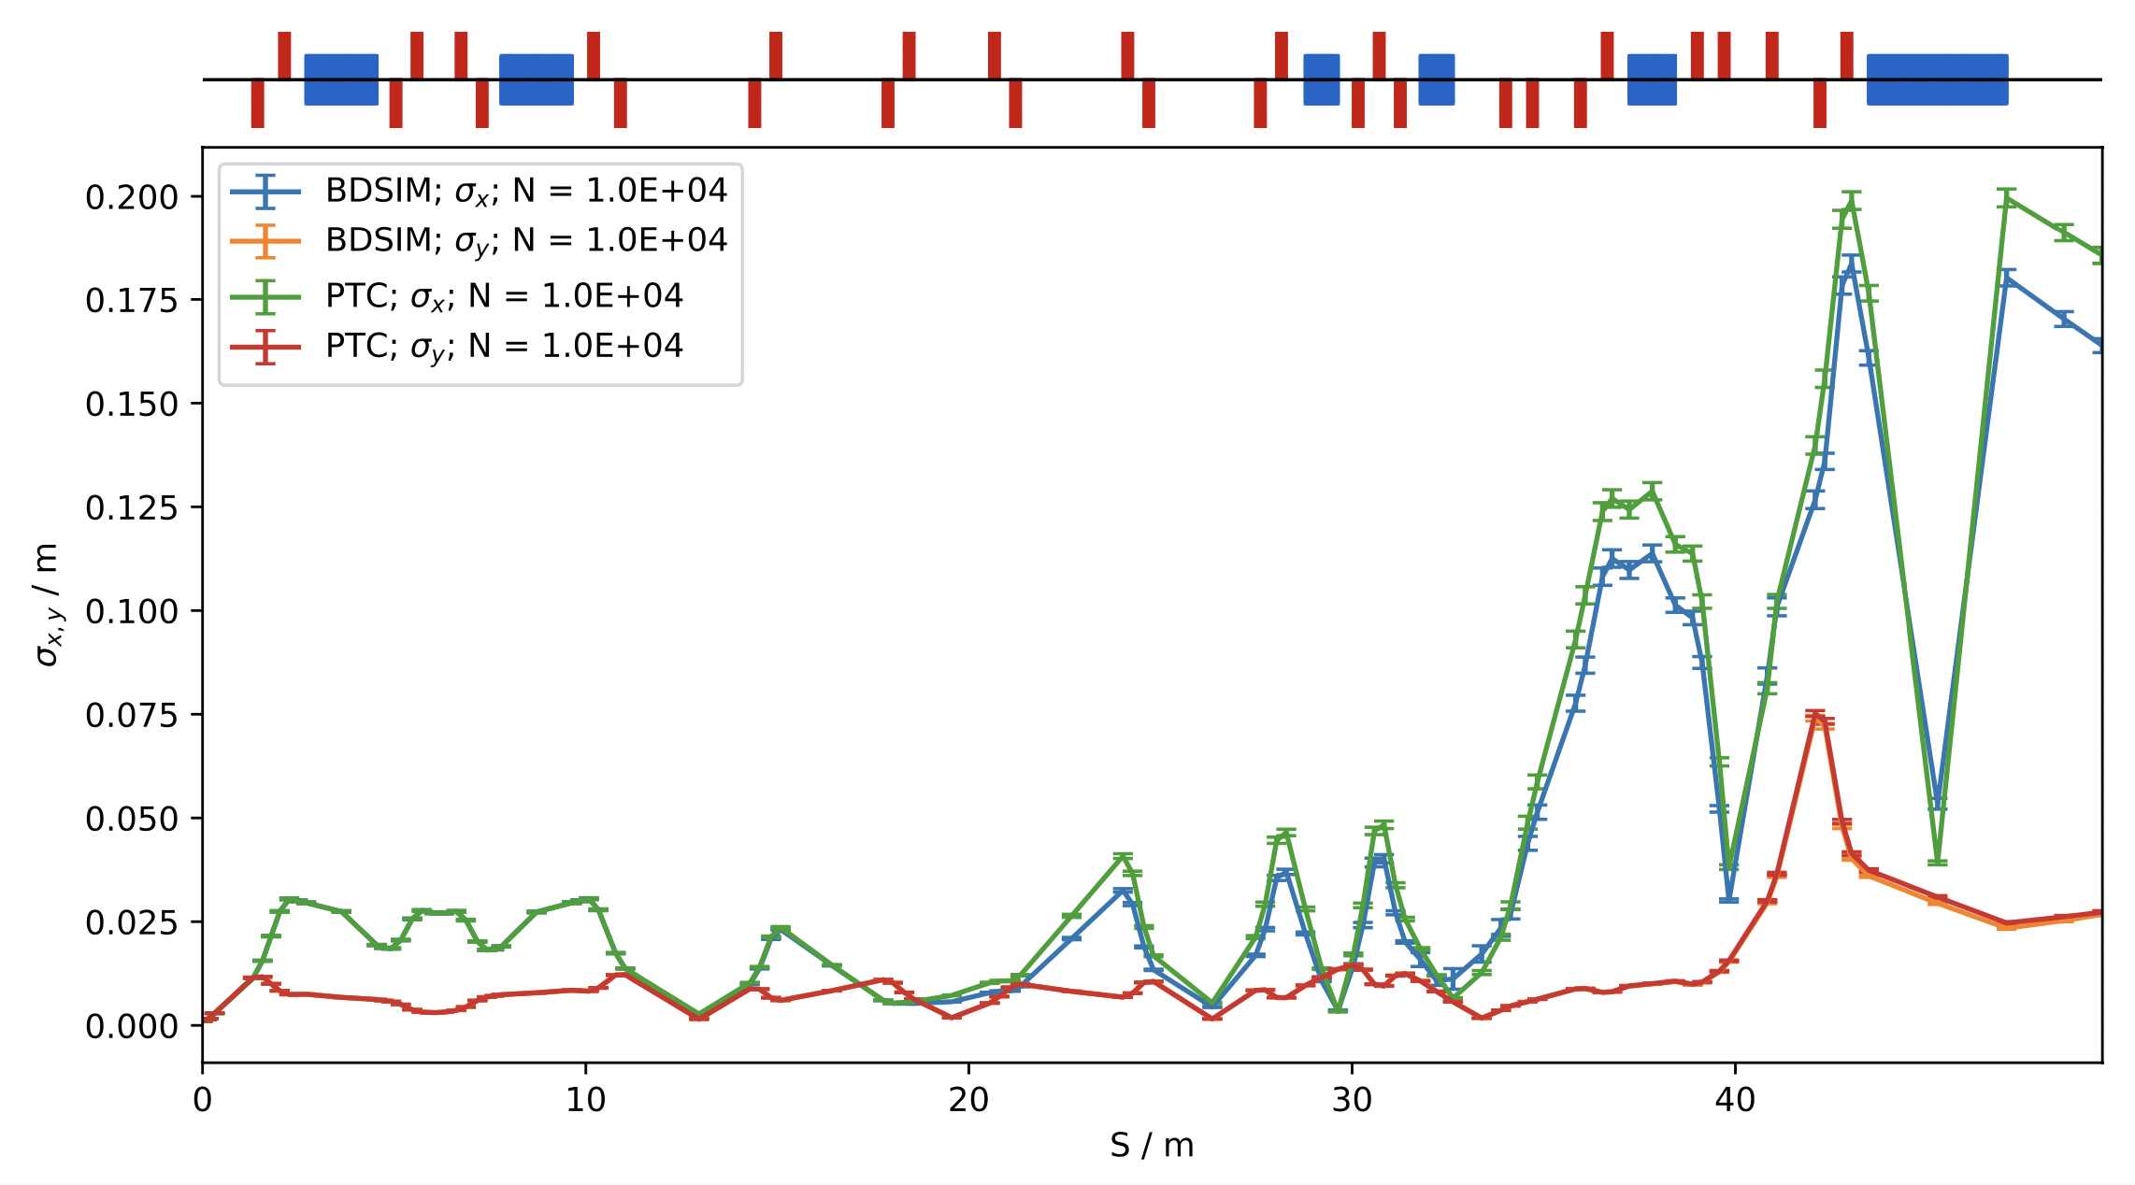
Optics & Losses
Reasonable agreement seen with PTC.
  Difference due to losses.
  Wide aperture model – 3.75 cm nominal aperture.
Optics validation of many machines in BDSIM.
  Medical & beyond.
Before
Hits, losses, and energy deposition seen throughout.
Machine protection.
Particularly useful for machines with SC magnets.
  Ion therapy beam lines.

Slide 8
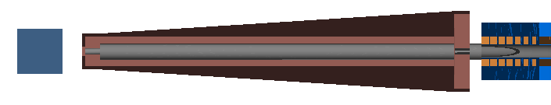
Nozzle: Dose Formation
Demonstrate that properties of the delivered dose can be considered whilst modelling the accelerator.
Single scattering nozzle to improve dose formation.
  Unsuitable dose with beam shaping elements.
  Low efficiency – heavy collimation & losses.
Shroud
Beam
Phantom
Collimator & window
Drifts
Scatterer
Collimator
Good depth-dose uniformity, improvement in lateral dose profile.
  High proximal dose from scatter-induced low energy tail.
Lateral Profile
Isodose
SOBP
8

Slide 9
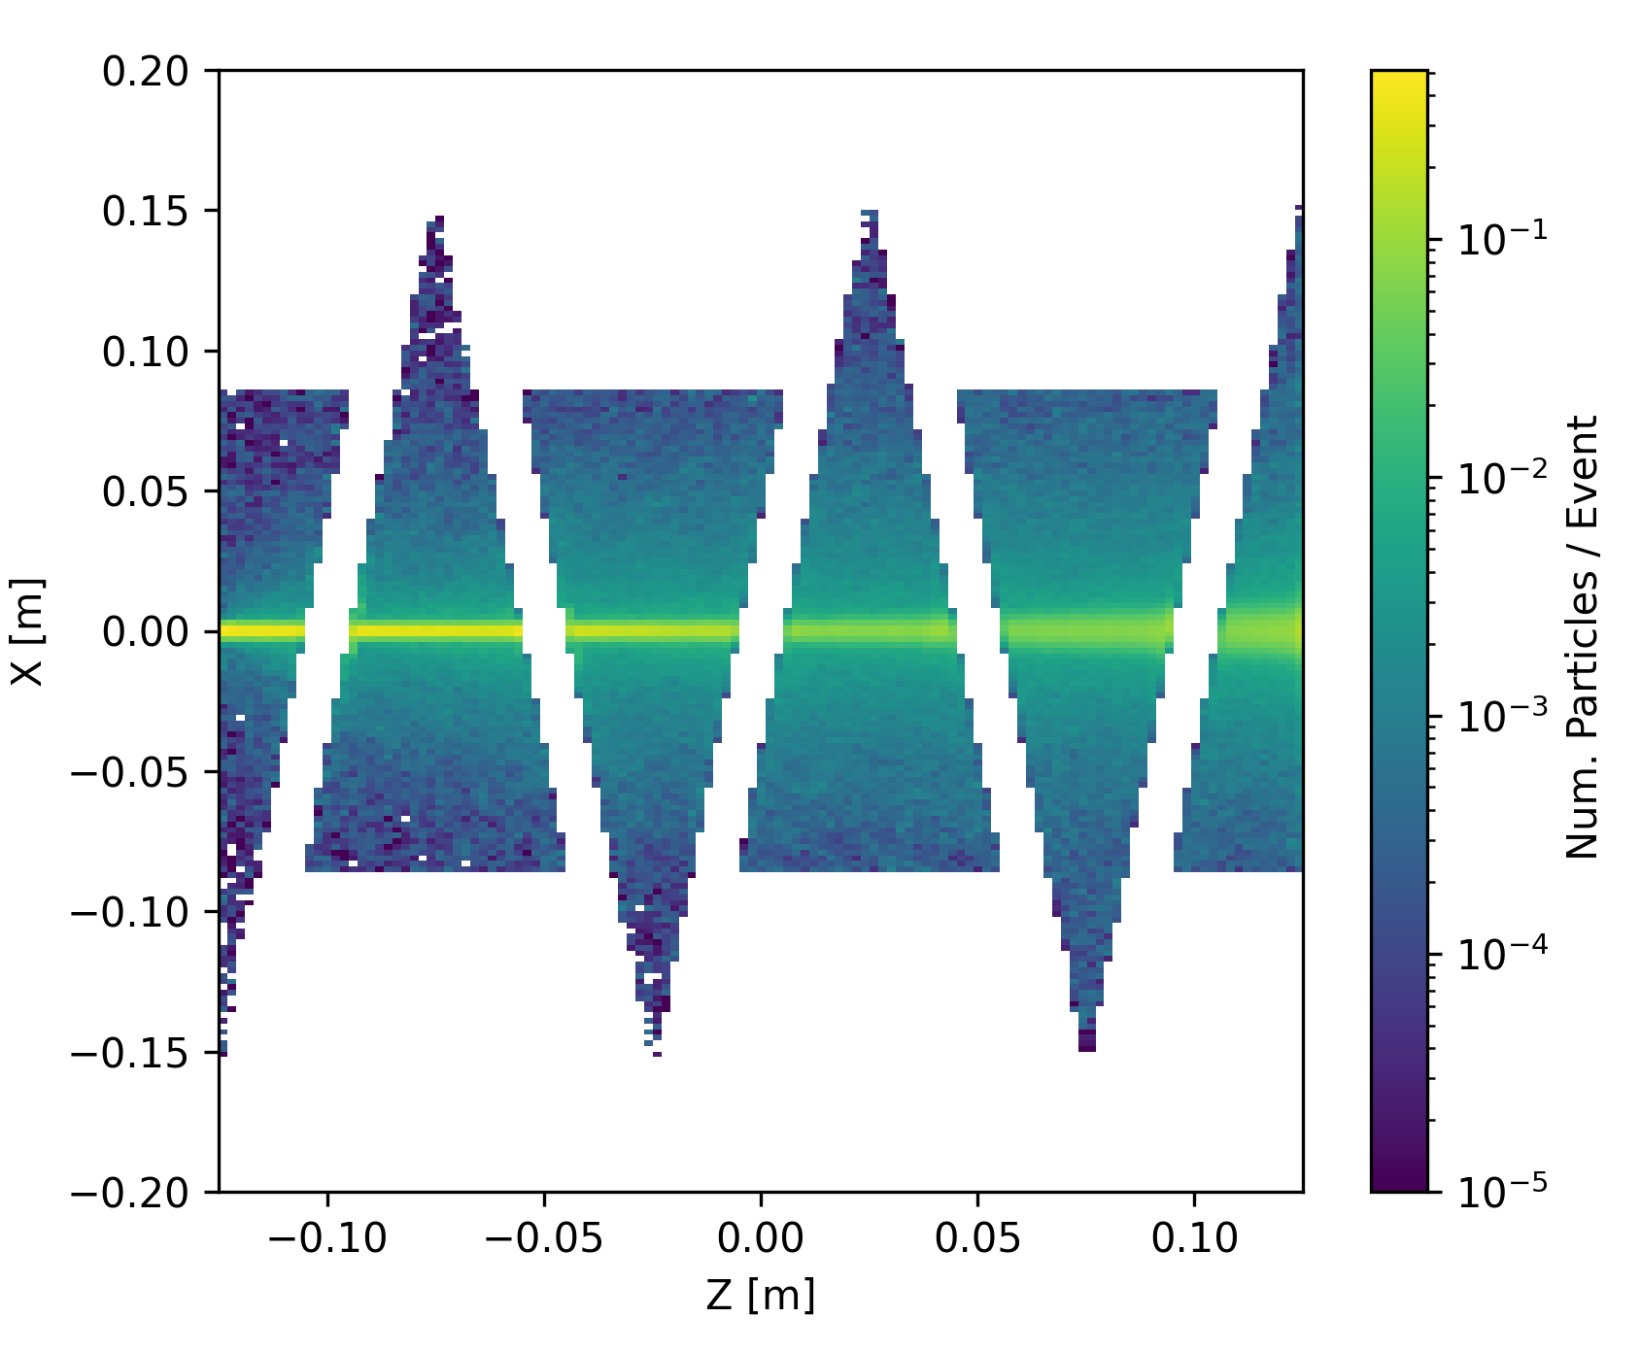
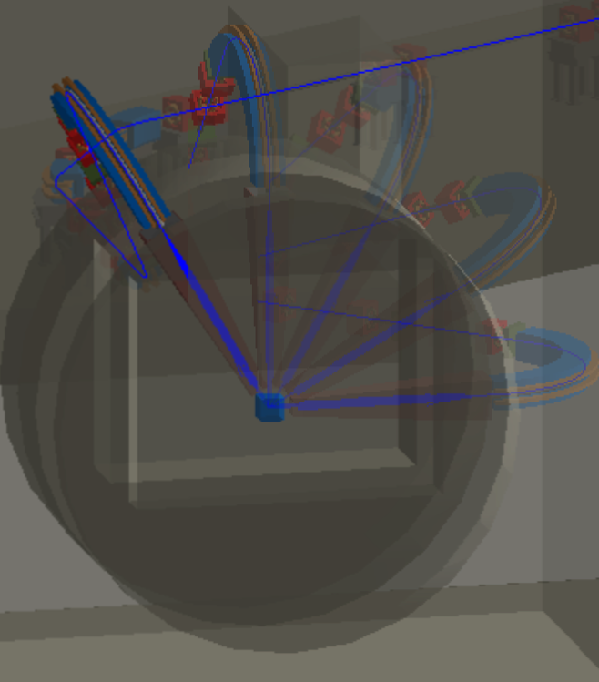
Other capabilities
Beam profiling after the energy degrader.
Hits and energy deposition in beam line elements.
Variance reduction techniques: importance sampling.
Neutron dose in a treatment room wall.
Heavy beam line losses.
Scoring maps: record integrated quantities.
Treatment room ambient dose equivalent.
Per-particle species.
Vary gantry rotation angle: dose modulation.
9

Slide 10


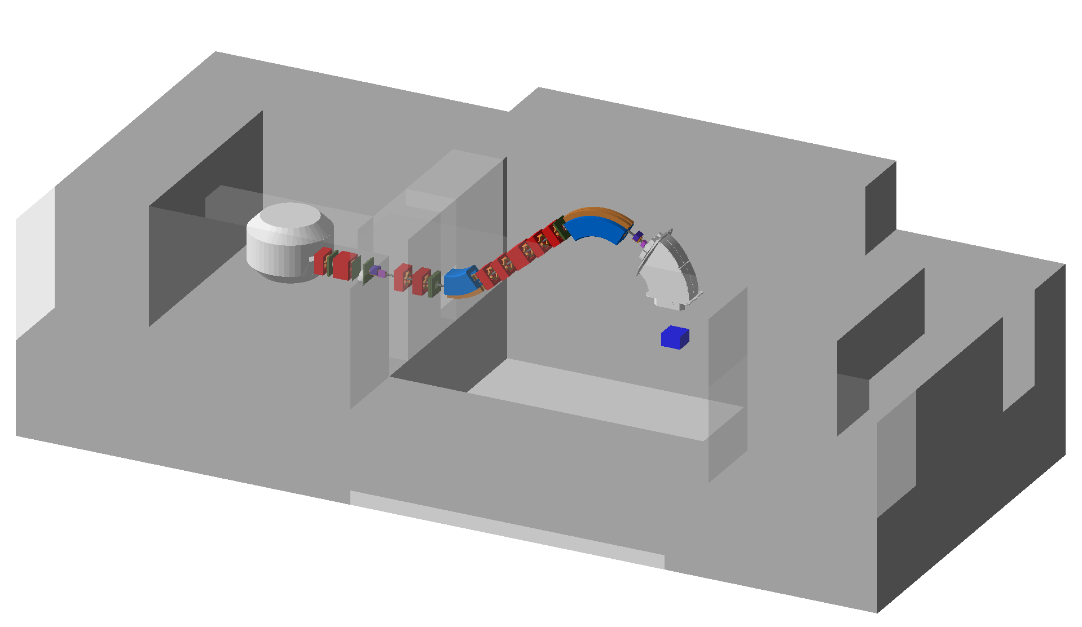
The ProteusOne Model in BDSIM
Start-to-end simulation of IBA’s ProteusOne systems.
Combination of standard BDSIM geometry & external files (via pyg4ometry).
  Cyclotron included for modelling losses & dose maps of cyclotron vault.
  Final dipole converted from CAD model – crucial to include fringes.
  3D magnetic field map attached to custom beamline element.
Degrader & collimators
Gantry & treatment room
Cyclotron
Shielding maze
C. Hernalsteens, W. Shields et al, European Physics Letters, (132), December 2020, 50004
Optics, cyclotron beam profile & losses:
R. Tesse. et al, IPAC2019,
10

Slide 11
Experimental Validation
Excellent agreement between experimental data and simulations.
Simulated horizontal & vertical beam profile.
Depth dose profile in water.
  Range & distal fall-off.
Total transmission efficiency.
  Extraction beamline & degrader to isocentre.
  Multiple ranges to cover all degrader materials.
Beam Profile
Depth dose profile
Transmission efficiency
11

Slide 12

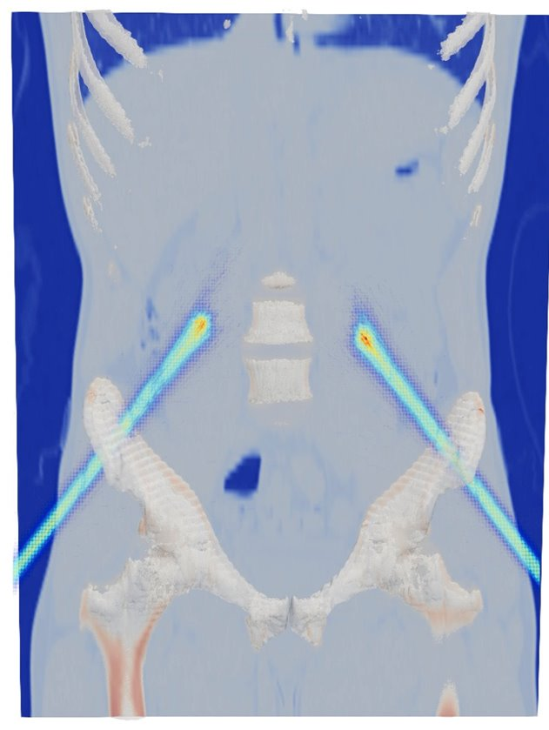
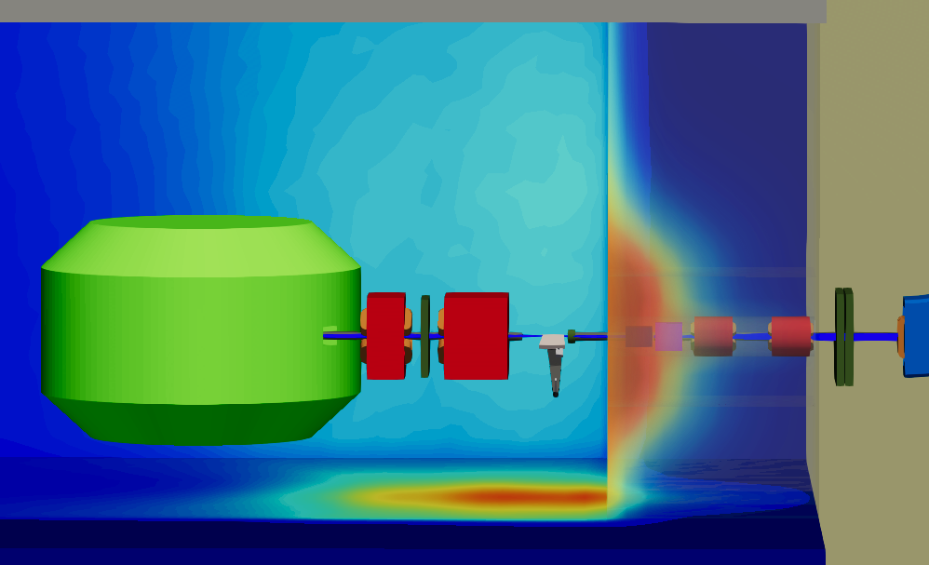
Other Studies & Developments
Ambient dose map for activation studies.
  Ambient dose equivalent scored in the cyclotron vault, treatment room, and the maze.
Beam transport & degrader losses for 28.65 cm range dose.
  High cyclotron vault dose: degrader and collimators.
  Smaller beam transport losses, air gap.
IPAC paper on ULB-lead developments.
DICOM files - dose deposition scoring in reconstructed volumes.
Step toward BDSIM involvement in validation of TPS treatment plans.
Shielding activation studies.
  BDSIM in conjunction with FISPACT-II.
Development of 4D scoring (3D + energy) – forms FISPACT input.
Studies ongoing.
12

Slide 13
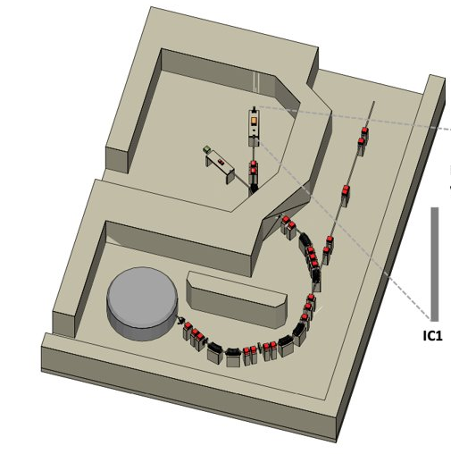
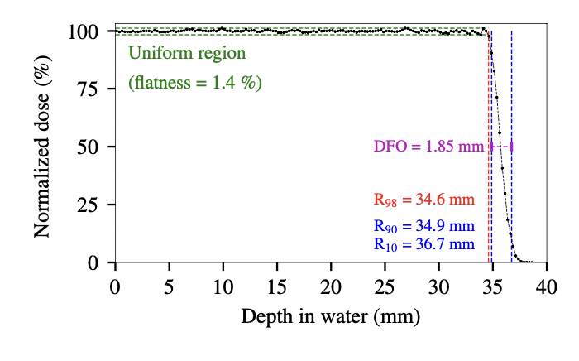
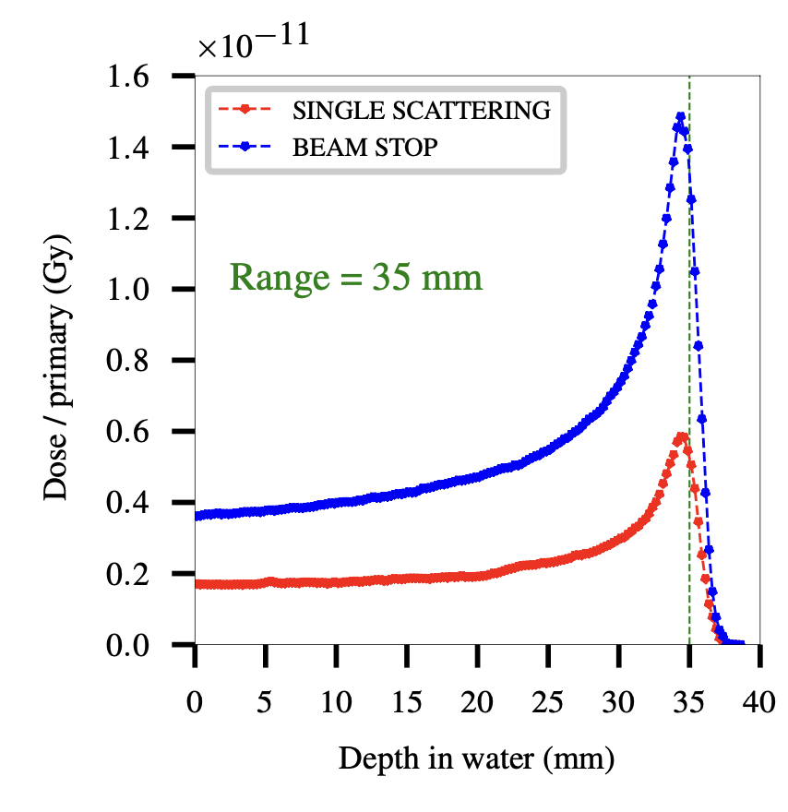
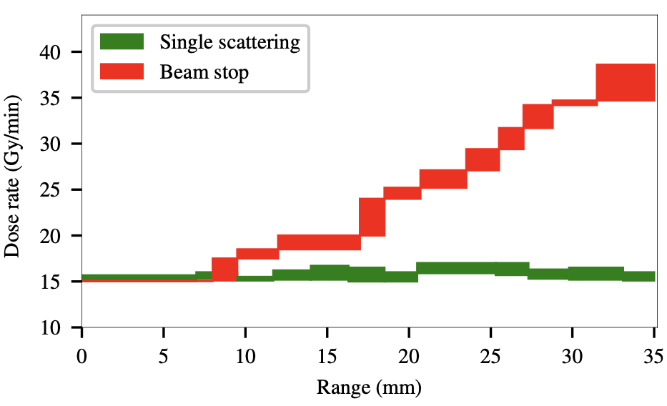
ProteusPlus Eyeline Optimisation
IBA eye-treatment beamline, part of the Proteus Plus (P+) system.
  Treatment of ocular tumours (70-105 MeV).
Publication submitted (E. Gnacadja, ULB).
Improve deliverable dose rate and depth-dose distal fall-off.
Optimise energy selection system, optics & nozzle
  Maintain clinical requirements.
Options defined providing uniform depth-dose to variety of depths.
  Maximum dose rates between 15.5 and 17.0 Gy/min.
Beam stopper added to the nozzle
  Factor of 3 improvement in deliverable dose.
  Complete treatment session in under 60 seconds.
13

Slide 14
CCAP: Overview
Centre for the Clinical Application of Particles (CCAP)
  Multi-disciplinary collaboration of academia, national laboratories, industry, clinical institutes, and accelerator laboratories
Design of a proposed facility for cutting edge radiobiology research – LhARA
  Multi-stage facility capable of delivering proton and ion beams in FLASH doses
Biophysical understanding of interactions between protons and ions with tissue.
  Radiobiology program in development.
Conceptual design complete – working towards technical design.
14

Slide 15
CCAP: LhARA
Conceptual design report (CDR) publication:
Full CDR Technical Note:
Aymar, G. et al, Frontiers in Physics, (8), September 2020, 567738
https://ccap.hep.ph.ic.ac.uk/trac/raw-attachment/wiki/Communication/Notes/CCAP-TN-01.pdf
15

Slide 16
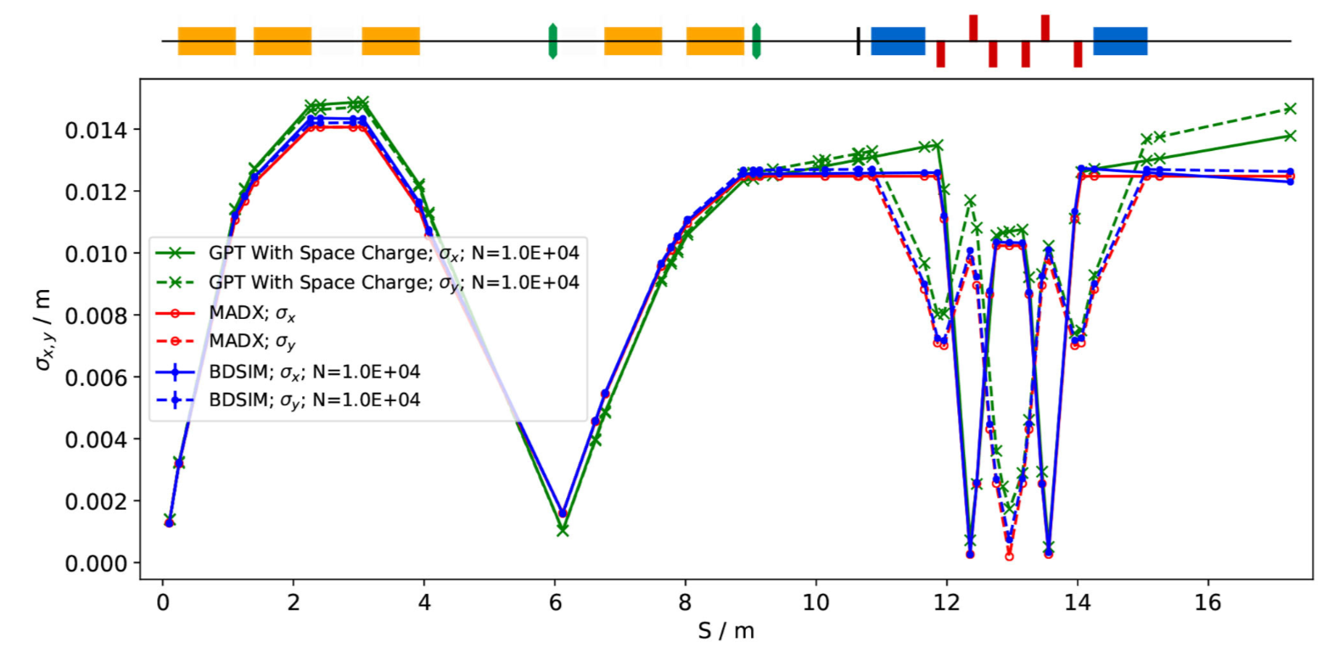
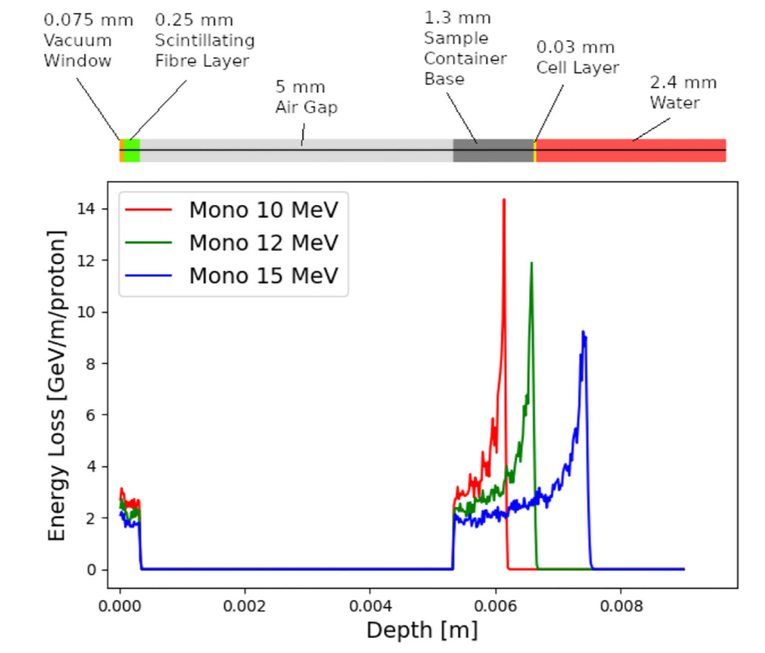
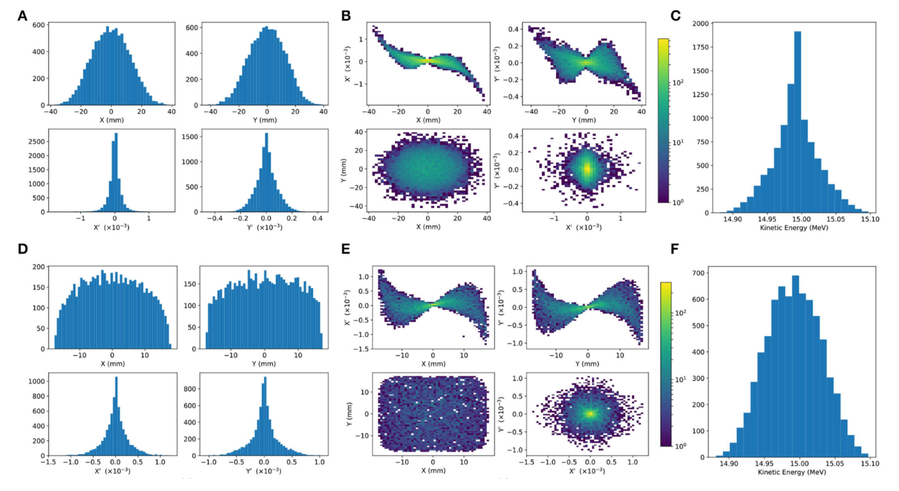
Stage 1 Performance Evaluation
Good optical agreement with space charge tracking simulations (GPT).
  Stage 1 simulated + stage 2 post FFA.
  Average dose of 128 Gy/s – FLASH capable.
Bragg peak range simulated in the end station.
Dose uniformity improved with octupole focusing and collimation.
A
B
16

Slide 17
Stage 2 Injection Line Performance
Stage 2 FFA injection line modelled (IPAC2021)
Semi-realistic beam from laser-target interaction simulation (H.T. Lau, IC).
  Good BDSIM & GPT agreement without space charge.
Emittance growth observed when modelling space charge.
  Final dimensions do not match FFA requirements
  GPT horizontal beam jumps are simulation artefacts
Phase space aberrations observed, previously seen in stage 1 simulations.
  Arises in stage 1 solenoids & persists in the injection line.
Replaced solenoids with 3D Gabor lens EM field map (T. S. Dascalu, IC).
  Minimal performance impact compared to solenoid optics.
  Similar phase space observed – unavoidable effect.
  Potentially acceptable by FFA – studies ongoing.
17

Slide 18
Summary
In-house model:
  Showcase BDSIM’s capabilities.
  Well developed code, highly suited to modelling proton therapy accelerators.
  Increasingly used in medical beam line research – academia & industry.
  Publication submission imminent.
ULB & IBA:
  Excellent agreement with experimental data.
  Successful modelling of 2 of IBA’s flagship proton therapy systems.
  Ongoing studies & developments.
LhARA:
  Crucial contribution in LhARA’s design performance evaluation.
  Continued use in design evolution.
18

Slide 19




Thank you for listening!
William Shields
william.shields@rhul.ac.uk
JAI Fest 2021
10th December

