Slide 1




Industry Connections
Laurie Nevay, RHUL
on behalf of the JAI
JAI Advisory Board - 19th April 2021

Slide 2
Introduction
The JAI has fundamental science at its heart, but an increasing part of its mission is promoting advanced accelerator applications in science and society
Connection with industry is a natural and valued part of its activity
Overview of recent industry connections presented here:
  betatron imaging
  CLIC RF
  industrialisation of BPMs for FELs
  precision metrology
  medical beam line system simulation
  radiation transport simulation
  additional Oxford commercialisation activity
JAI industrial activity is supported by technology transfer experts that reside in each institution
They guide or manage aspects of IP/contracts/fundraising etc to enable the pathway to commercialisation and support JAI researchers to make strategic decisions on commercialisation of the technology

Slide 3
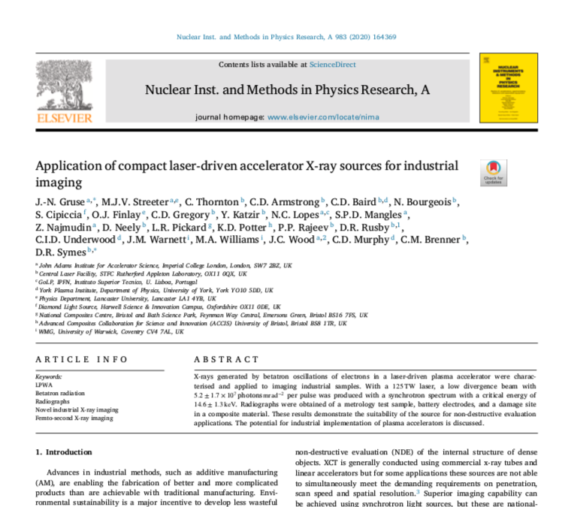

Betatron Imaging
Z. Najmudin
Use betatron radiation from plasma-based electron accelerator
Compact X-ray source comparable to national-level facilities
Wide variety of applications in (recent) industry
  non-destructive evaluation (NDE) of internal structure
  complex forms now made with additive manufacturing
  novel battery technology and structures
  evaluation of composite materials
https://doi.org/10.1016/j.nima.2020.164369
Notes:
additive manufacturing, new battery designs and volume production
use Xray CT

Slide 4
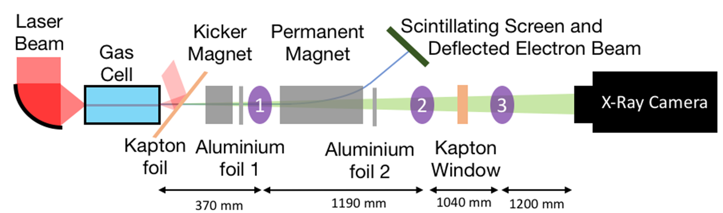
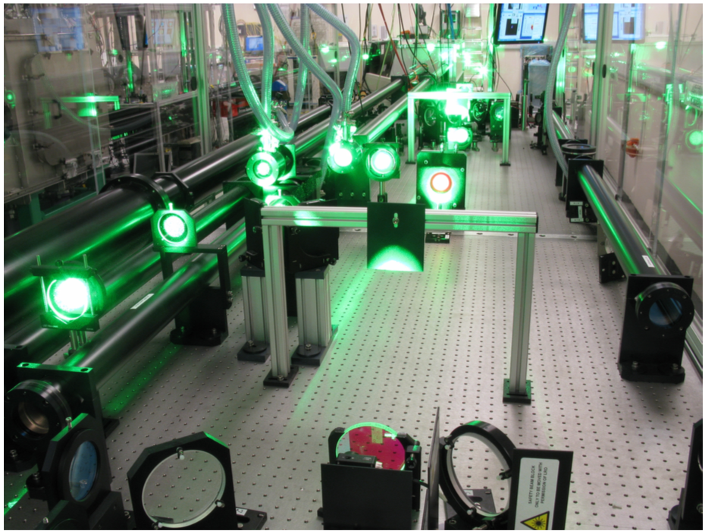
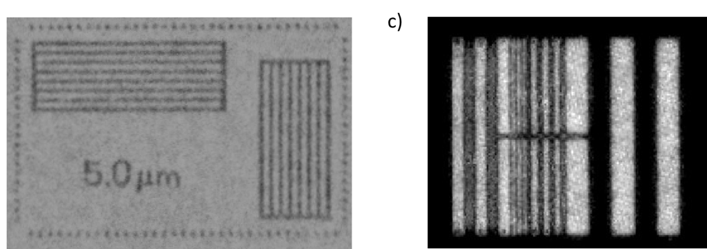
Betatron Imaging Experiments
Z. Najmudin
A number of experiments have been carried out with collaborators at RAL
View to testing for industrial applications
  using Gemini laser
  15 J at 800 nm in 2 independent beams
  pulse length < 40 fs, at 20s repetition rate
  f/40 for LWFA (a0 ~ 4)
typical imaging setup
synchrotron spectrum with
Ecrit = 17.2 ± 1.6 keV
𝑟𝛽 =1.2 ± 0.2μm
7.4 ± 2.6 × 10⁸ photons mrad⁻²
in 𝜃 ~10 mrad
resolution target imaged at position 1 (M=10.2)
gold grid imaged at position 2 (M=2.2)

Slide 5
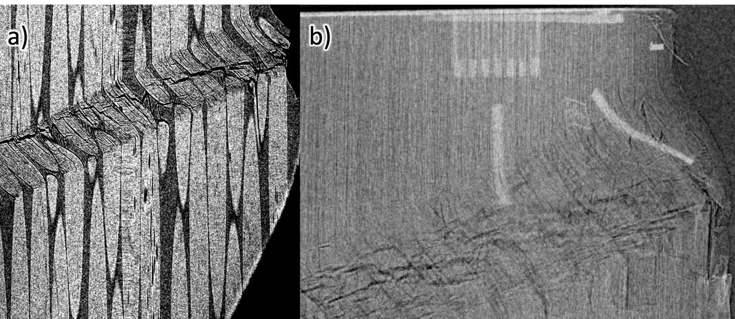
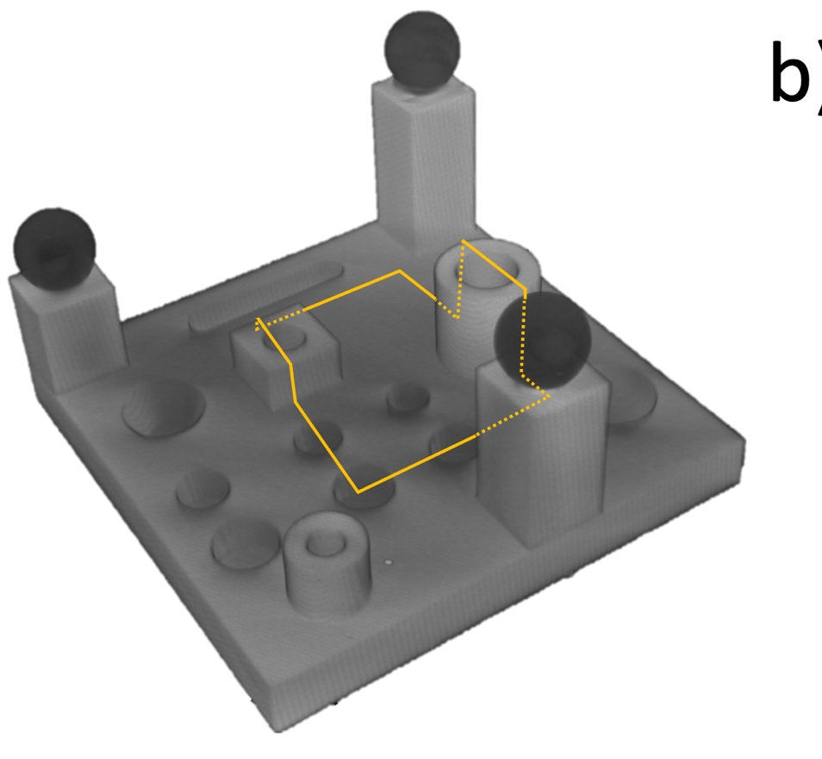
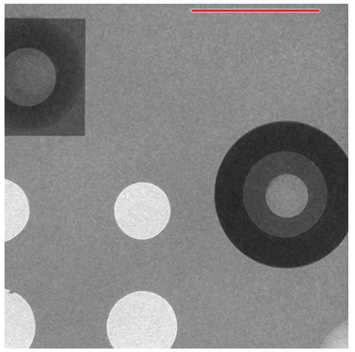
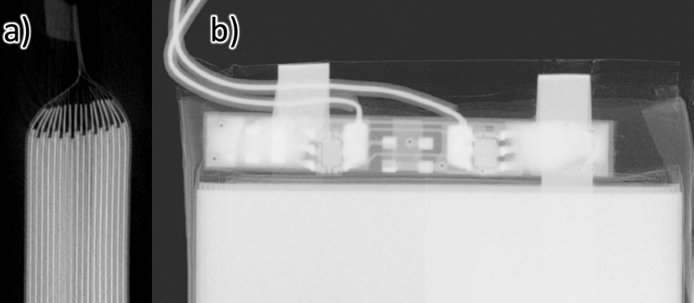
Betatron Imaging Results
Z. Najmudin
plastic 3D-printed test for XCT performance verification
2)
Betatron imaging used for phase contrast imaging of carbon fibre with kink band failure
1)
radiograph with the laser-betatron source
tomographic reconstruction using conventional lab x-ray CT
conventional X-ray source
betatron X-ray source
3)
radiograph obtained with the laser-betatron source with carbon fibre tows visible
novel lithium battery configurations

Slide 6
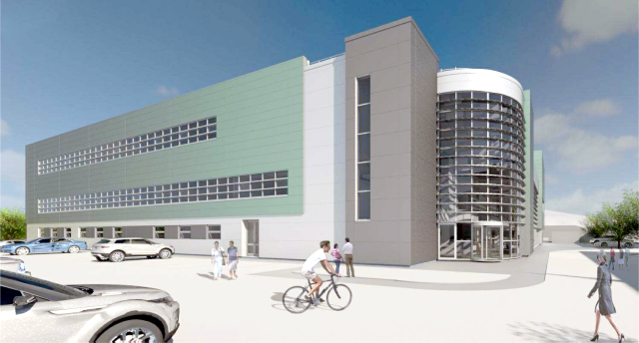
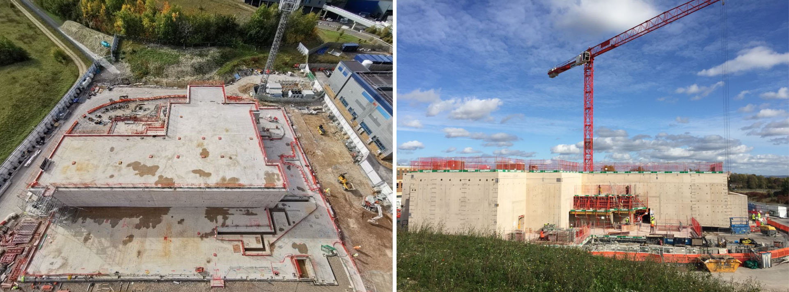
Extreme Photonics Application Centre
Z. Najmudin
> £81m facility being constructed at Rutherford-Appleton Laboratory
One of the major uses for EPAC will be betatron imaging and other X-ray techniques synchronised to secondary light and particle sources.

Slide 7
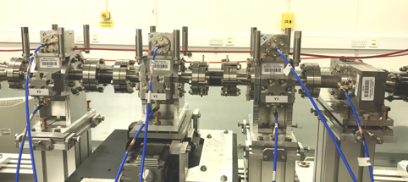
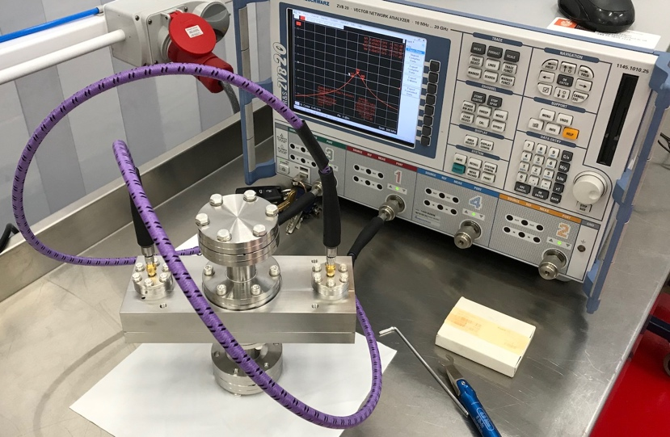
Industrialisation of BPMs for FELs
A. Lyapin
Cavity BPM designed for FELs
  underpinning research: precision diagnostics for linear colliders
Formal partnerships with FMB-Oxford and Instrumentation Technologies
  supported by STFC IPS grant 2013-2017
Complete off-the-shelf system
Cavity design licensed to FMB-Oxford in 2019
First contracts granted to both FMB and iTech in 2020 by ELI-BL, total ~€250k
Electronics delivered, cavities in the final stages of testing and tuning
REF2021 case study submitted
4 cavities in a test beamline
ELI BL cavities on the test bench
iTech’s Libera Cavity BPM now works with FMB’s cavities

Slide 8
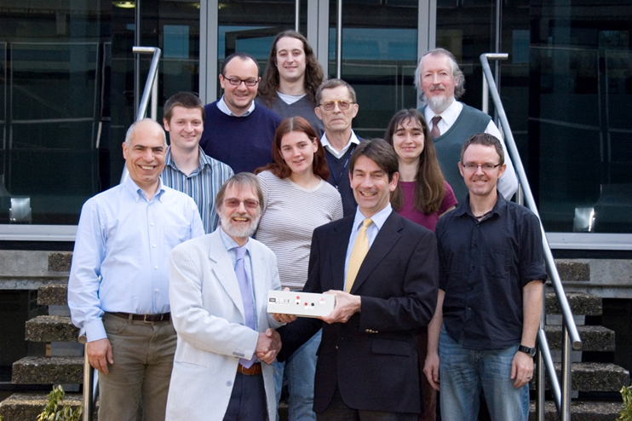
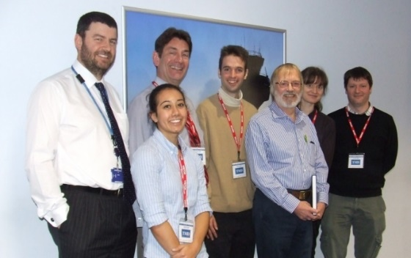
Oxford RF Work
P. Burrows
Burrows has a long-standing collaboration with UK advanced RF manufacturer TMD Technologies Ltd. (Hayes)
Jointly developed low-latency, high-power RF amplifier for beam feedback systems for ILC, deployed at KEK/ATF2
TMD sponsored PhD students via STFC ‘CASE’ scheme:
  Rebecca Ramjiawan (2019)
    Development of feedback algorithms for future linear colliders
  Neven Blaskovic Kraljevic (2015)
    Development of a high-precision low-latency position feedback system for single pass beamlines using stripline and cavity BPMs
  Christine Clarke (2008)
    The interaction point collision feedback system at the ILC and its sensitivity to expected electromagnetic backgrounds
CERN supported Doctoral Student on CLIC X-band structure performance:
  Jan Paszkiewicz (2020)
    Studies of breakdown and pre-breakdown phenomena in high gradient accelerating structures
This connection, and Burrows’ Spokespersonship of CLIC, led to TMD being qualified for bonding / brazing of CLIC X-band structures, with first structure assembled (2019/20)

Slide 9
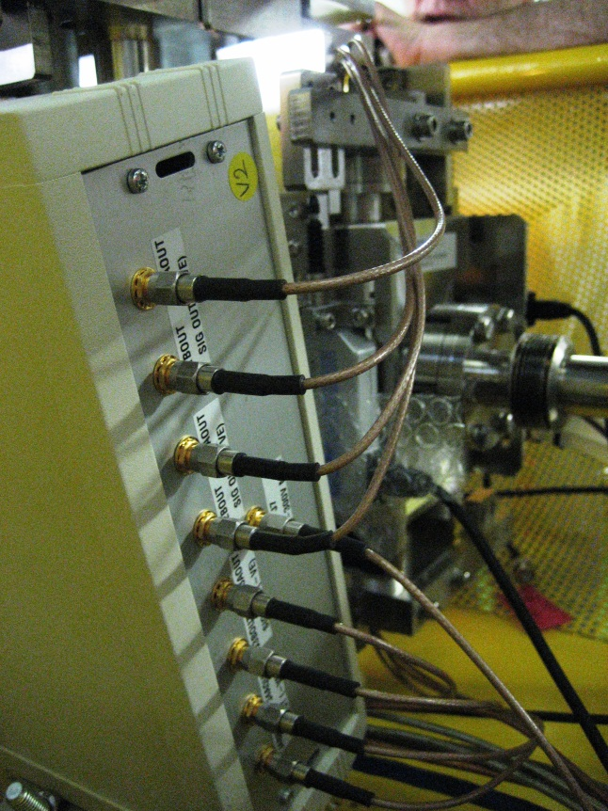
FONT Drive Amplifier
P. Burrows
Outline design done in JAI/Oxford
Production design + fabrication by TMD Technologies
Specifications:
  ± 15A (kicker terminated with 50 Ohm)
  ± 30A (kicker shorted at far end)
  35ns risetime (to 90%)
  pulse length 10 us
  repetition rate 10 Hz

Slide 10
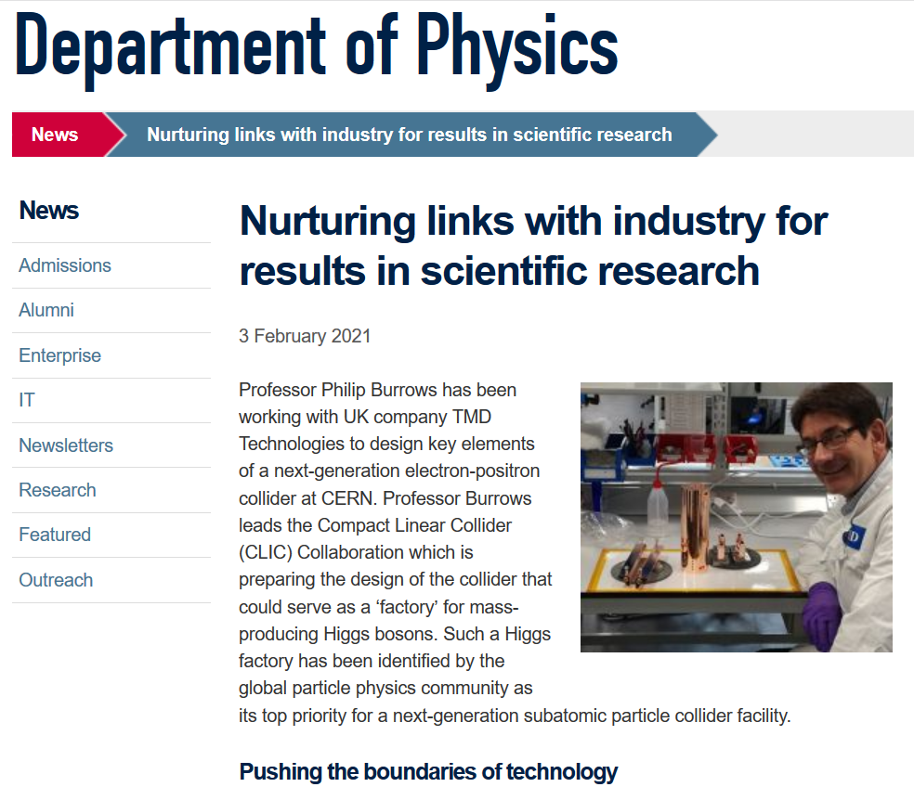
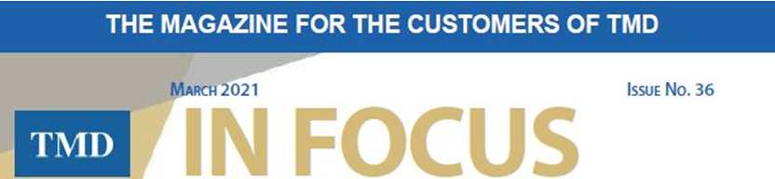
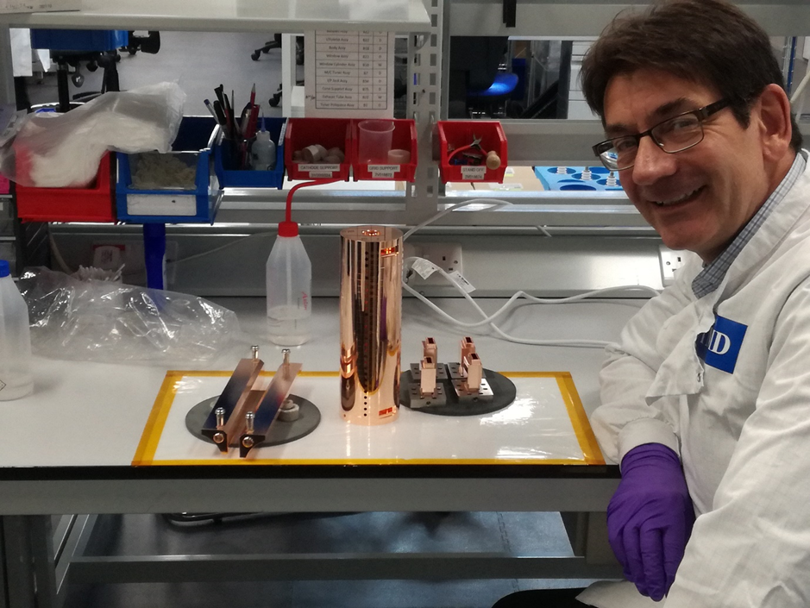
CLIC Industrialisation
Steady stream of CLIC prototypes
CLIC would eventually need tens of thousands
Developing applications:
compact light sources
VHEE therapy
FLASH therapy
(see also Manjit's talk)
P. Burrows

Slide 11
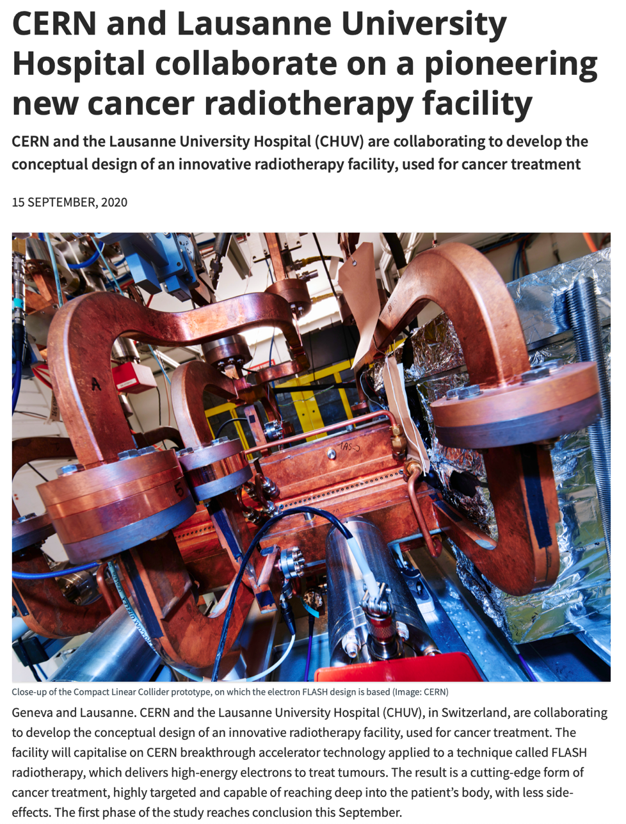
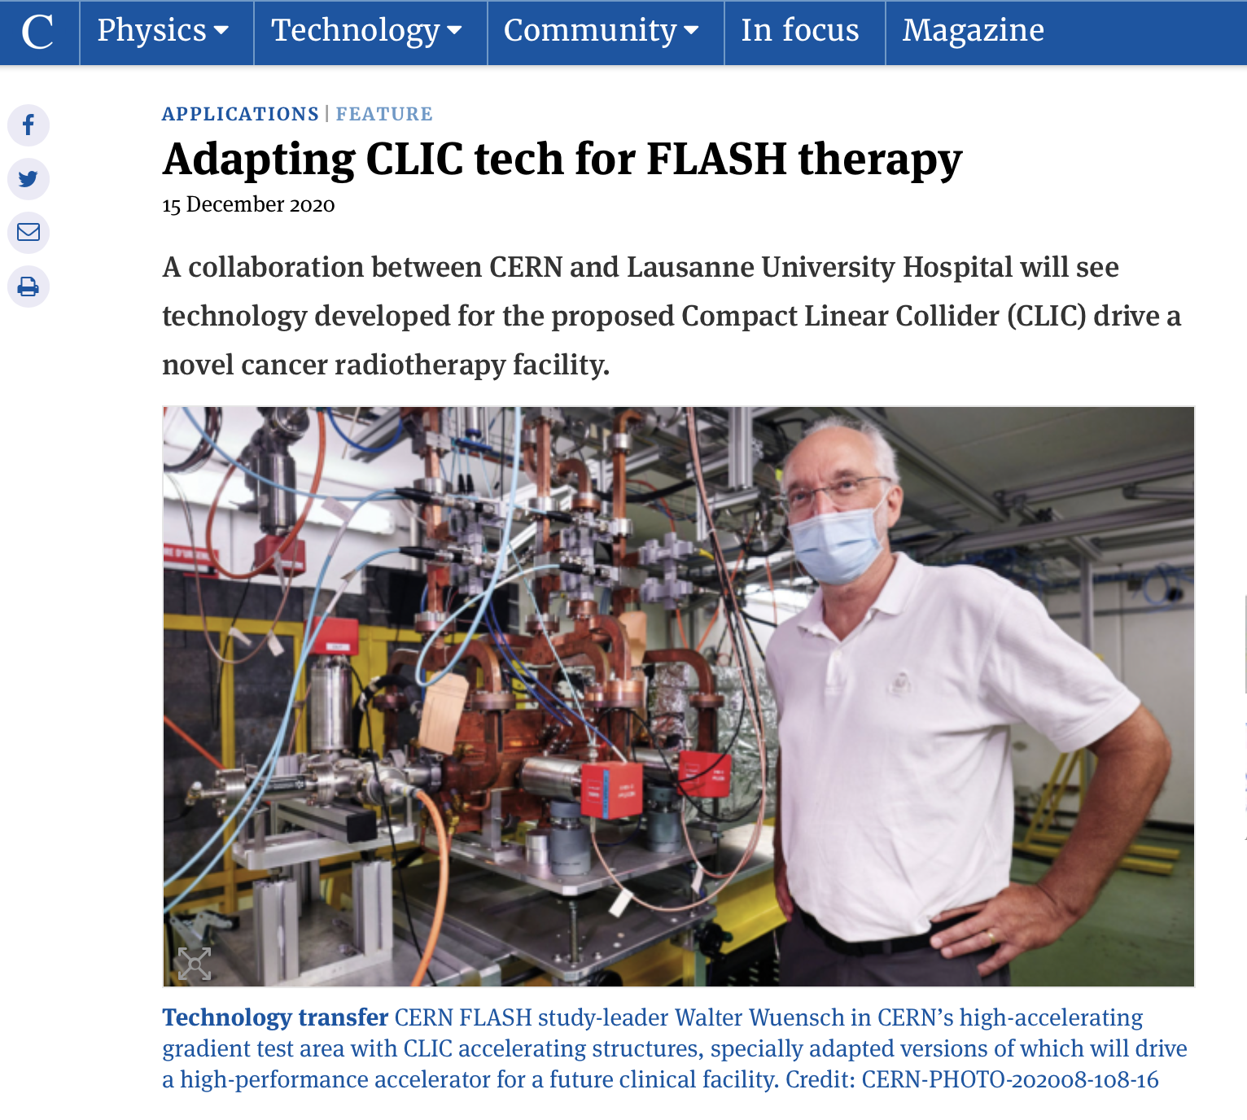
CLIC for Medical Applications
P. Burrows, M. Dosanjh
link
https://cerncourier.com/a/adapting-clic-tech-for-flash-therapy/

Slide 12
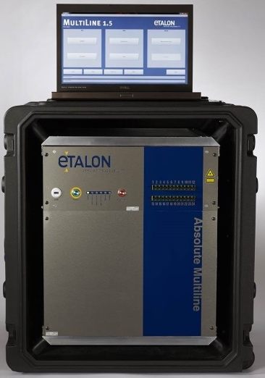
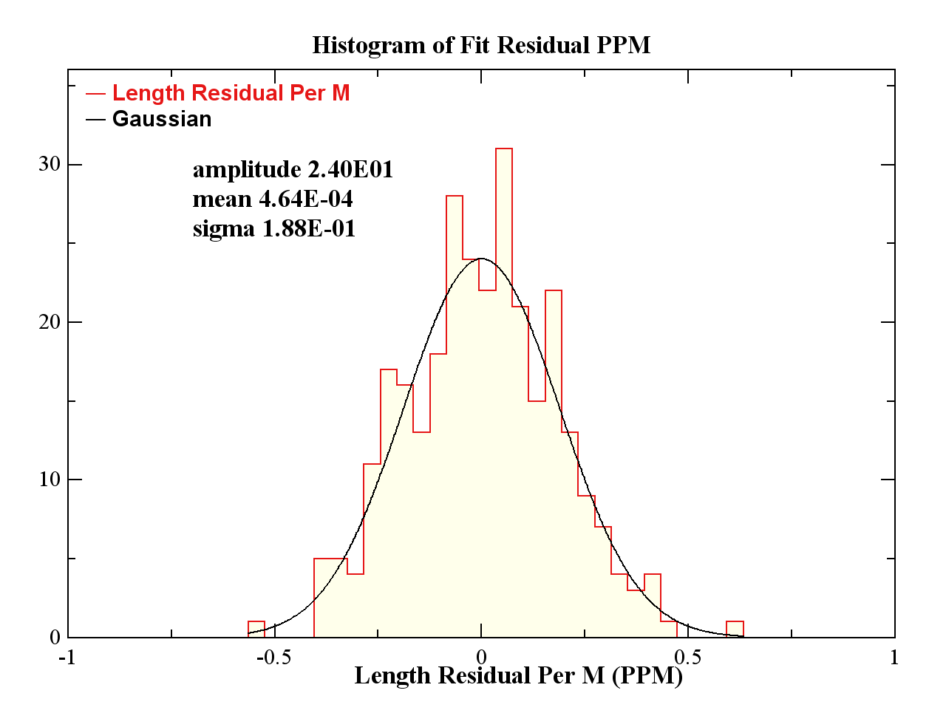
JAI Interferometry Capabilities
A. Reichold
2nd Generation absolute distance interferometry
Product = Absolute Multiline™ Interferometry
FSI = Frequency Scanning Interferometry
Up to 124 simultaneous absolute distance scans
Range 0.1m to 30m
Absolute uncertainty < ± 0.5 μm/m (95% conf.)
Scan parameters
  position resolution < ± 0.1 μm
  time resolution 125 MHz
  repetition rate 0.1 to 10 Hz
  dead time > 0.1 s
  latency > 1 s
Target motion < 19 mm/s
Vacuum & cryogenic environments
One fibre per channel
Measurement errors highly statistical
mean = 464 pm/m
➔ Averaging multiple measuremens improves accuracy
IF length is fixed
Sigma = 188 nm/m

Slide 13
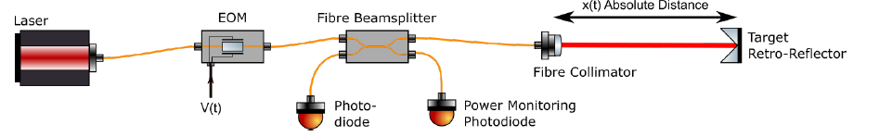
Current Progress: PaMIr
A. Reichold
Polychromatic, coherent
Light Source
measurement “channel”
(up to 12 per FPGA card)
Fizeau interferometer
Phase Modulation Interferometry
one of many
V_{mod}(t)
I_{int}(t)
optional
Real-time Displacement sensor: plug compatible to Multiline™ optics & readout
3-year IPS (project start = Feb 2019)
  £365k STFC-IPS
  £340k Industry (Etalon + VadaTech)
  £237k STFC equipment
  £188k Industry extension (Etalon)
Team = 2.5 FTE research engineers + PI
real time analysis in FPGA
D(t)
Displacement Out:
A-quad-B
PaMIr details confidential (patent pending)
Real time signal analysis in FPGA (90% complete)
  ΔT_{lat} < 10 μs (design)
  Update rate of A-quad-B 12.5 MHz
  12 channels per AMC523 (4 chan. version for Daedalus under consideration)
Any interferometer ok at any distance 0.1 – 30m
Simulations: ok at 1m/s target motion

Slide 14
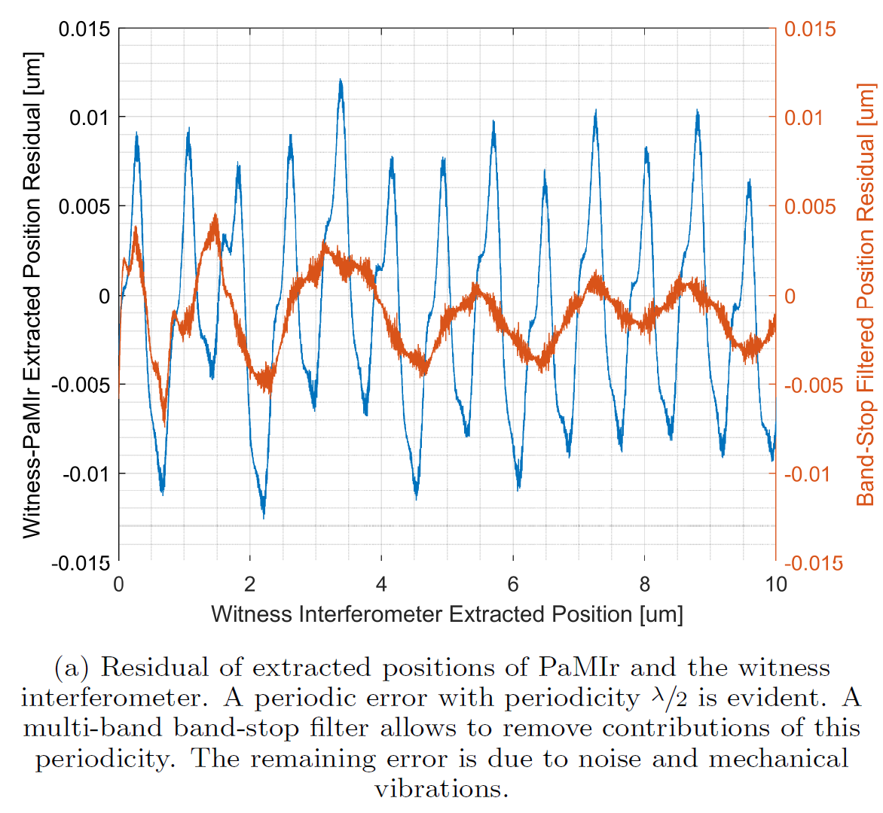
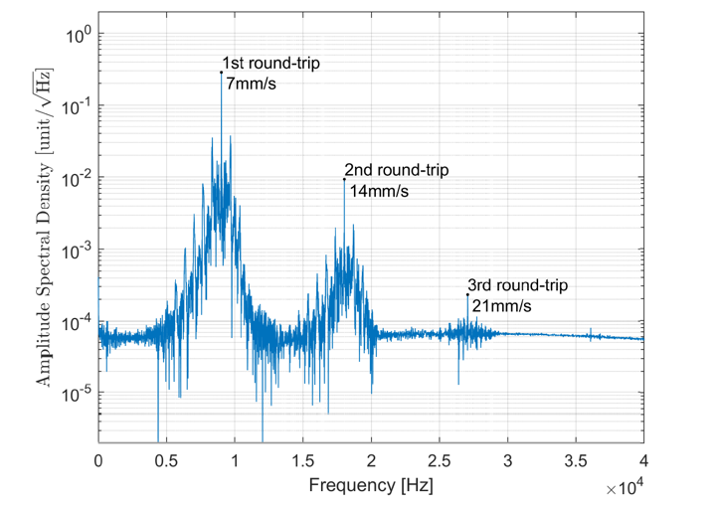
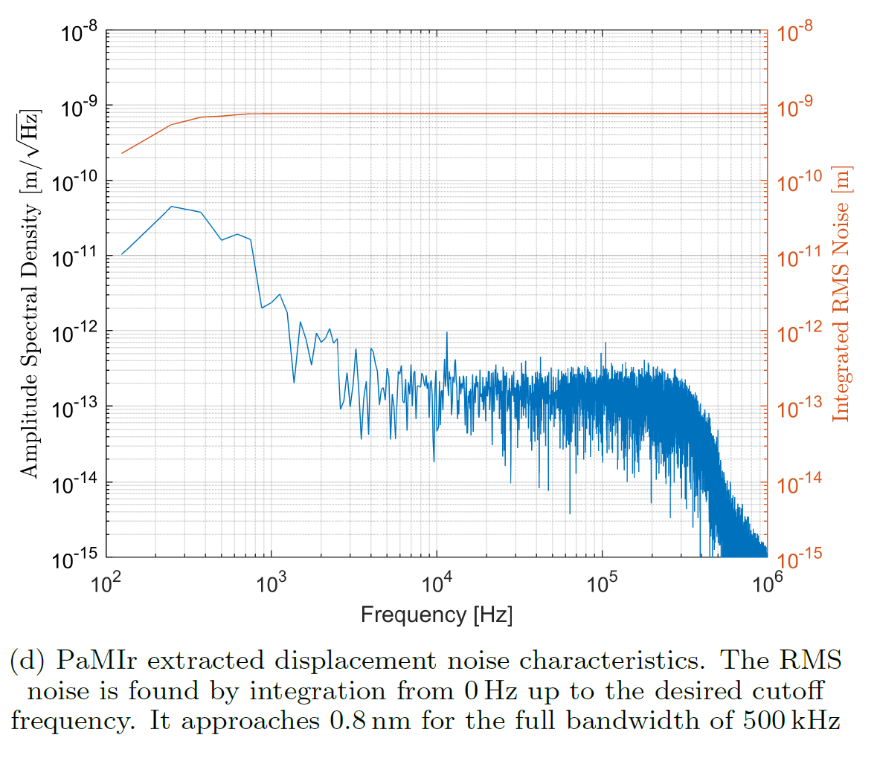
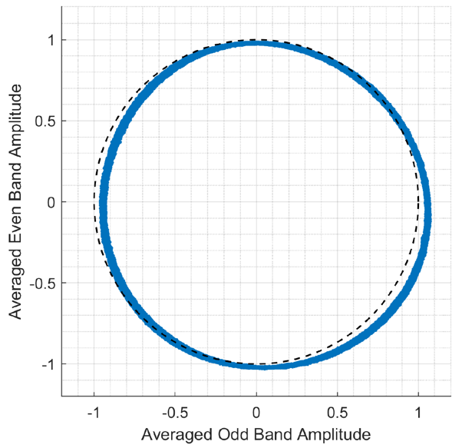
Real Data Results
A. Reichold
RMS noise 0.8 nm up to 500 kHz
  measured on stationary target
  OPD approximately 1 m
High quality quadrature signal
Multiple reflections lead to periodic distortions
Peak to peak residuals
  < 25 nm (including full periodic effect)
  < 12 nm (spectrally filtered)
Neural-net correction of periodic errors possible
Hardware suppression of round trips possible

Slide 15
Commercialisation So Far…
A. Reichold
Accelerator customers:
  2 x CERN - in-vacuum alignment of high luminosity LHC crab cavities and quadrupoles
  2 x SLAC - alignment of undulator magnets at LCLS-II
  GSI - a general purpose instrument
  PSI - in vacuum form measurement & alignment of X-ray mirrors for MAX IV synchrotron
  Argonne - monitoring of x-ray laser components
  IHEP China - Monitoring of Accelerator components
Astronomy customers:
  GMT - Giant Magellan Telescope: align primary to secondary mirror
  LBT - Large Binocular Telescope: align primary to secondary, increases usable observation time by 30 minutes per night
  ESO - European Southern Observatory: mirror deformation measurement and alignment of Harmoni instrument in cryostat
  SRT - Sardinian Radio Telescope: Monitoring of secondary mirror
  Russian Academy of Science - cryogenic, in-vacuum deformation tests for Millimetron Space Telescope
  CCAT - Cerro Chajnantor Atacama Telescope: measure form of 6m x 6m primary in situ, align prim. to secondary, uncertainty <= 5 µm
FSI Patented 2015 ➔ Four licenses to Etalon one to VadaTech
1st gen. sales >= 2013, 2nd gen. (μTCA) orders >= 2016
Sales & orders approx. £5.2M
Royalties to approx. £300k
Industrial customers:
  Siemens Energy - €1Bn off shore wind-energy platform monitoring
  SAFRAN Reosc - form metrology of 900 EELT mirrors at 20 nm uncertainty
  DMG Pfronten - thermal CNC machine deformation monitoring
  Heidenhain - novel calibration methods and thermal CNC monitoring
Other Research customers
  NARMC - UK’s Nuclear Advanced Materials Research Centre: facility wide CNC and CMM machine calibration network
  RWTH Aachen Machine Tool Lab - deformations of CNC machines
  University of Dresden - deformation of robots, presses, tools
  PTB (Physikalisch Technische Bundesanstalt) = Campus wide distribution network ➔ test rig for mobile metrology instruments, large ultra-precision CMM; deformations in wind energy, torque-test stand

Slide 16
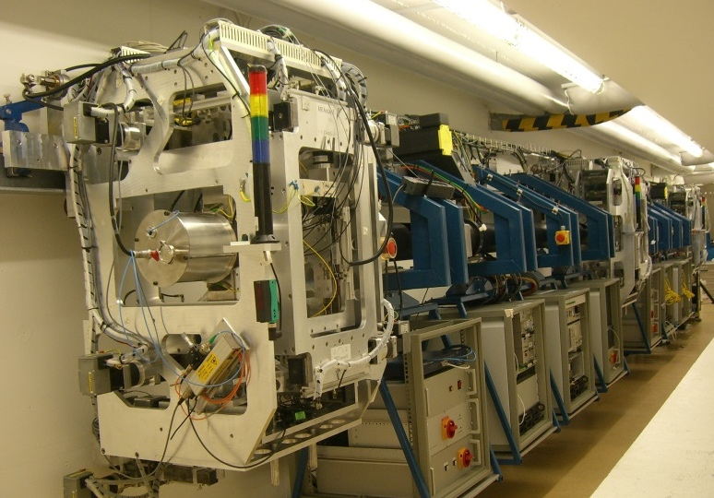

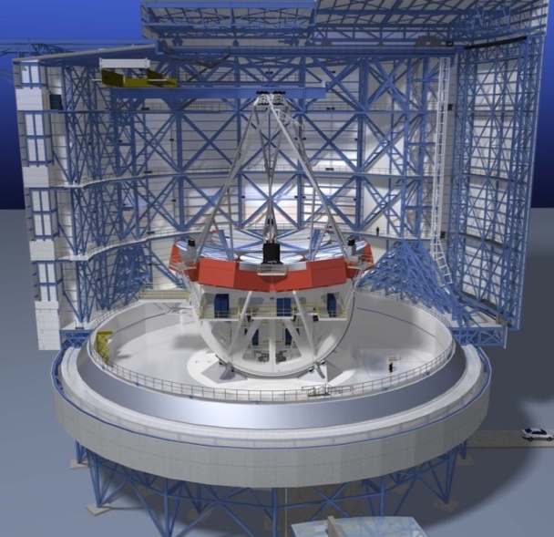


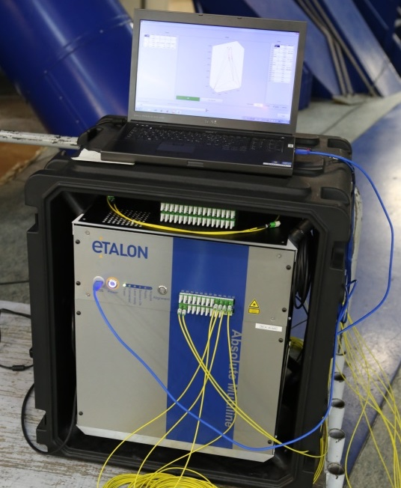


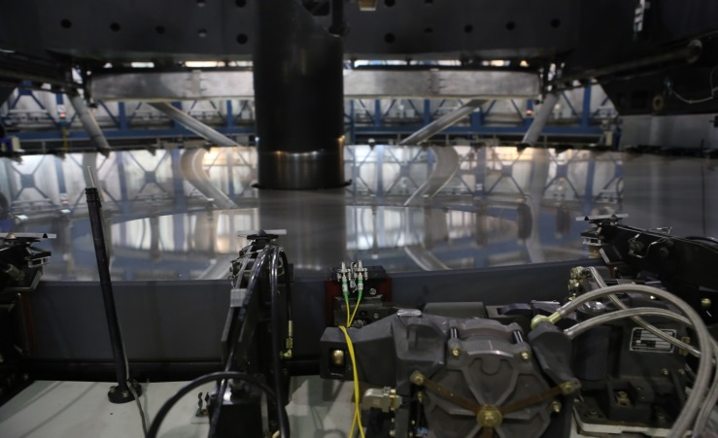
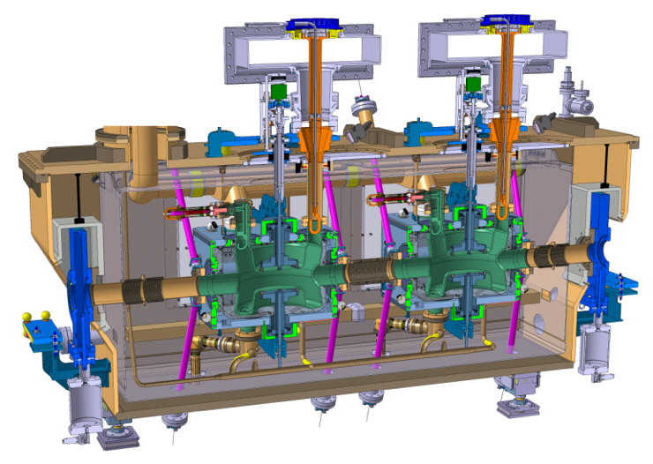

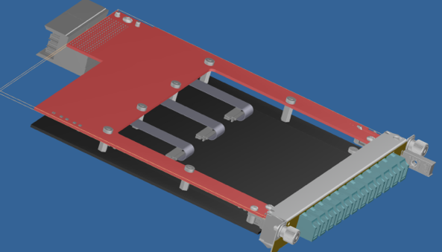

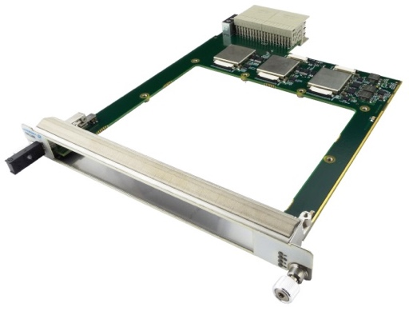

A Virtuous Circle of Metrology
A. Reichold
Robotic
Tunnel
Reference
Surveyor (ILC)
GMT primary vs. secondary Alignment
FSI Tech.
Transfer to
VLT alignment
prototyping by
one
example
FSI Tech
Update to
μTCA DAQ:
HL-LHC
crab cavity
alignment

Slide 17

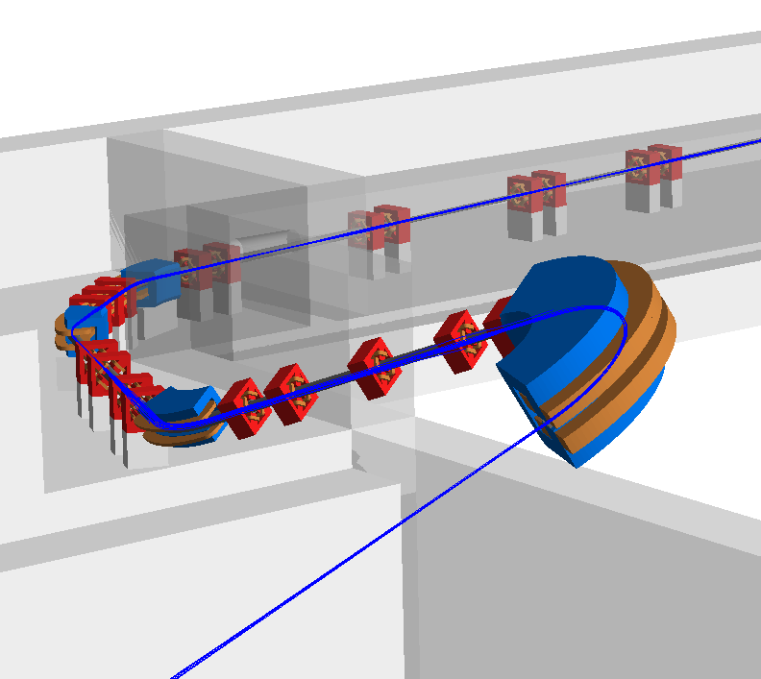

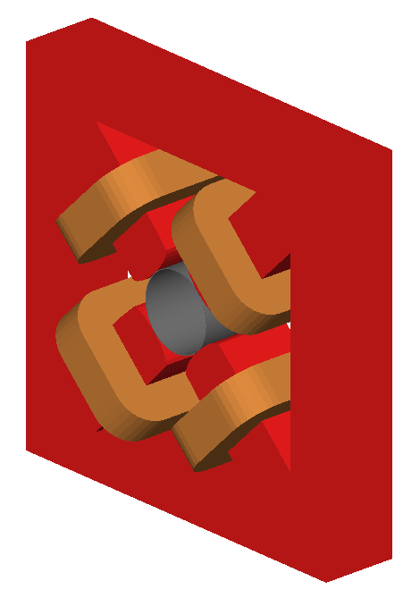
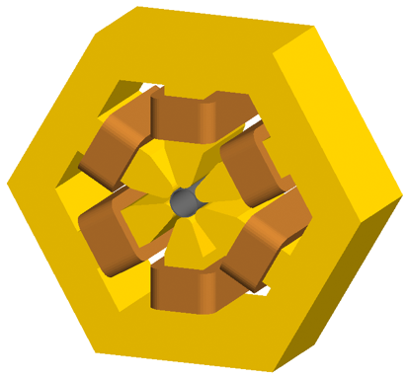
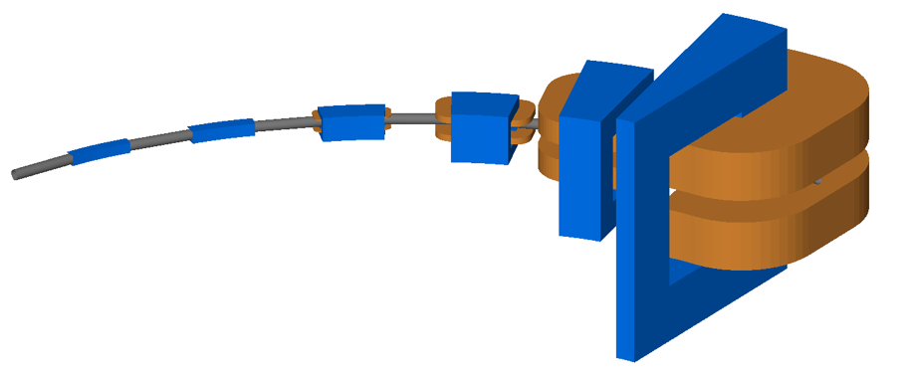
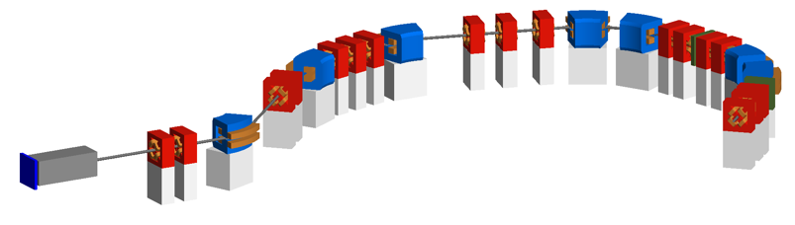
Beam Delivery Simulation (BDSIM)
L. Nevay, W. Shields, S. Boogert
Idea in 2004 by G. Blair at Royal Holloway for Linear Collider muon backgrounds
  re-developed and modernised since 2014 by L. Nevay, S. Boogert, W. Shields and RHUL group
Automatic Geant4 models of accelerators
Applied to many experiments and machines
  ILC / CLIC, AWAKE, XFEL undulators, LHC collimation, Laserwires, ATLAS non-collision backgrounds, MAGIX at MESA, and recently FASER, KLEVER, NA62 (PBC)
Strong application for medical therapy systems
  including radiobiological research facilities - e.g. LhARA
Computer Physics Communications (252), July 2020, 107200
PSI Gantry 2 model
scalable geometry
IBA ProteusPlus beam line
optical validation on ATF2 at KEK

Slide 18
Proton Therapy Evolution
L. Nevay, W. Shields, S. Boogert
Vendors are looking to create more compact facilities
  reduced cost and therefore greater accessibility to meet societal needs
More compact machines couple patient environment to accelerator one
Traditional modelling methods (point sources of losses) break down
Apply BDSIM's ability to create detailed radiation transport models with rich understanding in much smaller times
Validate against current facilities then apply to new, compact designs

Slide 19
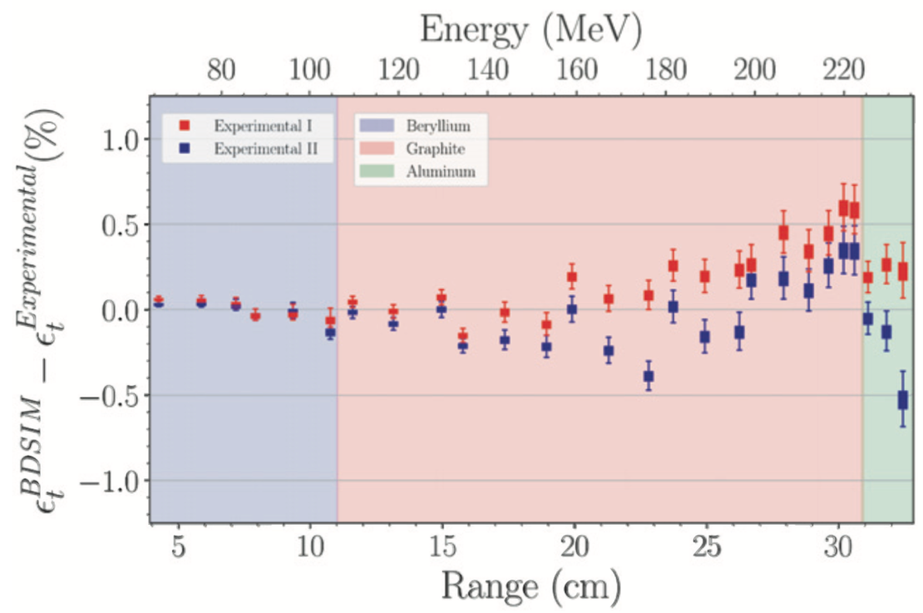
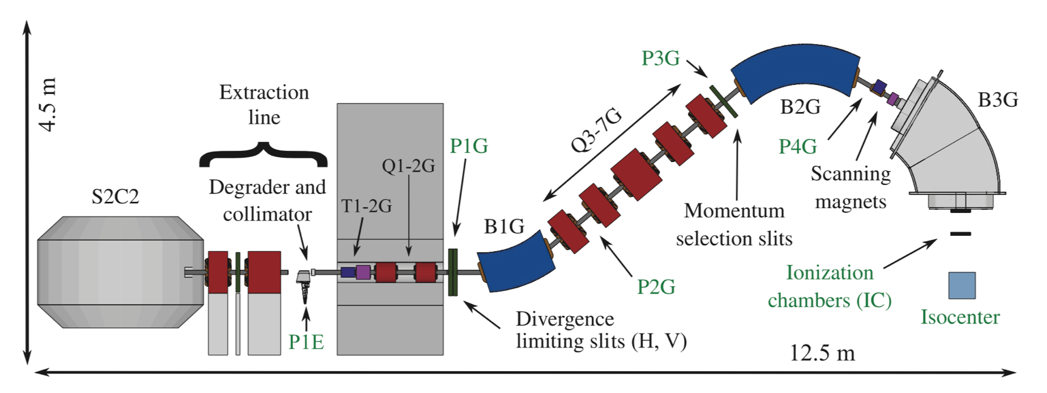
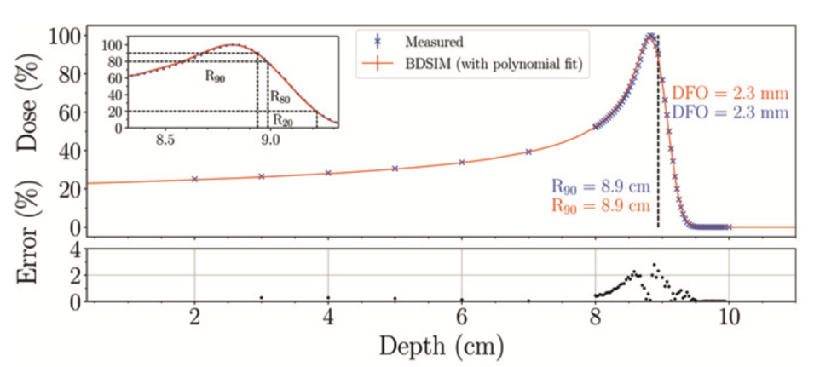
BDSIM Model of IBA Proton Therapy
L. Nevay, W. Shields, S. Boogert
In collaboration with ULB & IBA we simulated their Proteus One system
NDA in place between RHUL, IBA & ULB since 2018
Beam launched from exit of cyclotron
  interaction in material throughout including degrader
Excellent agreement in Bragg peaks in water phantom
  start-to-end simulation
Further developments underway for DICOM X-ray CT loading and 4D scoring
C. Hernalsteens, L. Nevay et al., European Physics Letters, 132 (2020) 50004

Slide 20
Further Industrial Applications
S. Boogert, S. Gibson, L. Nevay, W. Shields
Grant applications: STFC CLASP, EPSRC Research Software Engineering Fellowship, Marie Curie @ ULB
  impact acceleration funding supporting this activity, £68k
S. Boogert: studentship co-funded with Public Health England
  proton therapy quality assurance market
  50/50 PHE / RHUL funding for part-time PhD, 6Y
  former RHUL undergraduate applicant in place
Other potential industrial collaborations of RT simulations
  space: advanced geometry modelling capabilities
  particle transport at industrial levels e.g. RSim

Slide 21
LhARA
Work beginning with Corerain & Maxeler
  software companies
Dose deposition imaging and automation
Leo Cancer Care
  medical equipment provider
Automated positioning
Notes:
LhARA collaboration has agreed to dDeveloping its industrial activity through Leo Cancer Care and Industry Partnerships & Commercialisation Executive;
Discussing with Cosylab … some joint interest in novel dosimetry and automation; and
Industrial strategy development will be come a larger feature if STFC Visions process (to be described by Manjit) takes off …

Slide 22
Additional Oxford Commercialisation Activity
Spin-outs from the P. Norrey's group from research on plasma wakefield acceleration:
  Living Optics (2020) https://livingoptics.co/ is redefining hyperspectral imaging via an algorithmic approach, improving efficiency, resolution and enabling unprecedented miniaturisation: 13 employees, £XM raised.
  Machine Discovery (2019) https://machine-discovery.com/ develops and commercialises acceleration and optimisation software for quantum physics: 3 employees, £XM raised.
STFC IAA Funds:
  funded a project to hold an international workshop on “Growing a UK network to realise impact for a robust medical LINAC for challenging environments” - £17,600 (Event impacted by COVID-19, see presentation from Manjit Dosnah)
Entrepreneurship Training from Physics DPhil Students:
  7-week course delivered by physicists-turned entrepreneurs on how to apply physics research to commercialisation. Course was oversubscribed with 25 students completing the assessment.
“I think that physics and entrepreneurship go hand-in-hand, as the cutting-edge ideas and techniques researched in physics often have the potential to solve societal problems. It was also great to form a team with other physicists and get to know them, as well as develop our ideas alongside the formal teaching we had each week.” Laurence Wroe, JAI Student
https://www2.physics.ox.ac.uk/blog/alumni/2021/01/27/student-entrepreneurs

Slide 23
Thank you for your attention

