Slide 1

Light Sources Update
I. Martin
JAI Advisory Board Meeting
19th April 2021

Slide 2
Talk Outline
Overview of light source activities at JAI
Update on Diamond-II:
general introduction / reminder of the project
project status
Example topics from JAI members:
BPMs for FELs (A. Lyapin)
electron beam energy measurement using resonant spin depolarisation (N. Vitoratou)
integrated optics design for diffraction-limited storage rings (J. Li)
feasibility Studies of Cherenkov Diffraction Radiation BPMs (D. Harryman)
new studentships (S. Wilkes, +1)
Conclusions
Ian Martin, Light Sources, JAI AB, 19/04/2021

Slide 3
Overview of Light Source Activities
JAI contributes to light source design across broad range of topics:
Storage Rings Diamond-I (short pulses, THz emission / diagnostics, energy measurement, …)
Diamond-II (lattice design, beamline optimisation)
Free Electron Lasers CLARA (novel FEL schemes, multi-pulse / multi-colour operation, diagnostics, …)
NLS/UK-XFEL (facility design, diagnostics, short pulses, peak power, coherence, …)
LPWA (beam transport, spontaneous emission, FEL)
JAI contributors (past and present)
Staff: R. Bartolini (now at DESY), S. Boogert, P. Karataev, A. Lyapin
PDRA: A. Alekou, M. Korostelev, K. Lekomtsev
PhD/DPhil: M. Atay, S. Bajlekov, T. Chanwattana, K. Fedorov, A. Finn , D. Harryman, J. Li, I. Martin, T. Pulampong, J. Puntree, W. Shields, N. Vitoratou
Ian Martin, Light Sources, JAI AB, 19/04/2021

Slide 4
Diamond-II: Design Goals
Design goals for Diamond-II storage ring:
Improve quality of photon beams delivered to users:
  Increase spectral brightness
  Increase transverse coherence
  Reduced source size, line-width
  Optimise spectral range
Achieved via reduction in natural emittance, increase in beam energy, new IDs, (phase space matching - WIP)
  2) Increase number of straight sections:
  Space for new beamlines (up to nine)
  Choice of source for existing dipole beamlines (ID / wiggler / bespoke 3-pole wiggler)
  Space for ancillary components (RF cavities, diagnostics equipment, injection components, …)
Unique approach: Diamond-II combines both low emittance with high capacity
Ian Martin, Light Sources, JAI AB, 19/04/2021

Slide 5
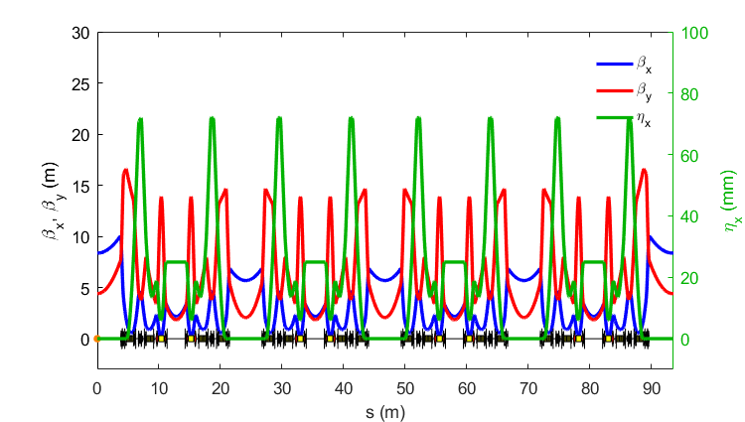

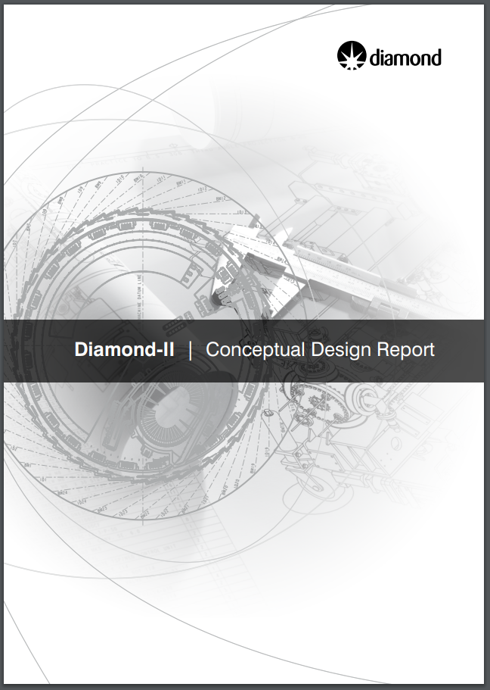
Diamond-II: Lattice
Lattice structure is a ‘Modified-Hybrid 6-Bend Achromat’, combining:
ESRF-EBS Hybrid 7BA cell
Mid-straights from Diamond Double-Double Bend Achromat
Each cell consists of:
4 longitudinally-varying dipoles
2 transverse gradient dipoles
16 (17) quadrupoles, 96 of which are displaced as anti-bends
12 sextupoles
2 octupoles
Conceptual Design Report (May 2019):
https://www.diamond.ac.uk/Home/About/Vision/Diamond-II.html
Emittance (bare lattice) 2.7 nm.rad (3 GeV) => 160 pm.rad (3.5 GeV)
Ian Martin, Light Sources, JAI AB, 19/04/2021

Slide 6
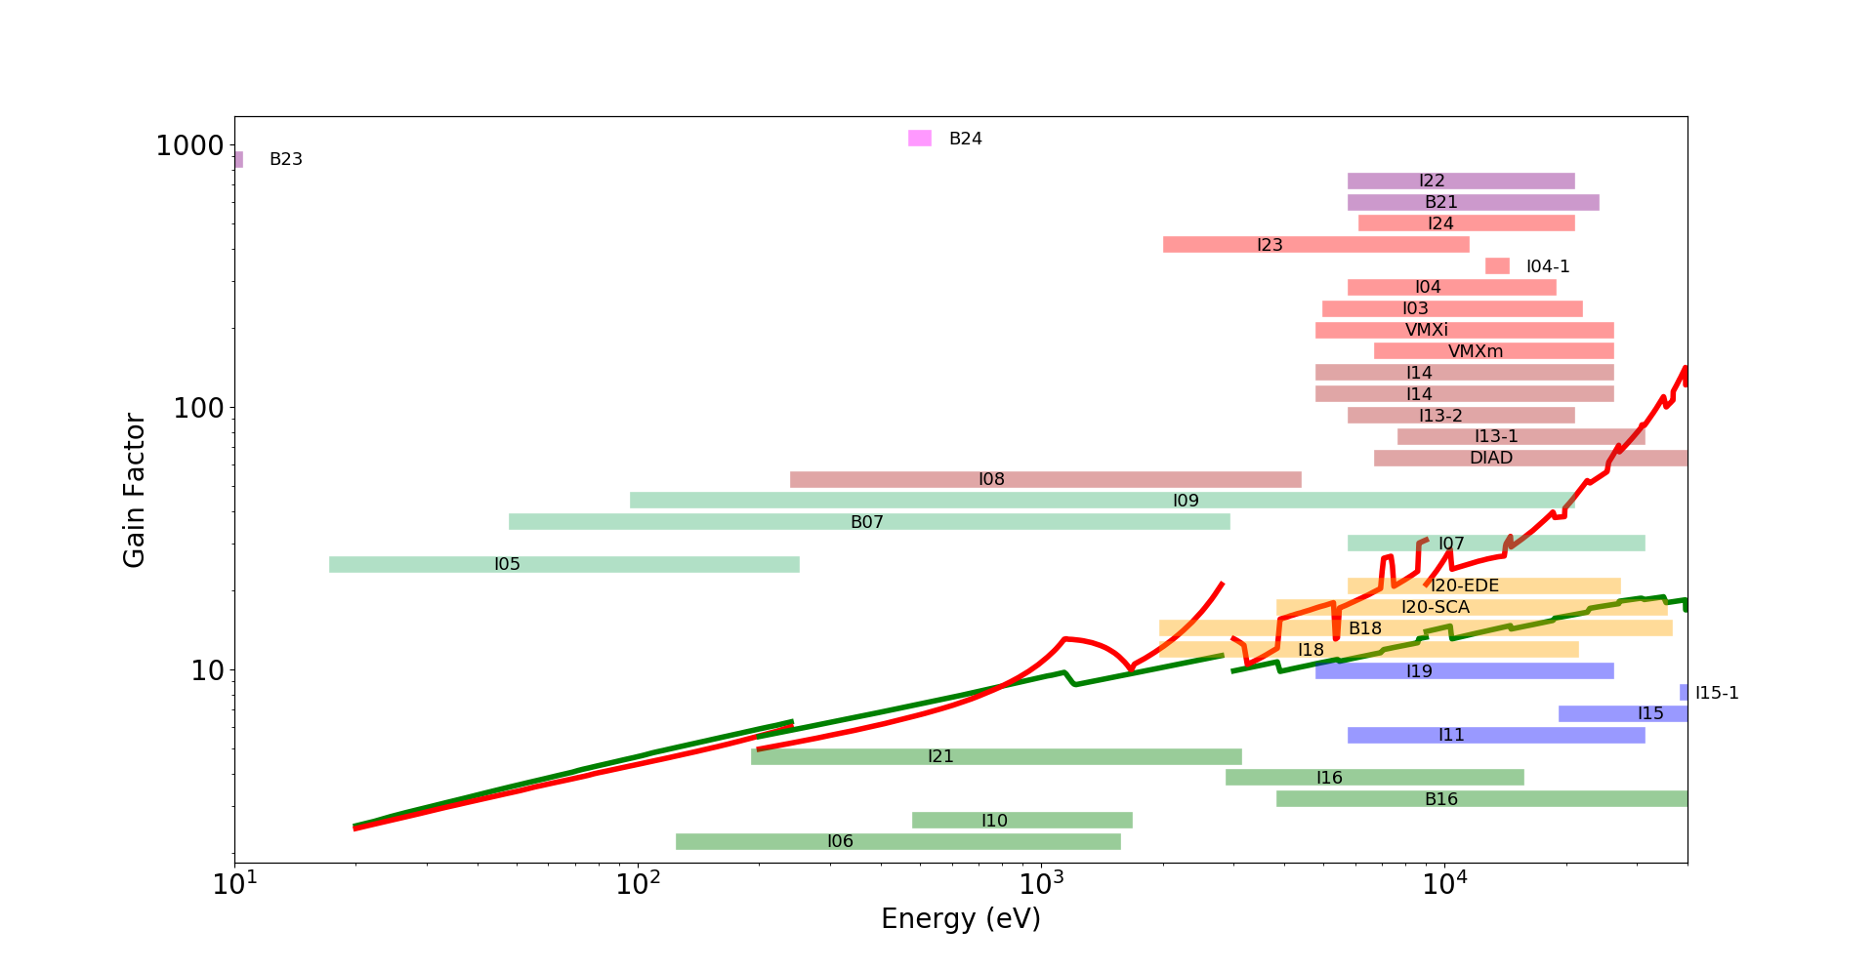
Diamond-II: Brightness Gain for CDR Lattice
 | emittance (no IDs) | Ratio | emittance (IDs+IBS) | Ratio
Diamond | 2.7 nm | 17.2 | 3.1 nm | 18.4
Diamond-II | 157 pm |  | 147 pm
3.5 GeV, 157 pm†
3.0 GeV
115 pm†
† bare lattices
Ian Martin, Light Sources, JAI AB, 19/04/2021

Slide 7
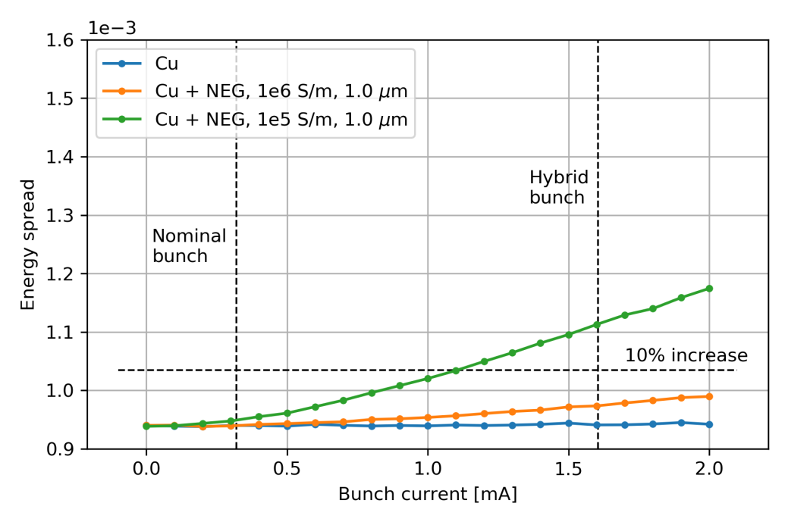
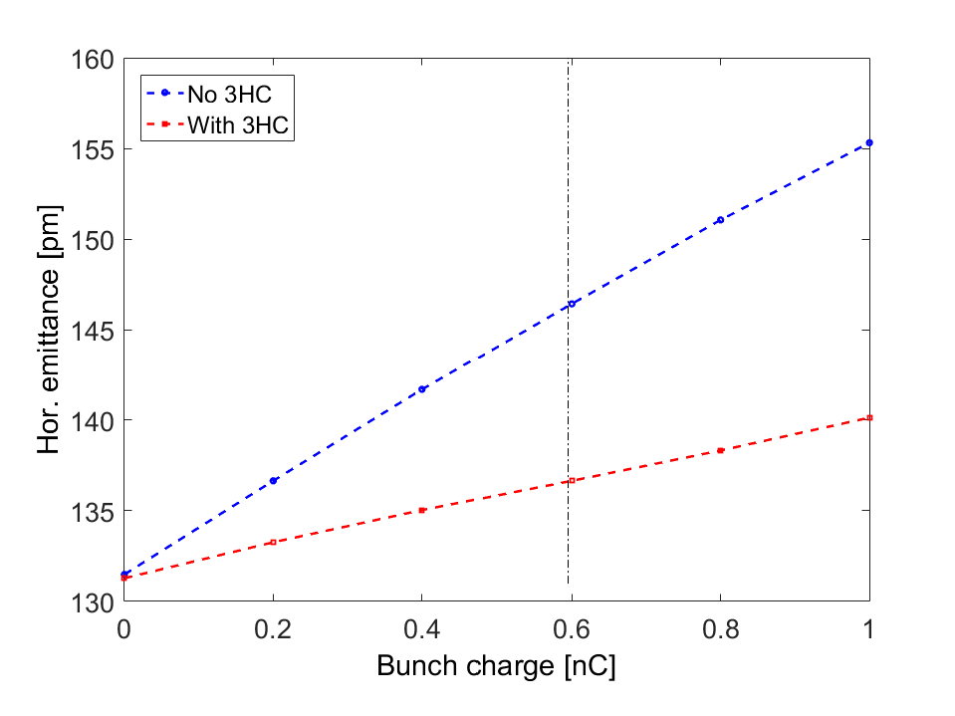
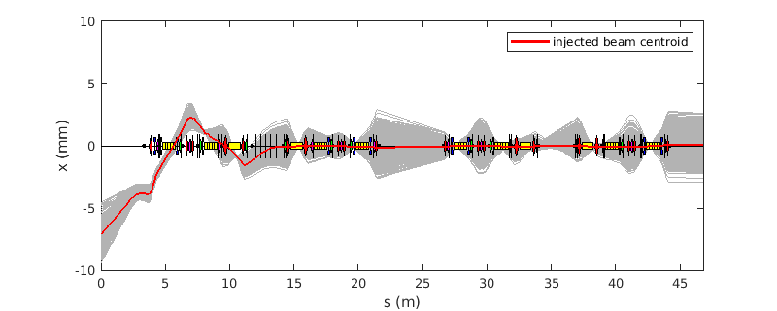
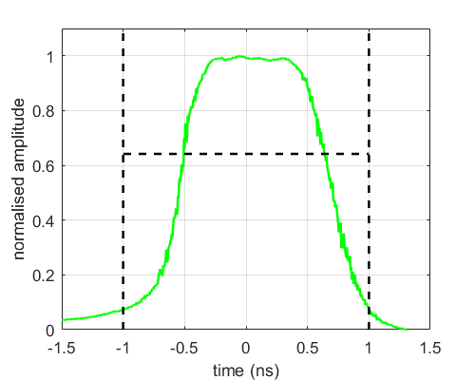
Diamond-II: Ongoing AP Activities
Lattice structure frozen since Feb. 2021 to allow Engineering, Vacuum and Magnet design work to progress.
Main focus for AP is now shifting towards characterisation and optimisation:
Develop transparent injection scheme using nonlinear kicker, possibly with fast single-bunch kickers
Studying collective effects / instability thresholds / intra-beam scattering
Choice of harmonic cavity for bunch lengthening (passive vs. active, normal conducting vs. superconducting)
Impact and compensation strategy for insertion devices
Lifetime with IDs, harmonic cavity, wakefields, IBS, predicted pressure distribution => collimation
Commissioning strategy starting from on-axis first turns through to user beam, etc., etc., ……..
Single-bunch kickers
Injected beam trajectory
Impact of intra-beam scattering
Material dependence of microwave instability threshold
Nonlinear kicker
Ian Martin, Light Sources, JAI AB, 19/04/2021

Slide 8
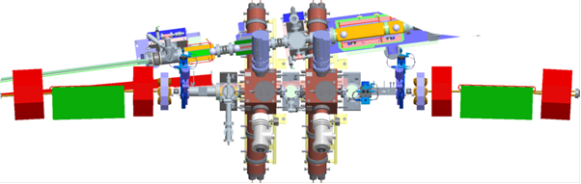
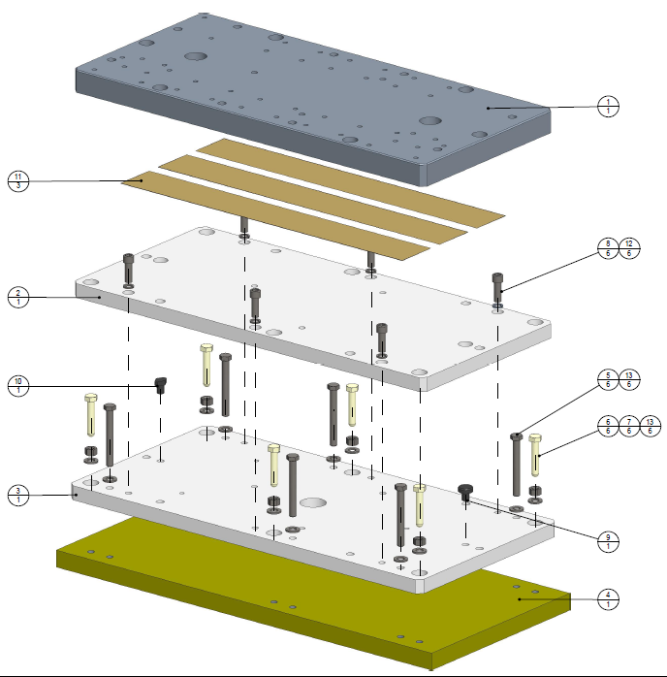
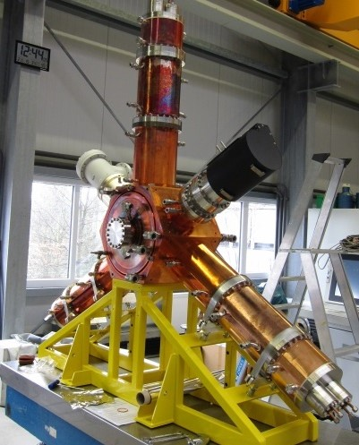
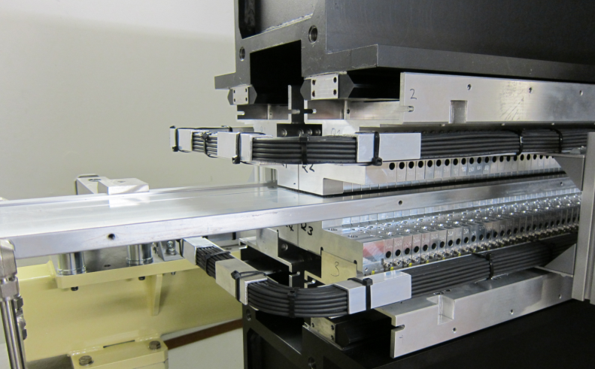
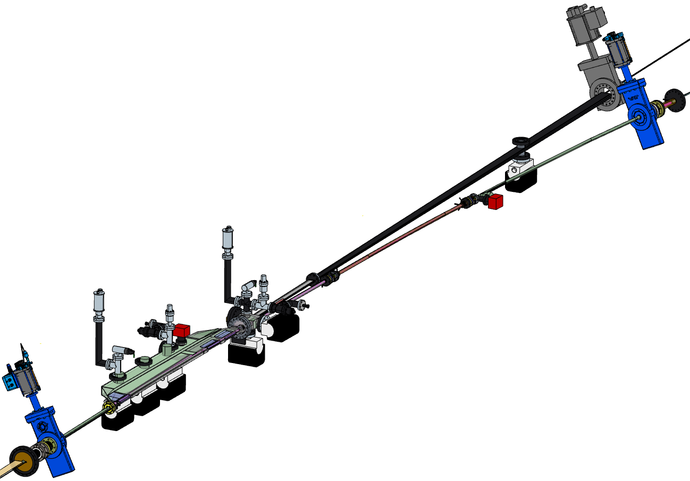
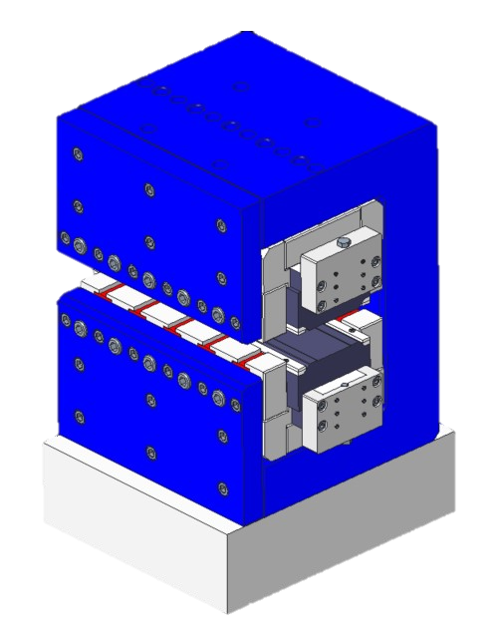
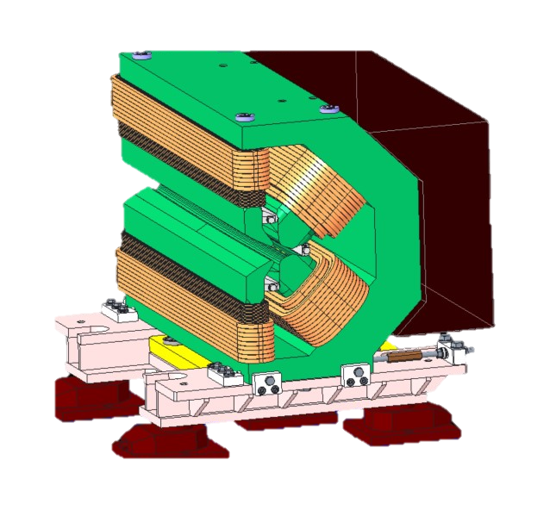
Diamond-II: Technical Design
Girders:
Single girder per half-cell (8m)
Viscoelastic tape in base-plates
RF: 8 NC EU HOM-damped
Digital LLRF
Solid-state amplifiers
IDs/vessels:
4 mm min gap
Magnets:
PM long. varying dipoles
EM magnets elsewhere
Vessels:
NEG-coated copper,
20 mm diameter
Aluminium dipole vessels
Ian Martin, Light Sources, JAI AB, 19/04/2021

Slide 9
Diamond-II: Timeline
Diamond-I funded as a Joint Venture between two sources (UK Government/STFC 86% and Wellcome Trust 14%)
Same funding structure planned for Diamond-II
Decision from both bodies anticipated within next 12 months
STFC CD-0 and CD-1 stages already complete, CD-2 and CD-3 outstanding
Nominal Timeline presented in CDR (TBC):
Event | Date
CDR Published | May 2019
Draft TDR | Dec. 2021
Start of funding and procurement | Apr. 2022
Start of shutdown | Dec. 2025
Resume full User Mode | Jun. 2027
Ian Martin, Light Sources, JAI AB, 19/04/2021

Slide 10
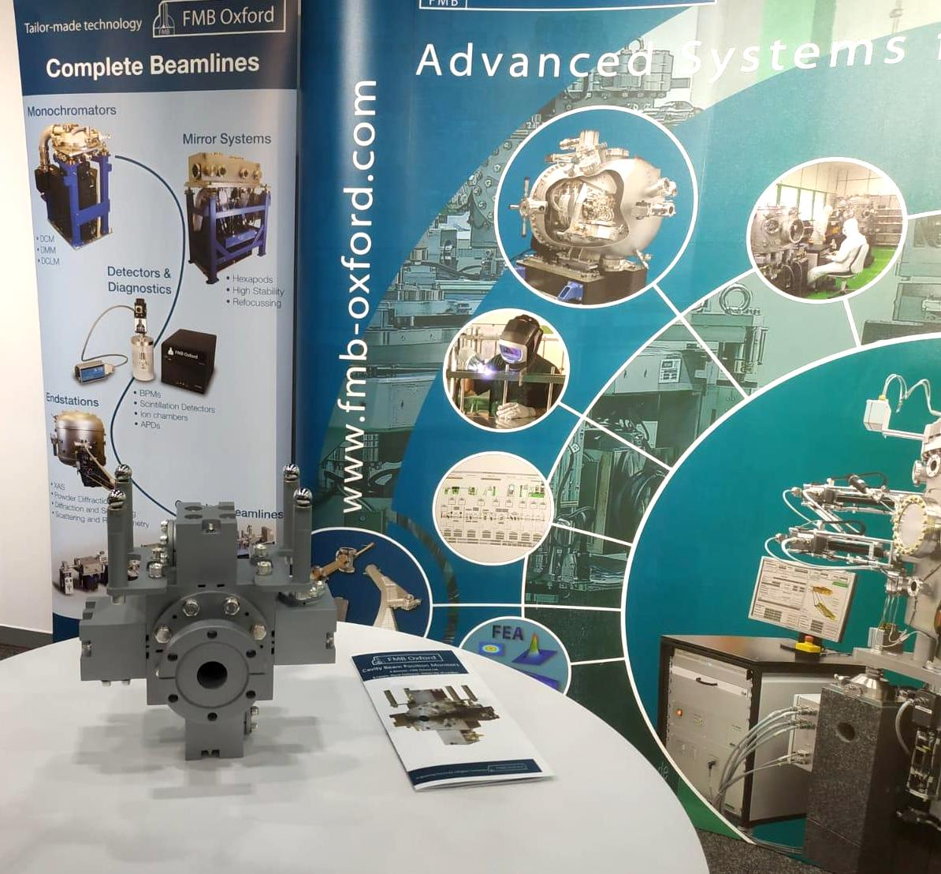
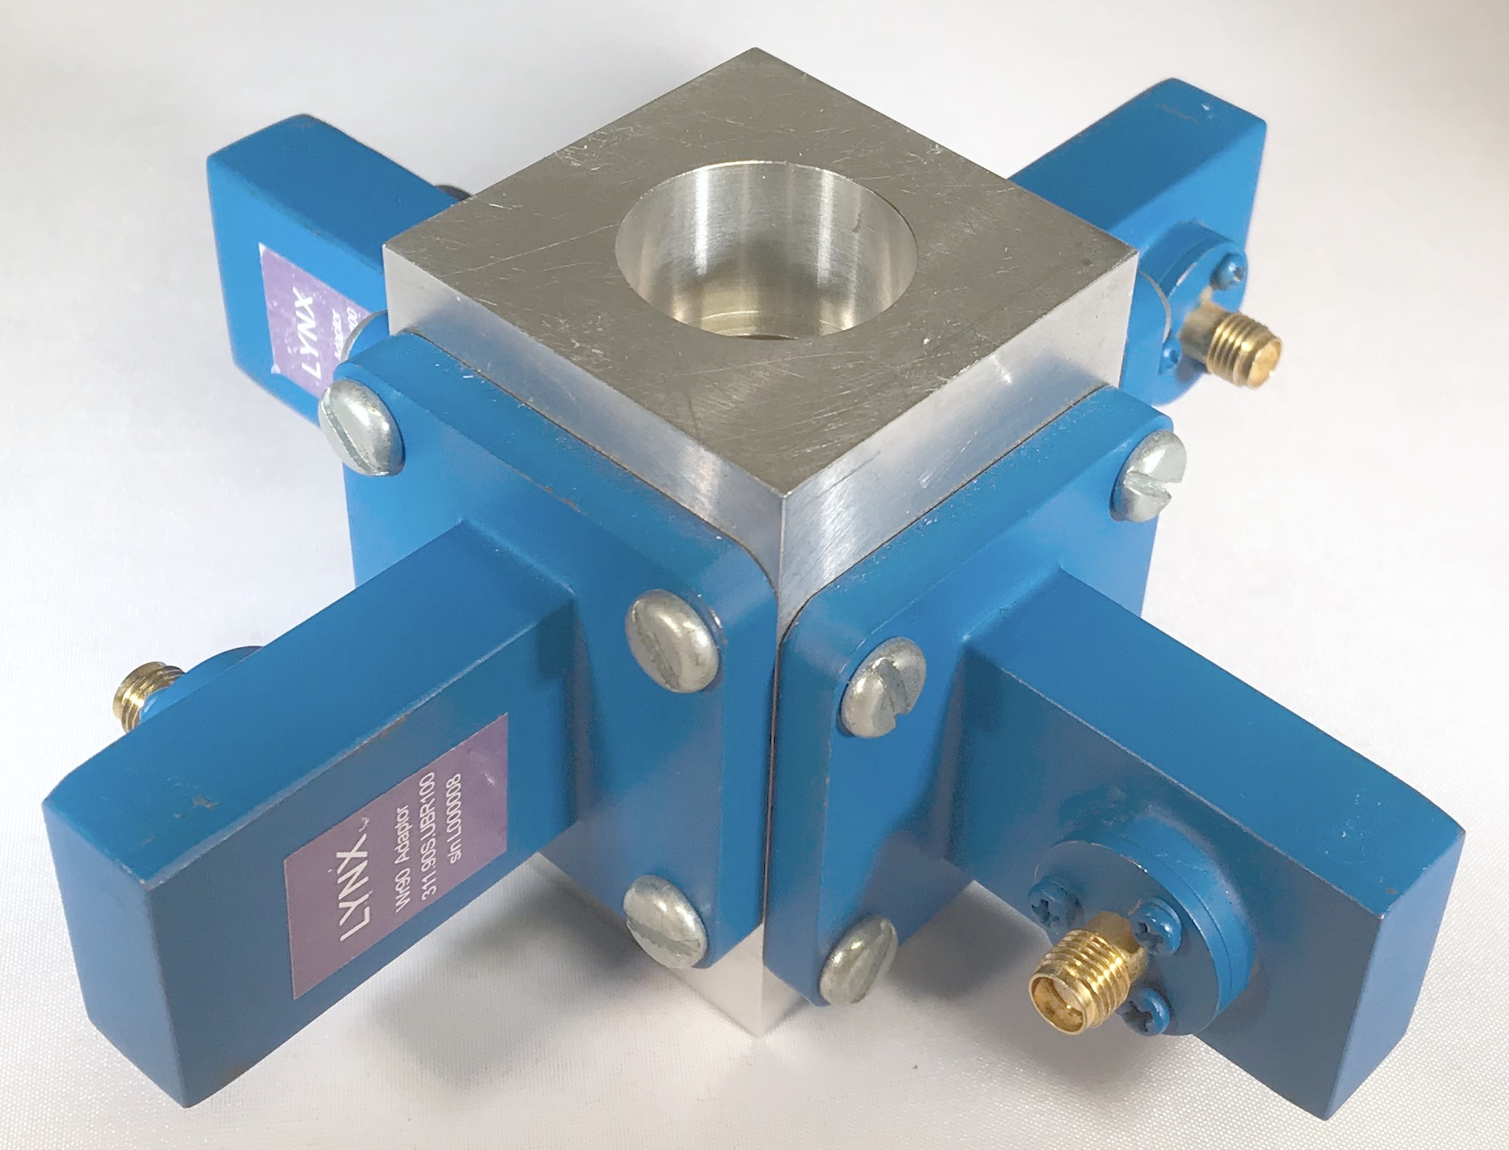
BPMs for FELs (A. Lyapin, RHUL)
Cavity BPMs:
  High precision position diagnostic, roots in LC research
  Supported by STFC IPS grant 2013-2017
  A design suitable for FELs now commercialized
  Smaller aperture design better suited for undulator beamlines in progress (would be a candidate for CLARA and UK XFEL)
  Compact higher operating frequency designs considered
  More details in industrialization talk
Waveguide BPMs:
  Spin-out from cavity BPM work
  Faster and cheaper than cavity BPMs, suitable for ns feedbacks
  Require no tuning
  But need wideband signal processing and have lower resolution potential
  STFC Follow-on Fund grant now in progress, extensive simulations resulted in several candidate designs
  A vacuum prototype WIP, slowed down by the pandemic
Project partner FMB-Oxford commercialized the cavities
Prototype WGBPM built for bench testing
Ian Martin, Light Sources, JAI AB, 19/04/2021

Slide 11
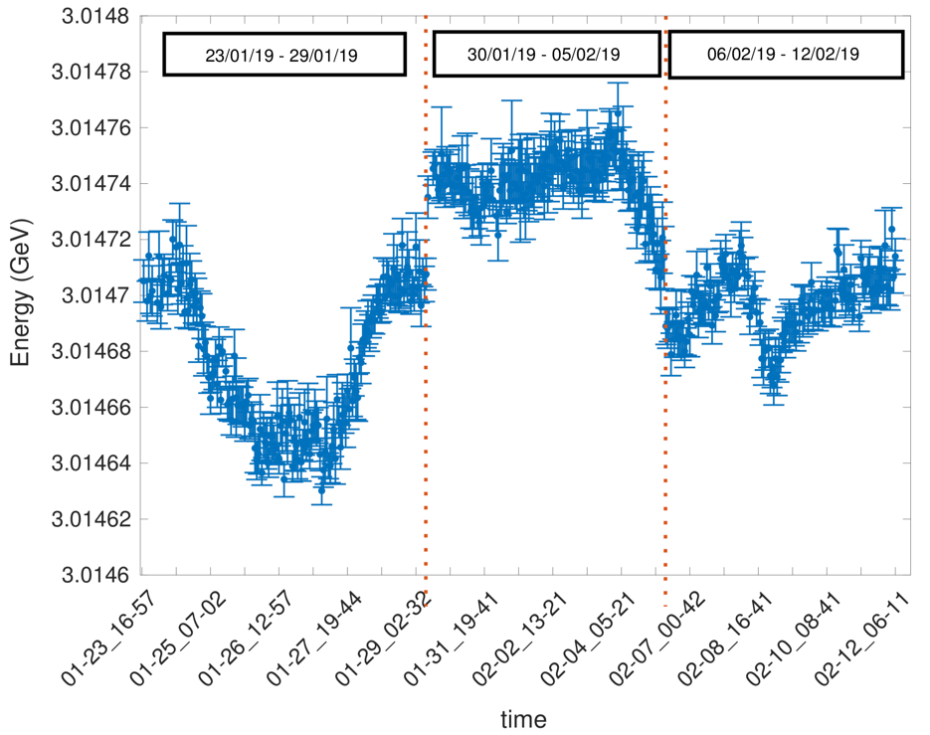
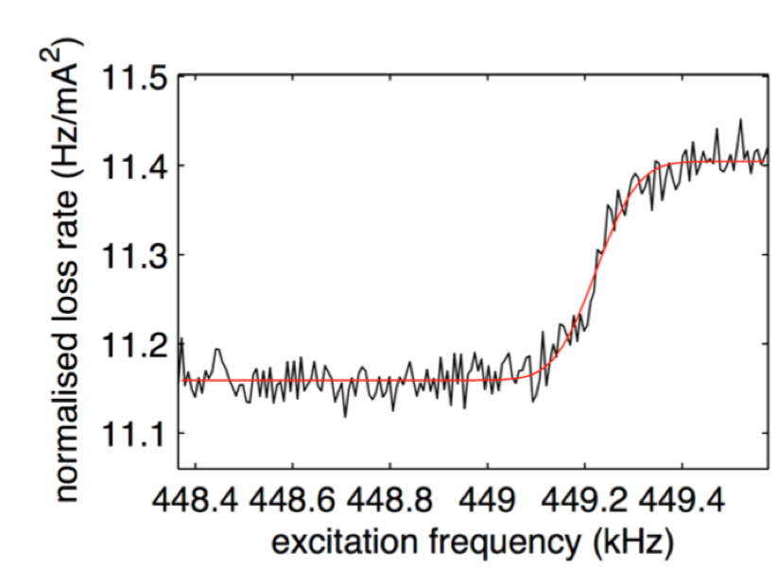
PhD Student: N. Vitoratou (2016-2020)
“Continuous Energy Measurements of the Electron Beam in the Storage Ring of Diamond Light Source”
The spin gradually aligns antiparallel with the main guide field of the bending magnets.
The polarised beam is excited by a horizontal magnetic field produced by striplines.
When the magnetic field oscillates at a frequency which matches the spin precession frequency the beam is depolarised.
The frequency at which depolarisation occurs corresponds to the beam energy.
Online energy measurement of the DLS storage ring during user operation.
N. Vitoratou, P. Karataev and G. Rehm, Phys. Rev. Accel. Beams, 22, 122801 (2019)
Supervisors: P. Karataev and G. Rehm
Ian Martin, Light Sources, JAI AB, 19/04/2021

Slide 12
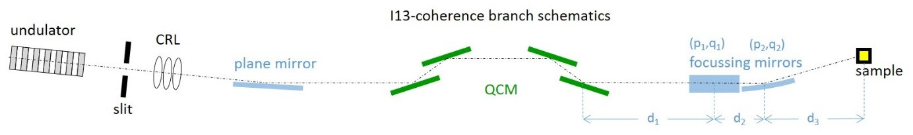
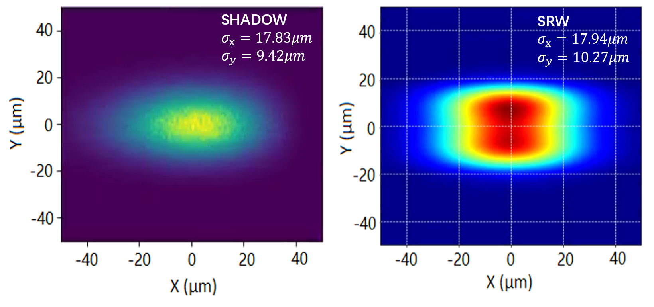
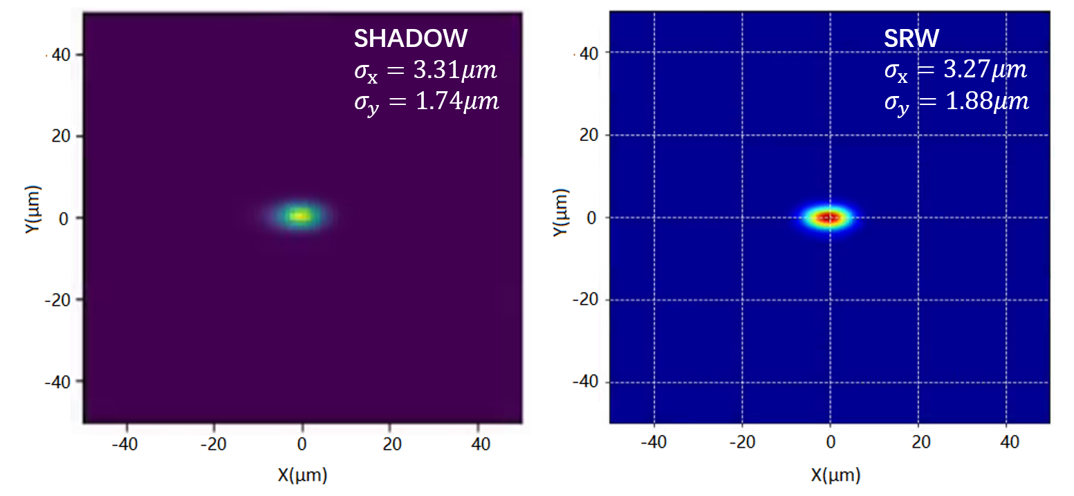
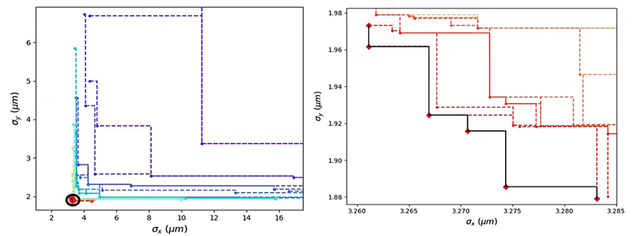
PhD Student: J. Li (2017-2021)
“Studies on Integrated Optics Design for Diffraction Limited Light Sources”
The goal is to integrate the design of electron and photons source to find the best trade off between accelerator and photon optics performance and guarantee the production of photon beam with best properties.
Integrated design:electron to sample (E2S)
Beamline parameters
Flux / Brightness
Tuning curves
Power density
Beam-spot intensities
Elegant
SRW
Beamline optimiser
SRW /
SHADOW
NSGA II
Better beamline configuration
Supervisors: R. Bartolini and P. Burrows
Ian Martin, Light Sources, JAI AB, 19/04/2021

Slide 13
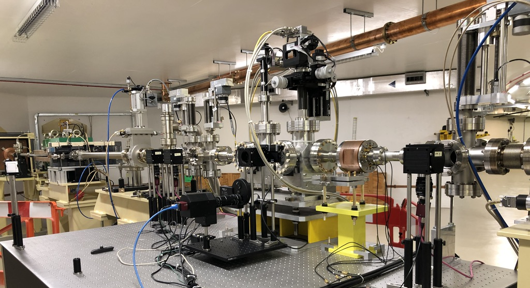
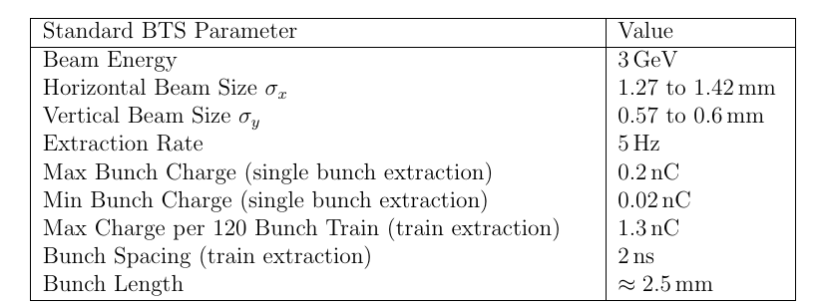
PhD Student: D. Harryman (Started 2018)
“Feasibility study on the use of incoherent Cherenkov Diffraction Radiation to develop a non-invasive BPM”
Cherenkov Diffraction Radiation (ChDR) is a type of polarisation radiation. It occurs when a charged particle moves in the vicinity a medium.
The photon yield of ChDR is dependent upon the distance between the charged particle and the dielectric medium.
Thus ChDR can be exploited for novel beam position monitors (BPM), where traditional rf pick-ups are challenging.
BTS Test Stand Vessel String
D. M. Harryman et al., Proc of IBIC’19, Malmo, Sweden, WEPP037
D. M. Harryman et al, Proc of IBIC’20, Santos, Brazil, THPP05
Supervisors: P. Karataev and L. Bobb
Ian Martin, Light Sources, JAI AB, 19/04/2021

Slide 14
PhD Vacancy at RHUL
“Feasibility study on the use of incoherent Cherenkov Diffraction Radiation to develop a non-invasive BPM”
This work is part of a wider research group* exploring the applications of ChDR for beam diagnostics in collaboration with CERN, Tomsk and Royal Holloway, Uni of London, with experimental setups at CERN, KEK and Diamond Light Source.
*R. Kieffer et al., Phys. Rev. Lett. 121, 054802 (2018)
We are currently advertising for a PhD student to continue this research to investigate BPM applications using a new target geometry and/or IR wavelengths.
PhD Info: https://www.diamond.ac.uk/Careers/Students/Studentships/2021-projects/2021-STU0397.html
Applications: https://www.findaphd.com/phds/project/feasibility-of-cherenkov-diffraction-radiation-beam-position-monitor-for-high-energy-electron-machines/?p114635
Supervisors: P. Karataev and L. Bobb
Ian Martin, Light Sources, JAI AB, 19/04/2021

Slide 15
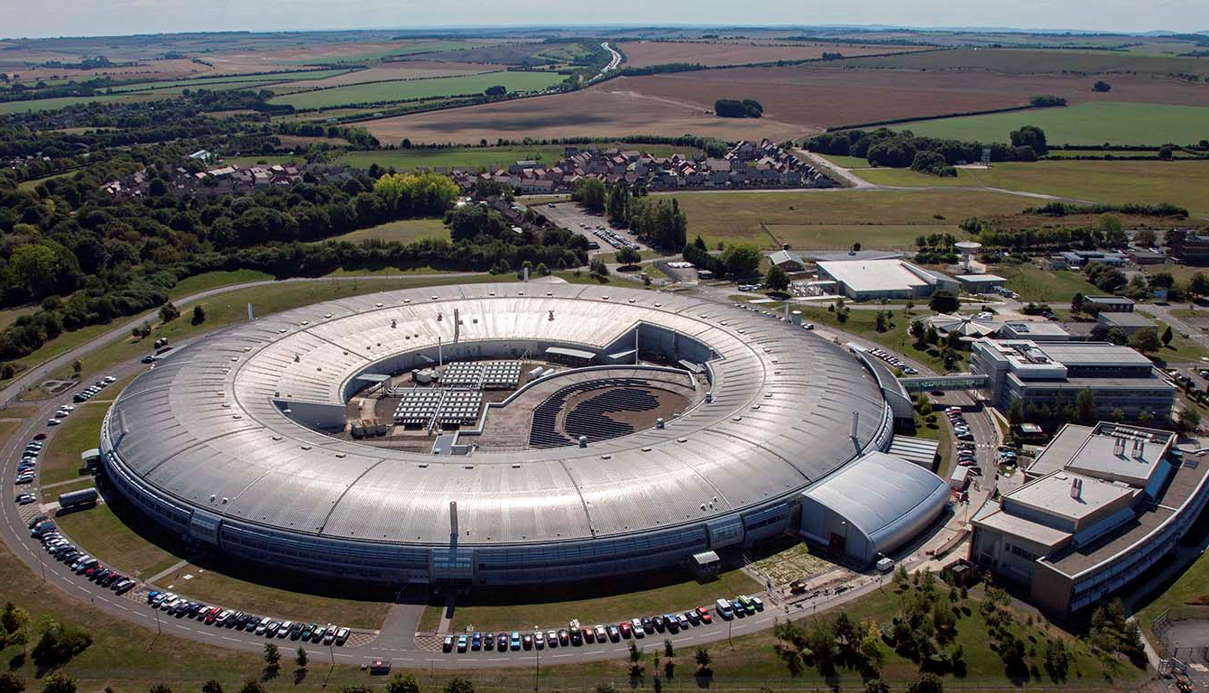
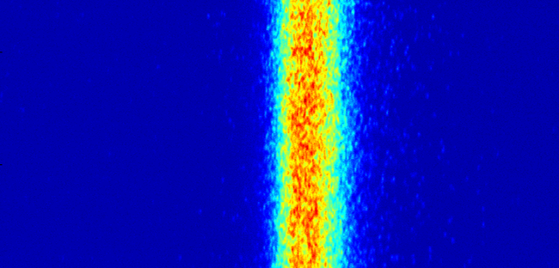
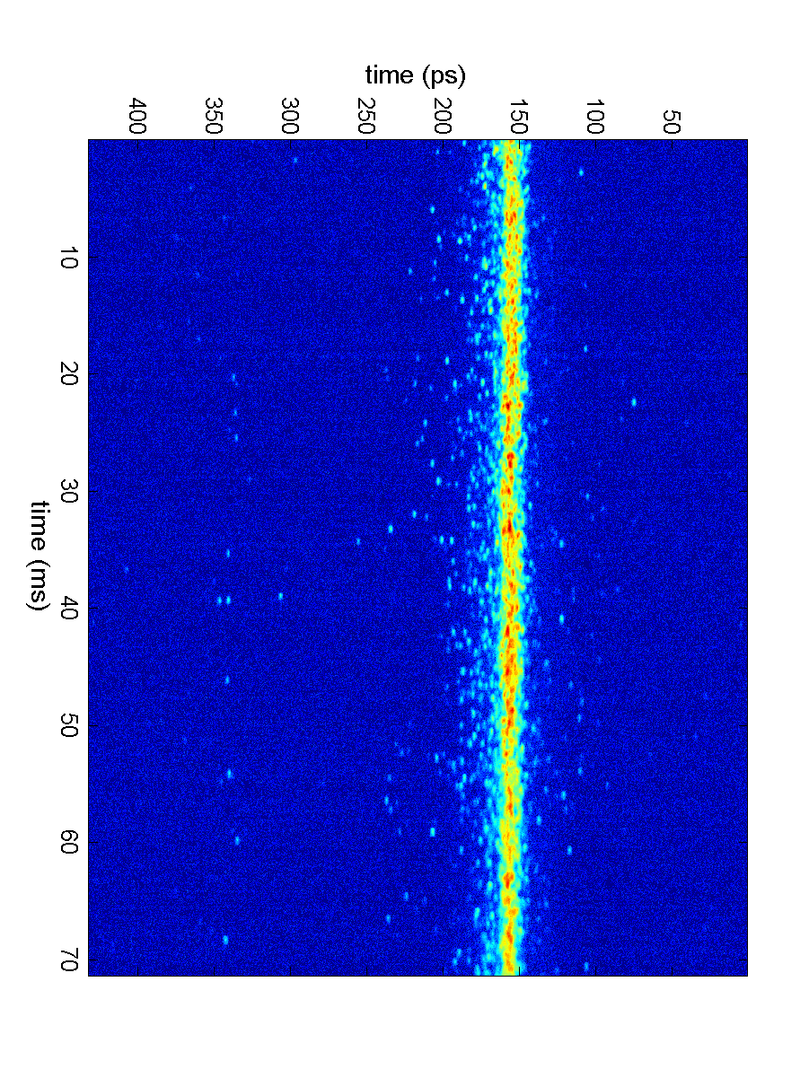
D.Phil. Student: S. Wilkes (Starting Sept. 2021)
“Provision for Timing Mode Users at Multi-bend Achromat Synchrotron Light Sources”
The Diamond-II storage ring design uses a multi-bend lattice to reduce the emittance by a factor 20 whilst increasing the space for beamlines
An open question is how best to provide short, isolated x-ray pulses for time-resolved studies
The student will study different options:
‘hybrid-mode’ filling pattern
Resonant excitation of a single bunch to increase the vertical beam size
Use of a higher-harmonic RF cavity to manipulate the longitudinal potential well
DIAMOND-I
Standard Mode
Short-pulse Mode
Turn number
Intensity vs time
Supervisors: P. Burrows and I. Martin
Ian Martin, Light Sources, JAI AB, 19/04/2021

Slide 16
Conclusions
JAI continues to be active in a number of areas of light source design and operation:
Facility design
Enhanced performance
Special operating modes
Photon / electron beam diagnostics
Diamond-II / UK-XFEL / CLARA key projects
Providing training and expertise for next generation of accelerator physicists:
New PhD Studentships starting September 2021
Proposal for Joint Diamond / JAI PDRA to work on Diamond-II under consideration
Ian Martin, Light Sources, JAI AB, 19/04/2021

