Slide 1
Advanced Acceleration
Zulfikar Najmudin
The John Adams Institute for Accelerator Science, Imperial College London
JAI Advisory Board
Monday 19 April 2021
              http://www.adams-institute.ac.uk http://www3.imperial.ac.uk/johnadamsinstitute

Slide 2
JAI Advanced Acceleration Effort
Staff | (Imperial) Ken Long, Stuart Mangles, Zulfikar Najmudin, Jaroslaw Paternak, Juergen Pozimski, Steve Rose (Oxford) Phil Burrows, Brian Foster, Simon Hooker, Peter Norreys, Roman Walczak | 11
Fellows + Post-docs | (Imperial) Rory Bagott, Nick Dover, Oliver Ettlinger, George Hicks, Brendan Kettle + (incoming) Ben Chen, Rakesh Kumar (Oxford) James Cowley, Rebecca Ramjiawan, Marko Mayr + 2 TBA | 12
Students | (Imperial) Robbie Watt, Cary Colgan, Michael Backhouse, Eva Los, Wei Wu, Toby Nonenmacher, HT Lau, Titus-Stefan Dascalu, Rebeca Taylor, Meriame Berboucha Adam Hughes, Nuo Xu, + (incoming) Annabel Gunn, Maria Maxouti (Oxford) Alexander von Boetticher, Jakob Jonnerby, Alex Picksley, Aimee Ross, Warren Wang, Emily Archer, Senes, Pakuza + 2 TBA (+ 2 students to join in October 2021 | 24
Recent leavers: | (Imperial) Emma-Jane Ditter, Jan-Niclas Gruse, Savio Rosario, Rob Shalloo, Matt Streeter (Oxford) Aarón Alejo, Jimmy Holloway | 7

Slide 3

LUND
CALA
ELI-ALPS
CUOS
DESY
CERN
KANSAI
SLAC
BNL

Slide 4
Automation of plasma accelerators

Slide 5
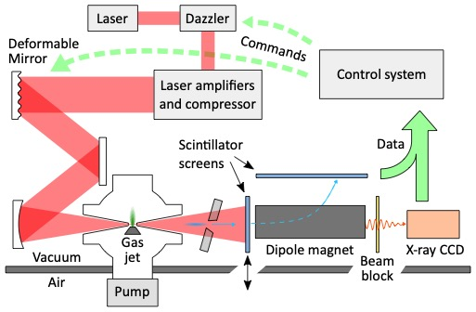
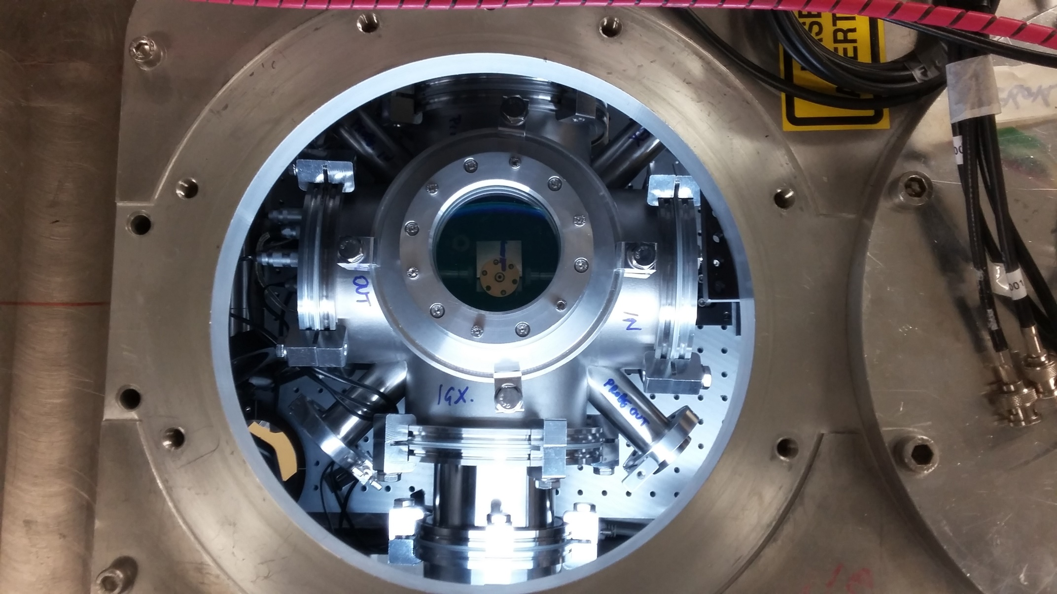
2017 Astra Gemini TA2 at the CLF
Parker Series 9 gas valve
(4 ms opening time)
Differentially pumped internal chamber
Input and output cones with 2mm apertures
TA2 has less energy (unto ~ 500 mJ) but can be operated at up to 5 Hz

Slide 6
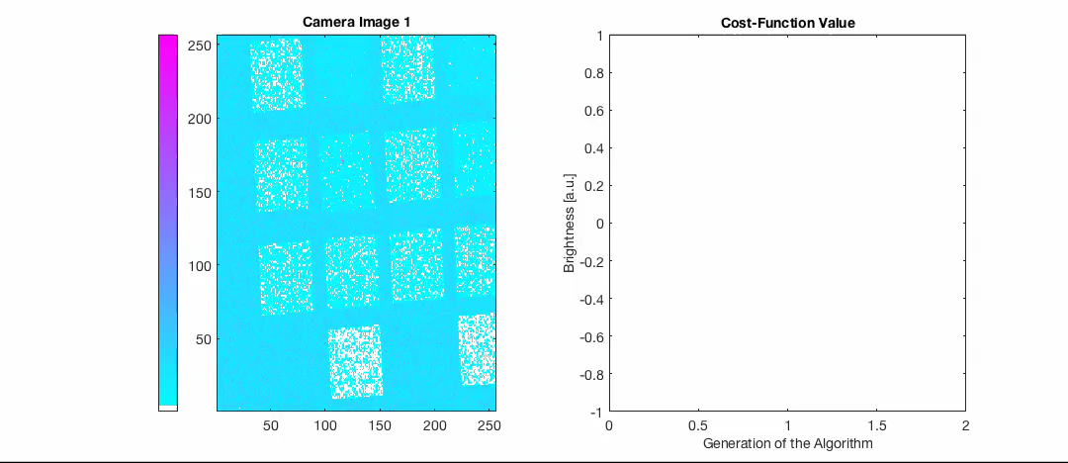
Optimisation with a genetic algorithm
Test the population
Creating the next generation
Parameters
Evaluation
Ranking
Selection and breeding
Mutation
1
2
3
4
S
S
1
2
3
4
1
2
3
4
1
2
3
4
S
S
1
2
3
4
1
2
3
4
1
2
3
4
S
S
1
2
3
4
1
2
3
4
1
2
3
4
S
S
1
2
3
4
1
2
3
4
1
2
3
4
S
S
1
2
3
4
1
2
3
4
1
2
3
4
S
S
1
2
3
4
1
2
3
4
To the next loop
x-ray filter image from 5 TW source
Started from ‘flat’ deformable mirror position with some random fluctuations
Optimised the actuator voltages so no need for measurements or calibrations
Equivalent level of performance when the spot was optimised manually
No obvious stopping point, optimisation sensitive to noise
  Streeter, M. J. V., et al. APL, 112(24), 244101 (2018). Dann, S. J. D. et al PRAB, 22(4), 041303 (2019).

Slide 7
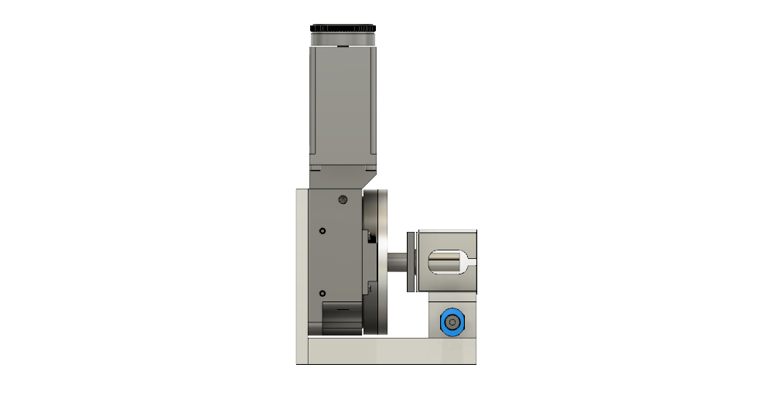
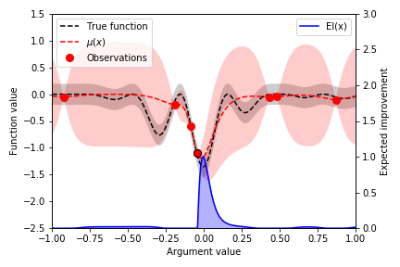
Gaussian process regression
Bayesian Optimisation on Gemini TA2
Control
Feedback
Laser
Energy
Spectral phase (temporal pulse shape)
Spatial phase
(focal spot shape)
Plasma
Density
Length
Longitudinal profile
Electrons
Maximum energy
Charge
Spectrum
Divergence
X-rays
Flux
Critical energy
Measure at the position of greatest expected improvement and update model

Slide 8
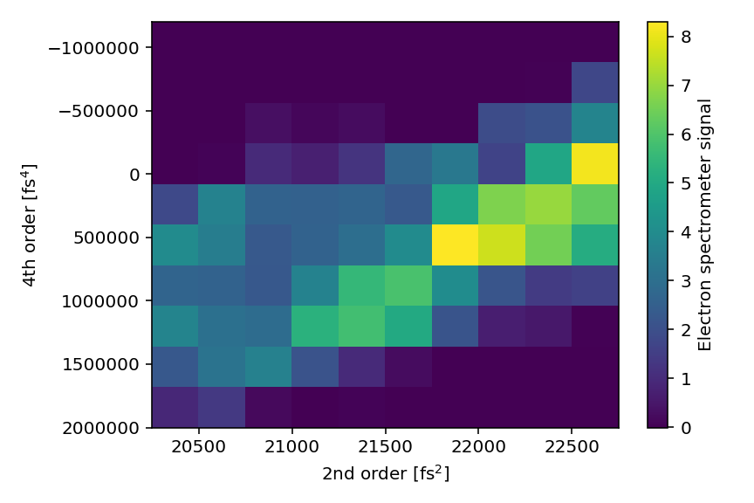
Bayesian optimisation of electron charge with 2nd and 4th order spectral phase
Incomplete and course scan of parameter space taking- 20 minutes
Due to correlated nature of the space, you could not just optimise by 2x 1D scans

Slide 9
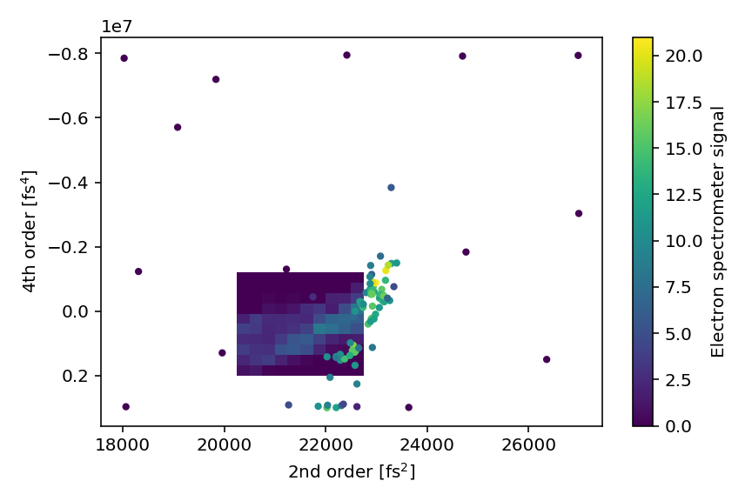
Optimisation found a maximum outside of original scan region
10 minutes of data
Over 2x enhancement
Shows some drift from 2D scan

Slide 10
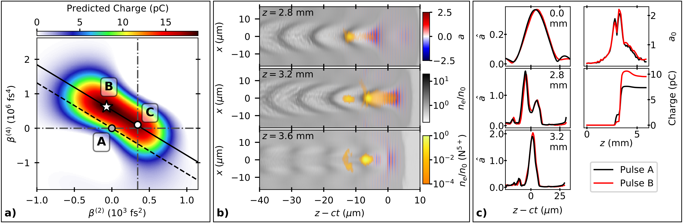
Optimisation demonstrates subtle physics effects

Slide 11
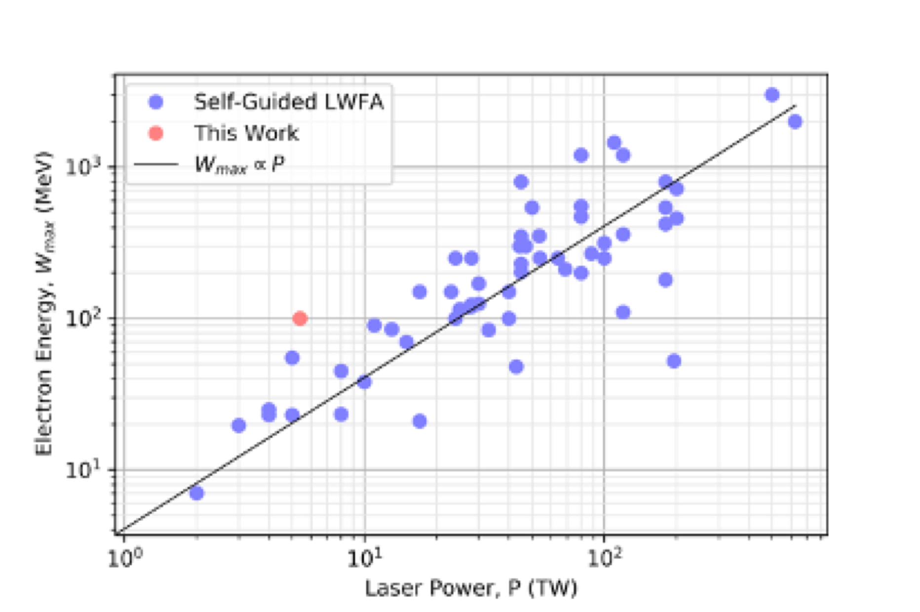
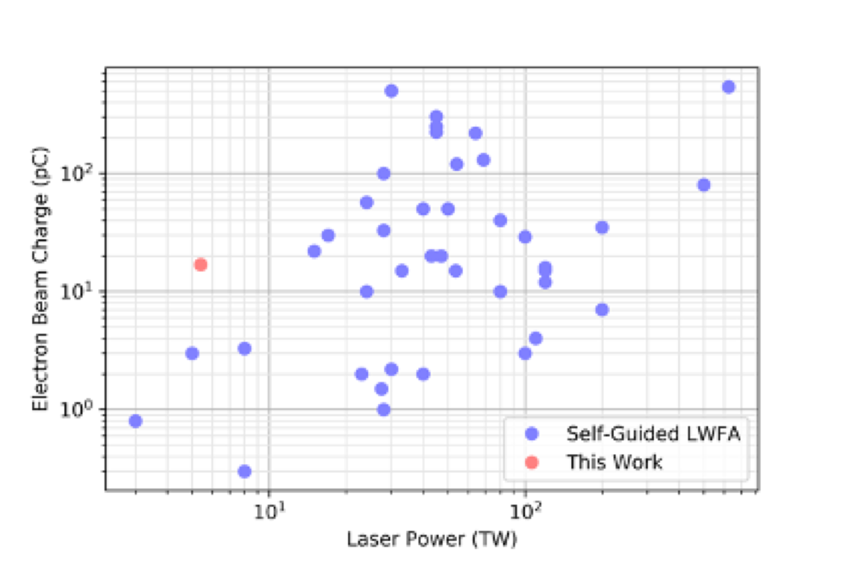
Comparison to previous studies
maximum electron charge exceeds results with other 5 TW systems by on average an order of magnitude
maximum energy exceeds other 5 TW systems by on average 5 times
Shalloo, R. J., S. J.D. Dann, J. N. Gruse, C. I.D. Underwood, A. F. Antoine, C. Arran, M. Backhouse, et al. “Automation and Control of Laser Wakefield Accelerators Using Bayesian Optimization.” Nature Communications 11, no. 1 (2020): 6355.

Slide 12
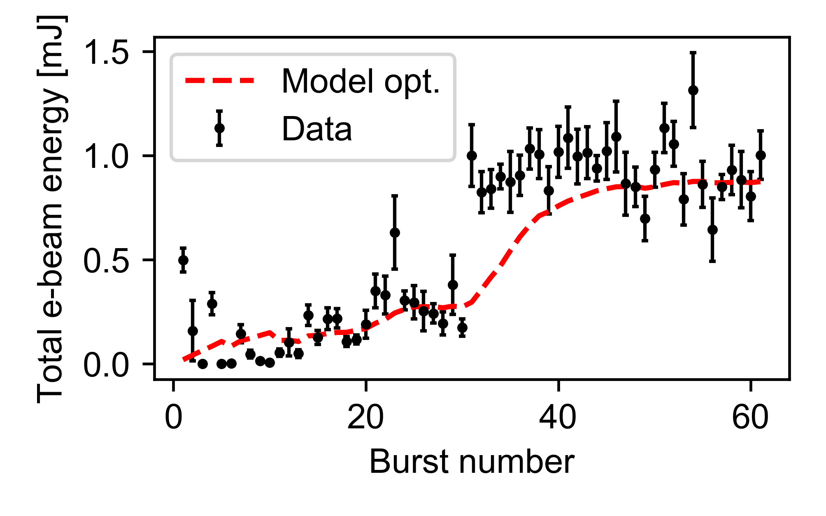
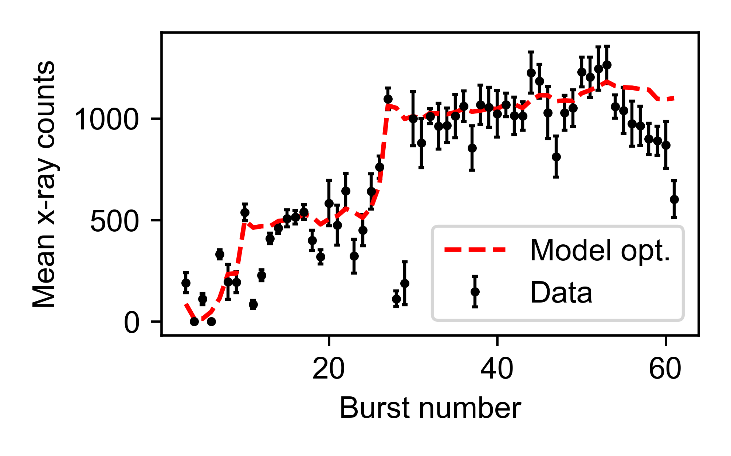
Algorithm allows automated optimisation
5D optimisation of total electron beam energy
6D optimisation of mean x-ray CCD counts
Optimisations started from previously identified optimum positions
Optimisations took 20 minutes compared to 35 mins for 4 successive 1D scans and found a better optimum
Optimisation algorithm makes morning start-up efficient and easy

Slide 13
Development of low-density plasma waveguides

Slide 14

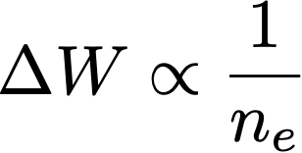
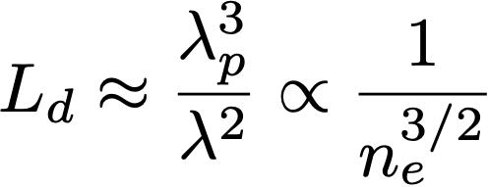
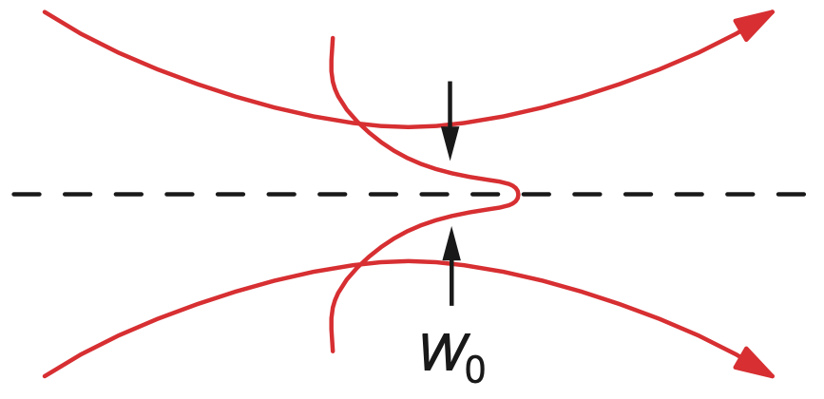
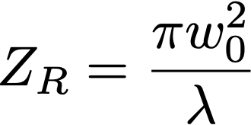
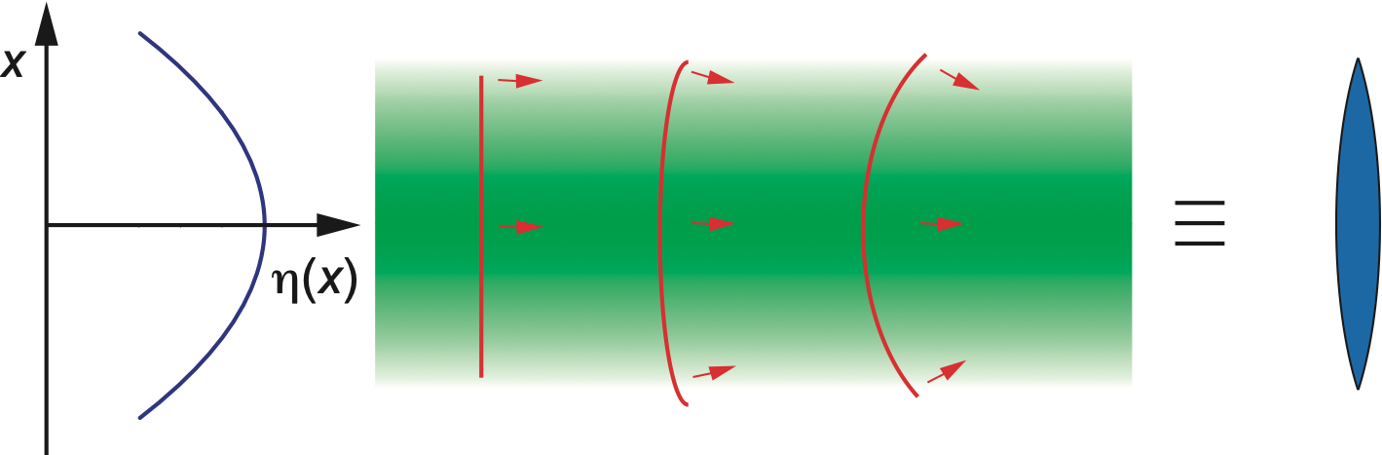
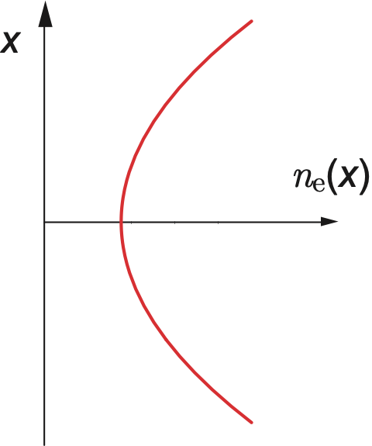
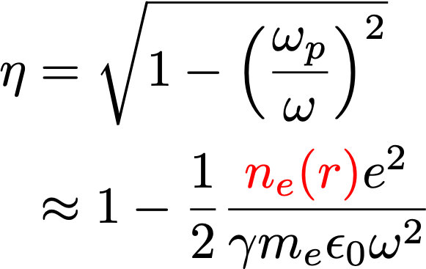



Motivation
  Multi-GeV stages require accelerator stages 100s mm long with densities ~ 10¹⁷ cm⁻³:
    EuPRAXIA ne = 1.8 × 10¹⁷ cm⁻³, Lacc = 118 mm [Cros et al. EuPRAXIA Milestone Report 3.1 (2017)]
    BELLA ne = 0.96 × 10¹⁷ cm⁻³, Lacc = 600 mm [Leemans et al. Proc. PAC 1416 (2011)]
    In addition, we would like to operate at high repetition rates (kHz) for extended periods
  There is a need for long (> 100 mm), low density (~ 10¹⁷ cm⁻³) plasma channels capable of high-rep-rate operation
Simon Hooker, JAI-Oxford
JAI Advisory Board, 2021

Slide 15
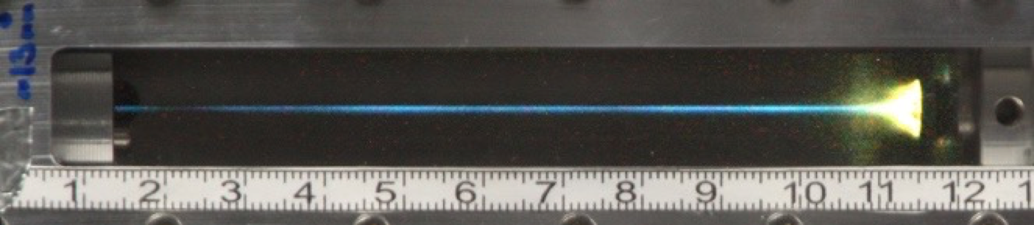
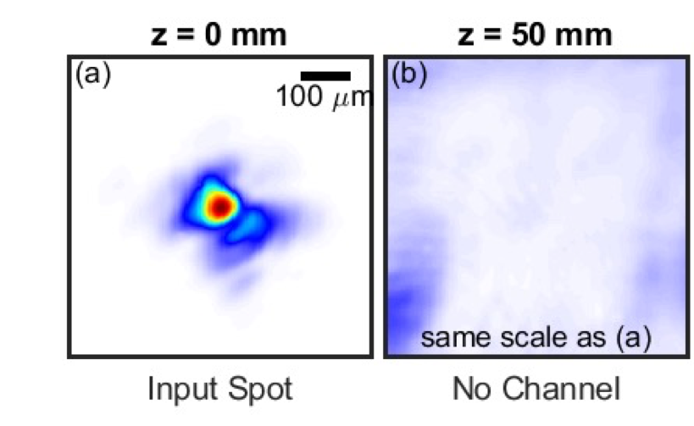
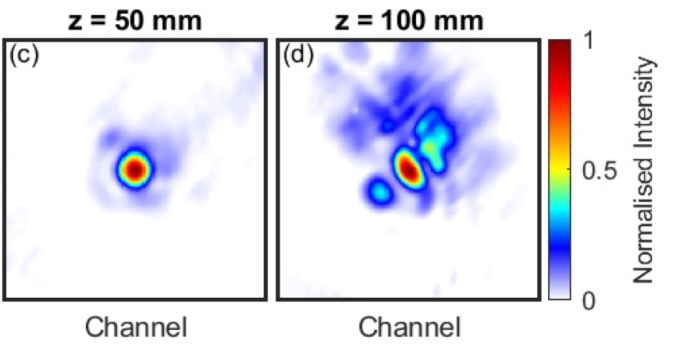
Hydrodynamic plasma waveguides
  There is a need for long (> 100 mm), low density (~ 10¹⁷ cm⁻³) plasma channels capable of high-rep-rate operation
  Capillary discharge waveguide (developed by Oxford) used in many GeV-scale expts (e.g. BELLA) but prone to laser damage
  Hydrodynamic channels attractive for high rep rate since free-standing ⇒ “indestructible”
    Create & heat column of hot plasma
    Expansion into surrounding cold gas / plasma drives cylindrical blast wave
    Plasma channel formed within expanding shell
  To date, plasma column has been heated collisionally:
  Requirement for fast heating limits axial density to ~ 10¹⁸ cm⁻³
  Expts with Gemini laser demonstrated guiding of 6 × 10¹⁷ Wcm⁻² pulses over 100 mm long channels with ne ~ 10¹⁷ cm⁻³
R.J. Shalloo et al. Phys Rev E 97 053203 (2018)
A. Picksley et al. Phys Rev Accel Beam 23 81303 (2020)
Simon Hooker, JAI-Oxford
JAI Advisory Board, 2021

Slide 16
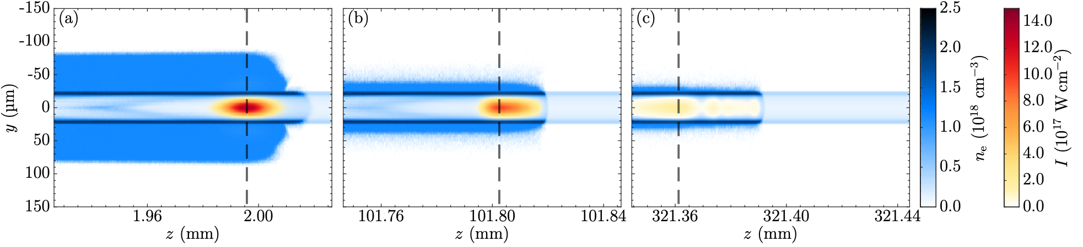
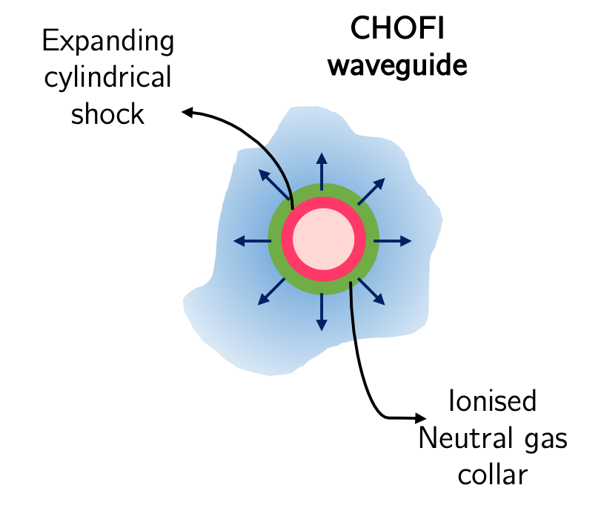
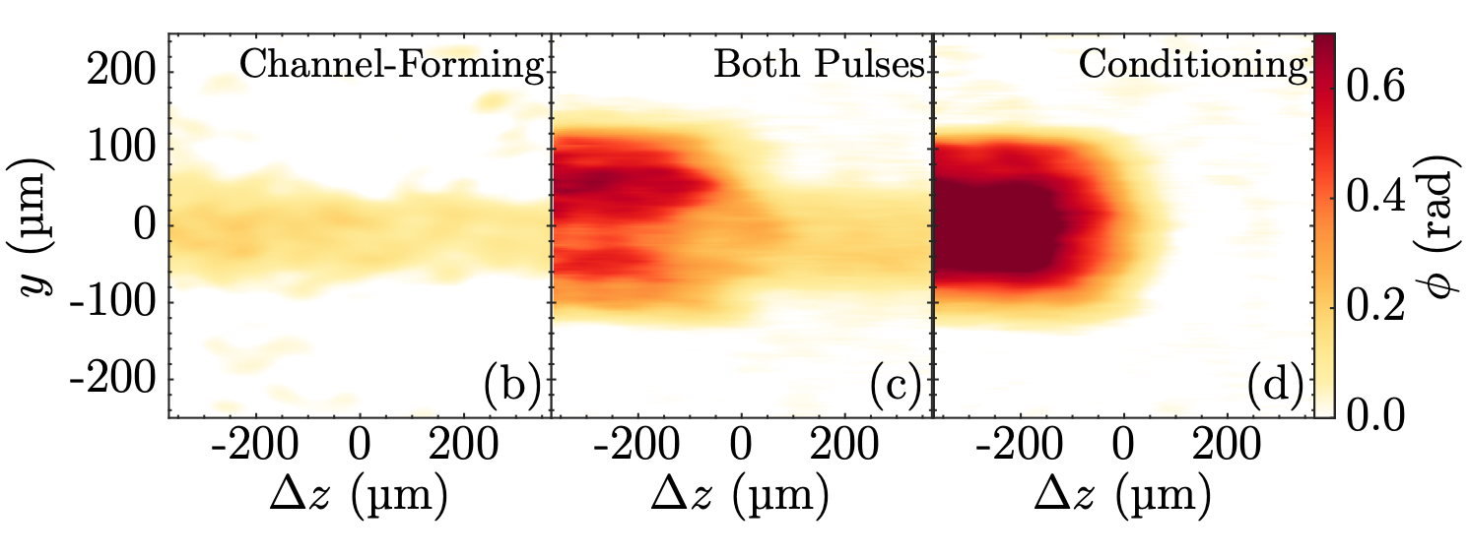
Conditioned HOFI (CHOFI) plasma waveguides
Deep, low-loss
CHOFI channel
Shallow
HOFI channel
  Expts with Astra TA2 laser showed additional ionization of channel wall by guided pulse
  Analysis shows:
    Collar of neutral gas pushed out by shock
    Collar ionized by guided / “conditioning” pulse to form a conditioned HOFI channel which has very low losses
Conditioning pulse guided by
HOFI & CHOFI channels
  FBPIC simulations using electron & neutral density profiles from FLASH simulations
  matched to 2018 Astra experiment
  Power attenuation of CHOFI channel 2.5 m!
  Metre-scale channels possible!
  Only ~ 1 J of laser energy per metre of channel
A. Picksley et al. Phys Rev E 102 053201 (2020)
R.J. Shalloo et al. Phys Rev Accel. Beam 22 41302 (2019)
A. Picksley et al. Phys Rev E 102 053201 (2020)
Simon Hooker, JAI-Oxford
JAI Advisory Board, 2021

Slide 17
EXAFS with Betatron source

Slide 18
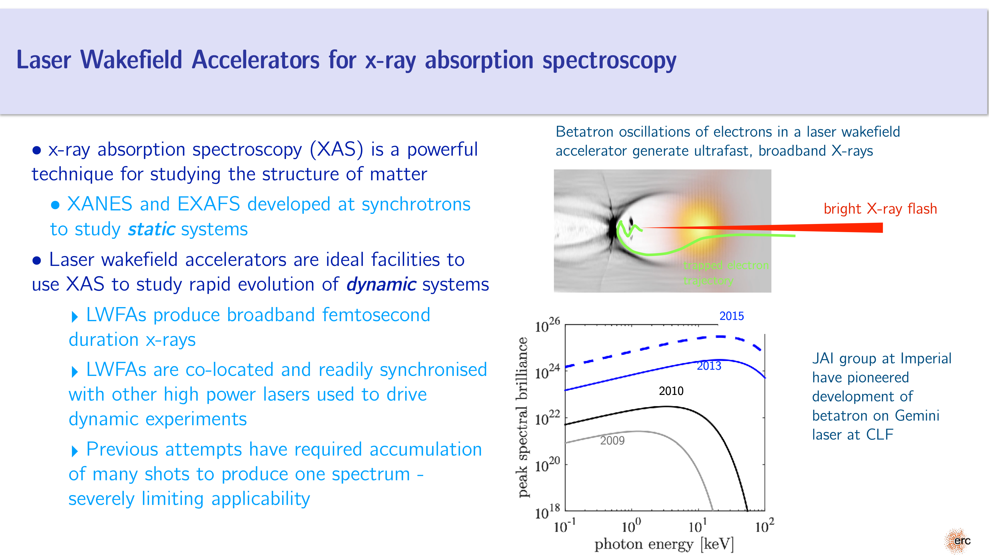

Slide 19
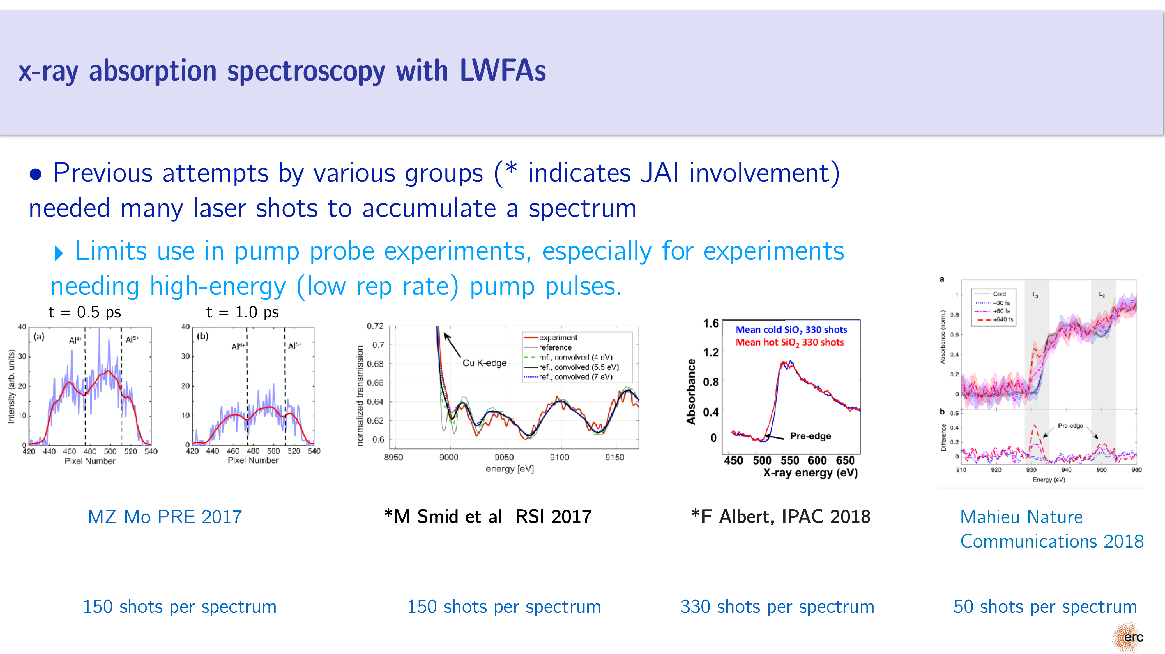

Slide 20
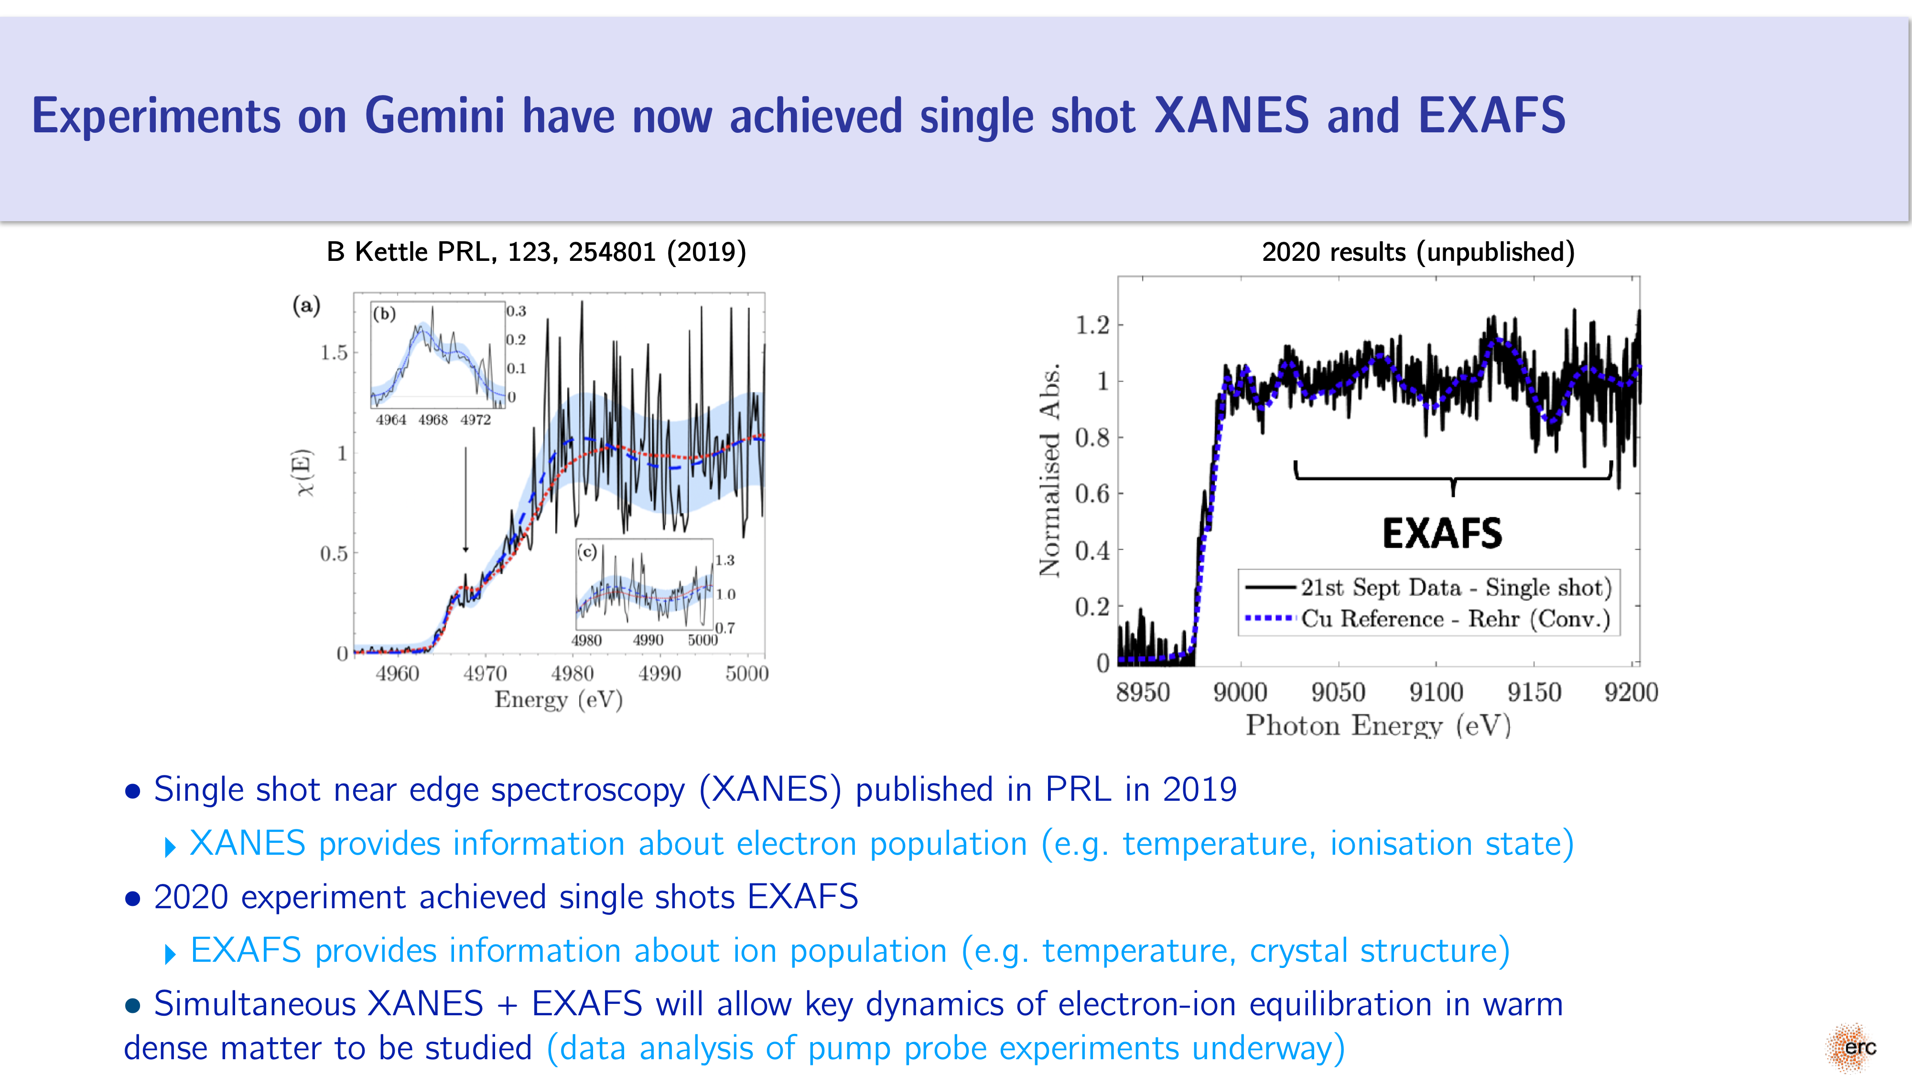

Slide 21
AWAKE

Slide 22
AWAKE-UK
New AWAKE-UK grant approved by STFC
£1.9m awarded (£0.6m JAI) with a gateway after two year to extend funding for another 3 years - supposed to lead until run-2 after next shutdown
  Gateway step due in 1 years time!
7 funded UK institutes including JAI-OX and JAI-IC (also UCL, Lancaster, Liverpool, Manchester, Strath)
Aligned to AWAKE run-2:
  Accelerate higher beam capture
  Acceleratre over multiple cells
Goal is to have an electron beam usable for HEP after run 2.

Slide 23
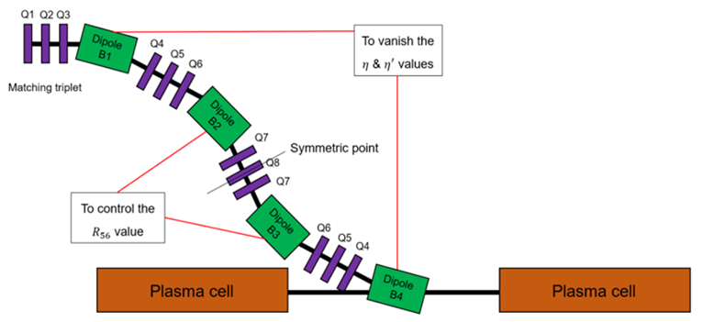

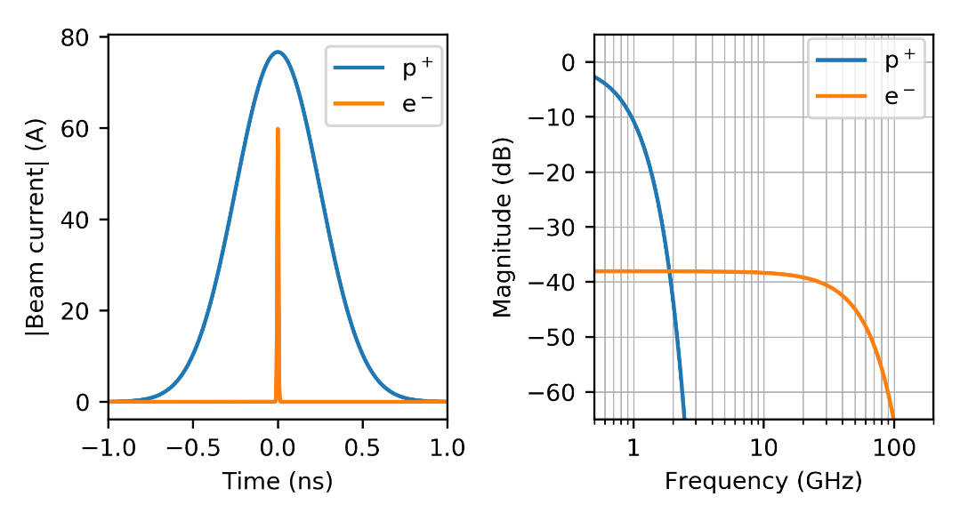
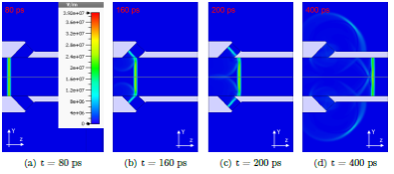

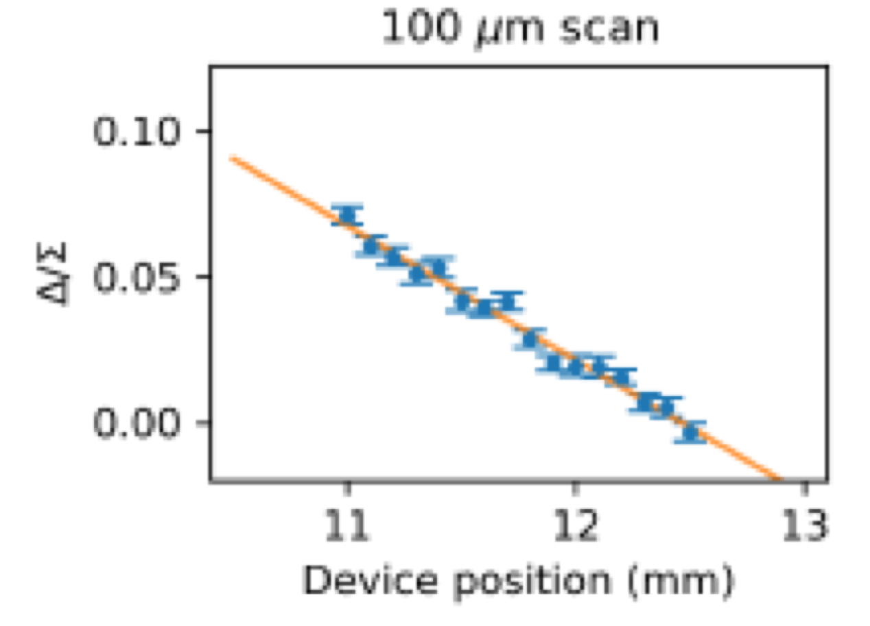
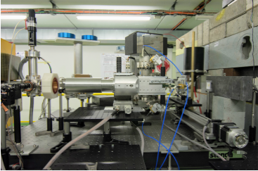

AWAKE Run 2: e-/p BPM
Major new initiative in Oxford Particle Physics
design of witness e- beamline for split plasma cell;
design/prototyping/testing of e-/p BPMs
Strong synergy with CLIC/CLEAR diagnostics
BPM based on Coherent Cherenkov Diffraction Radiation
Prototype built, and tested at CLEAR:

Slide 24
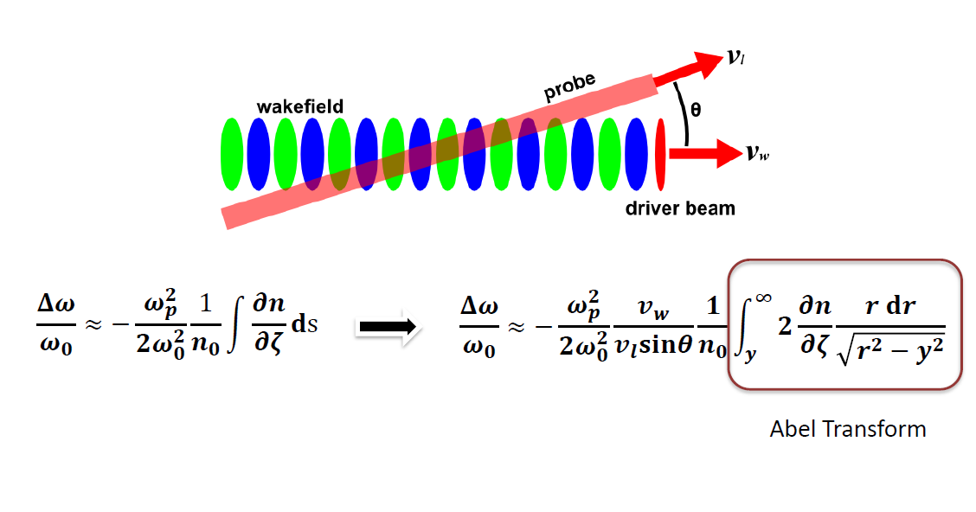
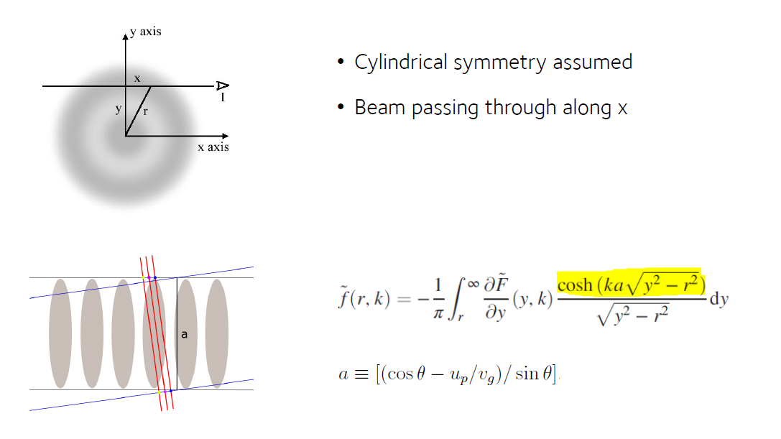

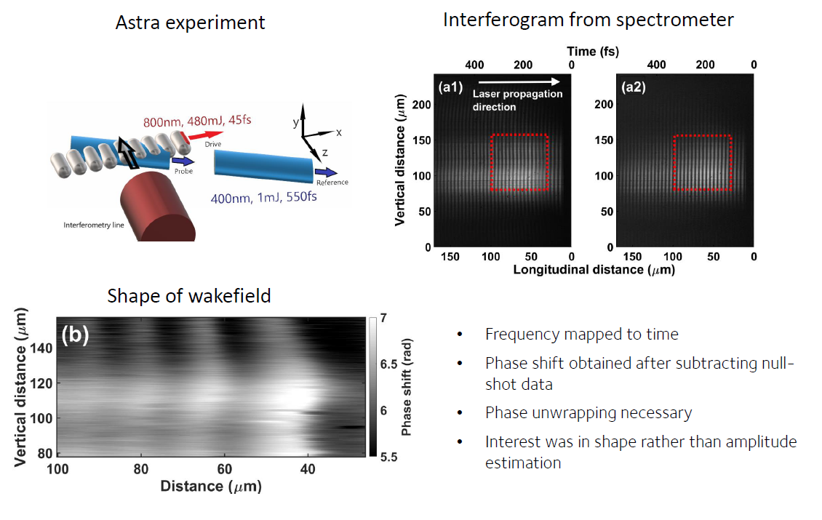
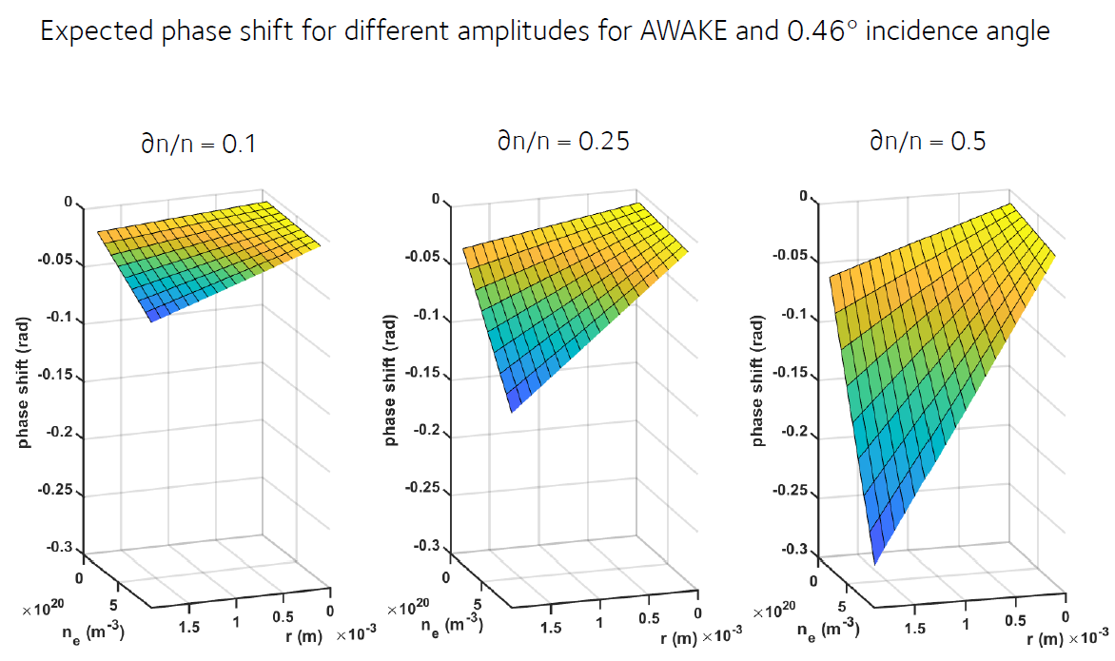
Visualising the density profile in plasma columns

Slide 25
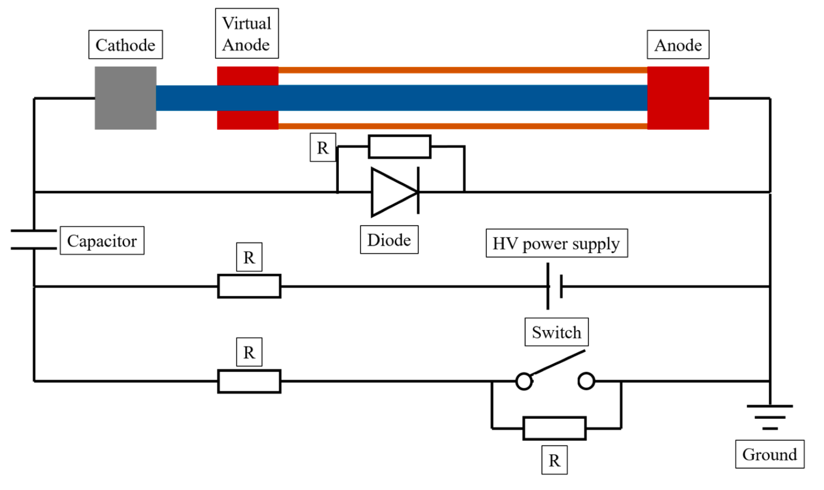
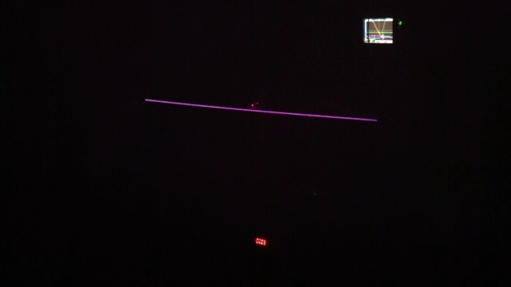
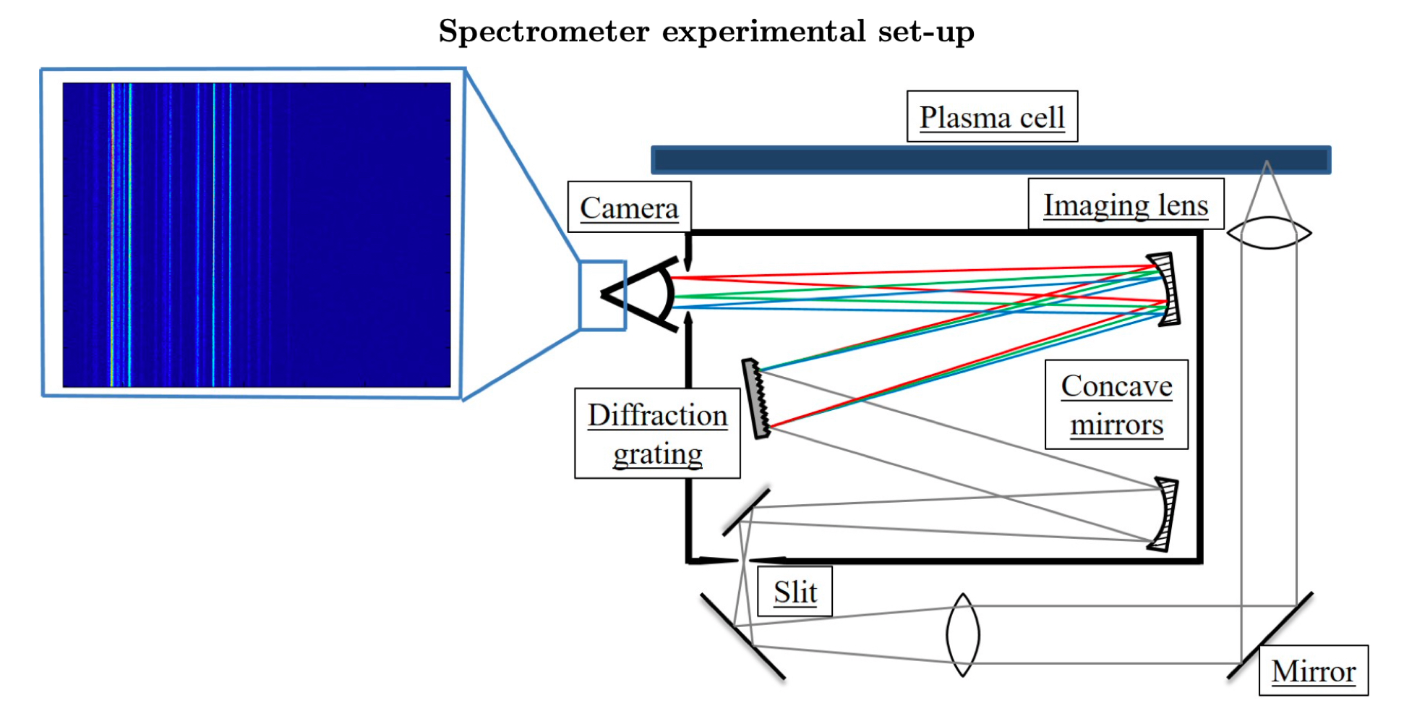
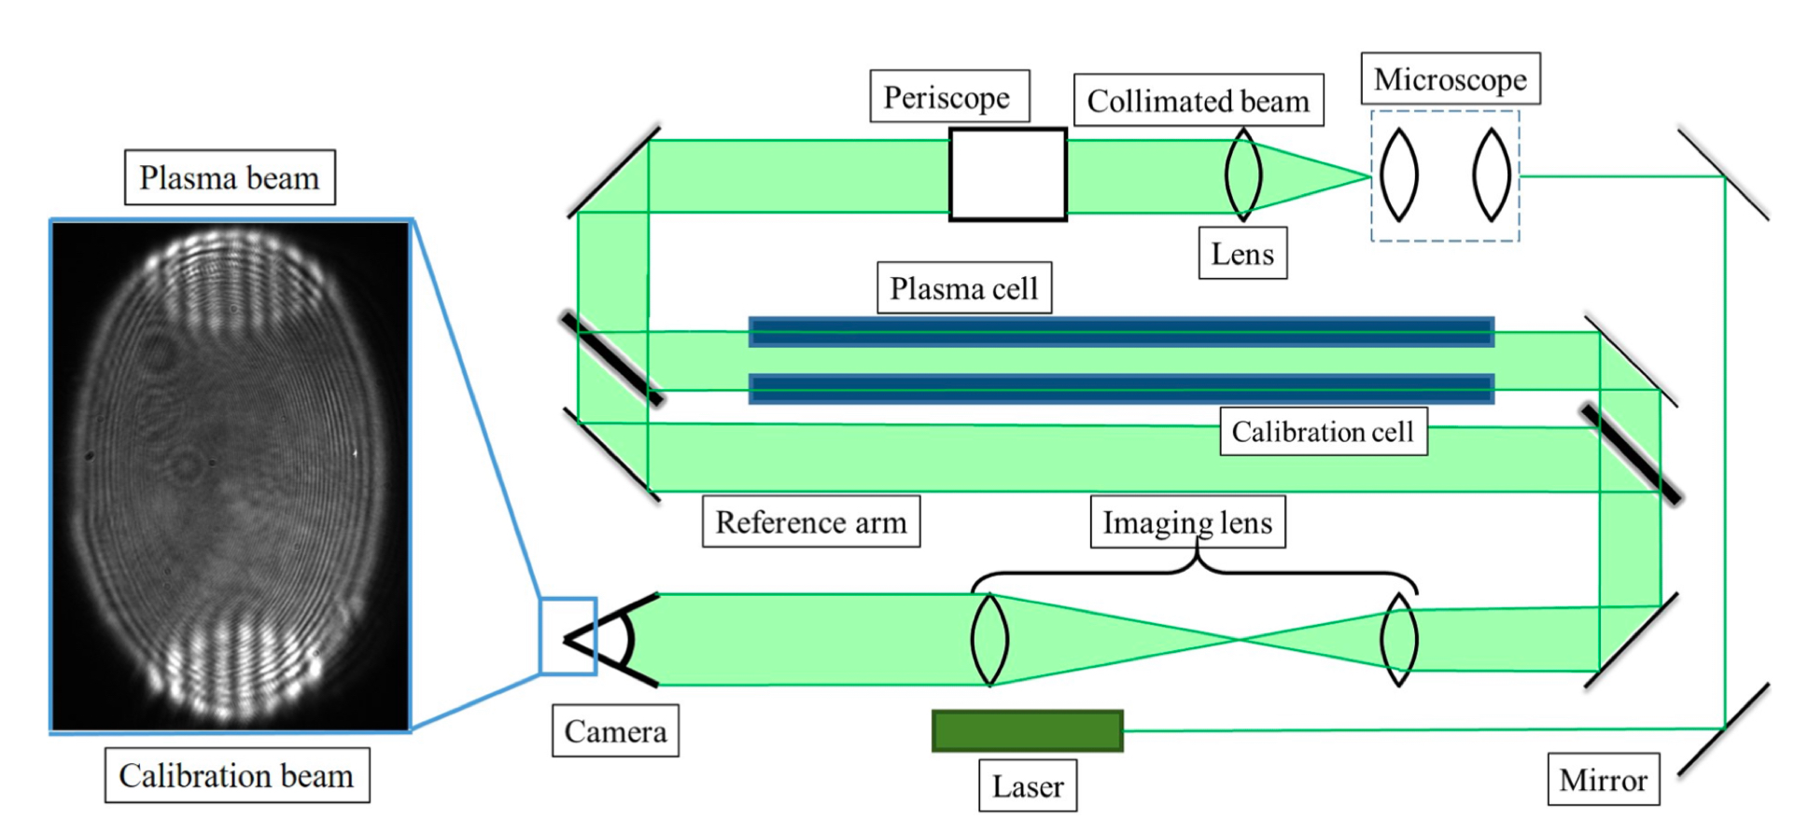
Plasma discharge development at ICL
10 m Ar discharge plasma to be developed with IST /CERN
Discharge based on Lopes design with solid-state switches
Developing plasma diagnostics including:
Spectroscopy
Interferometry

Slide 26
Funding & facilities

Slide 27
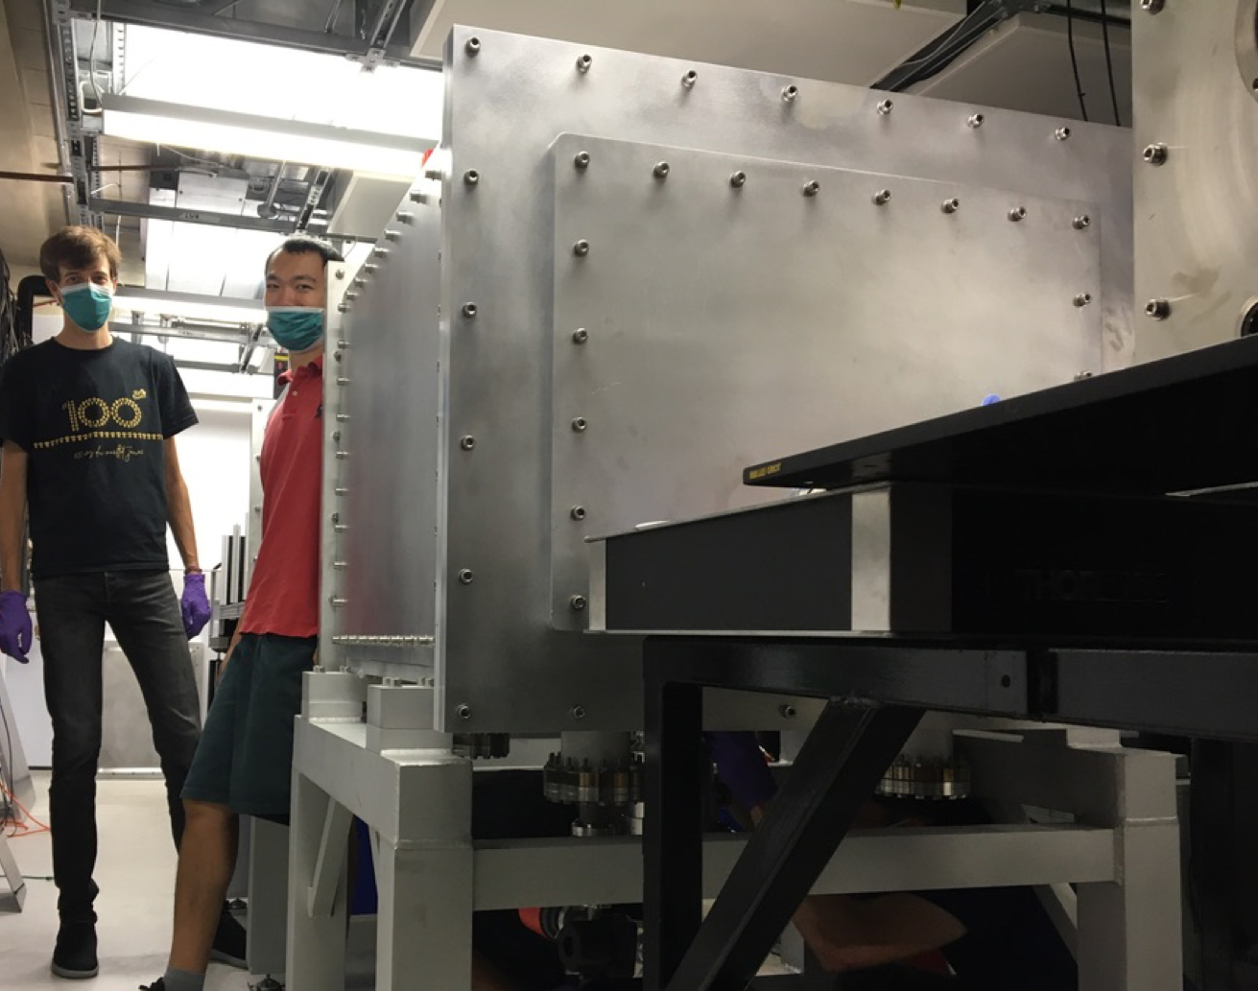


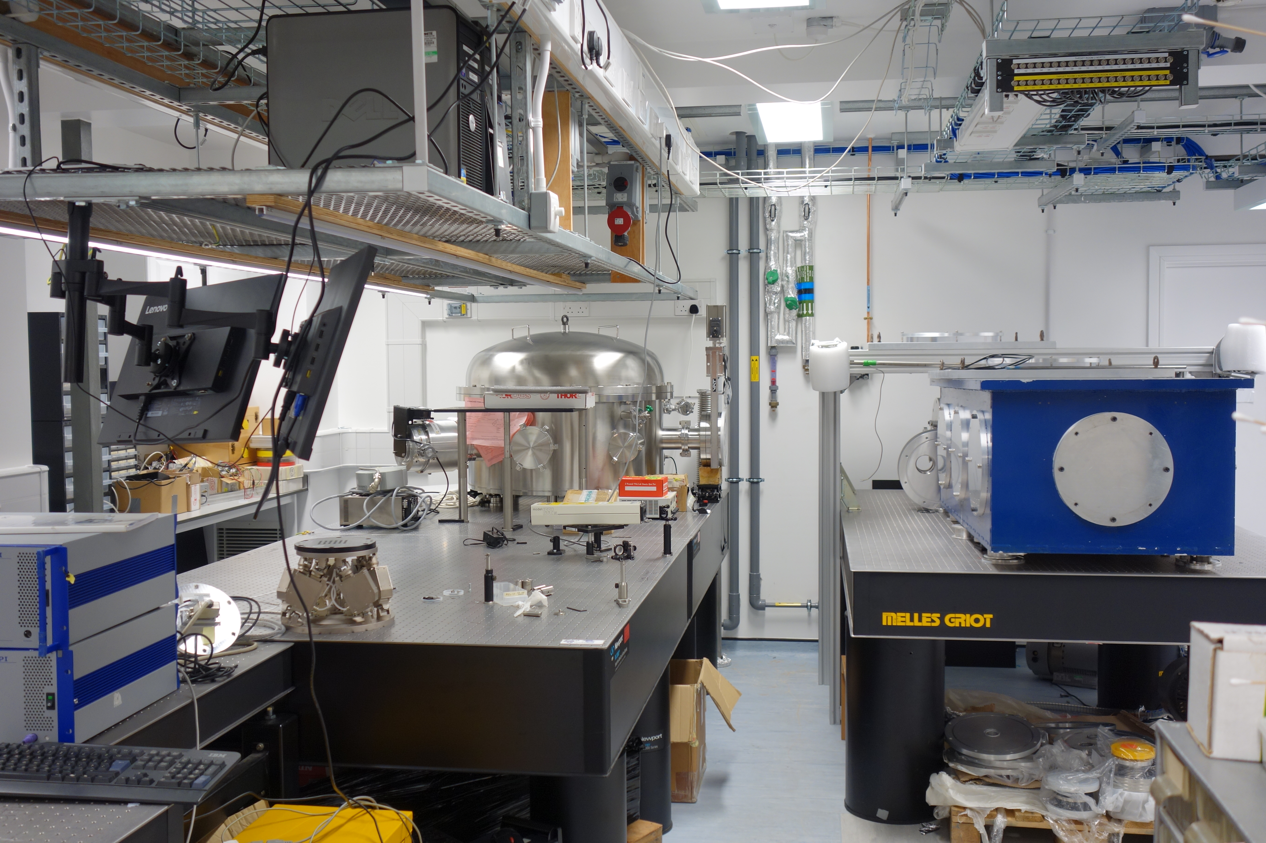
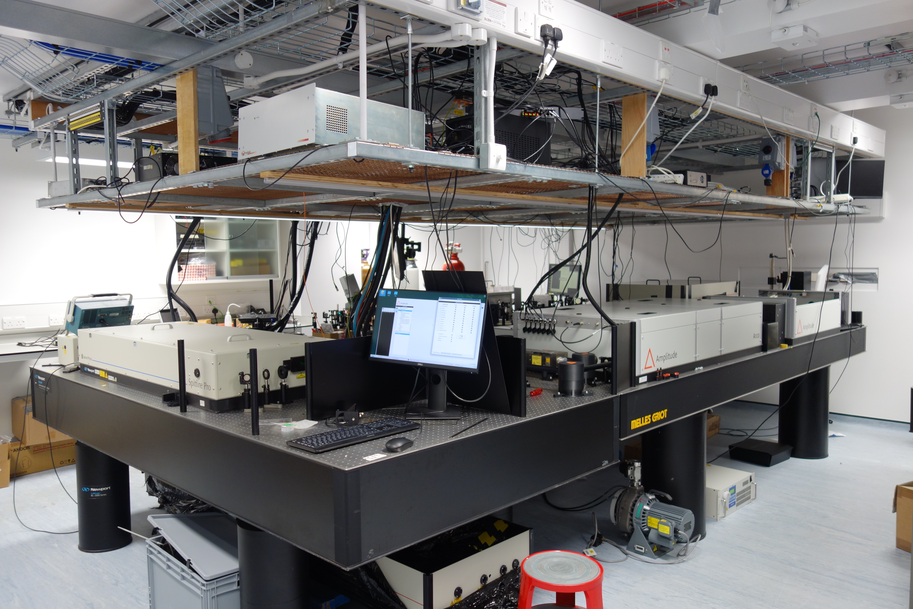
High-power laser lab development
Oxford
  £1.45M (OU) + £640k (STFC) to upgrade Oxford Ti:sa laser to 600 mJ, 40 fs, 10 Hz:
    Construction completed
    Laser system purchased and installed
    Preliminary experiments underway!
    Further capital items to be from JAI grant
Imperial
  Pump laser from MPQ Munich, £205k (STFC/ICL) to upgrade existing ICL Ti:sa laser to 600 mJ, 10 Hz, / 100 mJ, 100Hz
    Upgrade in progress
    Further capital items from new JAI grant
ICL Laser area
Ox Target area
Ox Laser area

Slide 28

Funding news
All-Optical Plasma Channels and Electron Injection with Spatio-temporal Control
Hooker, Walczak, Booth (Engineering), Milchberg (Maryland)
£2m over 4 years
  Develop high-rep-rate, GeV-scale stages
  Use spatio-temporal control to:
    Generate advanced plasma channels, including curved and tapered channels
    Control electron injection
  Demonstrate controlled electron acceleration in HOFI plasma channels for the first time
The new intensity frontier: exploring quantum electrodynamic plasmas
Ridgers, Murphy, Lancaster (York), Sarri (|QUB), McKenna (Strath), Mangles, Najmudin (ICL)
>2m over 4 years
  Investigate strong field QED effects on plasmas
  Realisation of QED-plasmas
  Benchmarking of QED models of electron beam-laser collisions
Hooker, Mangles, Najmudin, Walczak,
CDR (>600 pages) published:
  European Physical Journal Special Topics, 229, 3675 (2020)
Funding request to ESFRI (596 M€)
Consortium signed covering 40 members and 10 observers from 15 countries
Options being investigated for laser driven site - including Rutherford Lab.
Beam driven site already chosen - Frascati
LWFA design of EUPRAXIA experiment at Lund Laser Centre funded by Aries

Slide 29
Effects of Covid

Slide 30
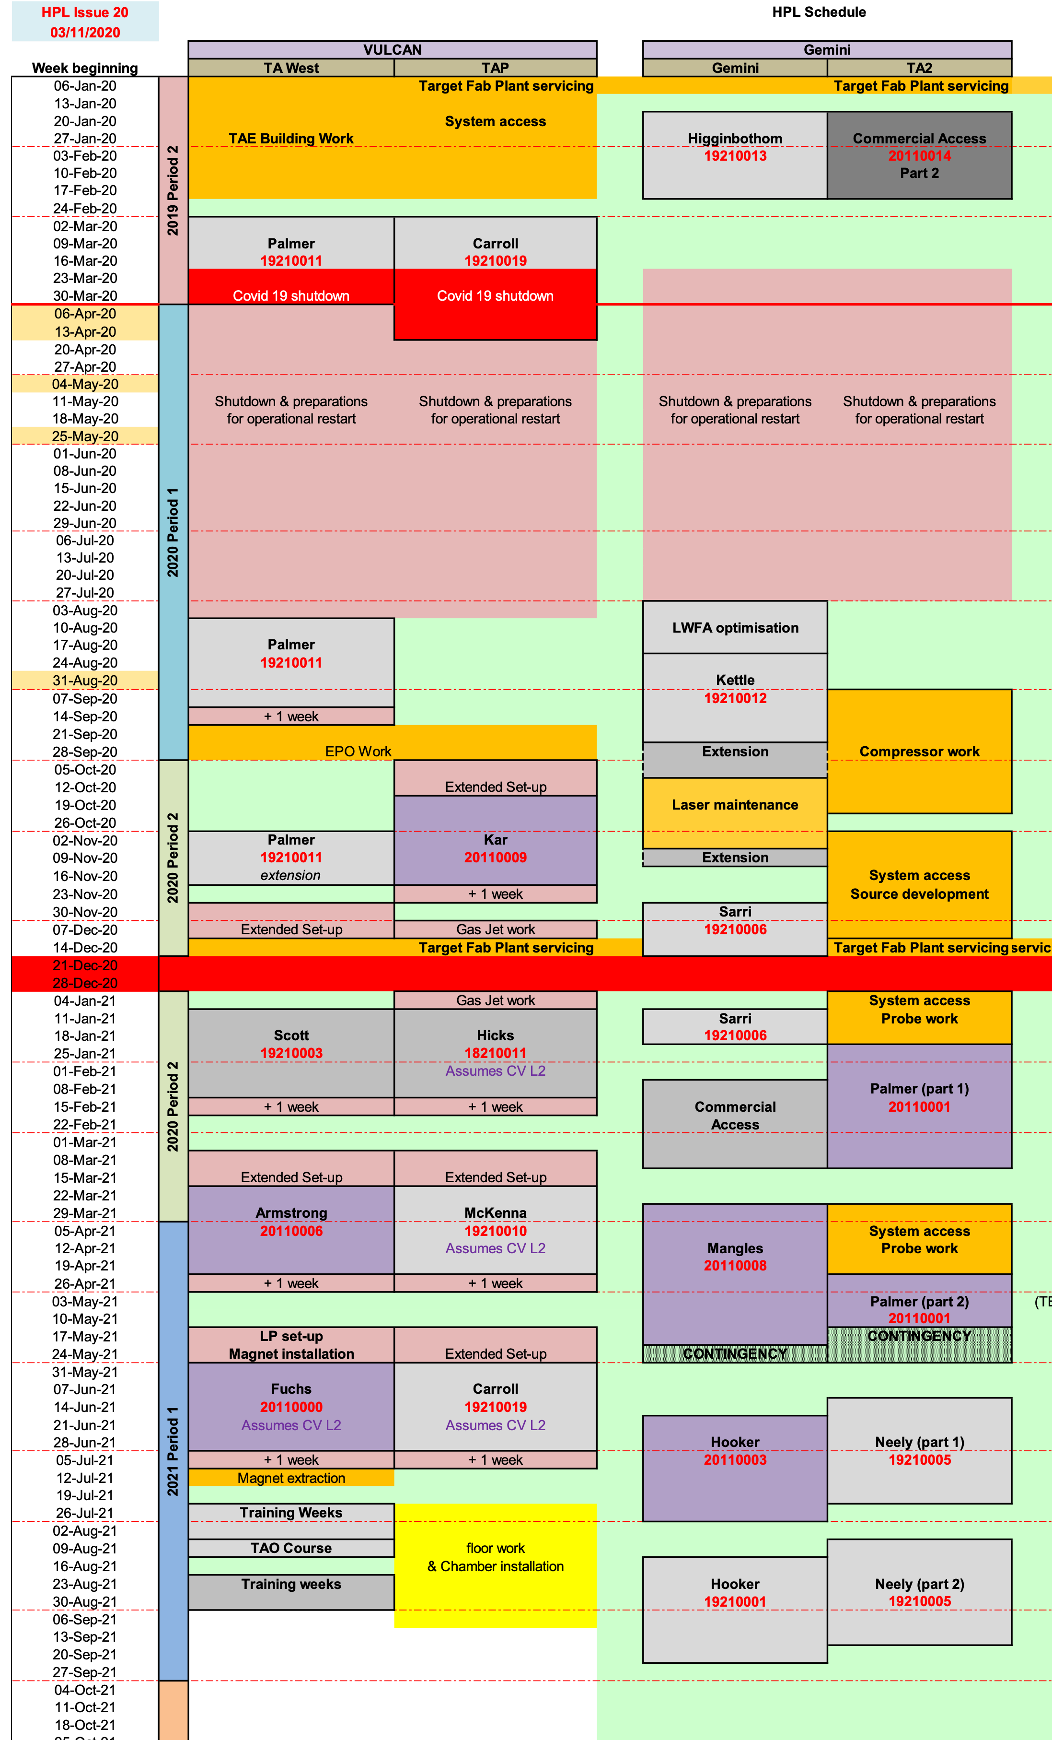
Effects of Covid
  Long delays to RAL schedules (closed from Mar-Jul 20):
    (QUB/ICL) Collisionless evolution of Weibel-like magnetic fields - Delayed from May 20 to Jan 21
    (ICL) Definitive measurement of quantum radiation reaction - Delayed from Jul 20 to Mar 21
    (OX) Electron acceleration in HOFI channels- Delayed from Dec 20 to Sep 21
    (OX) Multi-pulse LWFA experiment - Delayed from January 21 to Nov 21
    (ICL) Hole-boring acceleration - Delayed from Jan 21 to Jul 21
    Experiments partially remote; only 2 people on site (some experiments extended to 7 weeks)
  Unable to participate in experiments in Maryland, Colorado State, Brookhaven, Lund, CALA (Munich)
  Upgrades of new laser labs slowed

Slide 31
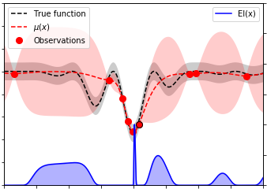
Conclusions
Research Highlights:
  Bayesian optimisation of LWFA implemented
  CHOFI plasma waveguides show better guiding
  First single shot EXAFS of laser irradiated samples
Other highlights:
  New grants for:
    AWAKE
    HOFI waveguides/spatiotemporal control
    High Field Effects
    Laser upgrades to OX, ICL lasers

Slide 32
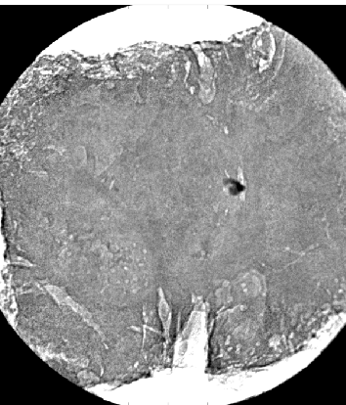
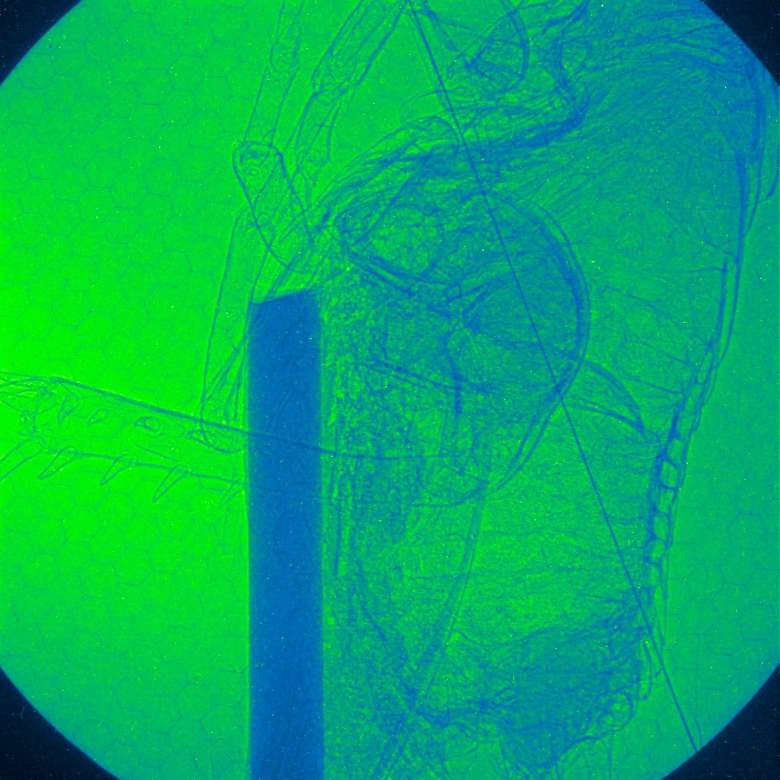
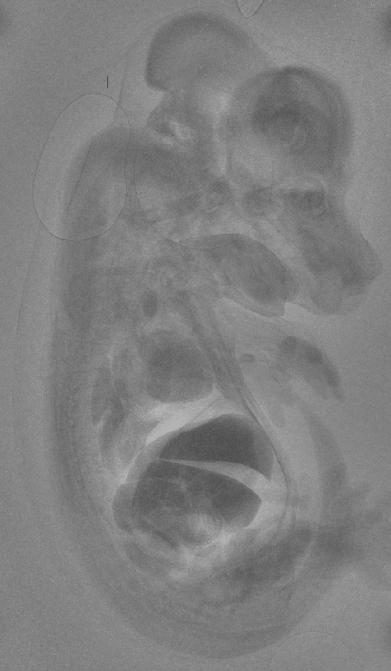
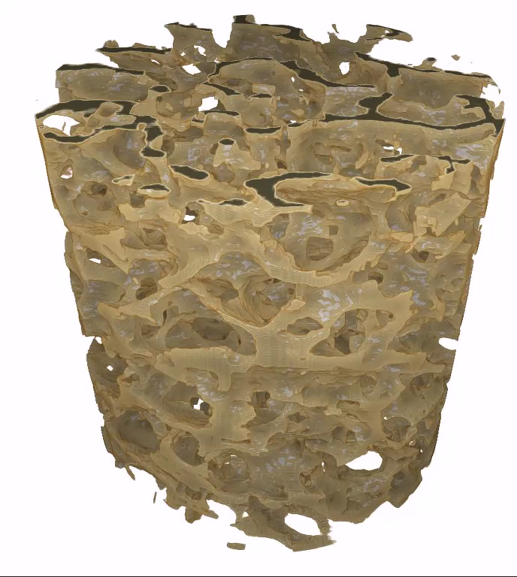
Imaging conclusions
Self-injected electrons can produced peak brightness >10²⁴ photons / sec mrad² mm² 0.1%BW
First 𝛽-tron imaging of fast shock dynamics in a dense plasma
Soft tissue imaged with ~ µm resolution, bone and mouse 𝛽CT performed with ~ 10 µm resolution
Time averaged brigtness/flux comparable to micro-CT, but with room for improvement

