Slide 1
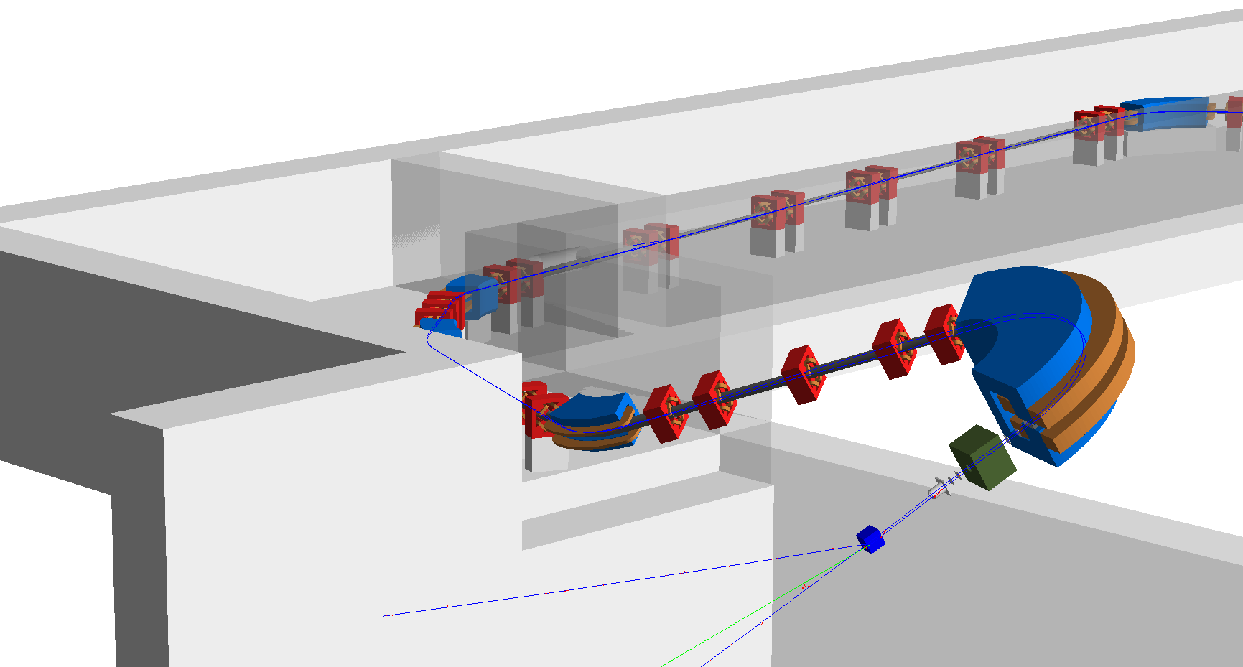
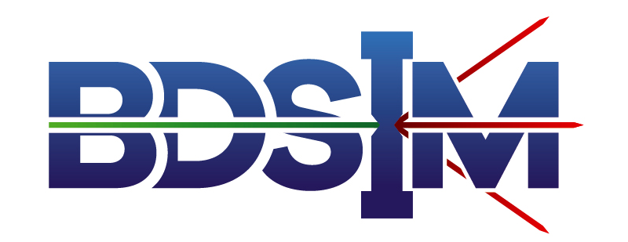


BDSIM Applications for Proton Therapy
William Shields
(william.shields@rhul.ac.uk)
on behalf of BDSIM group:
A. Abramov, S. Boogert, S. Gibson, H. Garcia-Morales, H. Pikhartova, L. Nevay, J. Snuverink, S. Walker
BDSIM:
https://arxiv.org/abs/1808.10745
http://www.pp.rhul.ac.uk/bdsim
7th December 2018, JAI Fest – RHUL.

Slide 2


Outline
Introduction.
Building a BDSIM model.
Proton therapy gantry example.
Collaboration.
Summary & outlook.
07th December 2018

Slide 3
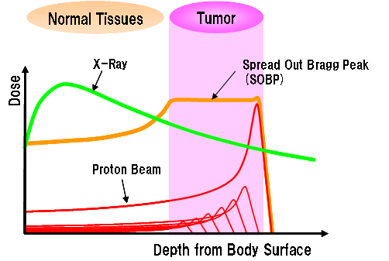
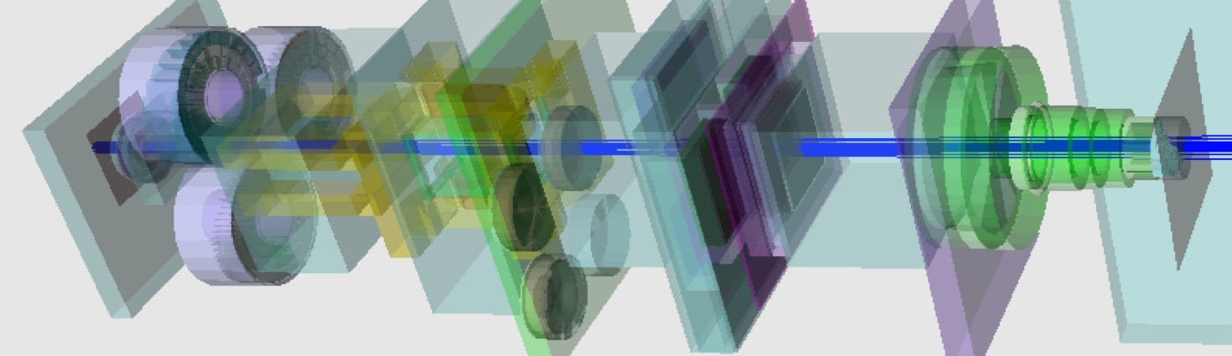
Proton Therapy Simulations
Radiotherapy technique using high energy protons.
Dose deposited at a precise depth.
Vary beam energy to build up Spread Out Bragg Peak.
Correct dose is crucial – energy, size, shape, etc.
Gantry nozzle simulations – no prior accelerator.
http://www.shi.co.jp/
Example TOPAS Simulation: https://gray.mgh.harvard.edu
07th December 2018
Notes:
Constant desire to improve proton therapy machines:
Treatment quality, efficiency, safety & reduced costs.
Monte Carlo modelling used in machine design.
Simulation challenges still exist:
Tight beam profile constraints at isocentre – high precision.
Significant losses – many particles required for accurate statistics.
Computationally expensive.
Separate simulations.

Slide 4
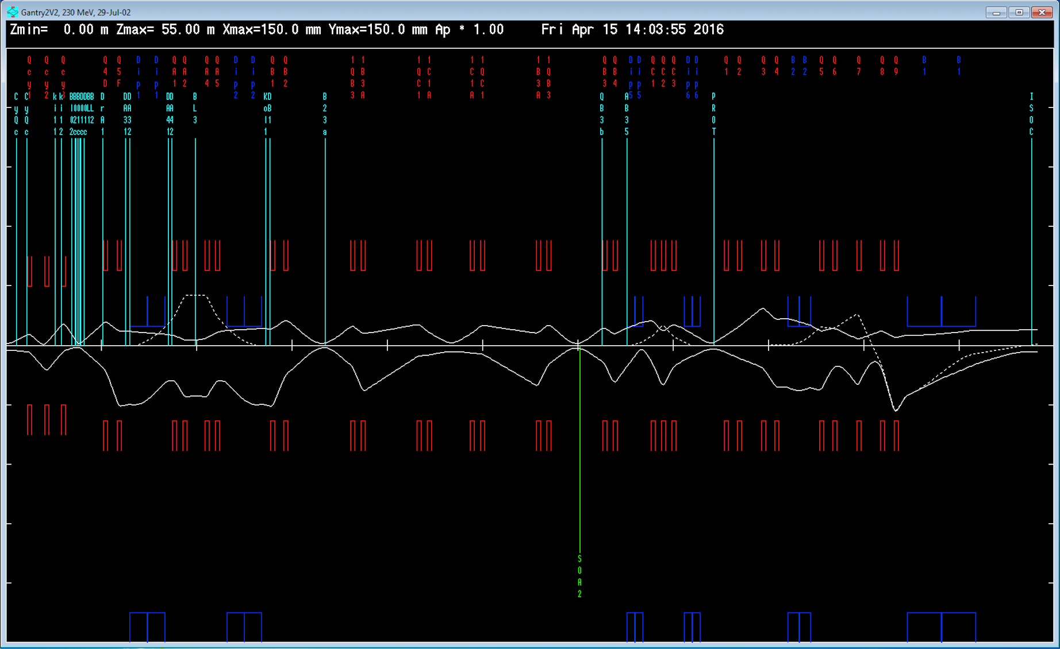
Standard Approach
Inspect machine optics and identify regions of interest.
  Develop Monte Carlo simulations as required.
Degrader and collimation
Nozzle and isocentre.
Wall aperture.
Simulation challenges - high precision, many particles:
  Computationally expensive.
  Separate simulations.
07th December 2018
Notes:
Constant desire to improve proton therapy machines:
Treatment quality, efficiency, safety & reduced costs.
Monte Carlo modelling used in machine design.
Simulation challenges still exist:
Tight beam profile constraints at isocentre – high precision.
Significant losses – many particles required for accurate statistics.
Computationally expensive.
Separate simulations.

Slide 5
Simulating a Beam Line
Regions of a proton therapy beamline:
  Particle source / acceleration.
  Beam transport to gantries.
  Gantry beam transport.
  Gantry nozzle.
  Isocentre.
  Shielding & Environment
3
1
2
4
5
6
Our aim: To demonstrate a start-to-end model of a proton therapy gantry in a single simulation.
07th December 2018

Slide 6
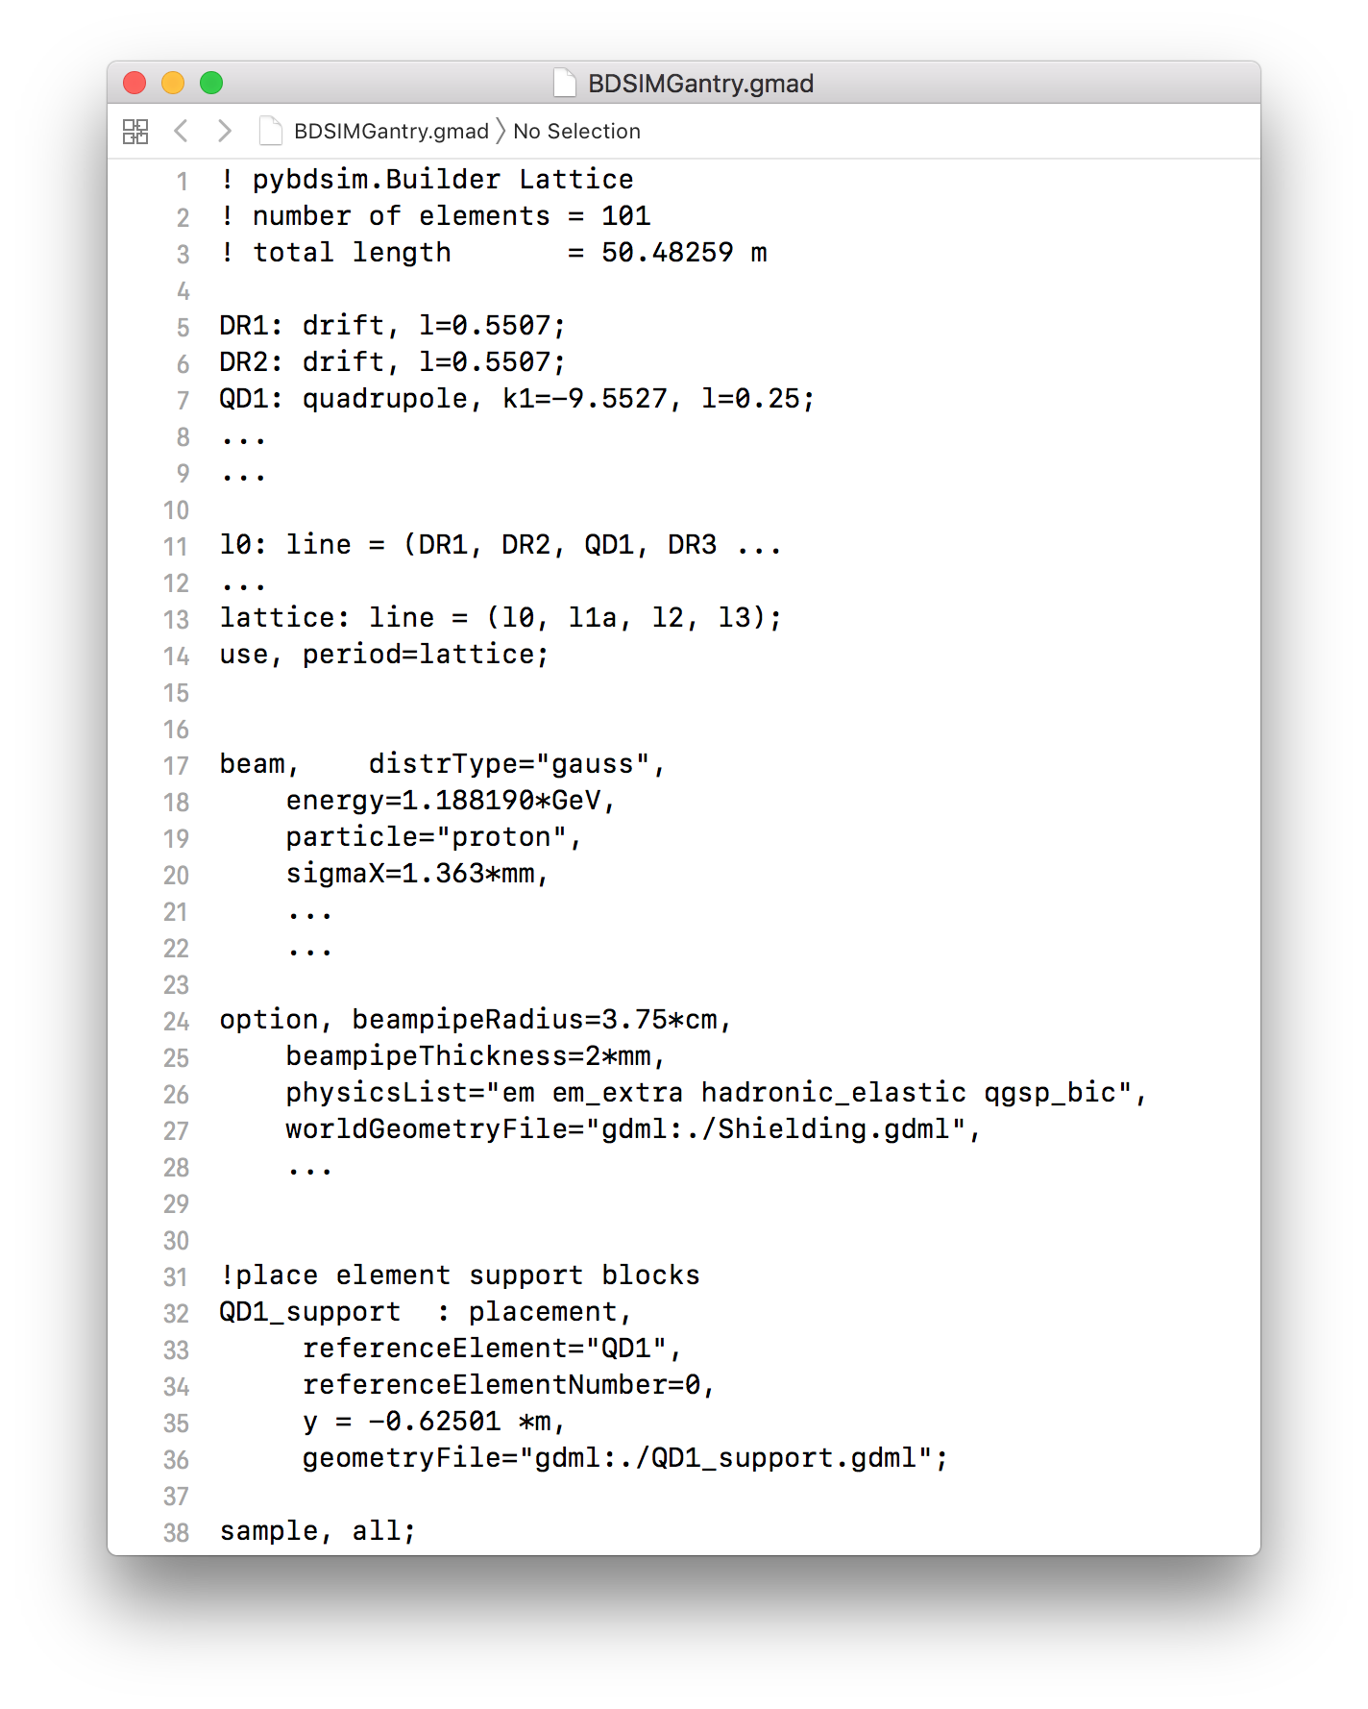
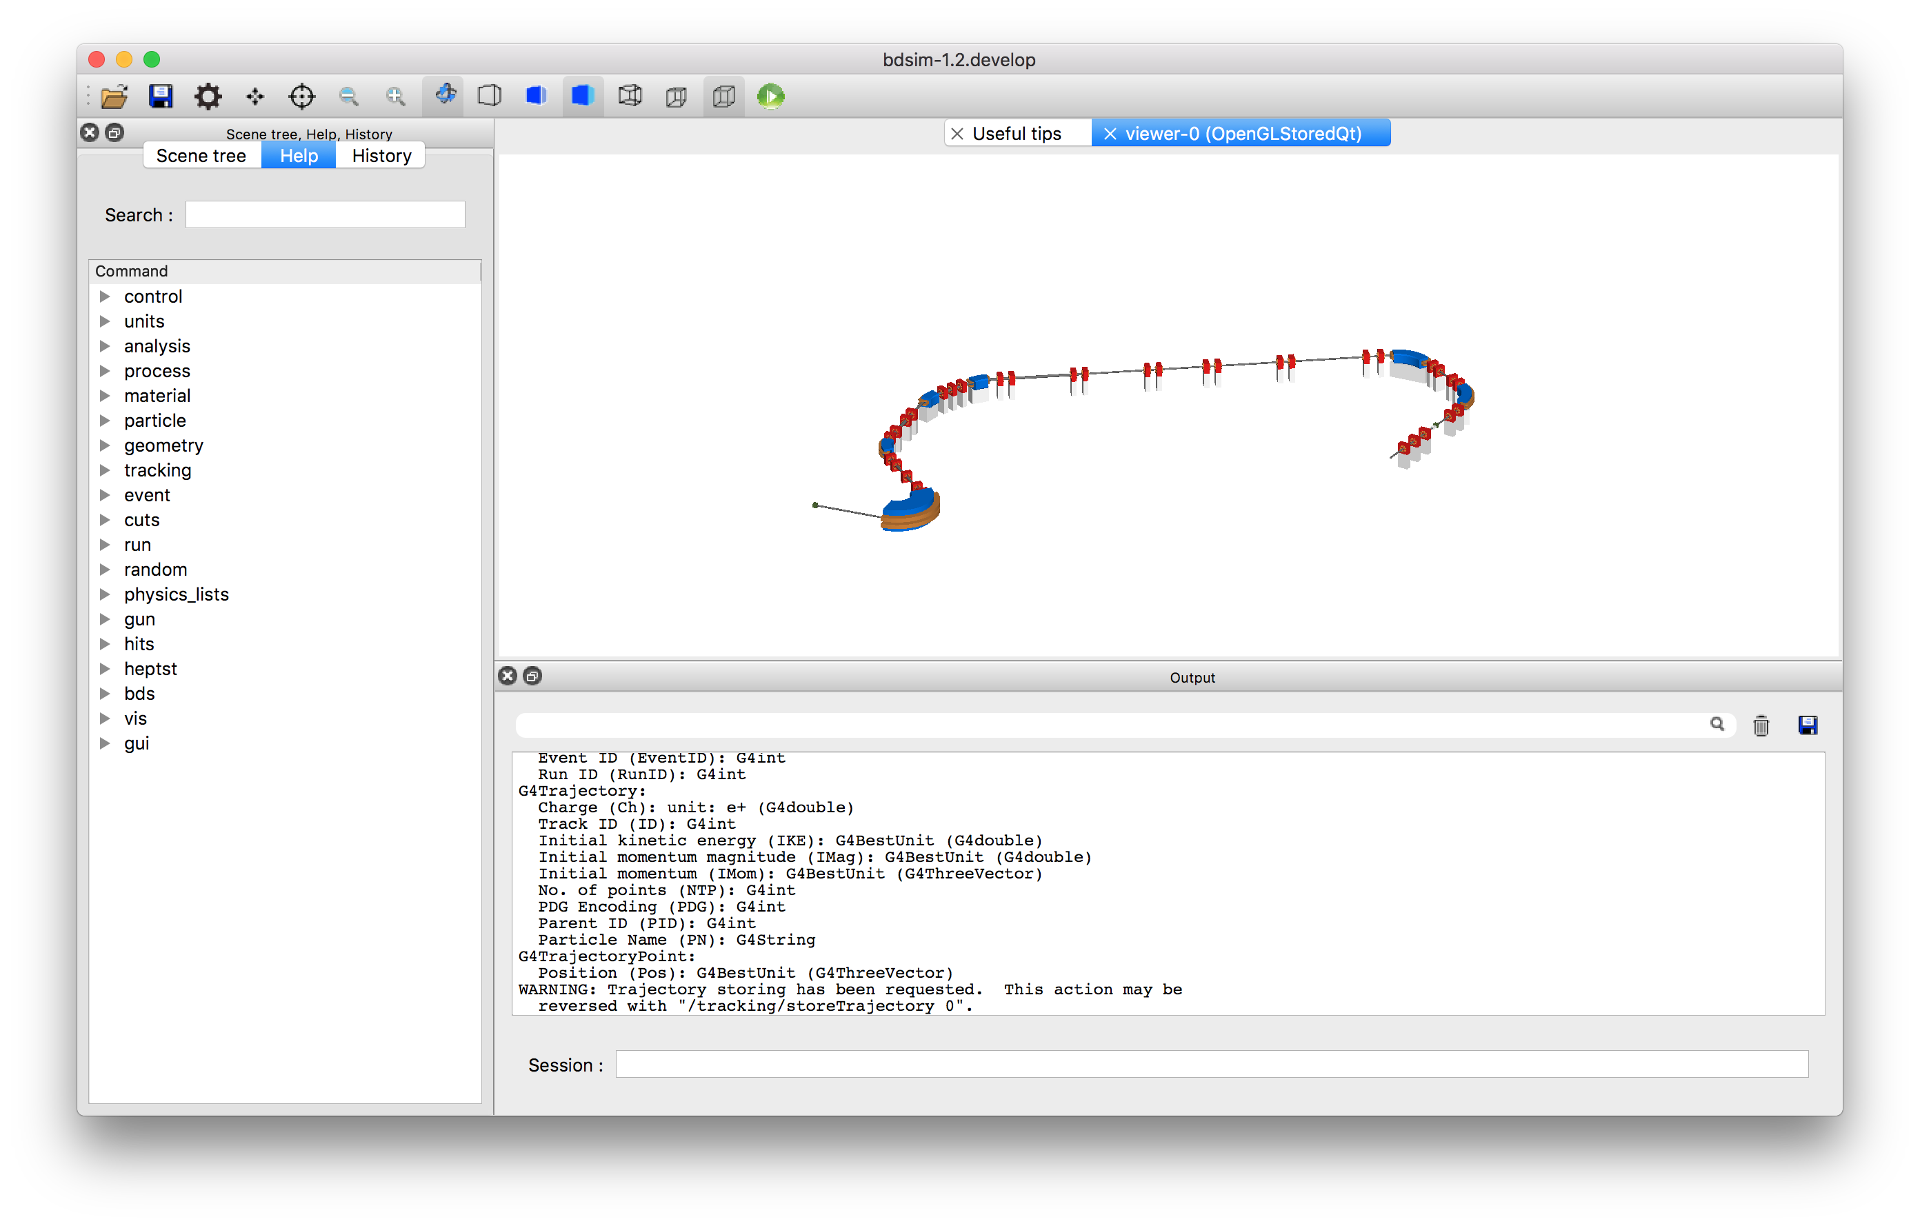
Building a BDSIM Model
Python utilities for automatic conversion:
  Pybdsim, pymadx, pymad8, pytransport
Optimise model with options.
Components
Sequence
Beam
Options
User geometry placement
07th December 2018

Slide 7
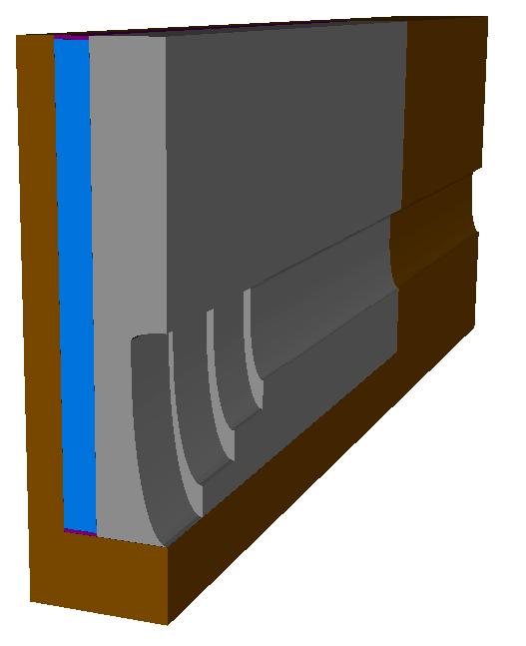
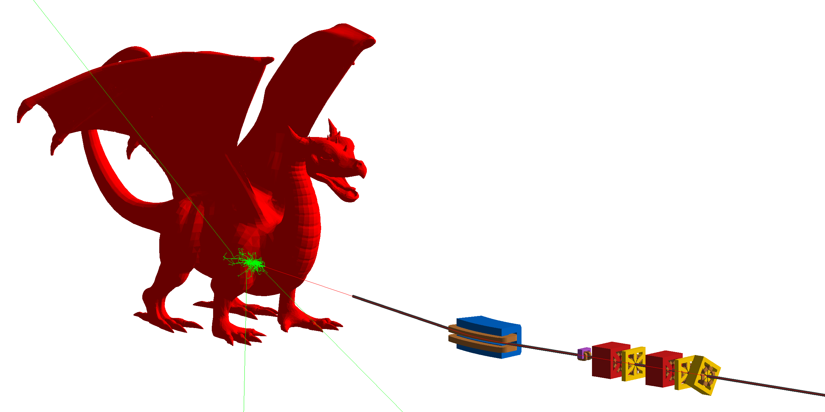
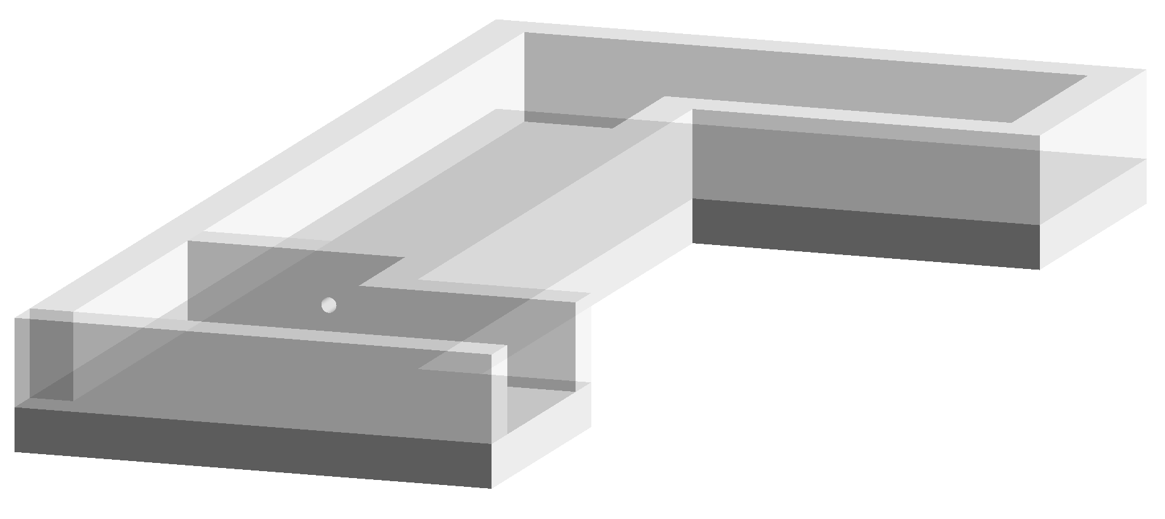
BDSIM Geometry
Custom external geometry can be placed and field maps overlaid.
Geometry e.g. GDML can be placed in the beam line.
Python package pyg4ometry to create Geant4 geometry
  https://bitbucket.org/jairhul/pyg4ometry/
  STL/STEP meshes.
Custom GDML collimator.
R. Bodenstein & A. Abramov.
Example concrete shielding
STL conversion to GDML.
07th December 2018

Slide 8
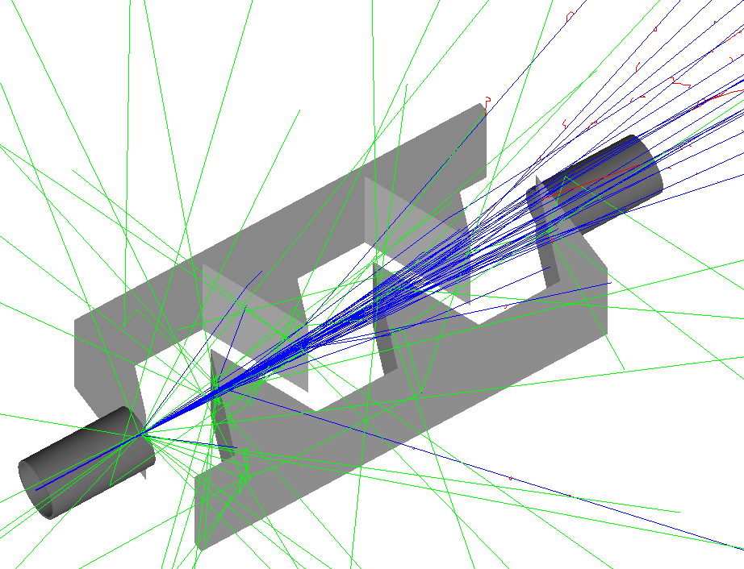
Energy Degrader
Interleaved wedge degrader based on design from Center for Proton Therapy at PSI .
Significant impact on beam phase space distribution and spectrum.
Before
After
07th December 2018

Slide 9
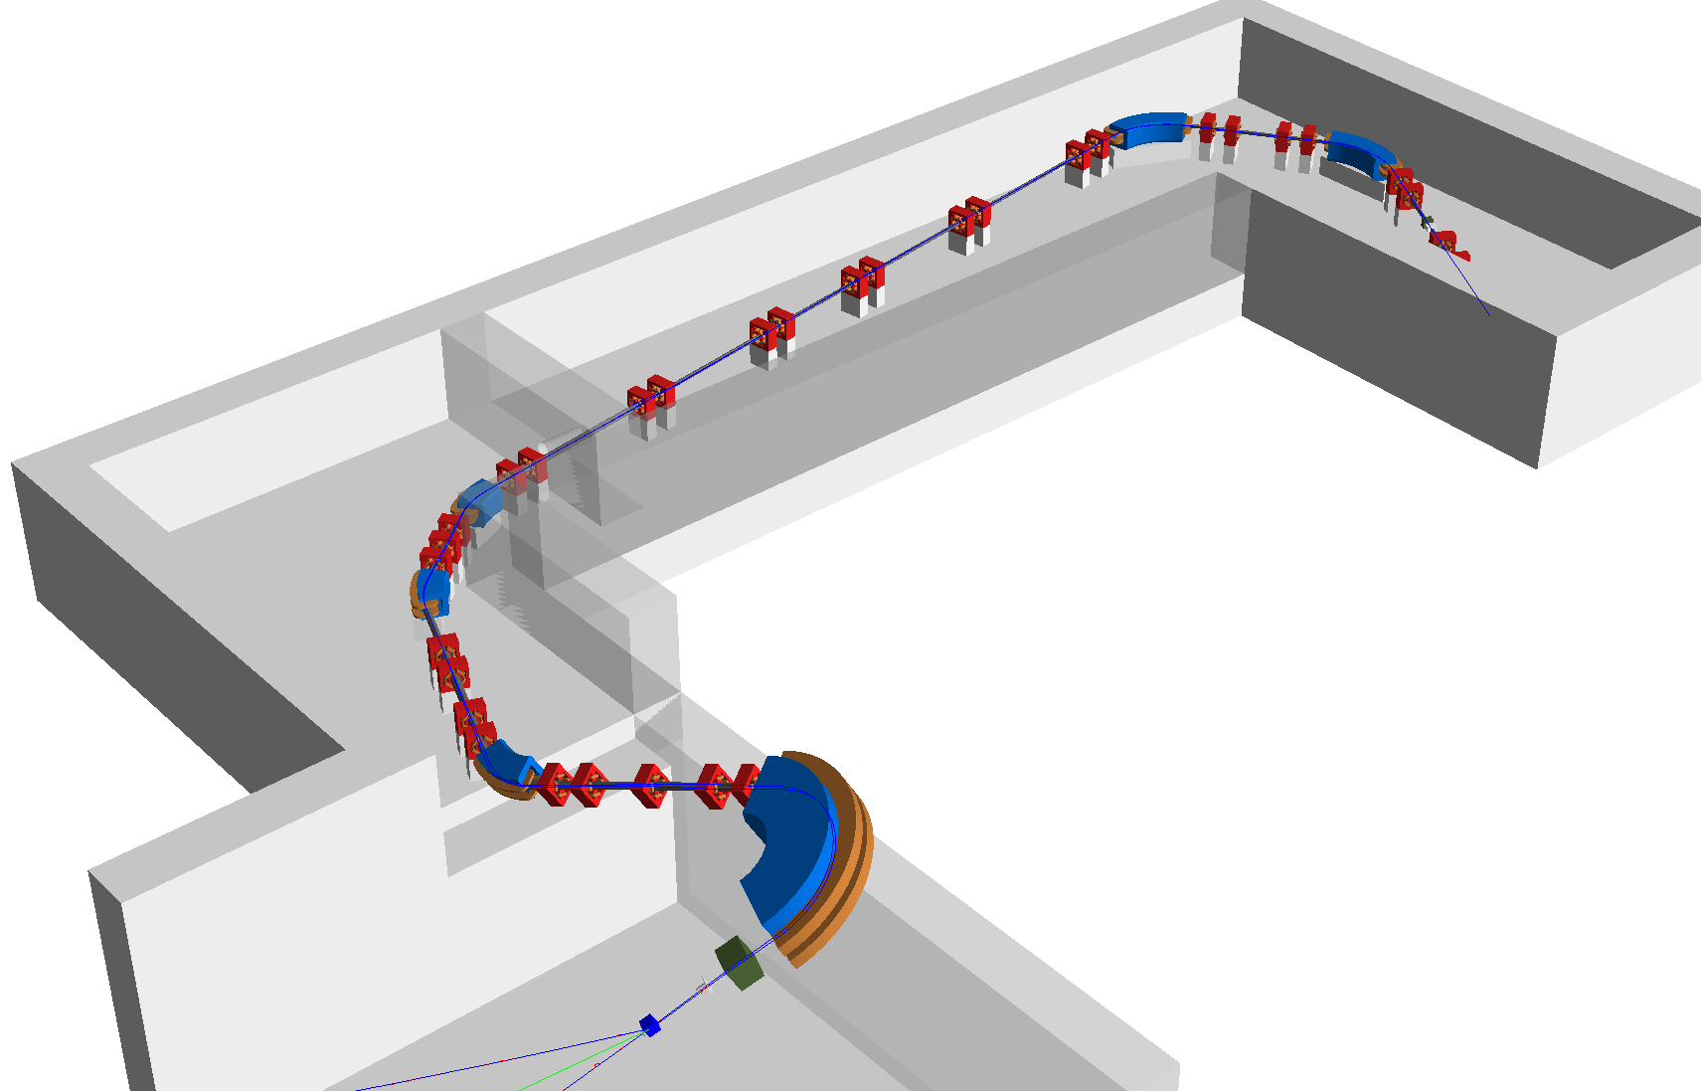
Example Proton Therapy Gantry
Gantry 2 from Paul Scherrer Institute in Switzerland.
  Lattice publicly available: http://aea.web.psi.ch/Urs_Rohrer/MyFtp
  Conceptual design – different from real machine.
Degrader and collimators added.
Example shielding and element support block geometry generated.
Support block
Shielding wall with aperture
Degrader for energy selection
Beam transport
Treatment Room
Suggested shielding
Isocentre
07th December 2018

Slide 10
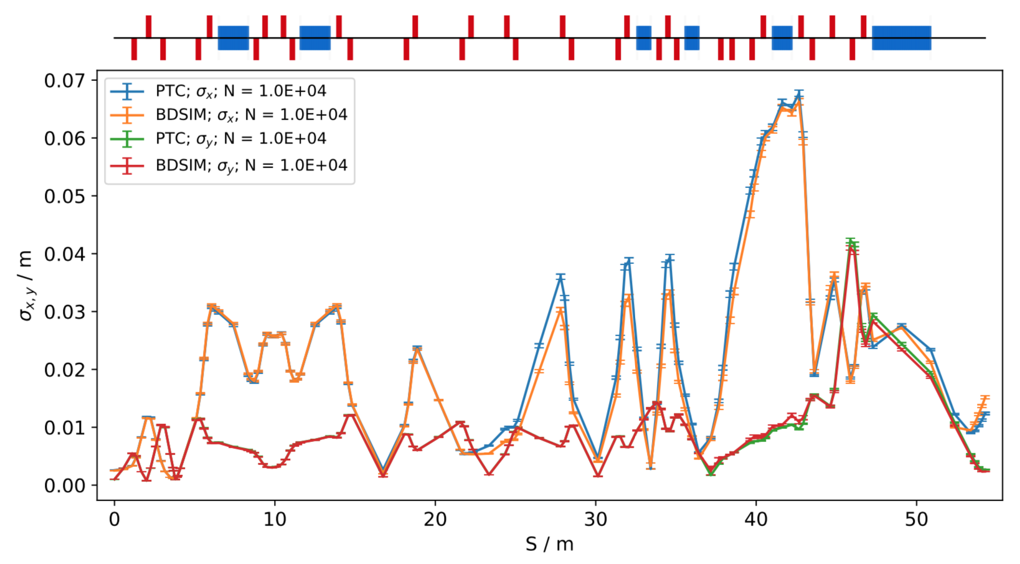
Lattice Optics
Particle properties recorded after every element (position, momentum, energy etc).
Twiss functions calculated with full statistical uncertainties.
Excellent agreement with PTC tracking routines.
07th December 2018

Slide 11
Loss Map and Energy Deposition
Energy deposition per 10 cm along curvilinear axis for full machine length.
07th December 2018

Slide 12
Spectra and Lateral Beam Profiles
Profiles prior to nozzle section.
  Primary protons and secondary particles.
Spectra of all particle species.
07th December 2018

Slide 13

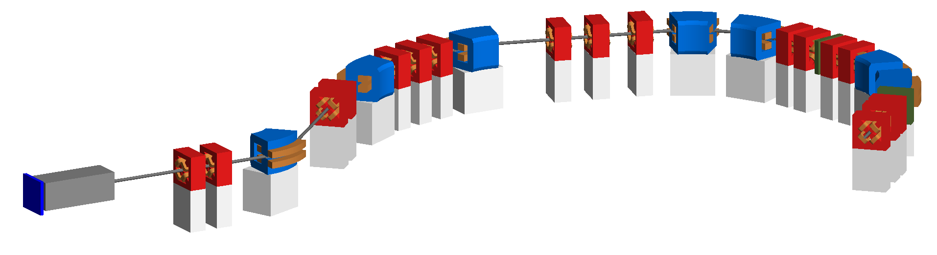
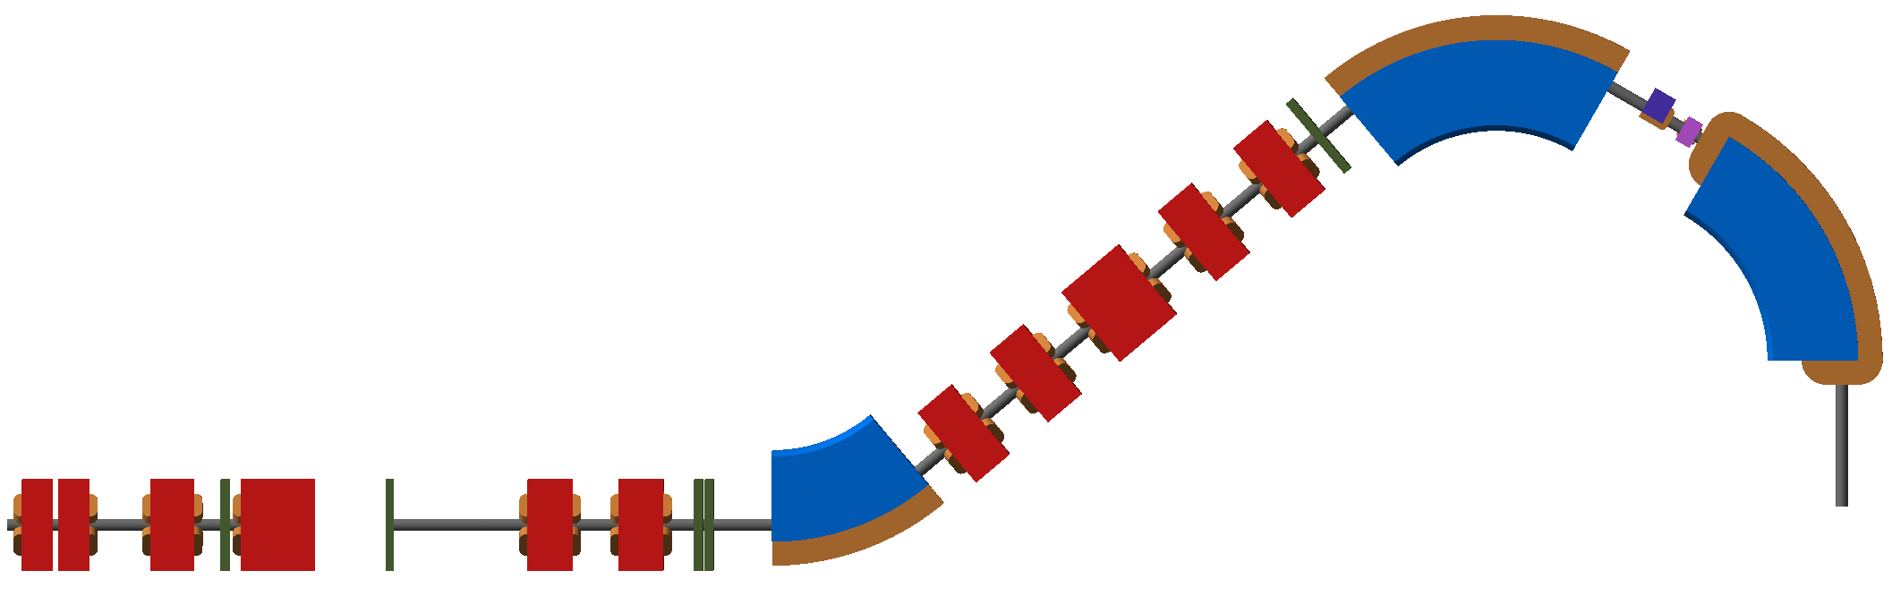
Collaboration with IBA
Collaboration with IBA (Ion Beam Applications), Belgium.
Simulation of two beam lines.
Improve beam profile with optimised nozzle and optics.
Enhanced dose rate from degrader efficiency studies.
Loss maps for shielding activation.
Publish next year.
To second room
Nozzle (enclosed)
Proscan Eyeline Beam Line
Degrader
Water Phantom
Gantry rotation point
Isocentre
Proteus One Compact Gantry
Degrader (enclosed)
07th December 2018

Slide 14
IBA Compact Gantry Optics
Excellent agreement with BDSIM and other tracking codes.
07th December 2018

Slide 15
IBA Compact Gantry Loss Map
Loss map for 70 MeV beam.
07th December 2018

Slide 16
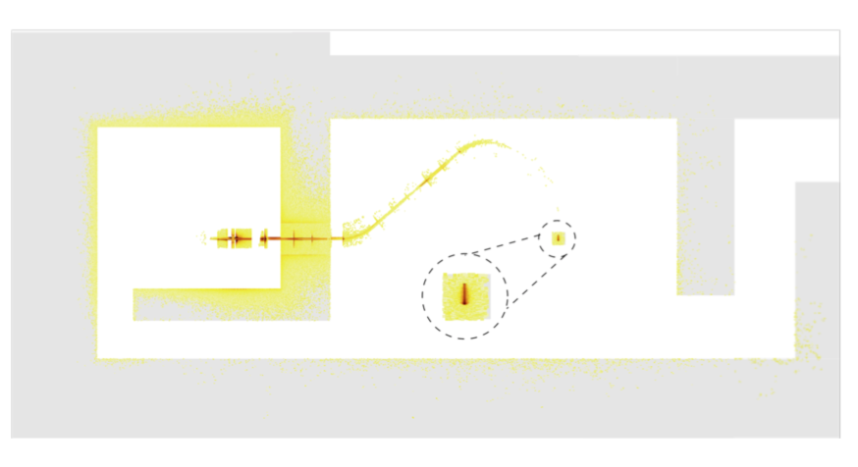
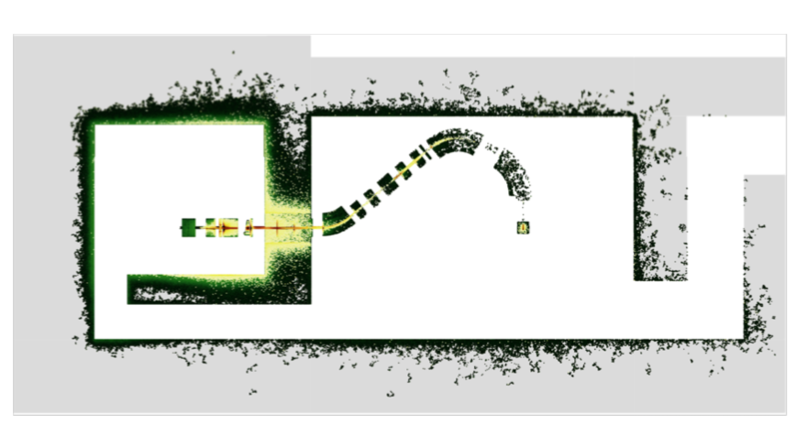
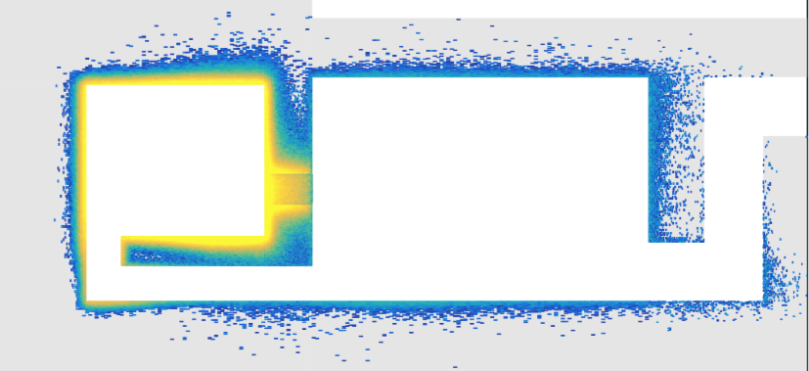
IBA Shielding Activation Studies
Proton interactions
Calculate shielding activation rate.
Presented in Robin Tesse PhD thesis (ULB).
ICAP 18 (20-24th Oct, Key West, Florida).
Protons & Neutron interactions
Shielding only
07th December 2018

Slide 17
Summary & Outlook
First start-to-end simulations of proton therapy beam lines.
Verified optics, generated loss maps, shown spectra and lateral profiles, and demonstrated potential for shielding & dosimetry.
BDSIM development:
  Dosimetry, further fringe fields, nozzle components.
Expanded analyses.
More detailed model.
Watch this space!
07th December 2018

Slide 18
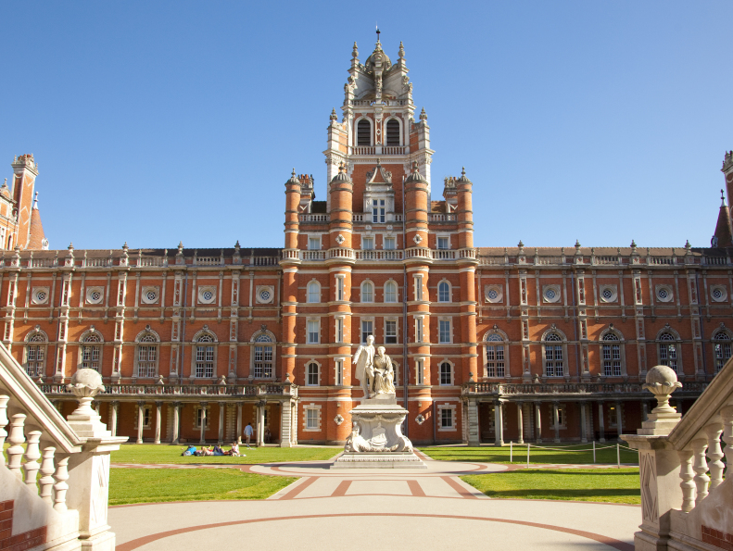

Thank you
William Shields
william.shields@rhul.ac.uk
http://www.pp.rhul.ac.uk/bdsim/

