Slide 1
Laser pulse evolution in non-linear plasma wakefield accelerators
Matthew Streeter
John Adams Institute for Accelerator Science, Imperial College London

Slide 2

Stating the obvious….
The plasma wave is generated by the drive laser

Slide 3
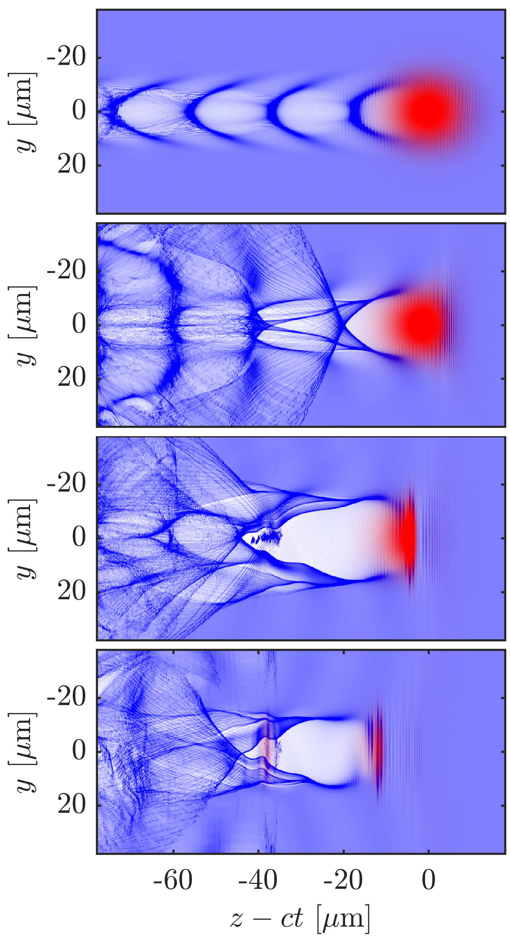
The plasma response modifies the laser pulse
0.0 mm
2.6 mm
5.3 mm
8.0 mm

Slide 4
Redshifted photons travel slower than the pulse front and cause power amplification
Group velocity of far redshifted photons can be less than the reduced group velocity of the laser
These photons drift backwards and contribute to field behind the depletion region
Pre-Injection Pulse Evolution length
For a gaussian pulse=:

Slide 5
An experiment to study laser, electron and x-ray beams simultaneously
Laser
12 J, 50 fs,
F/20 focusing
a₀ = 3
Laser diagnostics
Helium Gas jet
Electron spectrometer
Streeter, M. J. V., et al. (2018) Physical Review Letters, 120(25), 254801. https://doi.org/10.1103/PhysRevLett.120.254801
Bloom, M. S., et al. (2018). https://arxiv.org/abs/1710.05740

Slide 6
Laser evolution determines self-injection and acceleration behavior
Model of laser evolution
Streeter, M. J. V., et al. (2018) Physical Review Letters, 120(25), 254801. https://doi.org/10.1103/PhysRevLett.120.254801
Bloom, M. S., et al. (2018). https://arxiv.org/abs/1710.05740

Slide 7
Controlling the laser evolution by shaping the initial pulse profile
Model prediction
Input laser pulse shapes
1D PIC simulations
Electron density for calculations and simulations

Slide 8
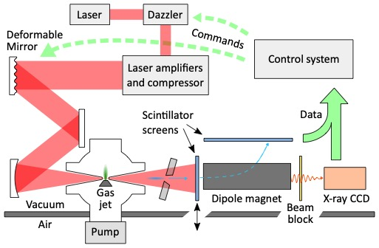
Using active feedback to optimize laser pulse shape
Streeter, M. J. V., et al. (2018). Applied Physics Letters, 112(24), 244101. https://doi.org/10.1063/1.5027297
Dann, S. J. D. et al (2018) In prep for submission

Slide 9
Algorithm autonomously improved electron spectrum through control of initial pulse shape
Electron spectrum before and after
Fully compressed pulse shape and optimized cases
Streeter, M. J. V., et al. (2018). Applied Physics Letters, 112(24), 244101. https://doi.org/10.1063/1.5027297
Dann, S. J. D. et al (2018) In prep for submission

Slide 10
Machine learning used to explore multi-dimensional parameter space and identify interesting regions for further study
Streeter, M. J. V., et al. (2018). Applied Physics Letters, 112(24), 244101. https://doi.org/10.1063/1.5027297
Dann, S. J. D. et al In prep for submission

Slide 11
Experiment with Long Focal Length focusing optic and variable length gas cell
Wood J.C. et al. In prep for submission

Slide 12
Large charge, high divergence electron beam injected at depletion length
For
depletion length
Wood J.C. et al. In prep for submission

Slide 13
Extending interaction length as leads to a huge increase in x-ray flux
Wood J.C. et al. In prep for submission

Slide 14
Conclusion
Detailed studies of laser pulse evolution are essential for understanding LWFA
Wakefield amplitude and size can vary dramatically in a constant plasma density
Great potential for optimization of electron and x-ray beams

