Slide 1


Longitudinal beam profile diagnostics using coherent Cherenkov diffraction radiation at CLARA accelerator
K. Fedorov ^{1,2}
P. Karataev ¹ | T. Pacey ^{3,4} | Y. Saveliev ^{3,5} | A. Potylitsyn ² | V. Antonov ¹
¹ John Adams Institute, Royal Holloway, University of London
² Tomsk Polytechnic University, Tomsk, Russia
³ The Cockcroft Institute, Daresbury Laboratory, Warrington, UK
⁴ School of Physics and Astronomy, University of Manchester, Manchester, UK
⁵ Accelerator Science and Technology Centre, STFC, Daresbury Laboratory, Warrington, UK

Slide 2
Coherent Cherenkov Radiation (CCR):
Coherent Transition Radiation (CCR):
Allow noninvasive diagnostic
Relatively high intensity
Highly directional
New technique
Well studied
$$γλ$$
Forward CTR
CCR
$$θ$$
e-beam
Backward CTR
e-beam
Fig.1 Schematic of CCR generation
Fig.2 Schematic of CTR generation

Slide 3
How does CCR and CTR diagnostic work?
The coherent spectral energy density produced by a bunch of N electrons is the product of the spectral energy density from by a single electron, the number of electrons squared and the absolute square of the form factor:
$$[\frac{d^{2}U}{dwdΩ}]_{coh}=N^{2}[\frac{d^{2}U}{dwdΩ}]_{single}|\overset{N}{\underset{j=1}{∑}}exp(iwc^{-1}z_{j})|^{2}=[\frac{d^{2}U}{dwdΩ}]_{single}\overset{N}{\underset{j=1}{∑}}exp(iwc^{-1}z_{j})\overset{N}{\underset{i=1}{∑}}exp(-iwc^{-1}z_{i})=$$
$$=[\frac{d^{2}U}{dwdΩ}]_{single}(N+\overset{N}{\underset{j=1}{∑}}exp(iwc^{-1}z_{j})\overset{N}{\underset{\begin{aligned}j=1 \\ j=i\end{aligned}}{∑}}exp(-iwc^{-1}z_{i}))=[\frac{d^{2}U}{dwdΩ}]_{single}](N+N(N-1)|∫ρ(z)exp(iwc^{-1}z)|^{2}$$
$$[\frac{d^{2}U}{dwdΩ}]_{coh}=N^{2}[\frac{d^{2}U}{dwdΩ}]_{single}|F(w)|^{2}$$
$$[\frac{d^{2}U}{dwdΩ}]_{coh}=N^{2}[\frac{d^{2}U}{dwdΩ}]_{single}[∫p(z)cos(z\frac{w}{c})dz]^{2}$$
experimental data
$$p(z)=\frac{1}{πc}∫_{0}^{∞}\sqrt{\frac{[\frac{d^{2}U}{dwdΩ}]_{coh}}{[\frac{d^{2}U}{dwdΩ}]_{single}}}cos(ψ(w)-z\frac{w}{c})dw$$
mathematical approach

Slide 4
How diagnostic is works?
$$\sqrt{\frac{[\frac{d^{2}U}{dwdΩ}]_{coh}}{[\frac{d^{2}U}{dwdΩ}]_{single}}}$$
$$p(z)=\frac{1}{πc}∫_{0}^{∞}\sqrt{F(W)}cos(ψ(w)-z\frac{w}{c})dw$$
$$F(w)|^{2}=\frac{S_{coh}(w)}{S_{single}(w)}$$
Kramers-Kronig
analysis
$$S_{coh}(w)$$
$$S_{single}(w)$$

Slide 5
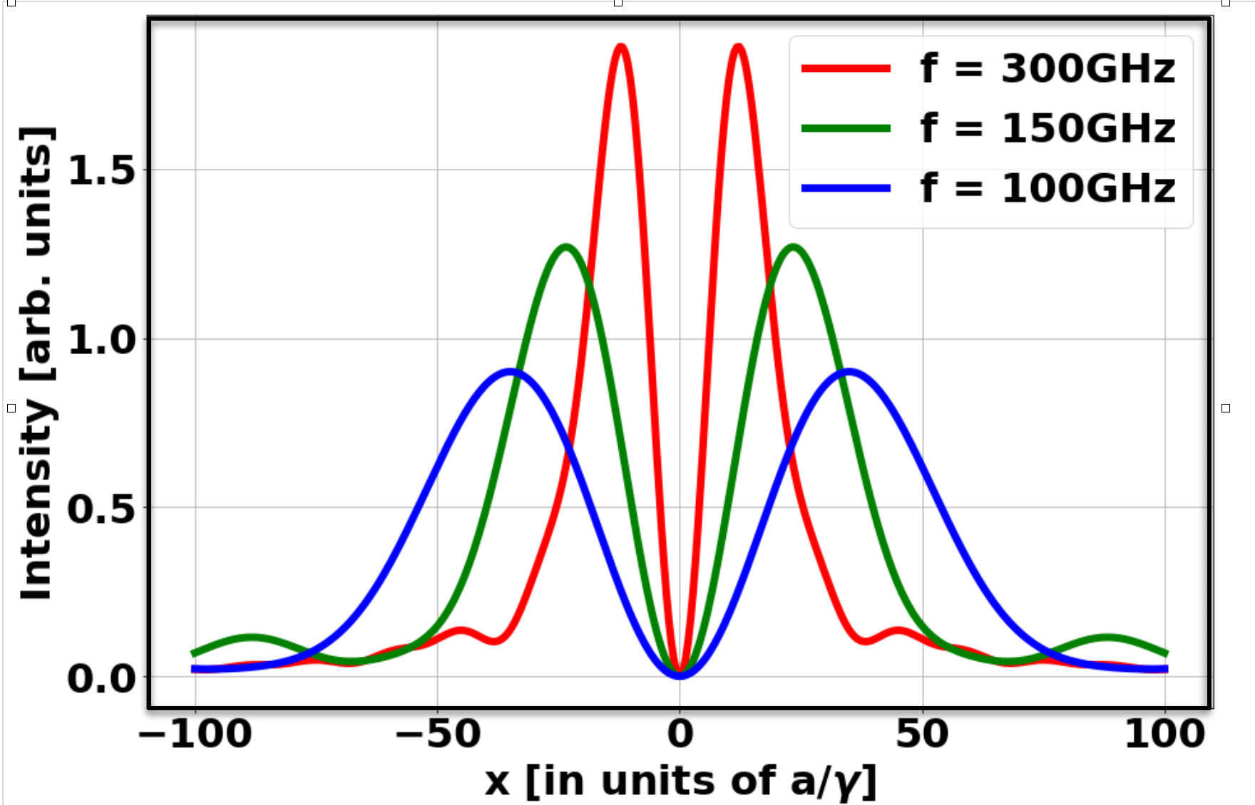
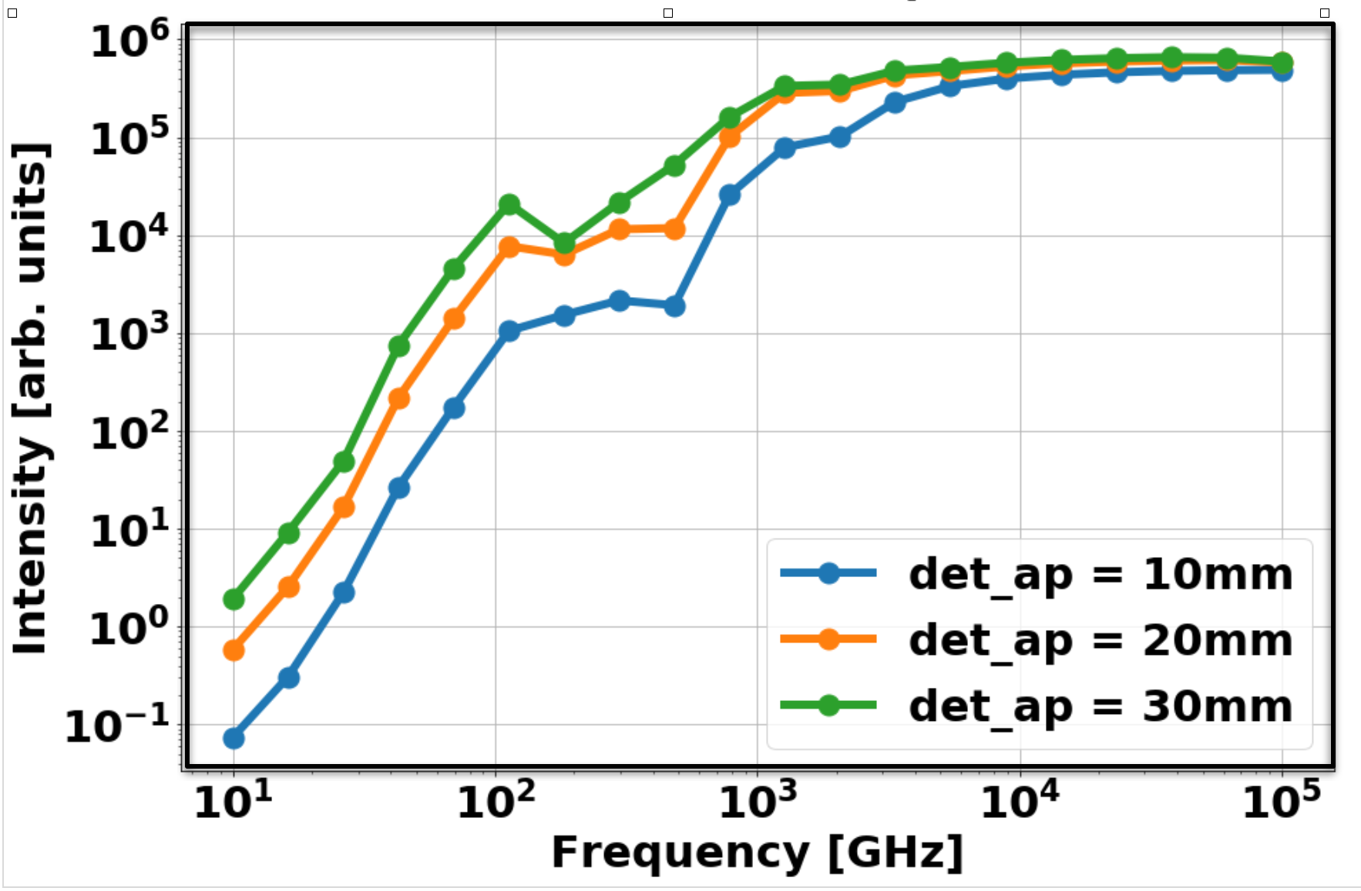
Transition radiation spectrum from a single electron
Models takes into account the following parameters:
Energy
TR target size
Distance between target and detector
Detector aperture
Fig.3 TR Spectral angular distribution
from a single electron
Fig.4 TR Spectrum for different detector apertures
Karataev Physics Letters A, Volume 345, Issue 4-6, p. 428-438., Jul 2005

Slide 6
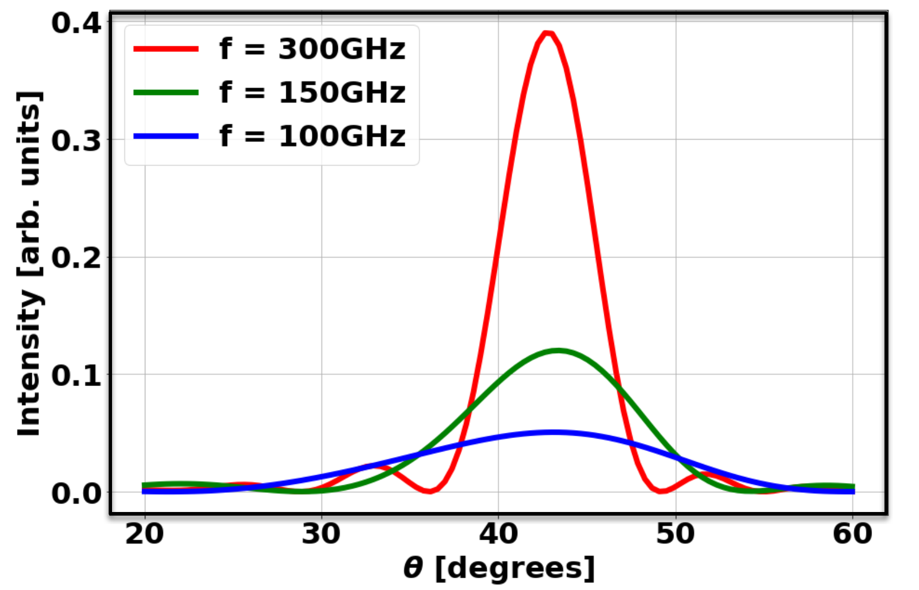
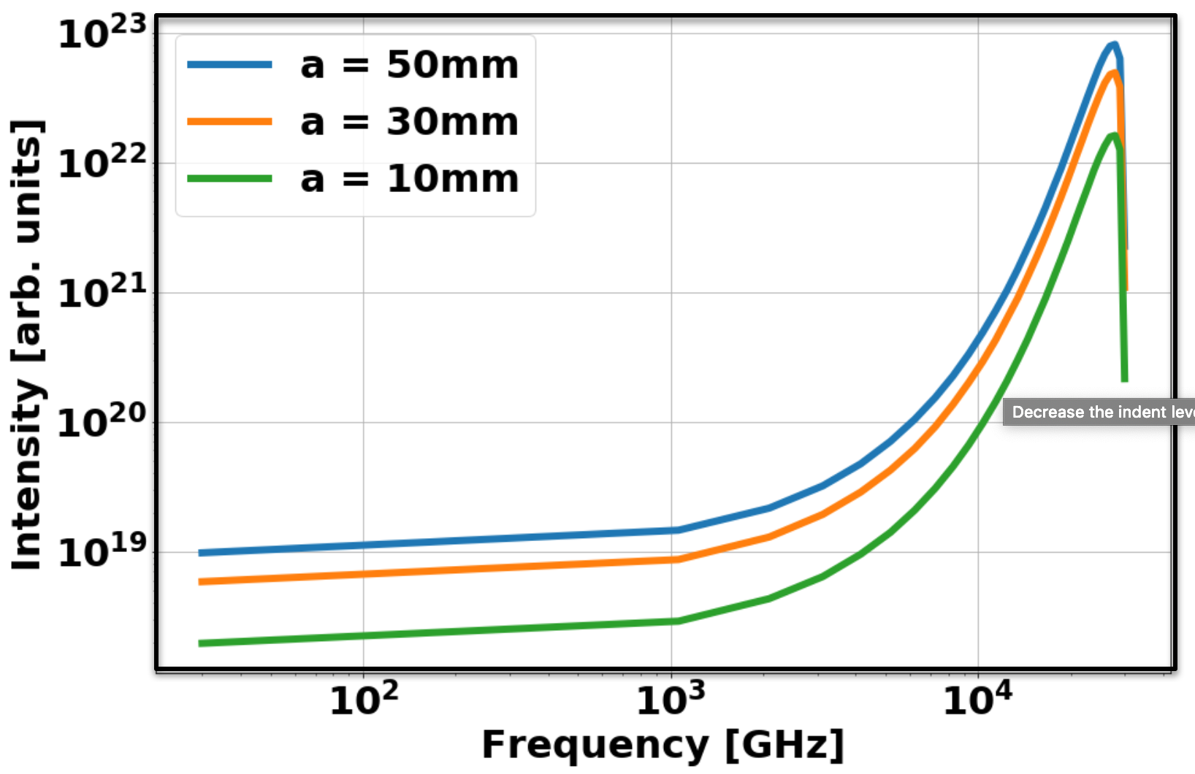
Cherenkov radiation spectrum from a single electron
Models takes into account the following parameters:
Energy
Cherenkov target dimensions (prismatic target)
Cherenkov target refractive index
Distance between target and detector
Detector aperture
Impact parameter (distance between beam and target)
Angle between target and particle direction
Fig. 5 VCR Spectral angular distribution
from a single electron
Fig. 5 VCR Spectrum for different detector apertures
M.V. Shevelev and A.S. Konkov, J. Exp. Theor. Phys. (2014) 118: 501.

Slide 7
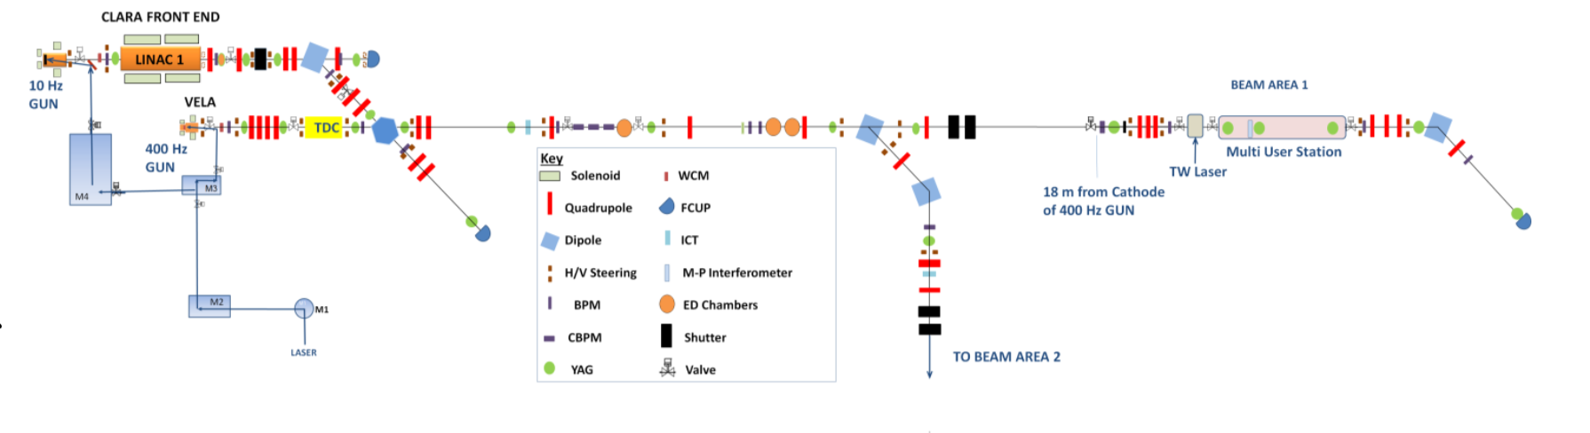
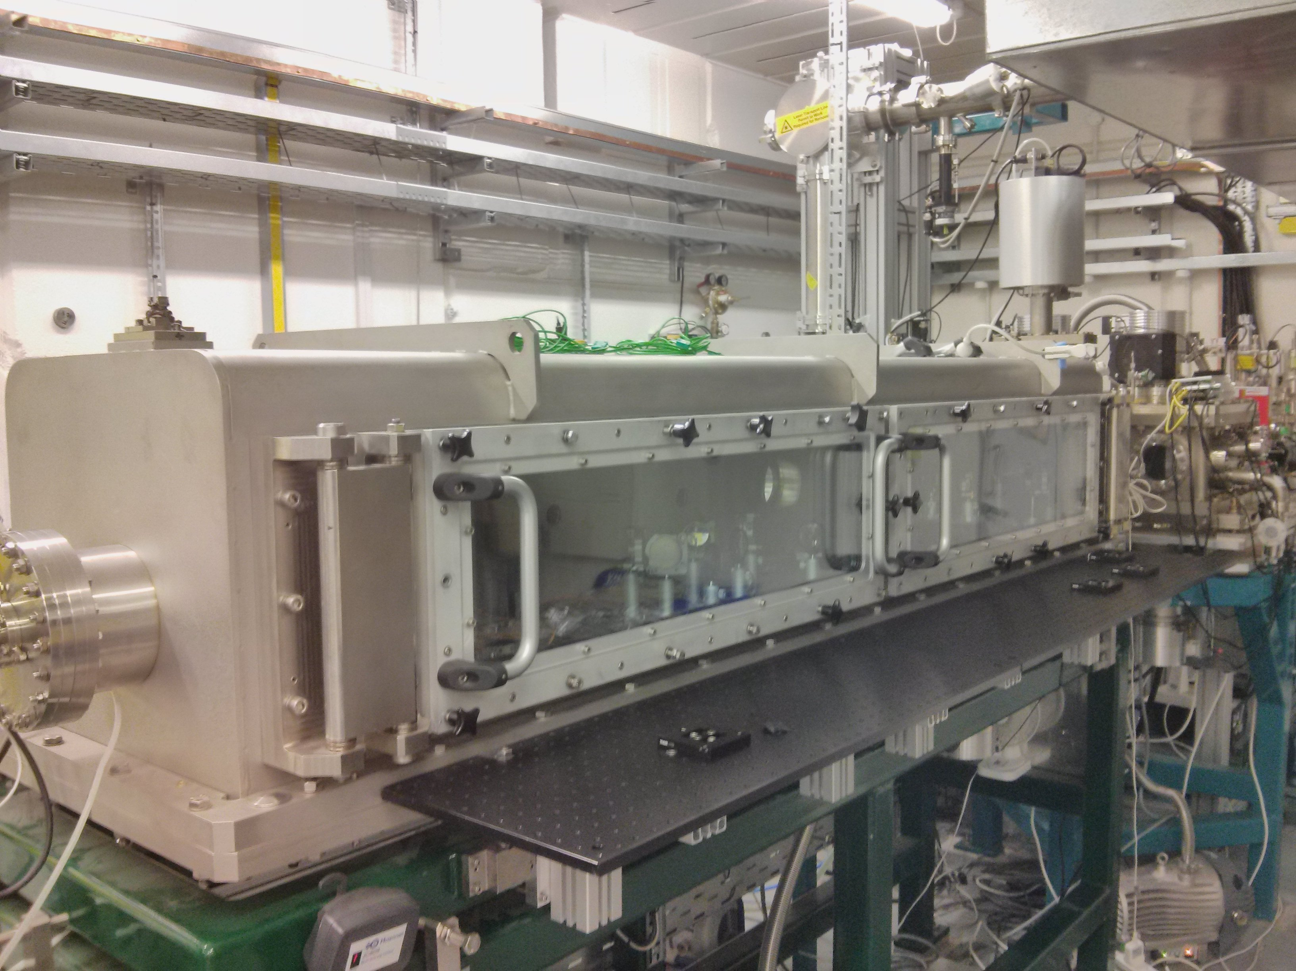
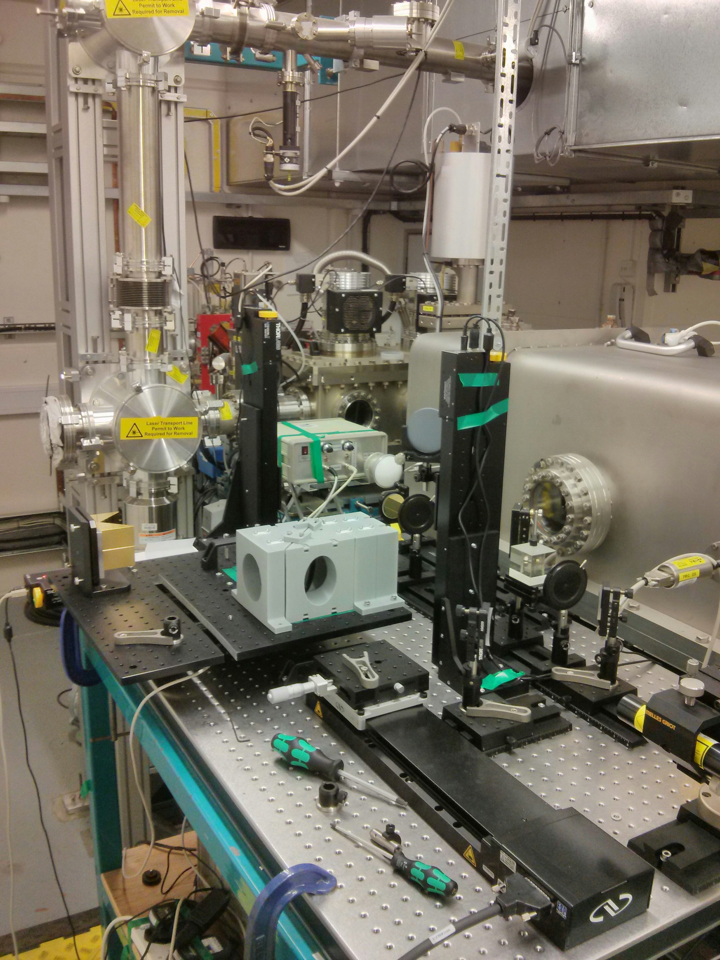
Experimental work at CLARA

Slide 8
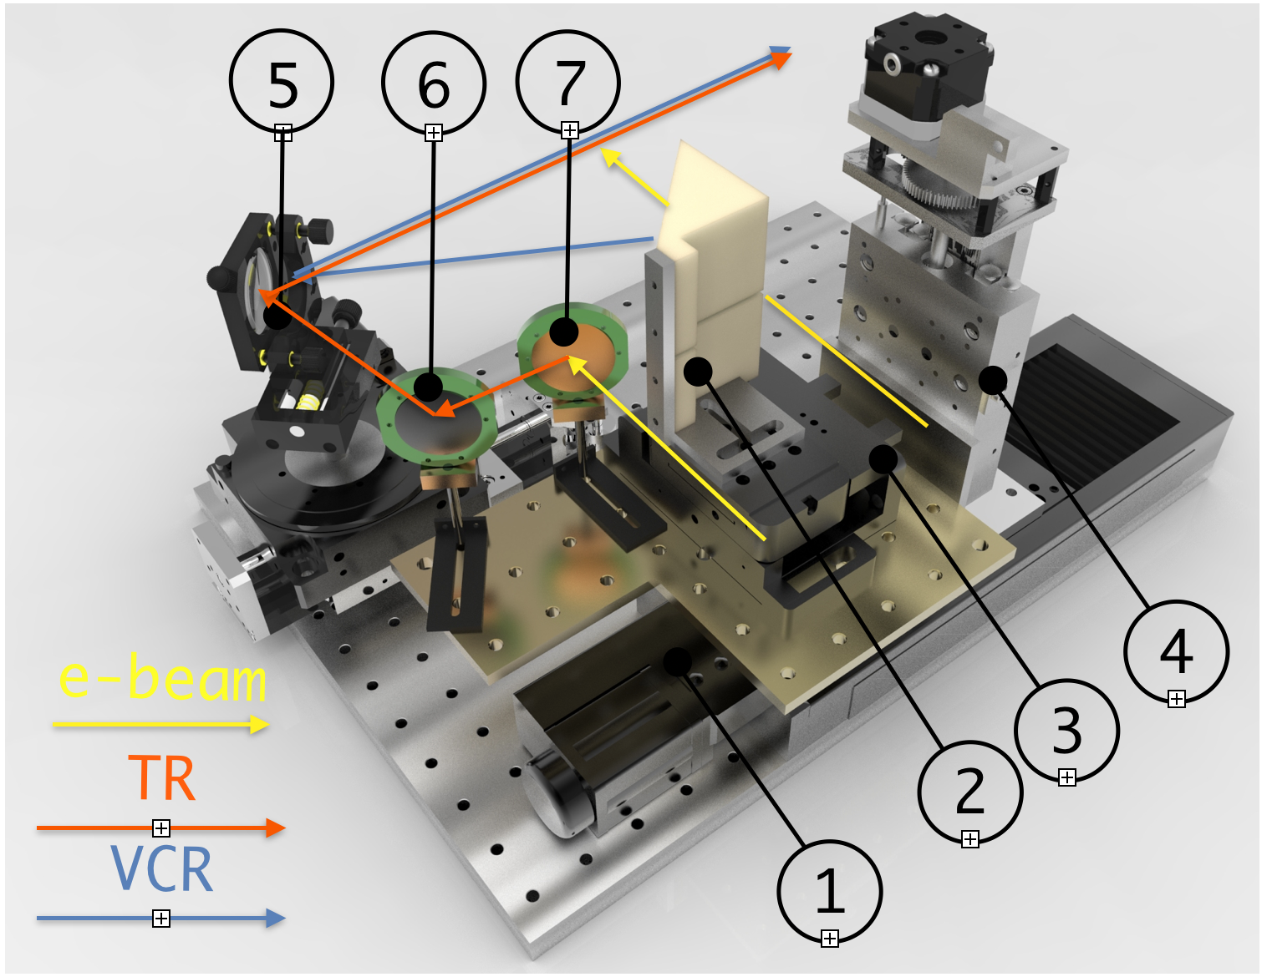
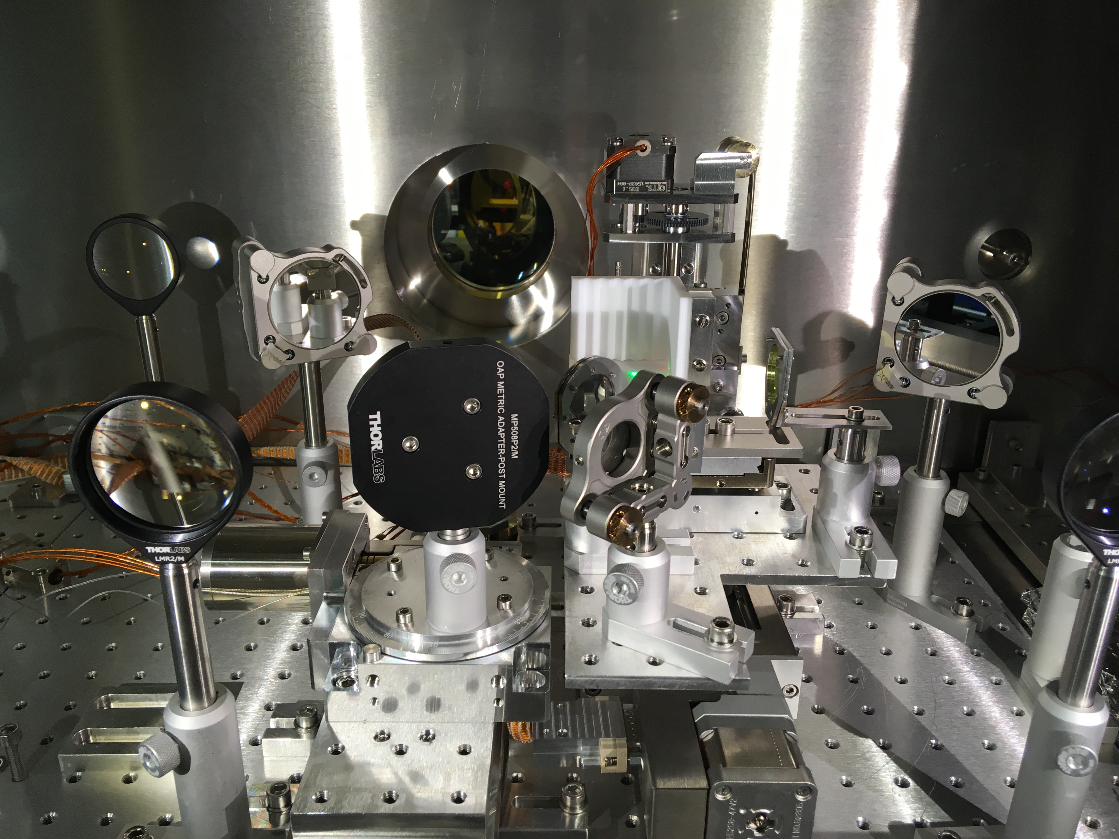
Setup inside of chamber
1 — Horizontal positioning stage
2 — Teflon (VCR) target
3 — Tip-Tilt stage
4 — Vertical positioning stage
5 — Concave mirror
6 — mirror
7 — Foil (TR) target
OUTPUT WINDOW
Setup inside of vacuum chamber allows us to register VCR and TR during single accelerator run.
VCR TARGET
TR TARGET
TR MIRROR
CONCAVE MIRROR

Slide 9
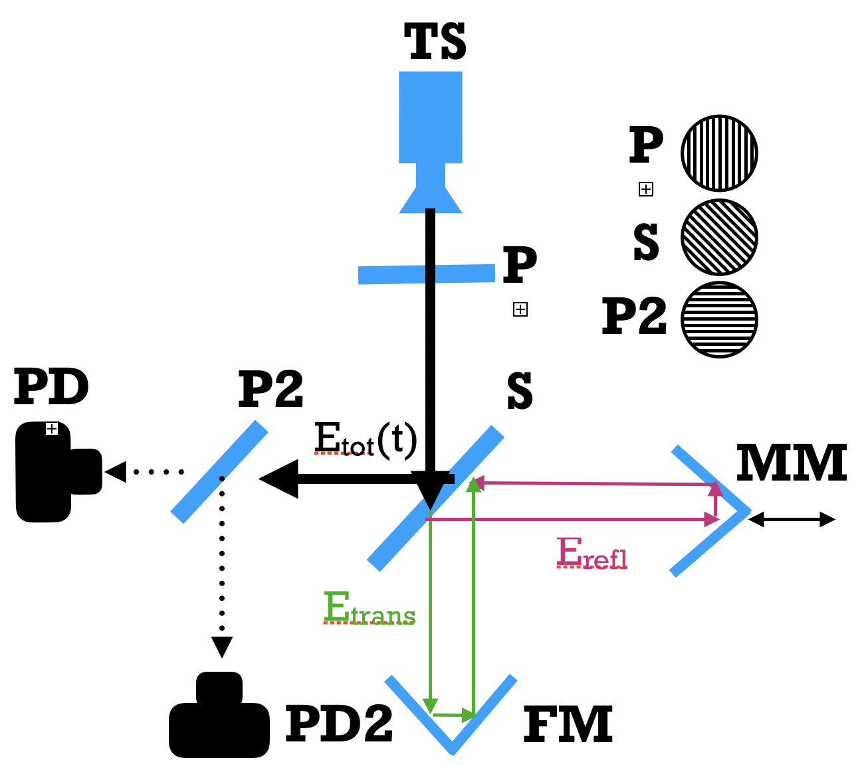
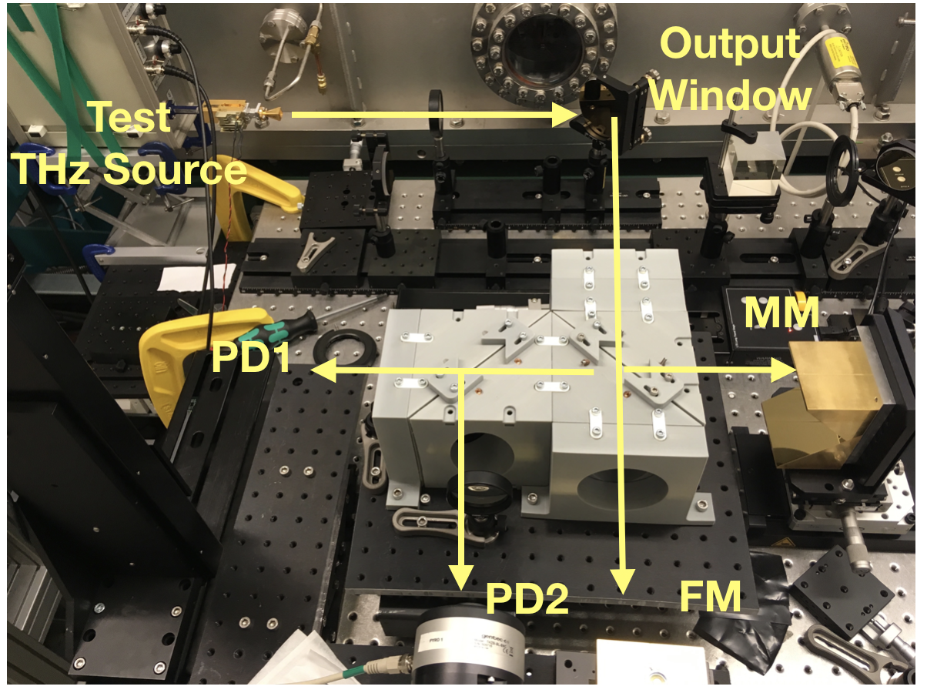
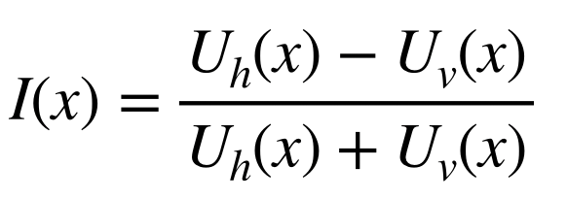
MPI Interferometer
PD3
Martin-Pupplet interferometer has a higher signal to noise ration and there is possibility to use two different output and make a noise normalisation:

Slide 10
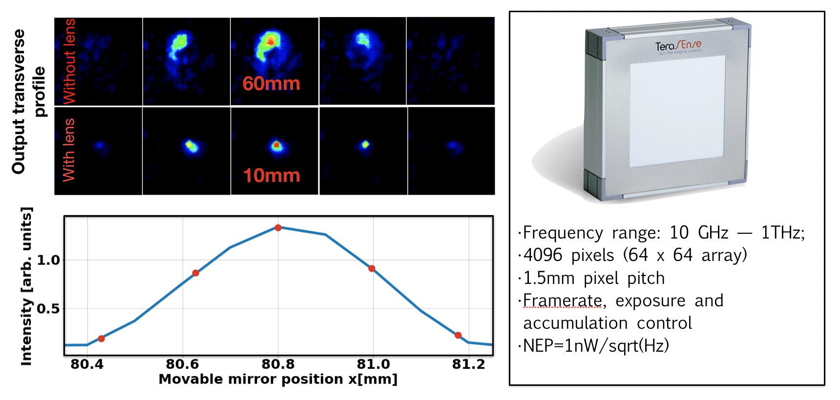
MPI precise alignment
By using THz camera and test THz source we were able to align interferometry system with good precision.

Slide 11
Experimental results:
CCR, h=2mm, 80-70pC, 200 microns RMS transversal bunch size, E=40MeV
Error bar
Appodization
Filtering

Slide 12
Experimental results
0.4 mm=1.2 ps

Slide 13
Experimental results. Two different klystron phase
0.4 mm=1.2 ps
0.5 mm=1.5 ps
-6deg
-11deg

Slide 14
Conclusion
Set of data for CTR for different klystron phases
Set of data for CCR for different klystron phases
CCR vs impact parameter (distance between target and beam)
CCR vs target-beam angle
Improve optical alignment
Optics for lower frequencies
Quasi-optical detector (with higher sensitivity)
Thank you for your attention!

