Slide 1
John Adams Institute Festival 2018
Friday 7th December 2018
RHUL
Low-latency beam feedbacks for e+e- colliders
Phil BURROWS, Colin PERRY, Douglas BETT, Rebecca RAMJIAWAN
University of Oxford

Slide 2
Contents
Introduction to Interaction Point (IP) feedback
FONT system and cavity BPM signal processing at KEK ATF2
Recent beam stabilisation results
  1-BPM feedback
  2-BPM feedback

Slide 3
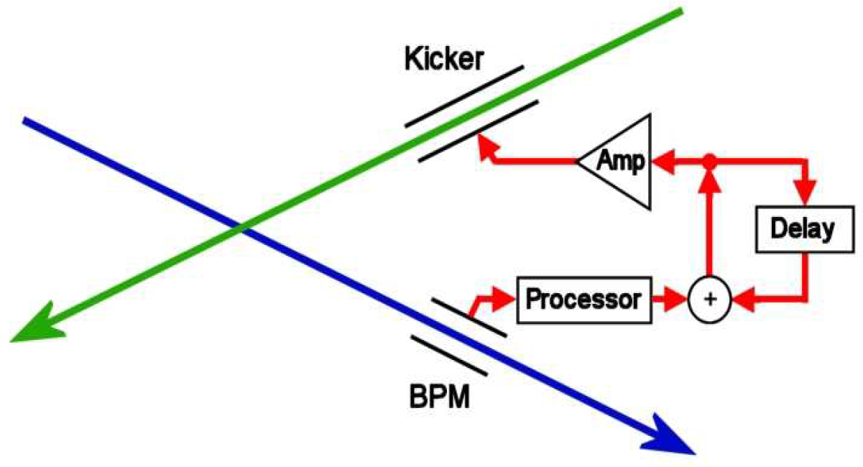
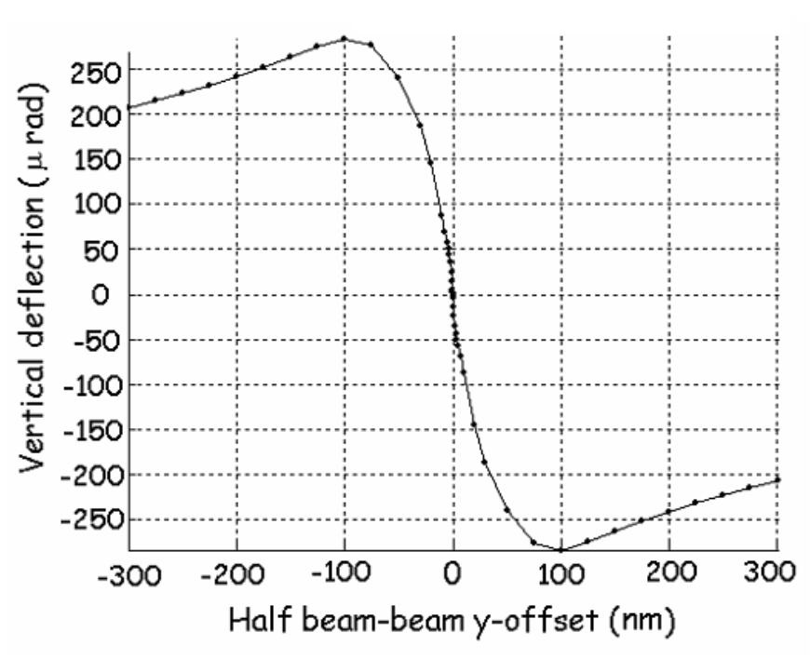
Interaction Point feedback
Offset of bunches at IP inferred from position of first bunch measured at downstream BPM
Second bunch kicked upstream of IP in other beamline to compensate for this misalignment
Delay loop preserves correction for subsequent bunches
Beam-beam deflection curve

Slide 4
KEK ATF2
Test accelerator in Japan using 1.3 GeV electron beam
Original aim to demonstrate super-low beam emittance required for future e+e- collider achieved 2001
ATF2 collaboration now has two goals for beam:
  37 nm beam size
  nm level beam stability

Slide 5
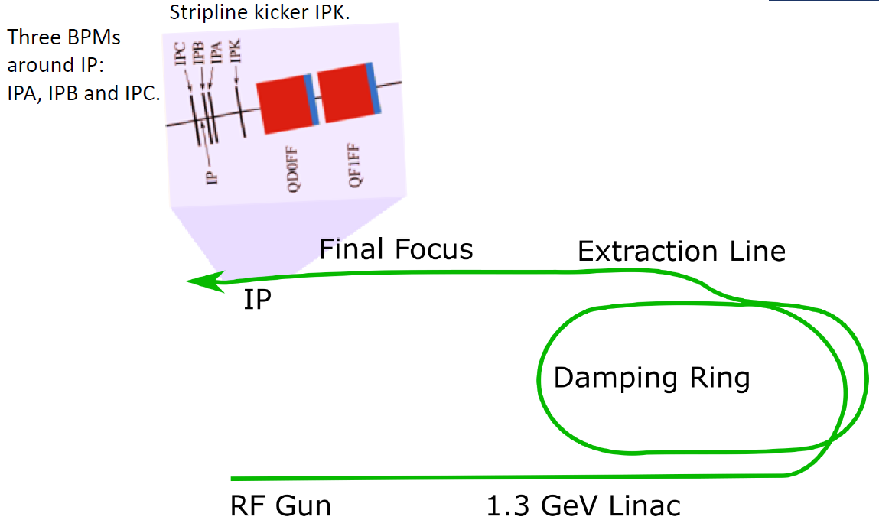
Beam stabilisation at ATF2
Feedback system used to measure position offset of first bunch in train to provide stabilisation for second bunch
Waveforms from low-Q C-band cavity BPMs processed by custom FONT5A digital board to give position from which correction can be calculated
Beam deflection applied by stripline kicker
Uses bunch trains of two bunches with bunch spacing of ~280 ns

Slide 6
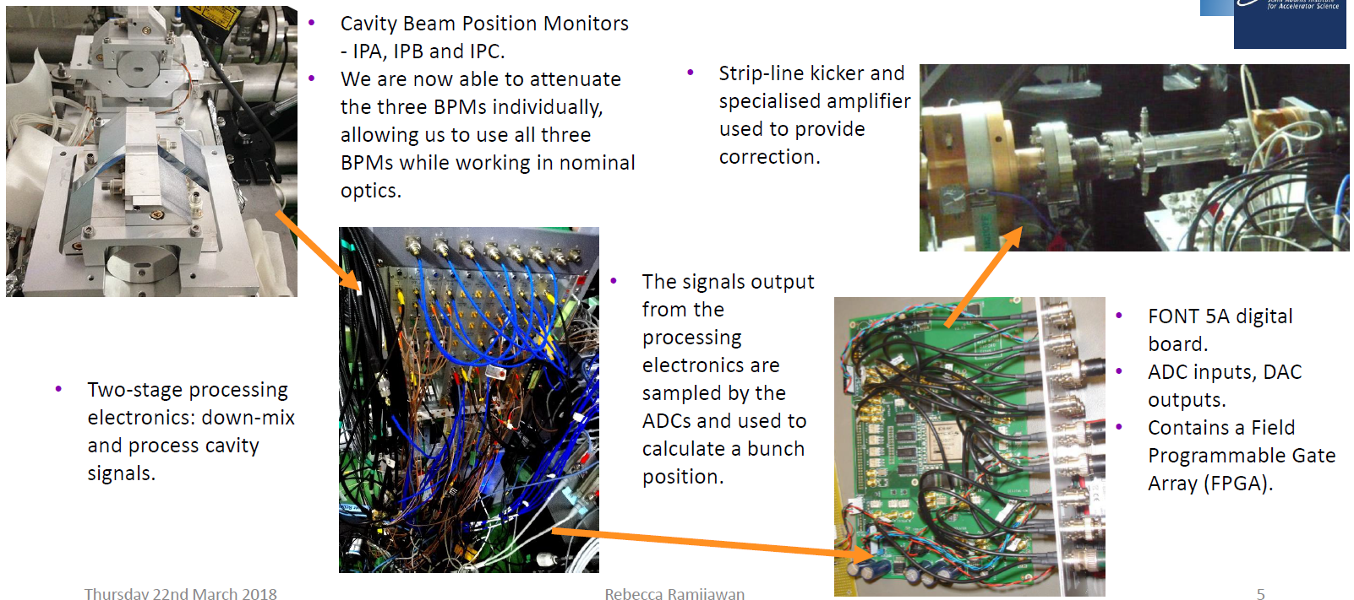
FONT IP feedback system

Slide 7
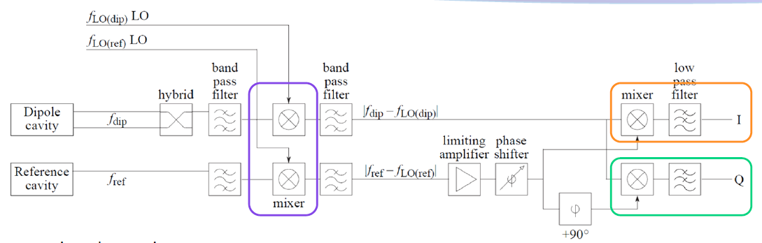
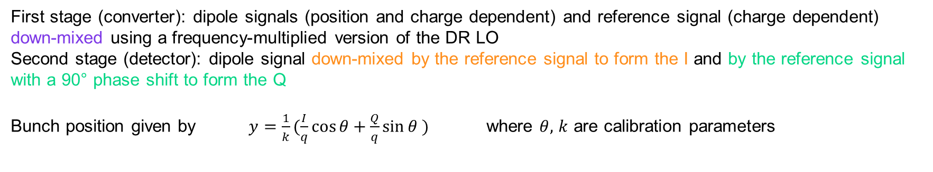
Cavity BPM signal processing
LO
First stage (converter): dipole signals (position and charge dependent) and reference signal (charge dependent) down-mixed using a frequency-multiplied version of the DR LO
Second stage (detector): dipole signal down-mixed by the reference signal to form the I and by the reference signal with a 90° phase shift to form the Q
Bunch position given by $y=\frac{1}{k}(\frac{I}{q}\cos{θ}+\frac{Q}{q}\sin{θ} )$ where $θ,$ $k$ are calibration parameters

Slide 8
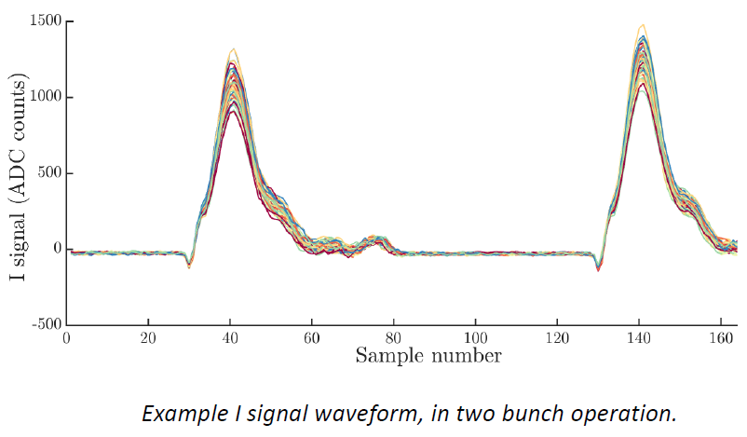
Measuring I and Q
Single sample vs. sample integration
Single sample: I, Q and q values for a given bunch obtained from a single sample of the waveform.
Sample integration: I and Q values obtained by integrating the waveform over a range of samples. This can improve the signal-to-noise ratio (and hence the resolution) of the position measurement.
Recent modifications to the FONT5A board firmware allow feedback to be performed using sample integration to calculate the position.

Slide 9
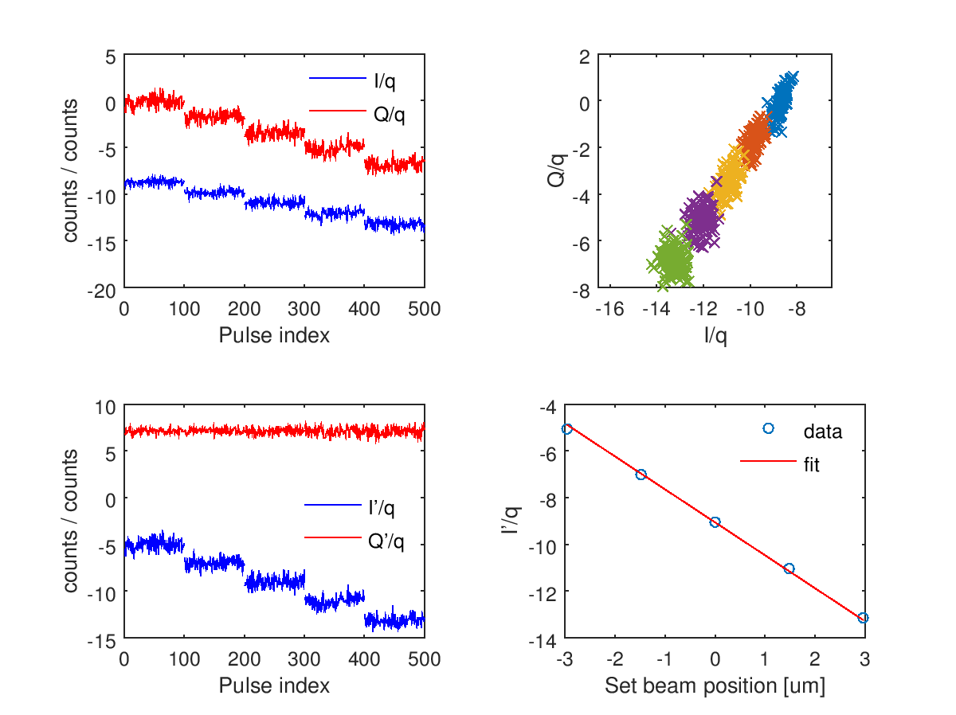

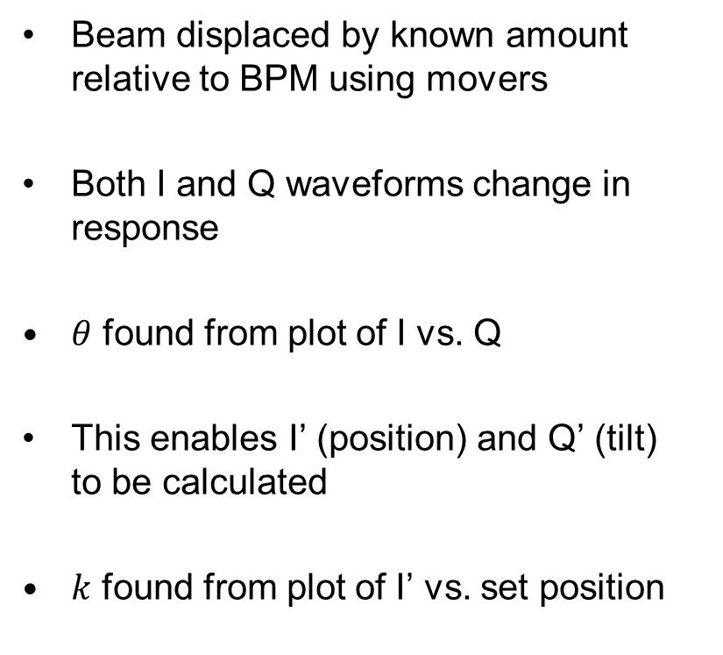
Example calibration
Beam displaced by known amount relative to BPM using movers
Both I and Q waveforms change in response
$θ$ found from plot of I vs. Q
This enables I’ (position) and Q’ (tilt)
to be calculated
$k$ found from plot of I’ vs. set position
$$θ$$

Slide 10
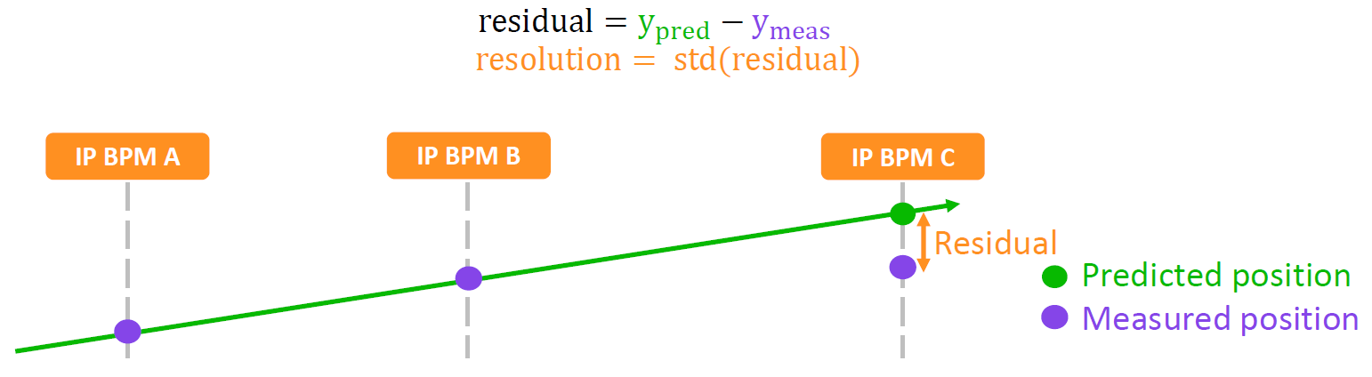
Calculating the resolution
Recent focus has been on improving the usable resolution of the system. The usable resolution applies to real-time position measurements used for feedback.
Higher resolution can be achieved in off-line analysis by fitting bunch position as a function of additional parameters.
/ geometric parameter

Slide 11
Best Resolution Run (19/04/18)
N = 400
Position jitters (um): IPA 0.45461, IPB 0.28977, IPC 0.35818
Mean position (um): IPA -0.18721, IPB -0.42826, IPC 3.8979
Resolution | IPA (nm) | IPB (nm) | IPC (nm) | Justification
Geometric | 20.6 ± 1.0 | 20.6 ± 1.0 | 20.6 ± 1.0 | -
Fit to position (fit for k) | 20.4 ± 1.0 | 20.5 ± 0.8 | 20.3 ± 0.8 | Fit out error in k
Fit to position and charge | 19.9 ± 0.9 | 19.9 ± 0.8 | 19.7 ± 0.9 | Fit out error in k and position-charge correlation
Fit for k and theta (fit to I and Q) | 20.3 ± 1.0 | 20.3 ± 0.8 | 20.2 ± 0.9 | Fit out error in k and theta.
Fit for k and theta and to charge | 19.6 ± 0.9 | 19.6 ± 0.8 | 19.6 ± 0.8 | Fit out error in k and theta, and position-charge correlation.
Fit for k, theta, charge and self Q’ | 19.5 ± 0.9 | 19.6 ± 0.8 | 19.2 ± 0.8 | Fit out all of the above, and also residual position information in Q’, or Q’ coupling in through phase jitter.

Slide 12
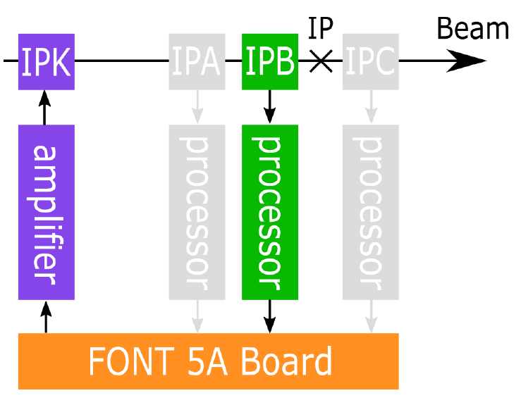
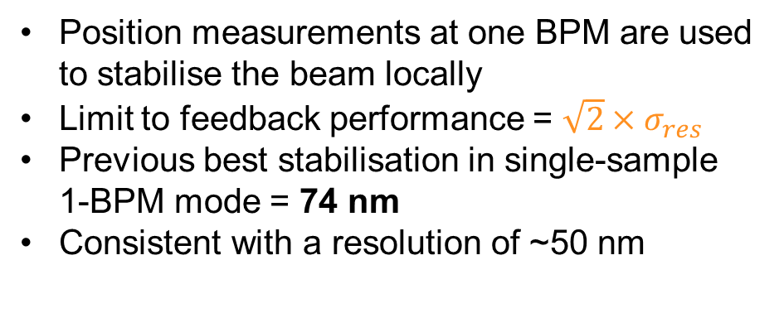
IP feedback results: 1-BPM mode
Position measurements at one BPM are used to stabilise the beam locally
Limit to feedback performance = $\sqrt{2}×σ_{res}$
Previous best stabilisation in single-sample 1-BPM mode = 74 nm
Consistent with a resolution of ~50 nm

Slide 13
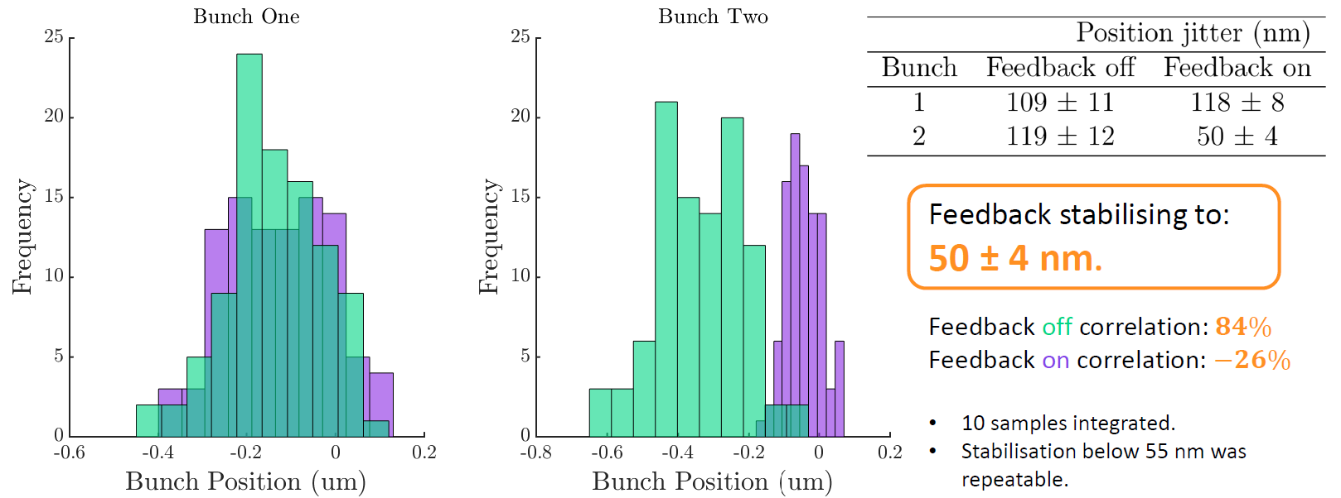
1-BPM feedback results

Slide 14
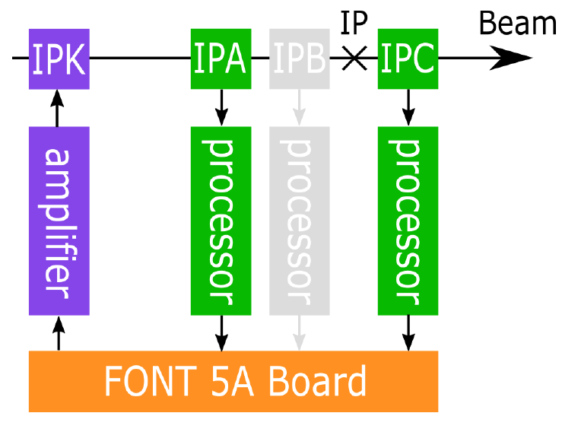
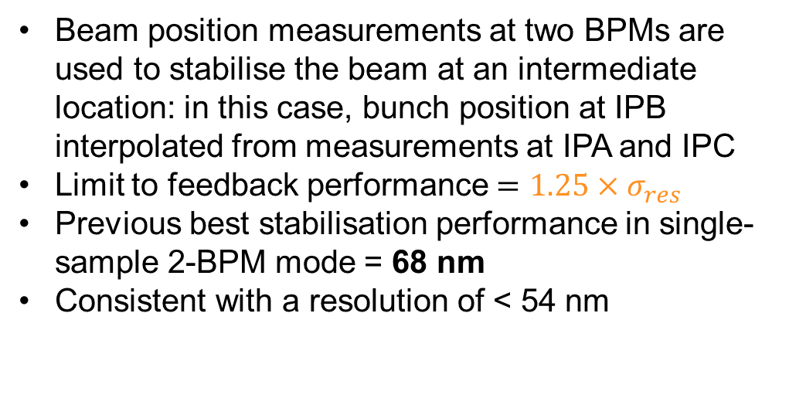
IP feedback results: 2-BPM mode
Beam position measurements at two BPMs are used to stabilise the beam at an intermediate location: in this case, bunch position at IPB interpolated from measurements at IPA and IPC
Limit to feedback performance $=1.25×σ_{res}$
Previous best stabilisation performance in single-sample 2-BPM mode = 68 nm
Consistent with a resolution of < 54 nm

Slide 15
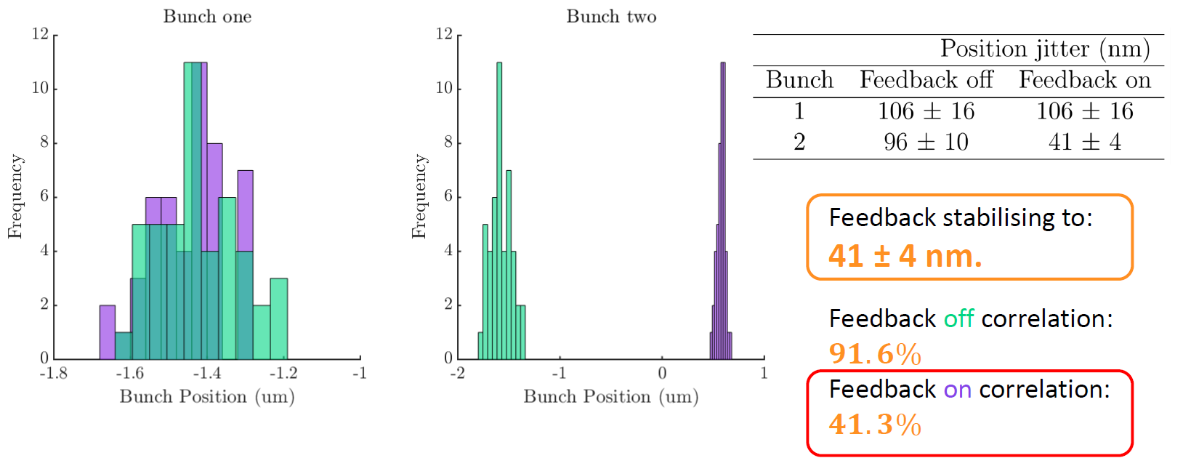
2-BPM feedback results

Slide 16
Summary
Best resolution ever measured: ~20 nm
Best feedback performance:
  1-BPM mode
    Previous best single-sample feedback: jitter of corrected bunch = 74 nm
    Reduced to 50 nm by integrating 10 samples
2-BPM mode
    Previous best single-sample feedback: jitter of corrected bunch = 68 nm
    Reduced to 41 nm by integrating 5 samples

