Slide 1
Simultaneous optimization of photons and electrons for mixed beam radiotherapy
Theodoros Christodoulou

Slide 2
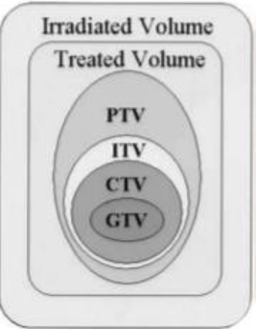
Background
Cross tumor volume (GTV): primary tumor
Clinical target volume (CTV): subclinical microscopic disease that lies around the tumor mass
Planning target volume (PTV): geometrical variations
Internal target volume (ITV): expansion of CTV for internal movement (e.g. breathing)
Treated volume (TV): isodose surface that corresponds to a dose level (e.g., 95%)
Irradiated volume (IV): the last volume of tissue will be irradiated with a dose considered significant in relation to tolerance

Slide 3
Background
Organs at risk (OAR): these tissues which usually are closed to the tumor or their radio sensitivity may have a significant outcome to the treatment planning or prescribed dose
Classification to OARs:
  Serial: Whole organ is a continued unit, and damage to one point will cause complete damage to the organ (spinal cord, digestive system).
  Parallel: Organ consists of several functional units and if one part is damaged, the rest of the organ will still be functioning and make up for the loss (lung, bladder).
  Serial Parallel: fall in both categories, such as kidneys and heart

Slide 4
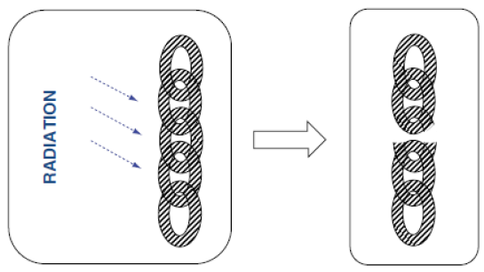
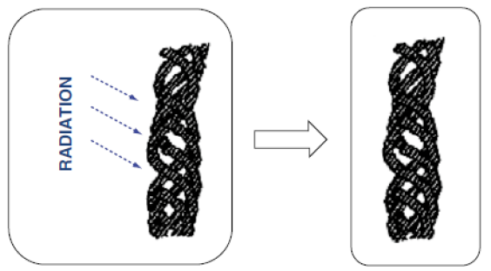
Background
Serial
Parallel

Slide 5
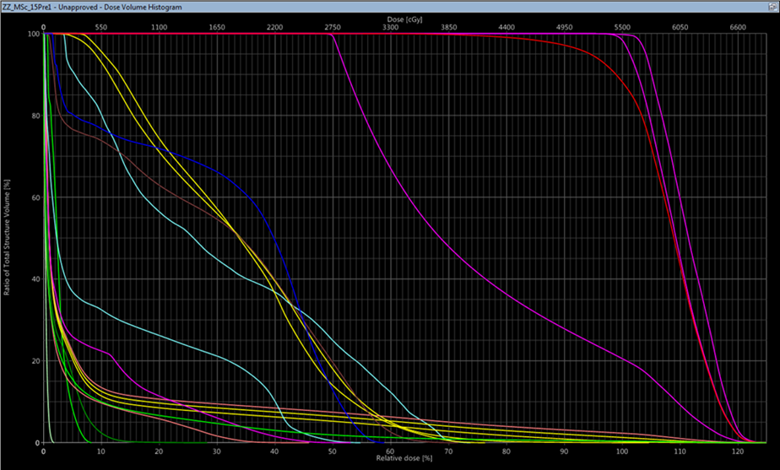
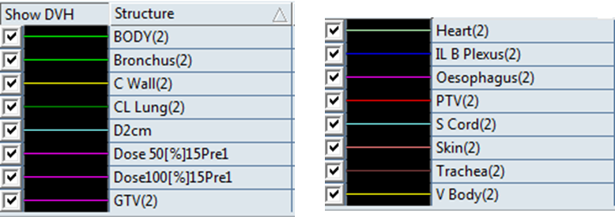
Background
Dose calculation using Dose Volume Histograms – DVH
  Y axis – Volume (absolute or percent)
  X axis – Dose (absolute or percent)

Slide 6
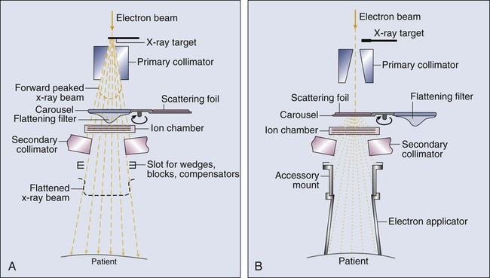
Background

Slide 7
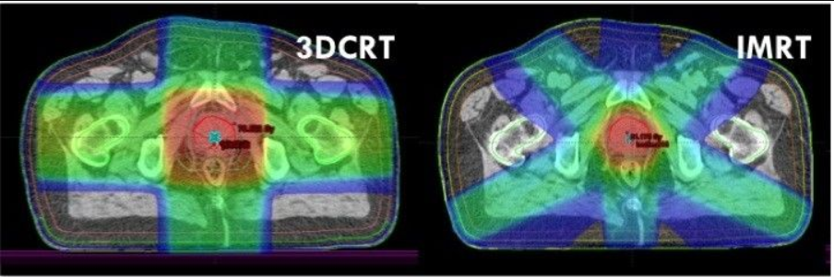
Background
IMRT(Intensity-Modulated Radiation Therapy)

Slide 8
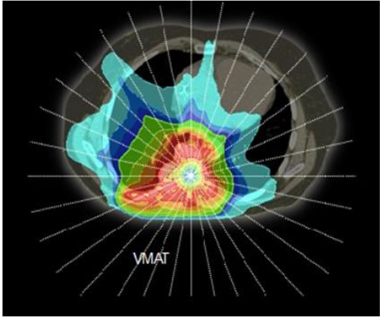
Background
VMAT (Volumetric-Modulated-Arc-Therapy)

Slide 9
Background
pMLC: photon multileaf collimator
  Lead leaves which shape the beam according to the tumor geometry
  Method: step and shoot
Modulated electron radiotherapy (MERT)
  Same idea as IMRT
eMLC: electron multileaf collimator leaves located at the bottom of a 25x25 cm2 applicator just a few cm from the patient surface

Slide 10
Mixed beam radiotherapy (MBRT)
Take the advantage of the properties of both electrons and photons

Slide 11
Mixed beam radiotherapy
AIM
  develop an MC(monte carlo) beamlet based inverse TPP (treatment plan process) for MBRT performing simultaneous optimization of photon and electron apertures with a simulated annealing based DAO (direct aperture optimization)
  apertures are determined to be delivered in a segmented manner and collimated with the pMLC for both photon and electron beams

Slide 12
Methods
CT images imported into the research version of the Eclipse treatment planning system (Varian)
Contouring of the planning target volume (PTV) and the OARs
Isocenter of the photon fields is located in the PTV
Electron fields the isocenter is positioned such that the source to surface distance (SSD) is reduced leading to a smaller penumbra (widening of the beam due to scatter, affects electrons more)

Slide 13
Methods
Beamlet dose distributions are then calculated (Swiss Monte Carlo Plan) based on pre patient phase spaces
  beamlet grid is positioned on the mid-plane of the pMLC
  Particles are transported throughthe treatment head and stored in the corresponding beamlet
When all dose distributions are calculated
  simultaneous optimization of photon and electron apertures
    (e.g number of apertures per field, weighting factors)

Slide 14
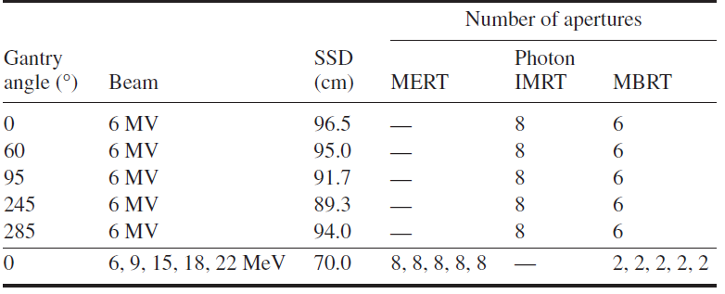
Methods
Photon and electron fields and the number of apertures per field used to create the coplanar MBRT, MERT and photon IMRT plans [2]

Slide 15
Methods
Two types of cancer are tested (Academically)
  Chest wall
  Squamous cell carcinoma
    uncontrolled growth of abnormal cells arising in the squamous cells, which compose most of the skin’s upper layers (the epidermis).
Homogeneity Index (HI) for the PTV
  HI = V95% − V107%,
    (V95%) percent volume that received at least 95% of the prescription dose
    (V107%) percent volume that received at least 107% of the prescription dose
OARs
  Dmean to the organ at risk

Slide 16
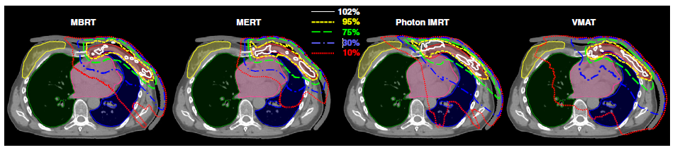
Results (Chest wall )
Homogeneity Index (HI) in the PTV is the same for VMAT and MBRT
5% higher than for the MERT and IMRT
MBRT plan outperforms the VMAT plan in terms of OAR sparing
MERT even better(but close) sparing except ipsilateral lung
IMRT only sparing of contralateral lung is similar

Slide 17
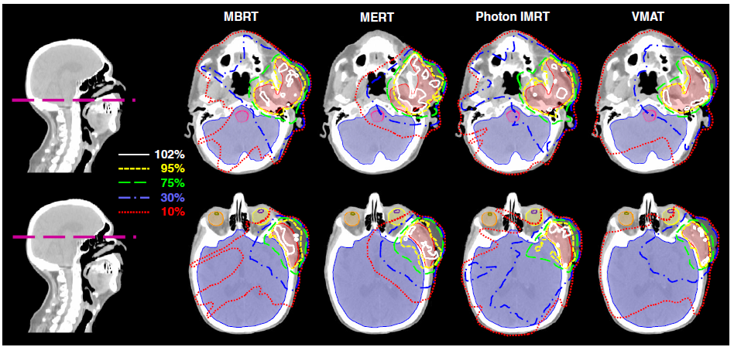
Results (Squamous cell carcinoma)

Slide 18
Results (Squamous cell carcinoma)
Homogeneity Index (HI) in the PTV for the MBRT plan
  2.2% higher than for the VMAT plan
  8.2% higher than for the MERT
  Similar with IMRT
OARs
  MBRT plan outperforms the VMAT plan
  MERT plan spare some structures had worse sparing and some better
  In case of the photon IMRT plan, all OARs are spared less or similar to the MBRT plan

Slide 19
Conclusion
The generated MBRT plans dosimetrically outperform the MERT, photon IMRT and VMAT plans for all investigated situations
Left chest wall and the squamous cell carcinoma, the MBRT plans cover the PTV similarly or more homogeneously than the VMAT plans
OARs are spared considerably better with average reductions of the mean dose to parallel OARs and D2% to serial OARs by 54% and 26%, respectively

