Slide 1
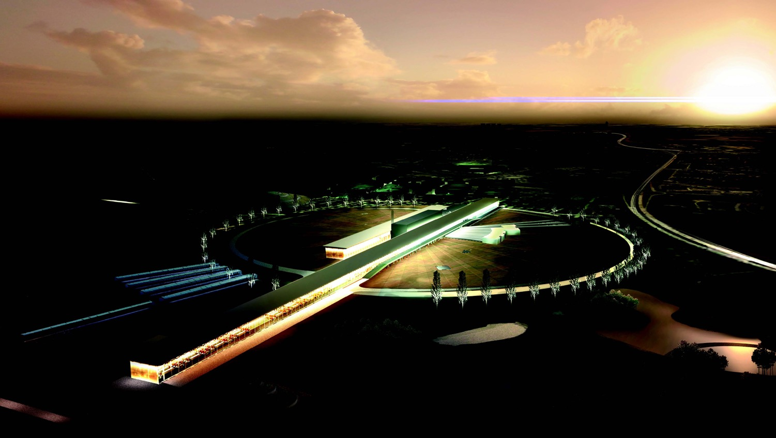
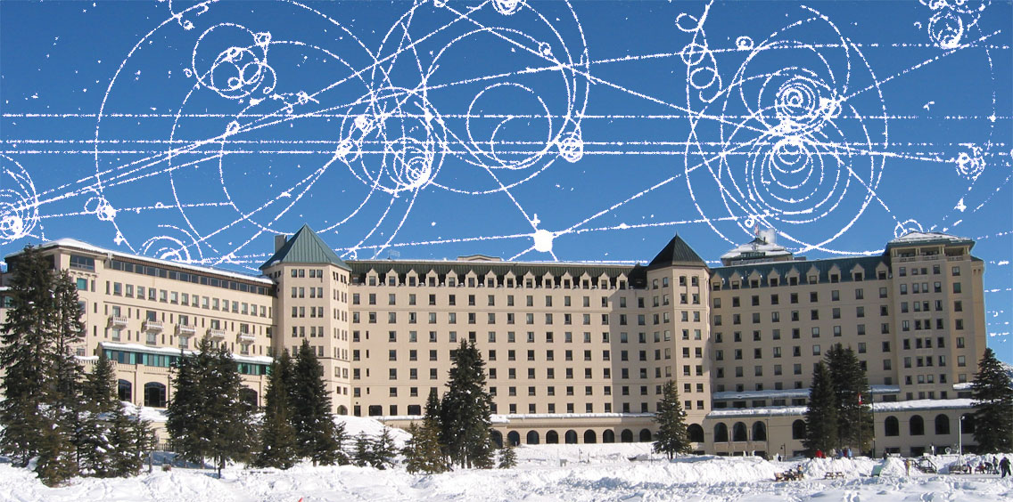

Neutrino CP Violation with the European Spallation Source neutrino Super Beam
Marcos Dracos
IPHC-Strasbourg
Lake Louise Winter Institute 2022
Design Study financed by EU

Slide 2
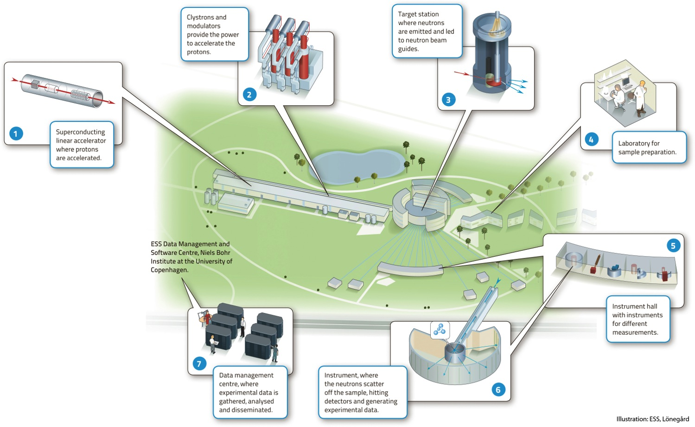

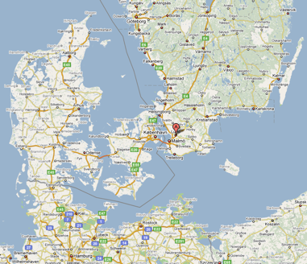
European Spallation Source
Neutron facility
(equivalent to SNS in the USA)
under construction phase
(~2 B€ facility)

Slide 3
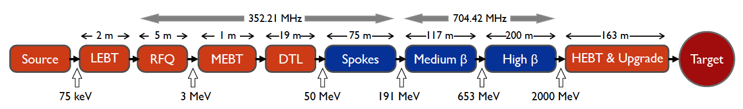
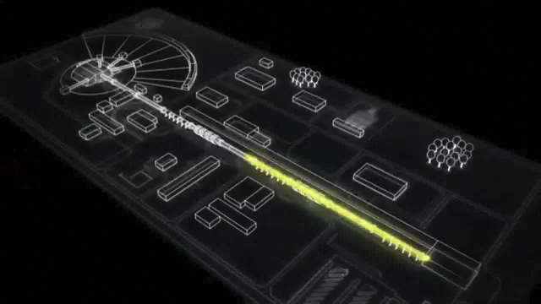
ESS proton linac
empty space for energy upgrades
The ESS will be a copious source of spallation neutrons.
5 MW average beam power.
125 MW peak power.
14 Hz repetition rate (2.86 ms pulse duration, 10¹⁵ protons).
Duty cycle 4%.
2.0 GeV protons
  up to 3.5 GeV with linac upgrades
>2.7x10²³ p.o.t/year.
8
x10¹⁴
ESS 5 MW
2015 design
7
λ = 1.5 Å
6
5
Brightness (n/cm²/s/sr/Å)
4
3
ESS 5 MW
2012 design (TDR)
Linac ready by 2025 (full power)
2
UK TS2
32 kW
SNS
1-2 MW
JPARC
0.3-1 MW
1
UK TS1
128 kW
ILL 57 MW
0
time (ms)
1
2
3
4

Slide 4
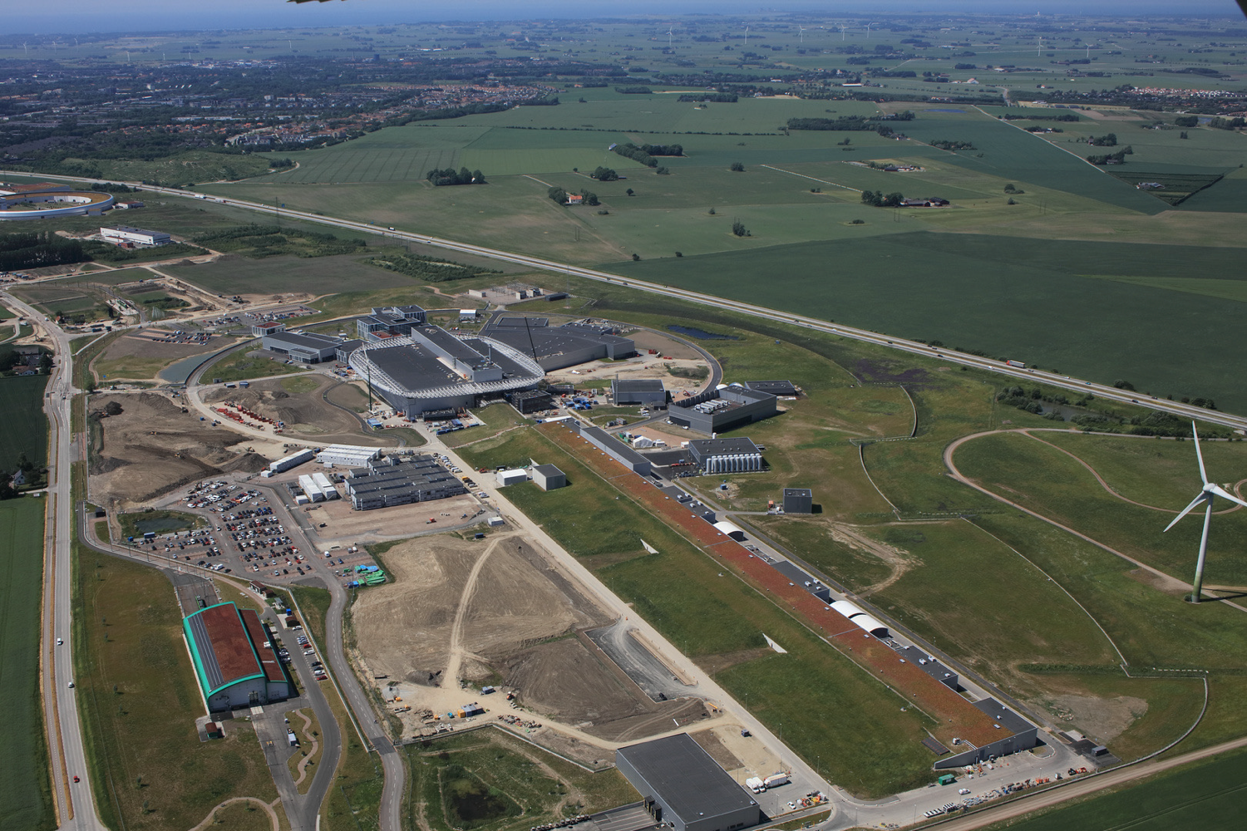

European Spallation Source
July 2021
target
instruments
utility buildings
linac
European Research Infrastructure Consortium (ERIC) since 2015
Beam commissioning end 2022, construction complete by 2025
Oct. 2020

Slide 5
European Spallation Source as Neutrino Facility for CP violation observation
(2nd Oscillation maximum)
or, what else can we do with 5 MW proton beam?
ν_{μ}→ν_{e}

Slide 6
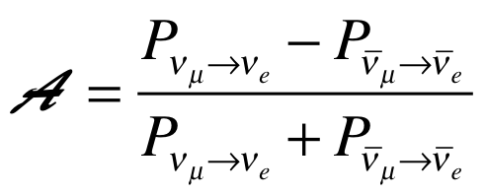
Oscillation probability
(neutrino beams)
"atmospheric"
"interference"
"solar"
matter effect
for antimatter: δ_{CP} →-δ_{CP} and a→-a
fake matter/antimatter asymetry due to matter effect
δ_{CP} dependence,
sizable matter effect for long baselines and high energy
Matter-antimatter asymmetry

Slide 7

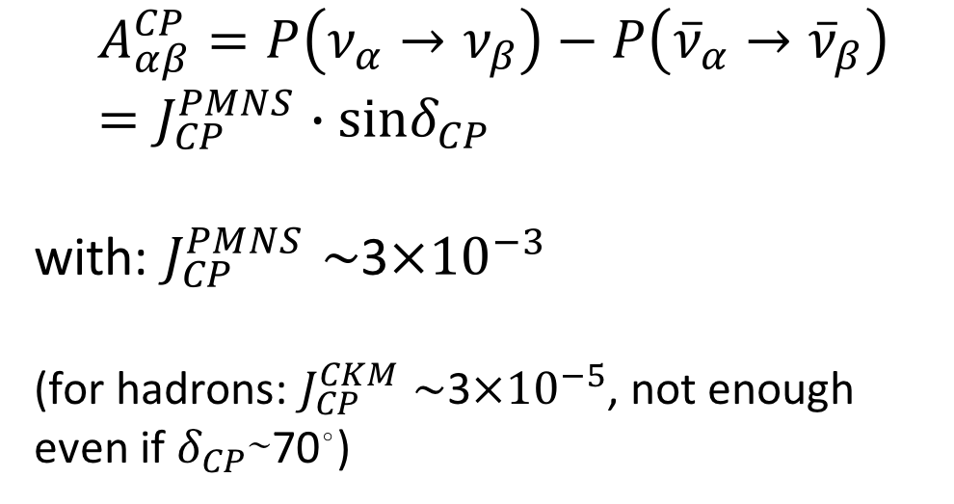
δ_{CP} and matter-antimatter asymmetry magnitude
(Jarlskog invariant)
(from the already observed CP violation in the hadronic sector)
Theoretical models predict that if |sinδ_{CP}|≳0.7 (45°<δ_{CP}<135° or 225°<δ_{CP}<315°), this could be enough, under assumptions, to explain the observed asymmetry.
(Nucl.Phys.B774:1-52,2007, arXiv:hep-ph/0611338)

Slide 8
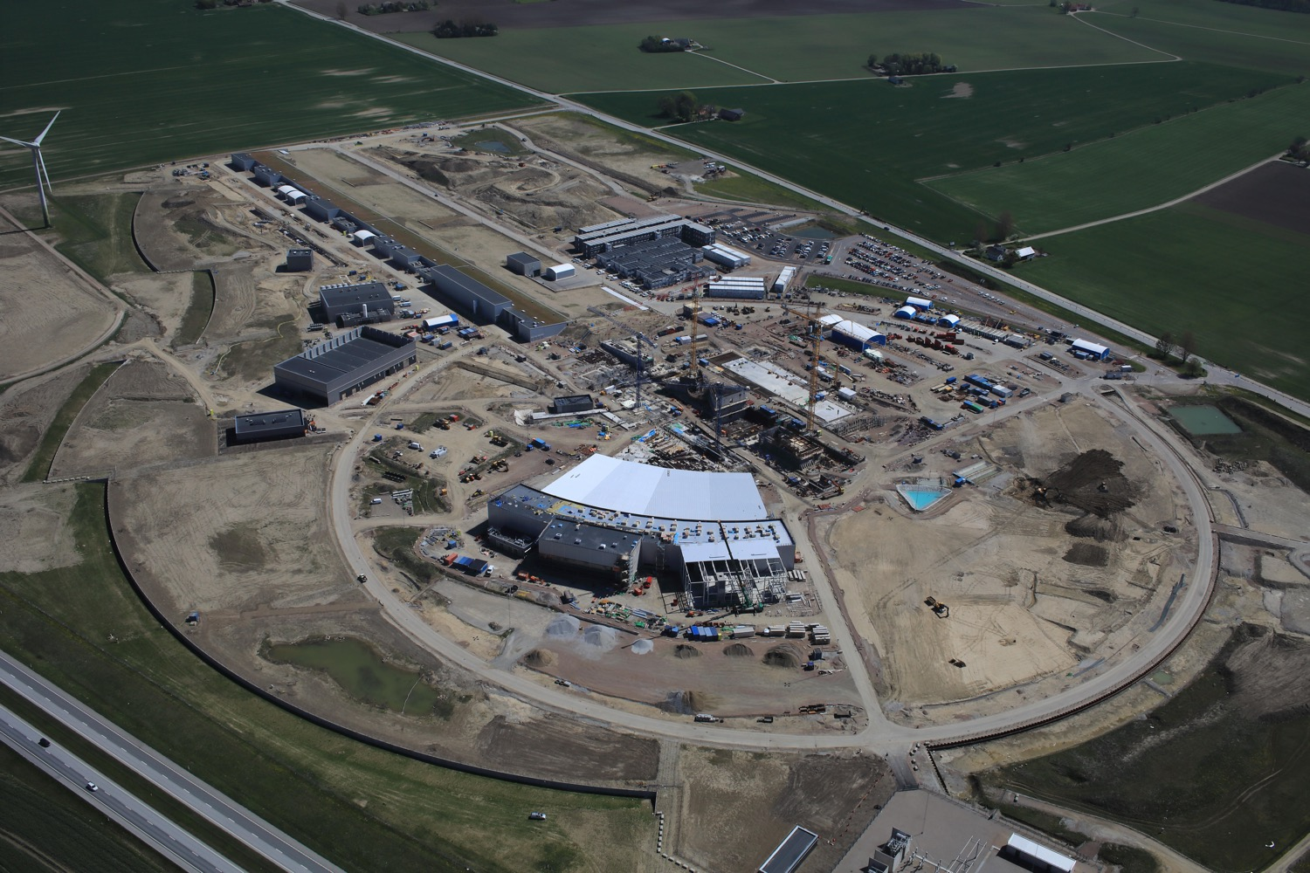

Use all this ESS linac power to go to the second oscillation maximum
but why?

Slide 9
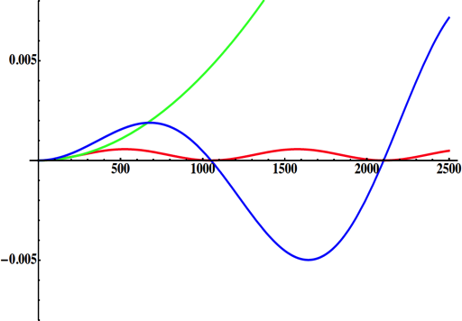
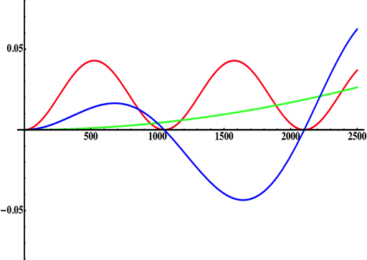
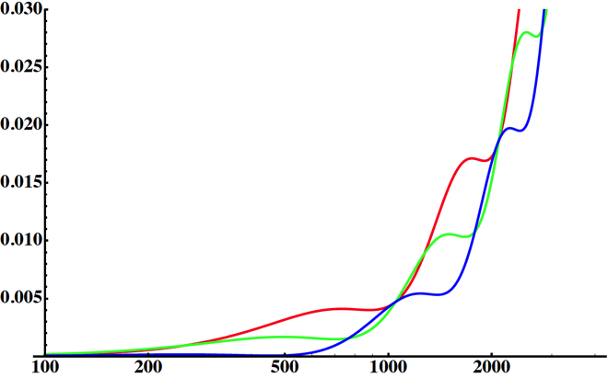
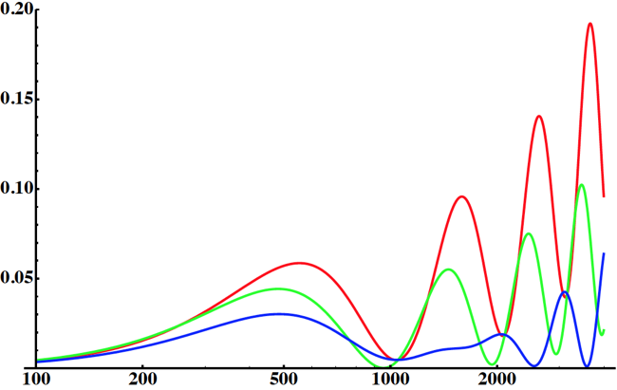
Neutrino Oscillations with "large" θ₁₃
solar
(after 2012)
(before 2012)
atmospheric
for "large" θ₁₃ 1st oscillation maximum is dominated by atmospheric term
for small θ₁₃ 1st oscillation maximum is better
atmospheric
solar
L/E
L/E
CP interference
(arXiv:1110.4583)
θ₁₃=1º
CP interference
θ₁₃=8.8º
solar
2nd oscillation maximum
P(ν_{μ}→ν_{e})
1st oscillation maximum
θ₁₃=1º
("small" θ₁₃)
δ_{CP}=-90
δ_{CP}=0
δ_{CP}=+90
θ₁₃=8.8º
("large" θ₁₃)
L/E
L/E
1st oscillation max.: A=0.3sinδ_{CP}
2nd oscillation max.: A=0.75sinδ_{CP}
more sensitivity at 2nd oscillation max.
(see arXiv:1310.5992 and arXiv:0710.0554)

Slide 10
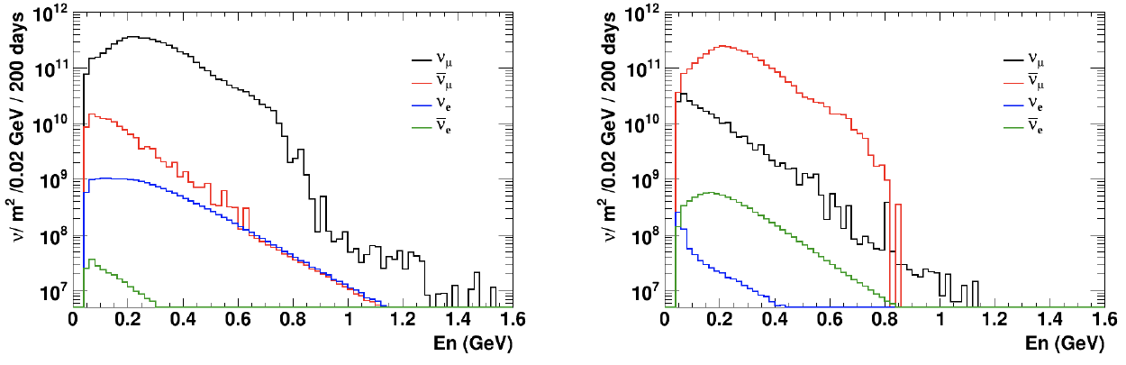
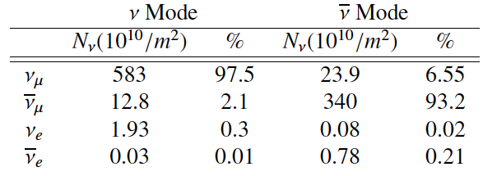
Having access to a powerful proton beam…
What can we do with:
5 MW power
2 GeV energy
14 Hz repetition rate
10¹⁵ protons/pulse
>2.7x10²³ protons/year
conventional neutrino (super) beam
proton beam
decay tunnel
p
hadrons
physics
π
ν
⨂B
target
hadronic collector
(focusing)
Detector
almost pure ν_{μ} beam
small ν_{e} contamination which could be used to measure ν_{e} cross-sections in a near detector
at 100 km from the target, per year (in absence of oscillations)

Slide 11
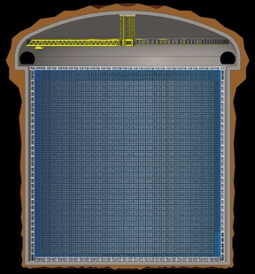
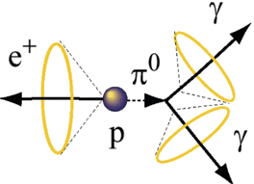
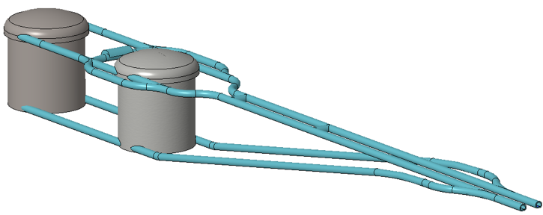
Can we go to the 2nd oscillation maximum using our proton beam?
Yes, if we place our far detector at around 500 km from the neutrino source.
Water Cherenkov detector
Neutrino Oscillations
Proton decay
Astroparticles
Understand the gravitational collapsing: galactic SN ν
  Supernovae "relics"
Solar Neutrinos
Atmospheric Neutrinos
78 m
78 m
500 kt fiducial volume (~20xSuperK)
Readout: ~20” PMTs
30% optical coverage

Slide 12
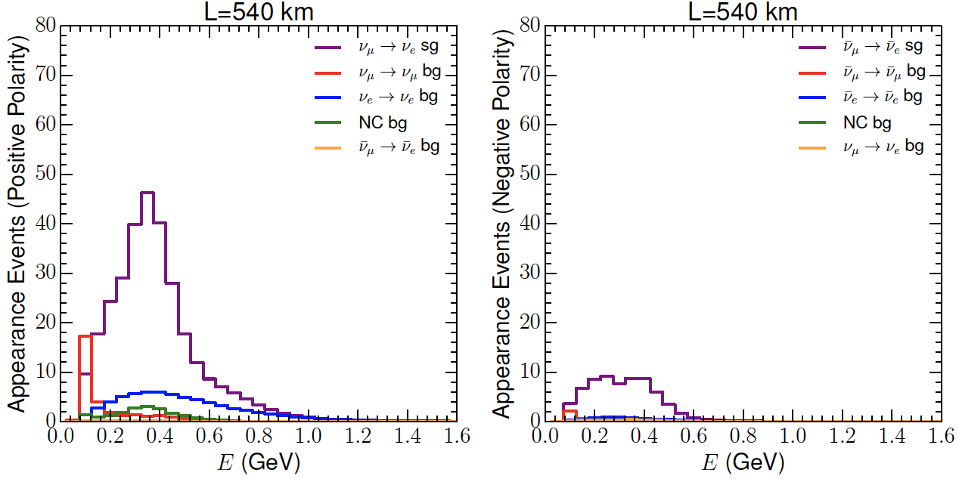
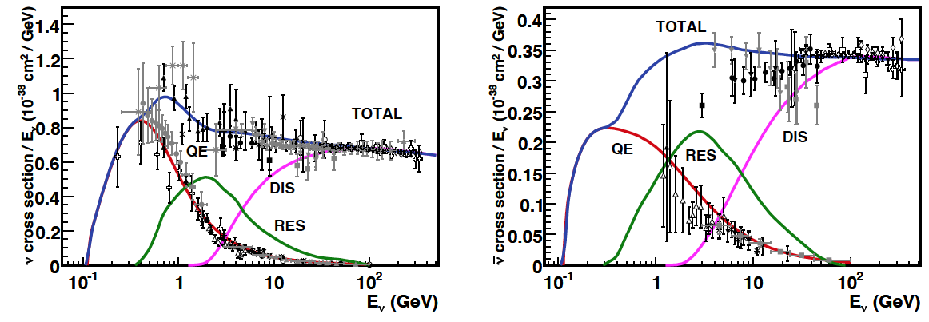
Neutrinos in the far detector
540 km (2.5 GeV), 10 years
neutrinos
anti-neutrinos
δ_{CP}=0
5 years
5 years
Below ν_{τ} production, almost only QE events, not suffering too much by π⁰ background.

Slide 13
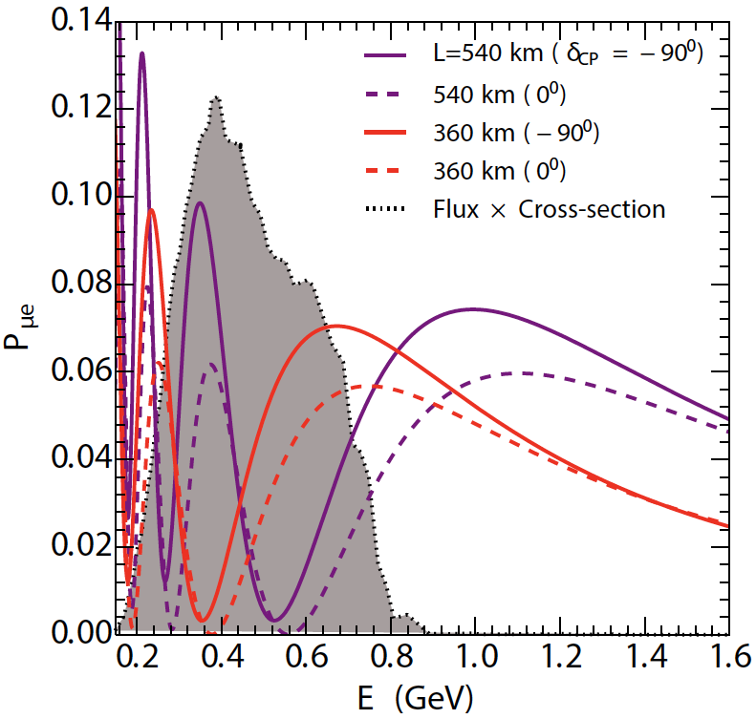
2nd Oscillation max. coverage
2nd oscillation max.
well covered by the ESS neutrino spectrum
1st oscillation max.
full coverage of the 2nd oscillation max.

Slide 14
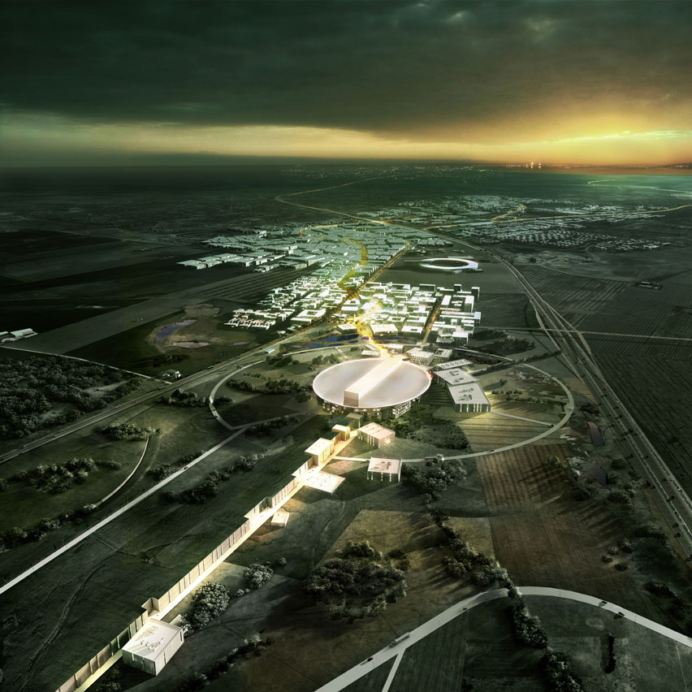
ESS Linac modifications to produce a neutrino Super Beam
European Spallation Source Linac

Slide 15
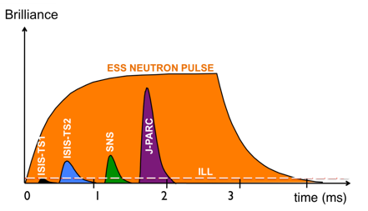
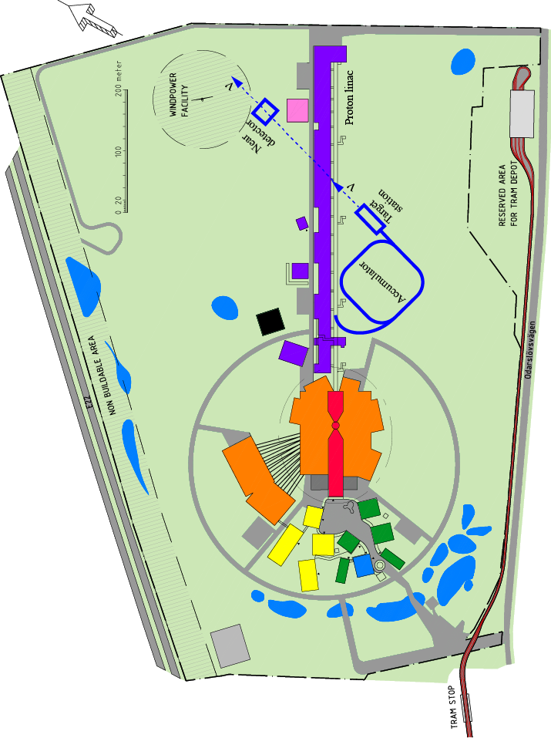
How to add a neutrino facility?
The neutron program must not be affected and if possible synergetic modifications.
Linac modifications: double the rate (14 Hz → 28 Hz), from 4% duty cycle to 8%.
Accumulator (C~400 m) needed to compress to few μs the 2.86 ms proton pulses, affordable by the magnetic horn (350 kA, power consumption, Joule effect)
  H⁻ source (instead of protons),
  space charge problems to be solved.
~300 MeV neutrinos.
Target station.
Underground detector.
Short pulses (~μs) will also allow DAR experiments (as those proposed for SNS) using the neutron target.

Slide 16
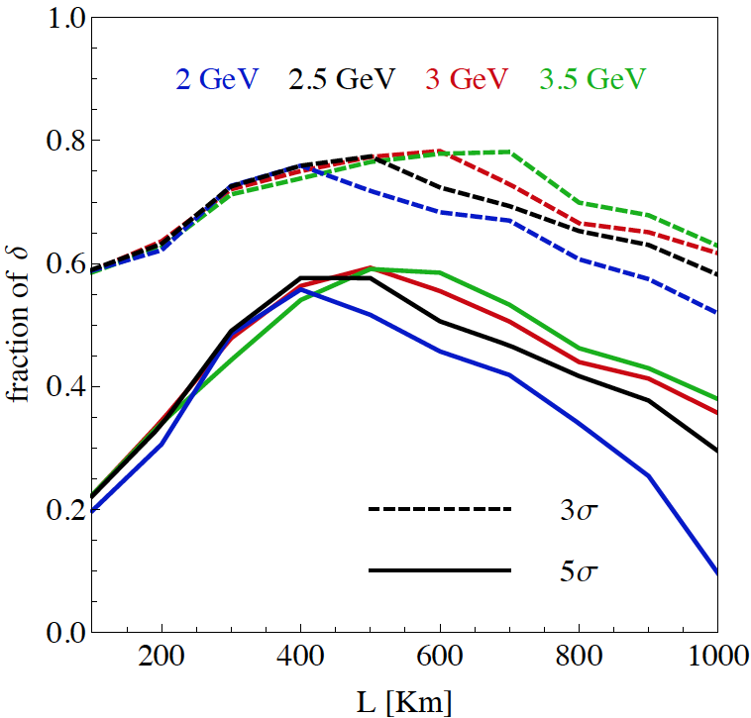
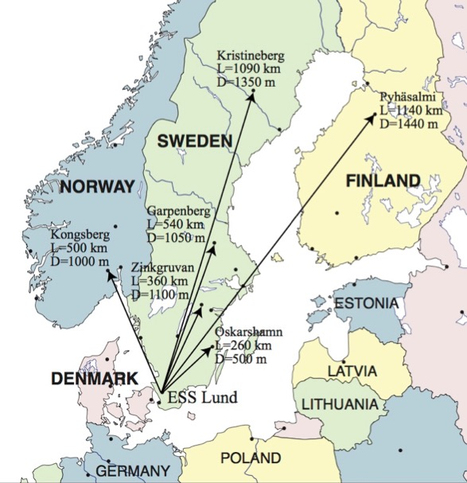
Which baseline?
pre-project studies
CPV (Nucl. Phys. B 885 (2014) 127)
Garpenberg
Zinkgruvan
~60% δ_{CP} coverage at 5 σ C.L.
>75% δ_{CP} coverage at 3 σ C.L.
systematic errors: 5%/10% (signal/backg.)
Candidate active mines

Slide 17
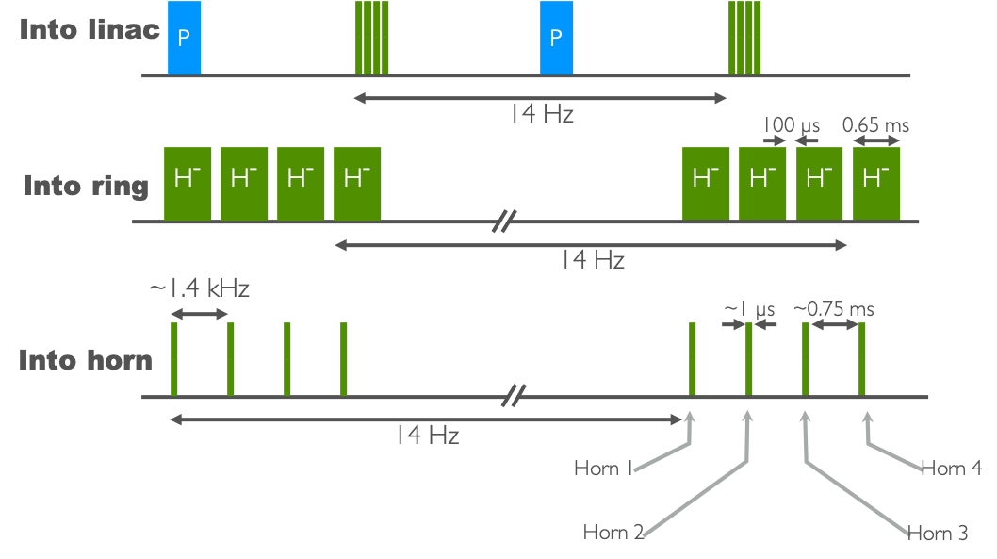
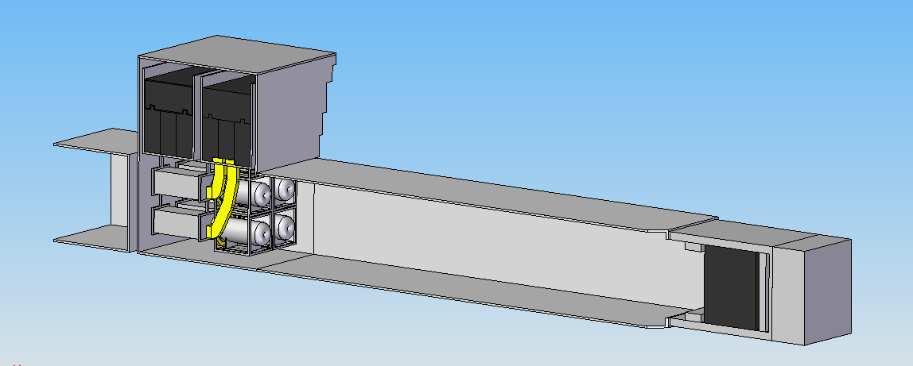
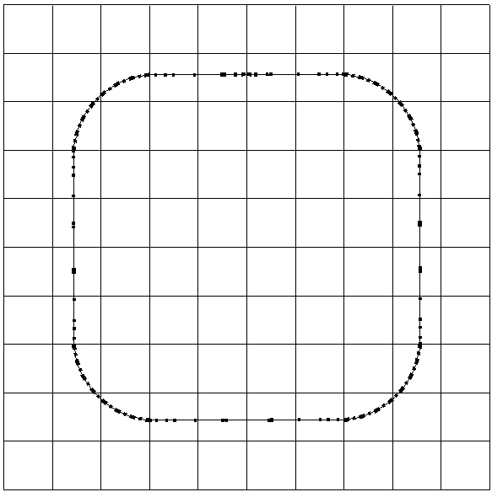
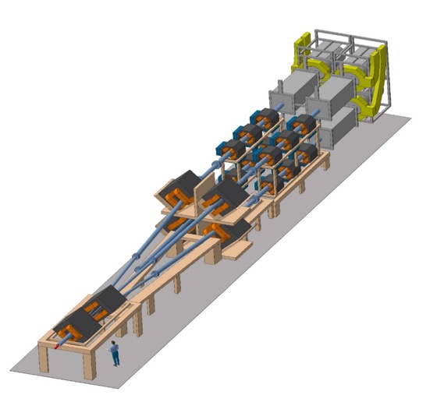
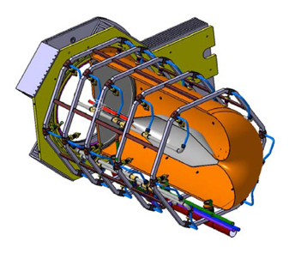
ESS modifications and operation
H⁻ source
time operation option
accumulator latice
injection
Split Proton Beam
8 m concrete
RF
Collimators
Horns and Targets
Decay Volume
(He, 4x4x25 m³)
Neutrino Beam Direction
Beam Dump
extraction
collimation
Switchyard

Slide 18
Latest Improvements
New Magriation Matrices for the far detector
Genetic Algorithm for Target Station optimisation
WC detector
new far detector reconstruction algorithm
(publication is coming)
Phys. Rev. ST Accel. Beams 16, 061001 (2013)
horn optimisation

Slide 19
Improvements and Optimisations
very preliminary
(to be confirmed)
very preliminary
(to be confirmed)
540 km
360 km
ESSnuSB
θ₁₂ = 33.44°
θ₁₃ = 8.57°
θ₂₃ = 49.2°
Δm²₂₁ = 7.42e-5
Δm²₃₁ = +2.517e-3
2nd osc. max.
507 ktons far detector
https://arxiv.org/abs/2107.07585

Slide 20
Improvements and optimisations
very preliminary
540 km
360 km
>72% after 10 years
540 km
Precision measurements
360 km
Δδ_{CP}<8° for all values

Slide 21
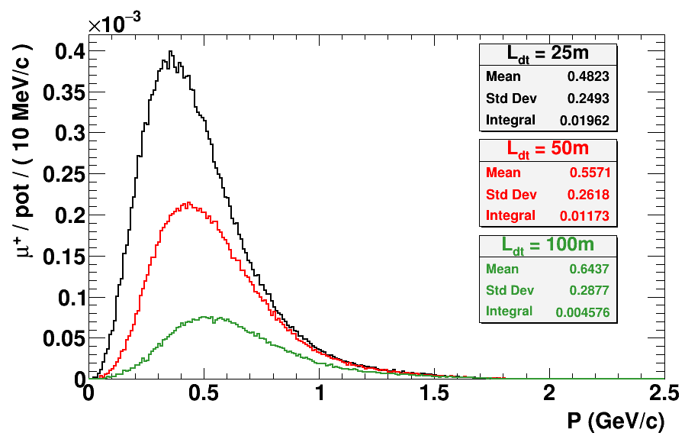
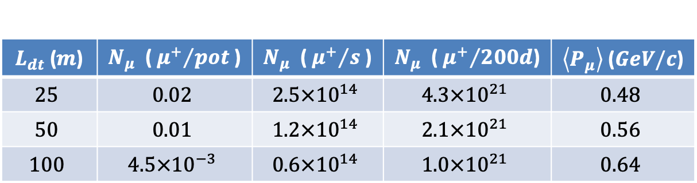
Muons at the level of the beam dump
<E_{μ}>~0.5 GeV
<L_{μ}>~3 km
$L_{dt}$ ($m$) | $N_{μ}$ ( ${μ^{+}}/{pot}$ ) | $N_{μ}$ ( ${μ^{+}}/s$ ) | $N_{μ}$ ( ${μ^{+}}/{200d}$) | $\left\langle P_{μ}\right\rangle$ ($GeV/c$)
$$25$$ | $$0.02$$ | $$2.5×{10}^{14}$$ | $$4.3×{10}^{21}$$ | $$0.48$$
$$50$$ | $$0.01$$ | $$1.2×{10}^{14}$$ | $$2.1×{10}^{21}$$ | $$0.56$$
$$100$$ | $$4.5×{10}^{−3}$$ | $$0.6×{10}^{14}$$ | $$1.0×{10}^{21}$$ | $$0.64$$
decay tunnel length

Slide 22
ESSνSB and (R&D) synergies
2.7x10²³ p.o.t/year
ν_{μ} + ‾ν_{e}
ν_{μ} or ‾ν_{μ}
ν_{e} + ‾ν_{μ}
Super Beam
nuSTORM
ESSνSB
+Decay At Rest and Coherent scat.
(with short pulses)
Neutrino Factory
Muon Collider
ESSμSB

Slide 23




Supporting institutions of ESSνSB
COST Action EuroNuNet (CA15139): ended March 2020
  https://euronunet.in2p3.fr
  video for scientists: https://www.youtube.com/watch?v=PwzNzLQh-Dw
EU-H2020 Design Study ESSνSB: on going up to March 2021 (3 months extension due to COVID19)
  https://essnusb.eu
  video for general public: https://www.youtube.com/watch?v=qAnvft0nAlg

Slide 24
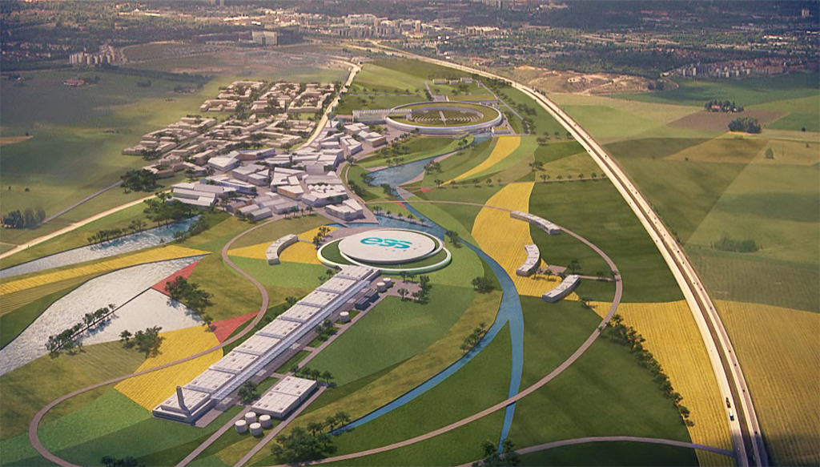
Conclusion
The ESS proton linac will be soon the most powerful linac in the world.
ESS can also become a neutrino facility (ESSνSB ) with enough protons to go to the 2nd oscillation maximum and increase significantly the CPV sensitivity and precise measurement of δ_{CP}.
The European Spallation Source will be ready by 2025, upgrade decisions by this moment.
Rich muon program for future ESS upgrades
  Low energy nuSTORM
  Muon Collider R&D
Conceptual Design Report by end of March 2022
New applications under preparation

Slide 25
Backup

Slide 26
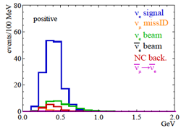
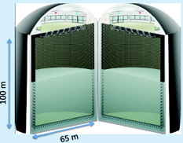
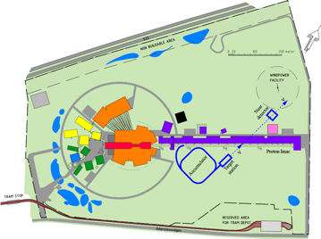
Possible ESSνSB schedule
(2nd generation neutrino Super Beam)
2021: End of ESSνSB Design Study, CDR and preliminary costing
2012: inception of the project
2016-2019: beginning of COST Action EuroNuNet
2018: beginning of ESSνSB Design Study (EU-H2020)
2022-2024: Preparatory Phase, TDR
2025-2026: Preconstruction Phase, International Agreement
2027-2035: Construction of the facility and detectors, including commissioning
2036-: Data taking
Nucl. Phys. B 885 (2014) 127
CDR

Slide 27
ESSνSB at the European level
Starting date: 01/01/2018
Ending date: 31/12/2021 → 31/03/2022,
Duration: 48+3 Months,
3 months extension due to COVID19
Kick-off meeting: 15 January 2018, Lund (ESS),
90% of the budget already received,
All deliverables and milestones ready on time (some rescheduling due to COVID19 has been arranged with the EU Project Officer)
11 countries

Slide 28
ESSνSB at the European level
A H2020 EU Design Study (Call INFRADEV-01-2017)
Title of Proposal: Discovery and measurement of leptonic CP violation using an intensive neutrino Super Beam generated with the exceptionally powerful ESS linear accelerator
Duration: 4 years
Total cost: 4.7 M€
Requested budget: 3 M€
15 participating institutes from
11 European countries including CERN and ESS
6 Work Packages
Approved end of August 2017
ESSνSB
BENE (2004-2008)
ISS (2005-2007)
EUROν (2008-2012)
LAGUNA (2008-2010)
LAGUNA-LBNO (2010-2014)
COST Action CA15139 (2015-2019)

Slide 29
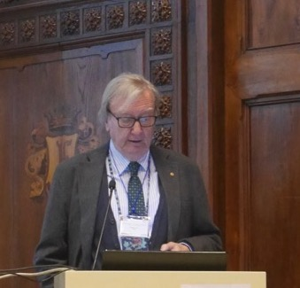
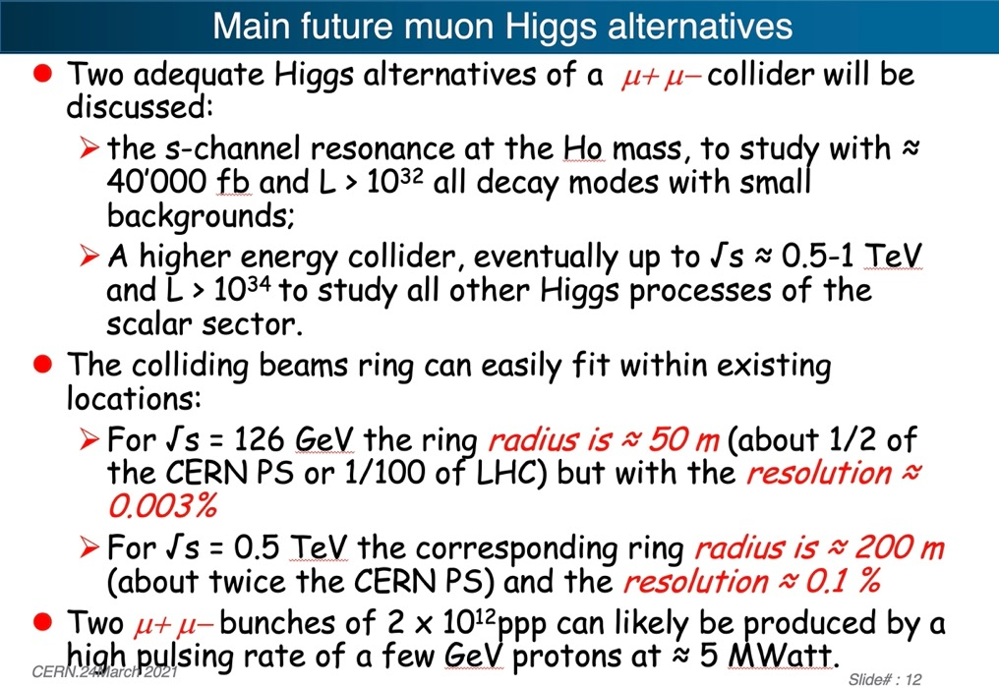
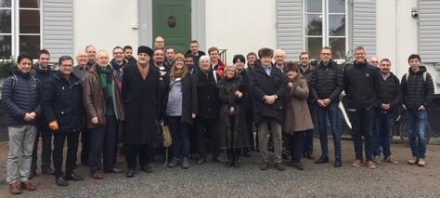
Muon Collider as Higgs Factory
Carlo Rubbia
arXiv:1908.05664
HIFI Uppsala Workshop 2-3 March 2020

Slide 30
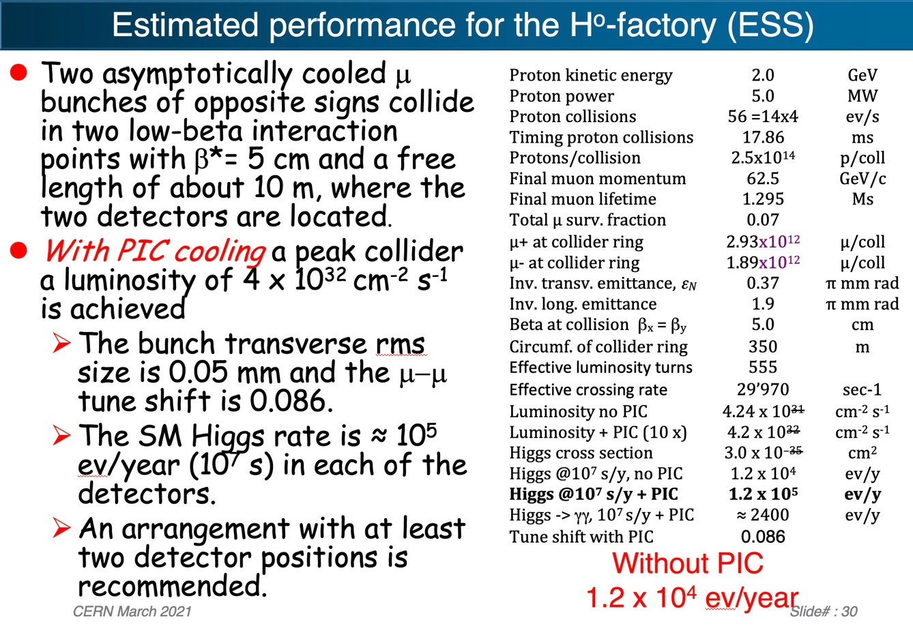
Muons at ESS (ESSμSB)

Slide 31
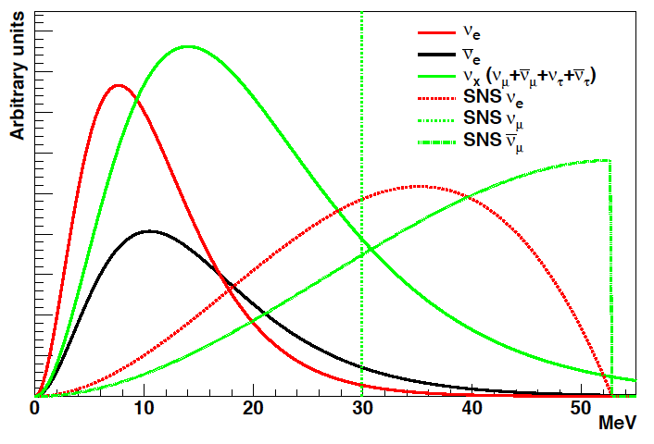
Decay At Rest at ESS
Possible if short pulses (~μs)
π⁻
~99%
capture
ν_{e}
Well known neutrino spectra (DAR).
Very high neutrino intensities ~ 5x10¹⁵ ν/s.
Separate neutrinos of different flavors by time cut.
Role that neutrino-nucleus interactions play in the supernova explosion process and subsequent nucleosynthesis.
Accurate knowledge of neutrino-nucleus cross sections is important (almost no data exist).
This lack of knowledge significantly limits our understanding of supernovae and of terrestrial observations of cosmic neutrinos to probe the deepest layer of these powerful explosions.
p
A
μ⁺
τ ≈ 2.2 μs
DAR
e⁺
π⁺
τ ≈ 26 ns
ν_{μ}
Fragments
ν_{μ}

Slide 32
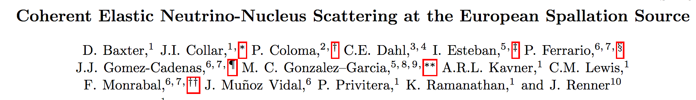
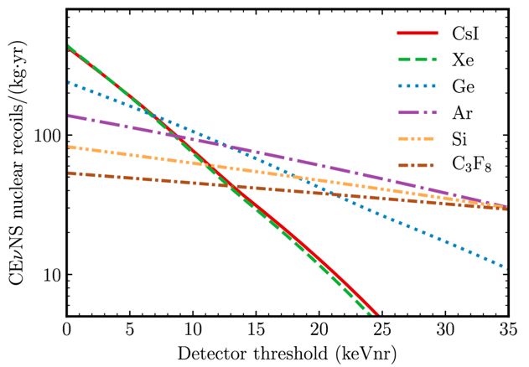
Coherent Scattering at ESS
JHEP 02 (2020) 123
ESS can generate the largest pulsed neutrino flux suitable for the detection of Coherent Elastic Neutrino-Nucleus Scattering (CEνNS ).
Innovative detector technologies able to profit from the order-of-magnitude increase in neutrino flux provided by the ESS, along with their sensitivity to a rich particle physics phenomenology accessible through high-statistics, precision CEνNS measurements, are under study.

Slide 33
Possible scenario for new near future applications
Possible WPs:
Civil engineering (onsite and offsite) abd safety.
Linac accumulator and race-track.
Target Station, hadron/muon production and muon extraction.
Low Energy nuSTORM.
Detectors and physics performance (synergy between ESSnuSB and LEnuSTORM).
Muons for future. applications, including 6D cooling tests (several locations are possible).

Slide 34
Low Energy nuSTORM at ESS
Sterile Neutrino searches
Neutrino cross sections measurements with unprecedented precision
LBL performance improvement by systematic error mitigation
To be adapted for lower muon energies (~0.5 GeV)
Proposed at FERMILAB and CERN (~3.8 GeV muons)
preliminar studies for ESS
sterile neutrino searches

