Slide 1

Higgs Boson Measurements at the High-Luminosity LHC with CMS
Prafulla Kumar Behera
Indian Institute of Technology Madras,
Lake Louise Winter Institute 2019, 10-16 Feb 2019, University of Alberta, Lake Louise (Canada)

Slide 2
Outline
Motivation
SM Higgs at HL-LHC. (https://arxiv.org/abs/1902.00134 )
Exotic Higgs at HL-LHC (CMS PAS FTR-18-035 )
Summary and Conclusion
Prafulla Kumar Behera@LLWI
11th Feb 2019

Slide 3
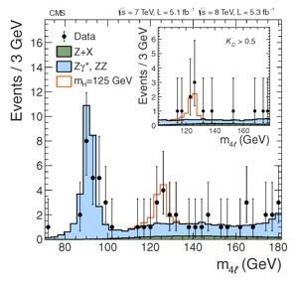
Higgs Discovery and Next
Higgs discovery
Precision measurements of top and W mass
Prafulla Kumar Behera@LLWI
11th Feb 2019

Slide 4
LHC UPGRADE PLAN
We are here
HL-LHC
HE-LHC????
3-4E34→5E34 cm⁻²s⁻¹(or maybe even 7-7.5E34)
60 → 250 fb⁻¹/year (300-350 fb⁻¹)
25 → 140 (200) pileup
Prafulla Kumar Behera@LLWI
11th Feb 2019

Slide 5
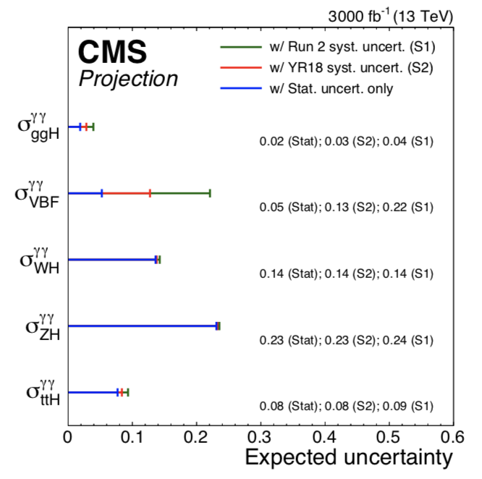
𝜢 ➞ 𝛄𝛄
Absolute rapidity < 2.5
Signal; PDF from MC and constrained by photon energy scale and resolution
Background PDF from data (36 fb⁻¹)
CMS extrapolation is obtained from the simultaneous fit in all production and decay modes
Measure systematics:
Background modelling
Photon isolation efficiencies
Jet uncertainties
The reduction of the total uncertainty with respect to the 80 fb−1 results ranges from a factor
of about 2 (3) for the S1 (S2) scenario for the ggH + b ̄bH, VBF, top cross sections, to a factor of
about 5(6) for the V H cross section, that remains dominated by the statistical uncertainty
Prafulla Kumar Behera@LLWI
11th Feb 2019

Slide 6
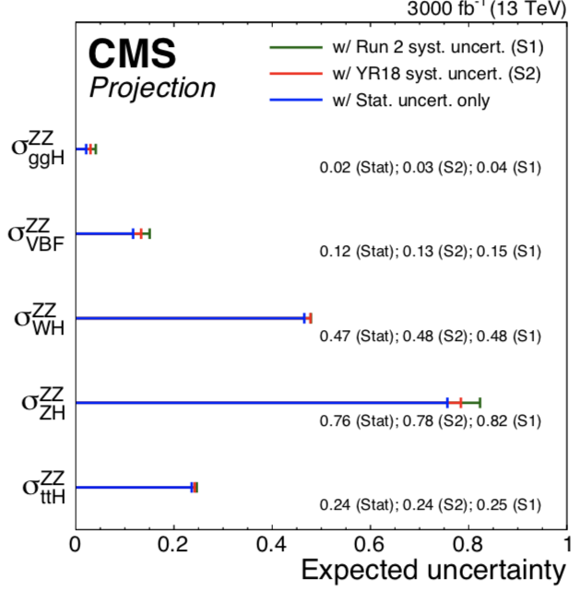
𝚮 ➞ 𝒁𝒁* ➞𝟒𝙡 and 𝐇 ➞ 𝒁𝛄 ➞𝙡𝙡𝛄
𝚮 ➞ 𝒁𝒁* ➞𝟒𝙡: At least two same-flavour opposite-sign di-lepton pairs. One on-shell Z boson helps improve S/B.
Dominant systematics:
VBF, VH and top : largely dominated by statistical uncertainty.
ggH and bbH: dominated by systematic from lepton reconstruction and identification and pile-up modelling
𝐇 ➞ 𝒁𝛄 ➞𝙡𝙡𝛄 : Due to small branching fraction: The cross section times branching ratio 1.00 ± 0.23 * SM prediction.
Prafulla Kumar Behera@LLWI
11th Feb 2019

Slide 7
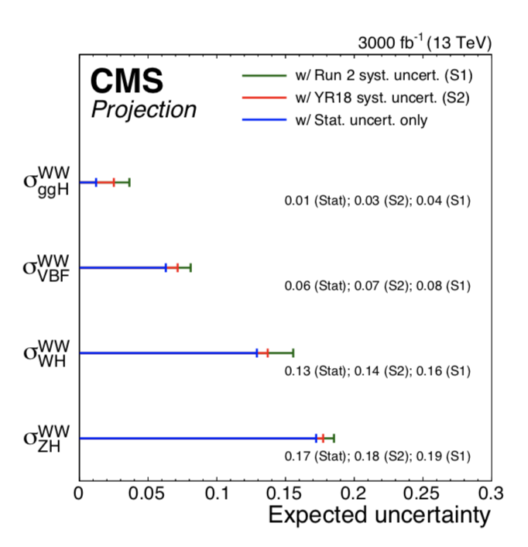
𝑯 ➞ 𝑾𝑾* ➞𝓁𝜈𝓵𝜈
Missing transverse momentum + two opposite-sign lepton
Event categorization as jet-multiplicity for different background composition in different category.
Systematic dominated by PDF uncertainties, jet-energy scale and flavour composition
Prafulla Kumar Behera@LLWI
11th Feb 2019

Slide 8
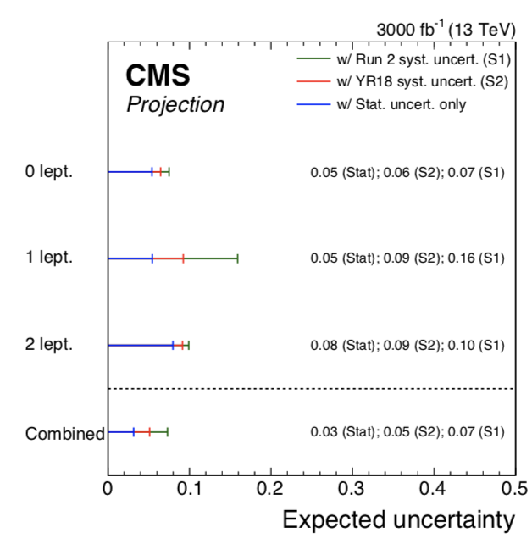
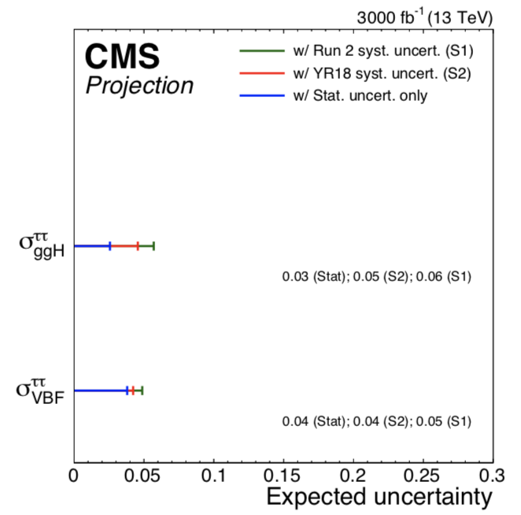
𝑯 ➞ 𝗯𝗯 / 𝜏𝜏
P_{t} > 100 GeV due to boost in production
Signal strength uncertainty ~6%, uncertainty due to theory dominates
Systematic dominated by background modelling,
Jet calibration and E_{T}^{miss}
Prafulla Kumar Behera@LLWI
11th Feb 2019

Slide 9
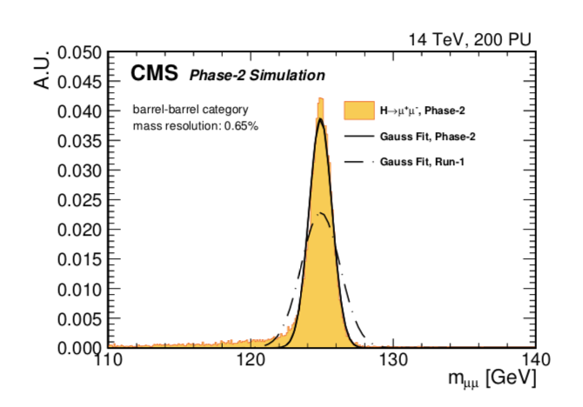
𝑯 ➞ 𝝁⁺ 𝝁⁻
Coupling to second fermion generation.
Over all uncertainty ~10 – 15%
Dominated by statistical uncertainty.
Mass resolution from 1.1% to 0.65 due to upgraded tracker.
Prafulla Kumar Behera@LLWI
11th Feb 2019

Slide 10
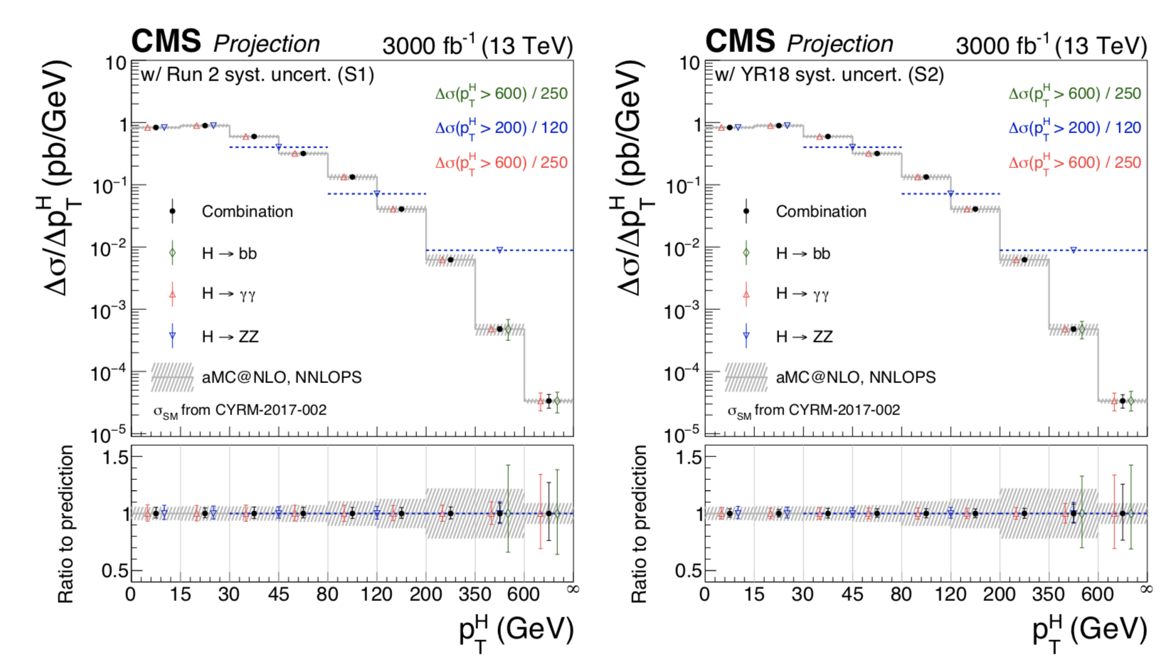
Differential cross section (Higgs)
Prafulla Kumar Behera@LLWI
11th Feb 2019

Slide 11
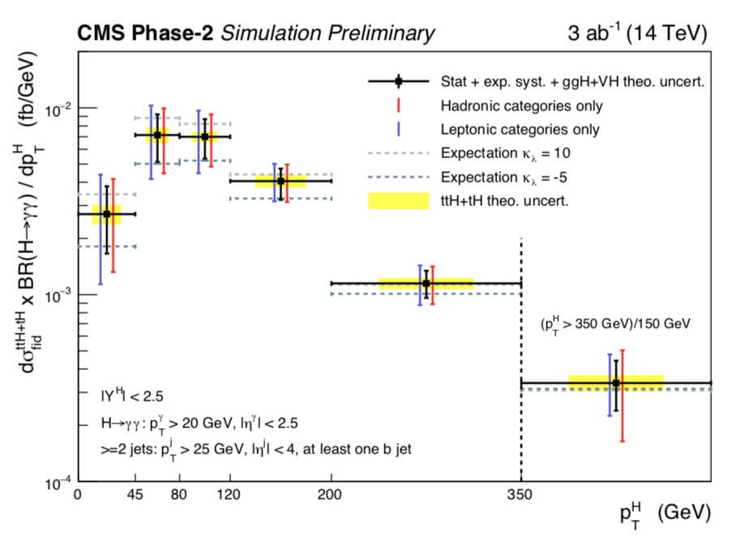
P_{T}(H) spectrum in ttH +tH
Differential cross section for the Higgs boson self-coupling (k_{𝜆} =10 and k_{𝜆} = -5 )
Prafulla Kumar Behera@LLWI
11th Feb 2019

Slide 12
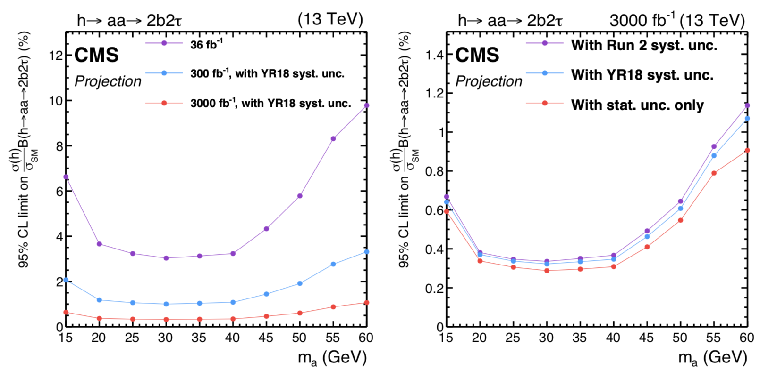
Exotic Decays of Higgs
Two-Higgs-doublet model extended with a scalar singlet (2HDM+S).
One scalar (𝗁 ➞ 𝖺𝖺 ➞ 2𝛕2𝙗) can be compatible with the Higgs (125 GeV)
Prafulla Kumar Behera@LLWI
11th Feb 2019

Slide 13
Summary
Large data sets with precision measurements, window to BSM.
Prafulla Kumar Behera@LLWI
11th Feb 2019

