Slide 1
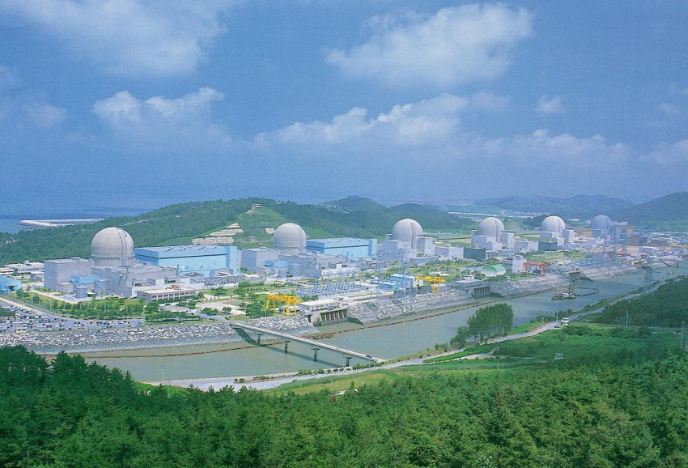

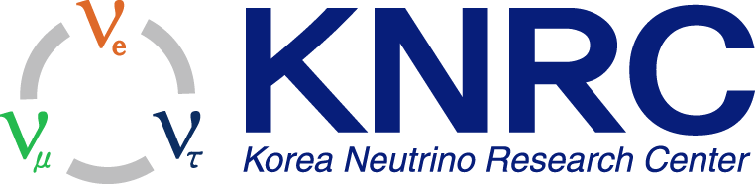
Results from RENO
Hyunkwan Seo for the RENO Collaboration
Seoul National University
Lake Louise Winter Institute 2017
Chateau Lake Louise, AB, Canada, February. 19-25, 2017

Slide 2
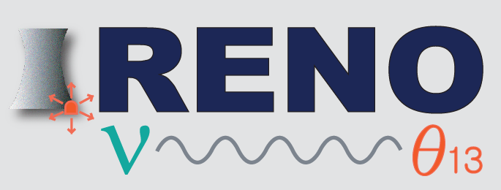
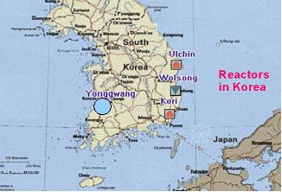
RENO Collaboration
Reactor Experiment for Neutrino Oscillation
(8 institutions and 40 physicists)
Chonnam National University
Dongshin University
GIST
Gyeongsang National University
Kyungpook National University
Seoul National University
Seoyeong University
Sungkyunkwan University
Total cost : $10M
Start of project : 2006
The first experiment running with both near & far detectors from Aug. 2011
YongGwang (靈光) :

Slide 3
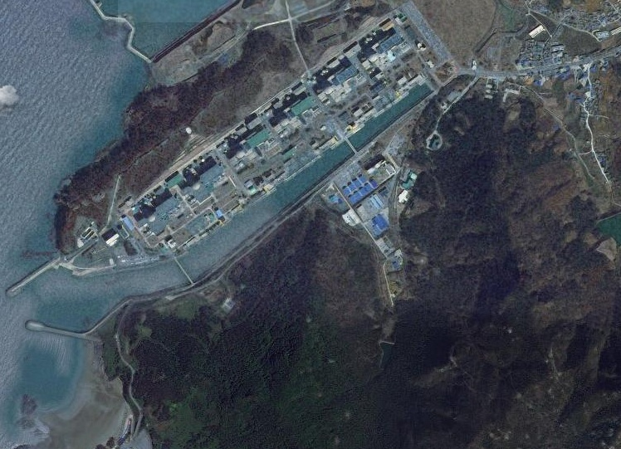

RENO Experimental Set-up
120 m.w.e.
Near Detector
290m
1380m
Far Detector
450 m.w.e.

Slide 4
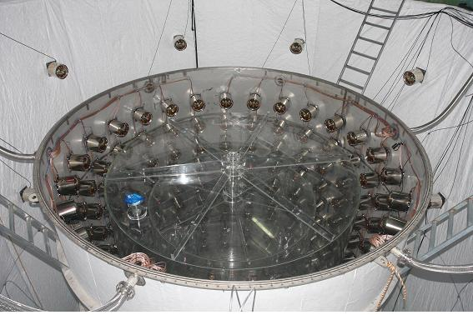
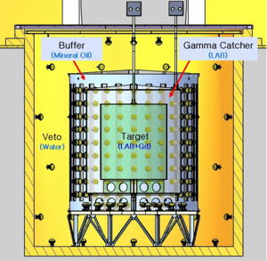
RENO Detector
Target : 16.5 ton Gd-LS (R=1.4m, H=3.2m)
Gamma Catcher : 30 ton LS (R=2.0m, H=4.4m)
Buffer : 65 ton mineral oil (R=2.7m, H=5.8m)
Veto : 350 ton water (R=4.2m, H=8.8m)
354 ID 10” PMTs
67 OD 10” PMTs

Slide 5
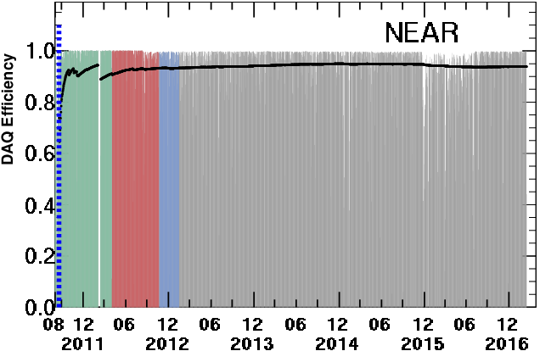
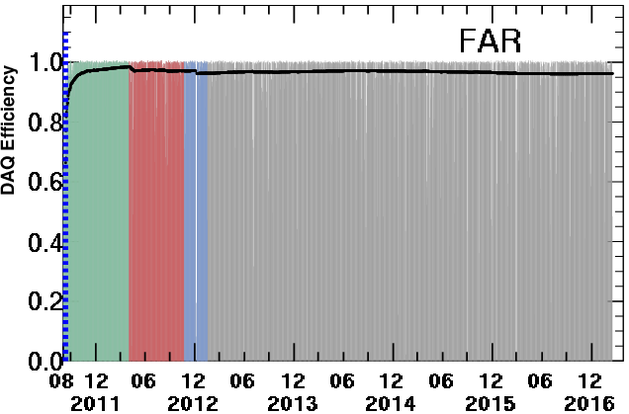
RENO Data-taking Status
Data taking began on Aug. 1, 2011 with both near and far detectors.
(DAQ efficiency : ~95%)
A
A (220 days) : First θ₁₃ result
[11 Aug, 2011~26 Mar, 2012]
PRL 108, 191802 (2012)
B
Now
B (403 days) : Improved θ₁₃ result
[11 Aug, 2011~13 Oct, 2012]
NuTel 2013, TAUP 2013, WIN 2013
C (500 days) : New results
Rate+shape analysis (θ₁₃ and |Δm_{ee}²|)
[11 Aug, 2011 ~ 21 Jan,2013]
PRL 116, 211801 (2016)
submitted to PRD (arXiv:1610.04326)
C
D
D (1400 days) : Spectrum
[11 Aug, 2011 ~ 30 Sep,2015]
Total ~2000 days

Slide 6
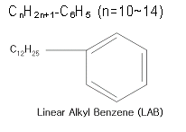

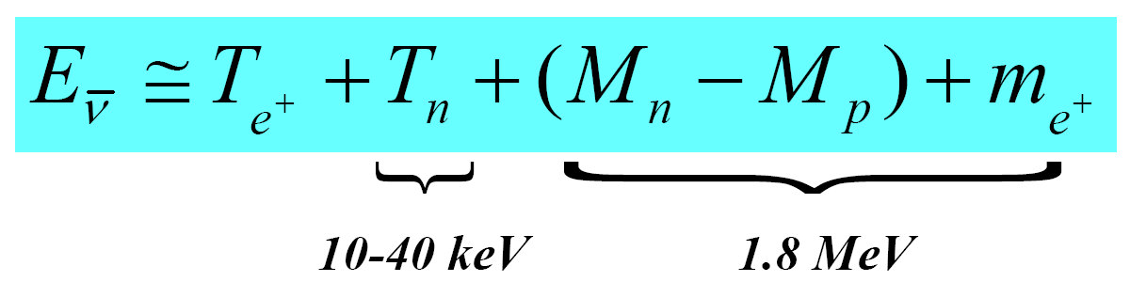
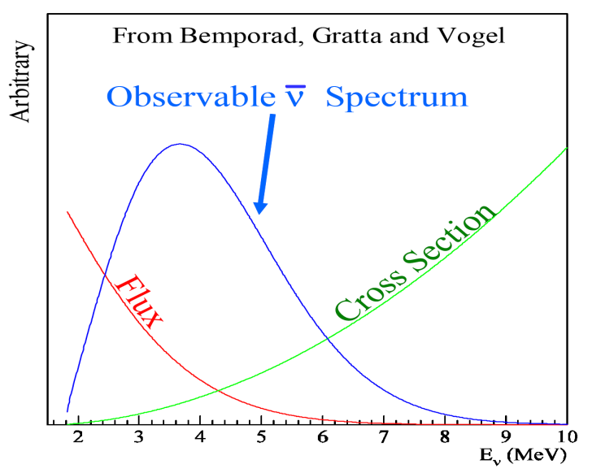
Detection of Reactor Antineutrinos
(prompt signal)
~180 μs
(delayed signal)
+ p → D + γ (2.2 MeV)
~28 μs
(0.1% Gd)
+ Gd → Gd + γ‘s (8 MeV)
Neutrino energy measurement

Slide 7
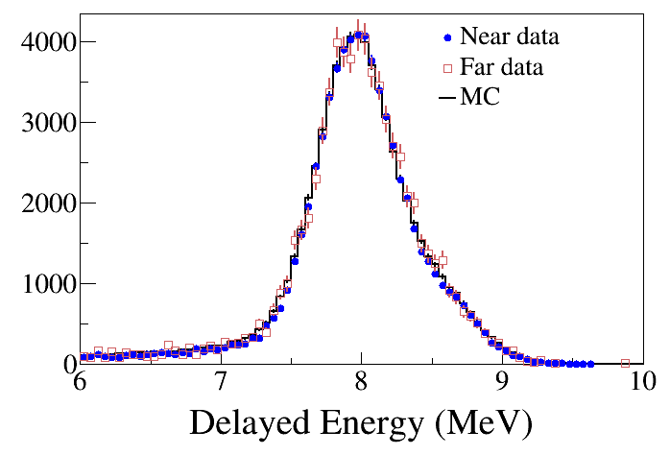
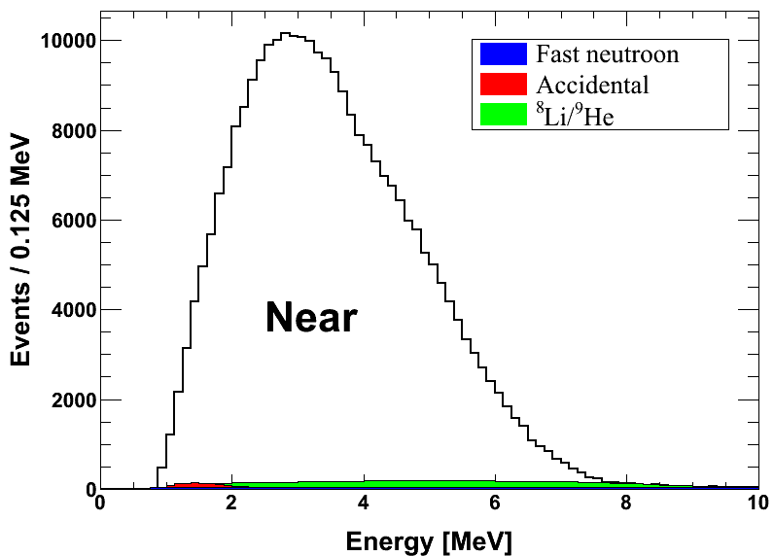
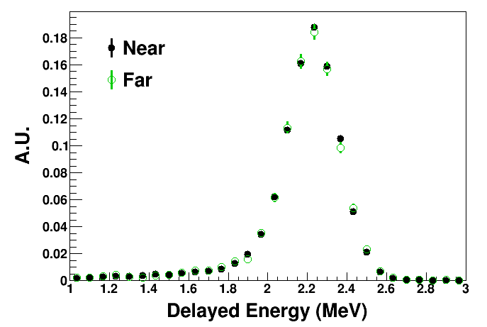
Coincidence of prompt and delayed signals
(prompt signal)
(delayed signal)
Delayed signal
Prompt signal
n-Gd IBD
~30 μs
8 MeV
~200 μs
n-H IBD
2.2 MeV

Slide 8
Results from RENO
Observation of energy dependent disappearance of reactor neutrinos to measure Δm_{ee}² and θ₁₃ using ~500 days of data (Aug. 2011 ~ Jan. 2013)
“Observation of Energy and Baseline Dependent Reactor Antineutrino Disappearance in the RENO Experiment” (PRL 116, 211801, 2016)
- The detail description has been submitted to PRD (arXiv:1610.04326)
Measurement of absolute reactor neutrino flux (500 days)
Observation of an excess at ~5 MeV in reactor neutrino spectrum using ~1400 days of data
Independent measurement of θ₁₃ with n-H for a delayed signal (additional background reduction achieved)
Obtained results from a sterile neutrinos search

Slide 9
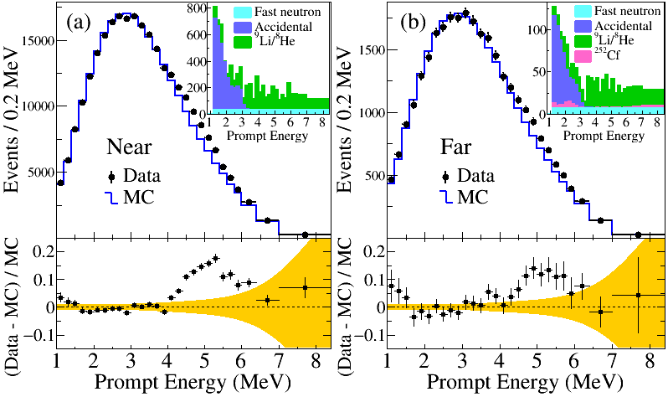
Measured Spectra of IBD Prompt Signal
Near Live time = 458.49 days
# of IBD candidate = 290,775
# of background = 8,041 (2.8 %)
Far Live time = 489.93 days
# of IBD candidate = 31,541
# of background = 1540 (4.9 %)

Slide 10
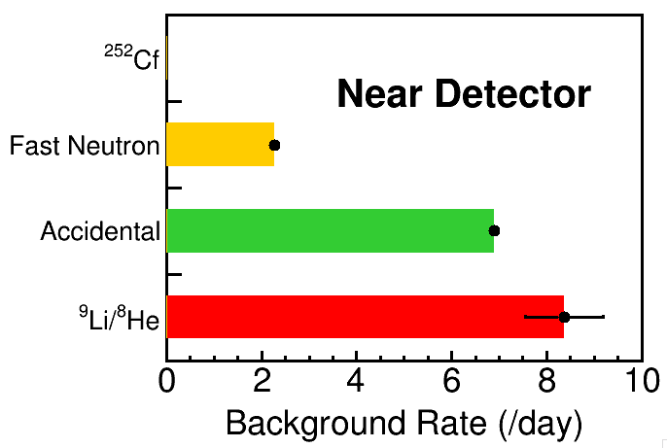
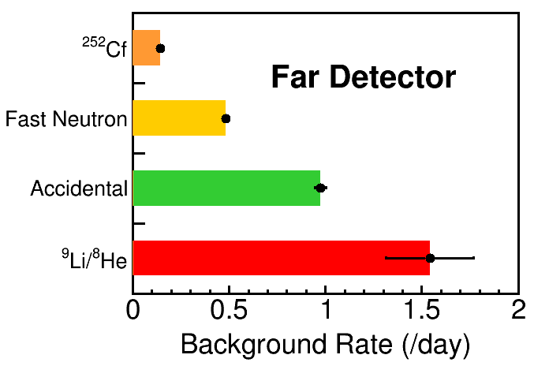
IBD Candidates & Backgrounds
 | Near | Far
DAQ live time (days) | 458.49 | 489.93
IBD candidates | 290755 | 31541
Total BKG rate (/day) | 17.54± 0.83 | 3.14± 0.21
IBD rate (/day) after BKG subtraction | 616.67± 1.44 | 61.24± 0.42

Slide 11
Observed Daily Averaged IBD Rate
preliminary
Good agreement with observed rate and prediction.
Accurate measurement of thermal power by reactor neutrinos

Slide 12
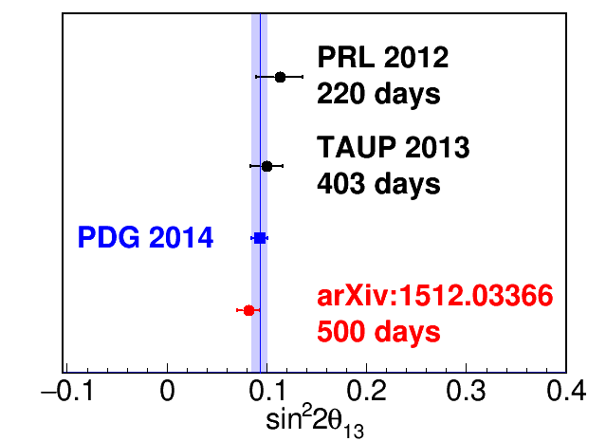
θ₁₃ Measurement by Rate-only Analysis
Rate-only
result
|Δm_{ee}²| = 2.49 x 10⁻³ eV² is used (PDG 2014)
By minimizing
PRL 116, 211801 (2016)

Slide 13

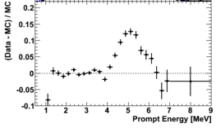
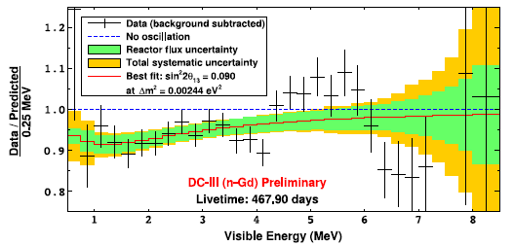
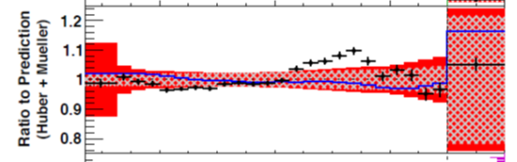
The 5 MeV Excess is there !
RENO
Double Chooz
Daya Bay
In 2014, RENO showed the 5 MeV excess
comes from reactors.

Slide 14
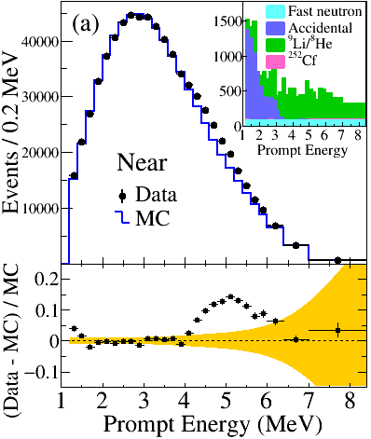
Observation of an excess at 5 MeV
1400 days of data (Aug. 2011 – Sep 2015)
(Preliminary)
The measured near spectrum is compared with prediction using χ²-square test.
Fraction of 5 MeV excess: 2.50 ± 0.21 (%)
~3%
Significance of the 5 MeV excess: ~12.7 σ

Slide 15
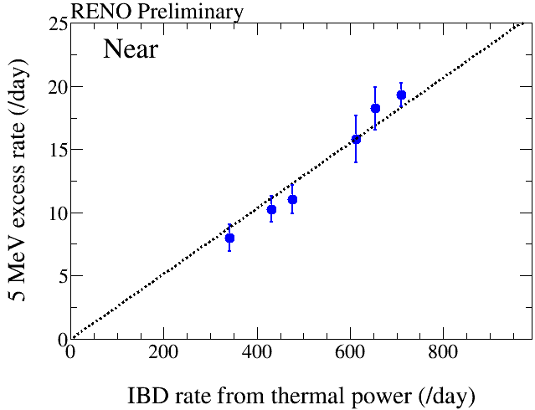
Correlation of 5 MeV Excess with Reactor Power
1400 days of data
5 MeV excess
has a clear
correlation
with reactor
thermal power !
two or three reactors are off
All the six reactors are on
The 5 MeV excess comes from reactors!

Slide 16
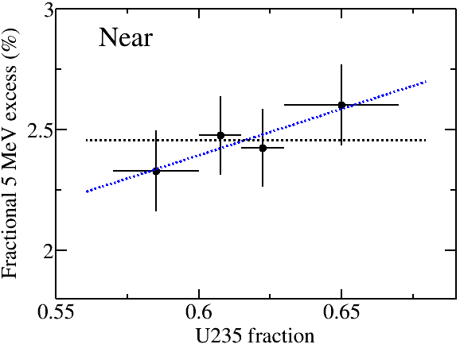
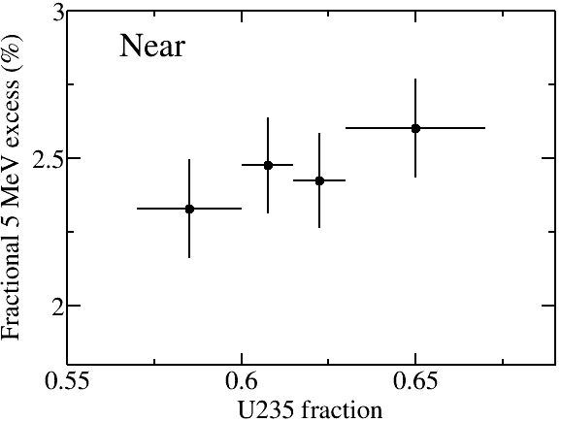
Correlation of 5 MeV excess with ²³⁵U isotope fraction
(Preliminary)
²³⁵U fraction corresponds to freshness of reactor fuel
Δχ² = 1.174
P-value = 0.240
Fit function | χ²
y = p0 | 1.407
y = p0 + p1*x | 0.233
(End
of reactor cycle)
(Beginning
of reactor cycle)

Slide 17
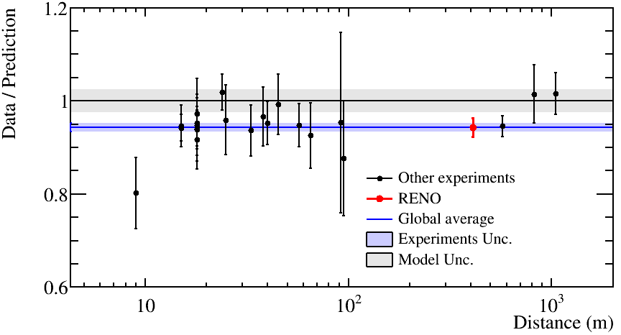
Measurement of Absolute Reactor Neutrino Flux
 | Data / Prediction (Huber + Mueller) | Flux weighted baseline at near
RENO (500 days) | 0.944 +- 0.021 | 411 m
*Prediction is corrected for three flavor neutrino oscillation
Preliminary
Daya Bay
Short baseline measurement (<100 m)
Deficit of observed reactor neutrino fluxes relative to the prediction (Huber + Mueller model) indicates an overestimated flux or possible oscillation to sterile neutrinos

Slide 18


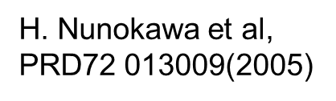

Reactor Neutrino Oscillations
ν_{e}
ν_{e}
Oscillations observed as a deficit of anti-neutrinos
ν_{e}
ν_{e}
ν_{e}
the position of the minimum is defined by Δm²_{ee}
ν_{e}
1.0
Probability ν_{e}
sin²2θ₁₃
flux before oscillation observed here
Distance
1200 to 1800 meters
$$\cos^{2}θ_{12}\left|Δ{m\text{2}}_{21}^{}\right|$$

Slide 19
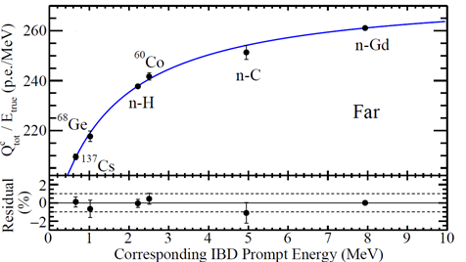
Energy Calibration from γ-ray Sources
Non-linear resonse of the scintillation energy is calibrated using γ-ray sources.
The visible energy from γ-ray is corrected to its corresponding positron energy.
Fit function : E_{vis}/E_{true} = a – b/(1 – exp(-cE_{true} – d))

Slide 20
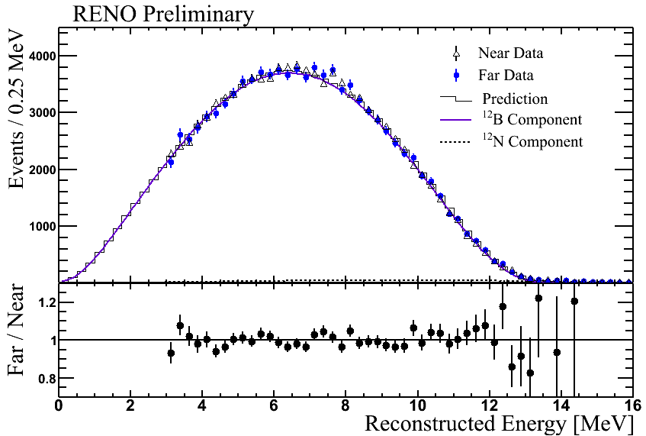
B12 Energy Spectrum (Near & Far)
Electron energy spectrum from β-decays from ¹²B and ¹²N,
which are produced by comic-muon interactions.
Good agreement between data and MC spectrum!

Slide 21
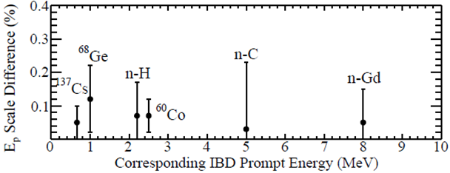
Energy Scale Difference between Near & Far
Energy scale difference < 0.15%

Slide 22
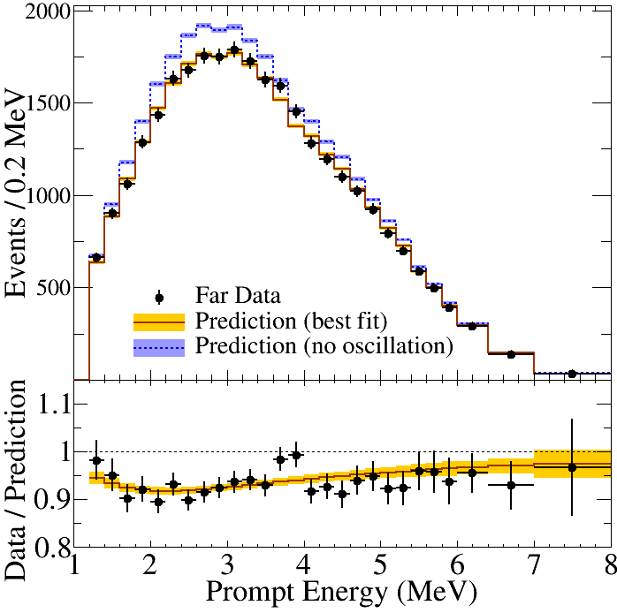
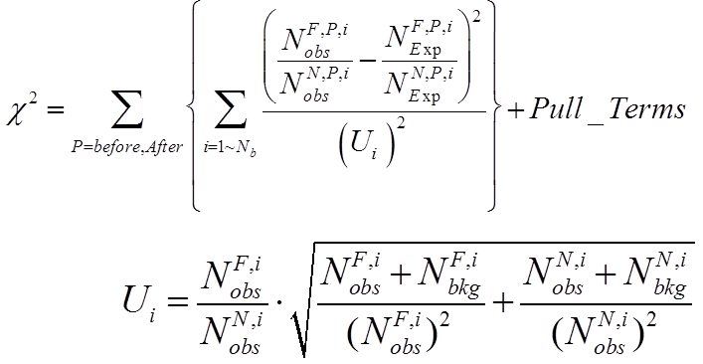
Far/Near Shape Analysis for |Δm_{ee}²|
PRL 116, 211801, 2016
Minimize Χ² Function

Slide 23
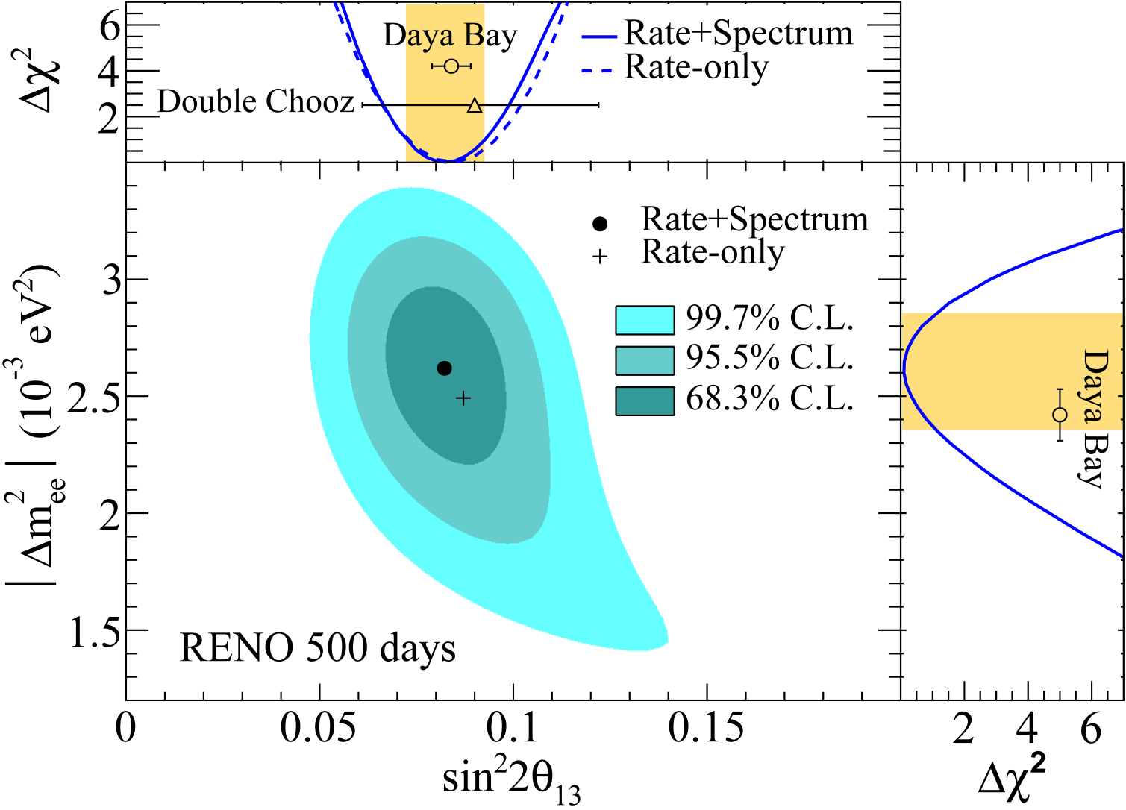

Results from Spectral Fit
Rate+shape
results
(± 12 %)
(± 10 %)

Slide 24
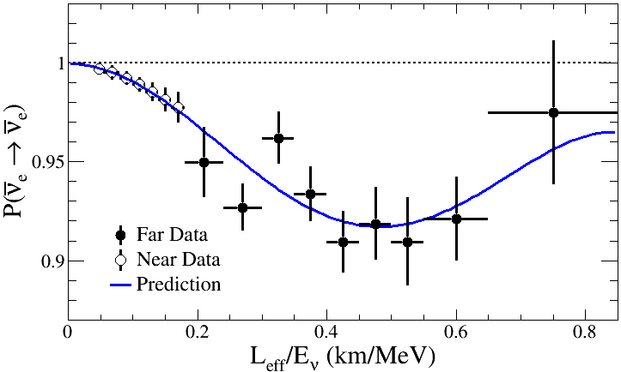
Observed L/E Dependent Oscillation

Slide 25
RENO Results
 | Rate-only | Rate+shape
Data set | 220 days (2012) 500 days(2015) | 500 days (2015)
|Δm_{ee}²| [ x10⁻³ eV²] | 2.32 2.49 (PDG 2010) (PDG 2014)
sin²(2θ₁₃) | 0.113 0.087 | 0.082
Stat. error | 0.013 0.009 | 0.009
Syst. error | 0.019 0.007 | 0.006
Total error | 0.023 0.011 | 0.011
Significance | 4.9 σ 7.9 σ | 7.5 σ
⁹Li/⁸He BKG uncertainty reduced greatly !
Near: 12.45 ± 5.93/day (48%)
Far: 2. 59 ± 0.75/day (29%)
Near: 8.36 ± 0.82/days (10%)
Far 1.54 ± 0.23/day (15%)
(220 days)
(500 days)

Slide 26
Expected θ₁₃ & |Δm_{ee}²| measurement
Current results (~500 days)
Precision measurement results based on ~2000 days of data will be reported soon (~8 % precision)
(±12%)
(±10%)
~6% is our ultimate goal
Plan for RENO data taking
2017 | 2018 | 2019 | 2020 | 2021
RENO data will be taken for 2 more years from now and it will take 3 additional years for the analysis.
Possible extension of additional 2~3 years
According to our recent study, the systematic error of |Δm_{ee}²| is smaller than the statistical error.
sin²2θ₁₃ and |Δm_{ee}²| will approach to ~6% precision (our design goal).

Slide 27
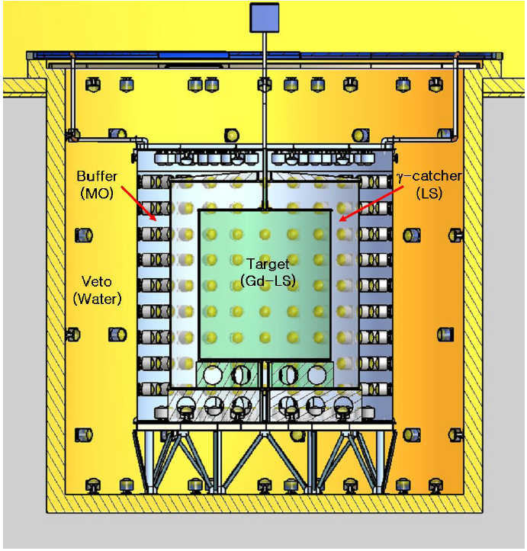
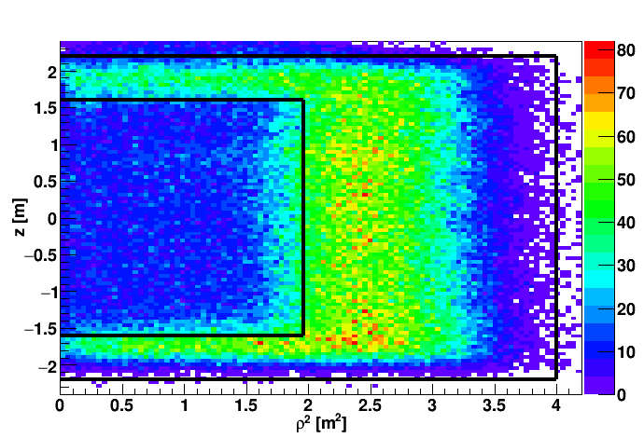
n-H IBD Analysis
Motivation:
1. Independent measurement of θ₁₃ value.
2. Consistency and systematic check on reactor neutrinos.
n-H IBD Event Vertex Distribution
target
γ-catcher

Slide 28
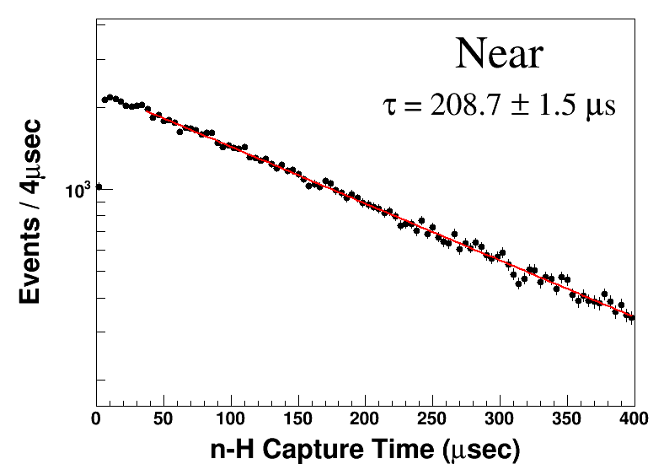
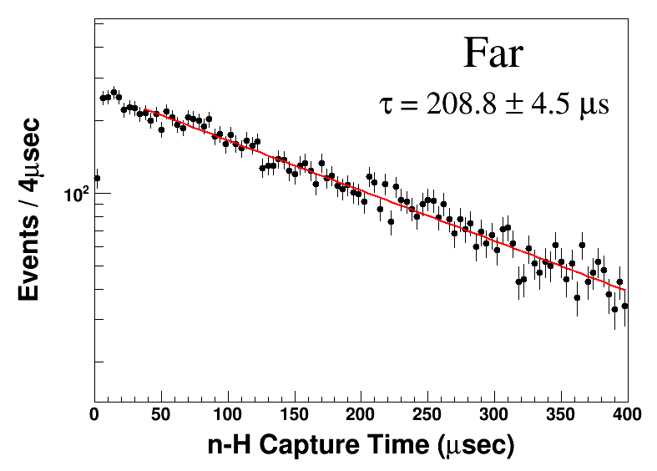
Delayed Spectrum and Capture Time
Delayed signal peak:
~2.2 MeV
Mean coincidence time:
~ 200 μs
28

Slide 29
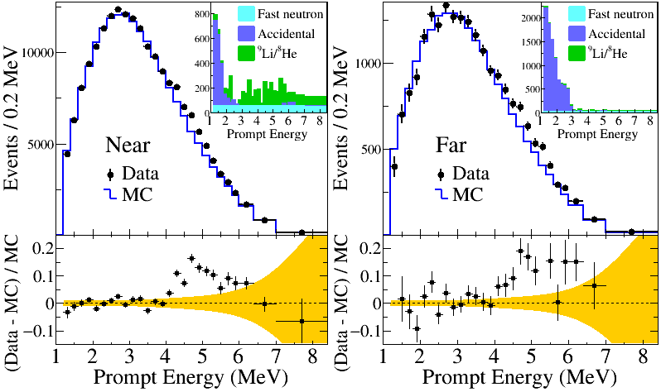
θ₁₃ Measurement with n-H
(Preliminary, 500 days)

Slide 30
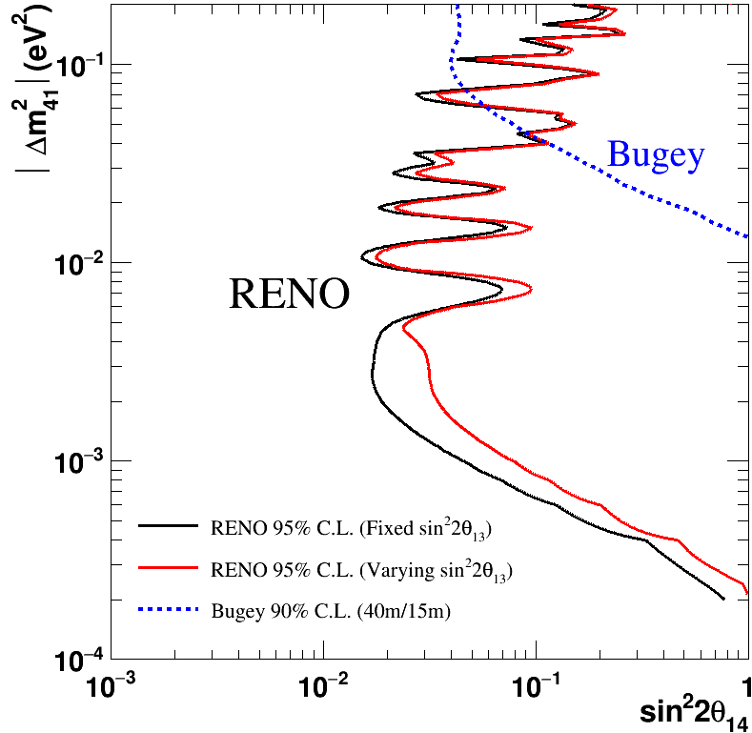
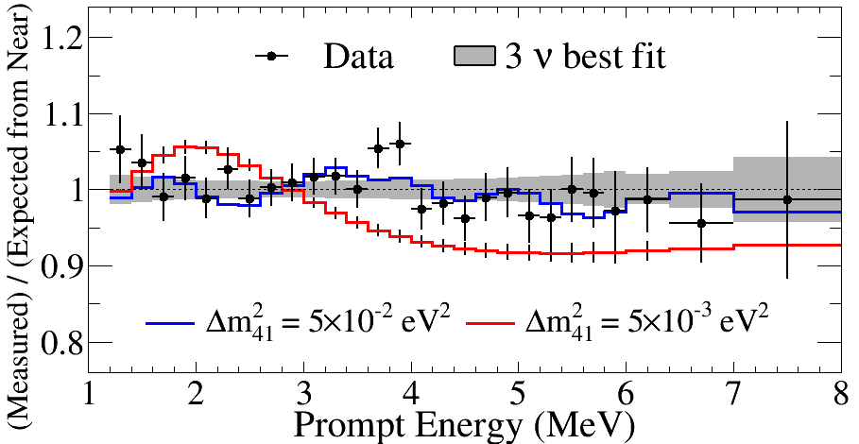
Light Sterile Neutrino Search Results
All 500 days of RENO data
Consistent with standard 3-flavor
neutrino oscillation model
Able to set stringent limits in
the region 10⁻³ < Δm_{ee}² < 0.1 eV²
(Preliminary)
full curves assumes sin²2θ₁₄ = 0.1

Slide 31
Summary
Observation of energy dependent disappearance of reactor neutrinos and our first measurement of Δm_{ee}²
12 % precision
10 % precision
Measured absolute reactor neutrino flux : R= 0.944±0.021
Observed an excess at 5 MeV in reactor neutrino spectrum
Measurement of θ₁₃ using n-H IBD analysis : 0.086±0.019
Obtained an excluded region from a sterile neutrino search
sin²(2θ₁₃) and Δm_{ee}² to 6% accuracy after 2 more years data taking
additional 2~3 years of data taking under consideration to improve Δm_{ee}² accuracy

Slide 32
Thanks for your attention!

Slide 33
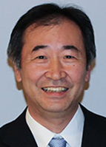
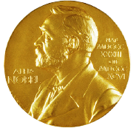
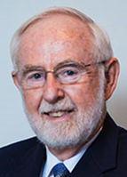
Neutrino Mixing Angles
Atmospheric Neutrino Oscillation
θ₂₃
~45º (1998)
Super-K; K2K
2015
Nobel
Prize
Solar Neutrino Oscillation
θ₁₂
34º (2001)
SNO, Super-K;
KamLAND
Reactor Neutrino Oscillation
θ₁₃
9º (2012)
Daya Bay, RENO
Double Chooz
“Neutrino has mass”
“Established three-flavor mixing framework”

Slide 34
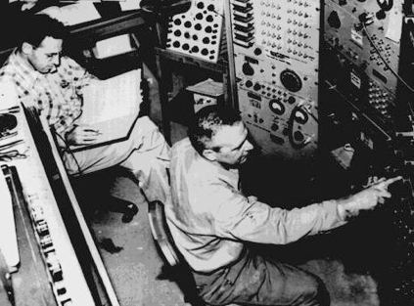
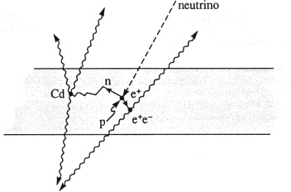
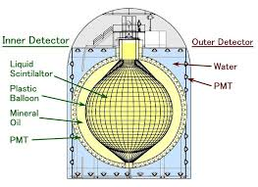
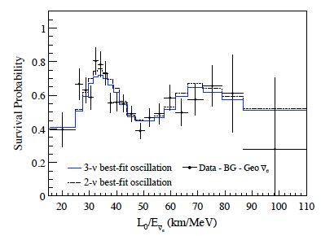
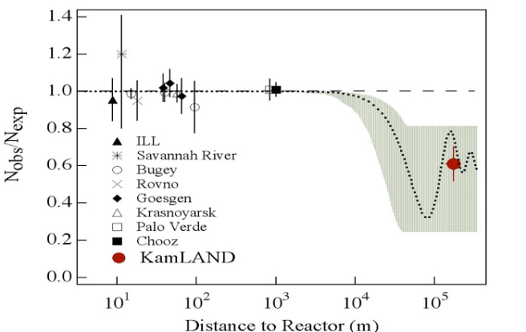





Neutrino Physics with Reactor
1956 Discovery of (anti)neutrino
Savannah River
2003 Observation of reactor neutrino oscillation (θ₁₂ & Δm₂₁²)
KamLAND
2012 Measurement of the smallest mixing angle θ₁₃

Slide 35




Reactor θ₁₃ Experiments
RENO at Yonggwang, Korea
Daya Bay at Daya Bay, China
Double Chooz at Chooz, France

Slide 36


Delayed Signals from Neutron Capture by Gd

Slide 37

Observed vs. Expected IBD Rates
- Good agreement between observed rate & prediction
- Indication of correct background subtraction

Slide 38
χ² equation for 5 MeV excess

Slide 39
Determination of normalization factor, R
A normalization factor R (= Data/Absolute Prediction) is determined using the χ² fitting
O_{d} : number of observed IBD events
b_{d} : number of background
T_{d} : number of expected IBD events
R : normalization factor
σ_{b} : uncertainty for background
σ_{ξ,cor} : correlated uncertainty for detection efficiency (1.04 %)
σ_{ξ,uncor} : uncorrelated uncertainty for detection efficiency (0.13 %)
f_{r,uncor} : uncorrelated uncertainty for reactor
f_{cor} : correlated uncertainty for reactor (2.0 %)
ξ_{cor}, ξ_{uncor}, f_{r,uncor}, f_{cor} are corresponding pull parameters to the above uncertainties
The χ² does not use far-to-near ratio in order to determine the normalization factor, R
Pull parameter for correlated detection efficiency and reactor are included unlike far-to-near ratio analysis

Slide 40

Projected Sensitivity of θ₁₃ & |Δm_{ee}²|
(±12%)
(±6 %)
(±10%)
(±6 %)
(~500 days)
(5 years of data)
(6 % precision)
(sensitivity goal of θ₁₃ )
Seminar @ CERN

