Slide 1
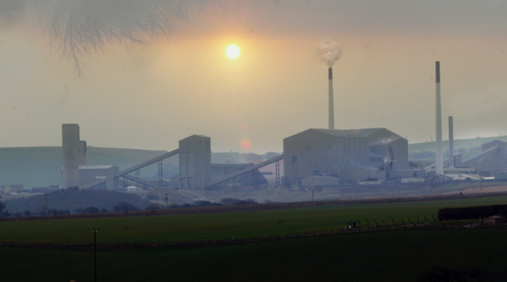

  Boulby Underground Laboratory
DMUK meeting 28th July 2017, Edinburgh
Emma Meehan

Slide 2
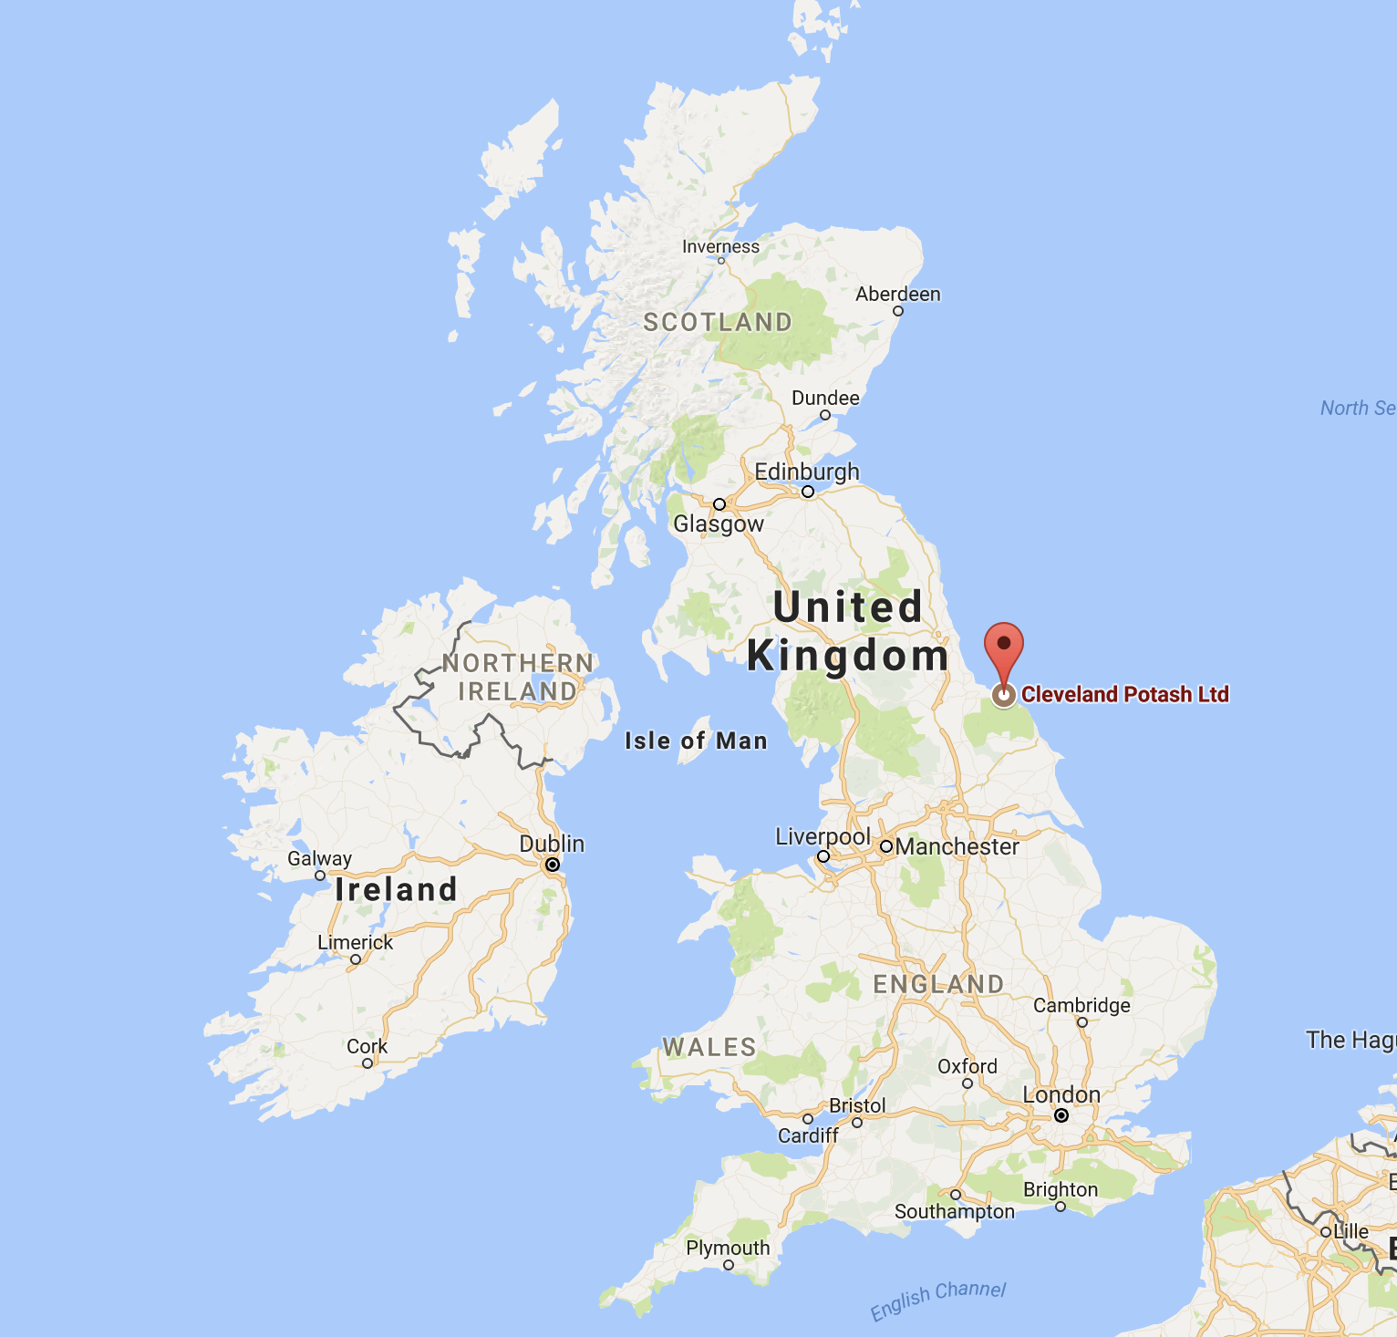
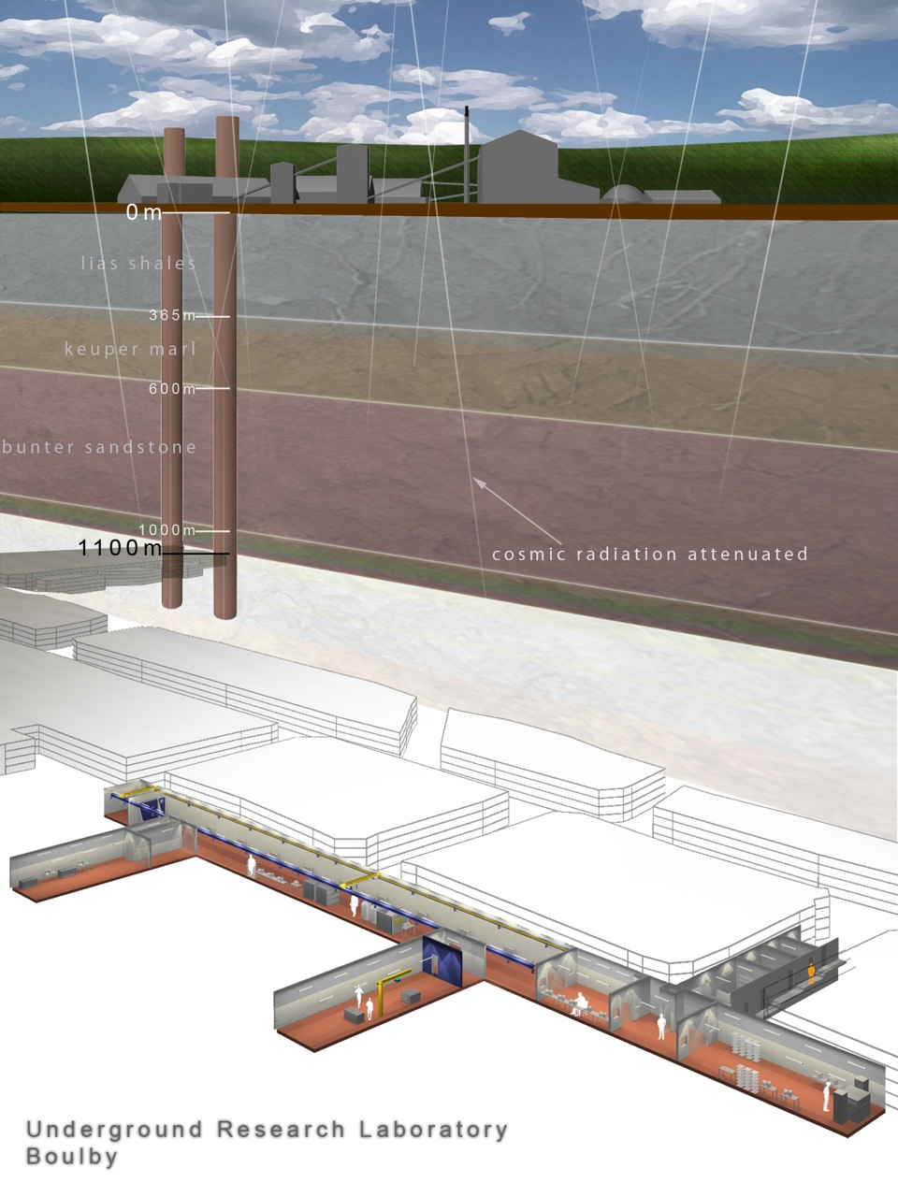
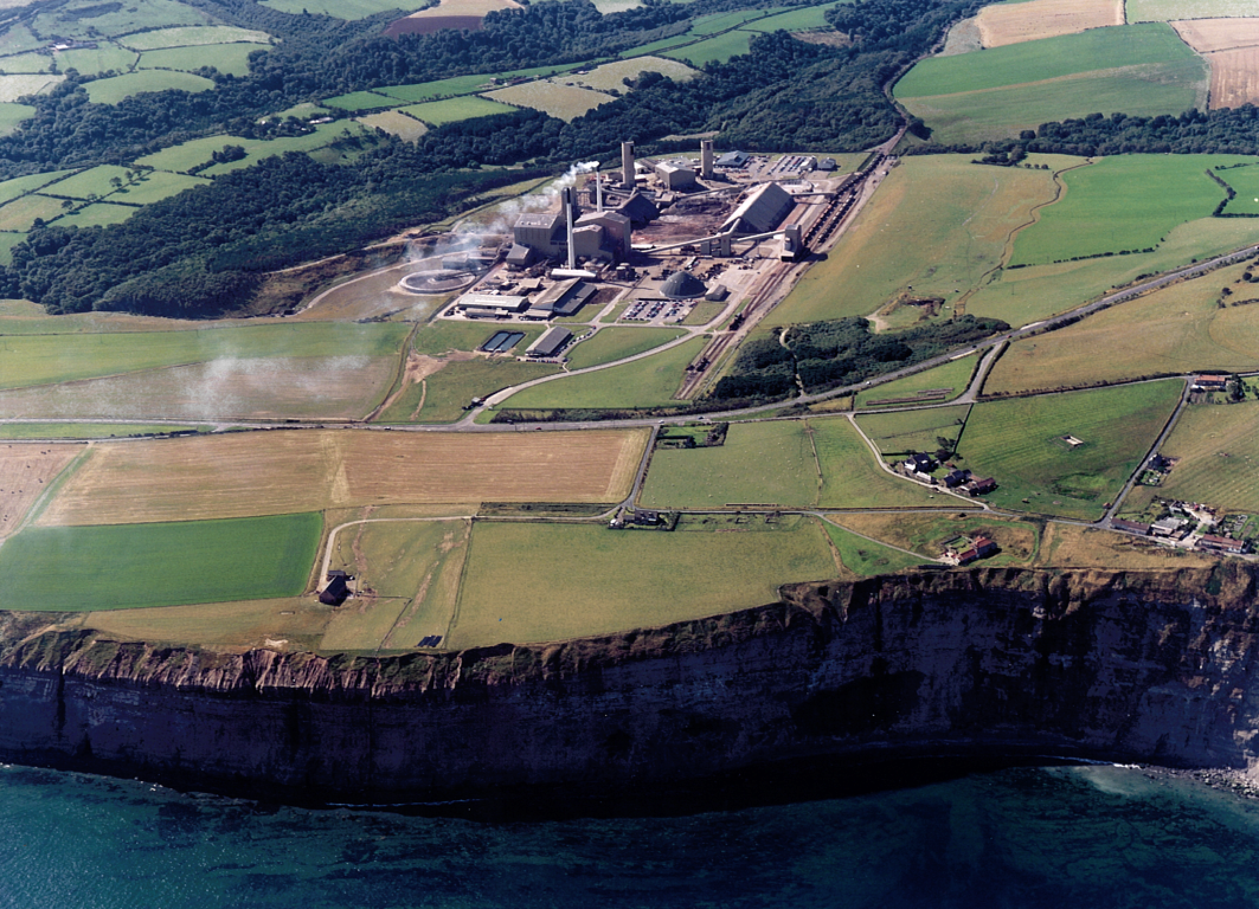


Boulby Underground Laboratory
The UK’s deep underground science facility operating in a working Potash, Polyhaylite and Salt mine
Operated by the UK’s Science & Technology Facilities Council (STFC)
Factor ~ 1 million reduction in cosmic ray muon flux vs. surface
1.1km depth (2805 mwe)

Slide 3

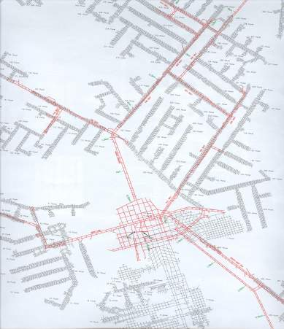
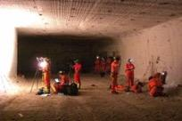
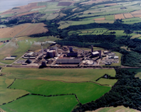
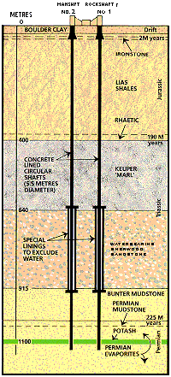


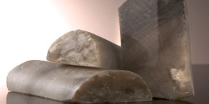
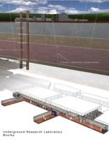

Boulby Geology & Mining
Excavations are in Salt (NaCl) Polyhalite (SKMgCa) & Potash (KCl) Permian evaporite layers left over from the Zechstein Sea.
Over 40 kms of tunnel mined each year (now >1,000kms in total), the long-lived roadways being cut in the lower NaCl layer.
Potash
Typical Boulby Salt Roadway
Rock-Salt
Boulby Mine
Mine Shafts
Polyhalite
U: 67 ± 6 ppb
Th: 125 ± 10 ppb
Low γ & n backgrounds
Low Rn (<3 Bqm⁻³)
Boulby Geology
Palmer Lab

Slide 4
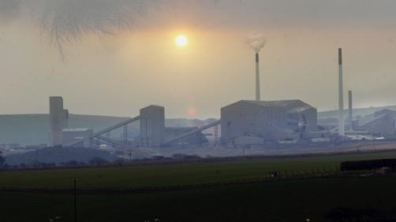
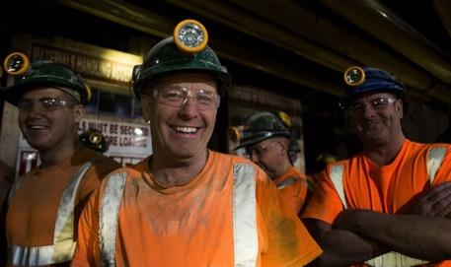
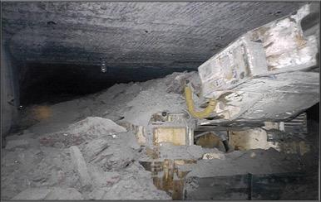
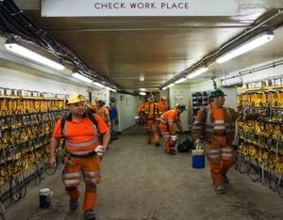
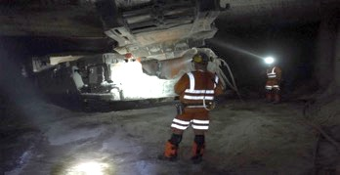
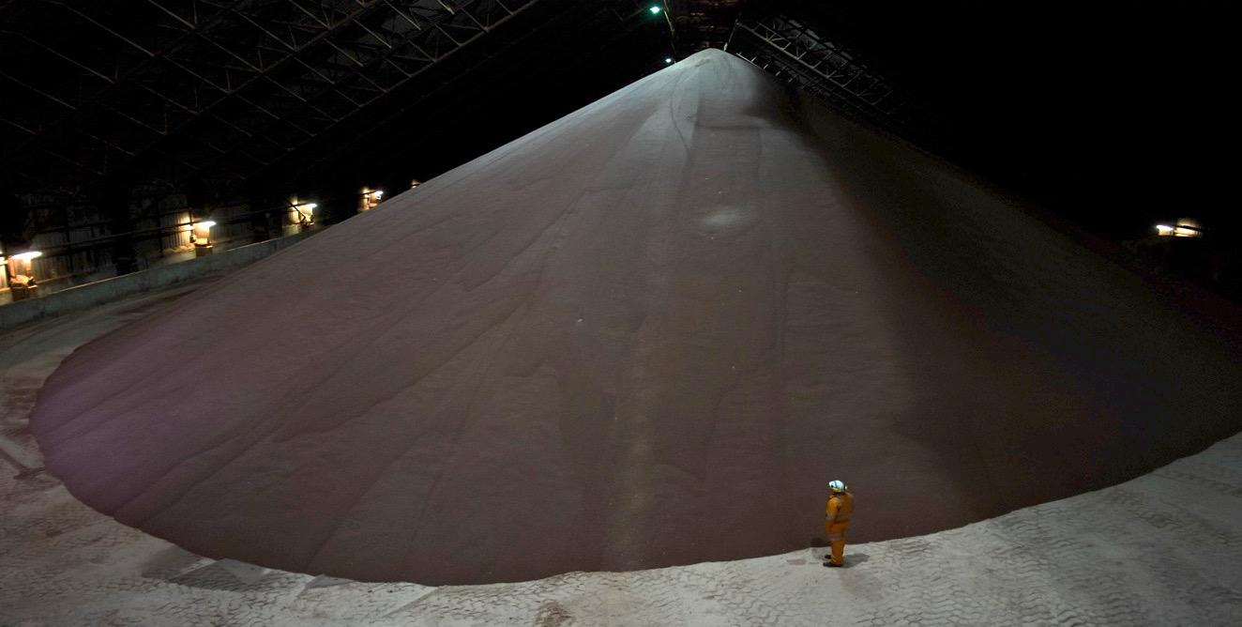
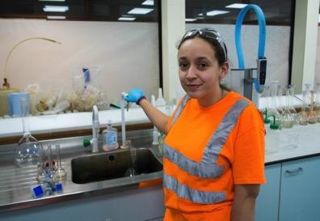

Mining at Boulby…
CPL/ICL support us:
Keep the mine operating and safe
Emergency H&S
Materials transportation
Misc. Facility maintenance
High level political support
ERSaB: Gamma spectroscopy & low BG counting environmental radioactivity studies

Slide 5

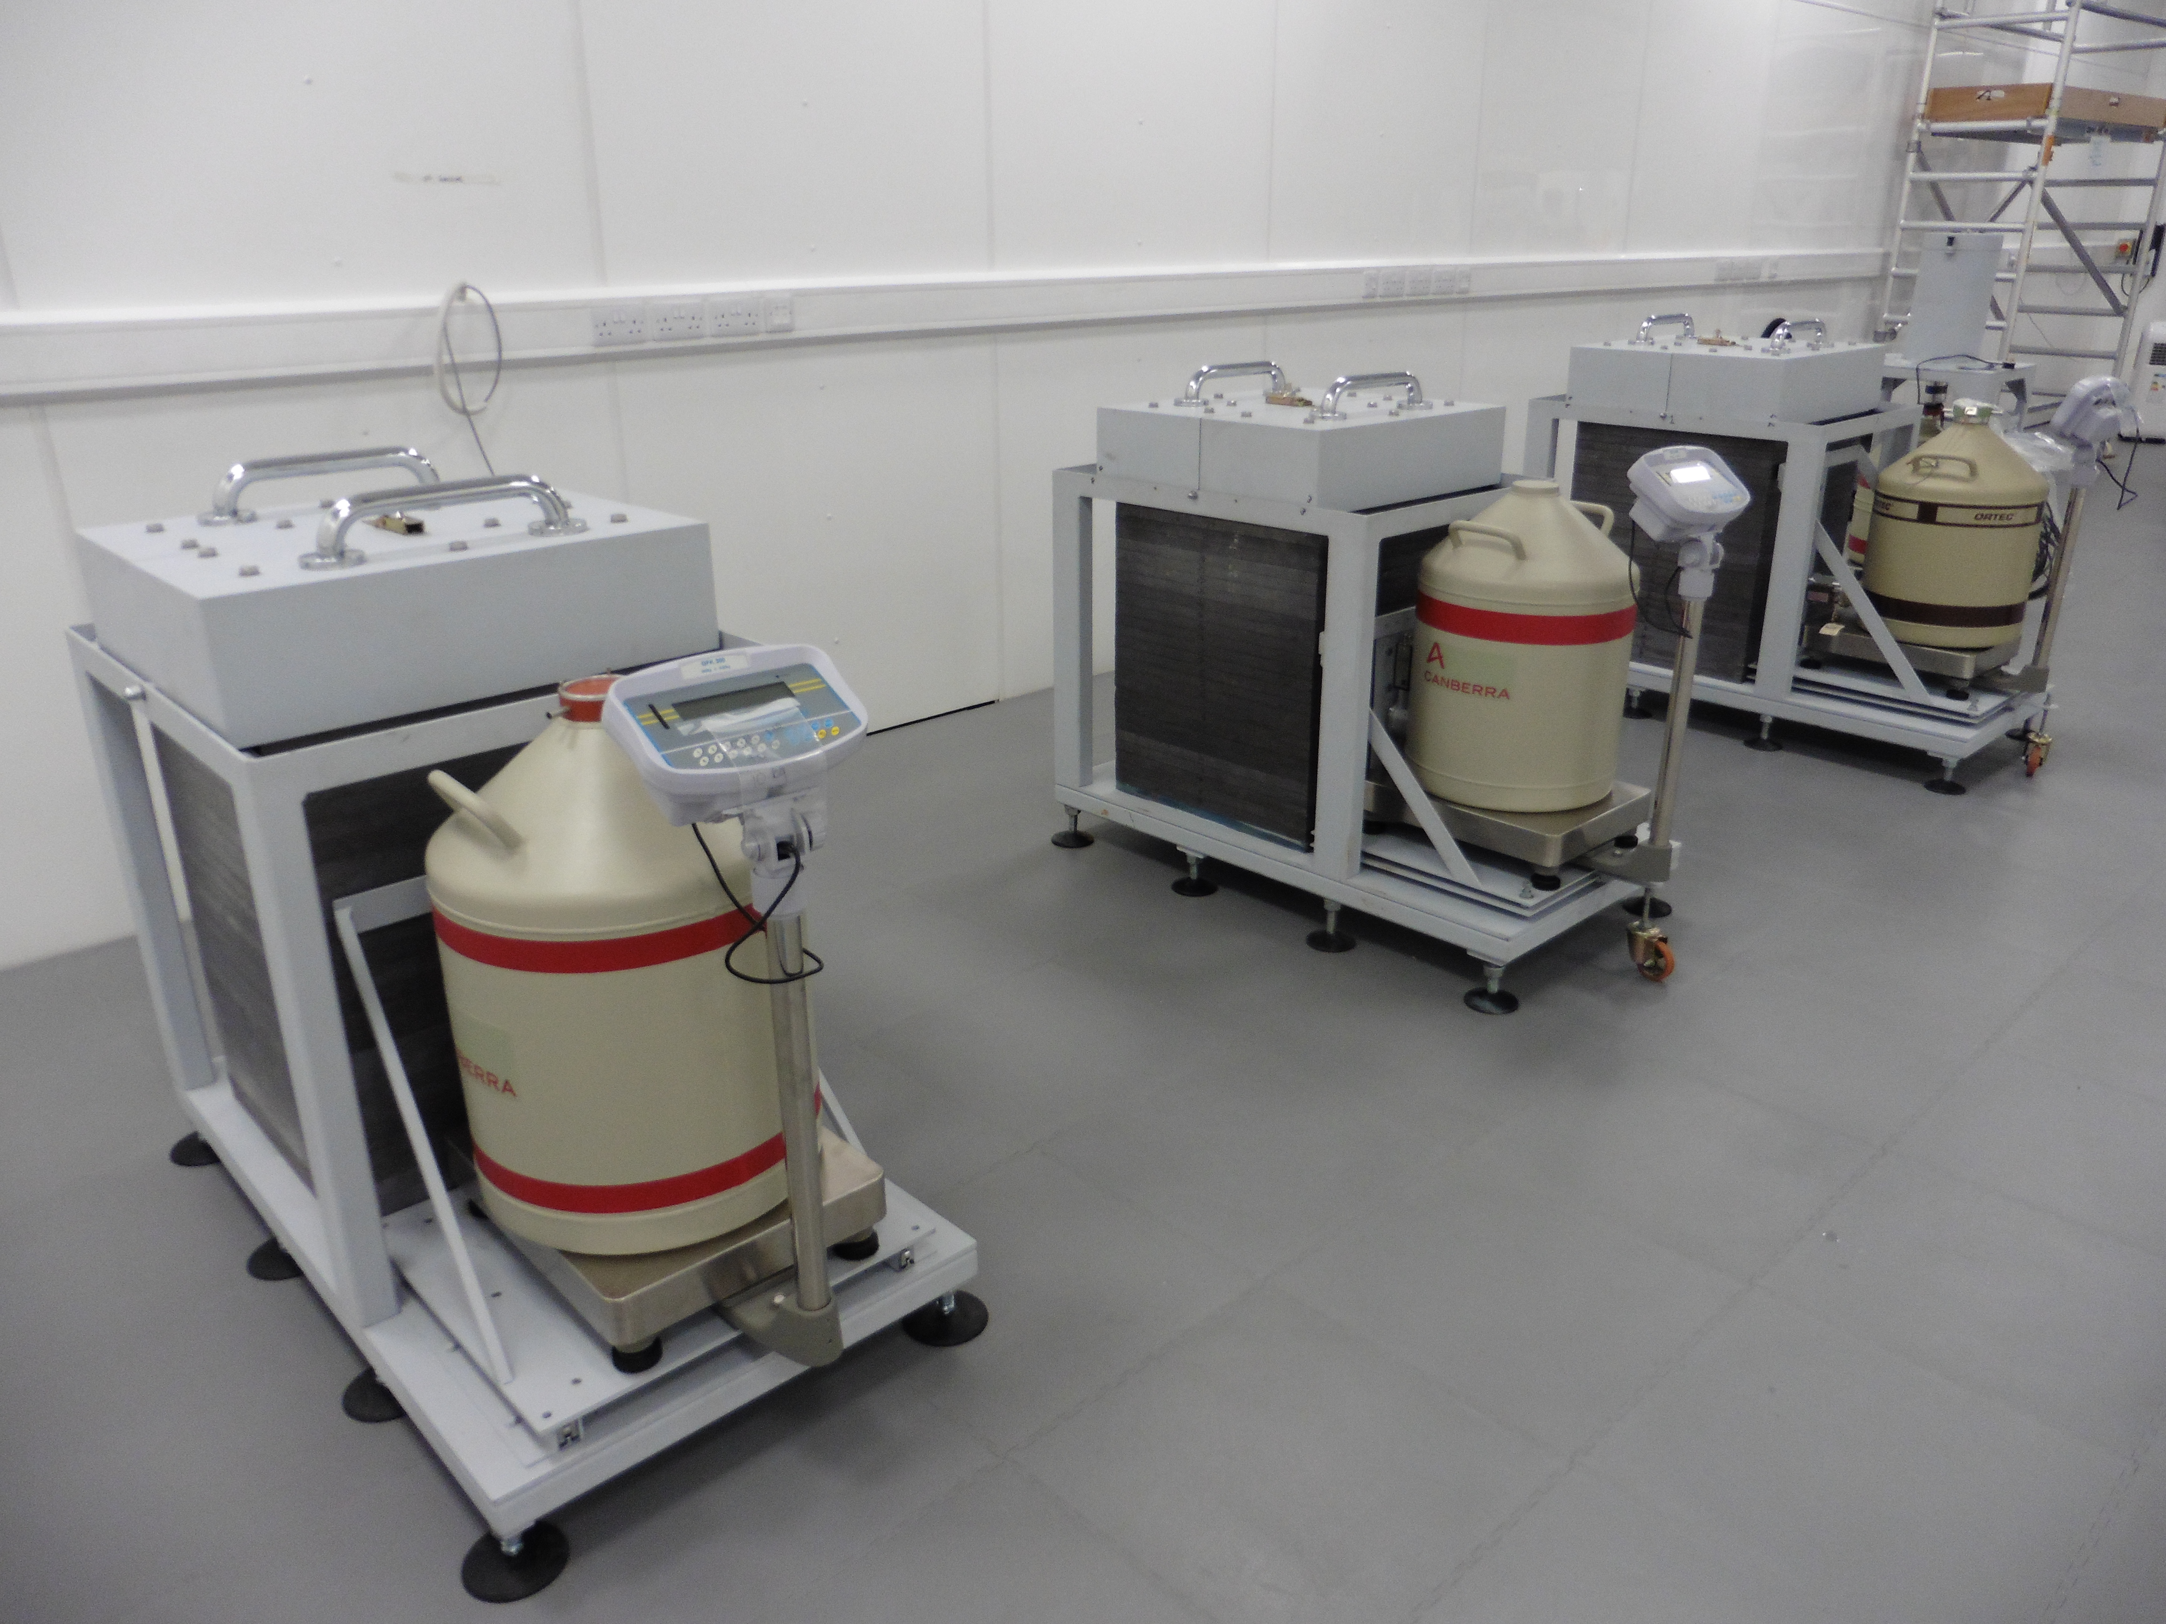
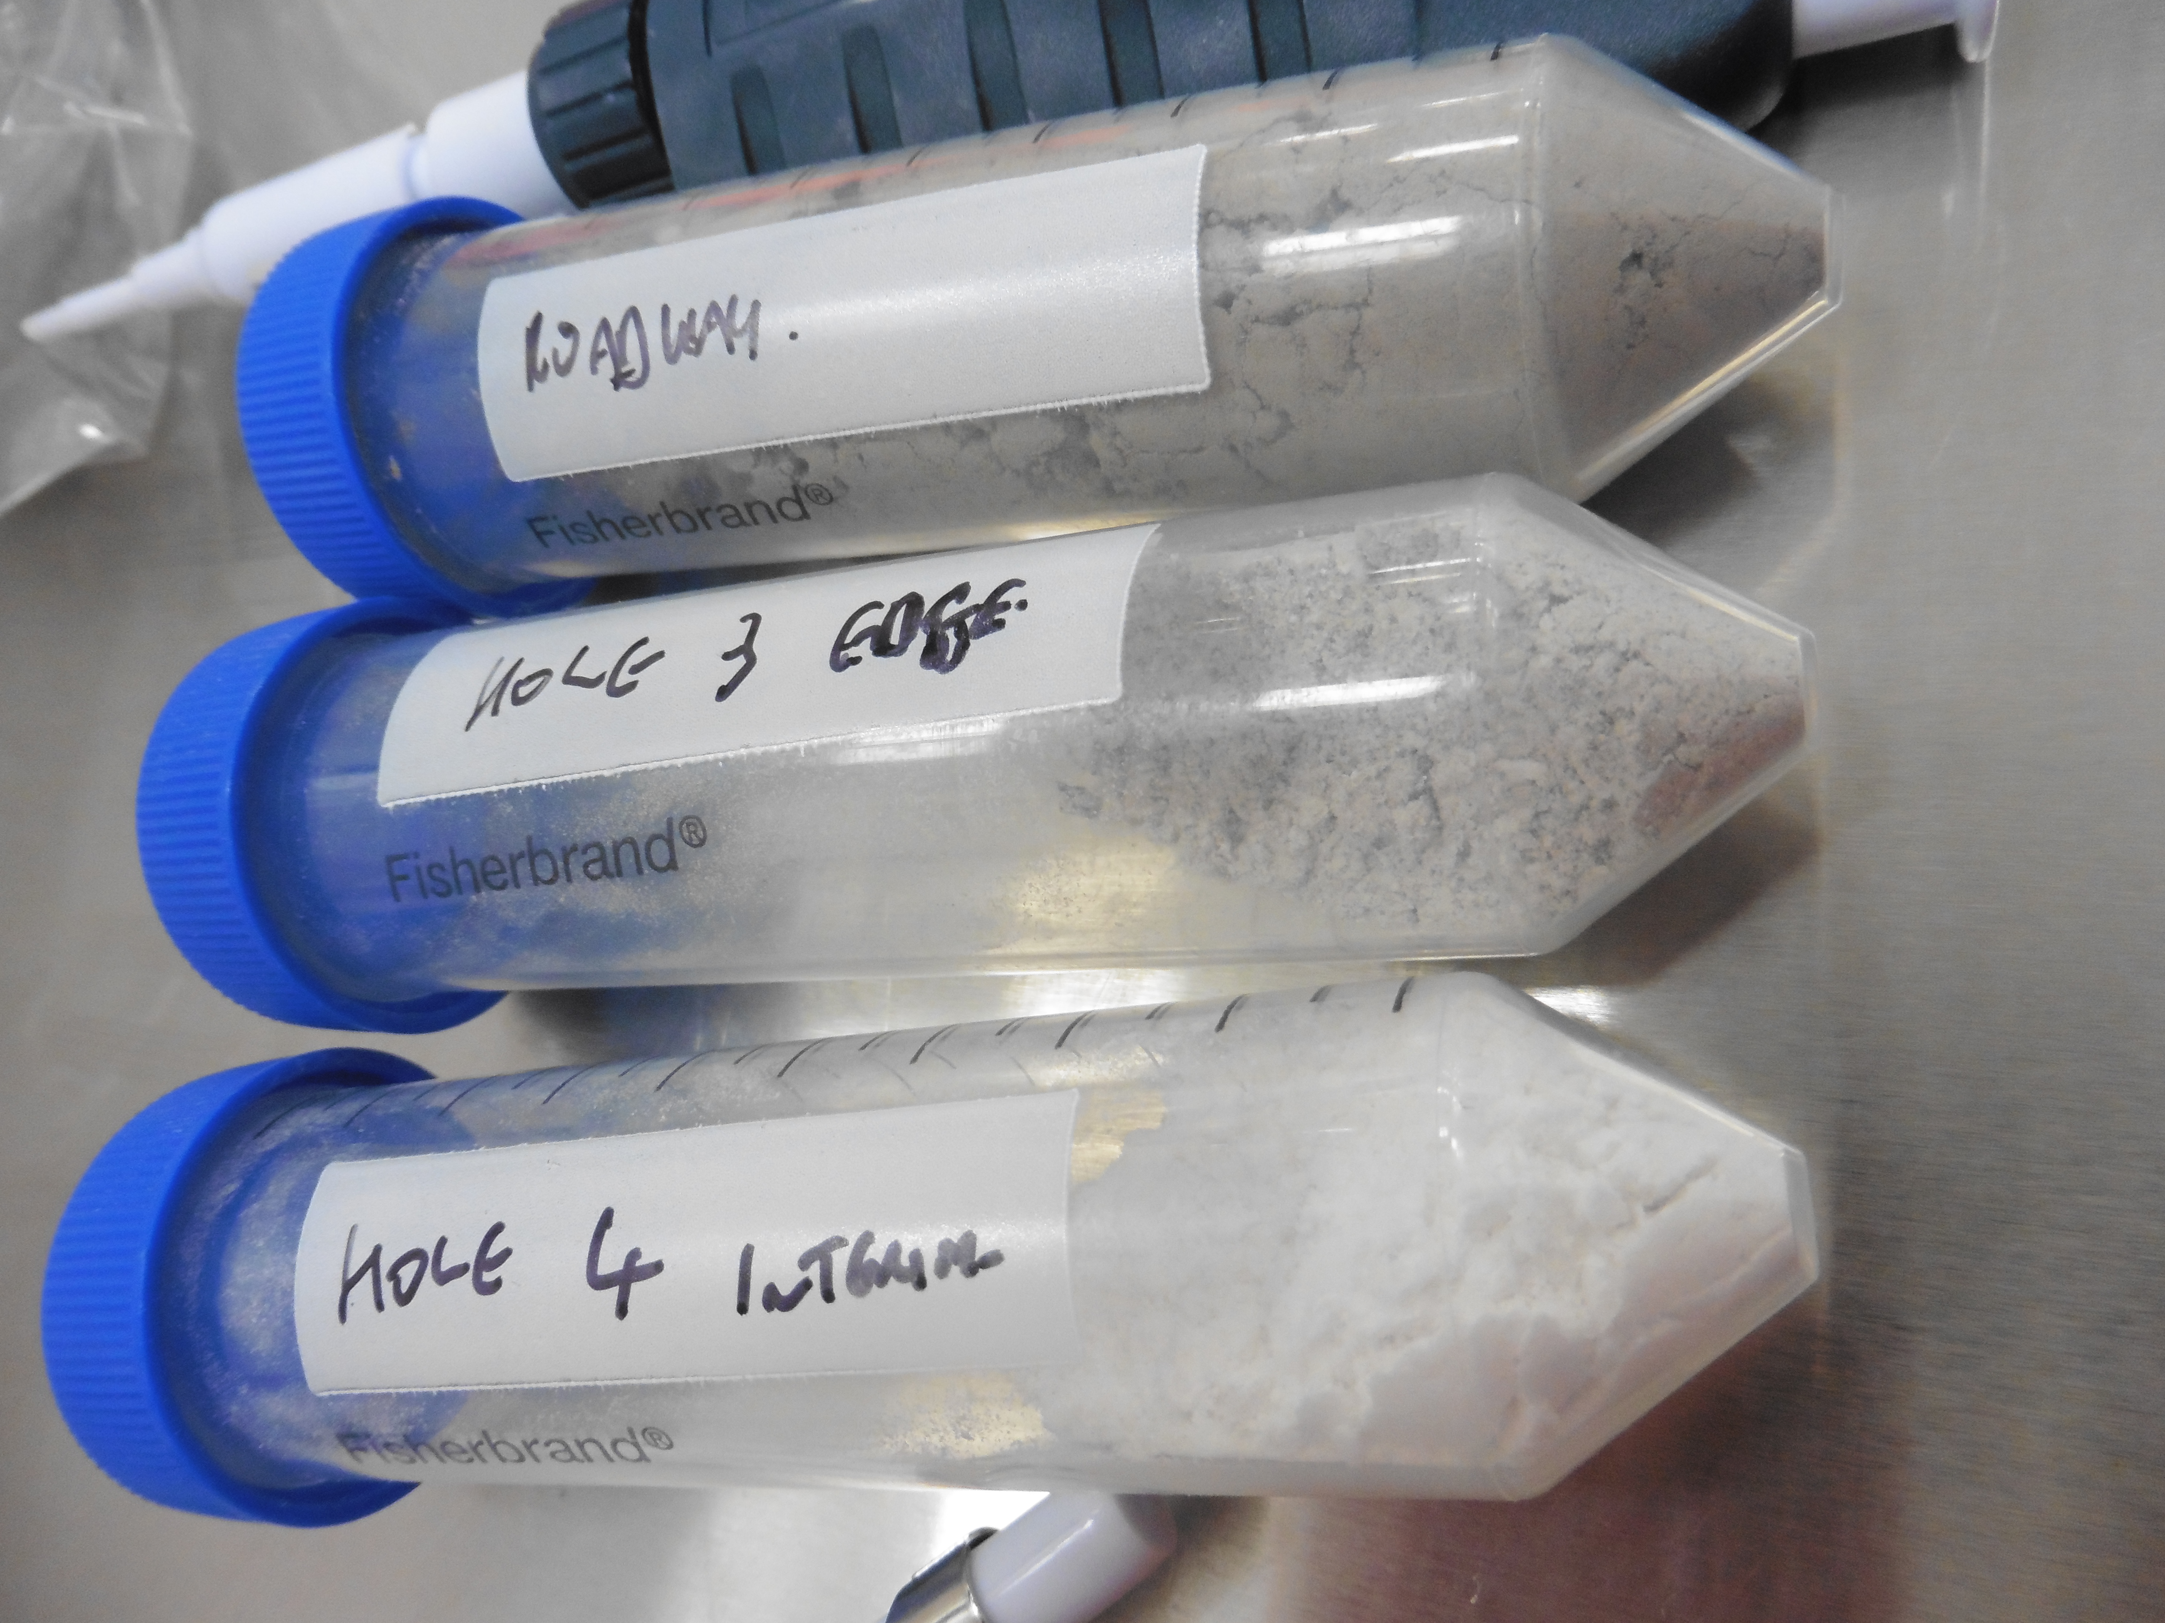

Underground Science at Boulby Mine
DRIFT: Directional Dark Matter Search
BUGS: Ultra-low background material screening
Deep Carbon: Muon Tomography for CCS (etc)
ERSaB: Environmental gamma spectroscopy
BISAL: Geomicrobiology / Astrobiology studies
MINAR: Space Exploration Tech. Development
SELLR: Life in Low background radiation
Misc. Geology / Geoscience
Misc. Low-background support projects
Etc... (More to come).
DRIFT
BUGS Lab
A growing multi-disciplinary science programme: from astro & particle physics to studies of geology, climate, the environment, life on Earth & beyond.

Slide 6

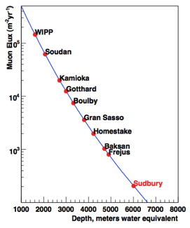
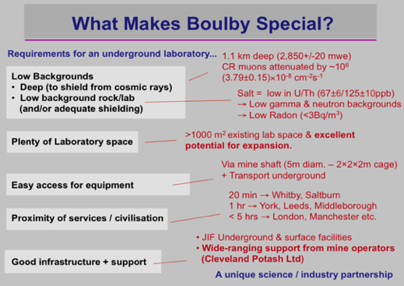
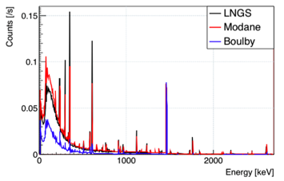
Boulby Underground Laboratory
4 (+3) onsite staff supporting 70 users from 20 UK & international universities and research institutes
Muons vs. depth
Low ambient gamma & radon levels (Rn <3 Bq/m³)
Good location. Ease of access. Close to services.
Operations well-supported by mine owners ICL
Interesting, diverse & impactful science programme
Low ambient gamma backgrounds

Slide 7

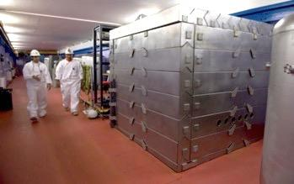
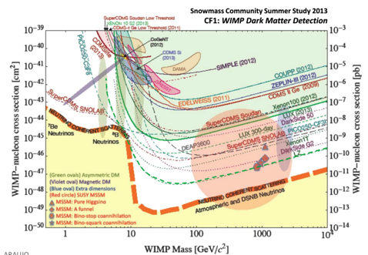
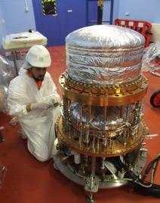
Boulby Dark Matter Studies
Boulby has hosted Dark Matter search studies for two decades. Including the NAIAD, DRIFT & ZEPLIN experiment programmes.
Boulby now hosts DRIFT Directional DM programme, CYGNUS Thick GEM R&D & provides ULB material screening for other studies, inc LUX-ZEPLIN
ZEPLIN-III @ Boulby
ZEPLIN: The world’s first
2-phase Xenon dark matter detector (Finished 2011)
DRIFT-IId
Current limits & future projections

Slide 8

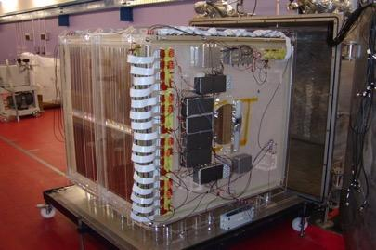
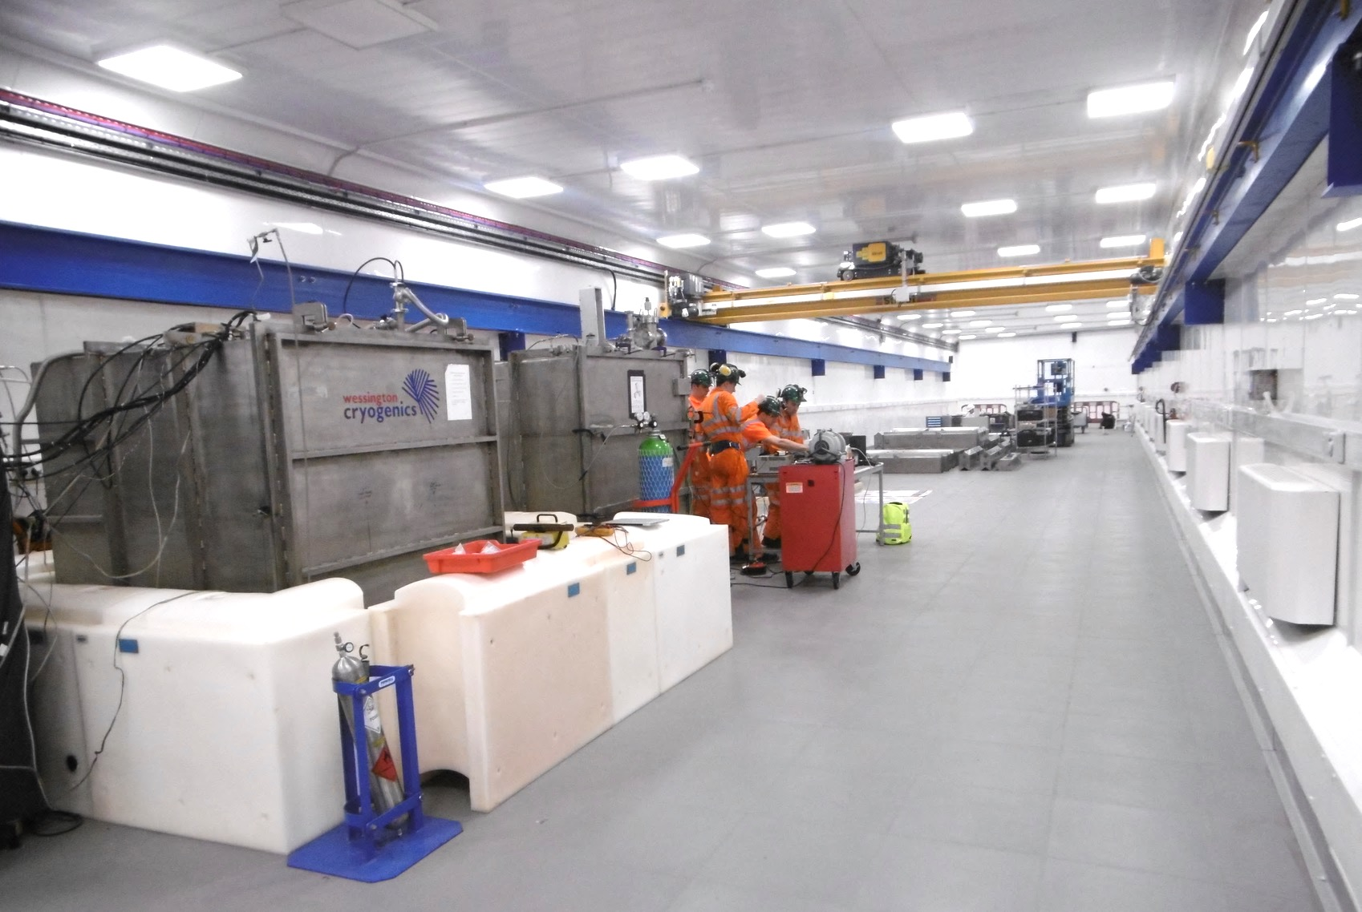
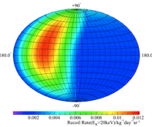
DRIFT-II at Boulby...
A DIRECTIONAL Dark Matter Detector.
Occidental College, New Mexico, Colorado State, Hawaii, Wellesley, Sheffield, Edinburgh, Boulby
STATUS: Programme operating at Boulby since 2001. Currently limit-setting and conducting system performance & scale-up R&D. Plans for further R&D & expansion / collaboration (CYGNUS).
DRIFT-IId @ Boulby
Dual (1m³ total) Negative Ion DRIFT TPC
Directional detection
Simulated data
New Lab December 2016
Directional DM detection – providing the most powerful direct detection signature

Slide 9

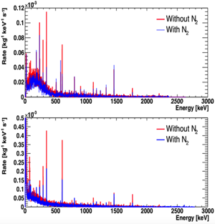
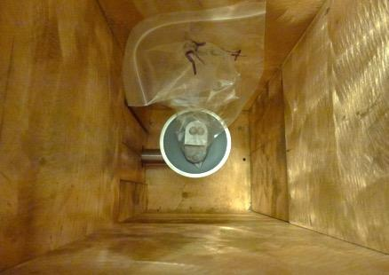
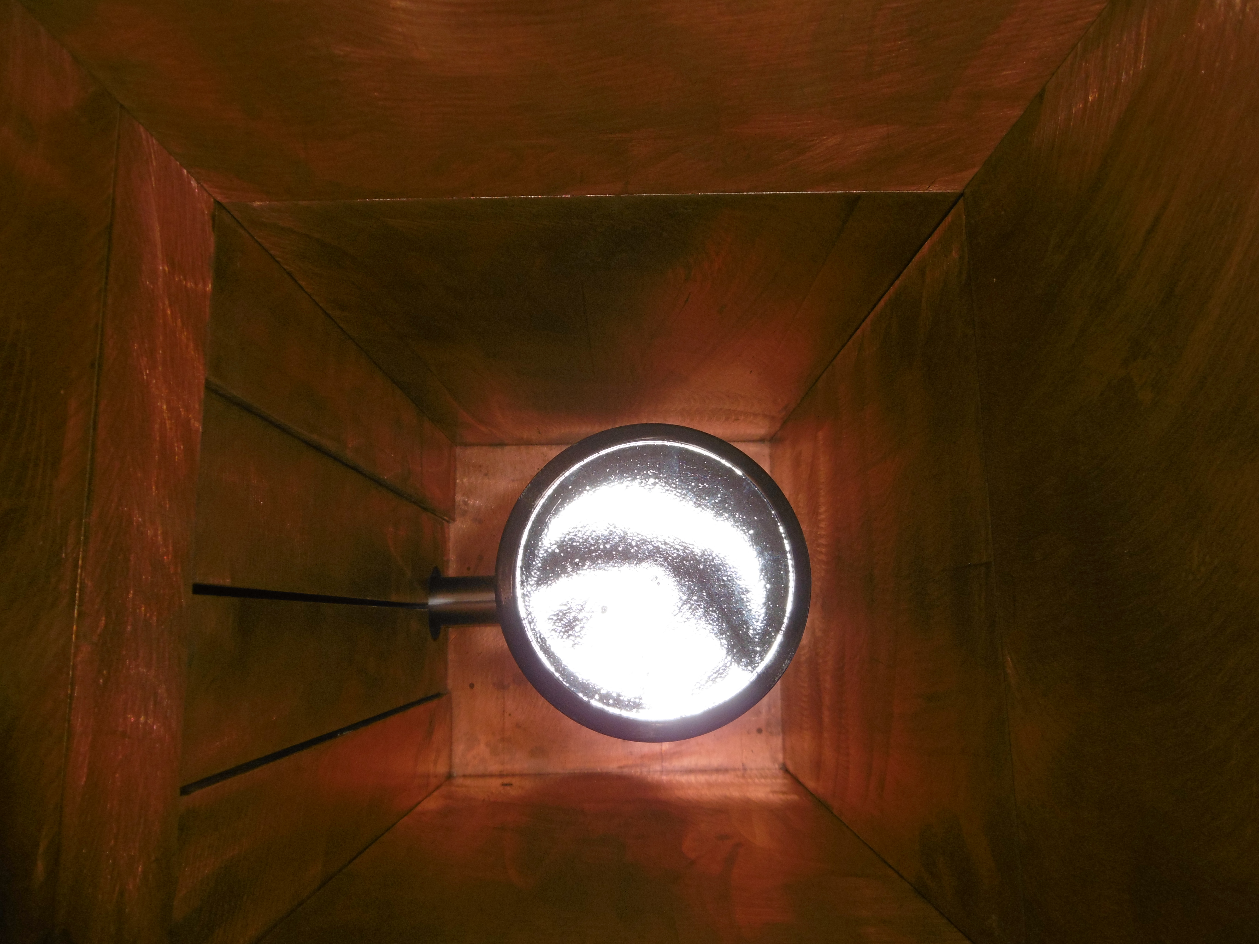
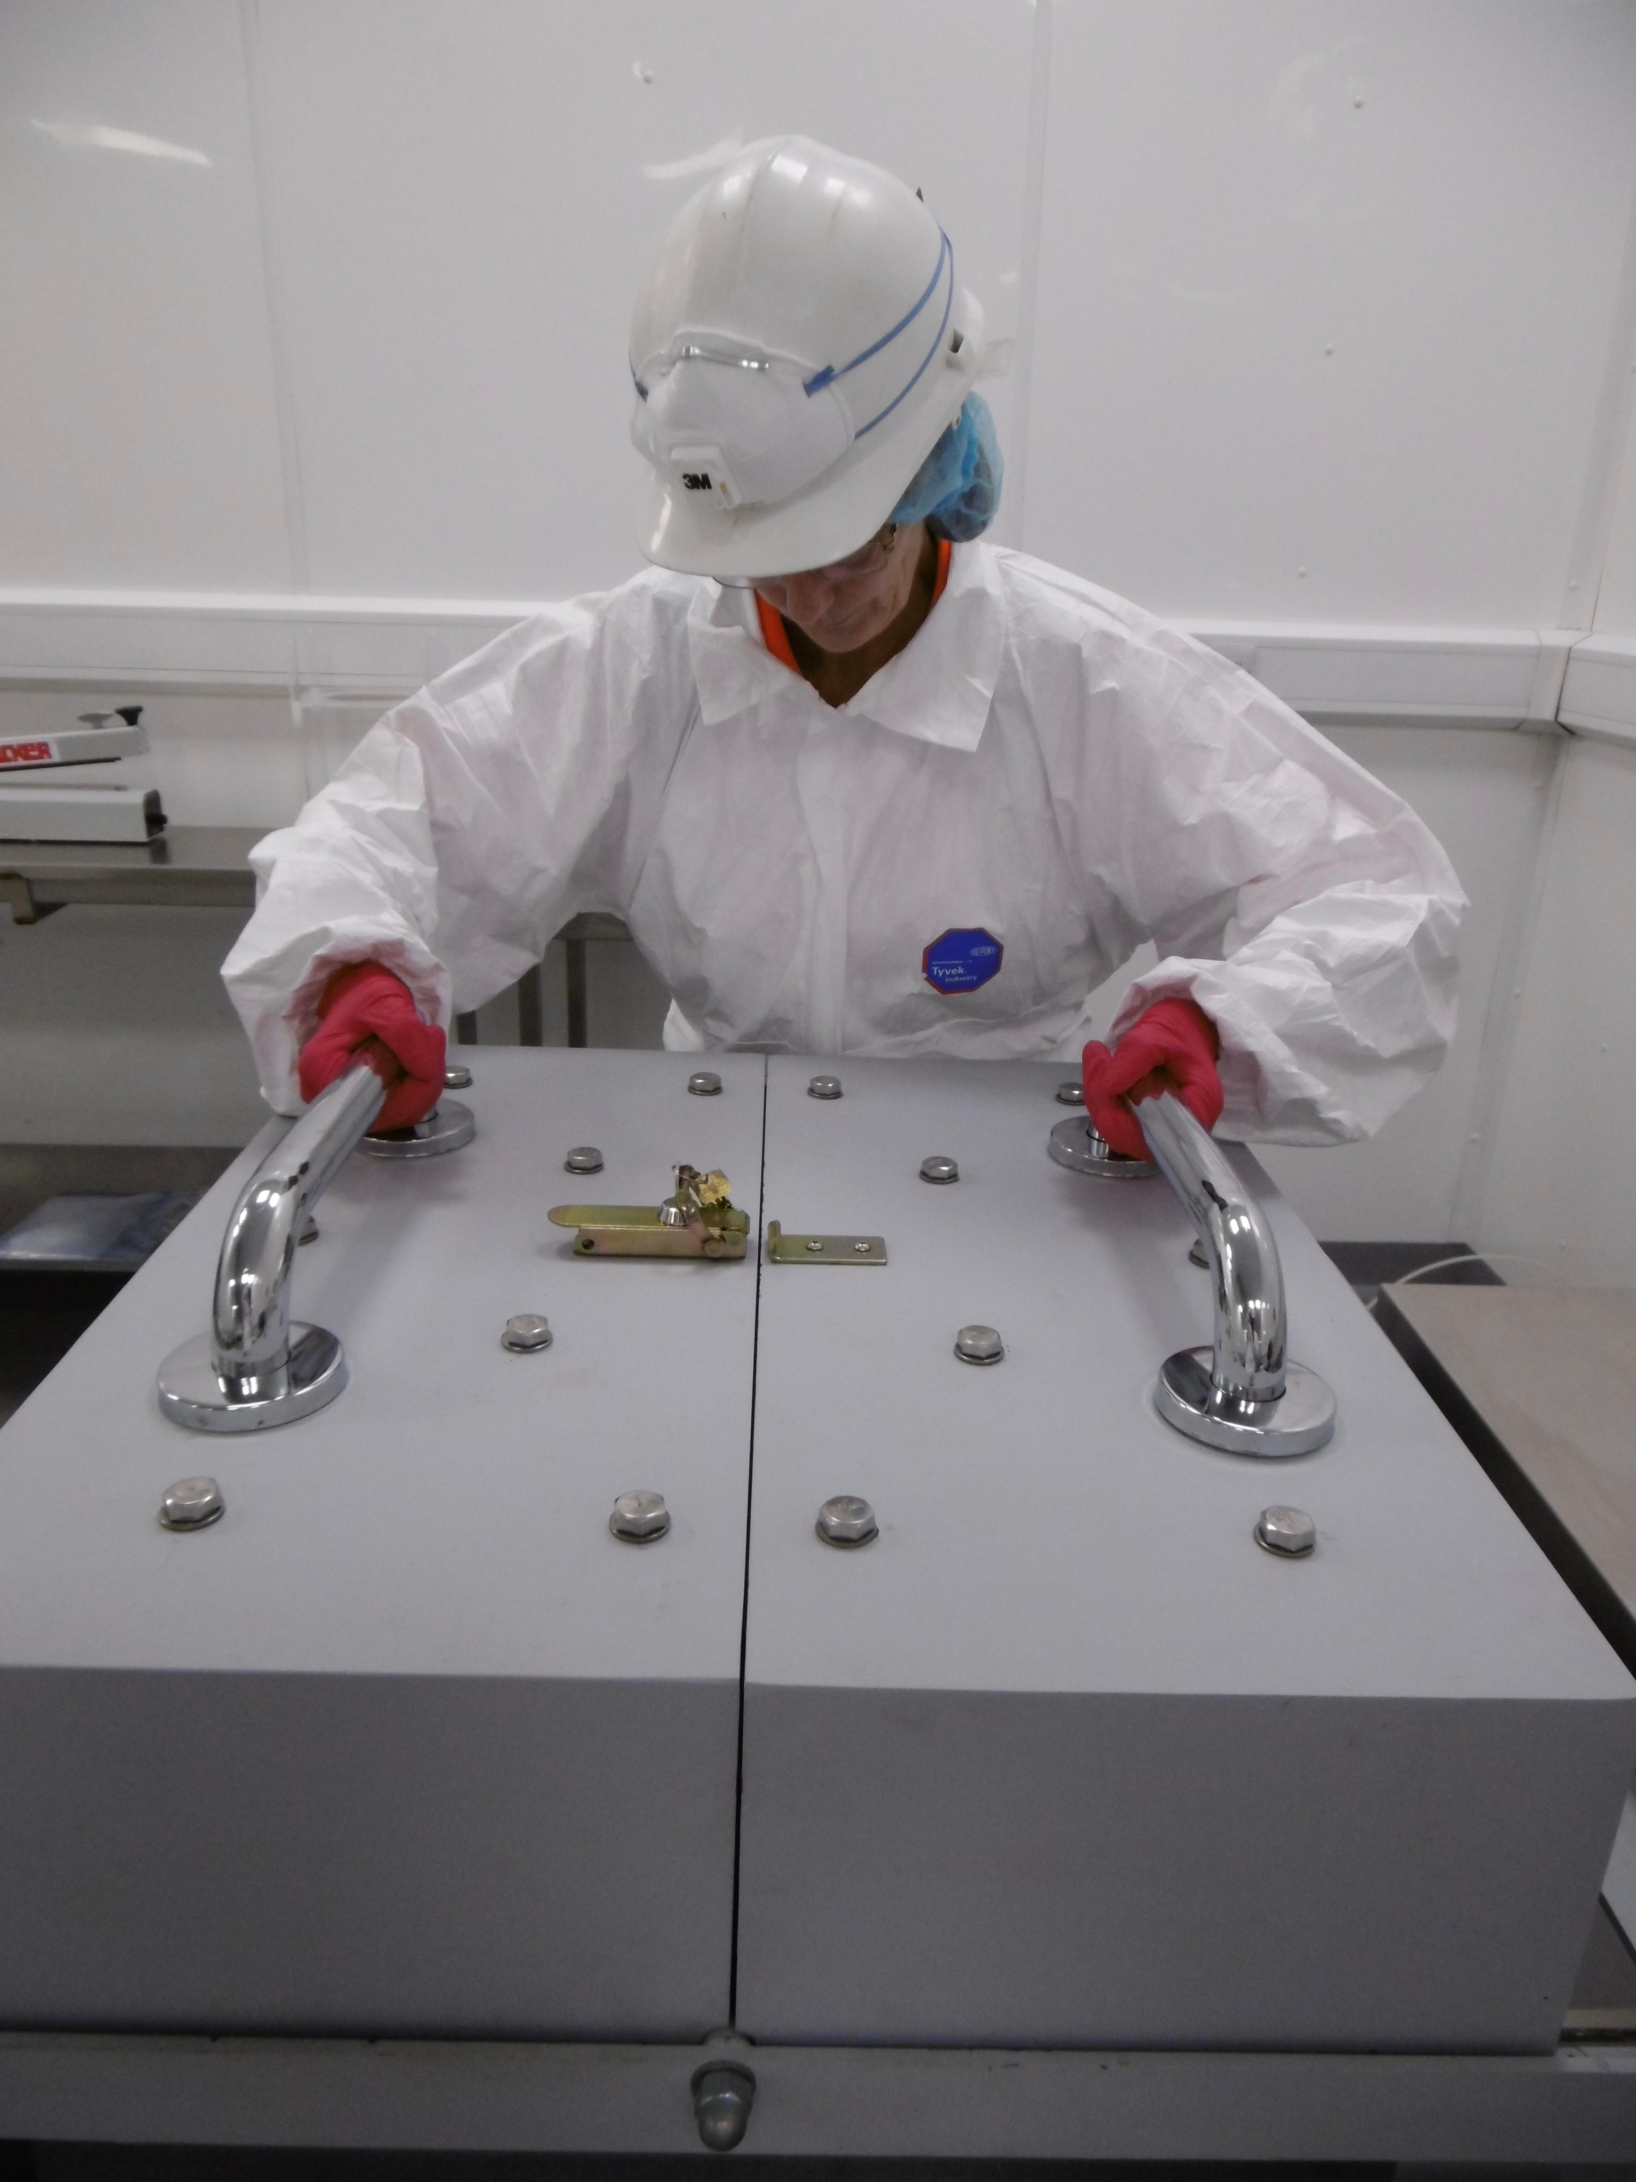
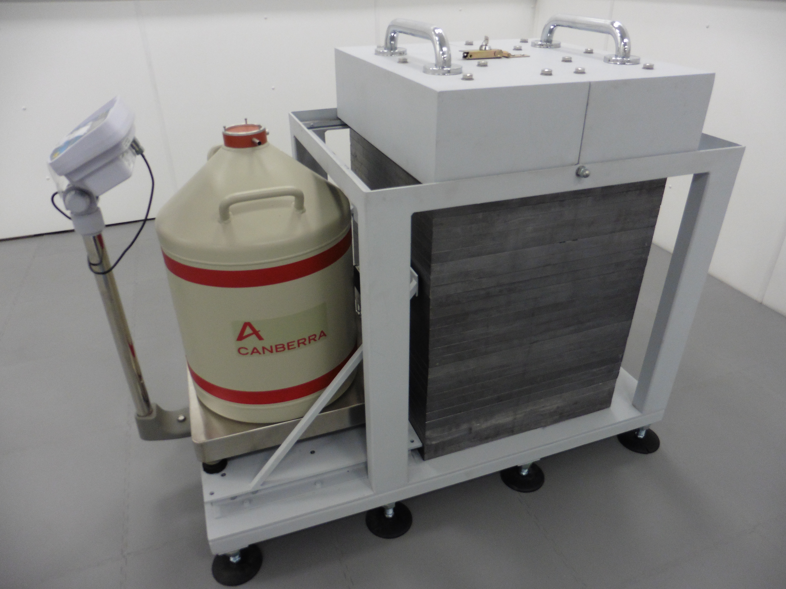
ULB Material Screening
Growing suite (‘BUGS’) of Ultra-Low-Background (ULB) germanium detector systems to support Dark Matter & misc ‘rare-event’ studies…
Ortec 2kg Coax.
3 Canberra BEGe detectors
Canberra SAGe Well-type
2 Canberra Coax (180% eff)
Ortec
Sensitivity down to <100ppt
U/Th per sample, & improving
Background Spectra
Activity testing steel samples
Canberra
ULB counting studies supporting UK DM (LZ) and neutrino study communities.
Now EXPANDING ULB
counting capabilities to meet
international demand.
In collaboration with UCL, Oxford, DMUK, Sheffield
LZ
LUX-ZEPLIN

Slide 10
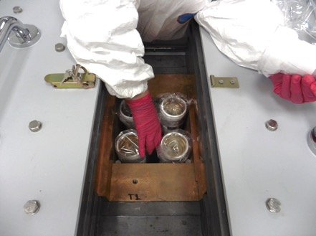
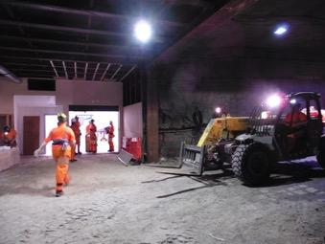
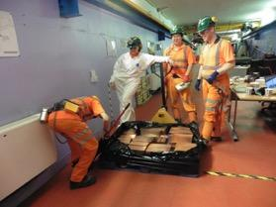
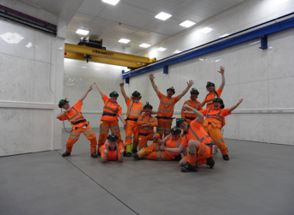
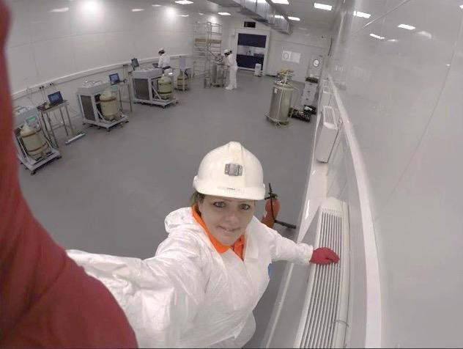
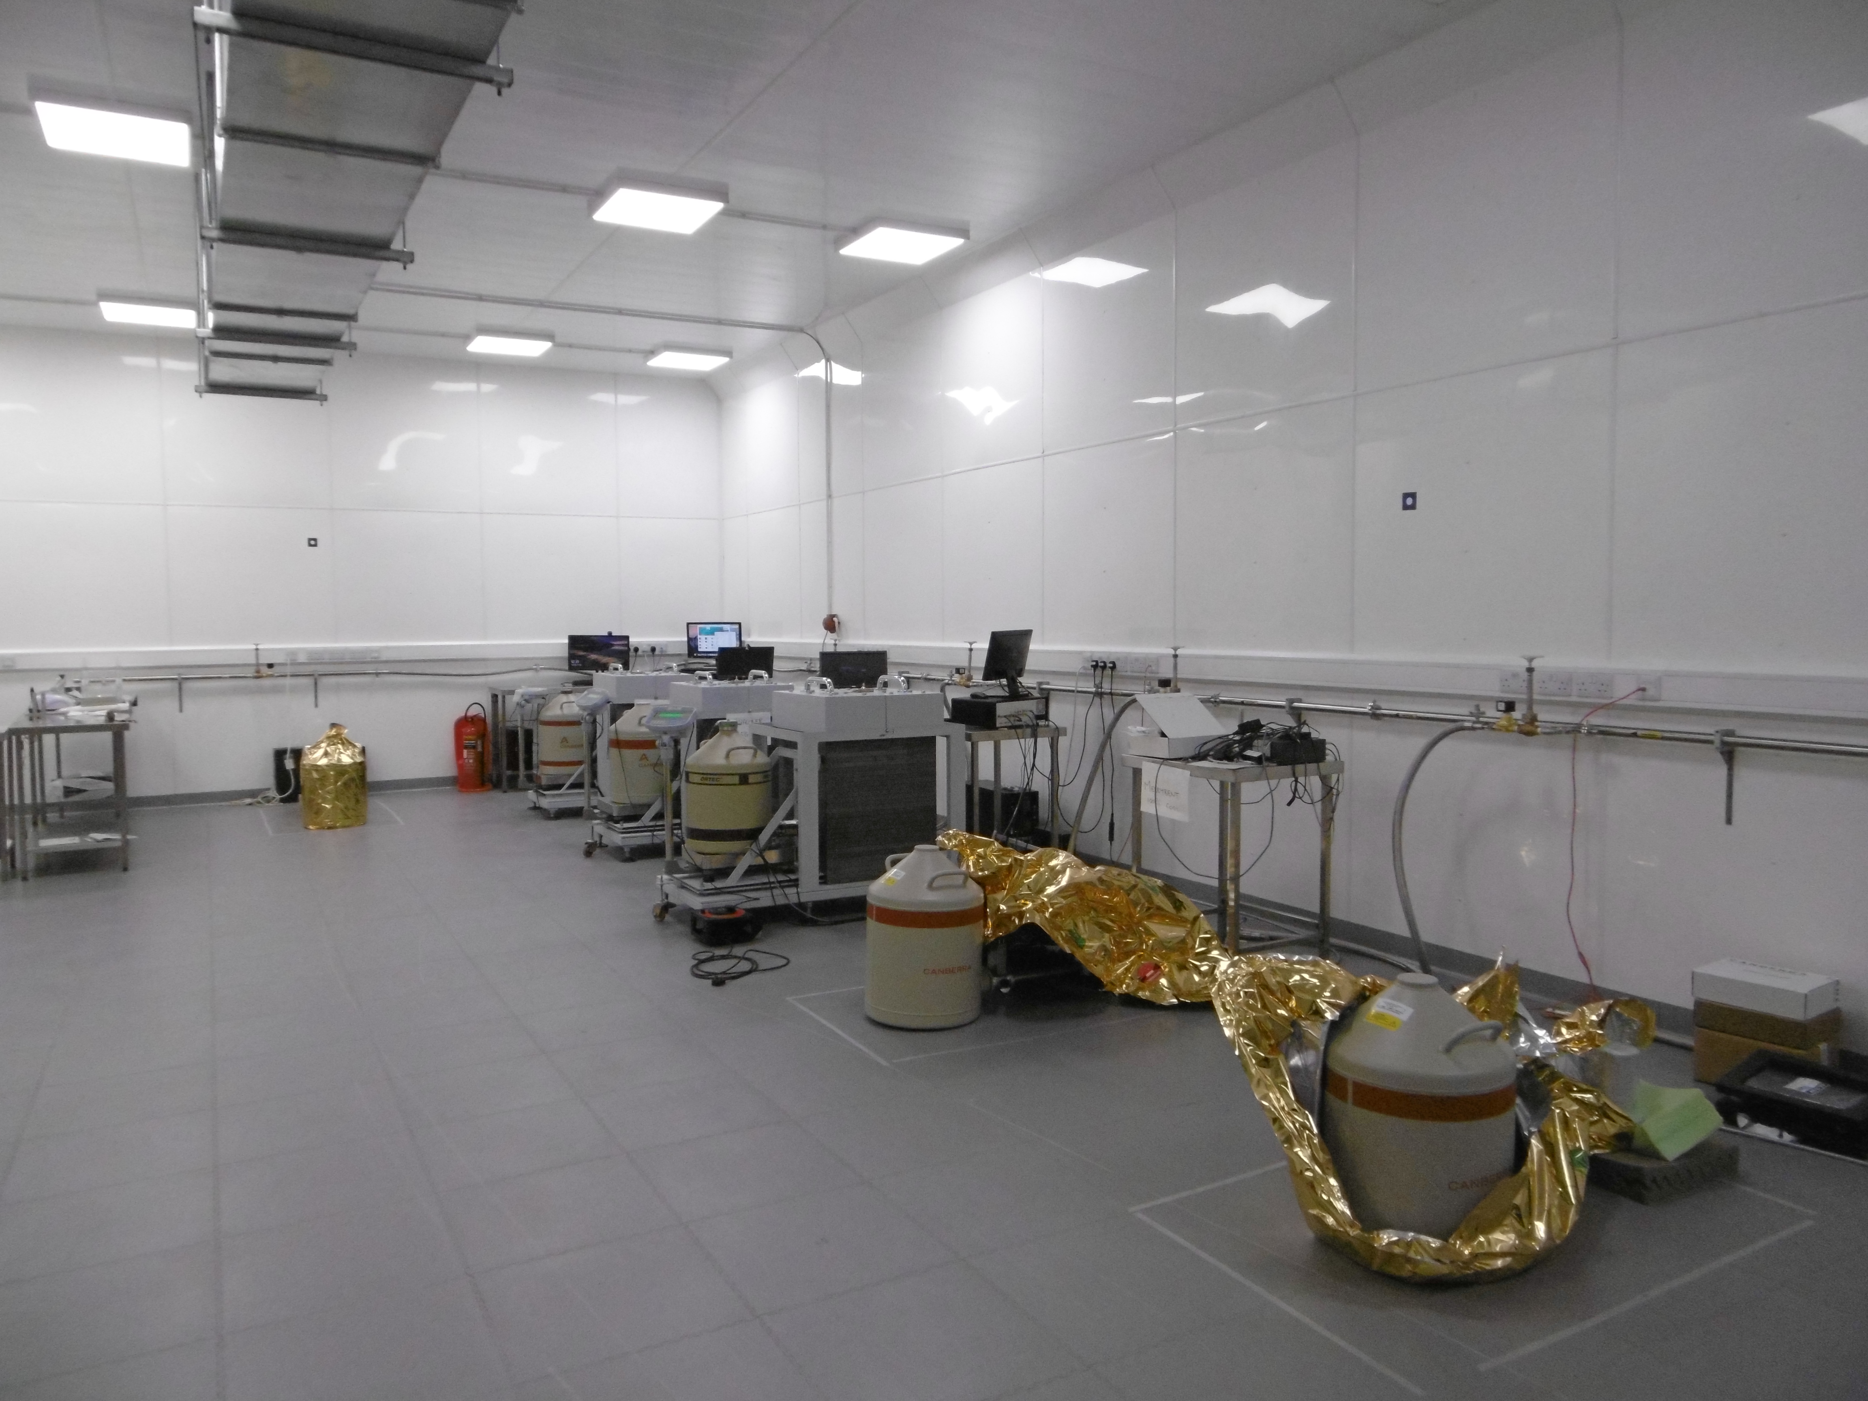
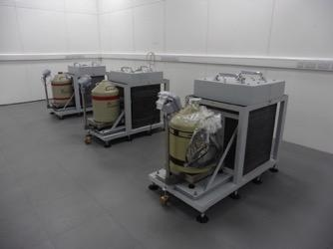
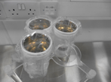
Occidental College, New Mexico, Colorado State, Hawaii, Wellesley, Sheffield, Edinburgh, Boulby
BUGS move to new lab complete… Detectors successfully installed and operating. LZ sample testing well underway…
Three additional world-class detectors now being installed (x10 sensitivity). Now better to support current & future ULB experiments (inc. Gd Super-K). Also nearer PPT sensitivity for G3 Dark Matter & Neutrino experiments.
LZ PMTs
S.M.Paling - Boulby@stfc.ac.uk

Slide 11

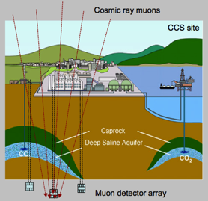
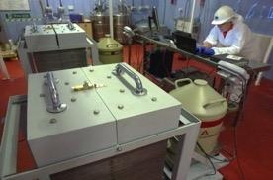
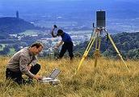
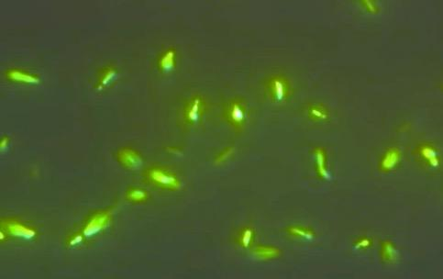
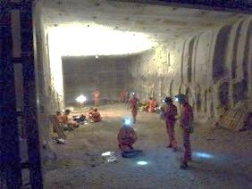

Boulby Multi-Disciplinary Studies
DEEP-Carbon: Muon Tomography for deep geological mapping applications including CCS
Boulby, Durham, Sheffield, Bath, Premier Oil, CPL.
ERSaB: Gamma spectroscopy & low background counting environmental radioactivity studies
From astrophysics to climate, geology, the environment, life on Earth & beyond...
Boulby, Scottish Universities Env. Research Ctr (SUERC)
Life in Boulby Salt…
MINAR: Space Technology
Development
Boulby, Edinburgh, NASA, DLR, CPL etc.
Plus Misc. Geology & Geoscience (& more to come)…
BISAL: Astrobiology / Geo-microbiology. Studies of life in salt, life on Earth & beyond

Slide 12

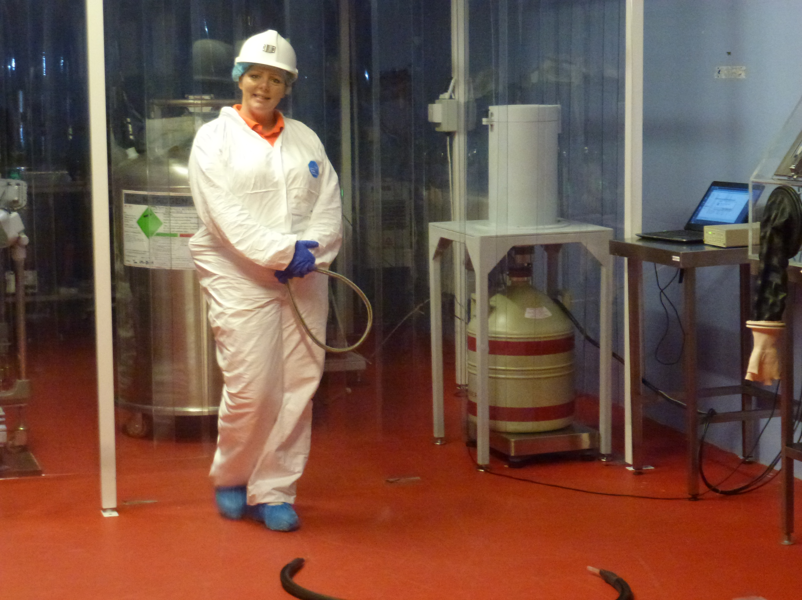
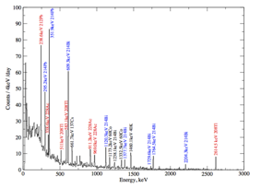
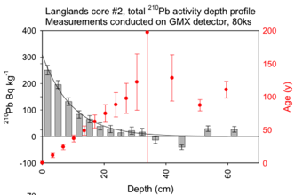
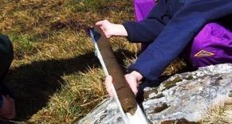


Low-BG Gamma Spectroscopy
Gamma spectroscopy and low-background counting for Environment studies & Beyond
The ultra-low background environment and Ge detectors at Boulby allow existing industrial, environmental and climate-related gamma spectroscopy studies to be extended and improved.
238U
232Th
Environmental applications:
Radioactive tracers for atmospheric
& ecosystem processes
Radio-dating: C-14, Pb-210, Si-32
Dosimetry in the environment
Marine radioactivity
Landscape evolution
Sedimentology…
Sample test output
Pb-210
Sedement dating
Pb-210 Radio-dating of the 50-250 year timescale is important for understanding RECENT affects of climate change.

Slide 13




Muon Tomography / Geo-survey
Development of a Muon Tomography techniques for deep 3D geological surveying - inc Carbon Capture @ Storage (CCS)
STFC-Boulby, Durham, Sheffield, Bath, NASA
Cosmic ray muons
Potential for cheap, reliable, practical, real-time long-term monitoring of deep structures. Potential applications:
Deep geological repository monitoring.
Monitoring in Carbon Capture & Storage (CCS)
CCS site
Muon detector array
Muon-tides detector development
Bore hole detector installation
Deep-Carbon Project: £1.4M funding from UK Dept of Energy & Climate change (DECC) & Premier Oil:
• Bore-hole detector development & testing @ Boulby
• Muon-Tides technology demonstrator
• Simulations of technique performance in CCS
Boulby site and skills uniquely well-suited for development and testing: appropriate depth and geology, ease of access, infrastructure & expertise

Slide 14








Astrobiology & Mars Analogue
Led by Edinburgh,
UKCA
Edinburgh, Boulby, NASA, DLR, CPL (etc)
A base for studies of life in Boulby rock – studies of limits of life on earth and on other planets
Sampling life in Boulby Brine
Subsurface Astrobiology Laboratory
Life in Boulby salt
ALSO: An important ‘Mars Analogue site’ – with geology & conditions to allow explorations & astrobiology technique & instrumentation development
Mining &
extraplanetary exploration instrumentation development
MINAR 2
sean.paling@stfc.ac.uk

Slide 15







A NEW LABORATORY now built at Boulby
To replace current facility and host planned & new projects for the next decade and more…
New Laboratory construction plan
Mars Analogue Area & outside testing area
Materials Entrance 1
Materials Entrance 2
Main hall: Internal Lab height/width of 4m/7m
Offices & People Entrance
MaterialStore
Large Expt. Cave Area: Internal lab height/width of 6.5m/7m
BUGS ULB Counting facility
Fully-equipped 4000m³ lab. Class 10K & 1K clean room throughout. 5-10T lifting capacity.
50m

Slide 16






‘BUGS’ ULB Germanium
Facility
Boulby New Lab Construction October 2016
Main Experimental Hall (7x4x60m)
> 4000m³ of well supported class 1,000 and class 10,000 clean room experimental space
Completion
Jan/Feb 2016
Large Experimental Cavern (LEC)
(7x7x35m)
AC, HEPA filtration, internet / comms, 5 & 10 T lifting capacity.

Slide 17




July 2017: Finishing touches to the lab and getting on with the science…

Slide 18



Old lab collapsed to create ‘outside experimentation area’
Boulby New Lab: Outside Experimentation Area
Final part of construction…
Open salt roadway experimental area supported and equipped for ‘out-of-lab’ projects

Slide 19

A change to work with an amazing team!

Slide 20









Slide 21
Thank you!

