Slide 1
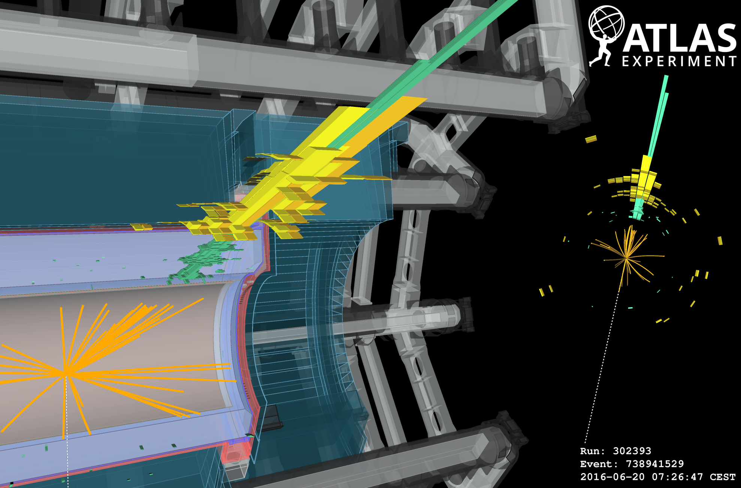



Dark Matter at the LHC
DMUK 2017
Alan Barr
July 2017
Notes:
We would appreciate if you could present a plenary talk (25+5 min) based on recent scientific achievements of ATLAS.
In particular we plan to cover the following issues:
1. SM Higgs boson
2. Extensions of the minimal scalar sector of the Standard Model(SM),
e.g. multi-Higgs Models
3. Composite Higgs bosons
4. Effective field theory approach to Higgs physics
5. Fundamental scalars within supersymmetric extensions of the SM 6. New scalars implied by extensions of the SM gauge group,
e.g. SU(2)_L x SU(2)_R x U(1)
7. Scalars within models of neutrino masses
8. Elementary scalars within extra dimensions: gauge-Higgs
unification, stabilization of extra dimensions, radions, bulk
scalars, etc...
9. Role of scalars within cosmology, e.g. dark matter, baryogenesis,
inflatons, axions, quintesence
10. Higgs bosons on lattice
11. Experimental search for scalars:
LHC
Tevatron
low energy colliders
future colliders
A jet with pT of 1707 GeV is indicated by the green and yellow bars corresponding to the energy deposition in the electromagnetic and hadronic calorimeters respectively. The E_{T}^{miss} of 1735 GeV is shown as the white dashed line in the opposite side of the detector.

Slide 2

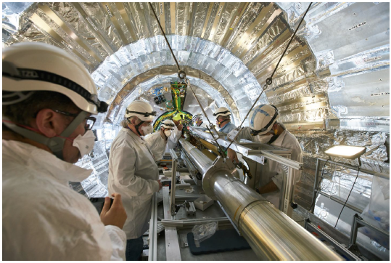
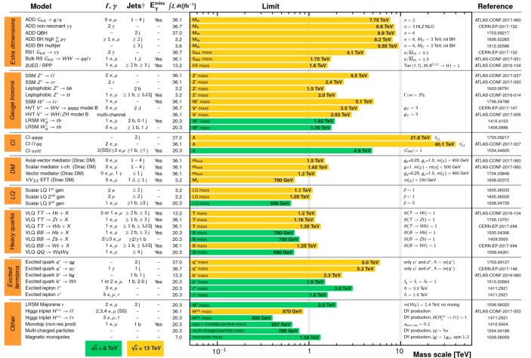
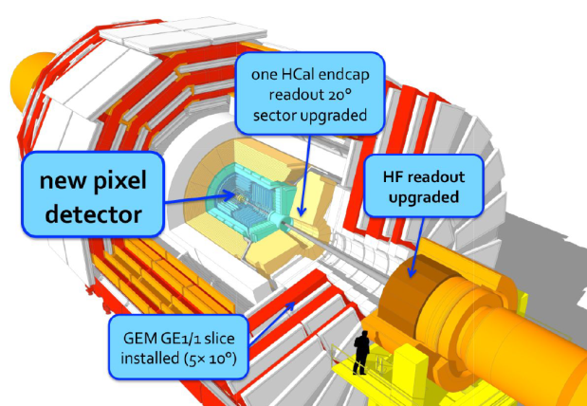
I’M NOT going to talk abouT…

Slide 3
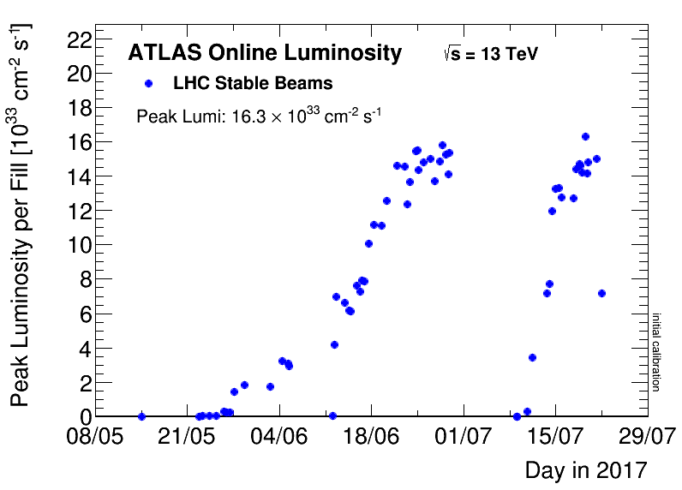
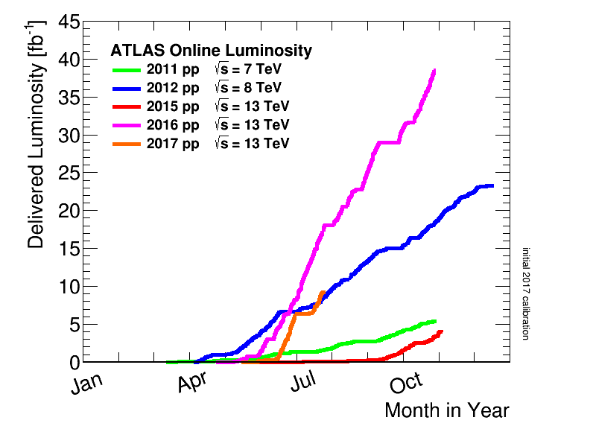
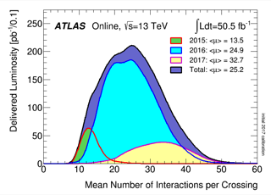
Impressive performance of the LHC
Record
Run 1
Design
Run 2
Luminosity well beyond design
Design
2017

Slide 4
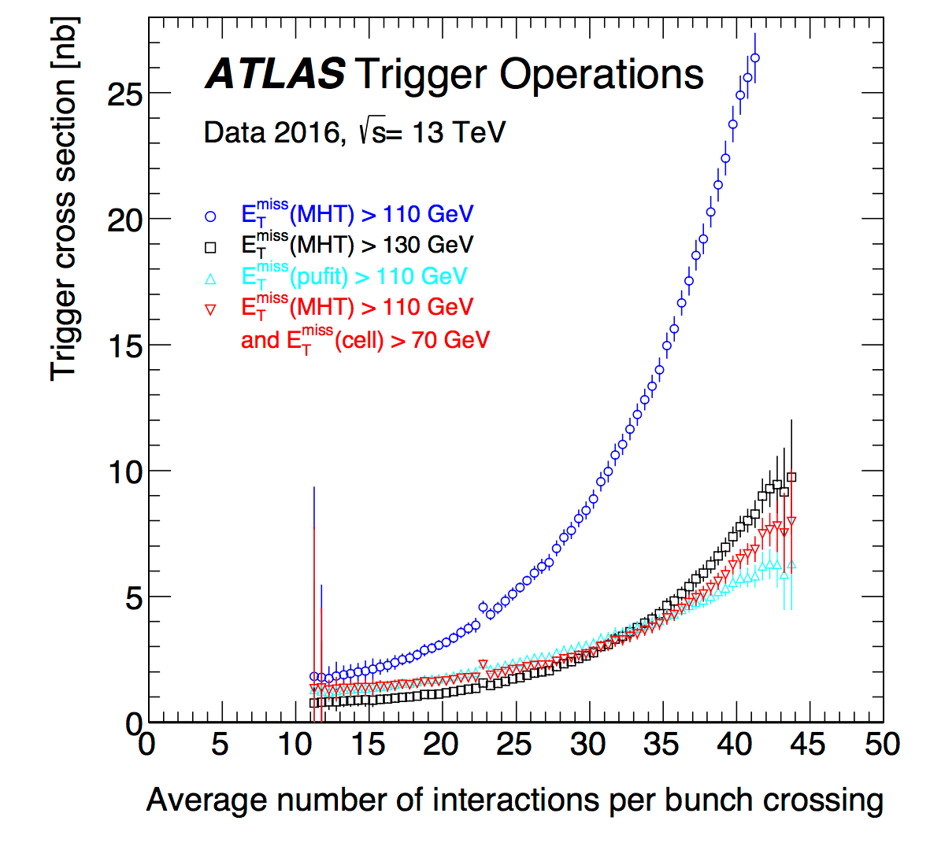
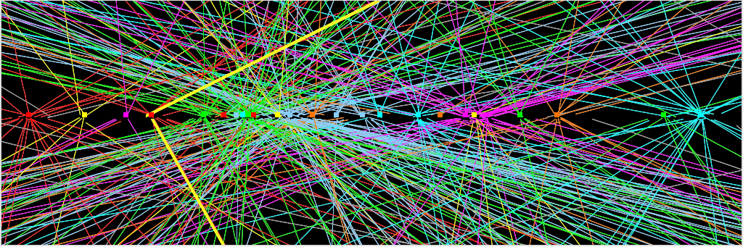
Pileup & how to deal with it
Continuous effort required in
operations, trigger,
reconstruction, computing,…

Slide 5
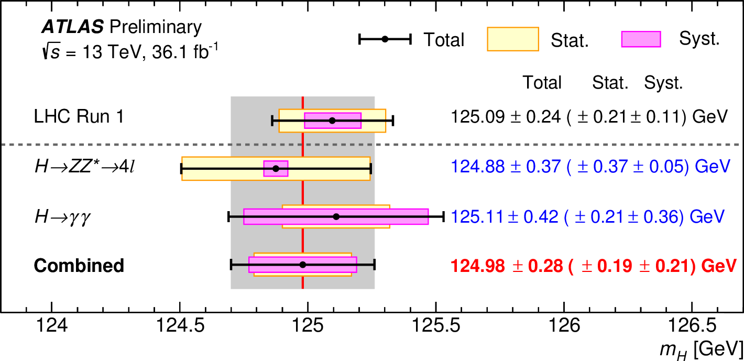
2-per-mille-level Higgs mass
arXiv:1503.07589
Combined ATLAS + CMS result from Run-1
The two experiments are now individually at the 0.2 GeV
level of precision – combination to follow
Notes:
20,000 Higgs bosons per day

Slide 6
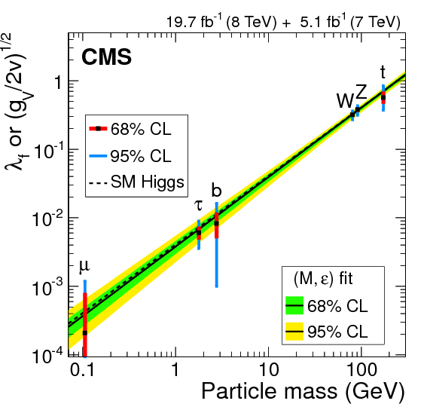
Higgs couplings campaign

Slide 7
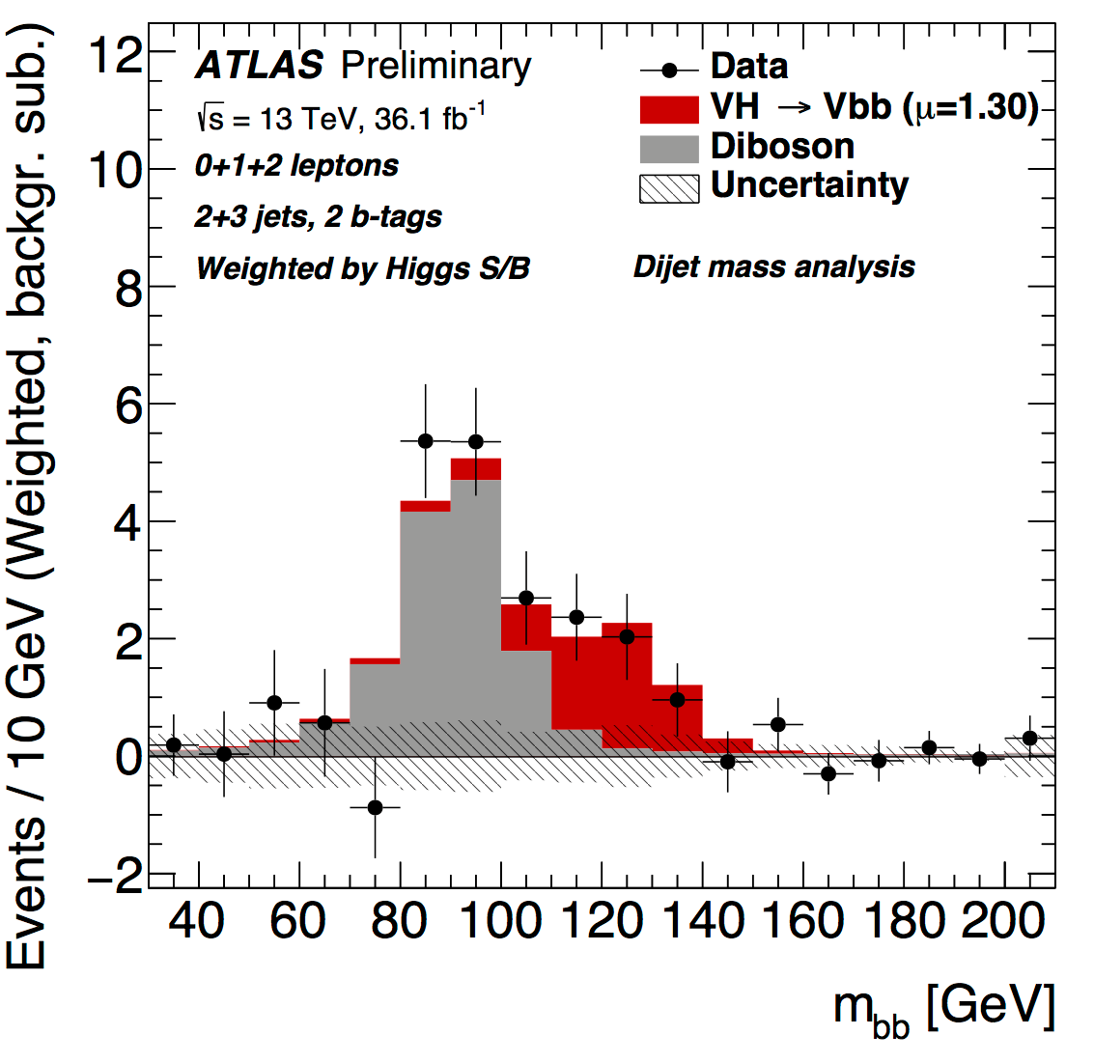

Higgs coupling to b-quarks
ATLAS-CONF-2017-041
ATLAS Run-1 + Run-2
gives 3.6σ observed
(4.0σ expected)

Slide 8
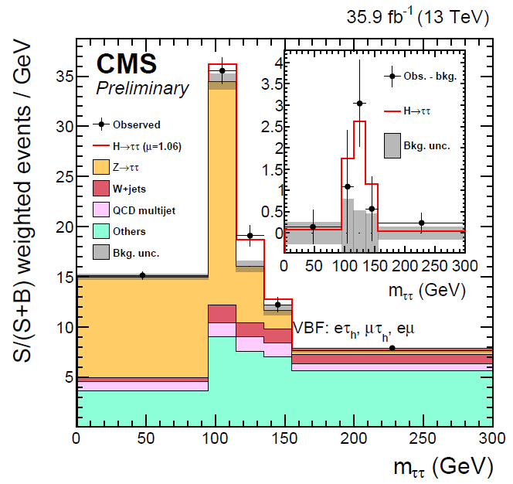
Higgs couplings to taus
CMS-PAS-HIG-16-043
J Alcaraz EPS 2017
Run-2 CMS: 4.9σ significance (exp.=obs.)
Combination with Run 1 gives 5.9σ (CMS only)

Slide 9
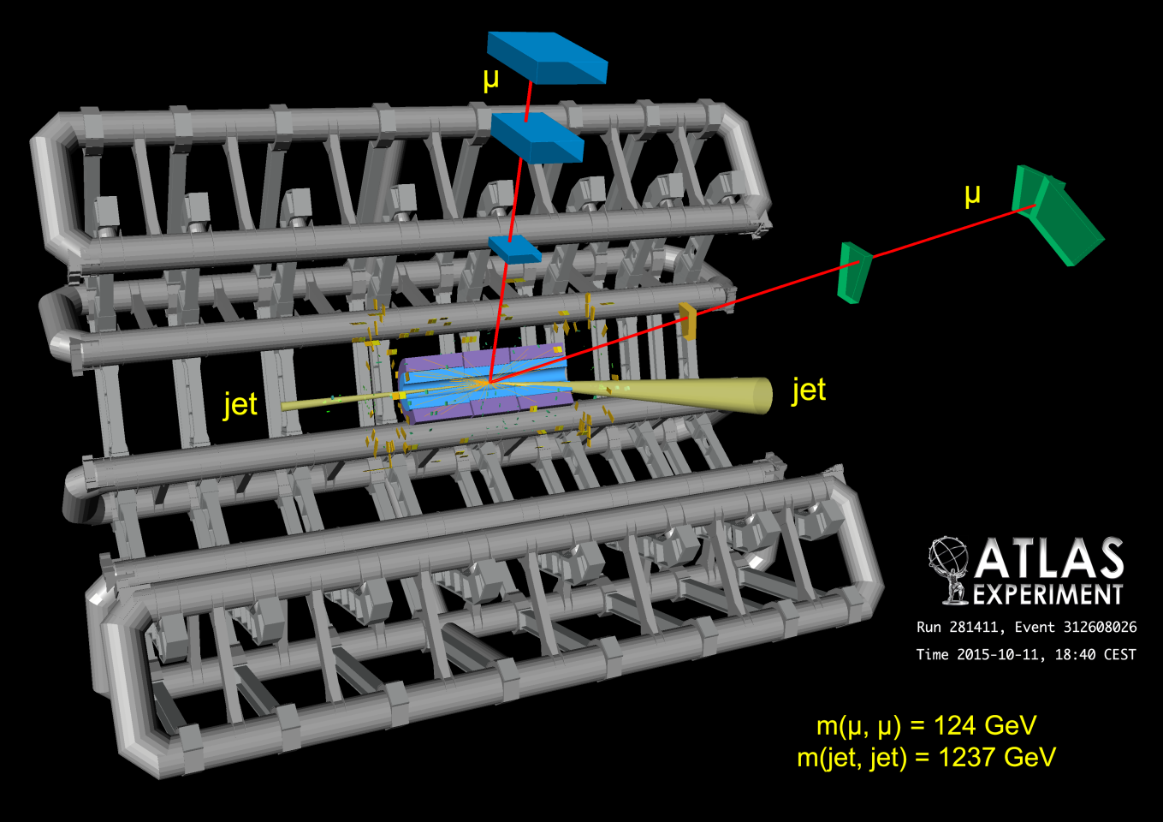
Higgs coupling to muons
arXiv:1705.04582
Upper limit at 3x SM
σ_{obs} < 3.0 x σ_{SM} (95% CL)
Notes:
Event display from “Search for the dimuon decay of the Higgs boson in
pp collisions at √s = 13 TeV with the ATLAS detector”

Slide 10
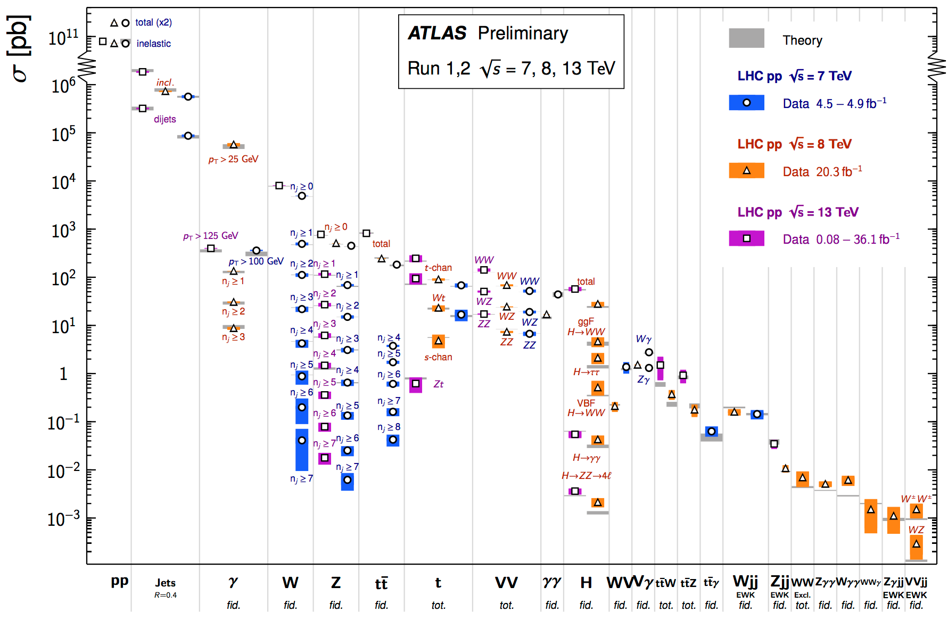
Hundreds of precision measurements made of SM processes

Slide 11
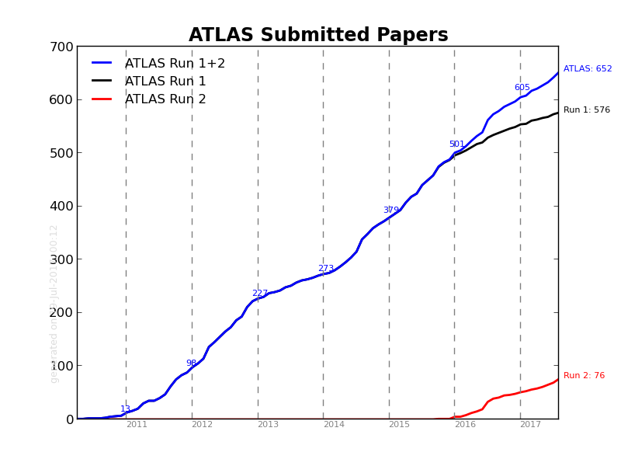
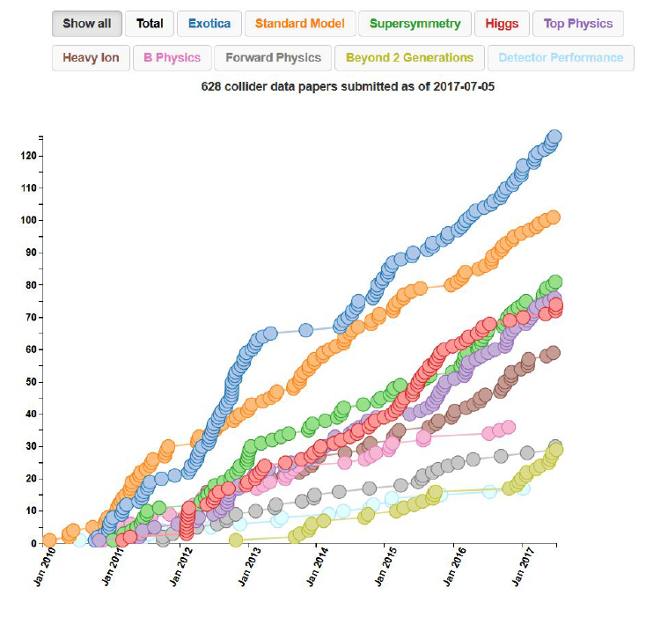
>600 papers for
each collaboration

Slide 12
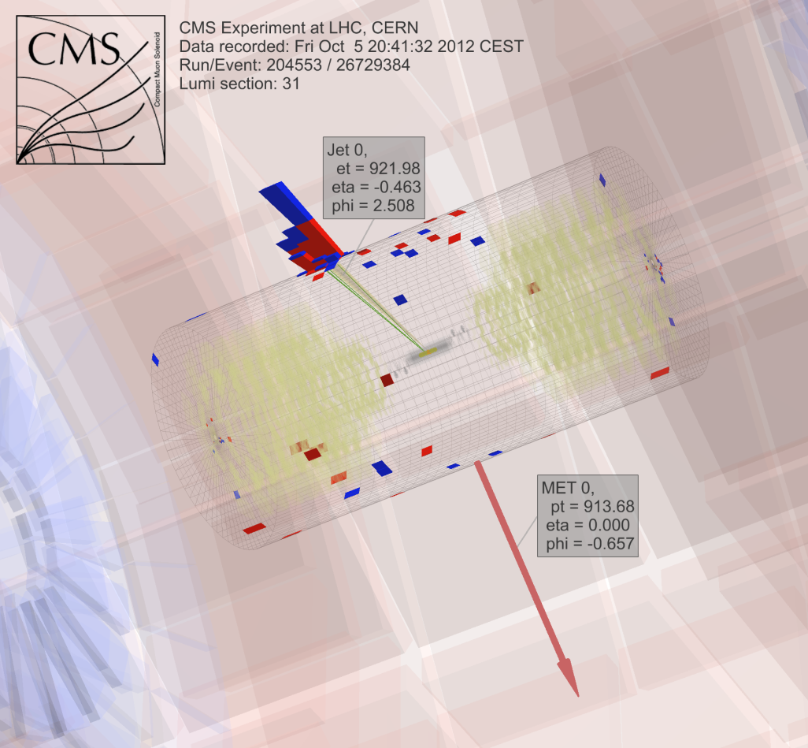
Dark Matter searches @ LHC

Slide 13
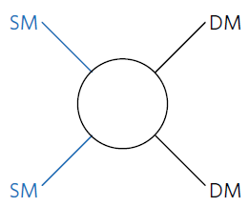
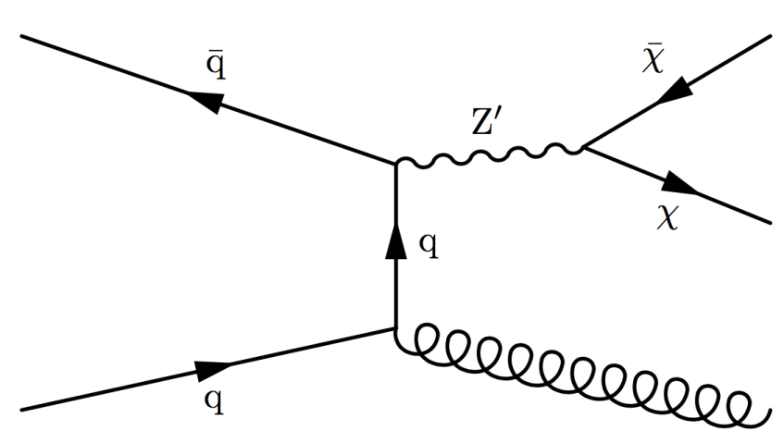
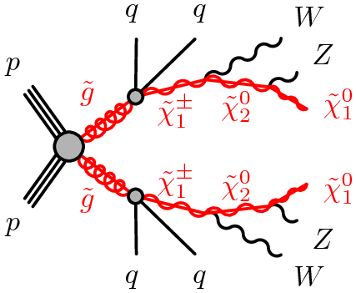
Dark Matter production mechanisms
Direct production
Cascade decays

Slide 14
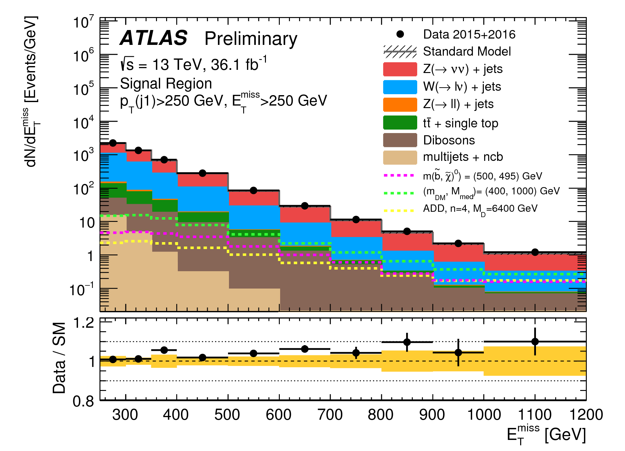
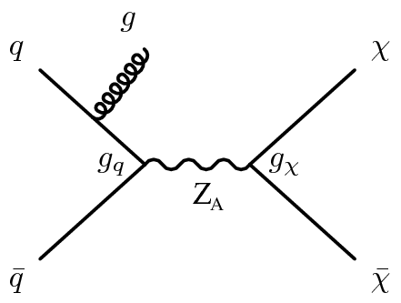
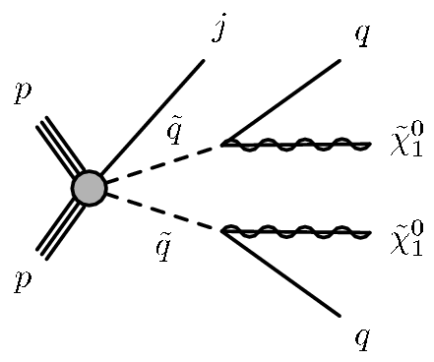
Direct production
ATLAS-CONF-2017-060
Data-driven background determinations
for W, Z, ttbar, multijet backgrounds
Notes:
Events are selected with EmissT > 250 GeV, where a leading (highest-pT) jet with pT > 250 GeV and |eta| < 2.4 is required. A maximum of four jets with pT > 30 GeV and |eta| < 2.8 are allowed. Separation in the azimuthal plane of (jet; pmissT ) > 0.4 between the missing transverse momentum direction and each selected jet is required (to reduce the multijet background contribution where a large EmissT can originate
from jet energy mismeasurement).
p-values for a background-only hypothesis are in the range 0.01–0.04, corresponding to a compatibility with the SM predictions within approximately 1.7 to 2.1

Slide 15
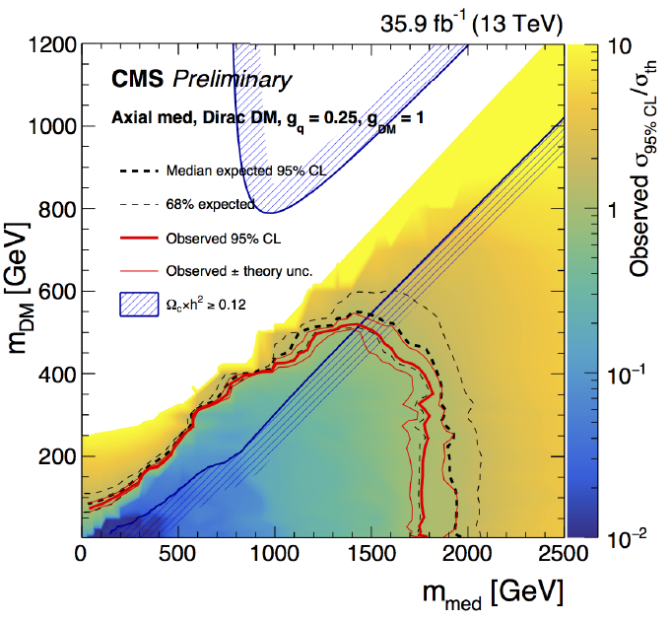
Interpretation – mass space
CMS PAS EXO-16-048
WIMP mass
Dirac fermion
0.25
1.0
Axial-vector
Excluded
Mediator mass

Slide 16
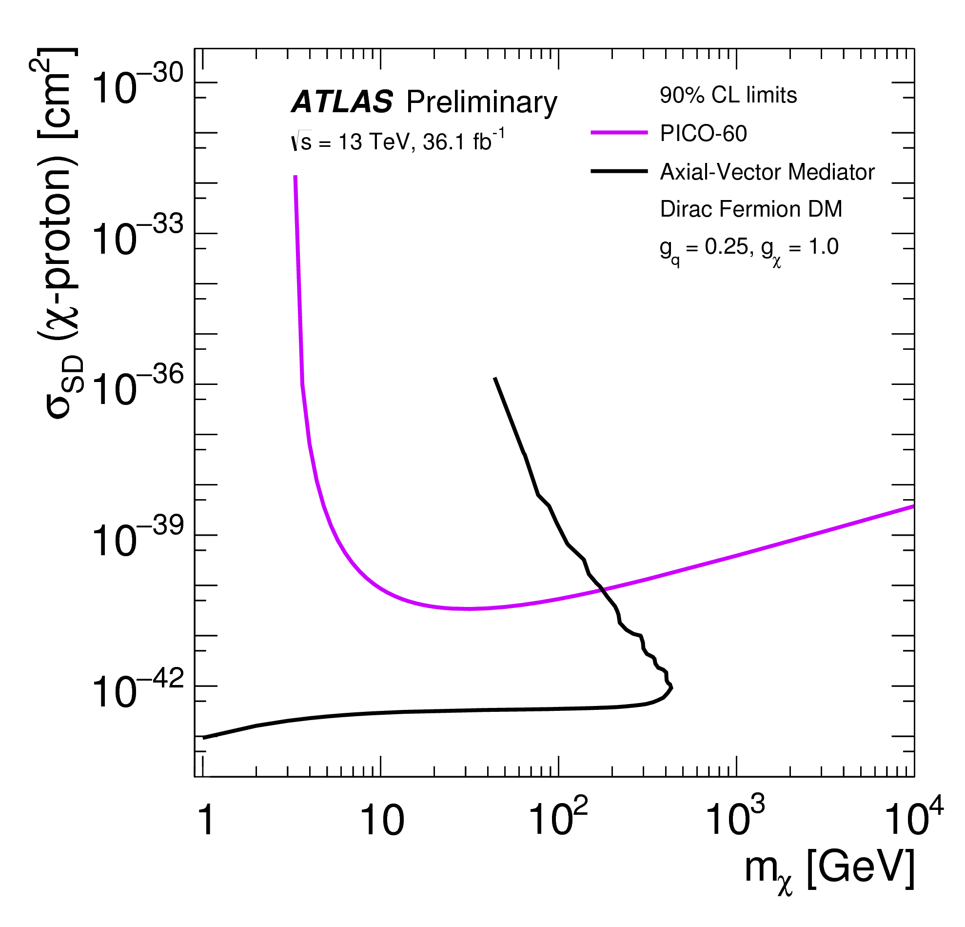
Interpretation – SD direct detection
ATLAS-CONF-2017-060
Dirac fermion
PICO60 @SNOLAB
52 kg C₃F₈
1167 kg.day
arXiv:1702.07666
0.25
1.0
Axial-vector
ATLAS exclusion
Notes:
This comparison is model-dependent and solely valid in the context of this particular Z’-like
model.
PICO-60 is a a bubble chamber filled with 52 kg of C3F8 located in the SNOLAB underground laboratory. Result quoted is 1167-kg-day exposure at a 3.3-keV thermodynamic threshold

Slide 17
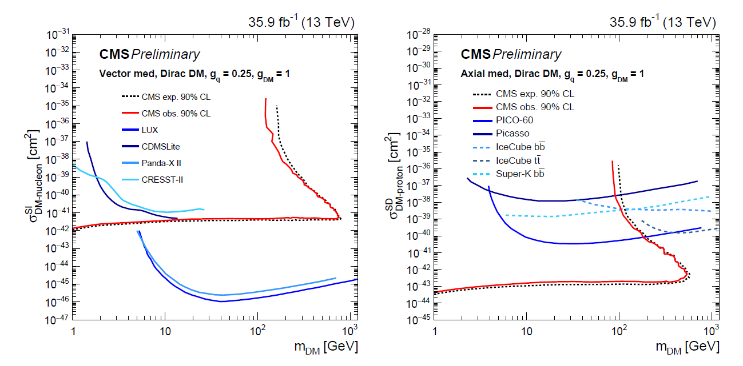
Comparison with Direct Detection
CMS PAS EXO-16-048
ATLAS limits somewhat similar for SI and SD
A² enhancement for SI in direct detection

Slide 18
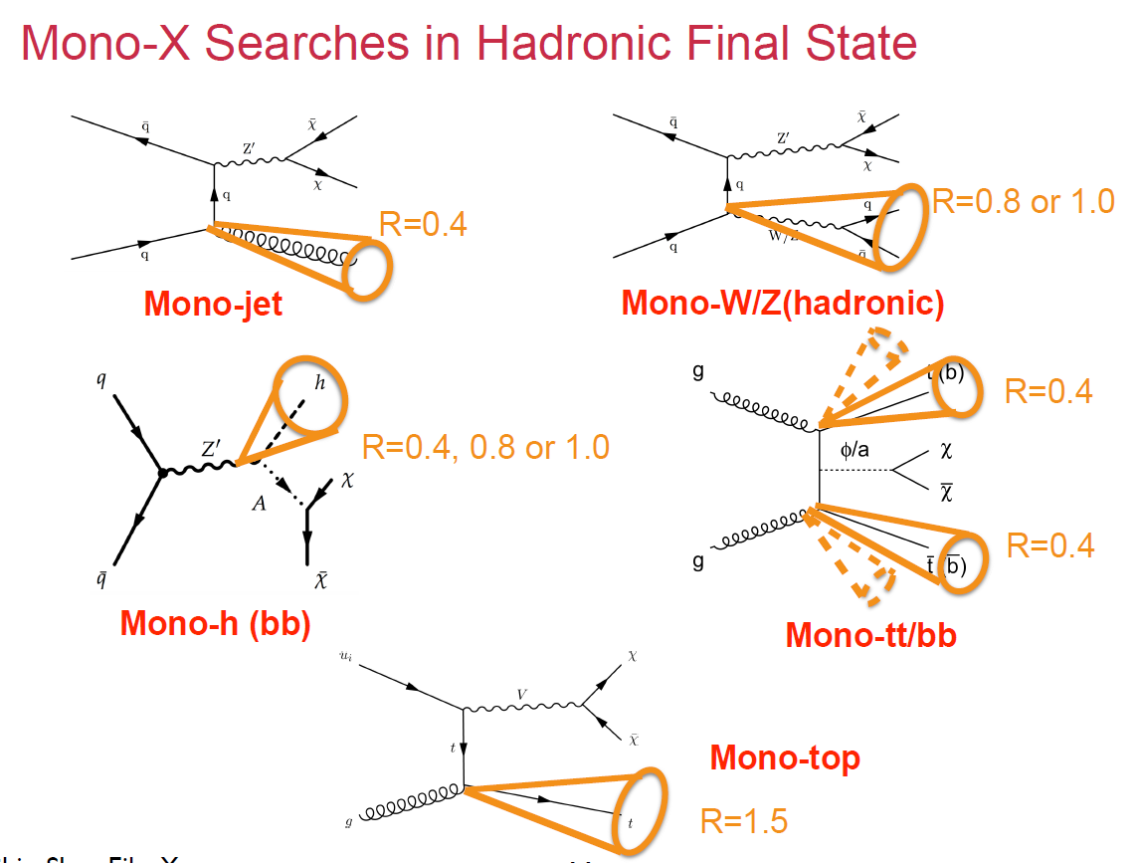
X + invisible
Shin-Shan Eiko Yu, EPS 2017

Slide 19
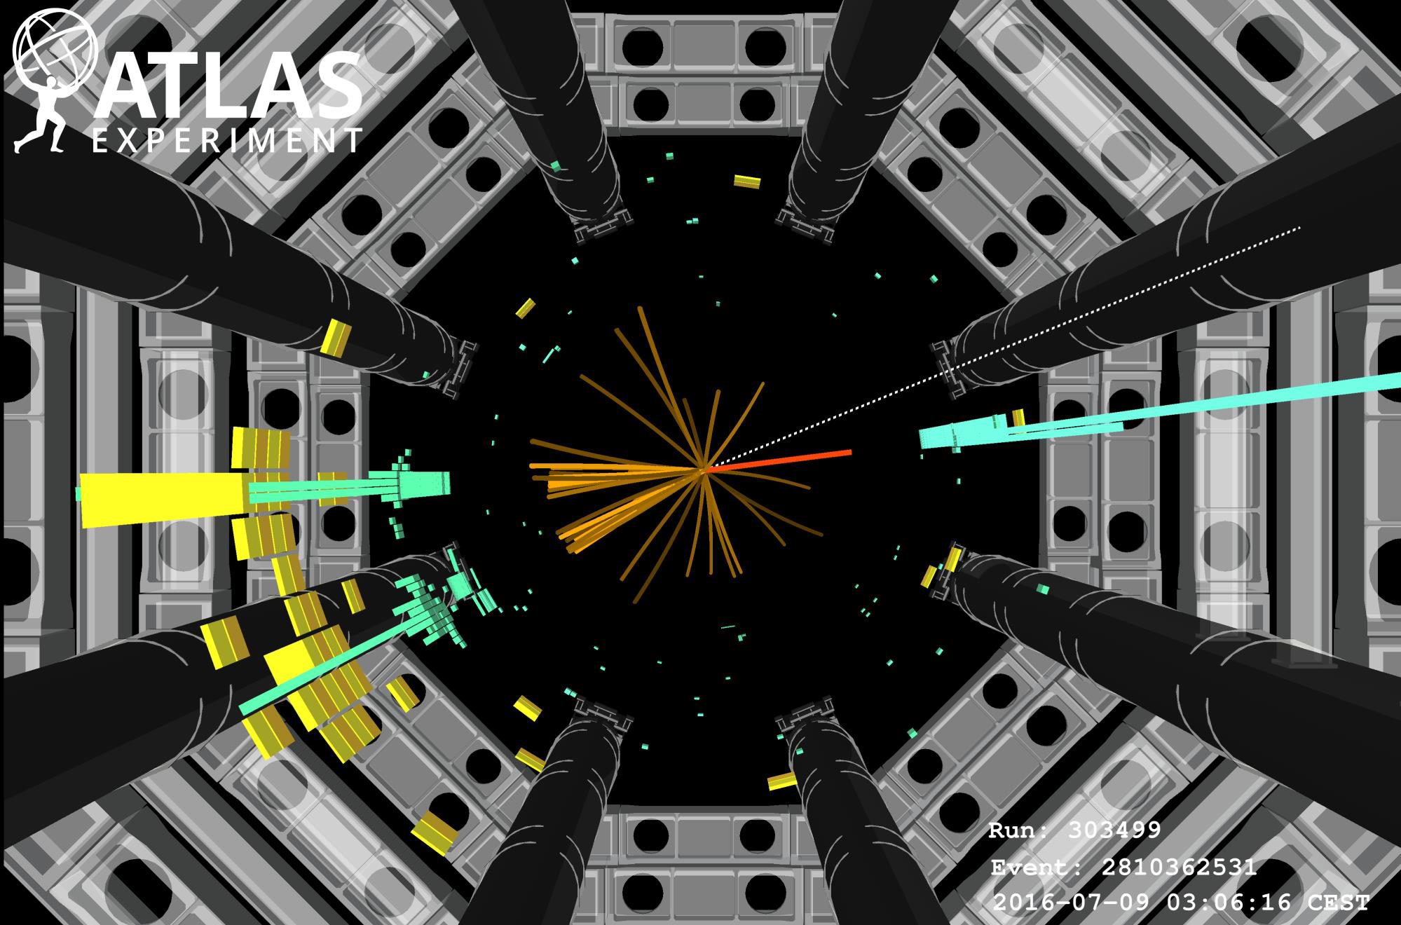
Notes:
W(→eυ) H(→bb) candidate

Slide 20
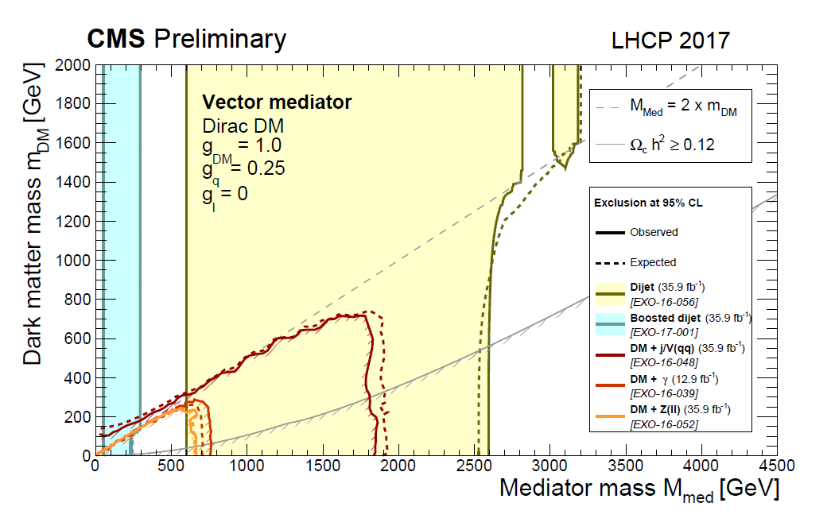
Direct Production Summary including direct search for mediator

Slide 21
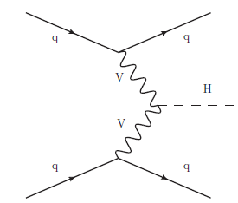
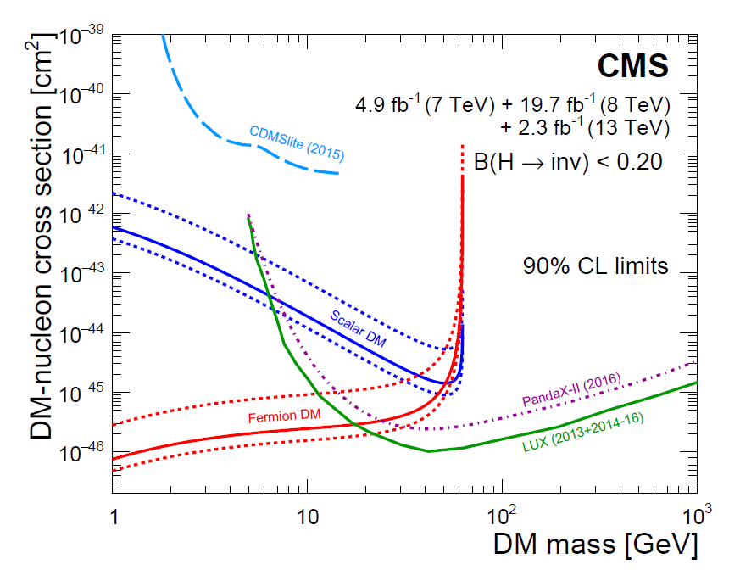
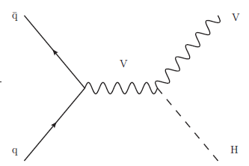
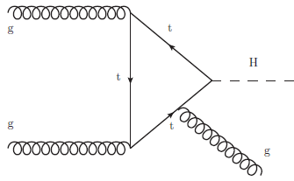
H→ invisible
arXiv:1610.09218
BR_{SM} (H→ inv ) ≈ 10⁻³
Observed: BR (H-> inv)<0.24
σ_{SI}
Notes:
Searches for invisible decays of the Higgs boson are presented. The data collected
with the CMS detector at the LHC correspond to integrated luminosities of 5.1, 19.7,
and 2.3 fb-1 at centre-of-mass energies of 7, 8, and 13 TeV, respectively. The search
channels target Higgs boson production via gluon fusion, vector boson fusion, and in
association with a vector boson. Upper limits are placed on the branching fraction of
the Higgs boson decay to invisible particles, as a function of the assumed production
cross sections. The combination of all channels, assuming standard model production,
yields an observed (expected) upper limit on the invisible branching fraction of
0.24 (0.23) at the 95% confidence level. The results are also interpreted in the context
of Higgs-portal dark matter models.

Slide 22
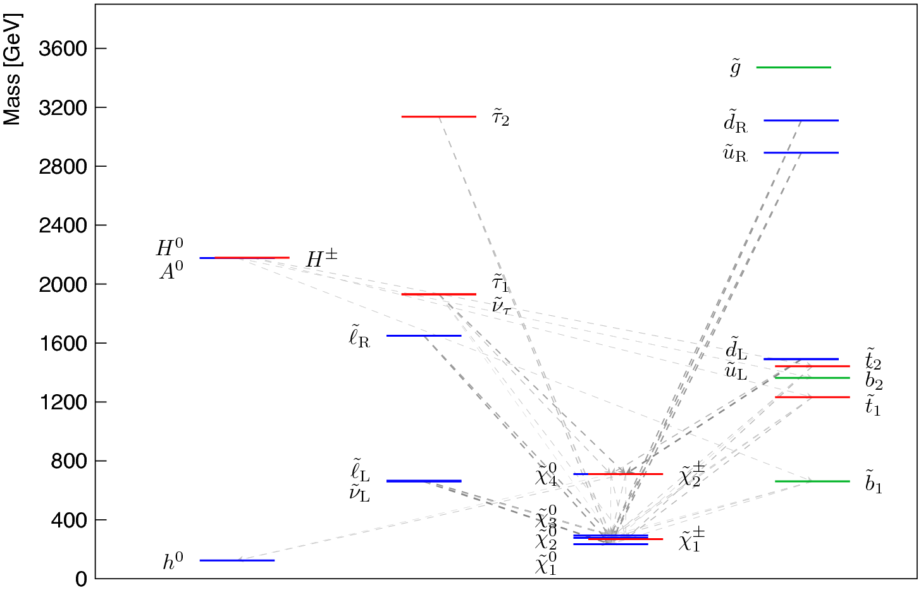
Cascade decays

Slide 23
TOPIC 2: Cascade decays
Strongly produced

Slide 24
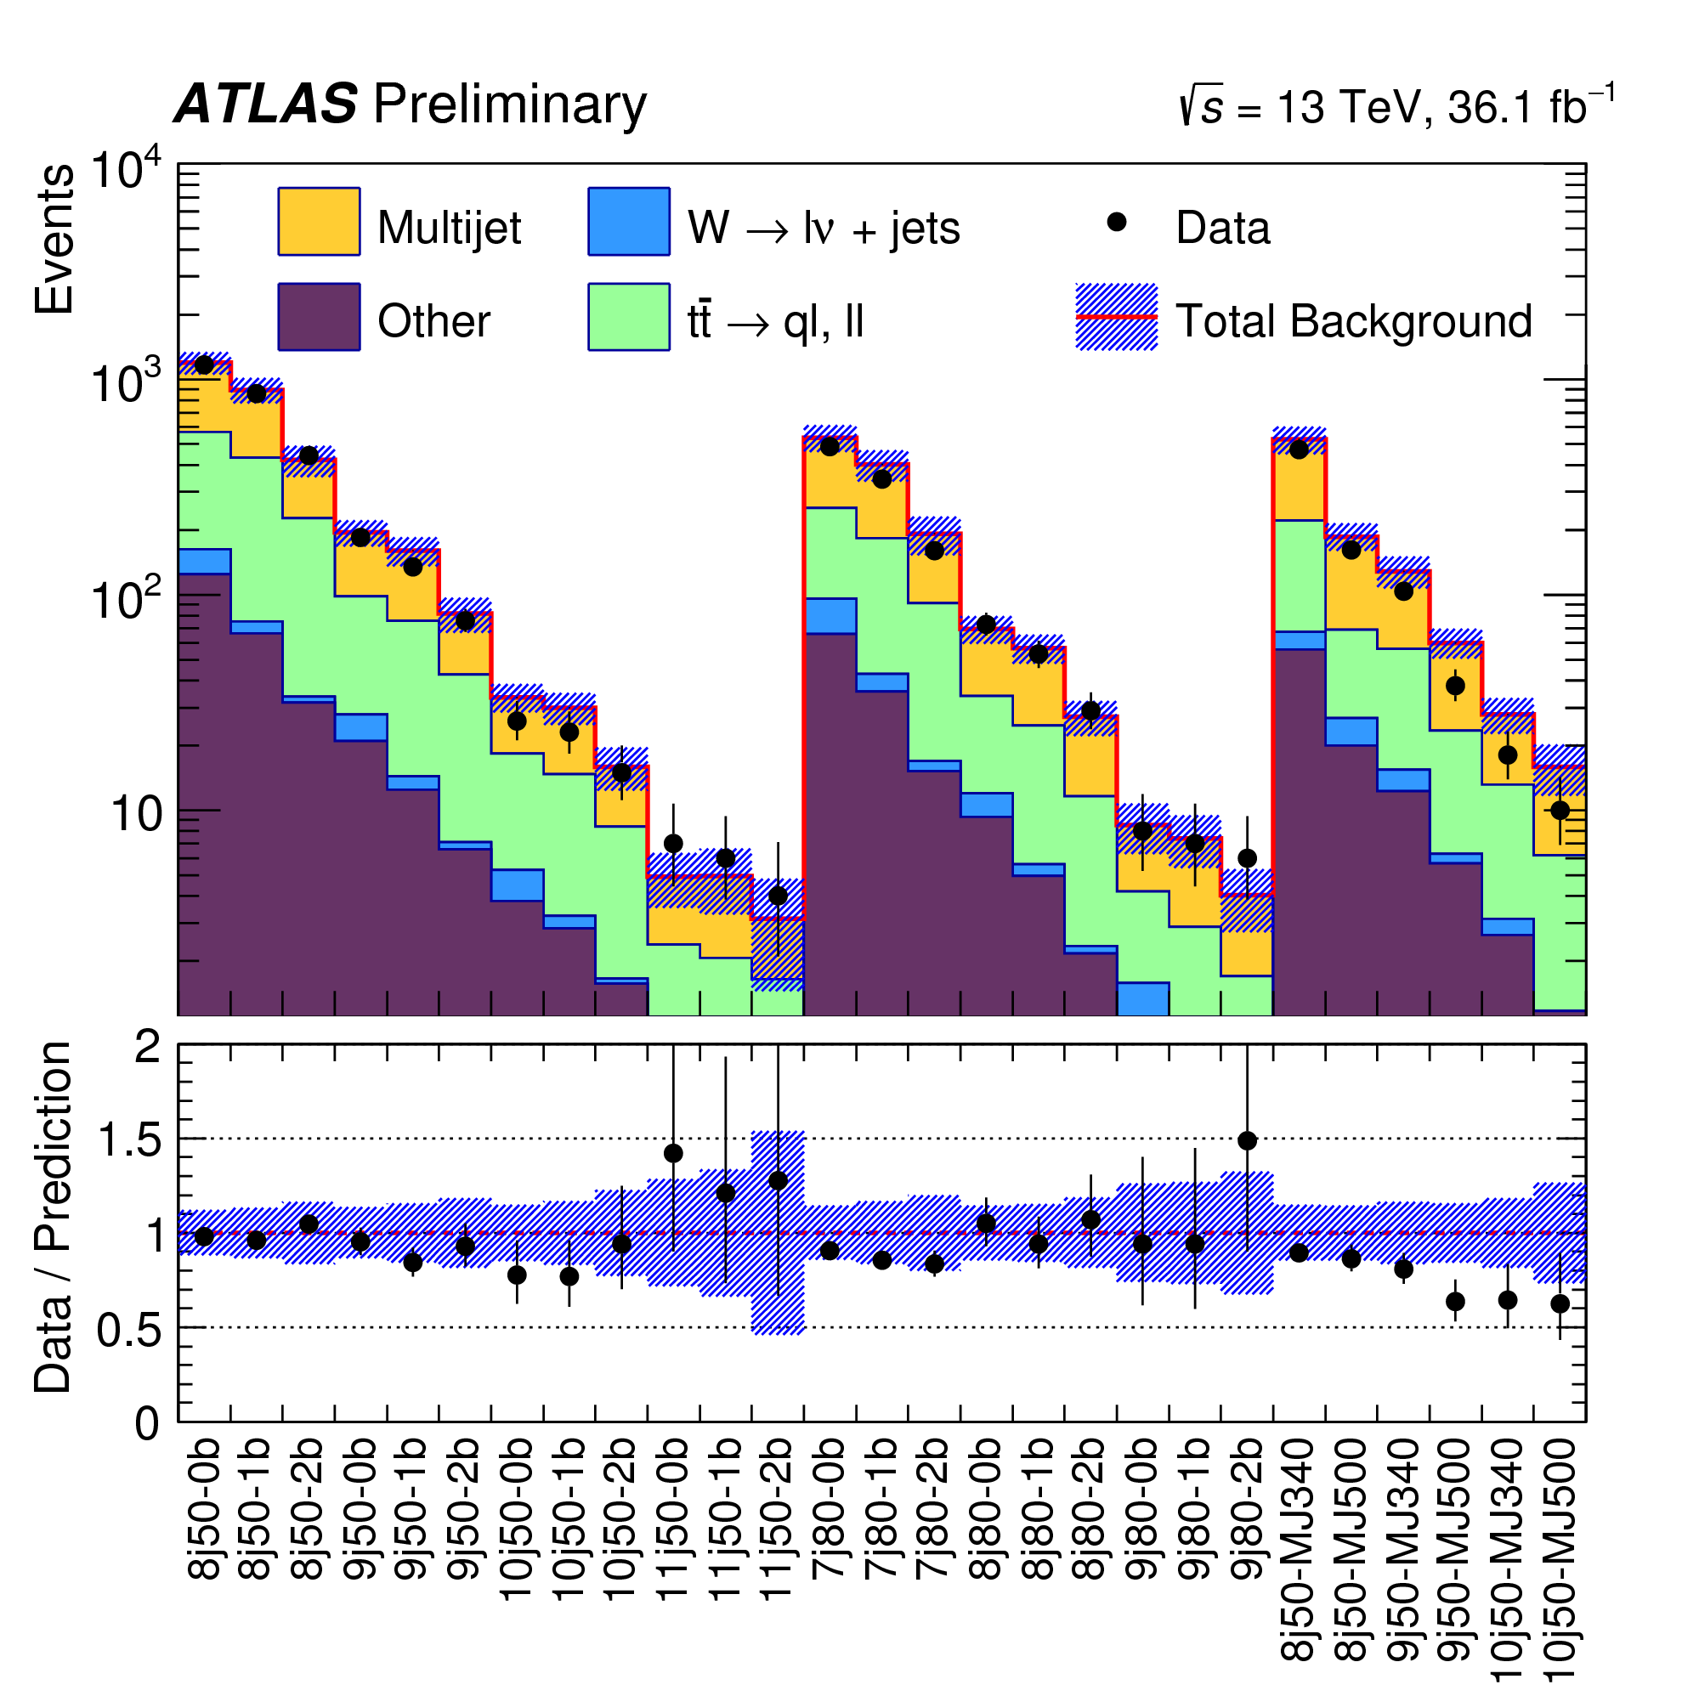
ATLAS-CONF-2017-033
“No stone unturned”

Slide 25
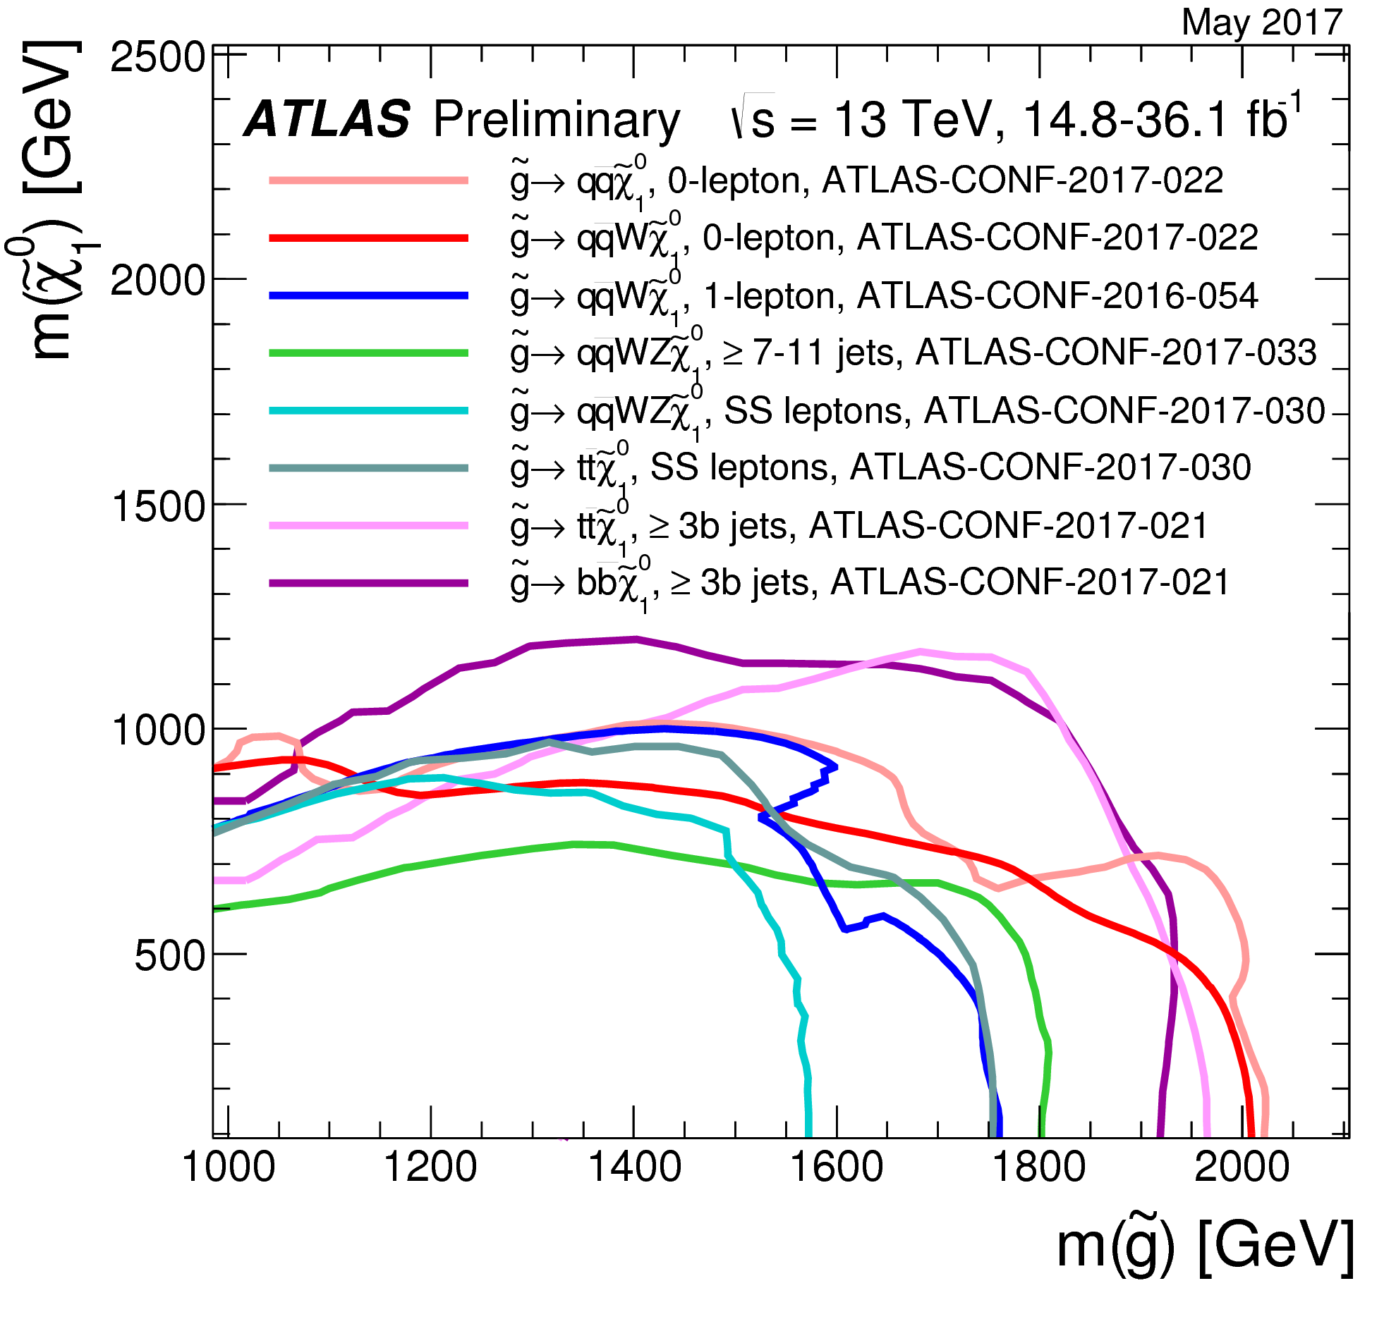
These curves just for the gluino

Slide 26
TOPIC 2: Cascade decays
Weakly produced

Slide 27
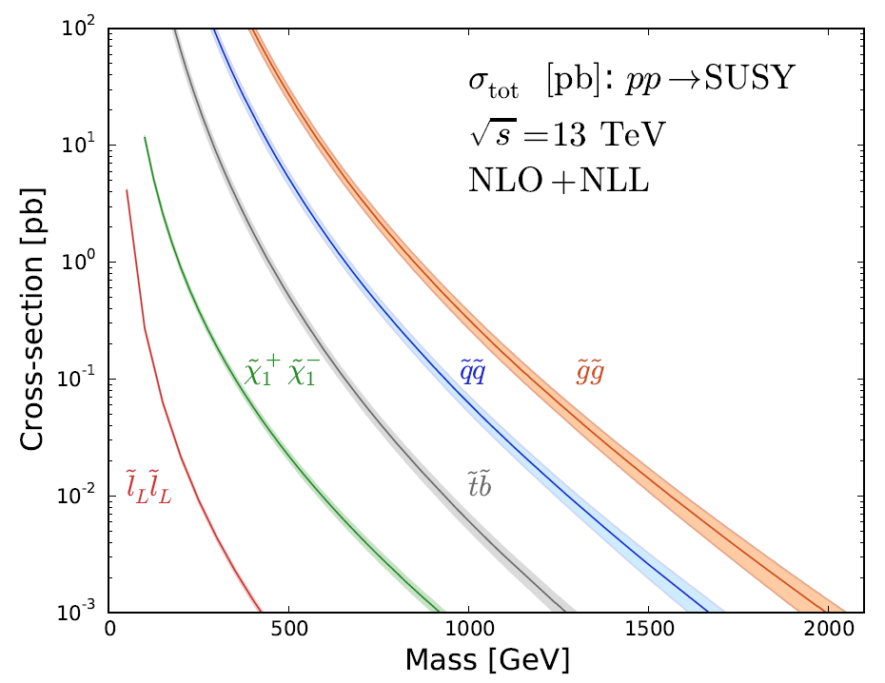

Slide 28
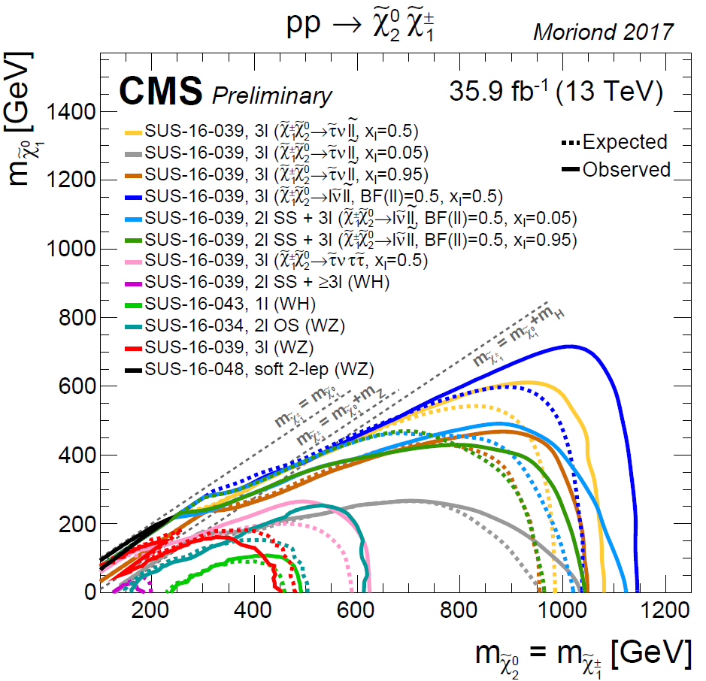
Electroweak production
Particularly interesting: Higgsinos

Slide 29
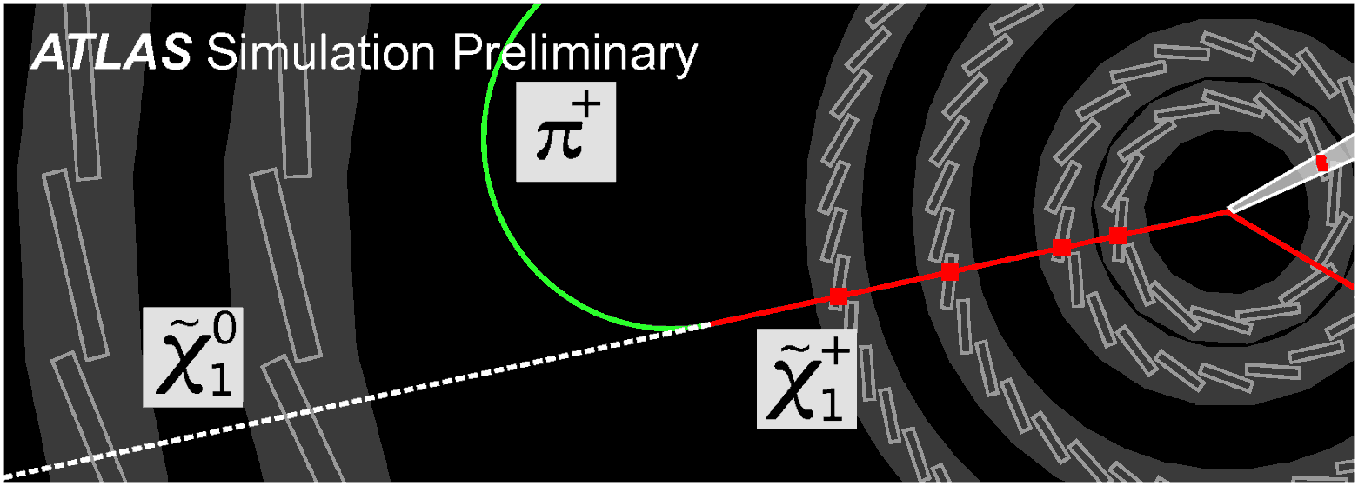
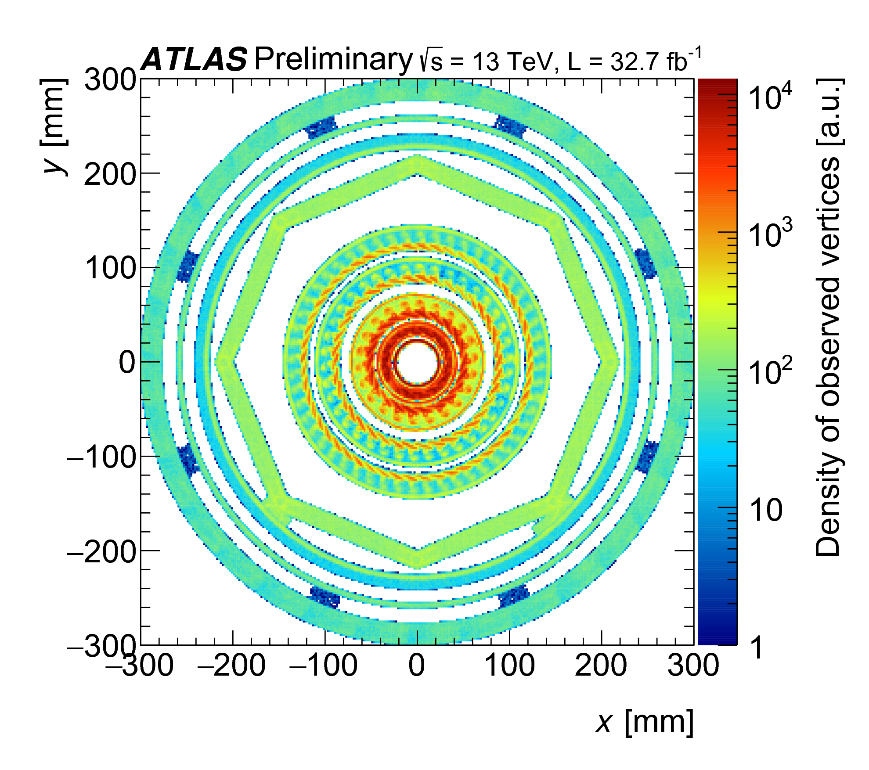
Disappearing tracks
ATLAS-CONF-2017-01
Long-lived decays
ATLAS-CONF-2017-026

Slide 30
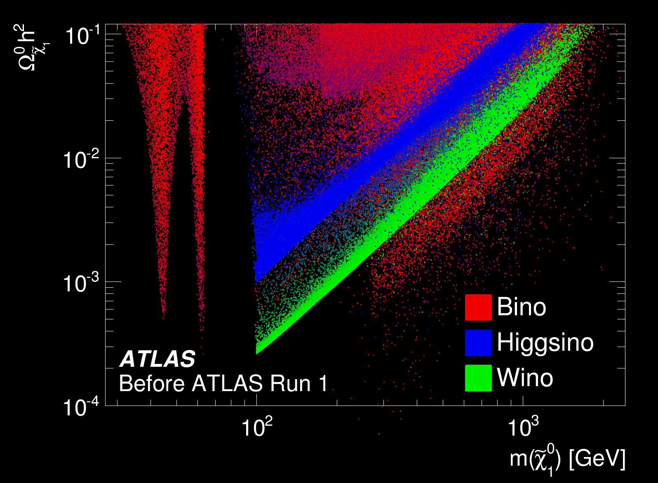
arXiv:1508.06608
Combined constraints from 22 different
Run-1 searches

Slide 31
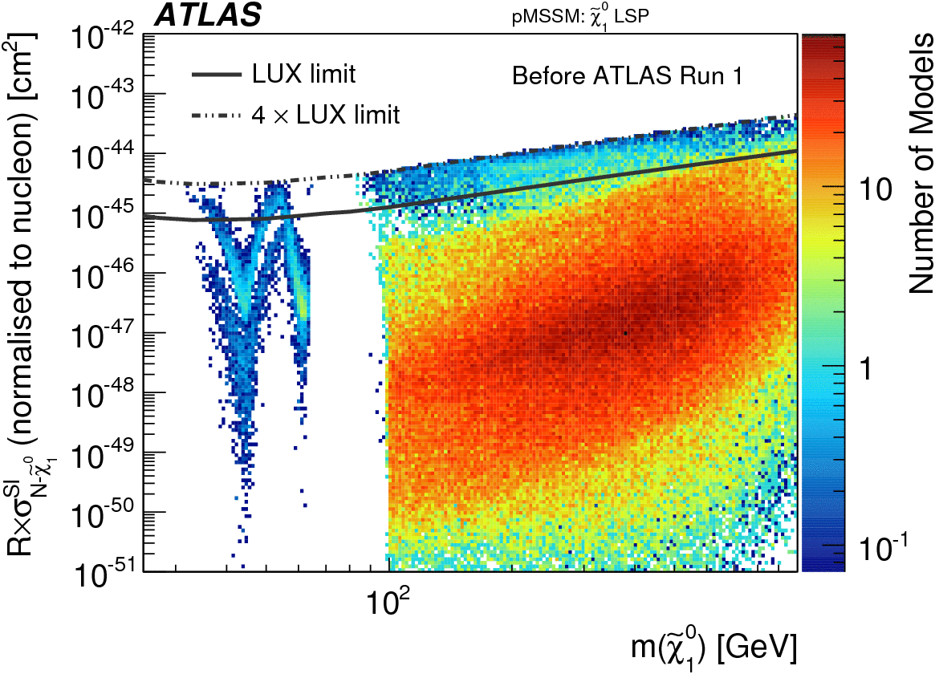

arXiv:1508.06608
Combined constraints from 22 different
Run-1 searches

Slide 33
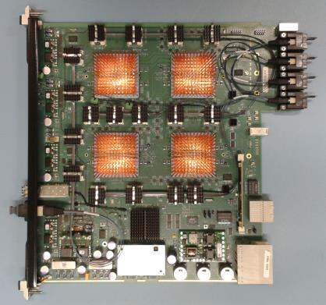
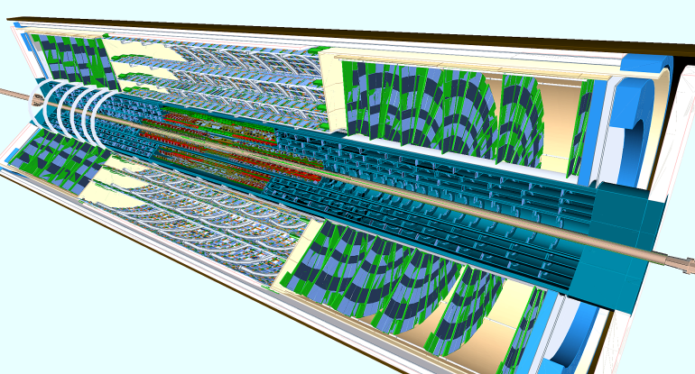
Outlook
Factor of ~100 more data to come

Slide 34

Summary
Superb operation of the LHC
Experiments performing well beyond spec
Analyses exploring very wide range of possibilities
Interpretations better harmonised with DD
Complementarity is clear
Strong production has increasingly
strong limits
There’s still a long way to go on the
Higgs and EW side

Slide 35

Extras

Slide 36
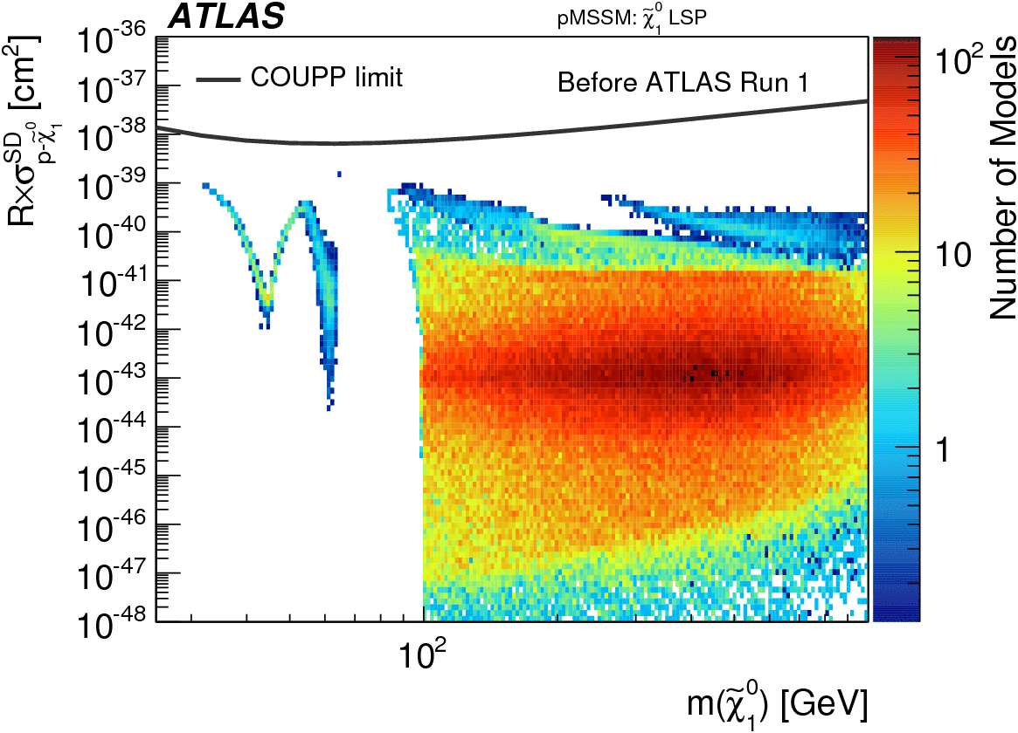
arXiv:1508.06608
Run 1 only

Slide 37
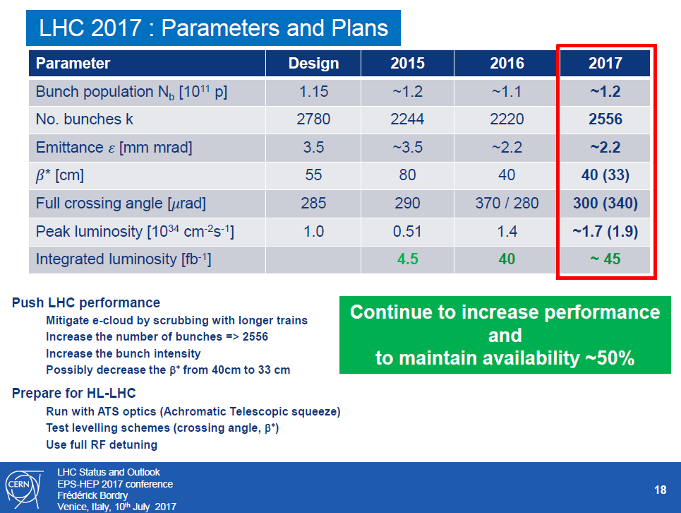

Slide 38
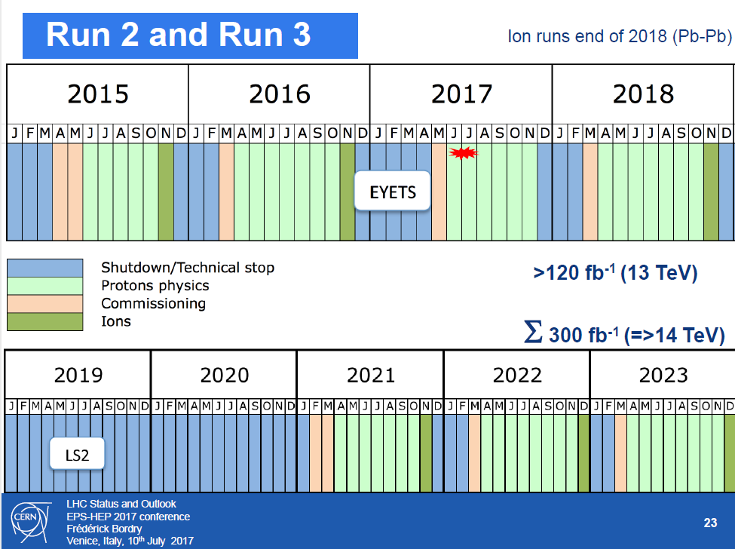

Slide 39
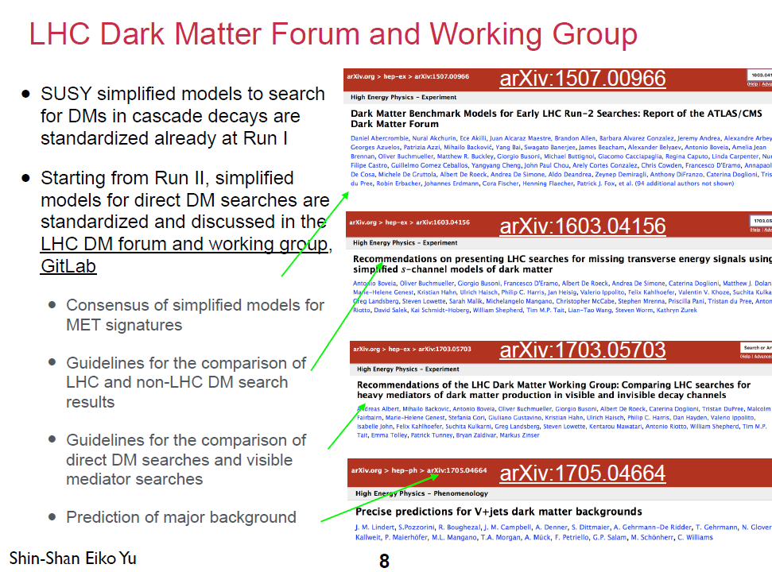

Slide 40
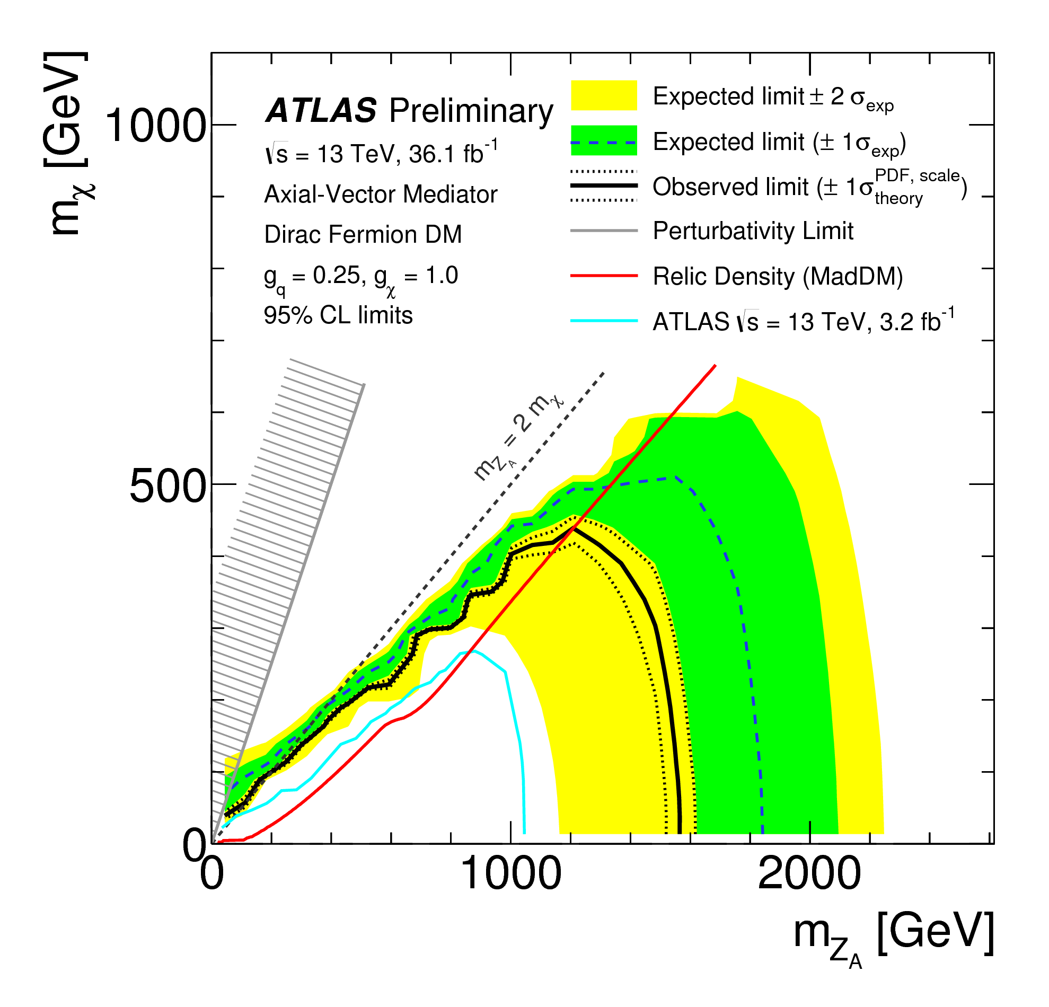
Interpretation – mass space
ATLAS-CONF-2017-060
WIMP mass
Dirac fermion
Correct relic density
0.25
1.0
Axial-vector
Excluded
1.55 TeV
Mediator mass
Notes:
Vector mediator → similar plot
Pseudoscalar mediator → no sensitivity yet

Slide 41

CMS PAS EXO-16-048

Slide 42

CMS PAS EXO-16-048

Slide 43


Slide 44


Slide 45


Slide 46

Higgs coupling to invisibles
arXiv:1610.09218
Upper limit at BR<0.24
Notes:
Event display from “Search for the dimuon decay of the Higgs boson in
pp collisions at √s = 13 TeV with the ATLAS detector”

Slide 47

Hard case: EW/Higgsinos only
arXiv:1608.00872
Run 1 only

