Slide 1


Recent BaBar results on charm mesons
Fergus Wilson
Rutherford Appleton Laboratory
For the BaBar collaboration
Lake Louise Workshop 2016

Slide 2

Outline
D⁰-D̄⁰ mixing with D⁰→π⁺π⁻π⁰ decays
  Measurement of x and y mixing parameters
  To be submitted to PRD (this week)
D⁰→π⁻e⁺ν_{e}
  Differential branching fractions
  CKM elements
  Form factors
  PRD 91, 052022 (2015)

Slide 3
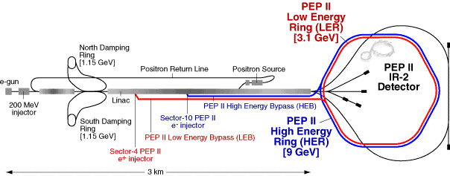
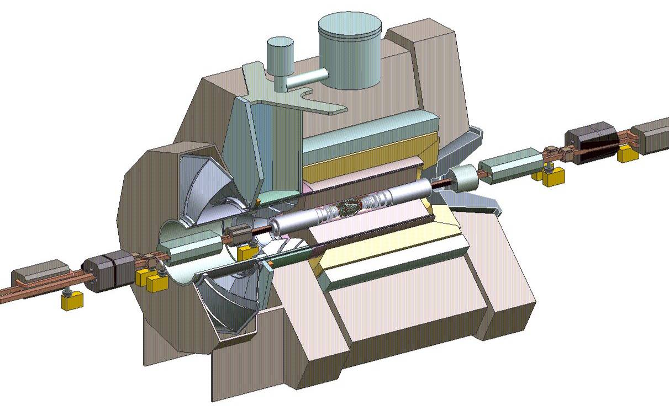
PEP II and BaBar
EMC
6580 CsI(Tl) crystals
1.5T solenoid
e⁺ (3.1GeV)
DIRC (PID)
144 fused silica bars
11000 PMs
e⁻ (9GeV)
Drift Chamber
40 layers
Instrumented Flux Return
Iron / Resistive Plate Chambers or Limited Streamer Tubes (muon / neutral hadrons)
Silicon Vertex Tracker
5 layers, double-sided strips

Slide 4
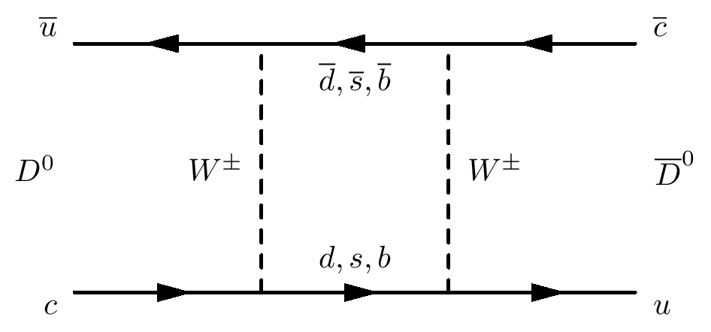
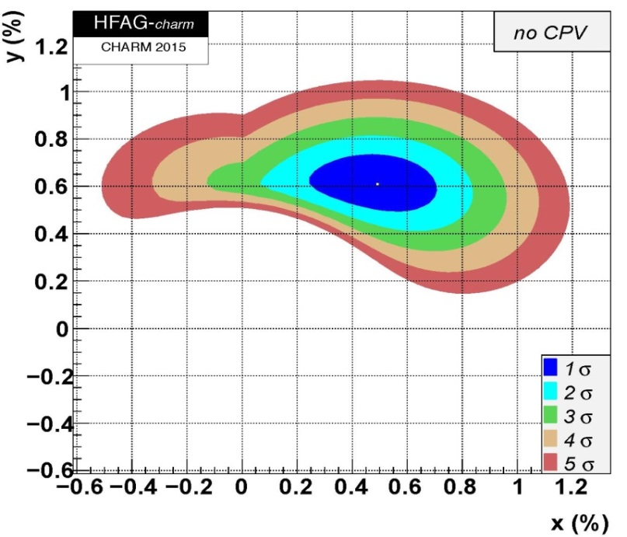
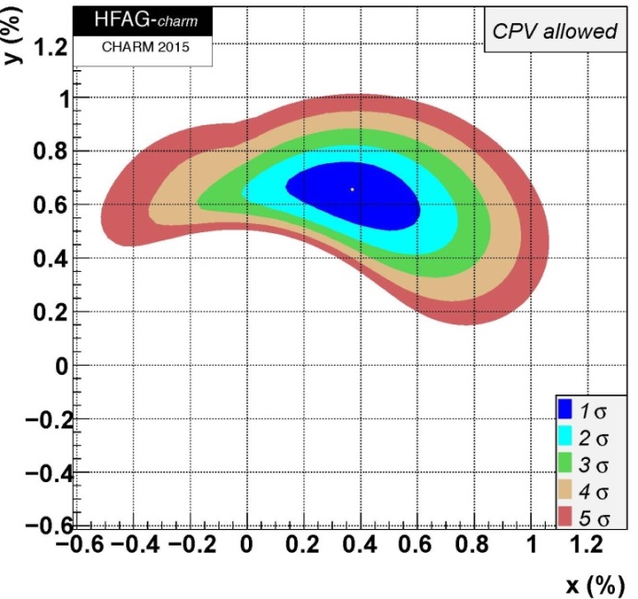
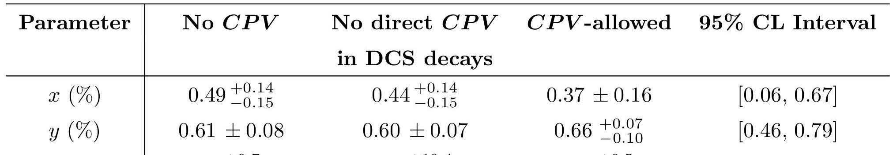
Time-dependent D⁰ mixing in D⁰→π⁺π⁻π⁰
Charm is an up-type quark. Complementary to studies in the K and B sectors.
Mixing and CP Violation (CPV) are small in the Standard Model
  CPV < 0.1% - 1% (depending on assumptions)
  Potentially Sensitive to New Physics.
D⁰ mixing well-established now:
  First measured in 2007 by BaBar and Belle
  Confirmed and extended by CLEO-c, CDF, BES-III, LHCb, …
Notes:
mass and widths of weak hamiltonian eigenstates

Slide 5
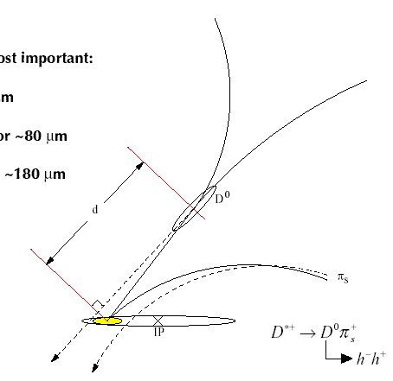




Time-dependent D⁰ mixing in D⁰→π⁺π⁻π⁰
  474 fb⁻¹
Direct decay D⁰→π⁺π⁻π⁰
Mixing D⁰ →D̄⁰ →π⁺π⁻π⁰
Interference
Amplitudes A_{f} depend on position in Dalitz Plot
π⁻
Sign of π⁺_{s} identifies D⁰ flavour at production.
Yield extracted from a 2-D fit to m_{D}⁰ and Δm = m_{D}*⁺ – m_{D}⁰
Ignore CP Violation
Fit time-dependent Dalitz plot
Extract x, y, τ_{D} and resonance parameters
D^{*+}

Slide 6
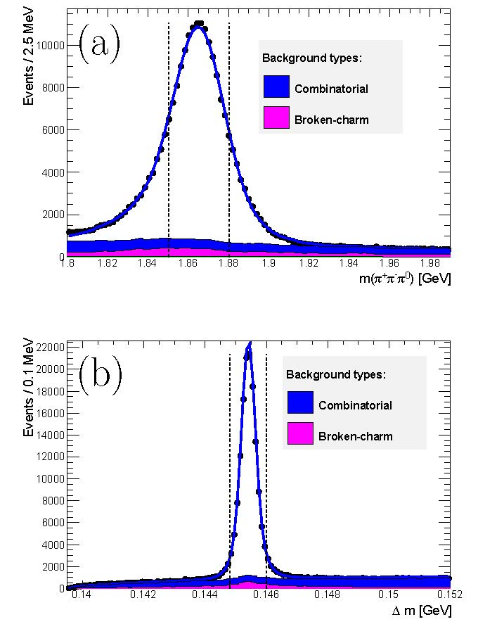
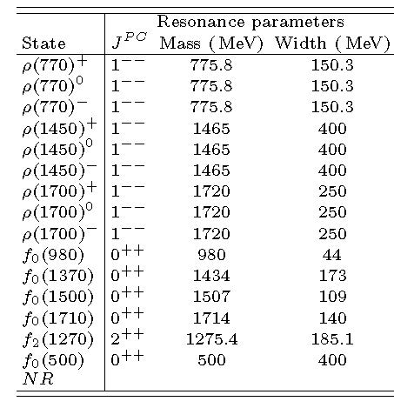
Yields and Dalitz Plot Amplitudes
Initial choice of Dalitz Plot amplitudes comes from BaBar’s B⁺→ D⁰(→π⁺π⁻π⁰)K⁺ paper: PRL 99, 251801 (2007).
Signal yield ~125,000
“Broken charm” : mis-reconstructed signal and other D⁰ decays

Slide 7
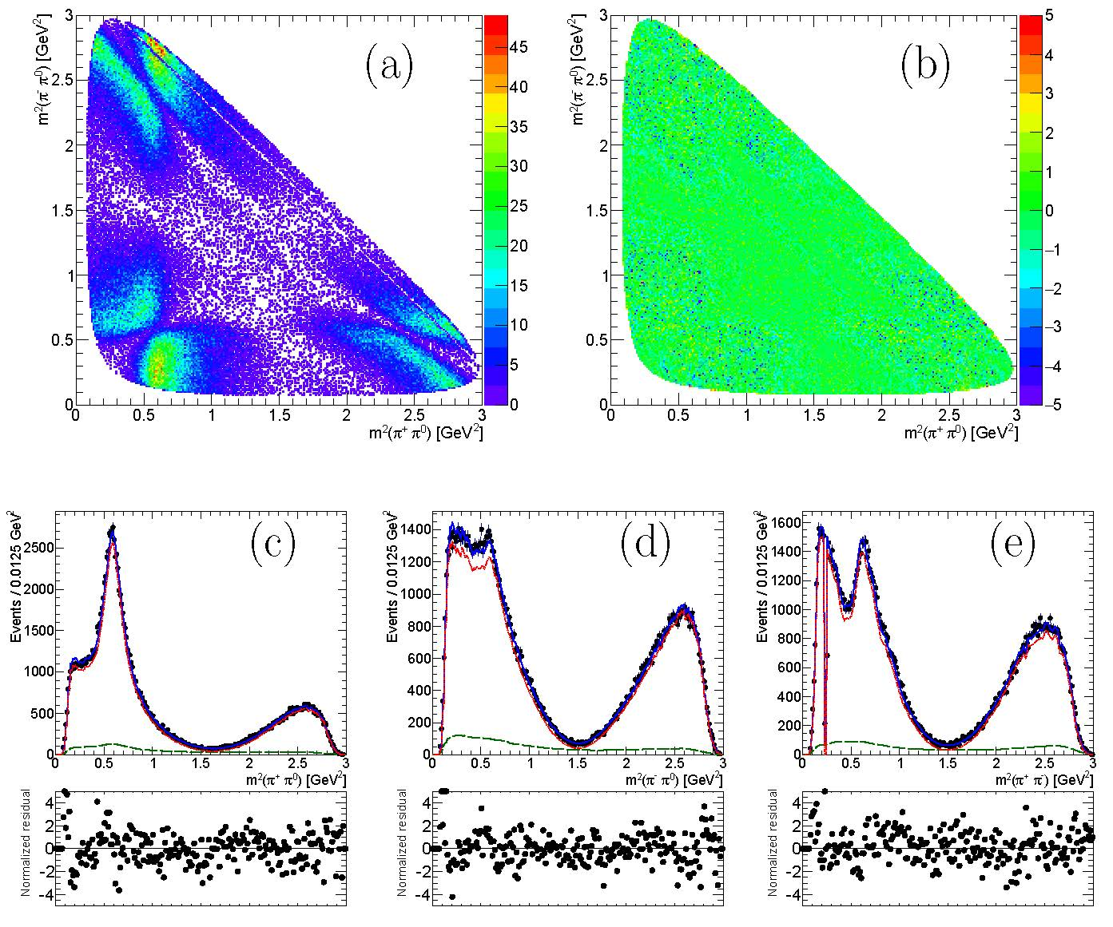
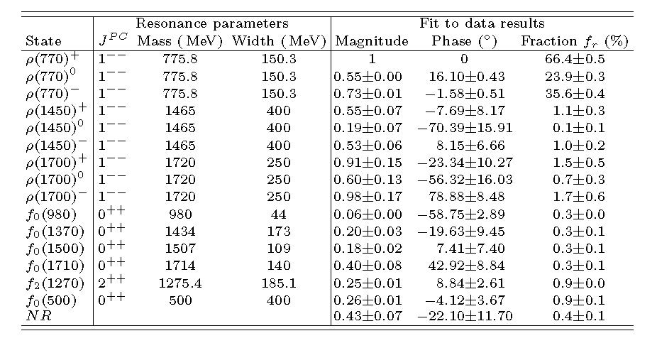
Dalitz Plot Fit and mixing results
Data
Blue = full fit
Red = signal
Green = background
Consistent with previous results

Slide 8
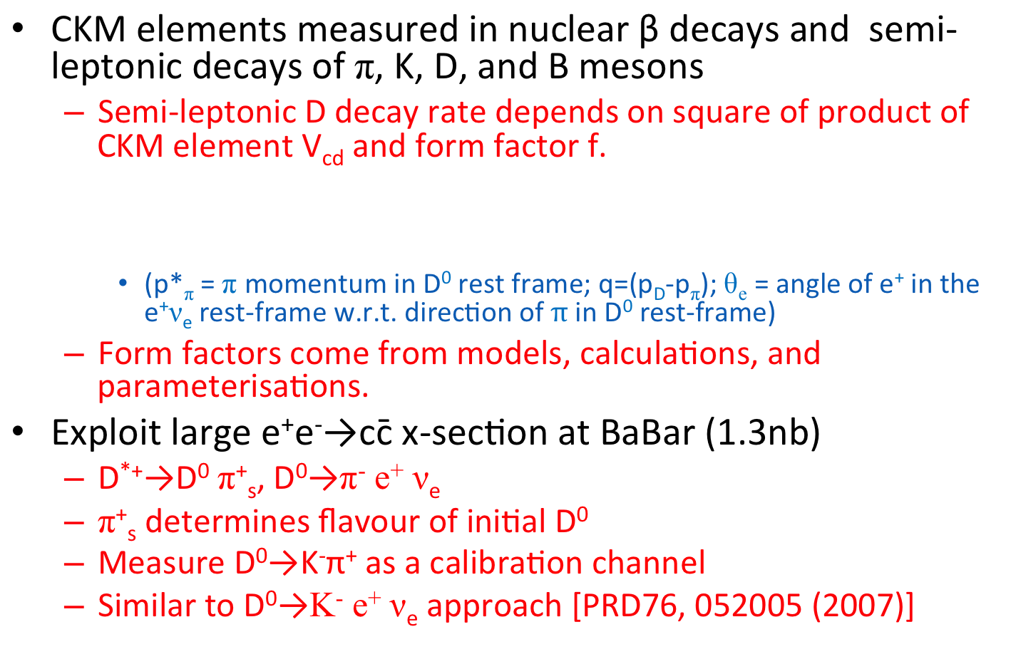
D⁰→e⁺π⁻ν_{e} decays and V_{cd}, V_{ub}, and f^{π}_{+D}
  PRD 91, 052022 (2015)
CKM elements measured in nuclear β decays and semi-leptonic decays of π, K, D, and B mesons
  Semi-leptonic D decay rate depends on square of product of CKM element V_{cd} and form factor f.
    (p*_{π} = π momentum in D⁰ rest frame; q=(p_{D}-p_{π}); θ_{e} = angle of e⁺ in the e⁺ν_{e} rest-frame w.r.t. direction of $π$ in D⁰ rest-frame)
  Form factors come from models, calculations, and parameterisations.
Exploit large e⁺e⁻→cc̄ x-section at BaBar (1.3nb)
  D^{*+}→D⁰ π⁺_{s}, D⁰→π⁻ e⁺ ν_{e}
  π⁺_{s} determines flavour of initial D⁰
  Measure D⁰→K⁻π⁺ as a calibration channel
  Similar to D⁰→K⁻ e⁺ ν_{e} approach [PRD76, 052005 (2007)]

Slide 9
Form Factor Calculation
  PRD 91, 052022 (2015)
General Expression:
Different theoretical approaches including:
  Dispersive.
  Multipole (“fixed pole” and “effective pole”).
  Z expansion (model independent).
  Quark model ISGW2 (PRD 52, 2783 (1995)).
(See backup slide for more details and formulae)

Slide 10
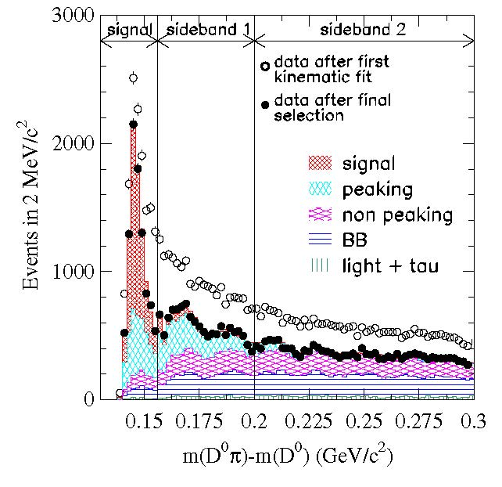
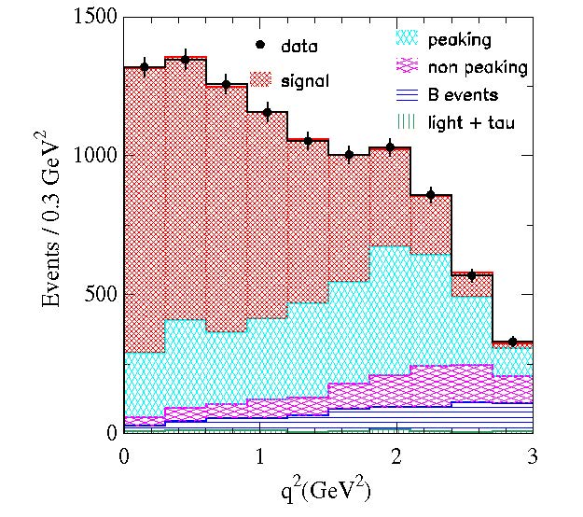
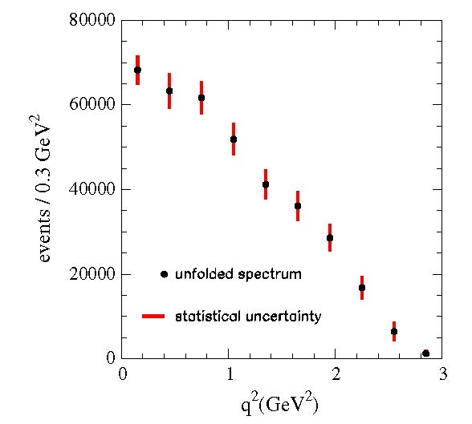
Differential decay rate
  PRD 91, 052022 (2015)
  Exploit 2-jet structure of cc̄ decays by splitting event into two hemispheres in the CM system around thrust axis. One hemisphere will contain the D⁰→π⁻ e⁺ ν_{e} decay.
Additional knowledge
  Estimate ν energy E_{ν} from missing energy in hemisphere with D⁰→π⁻ e⁺ ν_{e} decay.
  D⁰ direction can be estimated from sum of particles in other hemisphere.
  Perform kinematic fit to π⁻ e⁺ ν_{e} with E_{ν} , D⁰ direction, and D⁰ mass as additional constraints
Unfolded, corrected for efficiency, etc…
9926 signal, 4623 background events

Slide 11
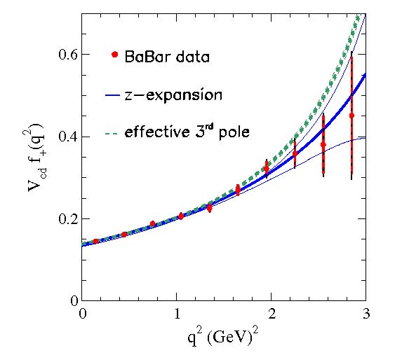
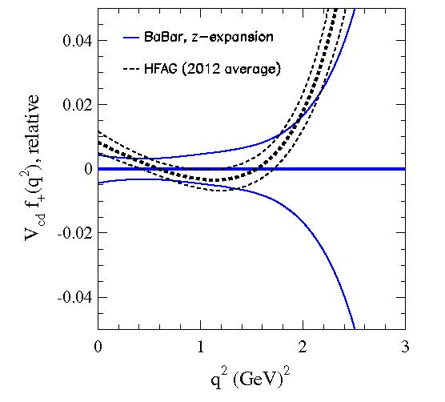
Branching fractions and V_{cd} x f^{π}_{+D}
  PRD 91, 052022 (2015)
(Using Z expansion to calculate I)

Slide 12
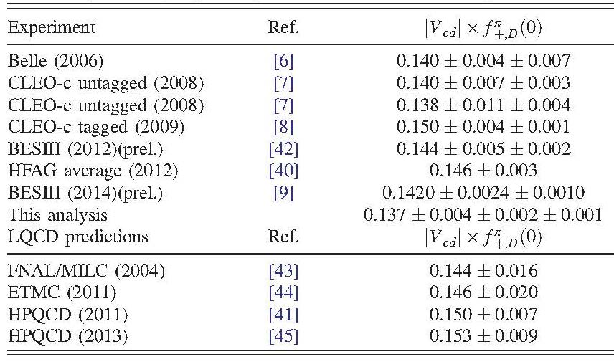
Comparison with earlier measurements
  PRD 91, 052022 (2015)
This result:
Lattice QCD gives f^{π}_{+D}(0)= 0.666±0.029:
Assuming |V_{cd}| = |V_{us}| = 0.2252 =λ (Wolfenstein):
  PRD 84, 114505 (2011)

Slide 13
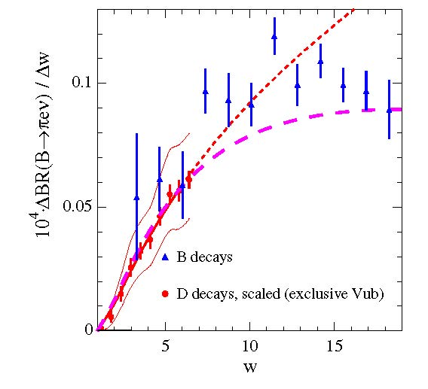
Extrapolation to B⁰→e⁺π⁻ν_{e} and V_{ub}
  PRD 91, 052022 (2015)
Extrapolate D⁰ measurements to B⁰ regime:
  R²_{BD} : ratio of B and D form factors from LQCD
  Fit to D⁰→e⁺π⁻ν_{e} with LQCD predictions for R²_{BD} =1.8±0.2
“Fixed” 3-pole ansatz
“Effective” 3-pole ansatz

Slide 14
Conclusions
BaBar continues to exploit its charm dataset.
D⁰→π⁺π⁻π⁰ :
  First measurement of D⁰-D̄⁰ mixing parameters from a time dependent analysis of D⁰→π⁺π⁻π⁰ decays.
  Consistent with other measurements.
D⁰→π⁻e⁺ν_{e} :
  Differential decay rates allow comparison between different approaches to form factor calculations and extraction of CKM elements.
  Effective 3-pole model describes data well but other models not ruled out.
  Dominant systematic errors should improve with further Lattice QCD calculations and so help inform form factor calculations.

Slide 15
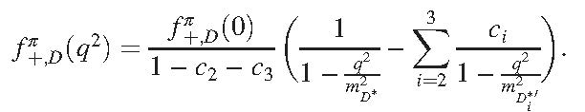
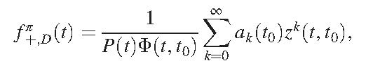
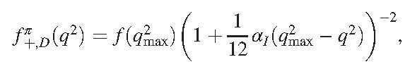
Form Factor Calculation
  PRD 91, 052022 (2015)
General Expression:
Theoretical Approaches:
  Dispersive Approach:
    D* pole, sum of radially excited J^{P}=1⁻ D₁*’, and Dπ continuum
  Multipole Approach:
    Limit to 1 (D*) , 2 (D* + first D₁*’), or 3 dominant poles + constraints
    3rd pole is either a D₁*’ (“fixed” ansatz) or sum of higher D₁*’ (“effective” ansatz)
    Other assumptions and constraints can modify the approximations.
  Z expansion:
    Model independent based on analyticity, unitarity and crossing symmetries
  Quark model ISGW2 (PRD 52, 2783 (1995)):

