Slide 1
The short-baseline Neutrino program @ Fermilab
Thomas Strauss
AEC-LHEP Bern, CH

Slide 2
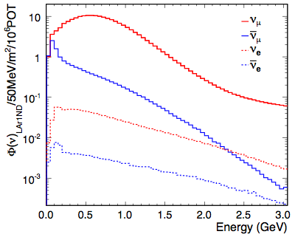
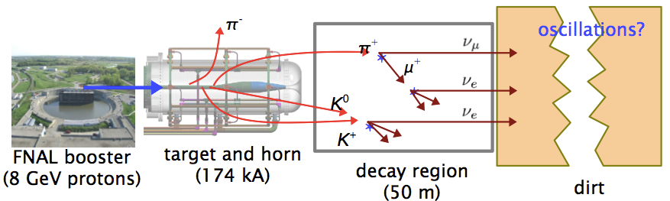
Short-Baseline: Booster Neutrino Beam
A.A. Aguilar-Arevalo, Phys. Rev. D79, 072002 (2009)
Fermilab protons hit a beryllium target QE: 99% of flux
Horn focuses positive charged particles <2.5 GeV
Decay in flight into neutrinos <E_{ν}> ~ 700 MeV
Very well known!
©RWTH Marius Wallraff
ArXiv: 0806.1449
Change phases
between mass wave function
Mass eigenstate
Flavor eigenstate
Flavor eigenstate

Slide 3
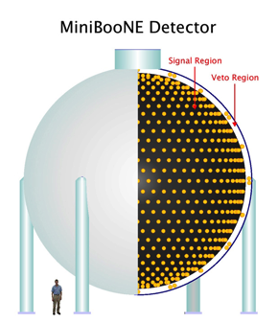
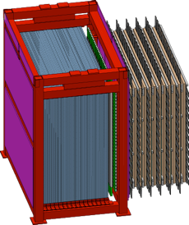
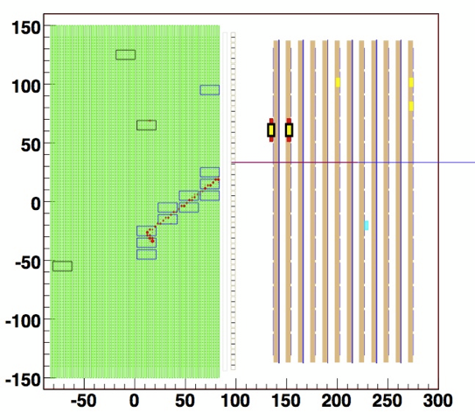
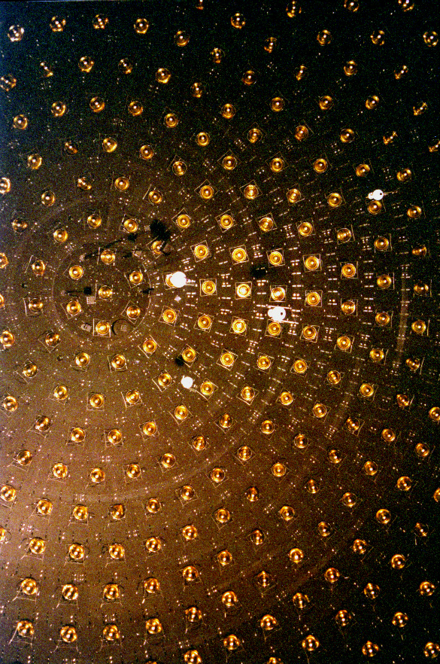
Prior Experiments on the BNB
MiniBooNE (2002-2014)
540m baseline, ν and anti-ν cross section and SBN oscillation
SciBooNE (2007-2008)
100m baseline, cross section
Scintillation Tracker 15t
  p/π ID
Electron catcher
  π₀/ν_{e} - ID
Muon range detector
  up to 1.2GeV
Cerenkov light detector
  800t mineral oil in 12.2m sphere
  1280 Photo Multiplier Tubes
  4 π angular coverage
12m
2m
4m

Slide 4
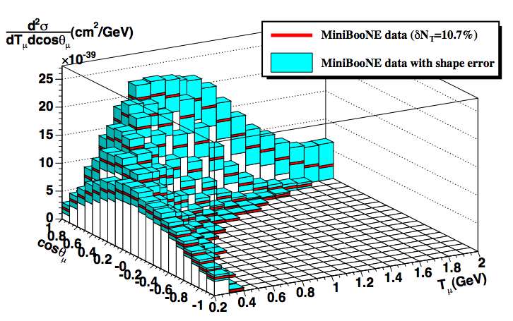
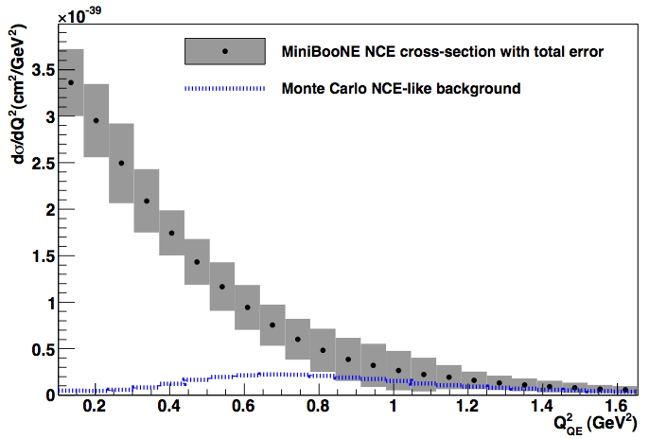
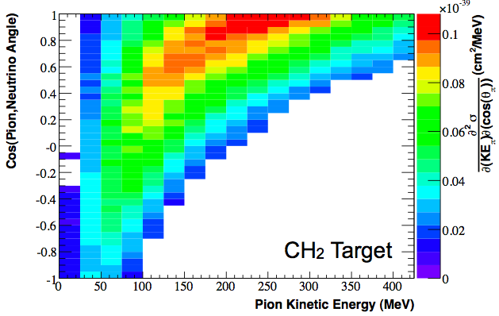
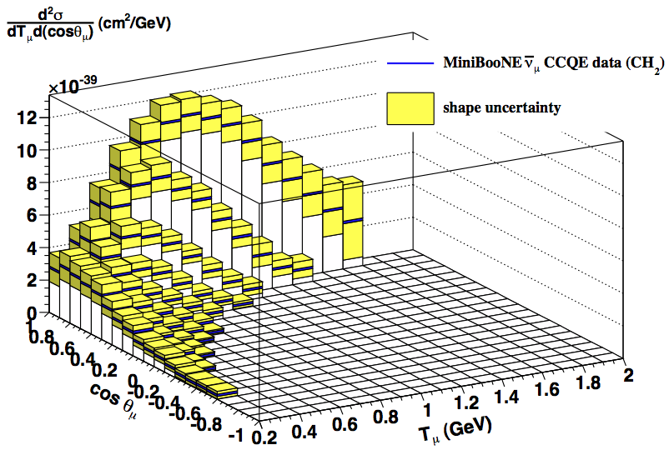
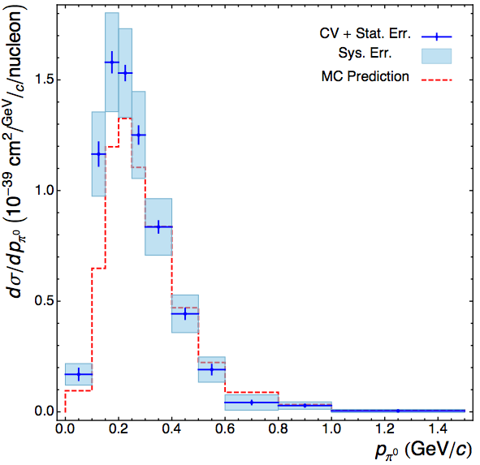
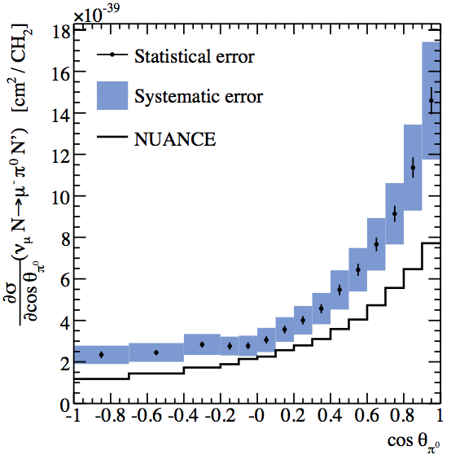
MiniBooNE Cross Section Program
has published cross sections for 90% of the ν interactions in MiniBooNE
- 1st time in history that full kinematics (diff’l & double diff’l cross sections)
have been reported for these reactions; total of 11 σ_{ν} publications
Nuclear effects are important, measurements possible due to precise knowledge of the BNB
ν quasi-elastic scattering
Phys. Rev. Lett. 100, 032301 (2008)
- Phys. Rev. D81, 092005 (2010)
ν and ν NC elastic scattering
Phys. Rev. D82, 902005 (2010)
Phys. Rev. D91, 012004 (2015)
CC π⁺ production
Phys. Rev. Lett. 103, 081801 (2009)
Phys. Rev. D83, 052007 (2011)
quasi-elastic scattering
Phys. Rev. D84, 072005 (2011)
Phys. Rev. D88, 032001 (2013)
NC π⁰ production
Phys. Lett. B664, 41 (2008)
Phys. Rev. D81, 013005 (2010)
CC π⁰ production
Phys. Rev. D83, 052009 (2011)

Slide 5
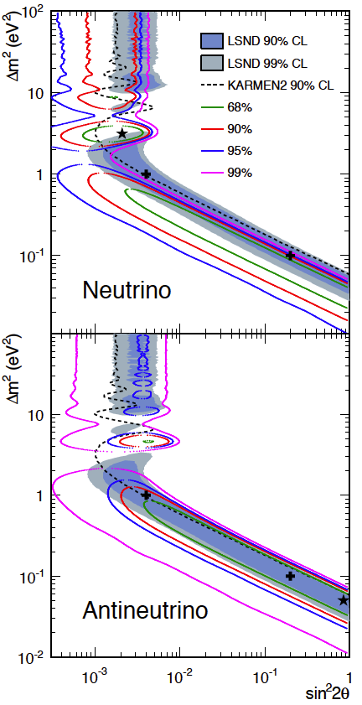
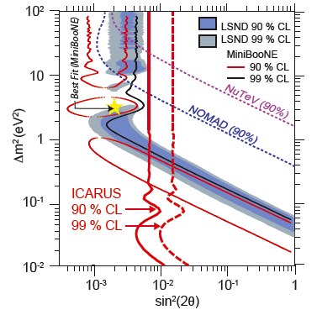
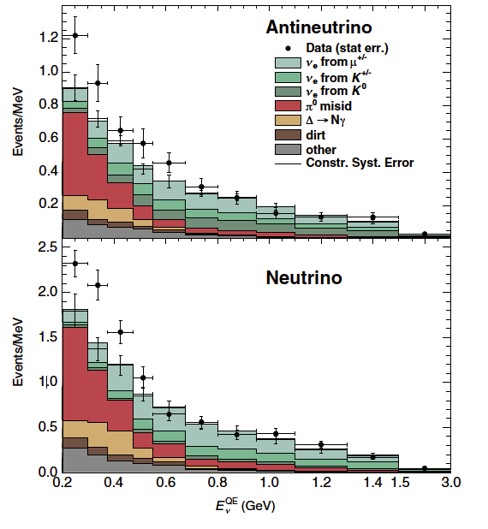
MiniBooNE: Oscillation results
Phys. Rev. Lett. 110, 161801 (2013)
Mini
BooNE
L/E for LSND
L/E for LSND
MiniBooNE can not confirm LSND in neutrino and anti-neutrino mode
Well understood detector, excellent beam simulation (arXiv:0806.1449), known target production measurements constrain systematic uncertainties (Harp Experiment, arXiv:hep-ex/0702024)
MiniBooNE sees an electromagnetic excess at very low energy, where NCγ and NCπ₀ are dominant backgrounds

Slide 6
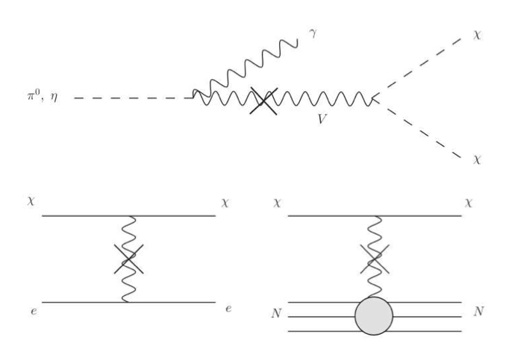
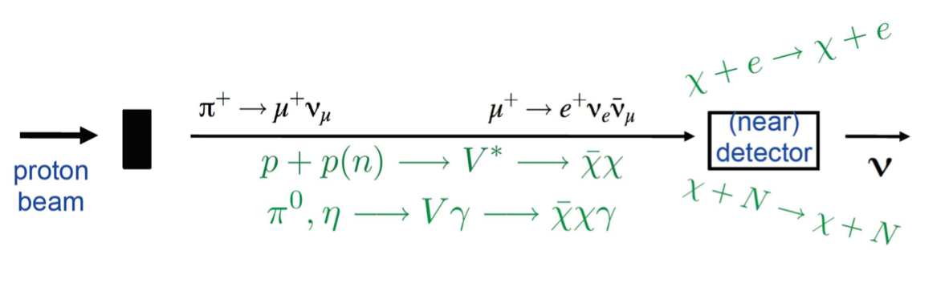
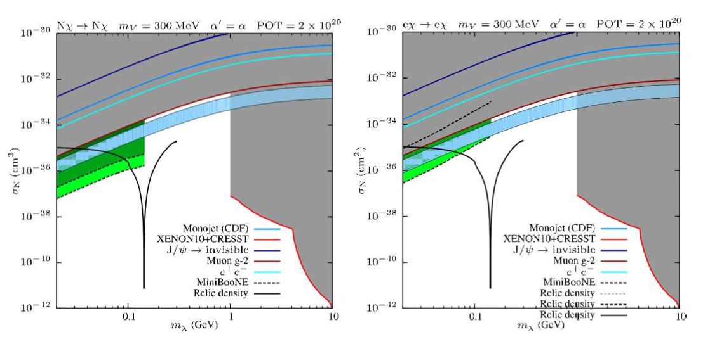
MiniBooNE search for Dark Matter
In the target/absorber:
In the detector:
Dark sector mediator (V) couples to photons from beam π⁰ decay.
Dark Matter (χ) travel to detector and scatters off nucleons
or electrons. (for details see arXiv:1211.2258)
Electron Elastic scattering
Nucleon Elastic scattering
Dark Matter-Nucleon
Dark Matter-Electron
Overlaps muon g-2 region and relic density curve (solid line).
FNAL approved beam-dump run, which significantly reduces neutrino backgrounds.
Recently completed 1.86E20POT beam-dump run.
First results in 2015!
Notes:
Regions of nucleon-WIMP scattering cross section (corresponding to dark matter in the halo
moving with v ∼ 10−3c ) vs WIMP mass. The plot uses mV = 300 MeV and α′ = α .
Constraints are
shown from dark force searches (labeled e+e− , and including from left-to-right limits from KLOE, APEX,
MAMI and BaBar) [20], limits on pp → j + inv. [33] (labeled Monojet), limits on J/ψ → inv. decays [34],
excessive contributions to (g − 2)μ [17], together with low-mass limits from the direct detection experiments
CRESST [31] (1-4 GeV) and XENON10 [32] (4-10 GeV). Note that a similar, but slightly stronger, exclusion
contour to CRESST has also been obtained by DAMIC [35]. The light blue band indicates the region where
the current ∼ 3σ discrepancy in (g − 2)μ is alleviated by 1-loop corrections from the vector mediator [17].
The solid black line shows points where the present relic density of the WIMP matches observations—the
structure in this occurs when the WIMP mass is such that its annihilation during freeze-out through an
off-shell s -channel V ∗ is resonantly enhanced. This relationship only applies for m < mV . The left panel
shows regions where we expect 1–10 (light green), 10–1000 (green), and more than 1000 (dark green) elastic
scattering events off nucleons in the MiniBooNE detector with 2 Å~ 1020 POT. The right panel shows the
same for elastic scattering off electrons.

Slide 7

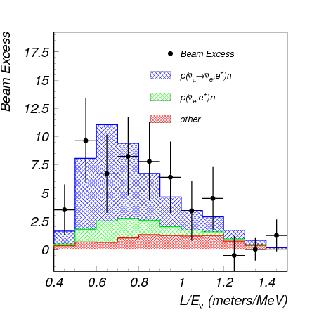
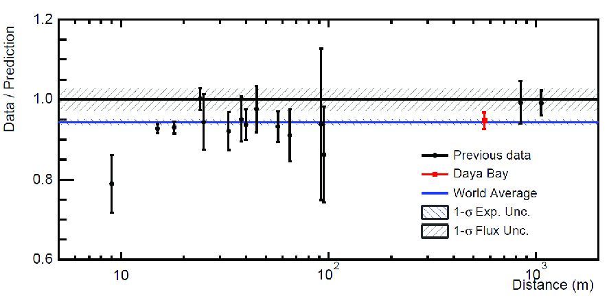
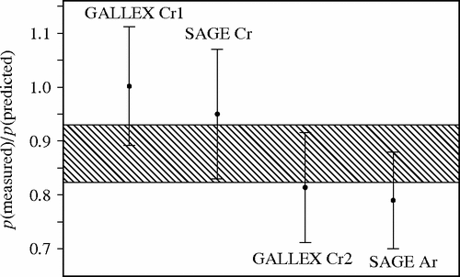
Sterile neutrino?
LSND
Nice read for the way home: “Light Sterile Neutrinos: A White Paper”
Abazajian, K.N. et al. arXiv:1204.5379
Aguilar et al.,
Phys. Rev. D 64, 112007, (2001)
Reactor flux
arXiv:1412.1364
Gallium anomaly, SAGE
Phys. Rev. C 73 (2006) 045805
Tension in global fits and results from other experiments T2K: ν_{μ} disappearance
signal vs. exclusions, nu vs. nubar, appearance vs. disappearance mode
Notes:
Nut: Tension for global fits and other experiments
T2K short baseline disappearance
signal vs. exclusions, nu vs. nubar, appearance vs. disappearance mode

Slide 8
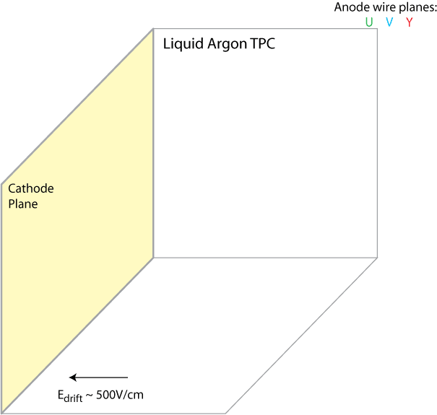

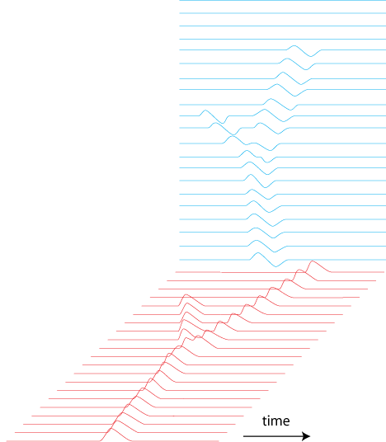
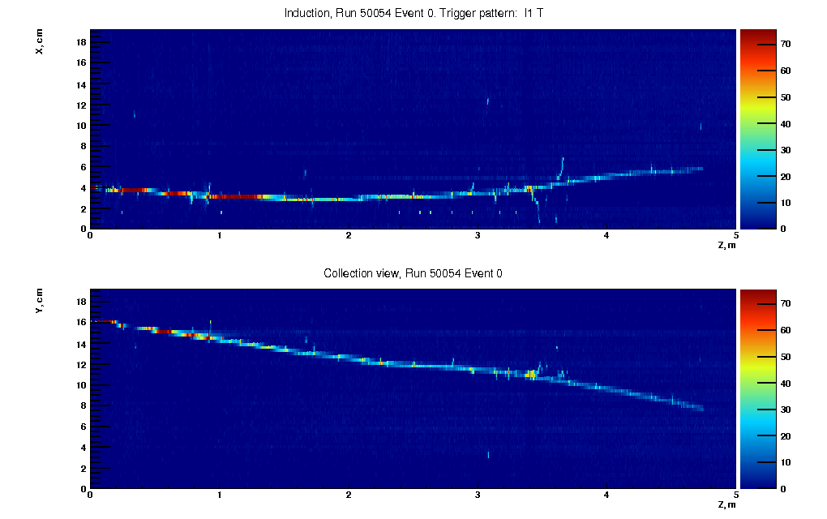
Liquid Argon Time Projection Chamber (LArTPC)
Ionisation tracks
Event Display
Liquid argon:
→ dense (1.4 g/cm³), liquid at 87K
→ abundant (1% of the atmosphere)
→ ionization yield of 55,000 e/cm for a MIP
→ high electron mobility (545 (cm/s)/(V/cm) at 87 K)
→ scintillates and is transparent to the produced light
Deposited charge
Channel #
Drift time

Slide 9
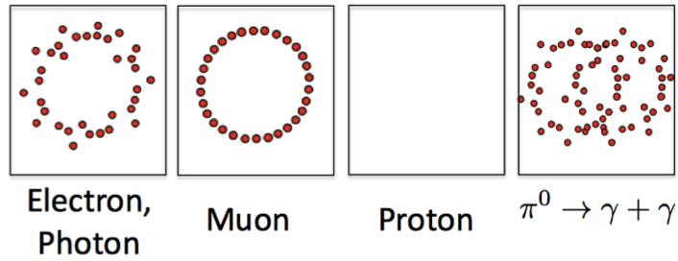
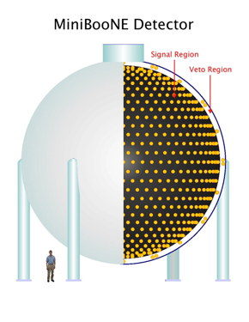
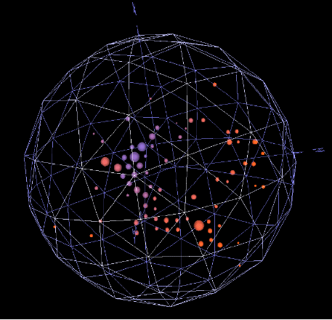
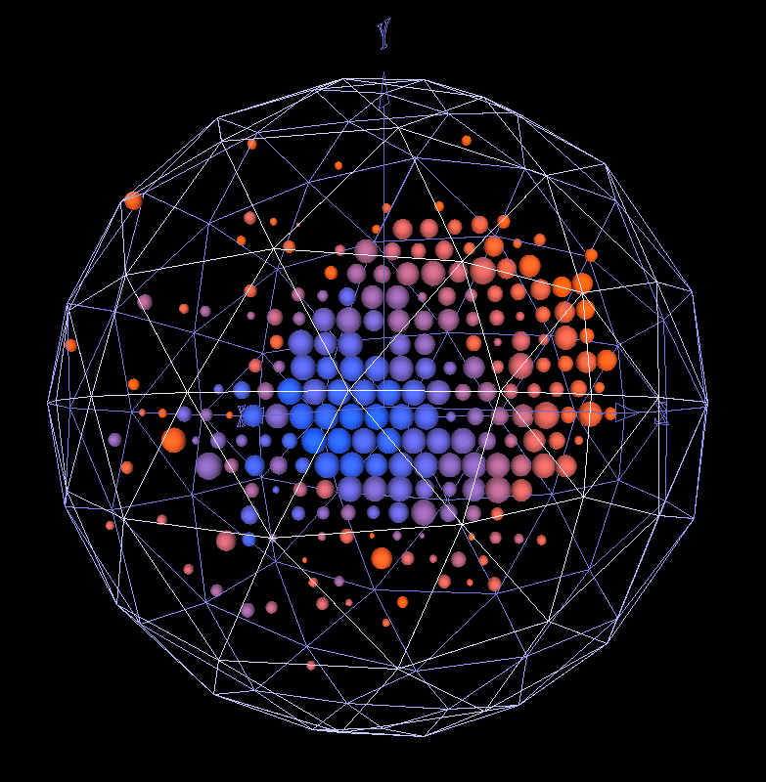
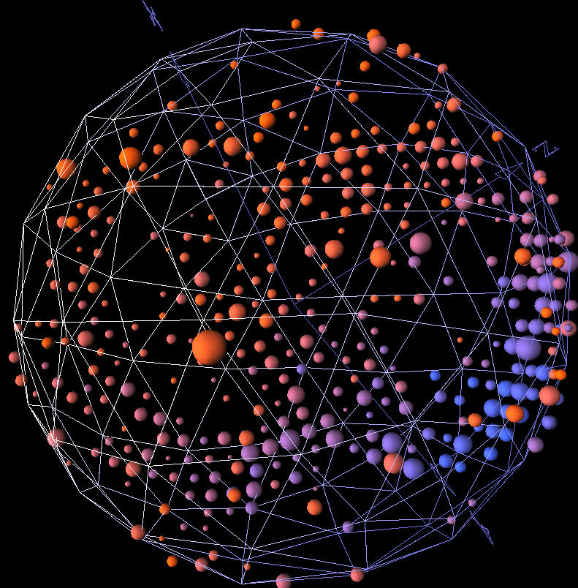
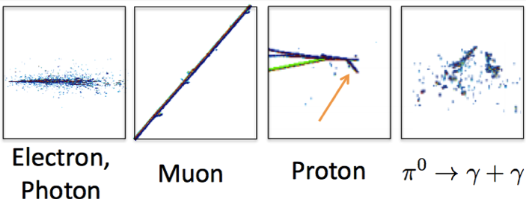
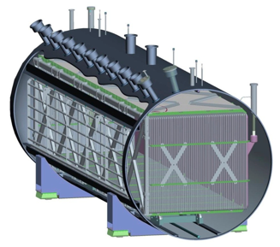
Investigate the Electromagnetic Signal
+ Michel e⁻ in time
Cerenkov detector
MicroBooNE Detector
Liquid Argon TPC

Slide 10
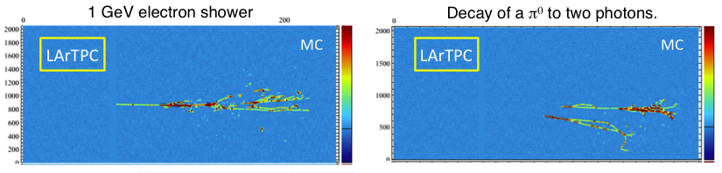
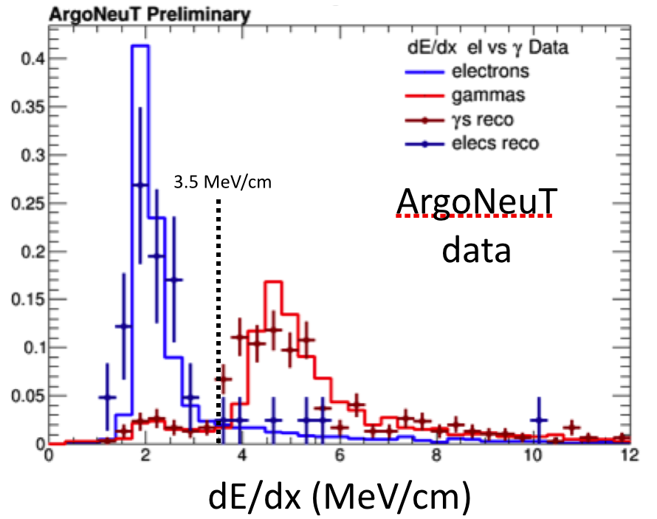

Electron – photon separation
Topology cut at the vertex level
  Photons have a gap
  Electrons/positrons are attached
dE/dx along the first cm of the track

Slide 11
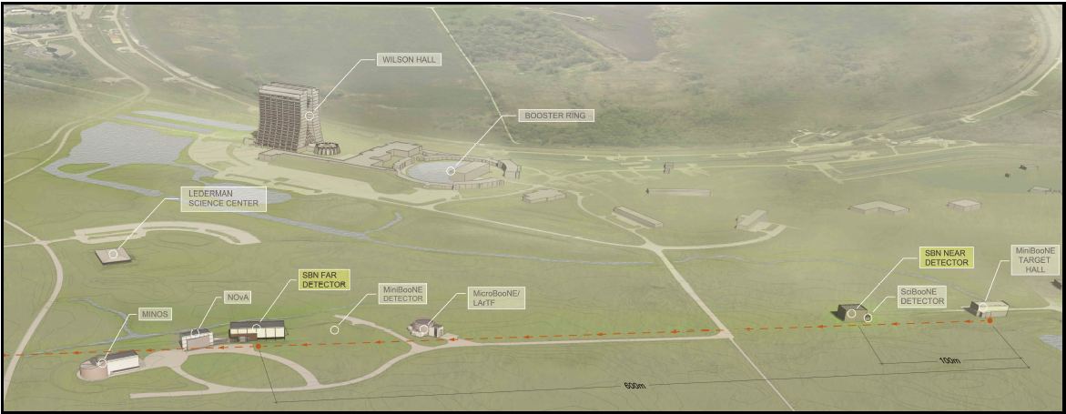
Short-baseline program at Fermilab
MicroBooNE: Investigate the Signal observed in the MiniBooNE
SBN program: Potential of discovering the sterile neutrino nature of the LSND and MiniBooNE signal by usage of detectors at different locations along the BNB, with the SAME technology (LAr1-ND, MicroBooNE, Icarus)

Slide 12
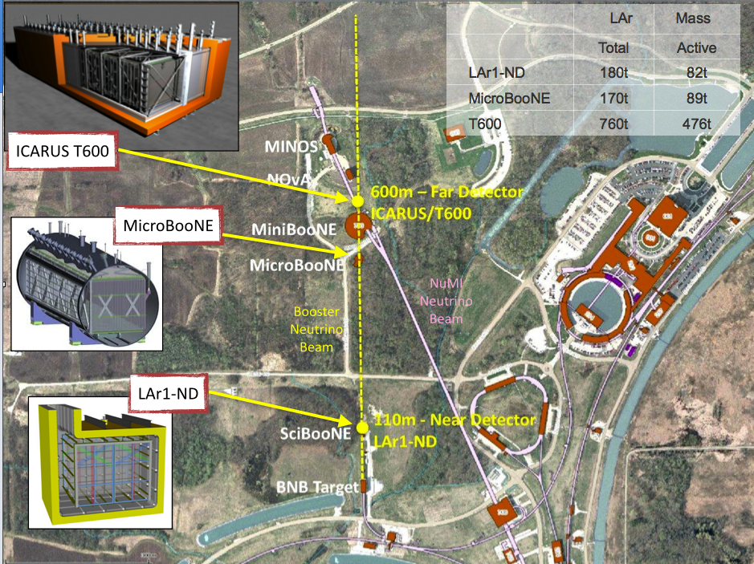
 | LAr | Mass
 | Total | Active
LAr1-ND | 220t | 112t
MicroBooNE | 170t | 89t
Icarus T600 | 760t | 476t

Slide 13
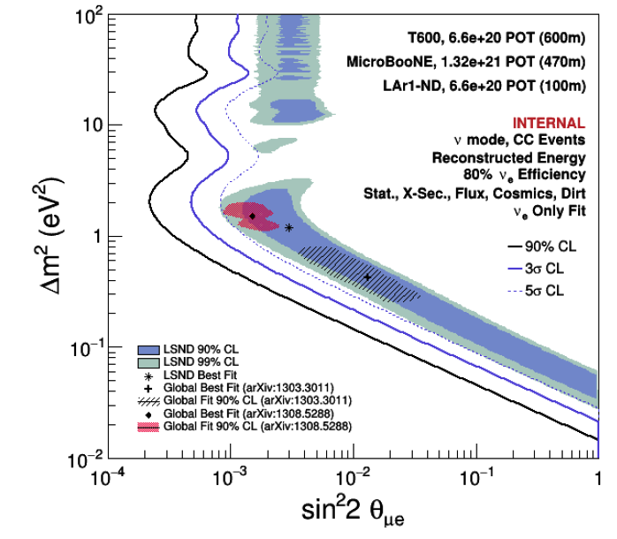
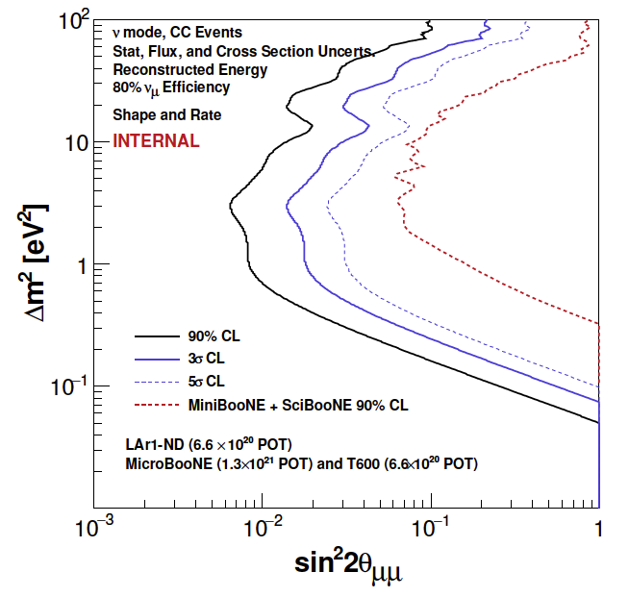
Oscillation Physics
ν_{μ} to ν_{e} oscillation
ν_{e} Appearance
ν_{μ} to ν_{x} oscillation
ν_{μ} Disappearance

Slide 14
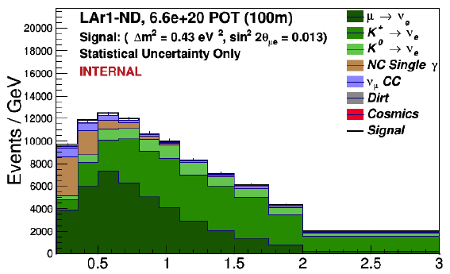
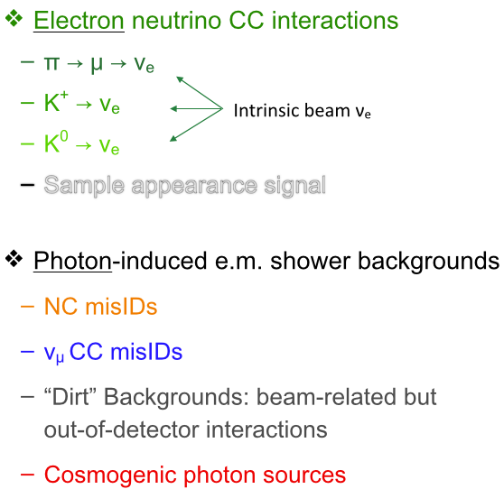
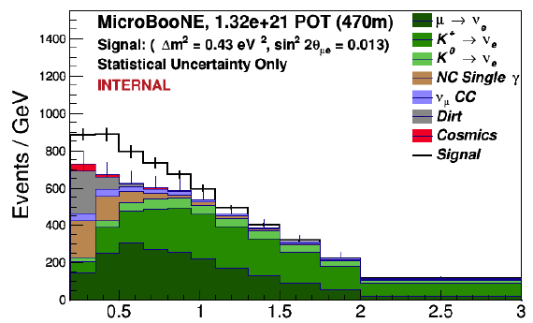
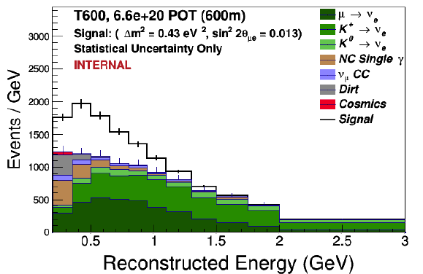
ν_{e} Signal and backgrounds
LAr1-ND
MicroBooNE
Icarus T600

Slide 15

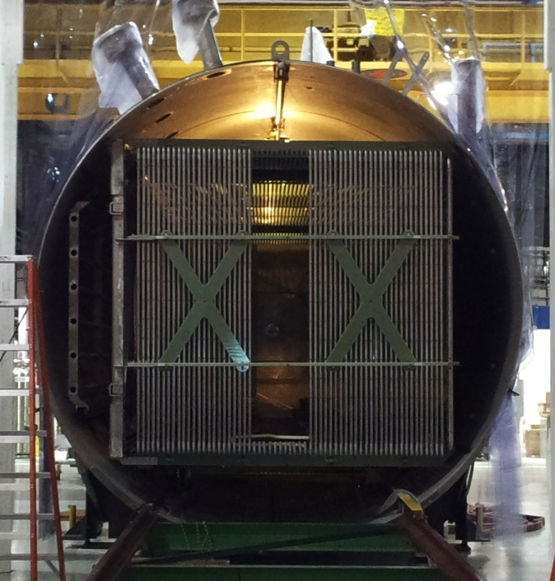
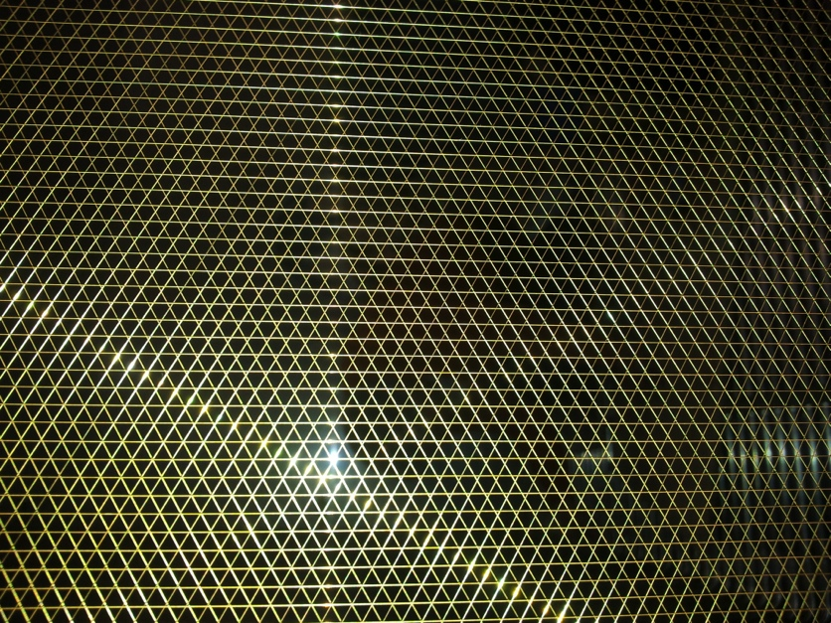
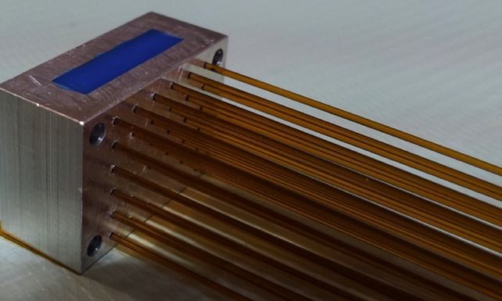
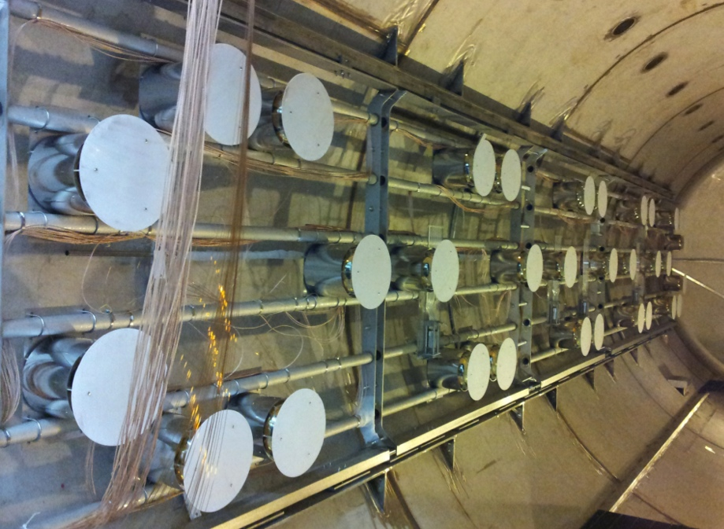
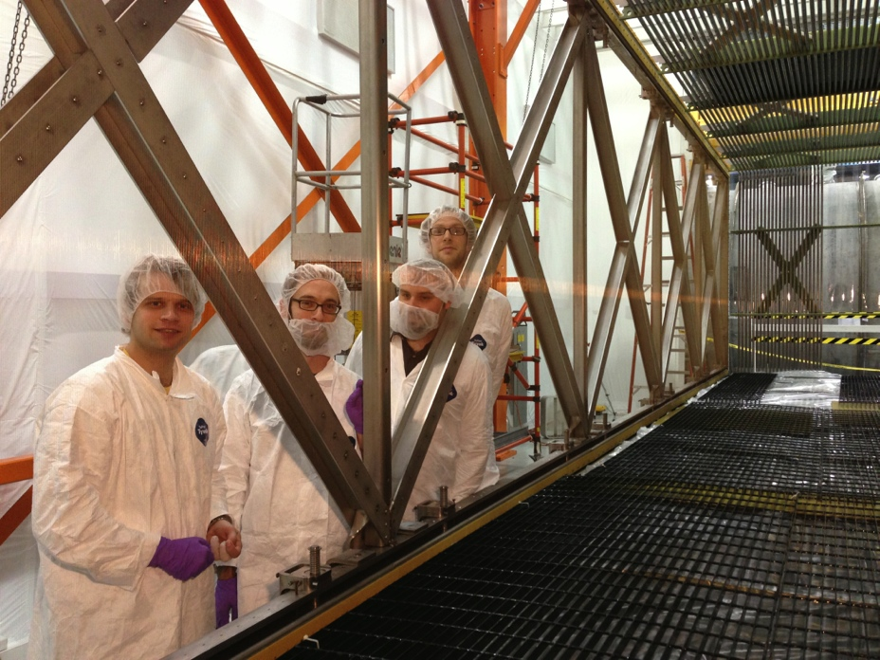
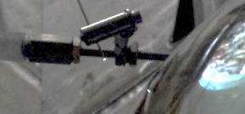
MicroBooNE at 470m
Active mass ~89t
~ 8300 readout wires
High Voltage 128kV
2 UV lasers
32 PMT’s
~2.3m
~2.5m
~10m
Phys Rev D 38, 2(1998), units in mm

Slide 16
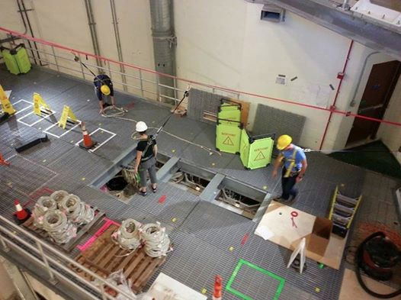
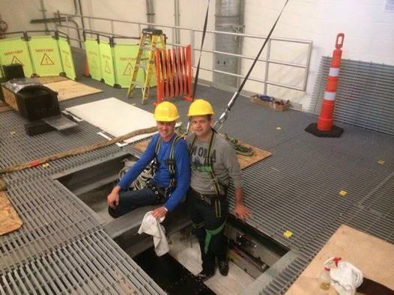
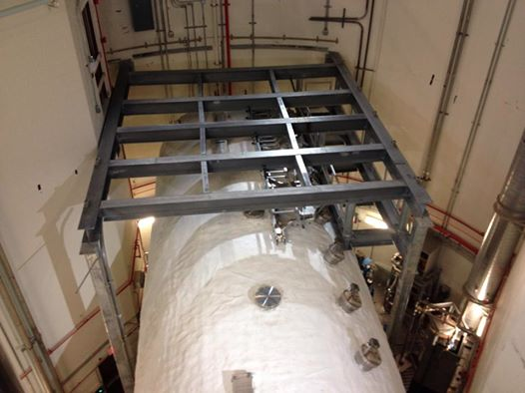





Slide 17

Status
HV system,
PMT system
UV laser system
Electronic readout racks
Cryogenics control
Purity Monitor
Cool down (87K) and filling with liquid argon will start this spring

Slide 18


Space Charge
Field distortion can lead to ‘bend’ tracks
  Surface location leads to abundance of ions
  Drifting ions are 10⁵ times slower than electrons
  HV resistor mismatch

Slide 19





Effects of the non-uniform drift field
Track distortion in a controlled way demonstrates the effect of ‘bend’
M. Lüthi, master thesis LHEP Bern

Slide 20


Drift field calibration with an UV laser
A 266nm UV laser can be used to ionize liquid argon
Send laser along different paths to map the drift field
arXiv:1406.6400
x2

Slide 21




Generate a UV laser beam
Laser box
UV – class 4 laser, invisible but powerful; contained path required

Slide 22




UV laser calibration system
Automatic system, remote control adjustment for position and UV laser energy, provides trigger to the DAQ
arXiv:1406.6400

Slide 23


Correction of the space charge effect
M. Schenk, master thesis LHEP Bern
non-uniform drift field for a TPC
Create straight ionization tracks: UV laser
Non-linear drift field leads to bend tracks compared to the optical path.
arXiv:1408.6635

Slide 24

Thank you

Slide 25



Slide 26


Slide 27


Slide 28



Slide 29


Slide 30


Slide 31


Slide 32




MiniBooNE search for dark matter
Using off-target and send protons on the beam dump
Charged mesons are absorbed/interact before decay: less ν
π₀ -> γ which may mix with dark photons, giving a signal in detector @540m

Slide 33



Slide 34


Preliminary Results (30% of data)
Similar event reconstruction as in beam-on-target antineutrino analysis.
• Monte Carlo neutrino background prediction tied to measured muon CCQE rate.
• Background stat. error dominated by beam-unrelated (cosmics) events.
• Working on further decreasing the ~16% systematic error on NC neutrino background.
• Data in agreement with background predictions.
• Use this dataset to study PID and background reduction techniques. The rest of the data will be used for the analysis.

Slide 35

MiniBooNE data
this data is challenging our assumptions about the size and source of
nuclear effects at ~1 GeV ν energies
data is being heavily utilized by
the community, a recent example
from MiniBooNE QE sample
- observe a substantially larger QE σ
than the ν predictions we have all
been using for decades, effect is
larger for larger μ scattering angles
there are sizable effects due to
correlated nucleons in the nucleus
- 1st seen in e-nucleus scattering
- now being put in ν Monte Carlos
there is a lot we still need to learn
about these correlated pairs (would like to measure proton emission, multiple energies & nuclei)
MiniBooNE QE data
Lalakulich, Gallmeister, Mosel, arXiv:1203.2935

