Slide 1
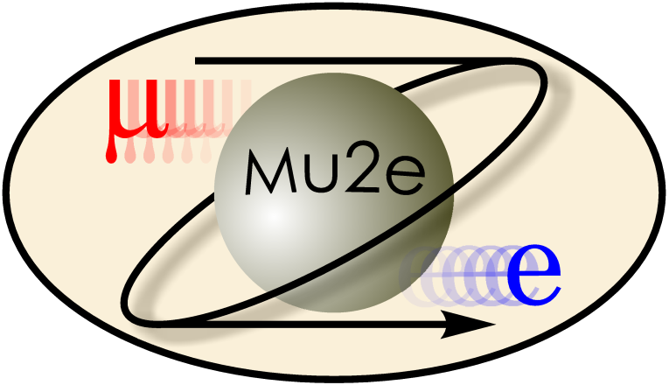

Mu2e: Probing the Frontiers of Physics Using Rare Particle Decays
E. Craig Dukes
University of Virginia
for the Mu2e Collaboration
Lake Louise Winter Institute
February 19, 2015

Slide 2
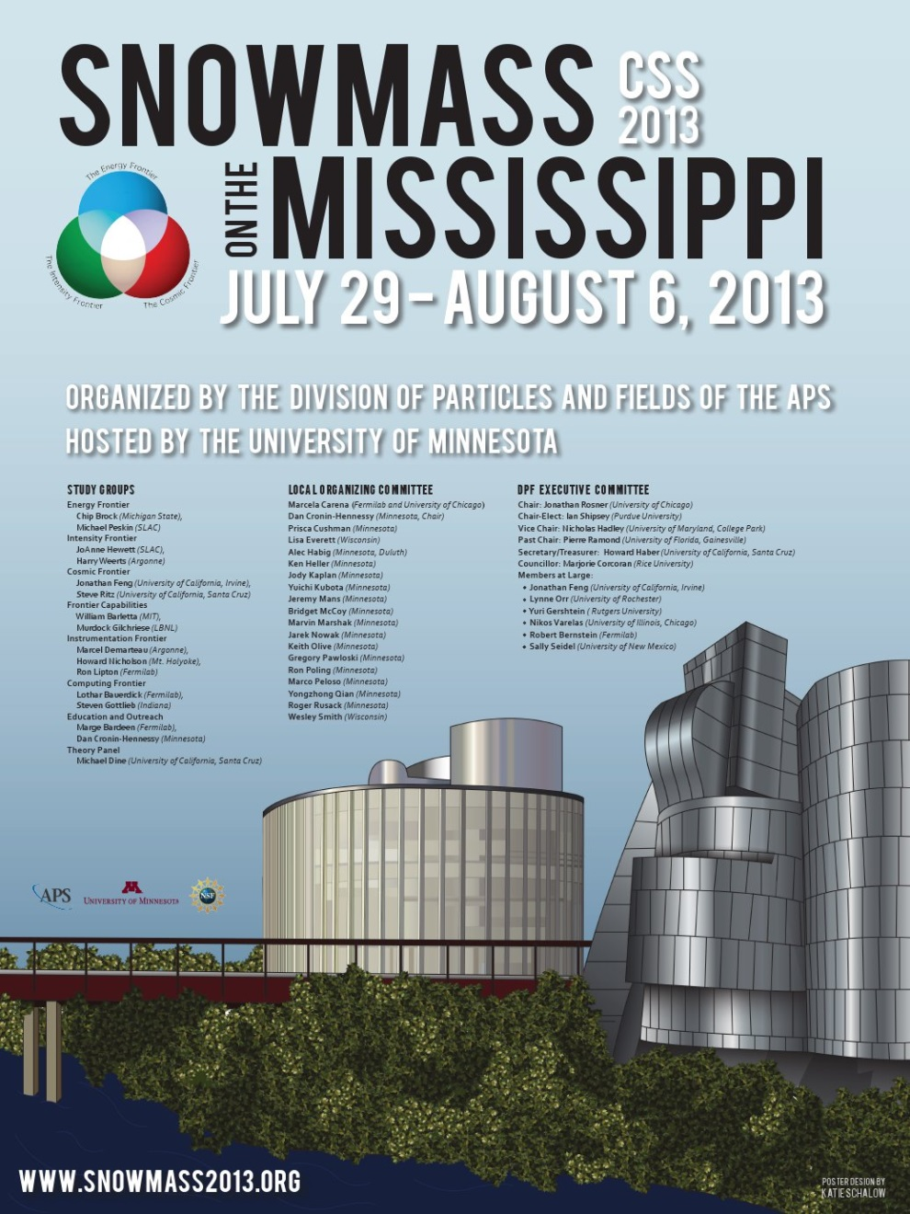
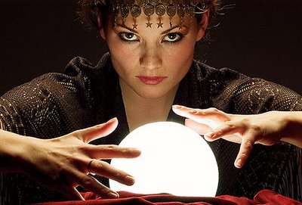
Planning the Future of Particle Physics
Two summers ago about a 1,000 physicists gathered together in Minneapolis for two weeks to plan the future of particle physics in the United States for the next decade.
“Prediction is very hard, especially about the future”
Yogi Berra

Slide 3
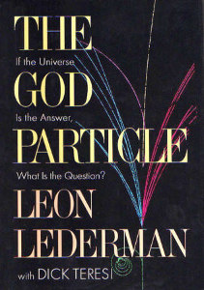
Context of Snowmass was Two Profound Discoveries
The discovery of the Higgs boson by the LHC
The particle that gives mass to all of the fundamental particles.
The Standard Model of particle physics is now complete.
CERN, July 4, 2012

Slide 4
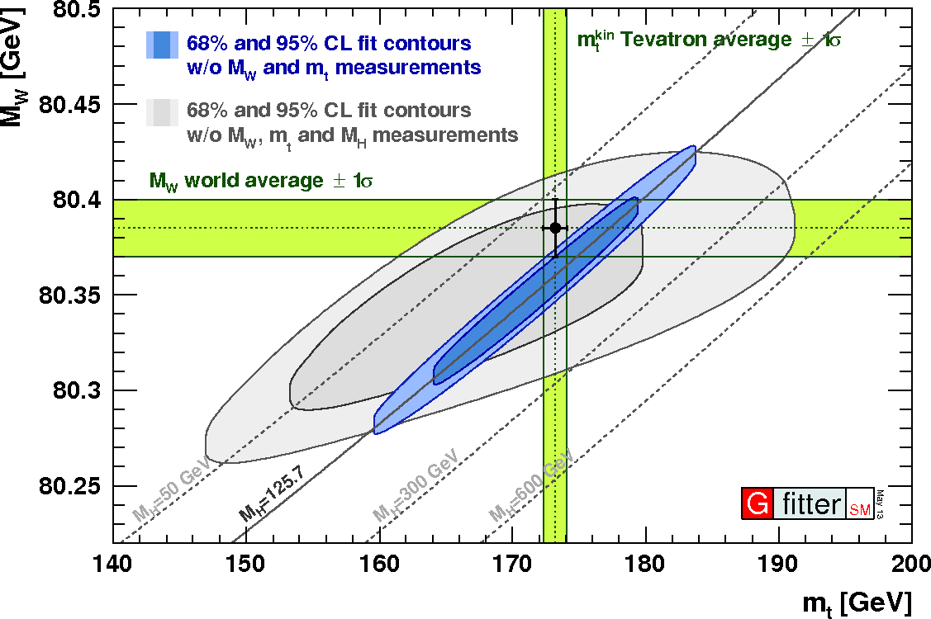
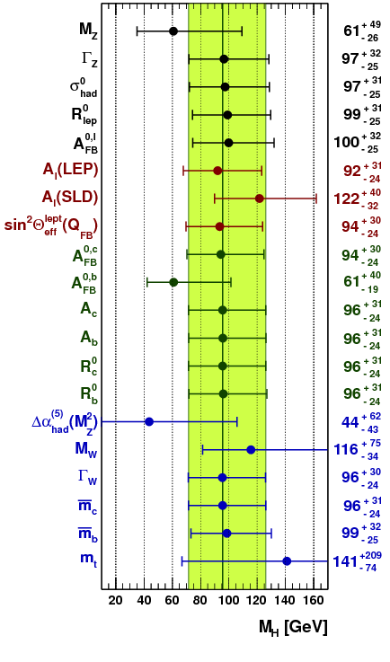
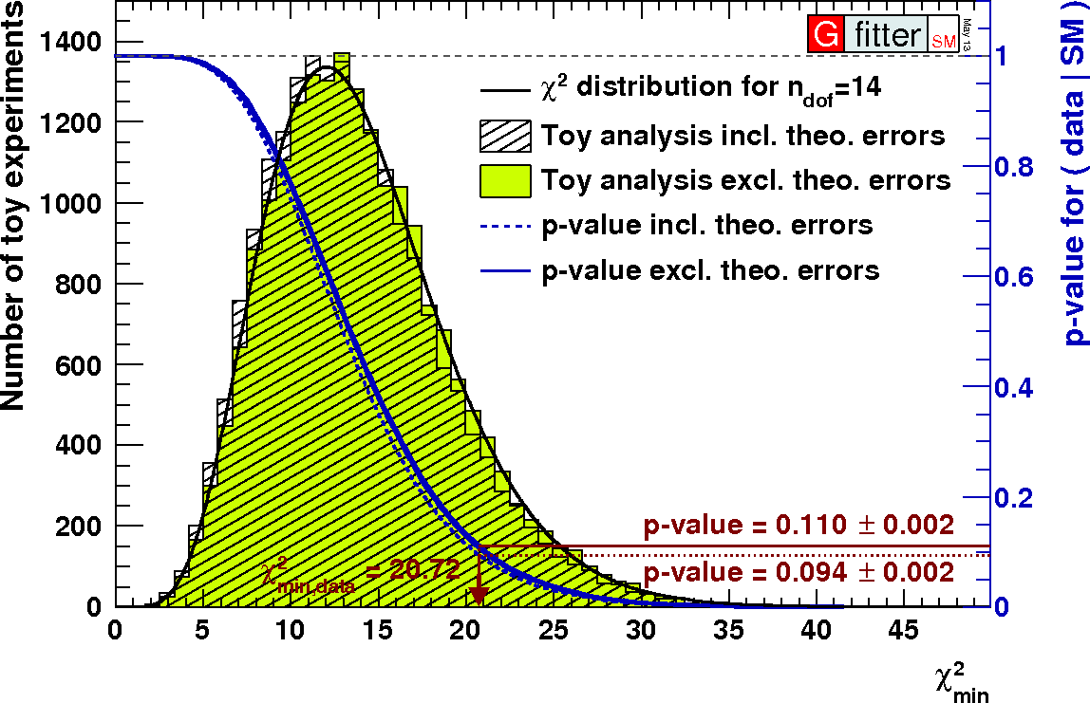
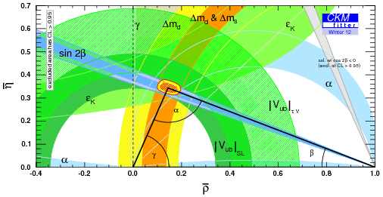
Standard Model and Data Agree Exquisitely Well!

Slide 5

Second Profound Discovery
The non-discovery of Supersymmetry by the LHC

Slide 6
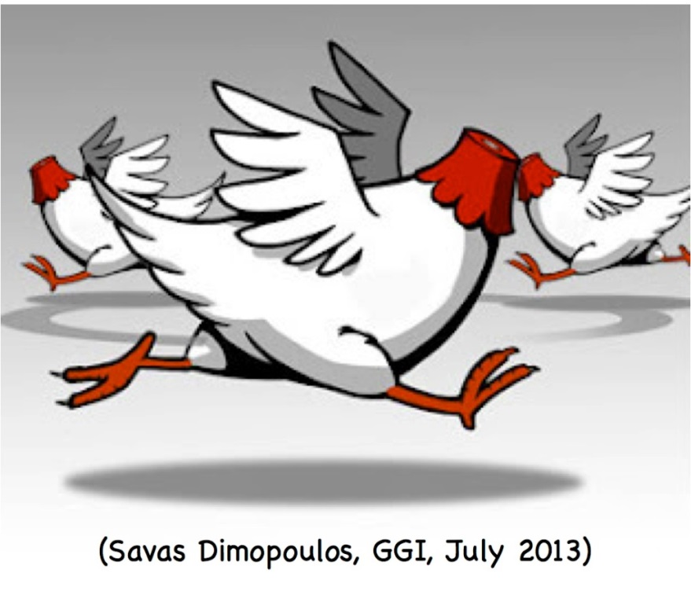
Current State of Theoretical Physics
We have a Standard Model that explains (almost) everything we see in our accelerator-based particle experiments.
It does not explain very gross features we unambiguously observe in the universe: dark matter, dark energy, antimatter asymmetry.
“If you ask most theorists working on particle physics, they’re in a state of confusion.”
Neil Turok, Director Perimeter Institute
How do we proceed from here?

Slide 7
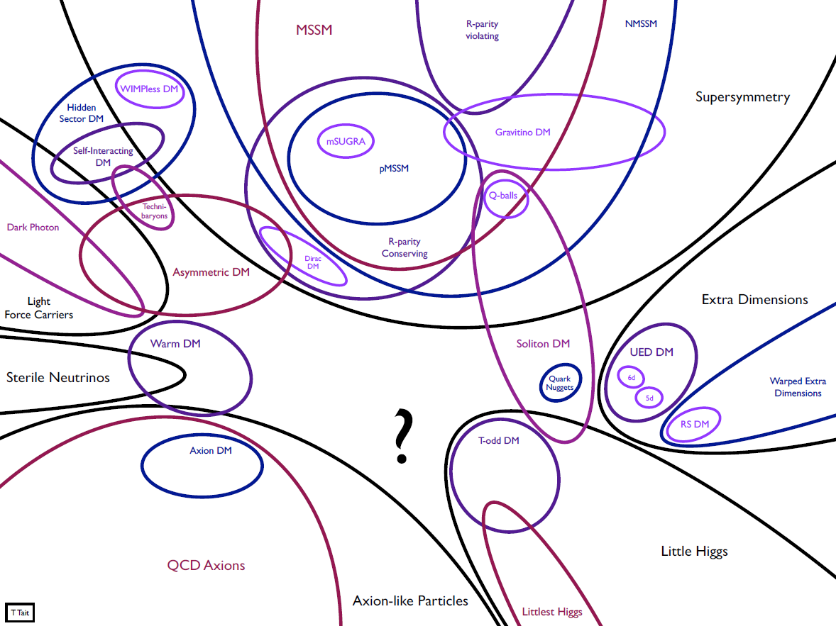
No Lack of Theoretical Ideas, but Little Guidance

Slide 8
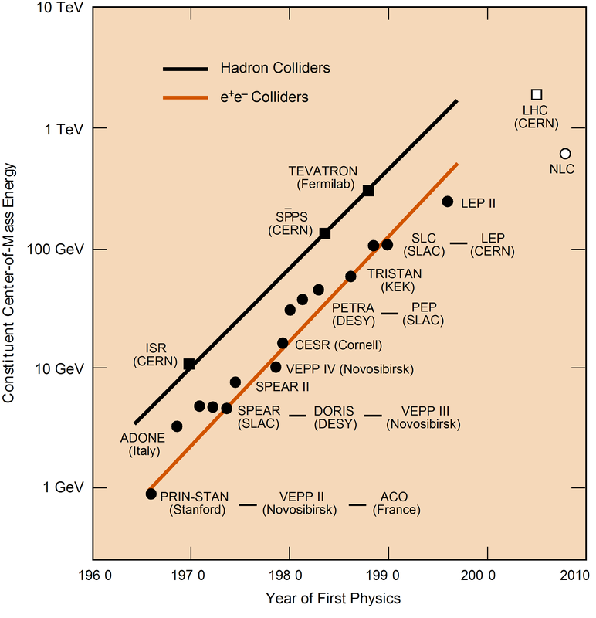
What Energy Accelerator is Needed to Probe New Physics?
We don’t know!
There is no guarantee that a new accelerator 10X or 100X the LHC energy will see anything new: just confirm the Standard Model at a new energy scale.
And accelerators are not cheap: a 10X the LHC energy accelerator would cost tens of billions of dollars.
Higgs
EW force
carriers
How best can we probe vastly higher energy scales?
Notes:
So what about the next step? How are we going to probe energy scales that are beyond the reach of the Large Hadron Collider? Although there has been an inexorable increase in accelerator energies over the last 50 years, as you can see by this plot particle physicists call the Livingston plot, for the first time in brief history of the field there are no concrete plans for the next generation of higher-energy accelerators. There is the International Linear Collider, called the NLC here, but it is designed to make precision studies of the regime first explored by the LHC, not to probe the next energy frontier.
How are we going to probe higher energies?

Slide 9
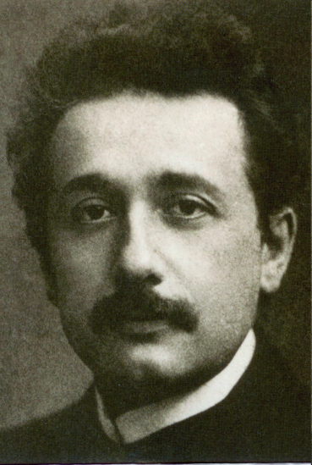
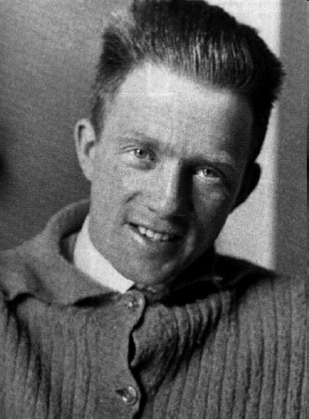
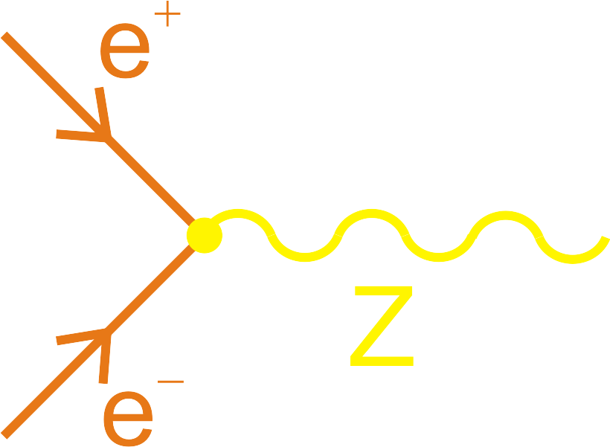
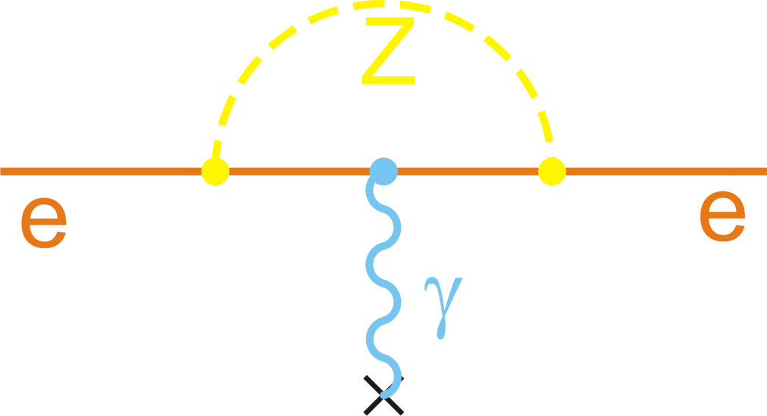
Rather than exploiting Einstein’s mass-energy relation, E=mc², exploit Heisenberg’s uncertainty principle, ΔEΔt≳ħ/2
Highest energy crucial
Highest intensities crucial
Notes:
The answer is we must turn away from our reliance on Einstein’s mass-energy relation, E=mc2, and exploit Heisenberg’s uncertainty principle. So, for example, rather than directly producing the Z boson, one of the carriers of the weak force, through electron-positron annihilation, we look for the effects of a virtual Z boson, which according to Heisenberg, even at low energies can be produced ever so briefly, and hence change for example, some of the properties of the electron, in particular, its magnetic moment. Such virtual particles appear and then disappear in what particle physicists call loop diagrams, which you will see throughout my talk.
In directly producing real particles the highest energies are crucial, the energy must be greater than the rest mass of the particle to be created. On the other hand, the effects of virtual particles can be quite subtle and hence large numbers are needed.

Slide 10
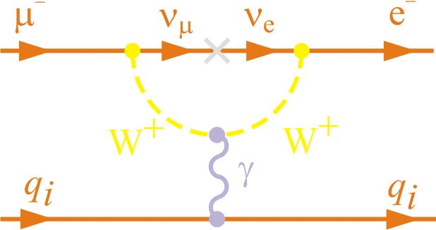
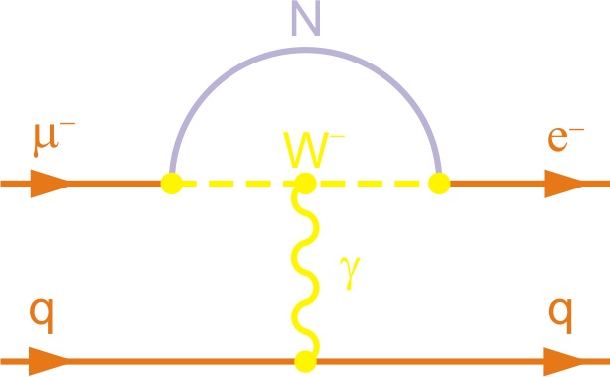
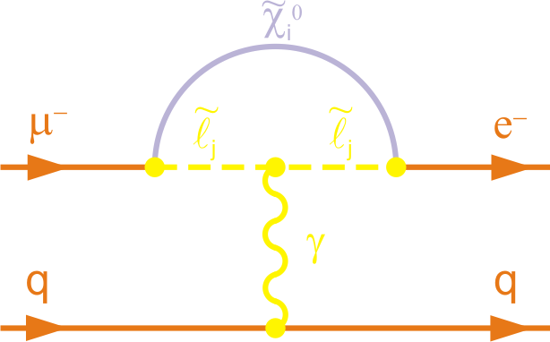
Mu2e: Probe New Physics Charged Lepton Flavor Violation
In Standard Model not there ⇨ neutrino mass discovery implies an unobservable 10⁻⁵² rate
Hence, any signal unambiguous evidence of new physics
Exquisite sensitivities can be obtained experimentally
  sensitivities that allow favored beyond-the-standard-model theories to be tested
Supersymmetry
New heavy neutrino

Slide 11
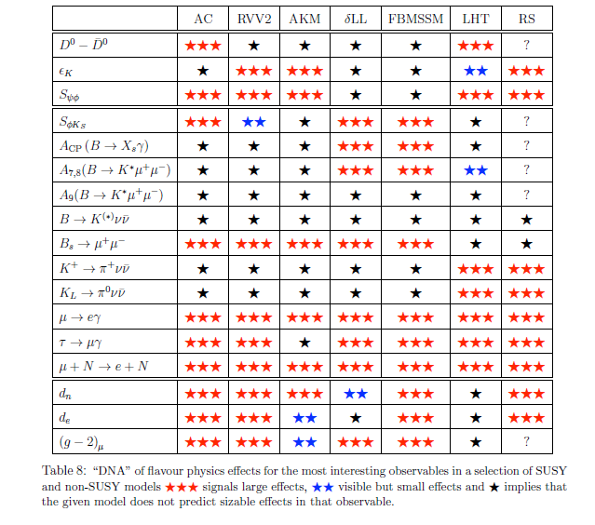
Why Muon-to-Electron Conversion?
Different SUSY and non-SUSY BSM models
Large effects
Visible, but small
No sizable effect
Altmannshofer et al., NPB 830, 17 (2010)

Slide 12
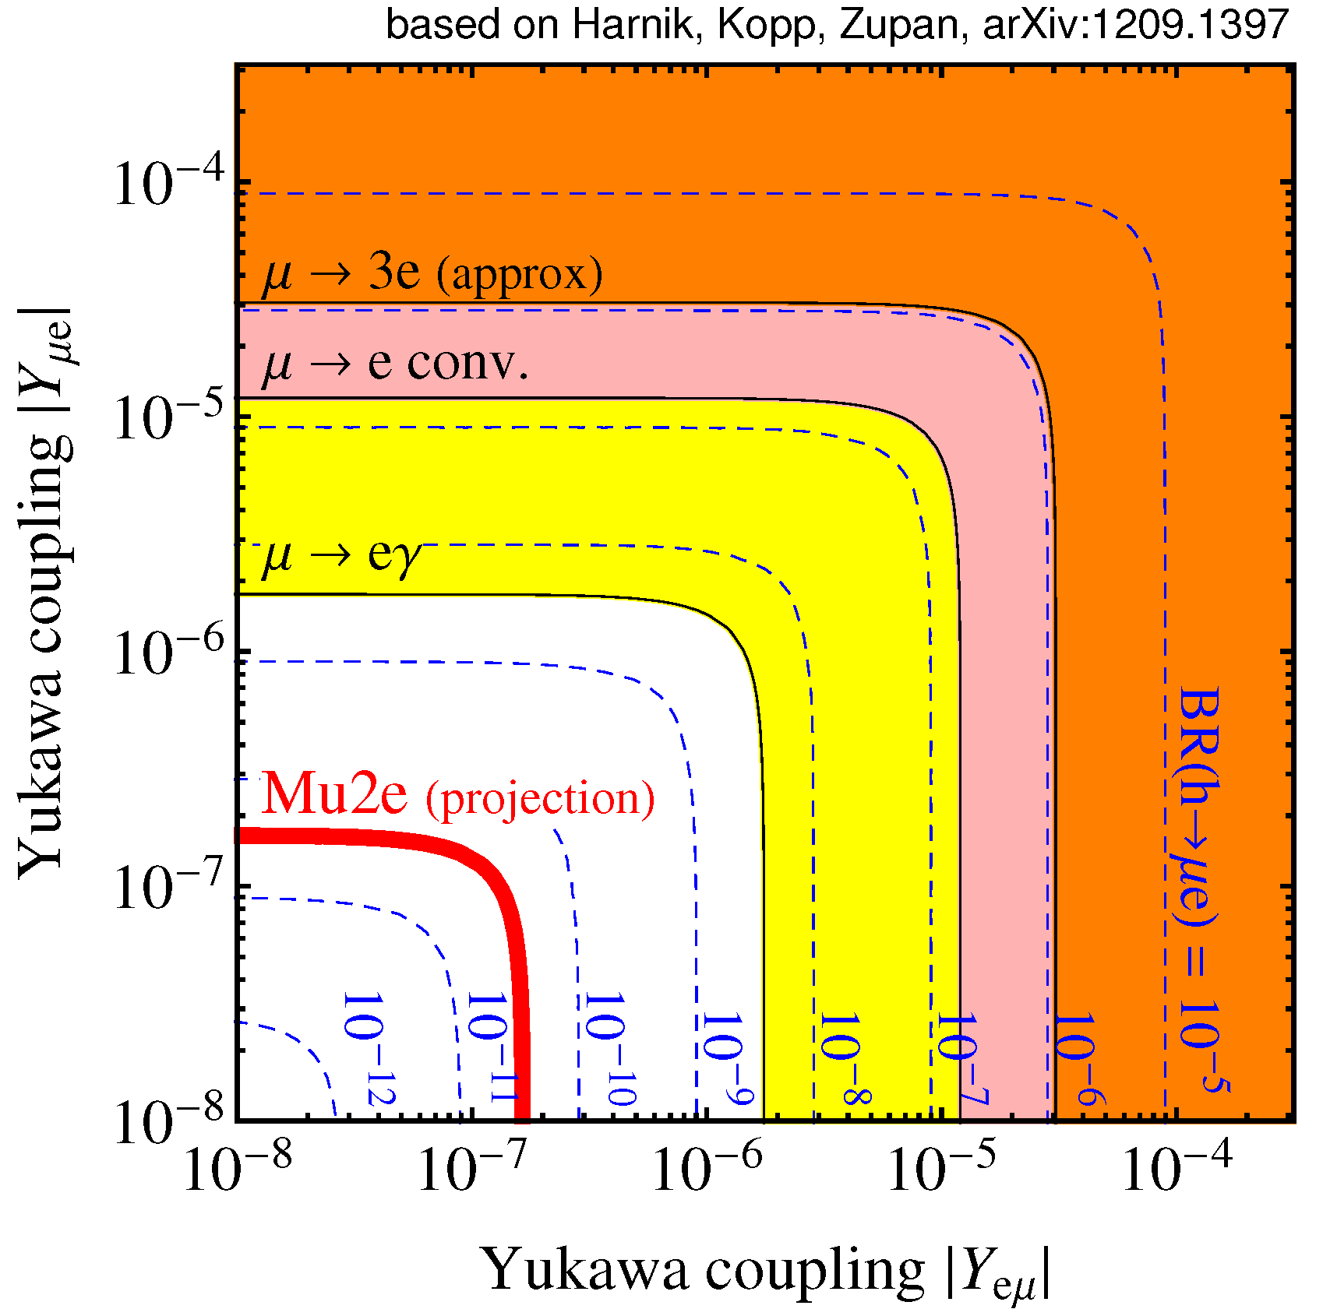
Example: Flavor-Violating Higgs Decays
Flavor violating HIggs couplings: h → μe
Mu2e sensitivity:

Slide 13


Mu2e Looking for an Exceedingly Rare Event
To achieve our proposed sensitivity of 3 x 10⁻¹⁷, a factor of 10,000 better than present limit, the number of muons needed is ~10¹⁹, roughly the number of grains of sand on Earth: ~10¹⁹

Slide 14
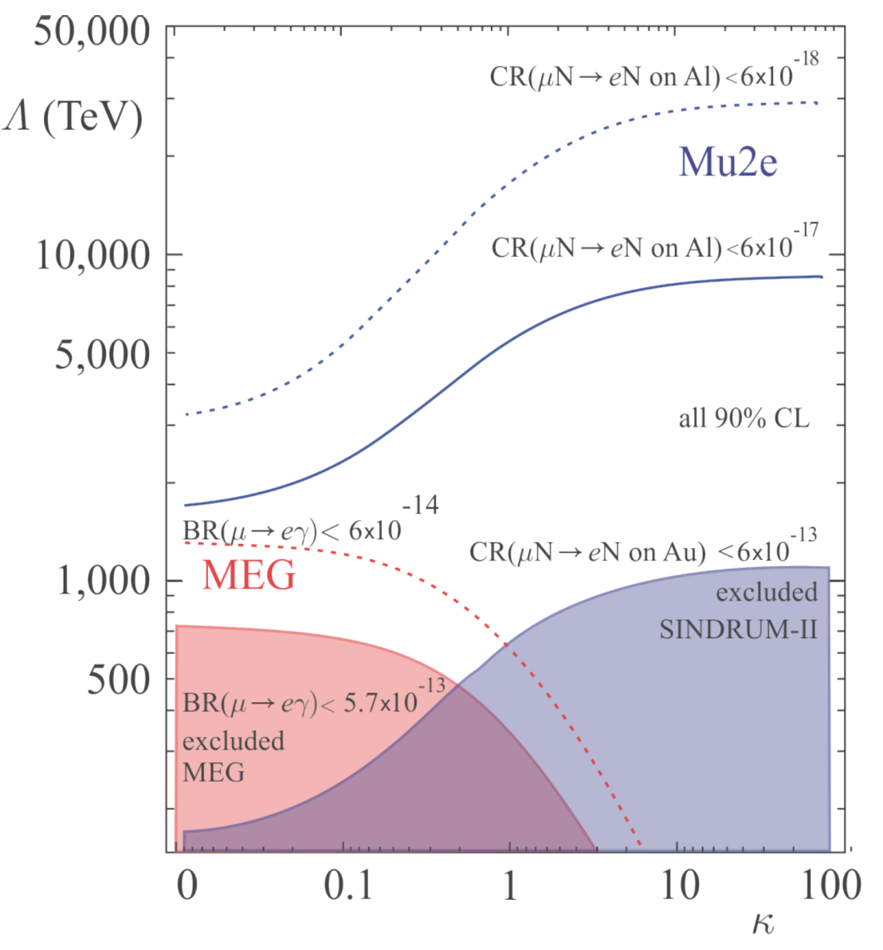
Mu2e Will Indirectly Probe Extremely High Mass Scales
Up to 10,000 TeV
or about ~10,000 times
that probed directly by
the LHC
loop dominated
contact dominated

Slide 15
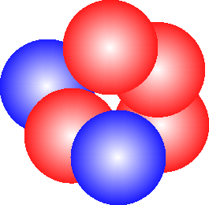
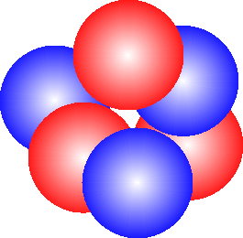
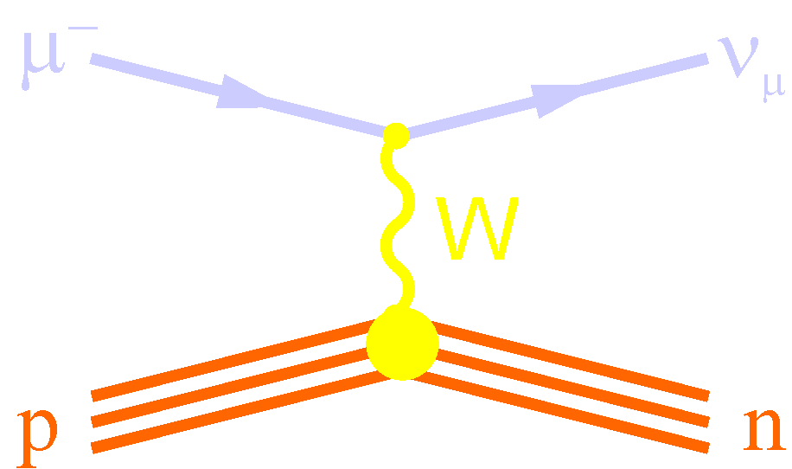
How to Search for μ⁻N→e⁻N
Stop muon in atom
Muon rapidly (10⁻¹⁶s) cascades to 1S state
Circles the nucleus for up to ~2 μs
Two things most likely happen:
  muon is captured by the nucleus: μ⁻N_{A,Z}→ν_{μ}N_{A,Z-1}
  muon decays in orbit: μ⁻N_{A,Z}→e⁻ν_{μ}ν_{e}N_{A,Z}
ν_{μ}
μ⁻
Al²⁶
Mg²⁶
Muon Capture

Slide 16
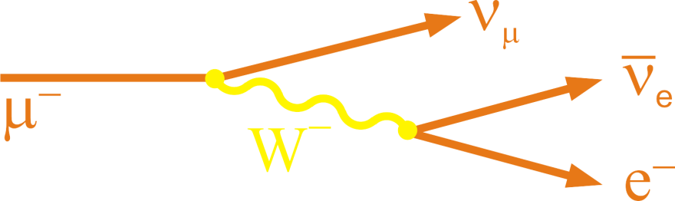
How to Search for μ⁻N→e⁻N
Stop muon in atom
Muon rapidly (10⁻¹⁶s) cascades to 1S state
Circles the nucleus for up to ~2 μs
Two things most likely happen:
  muon is captured by the nucleus: μ⁻N_{A,Z}→ν_{μ}N_{A,Z-1}
  muon decays in orbit: μ⁻N_{A,Z}→e⁻ν_{μ}ν_{e}N_{A,Z}
Al²⁶
e⁻
Muon Decay-in-Orbit

Slide 17
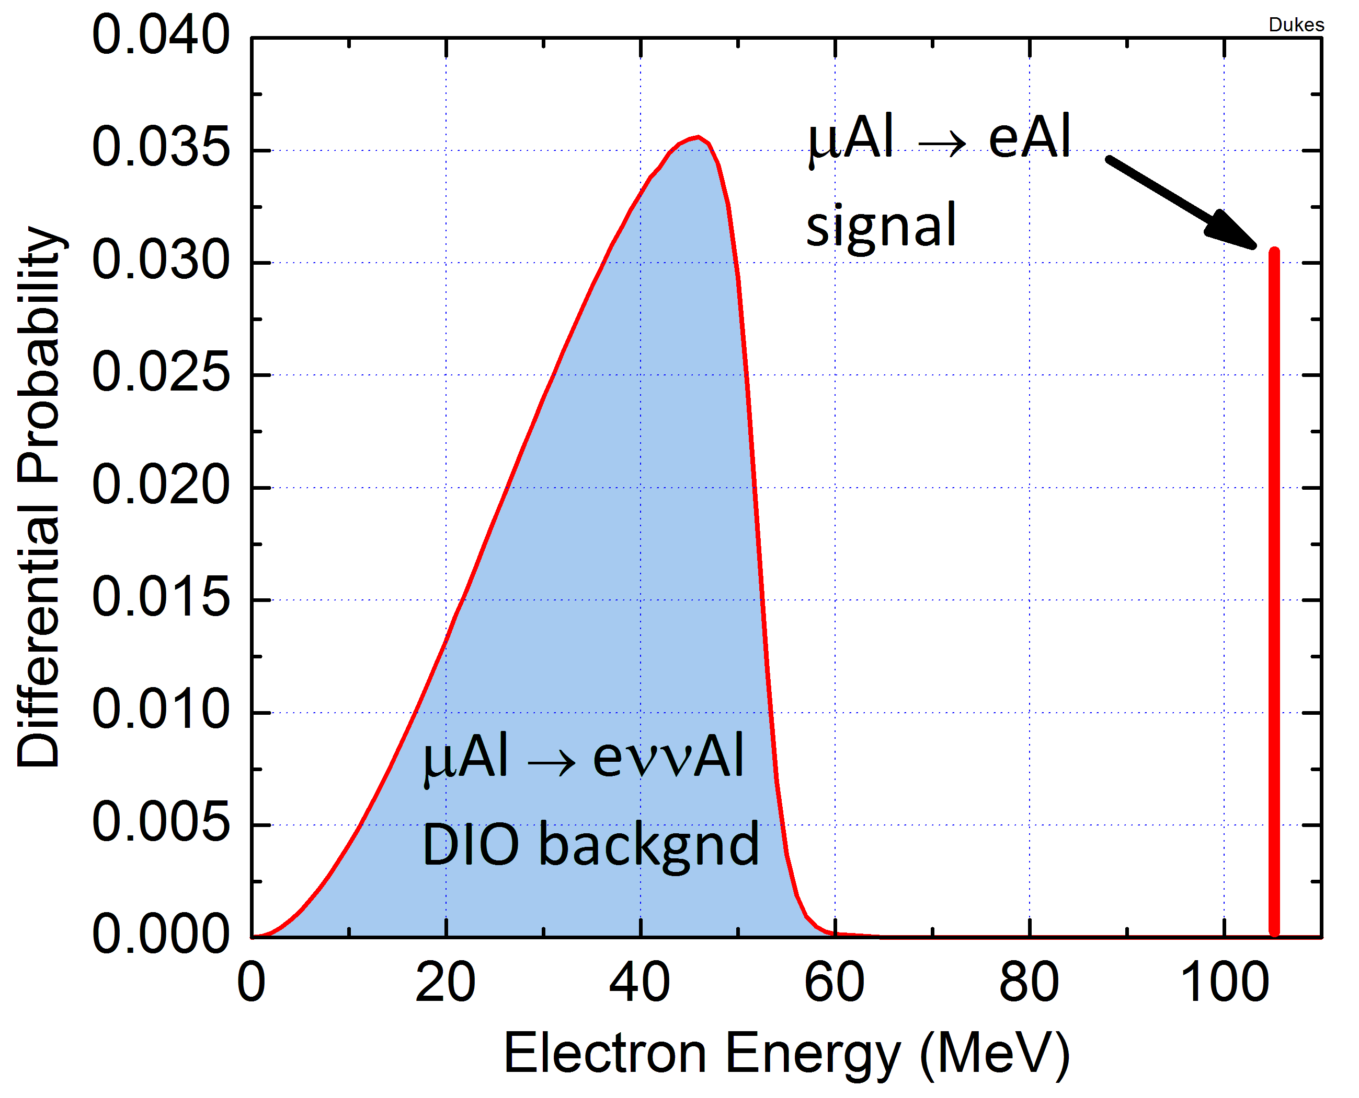
Mu2e Searching for a Third Process: μ⁻N→e⁻N
In μ⁻N→e⁻N the muon coherently interacts with nucleus leaving it in ground state
  signature delayed single isolated electron
  Electron energy is rest mass of the muon minus the nucleus recoil + binding energy:
  E_{e} = m_{μ} – E_{NR} - E_{b} ~ 104.97 MeV (Al)
Al²⁶
e⁻

Slide 18
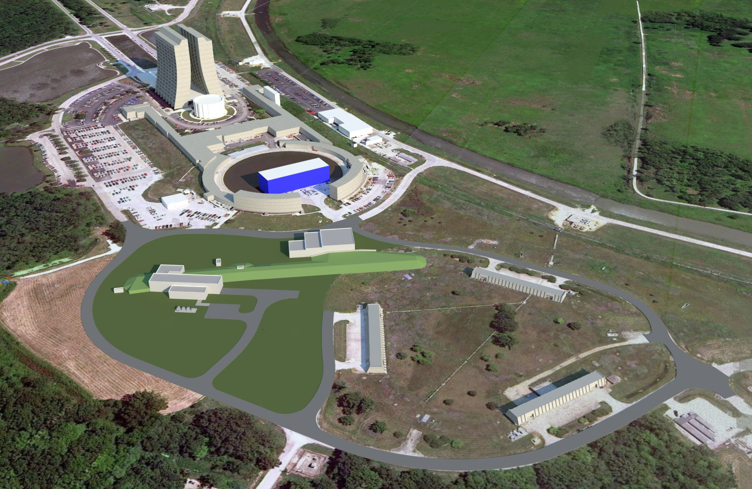
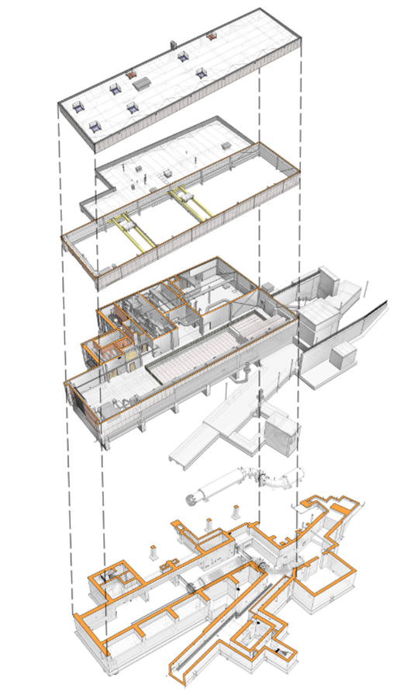
New Beamline and Detector Hall to be Built
g-2
Mu2e

Slide 19
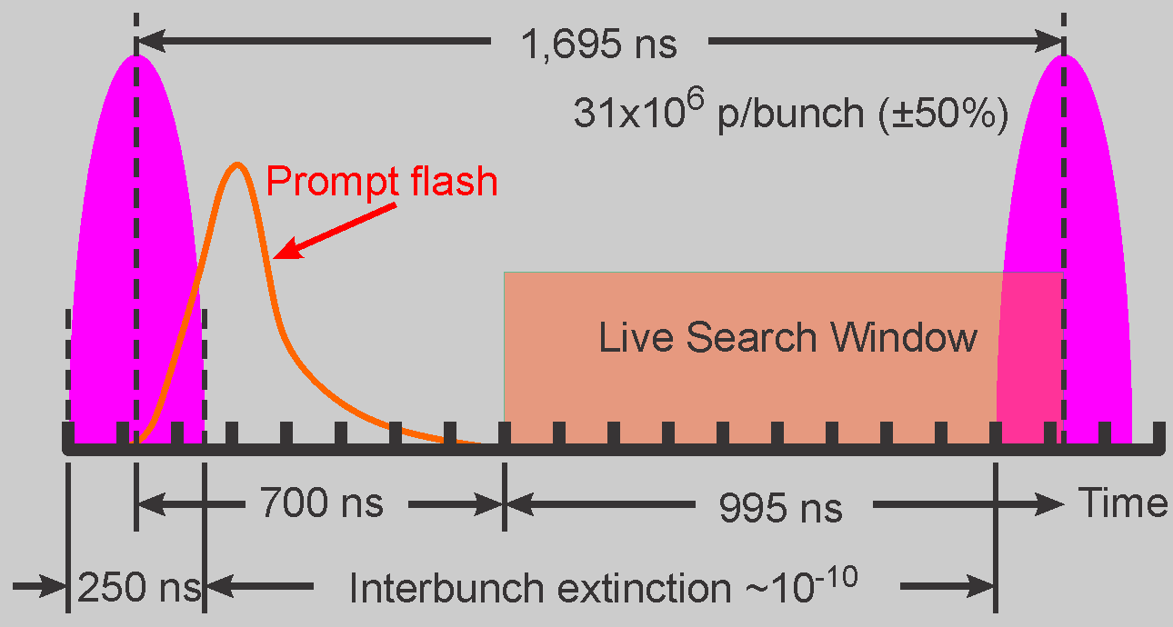
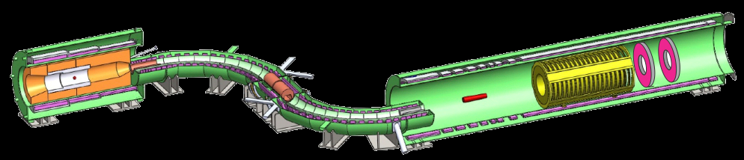

Mu2e Apparatus
Salient Features
Graded solenoidal field for pion capture
Muon transport in curved solenoid to eliminate neutral and positive particles
Pulsed beam to kill prompt backgrounds
No detector elements in muon beam
Muon Beam
Spectrometer
Production Solenoid
Transport Solenoid
Detector Solenoid
2.5T
1.0T
4.6T
2.0T
Production Target
Collimators
Stopping Target
Tracker
Calorimeter
25 m
50,000 μ⁻ stop every 1.7 μs
30 billion μ⁻ stops/spill-second

Slide 20
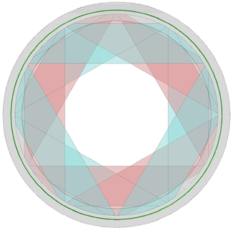
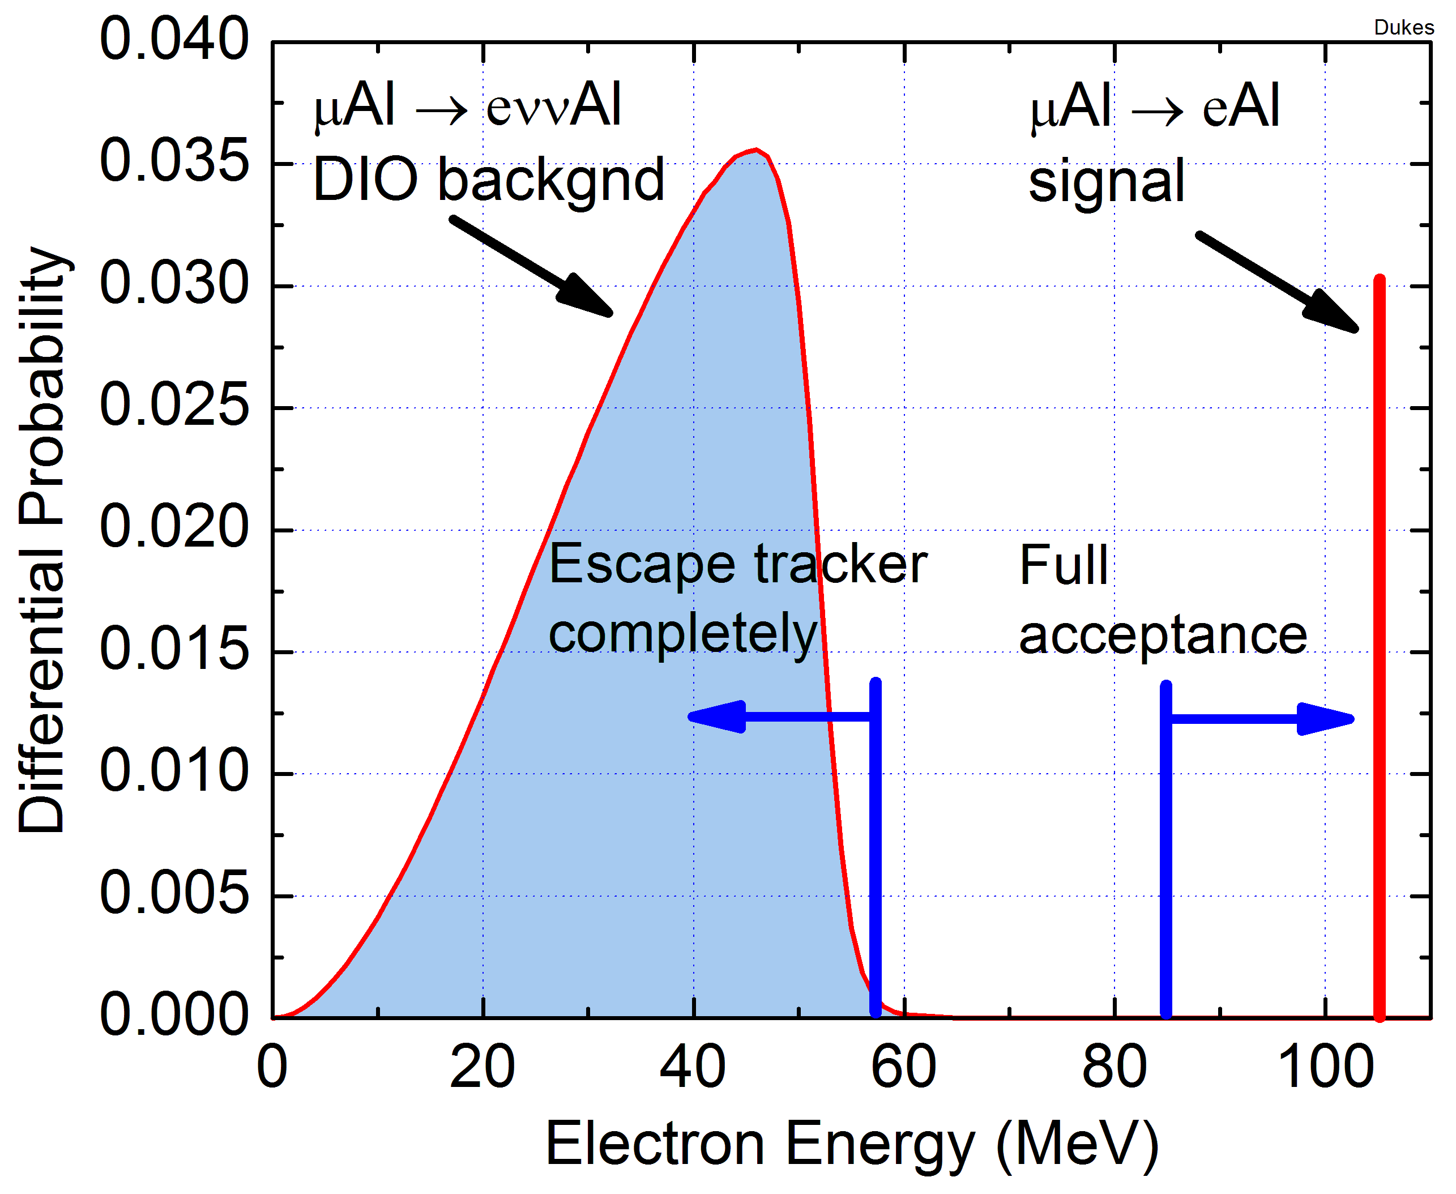
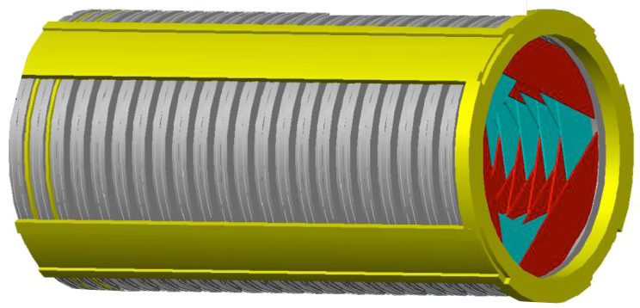
Heart of the Spectrometer: Straw Tracker
23,000 5-mm diameter straws arranged in octangonal geometry
Center beam region empty: intense muon beam passes freely through
Signal/DIO acceptance: >20%/<10⁻³
Excellent energy resolution: 115/175 KeV/c
Front View
Low energy DIO tracks
Target Foils
Trajectories
P_{t} > 90 MeV
90°±30°
85 cm
R=57 MeV
38 cm
Notes:
20

Slide 21
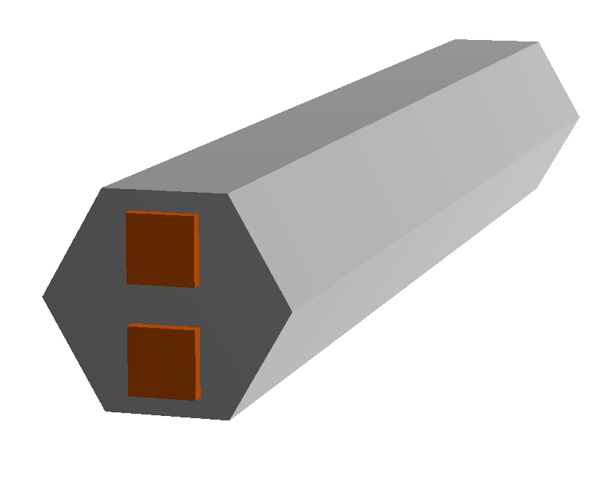
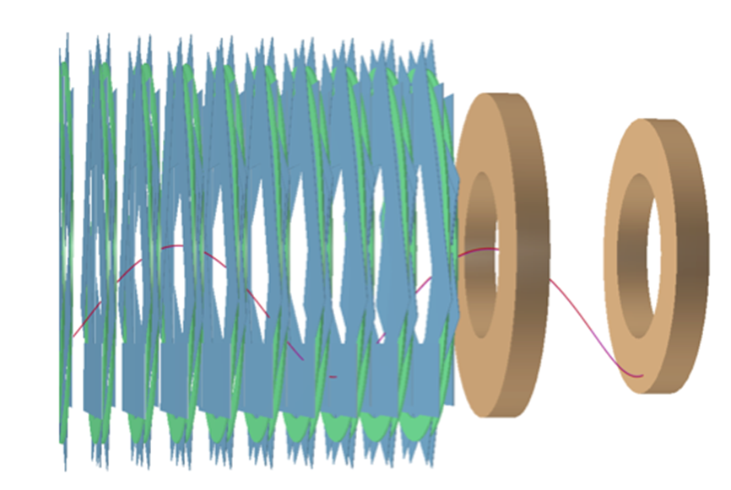
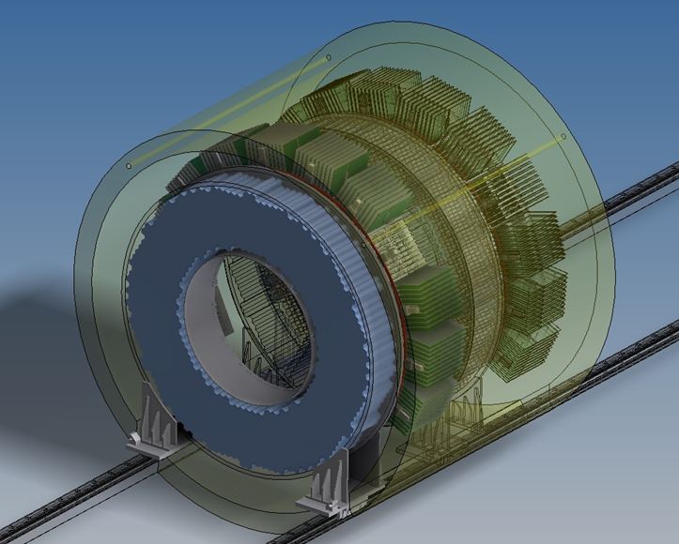
Electromagnetic Calorimeter
Needed for:
  Timing
  Confirmation of tracker energy measurement
  Particle ID: e vs μ
1500 BaF₂ crystals
Dual APD readout

Slide 22
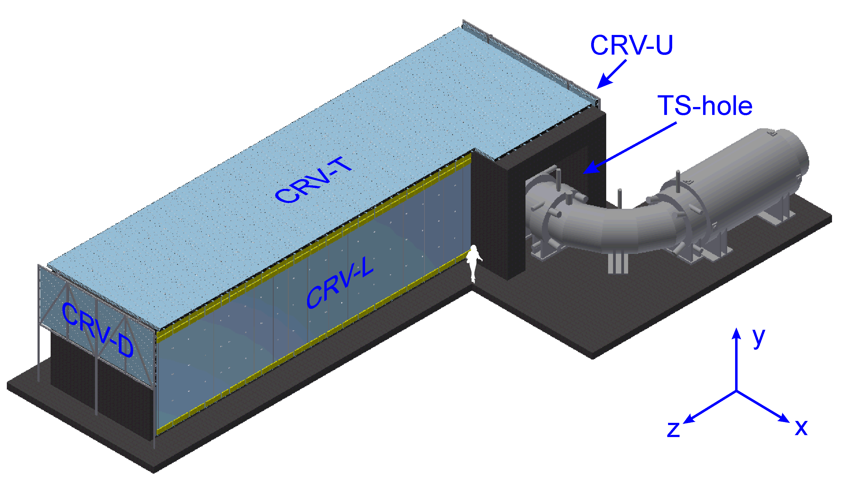
Cosmic Ray Veto
One fake event/day from cosmic-ray muons
Hence need 10⁻⁴ Inefficiency
Surround Detector Solenoid by 4 layers of scintillator read out by waveshifting fibers, and silicon photomultipliers

Slide 23
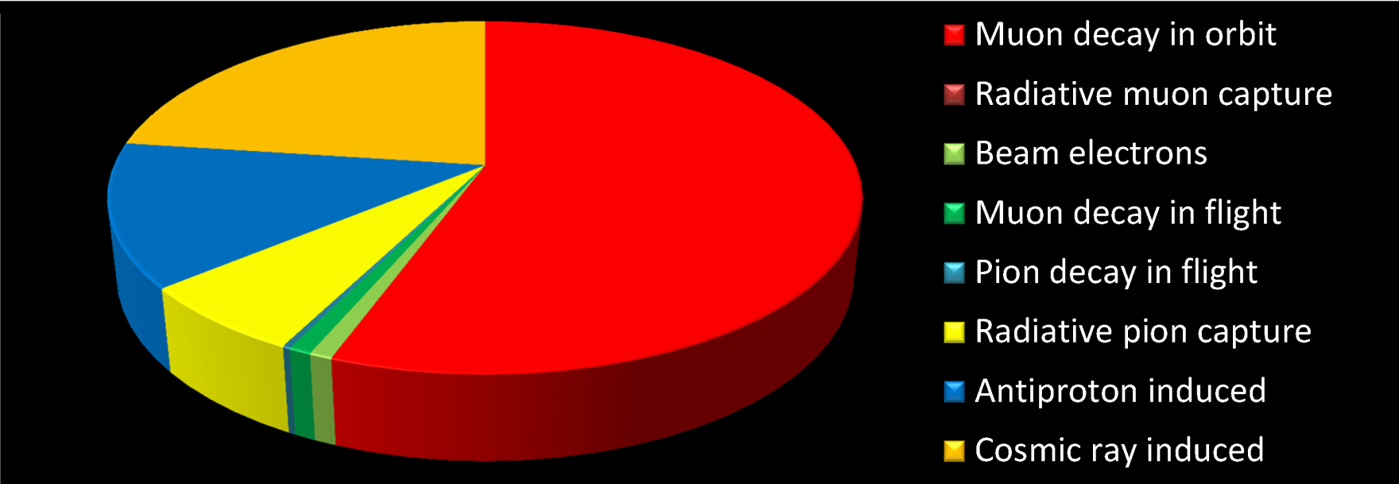
What we Get
Proton flux | 1.9x10¹³ p/s
Running time | 6x10⁷ s
Total protons | 3.6x10²⁰ p
μ⁻ stops/incident proton | 0.0019
μ⁻ capture probability | 0.609
Total acc. and selection eff. | 0.085
Single event sensitivity | 2.9x10⁻¹⁷
Detected events for R_{μe} = 10⁻¹⁶ | 3.4
Estimated background events | 0.36
10,000X improvement over present limit (SINDRUM II)

Slide 24
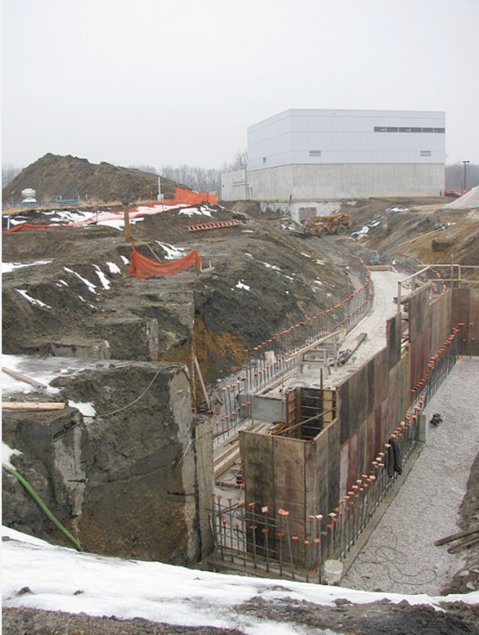
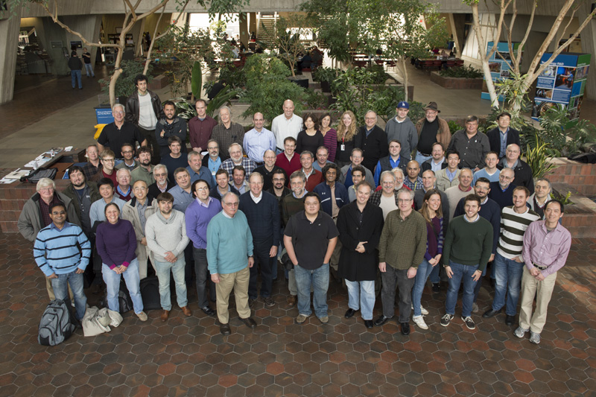
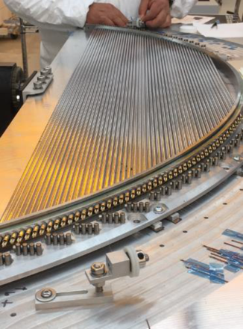
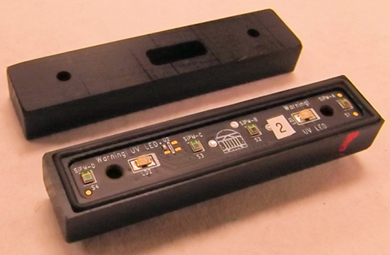
Status of Mu2e
Project a high priority of DOE and Fermilab, with a total project cost of $271M
Large, vigorous collaboration has been assembled
Civil and solenoid construction underway
Detector prototypes have been fabricated
Beam to detector in 2021
Currently:
186 scientists
32 institutions

Slide 25
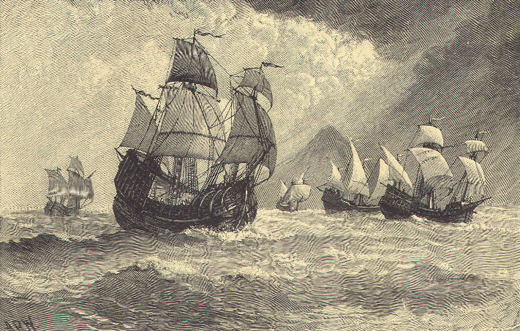

Where Best to Find the New Physics?
Mu2e
“The sense of mystery has never been more acute in our field”
Ian Shipsey, Snowmass 2013

Slide 26
Backup Slides

Slide 27
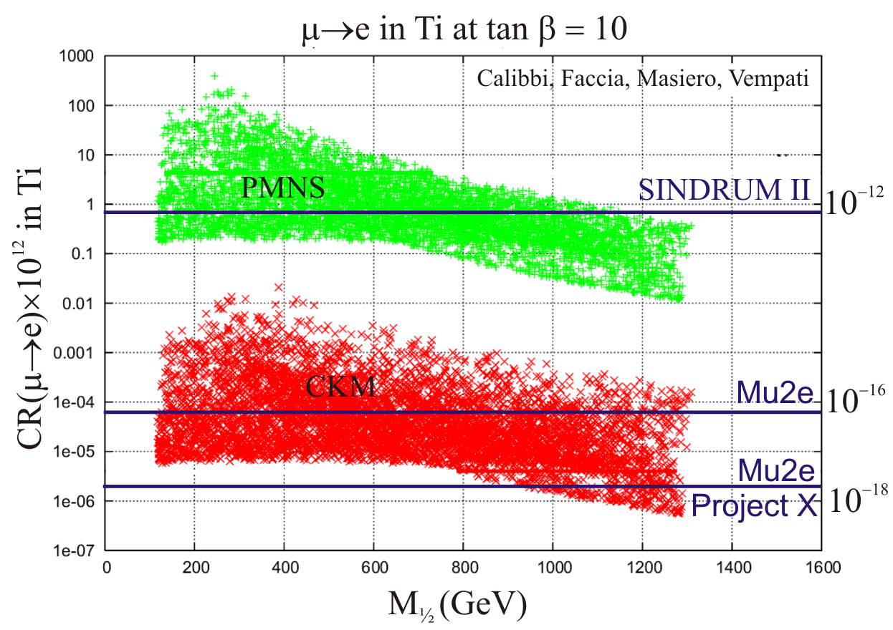
What Sensitivity is Needed?
Present sensitivity already interesting and constraining!
~10⁻¹⁶ removes many models
~10⁻¹⁸ extremely difficult for theorists to deal with
Current limit
SUSY GUT w Seesaw
PMNS: neutrino-like mixing
CKM: minimal flavor violation
M_{1/2} = gaugino mass

Slide 28
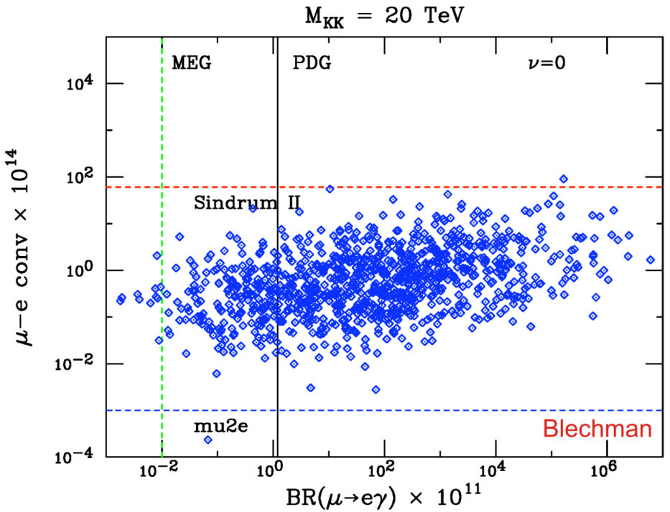
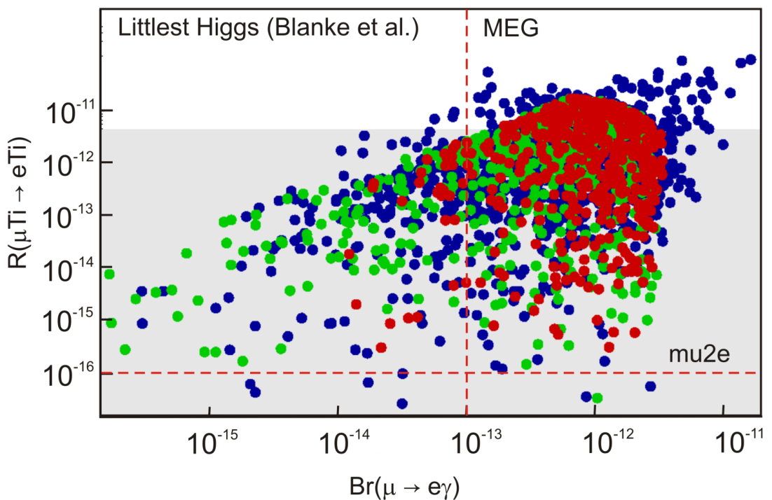
What Sensitivity is Needed?
Randall-Sundrum
Littlest Higgs

Slide 29
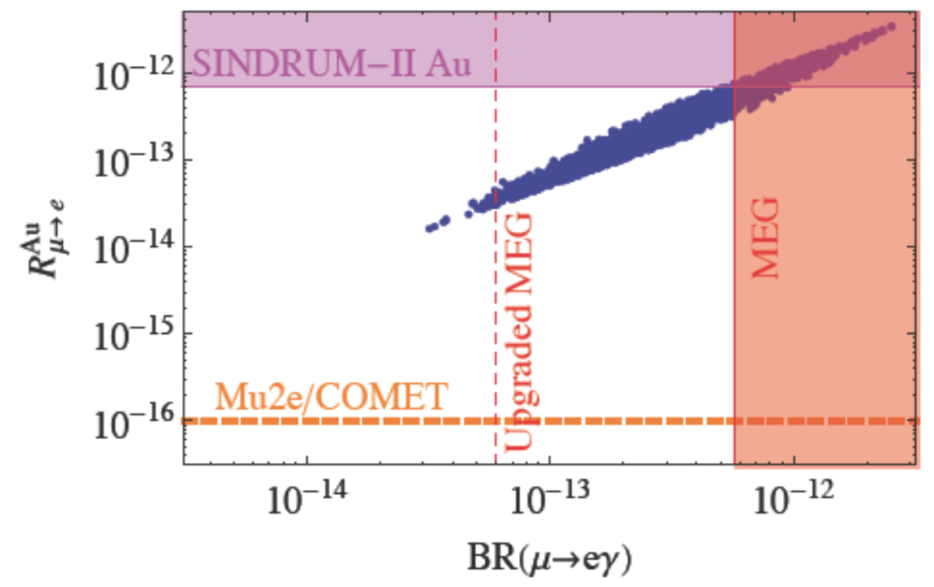
What Sensitivity is Needed?
Left-right symmetric model with Type-I Seesaw

Slide 30
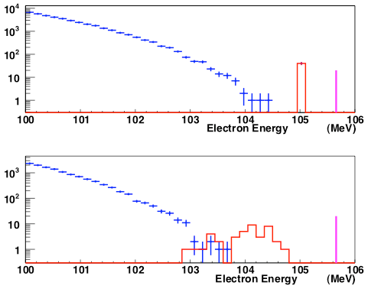
What we Get
Intrinsic tracker energy resolution:
σ(E) ≈ 150 keV
Perfect Detector
Decay in Orbit Tail
Binding + recoil energy
DIO tail
M_{μ}
Average energy loss due to spectrometer material:
E(shift) ≈ 1 MeV
Real Detector
Decay in Orbit Tail
M_{μ}
DIO tail

Slide 31
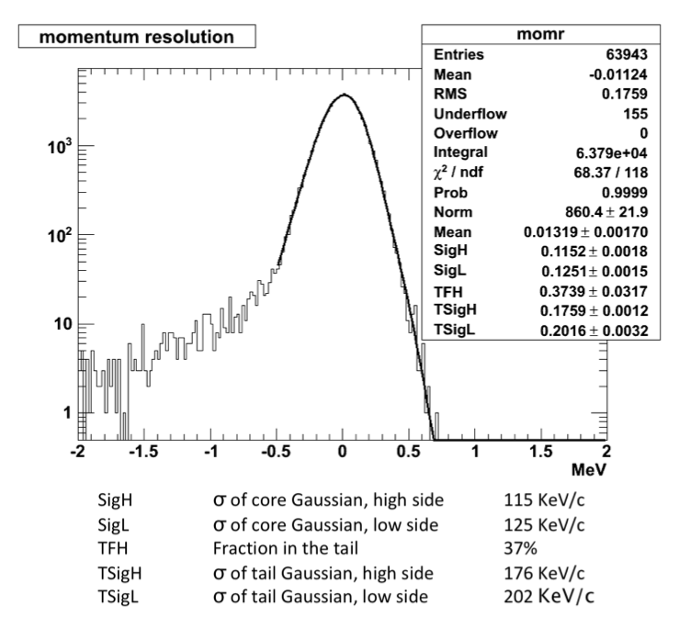
Tracker Performance
Tracker resolution for 105 MeV/c electrons
No high-side tail!
Core σ = 115 KeV/c
High-side tail σ = 176 KeV/c

Slide 32
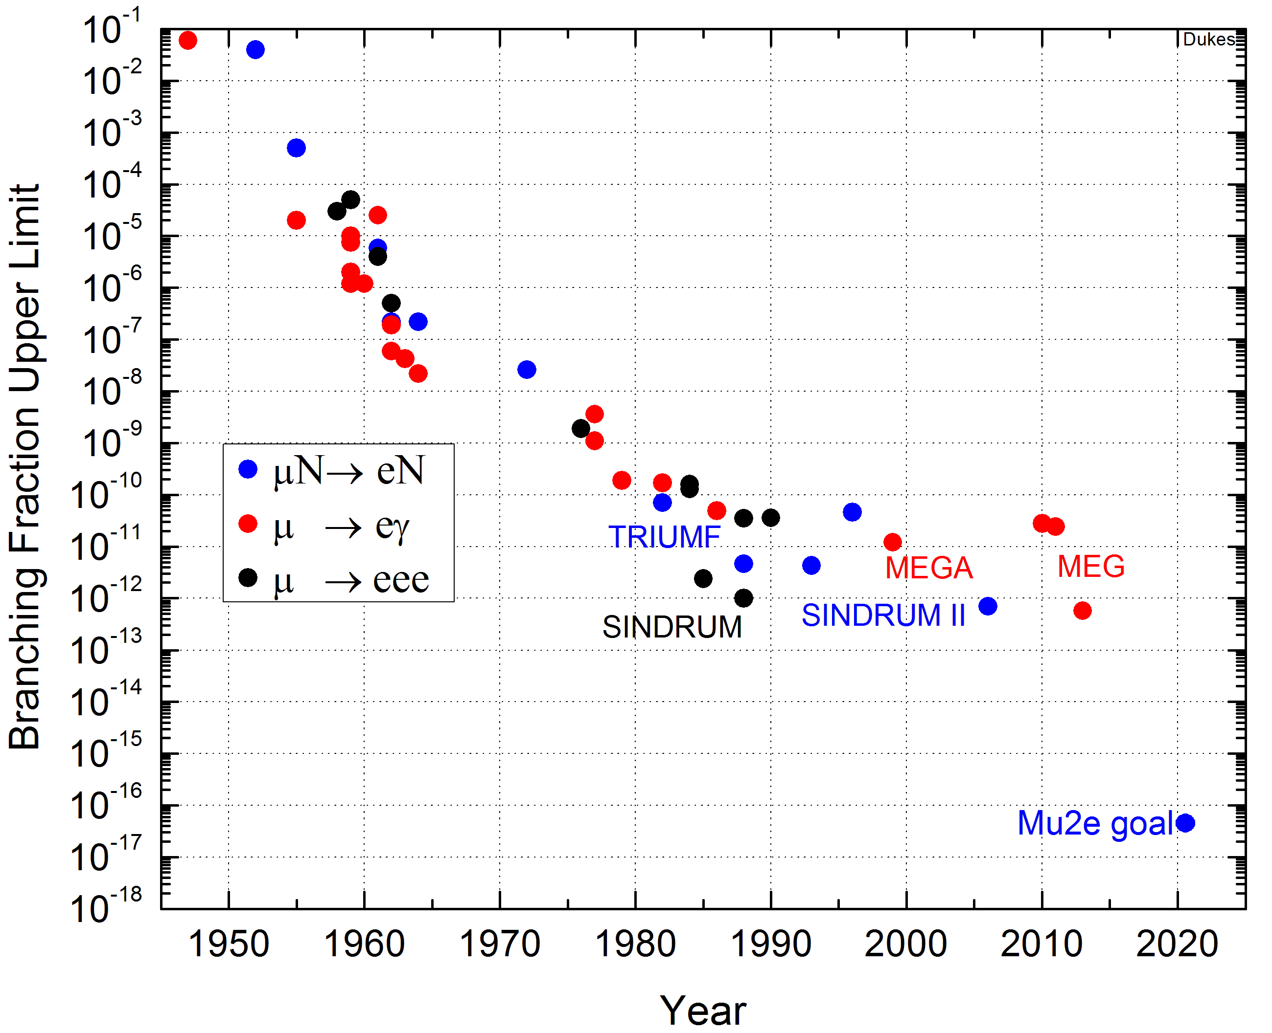
History of Muon Lepton Flavor Violation Searches
Muon established as independent lepton in 1947 as μ→eγ not seen
Mu2e at Fermilab
intends to improve
sensitivity by ~10,000
Feinberg 1958 loop calculation: μ→eγ must be 10⁻⁴-10⁻⁵
Non-observation of μ→eγ implies two neutrinos
Present limits constraining New Physics theories

Slide 33


Transport Solenoidal Magnet
Curved solenoid:
  separates charges by charge sign
  reduces line-of-sight transport of neutrals
Collimators eliminate wrong-sign particles and particles with too large momentum

Slide 34
Schedule
CD-3a
CD-3c
CD-2/3b
CD-4
Fabricate and QA Superconductor
KPPs Satisfied
Solenoid Design/Prototypes
Solenoid Fabrication and QA
Detector Hall Construction
Solenoid Infrastructure
Solenoid Installation and Commissioning
Detector Prototypes and Construction
Cosmic Ray System Test
Accelerator and Beamline Construction
Accelerator Commissioning (off Project)
Q3 | Q4 | Q1 | Q2 | Q3 | Q4 | Q1 | Q2 | Q3 | Q4 | Q1 | Q2 | Q3 | Q4 | Q1 | Q2 | Q3 | Q4 | Q1 | Q2 | Q3 | Q4 | Q1 | Q2 | Q3 | Q4 | Q1 | Q2 | Q3 | Q4 | Q1 | Q2 | Q3 | Q4
FY14 FY15 FY16 FY17 FY18 FY19 FY20 FY21

Slide 35

Proton Absorber

Slide 36



Choice of StoppingTarget Material
Large Z:
  rate ∝Z|F_{n}|² (F_{n} is the form factor)
  can reveal nature of interaction
Small Z:
  longer lifetime
  higher endpoint energy
Note: Need m_{Z-1} > m_{Z} to place max. energy of radiative capture muons below signal electrons
S, V, D dependence
unique to μN→eN
Initial Choice

