Slide 1

Quality Assurance Plan for the Telluric Acid Purification Plant
James Baker
Supervisor: Szymon Manecki
Canadian Astro-particle Physics Summer Student Talk Competition 2023
2023/08/17
“SNOLAB is located on the traditional territory of the Robinson-Huron Treaty of 1850, shared by the Indigenous people of the surrounding Atikameksheng Anishnawbek First Nation as part of the larger Anishinabek Nation.”

Slide 2
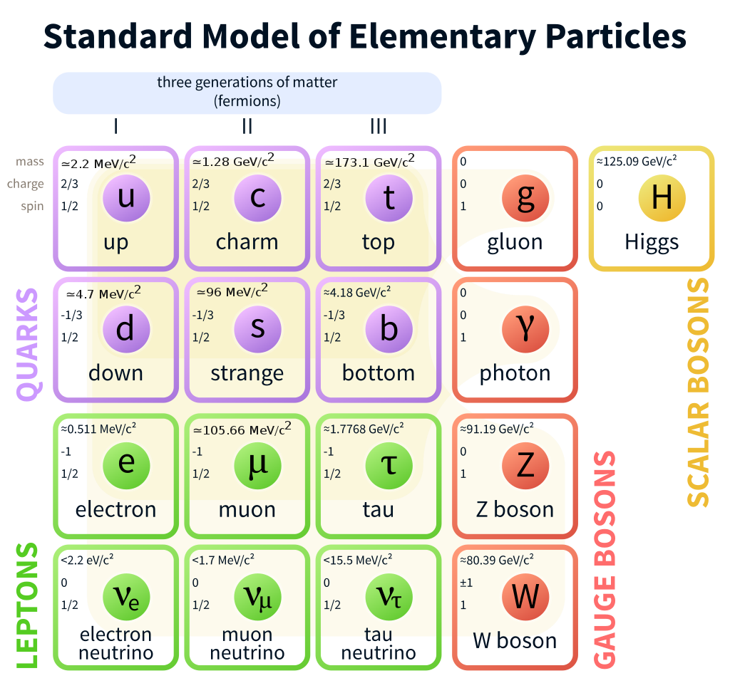


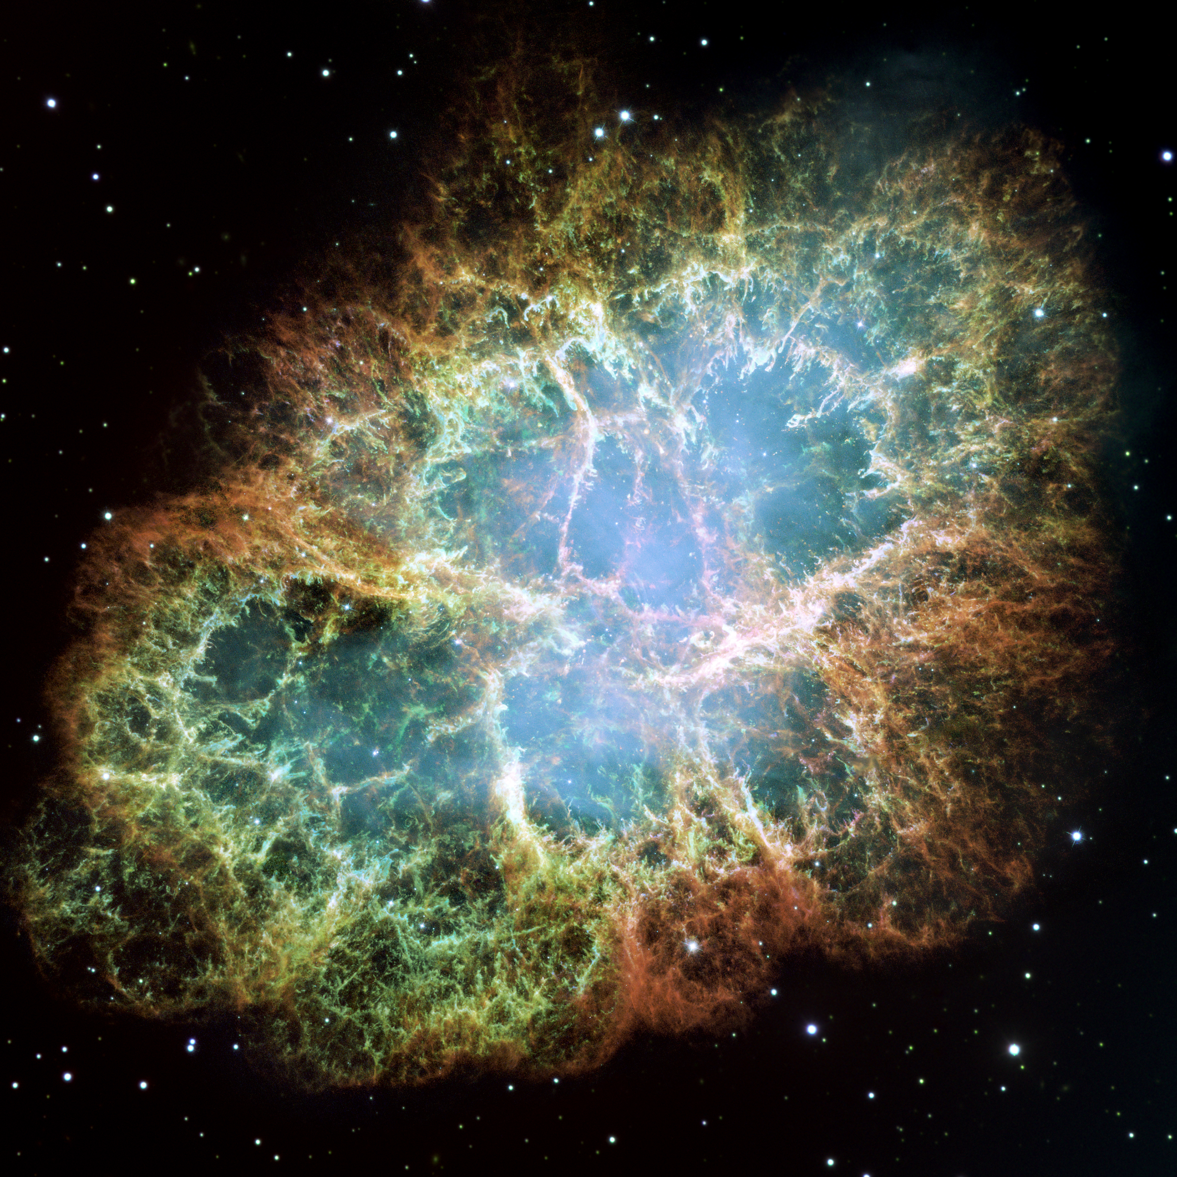
What is a Neutrino?
Most abundant
Relativistic
Three Flavours; 𝛎_{e},𝛎_{𝛍},𝛎_{𝛕}
Weakly interacting
Solar
  Fusion
  Electron neutrinos
Geo
  Decay of ²³⁸U, ²³²Th, ⁴⁰K
  Thermal history
Supernova
  Core collapse
  Massive flux

Slide 3
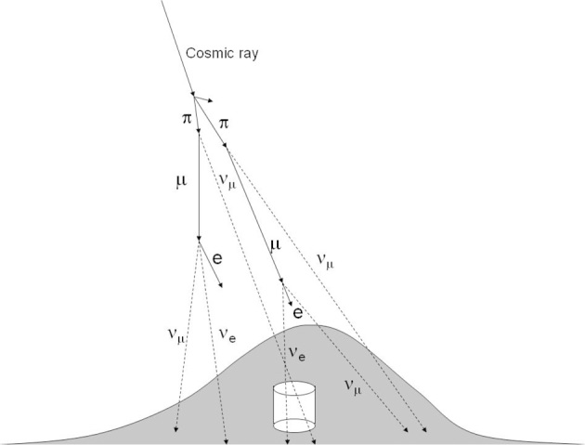
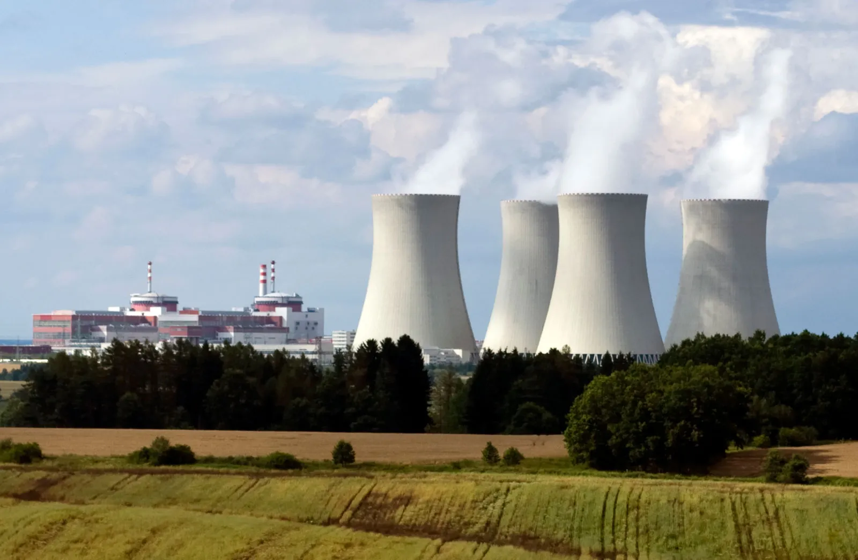
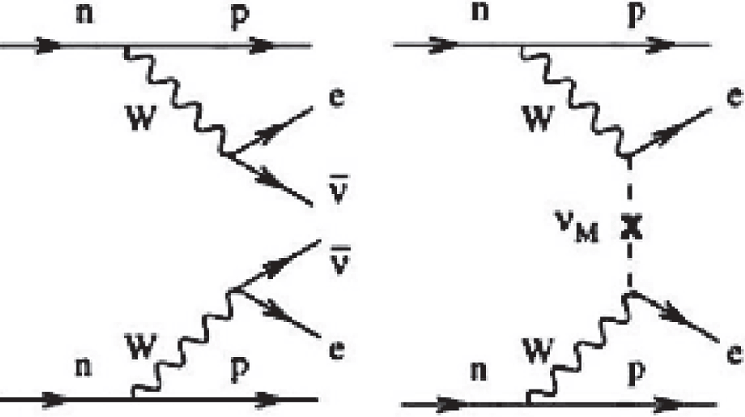
What is a Neutrino?
Most abundant
Relativistic
Three Flavours; 𝛎_{e},𝛎_{𝛍},𝛎_{𝛕}
Weakly interacting
Atmospheric
  Cosmic ray interaction
  Interaction at 15km up
Reactor
  Beta Decay
  Electron antineutrino
Beta Decay
  Neutrinoless Double Beta Decay
  ¹³⁰Te!

Slide 4
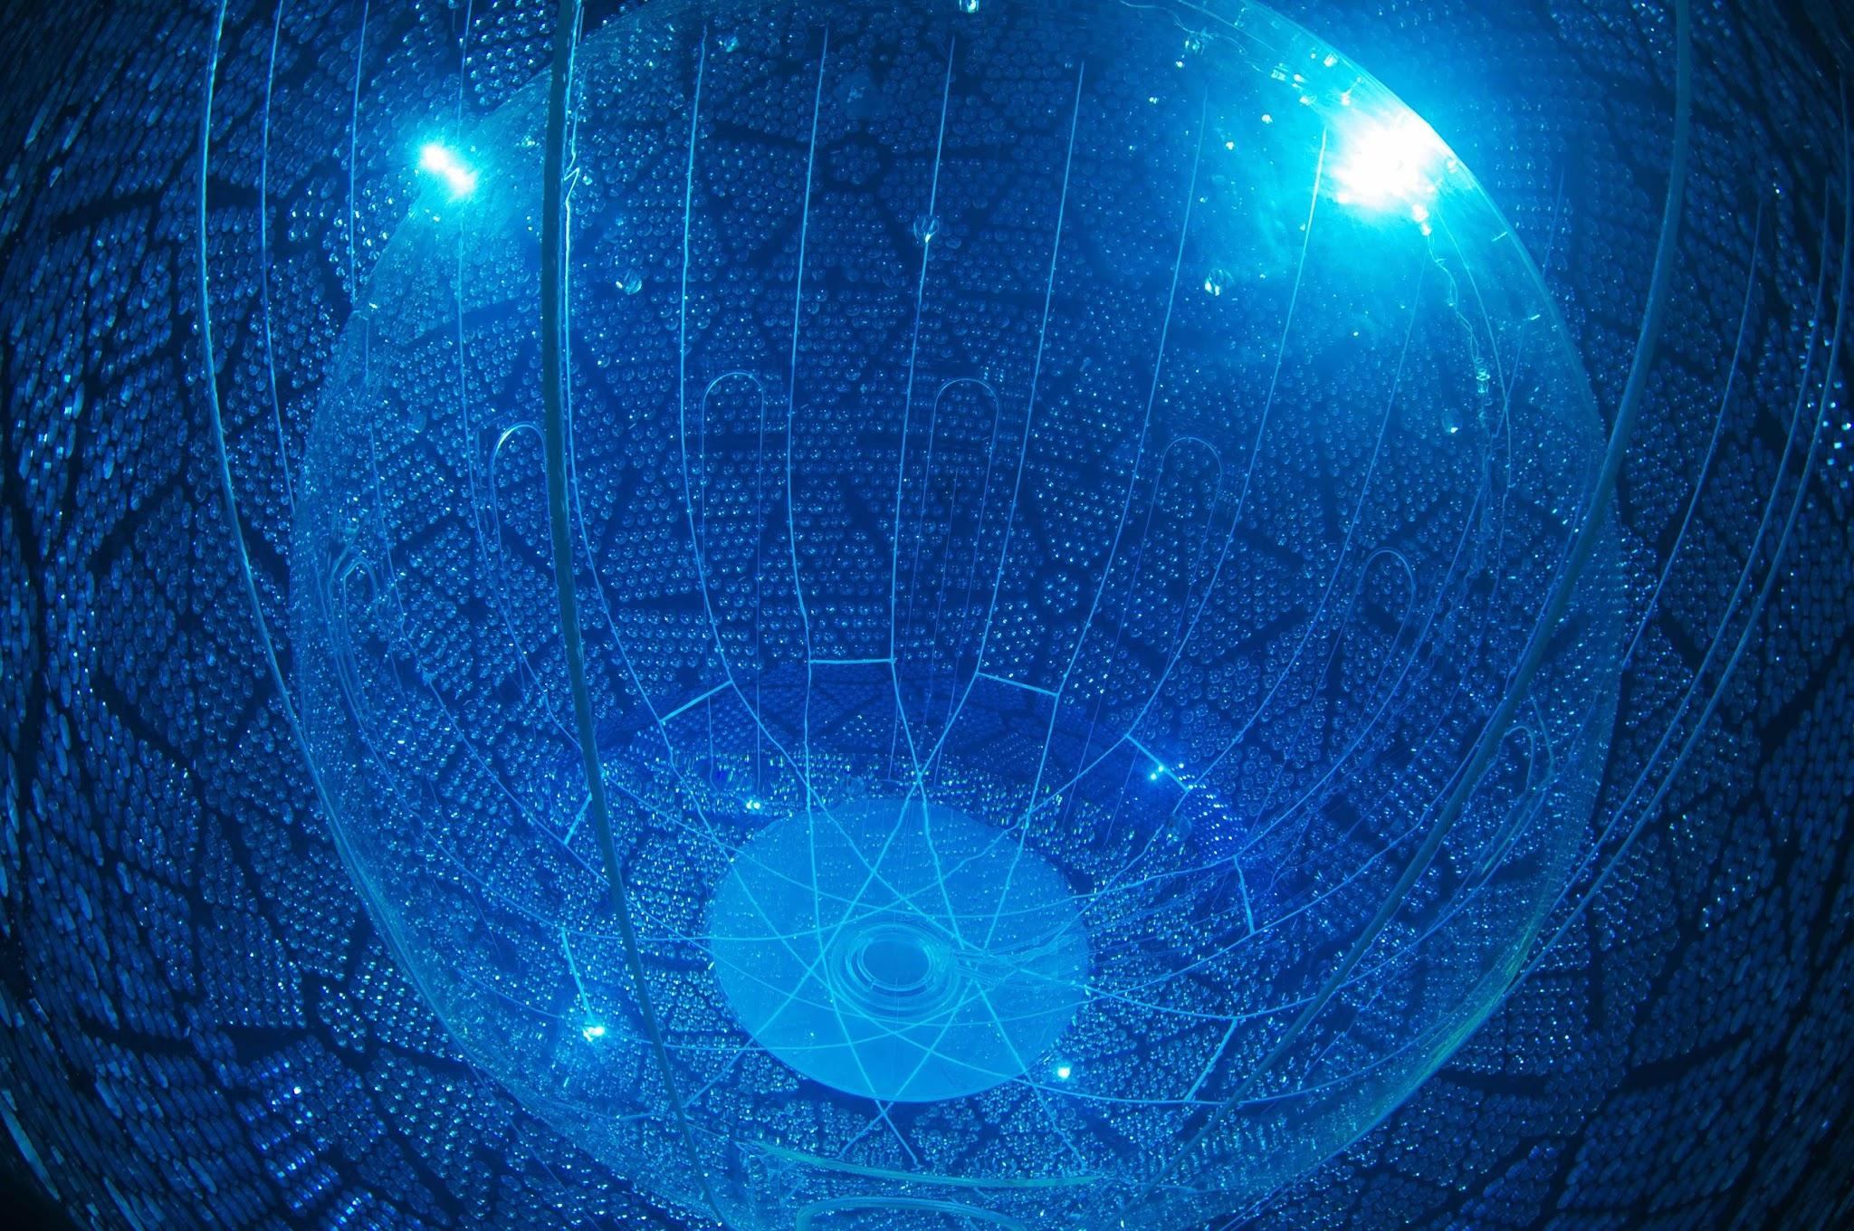
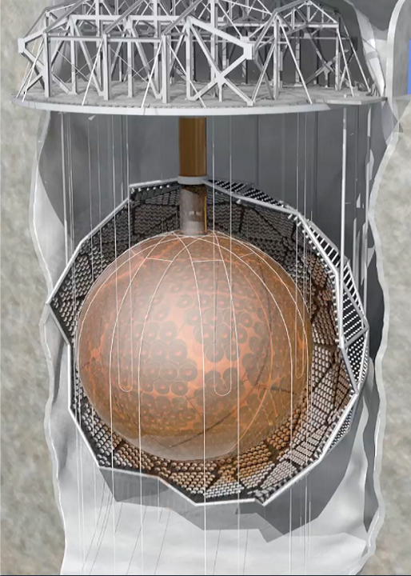
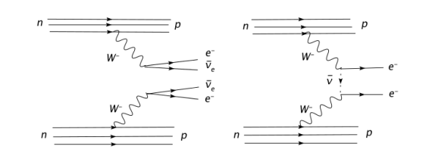
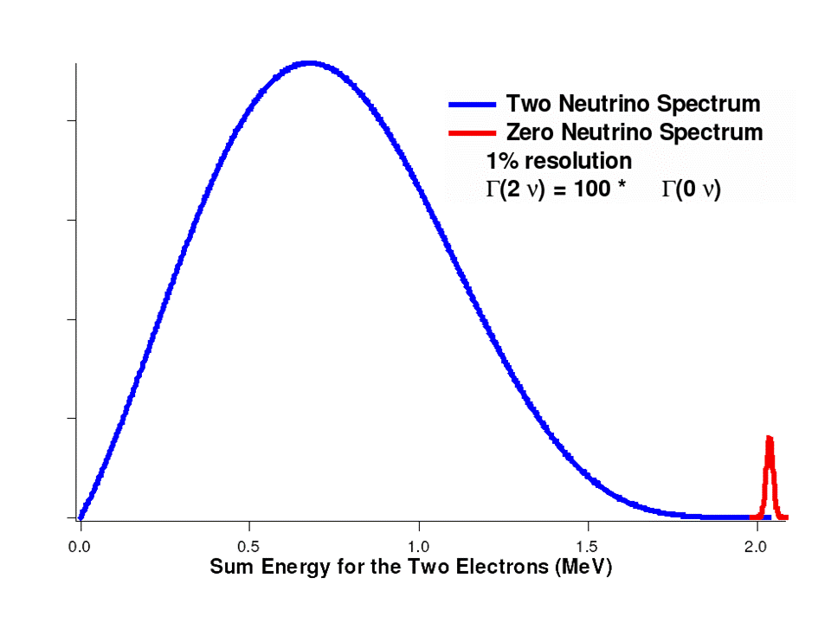
0⋎ββ in SNO+
PMTs
2⋎ββ
0⋎ββ
In 2⋎ββ: 2n -> 2p+2e⁻+2⊽_{e}
In 0⋎ββ: 2n -> 2p+2e⁻
Majorana particle
Only observed in
36 isotopes
Tellurium-130
Active Medium
2⋎ββ
0⋎ββ
The biggest challenge for double beta experiments is to determine the 0𝜈𝛃𝛃 within the continuum of the 2𝜈𝛃𝛃 energy spectrum and backgrounds.

Slide 5
Phases of SNO+
Water
980 tonnes of UPW
Purified by UPW Plant U/G
Scintillator
780 tonnes of LAB
Purified by the Scintillator Purification Plant
Tellurium
4 tonnes of Tellurium-Butane Diol cocktail
Purified by the TeA Plant and TeDiol Plant
2017-2019
2022-2025
2025+

Slide 6
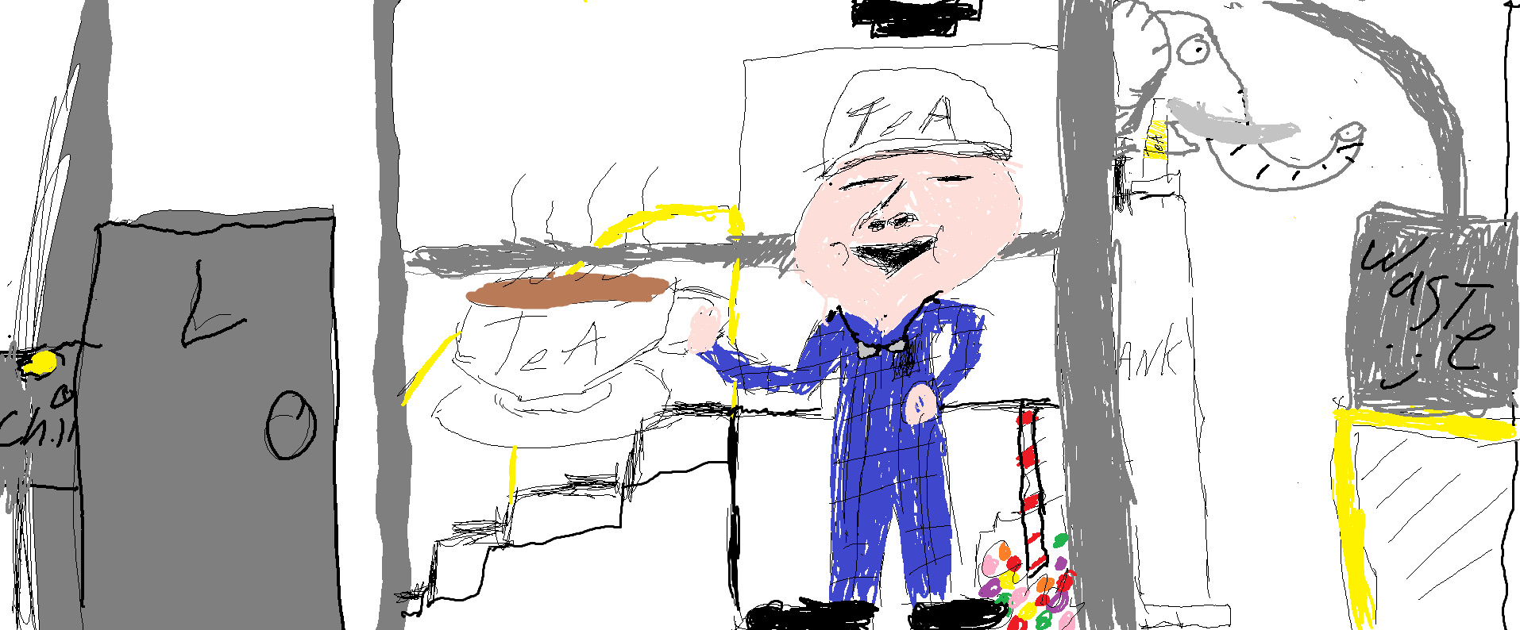
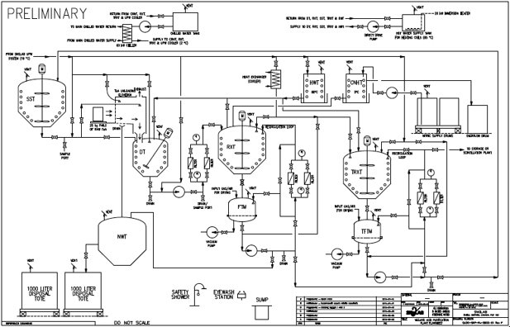
The TeA Purification Plant
DISSOLUTION TANK(DT)
Image from TeA plant Operators
Hot UPW (200kg) and TeA (200kg) will be added and mixed.
Target TeA concentration brought to 50%

Slide 7
The TeA Purification Plant
RXT and FTM
Image from TeA plant Operators
Acid Recrystallization
TeA and UPW is cooled.
Crystallization removes soluble impurities.
Slurry is rinsed twice with Nitric Acid which removes insoluble impurities.
Crystal slurry is transferred to FTM.
Second Dissolution

Slide 8
The TeA Purification Plant
Thermal Recrystallization
TRXT and TFTM
Image from TeA plant Operators
Cool the solution in the TRXT. (up to 2 days)
Rinse with UPW. 3x
Transfer the slurry to TFTM.
Dissolve with hot UPW.
Repeat three times.
Transfer to TeADiol then SNO+

Slide 9
Quality Assurance Plan
Quality Assurance is needed to ensure the limited background budget of the SNO+ detector.
Ensure that the plant is working at the level expected.
Plant Performance QA
Samples are collected to determine Nitric and TeA concentrations
Tellurium Yield
Plant Purification QA
Samples are collected to determine plant Uranium/Thorium levels
Analysis Tools
UV-Vis
  Nitric Acid Concentration
XRF
  Telluric Acid Concentration
Analysis Tools
ICPMs
  Uranium/Thorium levels
Test Batch
The purpose of the test batch is to analyze the Performance, Safety, and Purification capability of the Tellurium purification plant

Slide 10
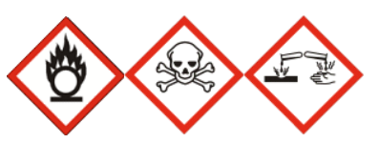
Safety Challenges
Nitric Acid
Oxidizing liquid
Corrosive to Metals
Acute Inhalation
Skin Corrosion
Serious eye damage
Telluric Acid
Acute inhalation
Skin Corrosion
Serious Eye Damage
Target Organ toxicity
Target Organs: Respiratory
pH: <1
pH: 1.4
Workplace Hazardous Material Information System(WHMIS): Health Canada
Vale
SNOLAB Hazardous Materials Policies

Slide 11

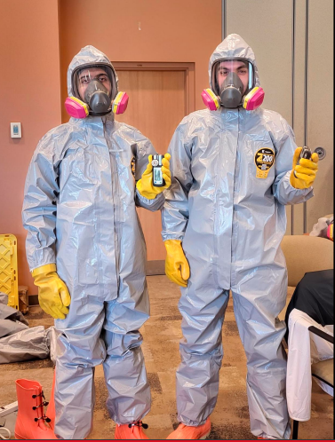
Risk Assessment
Personal protective equipment
  Lab coat
  Face shield
  3 layers of gloves
A Procedure was written to ensure safety and cleanliness.
Task Hazard Assessment
Spill response team
Reviews: Operations Readiness Review, Chemical safety handling
Sample line modifications.

Slide 12
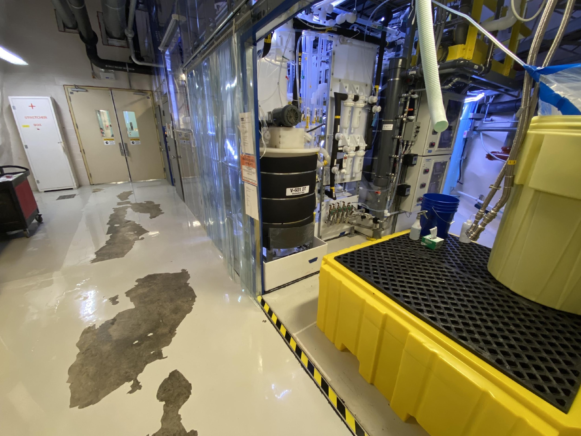
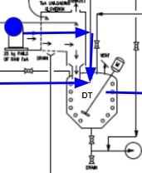
Dissolution Tank
SAMPLE PORT 1:
DISSOLUTION TANK(DT)
The sample port is located behind the Tank (V-601 DT) under the deck.
Sample port Needed to be moved.
Location | Phase | Hazards | XRF | ICPMS
Port 1: DT | Hot UPW | High Temperature 80 °C | - | ✔
 | TeA to DT | 50% TeA, High temperature 80 °C | ✔ | ✔

Slide 13
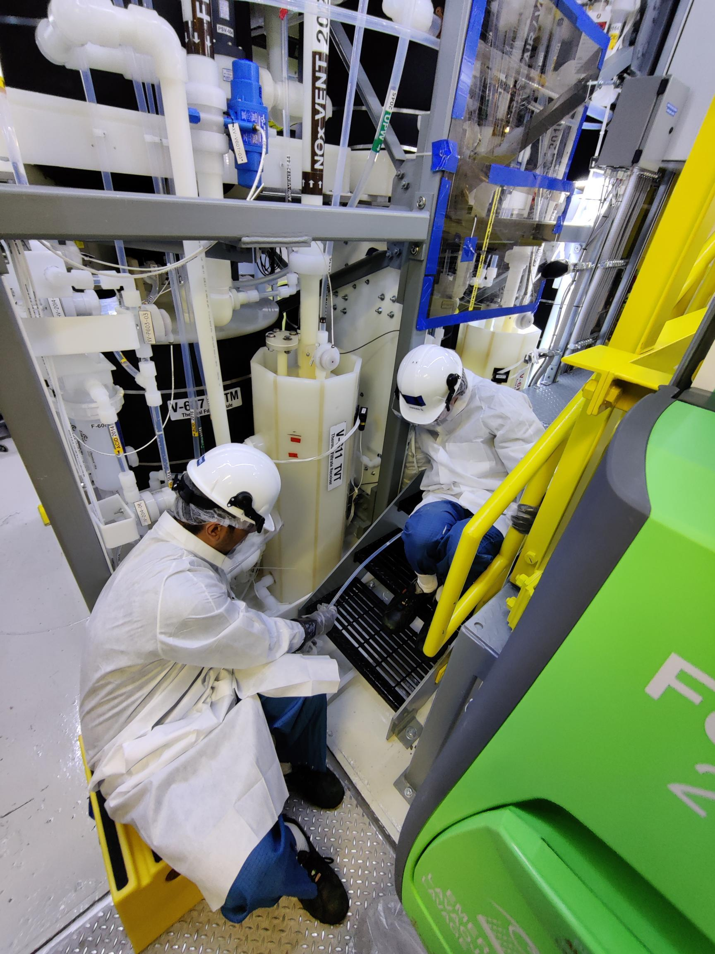

Acid Recrystallization
RXT and FTM
6 Samples total
UV-Vis, XRF, ICPMS
Cold 50% Nitric
Hot UPW
Location | Phase | Hazards | XRF/UV-VIS | ICPMS
Port 2:FTM | First Acid Precp | 38% HNO3, 5 °C | ✔ | ✔
Port 2: FTM | First Rinse | 44% HNO3, 5 °C | ✔ | -
 | Second rinse | 37% HNO3, 5 °C | ✔ | -
Port 2: FTM | Second Dissolution | 4% HNO3, High temperature 80°C | ✔ | ✔

Slide 14
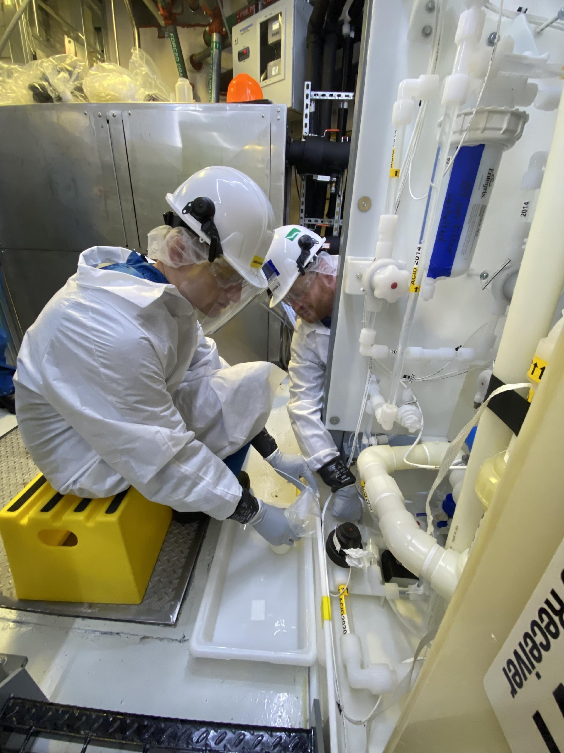
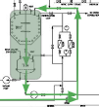
Thermal Recrystallization
TRXT and TFTM
4 Samples
UV-Vis, XRF, ICMPS
Low concentration Nitric Acid
High temperature
Location | Phase | Hazards | XRF/UV-VIS | ICPMS
Port 4: TFTM | First Rinse | 0.8% HNO3, 5 °C | ✔ | -
 | Second Rinse | 0.1% HNO3, 5 °C | ✔ | -
 | Third Rinse | 0.3% HNO3, 5 °C | ✔ | -
 | Final Dissolution | 0.023% HNO3, 80°C | - | ✔
10

Slide 15
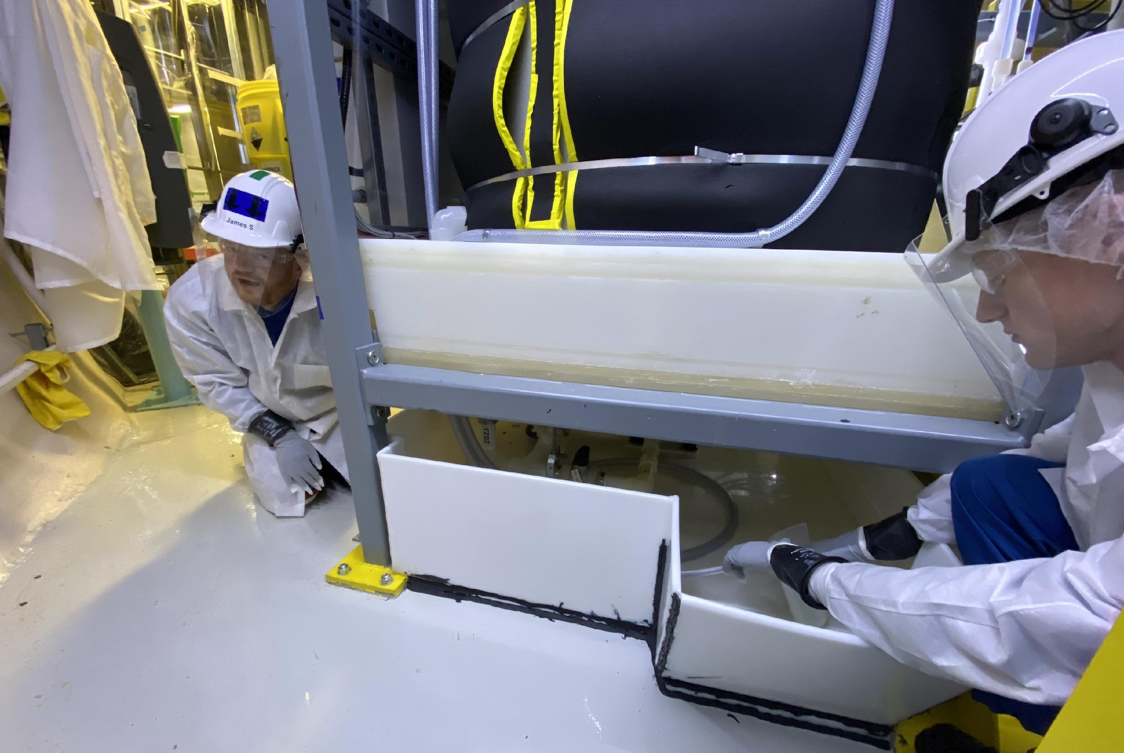
Nitric Waste Tank
Holds waste from each run.
Want to check TeA content at every step.
3 Samples
High Nitric concentration
UV-Vis, XRF
Location | Phase | Hazards | XRF/UV-VIS | ICPMS
Port 5: NWT | Nitric Waste Tank | 39% HNO3, 5 °C | ✔ | -
Port:5 NWT | NWT | 38% HNO3, 5 °C | ✔ | -
Port 5: NWT | Nitric waste Tank | 3.8% HNO3, 5 °C | ✔ | -

Slide 16
Summary
The goal is to understand the target acid concentrations at different stages of purification.
The sample points identified have procedures in place to safely decant the samples while maintaining the cleanliness standards
Comprehensive QA plan is in place
All safety related issues and concerns have been addressed
QA procedure is approved
Ready for Test Batch in Novemeber!

Slide 17
Thank you!
Acknowledgements: Szymon, TeA Plant Operators, Scientific Support, Adil.

Slide 18
Abstract
The SNO+ detector is located 2km underground in Sudbury, Ontario. The primary purpose of the experiment is to study extremely rare neutrinoless double beta decay using Te-130 as the double beta decay isotope. Te-130 was chosen due to it’s high natural abundance and high energy double beta decay end point. The detector will be initially loaded with 0.5% Tellurium which corresponds to 4 tons of synthesized Te. As the detector is studying very rare low energy events SNO+ has a very limited background budget, therefore any active medium in the detector must go through a series of purification steps. To maintain the low levels of backgrounds a Telluric acid purification plant has been built underground and is currently under commissioning phase. The Telluric acid will be processed through the TeA plant where it will be put through rigorous cleaning steps to pull out any heavy metal impurities such as cosmogenic impurities, uranium and thorium through filtration, recrystallization and rinsing. A test run is scheduled to be done in November 2023 which will determine the effectiveness, safety and purification capability of the plant. An extensive quality assurance plan is developed to understand the processes and overall yield of the plant.

Slide 19
Bibliography

Slide 21
All Samples
Location | Phase | Hazards | XRF/UV-VIS | ICPMS
Port 1: DT | Hot UPW | High Temperature 80 °C | - | ✔
 | TeA to DT | 50% TeA, High temperature 80 °C | ✔ | ✔
Port 4: NRT | Nitric Rinse Tank | 40% HNO3, 5 °C | ✔ | ✔
Port 2:FTM | First Acid Precp | 38% HNO3, 5 °C | ✔ | ✔
Port 5: NWT | Nitric Waste Tank | 39% HNO3, 5 °C | ✔ | -
Port 2: FTM | First Rinse | 44% HNO3, 5 °C | ✔ | -
 | Second rinse | 37% HNO3, 5 °C | ✔ | -
Port 4:NRT | NRT | 40% HNO3, 5 °C | ✔ | -
Port:5 NWT | NWT | 38% HNO3, 5 °C | ✔ | -
Port 2: FTM | Second Dissolution | 4% HNO3, High temperature 80°C | ✔ | ✔
HWT | HWT | High Temperature 80°C | - | ✔
Port 5: NWT | Nitric waste Tank | 3.8% HNO3, 5 °C | ✔ | -
Port 4: TFTM | First Rinse | 0.8% HNO3, 5 °C | ✔ | -
 | Second Rinse | 0.1% HNO3, 5 °C | ✔ | -
 | Third Rinse | 0.3% HNO3, 5 °C | ✔ | -
 | Final Dissolution | 0.023% HNO3, 80°C | - | ✔
TRT | Final Dissolution | 0.023% HNO3, 80°C | - | ✔
TVT | TVT | 0.023% HNO3, 5 °C | ✔ | ✔
Ports highlighted in yellow are not used for sampling during the test batch!

Slide 22
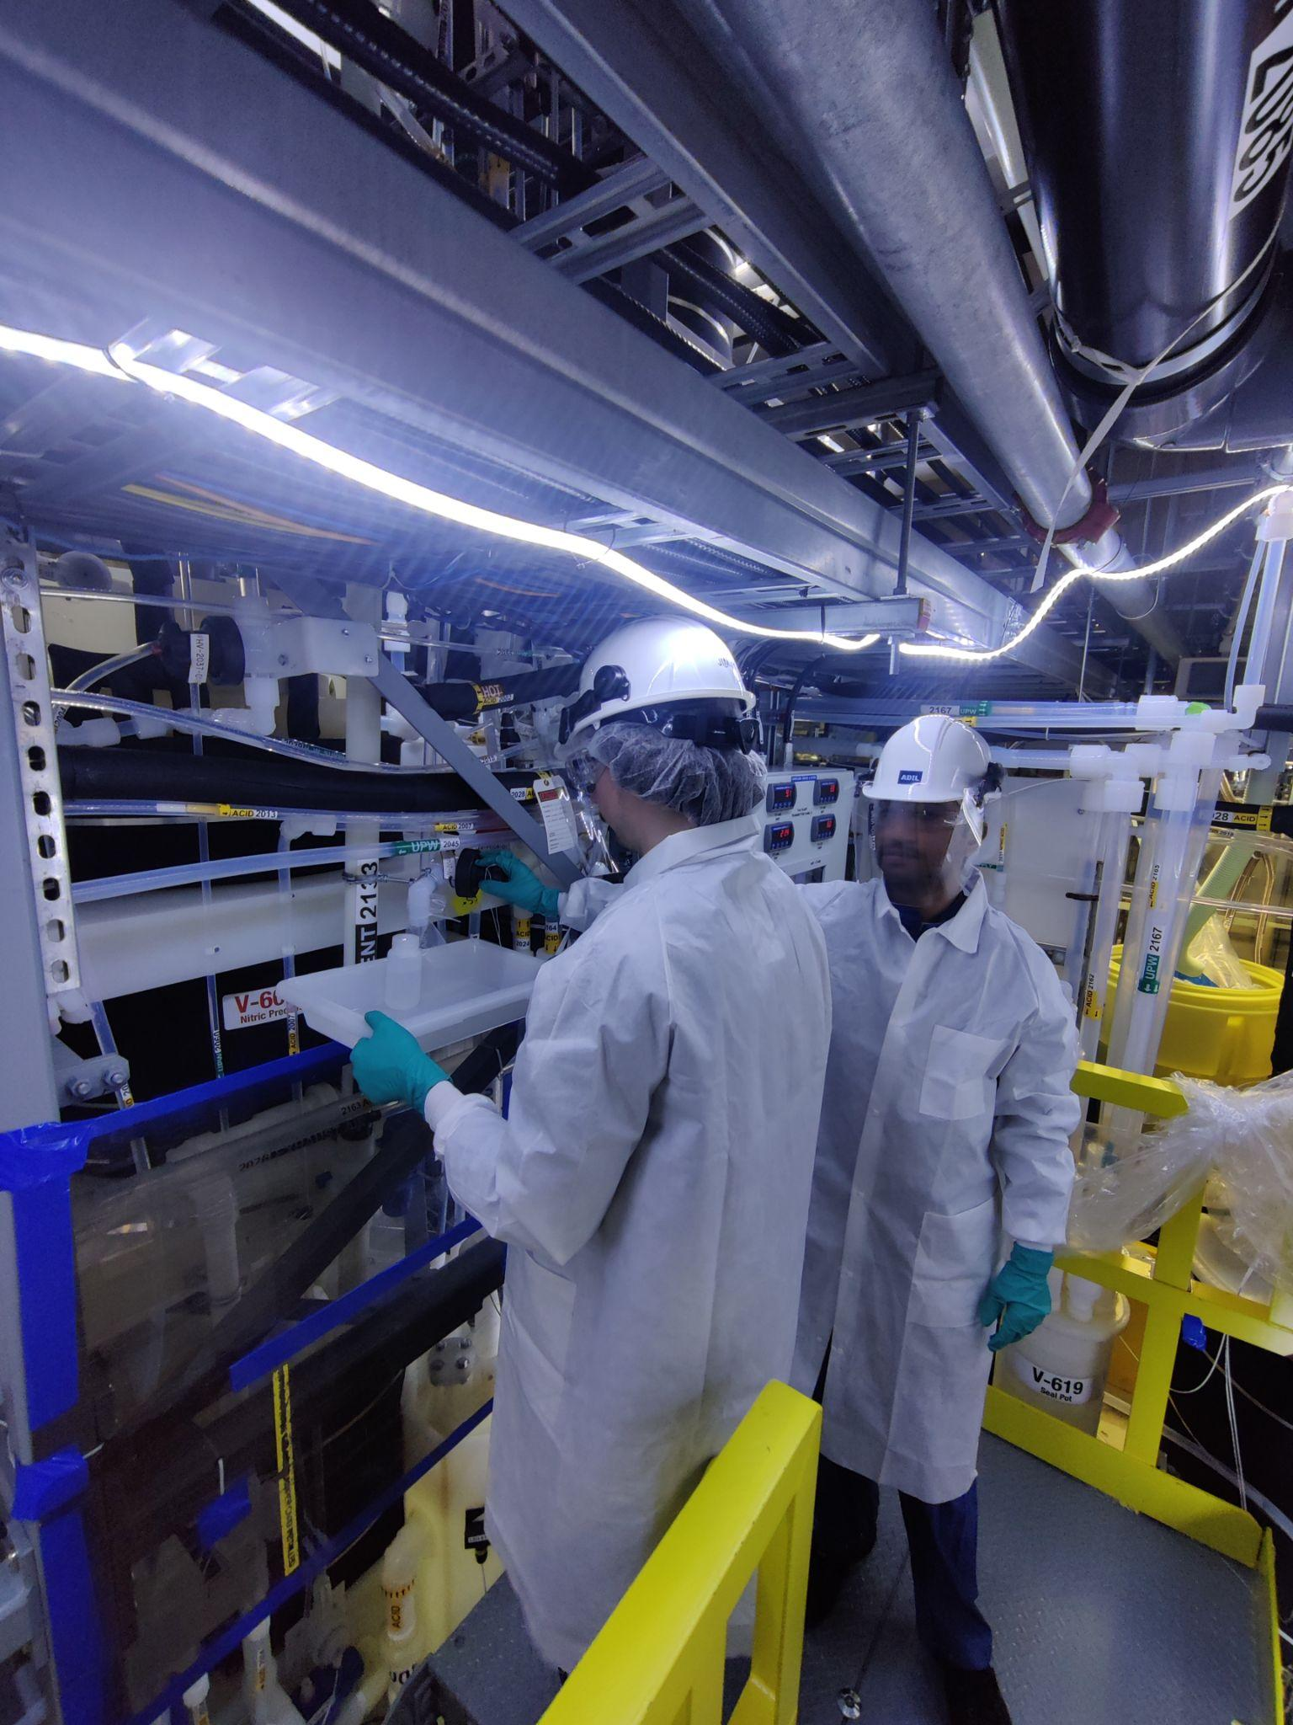
Nitric Rinse Tank
UPW will be added to 70% Nitric Acid.
Creates 40% Nitric Acid.
Three samples.
Sampling platform is being added for extra safety.
Location | Phase | Hazards | UV-Vis | ICPMS
Port 4: NRT | Nitric Rinse Tank | 40% HNO3, 5 °C | ✔ | ✔
Port 4:NRT | NRT | 40% HNO3, 5 °C | ✔ | -

Slide 23
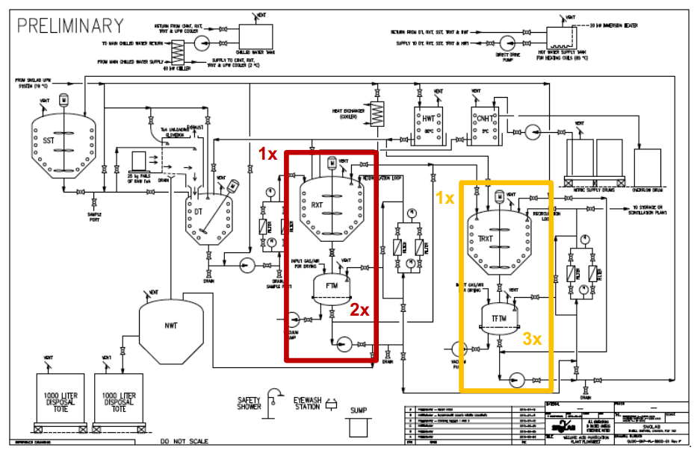
The TeA Purification Plant
Image from TeA plant Operators
DT
  Dissolution tank
RXT x3
  Re-crystallization tank
FTM x3
  Filter Transfer modules
TRXTx x3
  Thermal Re-crystallization tank
TFTM x3
  Thermal Filter Transfer Module
SST
  Supernatant Storage Tank
NWT
  Nitric Waste Tank
CNHT
Nitric Supply Drums
SST
DT
RXT
TRXT
to TeADiol
FTM
Telluric Acid
Nitric Acid
NWT
TFTM
To TeADiol
To Waste

Slide 24
0⋎ββ in SNO+
Initial fill
  0.5% or 4 tons ~1.3tons of ¹³⁰Te
0⋎ββ
  Theorized but never seen
  anti-neutrino neutrino annihilation
  Majorana particle
Why Tellurium?
  ββ ½ life vs 0⋎ββ
  High energy beta decay endpoint
  ¹³⁰Te 34.5% natural abundance
    Isotope enrichment not needed
  Price
2⋎ββ
0⋎ββ

