Slide 1


The Legacy of SNO
A New and Improved Website for the Sudbury Neutrino Observatory Experiment
Maggie Oxford, with Mark Richardson
Notes:
Hello everyone! Thank you for having me today. My work this summer in collaboration with my supervisor Mark Richardson has been to create a new official website for the Sudbury Neutrino Observatory experiment.

Slide 2
Content
Current Website
Proposed Improvements
Work Completed to Date
Next Steps
Impact

Slide 3

1. https://sno.phy.queensu.ca
Notes:
Please take a moment on your phone, your laptop, to type in this address and take a quick peruse. I’m only going to pause for like 10 seconds, because the next slide also has the web address.

Slide 4
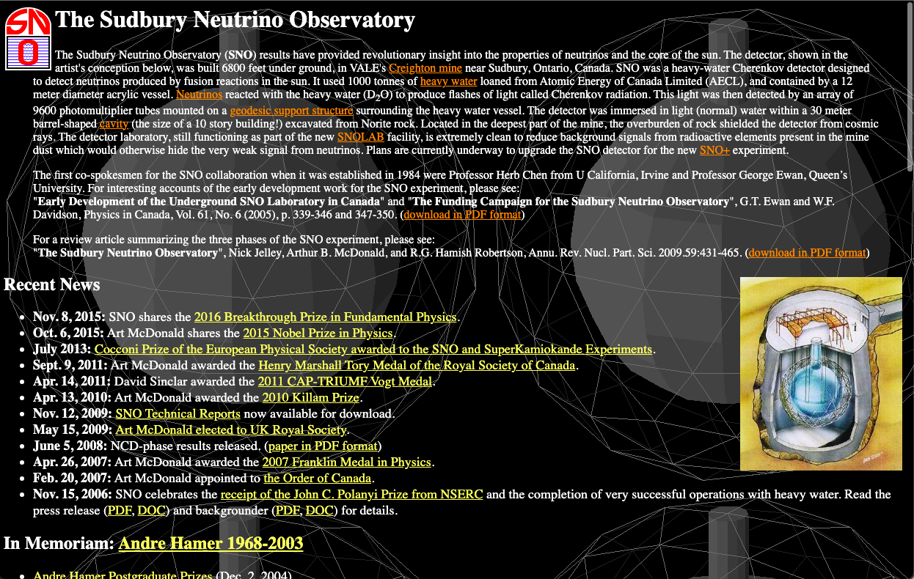
https://sno.phy.queensu.ca
Notes:
So the website I’ve directed you to is the current official website dedicated to the SNO experiment. If you scroll through a bit, I’d like to send you on a little scavenger hunt. I would like you to find out when the excavation of the cavity for SNO was finished. There are some papers in that first paragraph that contain that information, however I’d like for you to find it on the website itself.
Now the whole point of that exercise was a bit obvious, it was to demonstrate that navigating this website is a bit difficult, and it’s not always clear where to find certain information. If you were a grade nine student trying to write an essay on the SNO experiment, this is the sole place on the internet where most of this information is accessible.

Slide 5
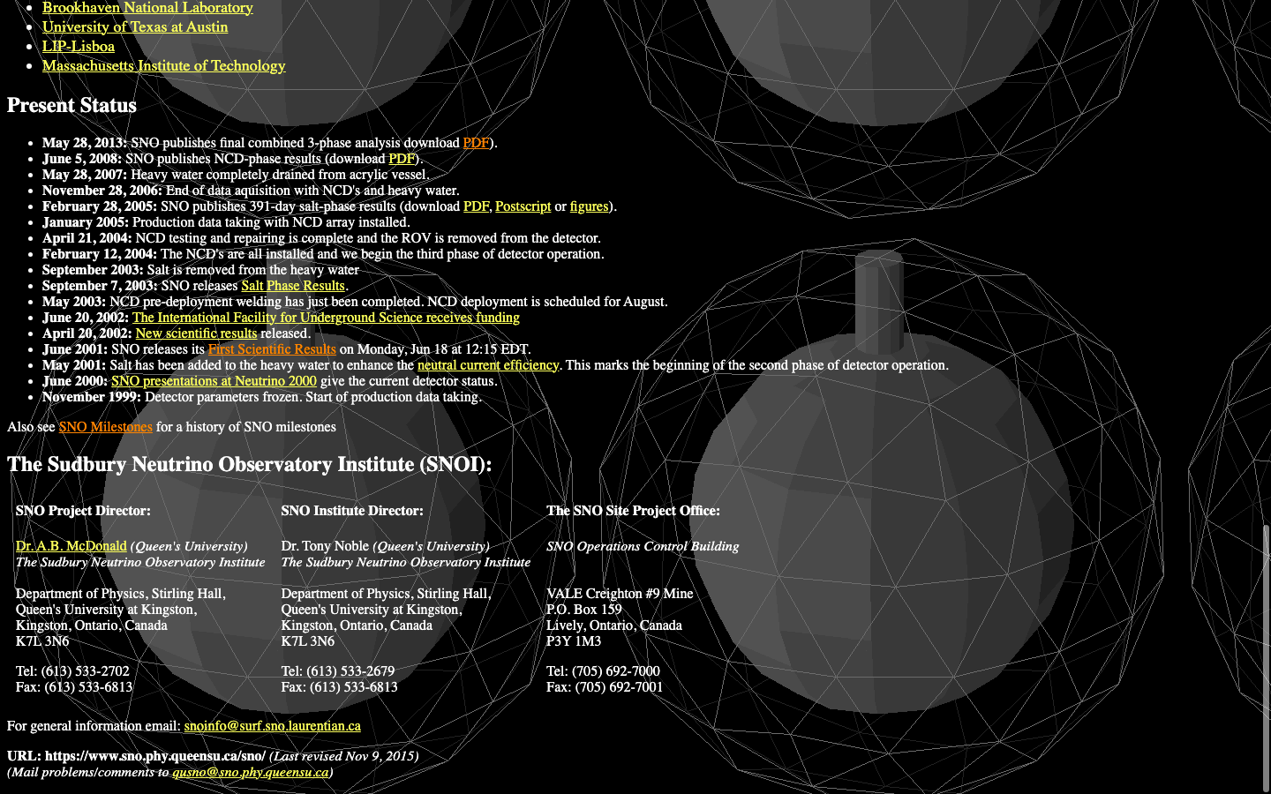
https://sno.phy.queensu.ca
Notes:
So if you scroll down, you’ll find this page. Let’s look into this a bit closer.

Slide 6
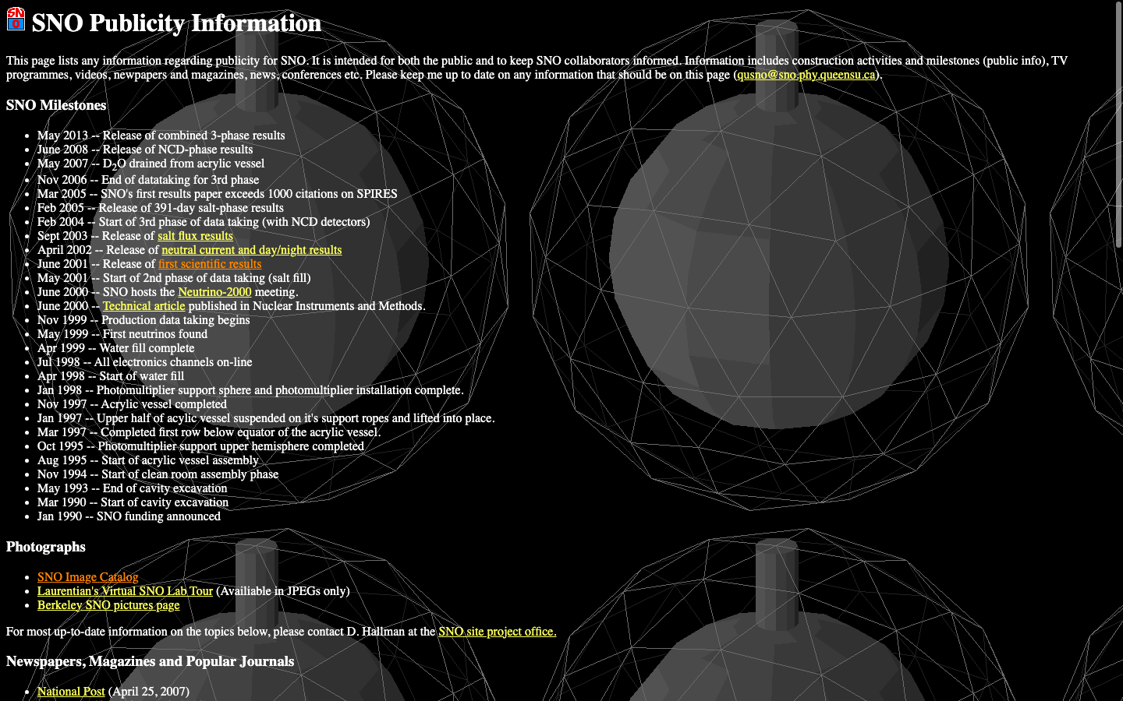
https://sno.phy.queensu.ca
Notes:
Now the whole point of that exercise was a bit obvious, it was to demonstrate that navigating this website is a bit difficult, and it’s not always clear where to find certain information. If you were a grade nine student trying to write an essay on the SNO experiment, this is the sole place on the internet where most of this information is accessible. There is an incredible wealth of information on this site, it’s simply difficult to find.

Slide 7
2. Proposed Improvements
Arthur B McDonald and Aksel Hallin, on behalf of SNO, worked with Charles (CJ) Woodford and Tony Noble at the McDonald Institute on creating a new website.
Areas of improvement were identified
  Visuals
  Navigation
  Layout
  Organization
  Tone and Language
CJ created a framework for the new website and had it approved by the other three working on the project.
And that is where I come in!
Notes:
In light of this, Art McDonald and Aksel Hallin (on behalf of SNO) worked with CJ Woodford and Tony Noble from the mcdonald institute to create a new website to showcase the sno experiment.
The work they did was they identified areas of improvement, such as visuals, navigation, layout, and organization. Another important point was the tone and language used should be accessible to a general audience.
So after these discussions were had, CJ created a very detailed framework for the new website, and it was approved by art, aksel and tony.
After all of that, I come in. My role in this project has been to write all new content for the website, to choose images, and to create a mockup using wordpress to show what it could look like.

Slide 8
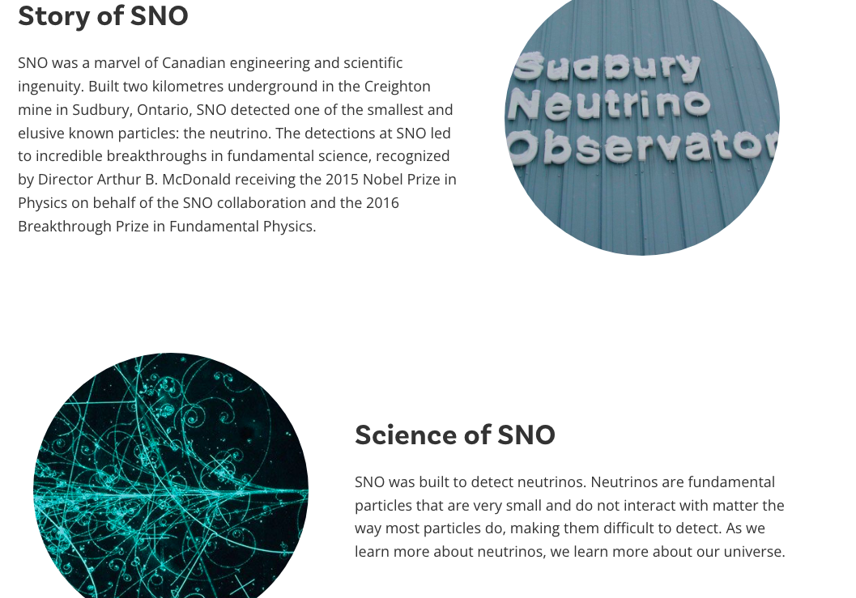
3. Work Completed to Date
Notes:
So now I’m going to share a bit of what I’ve been doing!

Slide 9
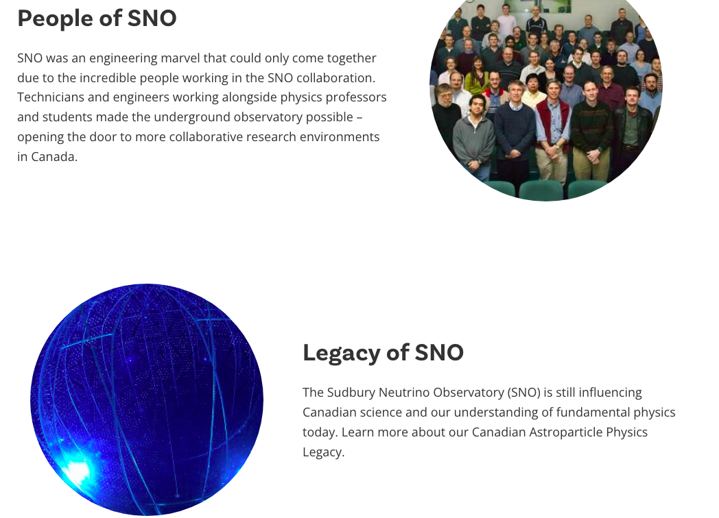
Notes:
So now I’m going to share a bit of what I’ve been doing!

Slide 10
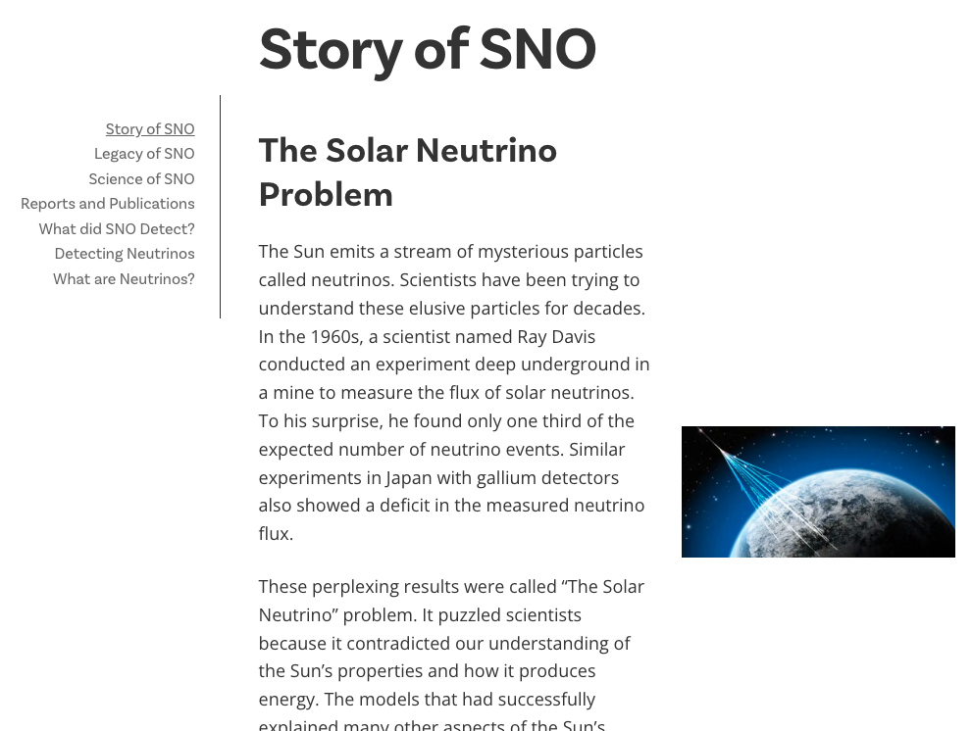
Notes:
So now I’m going to share a bit of what I’ve been doing!

Slide 11
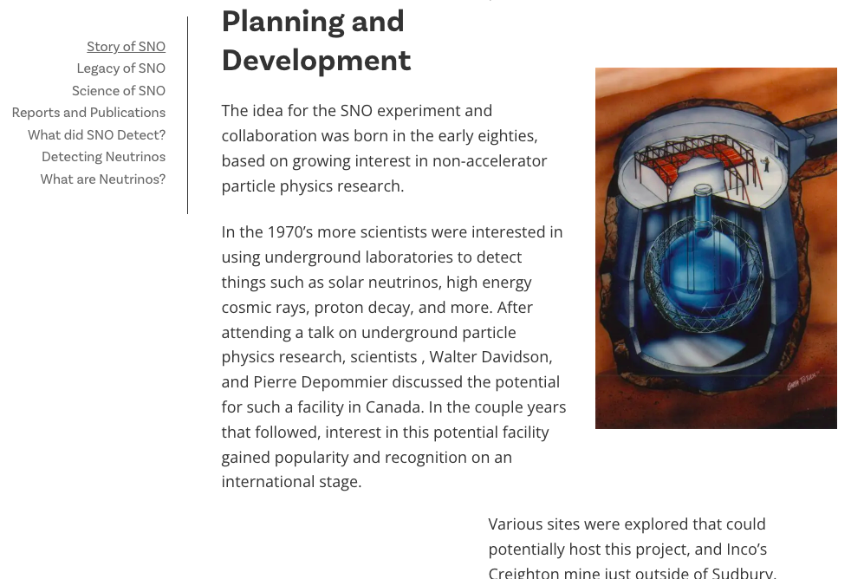
Notes:
So now I’m going to share a bit of what I’ve been doing!

Slide 12
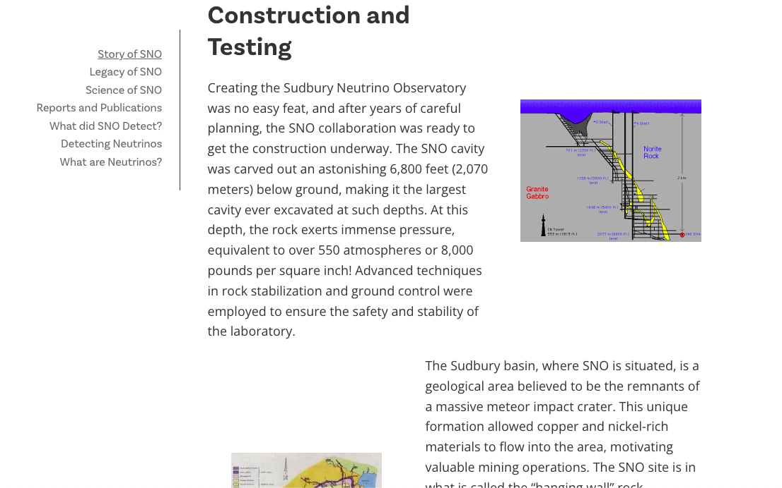
Notes:
So now I’m going to share a bit of what I’ve been doing!

Slide 13
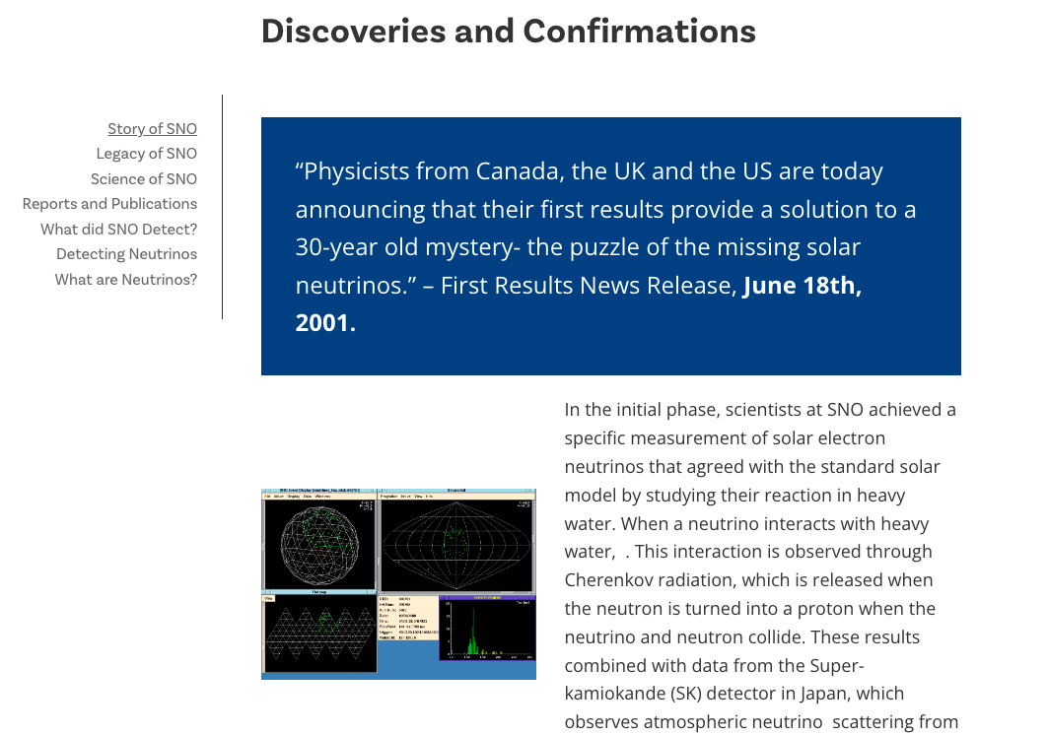
Notes:
So now I’m going to share a bit of what I’ve been doing!

Slide 14
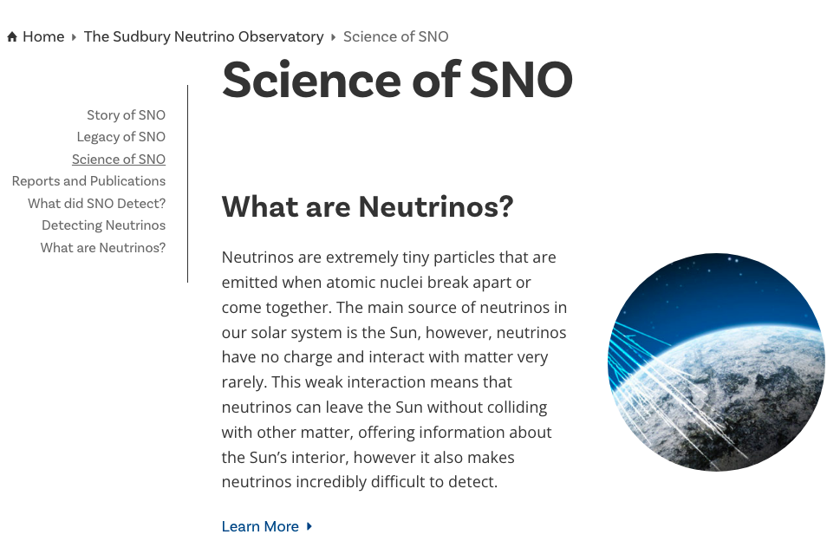
Notes:
So now I’m going to share a bit of what I’ve been doing!

Slide 15
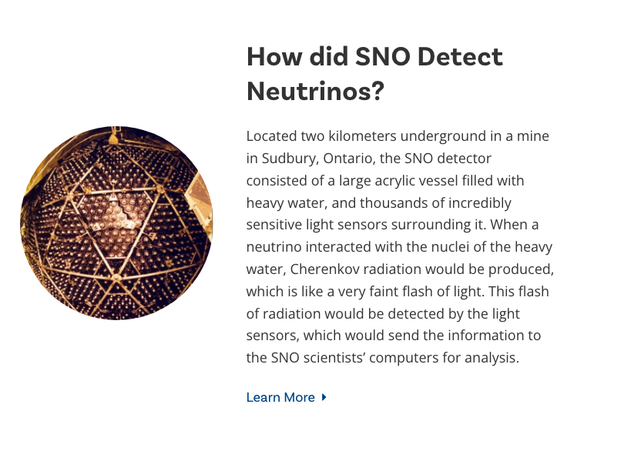
Notes:
So now I’m going to share a bit of what I’ve been doing!

Slide 16
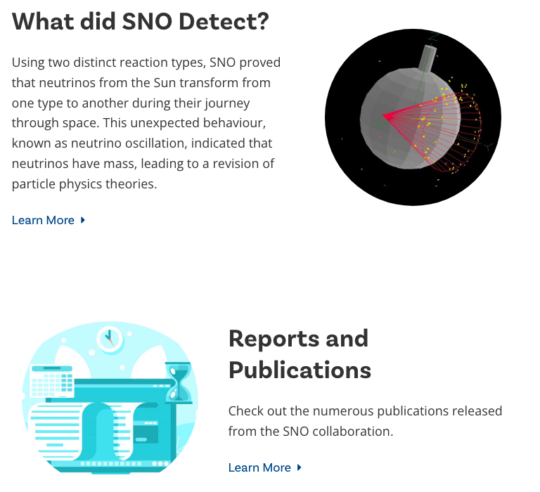
Notes:
So now I’m going to share a bit of what I’ve been doing!

Slide 17
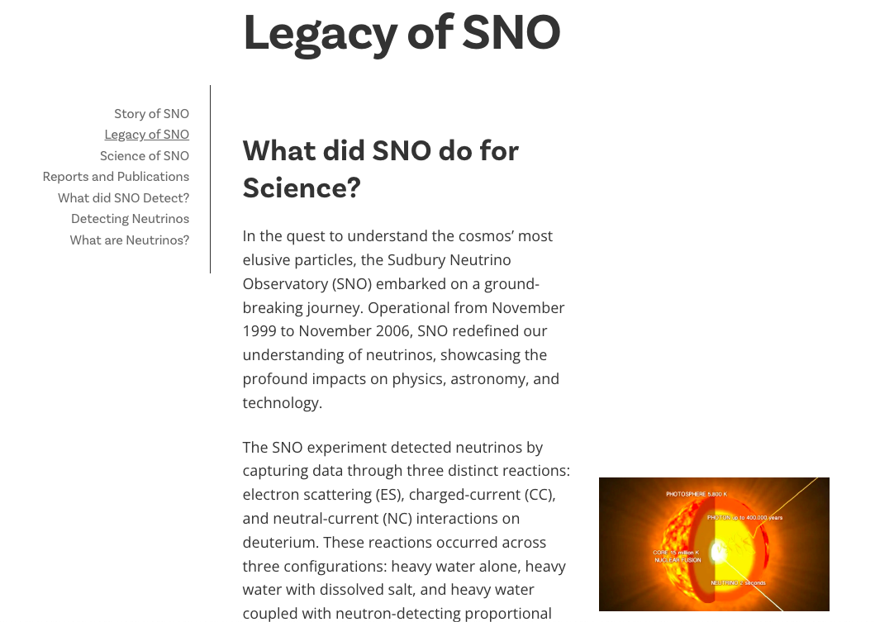
Notes:
So now I’m going to share a bit of what I’ve been doing!

Slide 18
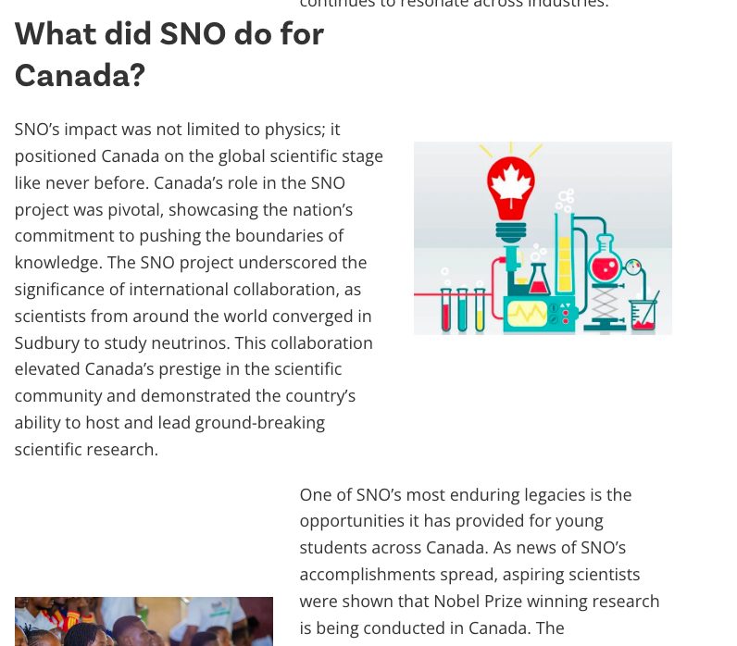
Notes:
So now I’m going to share a bit of what I’ve been doing!

Slide 19
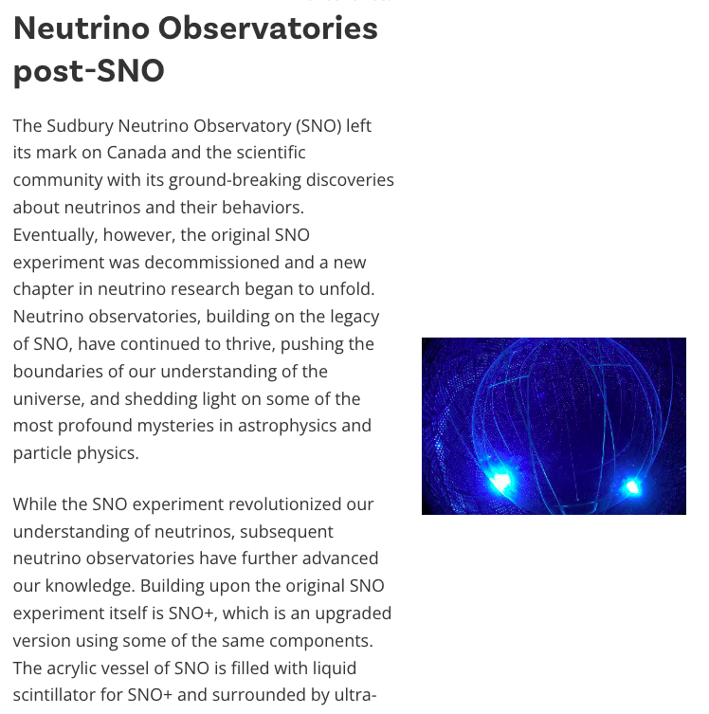

Slide 20
Sections to be Completed
People of SNO
Contacts

Slide 21
4. Next Steps
Some sections still to be completed.
Once I have the first draft of the website complete, it will be shared with various stakeholders, including SNO and SNOLAB personnel, to incorporate more feedback.
There will likely be several rounds of this process, and then the new website will go live and be made available to the public.

Slide 22



5. Impact
Notes:
Once this project is complete, this Nobel-Prize winning experiment will have an updated dedicated website that brings accessibility forward as the priority. It will be a space where the Story, the Science, the People, the Contacts, and the Legacy of SNO is honoured and readily available to the public. Importantly, it will have impacts for the naturally curious at home, to students and teachers highlighting Canadian success in science, to astroparticle physicists wanting to know more about sno.

Slide 23
Thank you for listening!

