Slide 1

External Cross Talk in LoLX1
CASST Student Talk Competition 2023
Notes:
- Lolx is a light detector
- spims inside (standing outside on a bright day, billions photons hit your eye every second – a sipm can detect a single photon)

Slide 2
Events in LoLX
LEGEND
Scintillation light
Cherenkov light
Liquid Xenon volume
Sr90 Source

Slide 3

How does a SiPM work?
Photon
E-field
p++
e⁻
p
Avalanche
n
n+

Slide 4
Events in LoLX
LEGEND
Scintillation light
Cherenkov light
Liquid Xenon volume
Sr90 Source
Cross Talk photon
Notes:
Mention that lolx is only a few cm wide, so cross talk happens almost instantaneously

Slide 5
Motivation for LoLX
nEXO is a rare event search experiment looking for neutrinoless double beta decay
To be able to detect neutrinoless double beta decay (if it exists), we need nEXO to have excellent energy resolution
An essential part to improving energy resolution is understanding external cross talk (eXT)
Since nEXO will be using both SiPMs and Liquid Xenon (like in LoLX), if we can understand eXT in LoLX it will help us understand eXT in nEXO
Notes:
Add slide explaining neutrinoless double beta decay

Slide 6
What does eXT look like in LoLX?
In LoLX, the only data we have is waveform of each channel. It looks something like this:
Each pulse is a SiPM detecting a photon. The larger the pulse, the more photons were detected. It is also possible that there is a pulse that was not caused by a photon hitting the SiPM (these are called dark counts)
Voltage
Time
There are 30 channels in LoLX, each with their own unique waveforms.
How do we assign physical meaning to a collection of waveforms?
Notes:
Mention that timing resolution is ~16ns

Slide 7
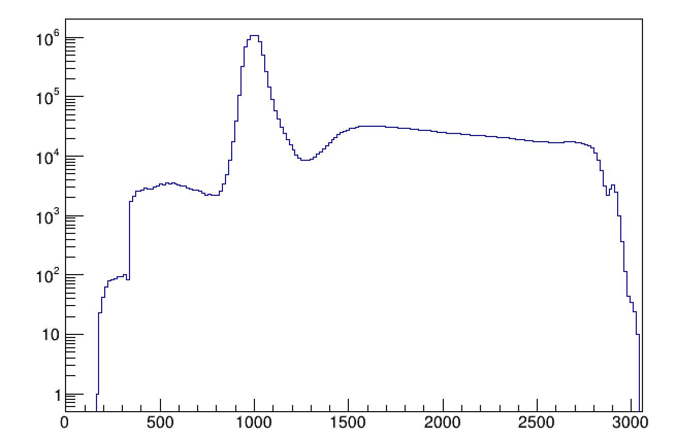
Time Distribution of Pulses in LoLX – RUN 1777
Event in LoLX
Region where we will look for eXT
Number of Pulses
Time [ns]
Notes:
Define what I mean by the cage. Maybe talk about fluorescence. If you look in the red region there is so much light that it is very difficult to pickup cross talk. Its kinda like if youre trying to listen to a presentation about external cross while a mariachi band is playing.

Slide 8





$Δ$t
$Δ$t
$Δ$t
$Δ$t
$Δ$t
Voltage
Channel 1
(“source”)
Time
Voltage
All other channels
(“target”)
Time

Slide 9
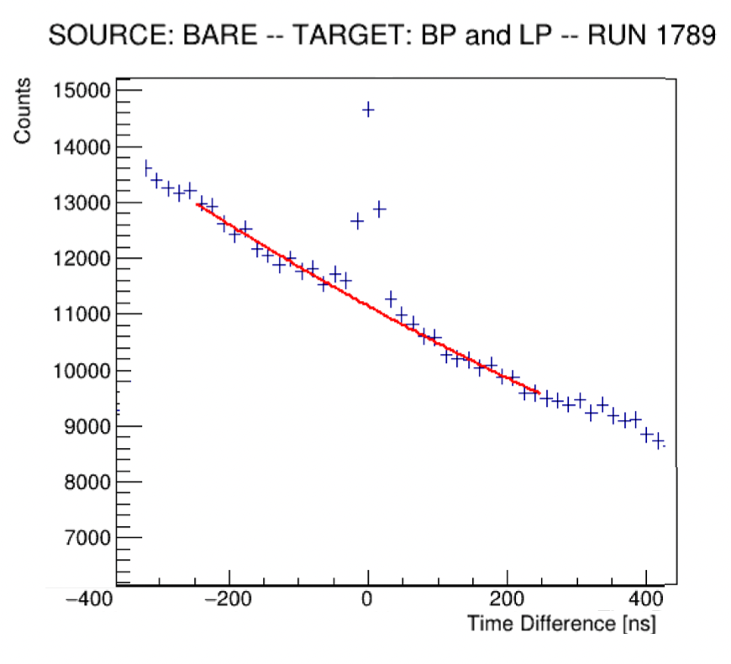
Counts under the red line: “background counts”
This is caused by the random chance that 2 pulses will be spaced “x” nanoseconds apart
The peak at 0ns is caused by eXT
Since the timing resolution of each pulse is 16ns, the combined resolution will be… worse
The width of this peak is ~48 ns, so for 2 pulses to be considered eXT pulses, they must occur within ~48ns.
Notes:
Were now in a position to start putting all this together to estimate eXT between different channels

Slide 10
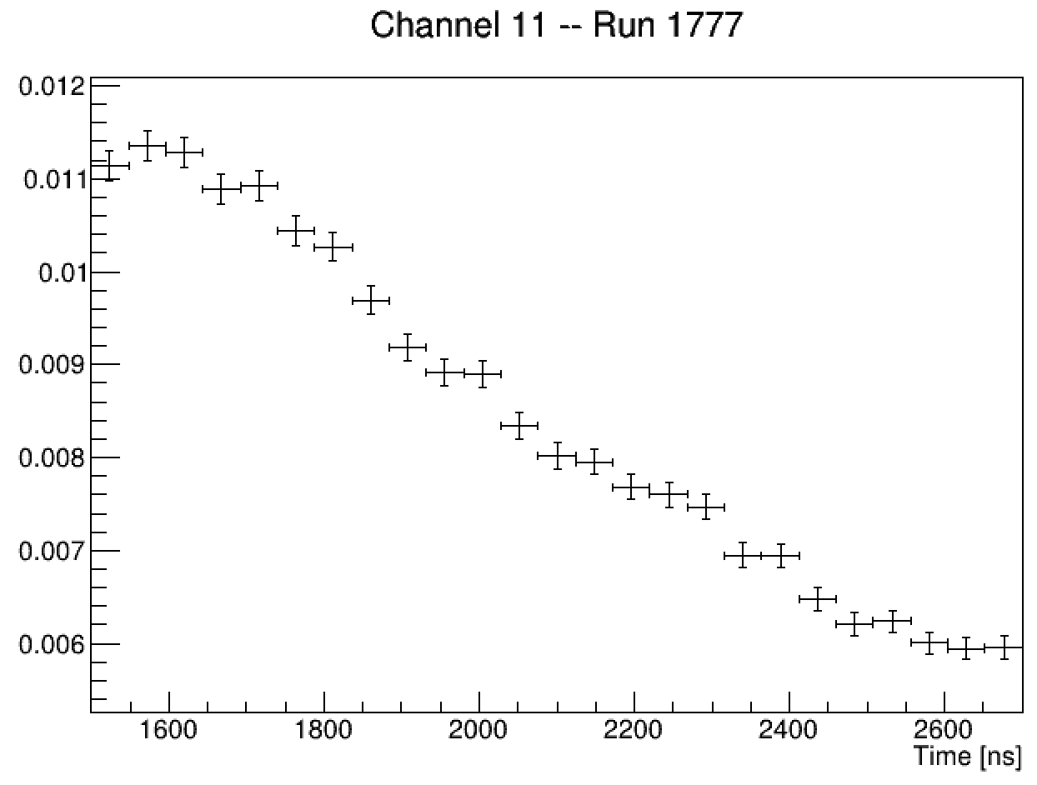
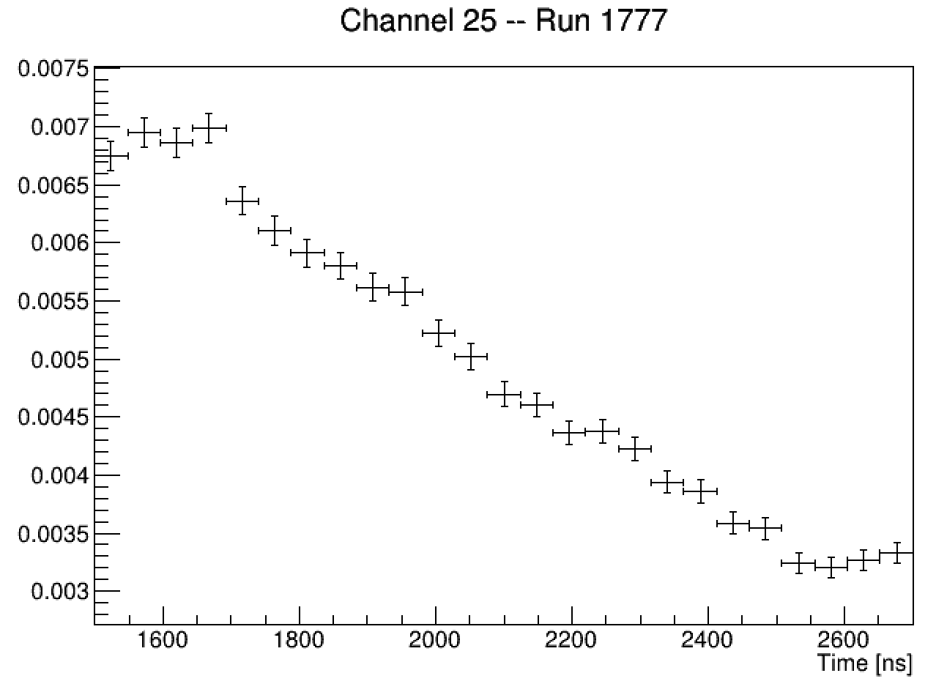
Example: eXT between Channels 11/25
P1
P2
Probability of a Pulse (per Event)
Probability of a Pulse (per Event)

Slide 11
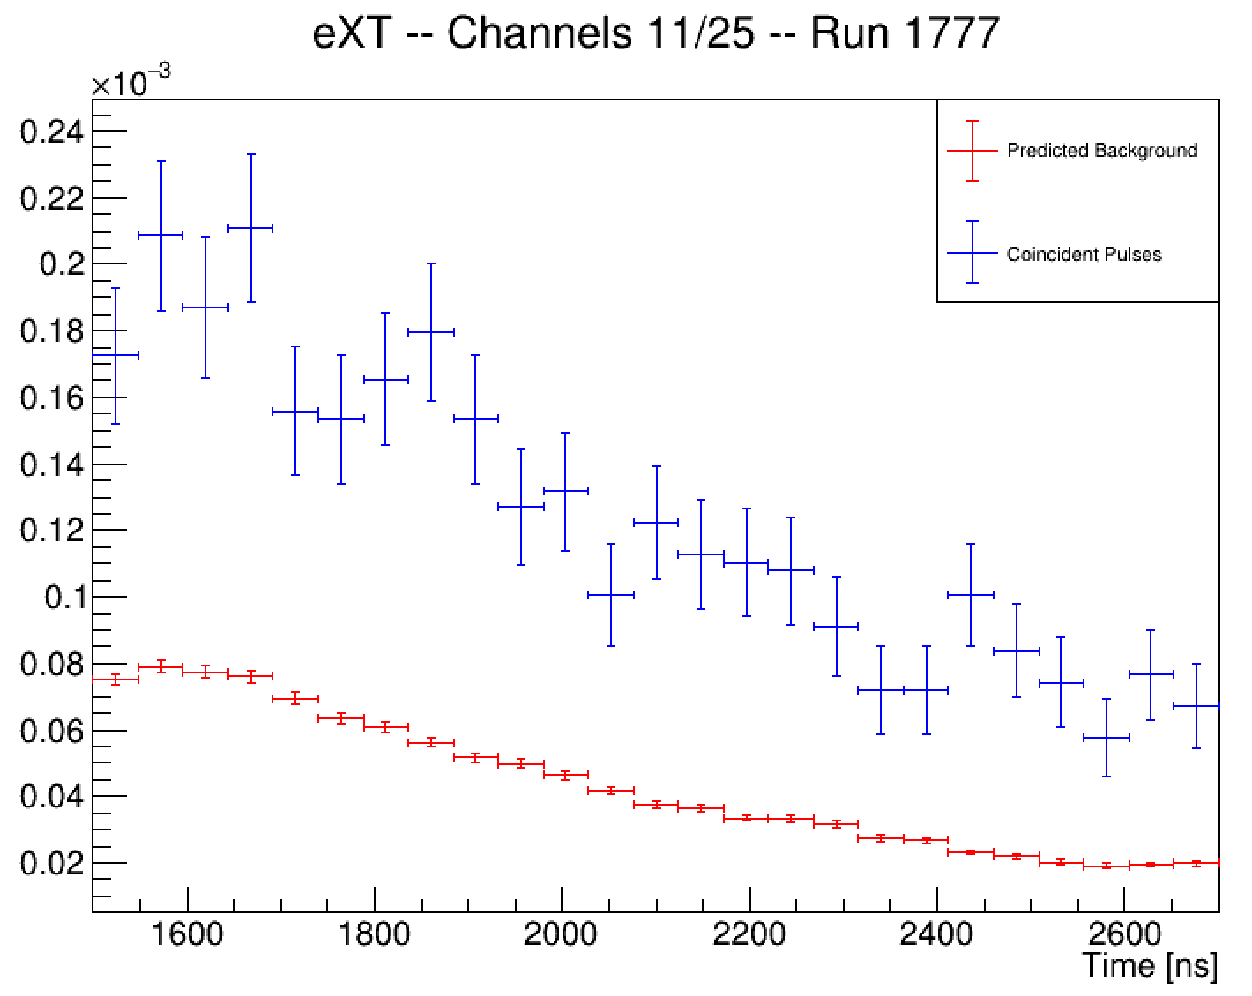
P12
(pulses within 48ns)
Probability
P1*P2

Slide 12
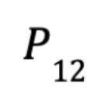
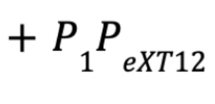
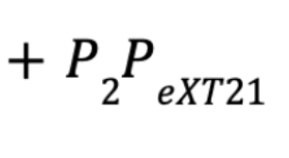
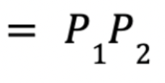
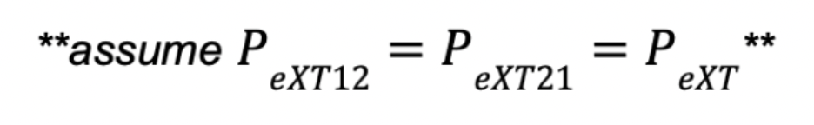
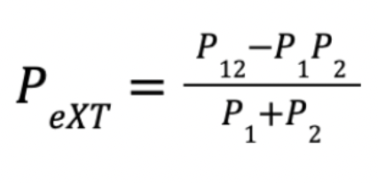
Probability of both channels independently pulsing in a given time window
Probability of channel 1 pulsing, and causing channel 2 to fire from eXT
Probability of channel 2 pulsing, and causing channel 1 to fire from eXT
Note: we can add the probabilities because they are small

Slide 13
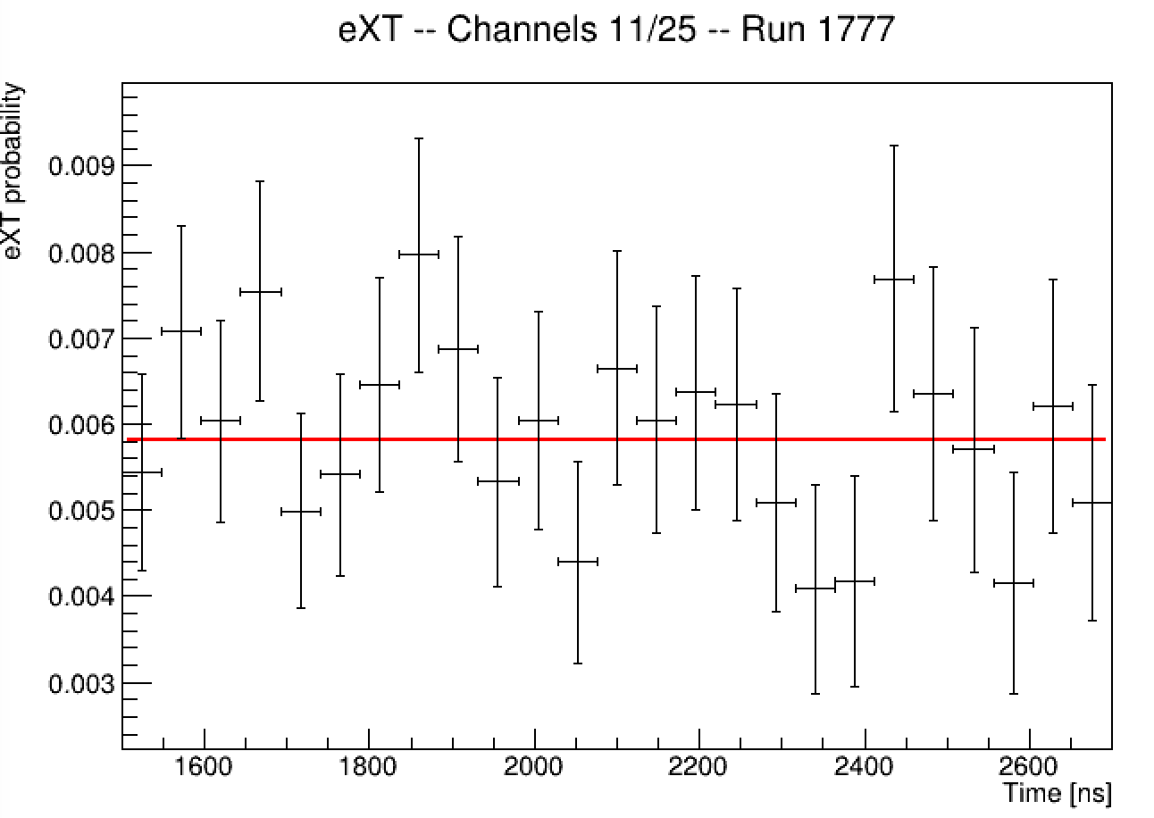
eXT Probability: 0.0058 +/- 0.0003

Slide 14
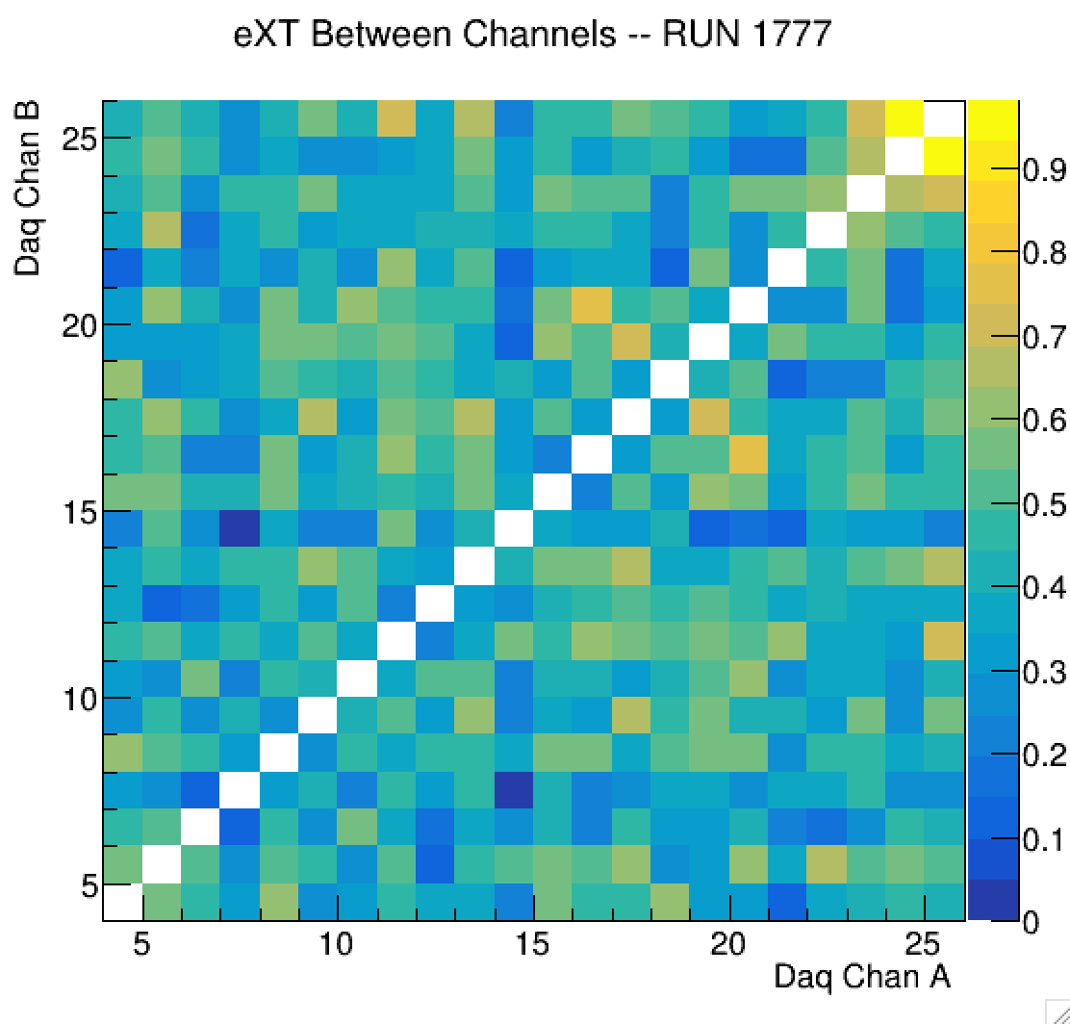
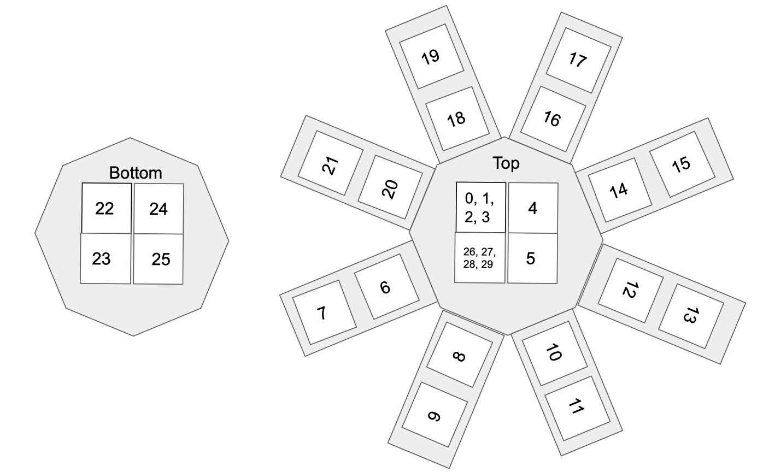
Interesting points:
There doesn’t seem to be a clear pattern of eXT with channel to channel angle
channels that are across from each other don’t seem to have a higher probability of eXT
example: channels 24/25

Slide 15


IDEA: Run simulations with different cage reflectivity’s and roughness, and see which results best match the data
$$θ$$
$$θ$$
Specular Reflection
Diffuse Reflection

Slide 16
CONFIGURATION 1:
Default sim settings
Uses Fresnel’s equations and the index of refraction of pmma to calculate reflectivity
Only diffuse reflections
CONFIGURATION 2:
Reflectivity set to 0
CONFIGURATION 3:
Reflectivity set to 100%
Only specular reflections
CONFIGURATION 4:
Reflectivity set to 100%
80% diffuse reflections, 20% specular reflections
CONFIGURATION 5:
Reflectivity set to 100%
Only diffuse reflections

Slide 17
OUTLOOK:
Hopefully with the simulations, I can see which configuration best matches the data
We have calculated the eXT values for every pair of channels in LoLX, but still need to better understand meaning of our results

