Slide 1
Maximum Likelihood Estimation of Errors for Measuring the Flux of Neutrons in the SNO Lab Underground Laboratory
By Tatum Soward for CASST

Slide 2
The Background Survey Improvement Project
SNO Lab's highly sensitive instruments detect neutrons emanating from the surrounding rock
These background neutrons need to be removed to ensure accurate data
Experiments are currently using an estimate of the neutron flux
The Background Survey Improvement Project aims to measure the flux of neutrons in SNO Lab's underground laboratory for more accurate data moving forward

Slide 3
Expected Results
Fluence is the number of neutrons per unit area (n/cm^2)
Flux is the fluence per unit time (n/cm^2/s)
SNOLAB Technical Reference Manual (Duncan et al., 2016) gives an estimated flux of 4000 n/m^2/day or 4.630e -6 n/cm^2/s
A computer simulation gave the results that most neutrons have an energy of ~3MeV
Versus on surface where the neutron flux is between 0.01 - 0.03 n/cm^2/s
  SNOLab is expected to be on the lower end of the range due to its latitude
The surface spectrum peaks at 1 MeV

Slide 4
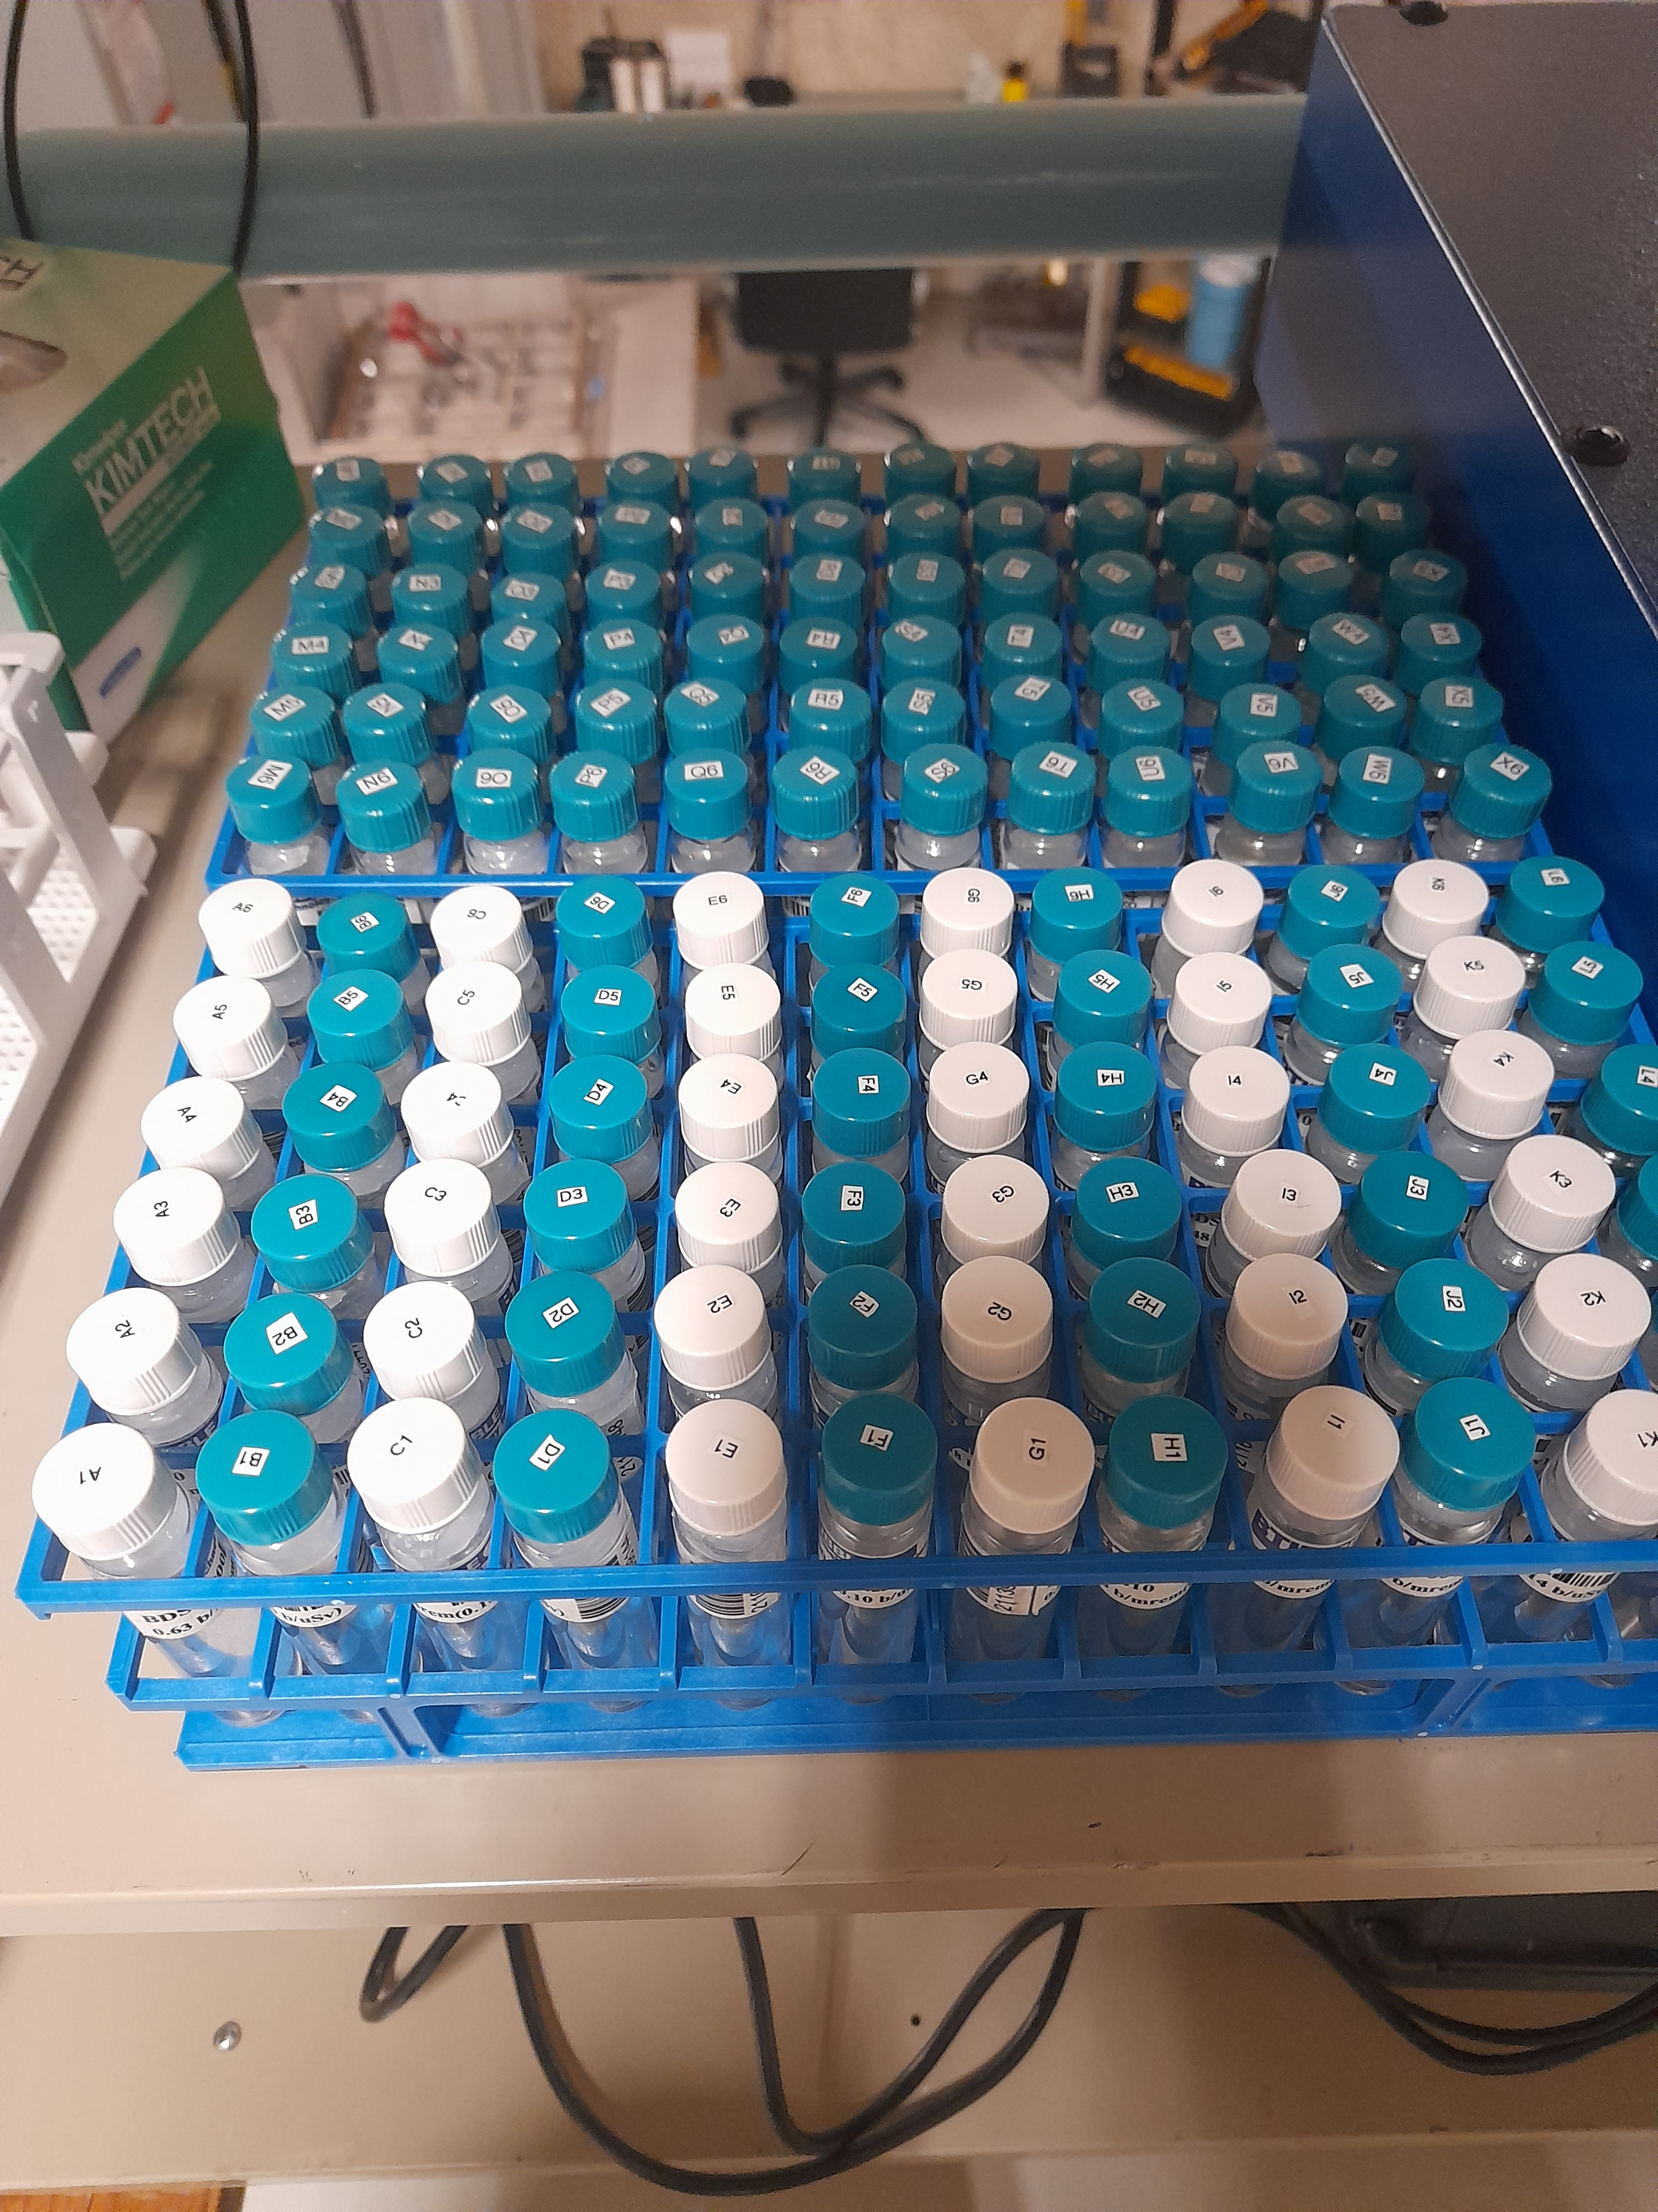
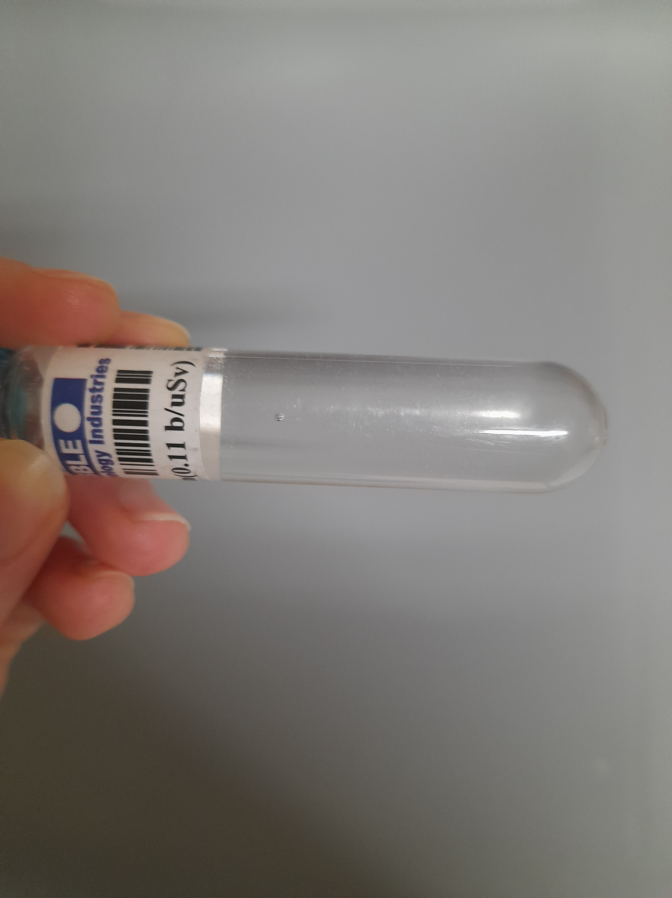
Materials and Methods Used
The project uses Bubble Detector Spectrometers (BDS) manufactured by Bubble Technology Industries (BTI)
The energy spectrum is divided into 6 ranges to which 6 BDS types have different sensitivities (Will go into more detail in the following slide)
24 detectors of each BDS type were used for a total of 144 detectors
When a neutron of a sensitive energy range interacts with a detector, a bubble is produced
Once a week the bubbles in the detectors are counted and updated to the total bubble count
The 144 detectors
Bubble
Neutron bubble in a BDS

Slide 5
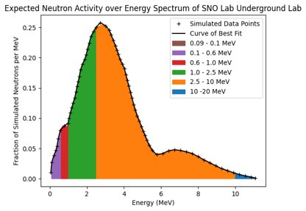
Materials and Methods Used
Majority of surface neutrons will have an energy in either the 0.6 - 1.0 MeV (red) range or 1.0 - 2.5 MeV (green) range.
Most underground neutrons will have an energy 2.5 - 10 MeV (orange). With the next majority being 1.0 - 2.5 MeV (green).
Simulated data integrated over ranges that the BDS are sensitive to

Slide 6
The Unfolding Process
By integrating over each coloured range and multiplying by the expected underground flux of 4.630e -6 n/cm^2/s the expected flux per range is found
The bottom row shows the expected total of bubbles per detector type as of 2023-07-19 given the above fluxes
Range (MeV):​​ | 0.09 - 0.1​​ | 0.1 - 0.6​​ | 0.6 - 1.0​​ | 1.0 - 2.5​​ | 2.5 - 10​​ | 10 - 20​​
Flux (n/cm^2/s):​​ | 1.151e-9​​ | 1.233e-7​​ | 1.615e-7​​ | 1.262e-6​​ | 3.057e-6​​ | 2.273e-8​​
Bubbles x 24 det​ | 3.74e-2​ | 4.02e-2​ | 4.11e-2​ | 2.30e-2​ | 2.02e-2​ | 2.13e-4​

Slide 7

Materials and Methods Used
The following table shows what ranges the BDS types are sensitive to (green)
The numbers are coefficients in units of (cm^2 * bubbles/n) which are used to convert bubbles into fluences and vice versa
The table is also called "the coefficient matrix" or
Range / BDS Type​ | 0.09 - 0.1 MeV​ | 0.1 - 0.6 MeV​ | 0.6 - 1.0 MeV​ | 1.0 - 2.5 MeV​ | 2.5 - 10 MeV​ | 10 – 20 MeV​
BDS10​ | 5.00e-6​ | 2.50e-5​ | 2.92e-5​ | 2.97e-5​ | 4.15e-5​ | 4.78e-5​
BDS100​ | 0​ | 2.27e-5​ | 3.14e-5​ | 3.23e-5​ | 4.47e-5​ | 5.09e-5​
BDS600​ | 0​ | 0​ | 1.60e-5​ | 3.27e-5​ | 4.75e-5​ | 5.45e-5​
BDS1000​ | 0​ | 0​ | 0​ | 1.32e-5​ | 3.50e-5​ | 5.90e-5​
BDS2500​ | 0​ | 0​ | 0​ | 0​ | 2.99e-5​ | 8.70e-5​
BDS10000​ | 0​ | 0​ | 0​ | 0​ | 0​ | 4.35e-5​

Slide 8

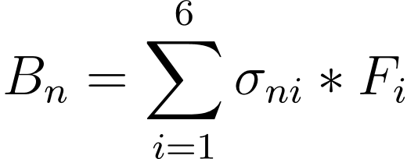
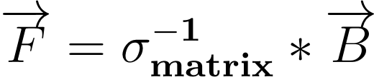
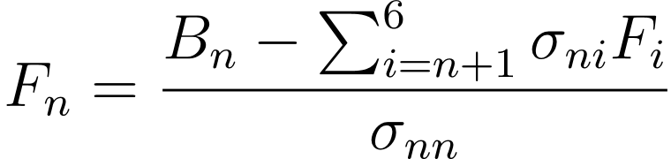
The Unfolding Process
The bubbles (per BDS type) in the detectors are equal the coefficient matrix multiplied by the fluence (per energy range)
(1) Or (2)
The fluence is therefore given by
(3) Or (4)

Slide 9
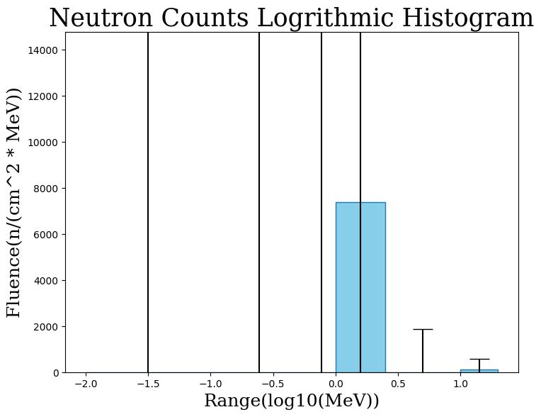
Current Error Analysis
What's the problem?
BDS are designed for measuring higher fluxes than underground
Current method has lower counts lead to higher errors
Fluence/Flux error (error in time is negligible) are higher than the values
Fluence Histogram of real data from 2023-07-19 using the unfolding method

Slide 10
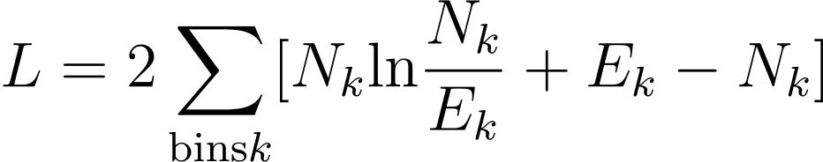
Maximum Likelihood Estimation
Why? Because the unfolding method uses the last BDS types to constrain the ones before
Accuracy is favoured for the higher energy ranges
MLE uses all the data from every detector to constrain the energy bins
(5)
L is the likelihood, we want to minimize for the most probable outcome
N_k is the counted number of bubbles
E_k is the expected number of bubbles from Equation 1
Fluences that give L_min are the Fluence measurement
Upper and Lower Limits of a Fluence are where L = L_min + 1

Slide 11
Implementation
3 sets of data
A hypothetical high flux scenario with a flux of 1e7 n/cm^2/MeV/day
  To ensure that both the unfolding process and MLE work as expected
Ambient surface data which had the detectors exposed for 1776 hours with 45 counts
  Higher flux real data to compare the results
Real underground data taken 2023-07-19, at this point the detectors had been exposed for 2499 hours with 44 counts
  The data that needs improvement

Slide 12
Results – High Flux Scenario
Fluence of Unfolder vs MLE for a flat fluence of 1e7 n/cm^2/MeV
Method/ Range (MeV) | Unfolder (n/cm^2/MeV) | Error | MLE (n/cm^2/MeV) | Error
0.09 - 0.1 | 9.55E+06 | 8.26E+10 | 8.49E+06 | 1.68E+08
0.1 - 0.6 | 1.00E+07 | 2.28E+09 | 1.02E+07 | 1.14E+07
0.6 - 1.0 | 1.01E+07 | 1.84E+09 | 9.84E+06 | 2.00E+07
1.0 - 2.5 | 9.97E+06 | 2.24E+08 | 1.00E+07 | 6.38E+06
2.5 - 10 | 1.00E+07 | 7.47E+05 | 1.00E+07 | 7.45E+05
10 - 20 | 1.00E+07 | 1.51E+05 | 1.00E+07 | 1.52E+05

Slide 13
Results – Surface Data
Unfolder vs MLE errors in fluence for Surface Data
Method/ Range (MeV) | Unfolder (n/cm^2/MeV) | MLE (n/cm^2/MeV)
0.09 - 0.1 | 2.60E+07 | 2.45E+06
0.1 - 0.6 | 1.10E+06 | 6.45E+04
0.6 - 1.0 | 1.20E+06 | 2.67E+05
1.0 - 2.5 | 3.63E+05 | 5.69E+04
2.5 - 10 | 5.34E+04 | 3.59E+03
10 - 20 | 1.32E+04 | 1.95E+03
Unfolding versus MLE Flux for Surface Data in n/m^2/s
Expected Flux | 100 – 300
Unfolder | 847
Unfolder Error | 3.39E+03
MLE | 317
MLE Error | 53.0

Slide 14
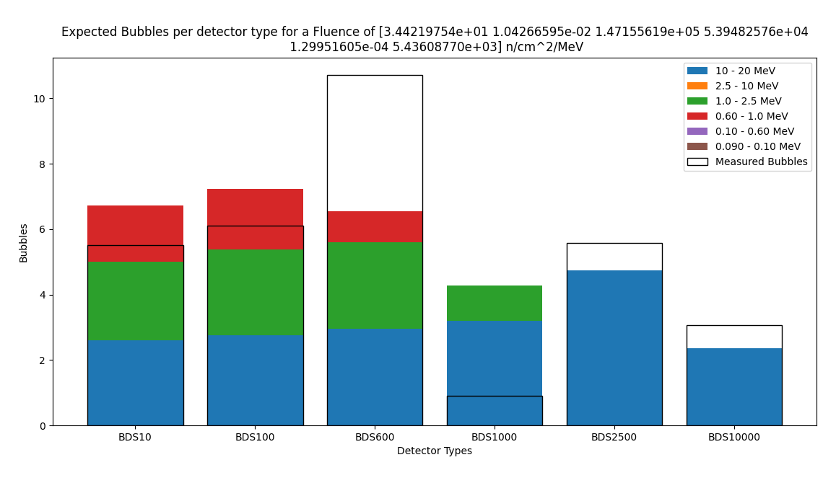
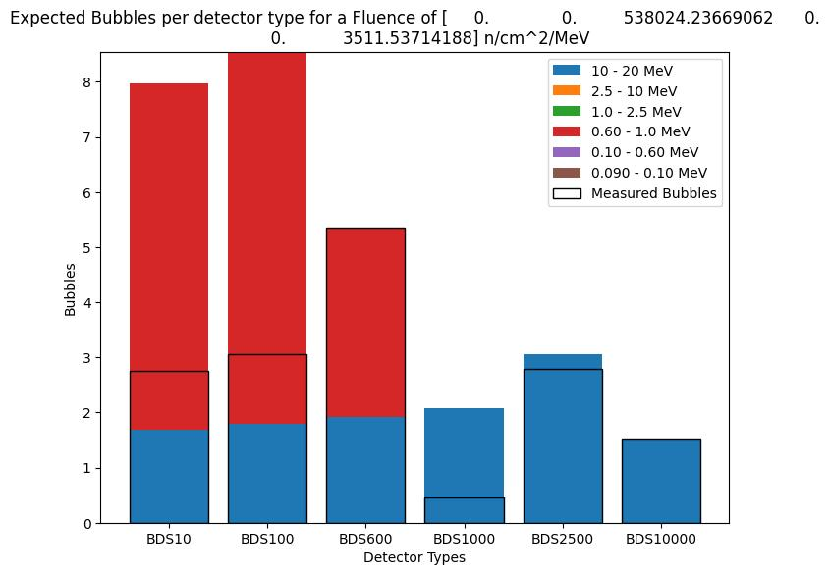
Results – Surface Data
Expected vs Measured Bubbles per BDS Type for Unfolding and MLE
Unfolding:
Average Diff - 2.1 bubbles
See majority 0.60 - 1.0 MeV
MLE:
Average Diff – 1.9 bubbles
See majority 0.60 - 1.0 and 1.0 - 2.5 MeV

Slide 15
Results – 2023-07-19 Data
Unfolding versus MLE errors for 2023-07-19 Data
Method/​Range (MeV)​ | Unfolder (n/cm^2/MeV) | MLE (n/cm^2/MeV)
0.09 - 0.1​ | 2.80E+07 | 2.47E+06
0.1 - 0.6​ | 1.32E+06 | 1.55E+05
0.6 - 1.0​ | 2.17E+06 | 2.23E+05
1.0 - 2.5​ | 2.80E+05 | 9.01E+04
2.5 - 10​ | 4.49E+04 | 7.45E+03
10 - 20​ | 1.13E+04 | 1.62E+03
Unfolding versus MLE Flux for 2023-07-19 Data in n/m^2/s
Expected Flux | 4.630E-02
Unfolder | 8.36
Unfolder Error | 217
MLE | 8.45
MLE Error | 3.98

Slide 16
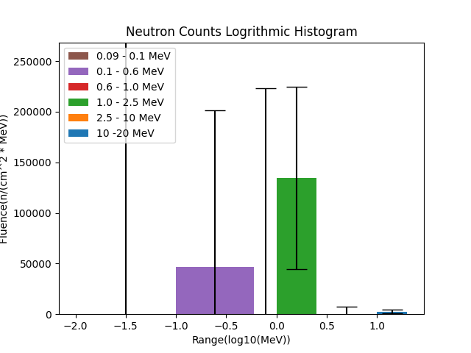
Results – 2023-07-19 Data
Fluence per energy range for 2023-07-19
See majority of fluence in 1.0 - 2.5 MeV
Expect to see the majority in the 2.5 - 10 MeV and second most in 1.0 - 2.5 MeV
Where is the fluence in the 2.5 - 10 MeV range? :(

Slide 17
Short comings
Code Broke!
The minimizer was unable to find solutions at low bubble counts

Slide 18
Short comings
What is going on?
The underground data is not fitting expected values, but that is a problem for another talk

Slide 19
Conclusion
The MLE analysis of errors offers promising results to reduce the uncertainties in the measurement of the neutron flux of the SNO Lab underground Laboratory
However, a lot of work still needs to be done to reduce the uncertainties and make the analysis suitable for the low neutron counts being measured
Both MLE and Unfolding methods produce inaccurate results for underground data, a potential cause is alpha decay in the detectors
The biggest challenge continues to be that the BDS are designed for measuring a higher flux, if nothing can be done to reduce the uncertainties, then the use of the BDS in this project should be reexamined

Slide 20
Thank You!
Steffon Luoma and Thomas Sonley
For their mentorship on this project and this presentation
CASST
For inviting me to speak
And to the Judges and Viewers
For your attention and questions

