Slide 1
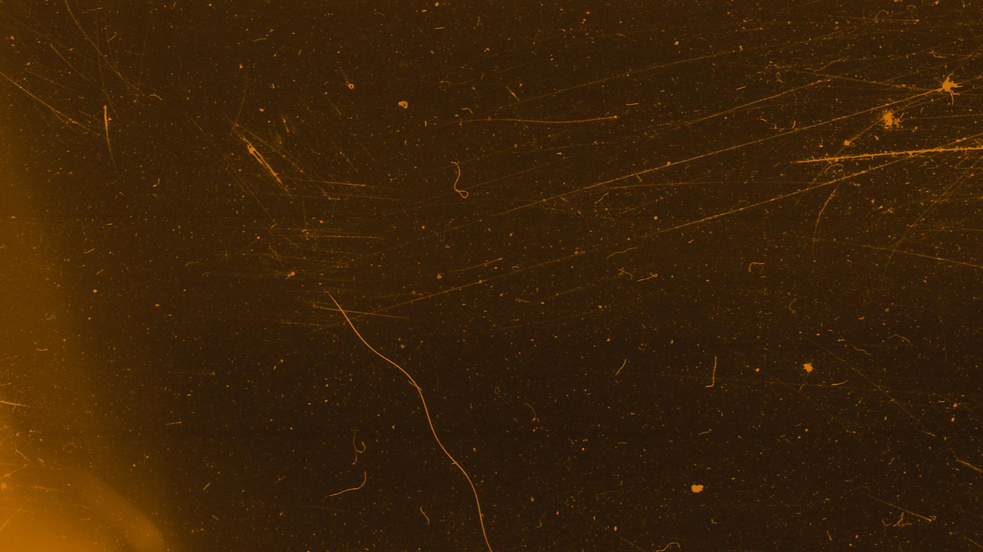

Improving the Radon Trapping Capability at SNOLAB using Activated Charcoal
CASST Summer 2023
Yusuf Ahmed
Supervisors: Nasim Fatemighomi & Lina Anselmo

Slide 2
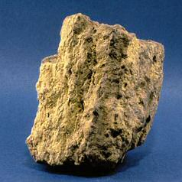
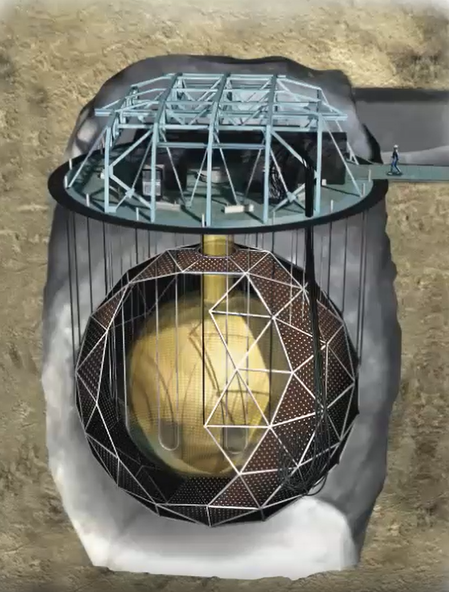
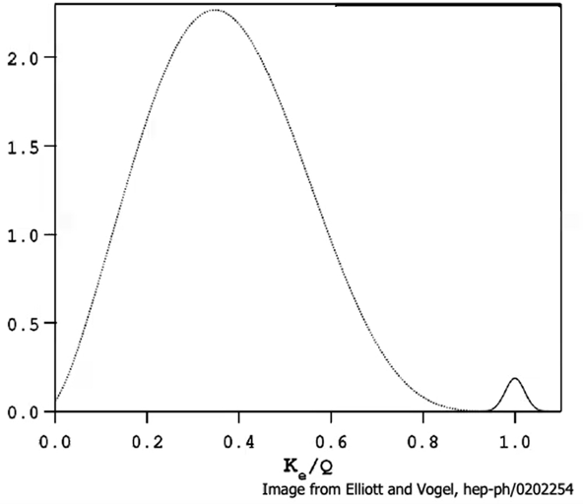
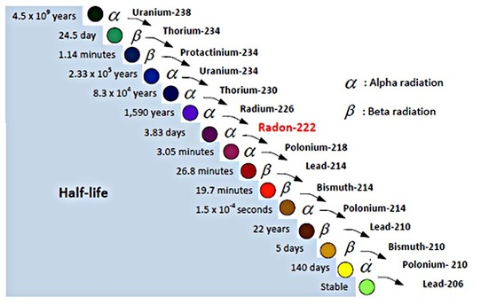

Why is Radon a problem?
Uranium Ore
$$0νββ$$
SNO+
Notes:
WHY IS RADON A PROBLEM?
Radon is radioactive gas from the decay of Uranium which is abundant in the rocks that surround the experiments underground. Being a gas and chemically non-reactive, it can flow into the detectors quite easily, producing backgrounds that can create scintillation that overlaps the energy regions of interest. For example, the SNO+ detector’s search for the $0νββ$ decay requires seeing that small peak which can be overlapped by the decay products of Bi-214, which follows from Radon. So, it’s not only important for us to reduce the level of Radon in our detectors but also to know how much Radon is in certain regions of the detectors.

Slide 3
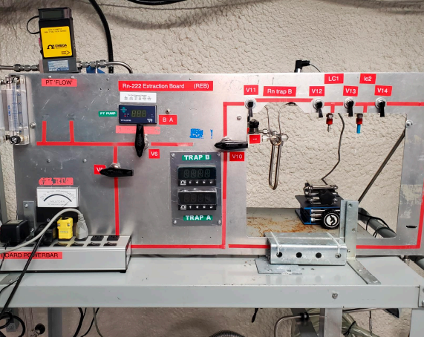
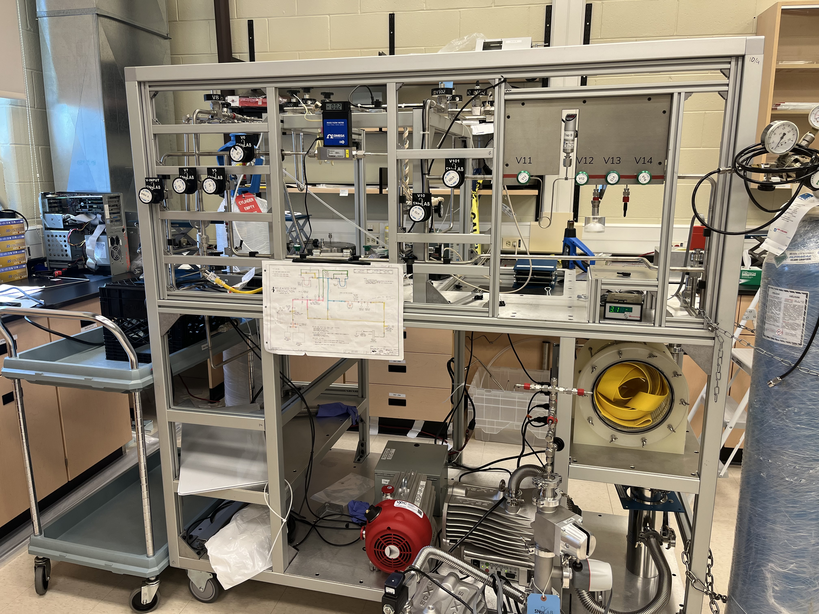
What is a Radon Gas Assay?
The extraction and the determination of the amount of extracted radon from a sample of gas.
Underground Assay Board
Surface Assay Board
Notes:
WHAT IS A RADON GAS ASSAY?
That’s where assays come in. Put simply, a radon gas assay is the extraction and the determination of the amount of extracted radon from a sample of gas.
On the left is the underground assay board, which, for example, samples the SNO+ cover gas and the LN2 plant vapour.
On the right is the surface assay board, which samples Radon emanated from any object that can fit into our emanation chamber and is also used for testing of new Radon traps.

Slide 4

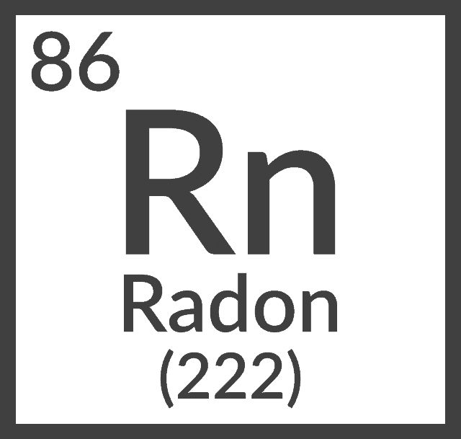
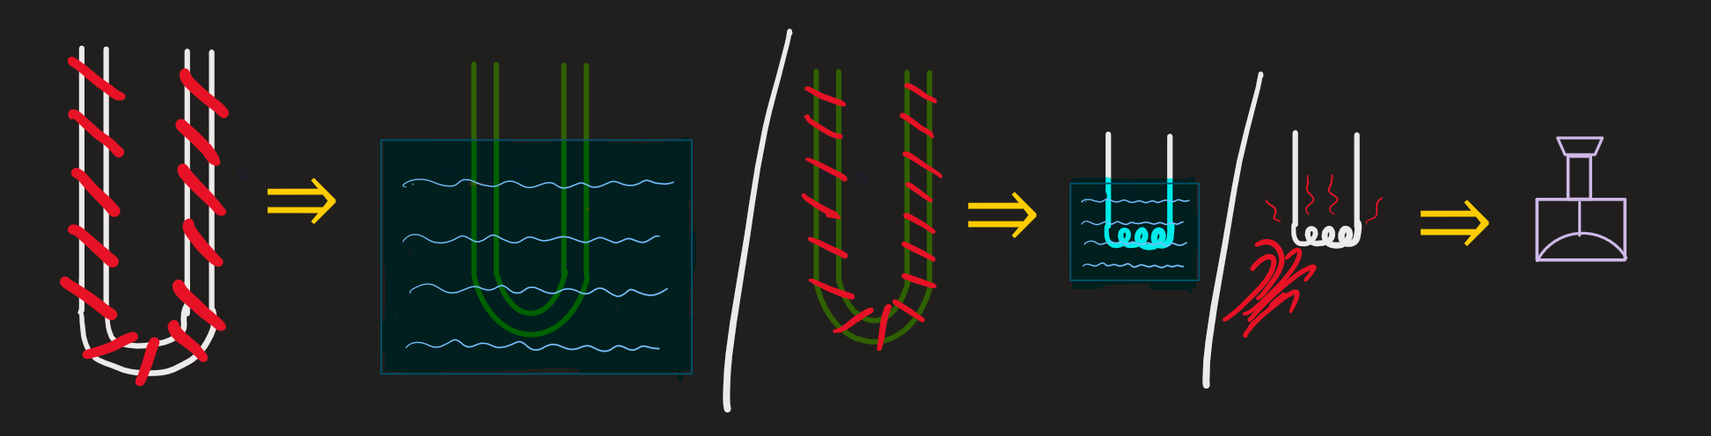










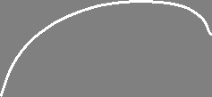
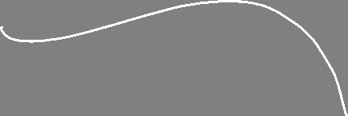



How we extract Radon
Notes:
Keeping it very simple, the main components of doing an assay underground involve the transferring of the sample gas to the primary trap while the trap is submerged in LN so that radon loses energy and is more easily able to adsorb to the material inside the trap, it is then heated and transferred to the secondary trap while the secondary trap is in LN, which is then transferred to the Lucas Cell.
The reason we transfer from one trap to another is to help isolate radon from the rest of the gases.
The Lucas Cell creates scintillation from the alphas from the radon decay chain, which is counted using a photomultiplier tube.

Slide 5
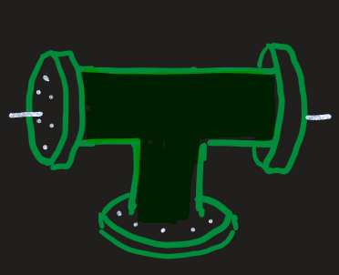
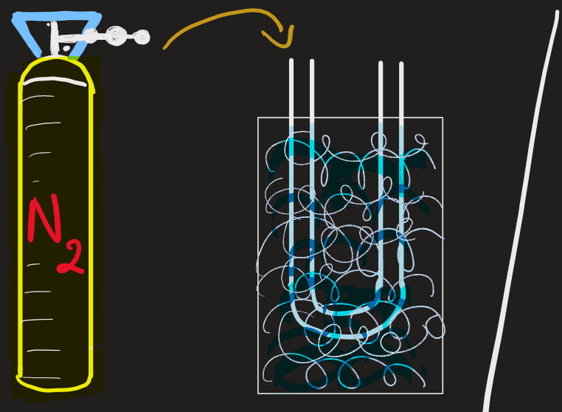
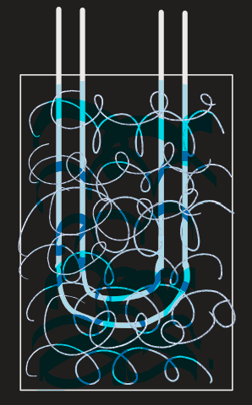
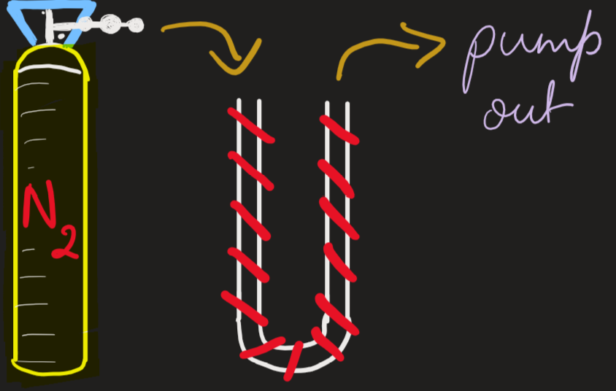
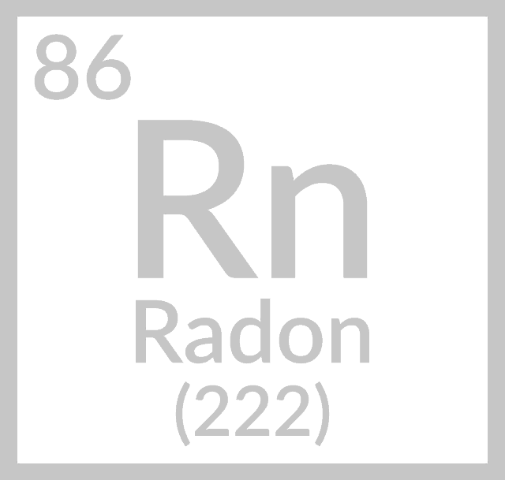

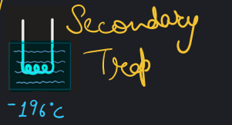


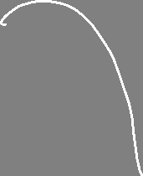


When testing a new trap
Notes:
When we are studying the efficiency of a new trap, we use Radon from an emanation source which is transferred with the help of Nitrogen gas to the new trap while the trap is cooled. Once this transfer is complete, the rest of the assay follows the same procedure as before, going to the primary trap, the secondary trap and the Lucas cell.

Slide 6
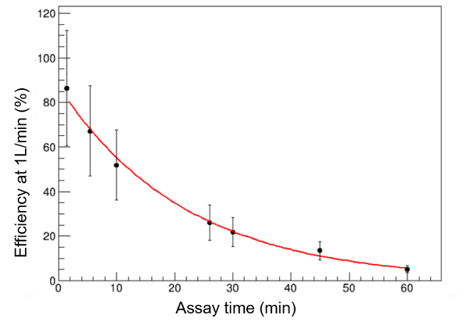
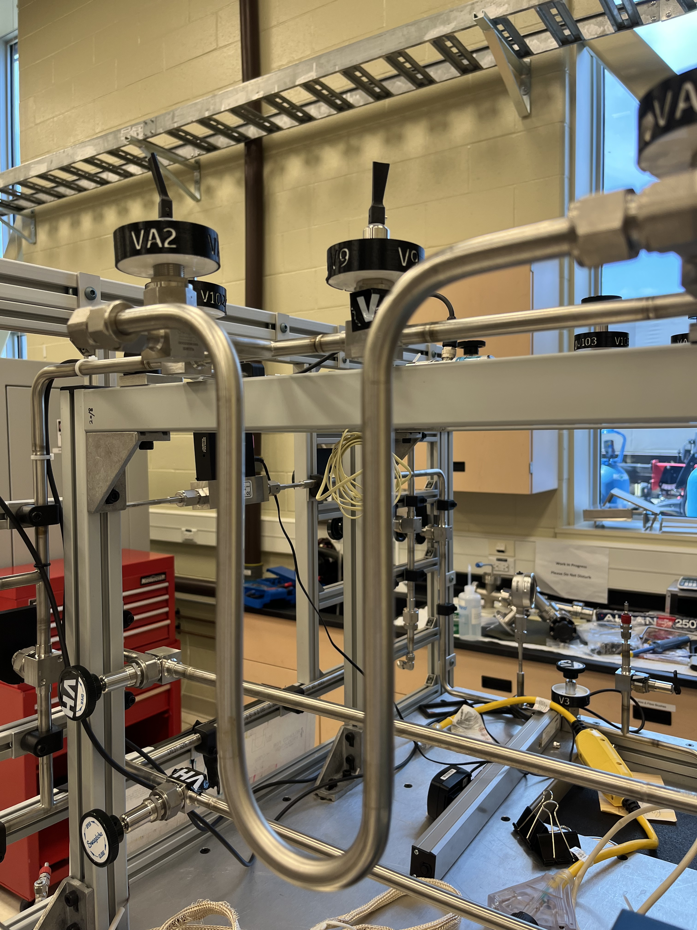
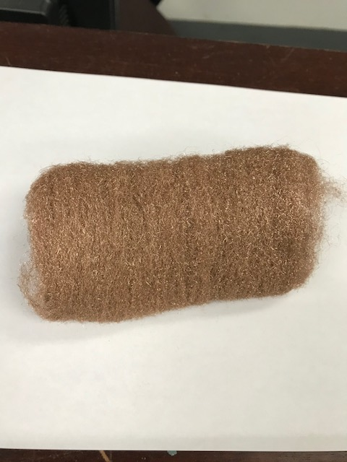
Why do we need a better trap?
Primary Trap (Bronze Wool)
Source: Adil Hussain, S. M. (2022) Evaluating 238U External Background for SNO+ Experiment using Radon Assays and 214Bi Analysis.
What we require: Retainment of efficiency at high flow rates
Proposed Better Material: Activated Charcoal
Greater heat capacity & surface area.
(can sustain longer and higher flow rates)
Greater radon trapping ability.
Notes:
MOTIVATION.
The primary trap consists of bronze wool and was found to reduce in its efficiency to hold Radon with increasing assay time, as seen on this efficiency vs assay time graph. Assay time is the duration for which the sample gas flows from the source to the first following trap. By the 60 min mark, the efficiency has dropped to nearly 5%. The reason for this decline is that bronze has a low heat capacity, meaning that the heat produced by the continuous flow of a gas through the trap creates a relatively high increase in temperature, allowing the trapped radon to escape.
What we needed was a trap that can retain its efficiency at high flow rates so that we may sample greater quantities of gases in a shorter period of time. The proposed solution was to use Activated Charcoal, which is known to have a greater heat capacity and surface area, and therefore expected to have a greater radon trapping ability.

Slide 7
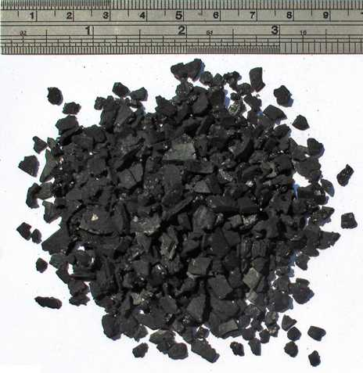
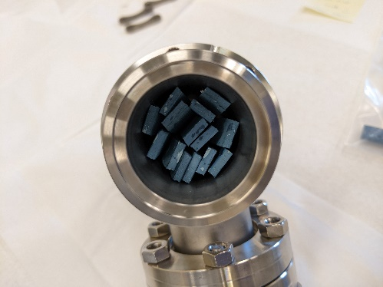
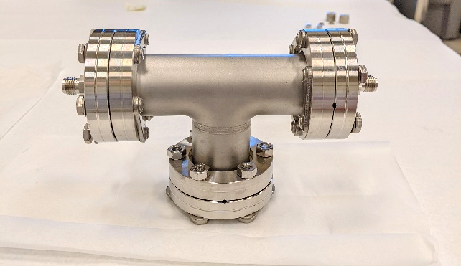
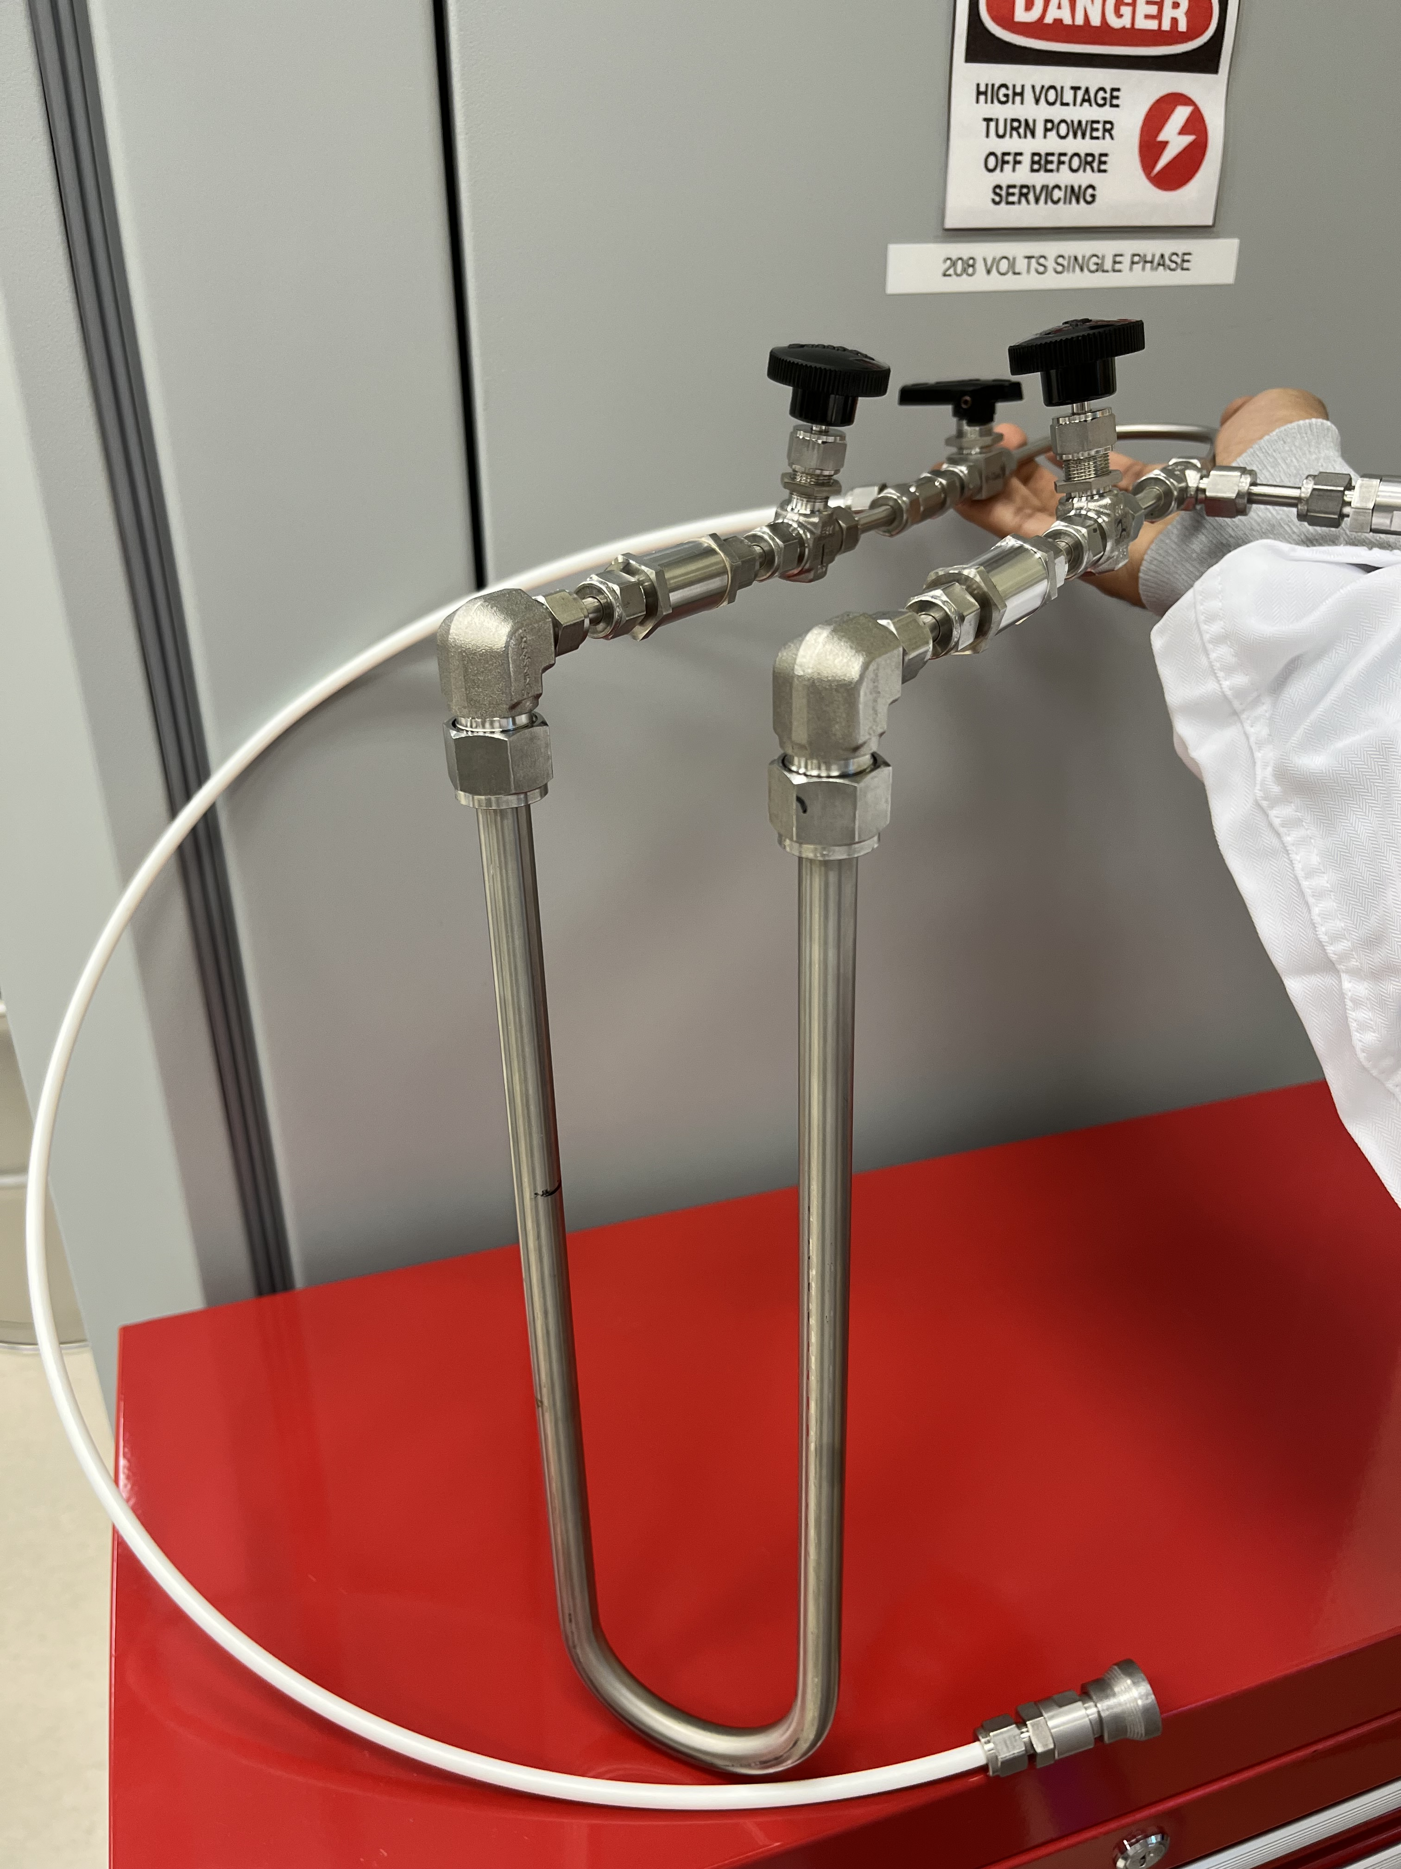
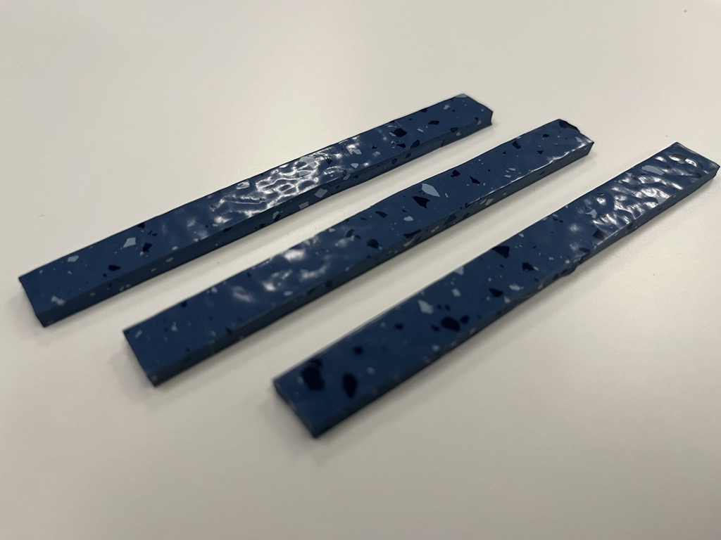
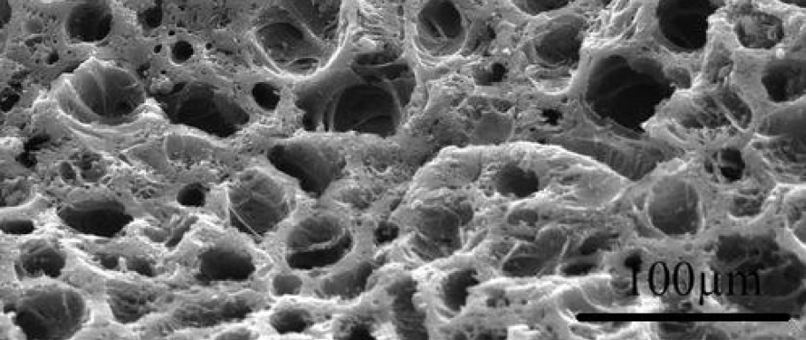
The Progress So Far
STEP 1: Making the Trap
STEP 2: Making a Calibration Can
10cm
100μm
Notes:
The first step was to make the trap. Inside this U-shaped tube is the charcoal which has gone through several stages of cleaning to reduce its radioactivity.
The second step was to make a calibration can, which is the source of Radon for testing the trap. It consists of strips of a rubber floor tile which showed relatively high uranium concentration.

Slide 8
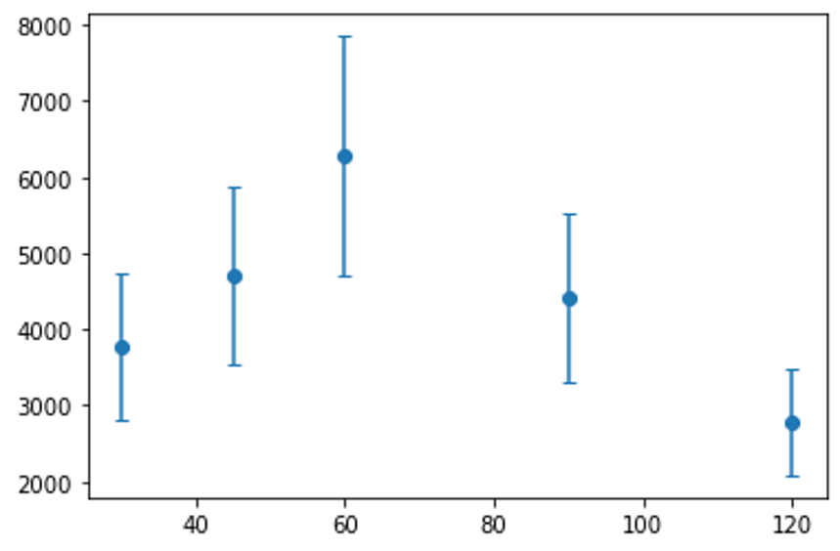
STEP 3: Calibration Can Assays
Bronze Wool
Activated Charcoal
Using lab air of known Radon concentration
Using calibration can of unknown Radon emanation
Source Emanation
(Radon atoms/day @ 1L/min)
Source: Jerry Lu, SNOLAB Fall 2022.
Notes:
On the left is the same plot we just saw, on the right is the radon atoms collected vs assay time for the charcoal trap which shows that it is able retain its efficiency with increasing assay time. Up to the, 60 min mark, while the bronze trap continuously drops in efficiency, the charcoal trap increases in efficiency.
Notice that these are results for a flow rate of 1L/min, and I said earlier that we want a trap that can sustain high flow rates.

Slide 9
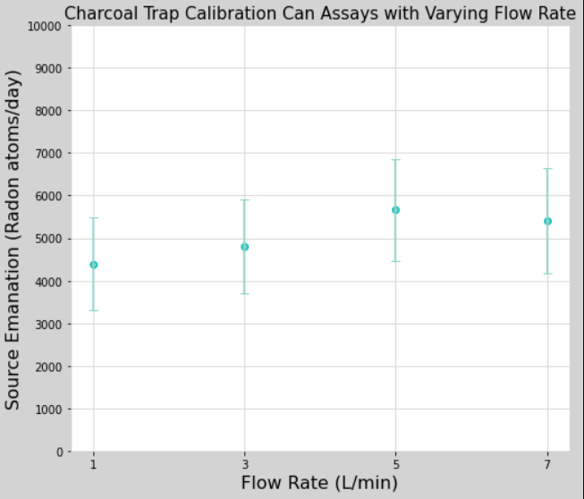
STEP 3: More Calibration Can Assays
Alcohol Slush.
(Reagent Alcohol + LN₂)
Fully submerged trap.
-88°C to -68°C
Notes:
So, I also tested the charcoal trap for 3, 5 and 7L/min, and found that it still does not drop relative efficiency.
In the past…….
We use alcohol slush to avoid over pressurising our traps and, more importantly, the Lucas Cell, which can easily happen if the charcoal trap is fully submerged in Liquid Nitrogen. So, we instead attempted to do an assay with the trap partially submerged in Liquid Nitrogen, and, as you see in the plot, found that the charcoal trap was able to retain even more Radon.
Notice that these are not percentage efficiency measurements, which kept bothering me, so I tried to understand the amount of Radon emanated from the calibration can.

Slide 10
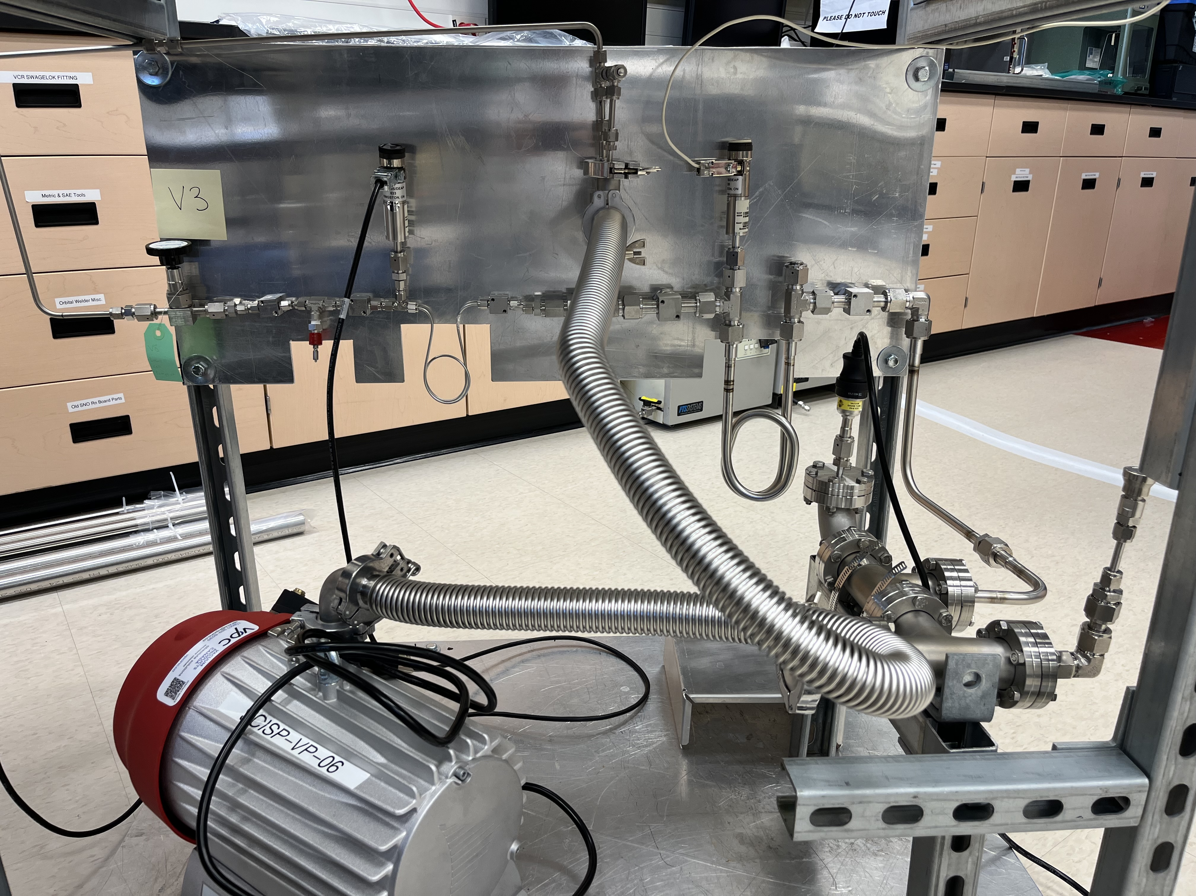
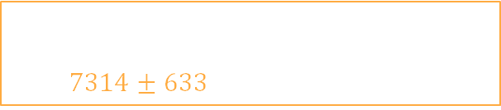
Calibration Can Emanation
Average Emanation (after 24 hours)
$$7314±633 \text{Radon} \text{atoms}\text{/}\text{day}$$
10cm
DEAP Assay Board
Notes:
Using the DEAP experiment’s assay board,

Slide 11
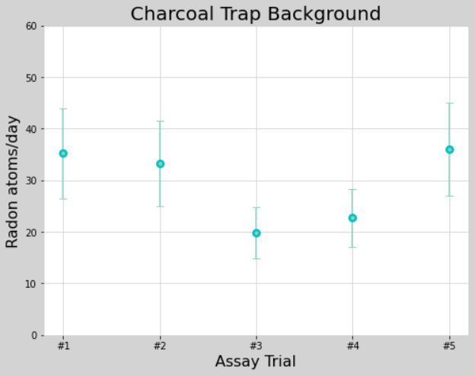
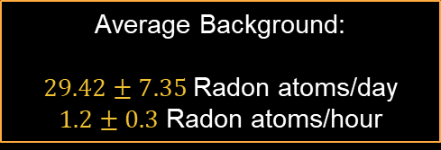
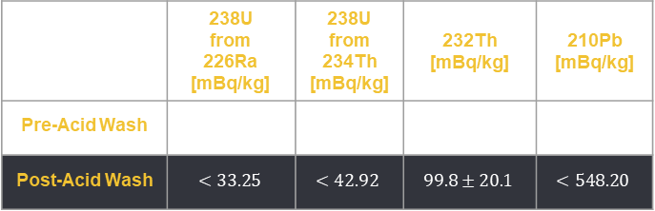
Background Assays
Table 1: Charcoal gamma counting results (2 weeks of counting)
 | 238U from 226Ra [mBq/kg] | 238U from 234Th [mBq/kg] | 232Th [mBq/kg] | 210Pb [mBq/kg]
Pre-Acid Wash | $$465.5±47.4$$ | $$<327.12$$ | $114.5±$ 37.6 | $$<1260.10$$
Post-Acid Wash | $$<33.25$$ | $$<42.92$$ | $$99.8±20.1$$ | $$<548.20$$
Average Background:
$29.42±7.35$Radon atoms/day
$1.2±0.3$ Radon atoms/hour
Notes:
Regular background assays have also been performed

Slide 12

The broad plan for the next four months
September | October | November | December
Calibration Can Emanation Charcoal Background Development of a new smaller trap | More data on flow rate dependency of charcoal efficiency | Cryogen temperature dependency of charcoal efficiency Testing new types of charcoals | Taking the trap underground Publish results
Other activities this term
SNO+ UI Assays + Background: Estimating the Radon concentration in the SNO+ cover gas.
SNO+ Water Assays: Estimating the Radon concentration in the SNO+ UPW.
LN₂ Plant Assay + Background: Estimating the Radon concentration in the LN₂ vapour.
Lucas Cell DAQ Channel Efficiencies: A study comparing the efficiencies of our eight data acquisition channels for Lucas Cells. Each channel comprises of a PMT across a high voltage.
Notes:
The plan for the next four months is to do some more studies the background and the calibration can emanation, and to make a new smaller trap whose parts have been ordered.
In October, more data on flow rate dependency.
In November, studying the cryogen temperature dependency.
And in December, we hope to take the trap underground and have publishable results.
Some of the other activities I have been involved in this term are doing underground assays on the SNO+ cover gas and cavity water, and the LN2 plant vapour. I am also working on comparing the efficiency of channels in the Lucas Cell data acquisition system on surface.

Slide 13
Thank you!
Supervisors: Nasim Fatemighomi & Lina Anselmo
Mentors:
Mark Ward,
Steffon Luoma,
Ian Lawson,
Adil Hussain,
Juliette DeLoye,
Dimpal Chauhan,
Thomas Sonley,
Deena Fabris.

Slide 14
SUPPLEMENTARY SLIDES

Slide 15
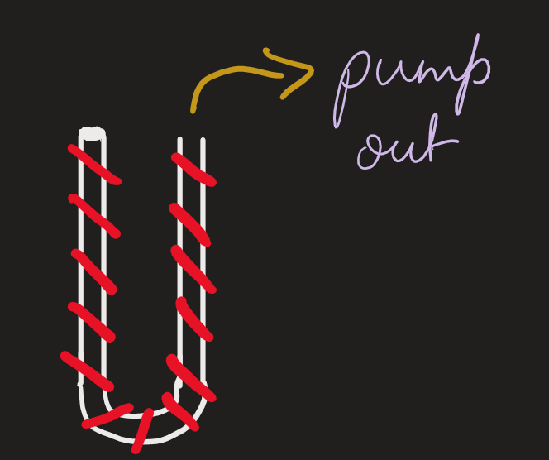
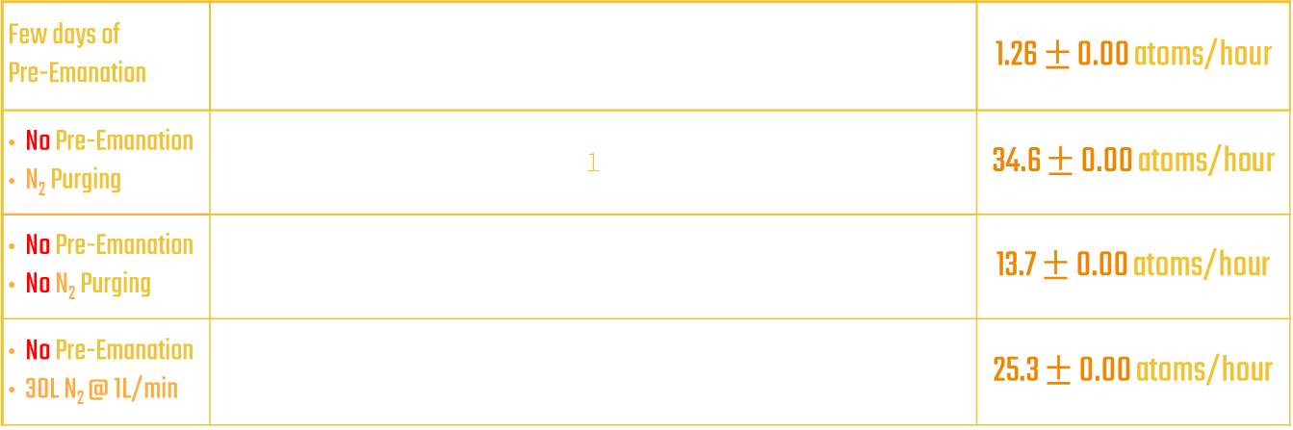
Background Assays
Few days of Pre-Emanation |  | 1.26 $±$ 0.00 atoms/hour
No Pre-Emanation N₂ Purging | 1 | 34.6 $±$ 0.00 atoms/hour
No Pre-Emanation No N₂ Purging |  | 13.7 $±$ 0.00 atoms/hour
No Pre-Emanation 30L N₂ @ 1L/min |  | 25.3 $±$ 0.00 atoms/hour
I
II
1
2
III
1
2
IV
1
2
Board Background Assay |  | 12.6 $±$ 0.00 atoms/hour

Slide 16
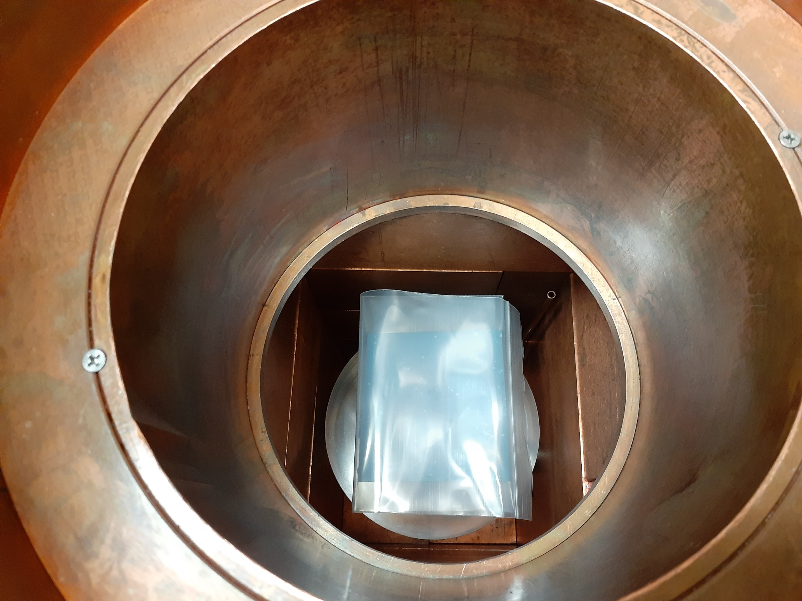
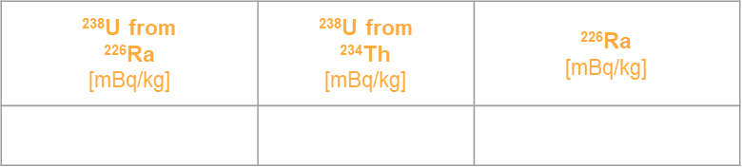
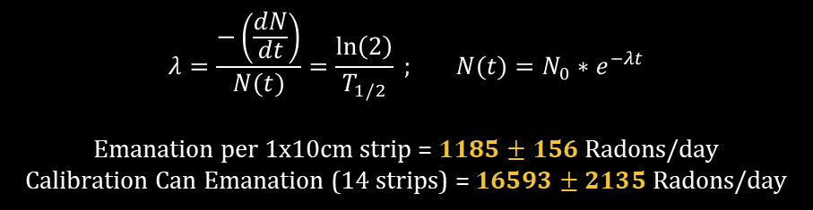
Calibration Can Emanation
Table 2: Rubber floor tile gamma counting results (2 weeks of counting)
Gamma counting chamber
Piece of foor tile
²³⁸U from ²²⁶Ra [mBq/kg] | ²³⁸U from ²³⁴Th [mBq/kg] | ²²⁶Ra [mBq/kg]
$$1892±61$$ | $$4621±1441$$ | $$2790±359$$
$$λ=\frac{−\left(\frac{dN}{dt}\right)}{N(t)}=\frac{\ln\left(2\right)}{T_{1/2}} ; N(t)=N_{0}∗e^{−λt}$$
Emanation per 1x10cm strip = $1185±156$ Radons/day
Calibration Can Emanation (14 strips) = $16593±2135$Radons/day
10cm

Slide 17
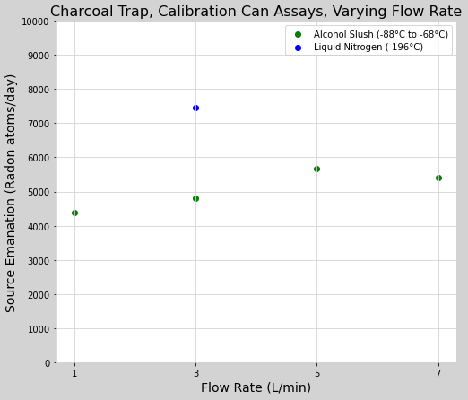
STEP 3: More Calibration Can Assays
**TENTATIVE GRAPH**
Liquid N₂
33% submerged trap.
-196°C
**MISSING ERROR BARS**
Alcohol Slush.
(Reagent Alcohol + LN₂)
Fully submerged trap.
-88 °C to -68°C
Notes:
So, I also tested the charcoal trap for 3, 5 and 7L/min, and found that it still does not drop relative efficiency.
In the past…….
We use alcohol slush to avoid over pressurising our traps and, more importantly, the Lucas Cell, which can easily happen if the charcoal trap is fully submerged in Liquid Nitrogen. So, we instead attempted to do an assay with the trap partially submerged in Liquid Nitrogen, and, as you see in the plot, found that the charcoal trap was able to retain even more Radon.
Notice that these are not percentage efficiency measurements, which kept bothering me, so I tried to understand the amount of Radon emanated from the calibration can.

