Slide 1

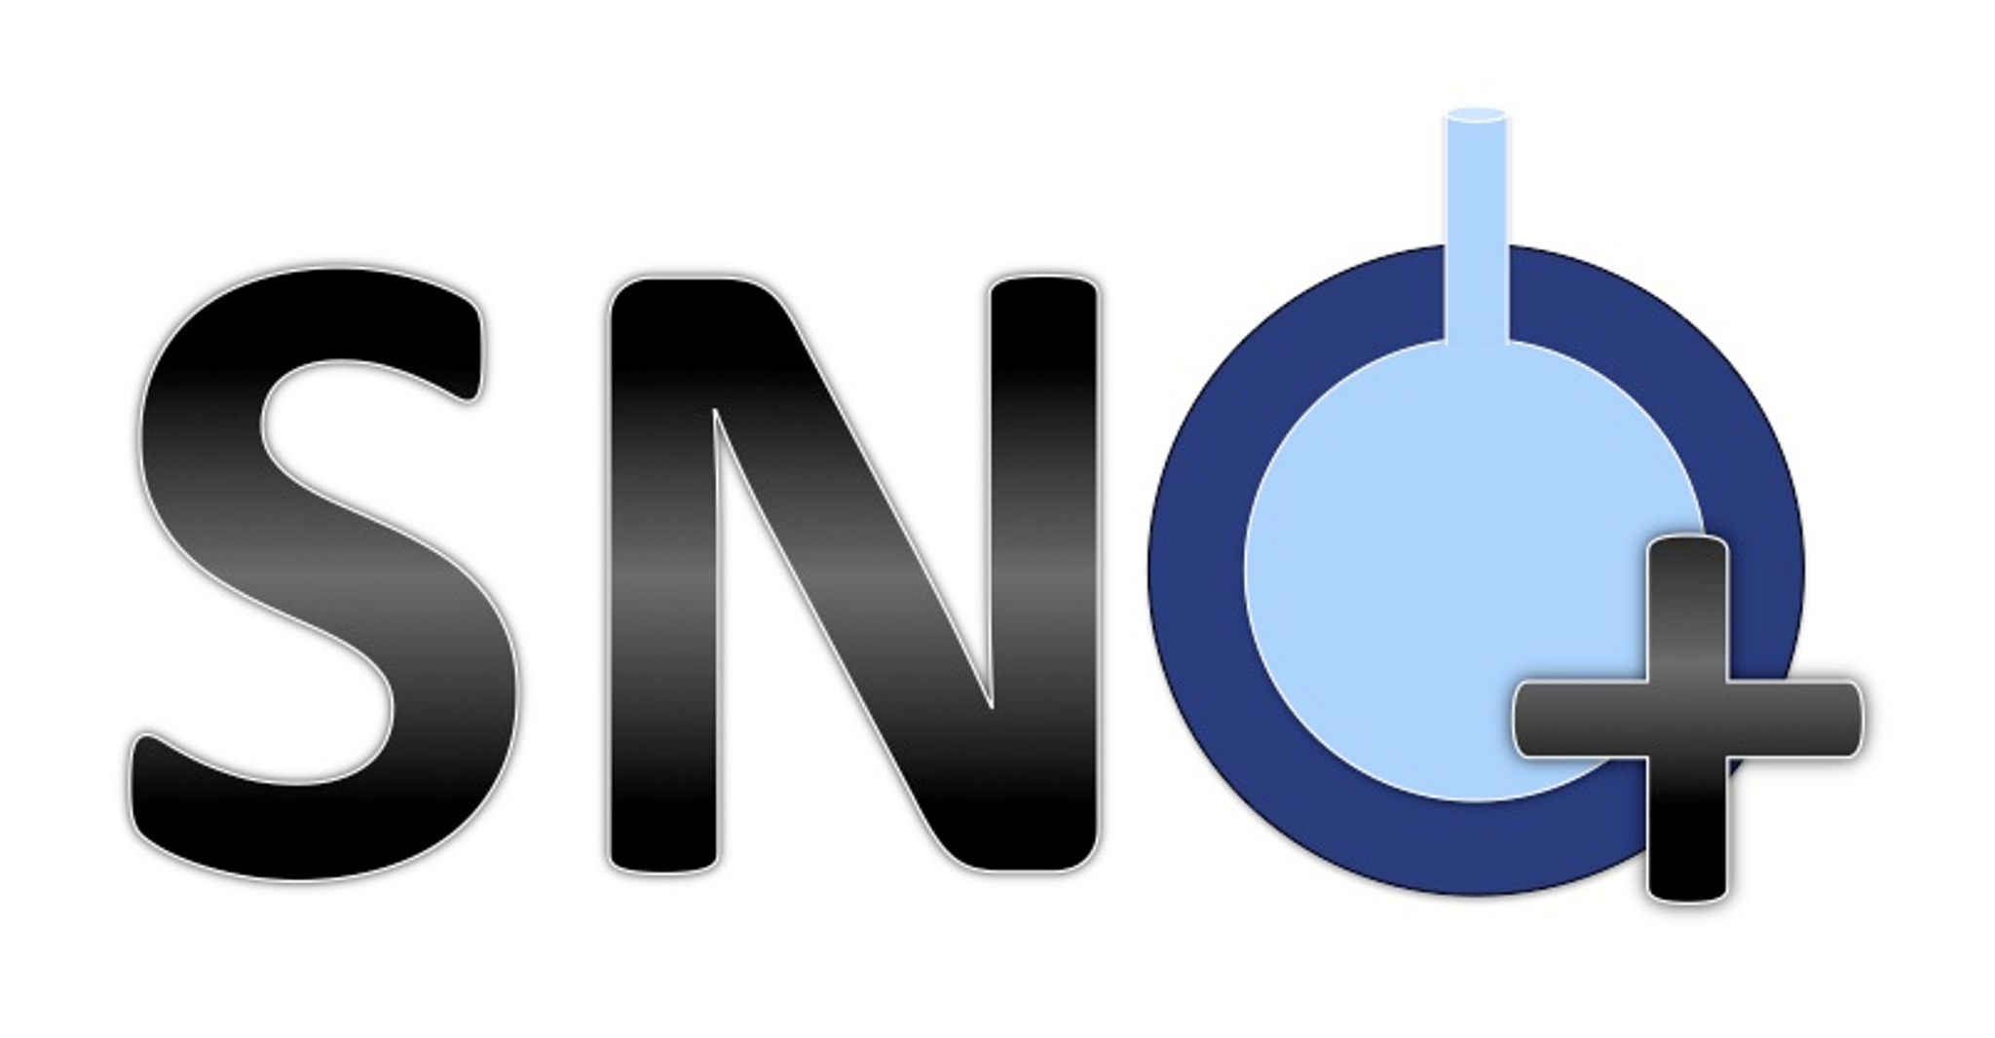
Cleaning Data with the Neck Cut in SNO+
Victoria Howard

Slide 2
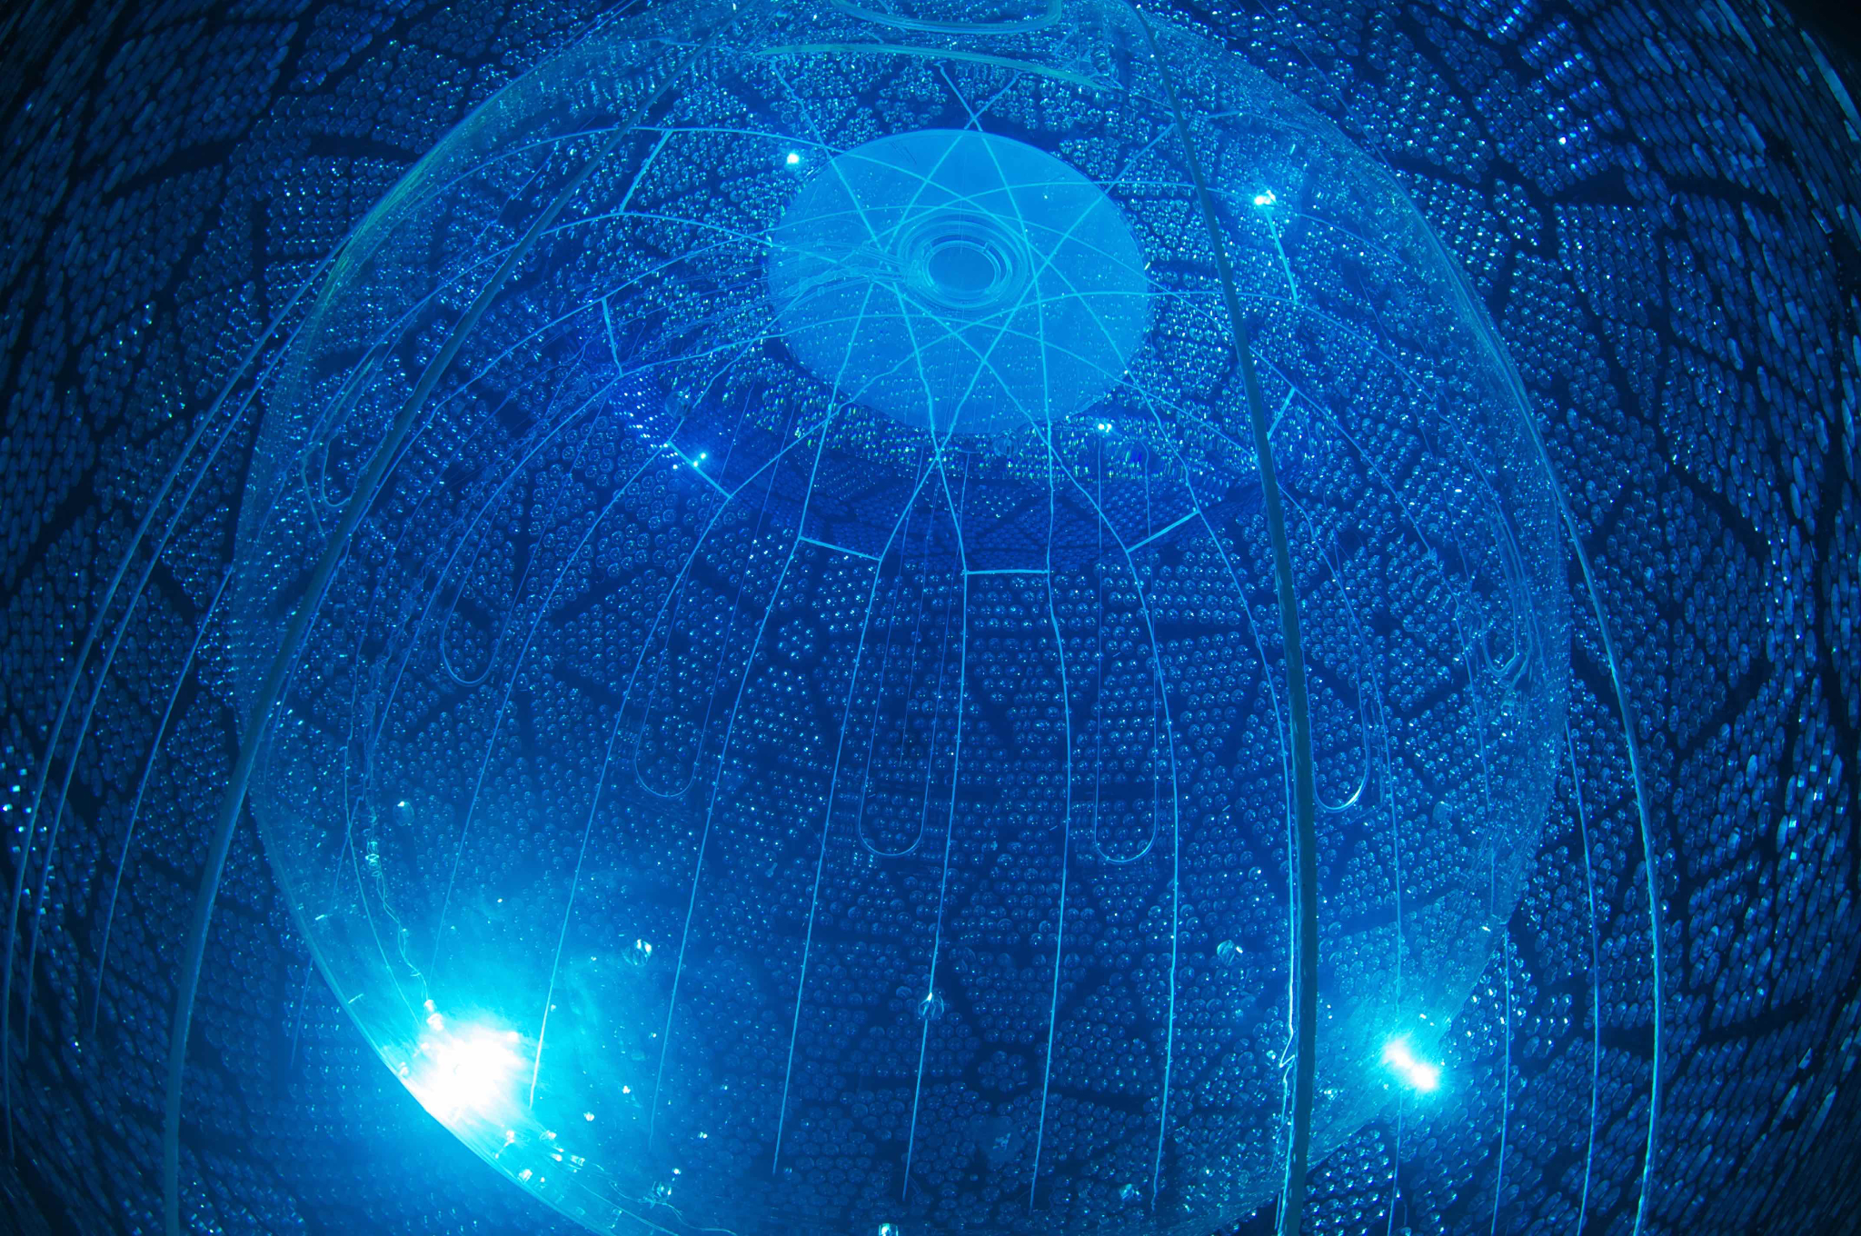
SNO+ is a liquid organic scintillator detector that is aiming to study neutrinos.
The detector is located 2km (~1.2 mi) below ground.
Notes:
SNO+ is a liquid organic scintillator detector that is aiming to study neutrinos.
The detector is located 2km (~1.2 mi) below ground.
The hardware is mostly inherited from the original SNO experiment, don’t say it was just ready to go because lots of work went into getting it ready to be SNO+

Slide 3
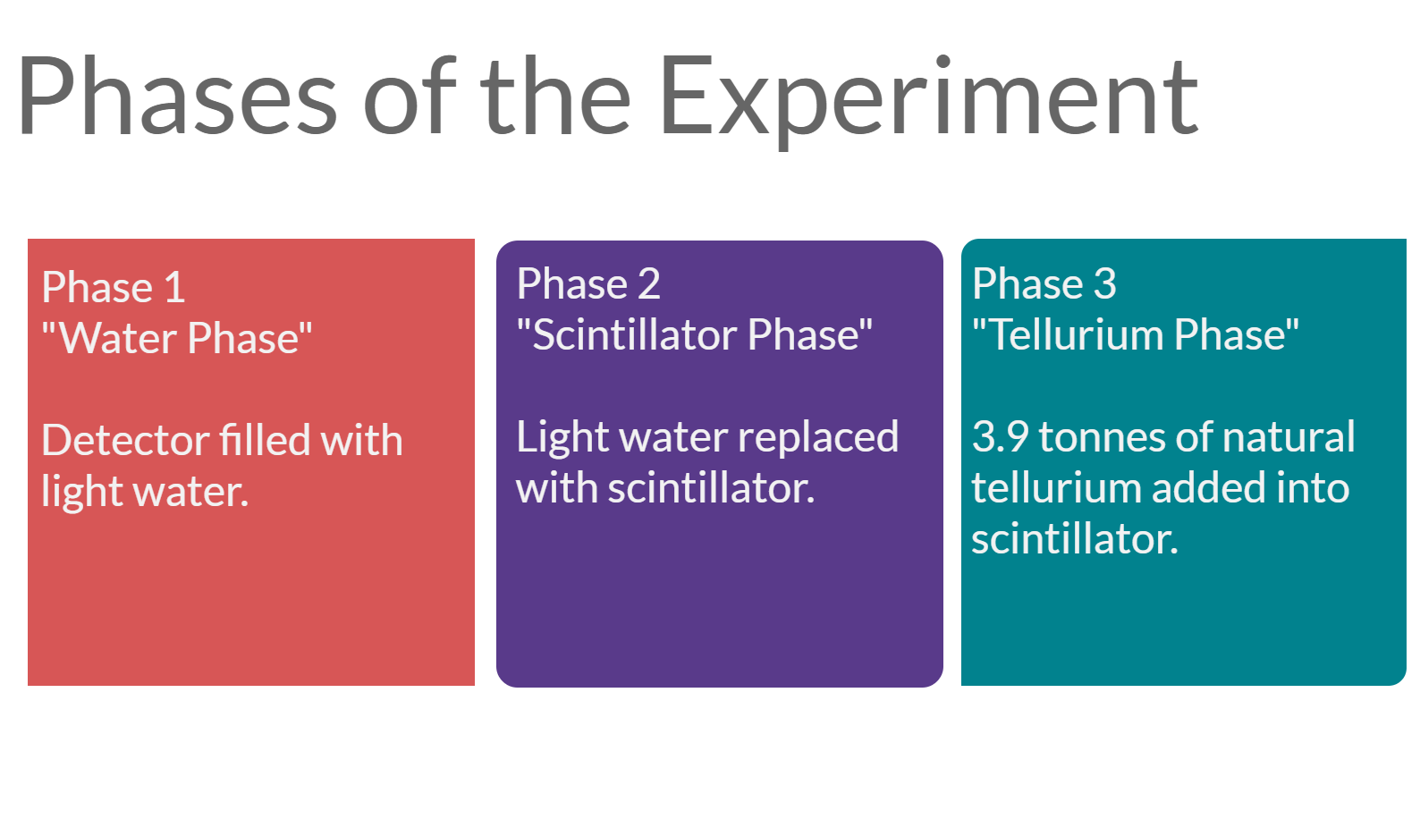
Completed
In progress
In preparation

Slide 4
Goals of the Experiment
Search for the neutrinoless double beta decay.
Measure the lifetime of the two-neutrino double beta decay.
Measuring of geoneutrinos.
Observation of reactor antineutrino oscillations.
Supernova neutrino monitoring.
Searching for exotic physics.

Slide 5
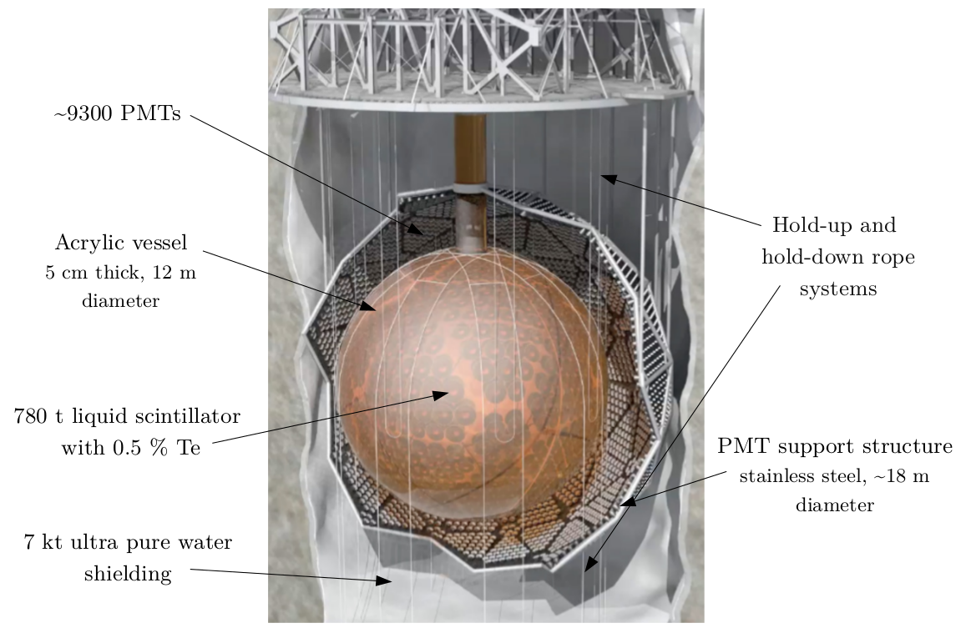

Slide 6
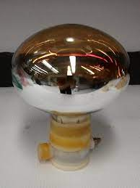
How Does SNO+ Detect Neutrinos?
For an observable neutrino to occur, it must first interact to produce a charged particle.
Interactions can be with particles such as electrons and nuclei.
Once the interaction has occurred, light is produced as the charged particle passes through the scintillator.
This light is detected by the PMTs.

Slide 7
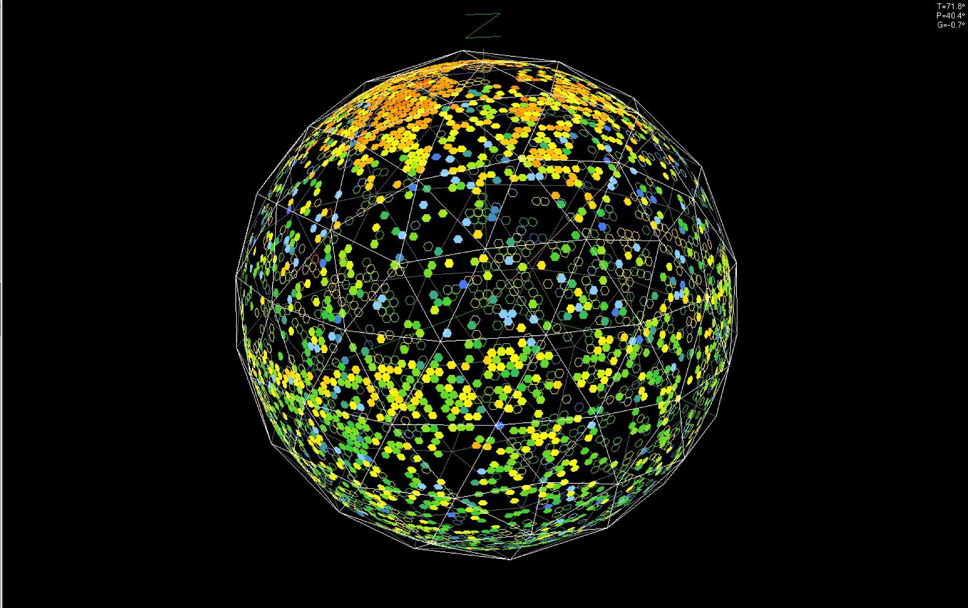
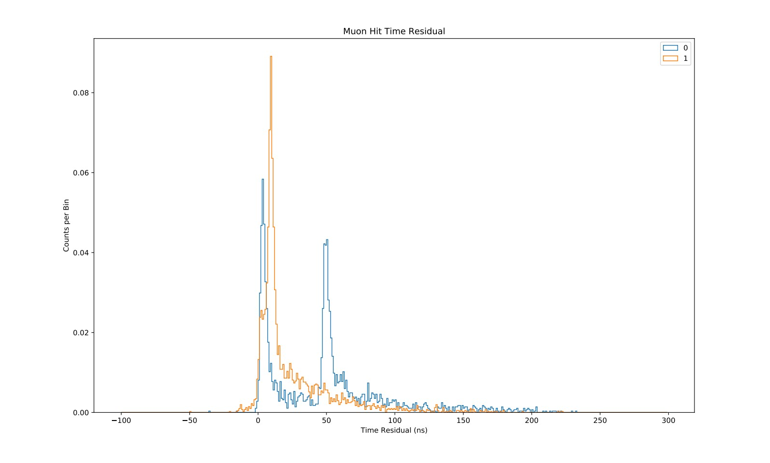
Neck Events
There are events that have been dubbed “neck events”.
These events have some characteristic features including:
  A ring of light around the top of the detector and the bottom with a stripe missing in between
  Reconstruction usually occurs at values larger than 5000, usually close to 6000 in the z direction
  There are usually 2700 nhits or more for these events
They started occurring around February 2022.
They have recently become less frequent.
It is hoped that the neck cut will be able to remove these events consistently.

Slide 8
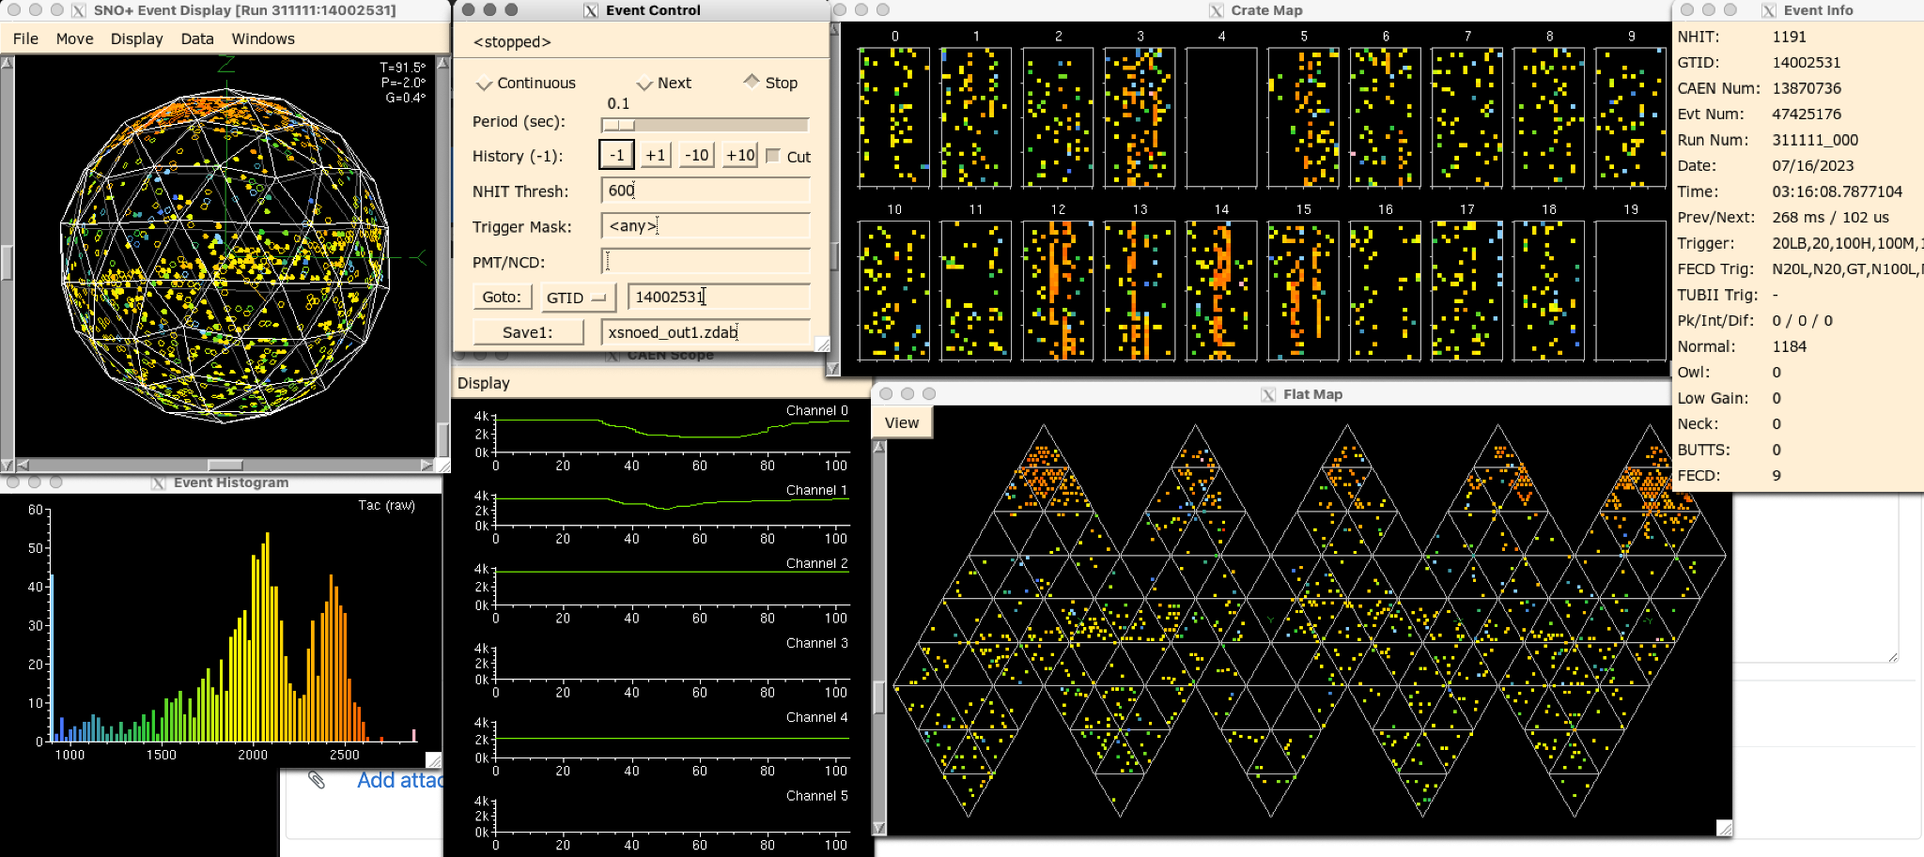
Neck Events
Some theories on what causes the neck events are:
  Light coming from the PSUP, hitting the AV with reflection back to the PMTs at high Z (first time peak) and then a creation of the typical ring around the equator (second time peak)
  Light coming down the neck through the acrylic
  Static electricity discharge being created by tension on the ropes or neck

Slide 9
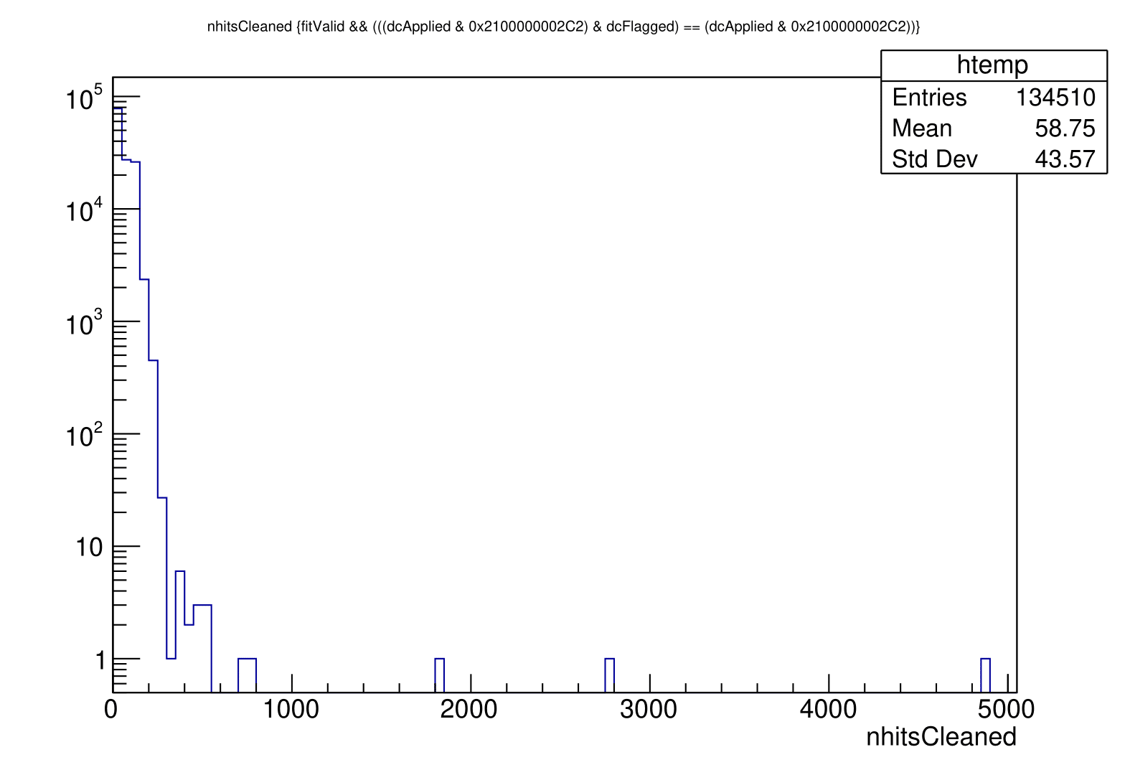

Neck Cut Effect
When the neck cut is applied, it is meant to remove events that have two or more neck tube hits.
This can be seen in the neck events that have been occurring.
The plots below show an example of a single event being removed due to the neck cut.
Counts
Counts
Neck Cut

Slide 10
Applying the Neck Cut to Multiple Runs
The neck cut was applied to many runs when the neck events were more present (300000-300163 and a few 300400 runs).
It was also applied to more recent runs (309000 runs).
This was done in an effort to see if more frequent neck events results in more cuts.
It was also done to see if the events being cut corresponded to the neck hot spots.

Slide 11
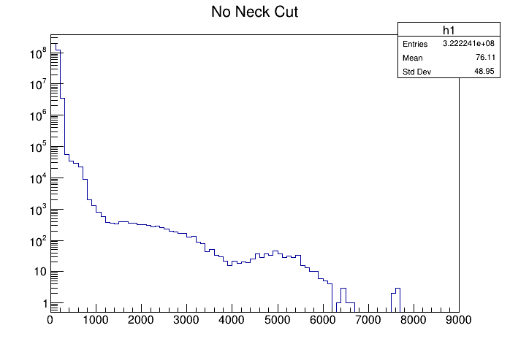
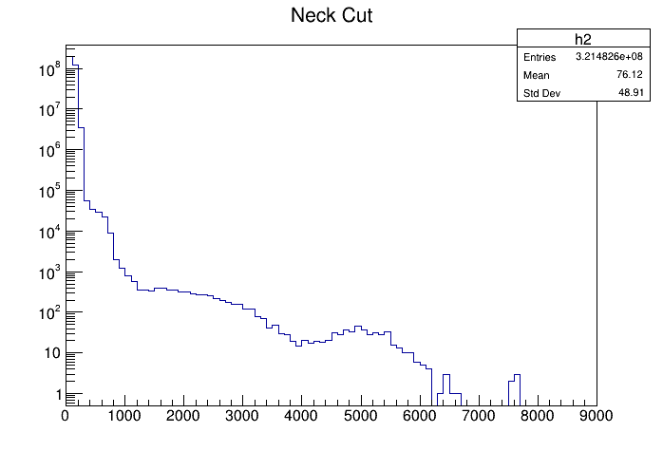
300000-300163 (plus 300400) Runs
nhitsCleaned (log-y) were plotted to see how adding the neck cut to the default mask would affect it.
There are 741500 less events when the neck cut is applied (~0.23% difference).
Counts
Counts
nhitsCleaned
nhitsCleaned

Slide 12
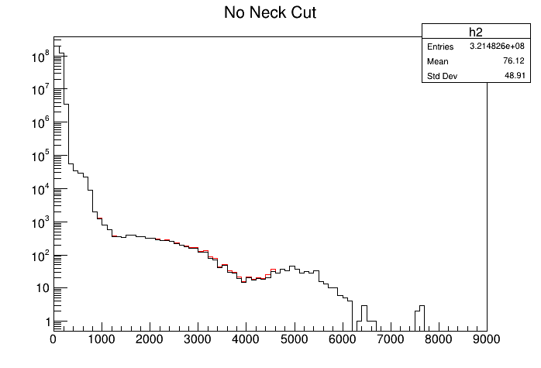
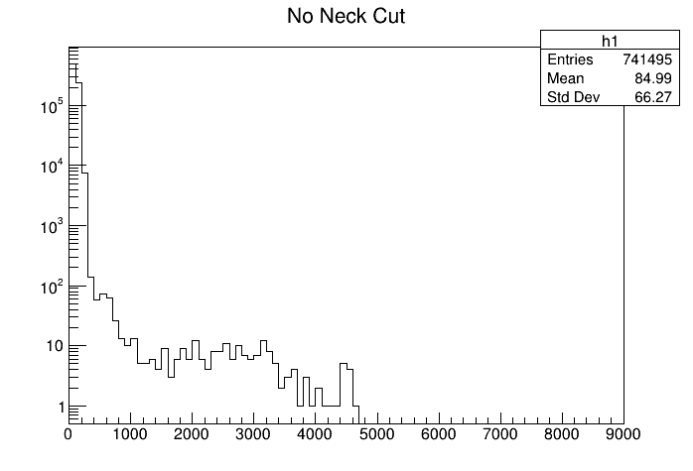
300000-300163 (plus 300400) Runs
The previous nhitsCleaned plots were plotted together and so was their difference.
The red is before the neck cut and black is after.
Counts
Counts
nhitsCleaned
nhitsCleaned

Slide 13
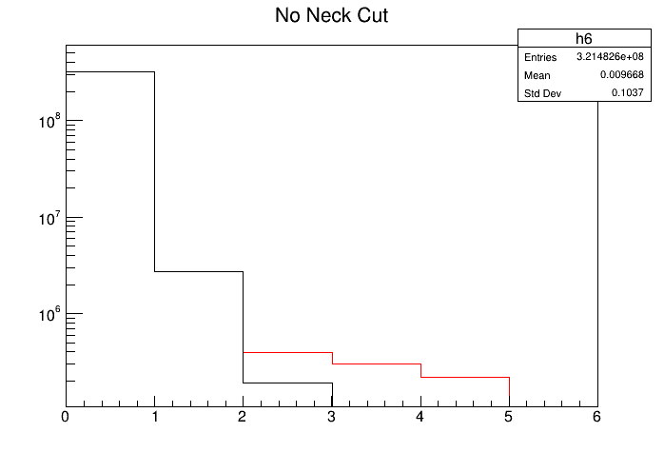
300000-300163 (plus 300400) Runs
Plotted the neck tube hits (log-y) with and without the neck cut applied.
There is a noticeable difference between with and without the neck cut.
Counts
Black = with neck cut
Red = without
necknhits

Slide 14
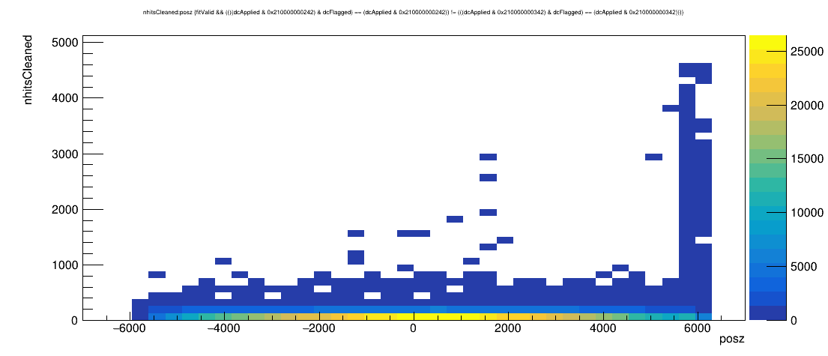
300000-300163 (plus 300400) Runs
Looked at where the cut events were occurring in the z direction.
There are a cluster of events occurring around 6000.

Slide 15
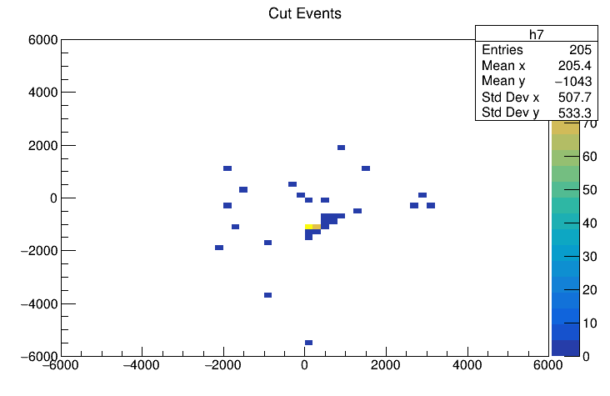
300000-300163 (plus 300400) Runs
Looked to see where these events were occurring in x and y.
All events <1000 nhits have been cut (known backgrounds).
There is a cluster of events in the region of one of the neck hot spots.
posy
posx

Slide 16
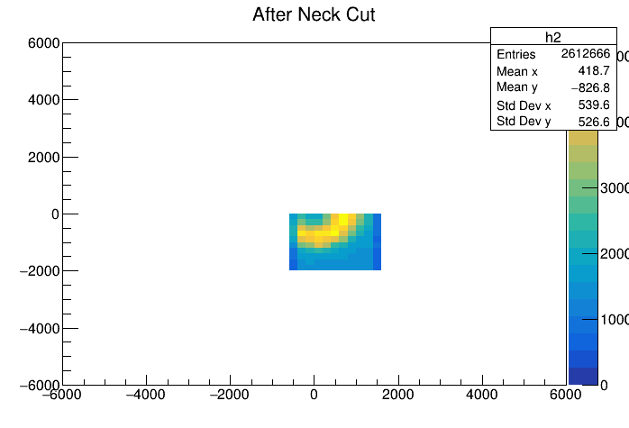
300000 runs with geometric cuts
I applied the follow cuts to x, y and z: -500 < posx < 1500, -2000 < posy < 0 and posz > 5000.
This region is roughly where neck events occur.
Plotting posy vs. posx shows that 7614 events are removed (0.29%).
posy
posx

Slide 17
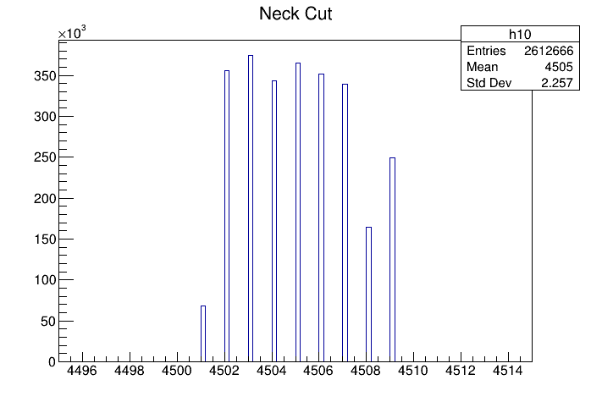
Looking at timing for the 300000 runs
I plotted the events as a function of time (uTDays) with and without the geometric cuts used from the previous slides.
With the geometric cuts below (binning = 100)
Counts
uTDays

Slide 18
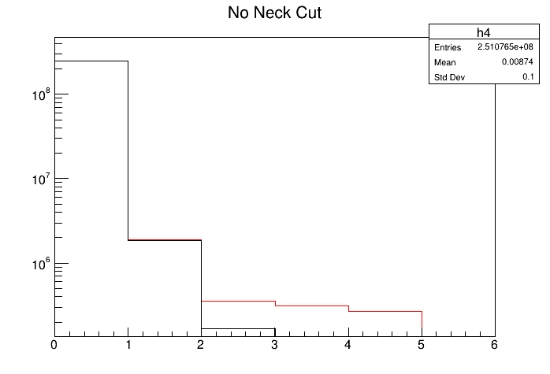
309000 Runs
To see the effectiveness of the neck cut, the same plots were created with more recent runs.
With these runs, there were 778900 fewer entries with the neck cut (~0.3%).
Looking at the neck tubes, there is a similar outcome to the previous runs.
Counts
Black = with neck cut
Red = without
necknhits

Slide 19
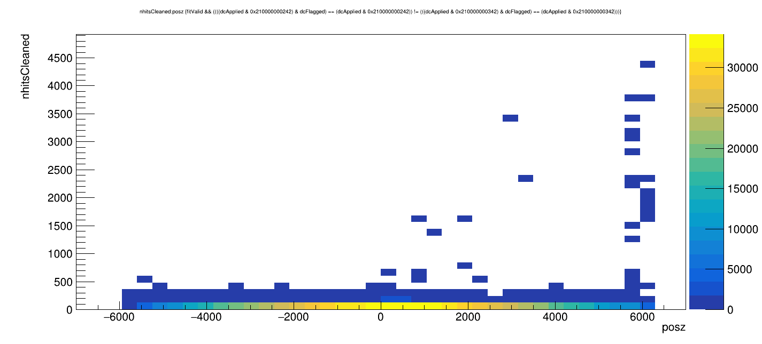
309000 Runs
Looked at where the cut events occurred.
In the z direction, there are less events around 6000.

Slide 20
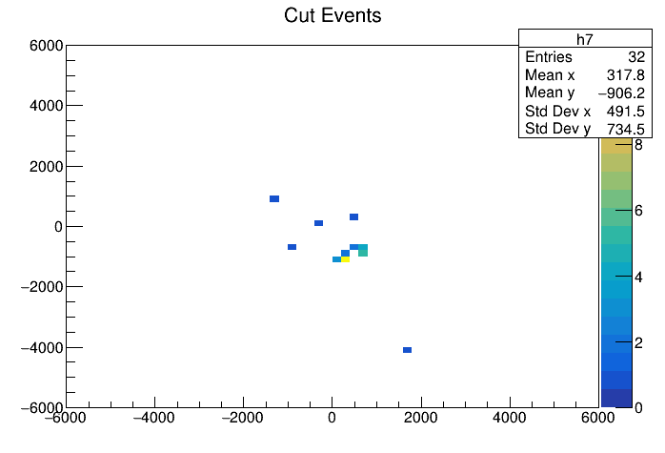
309000 Runs
In x and y, there are events in one of the neck hot spot regions, though noticeably less than with the other runs.
All events <1000 nhits have been cut.
posy
posx

Slide 21

309000 runs with only geometric cuts
I applied the follow cuts to x, y and z: -500 < posx < 1500, -2000 < posy < 0 and posz > 5000.
This region is roughly where neck events occur.
Plotting posy vs. posx shows that 6276 events are removed (0.34%).
posy
posx

Slide 22
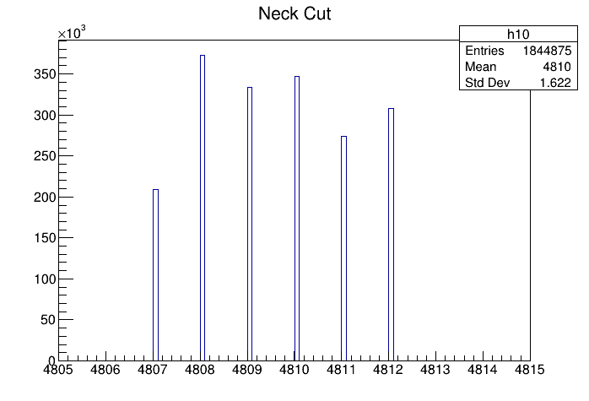
Looking at timing for the 309000 runs
I plotted the events as a function of time (uTDays) with and without the geometric cuts used from the previous slides.
With the geometric cuts below (binning = 100)
Counts
uTDays

Slide 23
309000 Runs
Compared to the 300000 runs, there are events occurring in roughly the same regions, though less are noted.
This could be caused by the decrease in neck events.
It’s noteworthy that there are more events removed by the neck cut for the 309000 runs, though less are in the area of the hot spot.

Slide 24
What does this all mean?
The neck cut seems to do a decent job at removing events that occur around the neck of the detector.
It gives a good solution for removing events that occur in the neck hot spot regions.
With a little bit of fine tuning, it would be a good idea to implement this cut into the data cleaning mask in the future.

Slide 25
Questions?

