Slide 1
Predicting Oxygen Sensor Failures using Data Analysis and Machine Learning
2023/08/18
Katherine Latosinsky
CASST 2023

Slide 2
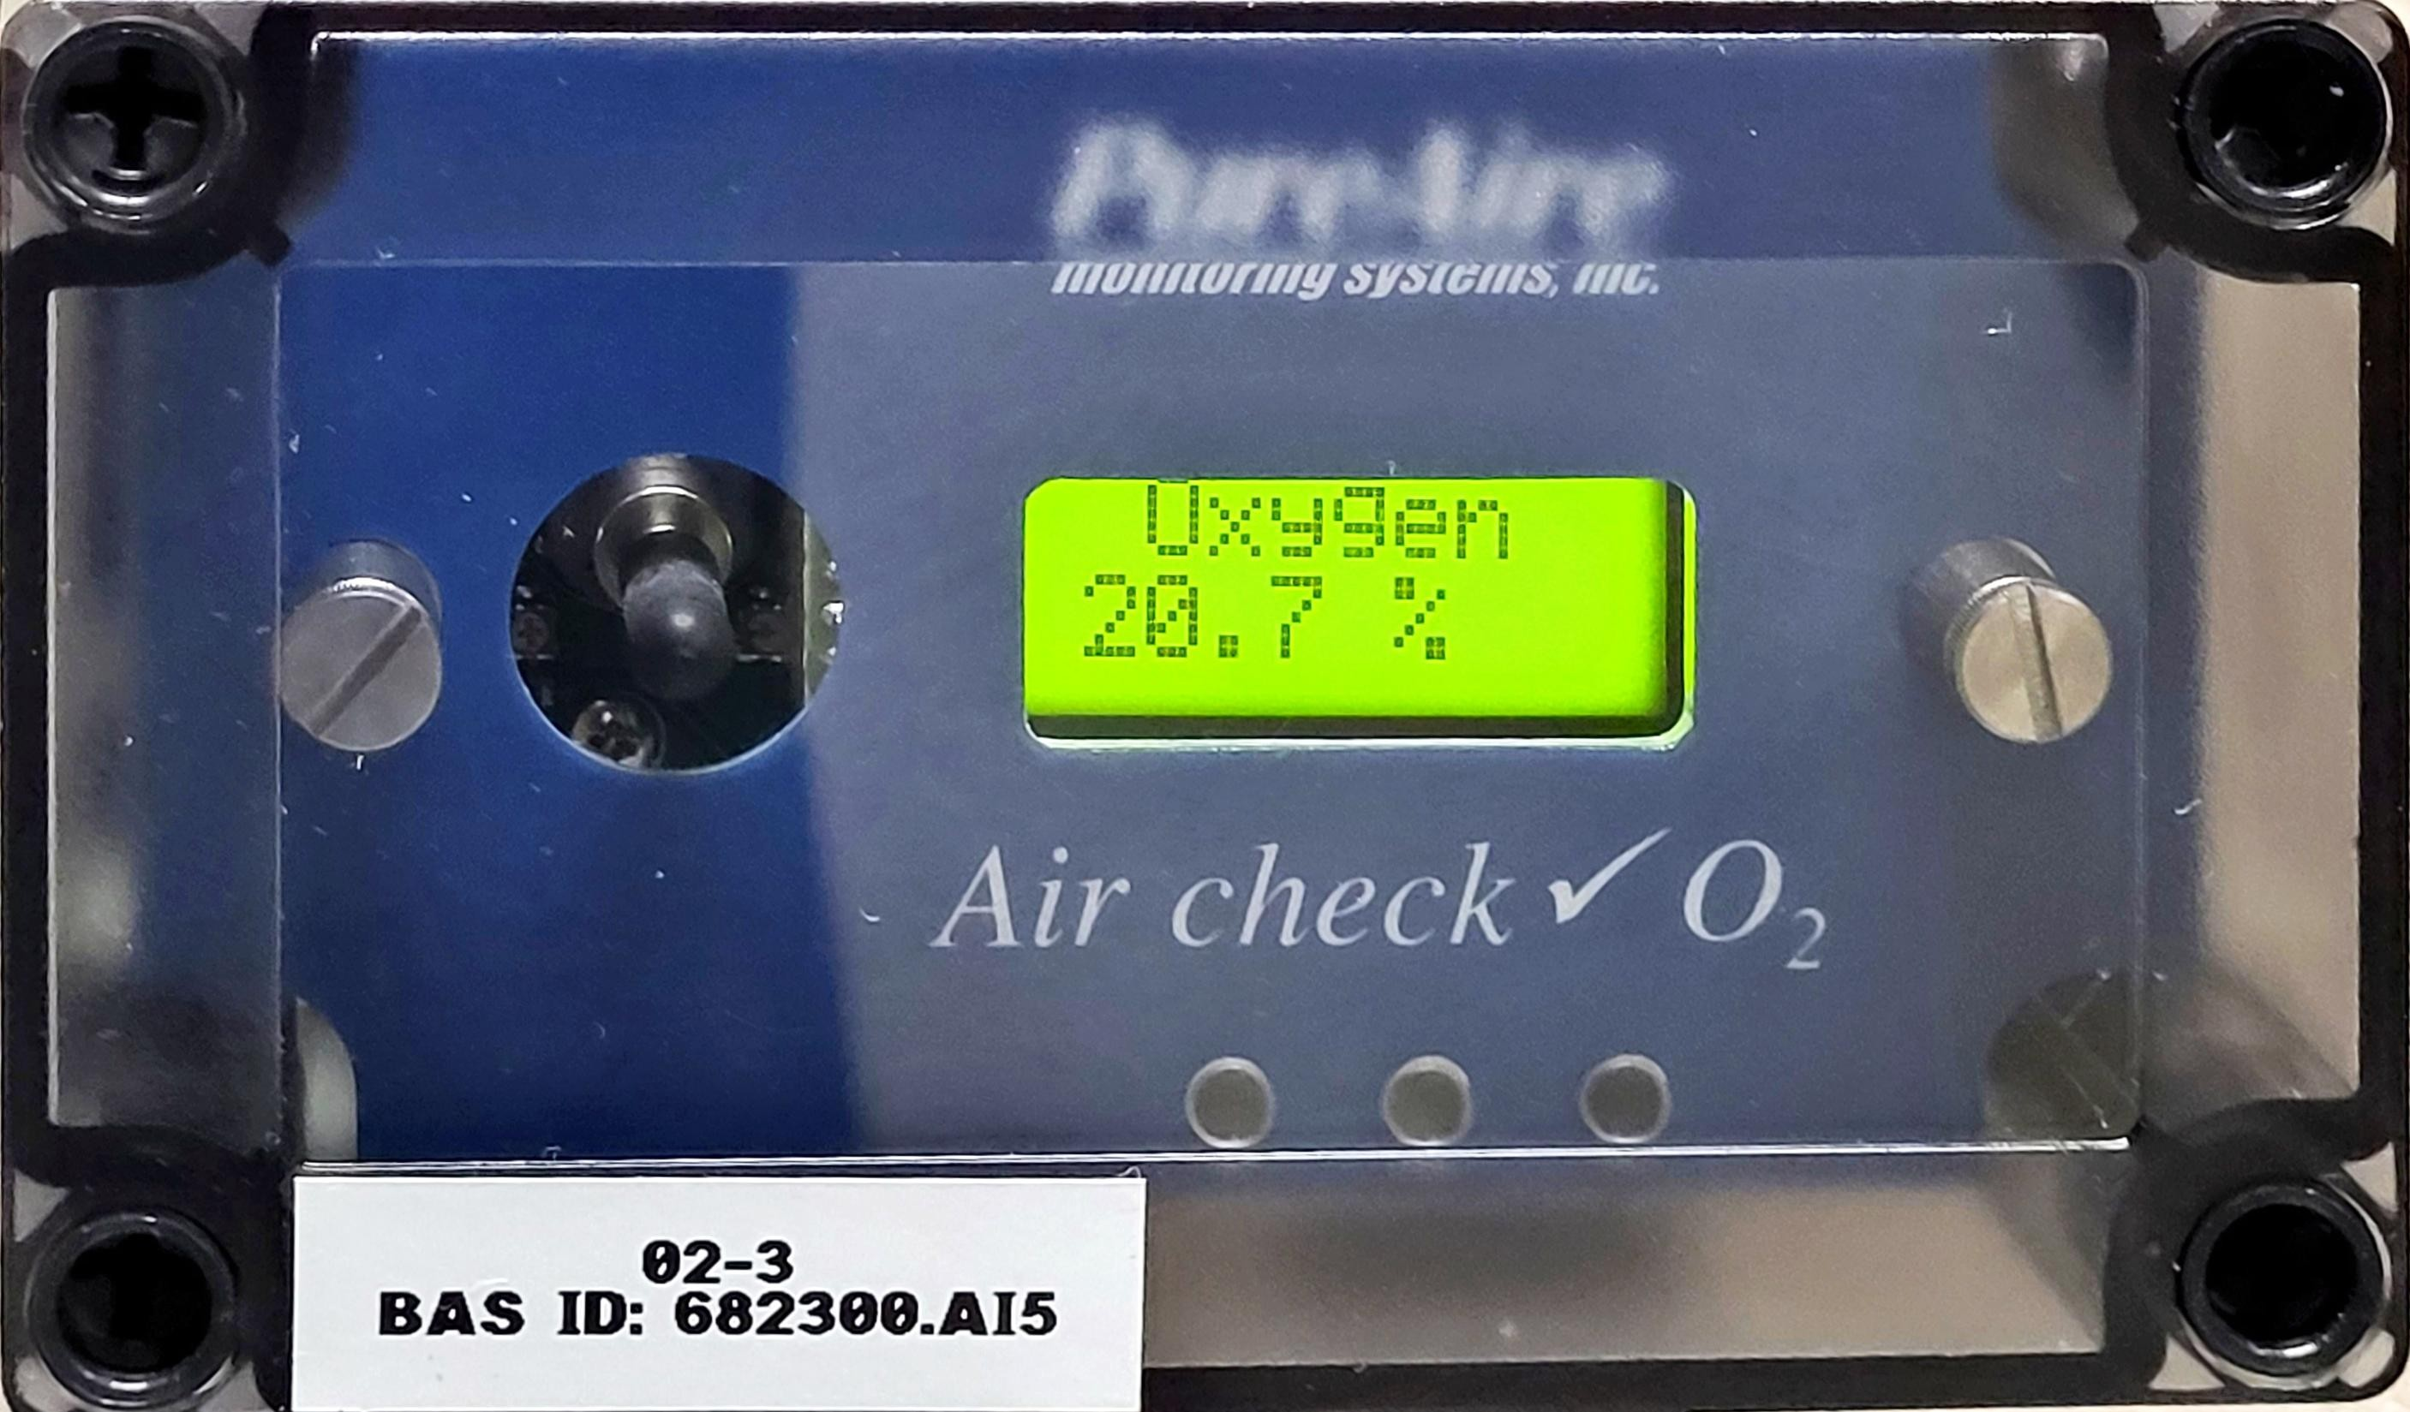
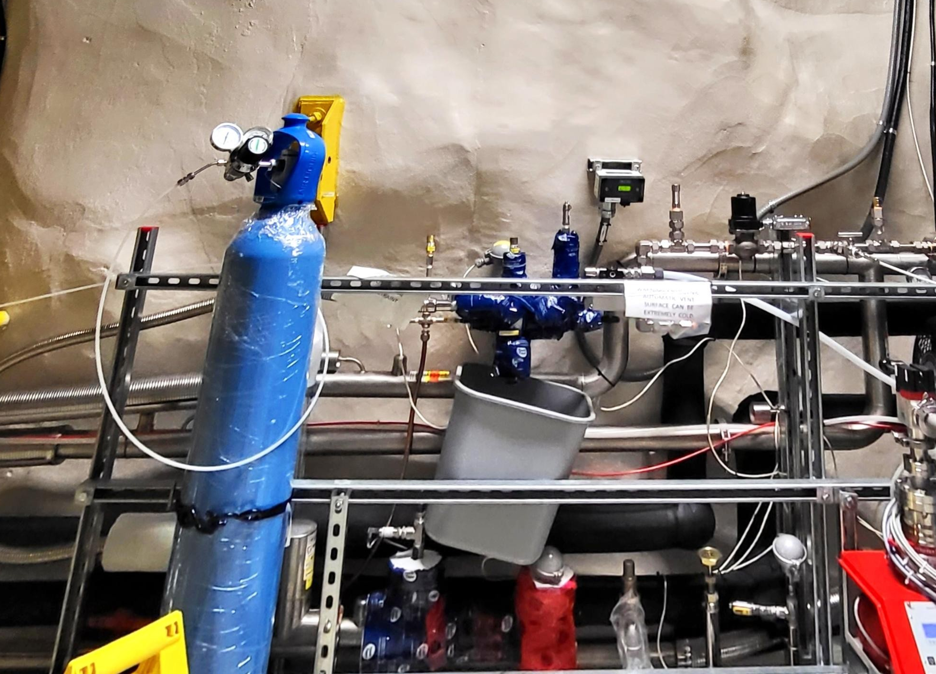
Problem
Background
There are 10 oxygen sensors located in the Cube Hall at SNOLAB.
These sensors occasionally fail, resulting in unnecessary evacuations of the Cube Hall
Question: Using historic sensor data, can we identify the causes of oxygen sensor failure, and/or predict when a sensor is going to fail?
*

Slide 3
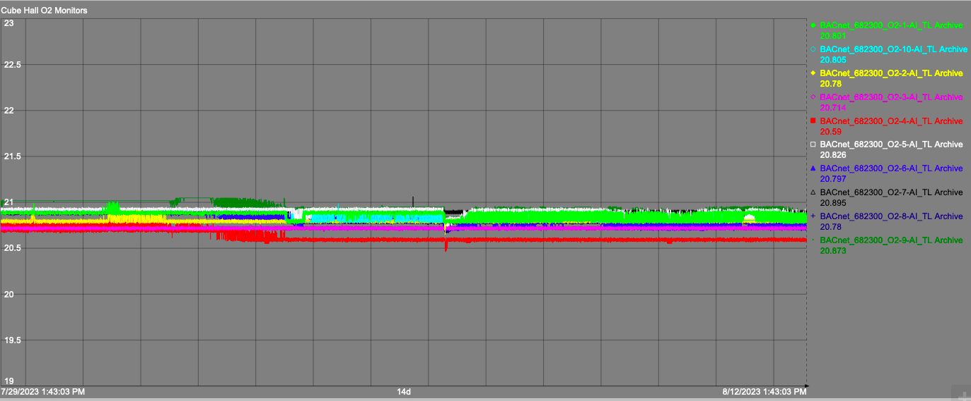
Two weeks of ordinary data
3

Slide 4
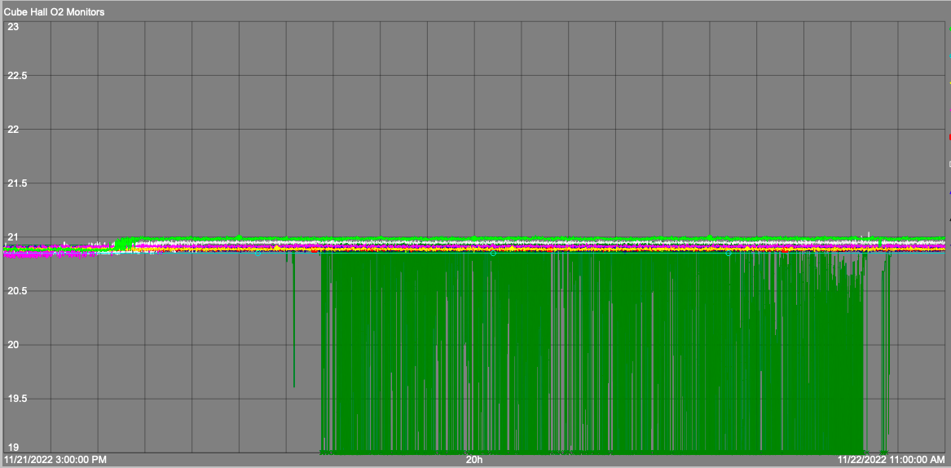
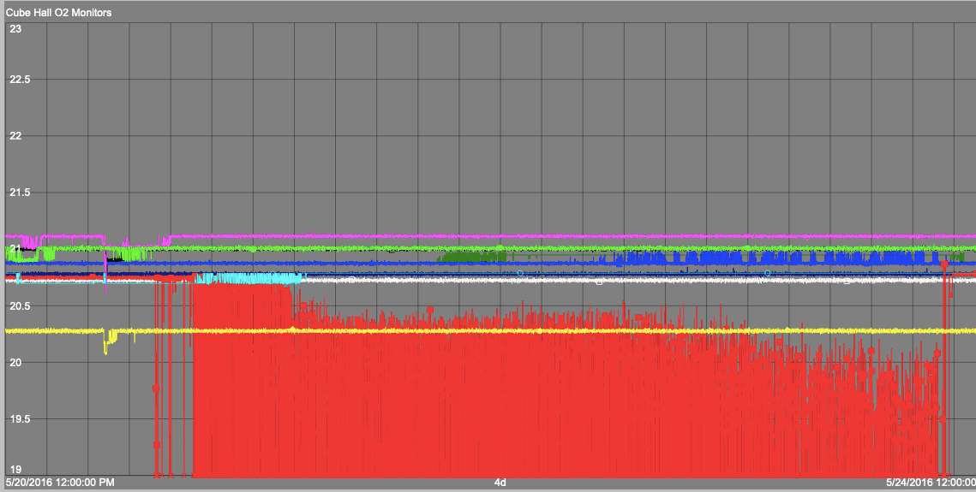
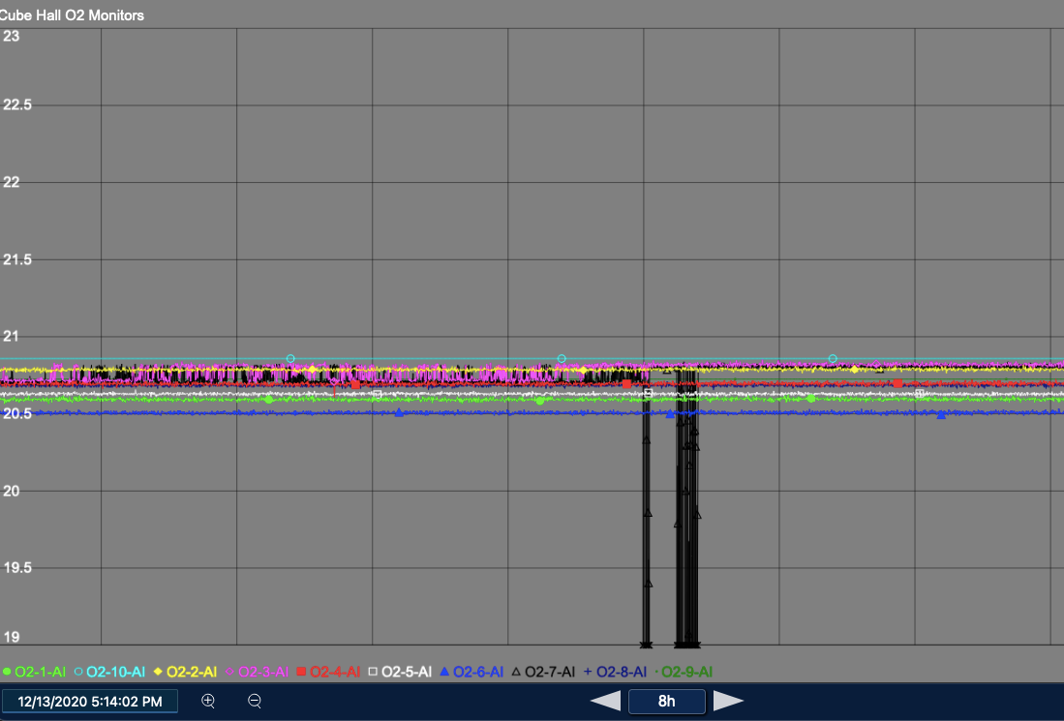
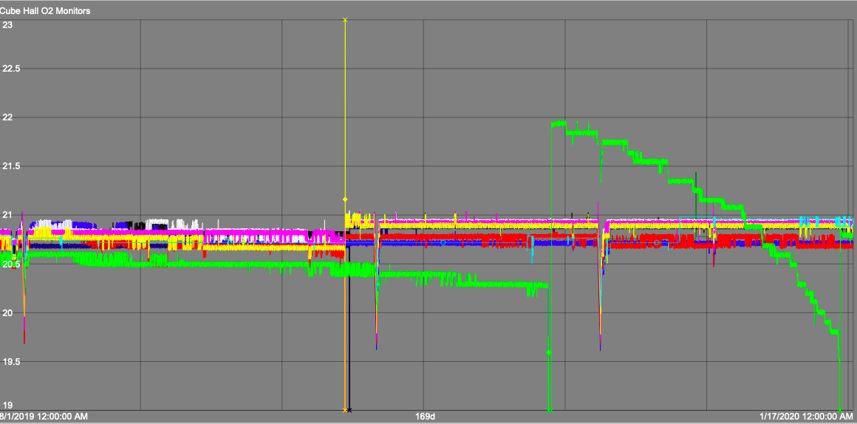
Failure Examples
4

Slide 5
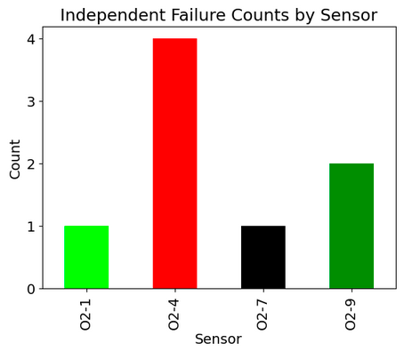
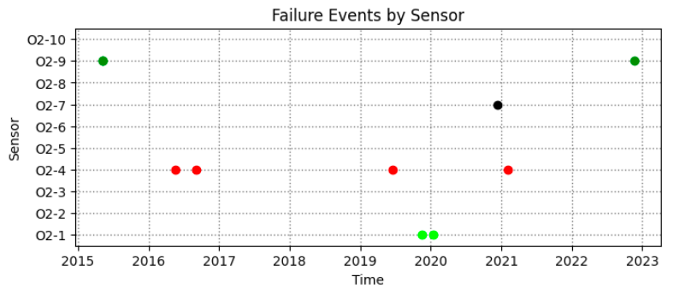
Investigating the Dataset
8 independent failure events since mid-2015
Other irregularities: data gaps, power outages, calibrations and spikes

Slide 6

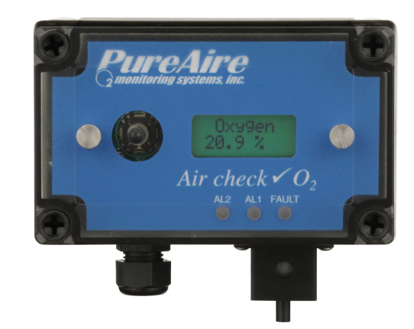
Diagnostic Efforts
Read the sensor manual
Called the manufacturer
3. Investigated possible connections to electrical fluctuations
4. Attempted an algorithm to select pre-failure declines
… but to no avail

Slide 7
Machine Learning

Slide 8
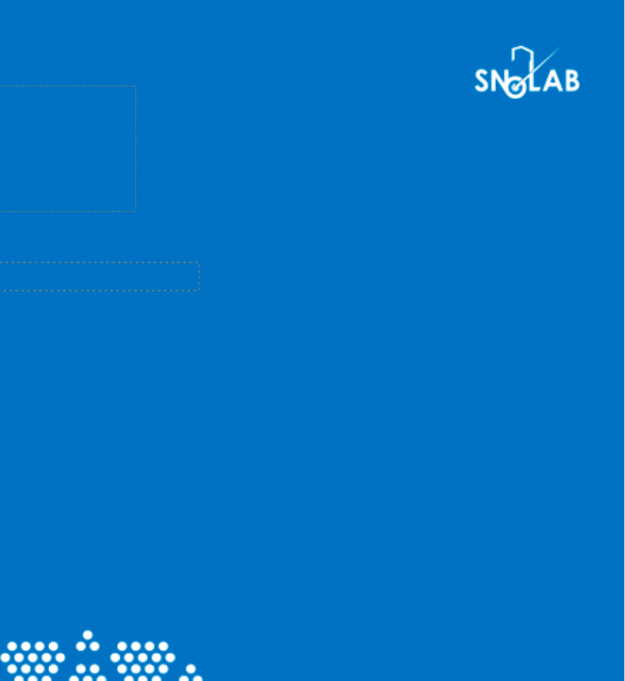
Why might ML work?
A well-designed model could pick up on features such as:
  Anomalous datapoints in time
  Periodic trends (with period > 20 seconds)
  Other time-series trends
  Relative performance between sensors.

Slide 9
Why might ML work?
What are the challenges?
A well-designed model could pick up on features such as:
  Anomalous datapoints in time
  Periodic trends (with period > 20 seconds)
  Other time-series trends
  Relative performance between sensors.
The failure dataset is very small
The data is highly imbalanced
It's possible that there is nothing to find
It's a black box solution

Slide 10
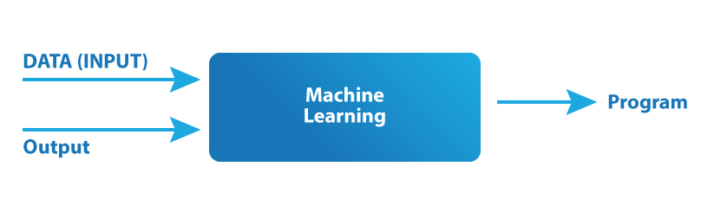
Applying Supervised Learning
INPUT DATA:
Oxygen sensor data
Non-overlapping samples of length L
10 channels (sensors) in each sample
Black box solution
PREDICTION
PROGRAM
Black box solution
LABELS:
Binary Failure prediction
True – A sensor will fail within time T
False – A sensor will not fail within time T

Slide 11
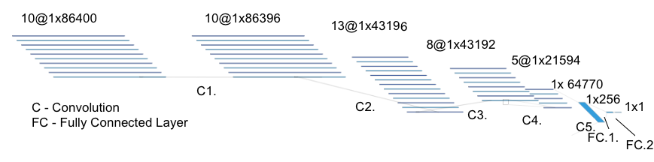
1st Model:
Convolutional Neural Network
A CNN is a commonly used model that encodes spatial information in hierarchical layers
Implemented in Python using the PyTorch library
Model architecture with sample length L=10 days:

Slide 12
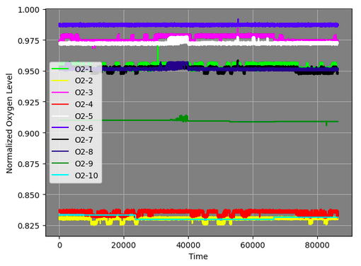
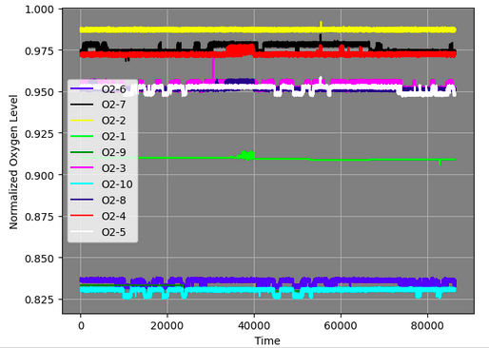
Regularization techniques
Original data
Techniques to prevent the model from overfitting the limited failure dataset:
  Batch normalization
  Dropout
  Data Augmentation: switching sensor labels
  Down-sampling the non-failure data
Used k-fold validation to evaluate the model performance.
Augmented data

Slide 13
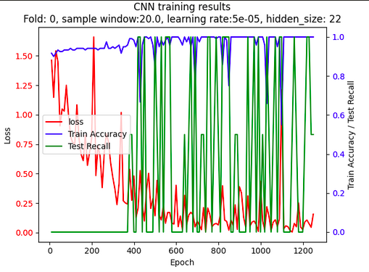
CNN Results
Example training fold, for 20 day sample length
Only correctly identified 1/8 true positives in the test set for 2 day samples
2/8 true positives for 20 day sample.
Not reliable enough to implement

Slide 14
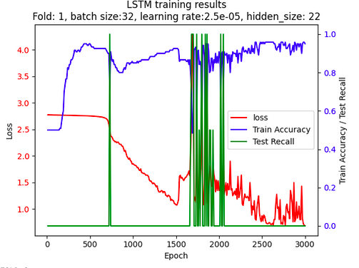
2nd Model:
Long Short Term Memory
Example training fold, for 20 day sample length
An LSTM is a type of recurrent neural network designed to capture relationships in long sequences of data.
Used a 1-layer LSTM, followed by a fully connected layer for classification
The model again only achieved 2/8 true positives on the two-day samples, 4/8 true positives on the 20-day samples

Slide 15
Summary
I investigated historic oxygen sensor data, but were not able to identify the causes of failure.
I trained machine learning models to predict failures using two architectures – a CNN and an LSTM – but neither was able to generalize to reliably predict failures
Although this project was ultimately unsuccessful in predicting sensor failures, in future, there may be potential to analyze other sensor data at SNOLAB to improve operational efficiencies.

Slide 16
Thank You. Questions?

Slide 17
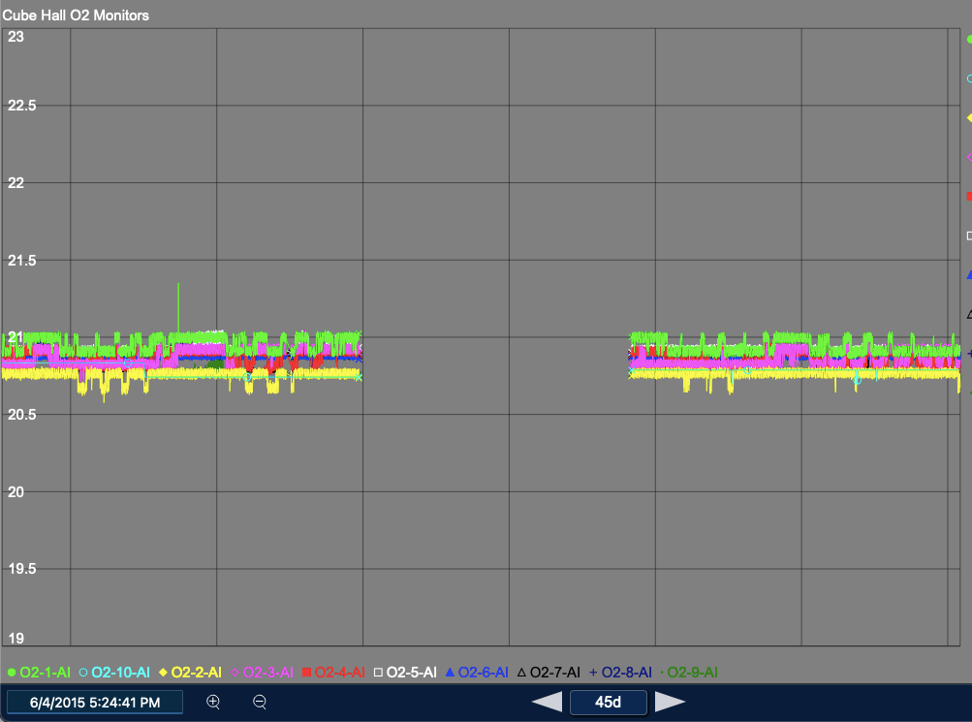
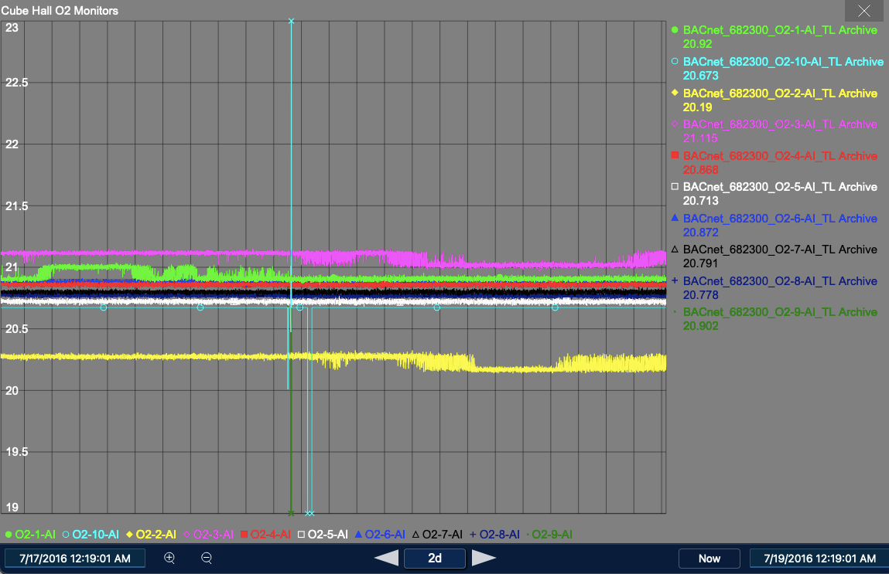
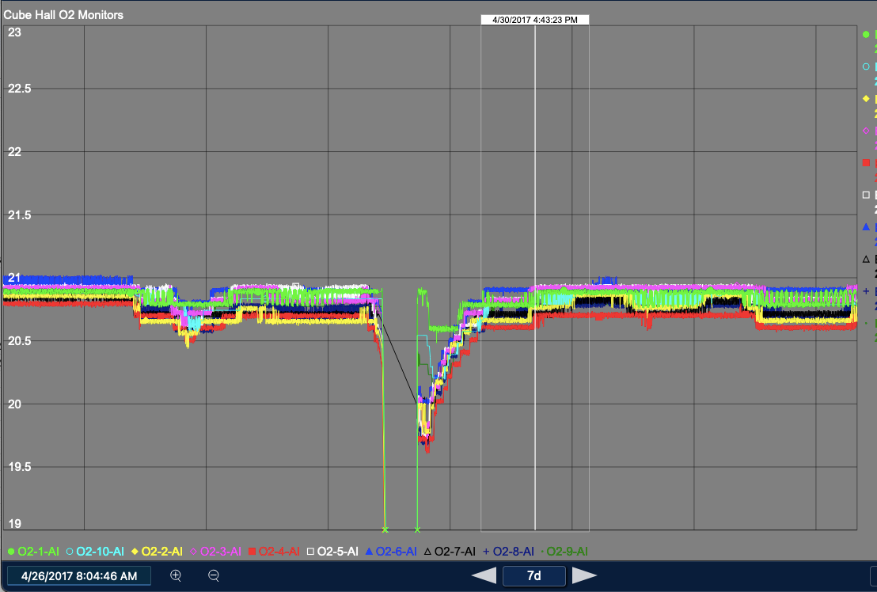
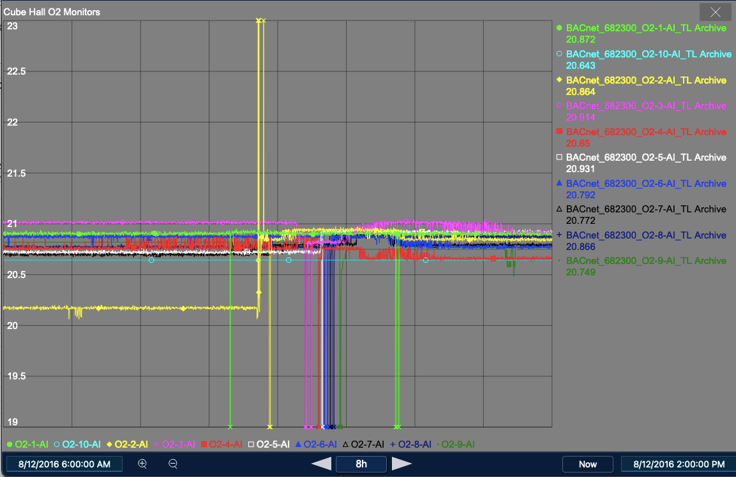

Slide 18
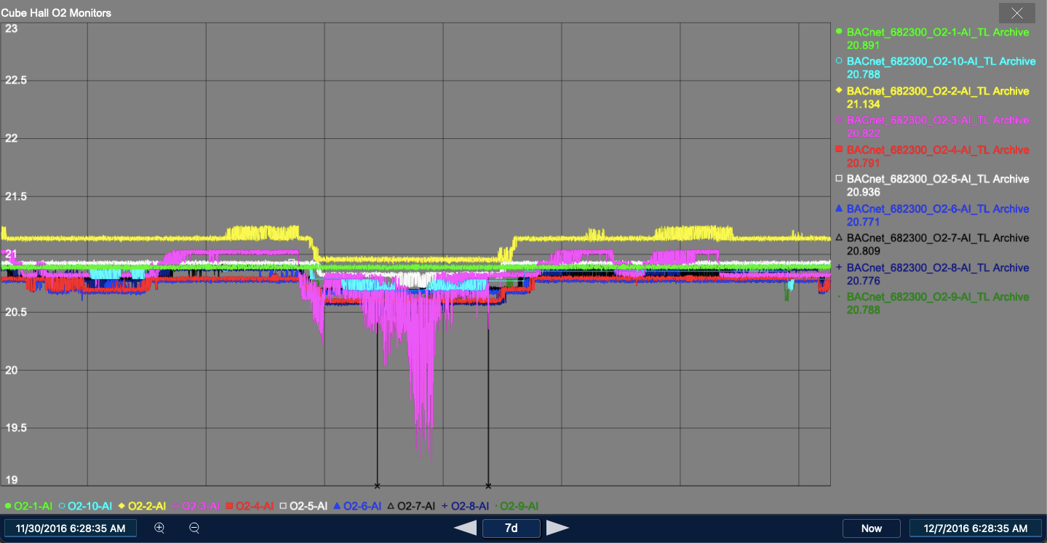
Real ODH event

Slide 19
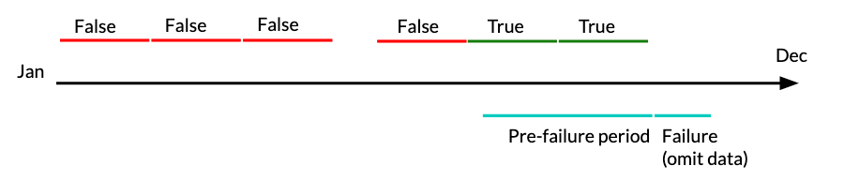
Processing the data
Choose to cut up the data into non-overlapping segments
Assign each sample a label according to whether it precedes a failure within a given amount of time (e.g. two weeks), and encode which sensor is about to fail.
Ensure that the samples align with the start times of failure events, to maximize the amount of pre-failure data available
Note: A shorter sample length means more samples, but limited opportunity for the model to learn trends

