Slide 1

Deeply Learning the Position Reconstruction of Antihydrogen Annihilations in ALPHA-g
The Canadian Astroparticle physics Summer Student Talk (CASST) Competition 2023
Ashley Ferreira August 17th, 2023

Slide 2
Matter
Electron (-)
Antimatter Crash Course
Antimatter has the opposite charge of normal matter
Equal amounts of matter and antimatter are thought to have been produced during the Big Bang
When a particle and its antiparticle meet, they annihilate
Our world is dominated by matter
This imbalance of matter and antimatter we observe is not well understood and is one of the motivations to study antimatter
There are numerous properties of antimatter researchers are keen to measure and one of them is effect of gravity
Proton (+)
Hydrogen
Antimatter
Positron (+)
Antiproton (-)
Graphic inspired by
https://www.popularmechanics.com/science/a25908/how-to-make-and-trap-antimatter/
Antihydrogen

Slide 3
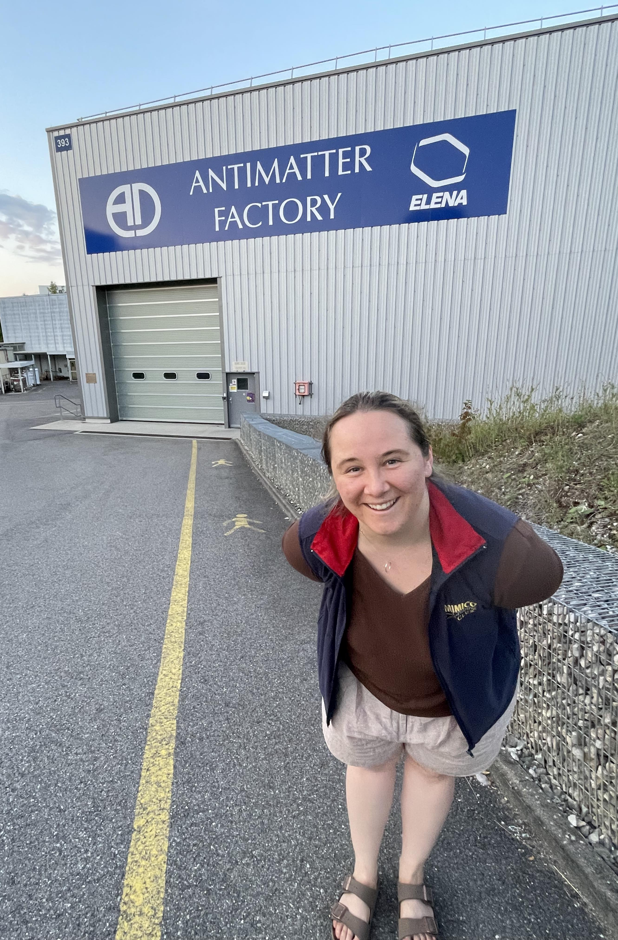

Making Antimatter at CERN
Graphic taken from
https://home.cern/science/accelerators/accelerator-complex

Slide 4
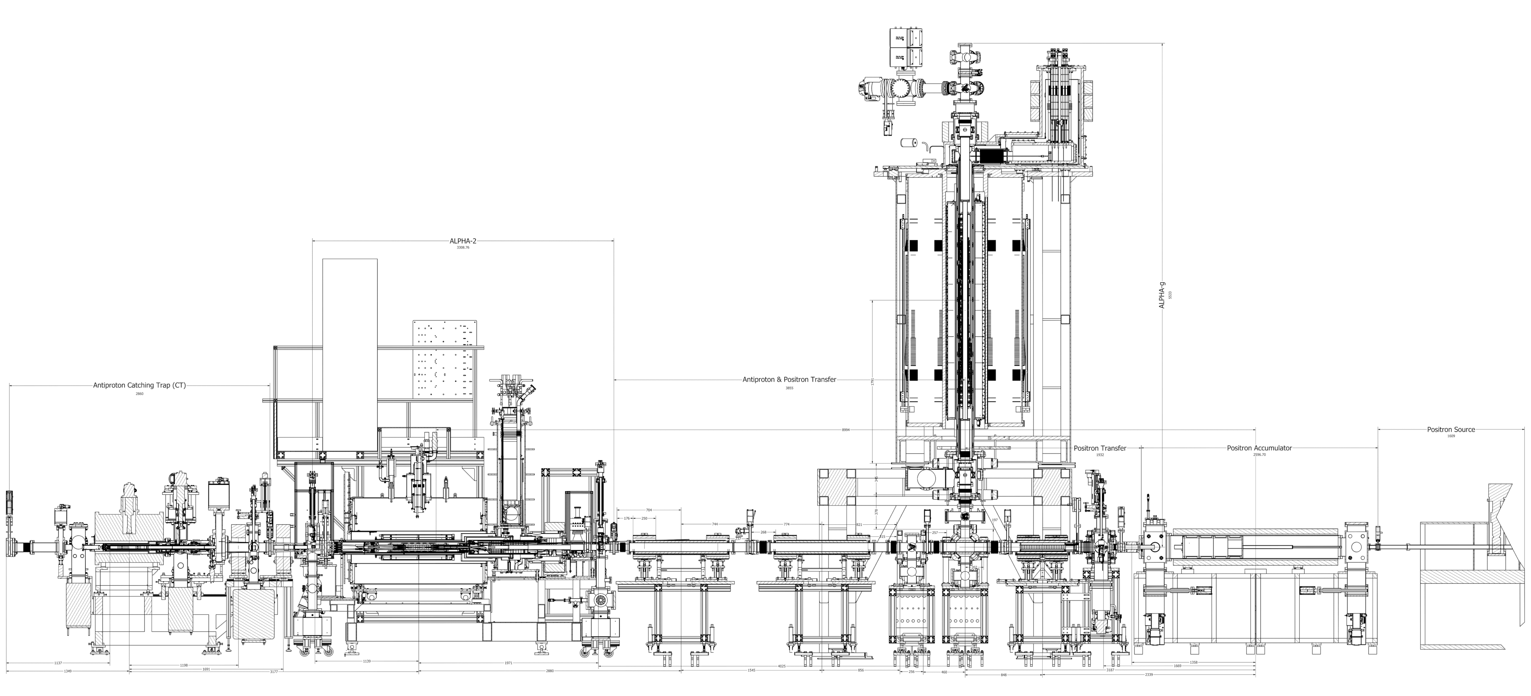
ALPHA-g
ALPHA Design
(Antihydrogen Laser Physics Apparatus)
Graphic taken from
https://alpha.web.cern.ch/experimental-cycle

Slide 5
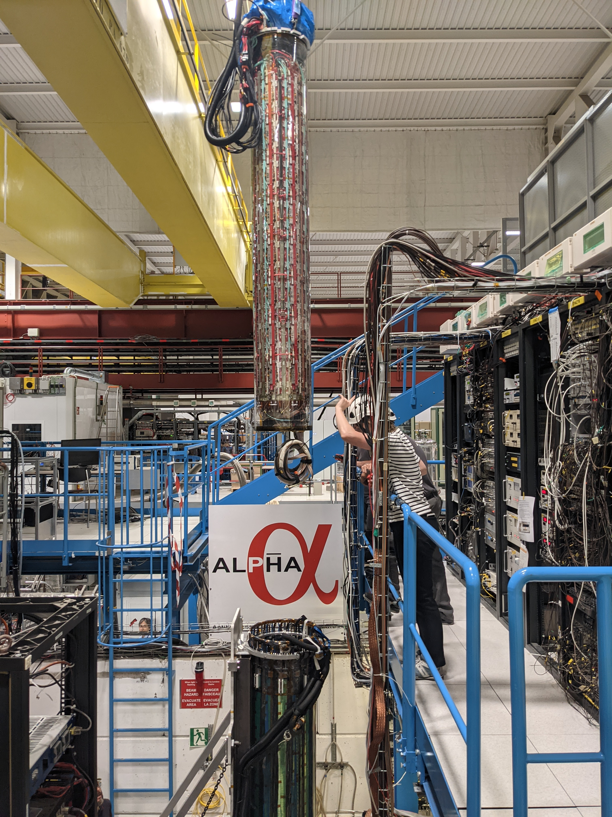
ALPHA-g Experiment
Aims to perform the first-ever direct measurement of the effect of gravity on antimatter to determine its weight to within 1% precision
rTPC is the central detector surrounding the main vacuum chamber
Antihydrogen held in magnetic trap and when released, it quickly hits the sides and annihilates
The annihilation position can be reconstructed from the electrical signals in the rTPC
rTPC
Fun fact: the rTPC was built at TRIUMF!

Slide 6
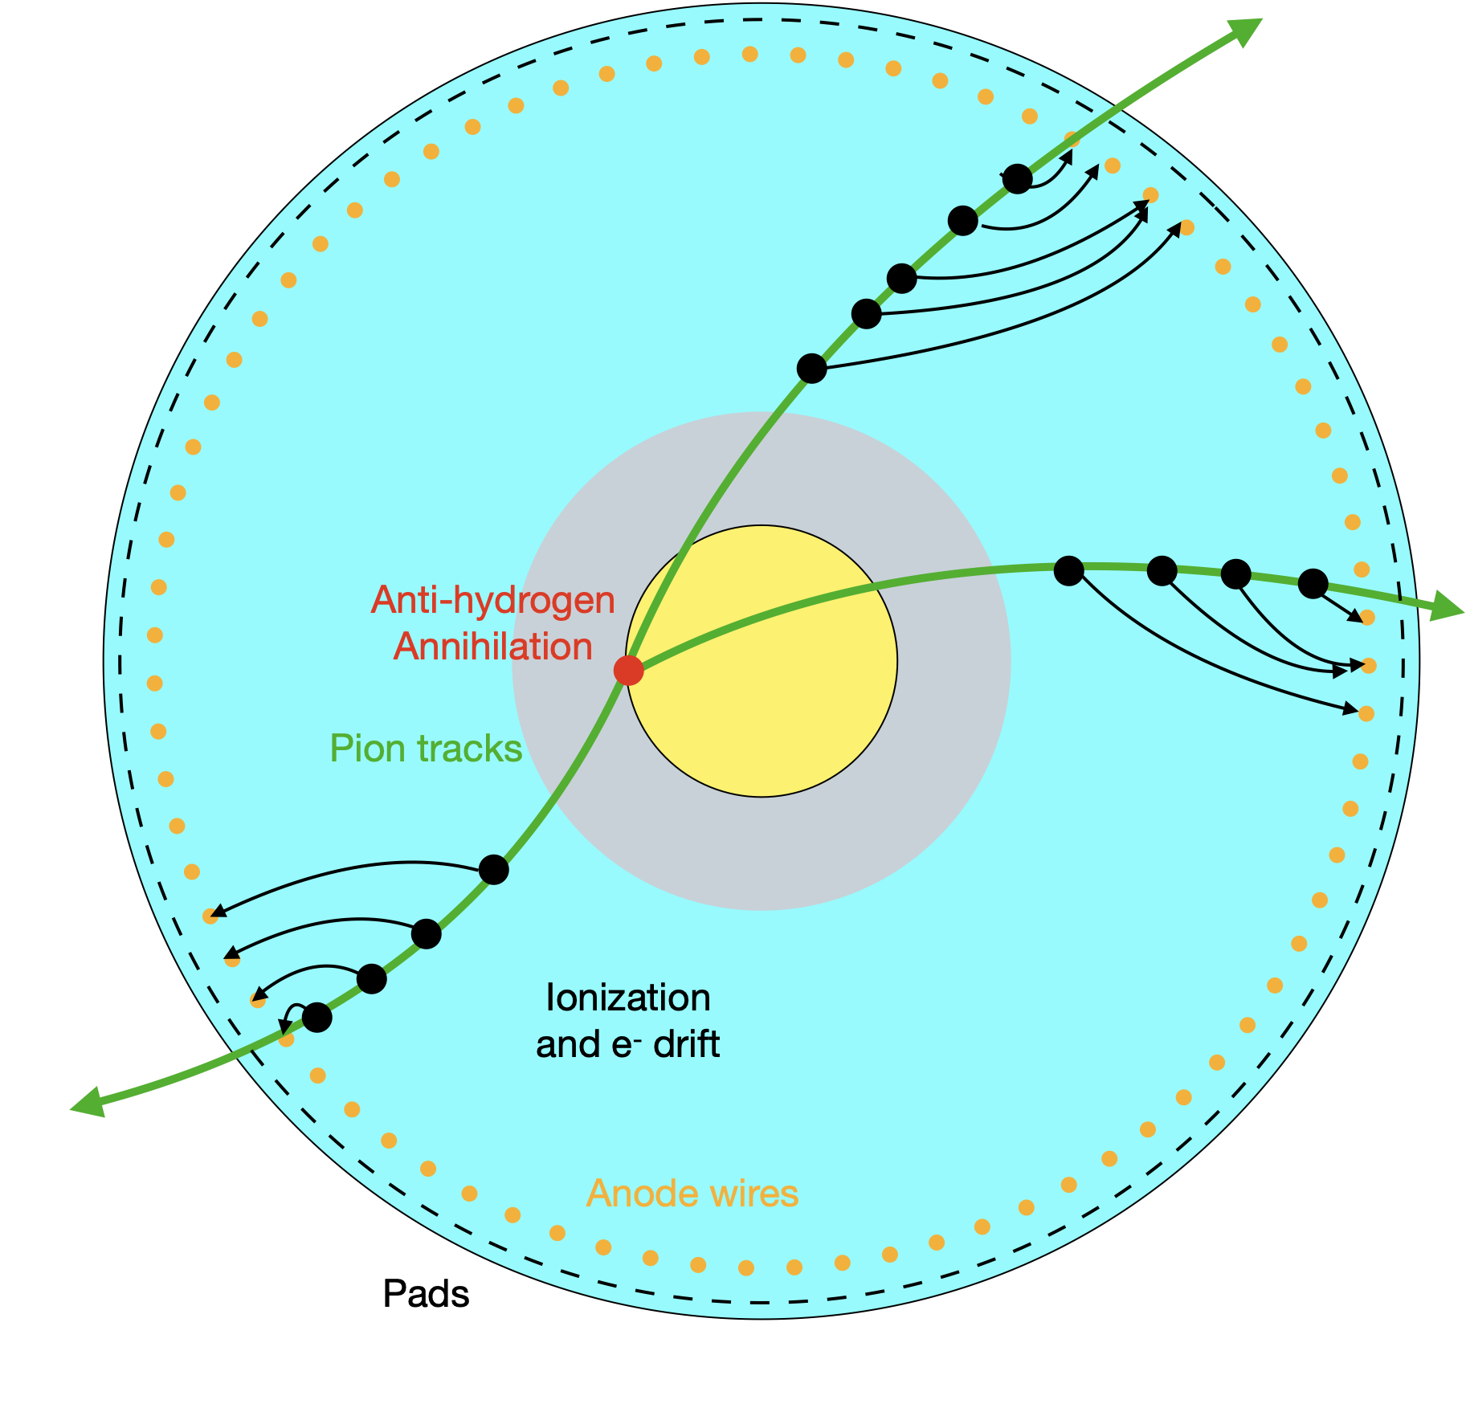
Cross-section of the rTPC
Current Reconstruction Method
Antiproton annihilations generate charged pions that ionize surroundings gas
Signal from pads and wires are deconvolved to find the arrival time of each electron
Time-projection used to find radial ionization positions
Resulting 3D positions points are called spacepoints
Spacepoints are grouped together to reconstruct pion tracks
Tracks are fit with 3D helix functions
Helices used to fit an annihilation position
Vacuum
Gas
“helix fit” method
Graphic + much of this explanation taken from Gareth Smith, TRIUMF

Slide 7
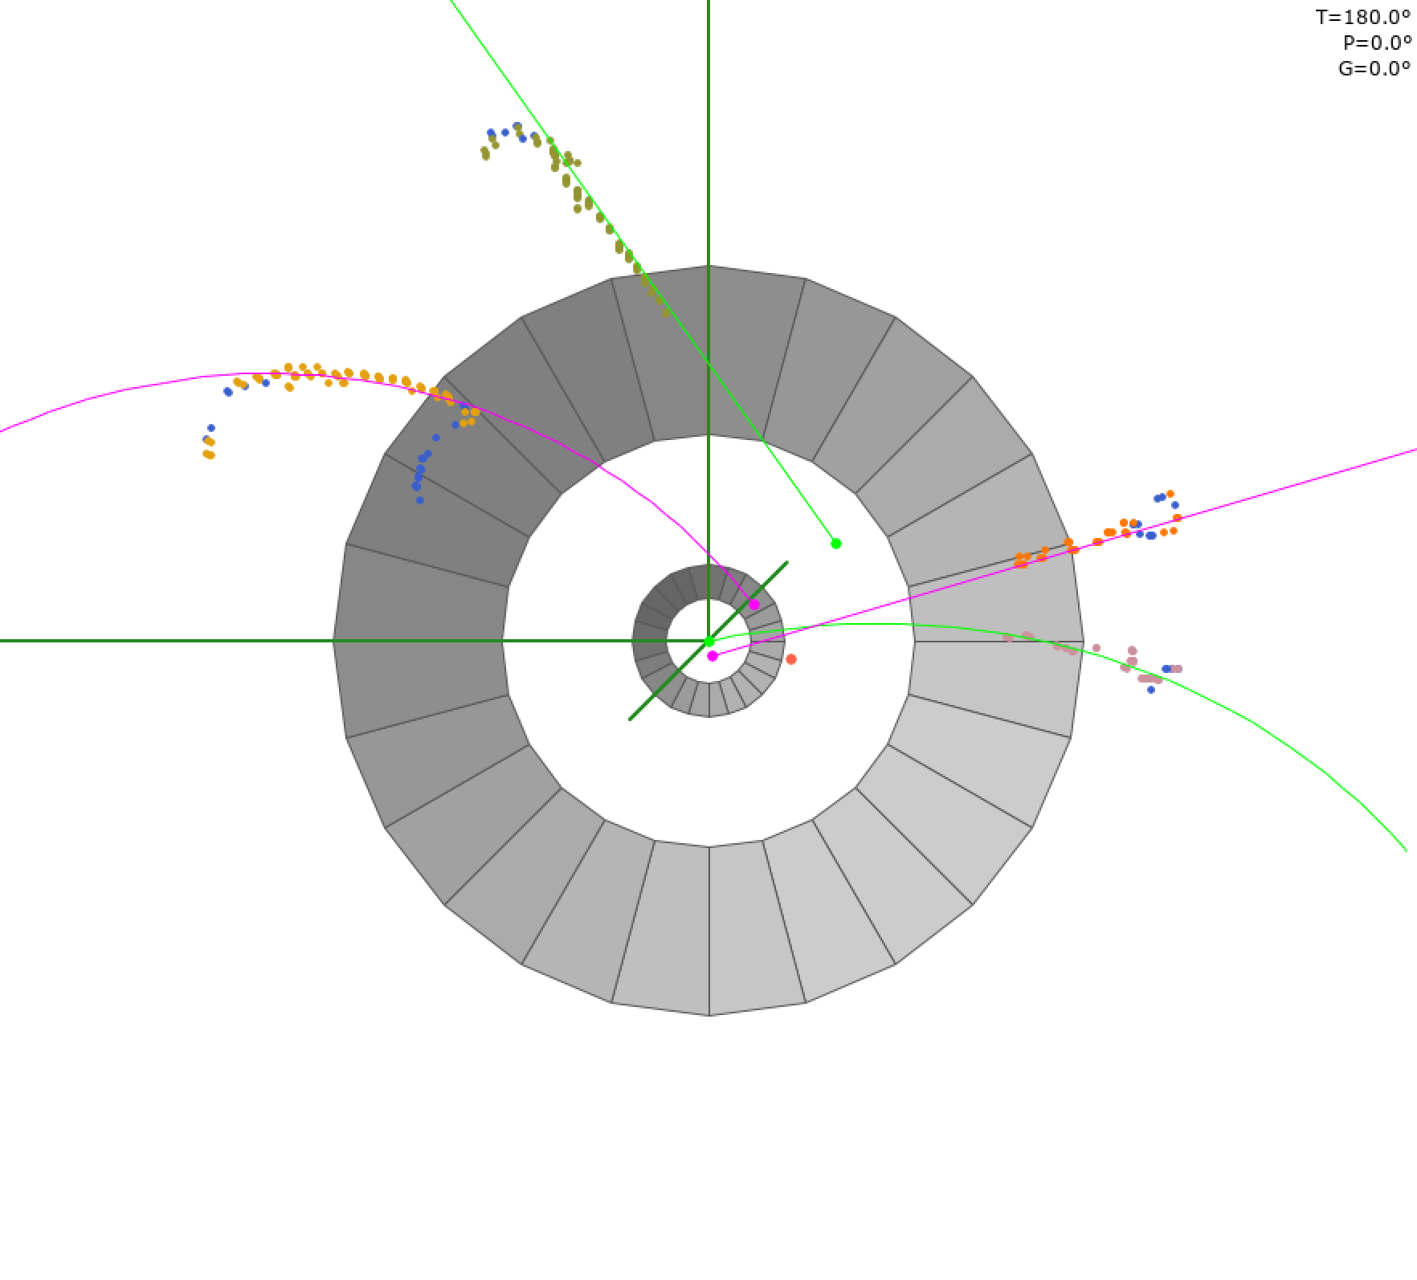
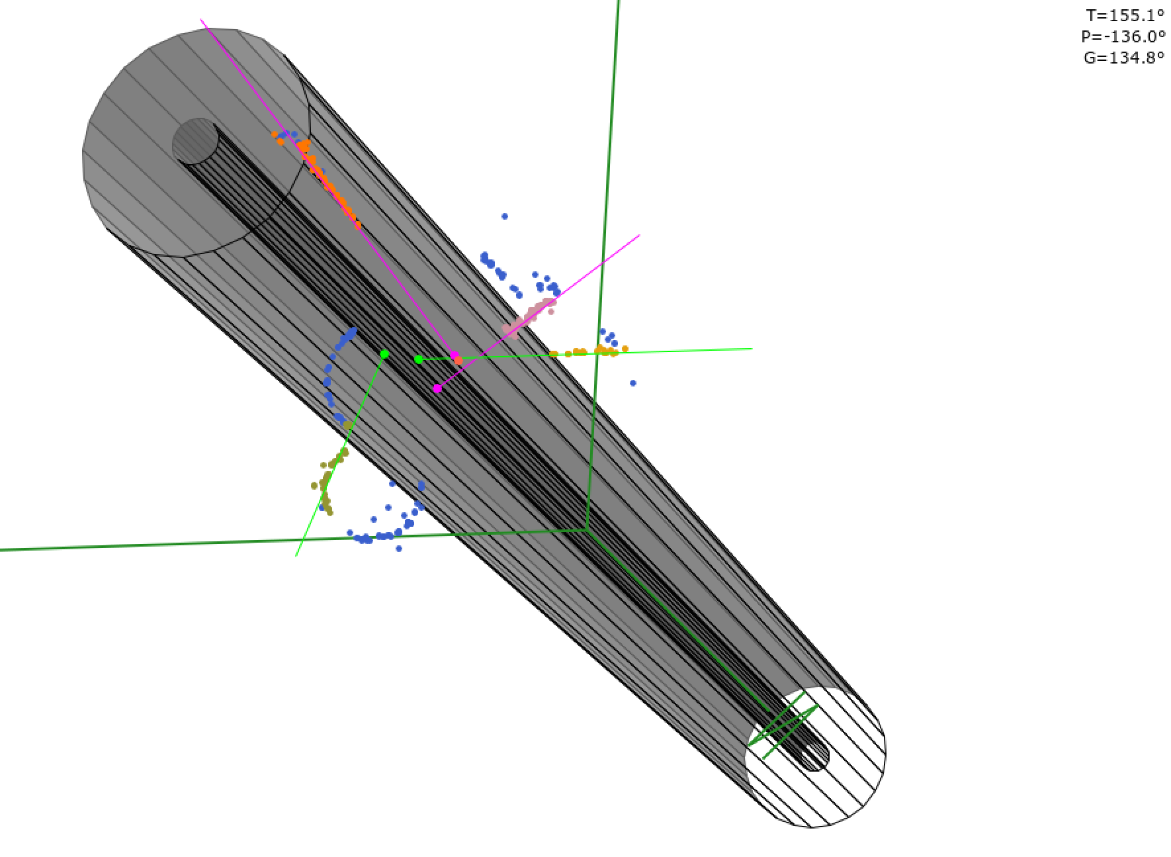
Event Display
Helix fit method is very successful and outputs predictions ~90% of the time on real data.
Graphic from Gareth Smith, TRIUMF & Phil Harvey, Queen's University

Slide 8
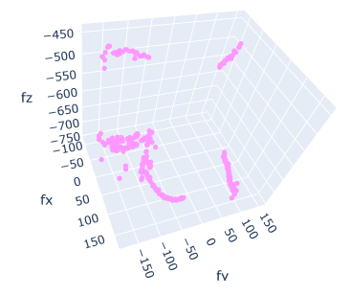
Project Goal
event spacepoints
rTPC
input
fancy deep learning model
output
Z = - 625 mm
(0,0,0)
[mm]
.
The annihilation happened at this vertical position
[mm]
The ideal model is one that can take in 3D point sets directly, the most popular and foundational of which is PointNet
y [mm]
We care most about the z-position for gravity studies
This is real data but due to the limited availability, I use data from Monte Carlo simulations of ALPHA-g
If this works, we can investigate :
Extending this to predicting the (x,y,z) position of the annihilation; and
Try using more raw forms of data than the spacepoints to help with steps earlier on in the reconstruction pipeline

Slide 9
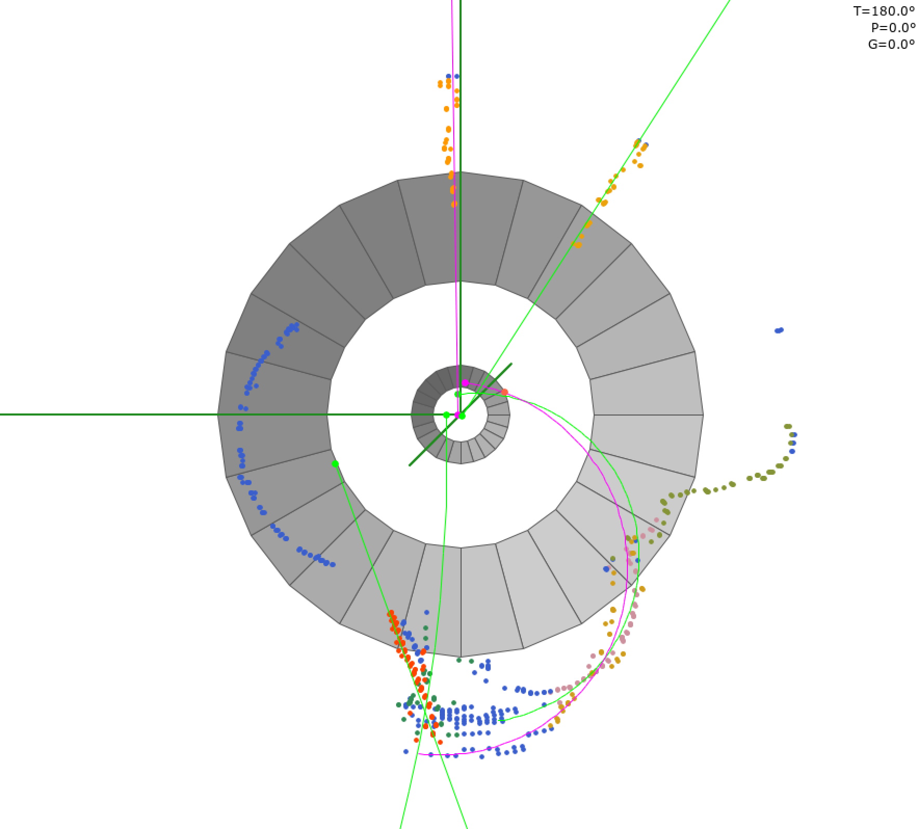
Why this Deep Learning Project?
These blue points have not been fit
Not reliant on recognition of tracks to utilize information from spacepoints
Potential to improve upon helix fit performance by squeezing more out of the data
Can help cross-check helix fit method
It always outputs a z-position prediction (even if not accurate…)
Which could be helpful when helix fit method is unable to make prediction
Graphic from Gareth Smith, TRIUMF & Phil Harvey, Queen's University

Slide 10
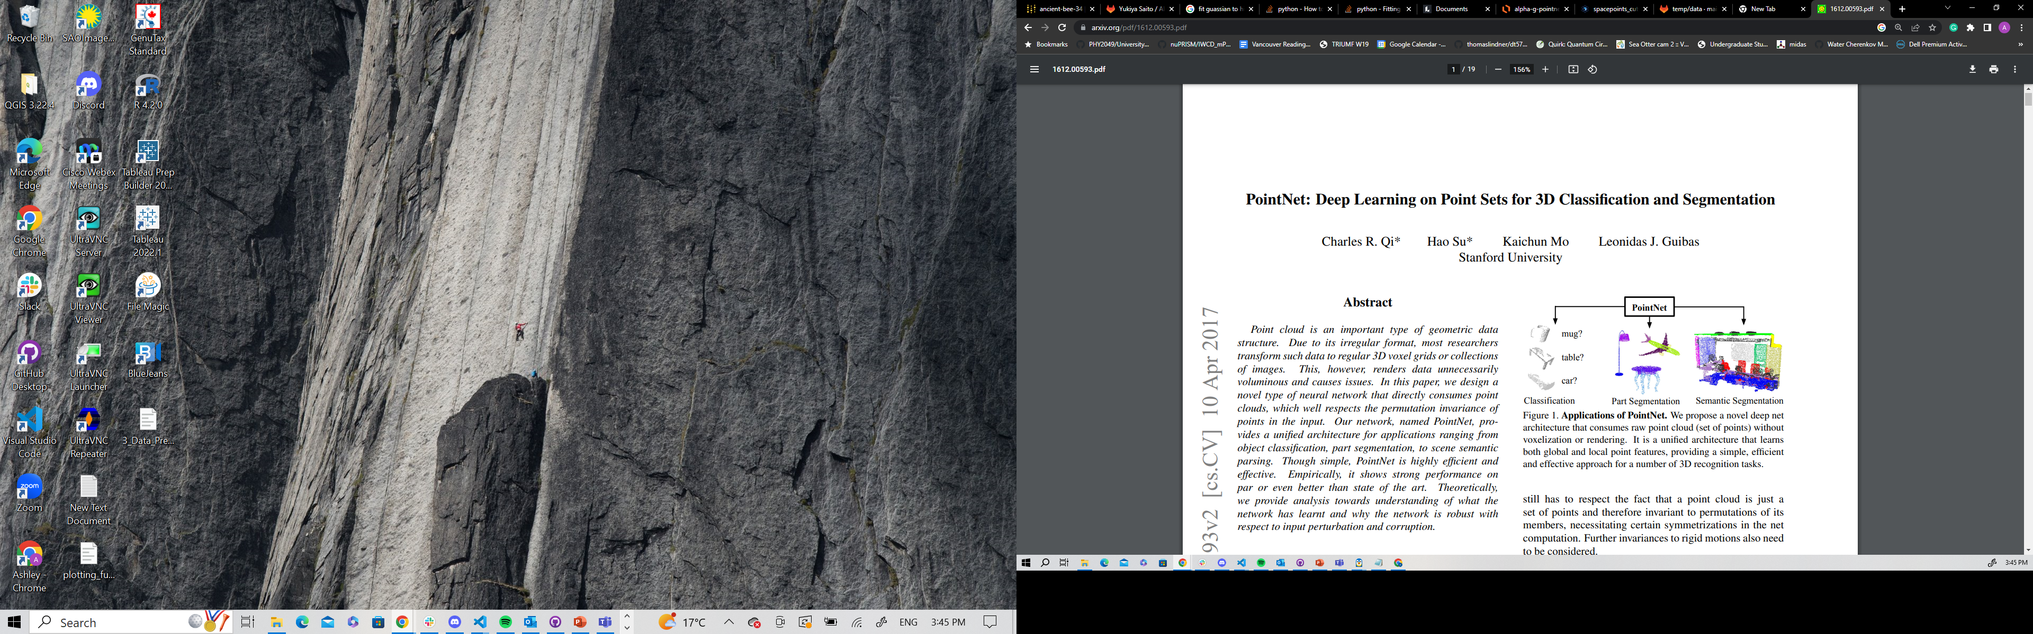
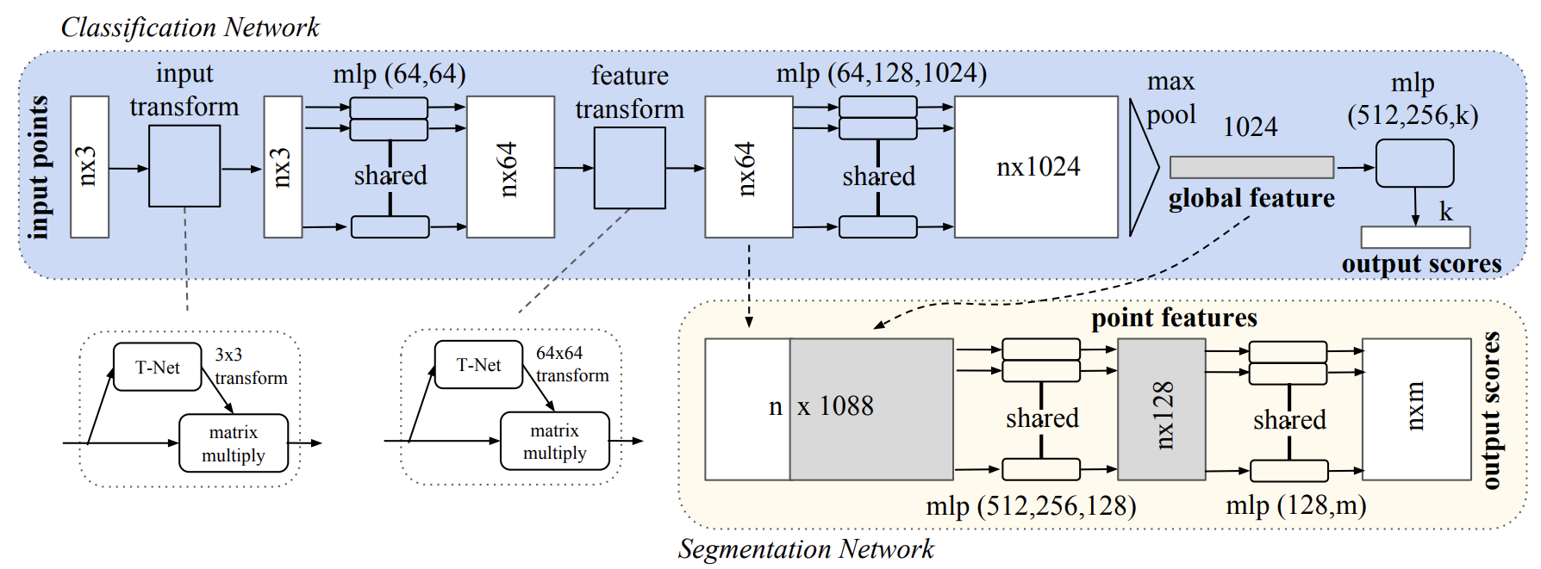
PointNet: Deep Learning on Point Sets for 3D Classification and Segmentation
https://arxiv.org/abs/1612.00593
Neural Network based architecture
Segmentation capability could be used to aid with track identification but has not been implemented yet
Changed the final layer of the network to do regression instead of classification

Slide 11
Deep Learning Method
* model architecture itself contains hyperparameters like dropout and bottleneck size
simulation data
*
repeat for another epoch
load training data
train the model
monitor loss
pick model with best validation loss
TRIUMF-ML1 server
load validation data
evaluate the model
do further analysis of performance
*
*
preprocess data
sample spacepoints for equal input size
normalize data
define a batch size
define a loss function for model to minimize during training
define an optimizer
pick a learning rate
*
split data into training, validation, & test sets
reformat data
tune hyperparameters and repeat all affected steps
* = contains hyperparameters

Slide 12
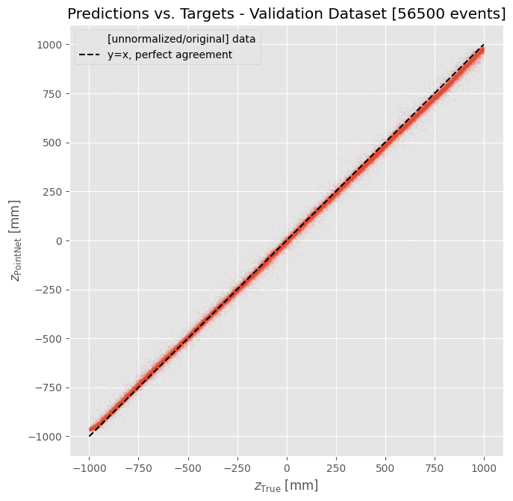
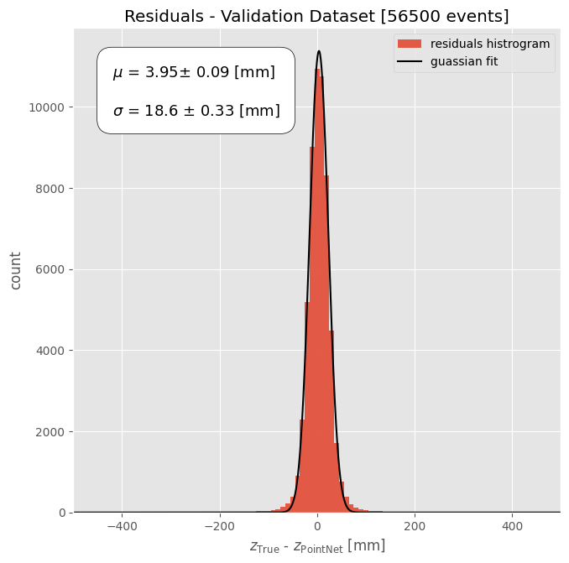
Preliminary Deep Learning Results
Results and fit uncertainties are preliminary
Mission accomplished, eh? Performance is good, speed is almost instantaneous, and there are no failures in predicting the annihilation z-positions.
56,500 events in 39s (loading & predictions) = 0.69 ms/event
(4 data loader worker, NVIDIA GeForce RTX 2080 Ti GPU)

Slide 13
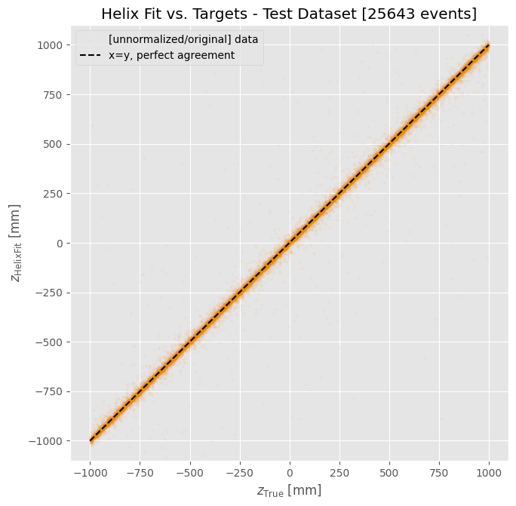
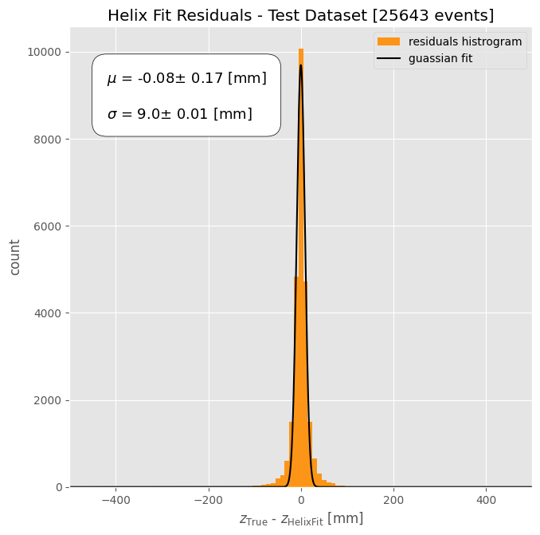
Helix Fit Results
Results and fit uncertainties are preliminary
We want to beat this.

Slide 14
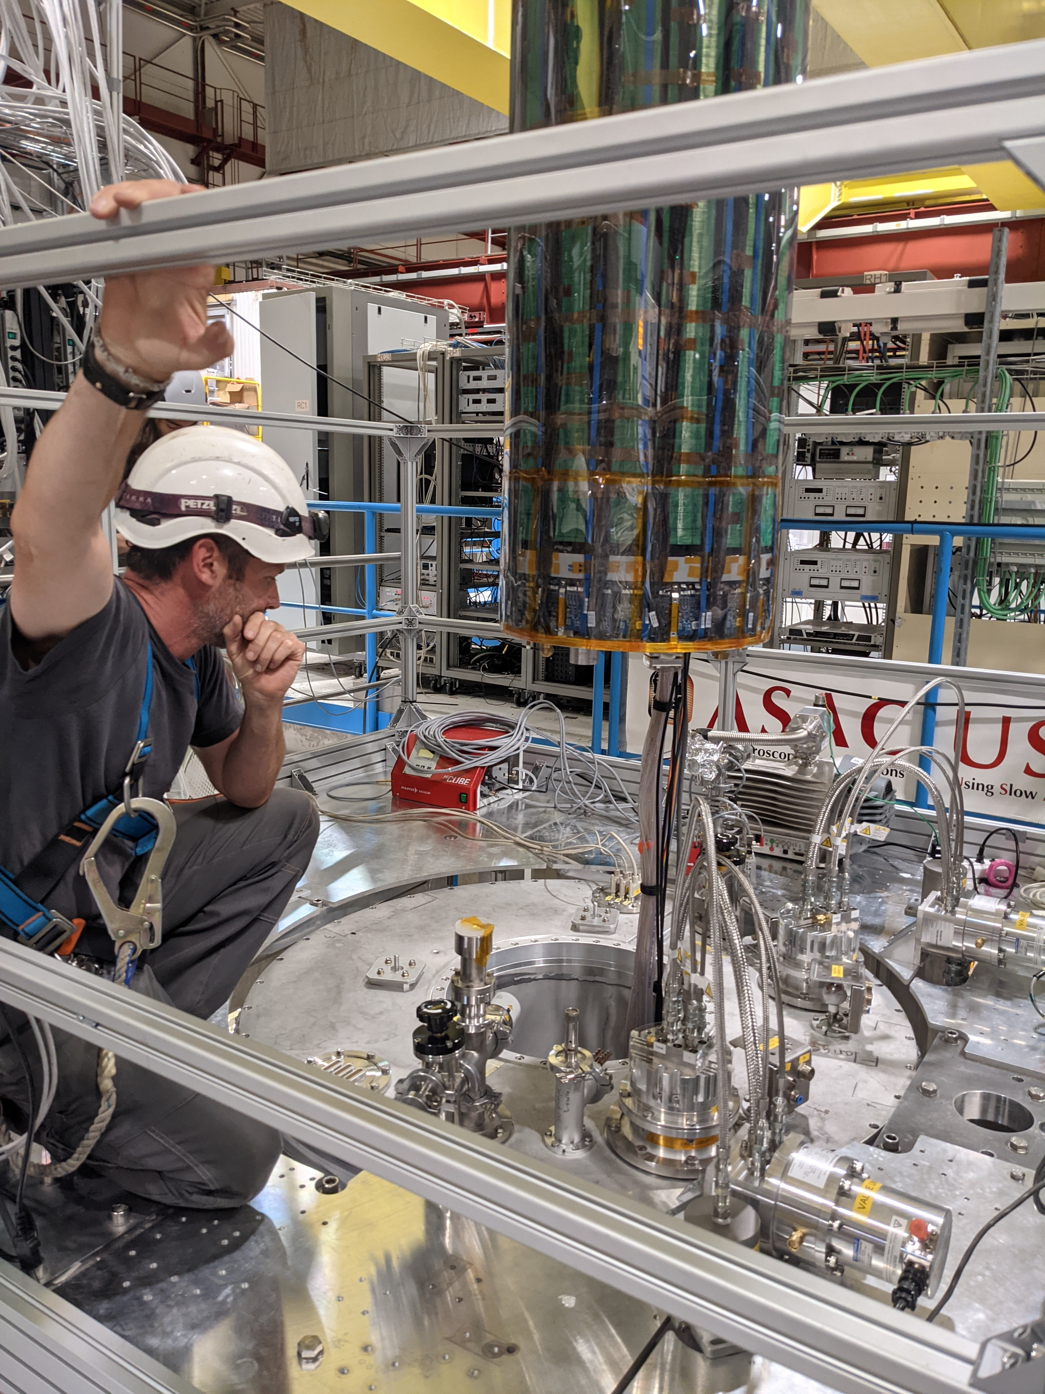
Future Work
Get deep learning model performing as well as possible on simulation data (provide more data)
This may mean exploring new ways to preprocess the data, or changing the model itself
Test performance on real data
Possible extensions:
Train model for a more complex task (e.g. predicting full Cartesian co-ordinates)
Explore track segmentation
Uncertainty estimations or implementing confidence threshold below which the prediction is unreliable

Slide 15
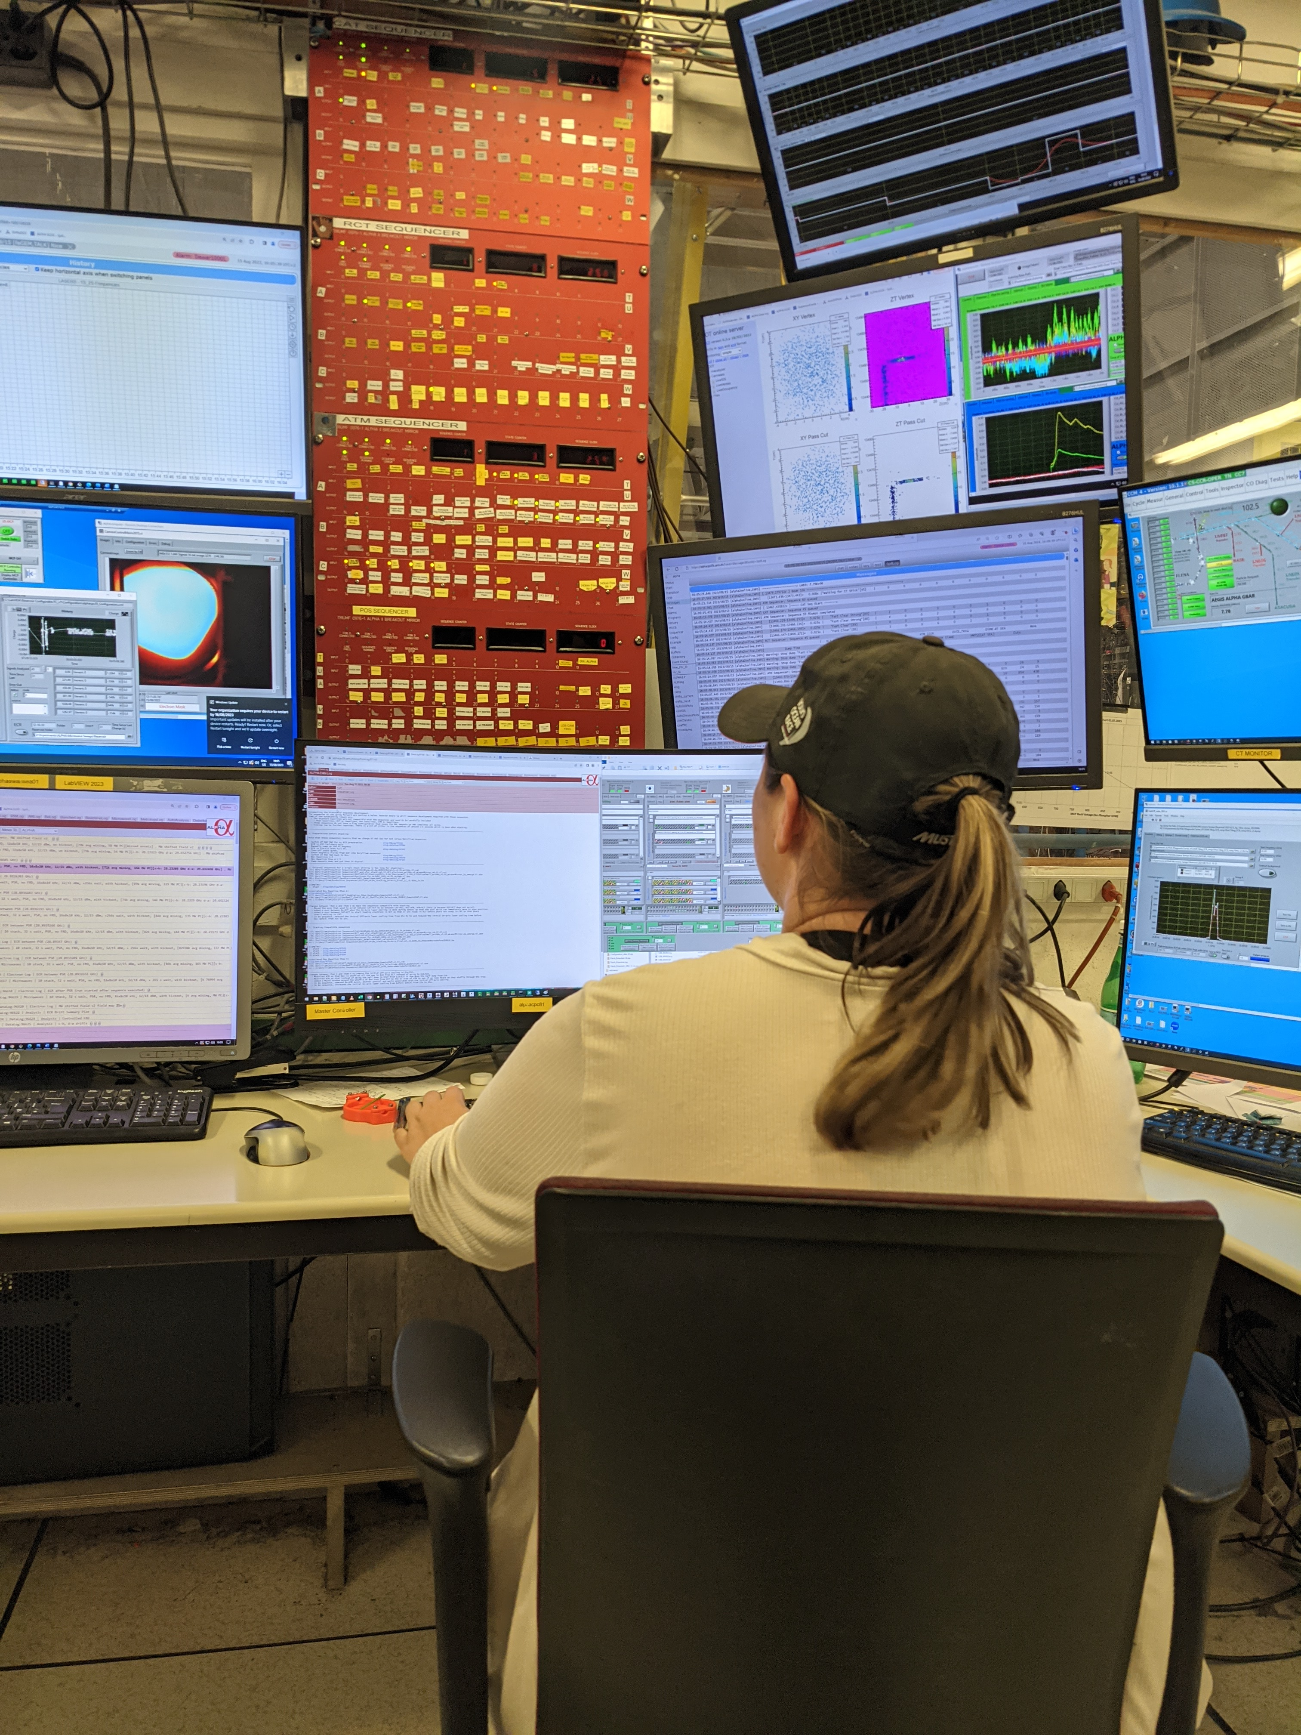

Conclusion & Acknowledgements
Promising initial results from this deep learning approach
Could be good option to compliment the helix fit method
+ Richard E. Azuma Fellowship
+ ALPHA People @CERN
+ Supervisors & Team
Makoto Fujiwara, Wojtek Fedorko, Yukiya Saito, Lars Martin, Andrea Capra, Gareth Smith, Daniel Duque
Good news! Yukiya Saito has been working a lot on this as well and yesterday got σ ~ 11 mm by using significantly more training data
This group has provided me with ample guidance and resources, without them my summer project would not have been possible.

Slide 16
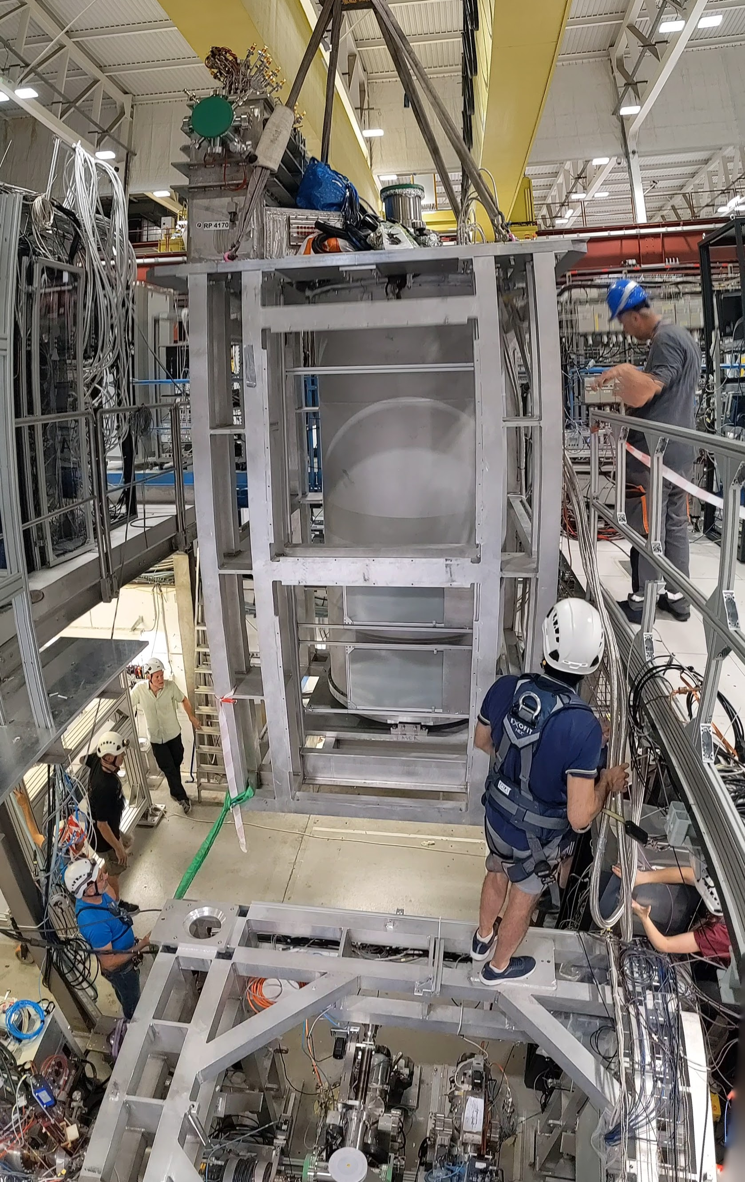
Possible Questions
If no one has any, here are some I’d be happy to discuss:
What other deep learning model architectures could be used? Why did you decide on PointNet instead of them?
Can you elaborate on why you chose to train on simulations instead of real data?
Can you elaborate on how the data is preprocessed and split into training, validation, and test sets?
How much did hyperparameter tunning help?
Can you think of ways to reduce the z-bias in results?
What are the PointNet results on the test set?
Could you touch a bit more on the possible extensions?
Where can I go to learn more about ALPHA-g?
Thank you!
Questions?

Slide 17
Appendix
Ashley Ferreira August 17th, 2023

Slide 18
simulation data
total of 188,336 events
simulation data
Partitioning the Data
this + reformatting
= preprocess data
data used to tune the model
(86 %)
data used to evaluate model once all tuning done (14 %)
random shuffle
test data (100%)
training data (70%)
validation data (30%)
to rigorously assess the final performance of the model on unseen data
directly trained on by model, the only case where the true values are given to model
check if model is actually learning + decide how to improve model
model given only spacepoints and not learning, just making predictions

Slide 19
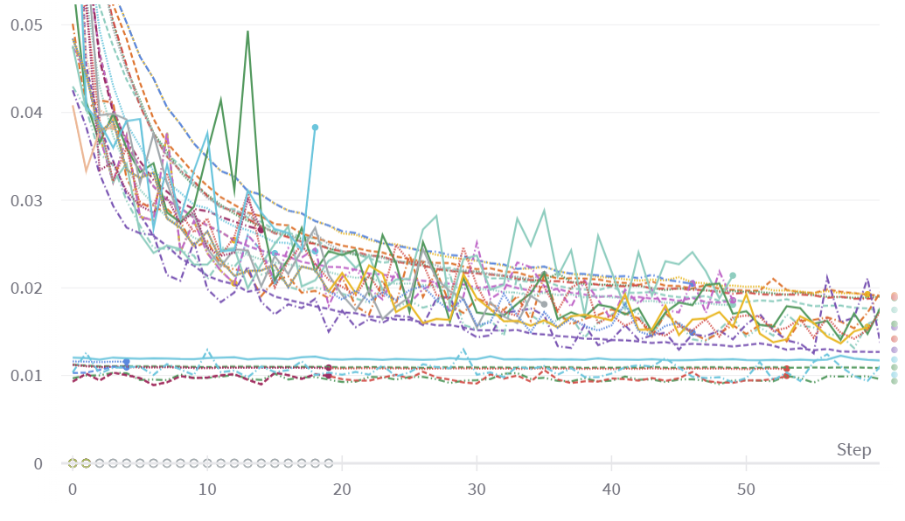
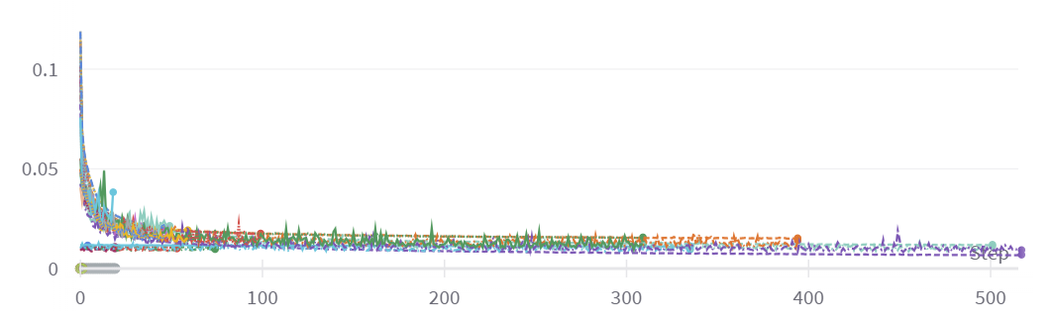
Hyperparameter Tuning
Tracked my experiments with Weights & Biases platform
Plot shows the loss curves from recent training runs (coloured)
Tuning hyperparameters provides improvements but reach similar loss plateau
Training existing models more
(that’s why they start with low loss)
Mean Absolute Error Loss
Epoch

