Slide 1


Object-oriented monte Carlo alpha analysis
Jeter Hall, Stephen Sekula, Mark Volin*

Slide 2















Reconstructed Data
Noise
...
$${\overset{⃑}{t}}_{n,r}$$
...
$$t_{n,r}^{1}$$
$$t_{n,r}^{2}$$
$$t_{n,r}^{3}$$
$$t_{n,r}^{4}$$
$$t_{n,r}^{5}$$
$$t_{n,r}^{6}$$
Alphas
$${\overset{⃑}{t}}_{α,r}$$
$$t_{α,r}^{1}$$
$$t_{α,r}^{2}$$
$$t_{α,r}^{3}$$
$$t_{α,r}^{4}$$
$$t_{α,r}^{5}$$
$$t_{α,r}^{6}$$
$$t_{α,r}^{7}$$

Slide 3
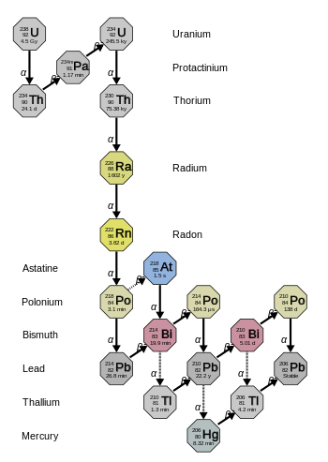
The Uranium Series

Slide 4








$$∝m$$
$${}_{86}^{222}{Rn}$$
$${}_{84}^{218}{Po}$$
$${}_{82}^{214}{Pb}$$
$${}_{83}^{214}{Bi}$$
$${}_{84}^{214}{Po}$$
$${}_{82}^{210}{Pb}$$
$$α$$
$$α$$
$$α$$
$$β^{−}$$
$$β^{−}$$
$$∝t$$
3.82 d
3.1 min
26.8 min
19.9 min
164.3 μs

Slide 5
$$∝m$$
$${}_{86}^{222}{Rn}$$
$${}_{84}^{218}{Po}$$
$${}_{82}^{214}{Pb}$$
$${}_{83}^{214}{Bi}$$
$${}_{84}^{214}{Po}$$
$${}_{82}^{210}{Pb}$$
$$α$$
$$α$$
$$α$$
$$β^{−}$$
$$β^{−}$$
$$∝t$$
3.1 min
46.7 min

Slide 6









$A(t)∝N(t)$
$A(t)=λN(t)$
$⇒$
$ℒ\left\{λN(t)\right\}=ℒ\left\{−\frac{dN(t)}{dt}\right\}$
$λN(t)=−\frac{dN(t)}{dt}$
$\tilde{N}(s)=\frac{N_{0}}{s+λ}$
$λ\tilde{N}(s)=−s\tilde{N}(s)+N_{0}$
$A(t)=−\frac{dN(t)}{dt}$
$N(t)=N_{0}e^{−λt}$

Slide 7




$N(t)=N_{0}e^{−λt}$
$\frac{1}{2}N_{0}=N_{0}e^{−λT_{1/2}}$
$\frac{1}{2}=e^{−λT_{1/2}}$
$T_{1/2}=\frac{\ln{2}}{λ}$
$\ln{\frac{1}{2}}=−λT_{1/2}$

Slide 8
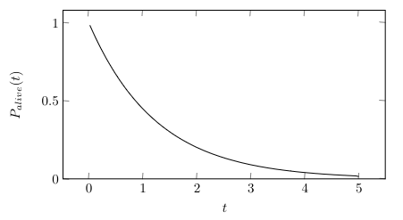
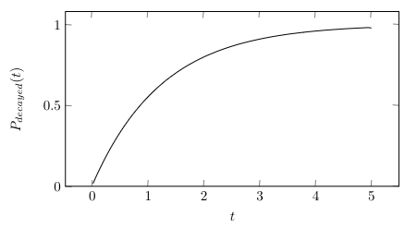




Small Systems
$N(t)=N_{0}e^{−λt}$
$T_{1/2}=\frac{\ln{2}}{λ}$
$P_{alive}(t)=e^{−λ(t−t_{0})}$
$P_{decayed}(t)=1−e^{−λ(t−t_{0})}$

Slide 9
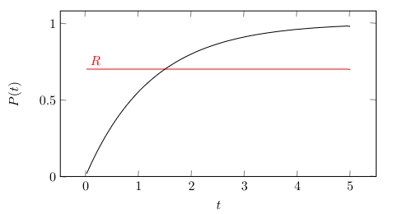




Monte Carlo
$N(t)=N_{0}e^{−λt}$
$T_{1/2}=\frac{\ln{2}}{λ}$
$−λ(t_{decay}−t_{0})=\ln\left(1−R\right)$
$t_{decay}=−\frac{\ln\left(1−R\right)}{λ}+t_{0}$
$t_{decay}=−T_{1/2}\log_{2}\left(1−R\right)+t_{0}$
$R=1−e^{−λ(t_{decay}−t_{0})}$
$e^{−λ(t_{decay}−t_{0})}=1−R$

Slide 10
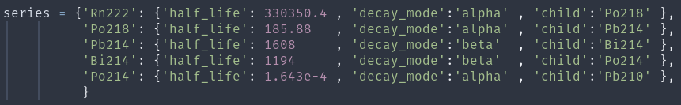
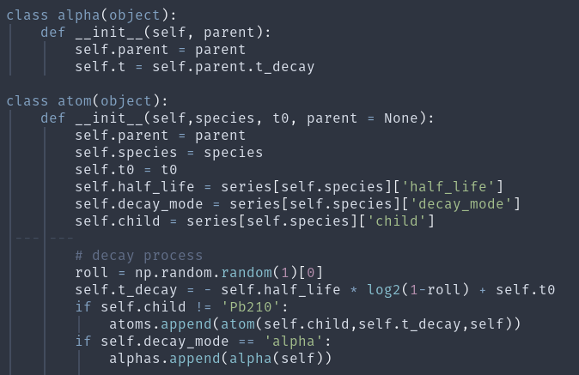
Object-Oriented Approach

Slide 11



Populating the System
$$Δt_{Rn}$$
$$t_{i}$$
...
$$t_{f}$$
...
3.82 d

Slide 12









Establishing Equilibrium
$$\frac{dN_{i}}{dt}=λ_{i−1}N_{i−1}(t)−λ_{i}N_{i}(t)$$
Bateman’s Equation
$$\frac{dN_{i}}{dt}=\left\{\begin{aligned}K−λ_{i}N_{i}(t) , i=1 \\ \\ λ_{i−1}N_{i−1}(t)−λ_{i}N_{i}(t) ,i>1\end{aligned}\right.$$
$${\tilde{N}}_{i}(s)=\frac{K}{s(s+λ_{i})}\prod_{j=1}^{i−1}{\frac{λ_{j}}{s+λ_{j}}}$$
$$〈N_{total−eq}〉=\sum_{i}{\frac{K}{λ_{i}}}$$
$$〈N_{total−eq}〉=\sum_{i}{N_{i,eq}}$$
$$K=\frac{1}{Δt_{Rn}}$$
$$N_{i}(∞)=\lim_{s→0}{s{\tilde{N}}_{i}(s)}=\frac{K}{λ_{i}}$$
$$t_{init−eq}=〈N_{total−eq}〉 ⋅Δt_{Rn}$$
$$N_{i,0}=0 ∀ i$$

Slide 13

Populating the System
$$Δt_{Rn}$$
$$t_{init−eq}$$
$$t_{i}$$
$$t_{f}$$
...
...
...

Slide 14






Accounting for Dead-time
Alpha
Noise
Dead-time
$$t_{α,p}^{1}$$
$$t_{α,p}^{2}$$
$$t_{α,p}^{3}$$
$$t_{α,p}^{4}$$
$$t_{α,p}^{5}$$
$${\overset{⃑}{t}}_{α,p}$$

Slide 15
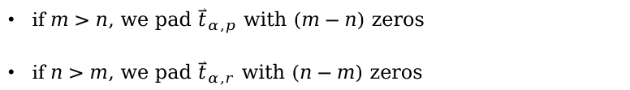
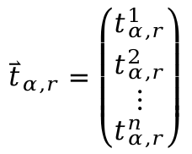
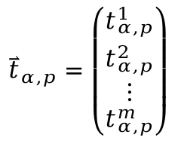
$${\overset{⃑}{t}}_{α,r}=\left(\begin{matrix}t_{α,r}^{1} \\ t_{α,r}^{2} \\ ⋮ \\ t_{α,r}^{n}\end{matrix}\right)$$
$${\overset{⃑}{t}}_{α,p}=\left(\begin{matrix}t_{α,p}^{1} \\ t_{α,p}^{2} \\ ⋮ \\ t_{α,p}^{m}\end{matrix}\right)$$
if $m>n$, we pad ${\overset{⃑}{t}}_{α,p}$ with $(m−n)$ zeros
if $n>m$, we pad ${\overset{⃑}{t}}_{α,r}$ with $(n−m)$ zeros

Slide 16





$${\overset{⃑}{t}}_{α,d}={\overset{⃑}{t}}_{α,r}−{\overset{⃑}{t}}_{α,p}$$
$$σ^{2}={\overset{⃑}{t}}_{α,d}⋅{\overset{⃑}{t}}_{α,d}$$
$(±1)=\operatorname{sgn}\left(\sum_{i}{t_{α,d}^{i}}\right)$
$$Δt_{Rn} ∗=(±1)⋅σ^{2}⋅L_{r}$$
$$L_{r}=1⋅{10}^{−8}$$

Slide 17
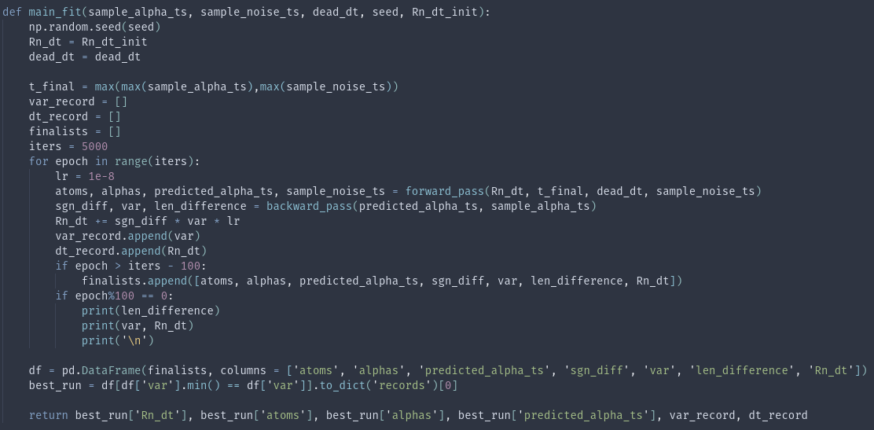
Learning Algorithm

Slide 18
Validation

Slide 19
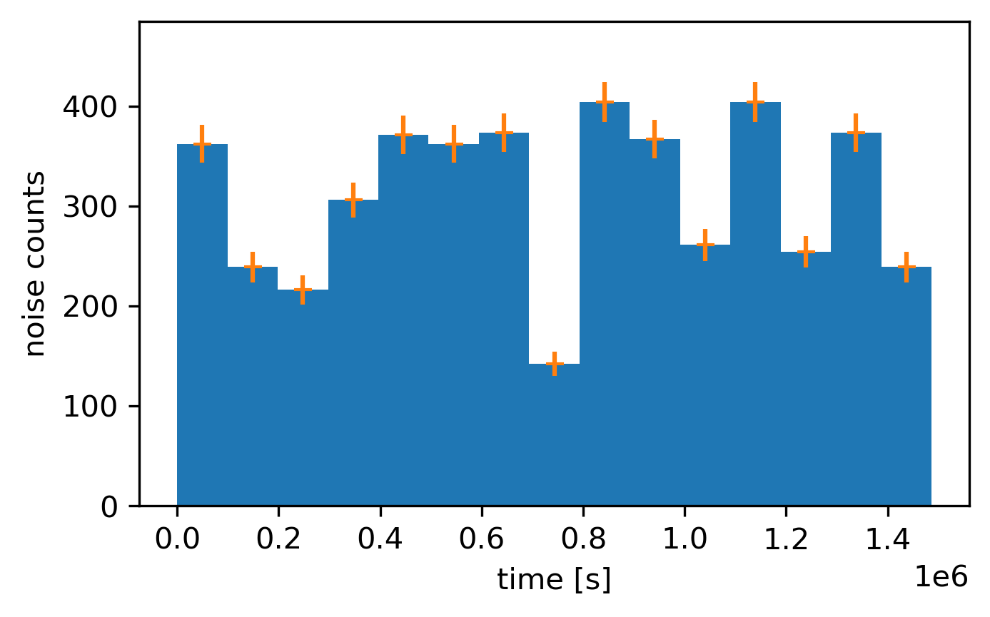
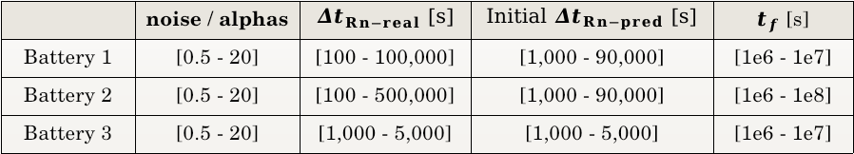
Tests
 | noise / alphas | $Δt_{Rn−real}$ [s] | Initial$Δt_{Rn−pred}$ [s] | $t_{f}$ [s]
Battery 1 | [0.5 - 20] | [100 - 100,000] | [1,000 - 90,000] | [1e6 - 1e7]
Battery 2 | [0.5 - 20] | [100 - 500,000] | [1,000 - 90,000] | [1e6 - 1e8]
Battery 3 | [0.5 - 20] | [1,000 - 5,000] | [1,000 - 5,000] | [1e6 - 1e7]
Noise is generated from a radom uniform distribution, in partial accordance to what was observed from PICO’s data.

Slide 20

Battery 1
noise / alphas | $Δt_{Rn−real}$ [s] | Initial$Δt_{Rn−pred}$ [s] | $t_{f}$ [s]
[0.5 - 20] | [100 - 100,000] | [1,000 - 90,000] | [1e6 - 1e7]

Slide 21

Battery 2
noise / alphas | $Δt_{Rn−real}$ [s] | Initial$Δt_{Rn−pred}$ [s] | $t_{f}$ [s]
[0.5 - 20] | [100 - 500,000] | [1,000 - 90,000] | [1e6 - 1e8]

Slide 22

Battery 3
noise / alphas | $Δt_{Rn−real}$ [s] | Initial$Δt_{Rn−pred}$ [s] | $t_{f}$ [s]
[0.5 - 20] | [1,000 - 5,000] | [1,000 - 5,000] | [1e6 - 1e7]

Slide 23
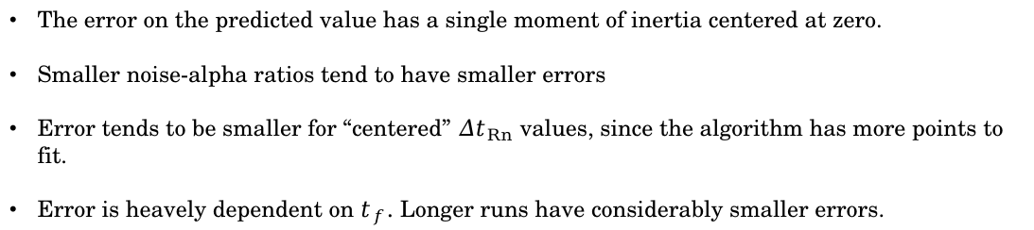
Key Takeaways
The error on the predicted value has a single moment of inertia centered at zero.
Smaller noise-alpha ratios tend to have smaller errors
Error tends to be smaller for “centered” $Δt_{Rn}$ values, since the algorithm has more points to fit.
Error is heavely dependent on $t_{f}$. Longer runs have considerably smaller errors.

Slide 24
Data pre-processing

Slide 25
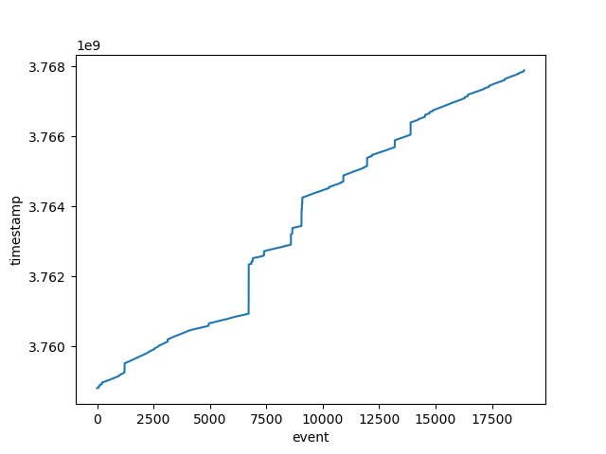
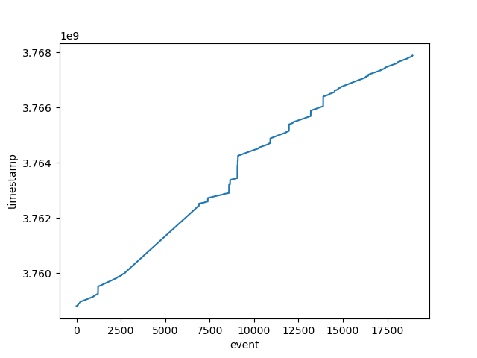
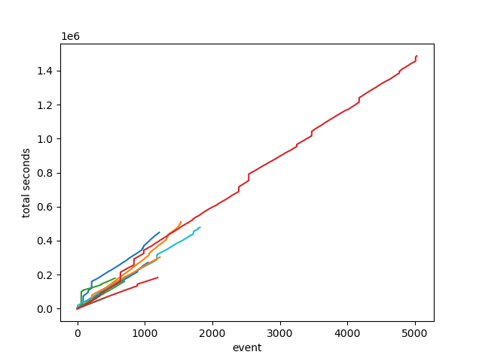

Run Type
$$Δt < 1e6$$
Reconstructed Data
‘Alpha Run’ Data
‘Continious’ Data

Slide 26
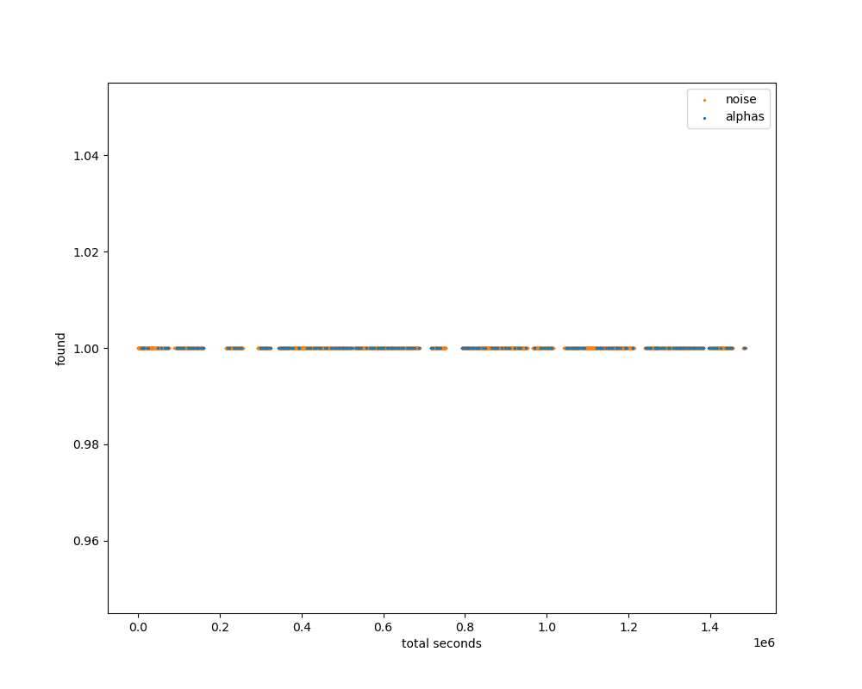
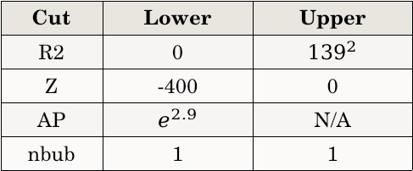
Alpha Cuts
Cut | Lower | Upper
R2 | 0 | $${139}^{2}$$
Z | -400 | 0
AP | $$e^{2.9}$$ | N/A
nbub | 1 | 1

Slide 27
Results

Slide 28
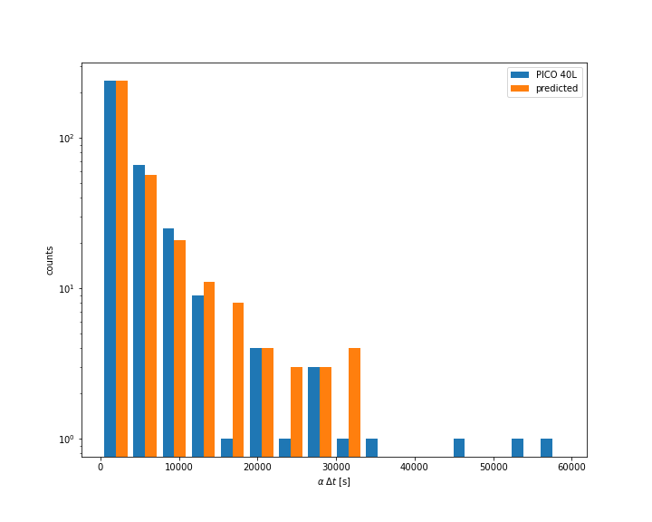
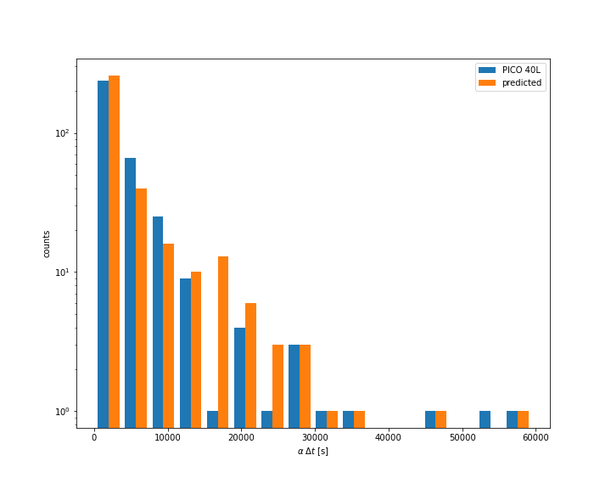
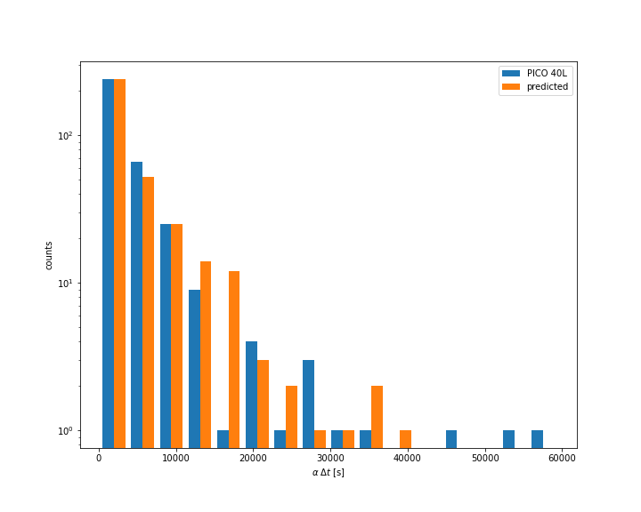
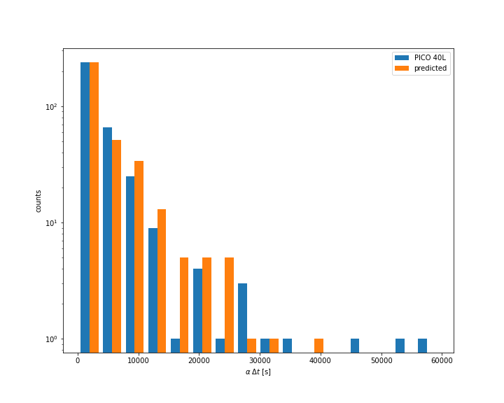
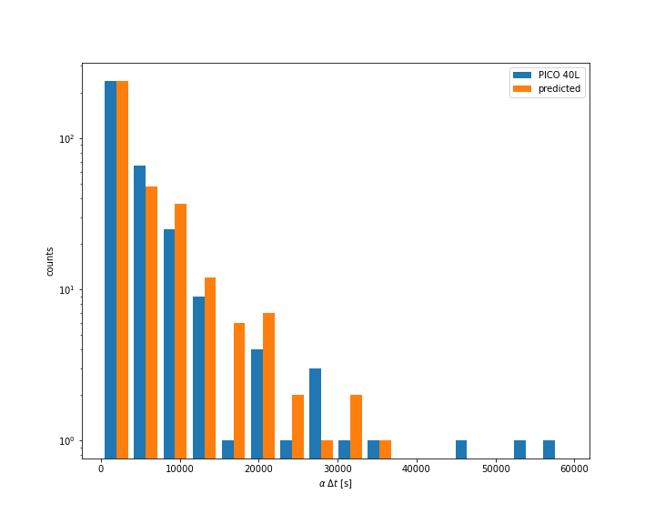
$$Δt_{Rn}= 3241.33 s$$
$$Δt_{Rn}= 3235.34 s$$
$$Δt_{Rn}= 3227.25 s$$
$$Δt_{Rn}= 3224.40 s$$
$$Δt_{Rn}= 3238.99 s$$
*Doane Binning

Slide 29




$$Δt_{Rn}= 53.92 min ± 8.09$$
$$Δt_{Rn}= 3235.34 s ± 485.30$$
$$Δt_{Rn}= 3235.34 s ± 15\%$$
$$〈N_{Rn}〉=\frac{K}{λ_{Rn}}$$
$$〈N_{Rn}〉=\frac{T_{1/2}}{Δt_{Rn}⋅\ln{2}}$$
$$〈N_{Rn}〉=147.17 ± 22.08$$
$$Δt_{Rn}= 3235.34 s$$

Slide 30
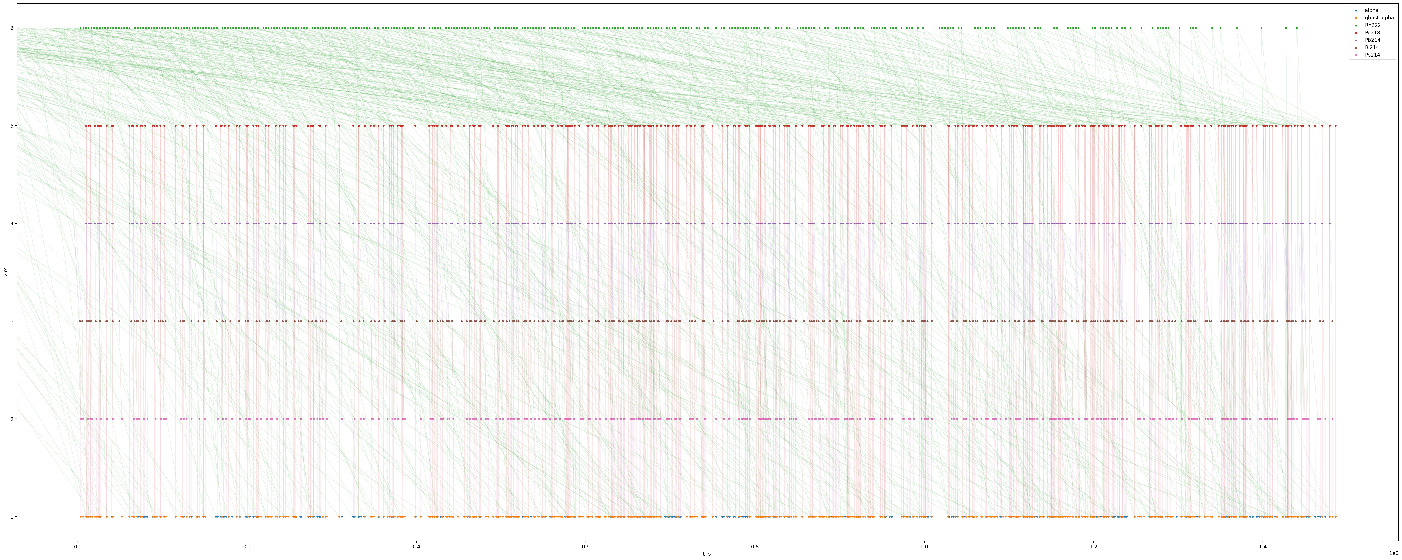
Recunstructing Decay Events

