Slide 1
Simulating Magnetic Fields in a Magnetically Shielded room for a Neutron
Electric Dipole Moment Experiment
Thomas Hepworth, The University of Winnipeg
Supervisor: Dr. Russell Mammei, The University of Winnipeg

Slide 2
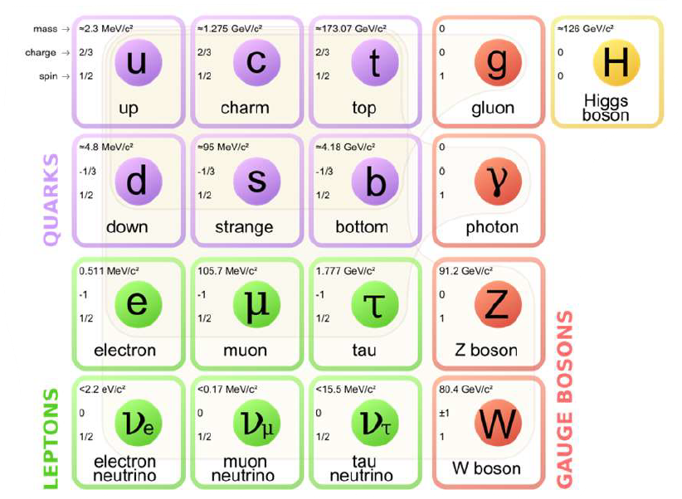
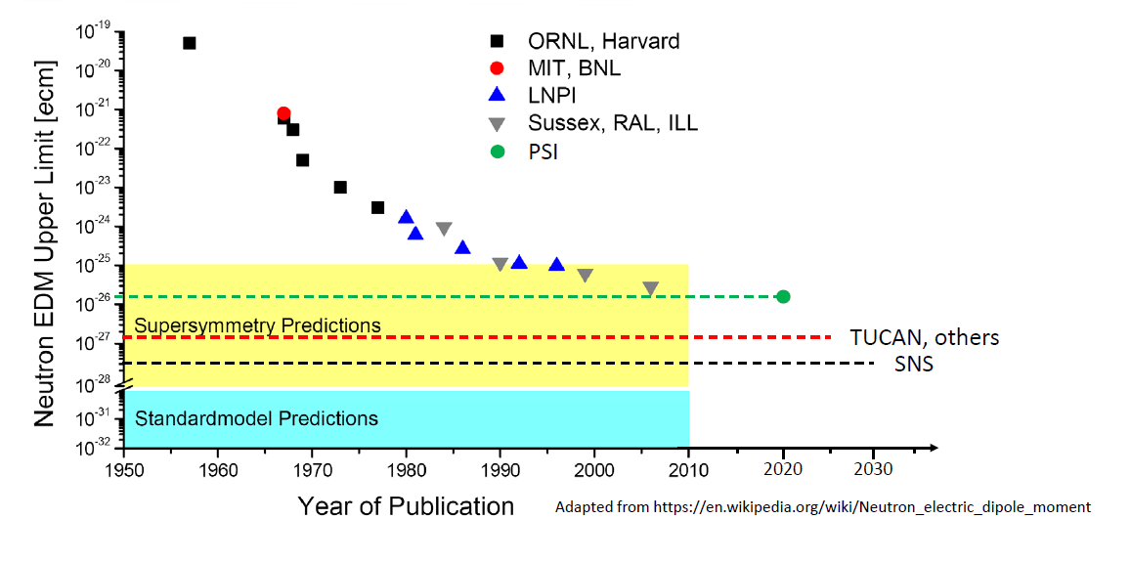

Slide 3
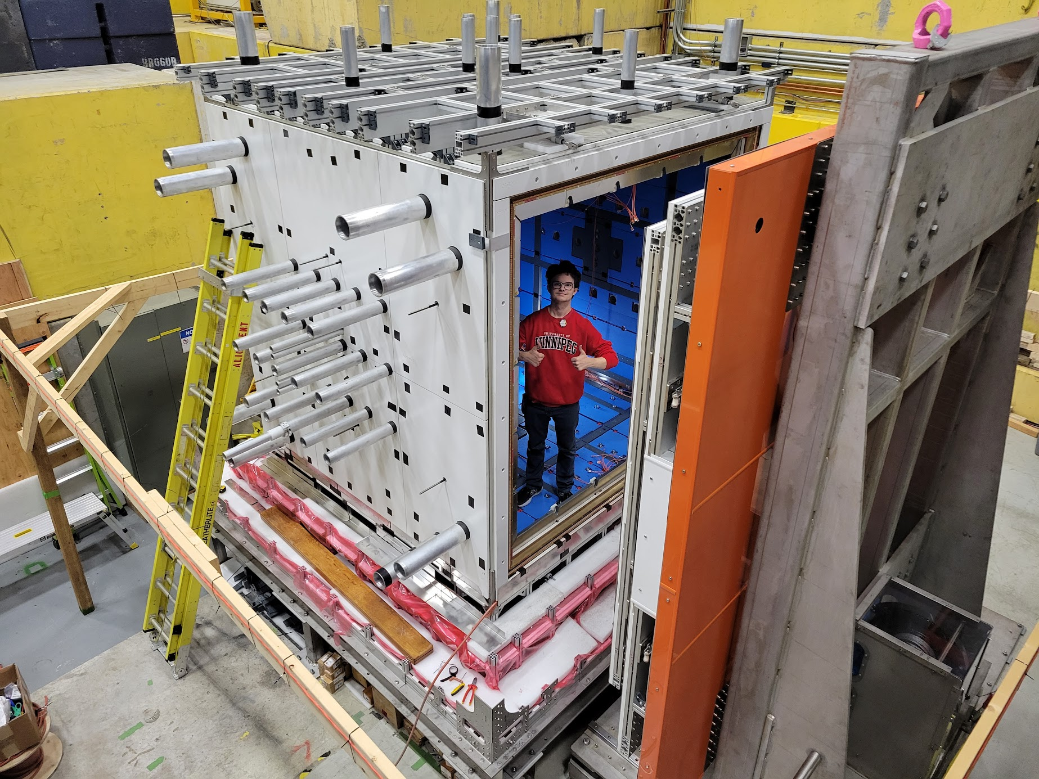
Myself, pictured inside the MSR in the Meson Hall at TRIUMF, Canada’s particle accelerator centre
MSR as of July 2023. Showing a fully completed door and layers 4 (copper) + 5 (inner most mu metal)

Slide 4
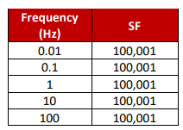
Characterizing the MSR
Shielding factor requirements of the fully assembled MSR
Involves the following major measurements
Shielding factor of the MSR at the displayed frequencies
  This is to be done at a few µT excitation (Field perturbed by wooden coil show in previous slide
Residual field measurement
  Field expected to be < 1 nT
Full inner field mapping
  To evaluate field homogeneity and to search for any anomalies, a complete field map must be done when the MSR is finished

Slide 5
The Field Mapping Problem
Mapping the magnetic field requires an external mapping device to enter the MSR through holes indicated by the arrow
This restricts the measurement positions to be along the axis of these holes
Measurement coarseness will determine the precision of the field we reproduce
MSR mapping holes. They will not extrude past the outermost layer when the MSR is complete

Slide 6
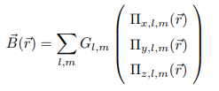

Fitting our fields
We employ a harmonic polynomial expansion of the magnetic field to calculate the MSR field from our collected data
where and
We fit for the G_{l,m} coefficients in our software, which describe the field based on the general polynomials
[1] @article{Abel:2018arc, author = "Abel, C. and others", title = "{Magnetic field uniformity in neutron electric dipole moment experiments}", eprint = "1811.06085", archivePrefix = "arXiv", primaryClass = "physics.ins-det", doi = "10.1103/PhysRevA.99.042112", journal = "Phys. Rev. A", volume = "99", number = "4", pages = "042112", year = "2019" }

Slide 7
Simulations of Magnetic Field
Want to determine the required measurement coarseness to reach our desired magnetic field precision
Simulation uses a dipole magnetic field on the wall of the MSR
  Dipoles can be induced by any stress in the material which is why we need to investigate how well we can fit them

Slide 8
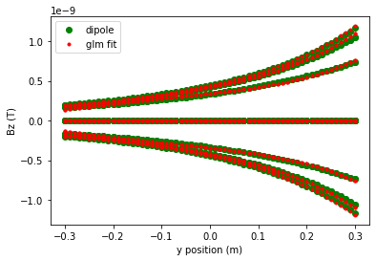
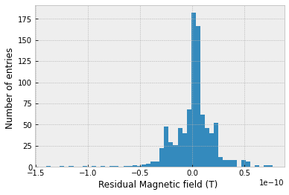
Results

Slide 9
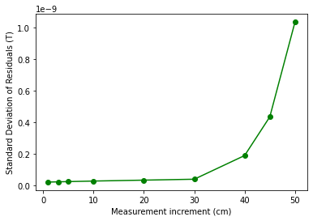
Conclusion
The standard deviation of the residual field is stable before increasing exponentially as the distance between measurements increases
A measurement increment of 5 cm is optimal for the level of precision and time saving it provides compared to 1 or 3 cm

Slide 10
Next Steps
Repeat simulations for more complicated magnetic situations.
Multiple dipoles of small and large magnitude which are randomly oriented will be included.
Introduce position and field measurement errors based on the magnetometers we employ and the level of positional control the mapping device has

Slide 11
Thank you!
Thomas Hepworth, thomashepworth12@gmail.com
https://www.linkedin.com/in/thomas-hepworth/

