Slide 1
Preliminary Steps Towards Calculating Minimum Detectable Activities of Coincidence Events in the CTBT Detector
Maxwell Bridgewater
Student Researcher
Low Background Counting Group

Slide 2
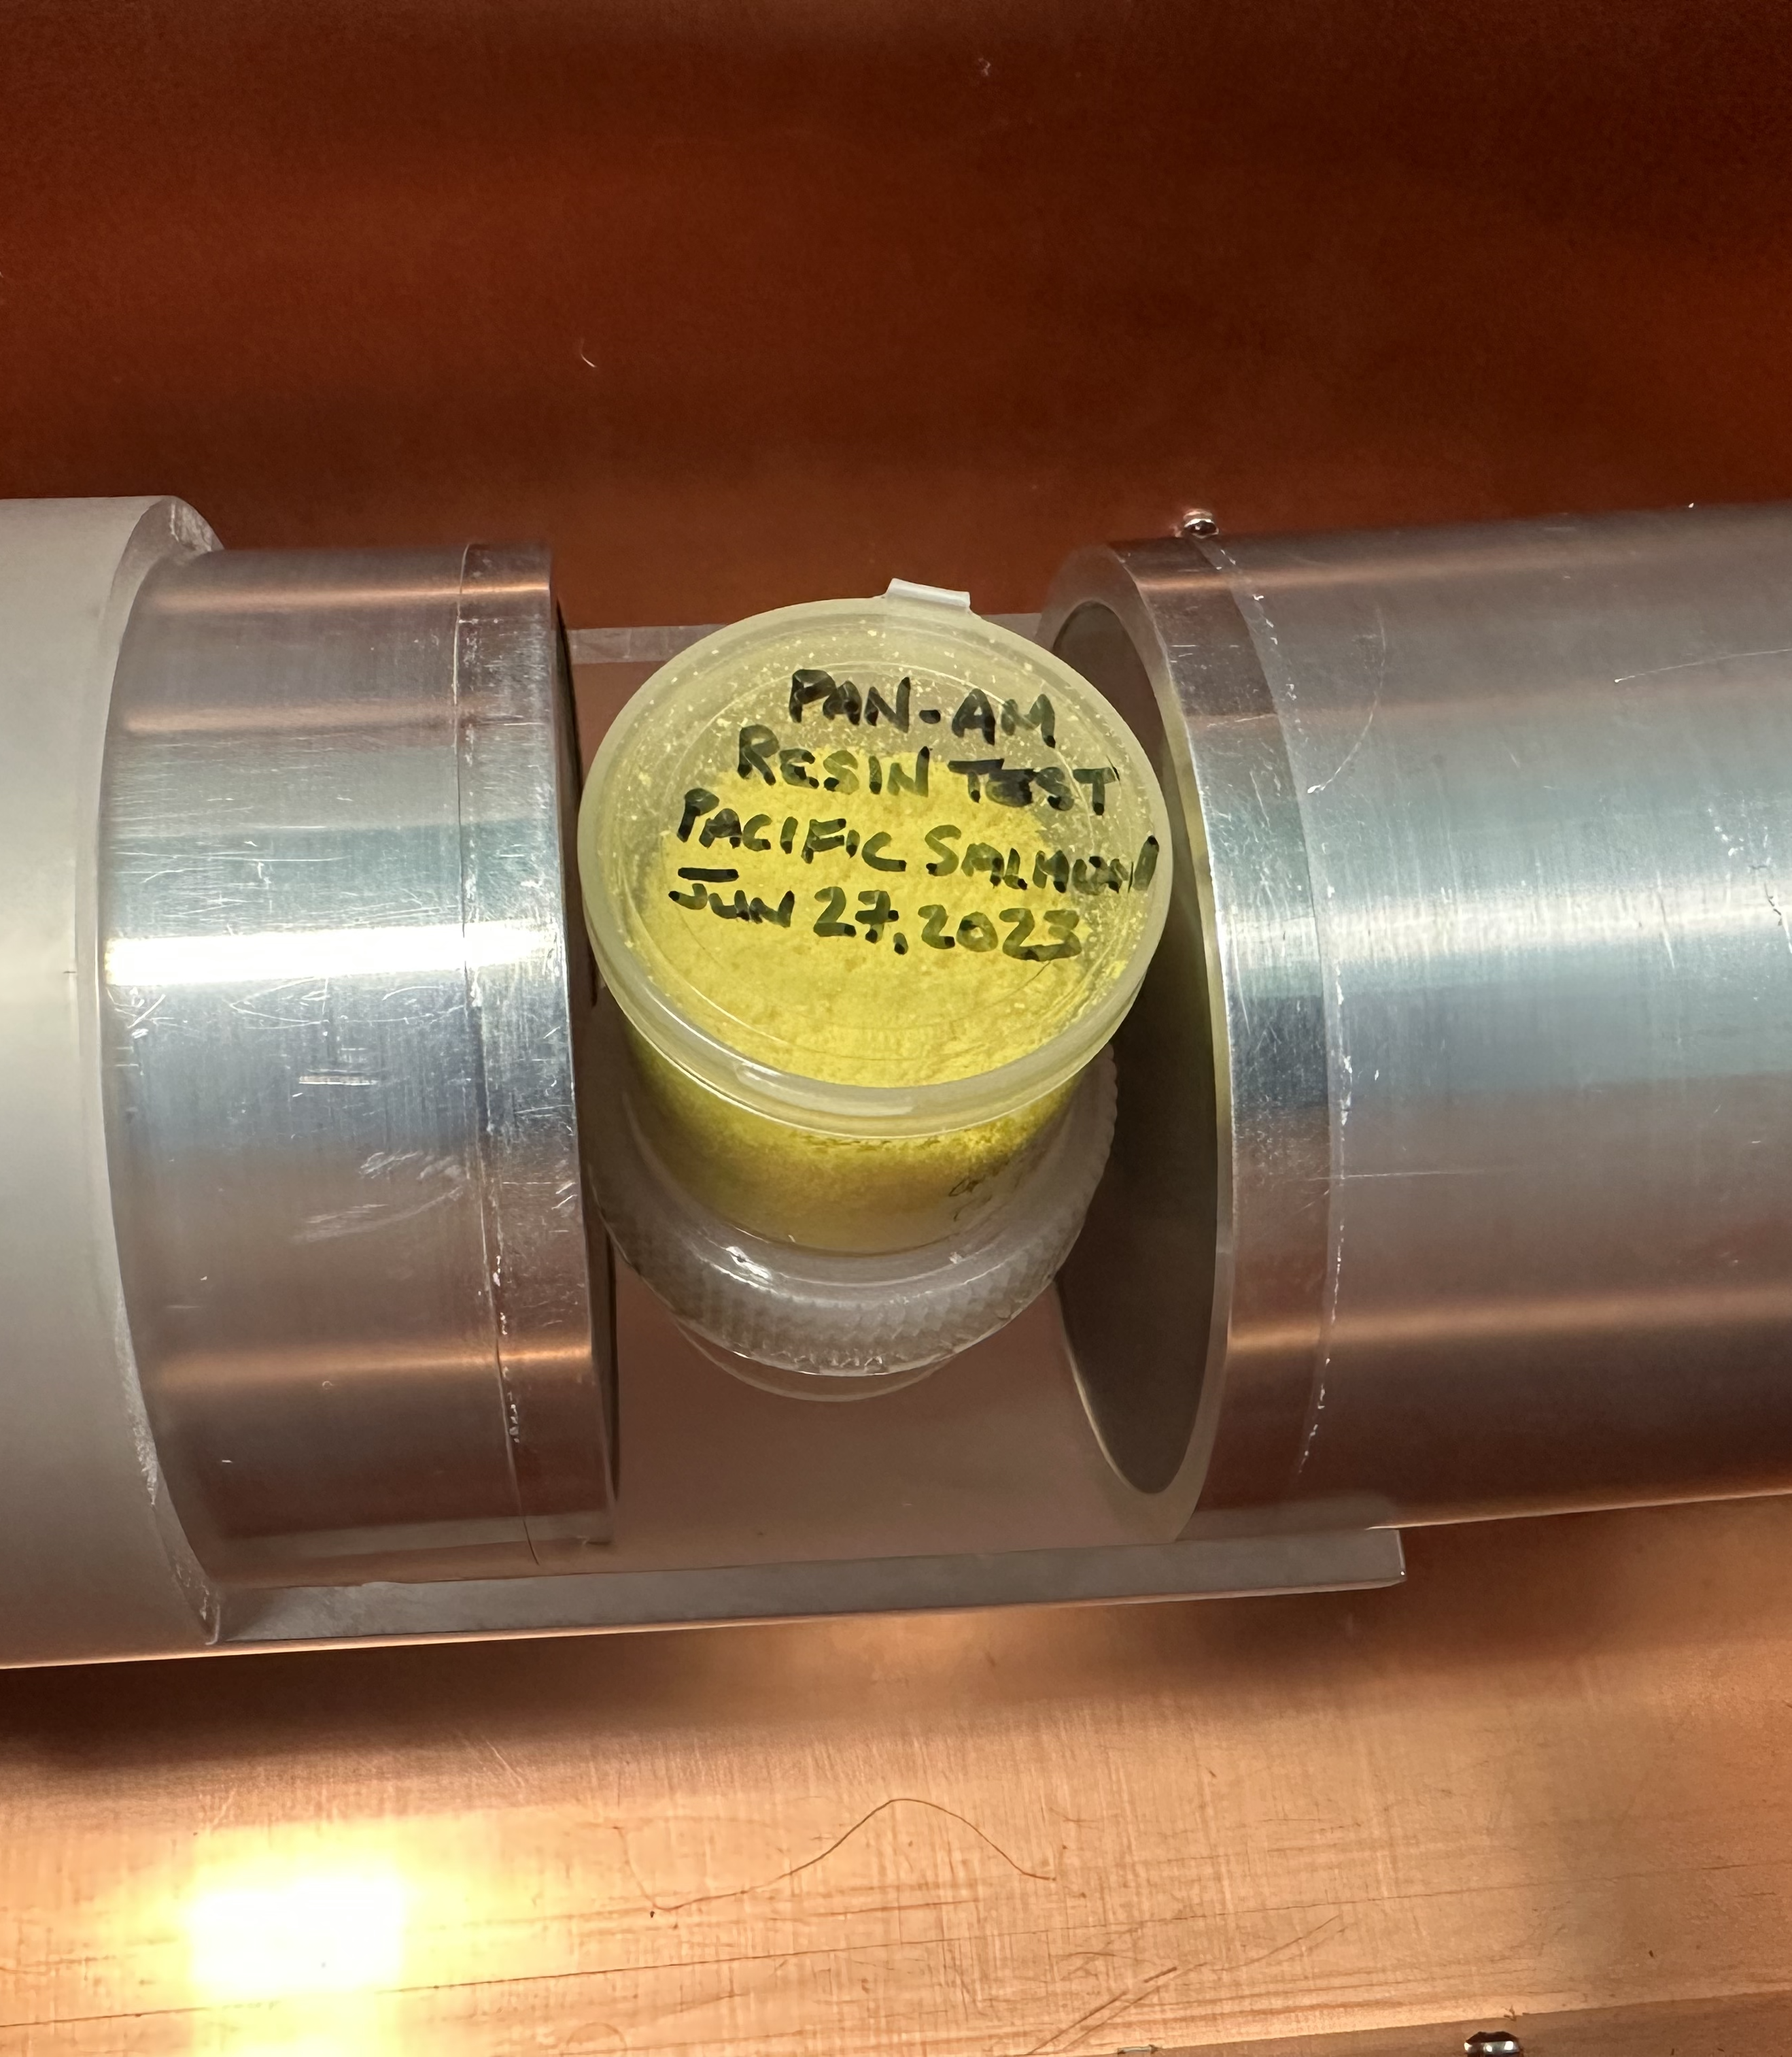
Motivation
Dark matter and Neutrino experiments depend on low background materials.
The Comprehensive Nuclear Test Ban Treaty (CTBT) is interested in counting short lived isotopes produced by nuclear tests or reactor leaks.
Why do we care about MDAs?
  Lower MDAs can increase the LBL’s sensitivity to smaller concentrations of radioactive isotopes.

Slide 3
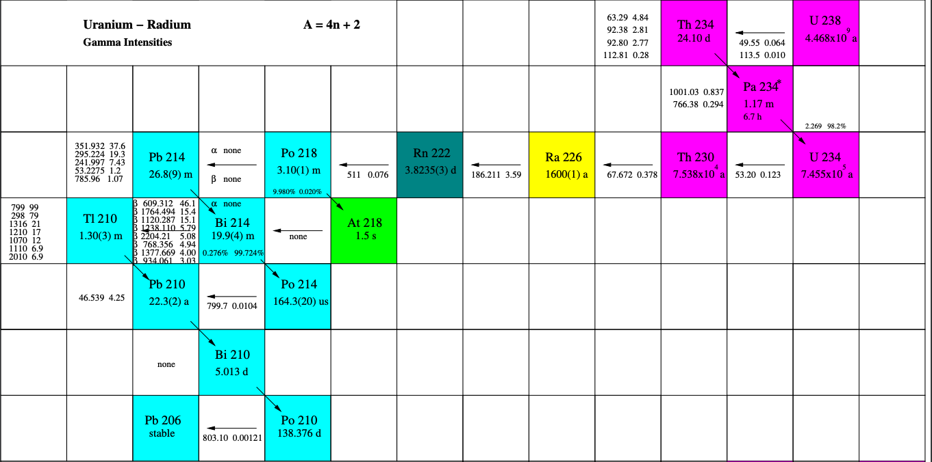
What is Gamma Counting?
Radioactive isotopes emit gamma particles.
Gamma particles are high energy photons.
These photons interact with a HPGe crystal (via photoelectric effect, Compton scattering, pair production) sensitive to the incident gamma photon’s energy.
By counting the number of gammas at specific energies we can determine the activity levels of radioactive isotopes in a sample.
U238 Decay Chain (Lawson, 2013)

Slide 4
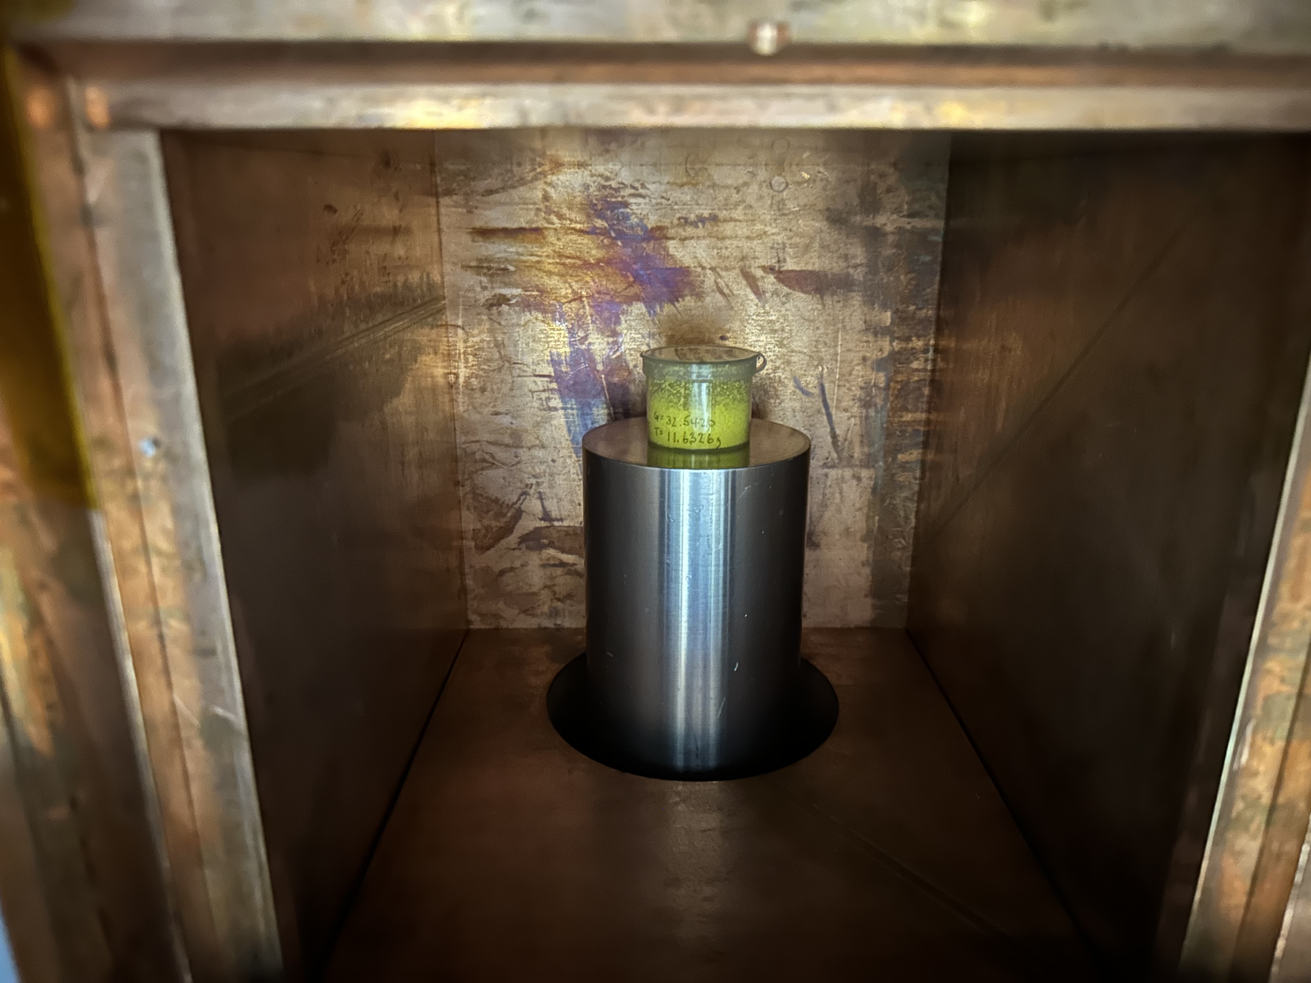
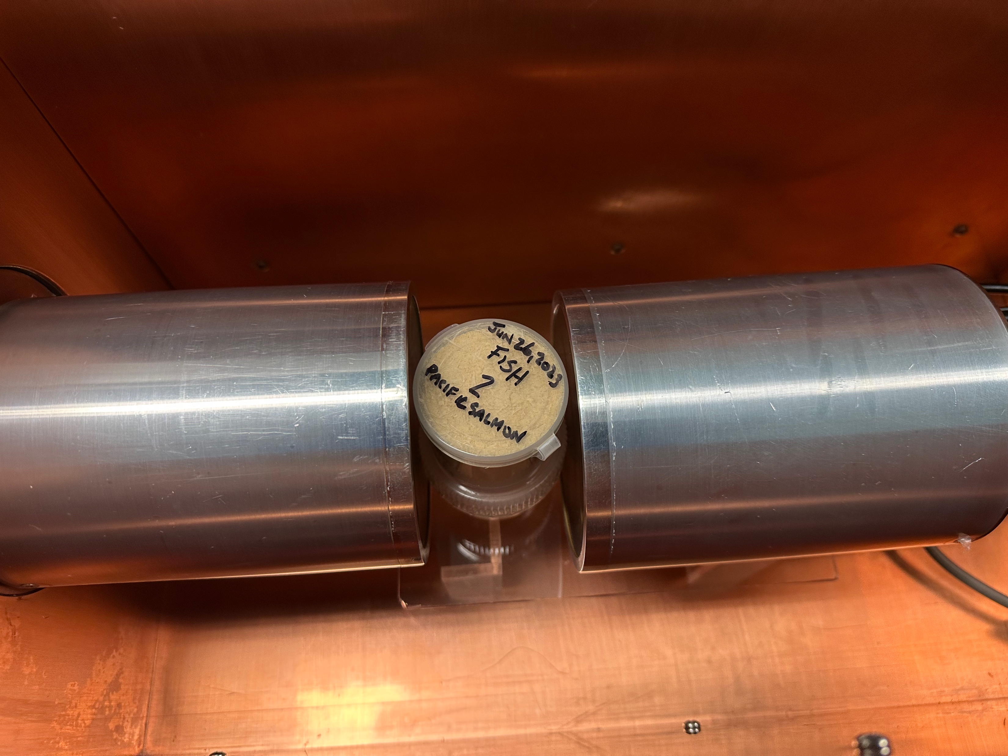
Single vs Dual Detector HPGEs
Great for looking at the broad gamma spectrum between 0– 3000 keV.
Has the ability to distinguish decay events that release two gammas via coincidence analysis!

Slide 5
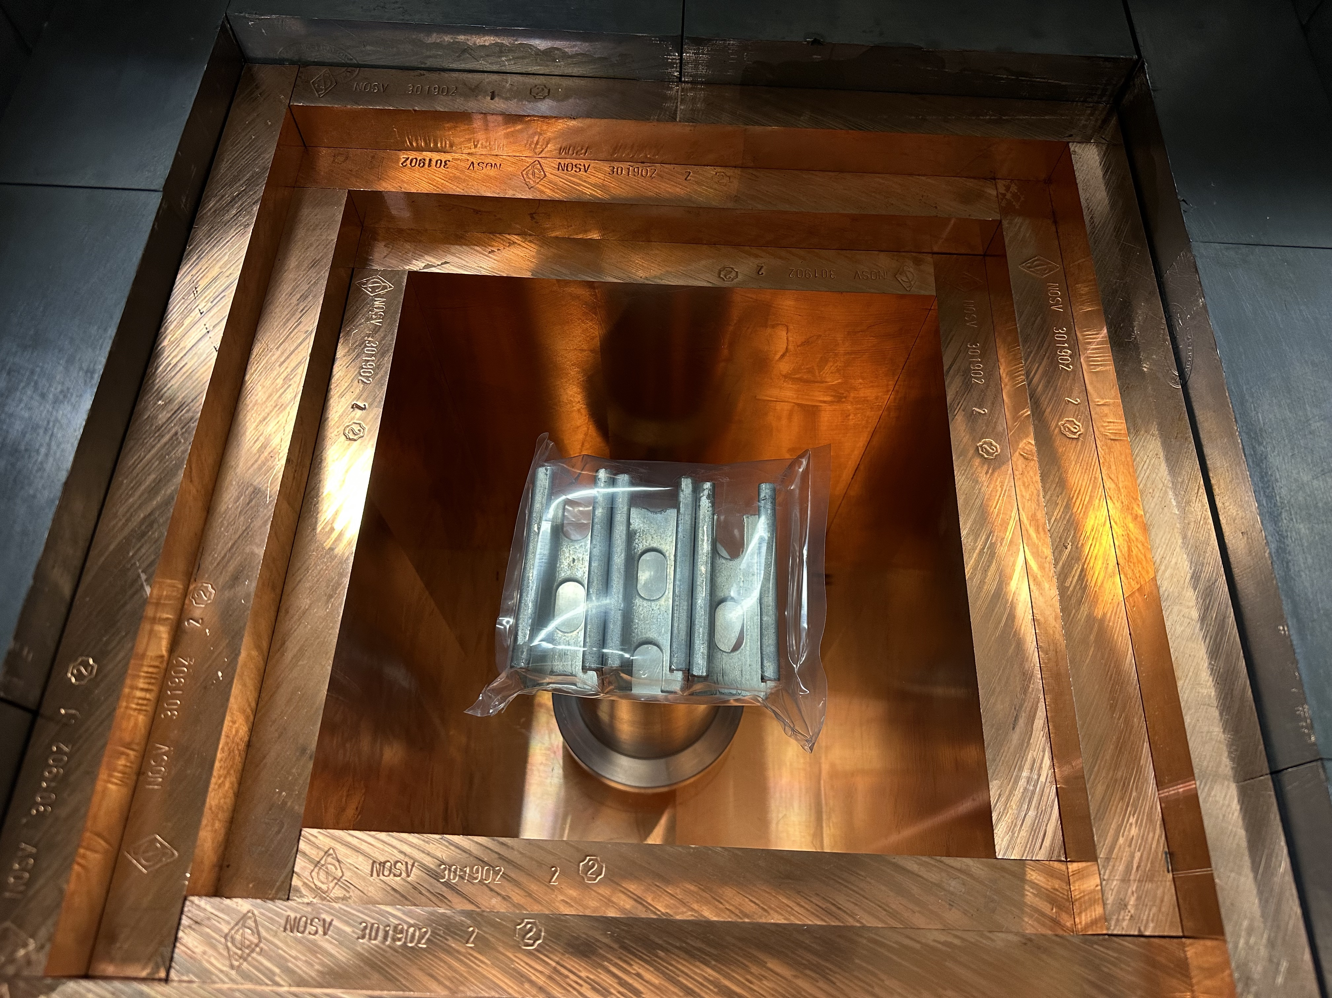
How do we count samples?
Count sample for 1-2 weeks
Simulate sample geometry
Determine sample efficiency
Analyse data to calculate sample activity and composition

Slide 6
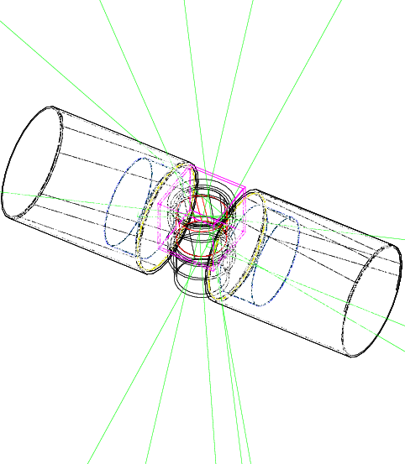
Simulating a sample
Model sample geometry in GEANT4
Placing it in the simulation
Why?
  Real U238/Th232 calibration source geometry is fixed.
  Calibration data can not cover all possible gammas/isotopes
Simulation Upgrades (Summer 2023)
  Added the CTBT simulation to SNOLAB's simulation toolkit
  Multi-Crystal Detectors

Slide 7
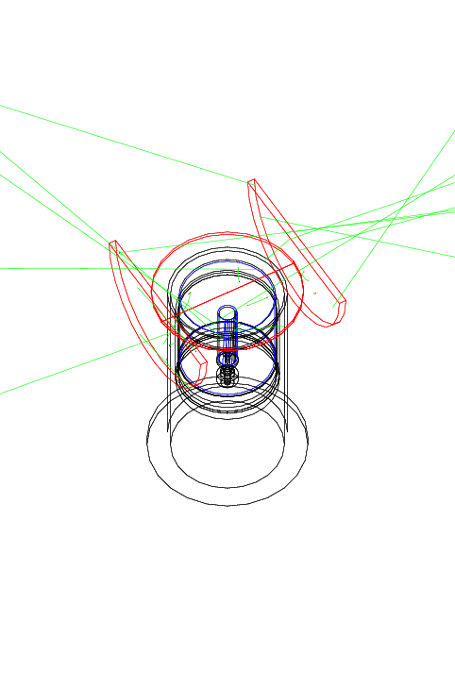
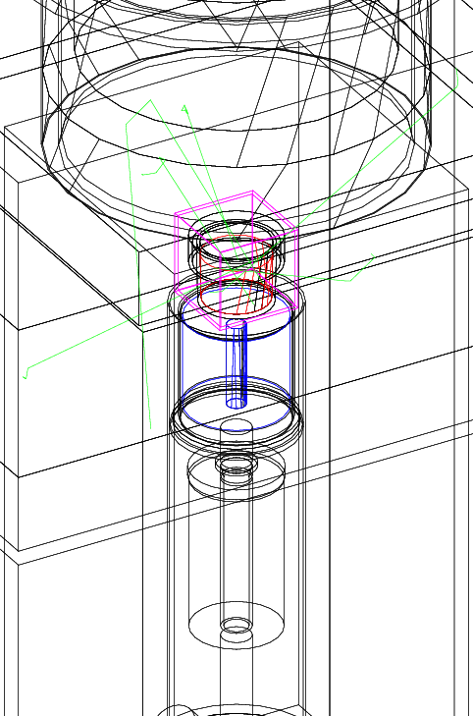

Slide 8
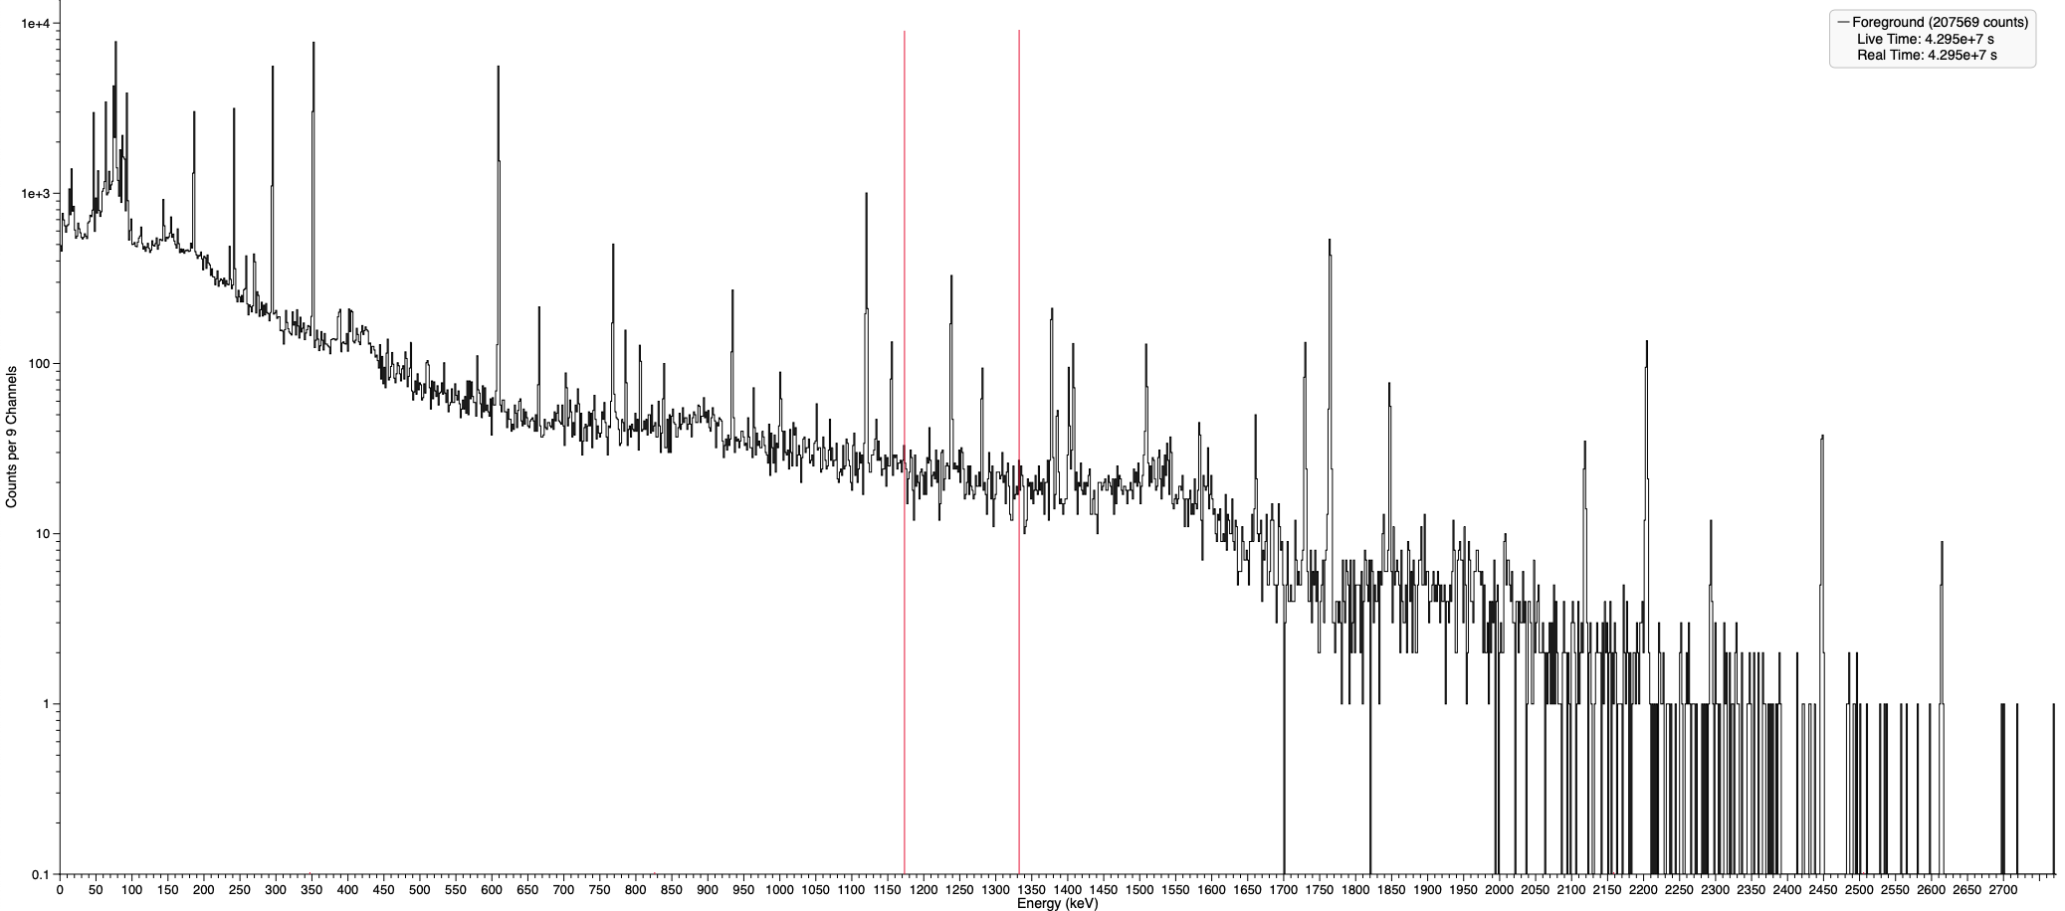

Gamma Spectroscopy Physics
Photoelectric Effect Peak Absorption
Co 60 Lines
Compton Scattering Rise in Continuum Background
Continuum Background
Detector Backgrounds
Real U238 Gamma Spectrum Example

Slide 9
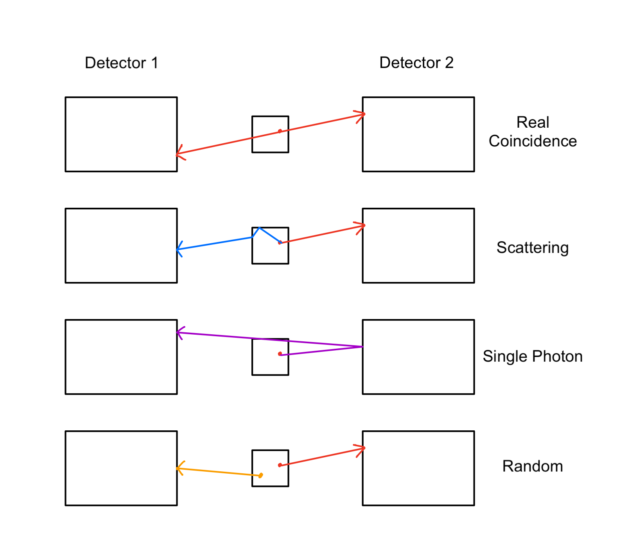

Coincidence Event Physics
SNOLAB's HPGE detectors are often limited by their continuum backgrounds
Advantages
  Coincidence event analysis greatly reduces continuum backgrounds
  Easier to detect low activity isotopes
Limitations
  Coincidence event analysis also reduces the total signal
  Isotope of interest needs to produce coincidence events with decent statistics.

Slide 10
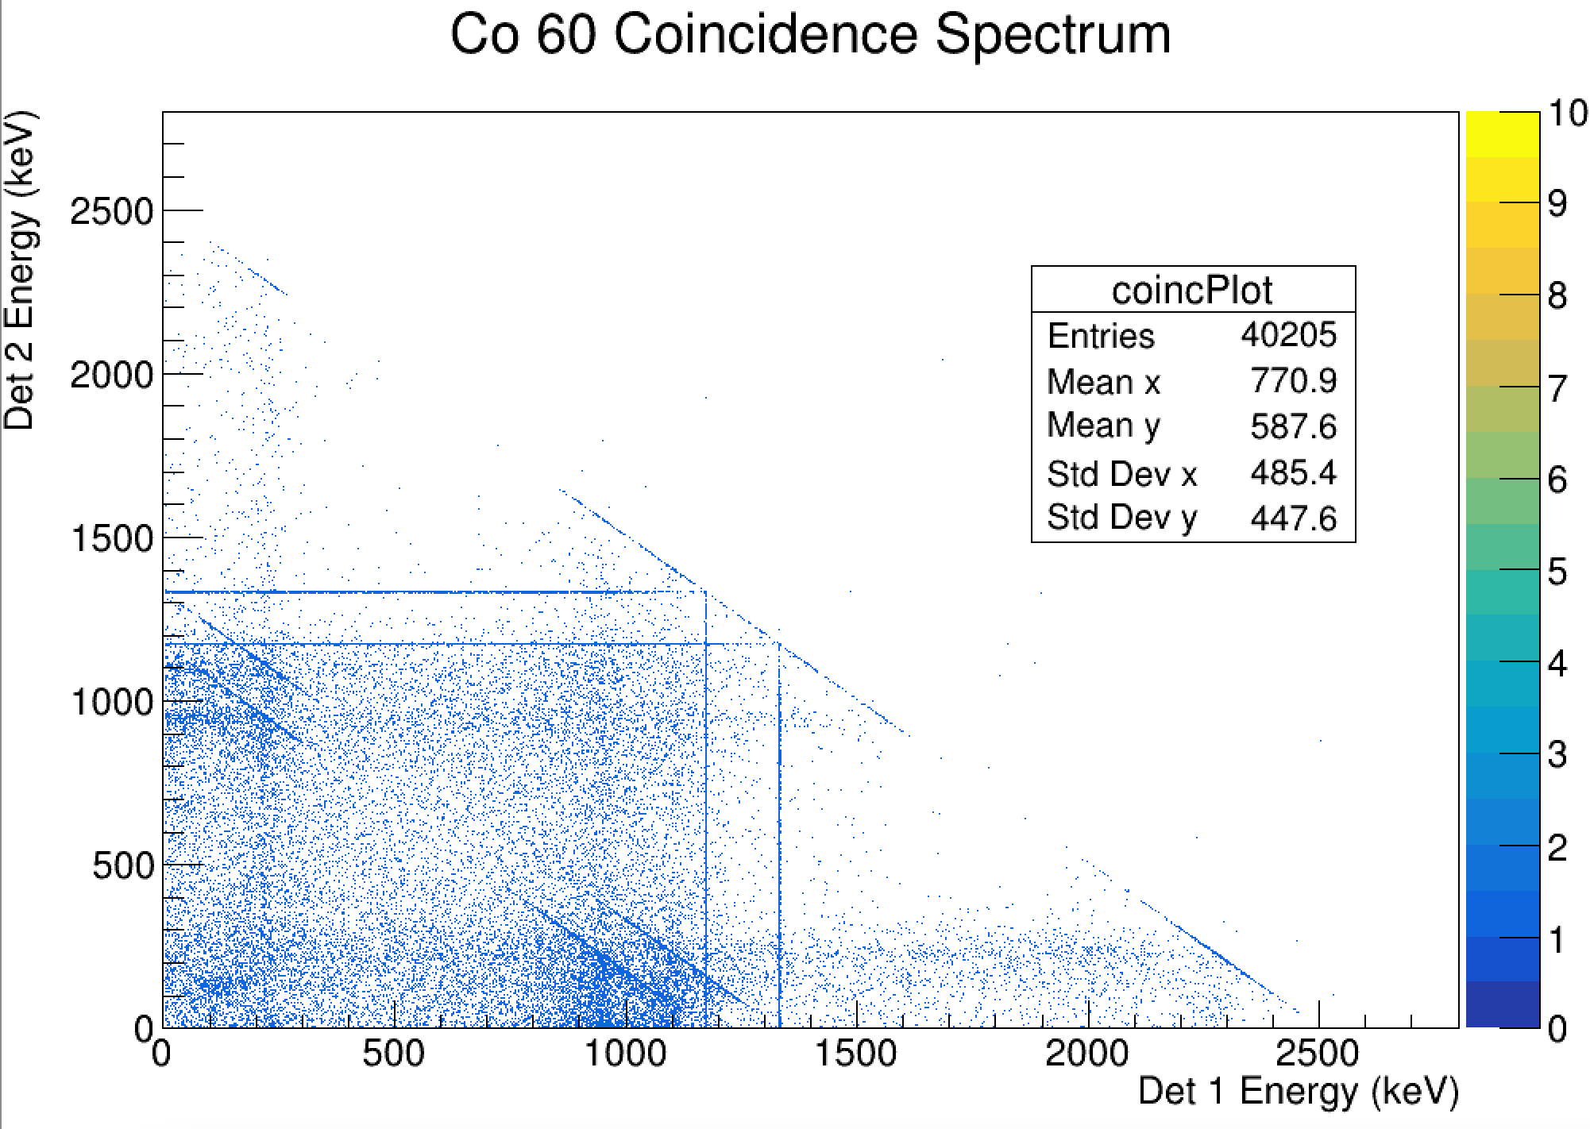
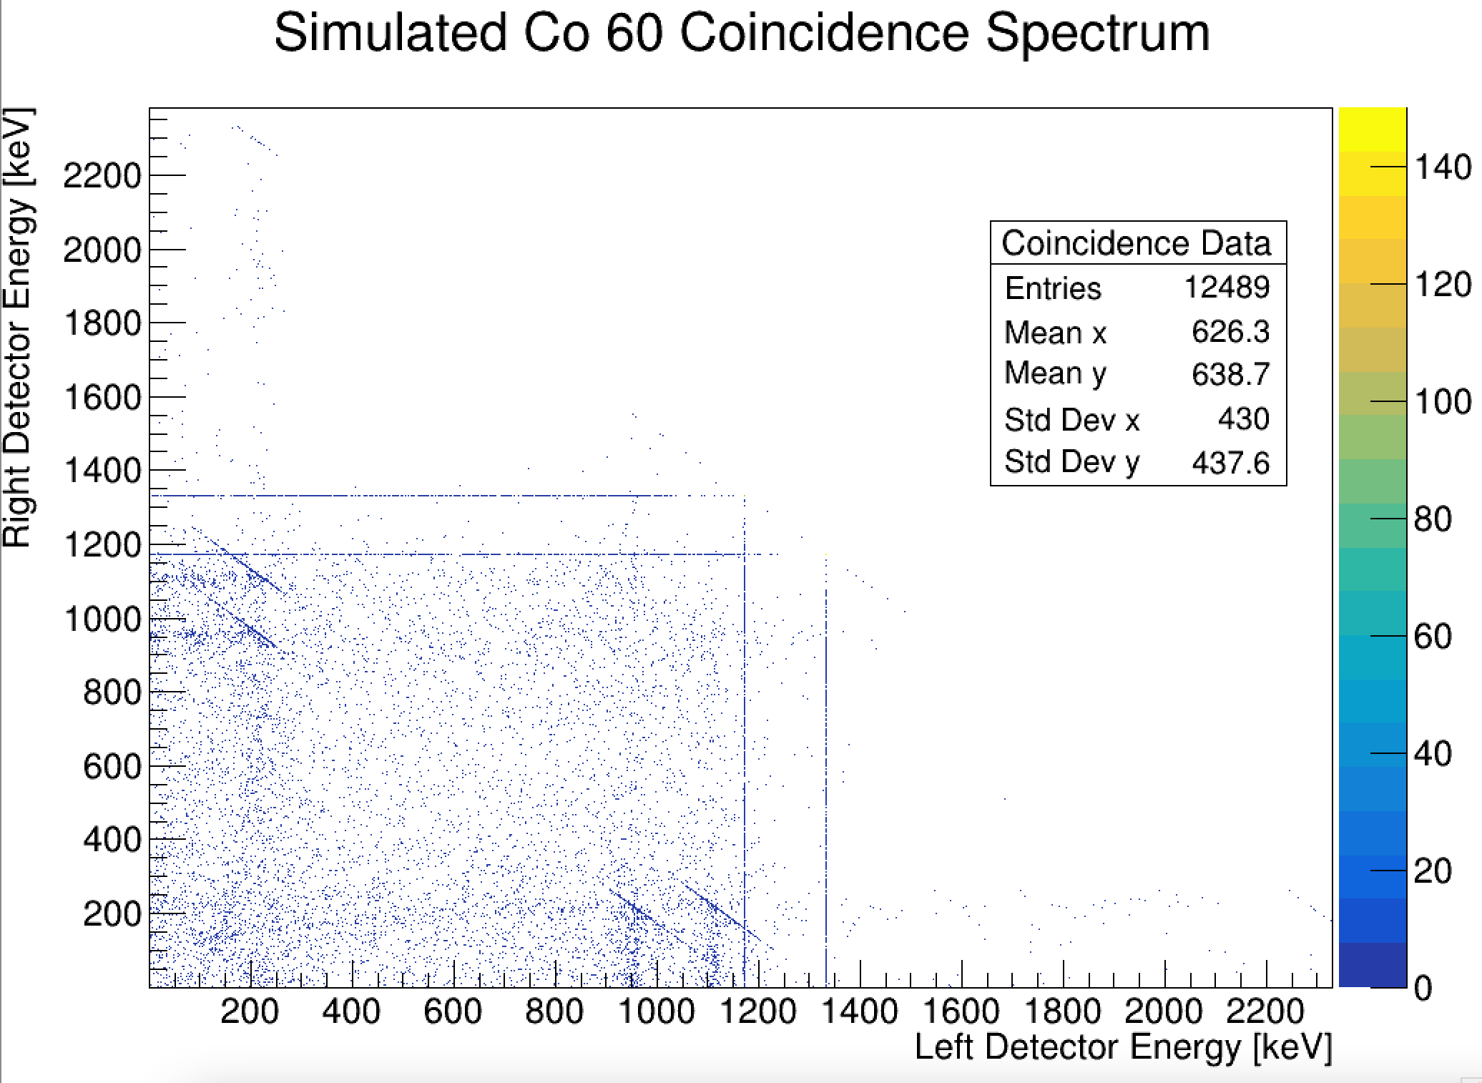
Simulation and Analysis of Coincidences
GEANT4 ion decay of coincidence producing isotopes
Coincidence events come from the same decay event
Allows for easy data analysis
Real events are tagged as a coincidence if they occur between 9 μS of each other.
Coincidence region

Slide 11
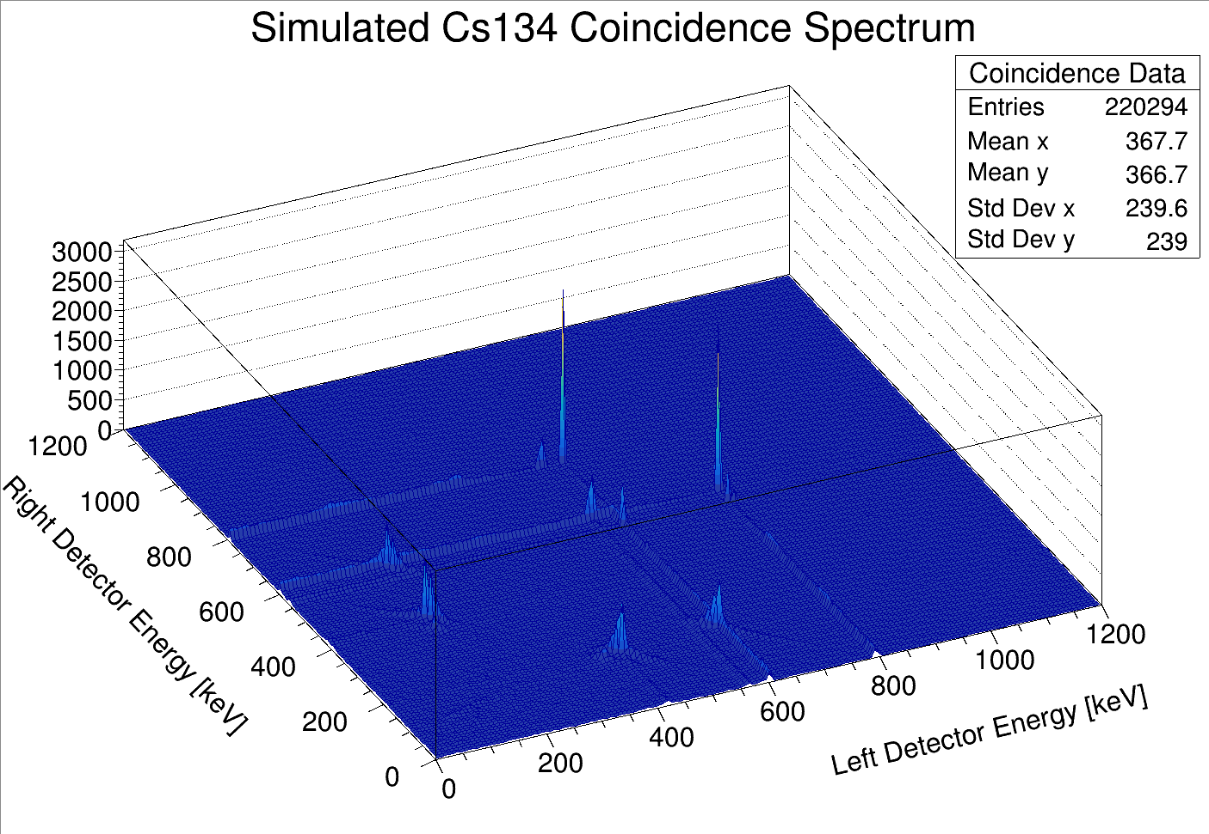

Slide 12
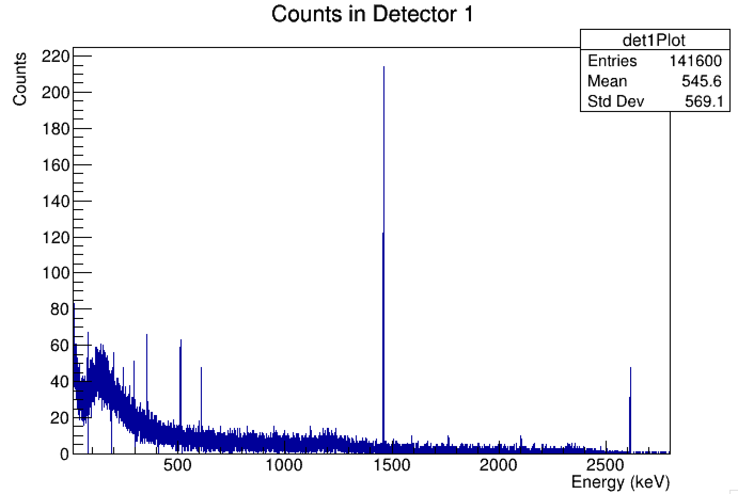
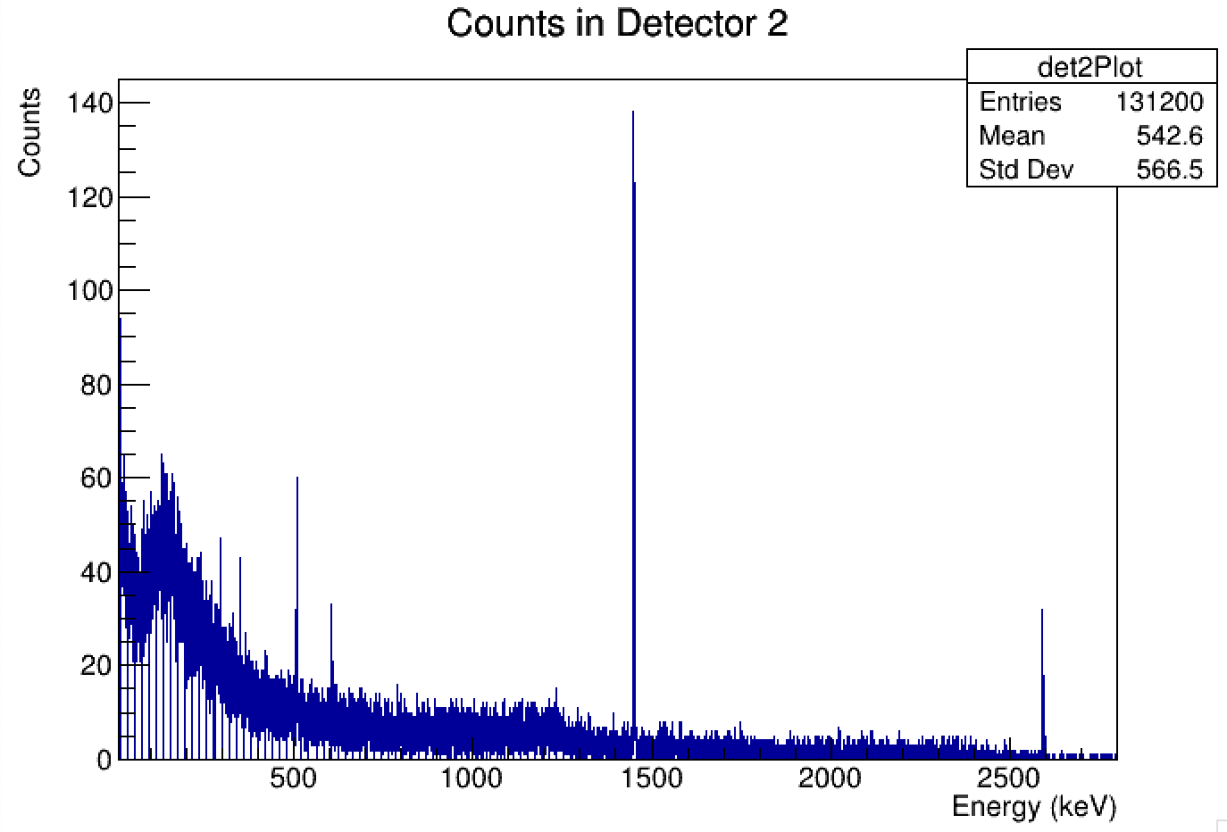
CNL Dissolved Pacific Salmon Sample 1D Spectra
Cs 134 Lines
Large K40 peak that will contribute to the Compton scattering continuum background.
Why do we care about Cs 134?
Cs 134 produced by nuclear reactors
      Ratio of Cs 134 and Cs 137 after a reactor accident yields information about the nuclear fuel burnup.

Slide 13
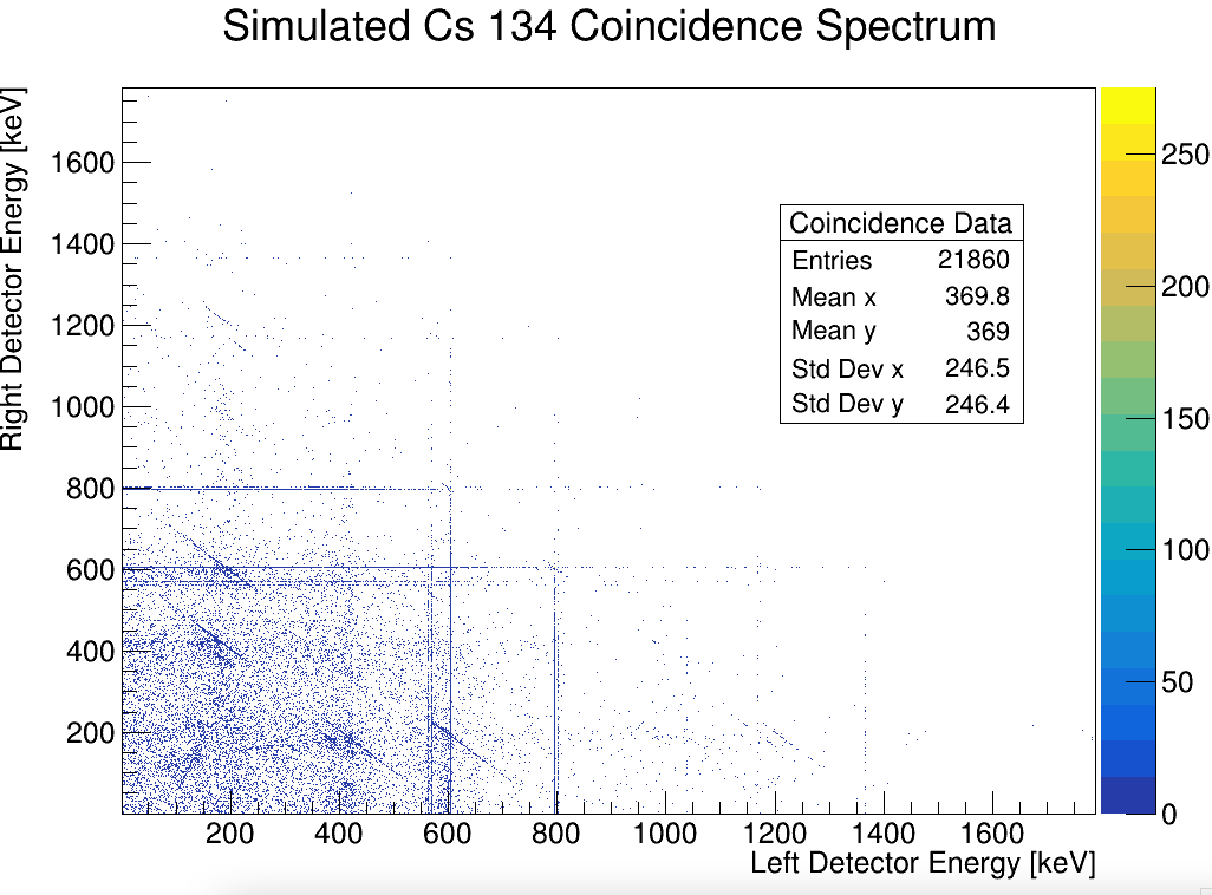
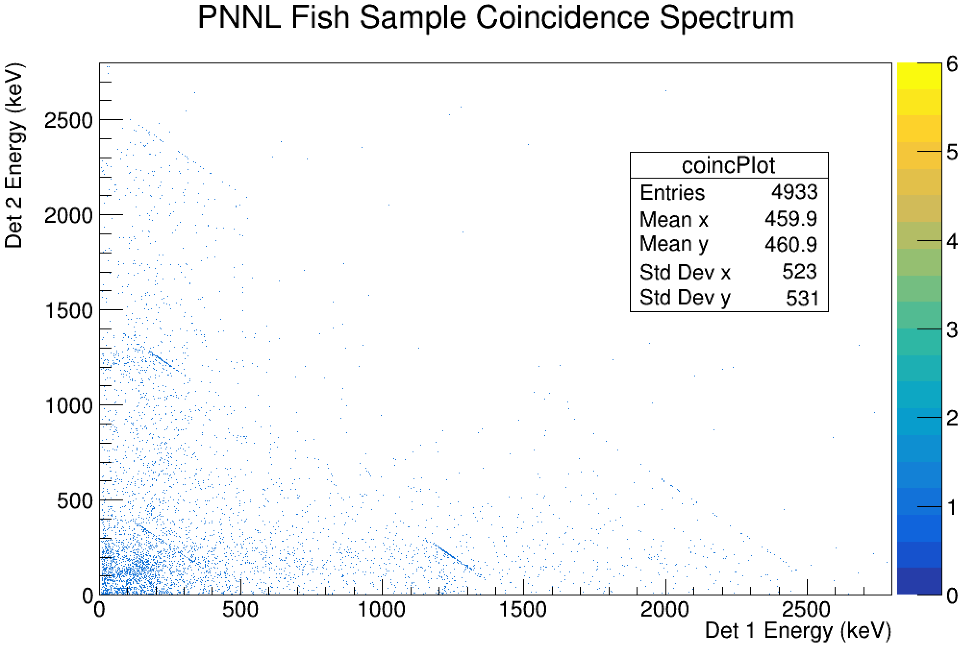
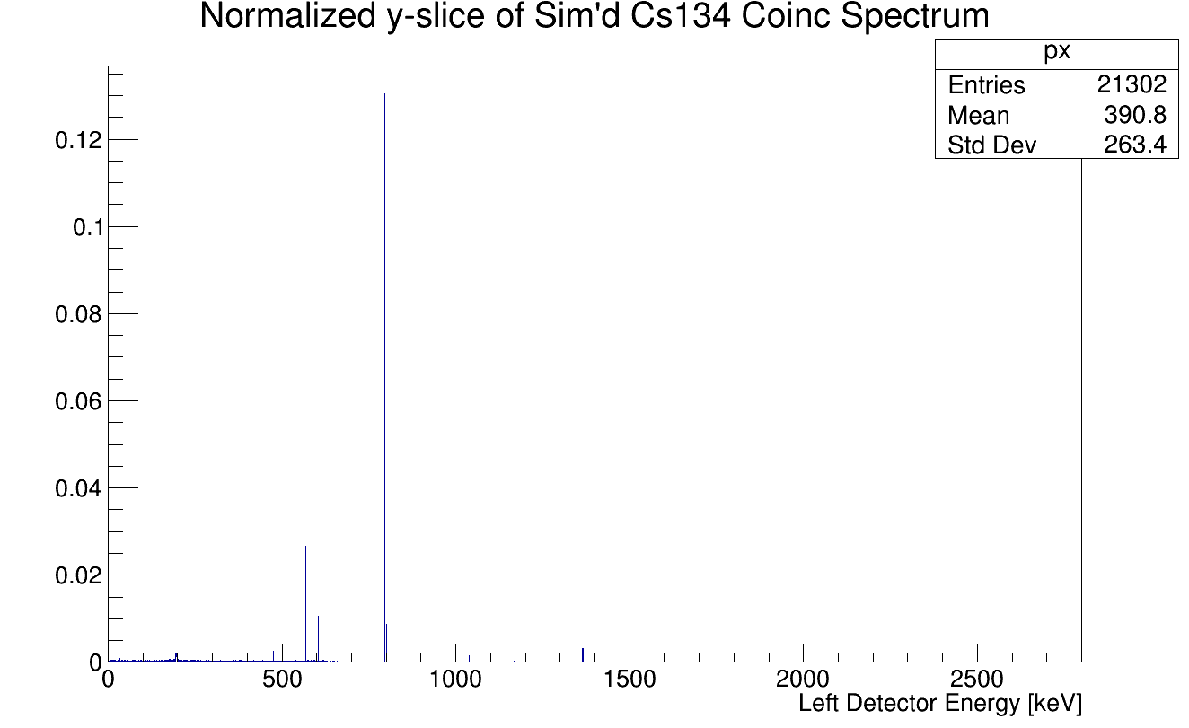
CNL/Cs134 Example
C

Slide 14
Minimum Detectable Activity
MDA: Smallest sample activity a given detector can see after a given sample time. Derivation follows:
Is the isotope present?
Did we detect the isotope?
Meaningful Physical Constants

Slide 15
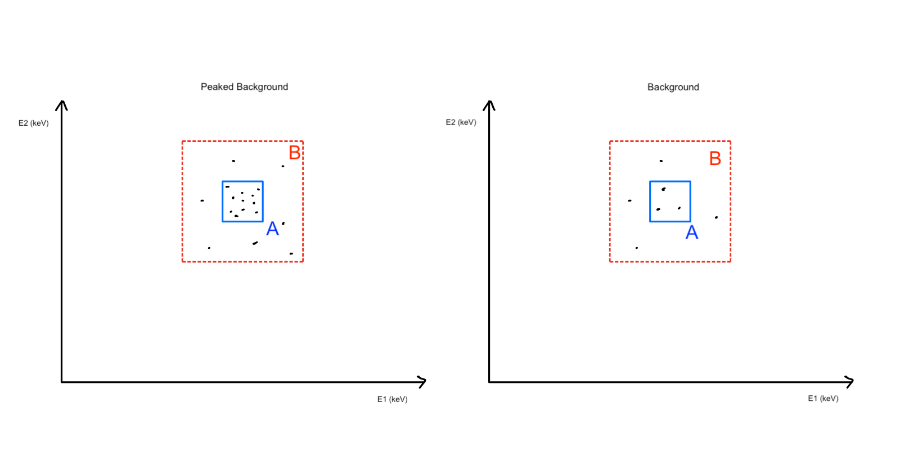
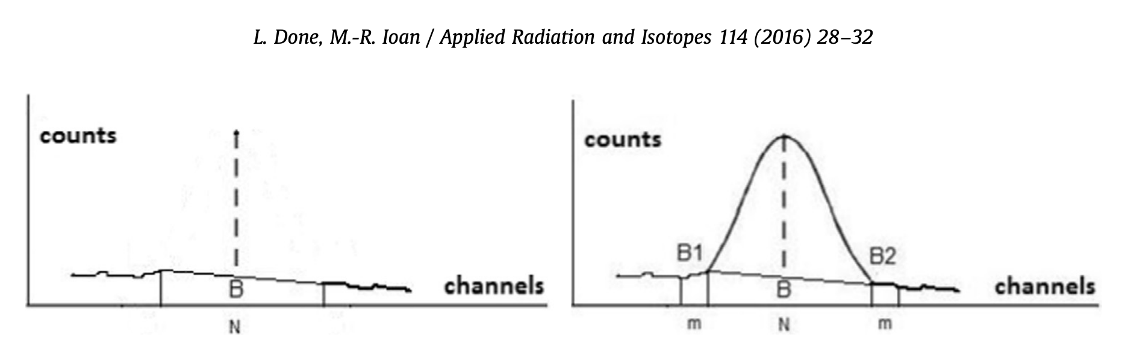
Detector and Continuum Backgrounds
1D Backgrounds
2D Backgrounds
NP
NB
Detector Background
Continuum Background

Slide 16
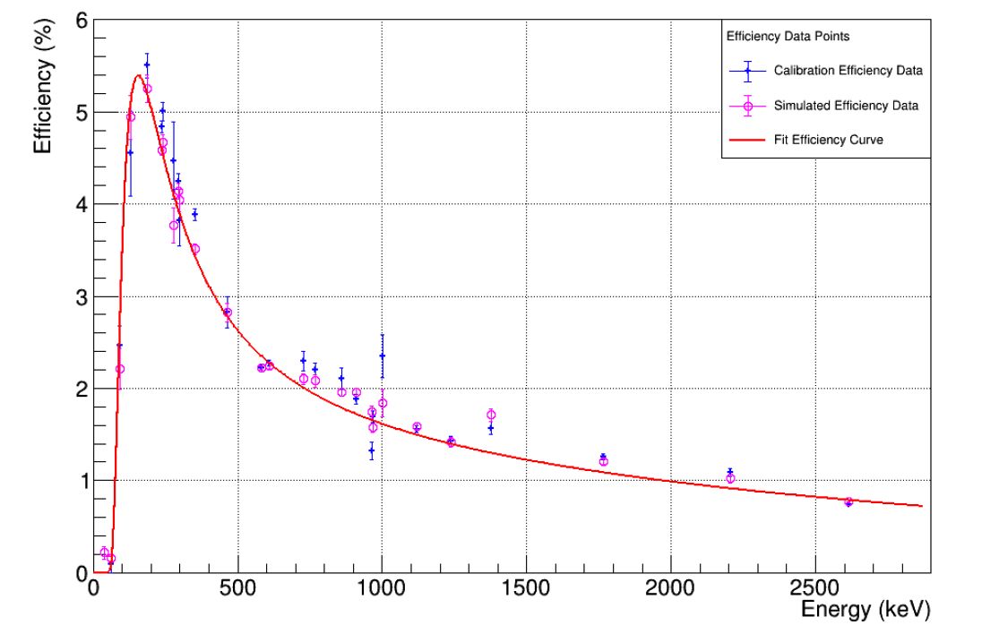
Efficiencies
1D Efficiencies
2D Efficiencies
Example Efficiency Curve

Slide 17
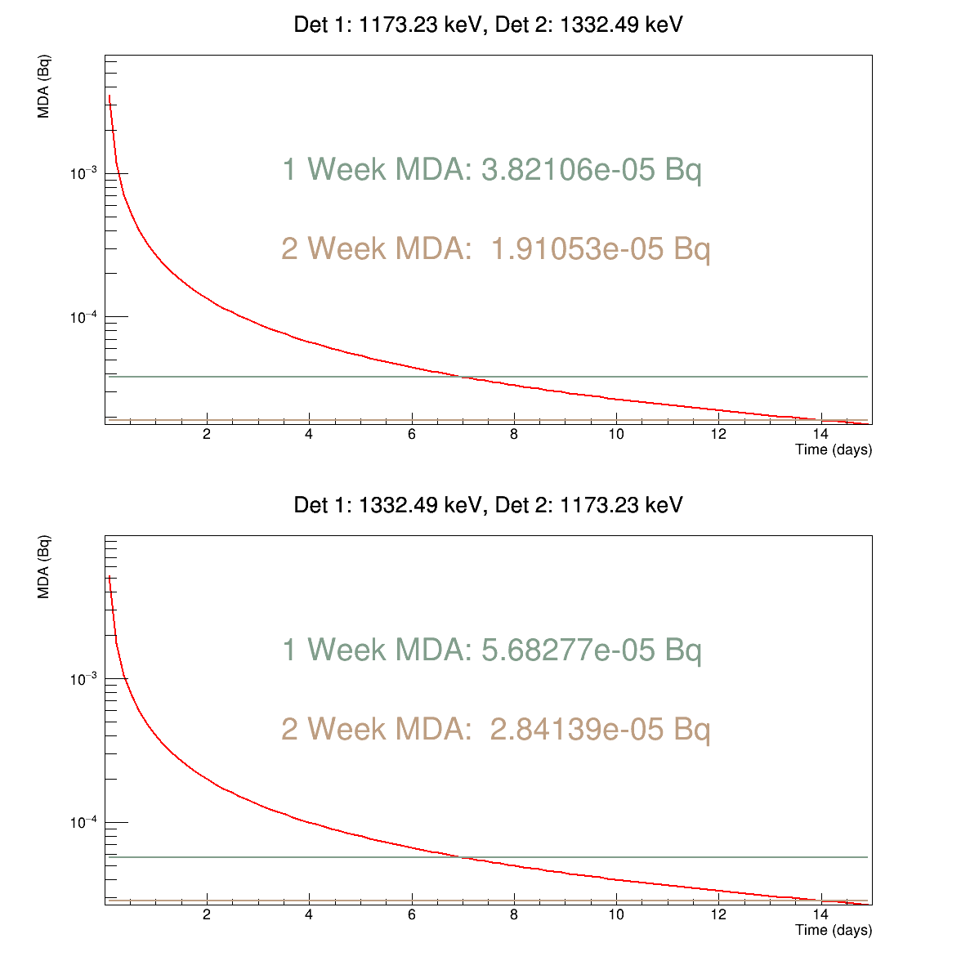
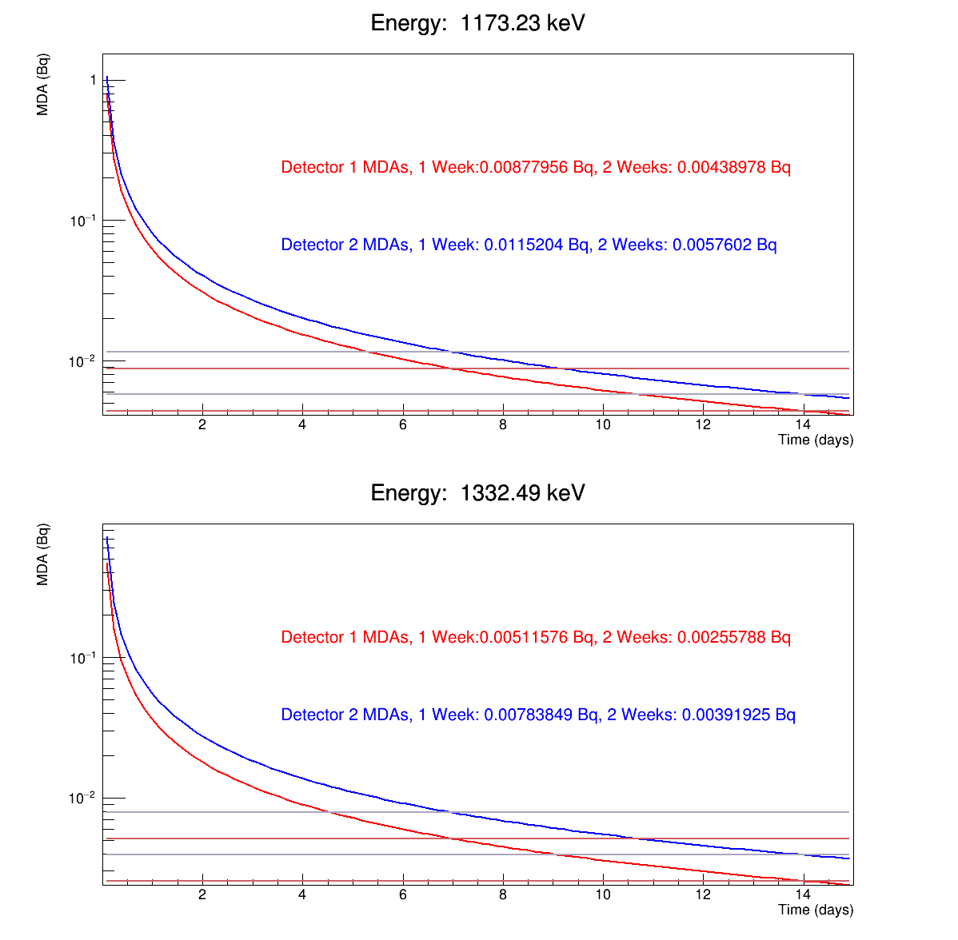
MDA Results Co 60
MDA (Bq)
MDA (Bq)
MDA (Bq)
MDA (Bq)
Coincidences
Single Detectors

Slide 18
2 Week MDA Highlights
Co 60 Results
Coincidence ROI (keV) | Coincidence MDA (Bq) | Detector 2 ROI (keV) | Single Detector 2 MDA (Bq) | Ratio Single : Coincidence
(1173, 1332) | 1.9e-05 | 1173 | 5.7e-03 | 300
(1332, 1173) | 2.8e-05 | 1332 | 4.0e-03 | 143
CNL Fish Sample Results
(604, 795) | 3.7e-03 | 795 | 3.8e-03 | 1.03
(232, 563) | 9.4e-02 | 232 | 1.6e-01 | 1.7
(563, 569) | 3.1e-02 | 569 | 1.8e-02 | 0.58
Cs 134 Simulation Results (w/ no K40)
(604, 795) | 8.3e-04 | 795 | 2.8e-02 | 33.7
(232, 563) | 1.4e-01 | 232 | 4.1e+01 | 294
(563, 569) | 4.4e-02 | 569 | 8.4e-01 | 19.1

Slide 19
Conclusion
Summary
Next Steps
When implemented well, coincidence analysis has the potential to dramatically reduce MDAs.
At current sample count times we can see isotopes that were otherwise indistinguishable from the background.
Simulation results show good potential if coincidence efficiencies can be better known on a per sample basis.
Introduce simulation techniques to determine sample coincidence efficiencies that can be verified against known good coincidence sources i.e. Co 60.
Wider literature review of different MDA analysis techniques/calculations.
Investigate shrinking the CTBT coincidence time window to improve coincidence plots further.

Slide 20
Works Cited
Currie, Lloyd A. “Limits for Qualitative Detection and Quantitative Determination. Application to Radiochemistry.” Analytical Chemistry, vol. 40, no. 3, 1968, pp. 586–593, https://doi.org/10.1021/ac60259a007.
Done, L., and M-R. Ioan. “Minimum Detectable Activity in Gamma Spectrometry and Its Use in Low Level Activity Measurements.” Applied Radiation and Isotopes, vol. 114, 2016, pp. 28–32, https://doi.org/10.1016/j.apradiso.2016.05.004.
Goetz, K Callie, et al. Oak Ridge, 2023, Investigation of Coincidence Counting for Improving Minimal Detectable Activity of 110mAg in Single Particle Gamma Analysis.
McIntyre, J I, et al. PNNL, 2006, Calculation of Minimum Detectable Concentration Levels of Radioxenon Isotopes Using the PNNL ARSA System.
Cleveland, Lawson. SNOLAB, 2014, Acquisition and Processing of Ge Detector Data at SNOLAB.

Slide 21
Thank you!
Special thanks to the LBC group and my supervisors: Ian Lawson, Steffon Luoma, Dimpal Chauhan, and Thomas Sonley

